Slide 1
COSMO-1
Status and recent developments
Oliver Fuhrer
With results from the whole COSMO-NExT Team
COSMO-GM 13, Sibiu

Slide 2
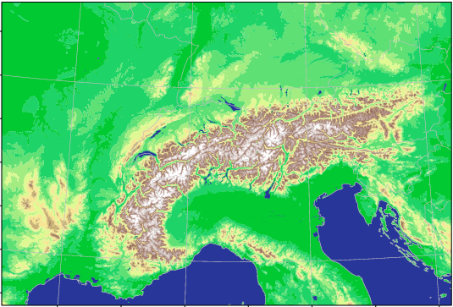

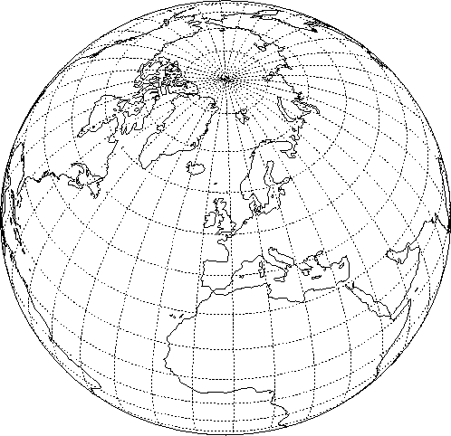
Project COSMO-NExT
Boundary conditions: IFS
10km
4x daily
Boundary conditions: VarEPS
20km
2x daily
ensemble data assimilation: LETKF
COSMO-1: 8x daily O(24 hour) forecasts
1.1km grid size (convection permitting)
COSMO-E: 2x daily 5 day forecasts
2.2km grid size (convection permitting)
O(21) ensemble members
Notes:
Um lokale Vorhersagen zu machen, verwendet man ein 3-stufiges Verfahren:
Zuerst ein globales Modell, das das Verhalten der Atmosphäre auf dem ganzen Globus vorhersagt. Dazu wird die Kugel mit einem Gitternetz überzogen, dessen Maschenweite ca. 16km beträgt.
Auf einem Ausschnitt über Europa wird die Prognose auf einem Gitter mit 6.6km Maschen verfeinert (COSMO-7).
Über dem Alpenbogen wird ein Netz mit 2.2km Machenweite aufgespannt (COSMO-2). Damit erhält man viel mehr Details, wie z.B. die Alpentäler.
Das jeweils eingebettete Modell braucht die Vorhersagen des übergeordneten an den Rändern (Ein- und Ausströmen der Luft).
Faustregel: eine 24h Vorhersage muss in 30‘ erstellt werden können, damit sie nützlich ist. Je enger die Maschen, desto grösser der Rechenaufwand, deshalb die immer kleineren Gebiete.

Slide 3
COSMO-1 related talks
Mon 11:00 (WG5): Verification of the experimental version of COSMO-1: Winter-Spring 2013
Mon 11:30 (WG3a): Turb-i-Sim: Evaluation and improvement of representation of turbulence in COSMO-1 over Alpine topography
Tue 14:55 (Plenary): EXTPAR developments towards version 2.0
Tue 17:40 (WG6): Single precision version of COSMO-1

Slide 4



Overview
Status
Verification
Constructions areas…
  Model stability
  External parameters
  (Moist) Turbulence
Next steps

Slide 5
Verification
Continuous 1km-assimilation cycle since end of August 2012 (including latent heat nudging and snow analysis)
Two forecasts per day (00/12 UTC) to +24h
Driven by the operational COSMO-7km forecasts
  Run at CSCS in approx. 1h45’ elapsed time
  with 2470 cores (60%) on CRAY XE6
Visualization, monitoring and verification for evaluation purposes but not for production!

Slide 6
Settings for dynamics and physics
New fast waves solver (consistent 2nd-order accuracy, strong conservation form of divergence operator, increased divergence damping)
Horizontal non-linear Smagorinsky diffusion
No artificial horizontal diffusion
Rayleigh damping of all variables at upper boundary
(test running with condition on w only looks very similar)
6 category microphysics including graupel (as COSMO-2)
Standard turbulence and multilayer soil module
Explicit deep convection but Tiedtke shallow convection (C-2)
Ritter-Geleyn radiation every 6’
Roughness length only from land use (Z₀ ≤ 1m)
No sub grid scale orography

Slide 7
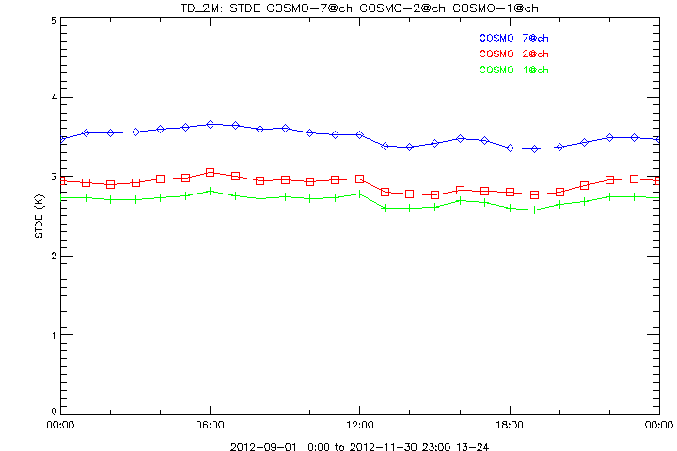
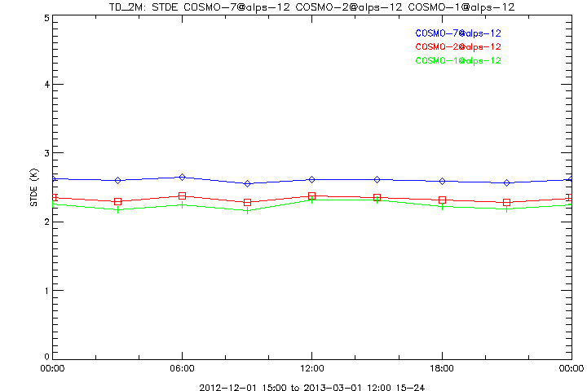
Dew Point Temp. at 2m of COSMO-1 for
SON 2012 DJF 2013
Standard Deviation CH +13-24h
Standard Deviation Alps +15-24h
COSMO-7
COSMO-2
COSMO-1
Notes:
Not the same domain because in autumn we had a cold bias over the SW area due to a completely wrong orography (holes !) near the coast line of South of France.

Slide 8
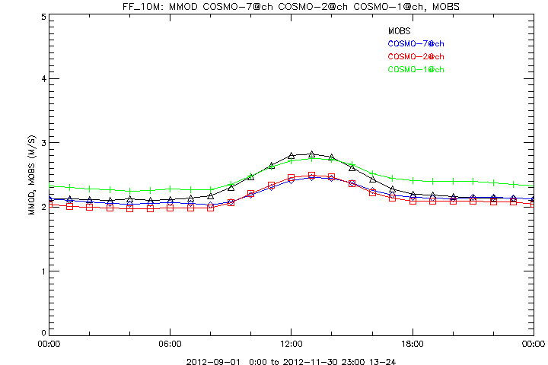
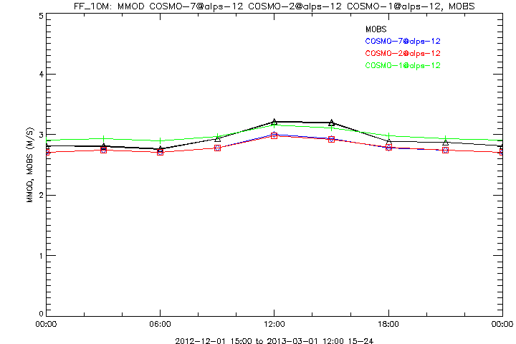
10m Wind Speed of COSMO-1 for
SON 2012 DJF 2013
Swiss domain +13-24h
Alps +15-24h
Higher wind speed due to lack of low level friction
COSMO-7
COSMO-2
COSMO-1
Notes:
Observations in BLACK. 12 UTC VERY good COSMO-1! Same picture for Winter over CH domain

Slide 9
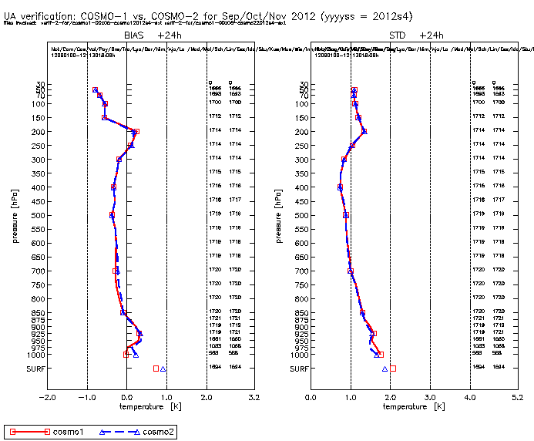
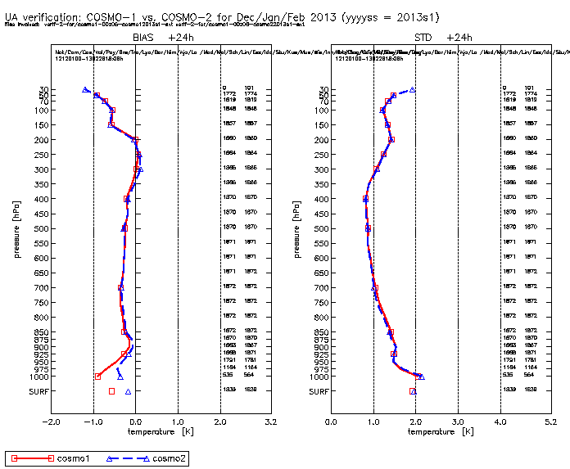
Upper Air Temperature Verification
COSMO-1 vs. COSMO-2 SON12
DJF13
+24h
all stations
BIAS
STD

Slide 10
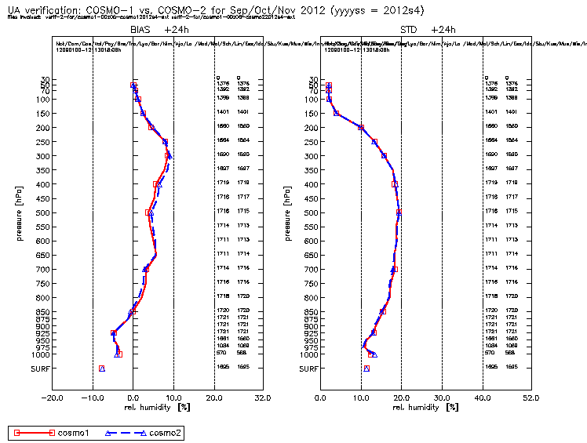
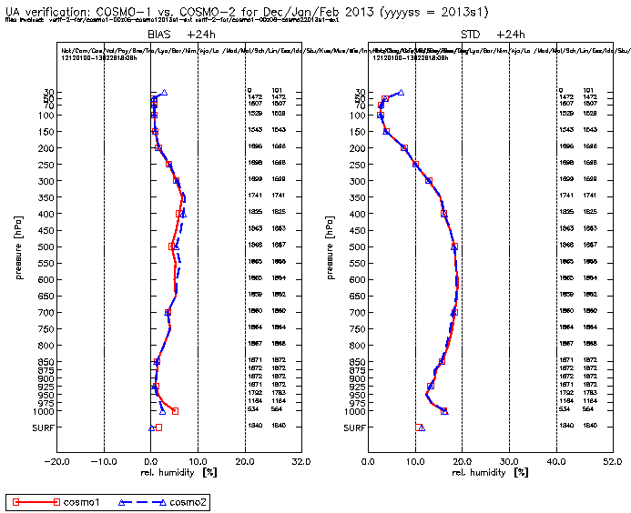
Upper Air Relative Humidity Verification
COSMO-1 vs. COSMO-2 SON12
DJF13

Slide 11
Summary Part II
Autumn and winter verifications of COSMO-1 show good results:
Better humidity specially in the standard deviation (surface)
Slight cold bias (not for all stations)
Overestimation of 10m winds (except around 12 UTC)
Good precipitation scores
Similar upper air scores as COSMO-2

Slide 12
Regular experimental runs
COSMO-1 is producing regular (00 UTC, 12 UTC) experimental forecasts since August 2012
17 missing forecasts until December 2012
due to crashes and/or model aborts
No crashed forecasts since then!
?

Slide 13
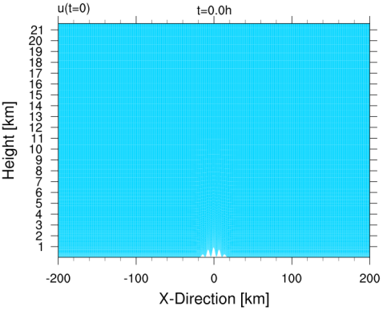

  Idealized test case I (atmosphere at rest)
2-dimensional
Schaer et al. MWR 2002 topography
80 level SLEVE2 coord.
∆x=1.1km, Lx=401km
∆z=20-812m, Lz=22km
∆t=10s
No humidity; Polytrope temp. gradient=0.0065K/m
Tropopause at 12km
Rayleigh sponge (>11.5km)
0 m s⁻¹
h₀=1000m (max. dh/dx=21⁰)
h₀=2000m (max. dh/dx=37⁰)
irk_order=3
iadv_order=5
ieva_order=3
Notes:
Slice model, mountain described by a large scale component a=25km and a small scale component lambda=8km with a maximum slope of 37 degrees if we choose the amplitude to be 2km. We use a dry version of the model with more or less the same settings as used operationally: 2 time level 3rd order Runge-Kutta scheme with ... Terrain following coordinates with the extension of SLEVE from Leuenberger 2010 so the grid is ... BLACK BOX for the following diagrams.

Slide 14
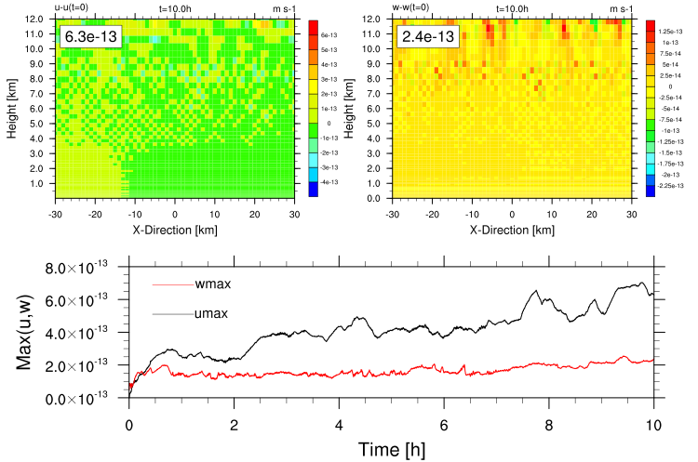
  Idealized test case I (atmosphere at rest)
max(|Δu|) m/s max(|Δw|) m/s
Vertical cross-section
through centre of domain
No mountain
h₀=0m
λ=8km
a=25km
ldyn_bbc=F
divdamp=20
Time series
Δu=
u(10h)-u(0h)
Δw=
w(10h)-w(0h)
Notes:
This is the reference run with NO MOUNTAIN ... small values

Slide 15
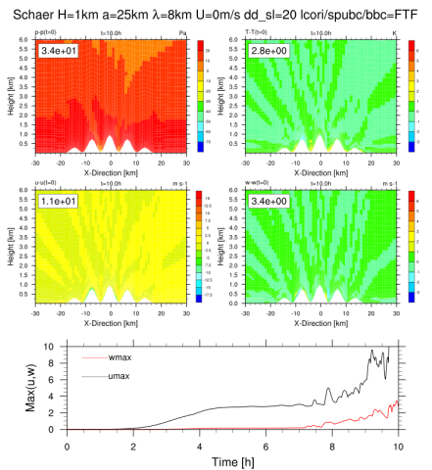
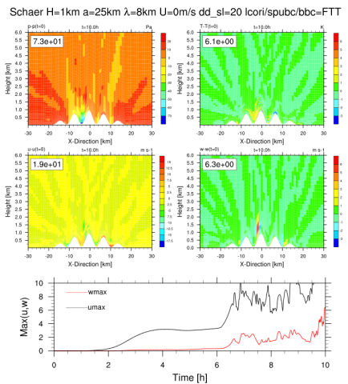
  Idealized test case I (atmosphere at rest)
h₀=1000m, divdamp_slope=20, nrdtau=16, svc2=3.5km
New Bottom Bound. Cond.(114) Old BBC for w
Δp
ΔT
Δp
ΔT
Δu
Δw
Δu
Δw
Notes:
This is a higher zoom from 0 to 6km for a 1km high mountain (21 degrees maximum slope) with 2 different BBC. Left for the latest formulation of COSMO and right the old formulation of Almut Gassmann. First 2h basically nothing then a plateau up to +6h or +8h for the latest formulation of COSMO (left) then quite lot of activity for the last 2 to 4h. This leads to a lot of differences near the orography but the consistent formulation (left) shows a less noisy pattern after 10h.

Slide 16
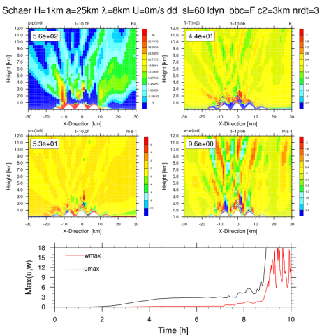
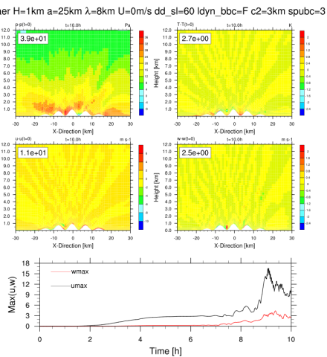
  Idealized test case I (atmosphere at rest)
h₀=1000m, divdamp_slope=60, nrdtau=3, svc2=3km
Damping all var. @ upper boundary Only w (Klemp,2008; itype_spubc=3)
Δp
ΔT
Δp
ΔT
Δu
Δw
Δu
Δw
Notes:
If we reduce the small scale terrain features (SVC2 decay) of the SLEVE coordinates and increase the Raleigh (nrdtau) and the divergence damping (slope) (both as operational) we can see that the usual treatment of all variables (left) can lead to very much noise that we can be controlled with a radiative formulation as proposed in a paper by Klemp in 2008. Positive pressure bias near the surface indicates that the formulation of the pressure gradients is important.

Slide 17
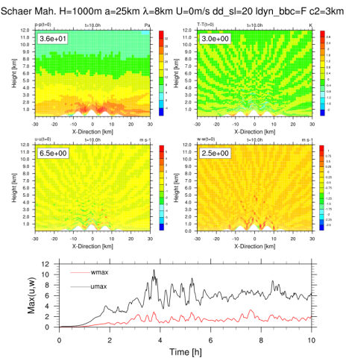
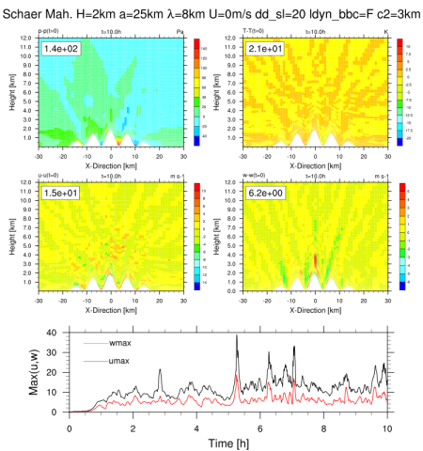
  Idealized test case I (atmosphere at rest)
Mahrer pressure gradients, divdamp_slope=20, svc2=3km
h₀=1000m h₀=2000m
Δp
ΔT
Δp
ΔT
Δu
Δw
Δu
Δw
(max. dh/dx=21⁰) (max. dh/dx=37⁰)
Notes:
By using a strict formulation of the horizontal pressure gradients (after Mahrer 1984) a reduced noise pattern can be attained, although the vertical and horizontal movements start before +2h. The Mahrer formulation is the only way to compute the 2km hill height on the right. But at some times the noise can reach high values !

Slide 18
Stability of dynamical core @1km
Not a lot of experience with new fast waves solver and fundamental changes
Consistent accuracy in numerics (2nd-order)
Strong conservation form of divergence operator
Investigation of 10 crashing cases and idealized setups
Increase of divergence damping could significantly increase stability
No artificial horizontal diffusion required!
The stability is sensitive to several parameters (e.g. upper/lower BC, divergence damping, etc.)
Vertical level distribution can have an impact on the stability of the model
A truly horizontal pressure gradients following Mahrer (1984) shows better results

Slide 19
External parameters
Current resolution of external parameters is
not sufficient for COSMO-1:
  Soil type database (FAO @10 km)
  Topography (GLOBE @900 m)
  No sub-grid scale roughness information!
  …
The model is not getting a fair chance to be better!
Work on the software for the generation of external parameters (EXTPAR) has finished
  Better topographic dataset (ASTER @30m)
  Better soil dataset (HWSD @1km)
  …

Slide 20
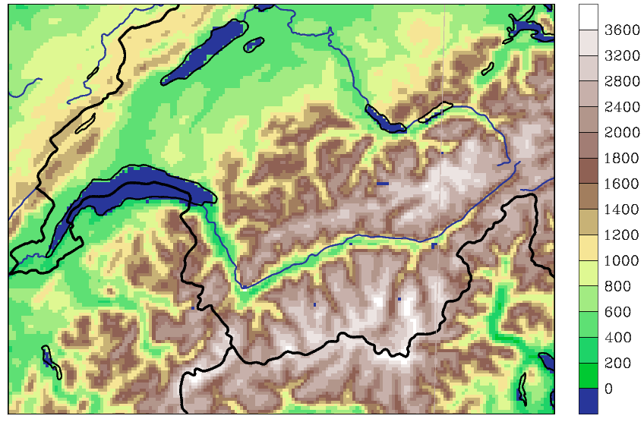
Topography:
Geolocation of GLOBE
Using GLOBE as raw topo-graphy, the Rhône runs over the mountain foot.
In reality it should go around Martigny.
COSMO-1

Slide 21
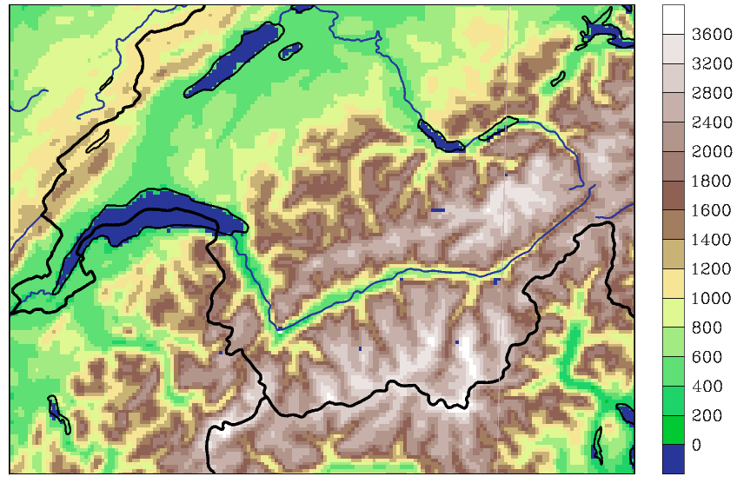
Topography:
Geolocation of ASTER
Using ASTER as raw topo-graphy, the location of the Rhône is better.
This implies again a shift in the raw GLOBE data set.
COSMO-1

Slide 22
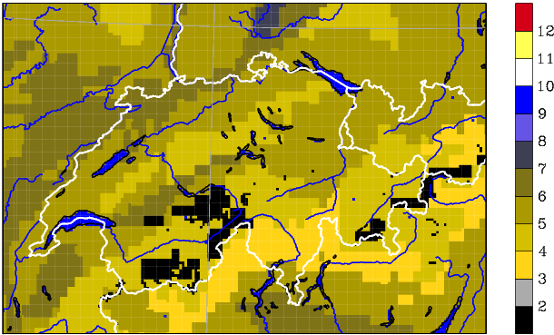
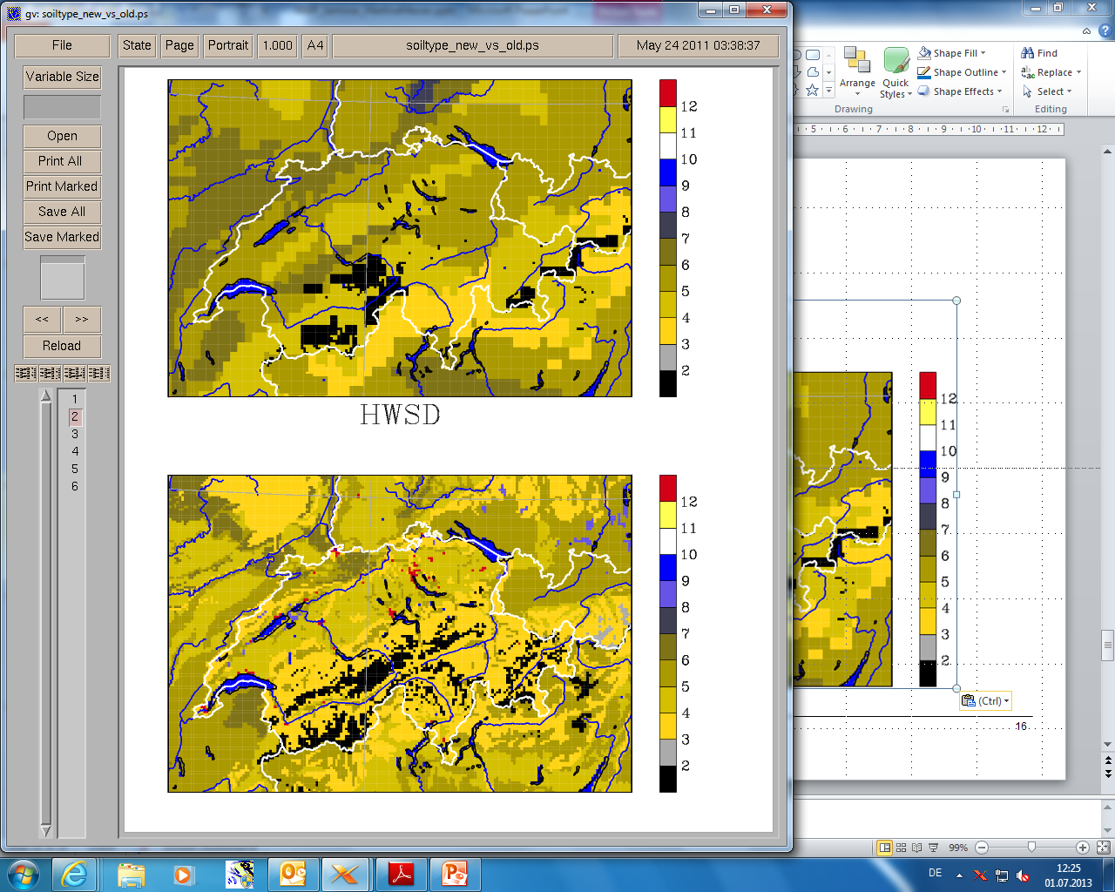
Soil type:
Comparison FAO and HWSD
Structure is much finer
Regions with ice represent reality much better
quadrangular structure is reduced.
Sand fraction is increased
Peat is represented
(Bernese Seeland)
FAO COSMO-2
‘HWSD’ COSMO-2
Legend:
loamy clay urban / unknown ^{new}
loam dunes ^{new}
sandy loam alkali flats ^{new}
sand water
rock peat
ice clay

Slide 23
General Remarks
Summary
New features in topography:
  ASTER, lradtopo, switch for SSO, scale separation
New features in land-use:
  Globcover, new consistency check for glaciers
New features in soil type:
  HWSD, differentiation of a top and sub-soil
New features in temperature climatology:
  Support of a height corrected temperature
Albedo is a completely new parameter

Slide 24
Improve (moist) turbulence
Overarching goal
Improve understanding and representation of turbulence (and SGS clouds) in kilometer-scale CRMs
→ Focus on diurnal cycle of moist convection over topography
Key processes
Representation of (subgrid) shallow convection
Triggering of deep convection
Convective mass flux and mixing in resolved deep convective cells
Role of thermally-induced circulations
Strongly linked to turbulence and SGS clouds!

Slide 25
Horizontal turbulent diffusion
Current
Not stable over Alps!
Strong extrapolation
New
Stable over Alps!
Local interpolation
Boundary handling?
Internship to implement this new formulation of the operator on-going

Slide 26
Summary (so far)
We have a 1km setup which runs stably!
Fall and winter verification shows good results
  Better humidity specially in the standard deviation
  Too strong 10m winds
  Good precipitation scores
  Similar upper air scores as COSMO-2
Improvements available or ongoing
  Configuration
  External parameters
  Turbulence

Slide 27
Next Steps
Monitor / validate / verify regular runs
Turbulence (Jürg Schmidli + Steef Böing)
External parameters
  Integrate new parameters into regular runs
Case studies (myCOSMO-NExT)
Model configuration
  COSMO v5.0
  Domain
  …

Slide 28
Contributions to CORSO?
External parameters
Namelists and model setup
Single precision

Slide 29
Thank you!
Questions?

Slide 30
The Abyss

Slide 31
Why a 1 km deterministic forecast?
Several key clients ask for higher resolution (e.g. ENSI)
Better resolution of extreme convective showers or storms
Better representation of local phenomena and Alpine meteorology
Continuous improvement of forecast quality

Slide 32
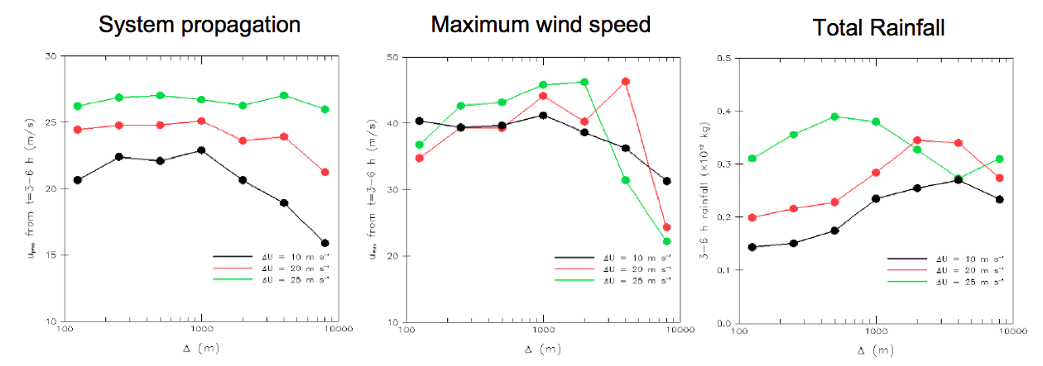
Converging Convection
Many bulk properties converge at O(1 km) resolution
Many bulk properties have predictable biases
Bryan, 2007

Slide 33
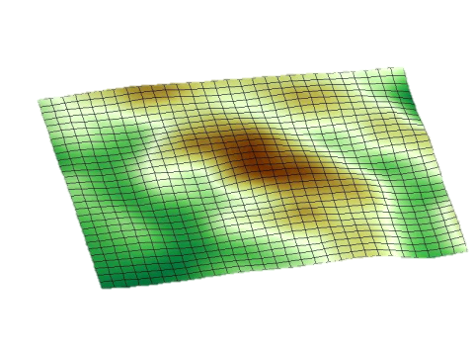
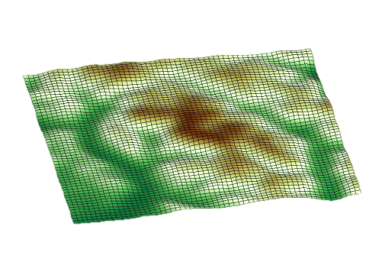
Better Topography
Better near surface wind field (valley winds, Föhn, drag, …)
Better representation of surface heterogeneity (triggering)
“Closer match to obs”
70 km
70 km
70 km
70 km
COSMO-2
COSMO-1
Notes:
Thun
Thunersee
Interlaken
Brienzersee
Haslital
Grimpselpass
Wallis
Eiger/Mönch/Jungfrau

Slide 34
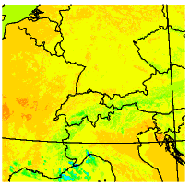
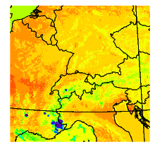
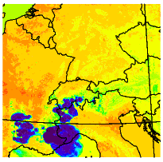
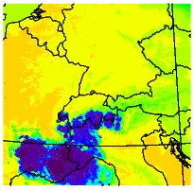
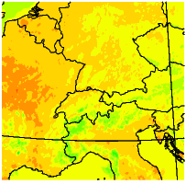
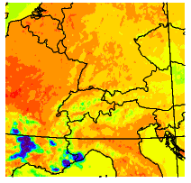
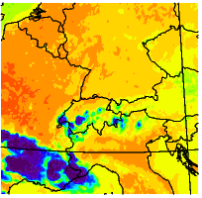
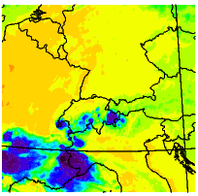
«Realistic» Output
Satellite vs. Model
Radar vs. Model
9 UTC
12 UTC
15 UTC
18 UTC
10.8 μm [K]

Slide 35
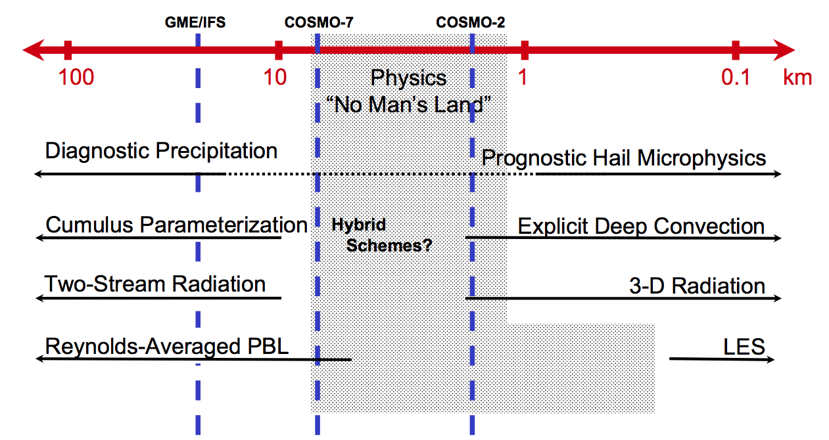
Reduced Uncertainty
COSMO-1
COSMO-1 can steer clear of a large part of the “grey zone” by jumping ahead to Δ=1 km
(adapted from Klemp 2007)

Slide 36
Overview: Setup
Sizing according to current resources
  One forecast takes ~2h on 60% of machine
Forward looking model setup
  Latest code version
  Aggressive use of new model features
  Switch off unnecessary parametrizations
Tuned using 3 cases
  Storm Carmen (12.11.2010)
  Strong convection (30.05.2010)
  Stratus (27.10.2009)

Slide 37
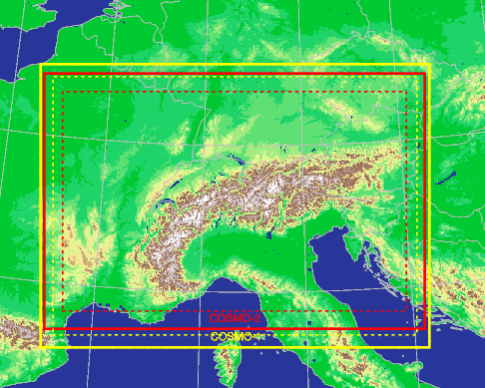

COSMO-1 Domain
lon × lat × lev = 1062 × 774 × 80
Notes:
The inner domain of COSMO-1 (without the relaxation zone: stippled line at 35 grid points from boundary) is close to the actual COSMO-2 domain (520 x 350)

Slide 38
Initial- & Boundary Conditions
Currently
  IC = 1 km assimilation cycle driven by COSMO-7
  BC = from COSMO-7
Long term
  IC = downscaled KENDA analysis
  BC = from IFS (~10 km)

Slide 39
New Dynamical Core
New fast-waves solver
  solves (most) stability problems for steep terrain
  has better accuracy in the vertical
…
Solves (most) stability problems of current dynamical core over steep topography

Slide 40
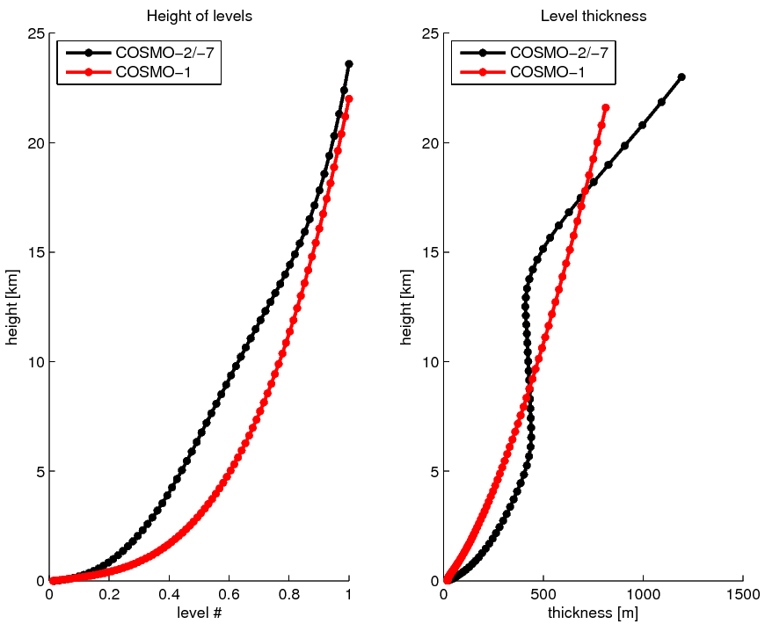
Increased Vertical Resolution
Foundation to improve PBL turbulence
and flow (wind, fog, triggering, …)
Higher resolution in PBL

Slide 41
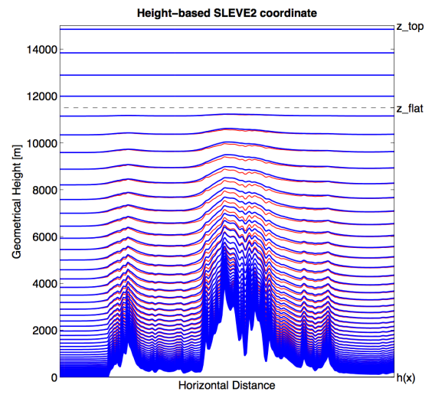
New Coordinate Transformation
Generalized SLEVE (after Leuenberger et al. 2010)

Slide 42
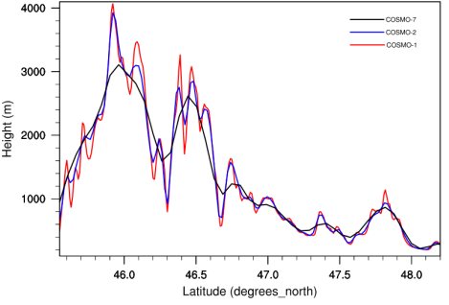
Orographic Filtering
Tune orographic filtering to advection operators
Monte Rosa
COSMO-1
COSMO-2
COSMO-7
Rhine
Rhône valley

Slide 43
Regular COSMO-1 runs
COSMO-1 forecasts since end of August
Two forecasts per day (00 UTC and 12 UTC) to +24h
Plots available in model browser
https://wlsdepl.meteoswiss.ch/modelbrowser/views.jsp
This is work in progress and experimental!

Slide 44
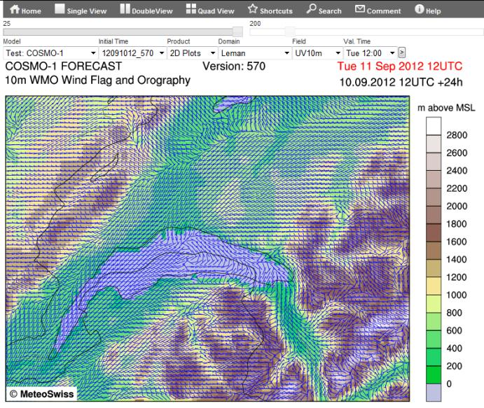
Model browser

Slide 45
Summary (First steps)
We have a 1km setup which runs (mostly)
The quality of the forecasts looks good
Now we can start the work
“Wir müssen gut sein, um besser zu werden”
ETH Rektor

Slide 46
How to get there (next steps)
Task | Start | End | Status
Define setup for COSMO-1 | May 12 | Jul 12 | Done
Define strategy for regular runs | Jun 12 | Jul 12 | Done
Implement regular runs | Aug 12 | Aug 12 | Done
Monitor / validate / verify regular runs | Sep 12 | – | Started
Improvements in turbulence (TKE advection, diffusion operator) | Jun 12 | Dec 12 | Started
Improve external parameters (topo, z0, soiltype, …) | Oct 12 | Jan 13
Case studies (→ myCOSMO-NExT) | Oct 12 | –
C2SM PostDoc
Review configuration and integrate improvements

Slide 47
External parameters
Current status
  GLOBE topo (~1 km)
  FAO soil (~10 km)
  GLC2000 land cover (~1 km)
Improvements?
  SRTM topo (~100 m)
  HWSD soil type (~1 km)
  CORINE land cover (~100 m)
Integration into EXTPAR?
Tuning of TERRA?

Slide 48
Model interpretation
“1 day convection = 10 day synoptics”
High-resolution + RUC = Information flood
Die Herausforderung besteht darin, die wesentliche Information klar aufzubereiten.
Skalenangepasste Modellinterpretation notwendig
Derived quantities (SDI)
Bulk quantities (temporal and spatial neighbourhood)
Intuitive quantities (dBZ)
Probabilistic quantities (lagged ensemble, COSMO-E)
Situation dependent

Slide 49
Scientific challenges
The physical parametrizations might requirement drastic changes and/or re-tuning
COSMO-1 is strongly dependent on the quality of its inputs (initial condition, boundary conditions, external parameters)
COSMO-1 will deliver products with a „realistic look & feel“ of a single realization of the future weather (possibly not the one nature will choose)
It will be hard work to make COSMO-1 as good / better than the existing well tuned models!

