Slide 1

Possible applications
of stochastic physics
Ekaterina Machulskaya
German Weather Service, Offenbach am Main, Germany
(ekaterina.machulskaya@dwd.de)
Working Group 3a
2 September 2013

Slide 2
Outline
Motivation: what do we want to achieve?
Formulation of the problem
How random variable may be propagated in time
Methods to construct random model error field
  “top-down”
  “bottom-up”
  “golden mean”
Outlook

Slide 3
Motivation 1: quality of forecasts
The model results are imperfect.
In the prognostic models, a part of errors stems from uncertain initial conditions.
But a part of errors appears due to the imperfection of a model itself.
Model errors are not negligible as compared to the errors due to initial conditions.
We are not content with the presence of model errors.
The ways to improve the situation: either to improve the deterministic model or to account for errors in a statistical way.
Some errors cannot be fully eliminated deterministically (i.e. from those parameterizations that would require almost infinite resolution, e.g. microphysics, soil, etc.)
Motivation Problem formulation Propagation in time Error field construction Outlook

Slide 4
Motivation 2: estimation of the background error
obs
Most of the data assimilation systems
represent an interpolation between
the observations and the first guess
to provide a new initial condition.
In KF, the weights for the
interpolation are reversely
proportional to the corresponding
uncertainties, or possible errors
An estimation of the model error is needed in order to give an appropriate weight to the first guess. If the model error is underestimated, this weight will be too large and less regard will be paid to the observations than should be.
model
obs
Motivation Problem formulation Propagation in time Error field construction Outlook

Slide 5
Motivation 3: estimation of the model uncertainty
For users, it is important to obtain an idea how reliable is the forecast and what amount of uncertainty contains the forecast
In principle, the model error estimation (goal 2) is not related to the quality of the forecast (goal 1).
The model can be left as is, even not so good, just the correct estimation of the error is needed.
However, it seems to be that the closer the model to the truth, the more correct the error estimation
Motivation Problem formulation Propagation in time Error field construction Outlook
Notes:
Finally, it is important to provide to those using the model the information how reliable is the forecast and what amount of uncertainty does it have.

Slide 6
Formulation of the problem
The task corresponding to the motivation 1:
to bring back into the model what is absent as compared to the nature or was lost during the coarse-graining.
It is not always possible to correct these model deficiencies in a deterministic way, but one can try to do it in the statistical sense:
treat the model error as a random field and
generate a random process, the statistical properties of which
(e.g. mean, higher-order moments, spatiotemporal autocorrelations, etc.) are equivalent to the statistical properties of the random spatiotemporal field called “model error”
The variance can also be estimated.
Motivation Problem formulation Propagation in time Error field construction Outlook

Slide 7
Formulation of the problem
Example of the solution (see Hasselmann, 1988)
if there exist a clear time and space scale separation between resolved and unresolved processes (∆x₁ >> ∆x₂) (= spectral gap!)
∆x₂
∆x₁
grid box
grid box
grid box
the cumulative effect of the random errors within each grid box may be represented by means of the Central Limit Theorem:
sum of many independent identically distributed random variables is Gaussian → the perturbations are the samples of the white noise process
Good for climate studies,
but no spectral gap and independence for the variables in NWP
Motivation Problem formulation Propagation in time Error field construction Outlook

Slide 8
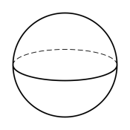
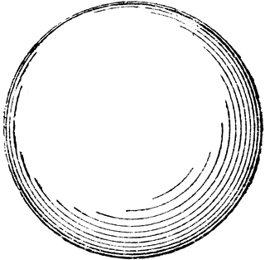



Formulation of the problem
r
$$\left\{p,q,r\right\}−$$
full set of modes (= nature)
$$\left\{p,q\right\}−$$
q
model variables
$$r−$$
unaccounted degree of freedom
p
Usually, the exact initial condition is not known.
Motivation Problem formulation Propagation in time Error field construction Outlook

Slide 9
Formulation of the problem
r
$$\left\{p,q,r\right\}−$$
full set of modes (= nature)
$$\left\{p,q\right\}−$$
q
model variables
$$r−$$
unaccounted degree of freedom
p
Usually, the exact initial condition is not known.
The lack of knowledge in the model variable’s plane (p,q) = the uncertainty in the model’s initial conditions.
Motivation Problem formulation Propagation in time Error field construction Outlook

Slide 10
Formulation of the problem
r
$$\left\{p,q,r\right\}−$$
full set of modes (= nature)
$$\left\{p,q\right\}−$$
q
model variables
$$r−$$
unaccounted degree of freedom
p
Usually, the exact initial condition is not known.
The lack of knowledge in the model variable’s plane (p,q) = the uncertainty in the model’s initial conditions.
The lack of knowledge in the unresolved mode r =
the uncertainty in the model’s physics.
Motivation Problem formulation Propagation in time Error field construction Outlook

Slide 11
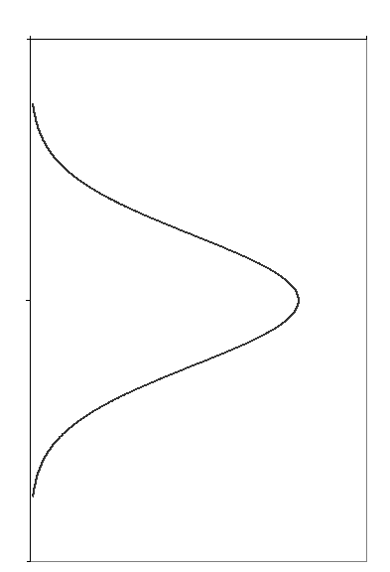
Propagation in time
If a (small) part of the model is random, then the model state is a random variable evolving in time (= random process). This evolution may be represented as
evolution of the probability density function (PDF);
evolution of all statistical moments of the PDF;
evolution of all particular realizations of the random process.
PDF(t)
(ensemble of)
trajectories
t
Theoretically these ways are equivalent, but practically not necessarily.
Which one to choose?
Motivation Problem formulation Propagation in time Error field construction Outlook
Notes:
Practically this means that if we were able to have an infinite number of the ensemble members, able to forecast the infinite number of statistical moments and able to propagate in time an infinite number of bins of the PDF, then we would obtain the same result. Since we are not able to do this, the results will differ. The question is, however, not only which method will produce the most accurate result, but mainly which method we are able to use practically. I give you one example.

Slide 12
Propagation in time
Example: the error due to the discretization of the advection process
Consider a transport equation of a quantity f:
Representing a quantity f as a sum of the ensemble average
(≈ resolved flow) and fluctuations therefrom (≈ unresolved) , one arrives at an ensemble (≈ spatially) averaged equation
with the second-order subgrid-scale contribution subject to a parameterization scheme (= statistical model bias correction due to the interaction between resolved and unresolved flow).
Motivation Problem formulation Propagation in time Error field construction Outlook
Notes:
Consider a transport equation for an arbitrary quantity f in the usual form (here u are the components of the flow velocity vector) and let us try to determine the error of this model for f due to the coarse-graining procedure. If we represent a quantity f as a sum of the ensemble average (…) and fluctuations from the mean, and inserting this representation as well as the similar representation for u into this equation, we obtain the transport equation for the resolved flow, where, due to nonlinearity of the original equation, this covariance appear, which is subject to some subgrid-scale parameterization schemes. We know the names of these schemes, these are turbulence and convection parameterization schemes. So we can say that

Slide 13
Propagation in time
From the governing equations for f and u the prognostic equations for all statistical moments can be derived, for example:
requires
assumptions
neglected
for the most part
known
→ all NWP and climate models account already for a part of the model error stochastically:
the error is the discretization error of the advection equations, and it is accounted for by means of the estimation of the statistical moments of the PDF of momentum, air temperature and humidity. The parts of the model that do this work are called turbulence and convection parameterization schemes.
Motivation Problem formulation Propagation in time Error field construction Outlook
Notes:
The message: if there is a process which can be described by means of an equation of a relatively simple form, then to describe the uncertainties that arise due to the discretization of this process there is no need in any ensemble, one can derive the set of the prognostic equations for a sufficient number of the statistical moments within a single run.
… the difference between the results obtained with the transport equation with this bias correction by means of the second moment and without this correction is exactly the same as the difference between the single deterministic run without this correction and the ensemble mean.

Slide 14



Propagation in time
If an equation is more complex (the right-hand side includes terms that are highly non-linear, have thresholds, etc.), then the prognostic equations for the moments cannot be easily obtained, if at all.
In this case it might be preferable to use other approaches, e.g. running an ensemble of realizations.
→ The methods can be combined!
If the propagation in time of the error due to advection discretization were done by means of an ensemble of realizations, then
would be the difference between the deterministic run
without error correction and the ensemble mean with statistical error correction (= mean bias correction)
$$−\frac{d}{dz}\overline{w^{′}θ′}$$
$$\overline{{θ′}^{2}}$$
$$\overline{u_{i}′u_{i}′}$$
, (TKE) – spread
Motivation Problem formulation Propagation in time Error field construction Outlook

Slide 15
How to construct the model error
Two ways are already tried in various studies:
to derive the statistical properties of the model error from the available model data (≈ “top-down”)
Statistical bias correction (e.g. Faller, 1975; Johansson & Saha, 1989; Danforth & Kalnay, 2007; DelSole et al., 2008)
Linear stochastic models (Nicolis et al., 1997; Achatz & Opsteegh, 2003; Berner, 2005; Sardeshmukh & Sura, 2009)
to think about “what can be uncertain and be the main source of errors and thus perturbed” (≈ “bottom-up”)
(Randall & Huffman, 1980; Majda & Khouider et al., 2002; Lin & Neelin et al., 2002; Craig & Cohen, 2006)
Motivation Problem formulation Propagation in time Error field construction Outlook

Slide 16
How to construct the model error
From the model data:
Whole error is accounted for by design (to a known accuracy)
Restricted applicability: parameters of the random processes are fitted to some certain conditions, model version, region etc.
Artificial dependencies can appear. Insufficient physical background.
“What should be perturbed”:
Physically based
There is no answer to the questions “How it should be perturbed?”, “How large is an uncertainty of what is known to be uncertain?”
Final results may not well represent the sought model error field. Danger of double-counting of the errors.
A golden mean is needed
Motivation Problem formulation Propagation in time Error field construction Outlook

Slide 17
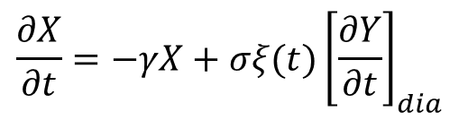
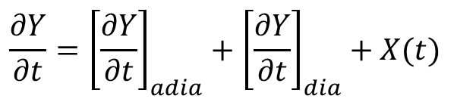
How to construct the model error
Short perspective
use the approach 1 (construct the properties of the model error from the computed data)
Approximate the parameters
γ and σ by means of the data
For the approximation technique, see Tsyrulnikov, 2005; Berner, 2005; Achatz et al., 1999
Assume the form of how the model error enters the governing equations:
Assume the form of the model error equation:
Take the forecast and analysis fields for each month
Compute
the difference “forecast–analysis”
$$\frac{∂Y}{∂t}={\left[\frac{∂Y}{∂t}\right]}_{adia}+{\left[\frac{∂Y}{∂t}\right]}_{dia}+X(t)$$
Decrease the dimensionality of the phase space – determine the leading patterns of the model error
$$\frac{∂X}{∂t}=−γX+σξ(t){\left[\frac{∂Y}{∂t}\right]}_{dia}$$
Motivation Problem formulation Propagation in time Error field construction Outlook

Slide 18
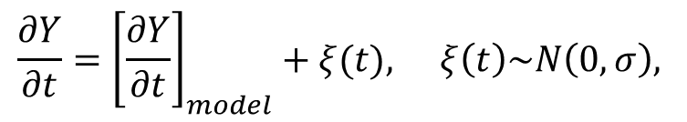
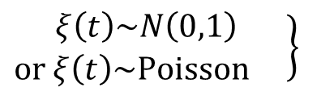
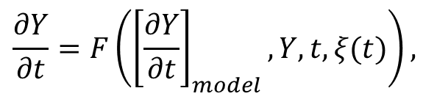
How to construct the model error
Additive white noise
$$\begin{matrix}\frac{∂Y}{∂t}={\left[\frac{∂Y}{∂t}\right]}_{model}+ξ(t)\text{,} & ξ\left(t\right)\sim N\left(0,σ\right),\end{matrix}$$
delta-correlated
Errors in tendencies per se are not delta-correlated white noise
The quantities should be found which might be indeed represented by some noise
$$\frac{∂Y}{∂t}=F\left({\left[\frac{∂Y}{∂t}\right]}_{model},Y,t,ξ(t)\right)\text{,}$$
$$\begin{matrix}\left.\begin{matrix}ξ\left(t\right)\sim N\left(0,1\right) \\ or ξ\left(t\right)\sim Poisson \end{matrix}\right\} \\ \end{matrix}$$
independent increments (Markov)
Noise structure should not be arbitrary, but determined by the equations
A feasible approach would be a method that allows to derive the statistical properties of the random process from the formulation of the model.
Motivation Problem formulation Propagation in time Error field construction Outlook
Notes:
all the rest should be done by the equations themselves, they should think

Slide 19
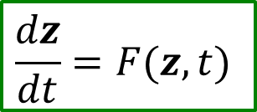
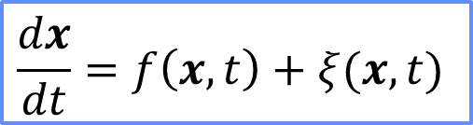


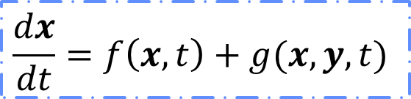
How to construct the model error
z – full set of modes (= nature)
$$z=\left\{x,y\right\}$$
(e.g. z can be the set of Fourier components of a solution of the equation prior to the discretization procedure)
Let us regard x as a set of resolved components (= model variables) and y as a set of unresolved components.
$$\frac{dx}{dt}=f\left(x,t\right)+g(x,y,t)$$
For each value of x there is an ensemble of values of the unresolved degrees of freedom y
$$\frac{dy}{dt}=h(x,y,t)$$
→ in the equation for x modes
the term g (x,y,t) may be represented
by an appropriate random process ξ:
$$\frac{dx}{dt}=f\left(x,t\right)+ξ(x,t)$$
Motivation Problem formulation Propagation in time Error field construction Outlook

Slide 20
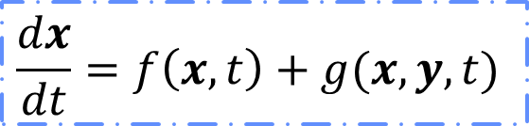

How to construct the model error
$$\frac{dx}{dt}=f\left(x,t\right)+g(x,y,t)$$
$$\frac{dx}{dt}=f\left(x,t\right)+ξ(x,t)$$
“Appropriate” means:
the properties of ξ should not be arbitrary, but consistent with the properties of g and h:
the statistics of ξ should be the same as of g
x is now a random variable → the moments of x should be constrained in order to yield a non-negative PDF of x (realizability) → these constraints can be translated to the constraints of the moments of ξ to ensure realizability of x
the structure of g and h should be used as the hint for the form of ξ
See Kraichnan, 1988; Lindenberg & West, 1984; Majda et al., 2001
Motivation Problem formulation Propagation in time Error field construction Outlook

Slide 21
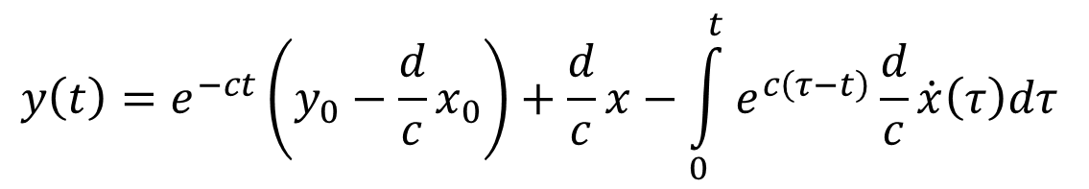
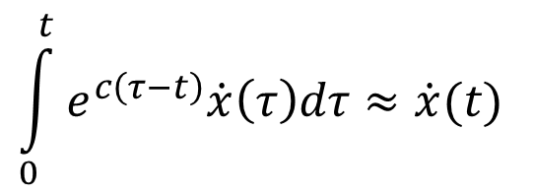



How to construct the model error
Linear system (Lindenberg & West, 1984):
$$\dot{x}=−ax+by$$
Let us regard x as observable, y as unobservable.
$$\dot{y}=dx−cy$$
The idea: to integrate (2) and to insert the result into (1),
thus eliminating the unresolved mode
Integrating (2):
Memoryless approximation:
Finally, inserting into (1):
$$\dot{x}=−Ax+B+Cy_{0}$$
A, B, and C are known functions
of the resolved interaction a and unresolved interactions b, c, and d
corrected
damping
deterministic
drift
additive noise
Motivation Problem formulation Propagation in time Error field construction Outlook

Slide 22


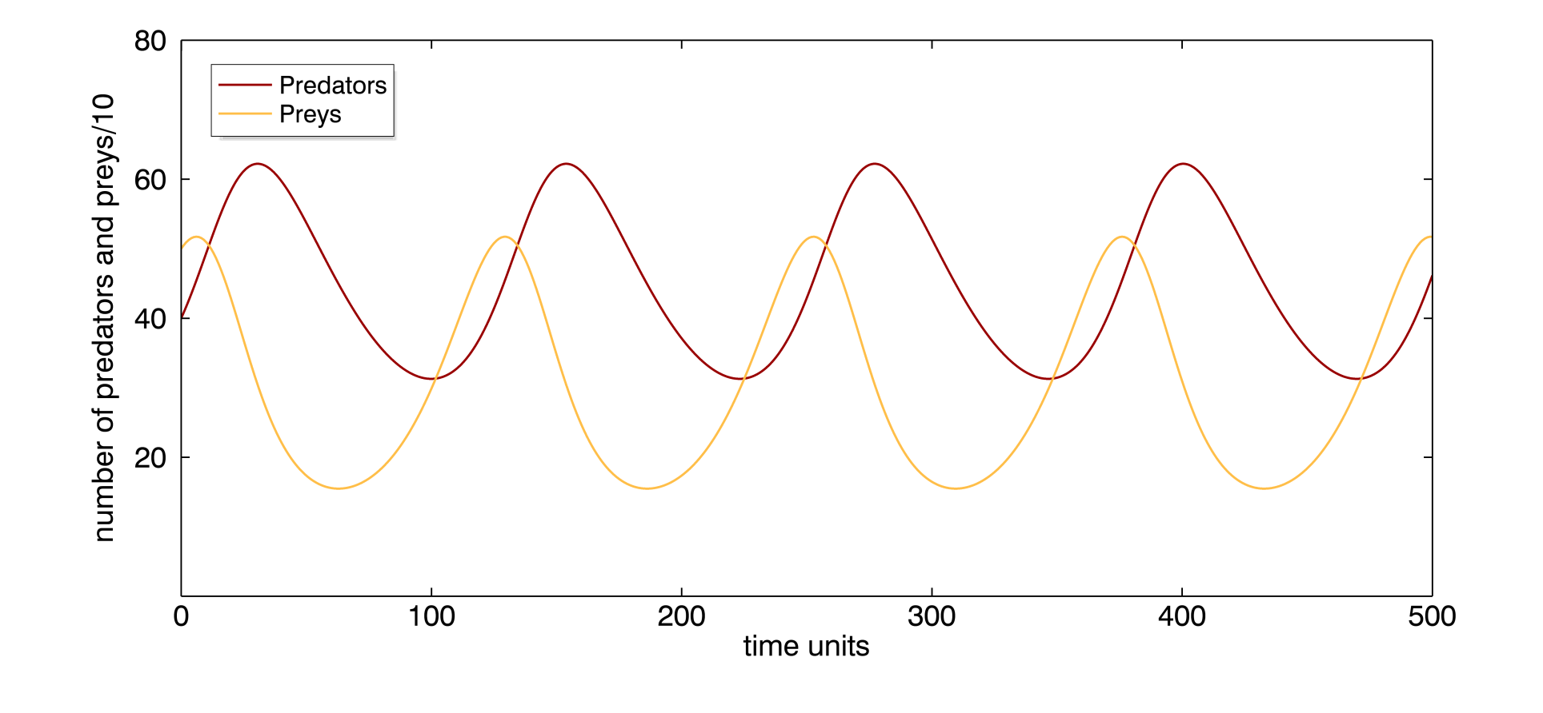
How to construct the model error
Nonlinear system “predator-prey”:
x – number of predators
y – number of preys
Motivation Problem formulation Propagation in time Error field construction Outlook

Slide 23
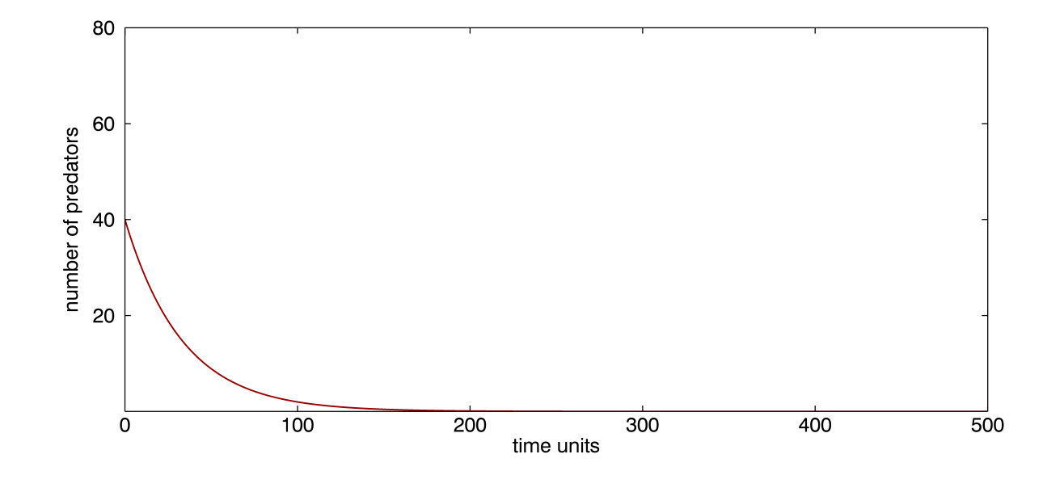
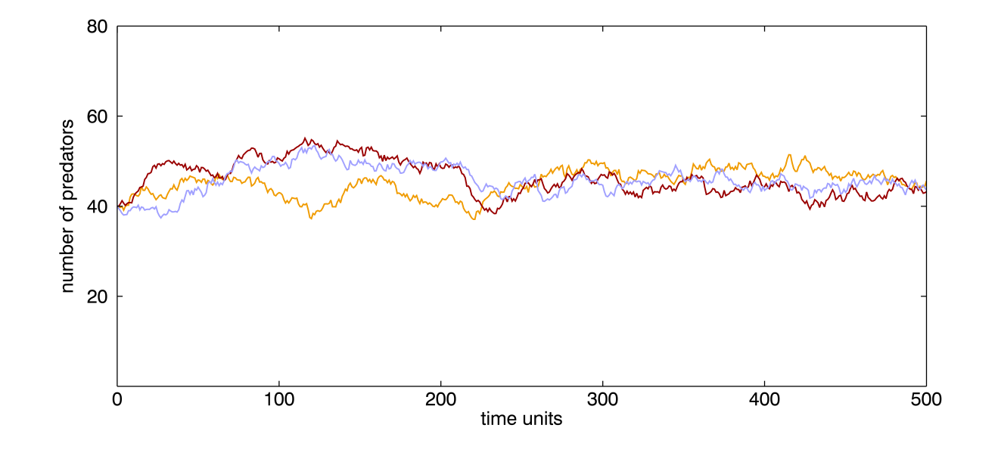




How to construct the model error
Let us regard x (predators) as observable, y (preys) as unobservable.
$$\dot{x}=−γx+δxy$$
This is what we do neglecting !
$$\dot{y}=αy−βxy$$
Neglecting
the unobservable component
Representing
the unobservable component
as white noise with drift
This is what we do replacing by 0.5 K in the Tiedtke scheme!
$$\dot{x}=−γx+η(t)$$
Noise structure is lost!
$$η\left(t\right)\sim N(a_{δxy},σ_{δxy})$$
Motivation Problem formulation Propagation in time Error field construction Outlook

Slide 24
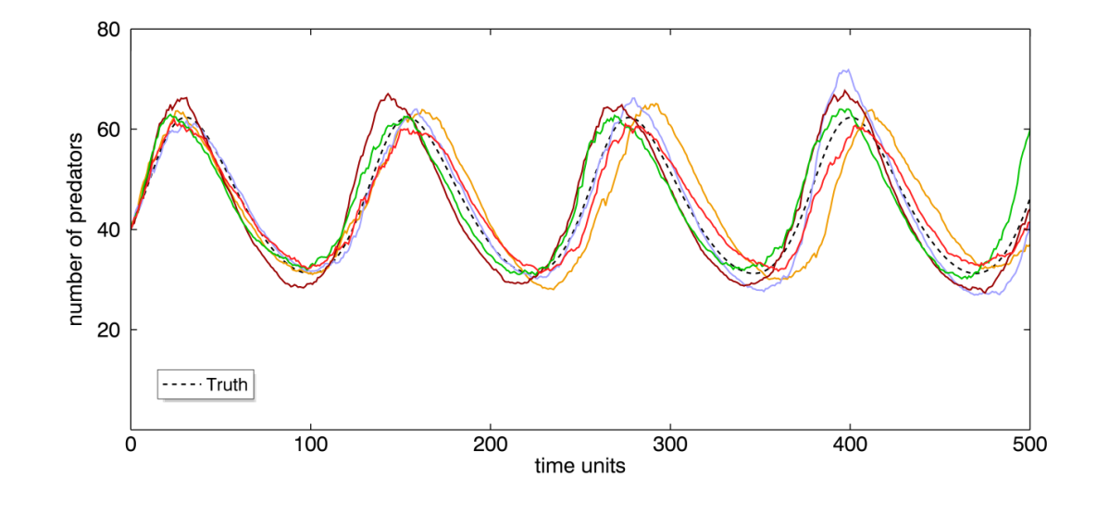
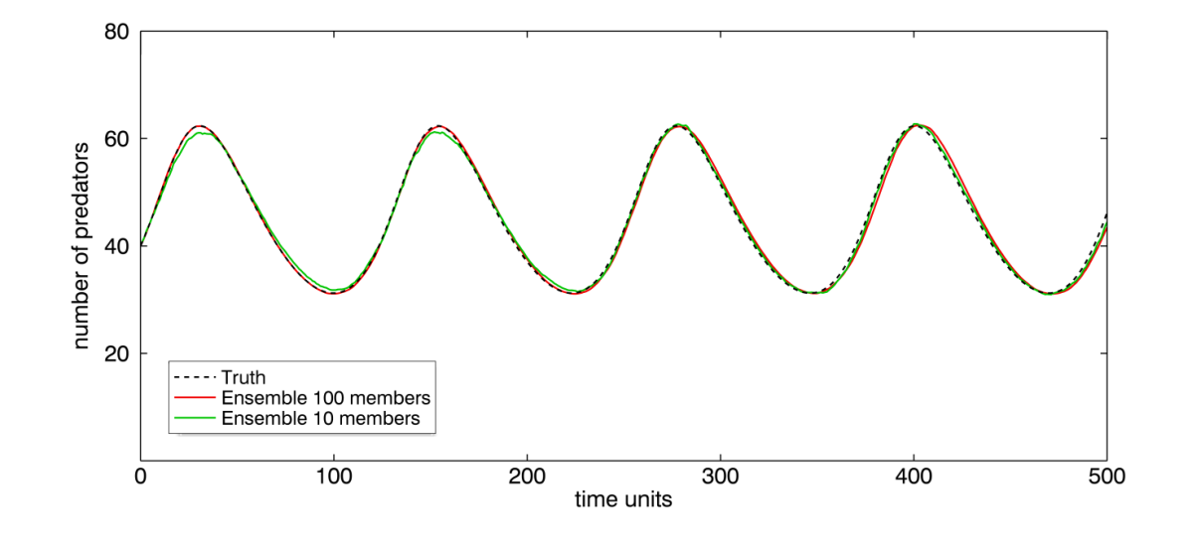
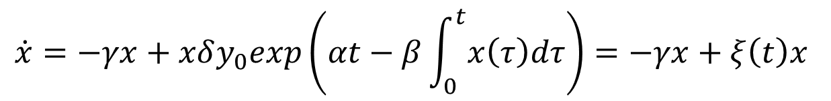
How to construct the model error
Integrating (2) and inserting the result into (1) →
$$\dot{x}=−γx+xδy_{0}exp\left(αt−β\int_{0}^{t}{x\left(τ\right)dτ}\right)=−γx+ξ\left(t\right)x$$
→ the noise should be multiplicative, with memory
Taking y₀ as normally distributed random variable, y₀ ~ N(a_{y}, σ²_{y}),
(with parameters estimated from the behaviour of the whole true system):
Examples of sample paths
Ensemble mean for x
Motivation Problem formulation Propagation in time Error field construction Outlook

Slide 25
Outlook
Implementation and testing of the approach 1
Is it possible to determine the errors from different physical parameterizations separately? (Discretization errors at least.)
If yes, implementation and testing of the approach 1 for each parameterization separately
Development of a more consistent approach

Slide 26
Thank you for your attention!
Thanks to Dmitrii Mironov and Bodo Ritter for fruitful discussions!

