Slide 1
First Experience with KENDA at MeteoSwiss
Daniel Leuenberger, MeteoSwiss
a big thanks to Hendrik Reich, Andreas Rhodin and Harald Anlauf (DWD)

Slide 2
Project COSMO-NExT
Boundary conditions: IFS 10km 4x daily
Boundary conditions: VarEPS 20km 2x daily
ensemble data assimilation: LETKF
COSMO-1: 8x daily O(24 hour) forecasts 1.1km grid size (convection permitting)
COSMO-E: 2x daily 5 day forecasts 2.2km grid size (convection permitting) O(21) ensemble members

Slide 3
First real case study
LETKF integrated in MeteoSwiss NWP suite
Assess the quality of the deterministic analysis and compare with a nudging experiment and a free forecast (work in progress)
Summer 2012 period 25.7.-31.7.2012 (7 days) with moderate convective activity and a cold front passage

Slide 4
Experimental setup I
Operational COSMO-2 setup
1h update cycles
LETKF
40 members + deterministic analysis (LETKF_DET)
DWD namelist adapted to COSMO-2
Constant covariance inflation (error in our setup)
LETKF_SPPT
Same as LETKF, but with use of SPPT during forecast step
NUDGING
As operational COSMO-2 analysis but without LHN and without assimilation of TD_2M
NO_OBS
Same as NUDGING, but no assimilation of observations

Slide 5
Experimental setup II
Identical set of observations (cdfin files) for all experiments TEMP, AMDAR, SYNOP,WINDPROF
LBC from operational ECMWF EPS (first 40 members) for LETKF and ECMWF deterministic forecast for LETKF_DET, NUDGING and NO_OBS
Idential IC at start of period for LETKF_DET, NUDGING and NO_OBS from COSMO-2 opr analysis of 25.7.2012 00UTC
Initial ensemble for LETKF at start of period downscaled from ECMWF EPS. Soil fields from COSMO-2 opr analysis for all members
COSMO 4.26 and LETKF 1.26 from 27.6.2013

Slide 6
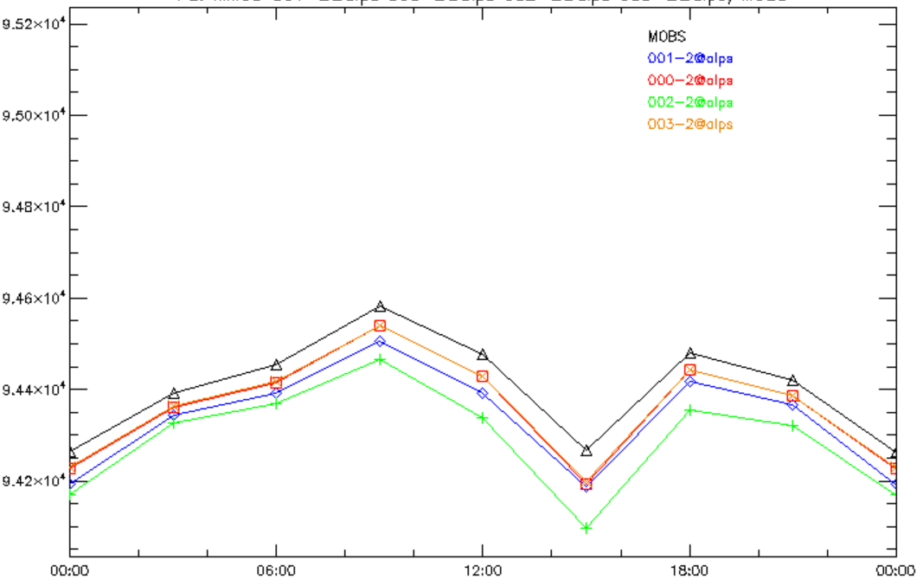
Comparison with surface obs
Mean daily cycle over ca 450 stations
and 7 days
T_2M
FF_10M
Ps
TD_2M

Slide 7
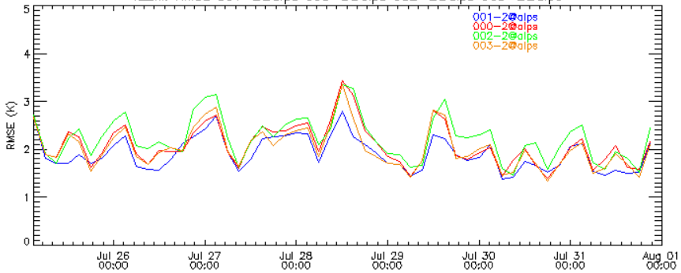
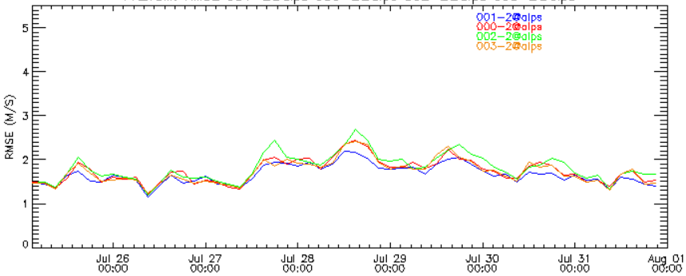
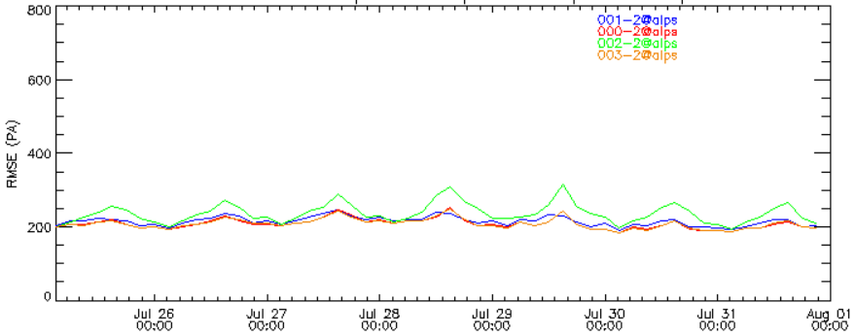
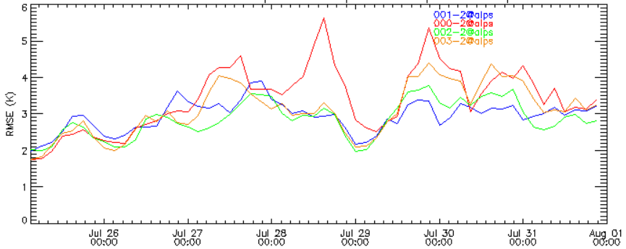
Comparison with surface obs
Temporal evolution of RMSE, mean over ca 450 stations
T_2M
FF_10M
Ps
TD_2M

Slide 8
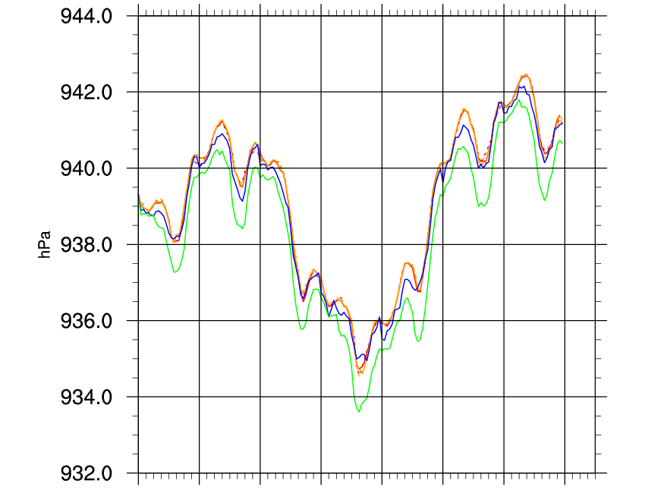
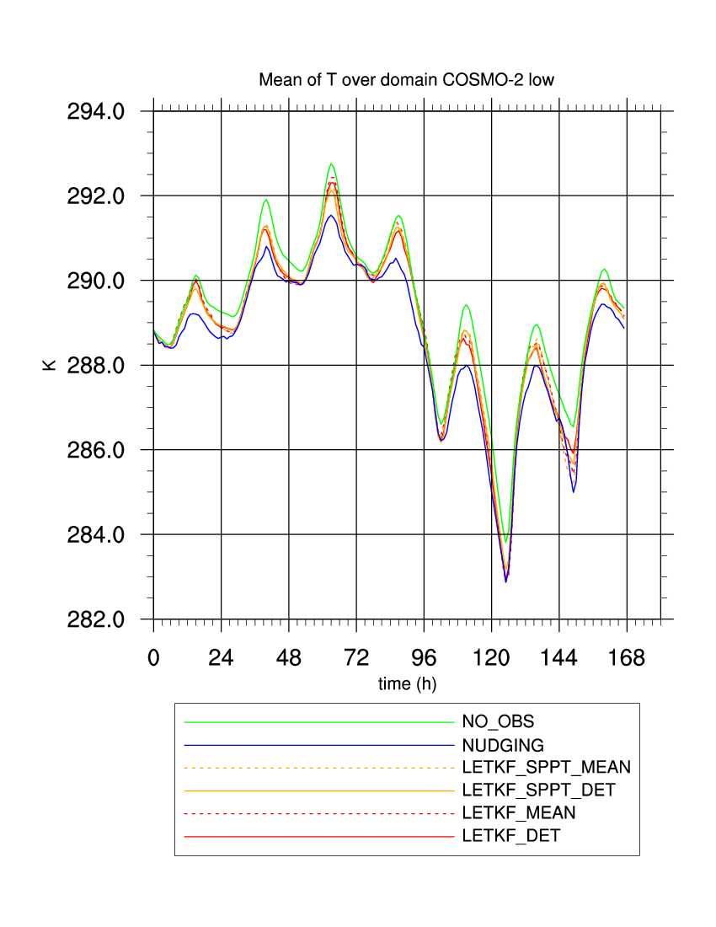
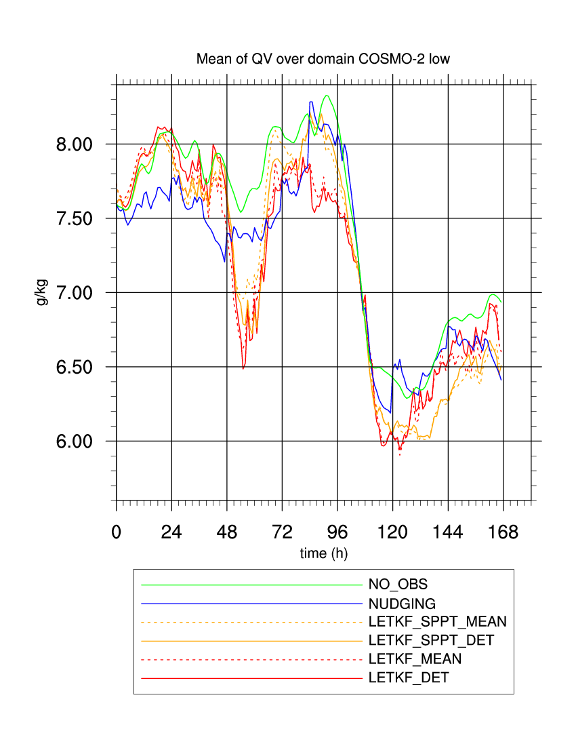
Analysis time evolution
Domain average, lower 3000m
Generally similar evolution of all experiments (we are in a LAM!)
LETKF ensemble mean generally very similar to LETKF det (this is good news!)
Influence of SPPT not really large
EXCEPT…
All above is not really true for humidity!
ps
T
qv

Slide 9
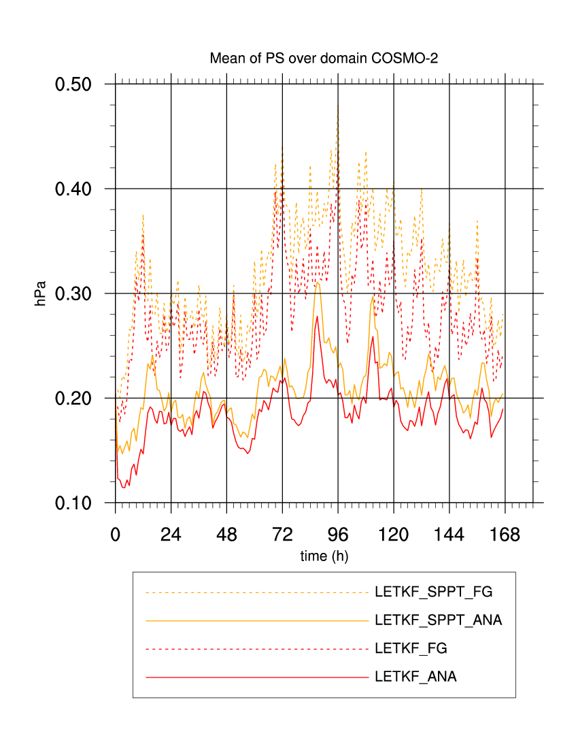
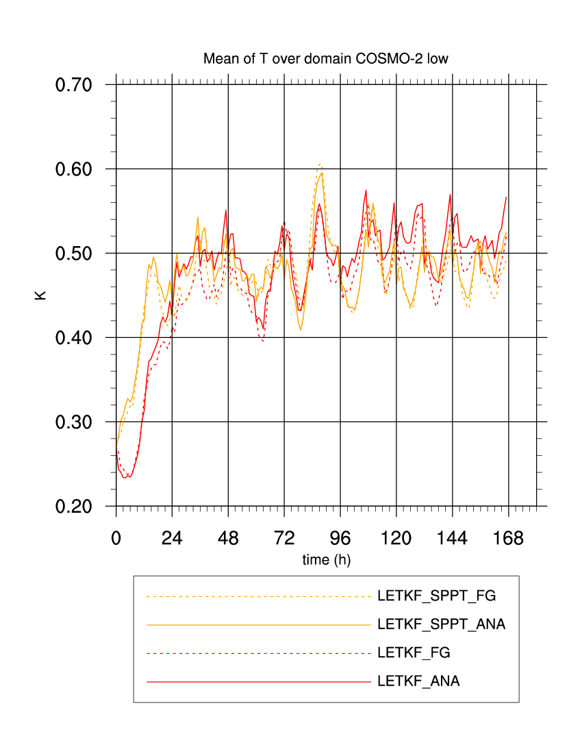
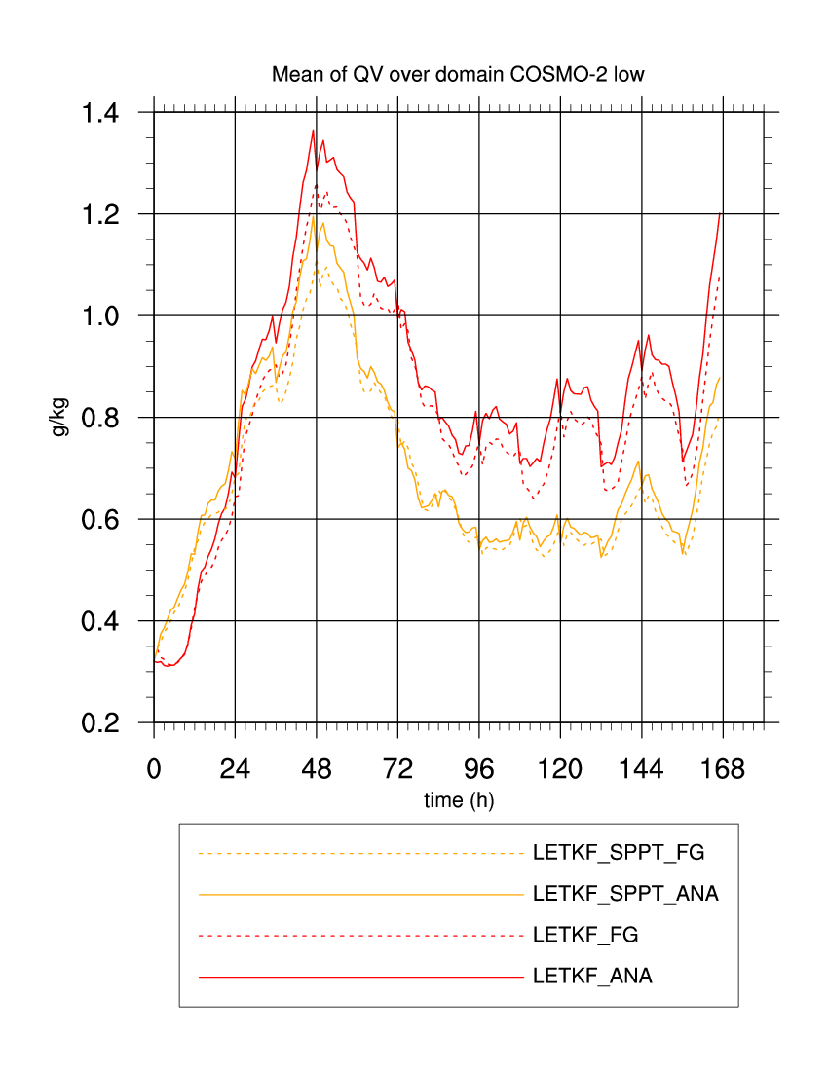
Spread «reduction» after LETKF

Slide 10
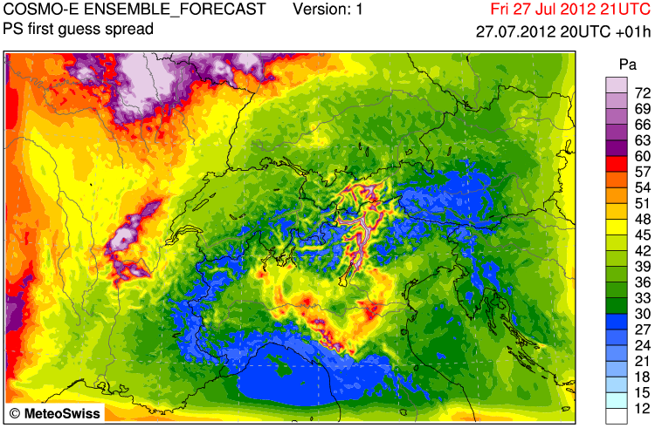
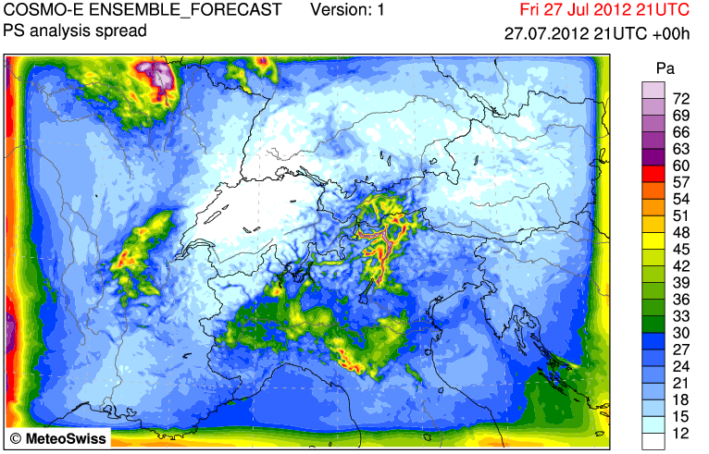
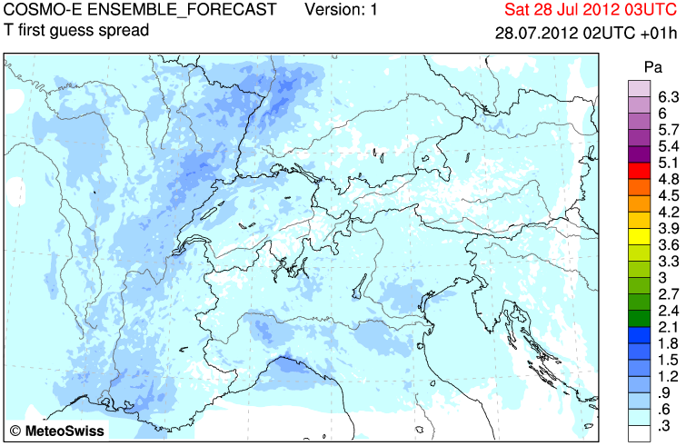
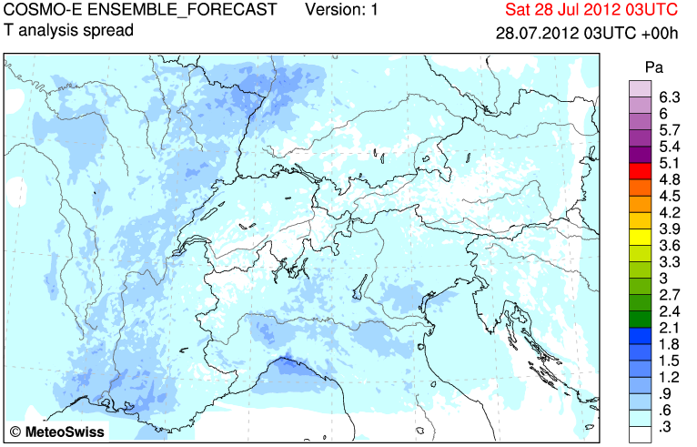
Spread «reduction» after LETKF
Large reduction in surface pressure spread, boundary effects…
Only small reduction in temperature spread at 900m
ps
K
K
T@900m

Slide 11
First impression
LETKF technically works
Comparison with surface observations suggest
Generally: LETKF better than NO_OBS, but worse than nudging
Assimilation of surface pressure appears to work particularly well
Differences between LETKF and nudging largest at noon and in the Po valley
Large RMSE in Td_2m (not assimilated in any of the experiments)
LETKF_DET analysis generally very close to LETKF ensemble mean
SPPT has only small but positive impact

Slide 12
Next steps
Look at covariance inflation (seems to be a technical problem)
Revise LBC strategy (IFS det + IFS EPS perturbations)
Look at diagnostics and innovation statistics (NEFFprove!)
Continue with idealized tests and develop tool for synthetic observations
Start with deterministic analysis for COSMO-1

Slide 13
Thank you for your attention

Slide 14
Adaptive Inflation

Slide 15
KENDA Road Map
Set up of LETKF with COSMO-E settings at CSCS
Start with idealized experiments (OSSE)
Stable atmosphere at rest
Mountain-plain flow (Alpine Pumping)
Real case experiments with COSMO-E
Deterministic analysis for COSMO-1
Regular assimilation cycle
KENDA operational
Developments in close collaboration with COSMO
Finished
Nov 2012
Q2 2013
Q4 2013
2014
2015

Slide 16
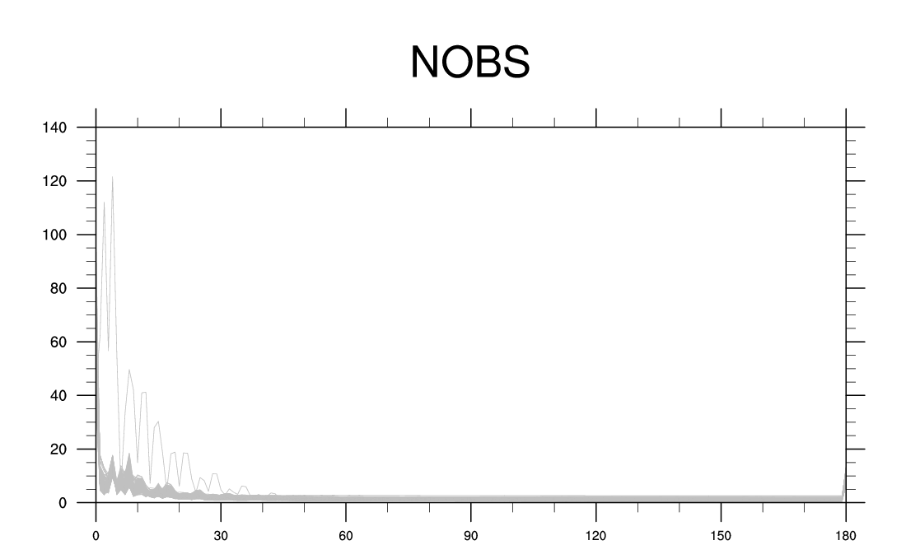
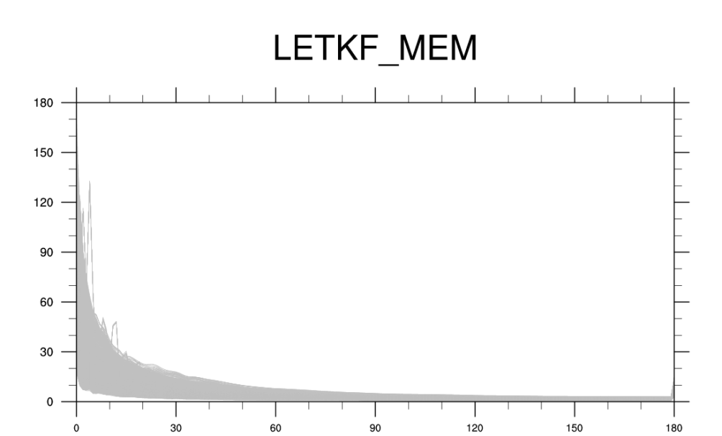
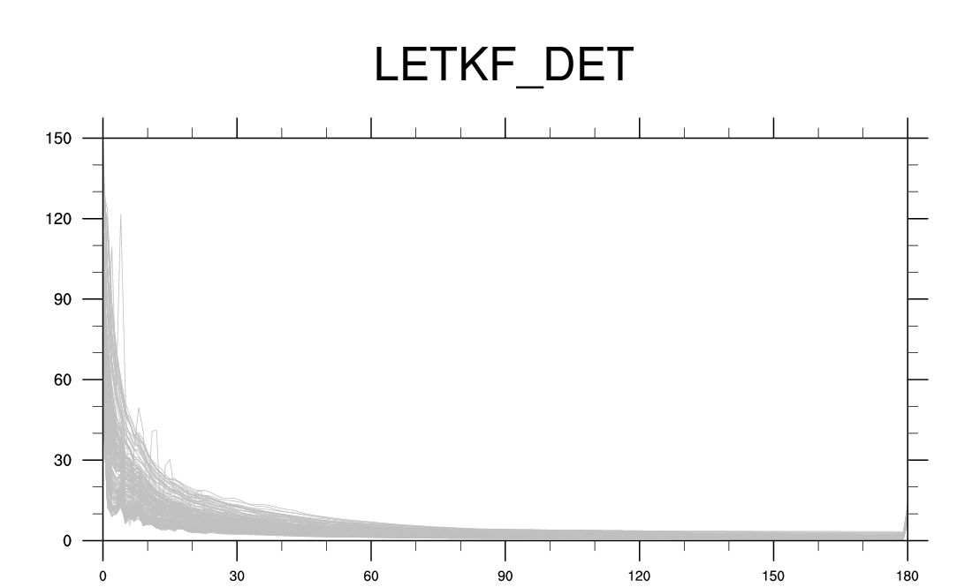
Noise of COSMO forecast steps

Slide 17
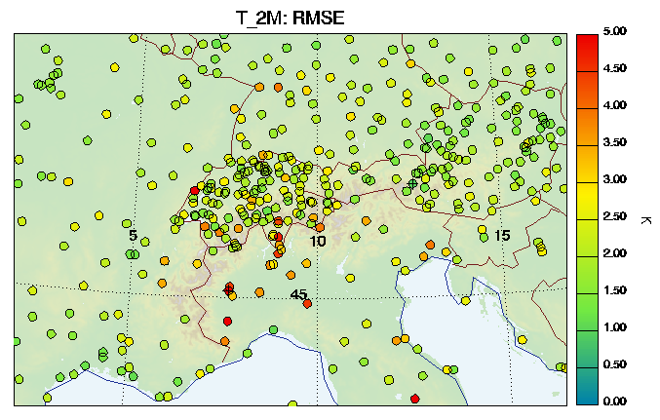
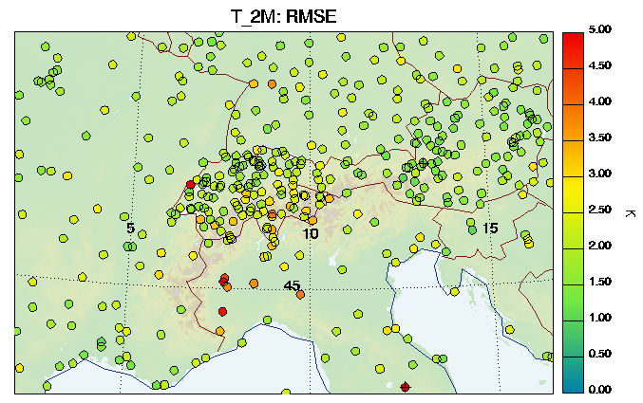
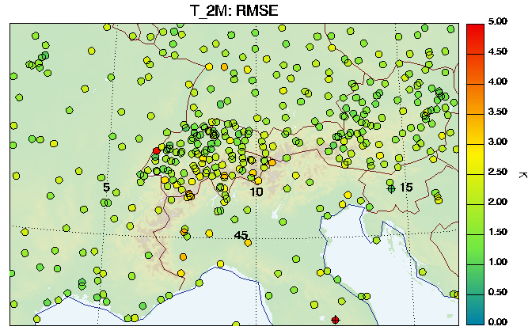
Spatial distribution of RMSE
Largest differences in the Po Valley
NUDGING closest to OBS
LETKF_DET similar to NO_OBS
NO_OBS
LETKF_DET
NUDGING

Slide 18
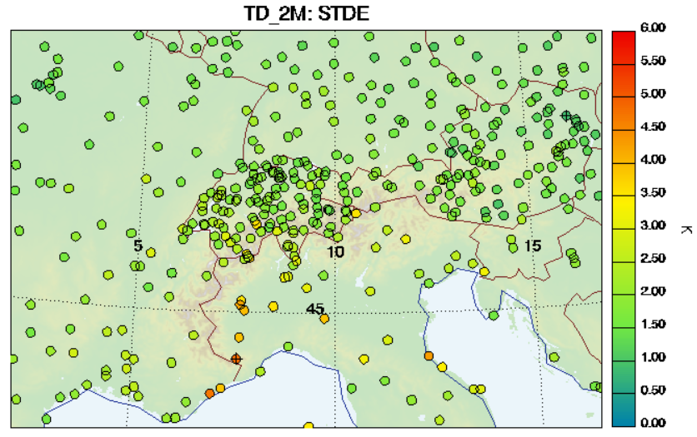
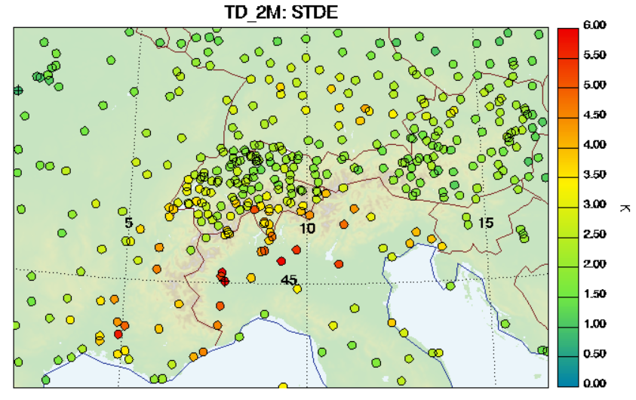
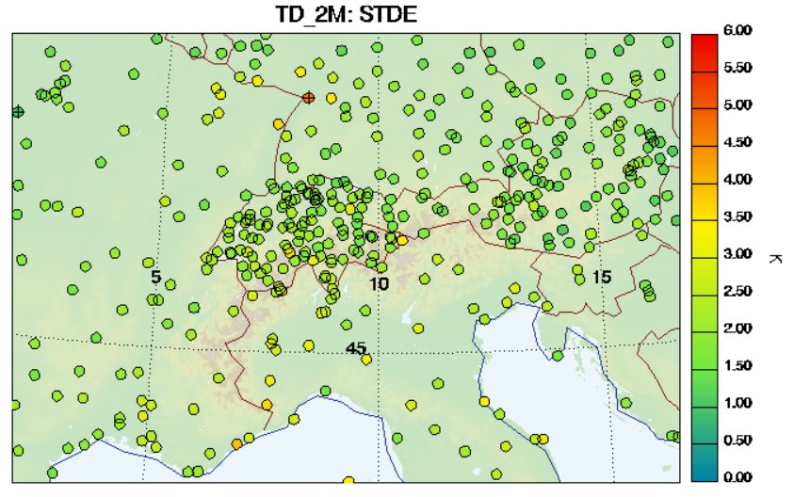
Spatial distribution of RMSE
Differences everywhere, but particularly over Po Valley
NO_OBS closest to obs!
NO_OBS
LETKF_DET
NUDGING

Slide 19
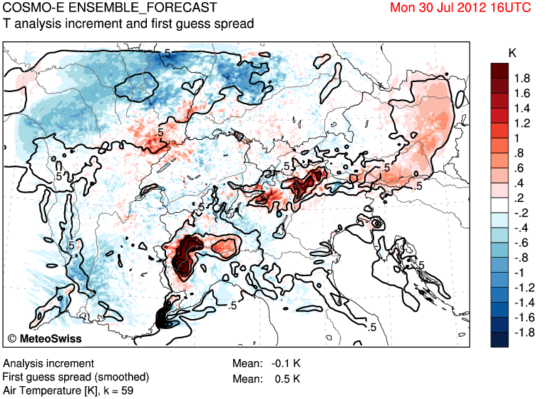
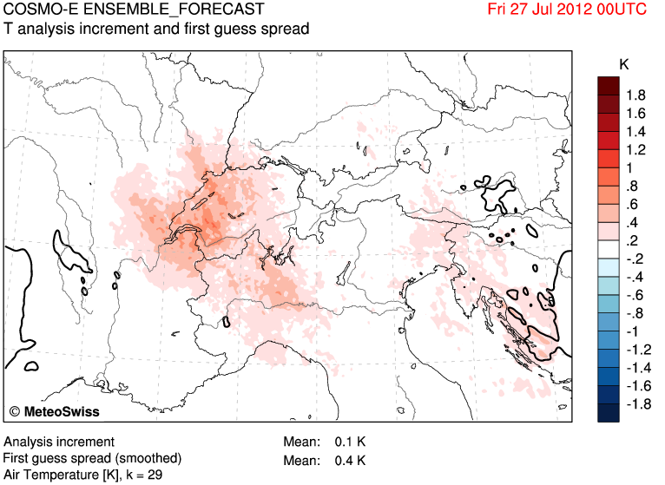
Analysis increments
Sometimes good correlation between analysis increments and first guess spread, sometimes not…

Slide 20
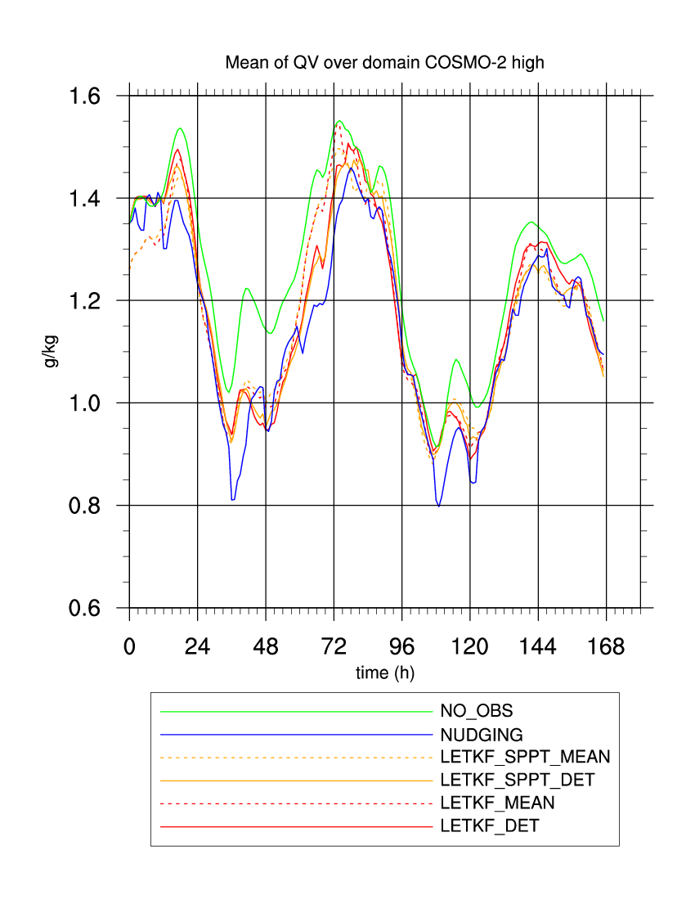
Qv domain average

Slide 21
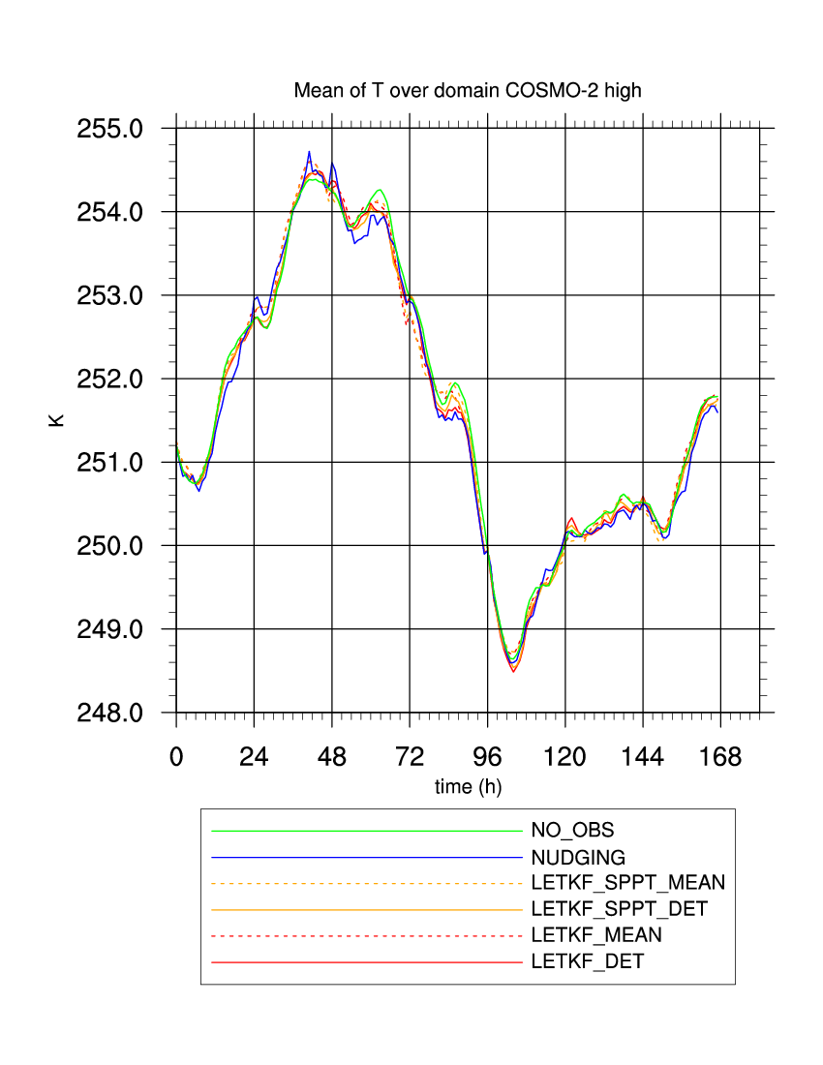
T domain average

Slide 22
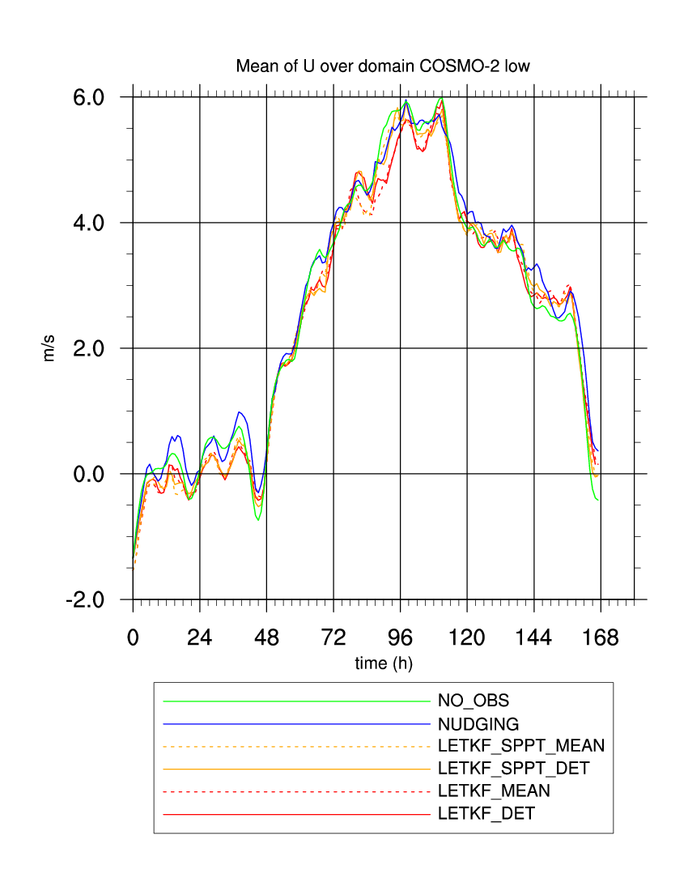
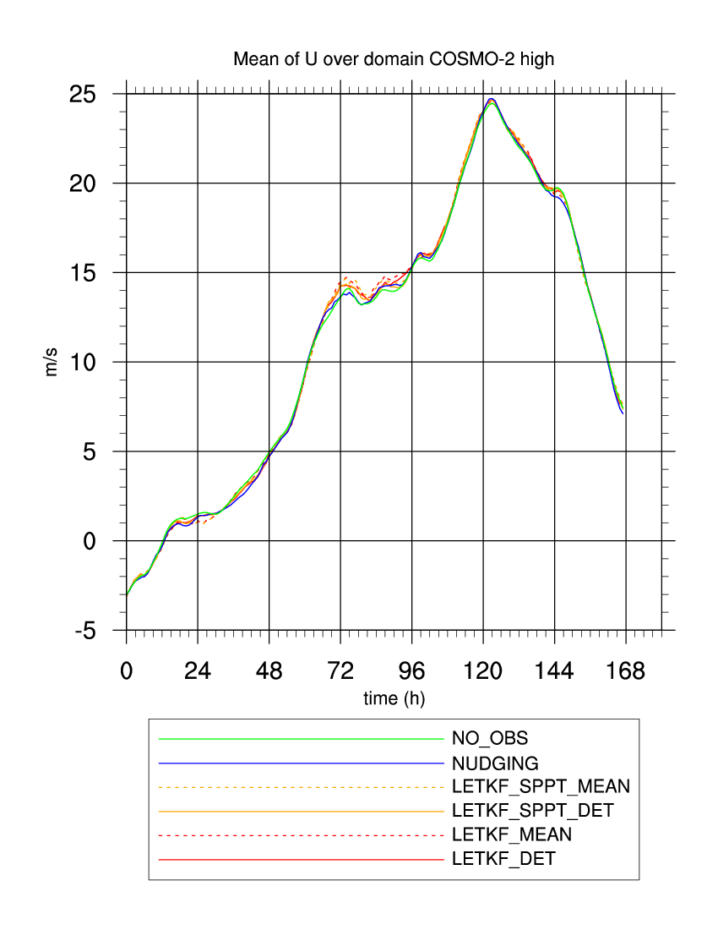
U domain average

Slide 23
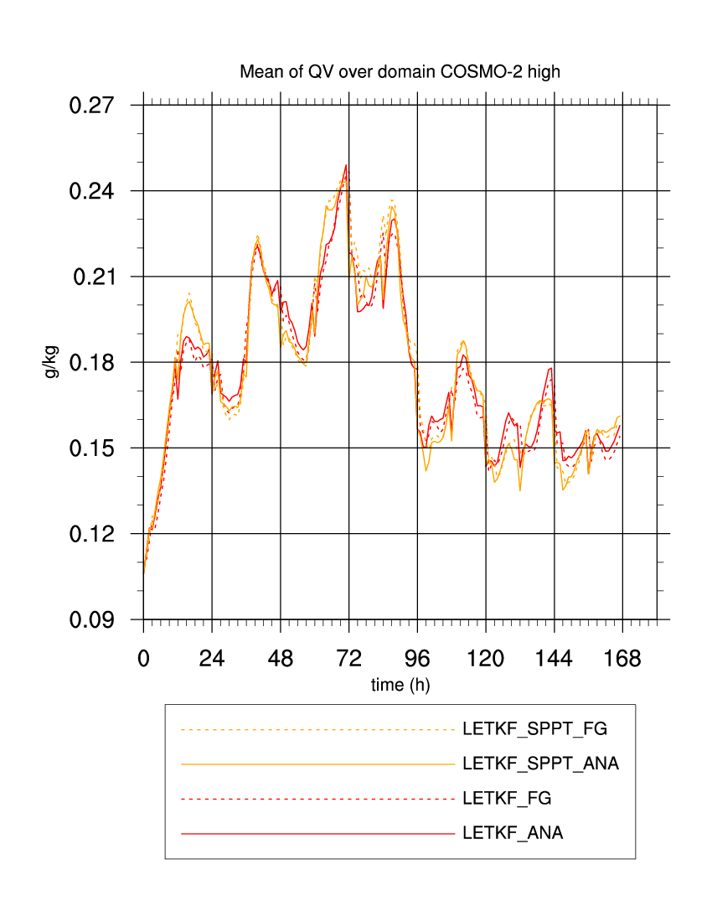
Qv spread domain average

Slide 24
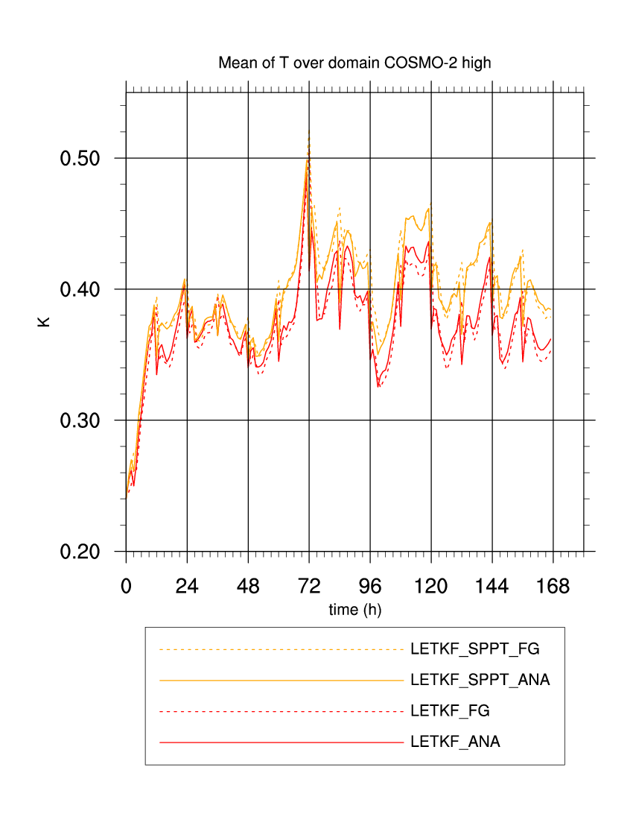
T spread domain average

Slide 25
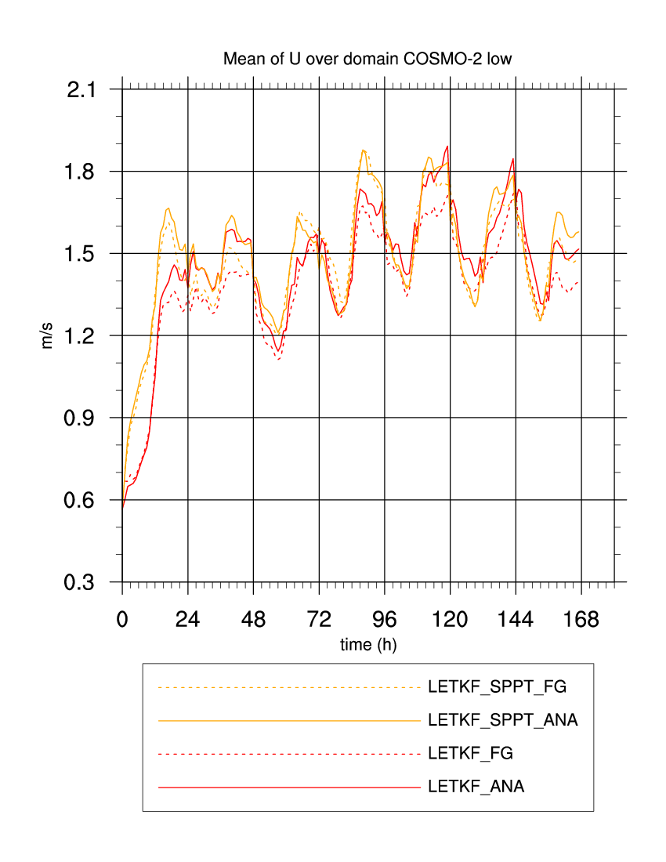
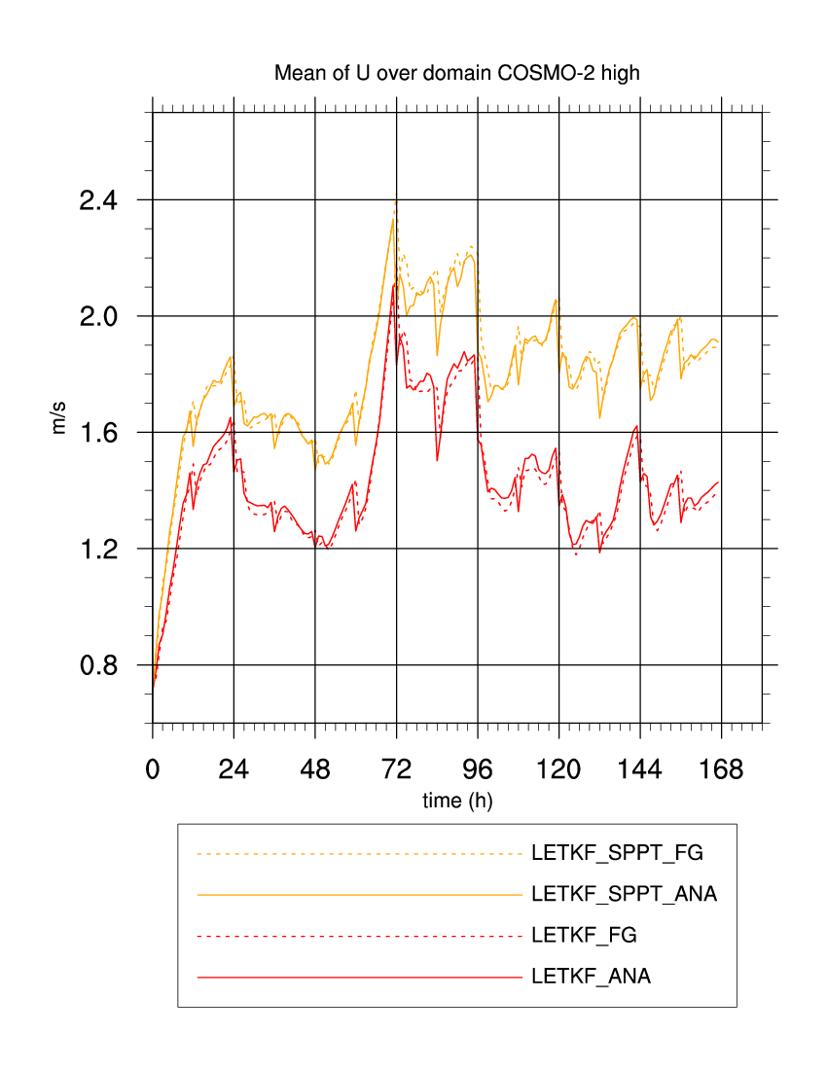
U spread domain average

Slide 26
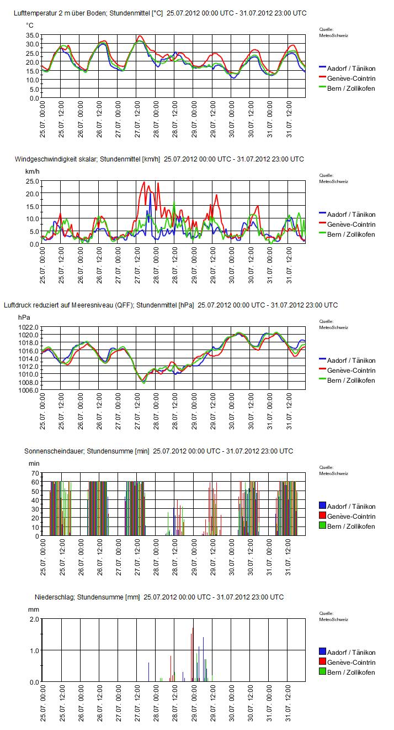
Case description
Period: 25.7.2012 – 31.7.2012
Flat pressure situation over Central Europe, low pressure system over Iceland, moving towards British Isles
Situation over Alpine Area:
25.-27.7.: Fair weather with high temperatures, and some localized convection
Cold front passage on late 27.7. with stratiform precipitation until 29.7.
30.7. and 31.7.: fair weather with very little precip

Slide 27
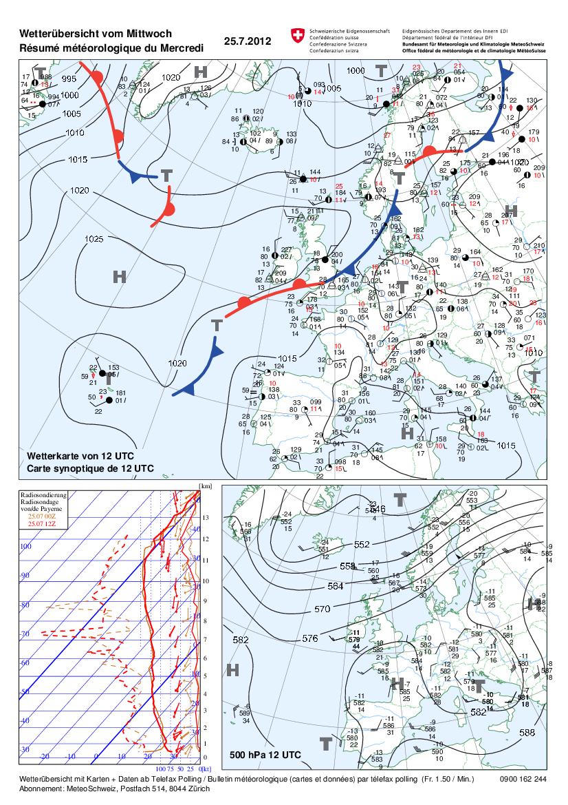
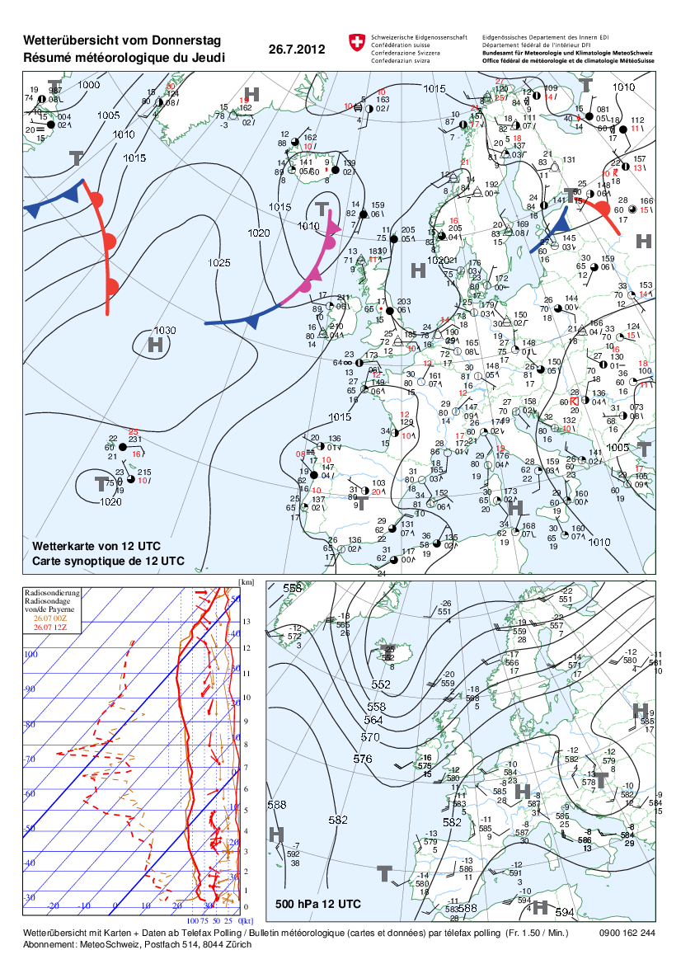

Slide 28
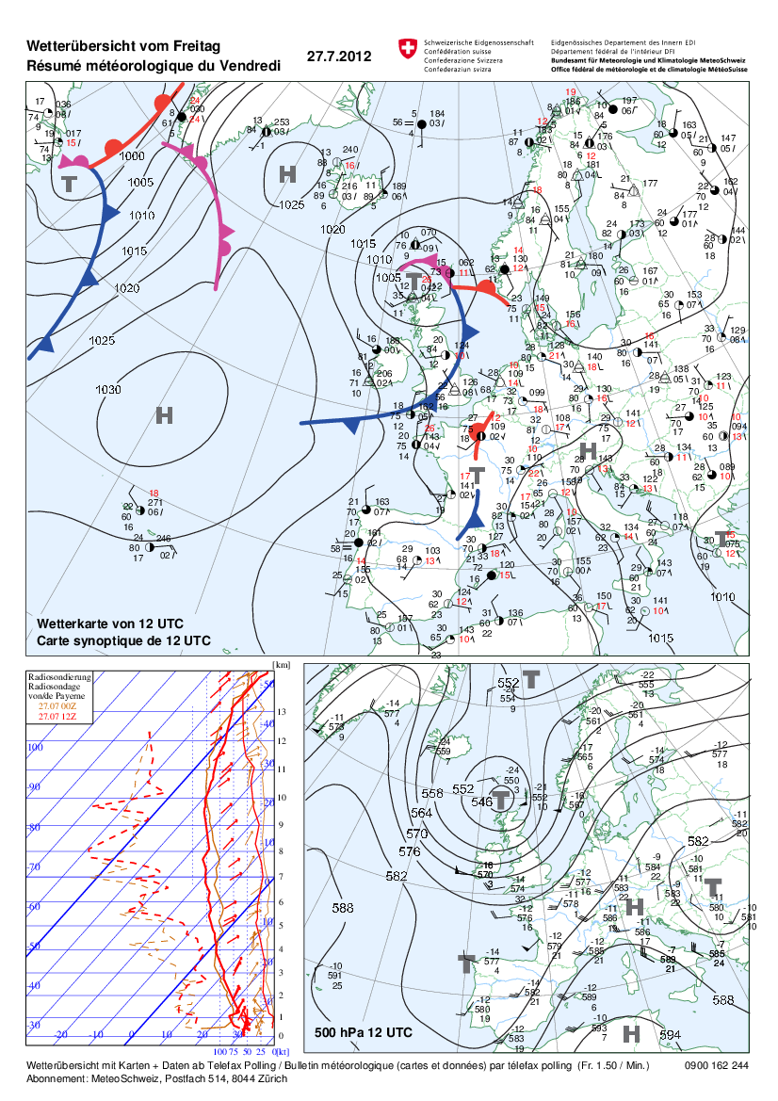
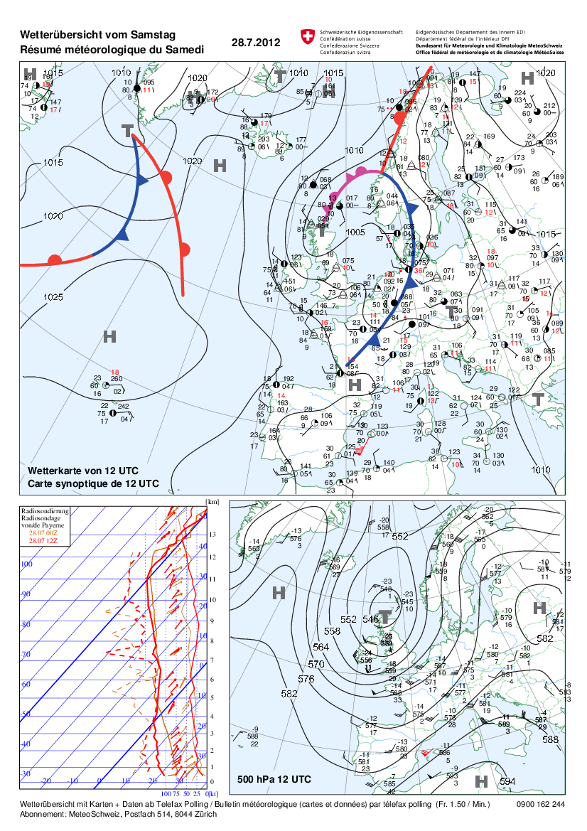

Slide 29
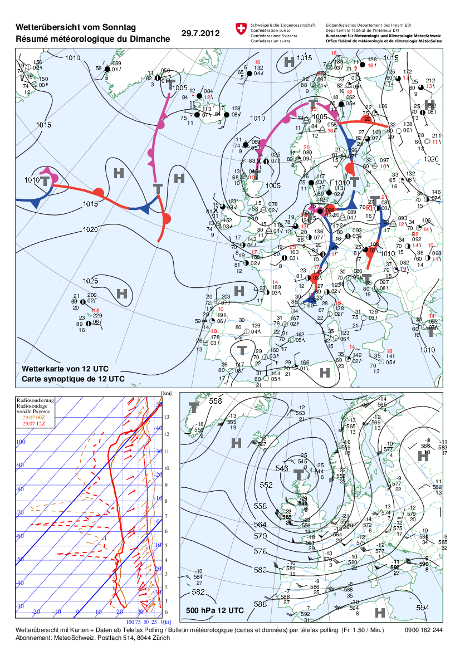
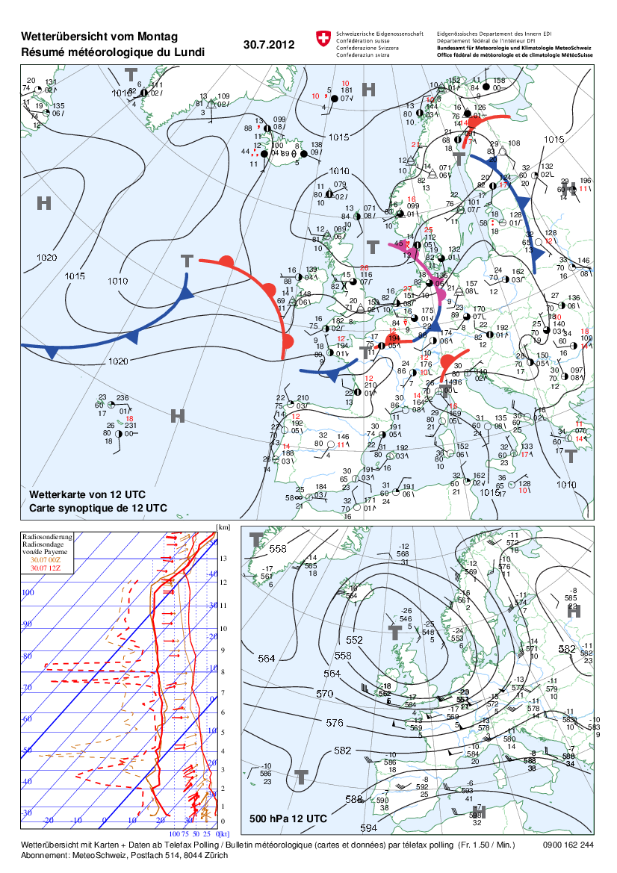

Slide 30
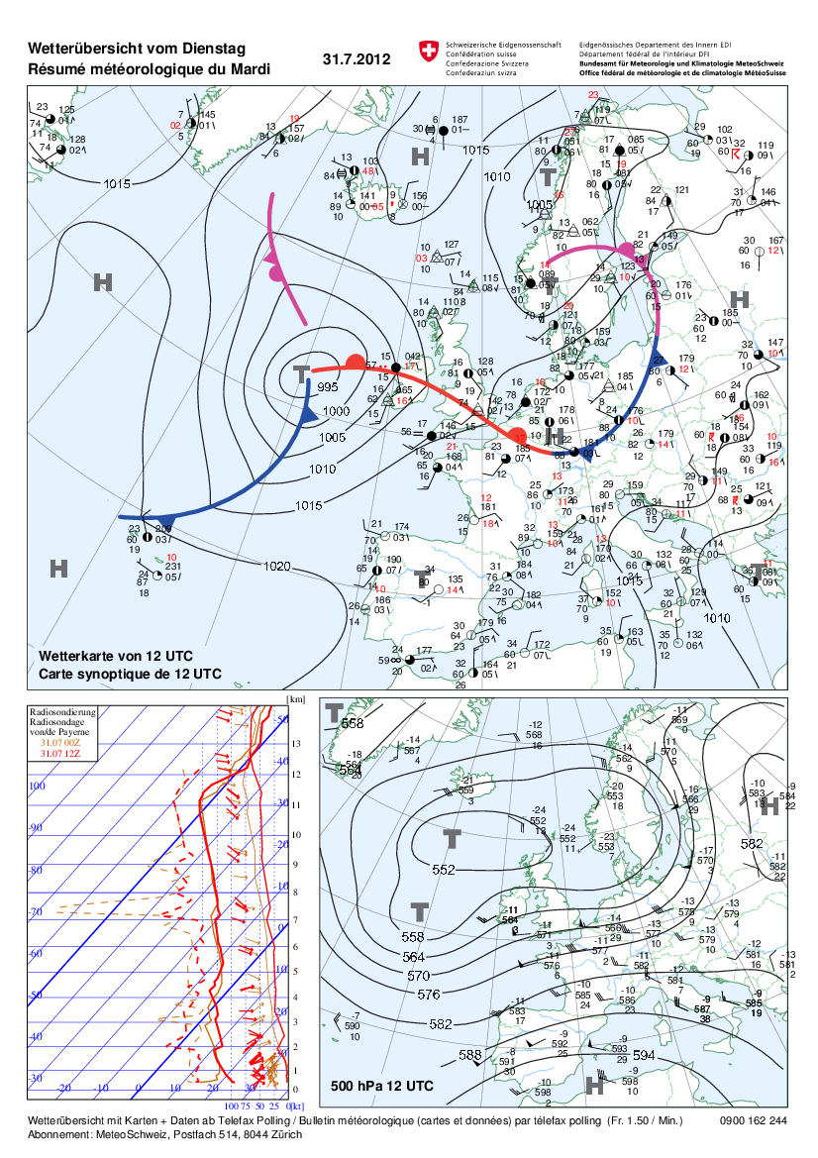
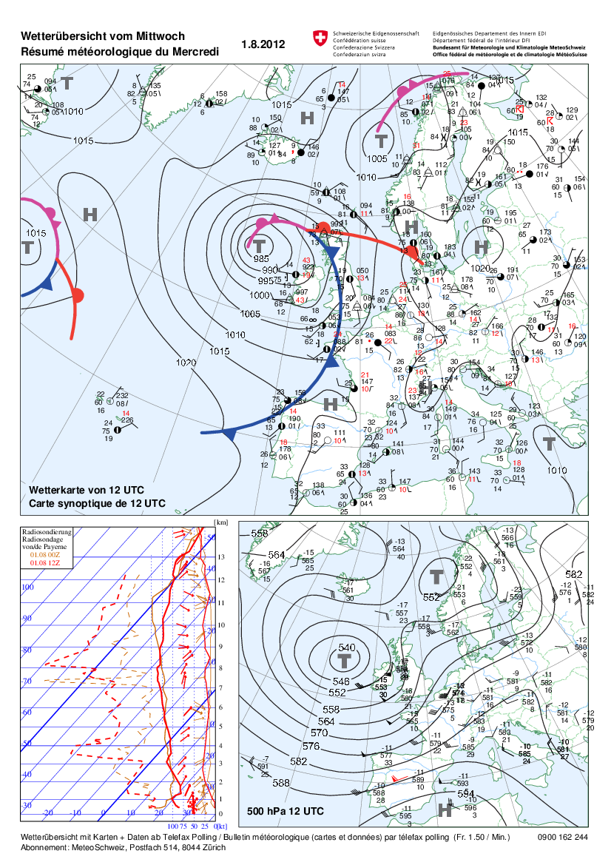

Slide 31
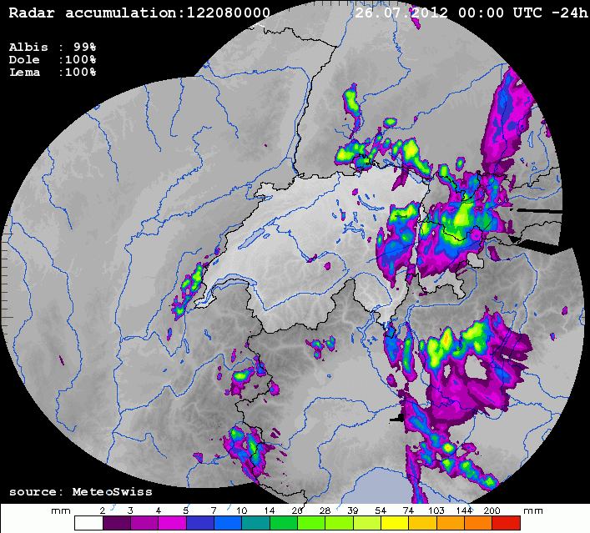
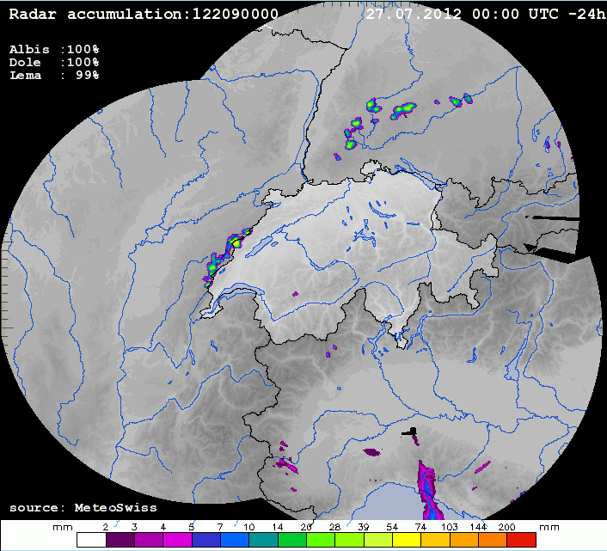
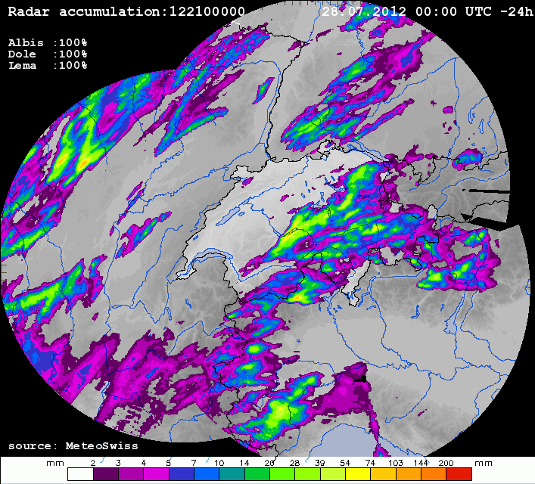
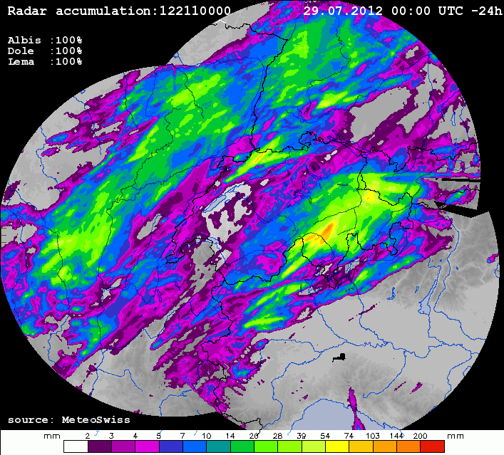
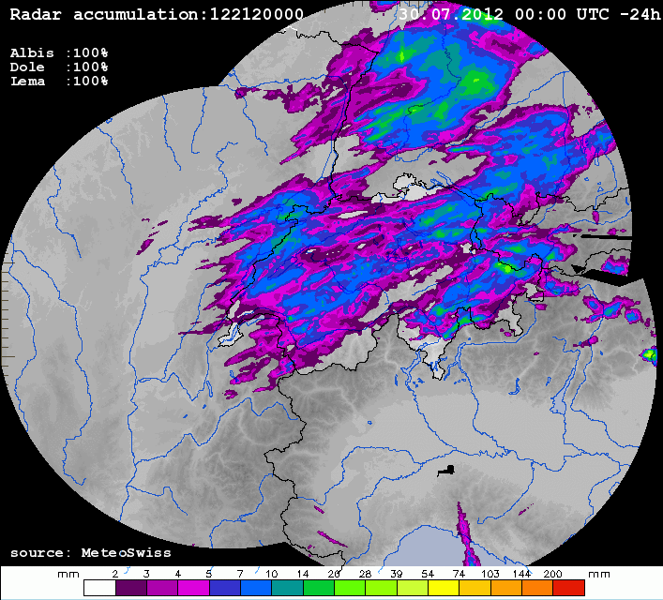
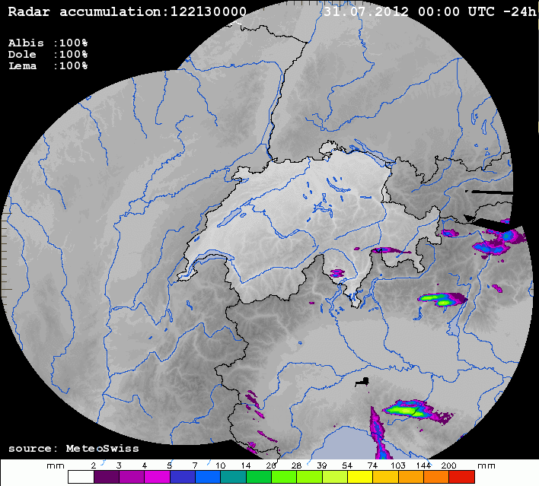
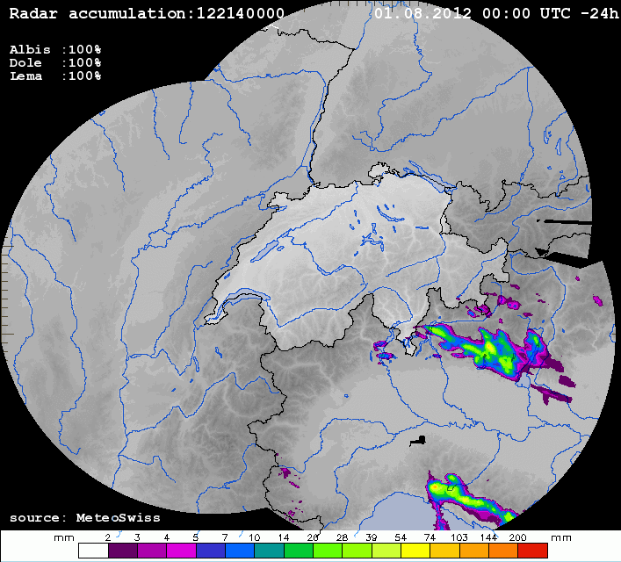
Radar precipitation

