Slide 1


The current status and
developments of COSMO-CLM
Barbara Früh
Deutscher Wetterdienst
COSMO General Meeting
September 02– 05, 2013
Sibiu

Slide 2
Outline
CLM Community development
COSMO-CLM model development
  Towards a regional earth system model: unified OASIS-MCT coupler
  Urban model intercomparison project
  COSMO-CLM model application
  CORDEX contribution

Slide 3
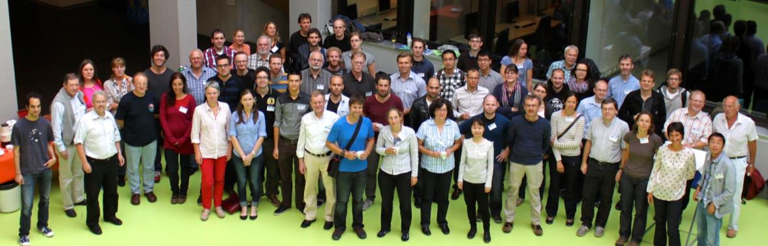
CLM-Community development
CLM-Community Assembly 2013, Zurich; Photo by Omar Bellprat

Slide 4
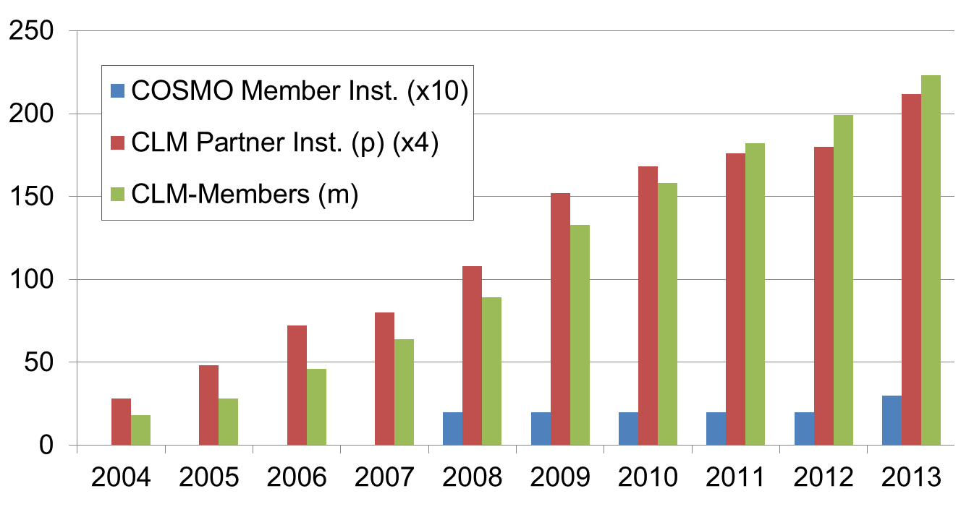
CLM-Community development
223
53

Slide 5






8 new institutions in 2013
TU Braunschweig (http://www.tu-braunschweig.de)
Lomonosov Moscow State University (http://www.msu.ru/en/)
Turkish Water Foundation (http://www.turkwater.org/)
Israel Meteorological Service
(http://www.ims.gov.il/IMSEng/All_tahazit/)
Tel Aviv University (http://english.tau.ac.il/)
Hellenic National Meteorological Service (http://www.hnms.gr/hnms/english/index_html)
Technical University of Crete (http://www.tuc.gr/3324.html/)
The Cyprus Institute (http://www.cyi.ac.cy)

Slide 6

CLM Community
23
Germany
Helmholtz-Zentrum Geesthacht
Brandenburg University of Technology Cottbus
Potsdam Institute for Climate Impact Research
Free University of Berlin
University of Bonn
Karlsruhe Institute of Technology
Georg-August-University Göttingen
German Climate Computing Center
Goethe University Frankfurt / BiKF
University of Cologne
Max-Planck-Institute for Chemistry
University of Trier
Johannes Gutenberg University Mainz
Deutscher Wetterdienst
Hessian State Office for Environment and Geology
Leibniz Institute for Tropospheric Research
Technische Universität Dresden
Helmholtz Centre for Environmental Research
Leibniz Centre for Agricultural Landscape Research
Leibniz University Hannover
Carl von Ossietzky University Oldenburg
German Aerospace Center
Technical University Braunschweig
4
3
2
1
1
2
Italy
AUstriA
Switzerland
Venezuela
Vietnam
USA
Euro Mediterranean Centre for Climatic Changes
Italian Aerospace Research Centre
University of Salento
Joint Research Centre
University of Graz
Austrian Institute of Technology GmbH
Central Institute for Meteorology & Geodynamics
Federal Institute of Technology of Zurich
Swiss Federal Laboratories for Materials Testing and Research
Center for Development Studies
Hanoi University of Science
National Center for Atmospheric Research
Georgia Institute of Technology
1
1
1
1
1
Cyprus
1
Senegal
Iran
22
finland
Irland
Mexico
National Meteorological Agency of Senegal
The Cyprus Institute
11
Free National University of Mexico
Semnan
University
University of Helsinki
University College Dublin
2
2
England
GreEce
1
University of Birmingham
University of Oxford
Hellenic National Meteorological Service
Technical University of Crete
Russia
EUROPE
Lomonosov Moscow State University
3
WORLD
2
1
Belgium
Israel
1
Turkey
Catholic University of Louvain
Catholic University Leuven
Flemish Institute for Technological Research
Israel Meteorological Service
Tel Aviv University
TanZania
1
1
Tanzania Meteorological Agency
Turkish Water Foundation
Luxembourg
Ukraine
Public Research Centre Gabriel Lippmann
National Academy of Sciences of Ukraine

Slide 7
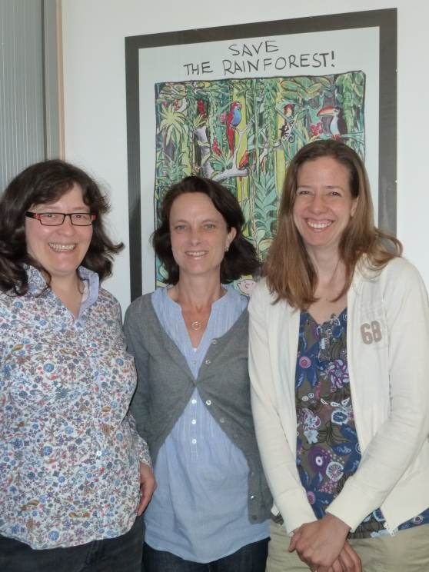
New coordination team
since August 1st 2013, coordination of CLM community is located at
Deutscher Wetterdienst
Contact:
clm.coordination@dwd.de
Barbara Früh
Susanne Brienen
Anja Thomas

Slide 8
COSMO-CLM model development
CLM-Community Assembly 2013, Zurich; Photo by Omar Bellprat

Slide 9
CLM-Community Science Plan – Goal
…
The main goals of the CLM-Community are
  the reduction of systematic errors of the model-system,
  the development of a regional earth system model
for the convective (1-3 km) to coarse (50 km) resolution and different regions in the world,
  the scientific documentation of the developments,
and
  to contribute to the understanding of climate feedbacks at regional scale.
…
[citation from the CLM-Community Science Plan – draft version]

Slide 10

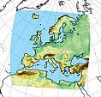
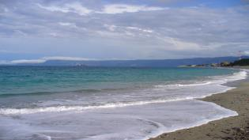
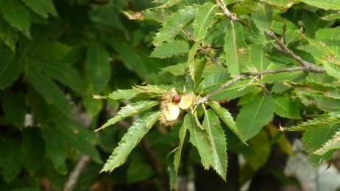
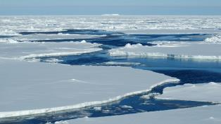
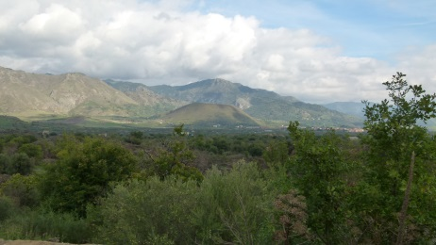
Towards a Regional Earth System Model:
Unified OASIS-MCT coupler
global
model
regional
model
OASIS-MCT
ocean
vegetation
sea-ice
land

Slide 11


OASIS-MCT plans for the future
Correct last bits of the unified interface, create a new version
take the next steps to include the unified interface in the next COSMO release:
  send the new version to source code administrator
  prepare user guide & scientific documentation
run all coupled systems on one computer -> beginning 2014 at DKRZ
run a multiple coupled system
write technical paper on the coupled systems

Slide 12
Scientific background of the coupling activities
model | climate system component | institution | status
ECHAM6 | 2-way nesting GCM | BTU | testing
Veg3D | vegetation | KIT | testing
Community Land Model | land | ETH | testing
global
model
vegetation
land

Slide 13
Coupling with regional ocean and sea ice models
model | Domain | institution | status
ROMS | Southern sea | ETH | testing
TRIM+CICE | North & Baltic Seas | HZG | testing
Nemo_Baltix | North & Baltic Seas | GUF/BIK_F/DWD | running
Nemo+MFS | Mediterranean | CMCC | running
Nemo_Med12 | Mediterranean | GUF/BIK_F/DWD | running
Fesom | Polar areas | Uni Trier | planned
ocean
sea-ice

Slide 14




Simulating urban climate using COSMO-CLM
  Impact of the climate to the city
  urban heat island
  reduced ventilation of the city
heat accumulation
runoff
  Impact of the city to the climate
  city as obstacle induces changes of circulation
  city as source of increased convection
  change of precipitation pattern
warm
cool
warm
warm
cool air
cool air
  Impact of climate change to the future city
Slide: K. Trusilova, 2011
2010
?

Slide 15





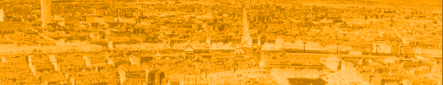

URB
MIP
The Urban Model Intercomparison Project
Hendrik Wouters, Kristina Trusilova, Sebastian Schubert, Matthias Demuzere, Susanne Grossman-Clarke, Barbara Früh
Comparison of urban models of different complexity in offline mode exist (Grimmond et al, 2012)
NEW: similar exercise in coupled model
  impact of urban parameterization complexity on the representation of the urban climate (e.g. magnitude, vertical/horizontal extent of urban heat island)
  strength and weeknesses of the different parameterizations
  recommendations on which urban parametrization is best suited for which purpose
Slide: H. Wouters, 2013 (with minor changes)

Slide 16
URB
MIP
Name | TERRA-URB | TERRA-ML/ TEB | TERRA-ML/ BEP
Complexity | low | medium | high
Responsibility | H. Wouters, KU Leuven | K. Trusilova, DWD | S. Schubert, PIK
Features | Direct representation in TERRA-ML, new surface-layer transfer coefficients, thermal capacity, anthropogenic heat, impervious surface interception distribution, tile approach | Street canyon model, inner building temperature, snow model, water skin layer, roofs/ walls/ roads, tiled urban fraction | Multi layer street canyon model, advanced double canyon radiation scheme, shadows, radiation trapping, roof/ wall/ ground fluxes coupled with PBL scheme
Input | Urban fraction, anthropogenic heat | Urban fraction, (anthropogenic heat) | Full 3D cityGML
References | Wouters et al (2013), Flanner (2010), Demuzere et al (2008), De Ridder (2012) | Trusilova et al (2013), Masson (2001) | Schubert et al (2012), Martilli et al (2002), Gröger et al (2008)
Aims | Urban climate & its impact on air quality simulations, Flanders Belgium | Urban climate of Europe and Germany | Urban climate of Basel and Berlin
Slide: H. Wouters, 2013 (with minor changes)

Slide 17
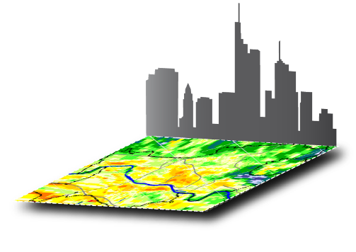
URB
MIP
Agreements for URBMIP
Definition of model configuration and boundary conditions
  CCLM4.8CLM19 @ 1km resolution, 50 vertical layers
  2002
  cascade-nested in ERA-INTERIM
Decision on model domain:
  Berlin: focus on urban model application & vertical extent of the UHI
  Basel: flux measurements
Shared data storage at DKRZ
Slide: H. Wouters, 2013 (with minor changes)

Slide 18
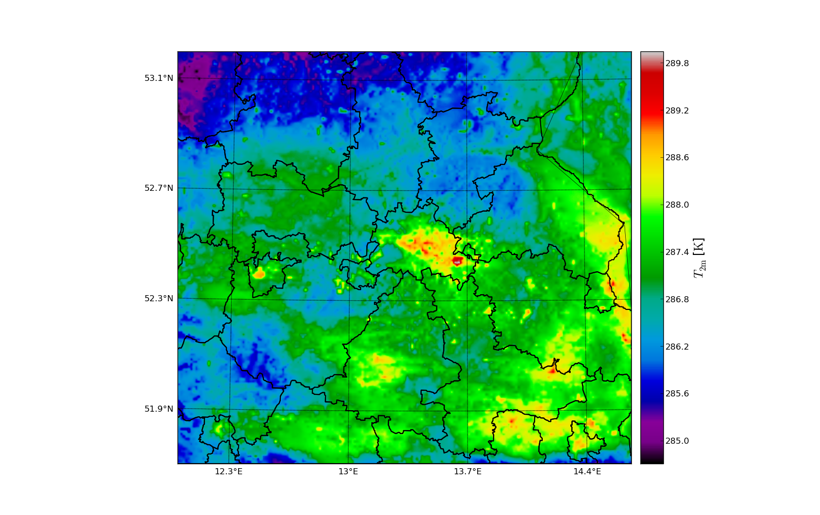
URB
MIP
Status
Boundary conditions for Basel and Berlin finished
Berlin runs finished → analysis starts
Basel runs started
Berlin @ 2002/06/26 00:00 UTC (CCLM+TERRA-URB)
Slide: H. Wouters, 2013 (with minor changes)

Slide 19
Further model development in the CLM-Community
Higher Order Schemes for the COSMO model (BTU Cottbus)
Comparison COSMO-CLM coupled to TERRA_ML / CLM3.5 for Europe (Davin et al., Clim. Dyn., 2011; Davin and Seneviratne, Biogeosciences, 2012; Lorenz et al., JGR, 2012) (ETH Zurich)
Similar comparison for Africa, South America, Australasia are under way (ETH Zurich)
Ground heat flux in the COSMO land surface scheme TERRA (GU Frankfurt)
Revised Lower Boundary Condition for Soil Temperature (GU Frankfurt)
Land Surface Data Assimilation (GU Frankfurt)

Slide 20
COSMO-CLM model application
CLM-Community Assembly 2013, Zurich; Photo by Omar Bellprat

Slide 21

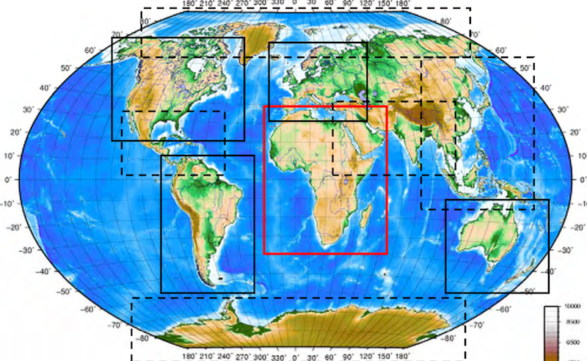
CLM-Community contribution to CORDEX
Coordinated Regional Climate Downscaling Experiment
Europe
Africa
South-America
Australasia

Slide 22

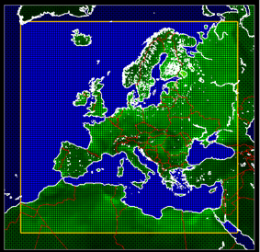
EURO-CORDEX
Downscaling
  9 RCMs (CCLM48, WRF331, WRF321, REMO, HIRHAM, RACMO2, ARPEGE, RCA4, PROMES)
  6 GCMs (MPI-ESM-LR, HadGEM2-ES, CNRM-CM5, EC-EARTH, MIROC5, IPSL-CM5A-MR, ?)
  RCP2.6, RCP4.5, and RCP8.5 (representative concentration pathways)
Evaluation (ERA-Interim driven simulations)
  1 paper in preparation
Climate Change signal
  2 papers in press

Slide 23
EURO-CORDEX: CLM-Community runs @ 0.11° resolution
GCM | Historical 1950 -2005 | RCP 4.5 2006-2100 | RCP 8.5 2006-2100 | RCP 2.6 2006-2100
MPI-ESM-LR r1 | BTU - finished | BTU - finished | BTU - finished | BTU -planned
HadGEM2-ES r1 | ETH - finished | ETH - finished | ETH - finished | ----
CNRM-CM5 r1 | BTU - finished | BTU - finished | BTU - finished | ----
EC-EARTH r12 | BTU - finished | BTU - finished | BTU - finished | ----
MIROC5 | UCD - running | UCD - planned | DWD -planned | ----
CCSM4 | DWD -planned | ---- | DWD -planned | ----

Slide 24


Relative seasonal precipitation bias 1989-2008 (9 RCMs)
DJF
E-OBS
CCLM
JJA
Notes:
Euro-CORDEX evaluation runs with CCLM and 8 other European RCMs at 0.11º resolution. Bias against E-OBS for winter and summer (absolute E-OBS values in upper left panels)

Slide 25
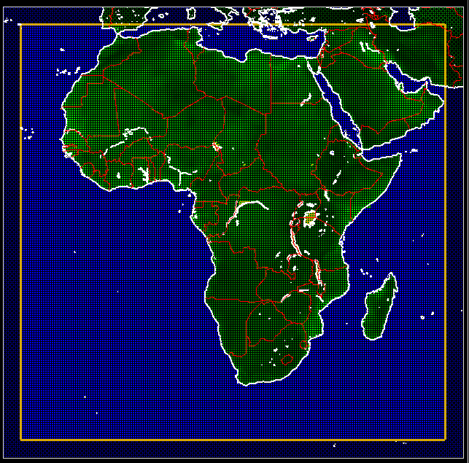
CORDEX-Africa
Downscaling
  4 CMPI5 GCMs (MPI_ESM_LR, HadGEM2-ES, CNRM-CM5, and EC-Earth)
  RCP4.5 and RCP8.5 (representative concentration pathways)
  JRC, KIT, PIK
Evaluation
(ERA-Interim driven simulations)
  2 papers in press, 2 papers published, 1 paper accepted
Climate change signal with COSMO-CLM in focus
  2 papers in preparation

Slide 26
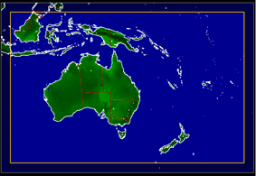
CORDEX-Australasia
Downscaling
  33 simulations : 3 months (07-09 2001, winter, rainy season)
  26 simulations : 3 years (04/2000 - 04/2002)
  2(+2) simulations : 31,5 years (07/1979-12/2010)
    cosmo_4.8_clm17 (CCLM-T) (TERRA, analog Africa setup)
    cosmo4.8_clm17-clm3.5 (CCLM-C) (spectral nudging, IFS convection)
  HZG
Evaluation 25 years: 01/1980 - 21/2004
  CRU-TS3.20 (T2M), GPCC 6 (precip)

Slide 27
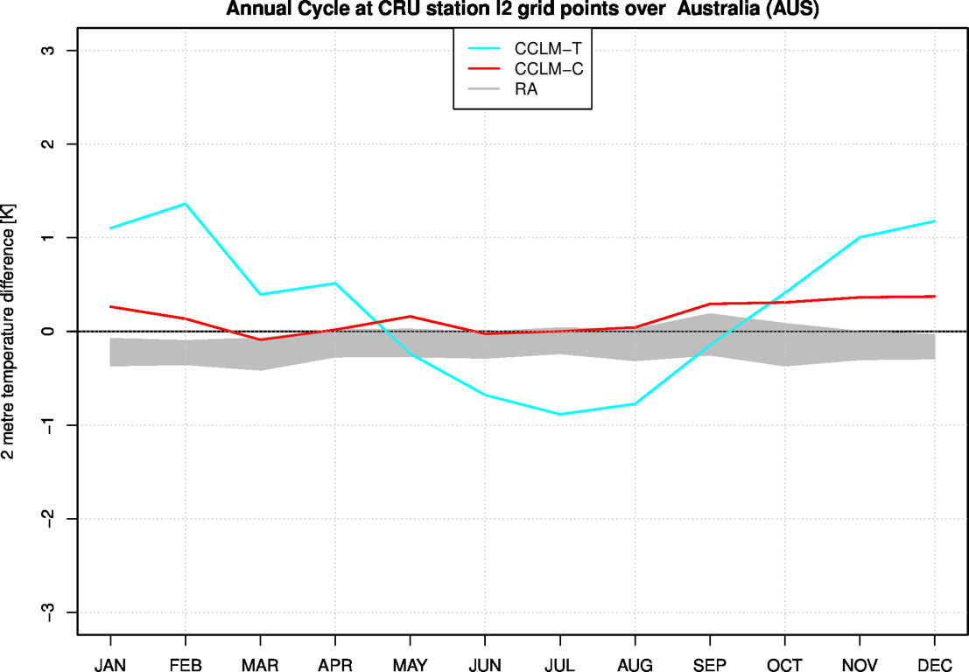
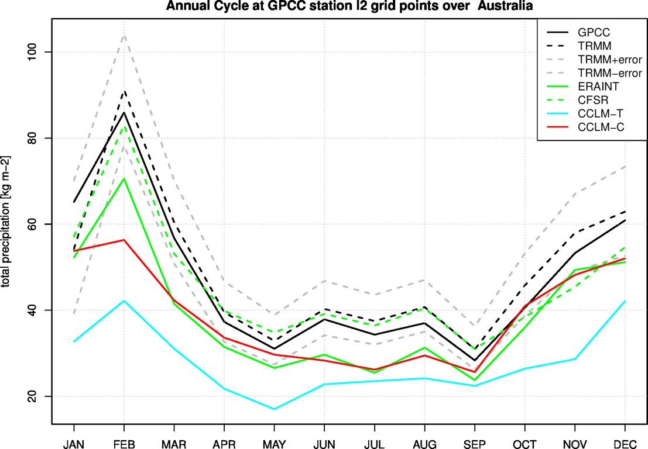
CORDEX-Australasia
Annual cycle at CRU stations
Annual cycle at GPCC stations
CCLM-T
CCLM-C
GPCC (solid)
TRMM (dashed)
TRMM+error
TRMM-error
ERAint (solid)
CFSR (ashed)
CCLM-T
CCLM-C
12 stations in Australia
Annual cycle of monthly means
2m air temperature difference [K]
Total precipitation [kg m-2]
RA
CFSR "Climate Forecast System Reanalyses" NCEP reanalysis (1979 onwards)
RA range of reanalyses ERAINT and CFSR differences to CRU T_2M

Slide 28
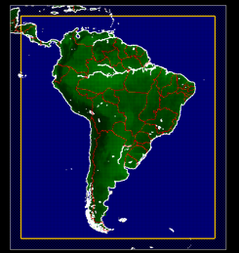
CORDEX-South America
Downscaling
  COSMO4.8-CLM19 coupled to Community Land Model (CLM3.5)
  South America CORDEX domain
  @ 50 km grid width
  ERAinterim-driven (1989-2008)
  Similar configuration as for CORDEX-Africa
  ETHZ

Slide 29
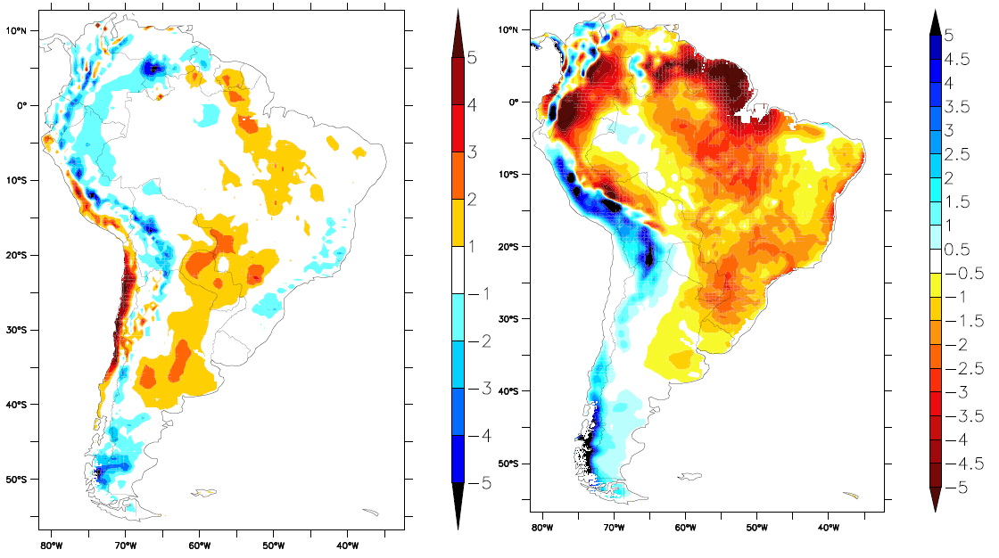
CORDEX-South America
2m air temperature bias [K]
precipitation bias [mm]
Similar biases when using TERRA (simulations S. Lange, PIK)
Precipitation underestimation: typical bias found in other RCMs (Solman et al., Clim. Dyn., 2013)

Slide 30
Further model application in the CLM-Community
Ensemble prediction system for decadal forecast (MiKlip, KIT, DWD, …)
Regional aerosol, cloud, chemistry interactions in decadal climate simulations with (KIT)
Quantifying the effect of soot aerosol on the 2003 heatwave (KIT)
Simulation of springtime arctic mixed-­phase clouds (ETHZ)
Susceptibilities of cloud properties (ETHZ)
Shiptracks in the Bay of Biscay (ETHZ)
Saharan dust outbreak of March 2004 (Uni Mainz)
Air-quality at 1km horizontal resolution over Flanders during 2009 (VITO)
Impact of microphysics complexity on surface precipitation characteristics (UCL)
Convection permitting climate simulations down to 1 km grid width (Wegener Center, Uni Göttingen, …)

Slide 31
Summary
CLM-Community Assembly 2013, Zurich; Photo by Omar Bellprat

Slide 32
Summary
Model development
  Unified OASIS-MCT coupler
  Urban parameterization
  Other land surface research with TERRA
  Dynamical core
Model application
  CORDEX contribution
  MiKlip
  ART
  Convection permitting climate simulations

Slide 33
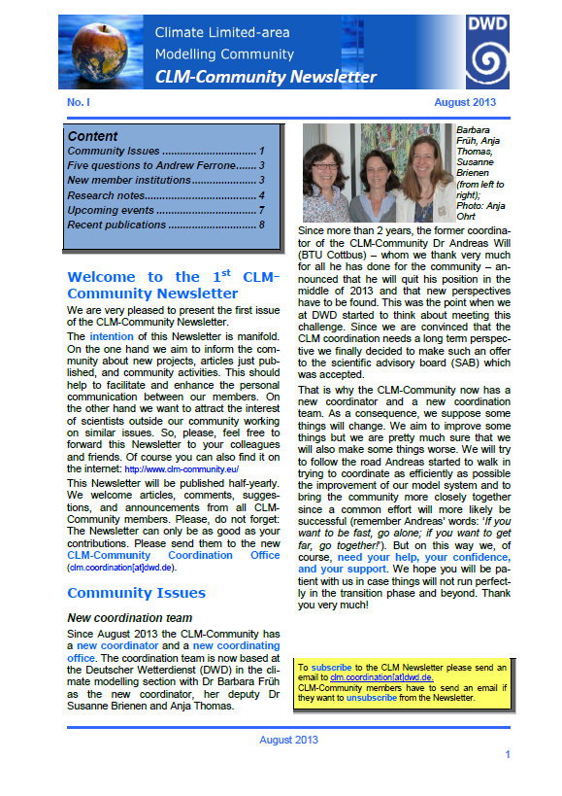
COSMO-CLM Newsletter
To improve the communication within the growing community:
CLM-Community Newsletter
If you are interested in receiving, please, send an email to:
clm.coordination@dwd.de

Slide 34
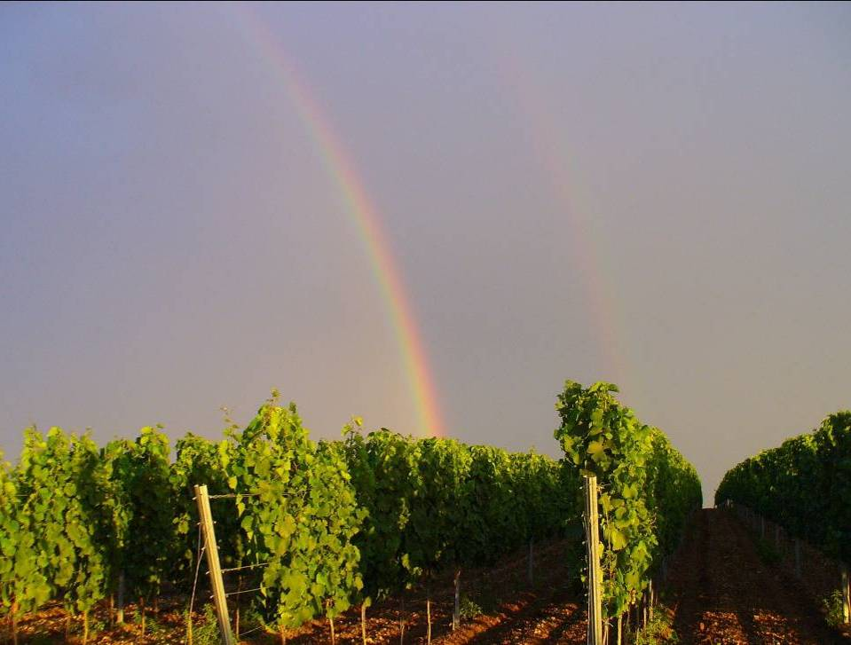
Thank you very much for your attention!!!
Barbara Früh
Notes:
34

Slide 35



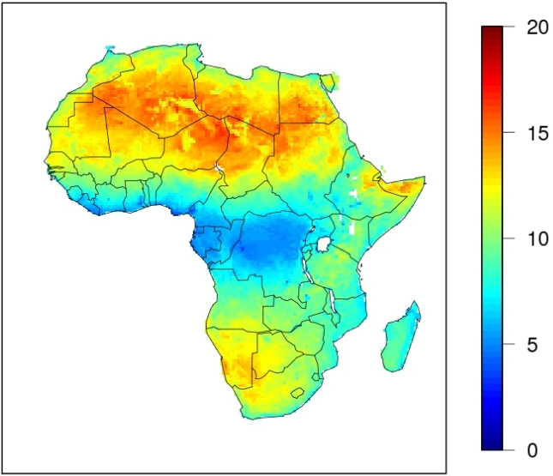
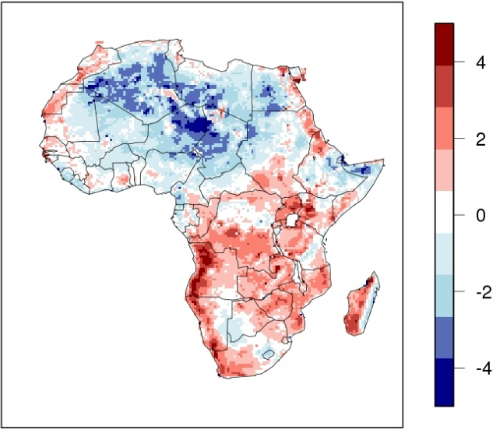
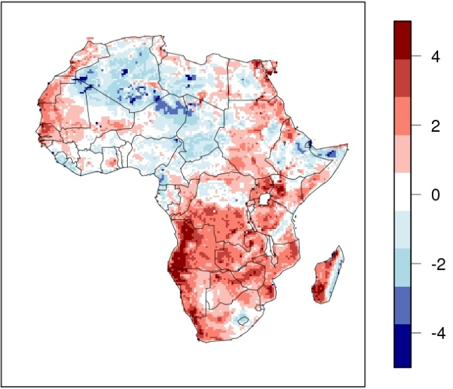
The ground heat flux in the COSMO land surface scheme TERRA
Jan-Peter Schulz, Gerd Vogel, Claudia Heret and Bodo Ahrens
Observation
COSMO-CLM (REF) - Obs
COSMO-CLM (EXP) - Obs
COSMO-CLM:
CORDEX Africa domain, horizontal resolution: 0.44º, ERA-Interim forcing, simulation period: 2008 – 2010
Observed average diurnal 2-m temperature range [ºC] (ADTR): High in arid regions, low in tropics
ADTR in COSMO-CLM reference: Underestimated in arid or semi-arid regions by up to 4°C
ADTR in COSMO-CLM experiment with soil thermal conductivity dependent on soil moisture:
Improvements in large parts of Sahara and Sahel

Slide 36
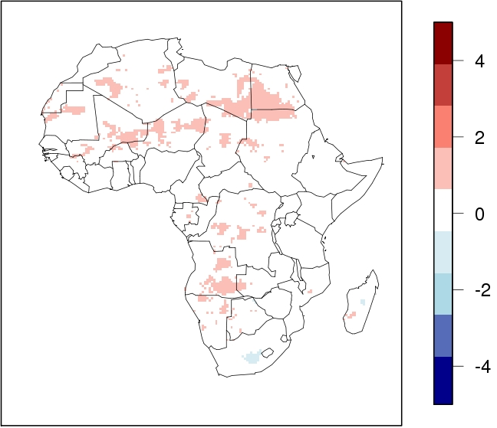
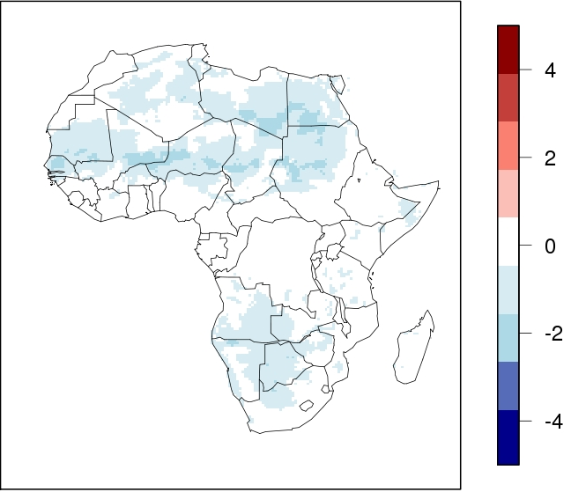
The ground heat flux in the COSMO land surface scheme TERRA
Jan-Peter Schulz, Gerd Vogel, Claudia Heret and Bodo Ahrens
TMAX_2M: EXP - REF
TMIN_2M: EXP - REF
COSMO-CLM EXP: Nighttime cooling more pronounced than daytime warming
Improves mean 2-m temperature which has a warm bias in COSMO-CLM in arid regions

Slide 37
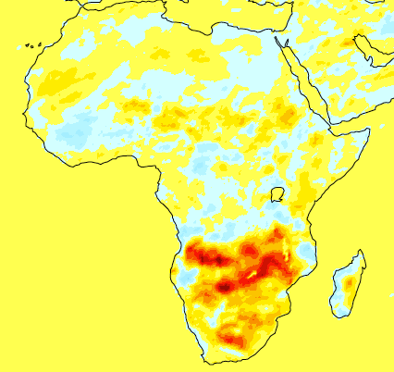

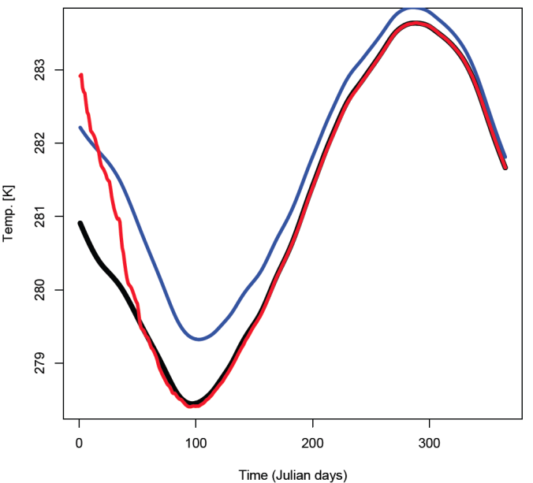

Land Surface Research with TERRA
J. Tödter, B. Ahrens
Revised Lower Boundary Condition for Soil Temperature
  „No heat flux“ instead of fixed EXTPAR temperature in deep soil
  Avoids artificial energy sources & sinks
  CLM simulation shows sensitivity even on medium-range
  Evaluation ongoing...
Land Surface Data Assimilation
  State & parameter estimation with EnKF
  Assimilation of soil-related observations
  Aims at improved initializiation/parameterization of soil state
  Potential relevance also for medium-range climate
Soil temp. in 5m
Twin experiment with truth:
EnKF analysis superior
versus spin-up run
Days

Slide 38
CORDEX-Africa
Evaluation Papers for CORDEX Africa (status September 2013)
Kalognomou E.A., C. Lennard, M. Shongwe, I. Pinto, A. Favre, M. Kent, B. Hewitson, A. Dosio, G, Nikulin. H.-J. Panitz, M. Büchner, 2013: A diagnostic evaluation of precipitation in CORDEX models over Southern Africa, J. Clim., in press
Endris H.S., P. Omondi, S. Jain, C. Lennard, B. Hewitson, L. Chang'a, J. Awange, A. Dosio, P. Ketiem, G. Nikulin, H.-J. Panitz, M. Büchner; F. Stordal, L. Tazalika, 2013: Assessment of the performance of CORDEX Regional Climate Models in Simulating Eastern Africa Rainfall, J.Clim., in press
Panitz H.-J., A. Dosio, M. Buechner, D. Luethi, K. Keuler, 2013: COSMO-CLM (CCLM) climate simulations over CORDEX Africa domain: Analysis of the ERA-Interim driven simulations at 0.44 and 0.22 deg. resolution, Clim Dyn, DOI: 10.1007/s00382-013-1834-5
Nikulin G., and Coauthors, 2012: Precipitation Climatology in an Ensemble of CORDEX-Africa Regional Climate Simulations. J. Clim, 25, 6057–6078.
Krähenmann S., S. Kothe, H.-J. Panitz, B. Ahrens: Evaluation of Daily Maximum and Minimum 2-m Temperatures as Simulated with the Regional Climate Model COSMO-CLM over Africa. Met.Z. Accepted

Slide 39
CORDEX-Africa
Analysis of the climate change signal (status September 2013)
COSMO-CLM
A.Dosio, H.-J.Panitz, M.Schubert-Frisius, D.Luethi: Dynamical downscaling of CMPI5 CGMs over CORDEX-Africa with COSMO-CLM. Part I: analysis of the added value over the present climate, Clim. Dyn., in preparation
H-J Panitz, A.Dosio, M. Schubert-Frisius, D.Luethi: Dynamical downscaling of CMPI5 CGMs over CORDEX-Africa with COSMO-CLM. Part II: analysis of the climate change signal for the near future and the end of the 21st century, Clim. Dyn., in preparation

Slide 40
EURO-CORDEX
Jacob D, Petersen J, Eggert B, Alias A, Christensen OB, Bouwer LM, Braun A, Colette A, Déqué M, Georgievski G, Georgopoulou E, Gobiet A, Nikulin G, Haensler A, Hempelmann N, Jones C, Keuler K, Kovats S, Kröner N, Kotlarski S, Kriegsmann A, Martin E, van Meijgaard E, Moseley C, Pfeifer S, Preuschmann S, Radtke K, Rechid D, Rounsevell M, Samuelsson P, Somot S, Soussana J-F, Teichmann C, Valentini R, Vautard R, Weber B: EURO-CORDEX: New high-resolution climate change projections for European impact research. Regional Environmental Change, in press.
Vautard R, Gobiet A, Jacob D, Belda M, Colette A, Déqué M, Fernández J, García-Díez M, Goergen K, Güttler I, Halenka T, Karakostas T, Katragkou E, Keuler K, Kotlarski S, Mayer S, Nikulin G, Patarcic M, Scinocca J, Sobolowski S, Suklitsch M, Teichmann C, van Meijgaard E, Warrach-Sagi K, Wulfmeyer V, Yiou P (2013) The Simulation of European heat waves from an ensemble of regional climate models within the EURO-CORDEX project. Climate Dynamics, in press.
Kotlarski, Keuler: evaluation of the ERA-Interim driven EURO-CORDEX ensemble. In preparation

