Slide 1
Preparing a new Model Version according to
Source Code Management
Ulrich Schättler
Source Code Administrator
COSMO-Model and (still) INT2LM

Slide 2
Contents
About Source Code Management
Last Changes for INT2LM and the COSMO-Model
Fulfilling the COSMO-Standards Requirements
Lessons Learned
Critical Issues

Slide 3
About Source Code Management
In 2011 we adopted the COSMO Standards for Source Code Management
Besides rules for coding and documenting, it also manages the Software Maintenance and Release Management.
For that we implemented the Release Management Pages on our web site, from where you can get information about ongoing developments and planned releases
A Bug Reporting Mechanism is still under construction
Since then all developments for the COSMO-Model and INT2LM are monitored by the Scientific Management Committee / the Working Group Coordinators (in principle)
Problem: There is not always time enough to discuss the more technical issues.

Slide 4
The Development Process
Reference Version
of The Software
Released Version
of The Software
Monitor:
Somethings going wrong?
Software incomplete?
New scientific breakthroughs?
Testing by special users:
COSMO Test Users
NWP Test Suite
The Idea
(and first development)
Development / Test Versions
of The Software
First Management Decision:
inline with planning?
needs resources?
The Implementation
(into an official version)
The Development
(of a private version)
Second Management Decision:
technical requirements fulfilled?
meteorological tests ok?
documentation available?

Slide 5
The Last Developments
Version | Date | Contents | Results Changes
C 4.26 | 12.12.12 | Technical Updates / Consolidations (e.g. Tracer Module, RTTOV10 interfaces) | No changes
C 4.27 | 13.03.13 | MESSy interfaces implemented Adaptations to new fast-waves solver Changed several Namelist defaults Bug Fix in Microphysics (distributed earlier in Version 4.26.1) Bug fix in horizontal advection | for new solver only yes yes
I 1.21 | 22.03.13 | grib_api for writing GRIB1/2 fields | No changes

Slide 6
The Last Developments
Version | Date | Contents | Results Changes
I 1.22 | 01.07.13 | First implementation of GRIB2 Bug fix for computing the boundary layer height for vertical interpolation Implementation of ART part | No Yes: for llm2lm
C 4.28 | 11.07.13 | Implemented grib_api Bug fix in Runge-Kutta scheme Quality check for p_{s} observations Adapted COSMO-ART to Tracer scheme | for new solver only for nudging only

Slide 7
Testing the latest Versions
All last versions have been distributed to the COSMO testers, WG6, CLM and ART-communities
Technical feedback already incorporated or about to incorporate in INT2LM 1.23 and COSMO 4.29 (though the Technical Test Suite has not been performed by the Source Code Administrator).
COSMO 4.29 and INT2LM 1.23 not yet available: These versions will not changes results!
NWP Verification for COSMO-EU and COSMO-DE presented to SMC during teleconference on 19th August (the NWP Test Suite, which will do this job in the future, is still under development)
Results accepted by SMC and STC: COSMO-Model 5.0 will be the new Reference Version

Slide 8
Testing the latest Versions (II)
Tests by CLM Community
  Technical issues with GRIB I/O have been solved: no technical problems any more
  Evaluation of climate mode was performed with COSMO 4.26: Results are not worse than with earlier version (but also not better)
  Version 5.0 will be accepted, but different configurations will be tested and evaluated with this version. It will take some time until CLM will promote the new version with „recommended configurations“.
Tests by ART:
  There were also technical issues with GRIB I/O: solved
  Technical issues also with 2-moment microphysics: fixed in 4.29
  Version 5.0 accepted

Slide 9
Testing the latest Versions (III)
COSMO-Model 4.28 and INT2LM 1.22 were also used during the Capacity Building in Langen in July. Therefore it has also been „tested“ by several of our licence takers

Slide 10
Going to COSMO-Model 5.0 and INT2LM 2.0
COSMO 4.29 contains:
  Technical adaptations and fixes
  Consolidation of MESSy interfaces and COSMO tracer structure
One issue not solved yet:
  Brazilian weather service reports a memory leak, most probably in GRIB-IO; (but up to now they are the only ones)
COSMO 4.29 will be renamed to 5.0 after few days of testing
There are also some technical updates for INT2LM: new version1.23
  Will be renamed to INT2LM 2.0 after few days of testing
Until the end of September

Slide 11
Fulfilling the COSMO-Standards Requirements
Basic contributions have been discussed by the SMC (but not all technical adaptations and consolidations of schemes)
Contributions have been documented (by extra documents: new fast waves solver; Tracer structure; in the User Guides)
Developments that changed the results have been tested and verified (in the Numex framework at DWD): The COSMO NWP test suite is still under development
The Technical Test Suite has not been applied by al l testers / developers, because it is not yet „fully distributed“
Conclusion: We are not yet fulfilling all aspects of the requirement, but we are on a good way!

Slide 12
Lessons Learned
We need a better / more realistic planning
  Our planning in the last 2 years seemed like shooting on a moving target
  This is not (only) due to a stricter source code management, but also due to the subjects (e.g. new tracer structure: needed few iterations with COSMO-ART and MESSy, until consolidated)
The developers should be aware of the fact that their Working Group Coordinator should monitor the development work and fill the corresponding web pages.

Slide 13
Critical Issues
SMC has to find the time to discuss all the developments
  This is critical! Consider: the group at DWD, who monitors all develpoments for the operational models (COSMO, GME, Assimilations) meets once a week for an hour!
Sometimes 0.3 FTEs for the Source Code Administrator are „challenging“
  This is not, because no more FTEs would be contributed to this task
  But there are other (more interesting) things to do!
  I also take part in the development: Implementation of grib_api, COSMO-ICON physics, not to mention POMPA
  Twice as much time can be easily spend on that task, but who wants to do so?

Slide 14
Beyond 5.0
After the match is before the match (old soccer wisdom)
Candidates for 5.1 are (but not yet approved by SMC)
  COSMO-ICON Physics (first: Turbulence)
  UTCS developments
  Bringing POMPA developments to the official version
Testing and implementing GRIB2 at our services
And sometime we will start to plan for COSMO-Model 6.0

Slide 15
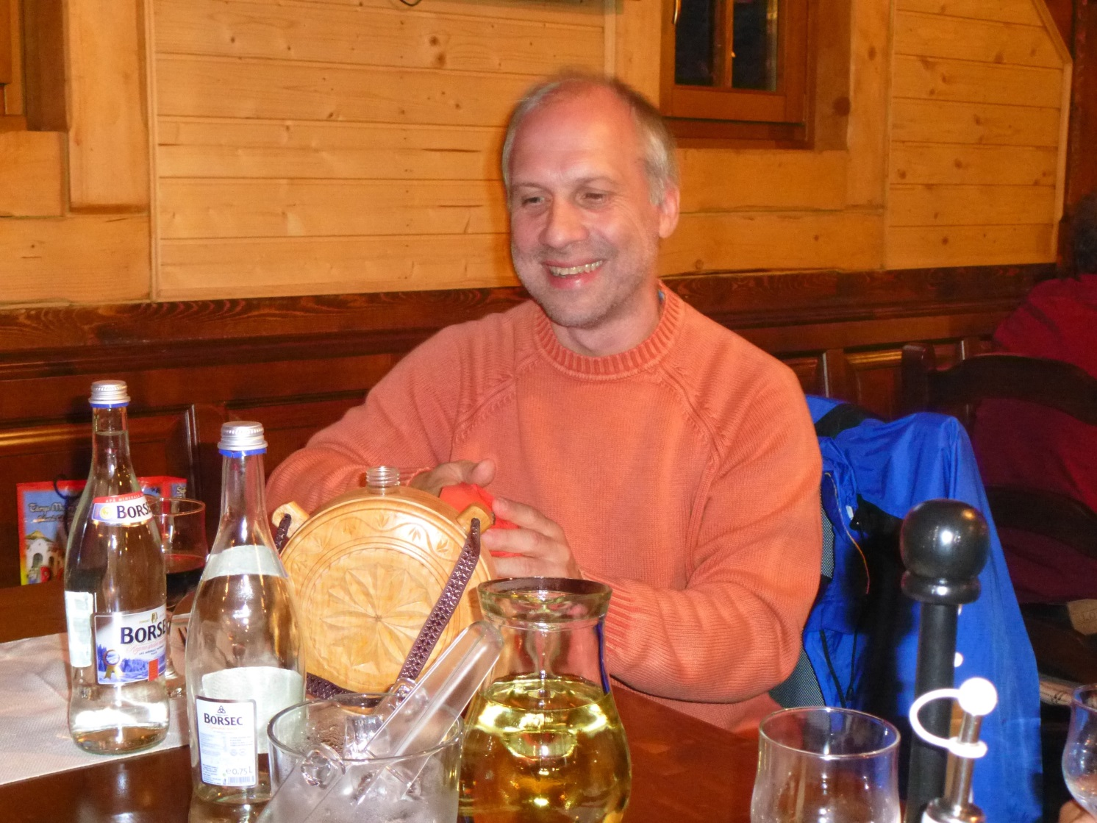
Thank you
very much
for your
attention

