Slide 1

WG7 summary and Science Plan
Chiara Marsigli
ARPA Emilia-Romagna, SIMC

Slide 2
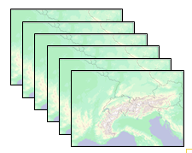
COSMO-E setup
Ensemble forecasts with convection-permitting resolution
(2.2 km mesh-size)
21 members
Twice a day up to +120h for Alpine area
(15% larger than COSMO-2 domain)
Range of possible scenarios and “best estimate”
COSMO version 4.26

Slide 3
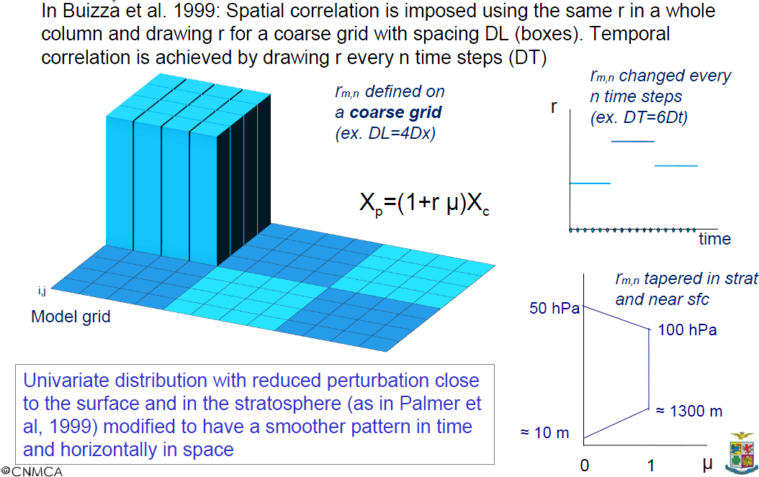
SPPT: implementation into COSMO
by L. Torrisi (CNMCA)

Slide 4
Validation of SPPT
SPPT must not degrade quality of members → show-stopper
deterministic runs for different SPPT setups:
  for all: lgauss_rn = lhorint_rn = ltimeint_rn = .true.
  ex0: no SPPT
  ex1: SPPT (sigma = 0.25 & random number within [-0.75, 0.75])
  ex2: lqv_pertlim = .true.
  ex3: sigma = 0.5 & random number within [-1.0, 1.0]
  ex4: length-scale = 0.5 deg., time-scale = 30 min
  (default: 5 deg., 6 hrs)
No significant quality degradation seen with SPPT except for ex3 (largest random numbers together with large correlation-lengths)
No tapering (default: tapering below approx. 850 hPa)

Slide 5
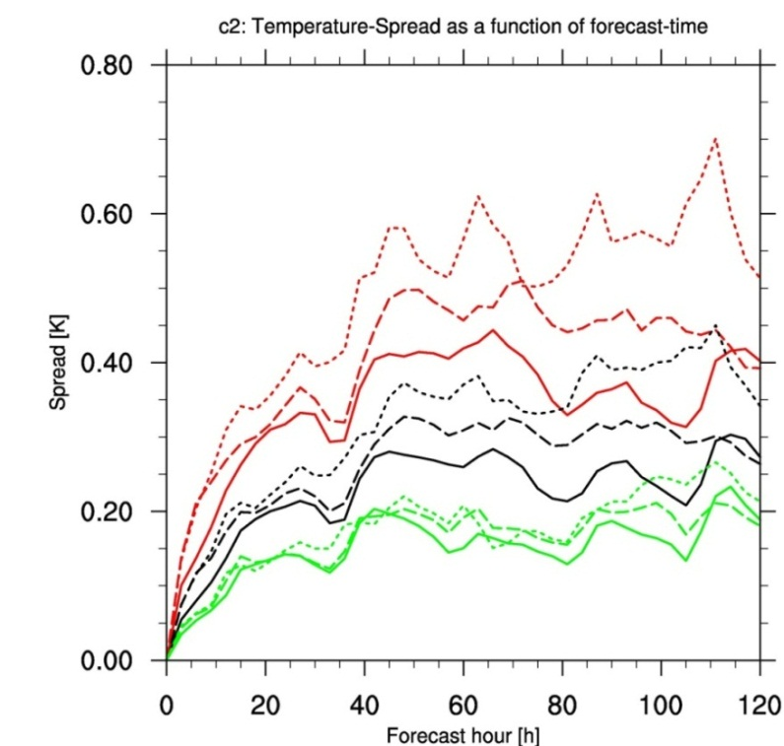
Impact of SPPT settings on spread
Case 2012-08-01: T spread COSMO-E domain
@ 500 (solid lines), 700 (dashed),
850 (dotted) hPa
large stdv_rn=0.5, range_rn=1 (ex3)
stdv_rn=0.25, range_rn=0.75 (ex1)
stdv_rn=0.25, range_rn=0.75, dlat_rn=dlon_rn=0.5°, ninc_rn=90 (ex4)
spread largest at 850 hPa, lowest at 500 hPa
spread saturation is reached at all height levels at about same lead-time
larger random numbers produce larger spread and faster spread growth
smaller correlation-lengths in space and time lead to smaller spread

Slide 6
First COSMO-E test suite
2 weeks period (2012-07-25 – 2012-08-07)
00 UTC forecast only
Experiments with 3 setups:
  LBC + SPPT:
    lqv_pertlim=.false. (default=.true.)
    dlat_rn=dlon_rn=0.5 (5.0)
    ninc_rn=180 (1080)
    stdv_rn=0.5 (0.5)
    range_rn=1.0 (1.0)
    no tapering near surface (code change)
    setup validated as well (not show before)
  LBC + COSMO-DE-EPS parameter perturbation (PP)
  LBC only
scale of convective systems

Slide 7
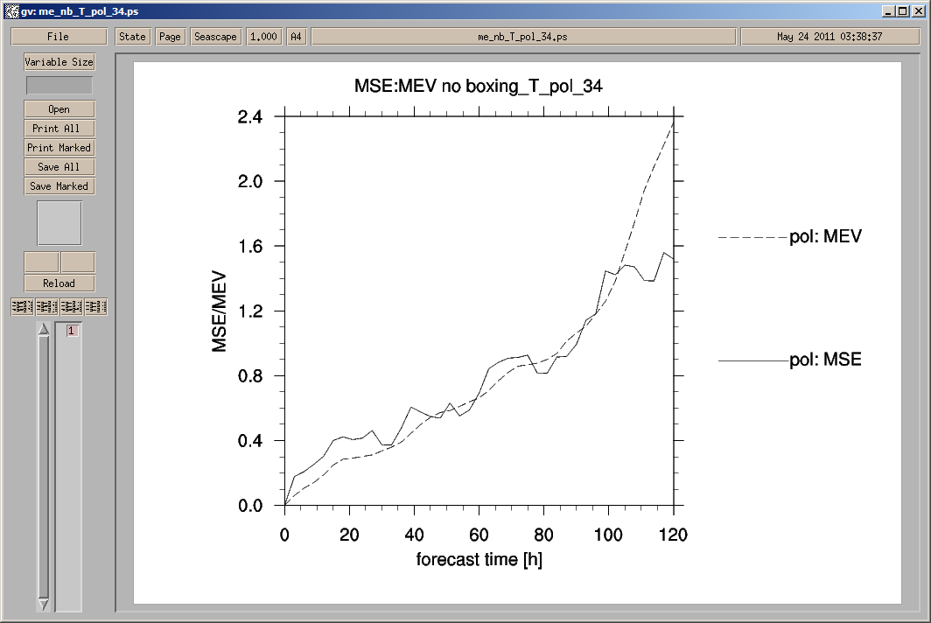
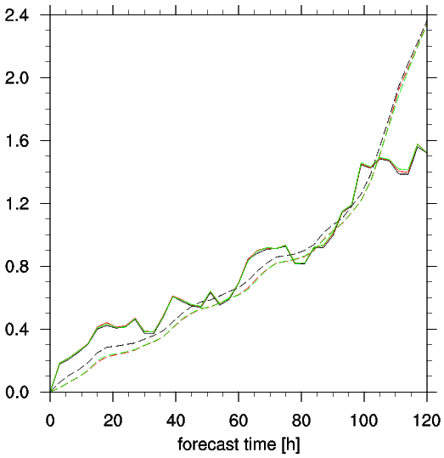
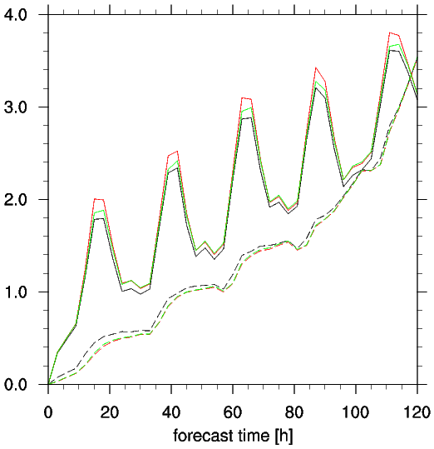
Spread & error temperature
mean squared error
mean ensemble variance
~5500m
~700m
LBC+SPPT
LBC+PP
LBC
LBC+SPPT
LBC+PP
LBC
LBC+PP and LBC slightly smaller spread
LBC show largest error
LBC+SPPT best, but differences small

Slide 8
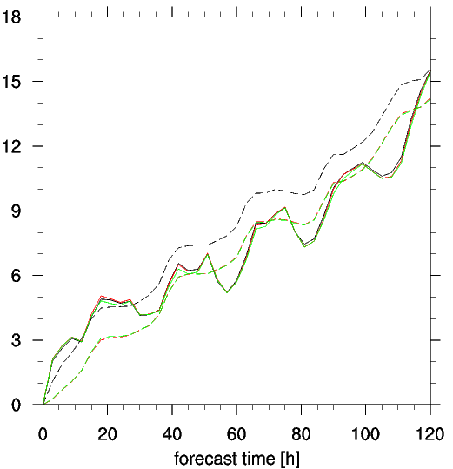
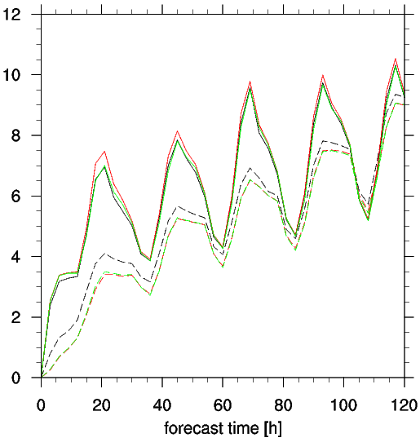
Spread & error wind speed
mean squared error
mean ensemble variance
~5500m
~700m
LBC+SPPT
LBC+PP
LBC
LBC+SPPT
LBC+PP
LBC
Too small spread in PBL for wind speed as well
LBC+SPPT rather too large spread in upper troposphere

Slide 9
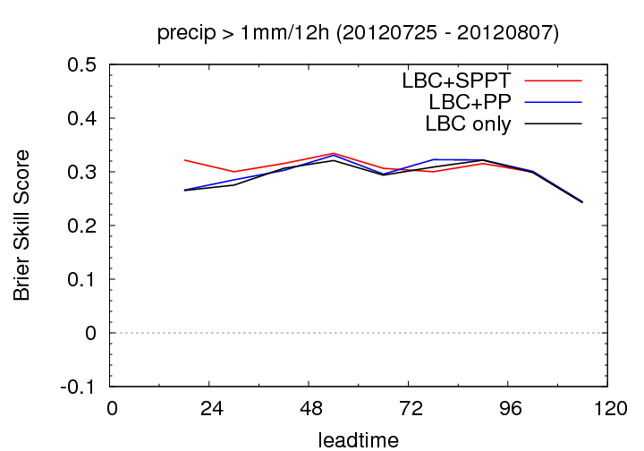
Brier Skill Score (ref=climatology)
better
worse than clim. forecast
Reference: forecast based on station climatology 2001-2010 (300 stations)
all experiments clearly better than clim. forecast for all lead-times
LBC+SPPT best until +72h, but differences very small

Slide 10
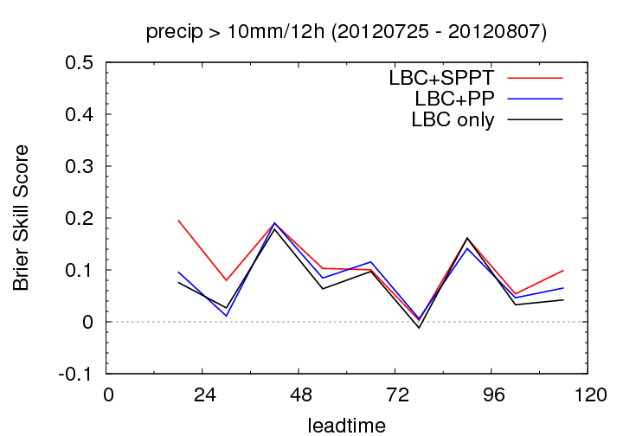
Brier Skill Score (ref=climatology)
better
worse than clim. forecast
Reference: Forecast based on station climatology 2001-2010 (300 stations)
daytime precip. only slightly better than clim. forecast
LBC+SPPT best experiment

Slide 11
Conclusions COSMO-E experiments
Surprisingly large reduction in spread with smaller correlation lengths for random numbers
SPPT produces only small additional spread for runs with LBC perturbations
3 setups LBC+SPPT, LBC+PP and LBC show similar results but impact of SPPT larger than of PP
spread in PBL clearly too small in PBL…
…but rather too large in upper-air with LBC+SPPT
only slightly better scores with SPPT so far
experiments shows surprisingly high reliability for precipitation probabilities (enough statistics?)

Slide 12
BC-EPS experiments
ECMWF provide 2 BC-EPS data sets for 3 periods:
  current resolution T_{L}639 (~32 km) → BCR
  high resolution T_{L}1279 (~16 km) → BCH
winter storm period 2011-12-26 – 2012-01-08 run with COSMO-E (without SPPT)
first results show slightly better scores with BCH in surface verification (500 stations)

Slide 13
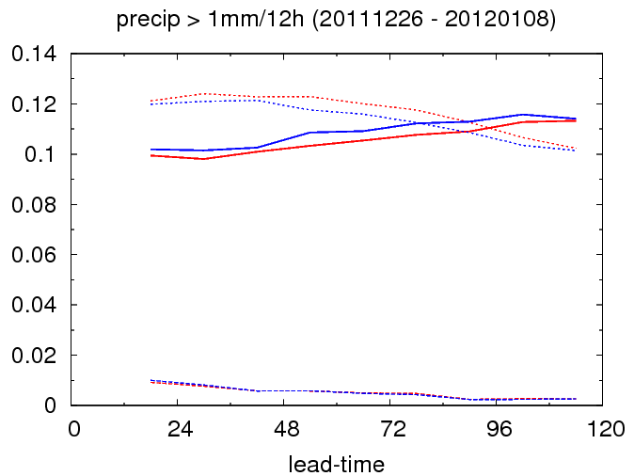
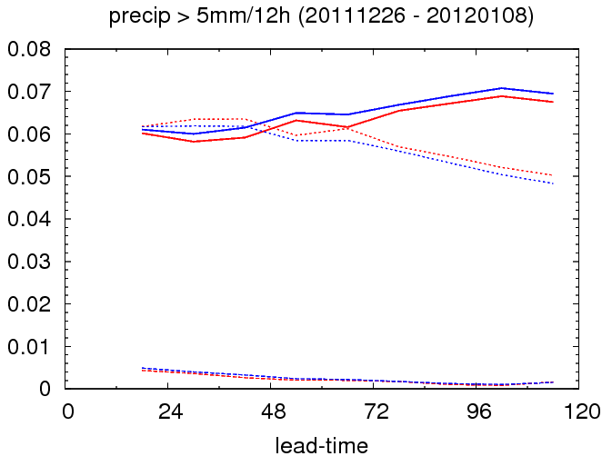
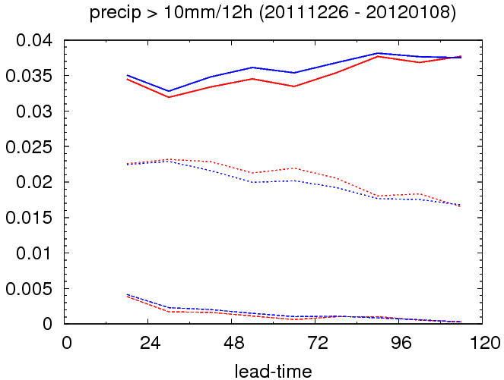
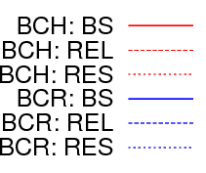
Brier score 12h sum of precipitation
BCH shows better scores
mainly thanks to better resolution

Slide 14

COSMO-IT-EPS: first KENDA experiments
DA cycle:
  3-hourly cycles, 36 hours
  10 members
  BCs from COSMO-LEPS (also ICs for cold start)
  no model perturbations
  observations: TEMP SYNOP ACARS AMDAR
Forecast:
  10 members
  36h forecast range
  parameter perturbations
  BCs from COSMO-LEPS

Slide 15
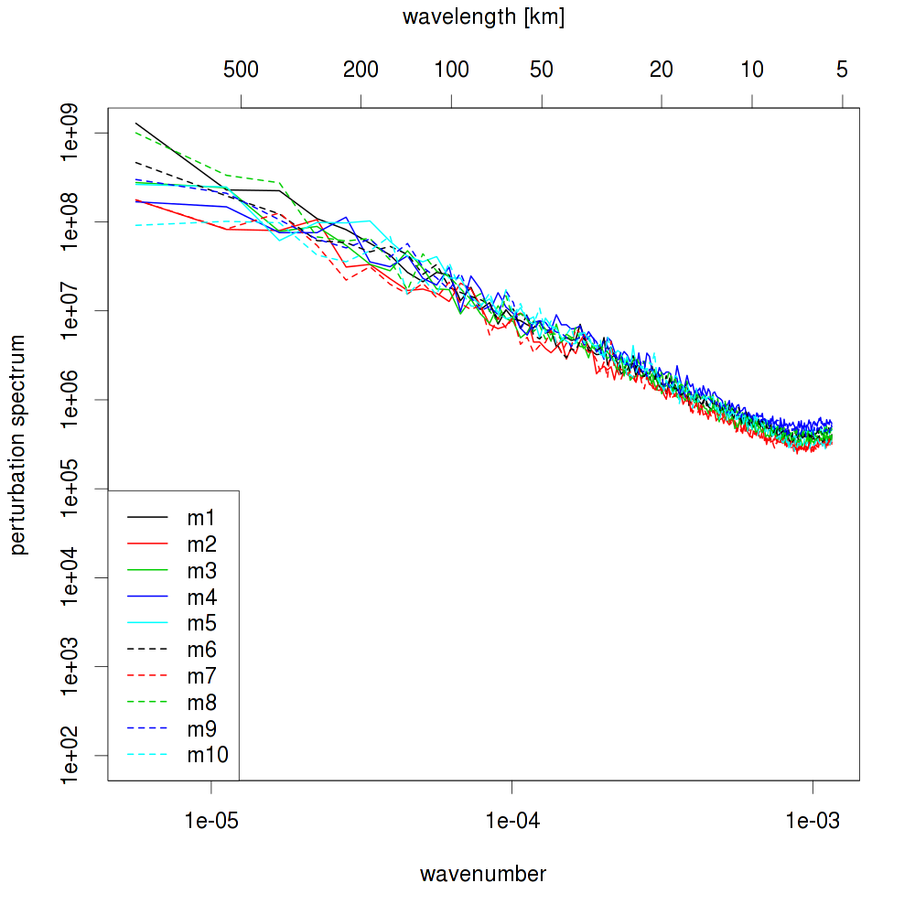
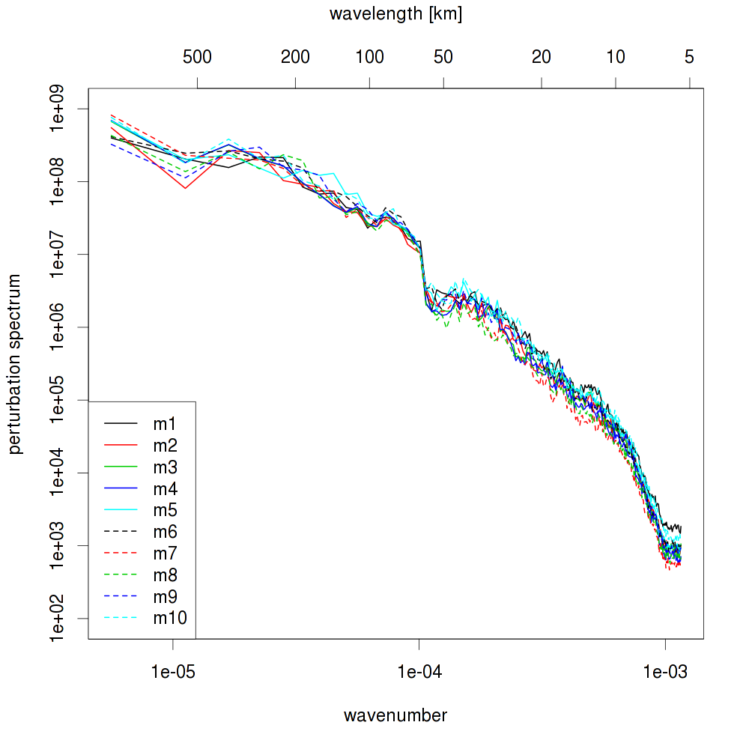
2012102512 - T level 50
KENDA analyses
COSMO-LEPS downscaled analyses

Slide 16
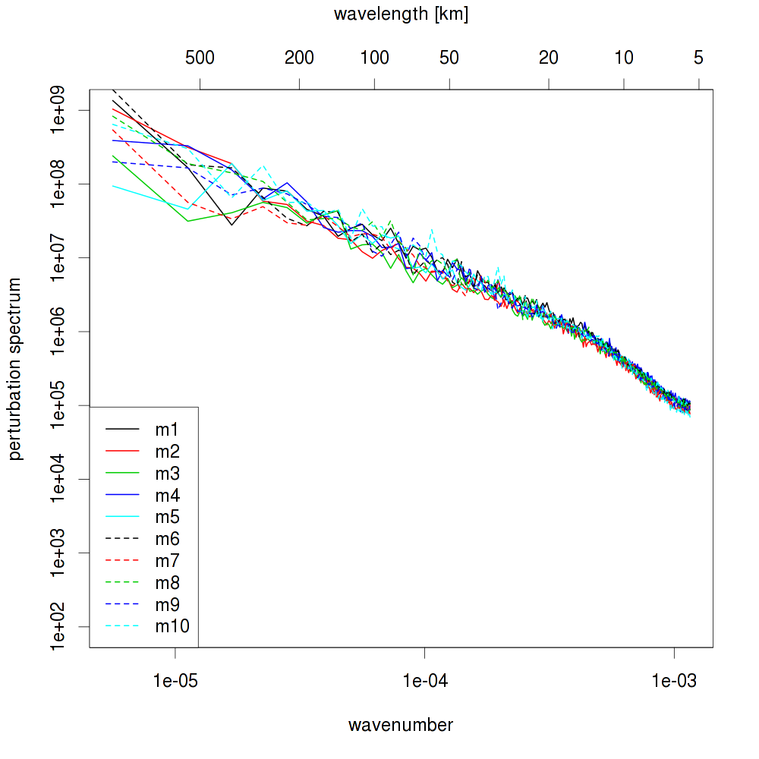
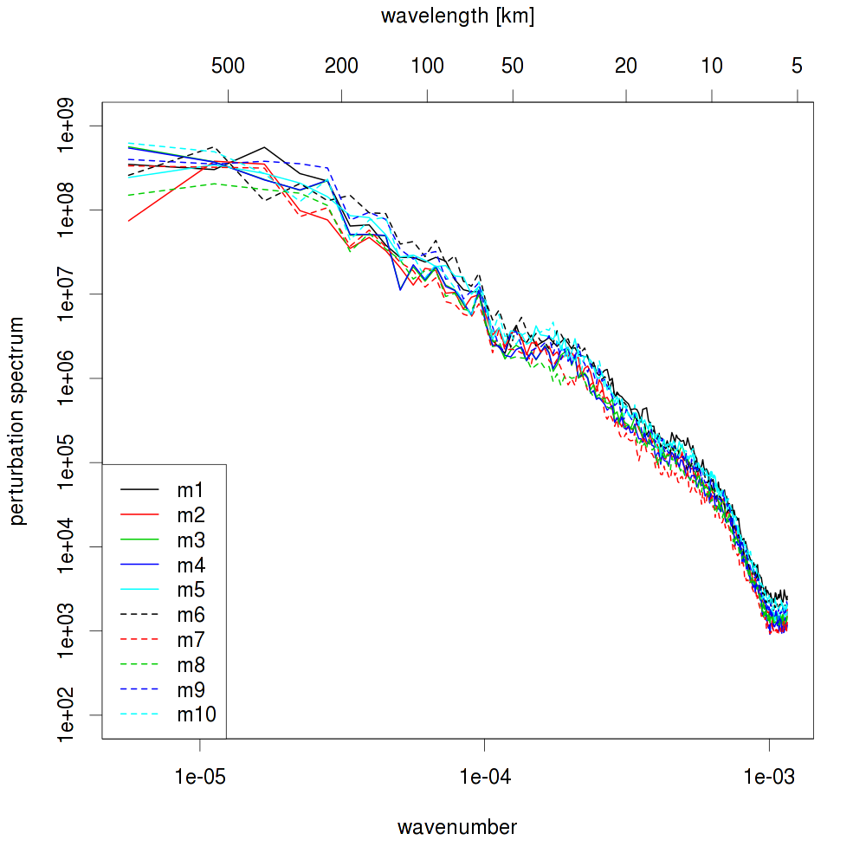
2012102512 - T level 40
KENDA analyses
COSMO-LEPS downscaled analyses

Slide 17
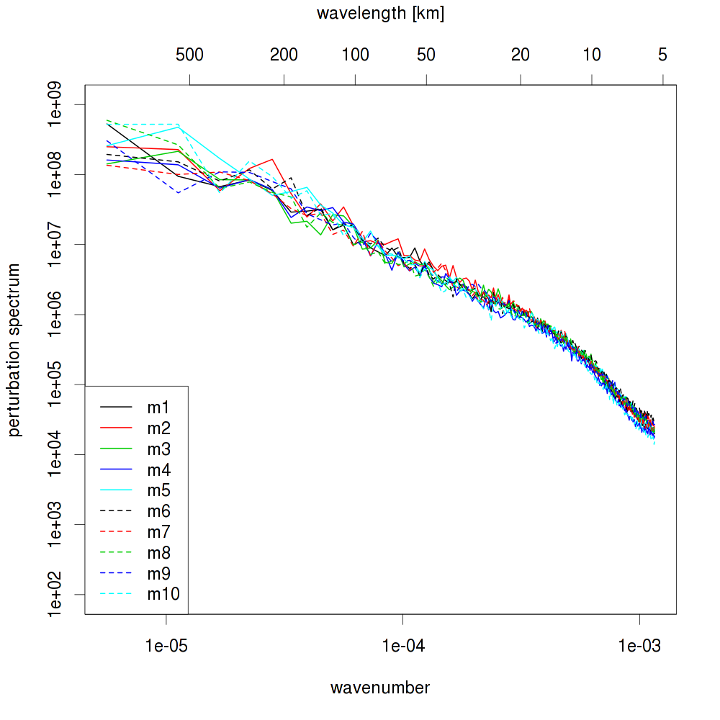
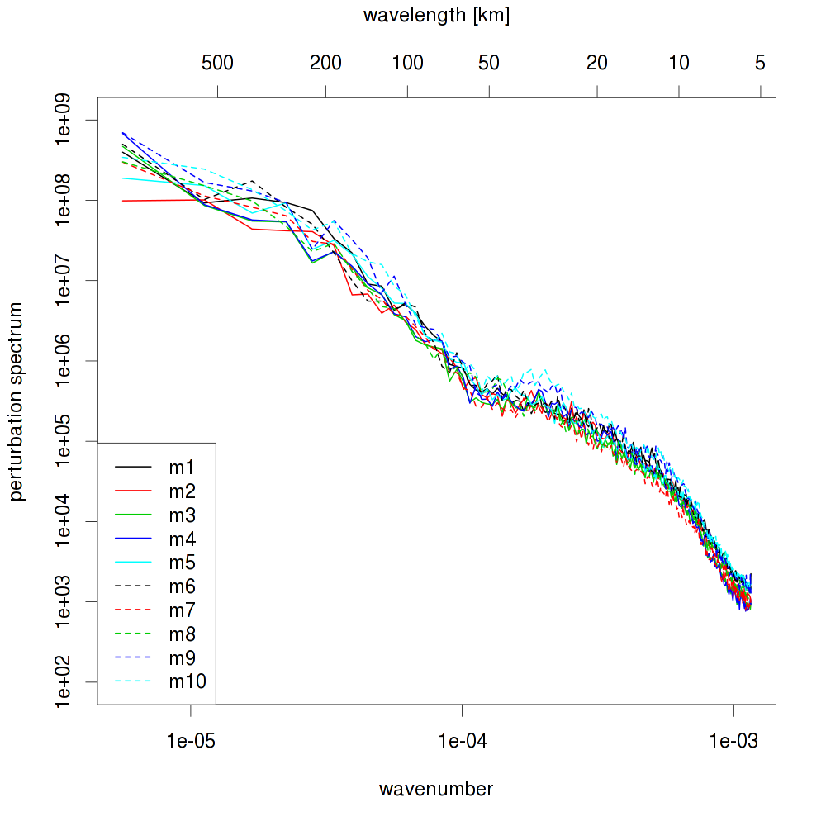
2012102512 - T level 30
KENDA analyses
COSMO-LEPS downscaled analyses

Slide 18
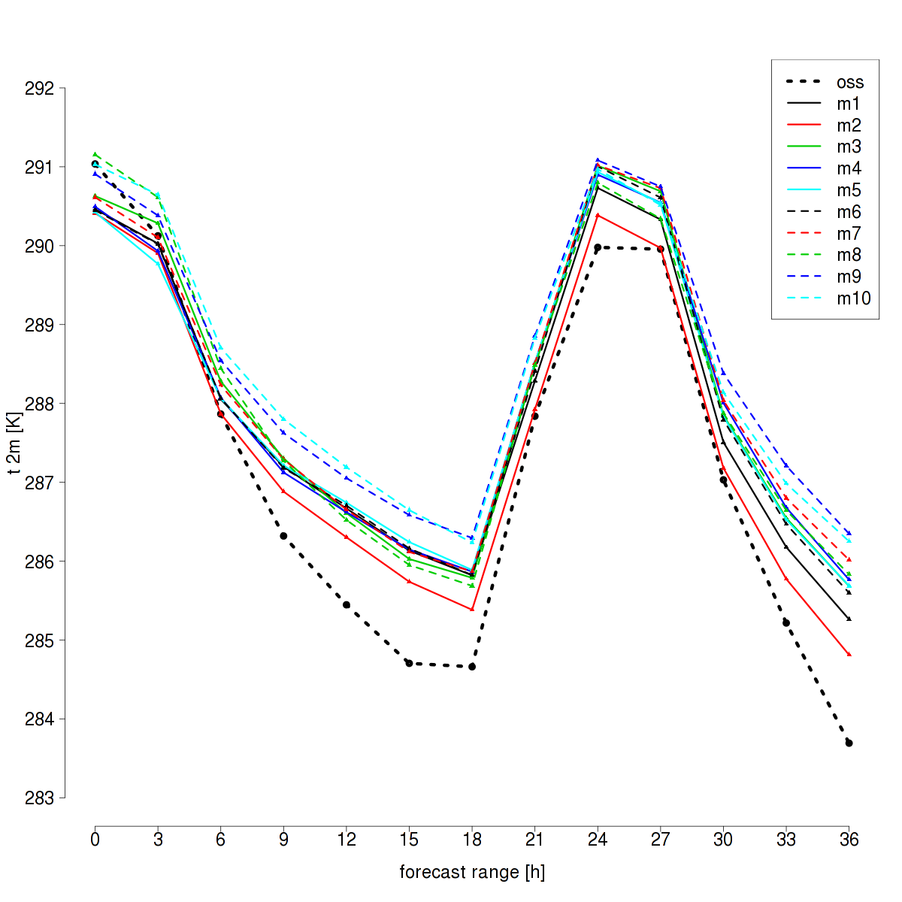
2012092612 - T2m areaTOT – downscaling ICs

Slide 19
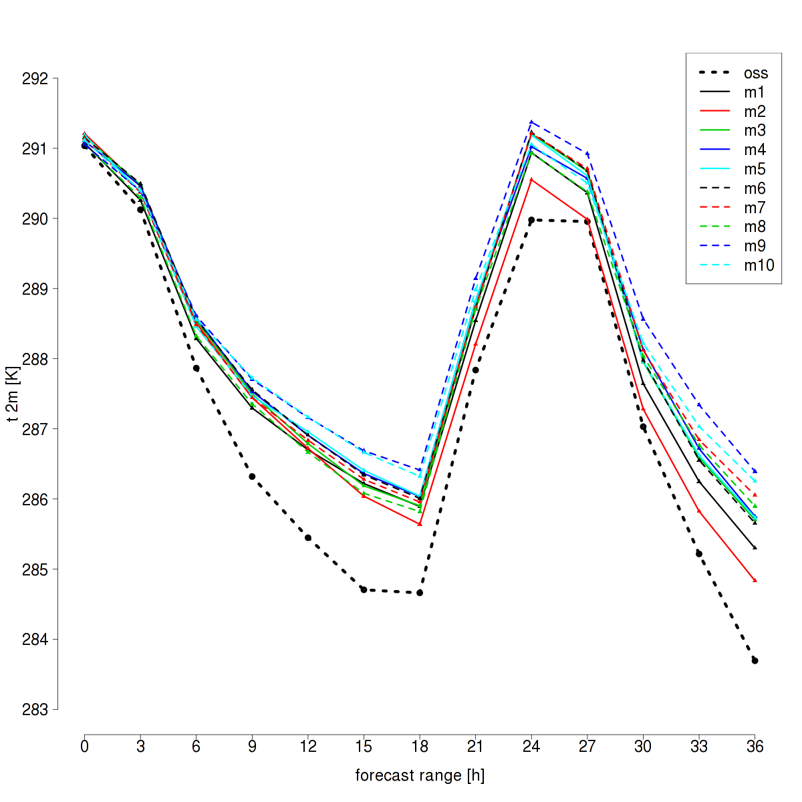
2012092612 - T2m areaTOT - kendaICs

Slide 20
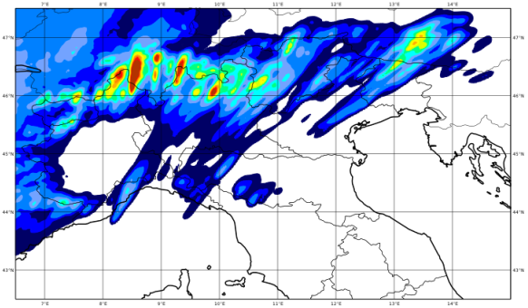
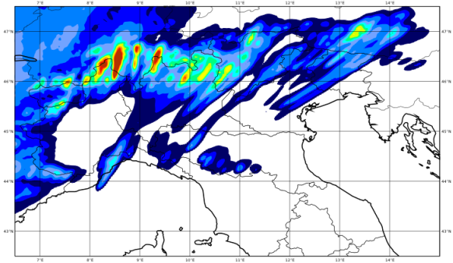
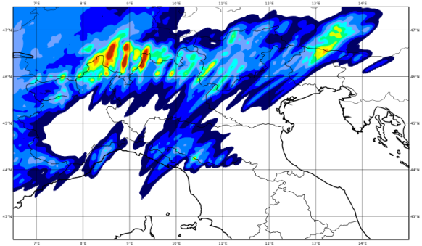
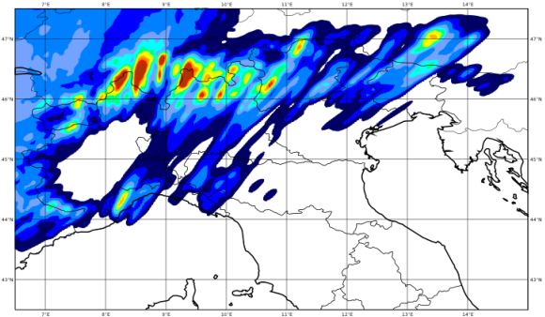
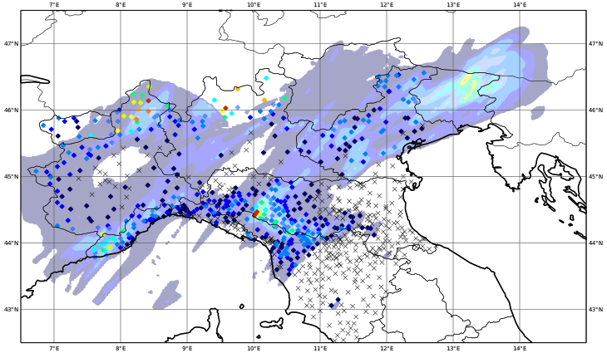
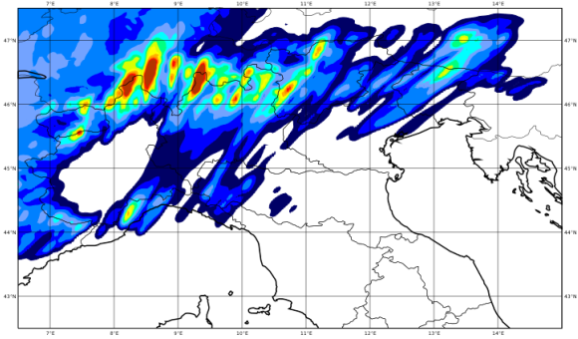
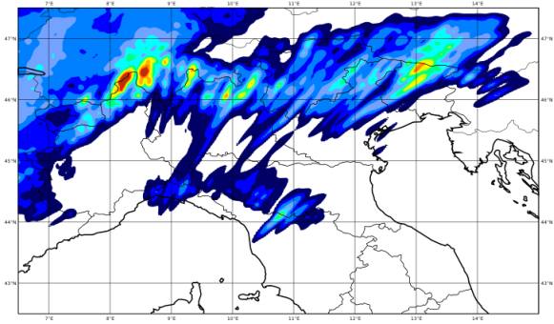
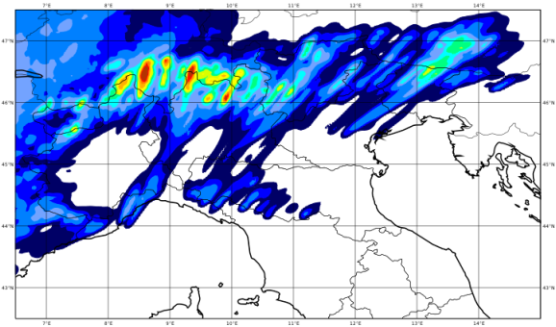
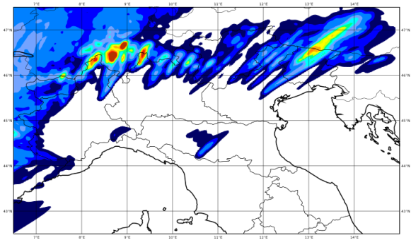
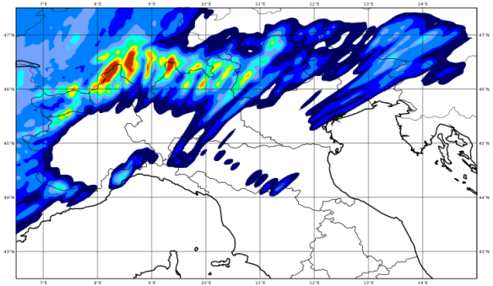
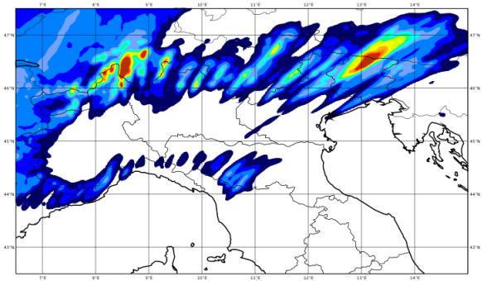
20120926 12-24 UTC
downscaling ICs
fc + 12 h
by V. Poli

Slide 21
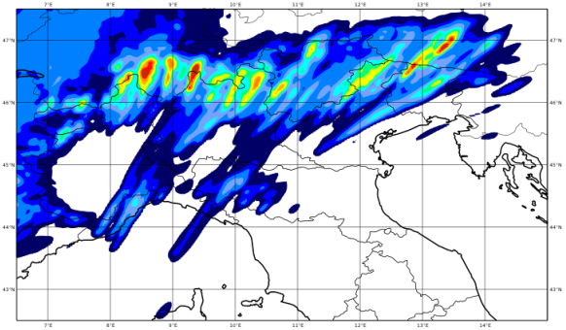
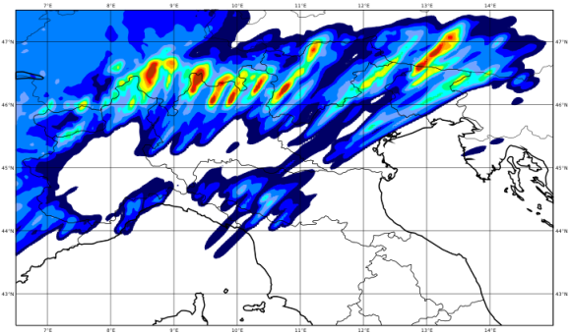
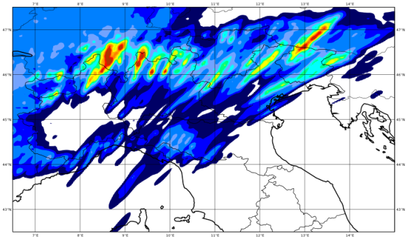
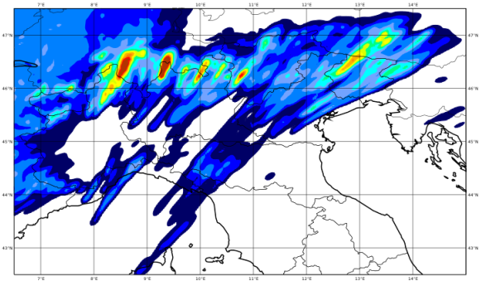
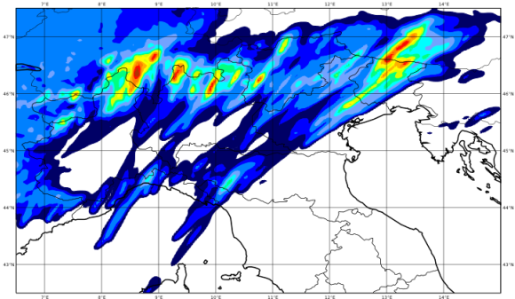
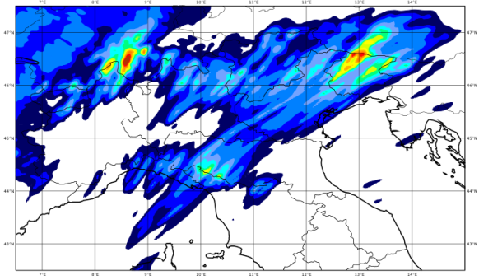
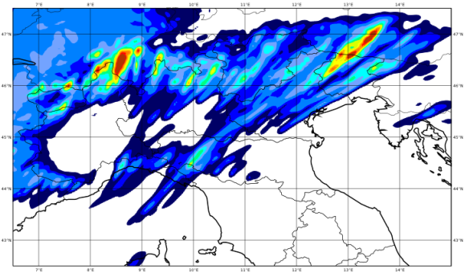
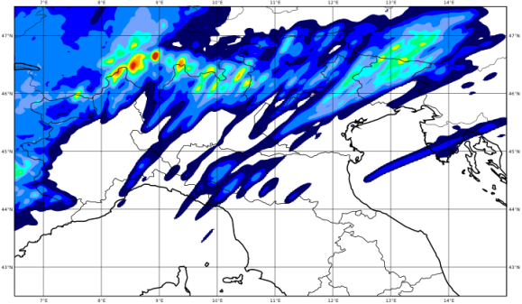
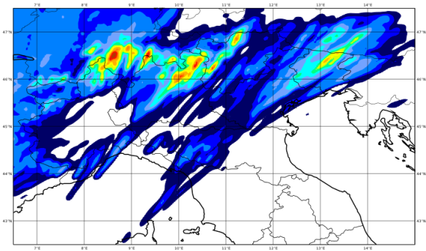
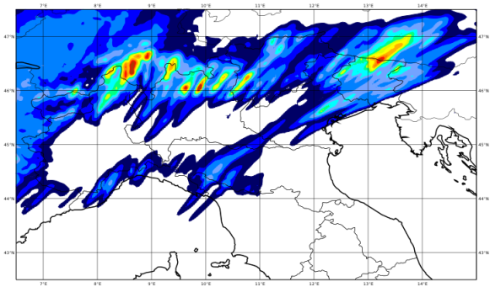
20120926 12-24 UTC
kenda ICs
fc + 12 h
by V. Poli

Slide 22
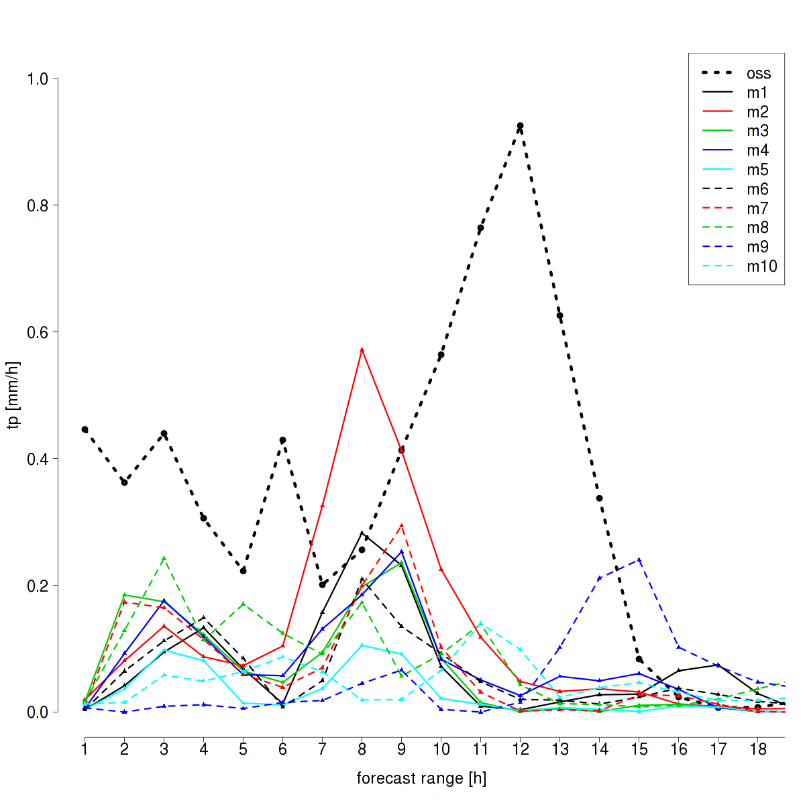
Downscaling ICs – area-averaged hourly precip.

Slide 23
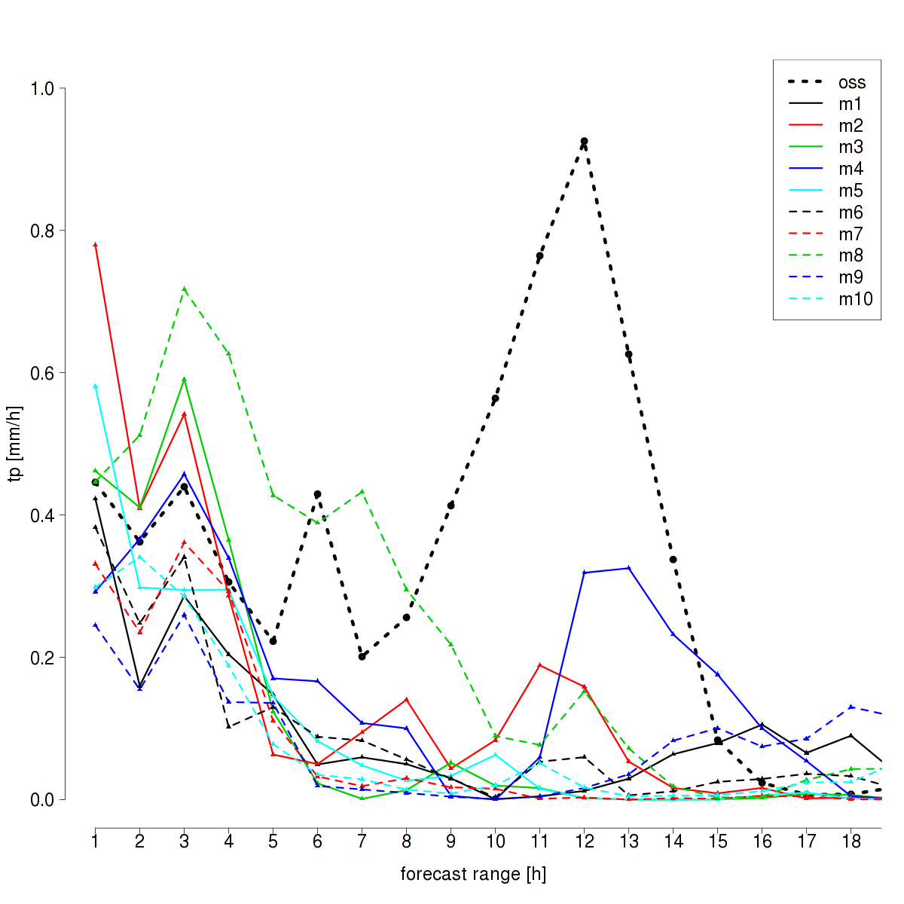
KENDA ICs – area-averaged hourly precip.

Slide 24
Concluding remarks
Analysis cycle:
  KENDA is able to introduce small scale perturbations
  KENDA analyses have less spread that downscaled analyses, especially at low levels
Forecast:
  Good performance for one case
  Bad performance for one case
Further tests:
    Run more ensemble members in the DA cycle (EPS BCs)
    Adding model perturbations in the analysis cycle
    Tune KENDA parameters
    Run idealised cases

Slide 25
Toward a probabilistic forecast system: the COSMO-ME EPS
The implementation of a short range EPS based on COSMO-ME is straightforward “extending” the forecast members integration
Analysis Step
Analysis Step
BG Forecast Step
BG
BG Forecasts
IC
time
A first implementation of COSMO-ME EPS has being tested at CNMCA in the framework of MYWAVE project (→ short range sea state EPS based on COSMO-ME EPS: NETTUNO EPS)
The main characteristics of COSMO-ME EPS are:
Domain and resolution: COSMO model is integrated on the same domain of the CNMCA-LETKF system.
IC and BC: initial conditions are derived from the CNMCA-LETKF system. Lateral boundaries conditions are from IFS deterministic run perturbed using ECMWF-EPS.
Model error: stochastics physics perturbation tendencies will be evaluated.
Forecast range: the 40+1 COSMO forecast members are running up to 48 hours in order to produce the wind forecast to be given as input to the NETTUNO system at 00 UTC.

Slide 26
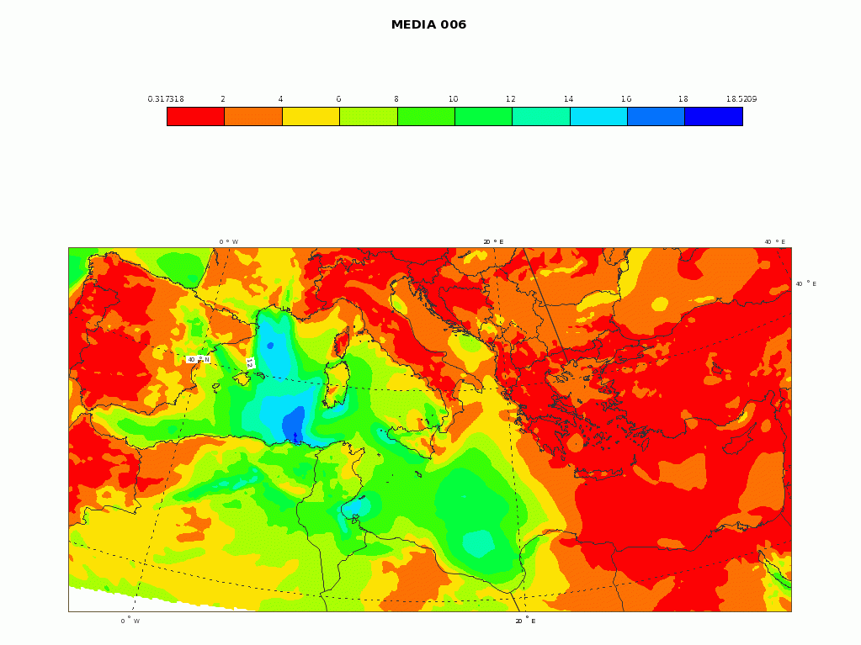
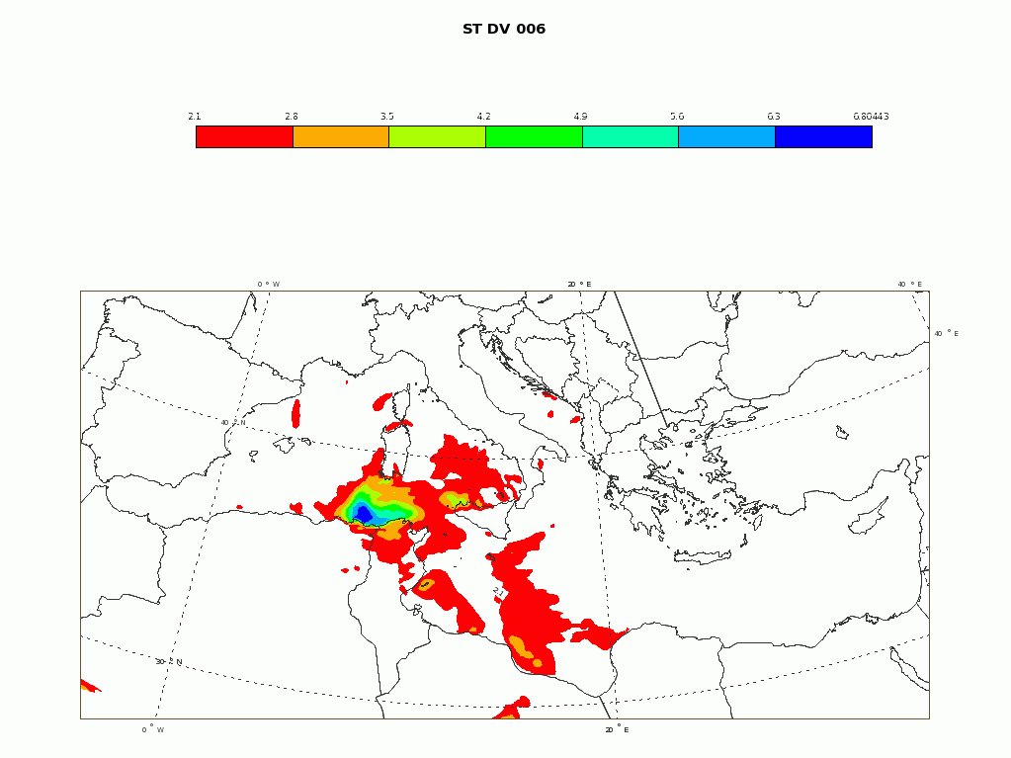
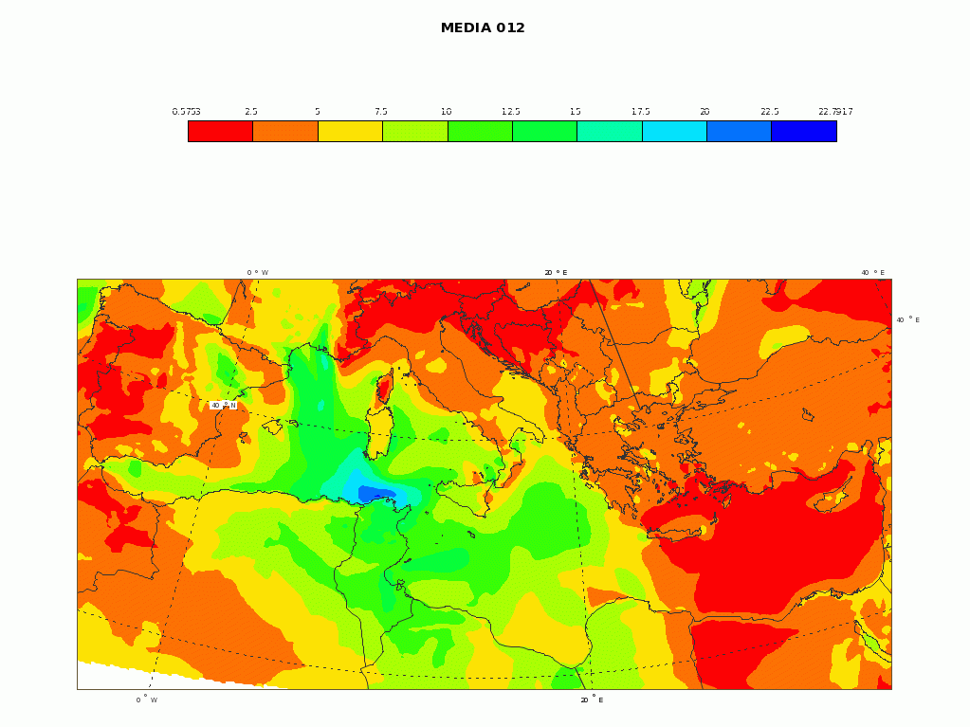
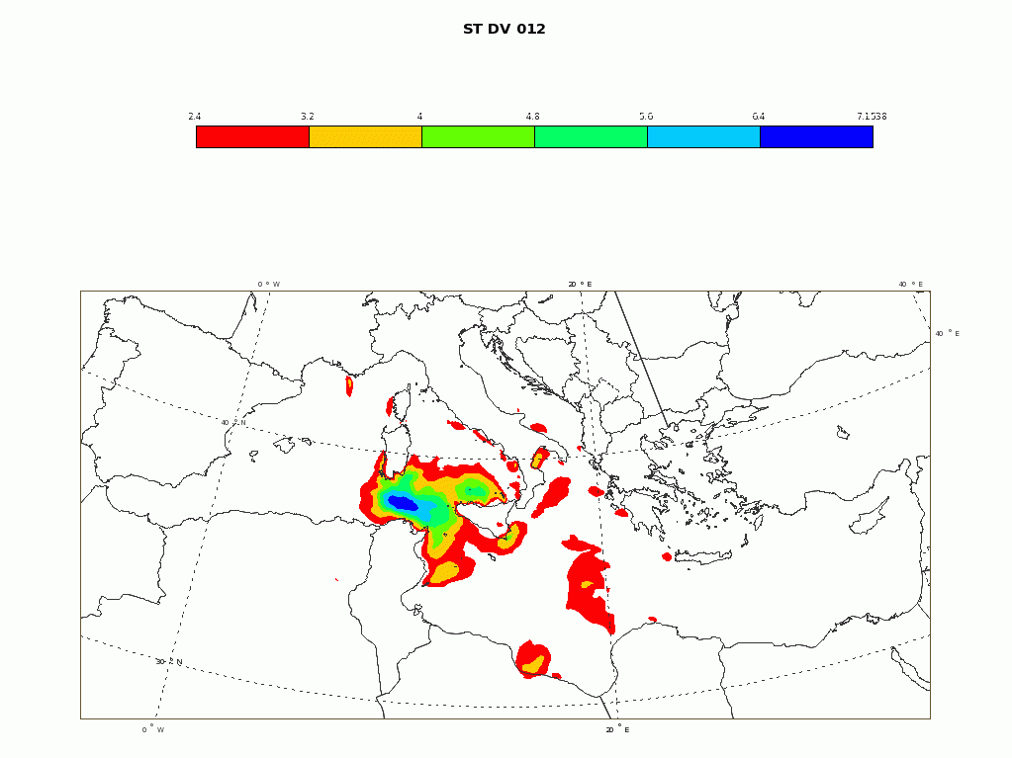
NETTUNO (Sea State) EPS
ens mean 06
ens spread 06
ens mean 12
ens spread 12

Slide 27
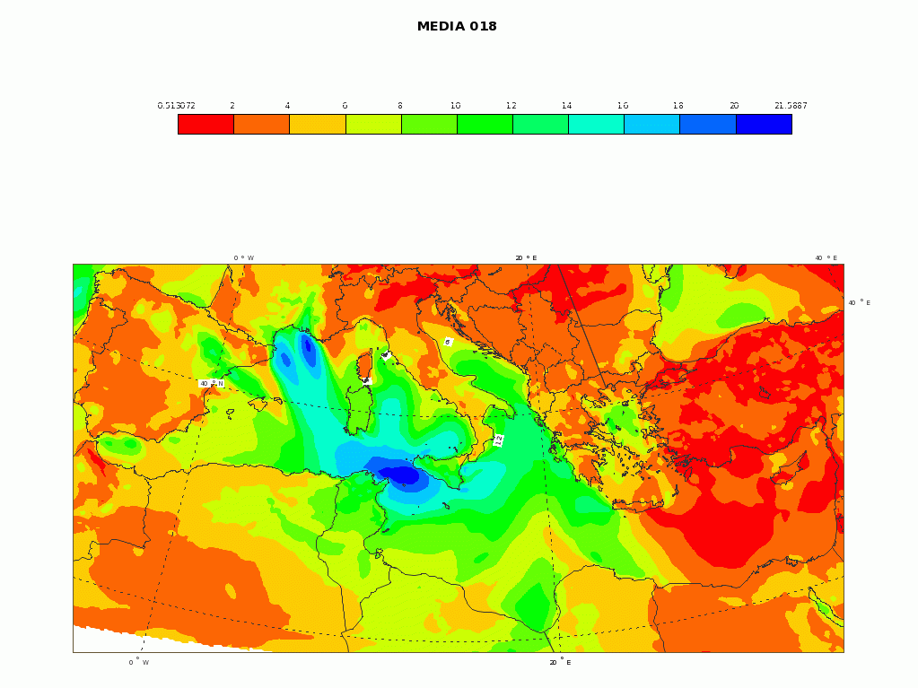



NETTUNO (Sea State) EPS
ens mean 18
ens spread 18
ens mean 24
ens spread 24

Slide 28




NETTUNO (Sea State) EPS
ens mean 30
ens spread 30
ens mean 36
ens spread 36

Slide 29




NETTUNO (Sea State) EPS
ens mean 42
ens spread 42
ens mean 48
ens spread 48

Slide 30
COSMO-LEPS
Evaluation of the convection schemes:
  members 1-8 use Tiedtke convection scheme (8TD),
  members 9-16 use Kain-Fritsch (8KF).
  MAM 2013: compare cleps16, 8TD, 8KF.
Work on the clustering technique

Slide 31




about the convection scheme
___ cleps16
___ 8TD ___ 8KF
BSS, tp > 10mm
BSS, tp > 1mm
As expected, best performance by the full ensemble (cleps16).
Tiedtke-members better than Kain-Fritsch members, but NOT for all scores.
ROC, tp > 1mm
ROC, tp > 10mm

Slide 32

COSMO-LEPS clustering technique
AIM: provide limited-area ensembles (either convection-parameterised or convection-permitting) with the best set of boundary conditions.
Consider distances between ECMWF EPS members according to “COSMO-LEPS metric” (Z, U, V, Q in the mid-lower troposphere over the clustering domain).
Look at distances between pairs of ECMWF EPS members: to what extent do these distances grow with forecast range, using “COSMO-LEPS metric”?
Study a number of seasons.
Compare against random choice.
Outcome: modifications to the number of clusters / number of EPS considered / clustering intervals.

Slide 33
Science Plan issues
derive ICs for ensemble members from KENDA (with KENDA/WG1)
evaluate perturbation of physics tendencies (SPPT); adaptation of the scheme to the O(1km) model resolution
evaluate SKEB scheme
move towards stochastic physics
develop lower boundary perturbations for O(1km) scale
better integration of ensemble in the model development/evaluation activities:
  ameliorate the link between model development and use of the model for ensemble forecasting purposes (WG1, WG3ab)
  include ensemble verification among standard verification practice (with WG5); use of the VERSUS package for the operational verification of the ensemble products
  address ensemble use and interpretation, in collaboration with WG4 and WG5
COSMO-LEPS maintenance:
  as a common forecasting ensemble
  It may facilitate research on convection-permitting ensembles (provision of boundary conditions) and provide a reference for CP ensemble development

Slide 34
Science Plan issues: long term perspective
Convection-permitting ensembles will be operational in several COSMO Countries -> possibility of sharing the developed perturbation methodologies and/or to provide combined products in the overlapping areas. Post-processing.
Applications based on ensemble outputs (e.g. for environmental prediction), requiring ad hoc products and tailoring of ensembles for the different applications.
Development of ICON ensemble -> providing Boundary Conditions to the higher resolution ensembles?

