Slide 1

COSMO STC Report
Sibiu, 5th of September 2013
Philippe Steiner

Slide 2
32nd STC meeting on 2nd/3rd Sept.
Participants:
D. Majewski (Germany),
P. Steiner (Switzerland, chair)
A. Raspanti (Italy)
T. Tzeferi (Greece)
A. Mazur (Poland)
G. Stancalie (Romania)
D. Kiktev (Russia)
M. Ziemianski (SPM)
Excused:
R. Bakowski (Poland)

Slide 3
COSMO Strategy & enlargement policy
On the request of the directors, future strategy of COSMO and enlargement policy of COSMO discussed during the 31st STC meeting in March 2013
Document worked out and version 0.92 recommended for the approval of the directors during the 32nd STC meeting
Brief historical recall:

Slide 4
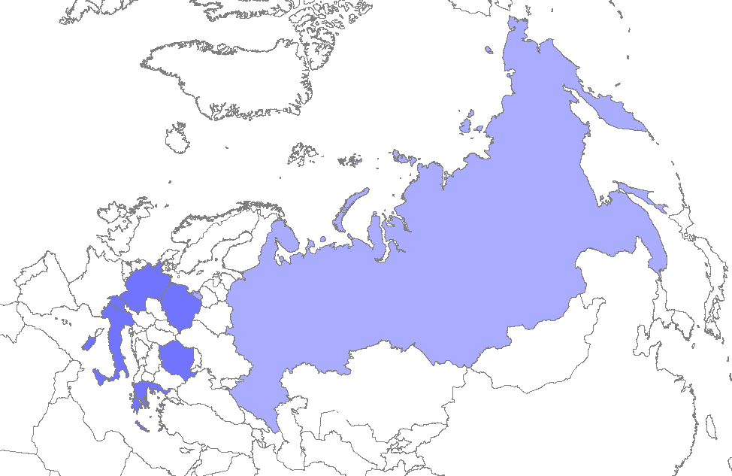


Full Members of COSMO
2001 Germany
Deutscher Wetterdienst (DWD)
2001 Switzerland
MeteoSwiss
2001 Italy
Ufficio Generale Spazio Aereo e Meteorologia (USAM)
2001 Greece
Hellenic National Meteorological Service (HNMS)
2002 Poland
Institute for Meteorology and Water Management (IMGW)
2009 Romania
National Meteorological Administration (NMA)
2009 Russia
Federal Service for Hydrometeorology and Environmental Monitoring (Roshydromet)

Slide 5
Policy of COSMO for enlargement
Decisions of the COSMO directors on memberships:
2005 meeting: no enlargement foreseen until the question of the future structure and operation of COSMO has been solved
2007 meeting:
  Mechanism of priority projects for FTE approved
  Development of a science plan decided (2010-14 approved)
  Licensing principle agreed
  Different types of membership (with rights/duties) agreed :
    Full Member
    Applicant
    Licensee
  Enlargements again possible

Slide 6
Newest interests for membership
Discussions with different countries during the last years
Only discussion with Israel (IMS) has lead to an official application to membership in 2012
COSMO directors have asked for an assessment of the future strategy of COSMO and of its enlargement policy before a decision on the application of IMS

Slide 7
  Current status of model and consortium
General increase of quality, importance and scope of NWP
  Central role in forecasting process / trend to automation
  COSMO + CLM, ART, Fieldextra, VERSUS,…
COSMO operational in many countries (incl. licensees)
each member with a convection-permitting version
Wide usage for research and in other communities
    Climate within the CLM-community ( ~60 institutes)
    ART for aerosols & atmosphere chemistry (~20 institutes)
Good performance compared to other models
  out of verification results
  leader in resolution of operational ensemble
  significant advance for new HPC architectures

Slide 8
  Current status of consortium
Community of NMS developing and operating a model
Mechanisms for development in place
  science plan, PP/PT, source management
Light governance
  no budget, no central position, no dedicated development team
  limited collaboration (local priorities, skills)
Revenues from license fees to support development work
Strong link with universities

Slide 9
Challenges
Global models reduce their mesh size:
  IFS to 10 km in 2015, NH-IFS maybe to 5 km in 2020
  ICON with possible local refinements and regional mode
Increased requirements from the users
  Expected growth of quality
  Seamless prediction
  More information (air composition, products for energy, aviation)
«Friendly competition» with other growing consortia
Disruptive evolution of HPC-architectures

Slide 10
Development of ICON at DWD
Development of ICON since 2004 at DWD and MPI-M
  common physics library for ICON / COSMO
  same data assimilation method as COSMO (LETKF)
  ultra-high resolution LES-mode and regional mode in 2015
  boundary condition from ICON and IFS possible
ICON operational at DWD in 2014
  replacing GME in 2014 and COSMO-EU in 2015
  COSMO for convection-permitting scales (COSMO-DE / -EPS)
Strong need at DWD to harmonise ICON & COSMO work
  potential conflicts of priorities and resources
  stronger focus on ICON dynamics and ICON regional mode
  Unified ICON strategic goal: NWP, CLM, ART; global &regional

Slide 11
COSMO Strategy
Work towards unified system
  Involvement of COSMO partners
  Common physics package and assimilation system
  Contribute to ICON regional mode
  Slow transition from COSMO to ICON modelling until 2020
Policy for enlargement
Allow for only modest enlargement (7 - ~10 members)
Avoid substantial adaptation of governance
Careful selection of new members (benefit for consortium) with objective evaluation criteria
Open for countries of WMO region for Europe (RA VI)

Slide 12
Consequences
Focus of COSMO:
  convective scale version
  migration of lower resolution versions to ICON-regional
  Support new anelastic dycore
Governance
  Developments from COSMO within COSMO PP/PT
  Apply COSMO standards with COSMO bodies to ICON regional mode
Need for new agreement
  Regulate the relation with CLM & ART (separate entities)
  Enable access to ICON-regional to COSMO
  Actualize the governance

Slide 13
Responsibility of COSMO for ICON
Application | COSMO-world | ICON-world
 |  | regional | global
NWP | COSMO for COSMO-model |  | DWD for ICON global mode
Climate | CLM-community for COSMO-CLM |  | MPI-M for ICON global mode
Environment | KIT for COSMO-ART |  | KIT for ICON-ART

Slide 14
Responsibility of COSMO for ICON
Application | COSMO-world | ICON-world
 |  | regional | global
NWP | COSMO for COSMO-model | COSMO for ICON reg. mode | DWD for ICON global mode
Climate | CLM-community for COSMO-CLM | CLM-community for ICON reg. mode | MPI-M for ICON global mode
Environment | KIT for COSMO-ART | KIT for ICON-ART | KIT for ICON-ART
COSMO with COSMO bodies and procedures will be responsible for ICON regional mode for NWP application, considering the impact of all decisions on the global mode
Discussions MPI-M / CLM community planned for the responsibility of ICON for regional climate applications

Slide 15
Development of ICON applications
DWD + MPI-M + KIT + FZJ
(project HD(CP)² )
DWD + MPI-M
ICON
Modelling
Framework
KIT
ICON-ART
ICON-LES
COSMO
CLM Community
KIT
ICON-NWP
ICON-CLM
ICON-ART
regional mode

Slide 16
4.1 New COSMO Agreement (1)
Version 0.9 of the new agreement recommended to the approval by the directors
Structure: main documents with 11 Annexes:
  Annex A: Definition of the COSMO-Software
  Annex B: Terms of Reference of the COSMO bodies
  Annex C: Rules for the contribution of the Partners
  Annex D: Relation to the CLM community
  Annex E: Relation to the COSMO-ART Developers at the Institute IMK-TRO (KIT)
  Annex F: Relation to the ICON Developers at DWD and MPI-M
  Annex G: Conditions for additional data and products according to resolution 40 (WMO Cg-XII)
  Annex H: Standard license contracts for COSMO-Software
  Annex I: Evaluation criteria for potential new COSMO-Partners
  Annex J: Declaration of Application for new Applicants
  Annex K: Declaration of Partnership for new Partners

Slide 17
New COSMO Agreement
Selected points
STC can modify, add, remove annexes, not the main part
(currently the STC can amend any part of the agreement)
Competence of directors explicitly specified (new)
IPR-rules clearly regulated (new)
Distribution of COSMO for research or to GHMS (Governmental Hydrometeorolological or Meteorological Services) for official duty
Rights and duties of Applicants now defined (new)
Relationship with CLM, ART and ICON regulated (new)
Partner can be forced to the terminate the partnership

Slide 18
Decisions on current projects
OK to continue work in PP POMPA on all tasks to deliver a GPU-capable version of COSMO based on dycore rewrite
  Target: actual, full version of COSMO with pre-operational quality in December 2014
  to be (incrementally) included in the official version
Approval of the plan of PP VERSUS2
  PPL to adapt until December plan and schedule to the available resources with no reduction of the deliverables
  Target: version of VERSUS to be used operationally by all members at the end of the project
Approval of updated plan of PP KENDA
  Target: LETKF version for operations as good as nudging
  Additional observation types possibly as follow-on action

Slide 19
Decisions on new projects
PT NWP Test Suite approved in March for 2014
  New leader: Amalia Iriza (NMA)
PT/PP ConSAT (Consolidate Surface Atmosphere Transfer scheme) conditionally approved and can start
  Leader: Matthias Raschendorfer (DWD)
  STC welcomes the submitted PT plan, but in view of the importance of the area prefers the form of a PP
  An extended PP plan to be submitted in December after definition of the suitable additional contributions (workshop foreseen in November)
PP COTEKINO (COsmo Towards Ensembles at the Km-scale IN Our countries) 2014-2015 approved
  Leader: Chiara Marsigli (ARPA-SIMC)

Slide 20
Elections
SCA for EXTPAR (new COSMO software): Daniel Lüthi ETH
Separate SCA for INT2LM: Ulrich Blahak (DWD)
3) Chairman of the STC: Philippe Steiner (MeteoSwiss)
reelected for one year

Slide 21
Other decisions
Approval of COSMO Version 5.0 and INT2LM Version 2.0
  Based on the verification on COSMO Version 4.28 and INT2LM 1.22
  Renaming of COSMO Version 4.29 and INT2LM Version 1.23
  Under the condition that these versions contain only technical modifications not affecting the content of the results
  Big milestone for COSMO !
Approval of new ToR for the TAG
(including now also the new SCA for EXTPAR and INT2LM)

Slide 22
Science plan
Input to the science plan reviewed and feed-back prepared
  Many thanks for the preparation in the WGs !
New version to be reviewed by the SMC until December and submitted to STC approval before distribution for external review

Slide 23
Next COSMO GM
8 – 11.9.2014 in Athens (GR)
2015 in Poland

Slide 25

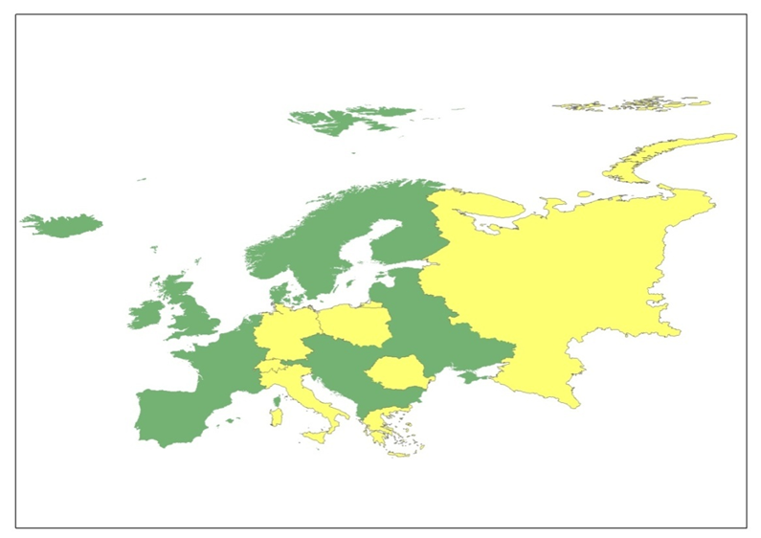
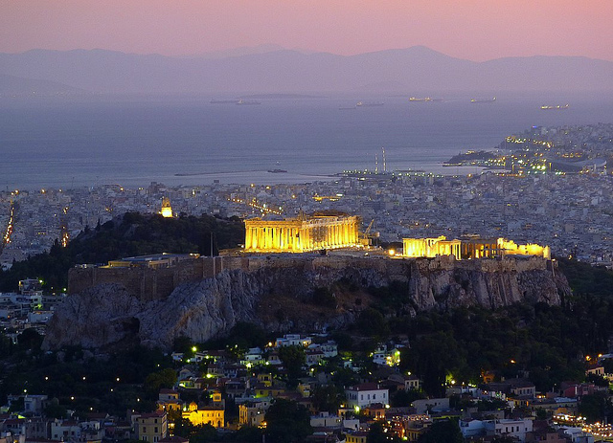

16th General Meeting
Date:
8 – 11 September 2014
Location:
Athens-Grecce
ART

Slide 26
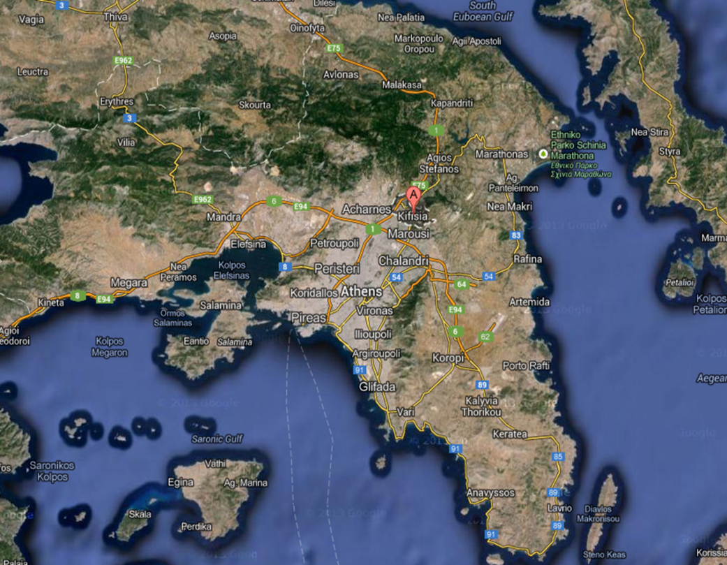
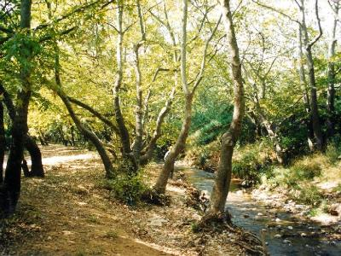
Kifisia
Kifisia (Greek: Κηφισιά) is one of the northern suburbs of Athens, Greece.
The area is known for the perfect layout, the particular architecture of the houses and love of its inhabitants for floriculture.
The name, Kifissia, comes from Kifiso river which runs to the west of Kifisia.

Slide 27
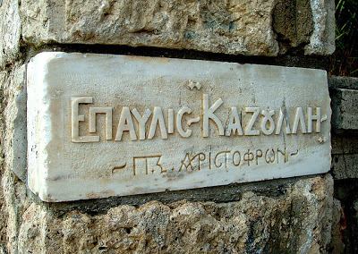
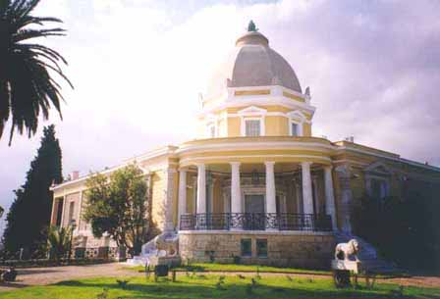
Villa Kazouli
Villa Kazouli is one of the most prominent buildings in Attica. It is a landmark at the southern entrance of Kifissia
It belonged to the Greek-Egyptian merchant sailor Nicholas Kazouli. It was built in 1902 by a foreign architect and used as a holiday home .

Slide 28
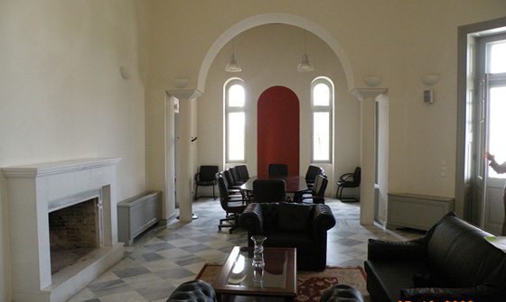
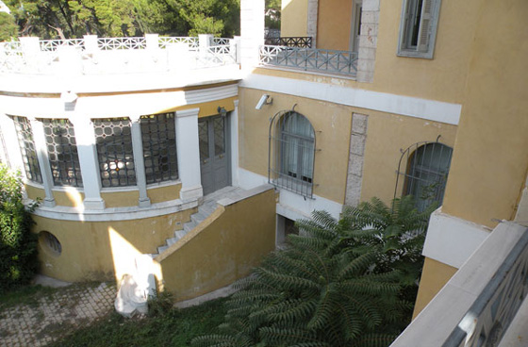
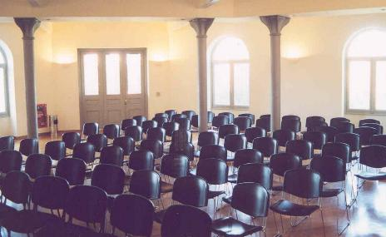
Since 2001 the renovated Villa Kazouli houses the “National Centre for Sustainable Development”. Further more the the villa accommodates environmental and cultural events as well as international conferences and workshops.

Slide 29
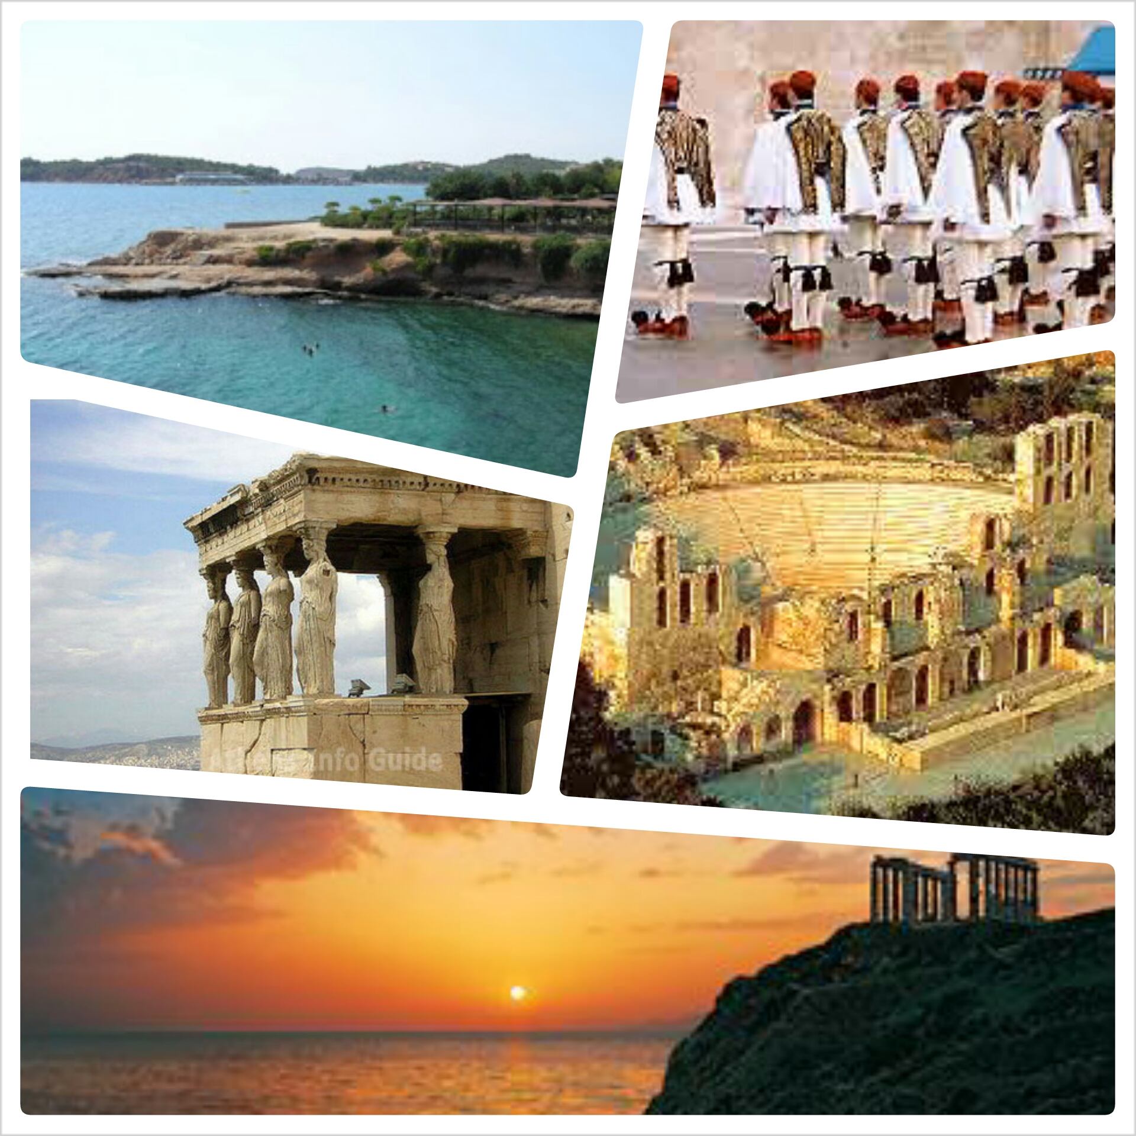
~ See You In Athens ~

