Slide 1
COSMO-ART Working Group meeting , 03.09.2013, ´Sibiu
Agenda:
B. Vogel: Recent Developments
A. Revokatova: Developments in Russia
P. Kaufmann: Plans for operaional use of COSMO-ART
for air quality forecast

Slide 2
Recent developments:
sanity check of the results
Adaptation of COSMO-ART to COSMO 5.0
tracer structure
chemical boundary conditions form MOZART and EMAC
INT2LM
restart with COSMO-ART output from previous runs

Slide 3
COSMO-ART users
IMK-IFU: Dust storms over China, air quality during the Olympic Games
IMK-AAF: Pollen , bacteria as IN
IMK-ASF: Troposphere-Stratosphere Exchange
EMPA, Switzerland: Aqueous chemistry, Validation,
Rosshydromet, Russia: Air quality above Moscow, Vegetation Fires
NCMS, United Arabic Emirates UAE: Dust storm forecast
Georgia Tec, USA: Aerosols and cloud formation
Carnegie Mellon, USA: Soot impact on regional climate

Slide 4
COSMO-ART users
Meteoswiss, Switzerland: Operational pollen forecast
DWD, Germany: Operational forecast of pollen, mineral dust,
volcanic ash
National Observatory, Greece: Forest fires, air quality
Weather service of Romania: Air quality
New user:
Tel-Aviv university: Dust and haze layer in der Dead Sea Area

Slide 5
Some other news:
COSMO-ART/M7
COSMO-ART serves as the base for EU Project EXA2GREEN
Test suite for COSMO-ART
Two extra days are foreseen for the next COSMO-CLM-ART
training course
New ways of visualization

Slide 7
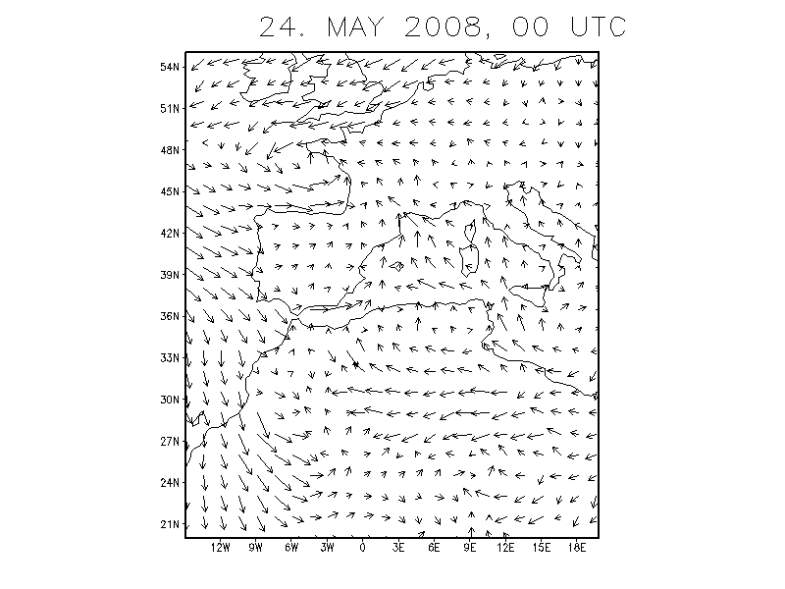
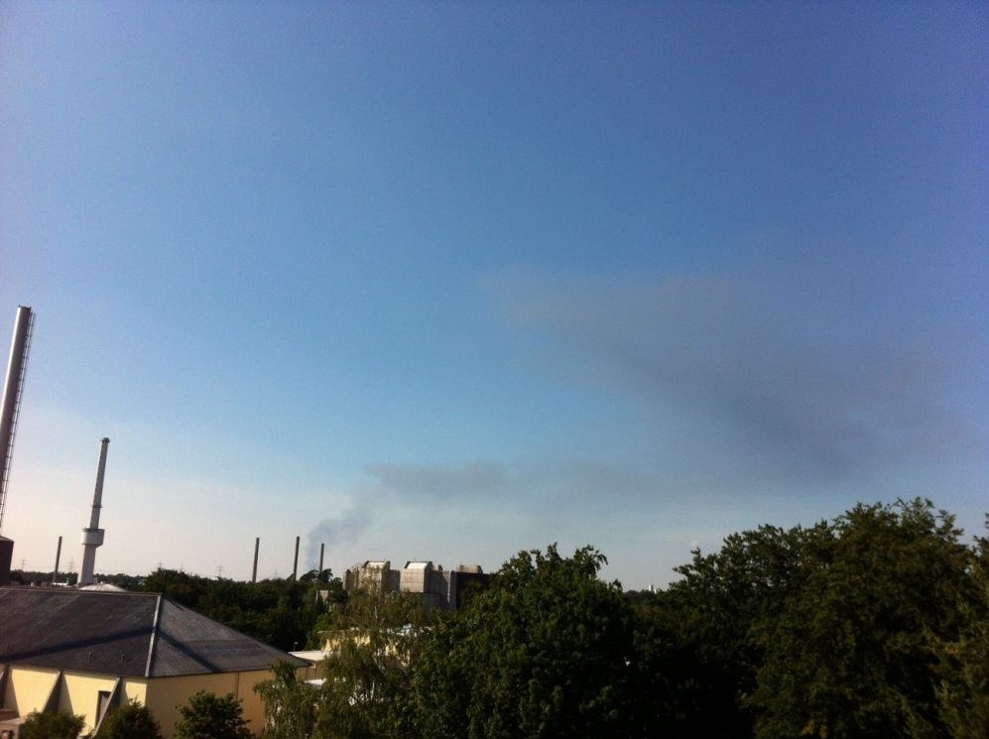
Single sources (emergency cases)

Slide 8
Realized so far:
Volcanic ash
Radioactive particles
Sea salt
Mineral dust
Bromocarbons (stratosphere-troposphere exchange)
Next steps:
chemistry
all other aerosols
A prototype should be ready in July 2014

