Slide 1
PP POMPA (WG6)
Overview Talk
Oliver Fuhrer (MeteoSwiss) and the whole POMPA project team
COSMO GM12, Lugano

Slide 2
Task Overview
Task 1 Performance analysis and documentation
Task 2 Redesign memory layout and data structures
Task 3 Improve current parallelization
Task 4 Parallel I/O
Task 5 Redesign implementation of dynamical core
Task 6 Explore GPU acceleration
Task 7 Implementation documentation
Talks of
Tobias and Carlos

Slide 3
Data Structures (Task 2)
First step: physical parametrizations with blocking
f(nproma,k,nblock)
New version of organize_physics() structured as follow
! start block loop
do ib=1,nblock
  call copy_to block f(i,j,k) ➔ f_b(nproma,k)
  call organize_gscp
  call organize_radiation
  call organize_turbulence
  call organize_soil
  call copy_back f_b(nproma,k) ➔ f(i,j,k)
  end do
Unified COSMO / ICON physics library
Straightforward OpenMP parallelization over blocks
inside physics scheme data is in block form f_b(nproma,ke)
Xavier Lapillonne
Notes:
All operation requiring horizontal neighbor shall be moved out: e.g. : velocity at mass point, shear …, rad coarse.

Slide 4
Asynchronous & Parallel I/O (Task 4)
IPCC benchmark of ETH (400 PEs + 3 I/O PEs)
Only for NetCDF output
Will be available in COSMO v5.0
Section | Runtime [s] ORIGINAL | Runtime [s] NEW
Dynamics | 258 | 257
Physics | 86 | 85
Additional Computations | 11 | 10
Input | 5 | 5
Output | 132 | 7
TOTAL | 499 | 370
Carlos Osuna

Slide 5
Explore GPU Acceleration (Task 6)
Goal
Investigate whether and how GPUs can be leveraged for numerical weather prediction with COSMO
Background
Pioneering work: WRF (Michalakes)
ASUCA (JMA): full rewrite to CUDA
HIRLAM: dynamical core in C and CUDA
GOES-5 (NASA): CUDA and PGI directives
CAM (CESM, NCAR): CUDA implementation
NIM (NOAA): custom compiler F2C-ACC or OpenACC
…and many others

Slide 6
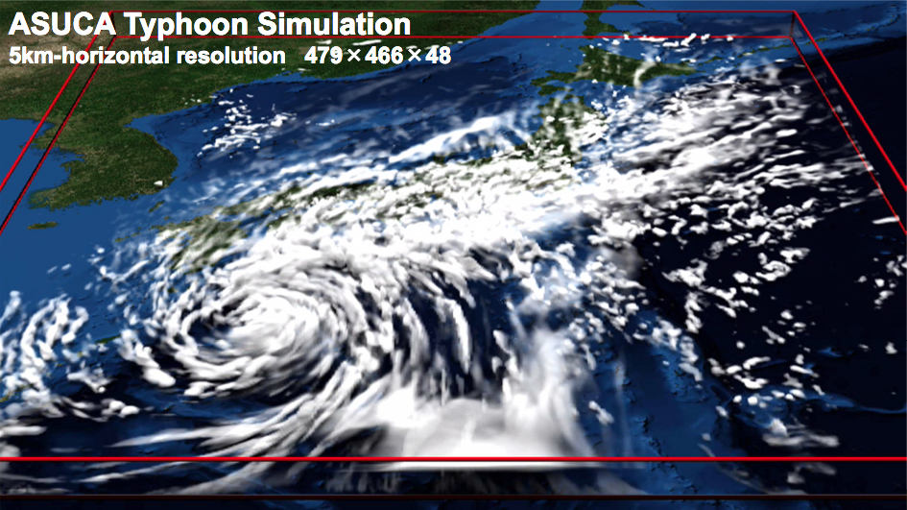
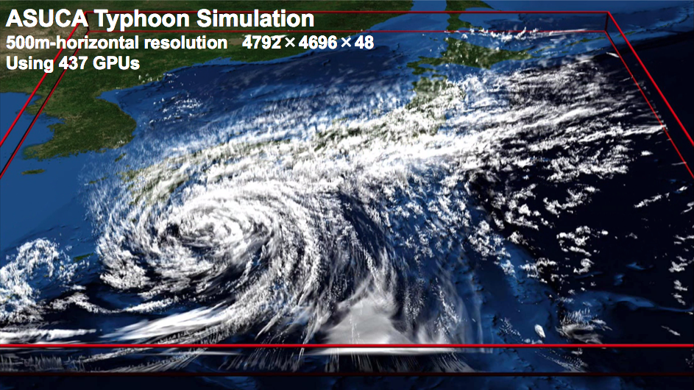
You are not alone!
J. Schalkwijk; Griffith, E.; Post, F; and Jonker, H.J.J.; High performance simulations of turbulent clouds on a desktop PC: exploiting the GPU, Bulletin of the American Meteorological Society, March 2012, pp. 307-314
Source: Aoki et al., Tokio Institute of Technology

Slide 7
Approach(es) in POMPA
How to achieve portable performance while retaining a single source code?
Dynamics
~60% of runtime
few core developers
many stencils
very memory intense
Physics + Assimilation
~20% of runtime
more developers
plug-in / shared code
“easy” to parallelize
DSEL approach
(see Tobias’ talk)
Accelerator
directives

Slide 8
Why Assimilation?
Only 2% of typical COSMO-2 forecast
Lot’s of code
GPU and CPU have different memories (currently)!
CPU
dynamics
CPU
GPU
dynamics

Slide 9
Full GPU Implemenation
Low FLOP count per load/store (stencils!)
Transfer of data on each timestep too expensive
(At least) All code which touches the prognostic variables every timestep has to be ported
*
§
Part | Time/Δt
Dynamics | 172 ms
Physics | 36 ms
Total | 253 ms
Transfer of ten
prognostic variables
vs
118 ms

Slide 10
Physics on GPU
Convection scheme in preparation by CASPUR
Meaningful subset of physics is ready!
Ported using OpenACC (accelerator directives standard)
 | CPU runtime [s] | GPU runtime [s] | Speedup
Microphysics | 17.9 | 2.6 | 6.8
Radiation | 12.7 | 3.0 | 4.3
Turbulence | 16.5 | 5.8 | 2.8
Soil | 1.4 | 0.6 | 2.4
Copy (ijk) ↔ block | - | 2.3 | -
Total physics | 48.5 | 14.3 | 3.4
Xavier Lapillonne
Notes:
Note: 12.5 s for 1h, i.e. 180 steps.
Time Physics/step = 69 ms
Note: Speed up depends and domain size
Note2: time spend in different part of the hysics

Slide 11
Outlook
2012
July
August
October
December
2013
functional CPU Version
dycore Integration, GCL tuning & storage order
GPU Version with dycore & GCL
GPU variant of GCL, boundary conditions kernels, first experience with directives/CUDA interoperability
GPU Version with timeloop
additional kernels (e.g. relaxation), non-periodic boundary conditions, GCL Fortran interfaces, interoperability directives/CUDA, meaningful subset of physics, communication using comm wrapper, nudging
GPU Version for realcases
performance optimization, remaining parts with directives, GCL tuning, dycore tuning

Slide 12
Integration
Making the advection scheme run fast on a GPU is one thing
Integration into operational code is another…
  Amdahl’s law
  usability
  sharing of data-structures
  clash of programming models
  maintainability
Significant effort in 2012 to integrate all POMPA GPU- developments into production code (HP2C OPCODE)
COSMO v4.19 + v4.22 assml

Slide 13
Feedback of Code?
Asynchronous, parallel NetCDF I/O
Alternative gather strategy in I/O
Consistent computation of tendencies
Loop level hybrid parallelization (OpenMP / MPI)
Blocked data structure in physics
More flexible halo-exchange interface
Consistent implementation of lateral BC
Switchable singe/double precision
…

Slide 14
Knowhow Transfer
“Transfer of knowhow is critical”
Dynamical core rewrite and GPU implementation
  5 – 7 FTEs in 2012!
  0.5 FTE from fixed COSMO staff
  rest is mostly temporary project staff
HP2C Initiative, CSCS and CASPUR are providing the bulk of resources
Knowhow transfer is only possible with a stronger engagement of COSMO staff!

Slide 15
Papers, Conferences and Workshops
X. Lapillonne, O. Fuhrer (submitted 2012) : Using compiler directives to port large scientific applications to GPUs: an example from atmospheric science. Submitted to Parallel Processing Letters.
Diamanti T., X. Lapillonne, O. Fuhrer, and D. Leuenberger, 2012: Porting the data assimilation of the atmospheric model COSMO to GPUs using directives. 41th SPEEDUP Workshop, Zurich, Switzerland.
Fuhrer, O., A. Walser, X. Lapillonne, D. Leuenberger, and T. Schönemeyer, 2011: Bringing the "new COSMO" to production: Opportunities and Challanges. SOS 15 Workshop, Engelberg, Switzerland.
Fuhrer, O., T. Gysi, X. Lapillonne, and T. Schulthess, 2012: Considerations for implementing NWP dynamical cores on next generation computers. EGU General Assembly, Vienna, Austria.
Gysi, T., and D.Müller, 2011: COSMO Dynamical Core Redesign - Motivation, Approach, Design & Expectations. SOS 15 Workshop, Engelberg, Switzerland
Gysi T., and D. Müller, 2011: COSMO Dynamical Core Redesign - Project, Approach by Example & Implementation. Programming weather, climate, and earth-system models on heterogeneous multi-core platforms, Boulder CO, USA
Gysi T., P. Messmer, T. Schröder, O. Fuhrer, C. Osuna, X. Lapillonne, W. Sawyer, M. Bianco, U. Varetto, D. Müller and T. Schulthess, 2012: Rewrite of the COSMO Dynamical Core. GPU Technology Conference, San Jose, USA.
Lapillonne, X., O. Fuhrer, 2012 : Porting the physical parametrizations of the atmospheric model COSMO to GPUs using directives, Speedup Conference, Basel, Switzerland.
Lapillonne, X., O. Fuhrer, 2011 : Porting the physical parametrizations on GPUs using directives. European Meteorological Society Conference, Berlin, Germany.
Lapillonne, X., O. Fuhrer, 2011: Adapting COSMO to next generation computers: The microphysics parametrization on GPUs using directives. Atelier de modélisation de l'atmosphère, Toulouse, France.
Osuna, C., O. Fuhrer and N. Stringfellow, 2012: Recent developments on NetCDF I/O: Towards hiding I/O computations in COSMO. Scalable I/O in climate models workshop, Hamburg, Germany.
Schulthess, T., 2010: GPU Considerations for Next Generation Weather Simulations. Supercomputing 2012, New Orleans, USA.
Steiner, P., M. de Lorenzi, and A. Mangili, 2010: Operational numerical weather prediction in Switzerland and evolution towards new supercomputer architectures. 14th ECMWF Workshop on High Performance Computing in Meteorology, Reading, United Kingdom

Slide 16
Thank you!
…and thanks to the POMPA project team for their work in 2012!

