Slide 1
EUMETNET C-SRNWP Programme:
status and plans
Gergely Bölöni
C-SRNWP: Coordination on Short Range
Numerical Weather Prediction

Slide 2
Introduction
Coordination on short range NWP between 32 European meteorological institutions
OMSZ is the actual Coordinating Member (till the end of 2012)
Main activities:
Represent short-range NWP needs in fornt of other institutions/projects (e.g. ECMWF or EUMETNET observation programmes)
Enhance cooperation on NWP: share resources in operations and stimulate competition on scientific development

Slide 3
Actual coordination activities
1) NWP requirements regarding OPERA products
  A related questionnaire was prepared by OPERA for NMSs → 19 NMSs answered
  The main outcome is that for SRNWP (assimilation) 3D volume (wind and reflectivity) data are required by all NMSs (which are received at Odyssey but not re-distributed at the moment) with an appropriate QC flagging (rain, no-rain, cluttered, etc.)
  Questionnaire outcomes taken into account when composing the OPERA project requirements for the next EUMETNET phase (2013-2017)
  ALADIN and HIRLAM provided proposals how to speed up and improve the volume data re-distribution (simple data policy, nominated transmission centers in each consortium, non-operational data service at the beginning, recommendation that NMSs include wind data and QC flags asap, SRNWP priorities for the next OPERA project)
  Feedback from OPERA: the NWP requirements were useful, recommendations for including wind data made by OPERA management through E-SAT (EUCOS Scientific Advisory Team), SRNWP priorities noticed

Slide 4
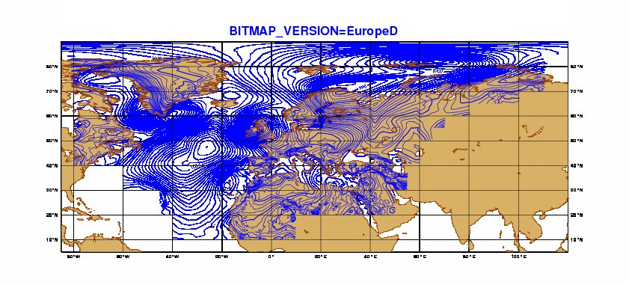
Actual coordination activities
2) ECMWF/IFS EPS LBCs to drive high resolution LAM EPS
  To drive future high resolution LAM EPS systems extra IFS EPS runs are anticipated by the SRNWP community from ECMWF on the top of the presently operational (higher resolution, 06 and 18 UTC runs)
  ECMWF developed an „economic archive” to store EPS model level fields only over Europe, North-Atlantic, North-Africa (covering all anticipated European EPS domains)
  The „economic archive” (reduced Gaussian grid) was succesfully tested by interested European consortia (relevant models: ALADIN/ALARO, AROME, COSMO, HIRLAM)
  Agreement reached (EPS-DA workshop Bologna 2011) within the SRNWP ET about the parameters (resolution, EPS size, forecast range) of future test runs
  IFS EPS tests are requested from ECMWF: 2x2 weeks T1279 test periods are to be run (periods to be agreed soon)

Slide 5
Actual coordination activities
3) SRNWP surface data base
(http://www.cosmo-model.org/srnwp/content/default.htm)
→thanks to C. Heret and T. Andreadis
  Data from Debrecen station entered the data base
  5 new users (Croatia, Germany, Hungary, Russia, Sweden)
4) EWGLAM workshop (Helsinki, 8-11 October 2012)
  http://en.ilmatieteenlaitos.fi/SRNWP2012/ (thanks to FMI, Carl Fortelius)
  65 participants registered
  Check out the programme (almost finalized)
5) High-resolution AMDAR profiles to be tested in SRNWP DA:
  High vertical resolution data provided by E-MADAR via GTS (17-18 May 2011)
  BUFR test data set prepared and distributed for the SRNWP DA community for providing reference (usual resolution)

Slide 6
Actual coordination activities
    Announcement sent to SRNWP DA community to run simple assimilation tests based on these 2 days to see whether monitoring statistics / analysis increments are affected
6) BUFR radiosond data:
    Collect info about the assimilation of BUFR (slanted) radiosond profiles (taking into account lat, lon, time information)
    Feedback to E-SAT
7) AMDAR humidity OSEs over US:
  AMDAR humidity profiles available over US
  Near future: EUCOS will invite SRNWP DA institutions to investigate the impact of the AMDAR humidity profiles over US using European SRNWP models / DA systems (dedicated budget)

Slide 7
Organizational matters (WARNING!)
Expert Teams
Expert Teams (and their chairs) are of key importance to coordinate cross-consortia issues!
There is no chair of the Expert Team for Physical Parametrizations, Dynamics and System Aspects → no candidate among ET members → candidates/proposals welcome
From January 2013 onwards no chair of the ET for Surface Aspects (Jean-Francois Mahfouf will step down from his chair position)
SRNWP AC should be renamed as SRNWP Expert Team (according to the new rules of EUMETNET) → proposal: composition and ToR remains the same, only the name is to be changed

Slide 8
Next EUMTENET phase: NWP related changes
2008-2012
Assembly
STAC
PFAC
Obs. + Clim. Programmes + EUMETCAL EMMA C-SRNWP SRNWP-I SRNWP-V
Roadmap documents
2011-2012
Observation
Programme
Climate
Programme
Forecasting Programme

Slide 9
Next EUMTENET phase: NWP related changes
2013-2017
Assembly
STAC
PFAC
Observation
Programme
Climate
Programme
Forecasting Programme
EUMETCAL EMMA C-SRNWP EPS Nowcasting
Projects to be finished: SRNWP-I and SRNWP-V (end of 2012)
New anticipated projects: EPS, Nowcasting

Slide 10
Next EUMTENET phase: NWP related changes
Jan-March 2012: project requirements were composed the 3 NWP related projects: C-SRNWP, EPS, Nowcasting → a less pessimistic picture about future EUMETNET projects than at last EWGLAM
End of March 2012: STAC/PFAC approved the Forecasting Programme requirements and sent it for approval to Assembly (May 2012) → this implies that the content of the C-SRNWP, EPS, Nowcasting projects were also approved by STAC/PFAC
Applications under evaluation for all future projects (including EPS, Nowcasting, C-SRNWP) → proposal to STAC/PFAC till mid September 2012
STAC/PFAC proposes projects and Coordinating Members based on the evaluation reports (October 2012)

Slide 11
Next EUMTENET phase: NWP related changes
Assembly decides about the future projects (November 2012)
Hand over existing projects (January-June 2013)
Feelings about the future (based on feedbacks from STAC/PFAC meetings):
  The actual start of projects related to forecasting/NWP (EPS, Nowcasting, C-SRNWP) will depend whether interested participating members can afford the budget (some of the important NMSs are not interested in these projects)
  the management structure will depend on incoming bids

Slide 12
Next EUMTENET phase: NWP related changes
Content of the anticipated NWP related projects:
EPS project: 1.5 year feasibility project with the main goal of preparing a solid EPS project for the period of 2014-2017 (review and harmonize NMS scientific strategies for high-res EPS, identify overlaps in plans, prepare plans for reducing costs)
Nowcasting activity: 1.5 year feasibility „activity” with the main goal of recuiting Nowcasting experts (create an ET) who prepare a solid Nowcasting project for 2014-2017 (identify exchangable knowladge, organize timely observation exchange, etc.)
C-SRNWP project: 5 year project coordinating SRNWP like since 2008

Slide 13
How to improve C-SRNWP?
My experience:
Scientific plans are driven at national or at conosrtia level (not at EUMETNET level)
→ C-SRNWP is NOT for driving plans
How to use best this coordination programme?
Identify subjects that are in the interest of (more or less) all NWP centers (consortia) in Europe
Then these interests gain an official status, which we might use to put forward common plans.
These interests then can be more efficiently represented in front of other EUMETNET programmes and other organizations outside EUMETNET
…?
Further questions:
Which interests more we have in common?
What do you all think about the above statements/questions?

