Slide 1
Multiple-scale asymptotics
of the interaction between
gravity waves and synoptic-scale flow
and its implications for
soundproof modelling
Ulrich Achatz
Goethe-Universität Frankfurt am Main

Slide 2
Gravity waves
in the atmosphere

Slide 3
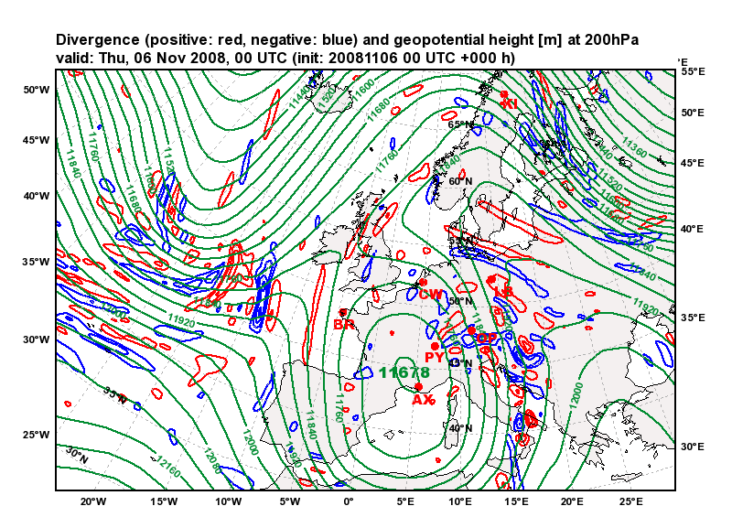
GW radiation: Spontaneous Imbalance
Source: ECMWF

Slide 4
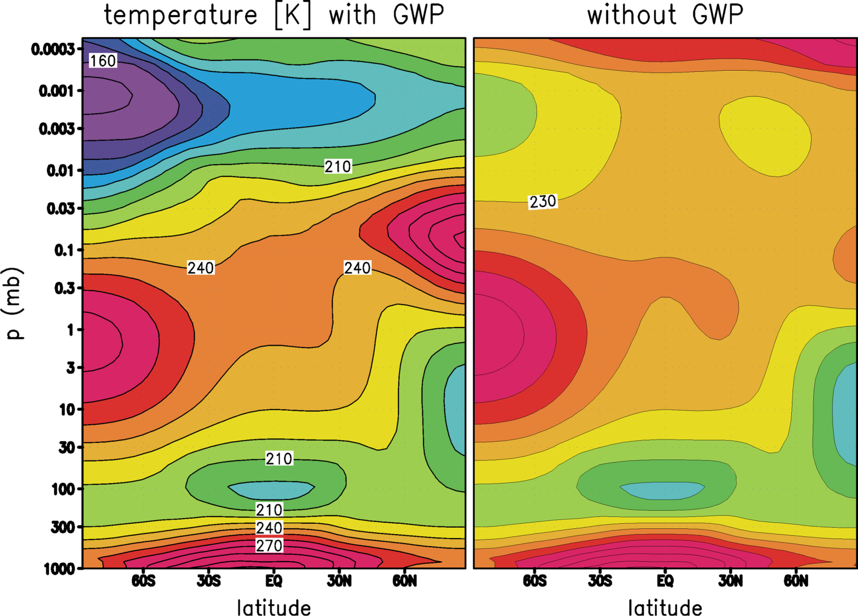
Gravity Waves in the Middle Atmosphere
Becker und Schmitz (2003)

Slide 5
Gravity Waves in the Middle Atmosphere
Becker und Schmitz (2003)

Slide 6
Gravity Waves in the Middle Atmosphere
Without GW parameterization
Becker und Schmitz (2003)

Slide 7
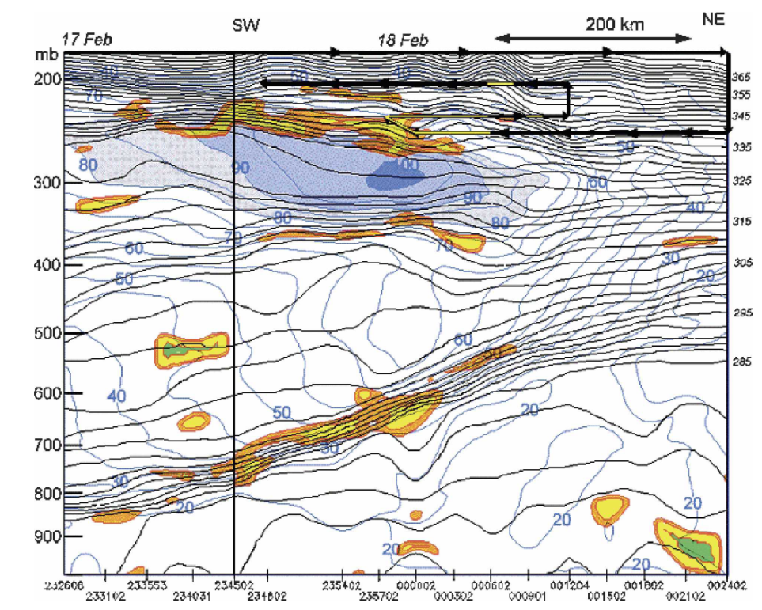
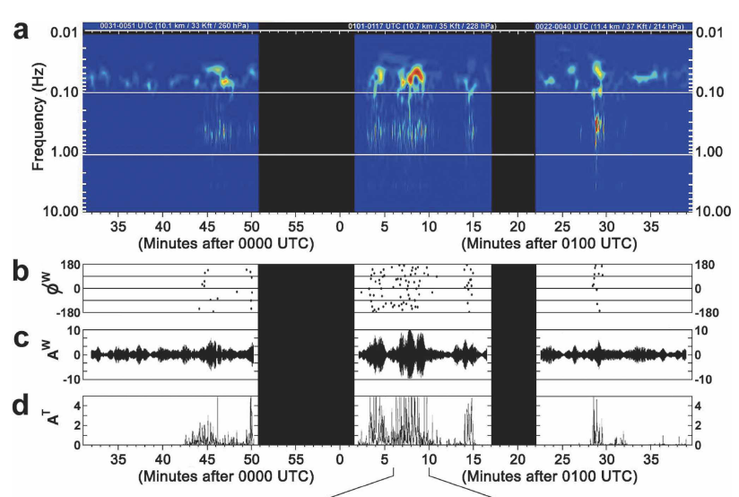
GWs and Clear-Air Turbulence
Koch et al (2008)

Slide 8
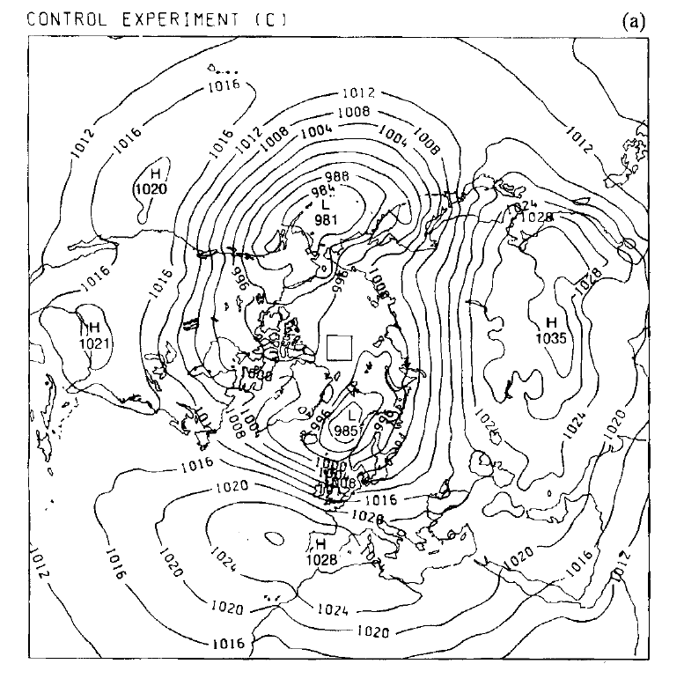
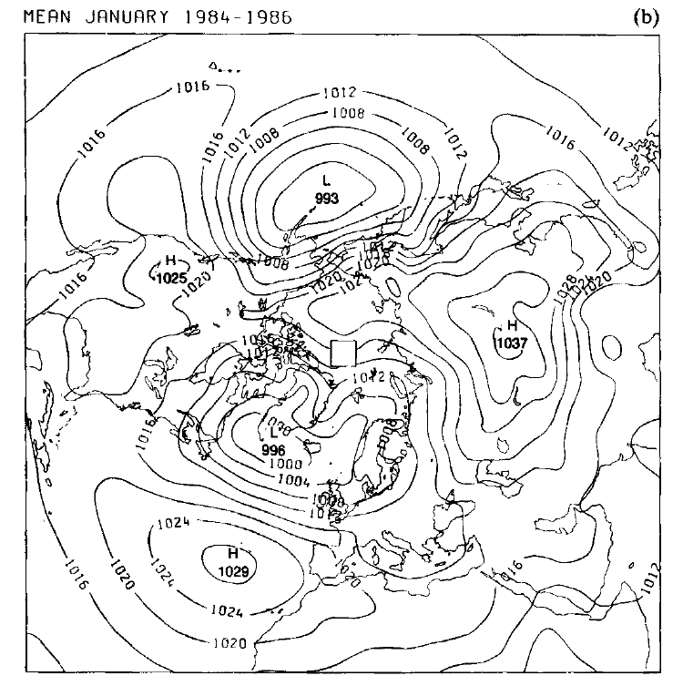
Impact GWs on Weather Forecasts
Without GWs
Analysis
Palmer et al (1986)

Slide 9
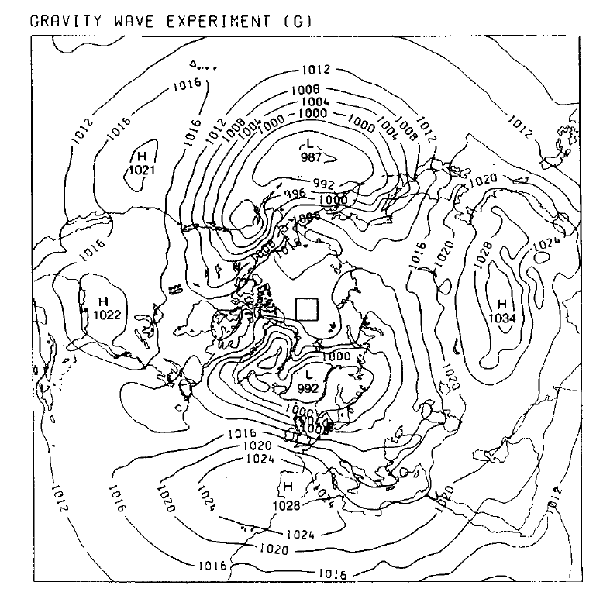
Impact GWs on Weather Forecasts
without GWs
with GWs
Analysis
Palmer et al (1986)

Slide 10
Open Questions

Slide 11
Open Questions and Research Strategy
How well do present parameterizations describe the GW impact? (theory needed!)
(e.g. Linzen 1981, Palmer et al 1986, McFarlane 1987, Medvedev and Klaassen 1995, Hines 1997, Lott and Miller 1997, Alexander and Dunkerton 1999, Warner and McIntyre 2001)
How well do we understand GW breaking?
How well do we understand GW propagation?
Presently no parameterization of spontaneous imbalance

Slide 12
Open Questions and Research Strategy
How well do present parameterizations describe the GW impact? (theory needed!)
(e.g. Linzen 1981, Palmer et al 1986, McFarlane 1987, Medvedev and Klaassen 1995, Hines 1997, Lott and Miller 1997, Alexander and Dunkerton 1999, Warner and McIntyre 2001)
How well do we understand GW breaking?
How well do we understand GW propagation?
Presently no parameterization of spontaneous imbalance
Approach:
  DNS (everything resolved)
  LES (turbulence parameterized, GWs resolved)
  GW parameterization

Slide 13
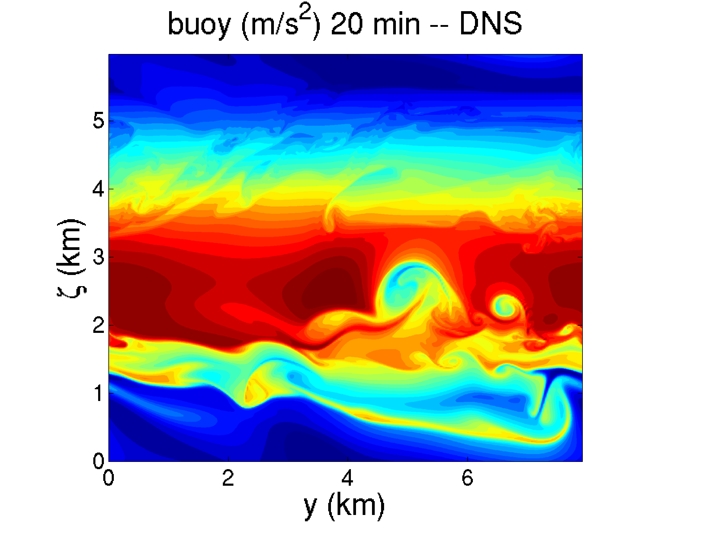
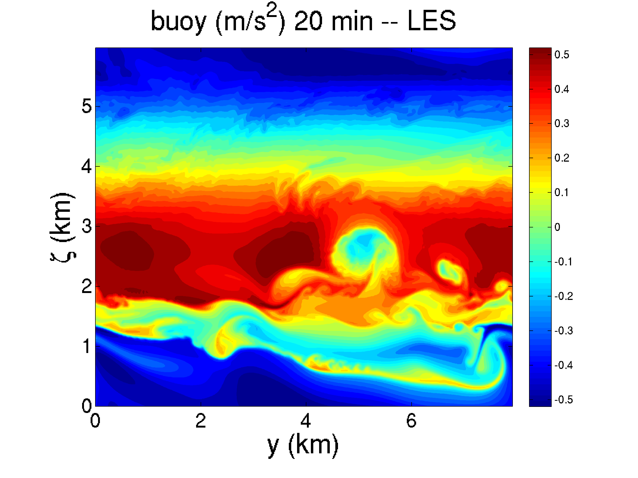
DNS and LES of breaking IGW (Boussinesq)
Perturbation IGW by leading transverse SV: snapshot
1152 x 1152 direct numerical simulation
288 x 288 simulation with ALDM (INCA)
Fruman, Achatz (GU Frankfurt), Remmler and Hickel (TU München)

Slide 14
DNS and LES of breaking IGW (Boussinesq)
Random perturbation IGW
Random perturbation NH GW
Horizontally averaged vertical spectrum of total energy density vs. wavenumber
Fruman, Achatz (GU Frankfurt), Remmler and Hickel (TU München)

Slide 15
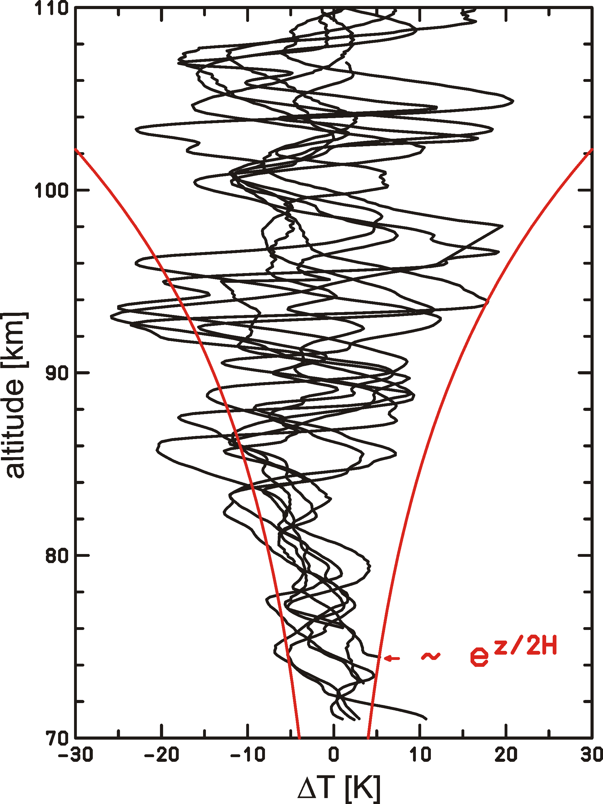
GW breaking in the middle atmosphere
Conservation
Instability at large altitudes
Momentum deposition…
Rapp et al. (priv. comm.)

Slide 16
GW breaking in the middle atmosphere
Conservation
Instability at large altitudes
Momentum deposition…
Competition between wave growth and dissipation:
  not in Boussinesq theory
Rapp et al. (priv. comm.)

Slide 17
GW breaking in the middle atmosphere
Conservation
Instability at large altitudes
Momentum deposition…
Competition between wave growth and dissipation:
  not in Boussinesq theory
  Soundproof candidates:
  Anelastic
  (Ogura and Philips 1962, Lipps and Hemler 1982)
  Pseudo-incompressible (Durran 1989)
Rapp et al. (priv. comm.)

Slide 18
GW breaking in the middle atmosphere
Conservation
Instability at large altitudes
Momentum deposition…
Competition between wave growth and dissipation:
  not in Boussinesq theory
  Soundproof candidates:
  Anelastic
  (Ogura and Philips 1962, Lipps and Hemler 1982)
  Pseudo-incompressible (Durran 1989)
Which soundproof model should be used?
Rapp et al. (priv. comm.)

Slide 19
Interaction between Large-Amplitude GW and Mean Flow:
Strong Stratification
No Rotation
Achatz, Klein, and Senf (2010)

Slide 20
Scales: time and space
for simplicity from now on: 2D
non-hydrostatic GWs: same spatial scale in horizontal and vertical
characteristic wave number
time scale set by GW frequency
characteristic frequency
dispersion relation for
Achatz, Klein, and Senf (2010)

Slide 21
Scales: time and space
for simplicity from now on: 2D
non-hydrostatic GWs: same spatial scale in horizontal and vertical
characteristic length scale
time scale set by GW frequency
characteristic frequency
dispersion relation for
Achatz, Klein, and Senf (2010)

Slide 22
Scales: time and space
for simplicity from now on: 2D
non-hydrostatic GWs: same spatial scale in horizontal and vertical
characteristic length scale
time scale set by GW frequency
characteristic time scale
dispersion relation for
Achatz, Klein, and Senf (2010)

Slide 23
Scales: time and space
for simplicity from now on: 2D
non-hydrostatic GWs: same spatial scale in horizontal and vertical
characteristic length scale
time scale set by GW frequency
characteristic time scale
linear dispersion relation for
Achatz, Klein, and Senf (2010)

Slide 24
Scales: velocities
winds determined by linear polarization relations:
what is ?
most interesting dynamics when GWs are close to breaking, i.e. locally
Achatz, Klein, and Senf (2010)

Slide 25
Scales: velocities
winds determined by linear polarization relations:
what is ?
most interesting dynamics when GWs are close to breaking, i.e. locally
Achatz, Klein, and Senf (2010)

Slide 26
Non-dimensional Euler equations
using:
yields
Achatz, Klein, and Senf (2010)

Slide 27
Non-dimensional Euler equations
using:
yields
isothermal potential-temperature scale height
Achatz, Klein, and Senf (2010)

Slide 28
Scales: thermodynamic wave fields
potential temperature:
Achatz, Klein, and Senf (2010)

Slide 29
Scales: thermodynamic wave fields
potential temperature:
Exner pressure:
Achatz, Klein, and Senf (2010)

Slide 30
Multi-Scale Asymptotics
Additional vertical scale needed:
and have vertical scale
scale of wave growth is
Therefore: Multi-scale-asymptotic ansatz
also assumed:
Achatz, Klein, and Senf (2010)

Slide 31
Multi-Scale Asymptotics
Additional vertical scale needed:
and have vertical scale
scale of wave growth is
Therefore: Multi-scale-asymptotic ansatz
also assumed:
Achatz, Klein, and Senf (2010)

Slide 32
Multi-Scale Asymptotics
Additional vertical scale needed:
and have vertical scale
scale of wave growth is
here assumed:
Achatz, Klein, and Senf (2010)

Slide 33
Large-amplitude WKBb
Achatz, Klein, and Senf (2010)

Slide 34
Large-amplitude WKB
Achatz, Klein, and Senf (2010)

Slide 35
Large-amplitude WKB
Achatz, Klein, and Senf (2010)

Slide 36
Large-amplitude WKB
Mean flow with only large-scale dependence
Achatz, Klein, and Senf (2010)

Slide 37
Large-amplitude WKB
Wavepacket with
large-scale amplitude
wavenumber and frequency with large-scale dependence
Achatz, Klein, and Senf (2010)

Slide 38
Large-amplitude WKB
Achatz, Klein, and Senf (2010)

Slide 39
Large-amplitude WKB
Next-order mean flow
Achatz, Klein, and Senf (2010)

Slide 40
Large-amplitude WKB
Harmonics of the wavepacket due to nonlinear interactions
Achatz, Klein, and Senf (2010)

Slide 41
Large-amplitude WKB
collect equal powers in
collect equal powers in
no linearization!
Achatz, Klein, and Senf (2010)

Slide 42
Large-amplitude WKB: leading order
Achatz, Klein, and Senf (2010)

Slide 43
Large-amplitude WKB: leading order
dispersion relation and structure as from Boussinesq
Achatz, Klein, and Senf (2010)

Slide 44
Large-amplitude WKB: 1st order
Achatz, Klein, and Senf (2010)

Slide 45
Large-amplitude WKB: 1st order
Solvability condition leads to wave-action conservation
(Bretherton 1966, Grimshaw 1975, Müller 1976)
Achatz, Klein, and Senf (2010)

Slide 46
Large-amplitude WKB: 1st order
Same result from pseudo-incompressible and from anelastic theory (Klein 2011)
Solvability condition leads to wave-action conservation
(Bretherton 1966, Grimshaw 1975, Müller 1976)
Achatz, Klein, and Senf (2010)

Slide 47
Large-amplitude WKB: 1st order, 2nd harmonics
Achatz, Klein, and Senf (2010)

Slide 48
Large-amplitude WKB: 1st order, 2nd harmonics
Achatz, Klein, and Senf (2010)

Slide 49
Large-amplitude WKB: 1st order, 2nd harmonics
2nd harmonics are slaved
Achatz, Klein, and Senf (2010)v

Slide 50
Large-amplitude WKB: 1st order, higher harmonics
Achatz, Klein, and Senf (2010)

Slide 51
Large-amplitude WKB: 1st order, higher harmonics
Achatz, Klein, and Senf (2010)

Slide 52
Large-amplitude WKB: 1st order, higher harmonics
higher harmonics vanish
(nonlinearity is weak)
Achatz, Klein, and Senf (2010)

Slide 53
Large-amplitude WKB: mean flow
Achatz, Klein, and Senf (2010)

Slide 54
Large-amplitude WKB: mean flow
acceleration by GW-momentum-flux divergence
Achatz, Klein, and Senf (2010)

Slide 55
Large-amplitude WKB: mean flow
acceleration by GW-momentum-flux divergence
p.-i. wave-correction of hydrostatic balance not appearing in anelastic dynamics
Achatz, Klein, and Senf (2010)

Slide 56
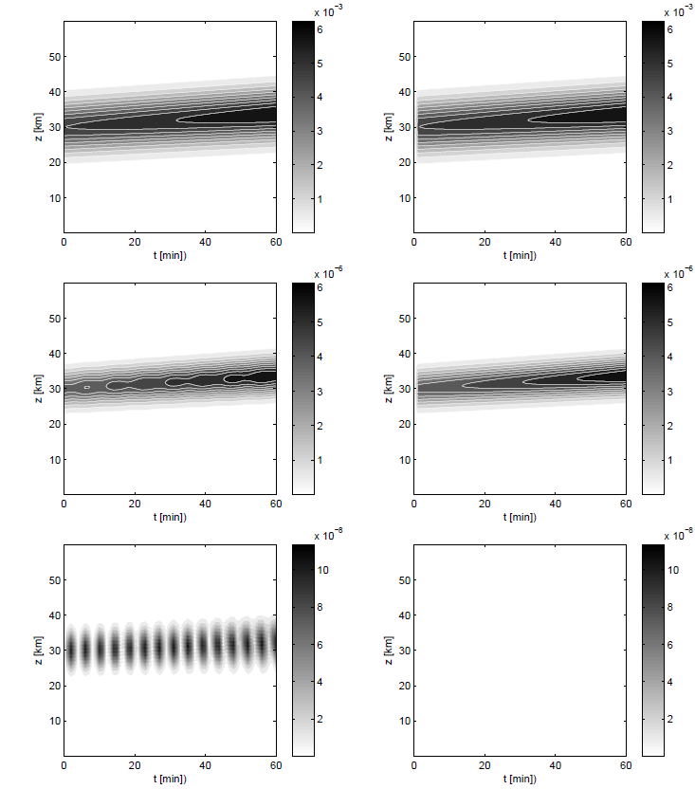
Large-amplitude WKB: Validation
1D GW packet in
isothermal atmosphere at rest
Pseudo-Incompressible
WKB
Buoyancy Wave 1
z
Buoyancy Wave 2
Buoyancy Wave 3
t
Rieper, Achatz and Klein (submitted)

Slide 57
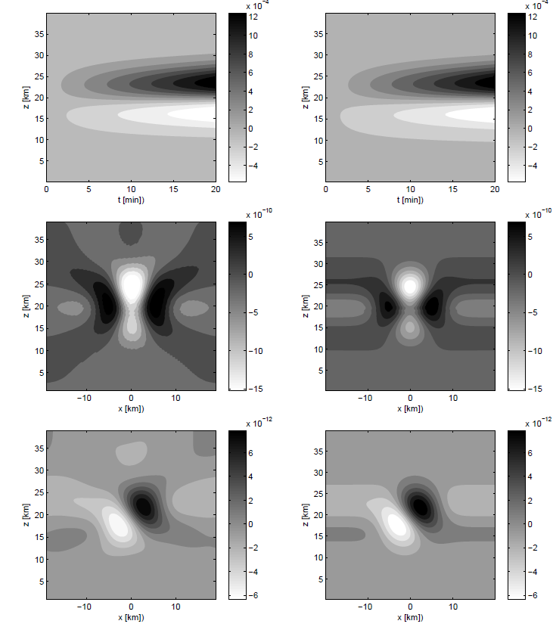
Large-amplitude WKB: Validation
2D GW packet in
isothermal atmosphere at rest
Pseudo-Incompressible
WKB
Mean horizontal wind
t
z
Horizontal gradient
mean buoyancy
Horizontal gradient
Exner pressure
x
Rieper, Achatz and Klein (submitted)

Slide 58
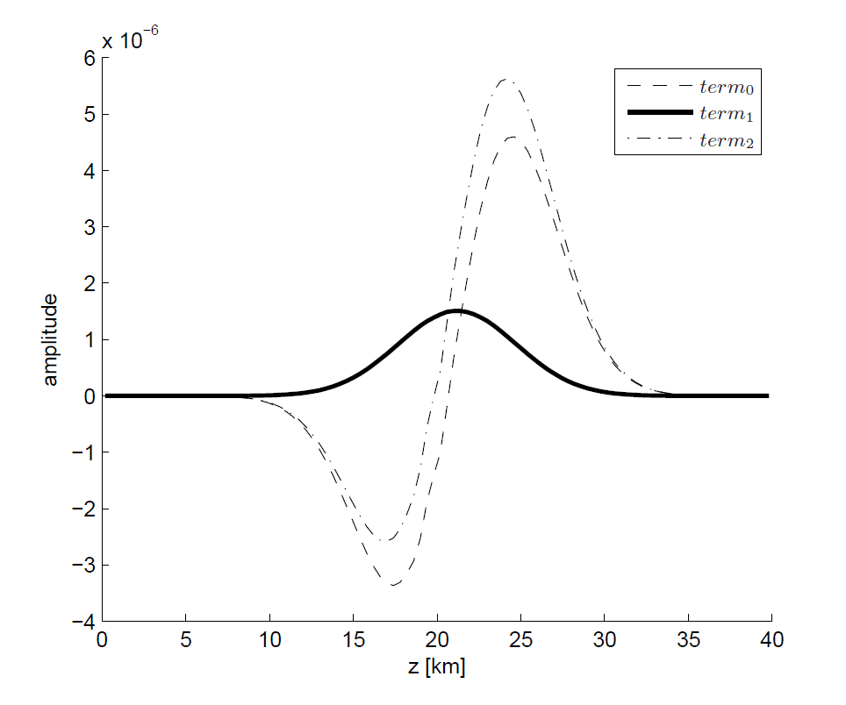
Large-amplitude WKB: Pseudo-Incompressible Effect
2D GW packet in
isothermal atmosphere at rest
Rieper, Achatz and Klein (submitted)

Slide 59
Large-amplitude WKB: Pseudo-Incompressible Effect
2D GW packet in
isothermal atmosphere at rest
p.i. effect 30% ~ O(κ)
Rieper, Achatz and Klein (submitted)

Slide 60
Interaction between Large-Amplitude GW and Synoptic-Scale Flow:
Near-Isothermal Stratification
With Rotation
Achatz, Senf, and Klein (in prep.)

Slide 61

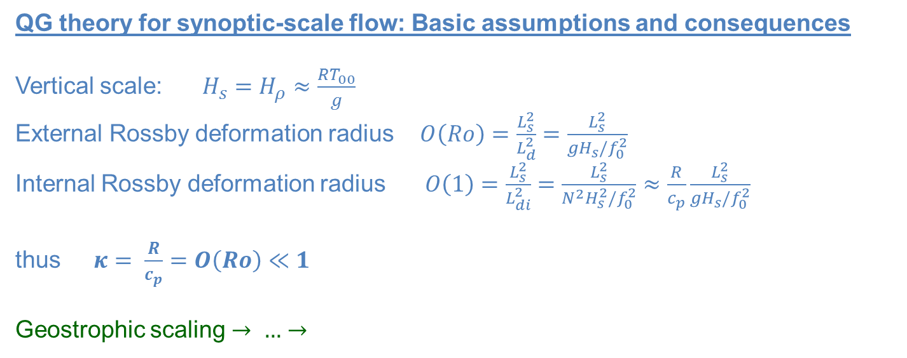
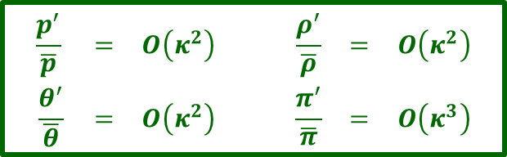
WKB in Near-Isothermal Stratification: QG Scaling
QG theory for synoptic-scale flow: Basic assumptions and consequences
Vertical scale: $H_{s}=H_{ρ}≈\frac{RT_{00}}{g}$
External Rossby deformation radius $O\left(Ro\right)=\frac{L_{s}^{2}}{L_{d}^{2}}=\frac{L_{s}^{2}}{gH_{s}/f_{0}^{2}}$
Internal Rossby deformation radius $O\left(1\right)=\frac{L_{s}^{2}}{L_{di}^{2}}=\frac{L_{s}^{2}}{N^{2}H_{s}^{2}/f_{0}^{2}}≈\frac{R}{c_{p}}\frac{L_{s}^{2}}{gH_{s}/f_{0}^{2}}$
thus $κ= \frac{R}{c_{p}}=O\left(Ro\right)≪1$
Geostrophic scaling $→ …→$
$$\begin{matrix}U_{s} & = & κ^{3/2}\sqrt{RT_{00}} \\ L_{s} & = & κ^{1/2}\sqrt{RT_{00}}/f_{0} \\ H_{s} & = & κ^{9/2}\sqrt{RT_{00}}/f_{0} \\ W_{s} & = & κ^{11/2}\sqrt{RT_{00}}/f_{0} \\ g & = & κ^{−9/2}f_{0}\sqrt{RT_{00}}\end{matrix}$$
$$\begin{matrix}\frac{p^{′}}{\overline{p}} & = & O\left(κ^{2}\right) & & \frac{ρ^{′}}{\overline{ρ}} & = & O\left(κ^{2}\right) \\ \frac{θ^{′}}{\overline{θ}} & = & O\left(κ^{2}\right) & & \frac{π^{′}}{\overline{π}} & = & O\left(κ^{3}\right)\end{matrix}$$
Achatz, Senf, and Klein (in prep.)

Slide 62

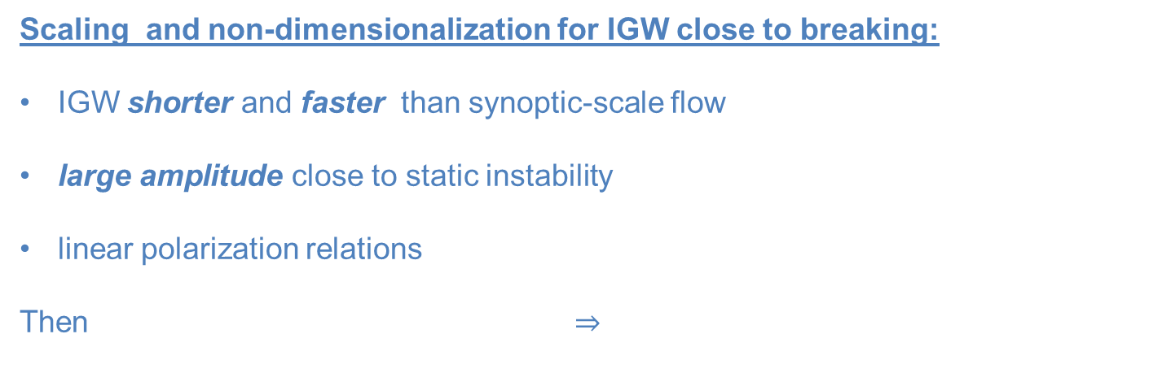
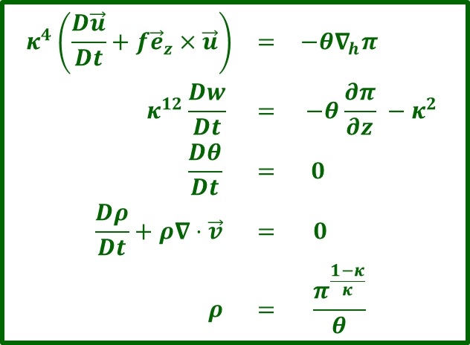
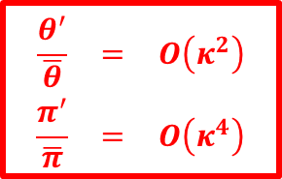
WKB in Near-Isothermal Stratification: IGW Scaling
Scaling and non-dimensionalization for IGW close to breaking:
IGW shorter and faster than synoptic-scale flow
large amplitude close to static instability
linear polarization relations
Then $⇒$
$$\begin{matrix}L & = & κL_{s} & = & κ^{3/2}\sqrt{RT_{00}}/f_{0} \\ H & = & κH_{s} & = & κ^{11/2}\sqrt{RT_{00}}/f_{0} \\ T & = & κT_{s} & = & 1/f_{0} \\ U & = & U_{s} & = & κ^{3/2}\sqrt{RT_{00}} \\ W & = & W_{s} & = & κ^{11/2}\sqrt{RT_{00}}\end{matrix}$$
$$\begin{matrix}κ^{4}\left(\frac{D\vec{u}}{Dt}+f{\vec{e}}_{z}×\vec{u}\right) & = & −θ∇_{h}π \\ κ^{12}\frac{Dw}{Dt} & = & −θ\frac{∂π}{∂z} −κ^{2} \\ \frac{Dθ}{Dt} & = & 0 \\ \frac{Dρ}{Dt}+ρ∇⋅\vec{v} & = & 0 \\ ρ & = & \frac{π^{\frac{1−κ}{κ}}}{θ} \end{matrix}$$
$$\begin{matrix}\frac{θ^{′}}{\overline{θ}} & = & O\left(κ^{2}\right) \\ \frac{π^{′}}{\overline{π}} & = & O\left(κ^{4}\right)\end{matrix}$$
Achatz, Senf, and Klein (in prep.)

Slide 63
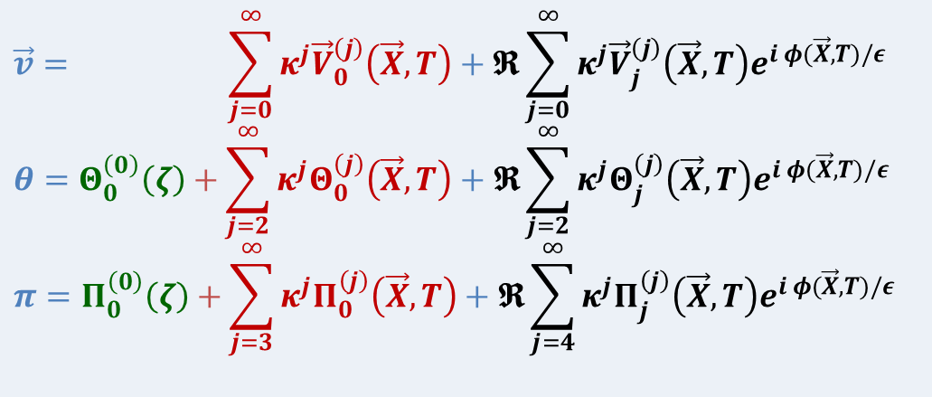
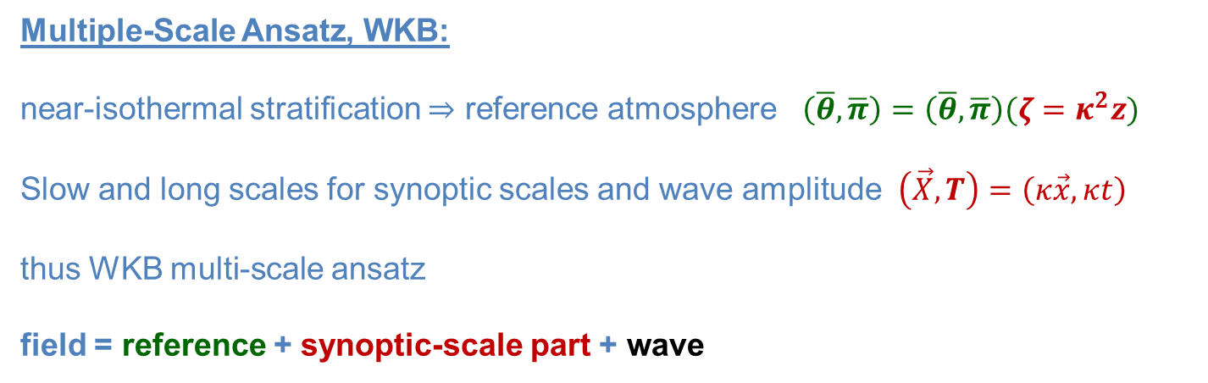
Large-Amplitude WKB in Near-Isothermal Stratification
Multiple-Scale Ansatz, WKB:
near-isothermal stratification $⇒$ reference atmosphere $\left(\overline{θ},\overline{π}\right)=\left(\overline{θ},\overline{π}\right)(ζ=κ^{2}z)$
Slow and long scales for synoptic scales and wave amplitude $\left(\vec{X},T\right)=\left(κ\vec{x},κt\right)$
thus WKB multi-scale ansatz
field = reference + synoptic-scale part + wave
$$\vec{v}= \sum_{j=0}^{∞}{κ^{j}{\vec{V}}_{0}^{\left(j\right)}\left(\vec{X},T\right)}+𝕽\sum_{j=0}^{∞}{κ^{j}{\vec{V}}_{j}^{\left(j\right)}\left(\vec{X},T\right)e^{i φ(\vec{X},T)/ε}}$$
$$θ=Θ_{0}^{\left(0\right)}\left(ζ\right)+\sum_{j=2}^{∞}{κ^{j}Θ_{0}^{\left(j\right)}\left(\vec{X},T\right)}+𝕽\sum_{j=2}^{∞}{κ^{j}Θ_{j}^{\left(j\right)}\left(\vec{X},T\right)e^{i φ(\vec{X},T)/ε}}$$
$$π=Π_{0}^{\left(0\right)}\left(ζ\right)+\sum_{j=3}^{∞}{κ^{j}Π_{0}^{\left(j\right)}\left(\vec{X},T\right)}+𝕽\sum_{j=4}^{∞}{κ^{j}Π_{j}^{\left(j\right)}\left(\vec{X},T\right)e^{i φ(\vec{X},T)/ε}}$$
Achatz, Senf, and Klein (in prep.)

Slide 64
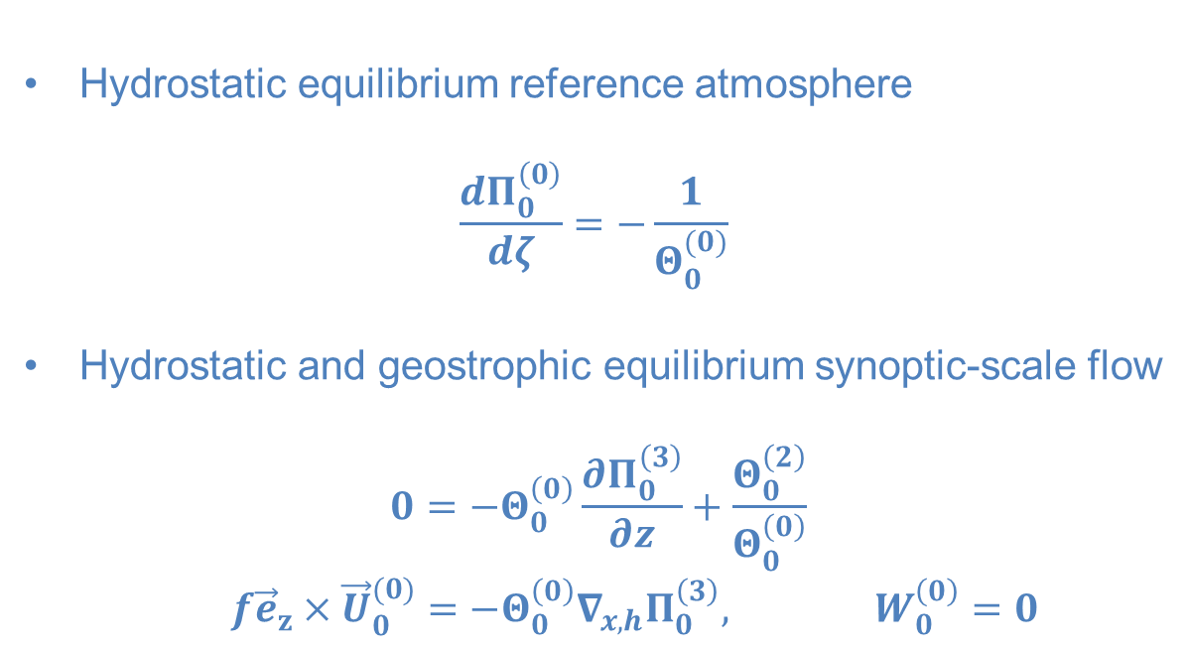
WKB in Near-Isothermal Stratification: Balance Equations
Hydrostatic equilibrium reference atmosphere
$$\frac{dΠ_{0}^{\left(0\right)}}{dζ}=−\frac{1}{Θ_{0}^{(0)}}$$
Hydrostatic and geostrophic equilibrium synoptic-scale flow
$$0=−Θ_{0}^{\left(0\right)}\frac{∂Π_{0}^{\left(3\right)}}{∂z}+\frac{Θ_{0}^{\left(2\right)}}{Θ_{0}^{\left(0\right)}}$$
$$f{\vec{e}}_{z}×{\vec{U}}_{0}^{(0)}=−Θ_{0}^{\left(0\right)}∇_{x,h}Π_{0}^{\left(3\right)}, W_{0}^{\left(0\right)}=0$$

Slide 65
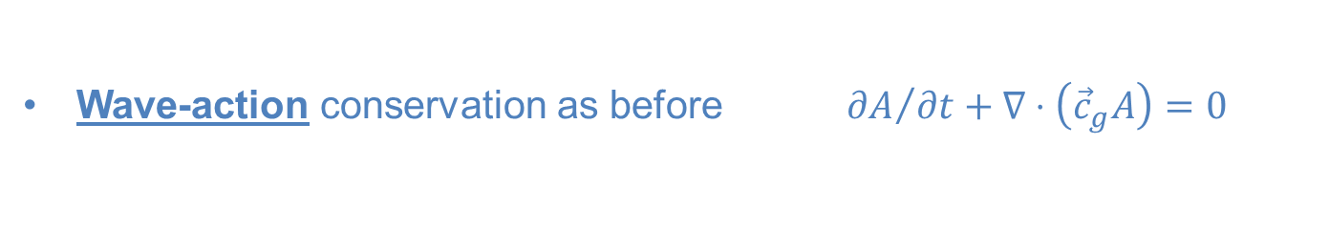
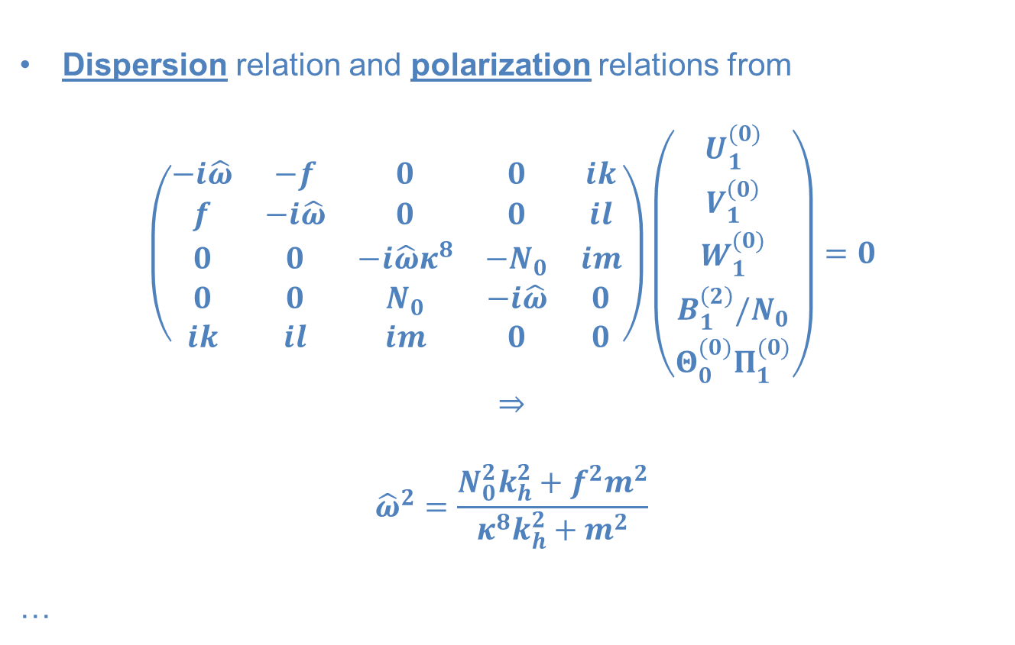
WKB in Near-Isothermal Stratification: Wave Dynamics
Dispersion relation and polarization relations from
$$\left(\begin{matrix}−i\hat{ω} & −f & 0 & 0 & ik \\ f & −i\hat{ω} & 0 & 0 & il \\ 0 & 0 & −i\hat{ω}κ^{8} & −N_{0} & im \\ 0 & 0 & N_{0} & −i\hat{ω} & 0 \\ ik & il & im & 0 & 0\end{matrix}\right)\left(\begin{matrix}U_{1}^{(0)} \\ V_{1}^{\left(0\right)} \\ W_{1}^{(0)} \\ B_{1}^{\left(2\right)}/N_{0} \\ Θ_{0}^{(0)}Π_{1}^{(0)}\end{matrix}\right)=0$$
$$⇒$$
$${\hat{ω}}^{2}=\frac{N_{0}^{2}k_{h}^{2}+f^{2}m^{2}}{κ^{8}k_{h}^{2}+m^{2}}$$
…
Wave-action conservation as before ${∂A}/{∂t}+∇⋅\left({\vec{c}}_{g}A\right)=0$

Slide 66
WKB in Near-Isothermal Stratification: Wave Dynamics
Dispersion relation and polarization relations from
$$\left(\begin{matrix}−i\hat{ω} & −f & 0 & 0 & ik \\ f & −i\hat{ω} & 0 & 0 & il \\ 0 & 0 & −i\hat{ω}κ^{8} & −N_{0} & im \\ 0 & 0 & N_{0} & −i\hat{ω} & 0 \\ ik & il & im & 0 & 0\end{matrix}\right)\left(\begin{matrix}U_{1}^{(0)} \\ V_{1}^{\left(0\right)} \\ W_{1}^{(0)} \\ B_{1}^{\left(2\right)}/N_{0} \\ Θ_{0}^{(0)}Π_{1}^{(0)}\end{matrix}\right)=0$$
$$⇒$$
$${\hat{ω}}^{2}=\frac{N_{0}^{2}k_{h}^{2}+f^{2}m^{2}}{κ^{8}k_{h}^{2}+m^{2}}$$
…
No Linearization!
Wave-action conservation as before ${∂A}/{∂t}+∇⋅\left({\vec{c}}_{g}A\right)=0$

Slide 67

WKB in Near-Isothermal Stratification: Mean Flow (1)
Mean flow:
$$\left(\frac{∂}{∂T}+{\vec{U}}_{0}^{(0)}⋅∇_{X}\right){\vec{U}}_{0}^{(0)}+βY{\vec{e}}_{z}×{\vec{U}}_{0}^{(0)}+f^{(0)}{\vec{e}}_{z}×{\vec{U}}_{0}^{(1)}=−Θ_{0}^{\left(0\right)}∇_{X,h}Π_{0}^{\left(4\right)}−\frac{1}{2}ℜ\frac{1}{ρ_{0}^{\left(0\right)}} ∇_{X}⋅\left(ρ_{0}^{(0)}{\vec{V}}_{1}^{\left(0\right)}{\vec{U}}_{1}^{\left(0\right)∗}\right)$$
$$\left(\frac{∂}{∂T}+{\vec{U}}_{0}^{(0)}⋅∇_{X}\right)Θ_{0}^{(2)}+W_{0}^{(1)}\frac{dΘ_{0}^{\left(0\right)}}{dζ}=−\frac{1}{2}ℜ\frac{1}{ρ_{0}^{\left(0\right)}} ∇_{X}⋅\left(ρ_{0}^{(0)}{\vec{V}}_{1}^{\left(0\right)}Θ_{1}^{\left(2\right)∗}\right)$$
$$∇_{X}⋅\left(ρ_{0}^{\left(0\right)}{\vec{V}}_{0}^{\left(1\right)}\right)=0$$
Same result in both pseudo-incompressible and anelastic theory!
There is a higher-order correction to hydrostatic equilibrium
$$−Θ_{0}^{\left(0\right)}\frac{∂Π_{0}^{\left(4\right)}}{∂Z}+\frac{Θ_{0}^{\left(3\right)}}{Θ_{0}^{\left(0\right)}}=−\frac{1}{2}ℜ\frac{1}{ρ_{0}^{\left(0\right)}} ∇_{X}⋅\left(ρ_{0}^{(0)}{\vec{V}}_{1}^{\left(0\right)}W_{1}^{\left(0\right)∗}\right)$$
but this has no non-anelastic correction, and it does not matter anyway!

Slide 68

WKB in Near-Isothermal Stratification: Mean Flow (2)
Final Result:PV conservation in QG approximation
$$\left(\frac{∂}{∂T}+{\vec{U}}_{0}^{(0)}⋅∇_{X}\right)P=−\frac{∂}{∂X}\left[\frac{1}{ρ_{0}^{\left(0\right)}}∇_{X}⋅\left({\vec{c}}_{g}lA\right)\right]+\frac{∂}{∂Y}\left[\frac{1}{ρ_{0}^{\left(0\right)}}∇_{X}⋅\left({\vec{c}}_{g}kA\right)\right]$$
$$P=∇_{X,h}^{2}\left(Θ_{0}^{(0)}Π_{0}^{(3)}\right)+f^{\left(0\right)}+βY+\frac{f^{\left(0\right)}}{ρ_{0}^{\left(0\right)}}\frac{∂}{∂Z} \left[\frac{ρ_{0}^{\left(0\right)}}{N_{0}^{2}}\frac{∂}{∂Z}\left(Θ_{0}^{(0)}Π_{0}^{(3)}\right)\right]$$
Balanced flow forced by pseudo-momentum-flux convergencies
(EP flux)

Slide 69
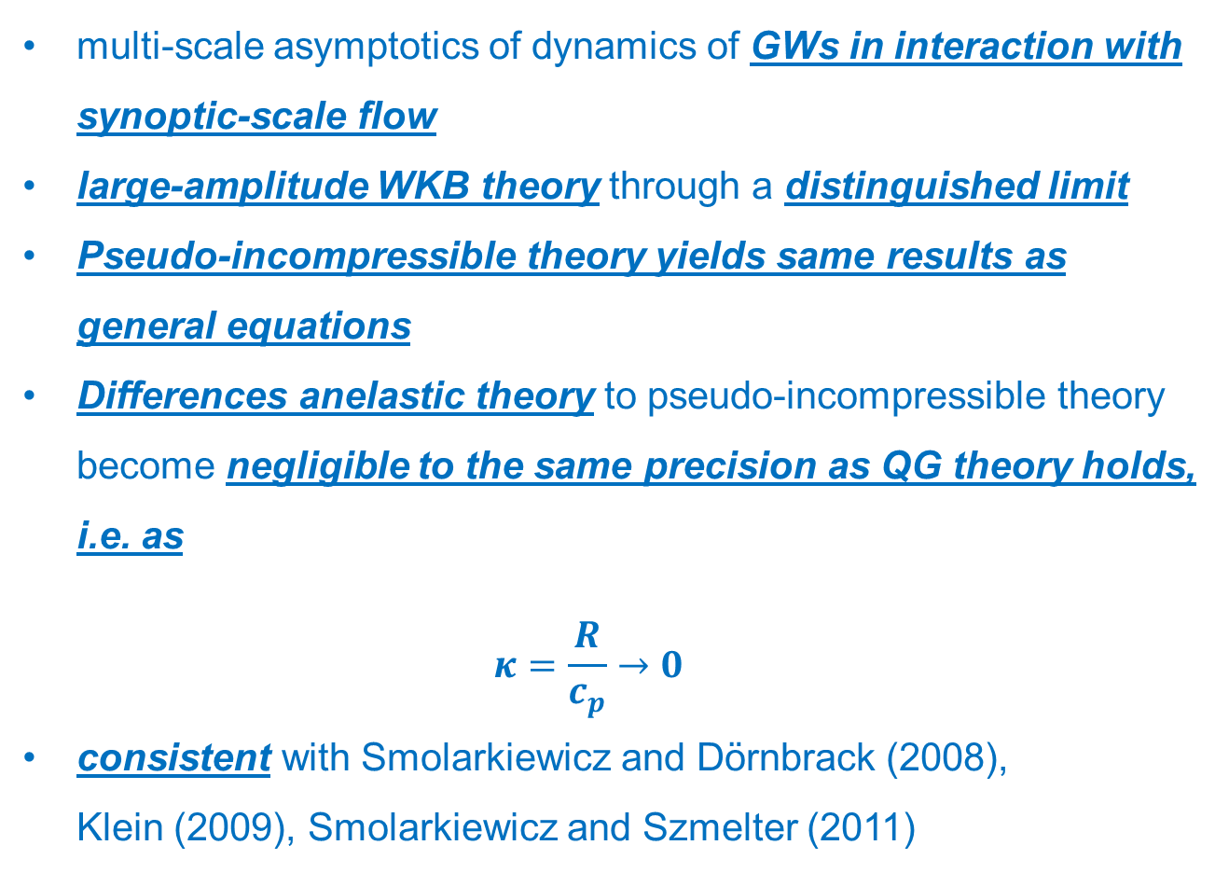
Summary
multi-scale asymptotics of dynamics of GWs in interaction with synoptic-scale flow
large-amplitude WKB theory through a distinguished limit
Pseudo-incompressible theory yields same results as general equations
Differences anelastic theory to pseudo-incompressible theory become negligible to the same precision as QG theory holds, i.e. as
$κ=\frac{R}{c_{p}}→0$
consistent with Smolarkiewicz and Dörnbrack (2008),
Klein (2009), Smolarkiewicz and Szmelter (2011)

