Slide 1
Some results from operational verification in Italy
Angela Celozzi – Giovanni Favicchio
Elena Oberto – Adriano Raspanti
Maria Stefania Tesini - Naima Vela

Slide 2
Verification
CROSS MODEL COSMOME vs ECMWF
CROSS MODEL COSMOI7 vs ECMWF
CROSS MODEL COSMOME vs COSMOIT
COSMOME –Upper Air
COSMOI7 – Upper Air (OBS and Analysis)
CONDITIONAL VERIFICATIONS
High resolution verification with raingauges

Slide 3
Verification
CROSS MODEL COSMOME vs ECMWF
CROSS MODEL ECMWF vs COSMOI7
CROSS MODEL COSMOME vs COSMOIT
COSMOME –Upper Air
COSMOI7 – Upper Air
CONDITIONAL VERIFICATIONS
High resolution verification with raingauges

Slide 4
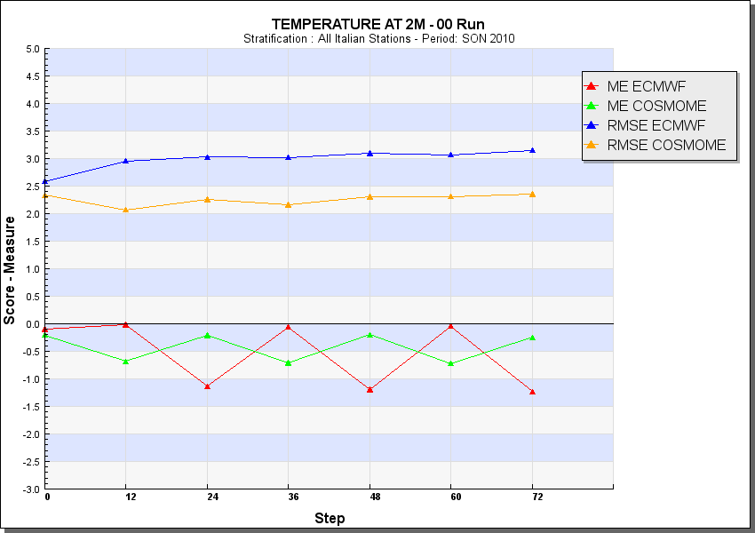
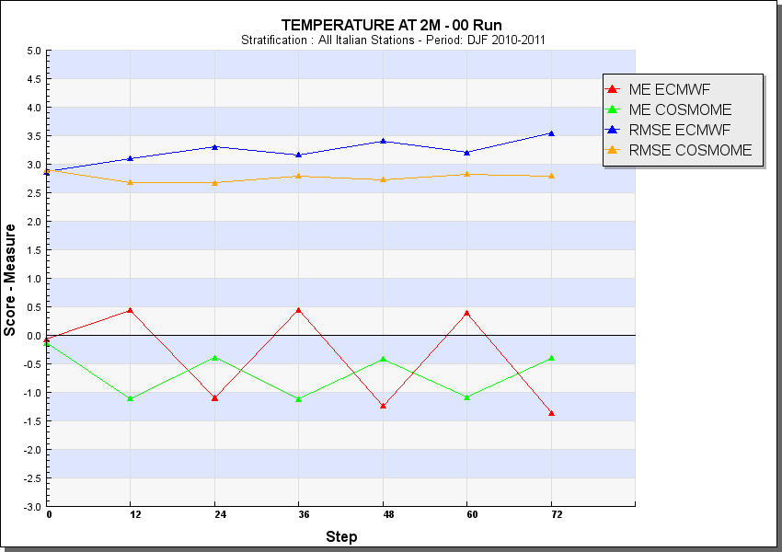
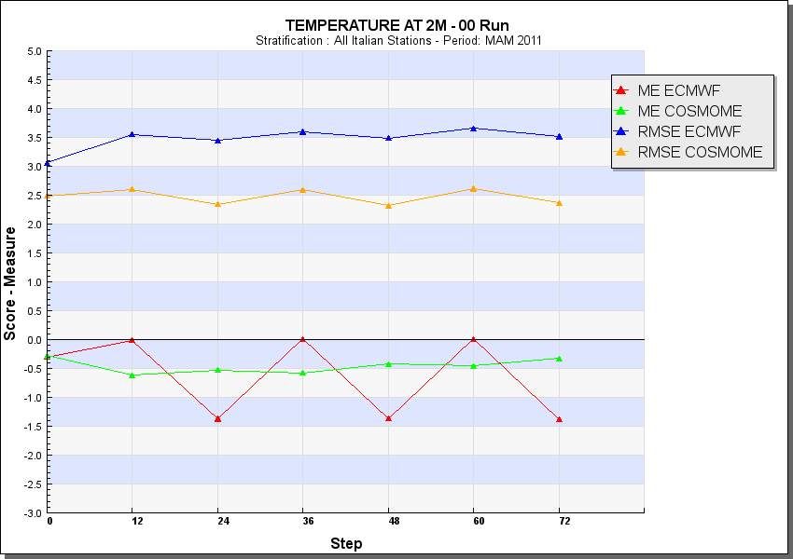
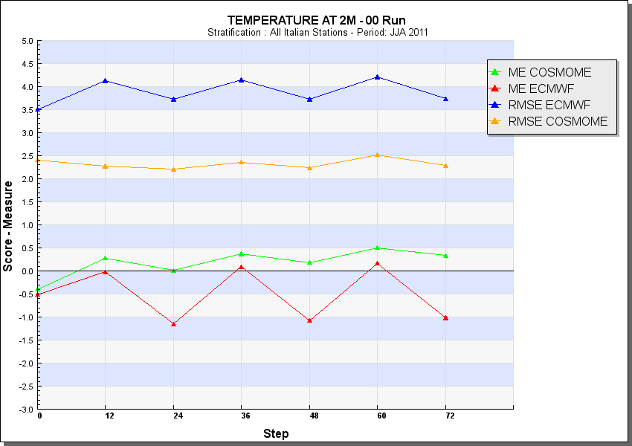
COSMOME vs ECMWF Temperature
DJF
SON
MAM
JJA

Slide 5
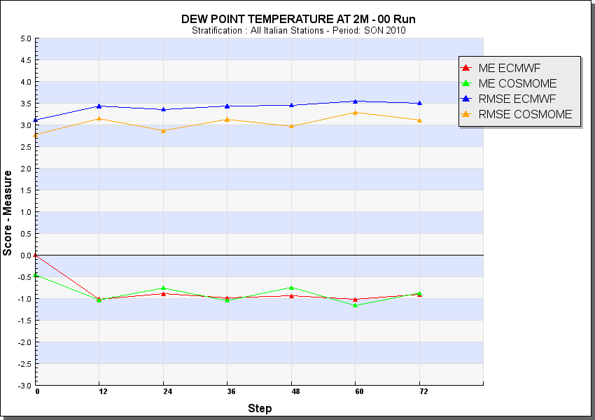
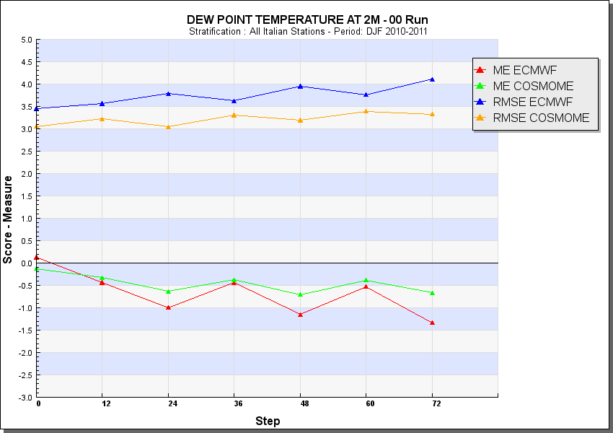
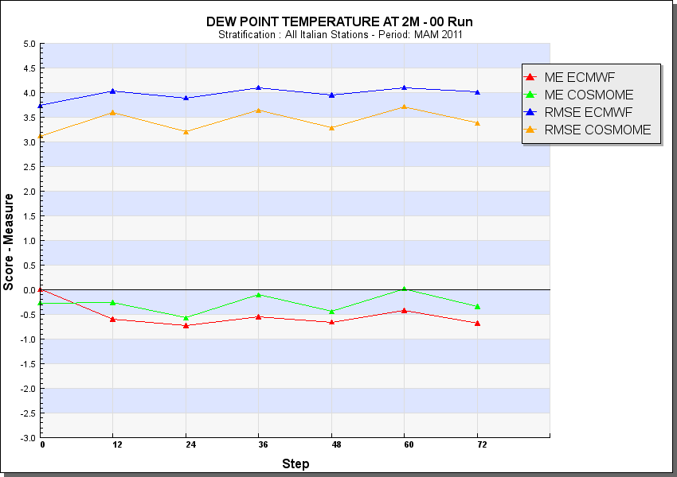
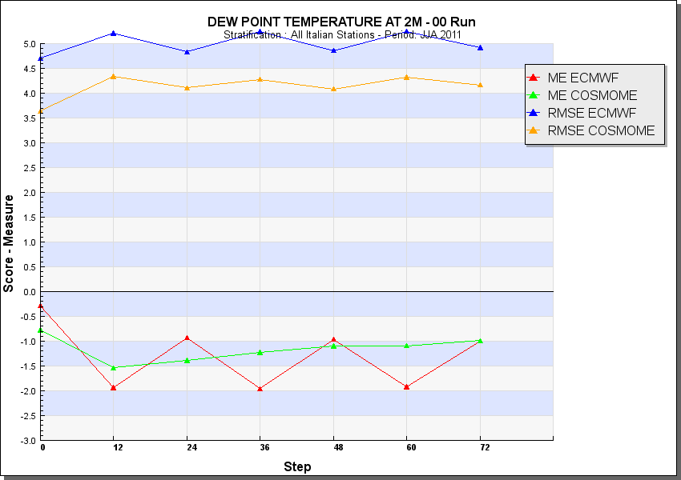
COSMOME vs ECMWF Dew Point Temperature
DJF
SON
MAM
JJA

Slide 6
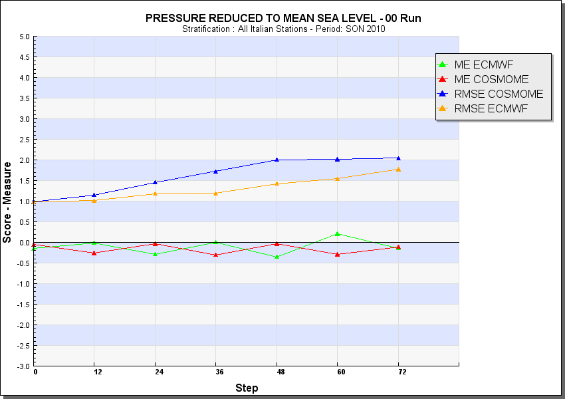
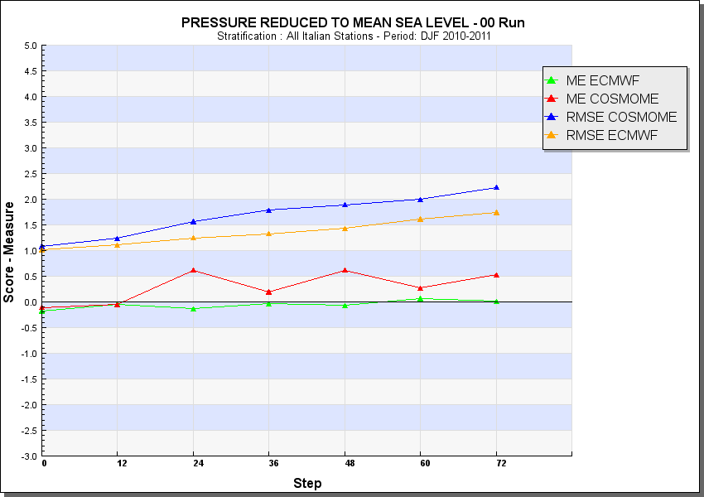
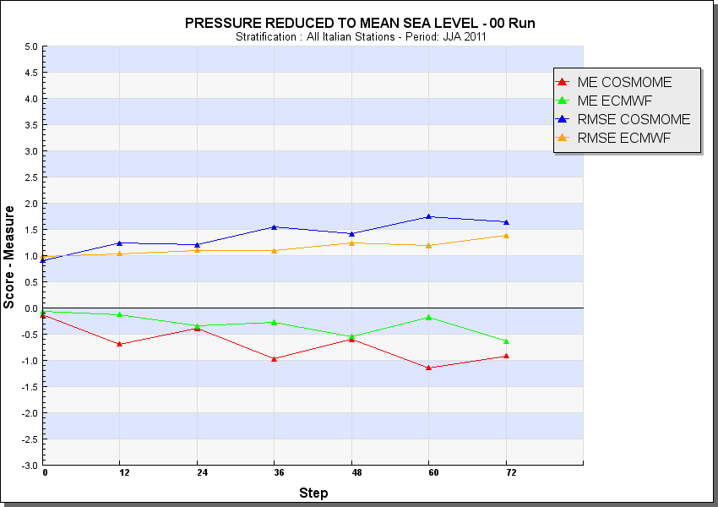
COSMOME vs ECMWF Mean Sea Level Pressure
DJF
SON
MAM
JJA

Slide 7
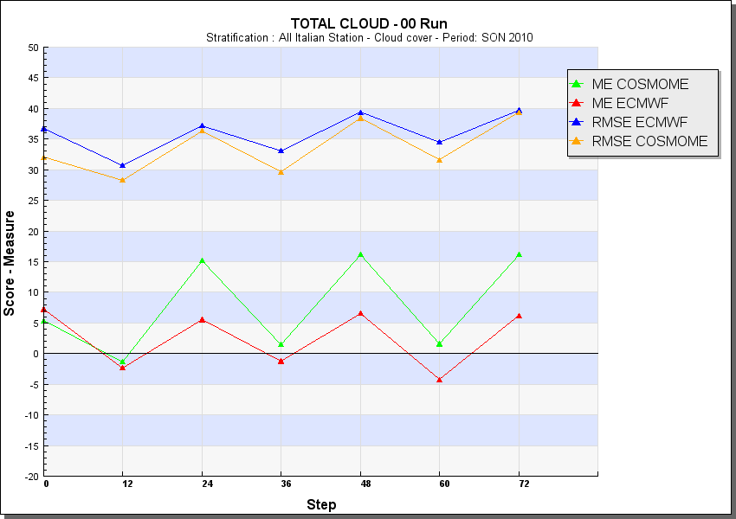
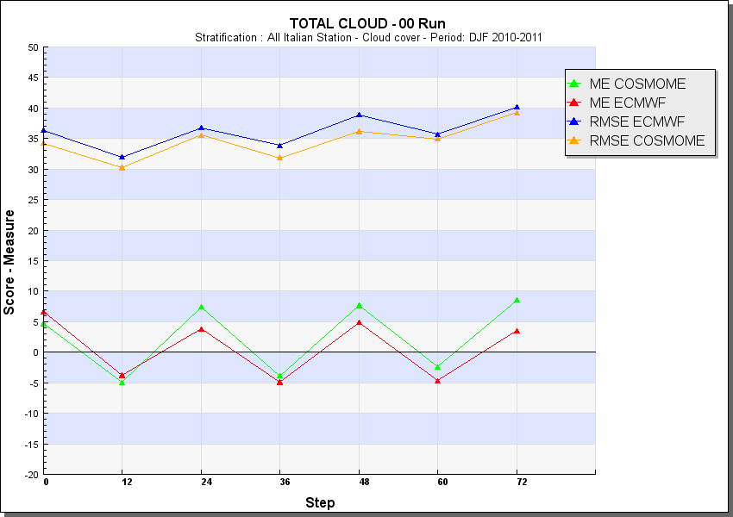
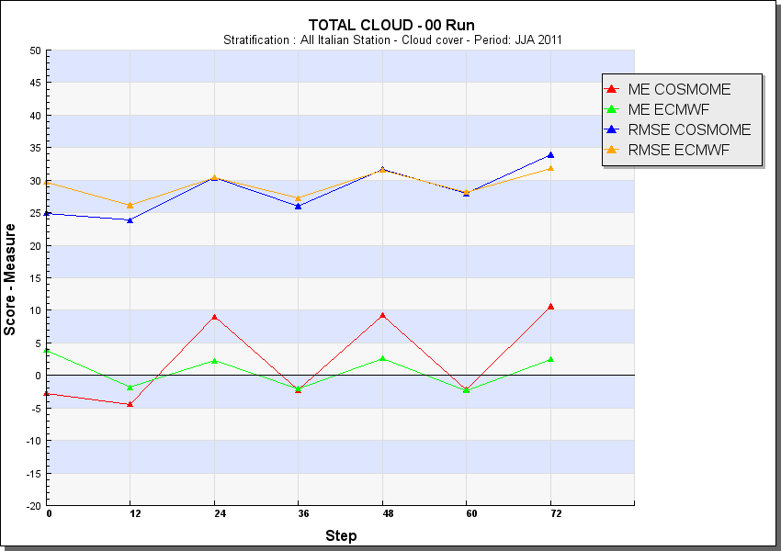
COSMOME vs ECMWF Total Cloud Cover
DJF
SON
MAM
JJA

Slide 8
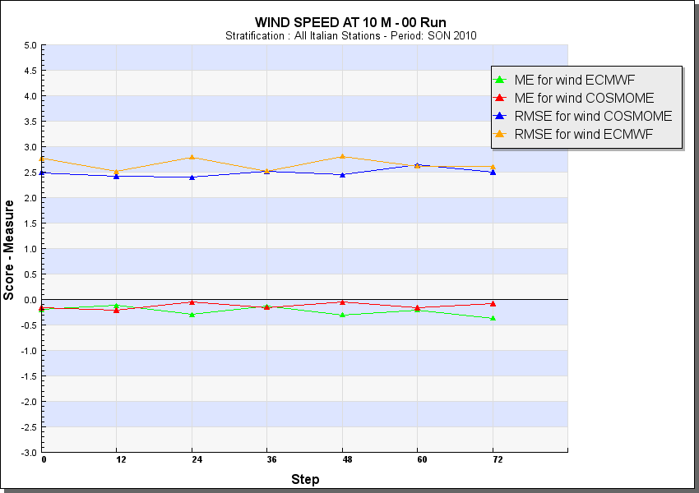
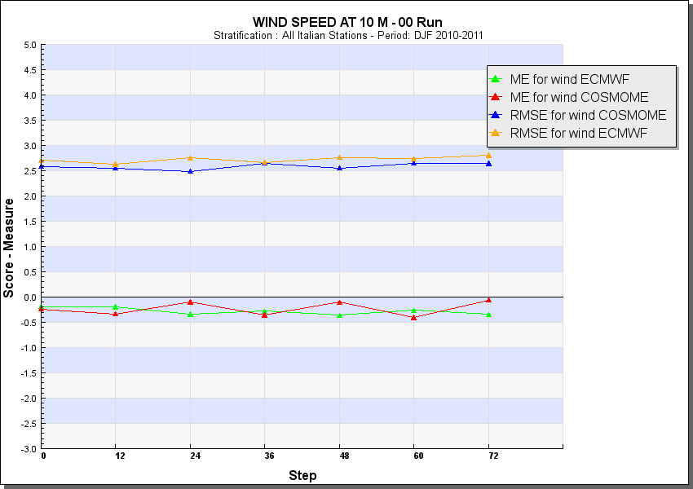
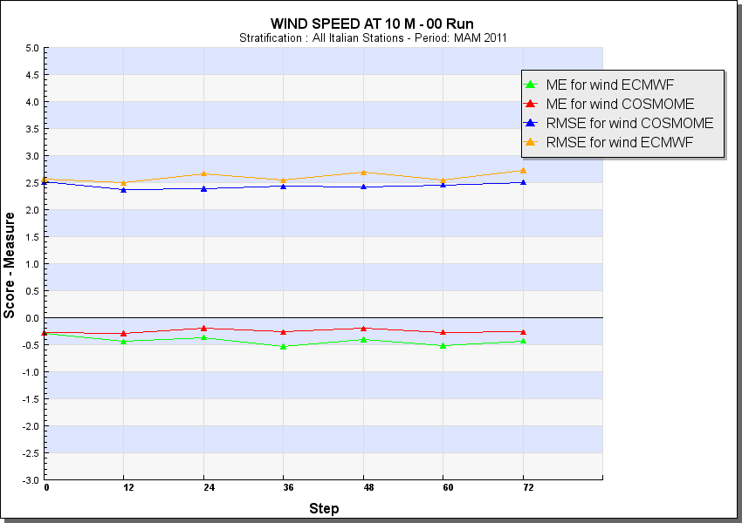
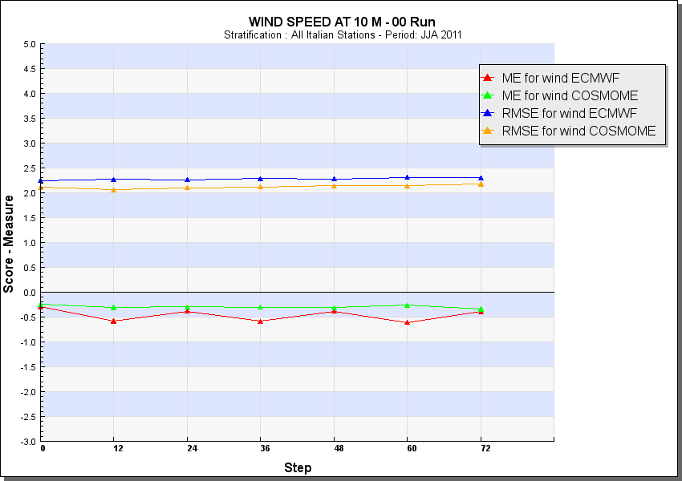
COSMOME vs ECMWF Wind Speed
DJF
SON
MAM
JJA

Slide 9
Verification
CROSS MODEL COSMOME vs ECMWF
CROSS MODEL ECMWF vs COSMOI7
CROSS MODEL COSMOME vs COSMOIT
COSMOME –Upper Air
COSMOI7 – Upper Air
CONDITIONAL VERIFICATIONS
High resolution verification with raingauges

Slide 10
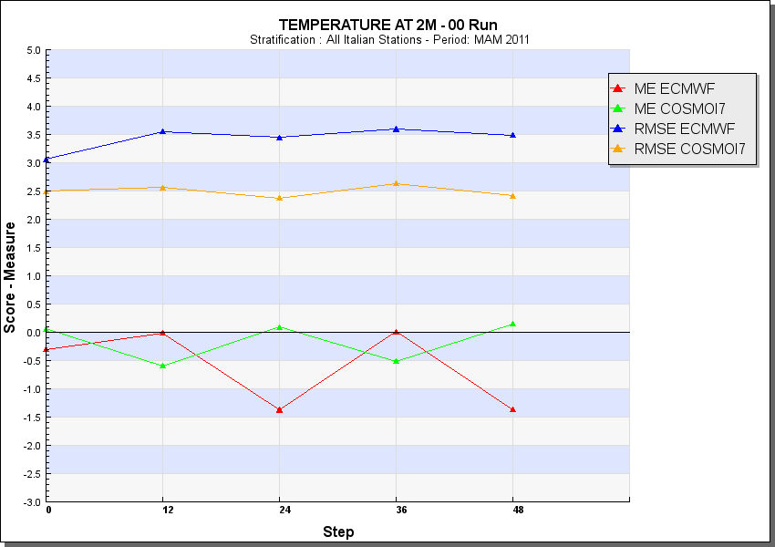
COSMOI7 vs ECMWF Temperature
DJF
SON
MAM
JJA

Slide 11
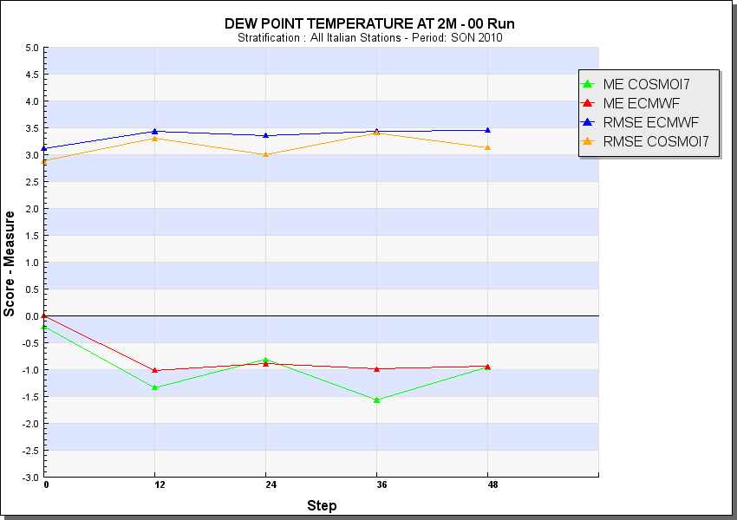
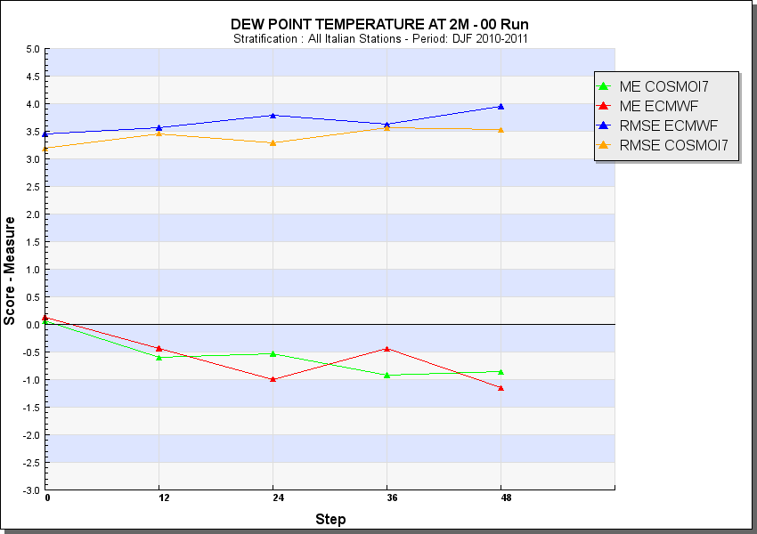
COSMOI7 vs ECMWF Dew Point Temperature
DJF
SON
MAM
JJA

Slide 12
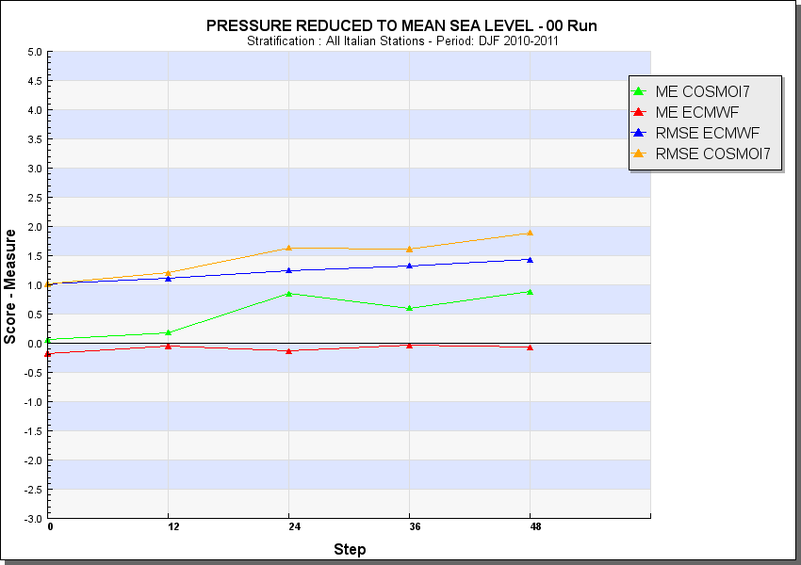
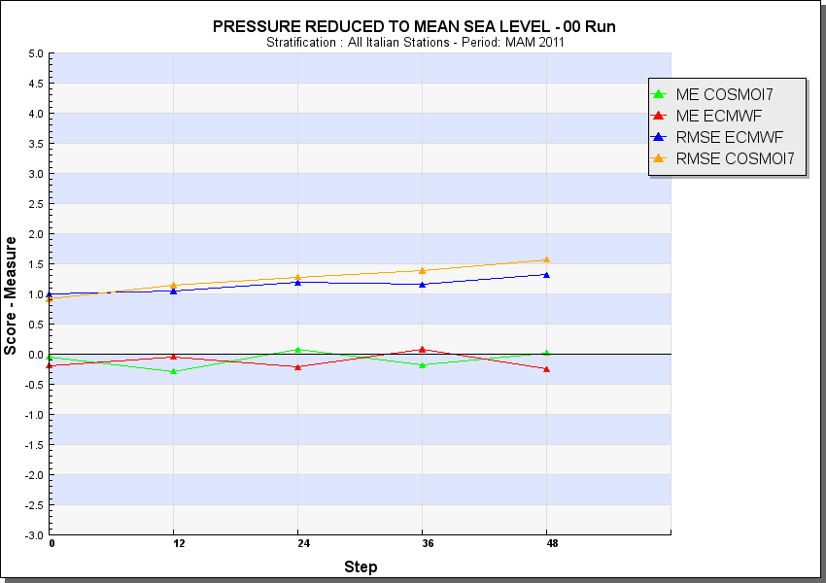
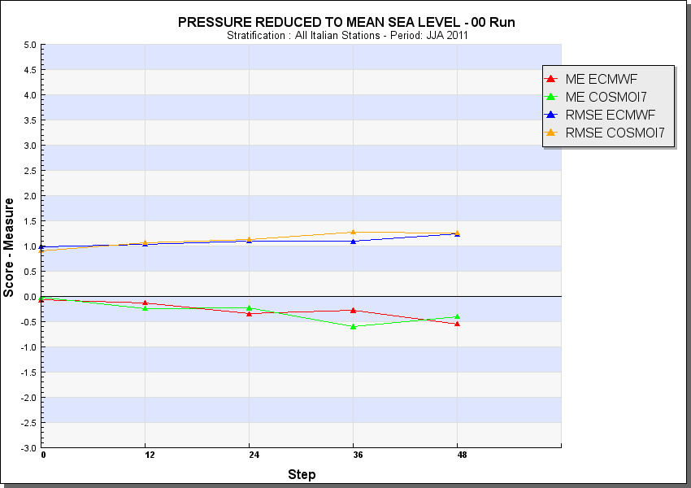
COSMOI7 vs ECMWF Mean Sea Level Pressure
DJF
SON
MAM
JJA

Slide 13
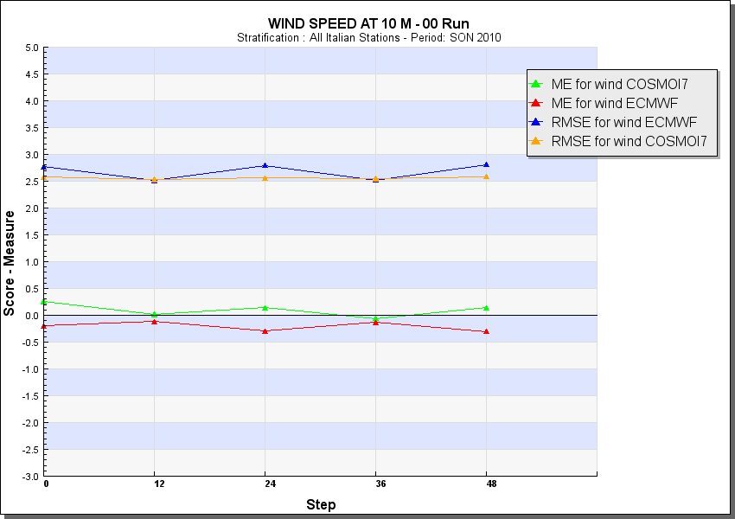
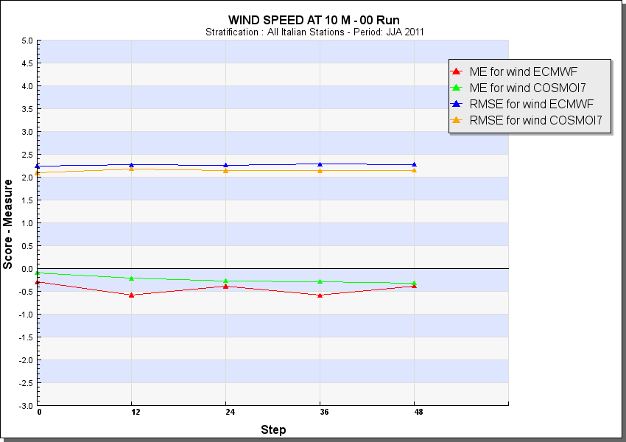
COSMOI7 vs ECMWF Wind Speed
DJF
SON
MAM
JJA

Slide 14
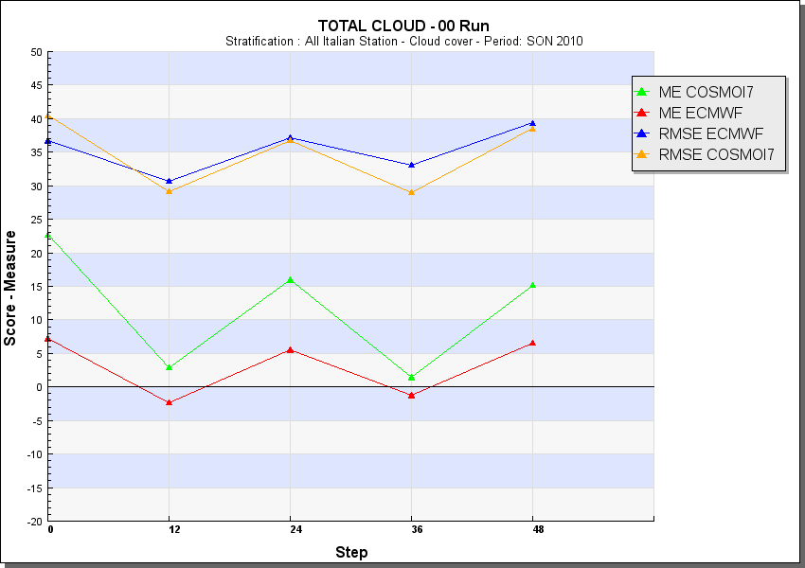
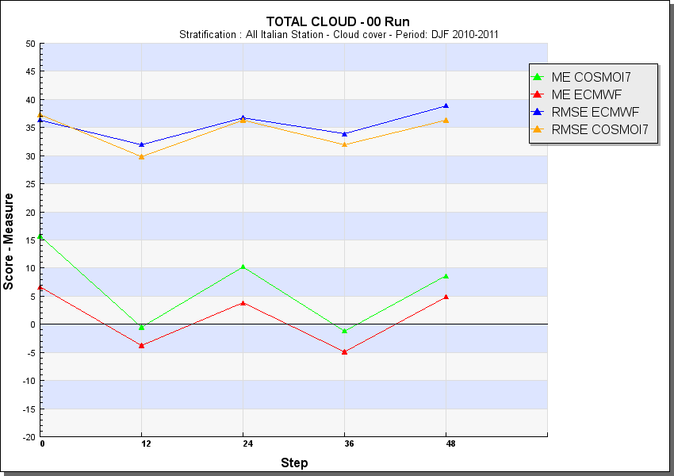
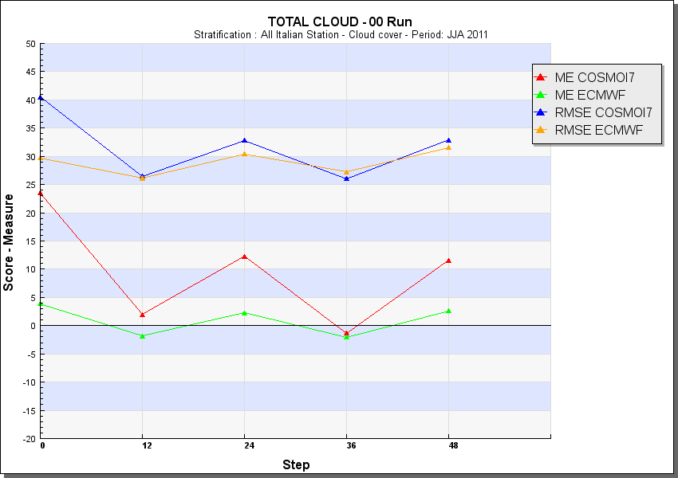
COSMOI7 vs ECMWF Total Cloud Cover
DJF
SON
MAM
JJA

Slide 15
Verification
CROSS MODEL COSMOME vs ECMWF
CROSS MODEL ECMWF vs COSMOI7
CROSS MODEL COSMOME vs COSMOIT
COSMOME –Upper Air
COSMOI7 – Upper Air
CONDITIONAL VERIFICATIONS
High resolution verification with raingauges

Slide 16
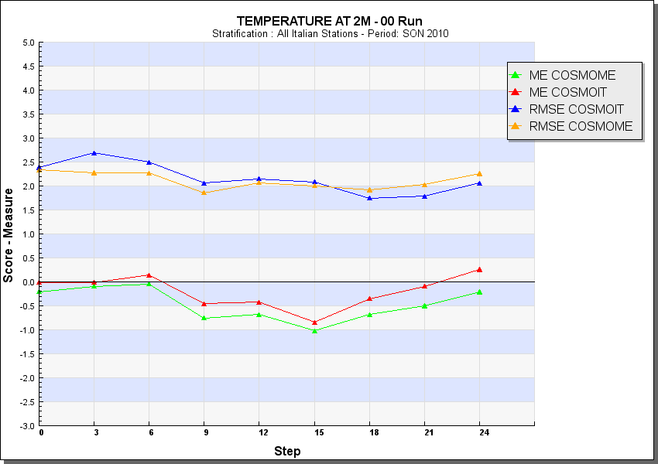
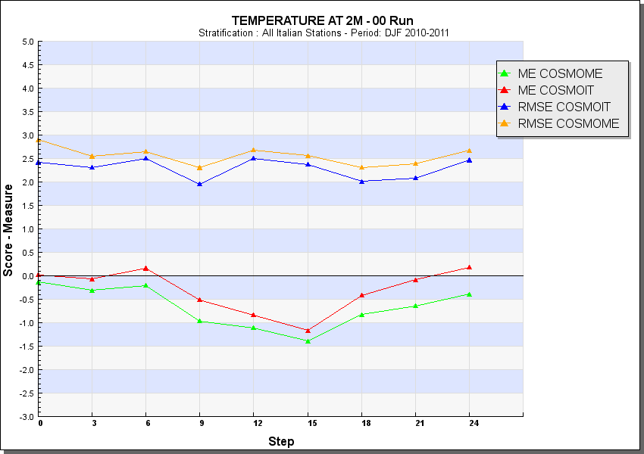
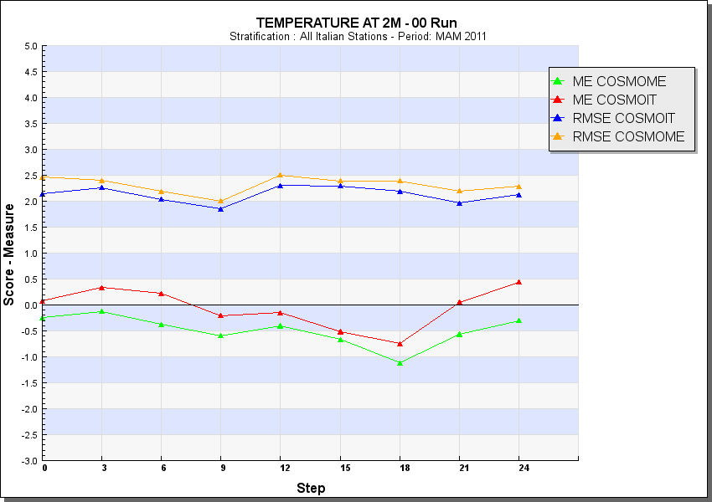
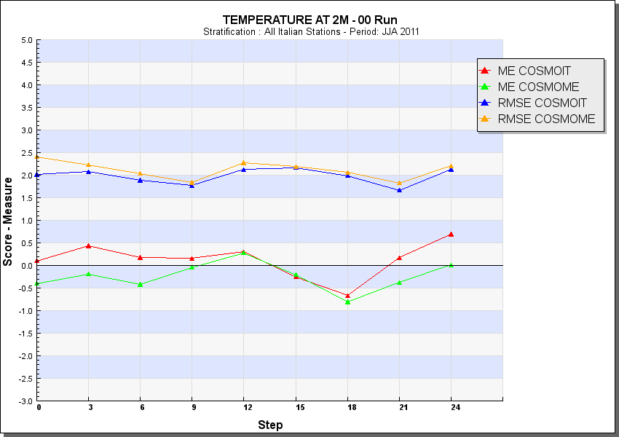
Temperature COSMOME vs COSMOIT
DJF
SON
MAM
JJA

Slide 17
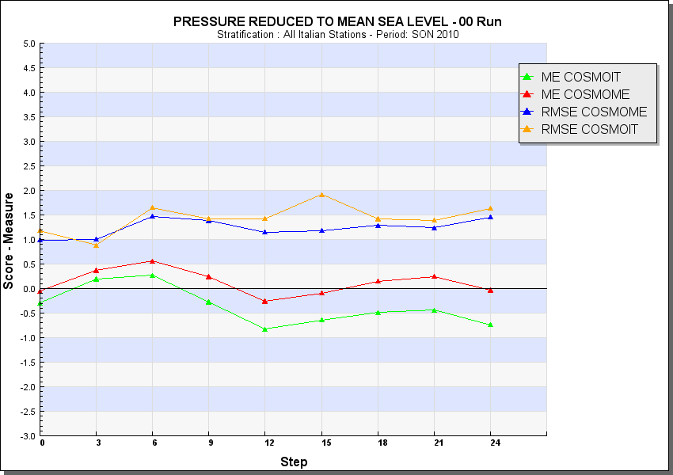
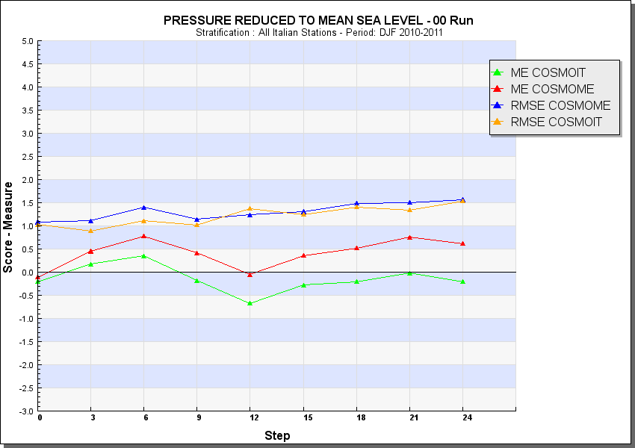
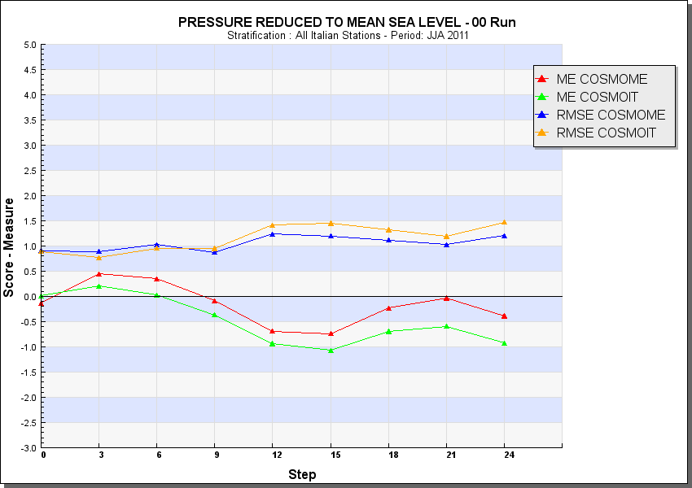
Mean Sea Level Pressure COSMOME vs COSMOIT
DJF
SON
MAM
JJA

Slide 18
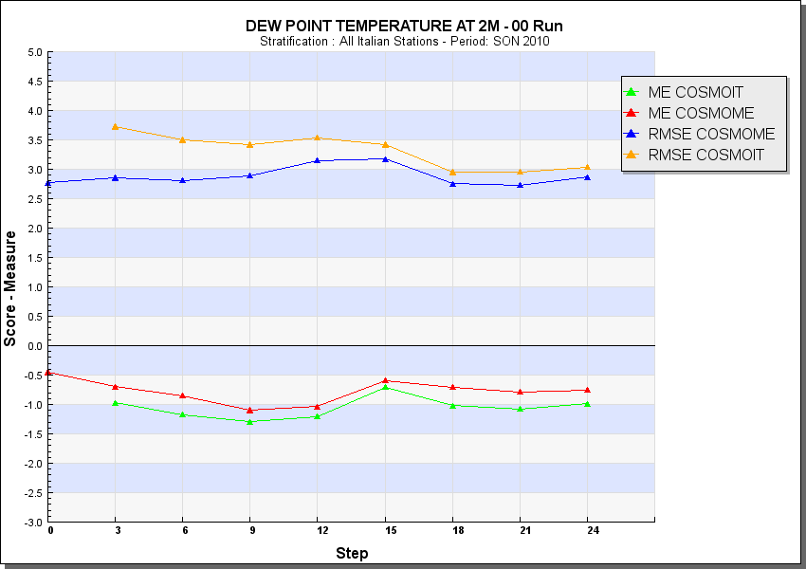
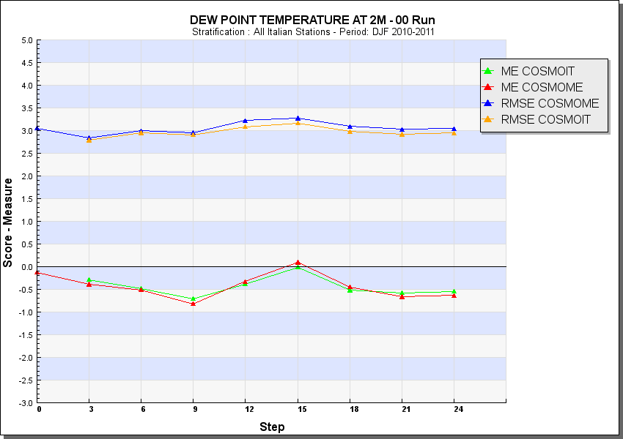
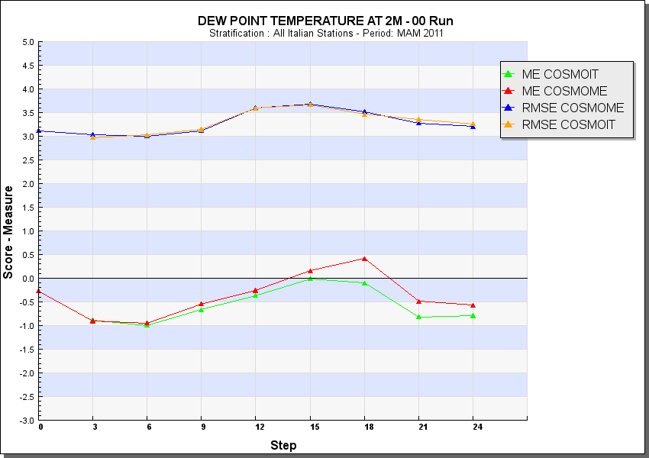
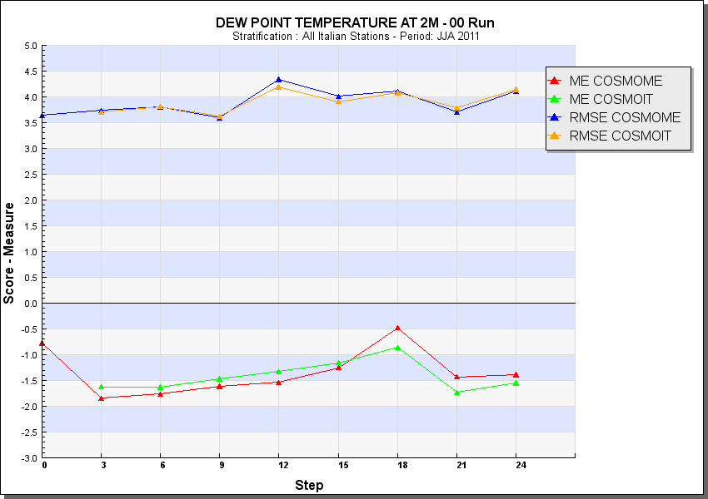
Dew PointTemperature COSMOME vs COSMOIT
DJF
SON
MAM
JJA

Slide 19
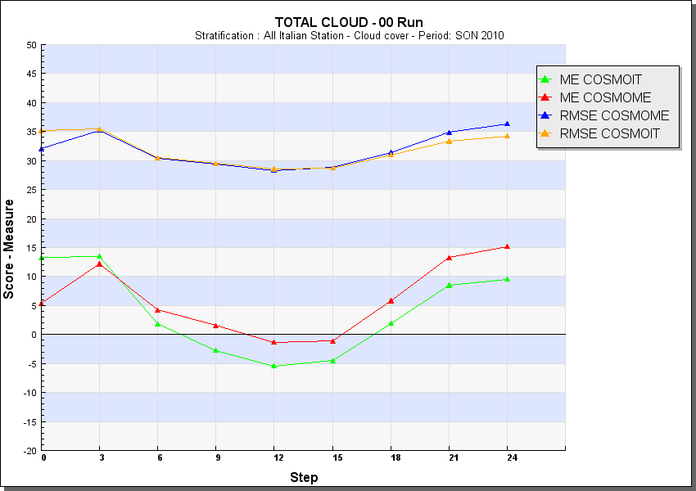
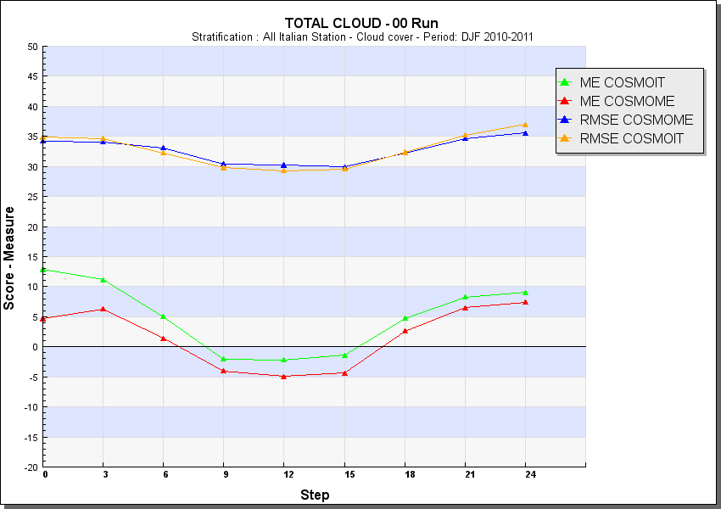
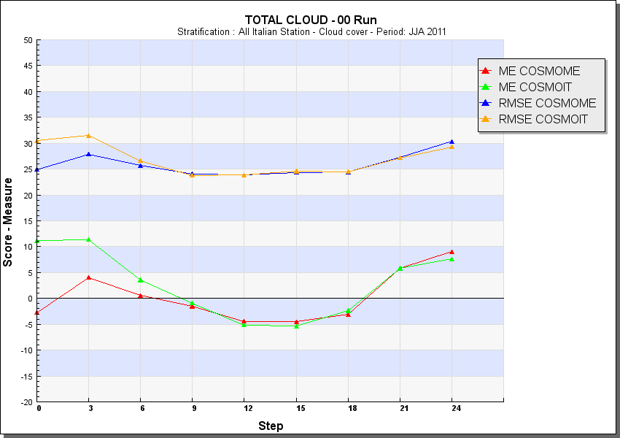
Total Cloud Cover COSMOME vs COSMOIT
DJF
SON
MAM
JJA

Slide 20
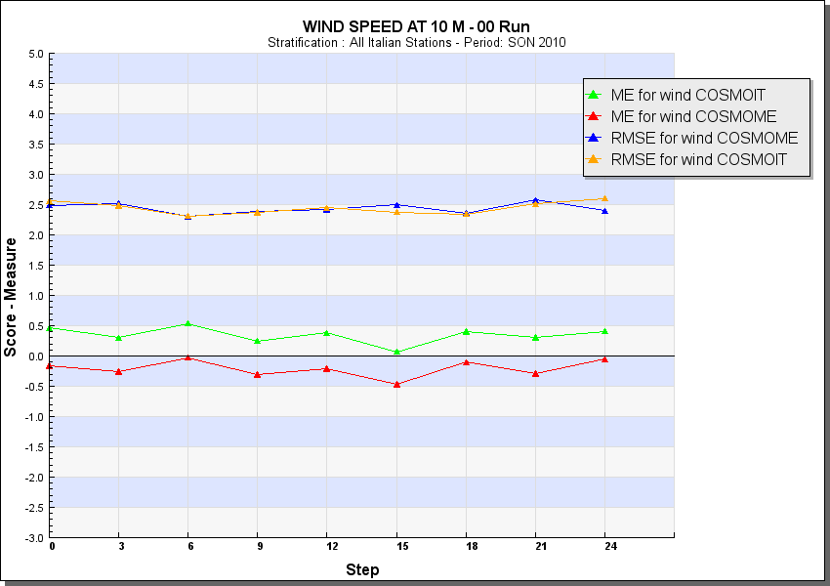
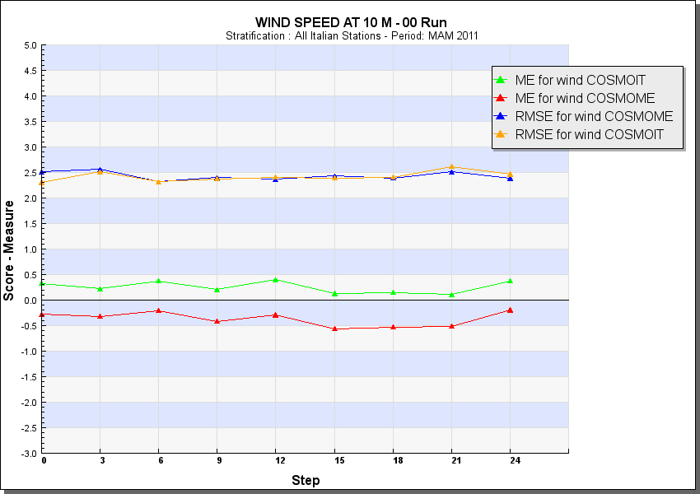
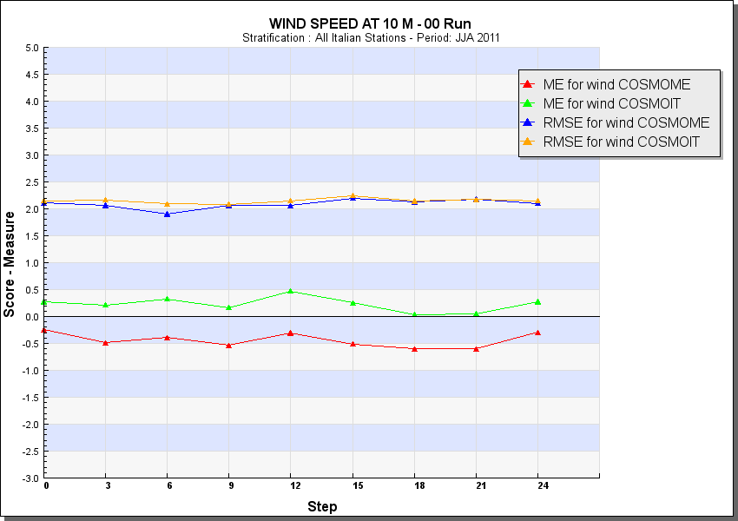
Wind Speed COSMOME vs COSMOIT
DJF
SON
MAM
JJA

Slide 21
Conclusion
COSMO - ME generally better than IFS
COSMO – I7 better or almost the same than IFS
Comparison COSMO-ME and COSMO-IT shows improvements for High-Res.

Slide 22
Verification
CROSS MODEL COSMOME vs COSMOIT
CROSS MODEL COSMOME vs ECMWF
CROSS MODEL ECMWF vs COSMOI7
COSMOME – Upper Air
COSMOI7 – Upper Air
CONDITIONAL VERIFICATIONS
High resolution verification with raingauges

Slide 23
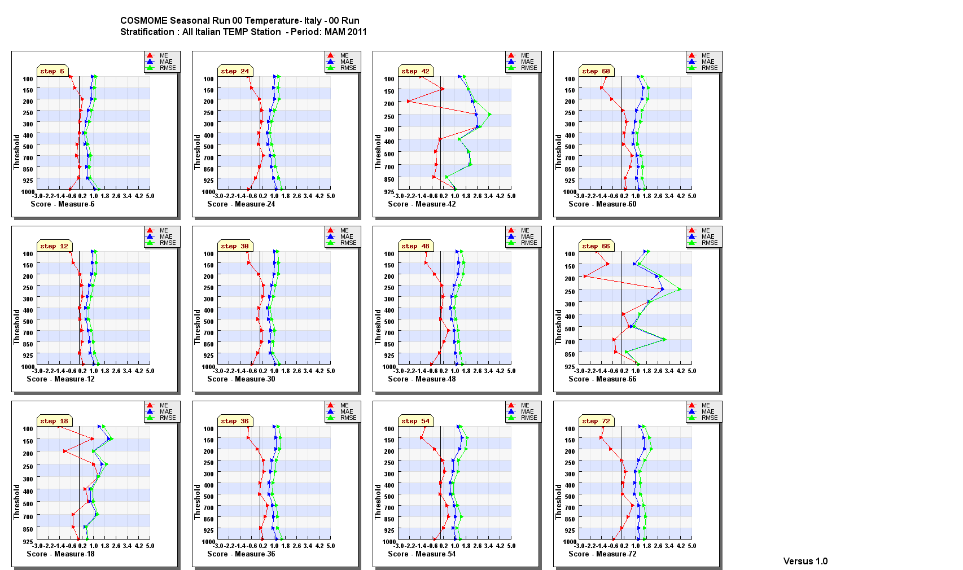
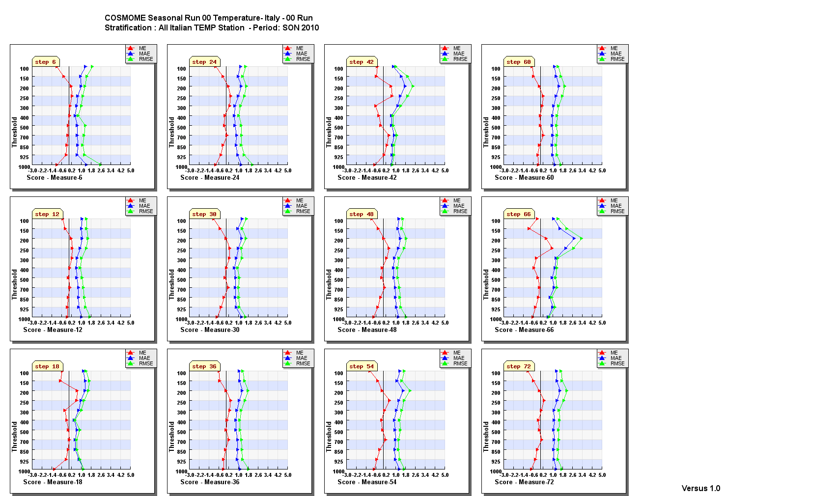
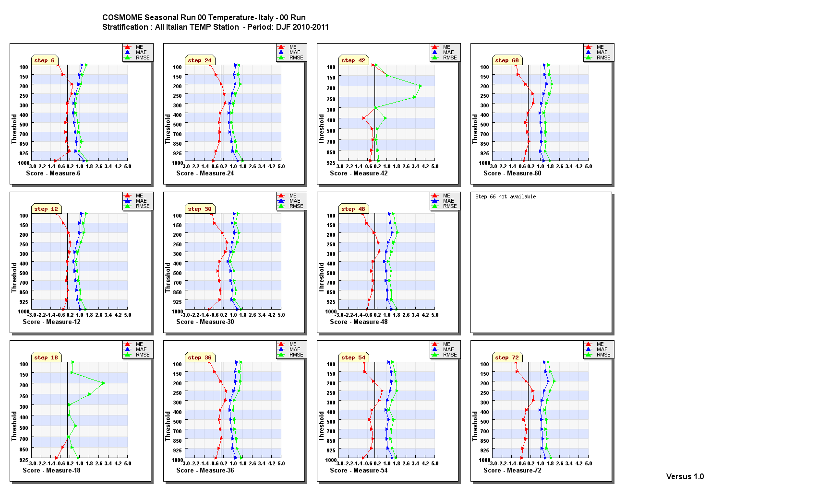
COSMOME –Upper Air Temp

Slide 24
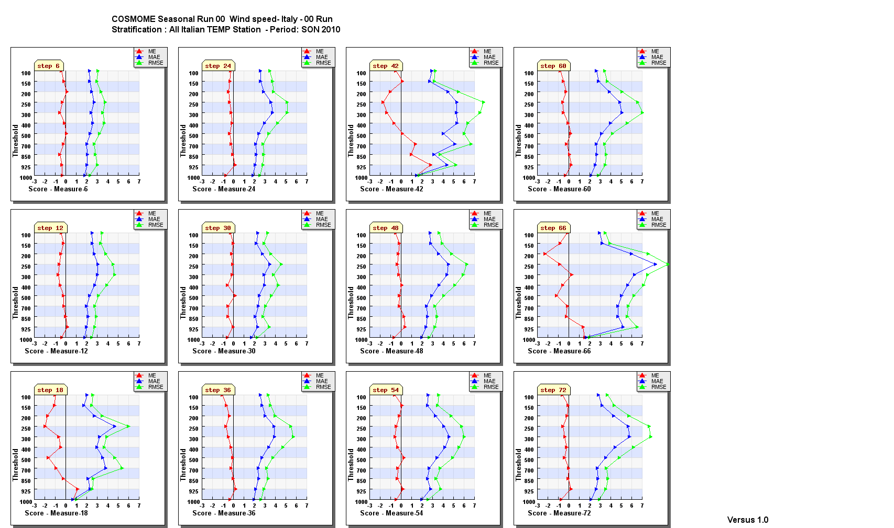
COSMOME – Upper Air WSpeed

Slide 25
Verification
CROSS MODEL COSMOME vs COSMOIT
CROSS MODEL COSMOME vs ECMWF
CROSS MODEL ECMWF vs COSMOI7
COSMOME –UpperAir
COSMOI7 – Upper Air
CONDITIONAL VERIFICATIONS
High resolution verification with raingauges

Slide 26
COSMOI7 –Upper Air Temperature

Slide 27
COSMOI7 –Upper Air Wind Speed

Slide 28
Conclusion
COSMO – ME and COSMO-I7 have a general good result in upper air Verification
COSMO-ME seems better mainly for wind speed

Slide 29
Verification
CROSS MODEL COSMOME vs COSMOIT
CROSS MODEL COSMOME vs ECMWF
CROSS MODEL ECMWF vs COSMOI7
COSMOME –Upper Air
COSMOI7 – Upper Air
CONDITIONAL VERIFICATIONS
High resolution verification with raingauges

Slide 30
Conditional Verification Temp – TCC obs <=25%
SON
DJF
MAM
JJA
Better behaviour for all the seasons
Compare to no condition model

Slide 31
Conditional Verification Temp – TCC obs >=75%
Sorry colours inverted with the previous one!!!
SON
DJF
JJA
MAM
Better behaviour for all the seasons
Compare to no condition model

Slide 32
Conditional Verification Temp – TCC obs >=75%&Wind Speed (obs) <=2 m/s
DJF
SON
MAM
JJA
Similar. Differences in bias

Slide 33
Conditional Verification Temp – TCC obs <=25%&Wind Speed (obs) <=2 m/s
DJF
DJF
SON
MAM
JJA
Similar. Differences in bias

Slide 34
Conditional Verification Tdew – Wind Speed (obs) <=2 m/s
DJF
SON
JJA
MAM
Slightly better SON and DJF

Slide 35
Conclusion
Comparison between NC and Cond verification seems effective in most of the cases
A standard set of Conditions has been decided by WG5 in Langen 2011 and should be produce on regular basis in the next future

Slide 36
Verification
CROSS MODEL COSMOME vs COSMOIT
CROSS MODEL COSMOME vs ECMWF
CROSS MODEL ECMWF vs COSMOI7
COSMOME –Upper Air
COSMOI7 – Upper Air
CONDITIONAL VERIFICATIONS
High resolution verification using raingauges

Slide 37
extreme dependency score → investigate the performance of an NWP model for rare events
Stephenson et al. Introduce the extreme dependency score (EDS) as a good alternative to standard scores for verification of rare events.
 | Event observed yes | Event observed no | Total
Forecast yes | A | b | a + b
Forecast no | c | d | c + d
Total | a +c | b+d | n= a + b + c + d

Slide 38
frequency bias index | FBI = (a + b)/(a + c) | [0,∞] best 1 | The frequency bias index indicates whether the forecasting system under or over-forecasts the number of events.
hit rate (POD) | H = a/(a + c) | [0,1] best 1 | The hit rate represents the probability that the event is forecast when it occurs
false alarm rate (POFD) | F = b/(b + d) | [0,1] best 0 | The false alarm rate represents the probability of forecasting the event when it did not occur. % not events obs. Not correctly forecasted. fraction of the observed "no" events were incorrectly forecast as "yes“.
true skill score | T SS = H −F | [-1,1] best 1 | The true skill score gives information on how the forecasting system distinguishes between occurrences and not occurrences.
base rate | BR = (a + c)/n | [0,1] | The base rate represents the probability that the event occurs. By definition, 1-BR plotted versus increasing thresholds represents the probability that precipitation amount does not exceed a certain threshold.
extreme dependency score | EDS= 2[ln((a+c)/n)/ln(a/n)]-1 | [-1,1] best 1 | What is the association between forecast and observed rare events? Converges to 2η-1 as event frequency approaches 0, where η is a parameter describing how fast the hit rate converges to zero for rarer events. EDS is independent of bias, so should be presented together with the frequency bias

Slide 39
To get clear information about how the forecasting system detects the extreme events, it would be fair if the EDS is compared for events having the same base rate. One has to investigate if better value of the EDS are related to an improvement in the quality of the forecasting system or if they are due to the event variability over the years.
The equation defining the EDS uses the left hand side of a contingency table and the total number of cases (sample size). This results in an increased freedom for false alarms and correct negatives, which can freely vary with the only restriction that their sum has to be constant. Therefore, it is paramount to use the EDS in combination with other scores that include the right hand side of the contingency table, as the F and/or the FBI to show that improvements are not due to an increase of false alarms. (Ghelli&Primo,2009)

Slide 40
The affect of the base rate on the extreme dependency score (Ghelli&Primo,2009)
The Extreme Dependency Score (EDS) has been introduced as an alternative measure to verify the performance of numerical weather prediction models for rare events, taking advantage of the non-vanishing property of the score when the event probability tends to zero. This score varies from 1 (best value) to −1 (worst value). The EDS is written as a function of BR: EDS =[ln(BR) − ln(HR)]/[ln(BR) + ln(HR)] Equation presents the EDS as a function of the base rate and the hit rate. when HR = 1, the EDS = 1 and when BR = 1, the EDS = −1. On the other hand, when the base rate is equal to one, the event happens all the time and so the EDS is not an appropriate score since it is focused on verification of extreme events (low probability of occurrence). Therefore, if different data samples need to be compared, it is imperative to have similar base rate.

Slide 41
Thus, even if there are no misses and the EDS value is maximum, the forecasting system might have a high number of false alarms. Therefore, an EDS = 1 does not imply a skilful system. If values of the EDS for different periods need to be compared, then the base rate must be constant in time to avoid changes in the EDS to be just a reflection of changes in the BR.
If the base rate is constant, an increase of the EDS implies a better probability of detection (hit rate), i.e. a more skilful system. If only the hit rate is constant, then an increase of the EDS is only due to a higher event probability. If neither the base rate nor the hit rate is constant, then the improvement of the EDS could be due to any of the previous reasons.

Slide 42
The extreme dependency score: a non-vanishing measure for forecasts of rare events (Stephenson et al.)
EDS takes the value of 1 for perfect forecasts and 0 for random forecasts, and is greater than zero for forecasts that have hit rates that converge slower than those of random forecasts
EDS has demonstrated here that there is dependency between the forecasts and the observations for more rare events, which is masked by the traditional skill scores that converge to zero as the base rate vanishes. EDS does not explicitly depend on the bias in the system for vanishing base rate and so is less prone to improvement by hedging the forecasts. EDS has the disadvantage that it is based only on the numbers of hits and misses, and so ignores information about false alarms and correct rejections. Therefore, EDS is non-informative about forecast bias, and a forecasting system with a good EDS could be very biased. Therefore, one should present EDS together with the frequency bias as a function of threshold in order to provide a complete summary of forecast performance.

Slide 43
Intercomparison COSMO-ME/COSMO-I7, FIRST 24H
COSMO-ME
Up to 20mm ME ovest. more than I7
Up to 20mm ME better pod and eds
Same POFD

Slide 44
Intercomparison COSMO-ME/COSMO-I7, SECOND 24H
ME overes. more than I7
ME better pod, eds up to 30mm BUT more false alarms

Slide 45
0.2
2
5
0.2
Driving model comparison: ECMWF/COSMO-ME/COSMO-IT
FIRST 24H
10
2
5
20
10
20
30
low thres. Up to 10/20 mm: better pod for ecmwf but more false alarms
Above 10/20 mm the best is Cosmo-ME
Cosmo-ME is better than cosmo-IT
30
40
40
BIAS: ecmwf overestimates for low thres., underestimates for high thres.
BIAS: ME slightly overest. up to 10mm, above good performance
EDS: the best is ecmwf up to 20mm. Above the best is COSMO-ME
50
50

Slide 46
0.2
2
5
0.2
Driving model comparison: ECMWF/COSMO-ME
SECOND 24H
10
2
5
10
20
20
30
30
low thres. Up to 10 mm: better pod for ecmwf but more false alarms
Above 20 mm the best is COSMO-ME
40
40
BIAS: ecmwf overestimates for low thres., underestimates for high thres.
BIAS: ME overestimates
EDS: the best is ecmwf up to 20mm. Above the best is COSMO-ME
50
50

Slide 47
0.2
2
5
0.2
Driving model comparison: ECMWF/COSMO-I7/COSMO-I2
FIRST 24H
10
2
5
low thres. (0.2-5)→ecmwf better but more false alarms
Medium thres (10-20)→better ecmwf
High thres. >=30 →better I7
I7 and I2 similar up to 10 mm, above I7 is better
20
10
30
20
30
40
40
BIAS: ecmwf overestimates for low thres., underestimates for high thres.
BIAS: I7 and I2 similar up to 10mm, above I7 is better
EDS: the best is ecmwf up to 20mm. Above the best is cosmo-I7
50
50

Slide 48
0.2
2
5
Driving model comparison: ECMWF/COSMO-I7/COSMO-I2
SECOND 24H
0.2
10
2
low thres. (0.2-5)→ecmwf better but more false alarms
Medium thres (10-20)→better ecmwf
High thres.>=30 →better I7
I7 and I2 similar up to 10 mm, above I7 is better
5
20
10
30
20
40
30
40
BIAS: ecmwf overestimates for low thres., underestimates for high thres.
BIAS: I7 and I2 similar up to 10mm, above I7 is better
EDS: the best is ecmwf up to 20mm. Above the best is cosmo-I7
50
50

Slide 49
PERFORMANCE DIAGRAM
Period
March 2010 - April 2011

Slide 50
50% of points (median) > 1 mm/24h

Slide 51
50% of points (median) > 5 mm/24h

Slide 52
50% of points (median) > 10 mm/24h

Slide 53
50% of points (median) > 20 mm/24h

Slide 54
1 Point (maximum) > 1 mm/24h

Slide 55
1 Point (maximum) > 5 mm/24h

Slide 56
1 Point (maximum) > 10 mm/24h

Slide 57
1 Point (maximum) > 20 mm/24h

Slide 58
50% of points (median) > 1 mm/24h
&
Maximum > 25 mm/24h

Slide 59
50% of points (median) > 1 mm/24h
&
Maximum > 50 mm/24h

Slide 60
50% of points (median) > 1 mm/24h
&
Maximum > 75 mm/24h

Slide 61
50% of points (median) > 1 mm/24h
&
Maximum > 100 mm/24h

Slide 62
50% of points (median) > 5 mm/24h
&
Maximum > 25 mm/24h

Slide 63
50% of points (median) > 5 mm/24h
&
Maximum > 50 mm/24h

Slide 64
50% of points (median) > 5 mm/24h
&
Maximum > 75 mm/24h

Slide 65
50% of points (median) > 5 mm/24h
&
Maximum > 100 mm/24h

Slide 66
50% of points (median) > 10 mm/24h
&
Maximum > 25 mm/24h

Slide 67
50% of points (median) > 10 mm/24h
&
Maximum > 50 mm/24h

Slide 68
50% of points (median) > 10 mm/24h
&
Maximum > 75 mm/24h

Slide 69
50% of points (median) > 10 mm/24h
&
Maximum > 100 mm/24h

Slide 70
50% of points (median) > 20 mm/24h
&
Maximum > 25 mm/24h

Slide 71
50% of points (median) > 20 mm/24h
&
Maximum > 50 mm/24h

Slide 72
50% of points (median) > 20 mm/24h
&
Maximum > 75 mm/24h

Slide 73
50% of points (median) > 20 mm/24h
&
Maximum > 75 mm/24h

Slide 74
RELATIVE ERROR winter 2010
Cosmo-I7
Cosmo-ME
Cumulated obs. Prec.
Few precipitation amount in the Padana Plain: very snowy winter also in plain areas where there are no heated rain gauges → lack of representativeness → in fact all the models foresee less prec. Over Padana Plain
Cosmo –I7 overestimates more
Rel Err= (for-obs)/obs %
Cumulated seasonal precipitation (mm)
Ecmwf

Slide 75
RELATIVE ERROR winter 2011
Cosmo-I7
Cosmo-ME
Cumulated obs. Prec.
Winter 2011 drier than 2010
Ecmwf overestimates
LAMs overestimate over North, underestimate over South
Rel Err= (for-obs)/obs %
Cumulated seasonal precipitation (mm)
Ecmwf

Slide 76
RELATIVE ERROR spring 2010
Cosmo-I7
Cosmo-ME
Cumulated obs. Prec.
Spring 2010 moderately moist
General good model performance
Ecmwf slightly overestimates
Rel Err= (for-obs)/obs %
Cumulated seasonal precipitation (mm)
Ecmwf

Slide 77
RELATIVE ERROR spring 2011
Cosmo-I7
Cosmo-ME
Cumulated obs. Prec.
Spring 2011 definitely drier than 2010
General model worsening
Rel Err= (for-obs)/obs %
Cumulated seasonal precipitation (mm)
Ecmwf

Slide 78
24h precipitation - Fct + 48
Threat Score
50 % of points (median)
> 5 mm/24h
ECMWF
Cosmo-Med
Cosmo-I7
Cosmo-I2

Slide 79
24h precipitation - Fct + 48
Bias Score
50 % of points (median)
> 5 mm/24h
ECMWF
Cosmo-Med
Cosmo-I7
Cosmo-I2

Slide 80
24h precipitation - Fct + 48
Threat Score
At least 1 point (maximum)
> 20 mm/24h
ECMWF
Cosmo-Med
Cosmo-I7
Cosmo-I2

Slide 81
24h precipitation - Fct + 48
Bias Score
At least 1 point (maximum)
> 20 mm/24h
ECMWF
Cosmo-Med
Cosmo-I7
Cosmo-I2

Slide 82
24h precipitation - Fct + 48
Bias Score
50% of points >5 mm/24 &
at least 1 point (maximum)
> 25 mm/24h
ECMWF
Cosmo-Med
Cosmo-I7
Cosmo-I2

Slide 83
24h precipitation - Fct + 48
Extreme Depedentcy Score
50% of points >5 mm/24 &
at least 1 point (maximum)
> 25 mm/24h
ECMWF
Cosmo-Med
Cosmo-I7
Cosmo-I2

Slide 84
24h precipitation - Fct + 48
Bias Score
50% of points >5 mm/24 &
at least 1 point (maximum)
> 75 mm/24h
ECMWF
Cosmo-Med
Cosmo-I7
Cosmo-I2

Slide 85
24h precipitation - Fct + 48
Extreme Depedentcy Score
50% of points >5 mm/24 &
at least 1 point (maximum)
> 75 mm/24h
ECMWF
Cosmo-Med
Cosmo-I7
Cosmo-I2

Slide 86
Seasonal trend 0.2mm/24h
+ ECMWF
Dataset: high resolution network of rain gauges coming from COSMO dataset and Civil Protection Department → 1300 stations
Method: 24h/6h averaged cumulated precipitation value over 90 meteo-hydrological basins
All the versions present a seasonal cycle with an overestimation during summertime (except COSMO-7 and I2)
COSMO-7 and I2 underestimate
Overestimation error decreases in D+2 (spin-up effect vanished)
Latest summer→ worsening EU and I2

Slide 87
Seasonal trend 20mm/24h
+ ECMWF
Slight bias reduction during latest seasons
winter 2010: all the versions overestimate (probably due to lack of representativeness of the rain gauges over the plain during snowfall)
Strong COSMO-7 underestimation BUT slight improvement during latest seasons
General underestimation during latest seasons exc. I7

Slide 88
Seasonal trend 0.2mm/24h
+ ECMWF
Very light improvement trend
Seasonal error cycle: lower ets during winter and summertime
no significant differences between D+1 and D+2
winter 2010 (very snowy particularly in Northern Italy): low ets value (D+1 and D+2)→ model error or lack of representativeness of the rain gauges over the plain during snowfall ?

Slide 89
Seasonal trend 20mm/24h
+ ECMWF
Low values during summertime (in general)
All the versions present two “big jump” at jja08 and jja09, after the values increase and become quite stationary
Skill decreases with forecast time

Slide 90
Diurnal cycle 2mm/6h
+ ECMWF
Little initial spin-up (especially for I7 and I2)
No strong performance differences among the versions
Slight diurnal cycle
Slight worsening with forecast time

Slide 91
Diurnal cycle 20mm/6h
+ ECMWF
Little initial spin-up vanished with threshold increasing
No strong performance differences among the versions except COSMO-7 underestimation
diurnal cycle: overs. During midday, best performance during +24h/+48h

