Slide 1

Status of Dynamical Core
C++ Rewrite (Task 5)
Oliver Fuhrer (MeteoSwiss), Tobias Gysi (SCS), Men Muhheim (SCS), Katharina Riedinger (SCS), David Müller (SCS), Thomas Schulthess (CSCS)
…and the rest of the HP2C team!

Slide 2
Outline
Motivation
Design choices
CPU and GPU implementation status
Users perspective
Outlook
Notes:
High risk, high potential task (not everything that we do in this task must eventually lead to an positive result or an operational system!)

Slide 3

Motivation
Memory bandwidth is the main performance limiter on “commodity” hardware

Slide 4
Motivation
Prototype implementation of fast-waves solver (30% of total runtime) showed considerable potential
Current
Prototype

Slide 5
Wishlist
Correctness
  Unit-testing
  Verification framework
Performance
  Apply performance optimizations from prototype (avoid pre-computation, loop merging, iterators, configurable storage order, cache friendly buffers)
Portability
  Run both on x86 and GPU
  3 levels of parallelism (vector, multi-core node, multiple nodes)
Ease of use
  Readibility
  Useability
  Maintainability

Slide 6
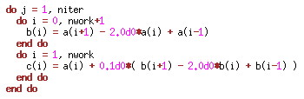
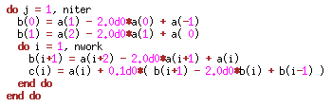
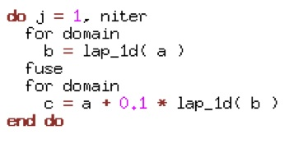
Idea: Domain Specific Embedded Language (DSEL)
Version 1 (current)
stencil written out
inefficient
Version 2 (optimized)
more difficult to read
efficient (x1.2 speedup)
Version 3 (DSEL)
stencil and loop abstracted
operator notation
easy to read/modify
efficient (optimizations hidden in library)

Slide 7
Dycore Rewrite Status
Fully functional single-node CPU implementation
  fast wave solver
  horizontal advection (5th-order upstream, Bott)
  implicit vertical diffusion and advection
  horizontal hyper-diffusion
  Coriolis and other smaller stencils
Verified against Fortran reference to machine precision
No SSE-specific optimizations done yet!

Slide 8
Rewrite vs. Current COSMO
The following table compares total execution time
100 timesteps using 6 cores on Palu (Cray XE6, AMD Opteron Magny-Cours)
COSMO performance is dependent on domain size (partly due to vectorization)
Domain Size | COSMO | Rewrite | Speedup
32x48 | 19.06 s | 10.25 s | 1.86
48x32 | 16.70 s | 10.17 s | 1.64
96x16 | 15.60 s | 10.13 s | 1.54

Slide 9
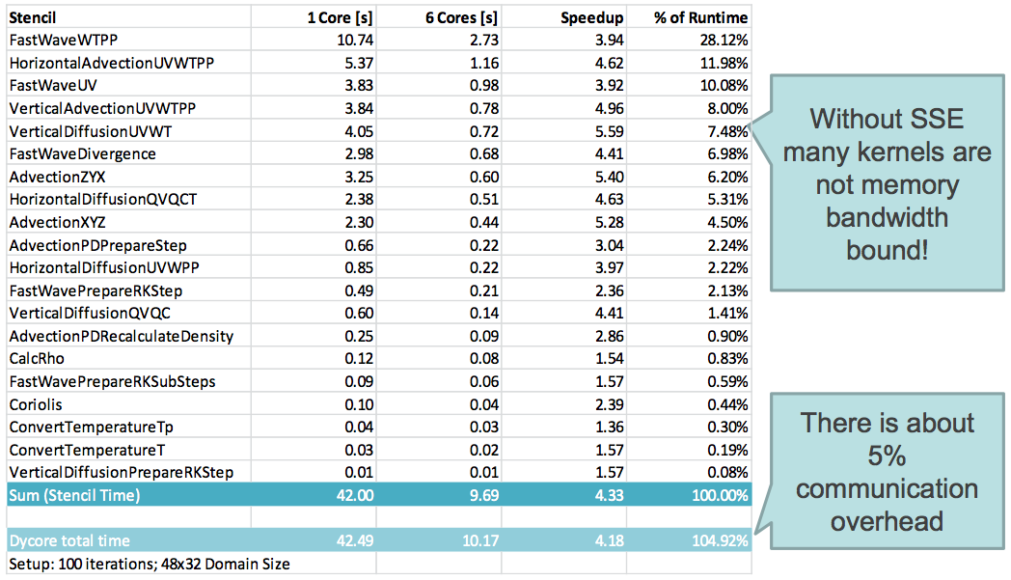
Performance and scaling

Slide 10
Schedule
Feasibility Study
Library
You Are Here
Rewrite
Test
Tune
CPU
GPU
t
Feasibility
~2 Years
Library
Test & Tune

Slide 11
GPU Implementation - Design Decisions
IJK loop order (vs. KJI for CPU)
Iterators replaced by pointers, indexes and strides
  There is only one index and stride instance per data field type
  Strides and pointers are stored in shared memory
  Indexes are stored in registers
  There is no range check!
3D fields are padded in order to improve alignment (no overfetch!)
Automatic synchronization between device and host storage
Column buffers are full 3D fields
  If necessary there is a halo around every block in order to guarantee block private access to the buffer

Slide 12
GPU Implementation - Status
The GPU backend of the stencil library is functional
The following kernels adapted and tested so far
  Fast Wave UV Update
  Vertical Advection
  Horizontal Advection
  Horizontal Diffusion
  Coriolis
But there is still work ahead for a GPU
  Adapt all kernels to the framework
  Implement boundary exchange and data field initialization kernels
  Write more tests
  Potentially a lot of performance work
  (e.g. merge loops and buffer intermediate values in shared memory)

Slide 13
An Example (1/2)
Pressure gradient force (coordinate free)
x-component (Cartesian coordinates)
x-component (transformed into spherical, terrain-following coordinates)

Slide 14
Computational Grid
w(i,k+1)
hhl(i,k+1)
u(i,k)
rho(i,k)
t(i,k)
u(i+1,k)
w(i,k)
hhl(i,k)
Terrain-following coordinates
Staggered grid

Slide 15
An Example (2/2)
x-component (transformed into spherical, terrain-following coordinates)
x-component (discretized form)
Basic operators

Slide 16
Fortran Version
[...precompute sqrtg_r_u(i,j,k using hhl(i,j,k) ]
[...precompute rhoqx_i(i,j,k) using rho(i,j,k) ]
[...precompute hml(i,j,k) using hhl(i,j,k) ]
DO k = 1, ke
DO j = jstart-1, jend
DO i = istart-1, iend
dzdx(i,j,k) = 0.5 * sqrtg_r_u(i,j,k) * ( hml(i+1,j,k) - hml(i,j,k) )
ENDDO
ENDDO
ENDDO
DO k = 1, ke
DO j = jstart-1, jend+1
DO i = istart-1, iend+1
dpdz(i,j,k) = + pp(i,j,k+1) * (wgt(i,j,k+1) ) &
+ pp(i,j,k ) * (1.0 - wgt(i,j,k+1) - wgt(i,j,k)) &
+ pp(i,j,k-1) * (wgt(i,j,k) – 1.0 )
ENDDO
ENDDO
ENDDO
DO k = 1, ke
DO j = jstartu, jendu
DO i = ilowu, iendu
zdzpz = ( dpdz(i+1,j,k) + dpdz(i,j,k) ) * dzdx(i,j,k)
zdpdx = pp(i+1,j,k) - pp(i,j,k)
zpgradx = ( zdpdx + zdzpz ) * rhoqx_i(i,j,k)
u(i,j,k,nnew) = u(i,j,k,nnew) – zpgradx * dts
ENDDO
ENDDO
ENDDO

Slide 17
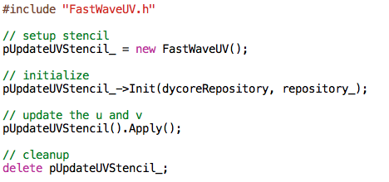
C++ Version

Slide 18
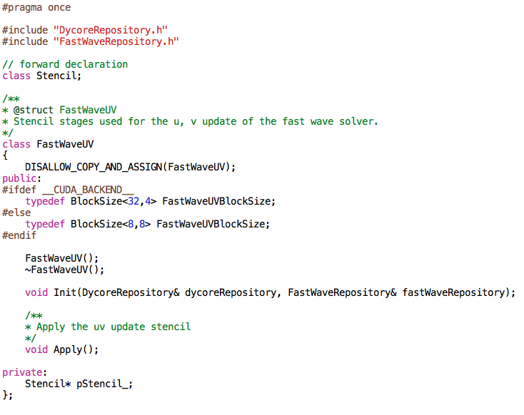
FastWaveUV.h

Slide 19
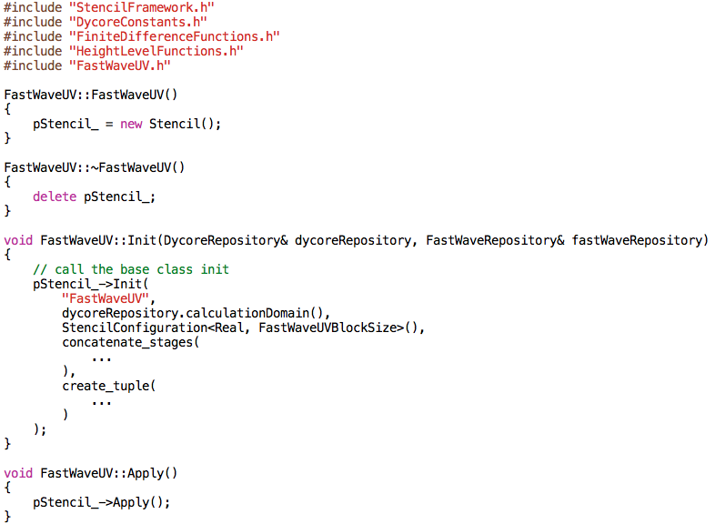
FastWave.cpp
Stencil stages
Input / Output / Temporary fields

Slide 20
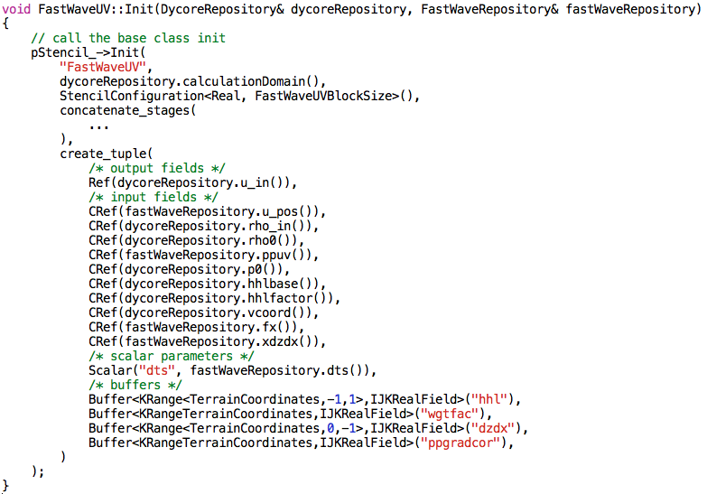
Input / Output / Buffer Fields

Slide 21
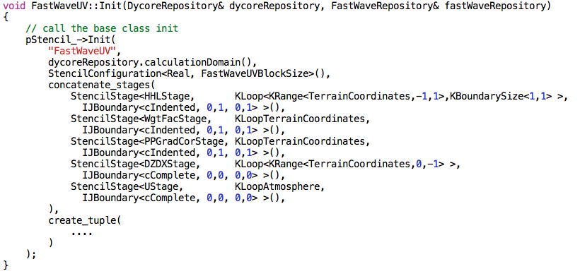
Stencil stages

Slide 22
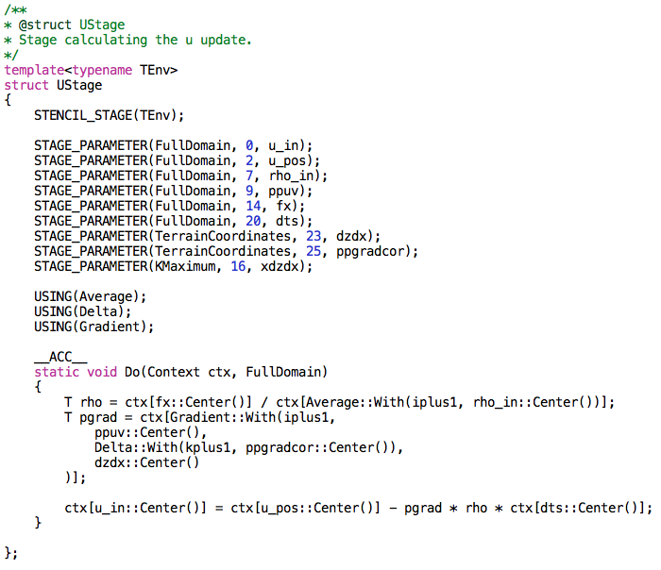
Stencil stages (UStage)
dzdx
ppgradcor

Slide 23
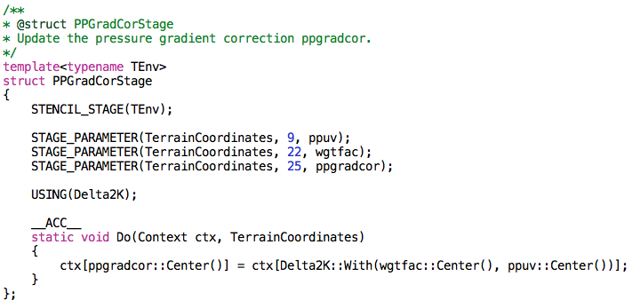
Stencil stages (PGradCorStage)

Slide 24
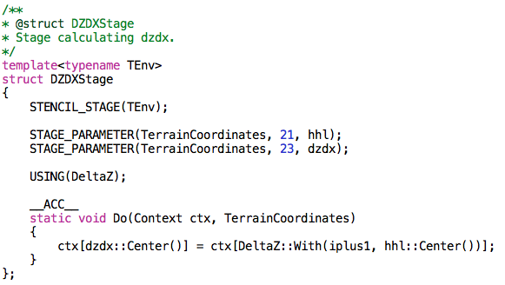
Stencil stages (DZDXStage)

Slide 25
Conclusions
Successful DSEL implementation of COSMO dynamical core
Significant speedup on CPU (x1.5 – x1.8)
Most identified risks turned out to be manageable
  Team members without C++ experience were able to implement kernels (e.g. Bott advection)
  Error messages pointed mostly directly to problem
  Compilation time reasonable
  Debug information / symbols make executable huge
There are areas where C++ is lagging behind Fortran
  e.g. bad SSE support (manual effort needed)
GPU backend implementation ongoing
  NVIDIA toolchain is capable to handle C++ rewrite

Slide 26
Next Steps
Port whole HP2C dycore to GPU
Understand GPU performance characteristics
GPU performance results by October 2011
Decide on how to proceed further…
Questions
Is COSMO ready/willing to absorb a shift to C++ for dycore and have a mixed-language code?

Slide 27
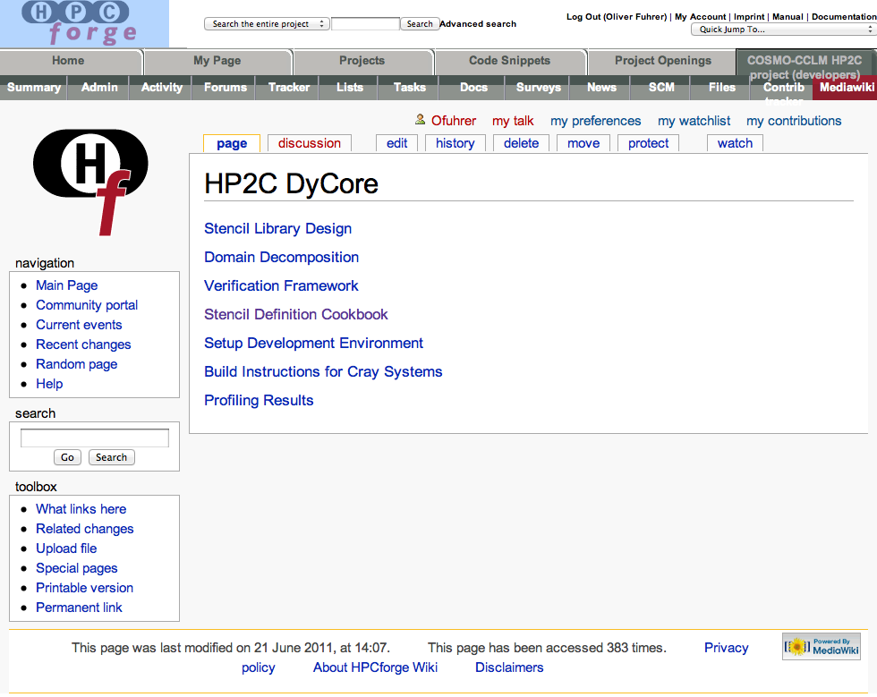
For more information…
https://hpcforge.org/plugins/mediawiki/wiki/cclm-dev/index.php/HP2C_DyCore

