Slide 1


Some results from operational verification in Italy
Adriano Raspanti – Angela Celozzi –David Palella (with contributions from Lucio Torrisi
10° COSMO General Meeting – Cracow 15-19 Sept 2008

Slide 2
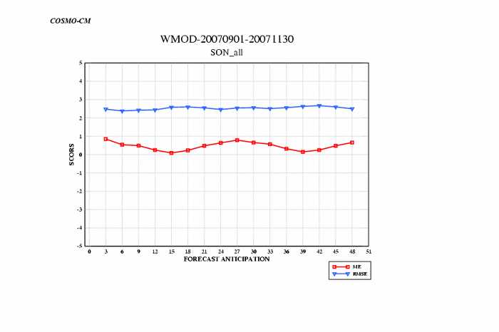
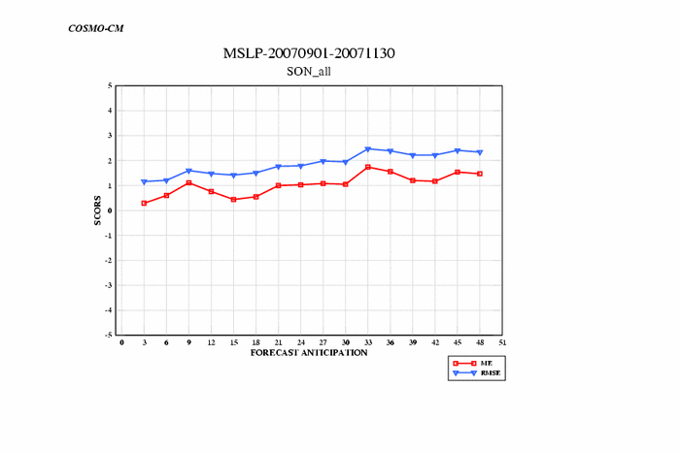
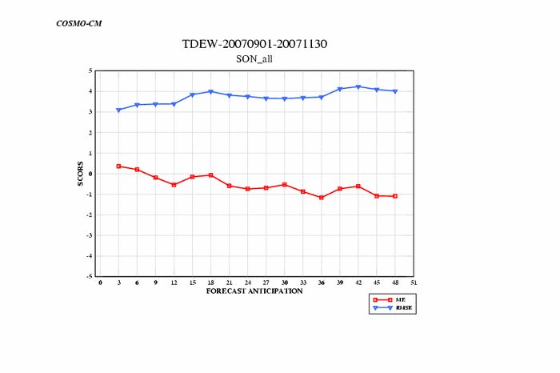
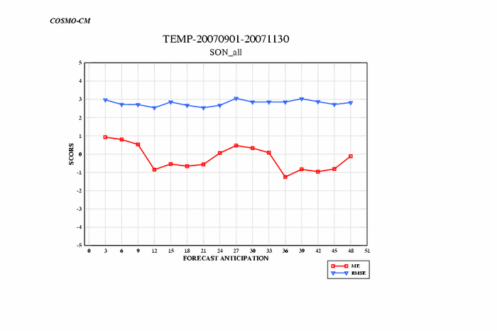
CM - SON 2007
10° COSMO General Meeting – Cracow 15-19 Sept 2008

Slide 3
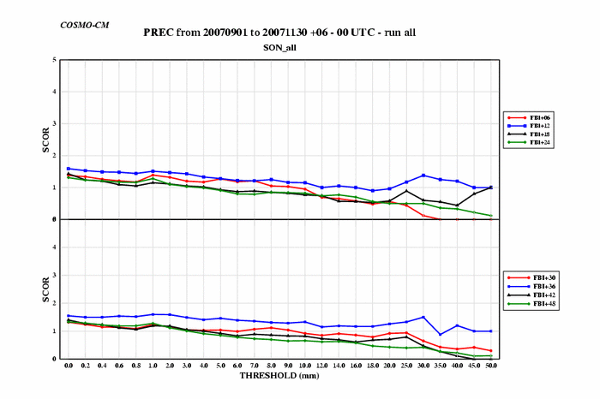
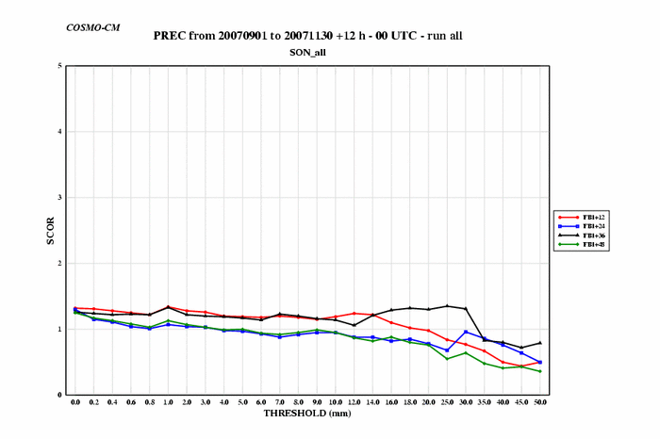
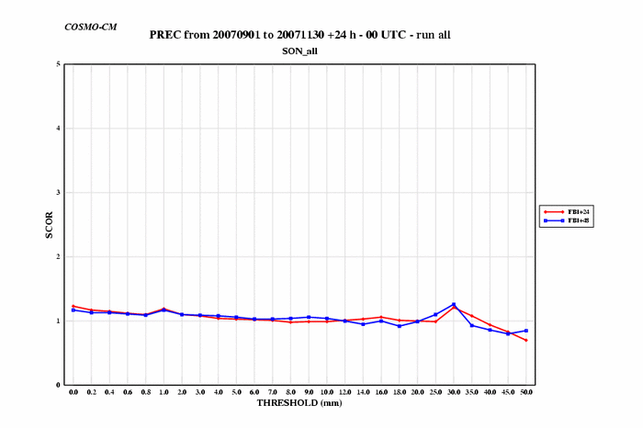
CM - SON 2007
10° COSMO General Meeting – Cracow 15-19 Sept 2008

Slide 4
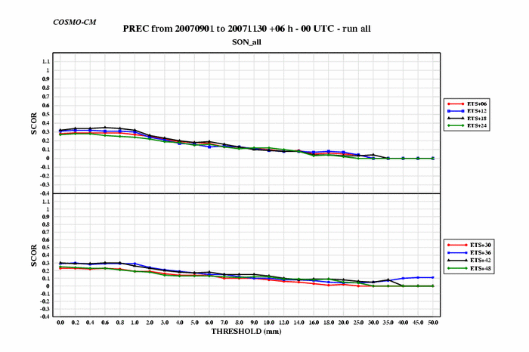
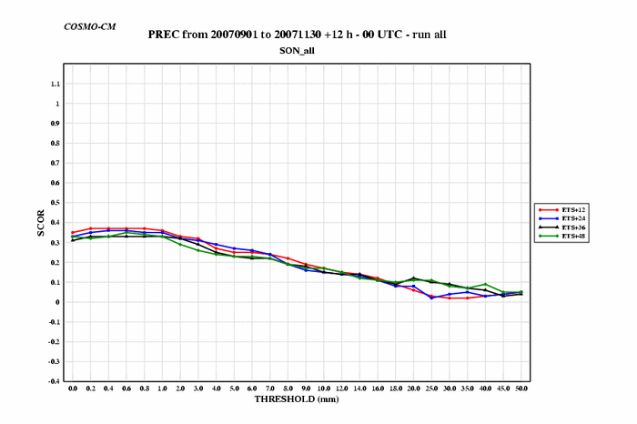
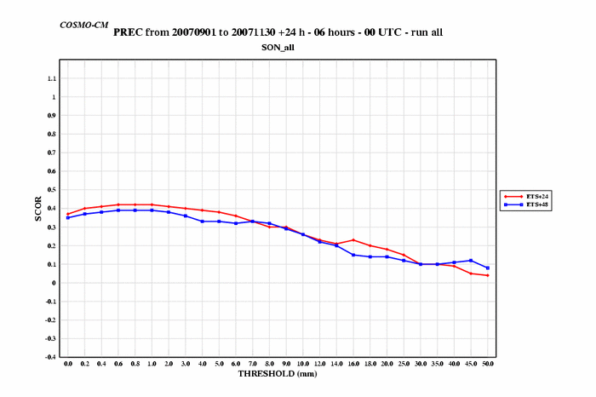
CM - SON 2007
10° COSMO General Meeting – Cracow 15-19 Sept 2008

Slide 5
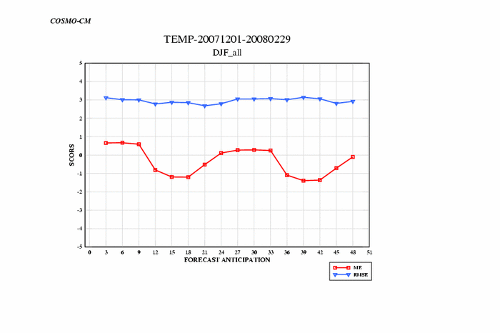

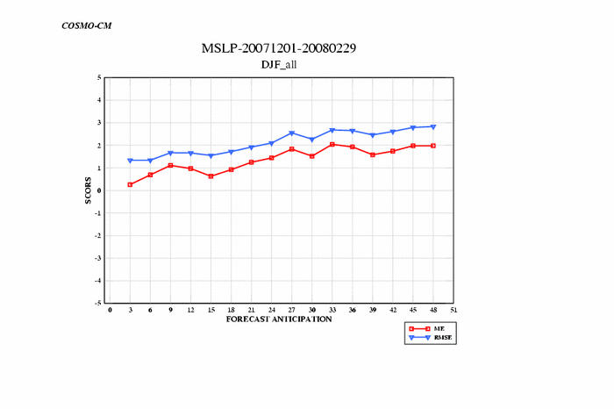
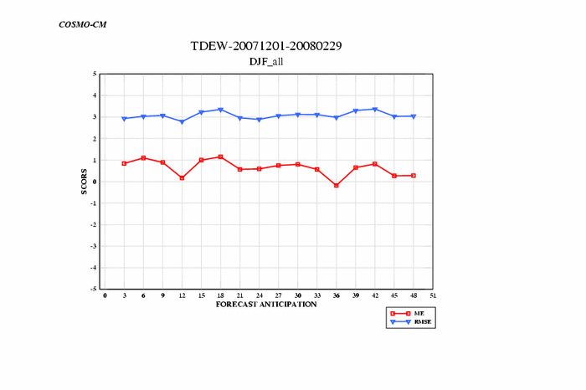
CM - DJF 2007-08
10° COSMO General Meeting – Cracow 15-19 Sept 2008

Slide 6
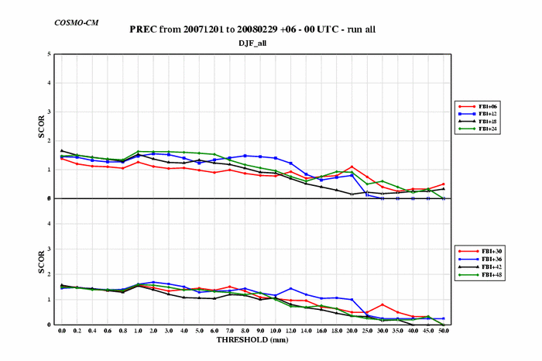
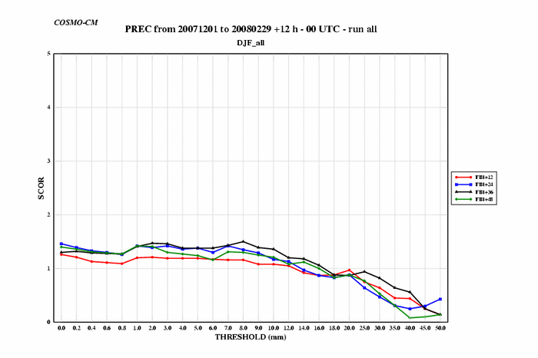
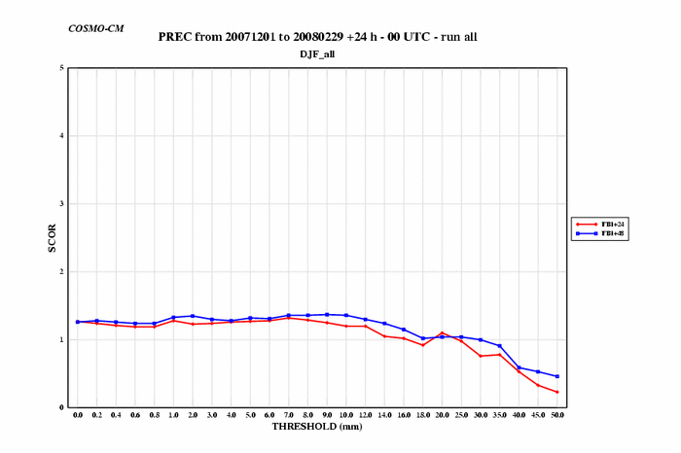
CM - DJF 2007-08
10° COSMO General Meeting – Cracow 15-19 Sept 2008

Slide 7
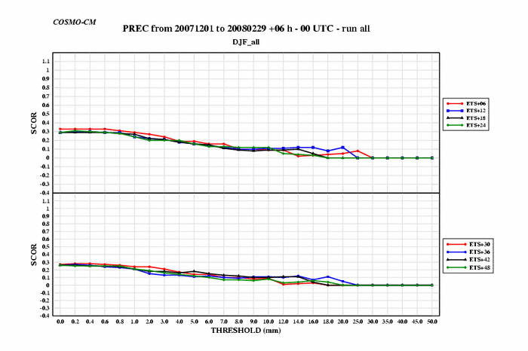
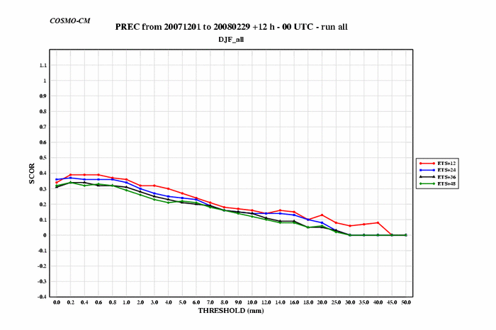
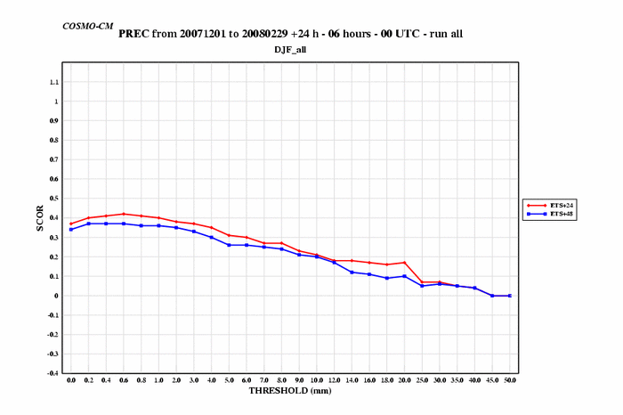
CM - DJF 2007-08
10° COSMO General Meeting – Cracow 15-19 Sept 2008

Slide 8
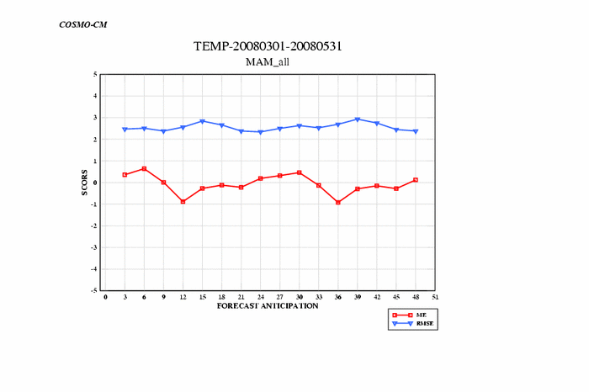
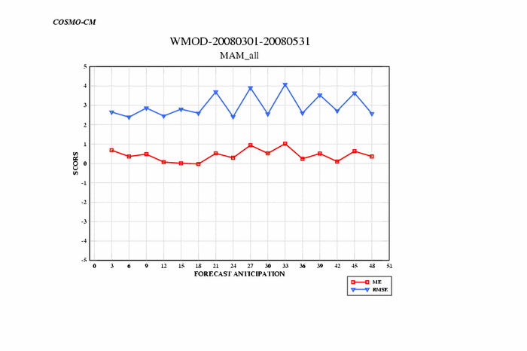
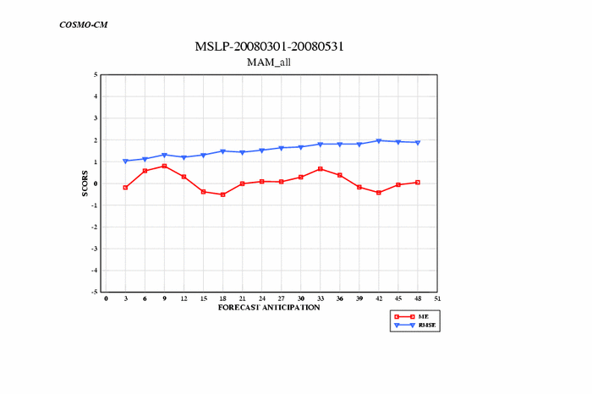
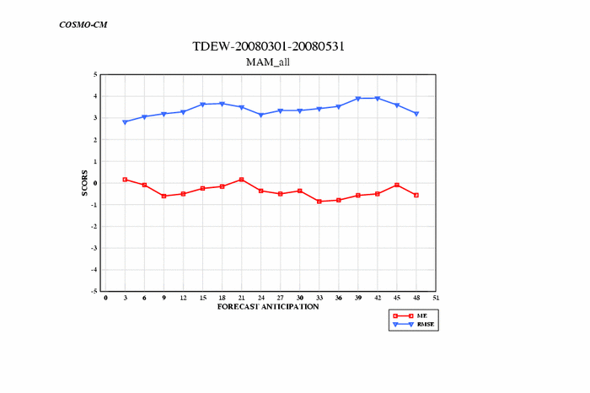
CM – MAM 2008
10° COSMO General Meeting – Cracow 15-19 Sept 2008

Slide 9
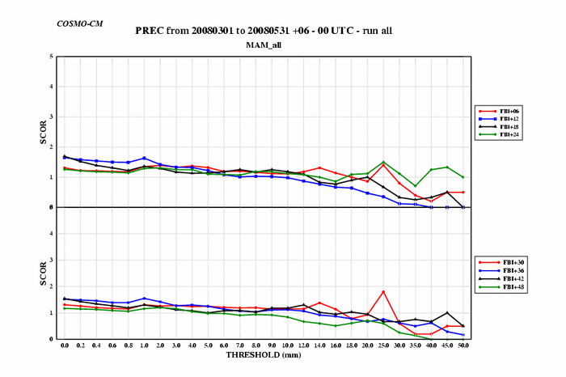
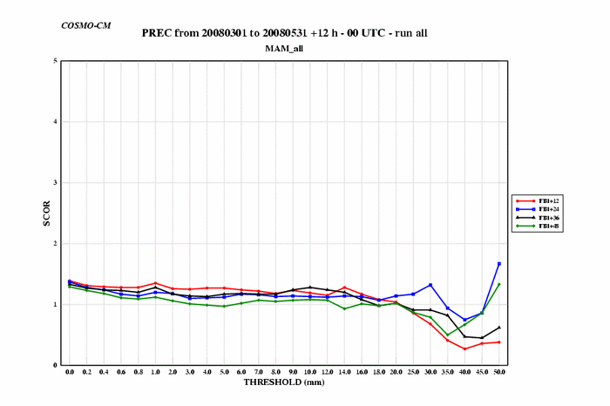
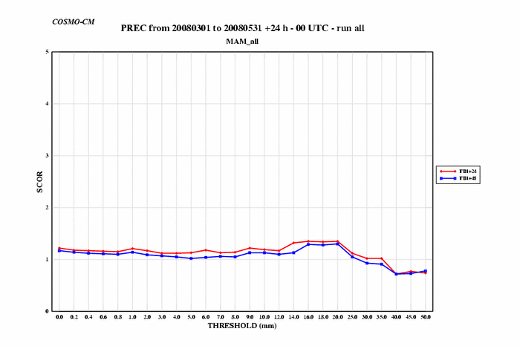
CM – MAM 2008
10° COSMO General Meeting – Cracow 15-19 Sept 2008

Slide 10
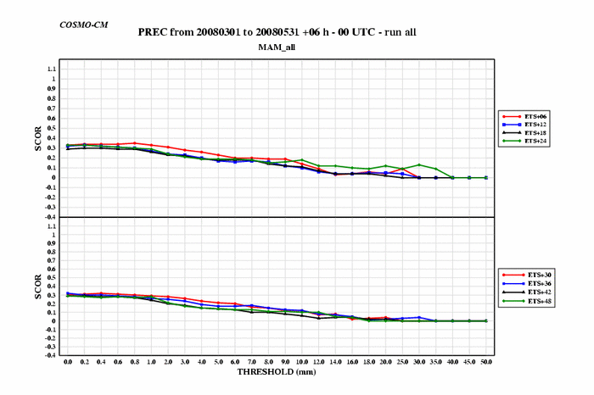
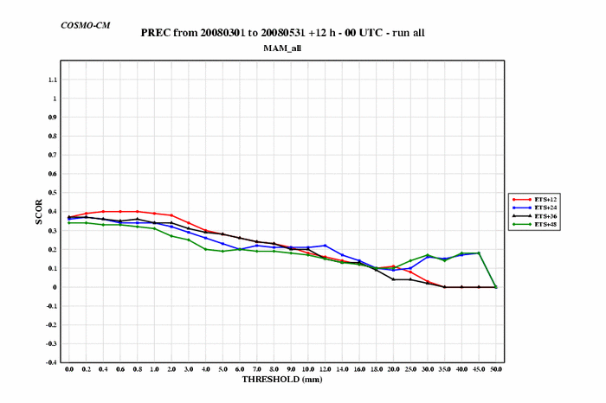
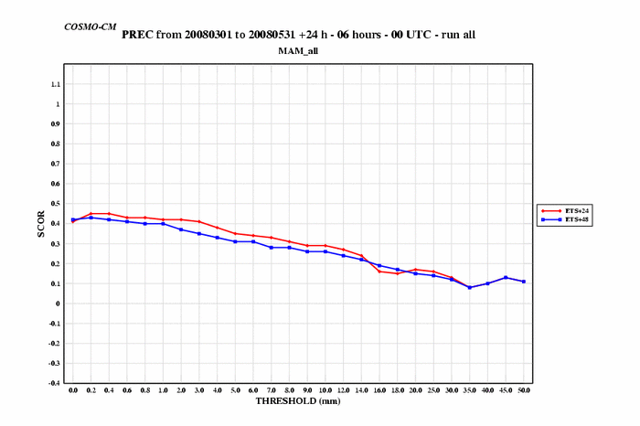
CM – MAM 2008
10° COSMO General Meeting – Cracow 15-19 Sept 2008

Slide 11
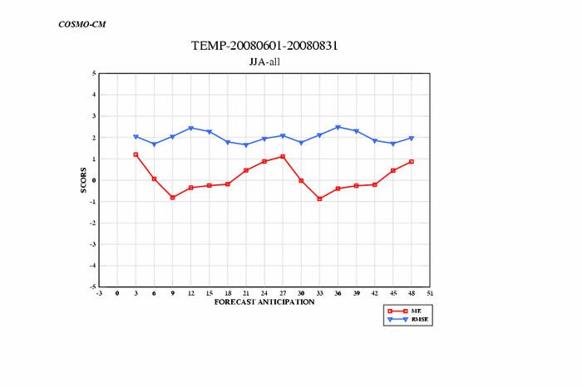
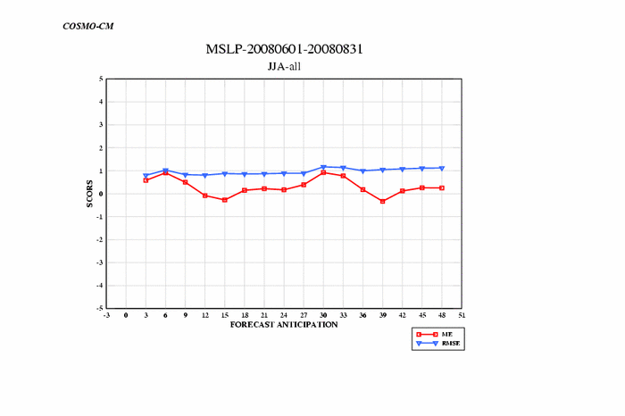
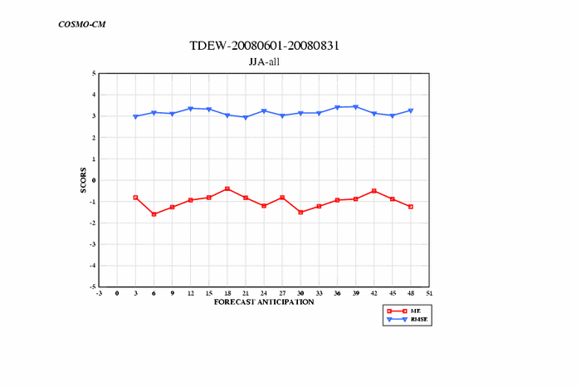
CM – JJA 2008
10° COSMO General Meeting – Cracow 15-19 Sept 2008

Slide 12
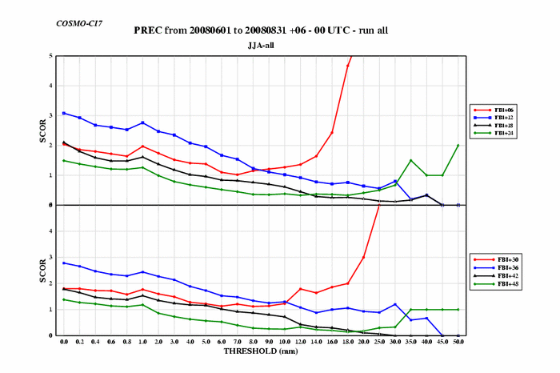
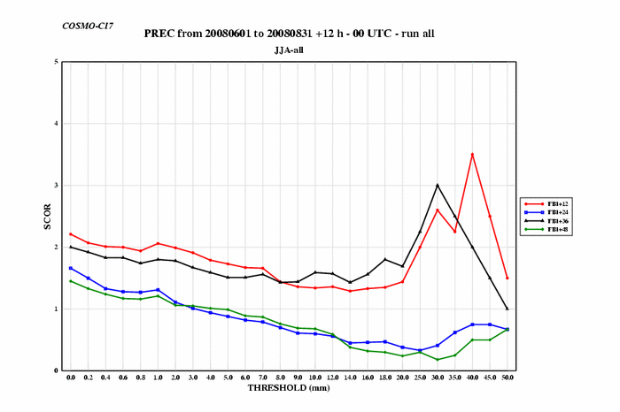
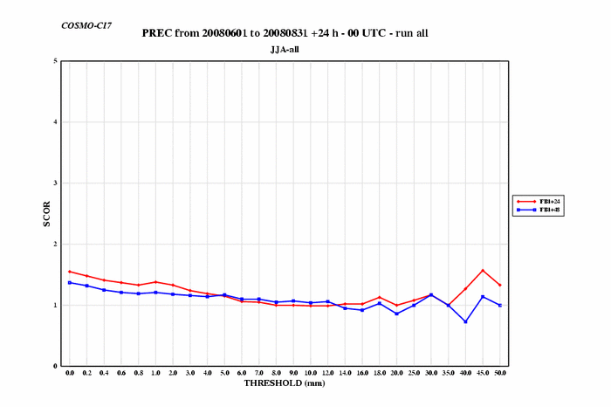
CM – JJA 2008
10° COSMO General Meeting – Cracow 15-19 Sept 2008

Slide 13
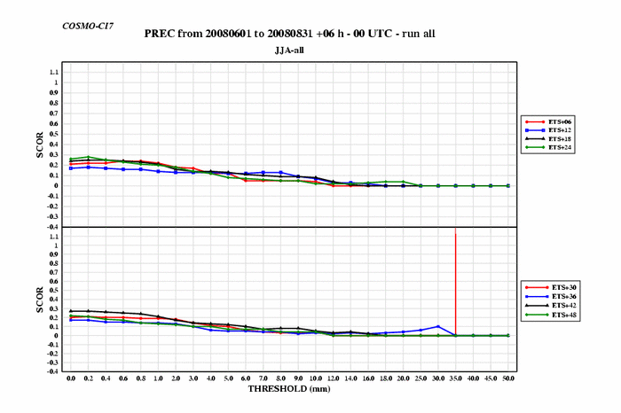
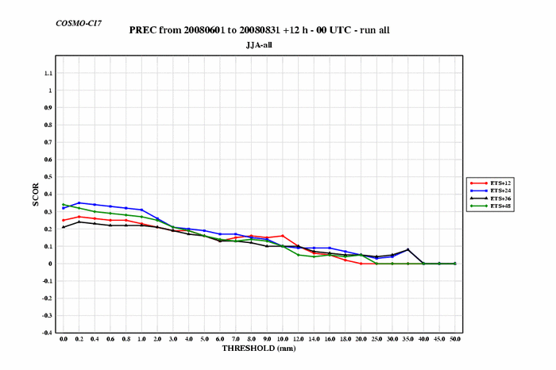
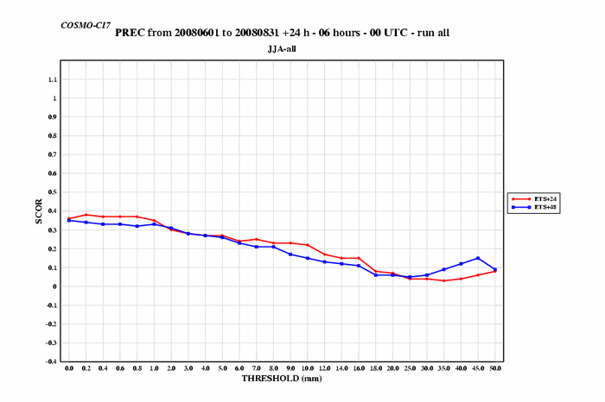
CM – JJA 2008
10° COSMO General Meeting – Cracow 15-19 Sept 2008

Slide 14
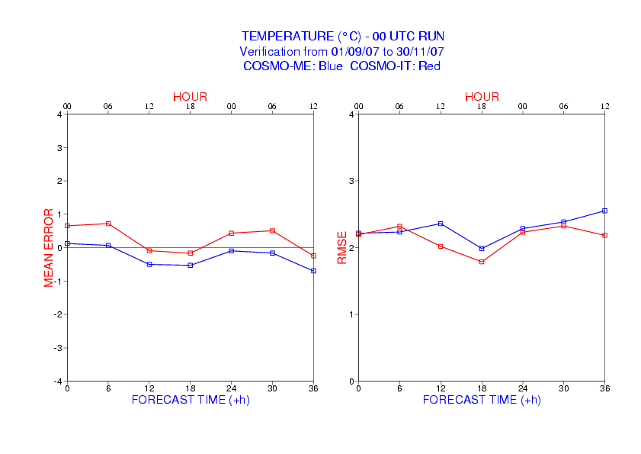
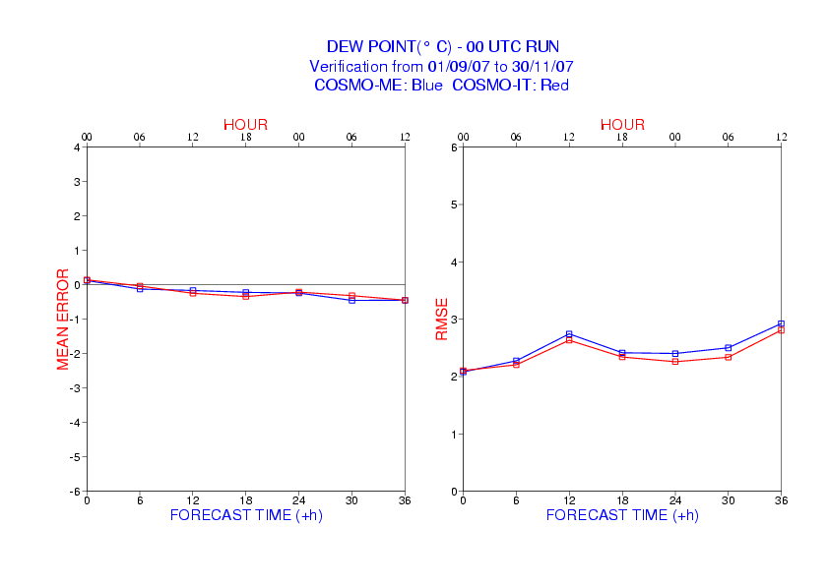
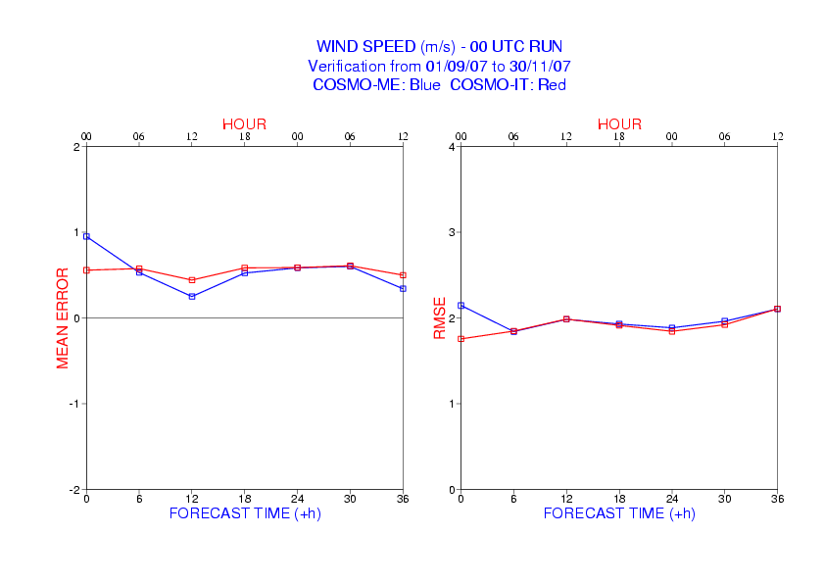
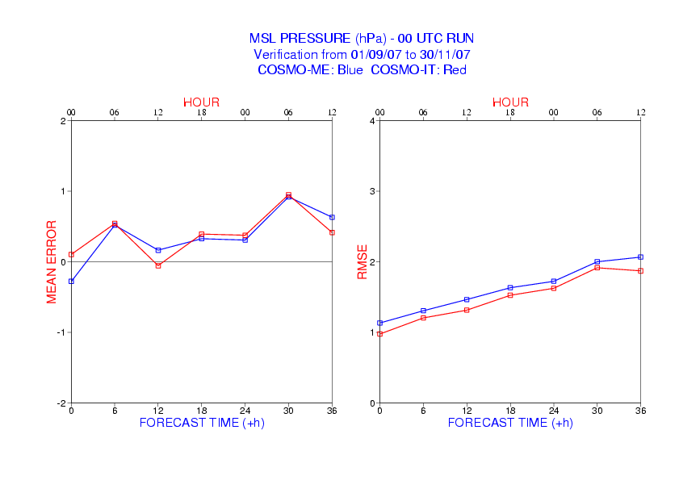
SON 2007
CIT - CME
10° COSMO General Meeting – Cracow 15-19 Sept 2008

Slide 15
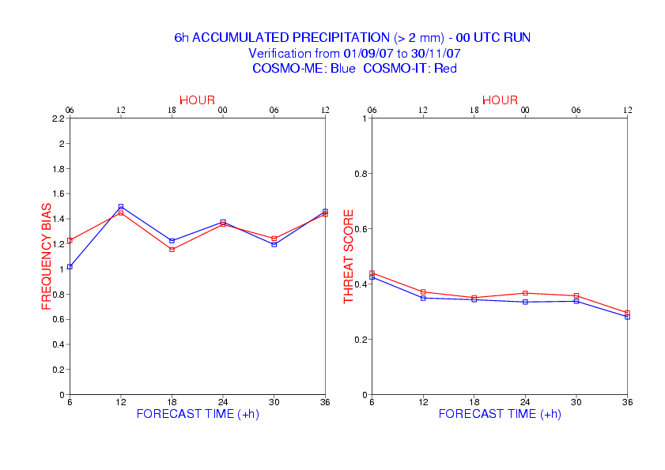
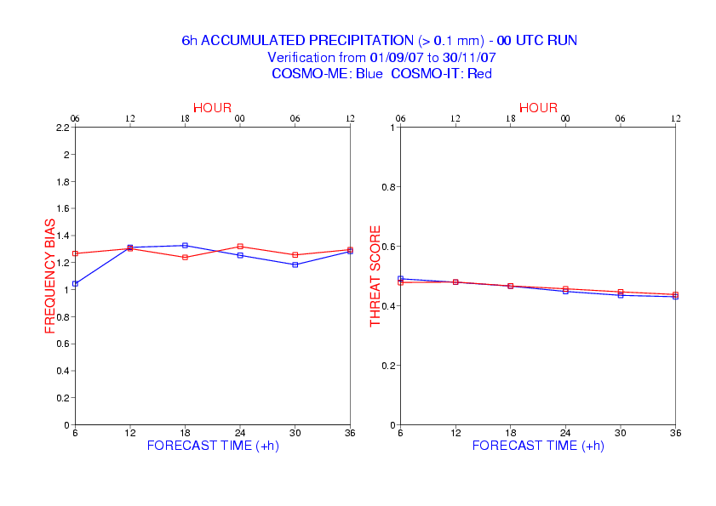
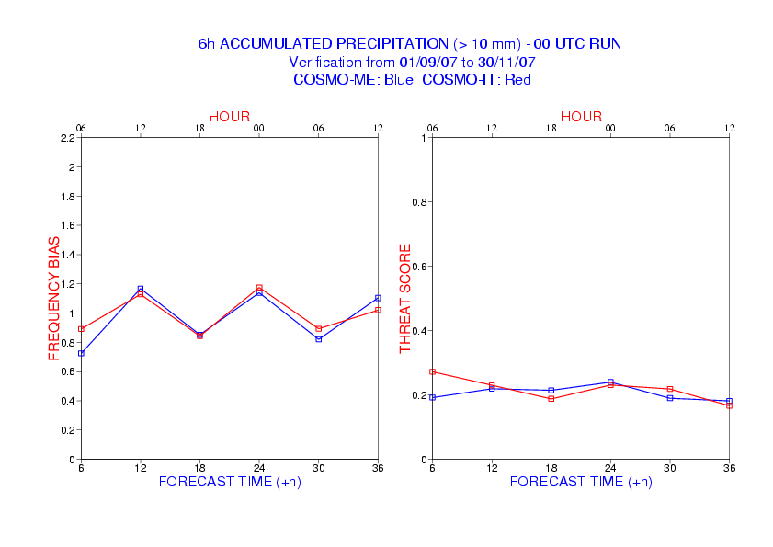
SON 2007
CIT - CME
10° COSMO General Meeting – Cracow 15-19 Sept 2008

Slide 16
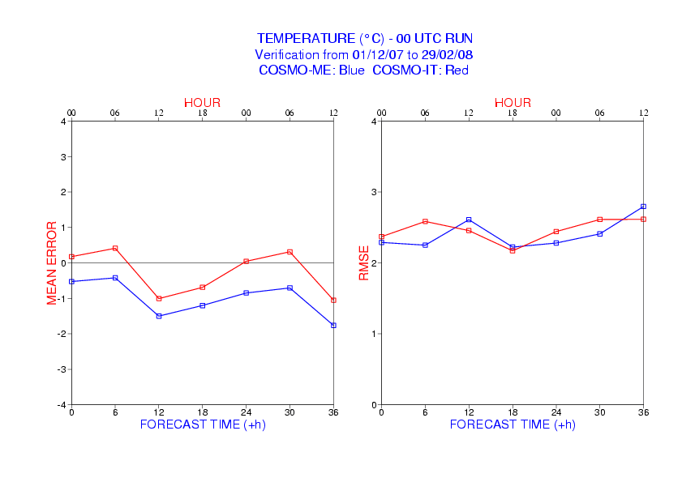
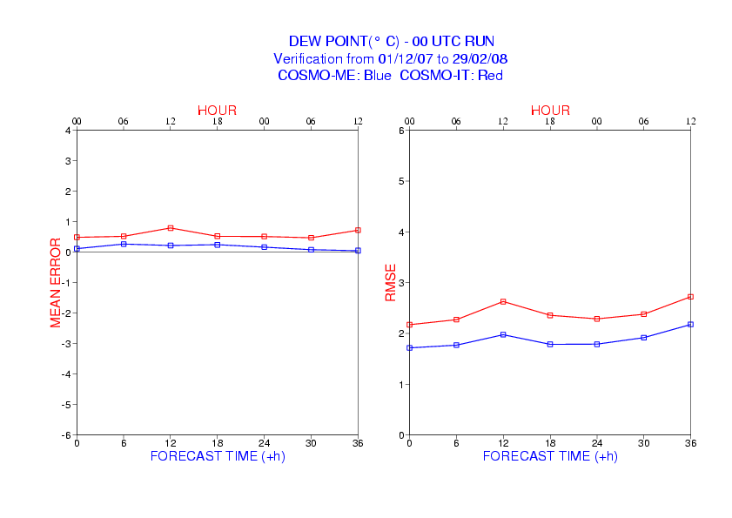
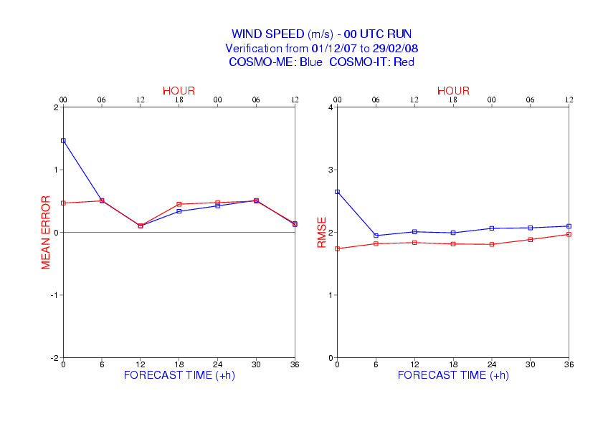
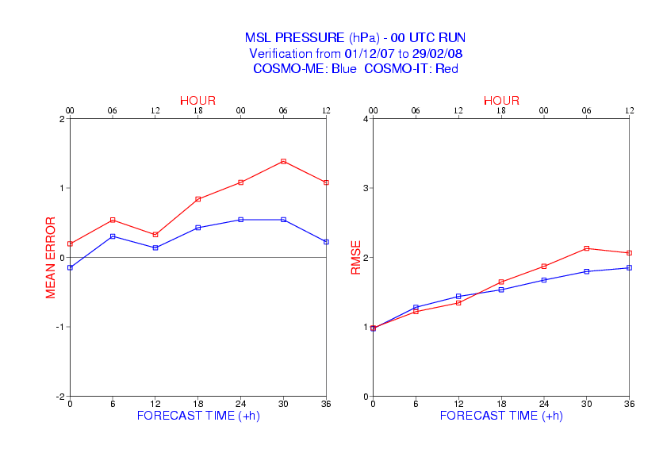
DJF 2007-2008
CIT - CME
10° COSMO General Meeting – Cracow 15-19 Sept 2008

Slide 17
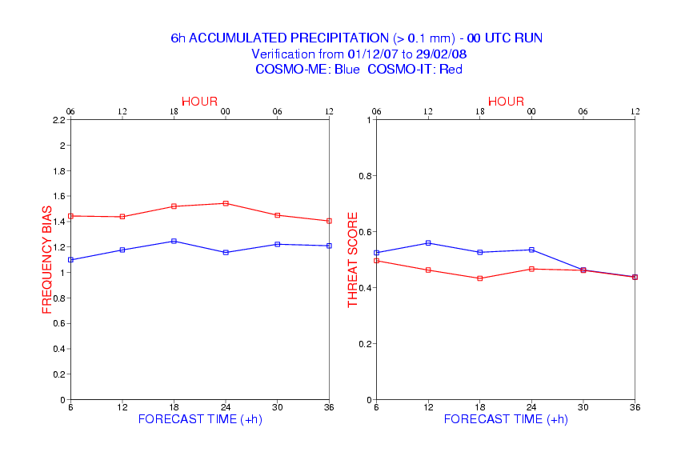

DJF 2007-2008
CIT - CME
10° COSMO General Meeting – Cracow 15-19 Sept 2008

Slide 18




MAM 2008
CIT - CME
10° COSMO General Meeting – Cracow 15-19 Sept 2008

Slide 19


MAM 2008
CIT - CME
10° COSMO General Meeting – Cracow 15-19 Sept 2008

Slide 20




JJA 2008
CIT - CME
10° COSMO General Meeting – Cracow 15-19 Sept 2008

Slide 21



JJA 2008
CIT - CME
10° COSMO General Meeting – Cracow 15-19 Sept 2008

Slide 22


CI7 – CME SON 2007
10° COSMO General Meeting – Cracow 15-19 Sept 2008

Slide 23


CI7 – CME DJF 2007-08
10° COSMO General Meeting – Cracow 15-19 Sept 2008

Slide 24


CI7 – CME MAM 2008
10° COSMO General Meeting – Cracow 15-19 Sept 2008

Slide 25


CI7 – CME JJA 2008
10° COSMO General Meeting – Cracow 15-19 Sept 2008

