Slide 1
VERIFICATION Highligths by WG5

Slide 2
Working package/Task on “standardization”
The “core”
Continuous parameters:
T2m, Td2m, Mslp, Wspeed
ME, RMSE
period Monthly means and SON, DJF, MAM, JJA (if possible)
at least 00 UTC run
Precipitation:
6h, 12 h and 24 cumulated
thresholds 0,2 2 5 10 mm/6h and mm/12h
thresholds 0,2 2 10 20 mm/24h
scores FBI, ETS

Slide 3
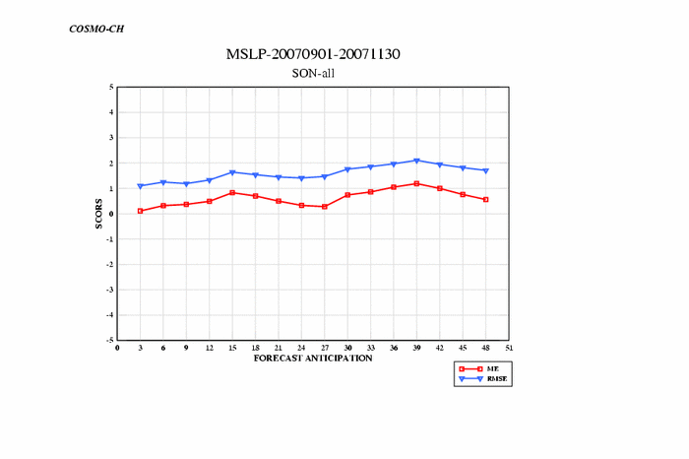
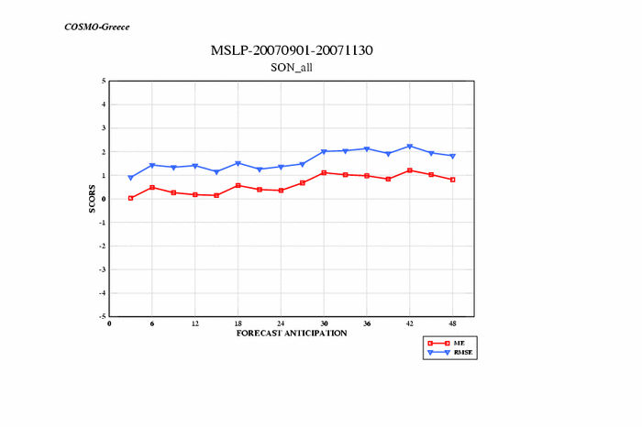
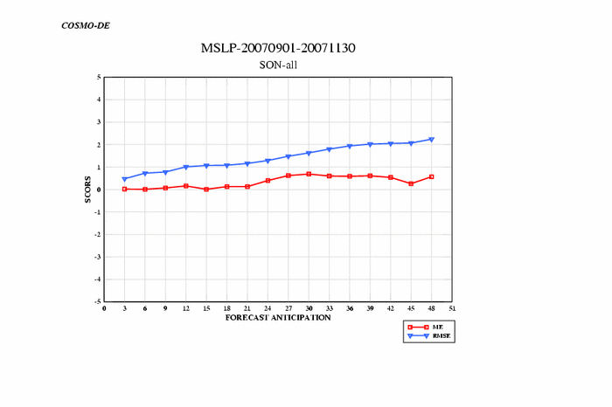
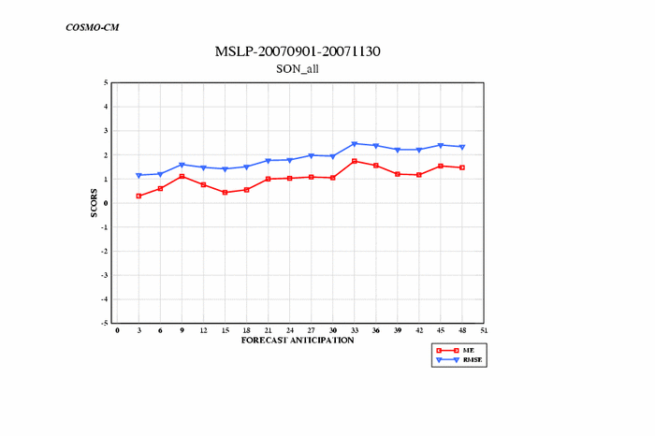
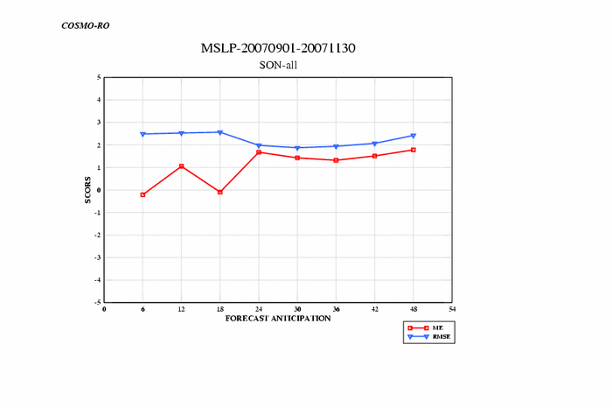
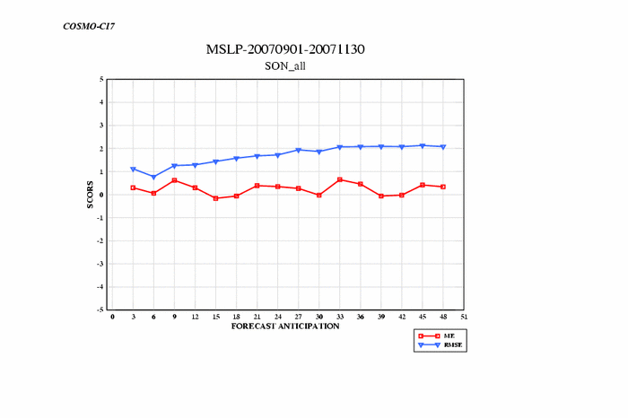
SON
MSLP

Slide 4
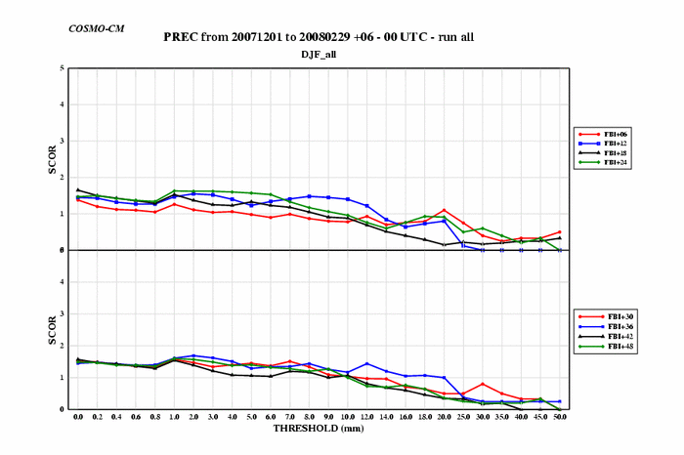
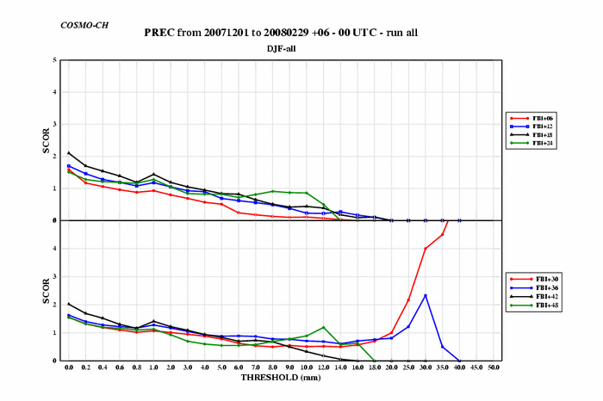
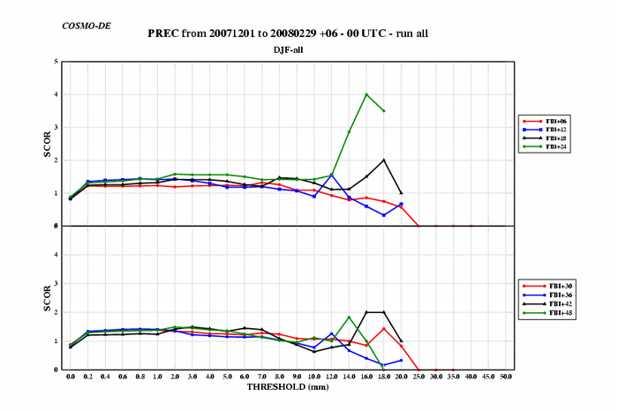
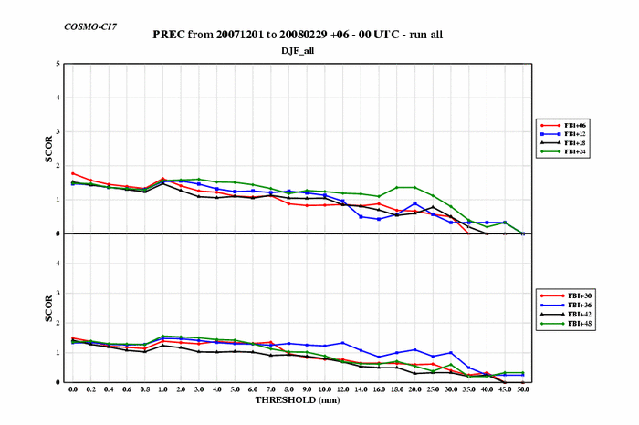
DJF
PREC
FBI

Slide 5
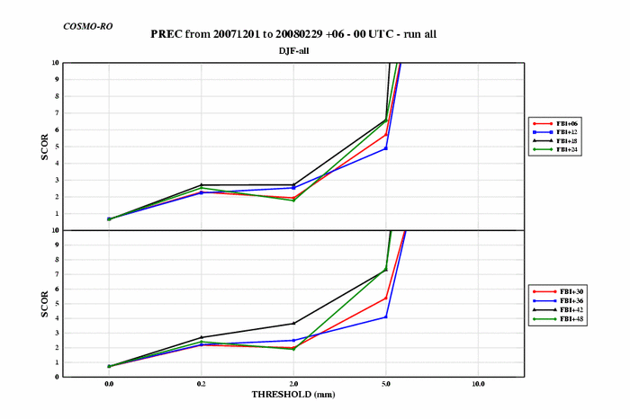
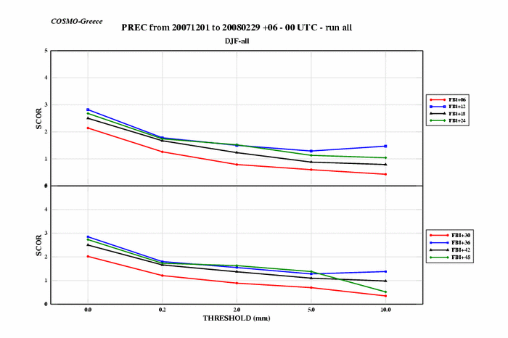
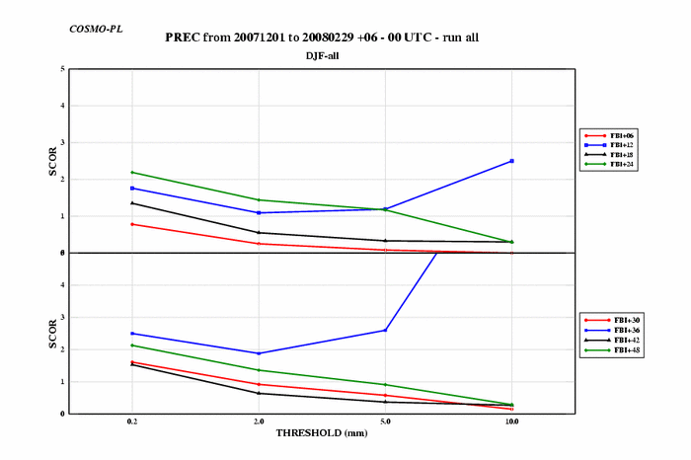
DJF
PREC
FBI

Slide 6
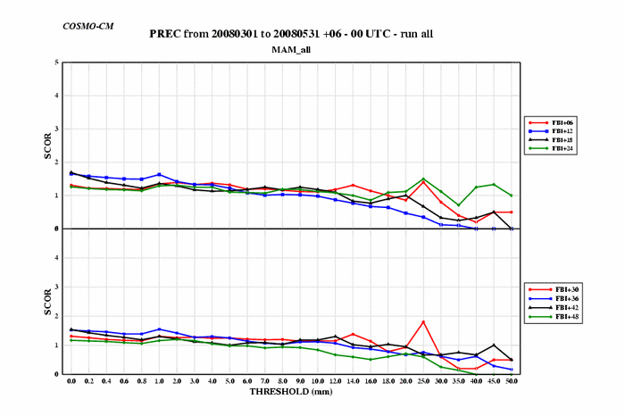
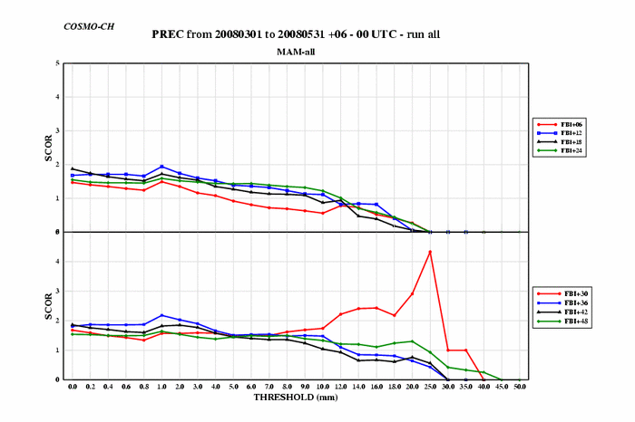
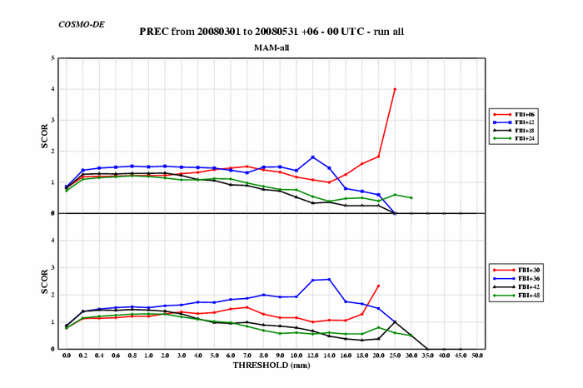
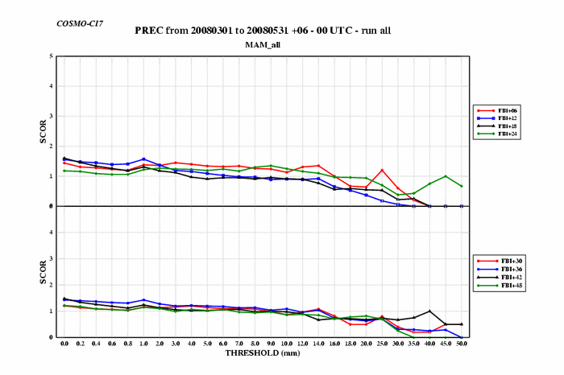
MAM
PREC
FBI

Slide 7
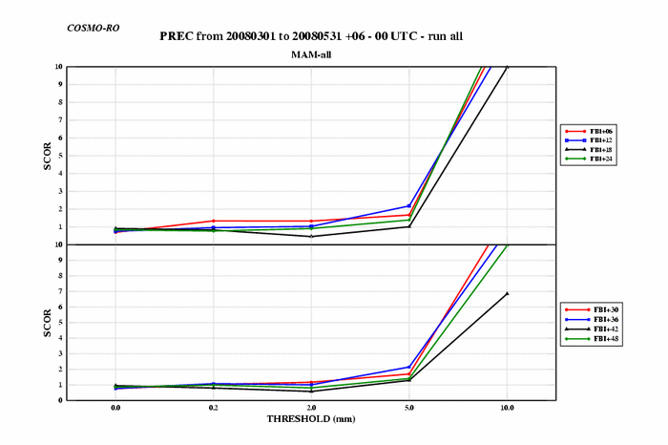
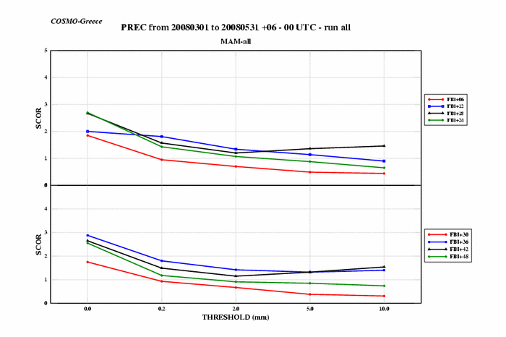
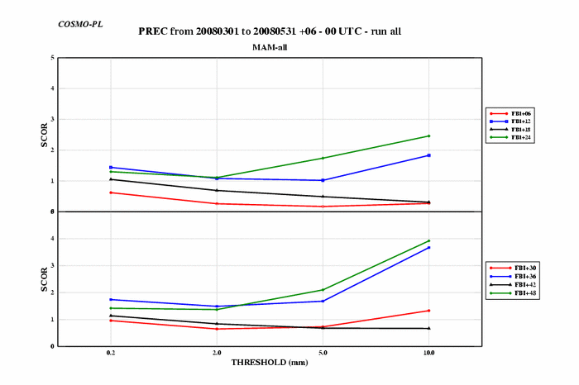
MAM
PREC
FBI

Slide 8
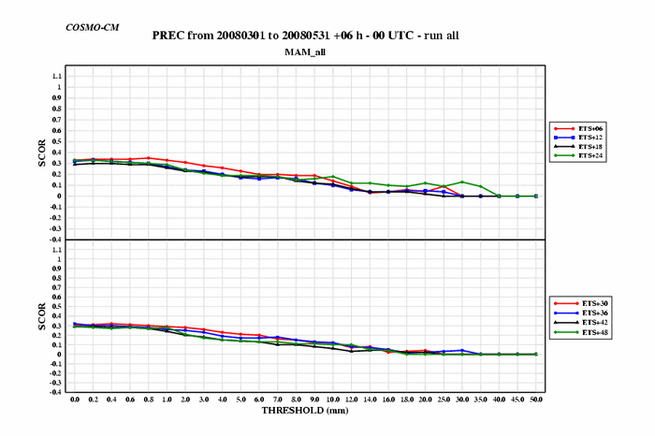
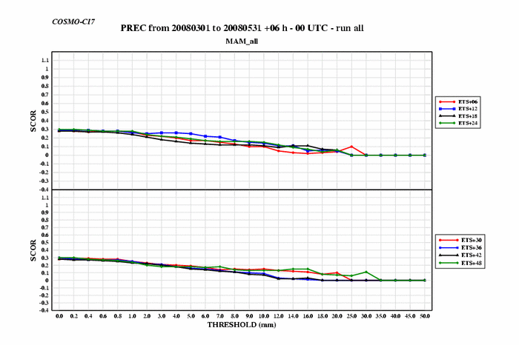
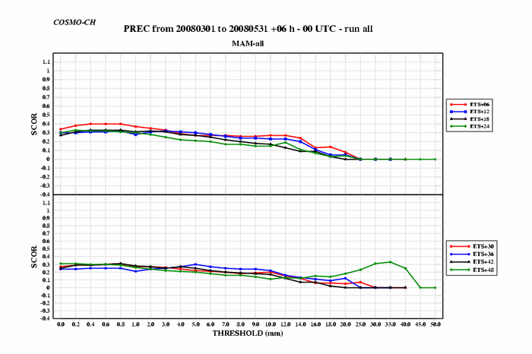
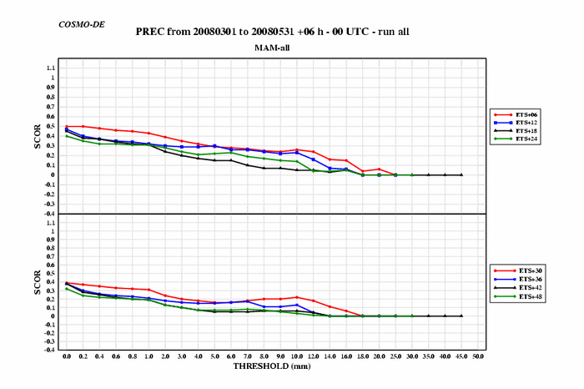
MAM
PREC
ETS

Slide 9
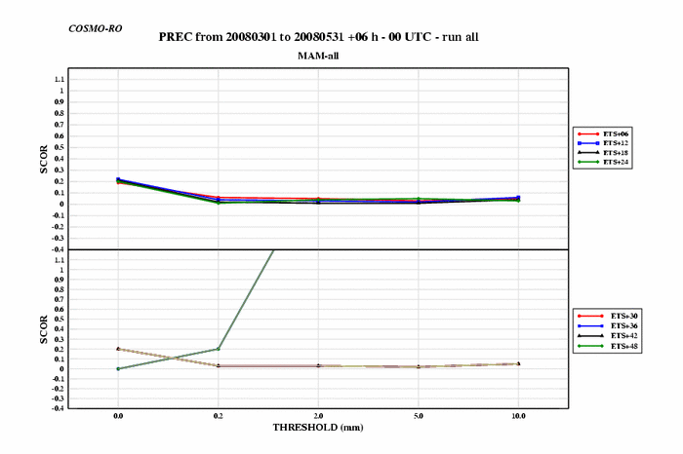
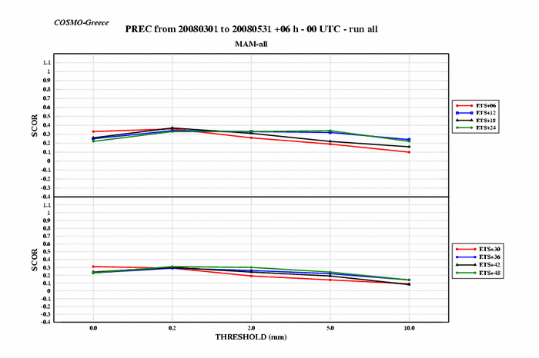
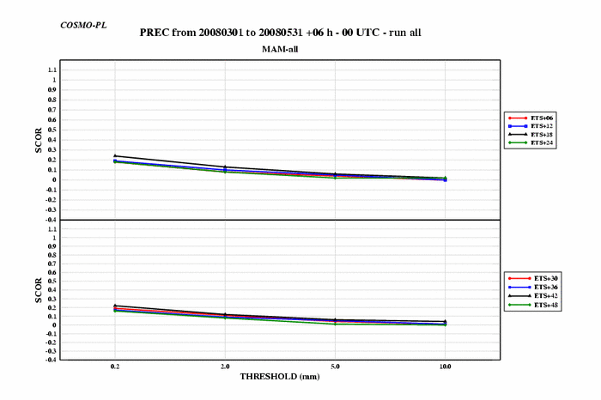
MAM
PREC
ETS

Slide 10
Monthly precipitation, model, stations, January 2008
Minimum: 35.34
25%-tile: 51.65
Median: 64.49
75%-tile: 72.95
Maximum: 110.62
Minimum: 0
25%-tile: 36
Median: 47.5
75%-tile: 61.3
Maximum: 157

Slide 11
Monthly precipitation, model, stations, April 2008
Minimum: 29.42
25%-tile: 50.14
Median: 59.26
75%-tile: 77.66
Maximum: 118.47
Minimum: 0
25%-tile: 36.2
Median: 49.3
75%-tile: 66
Maximum: 133.3

Slide 12
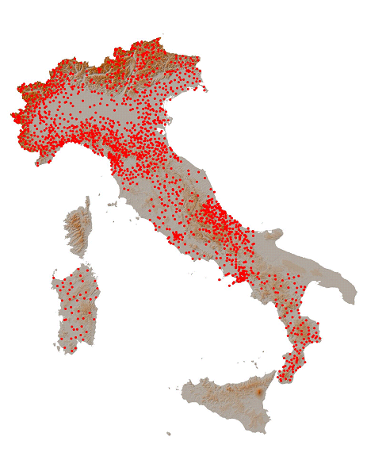
Precipitation verification comparison among COSMO-I7, COSMO-EU, COSMO-7, COSMO-ME, COSMO-I2, COSMO-IT
(Elena Oberto, Massimo Milelli - ARPA Piemonte)
QPF verification of the 4 model versions at 7 km res. (COSMO-I7, COSMO-7, COSMO-EU, COSMO-ME) with the 2 model versions at 2 km res. (COSMO-I2, COSMO-IT)
Specifications:
Dataset: high resolution network of rain gauges coming from COSMO dataset and Civil Protection Department → 1300 stations
Method: 24h/6h averaged cumulated precipitation value over 90 meteo-hydrological basins

Slide 13
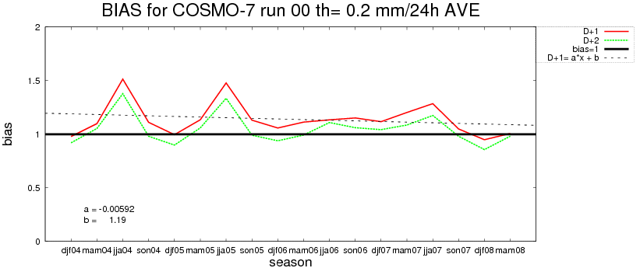
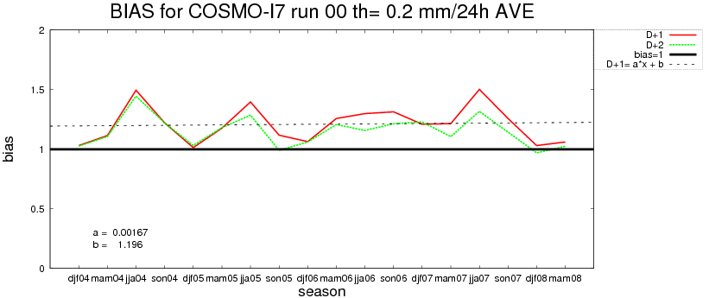
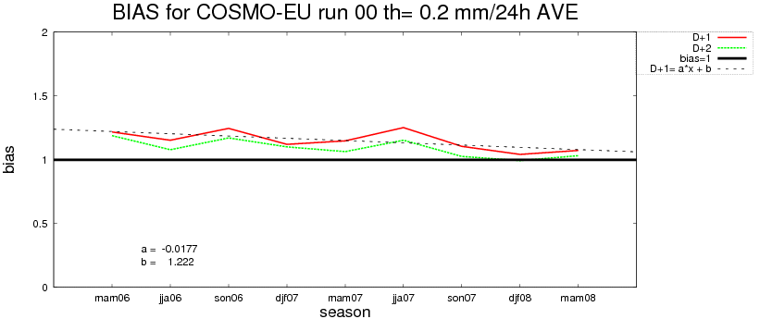
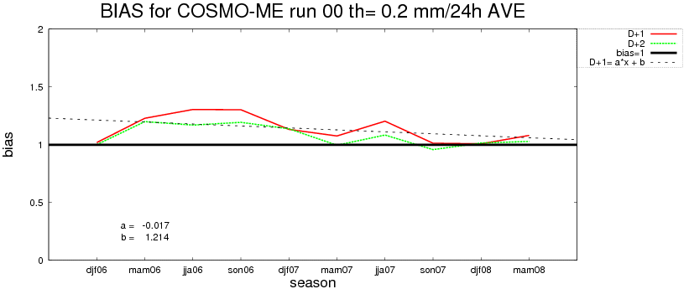
Seasonal trends BIAS th 0.2mm/24h

Slide 14
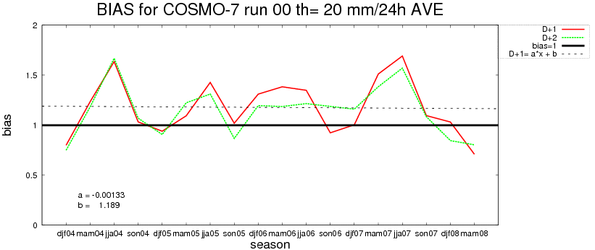
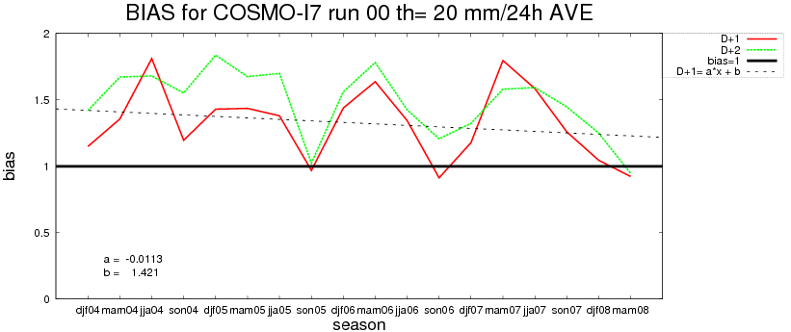
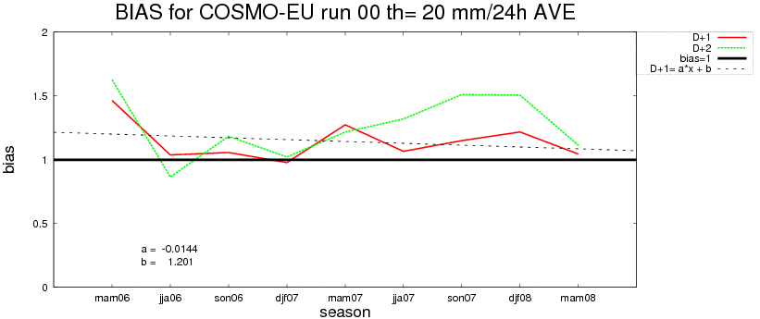
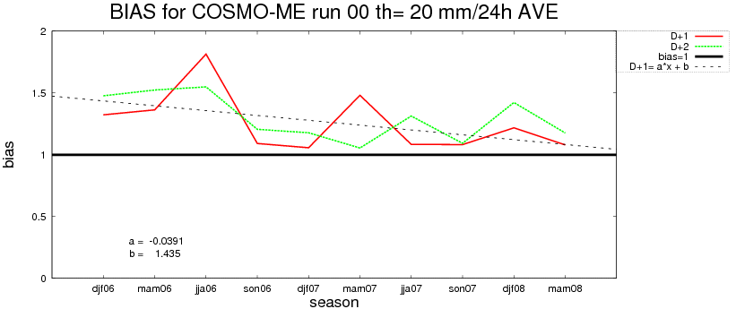
Seasonal trends BIAS th 20mm/24h

Slide 15
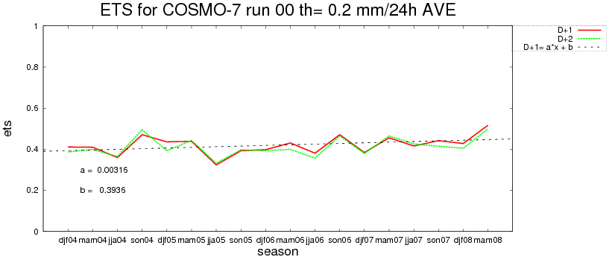
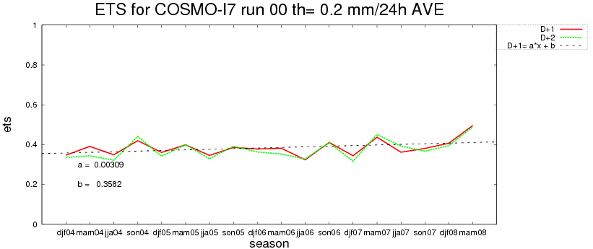
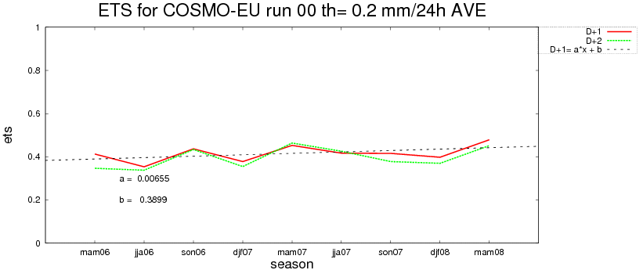
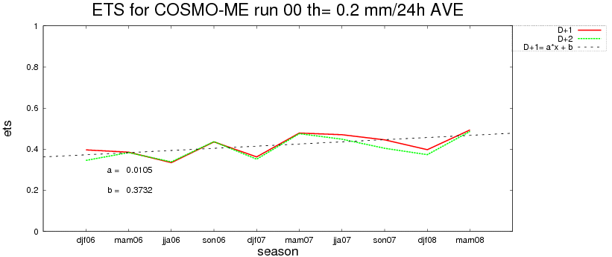
Seasonal trends ETS th 0.2mm/24h

Slide 16
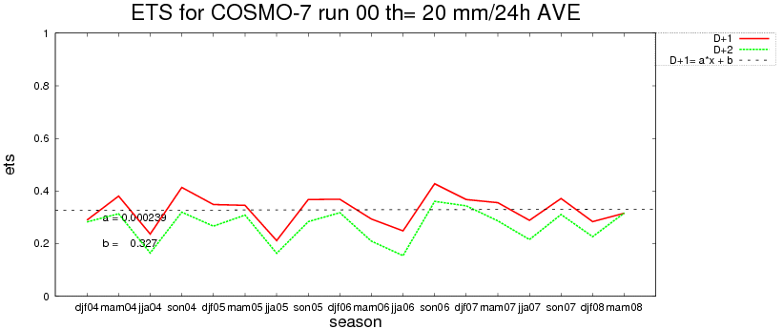
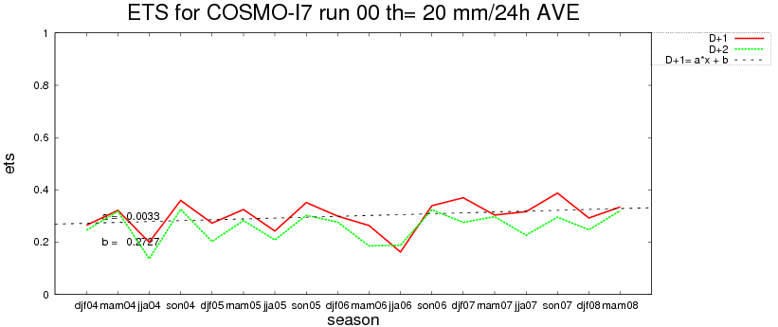
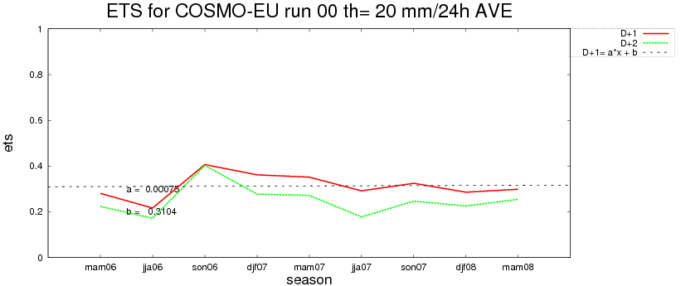
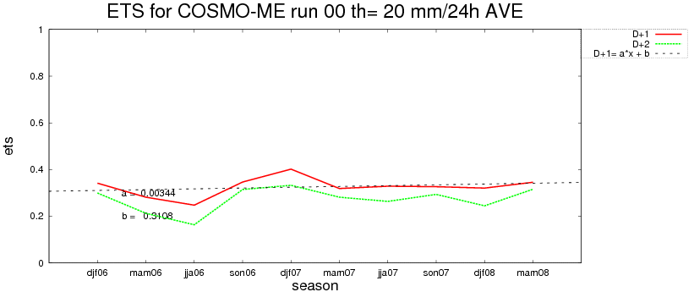
Seasonal trends ETS th 20mm/24h

Slide 17
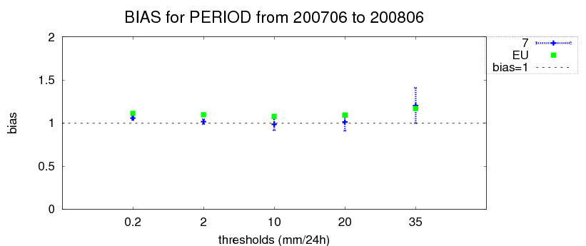
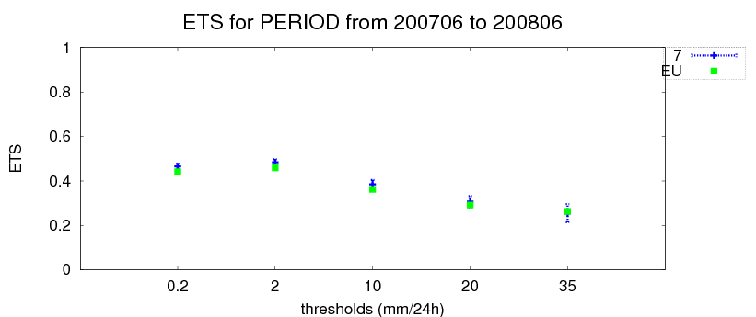
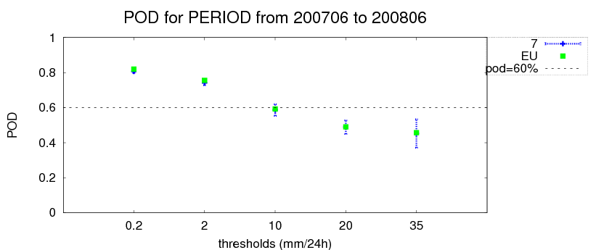
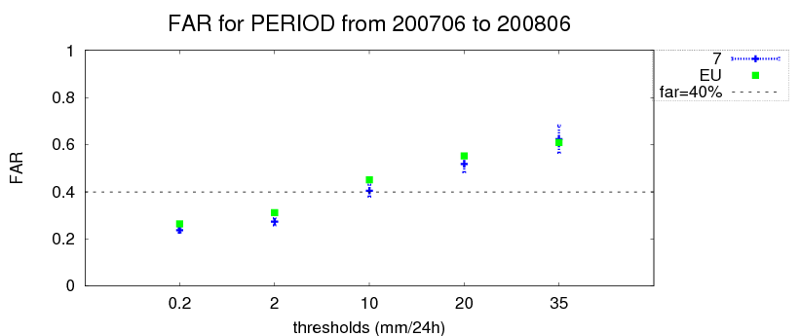
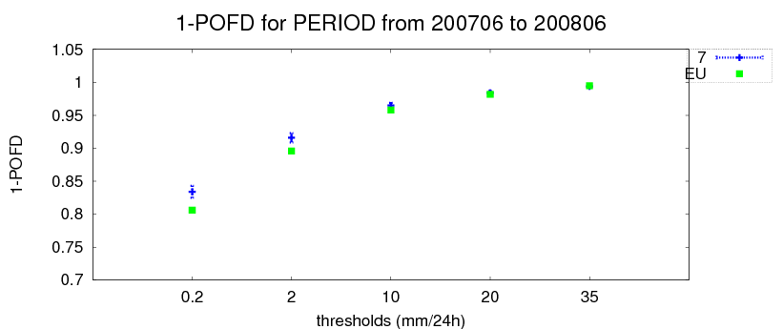
Not so strong differences
COSMO-7 sligtly better on average

Slide 18
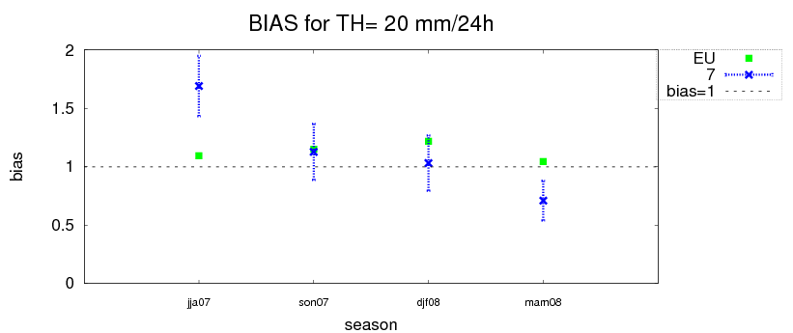
Strong differences during the single season
COSMO-EU quite stable overestimation
COSMO-7 bias and pod decrease (far reduction)

Slide 19
Not so strong differences
COSMO-ME sligtly better on average

Slide 20
Strong differences during the single season
COSMO-ME quite stable overestimation
COSMO-I7 bias and pod decrease

Slide 21
COSMO-I2 sligtly better on average

Slide 22
COSMO-I2 trend seems to follow COSMO-I7 trend
COSMO-I2 worsening: strong positive bias last summer (deep convection on), negative bias this spring (deep convection off)

Slide 23
No significant differences

Slide 24
Generally the same trend
bias > 1
Sligltly improvement for pod, ets,far

Slide 25
Bias overestimation peak during midday
Best value peak for pod, ets, far during afternoon
Spin-up problem for all the models especially COSMO-I7 and COSMO-I2

Slide 26
General worsening with forecast time
The spin-up seems to disappear except for COSMO-I2
Anomalous behaviour for COSMO-I2
COSMO-7 underestimates

Slide 27
SON 2007
CIT - CME
10° COSMO General Meeting – Cracow 15-19 Sept 2008

Slide 28
SON 2007
CIT - CME
10° COSMO General Meeting – Cracow 15-19 Sept 2008

Slide 29
DJF 2007-2008
CIT - CME
10° COSMO General Meeting – Cracow 15-19 Sept 2008

Slide 30
DJF 2007-2008
CIT - CME
10° COSMO General Meeting – Cracow 15-19 Sept 2008

Slide 31
MAM 2008
CIT - CME
10° COSMO General Meeting – Cracow 15-19 Sept 2008

Slide 32
MAM 2008
CIT - CME
10° COSMO General Meeting – Cracow 15-19 Sept 2008

Slide 33
JJA 2008
CIT - CME
10° COSMO General Meeting – Cracow 15-19 Sept 2008

Slide 34
JJA 2008
CIT - CME
10° COSMO General Meeting – Cracow 15-19 Sept 2008

Slide 35
RMSE of Tmax 2m September 2006 - August 2007, COSMO-DE, vv=18, and vv =42, Start 00 UTC

Slide 36
RMSE of Tmax 2m September 2007 - August 2008, COSMO-DE, vv=18, and vv =42, Start 00 UTC
Introduction of
new diagnosis for T2m

Slide 37
The effect of new diagnosis of 2m temperature on forecast quality of COSMO-EU‘s maximum temperature over Germany

Slide 38
2m temperature diagnostics impact on mean diurnal cycle
Summer 2007 Summer 2008
The (well known) errors of:
- too strong temperature increase in the morning - maxima reached ~ 1.5-2 h too early is removed with the new 2m temperature diagnostics (introduced operationally 09.06.08)

Slide 39
The effect of new diagnosis gusts on forecast quality of COSMO-EU‘s gusts over Germany
2006:
Mean of observation: 6.8 m/s
Mean of forecast : 8.8 m/s
RMSE at 72 h :4.2 m/s

Slide 40
The effect of new diagnosis gusts on forecast quality of COSMO-EU‘s gusts over Germany
2006:
Mean of observation: 6.8 m/s
Mean of forecast : 8.8 m/s
RMSE at 72 h :4.2 m/s
2008:
Mean of observation: 6.6 m/s
Mean of forecast : 7.7 m/s
RMSE at 72 h :3.5 m/s

Slide 41
windgust: old vs new for 16.01.-17.03.08

Slide 42
windgust: old vs new for 16.01.-17.03.08

Slide 43
Verification global radiation: Kloten

Slide 44
Verification global radiation: Kloten

Slide 45
Comparison of all operational models at HNMS

Slide 46
Precipitation statistical scores…

Slide 47
Observations: Autumns 2005-2007
North-West North Appenine N-East Centre of Italy Sout of Italy Sardinia
99 th perc
90 th perc
ECMWF AUT2005-2007

Slide 48
COSMO-I7: Autumns 2005-2007
North-West North Appenine N-East Centre of Italy Sout of Italy Sardinia

Slide 49
ECMWF: Autumns 2005-2007
North-West North Appenine N-East Centre of Italy Sout of Italy Sardinia
OSSERVATI AUTUNNO 2005-2007

Slide 50
Observations: Spring 2005-2006-2007
North-West North Appenine N-East Centre of Italy Sout of Italy Sardinia

Slide 51
COSMO-I7: Spring 2005-2006-2007
North-West North Appenine N-East Centre of Italy Sout of Italy Sardinia

Slide 52
Observations: Summer 2005-2006-2007
North-West North Appenine N-East Centre of Italy Sout of Italy Sardinia

Slide 53
COSMO-I7: Summer 2005-2006-2007
North-West North Appenine N-East Centre of Italy Sout of Italy Sardinia

Slide 54
3. Use and interpretation of models
Forecasters: we all started to use WRF for precipitation!
mm/24h
COSMO-2
RADAR

Slide 55
To forecasters:
Please, give to COSMO model one more chance!
COSMO-IT (2.8km): CNMCA-Rome

