Slide 1
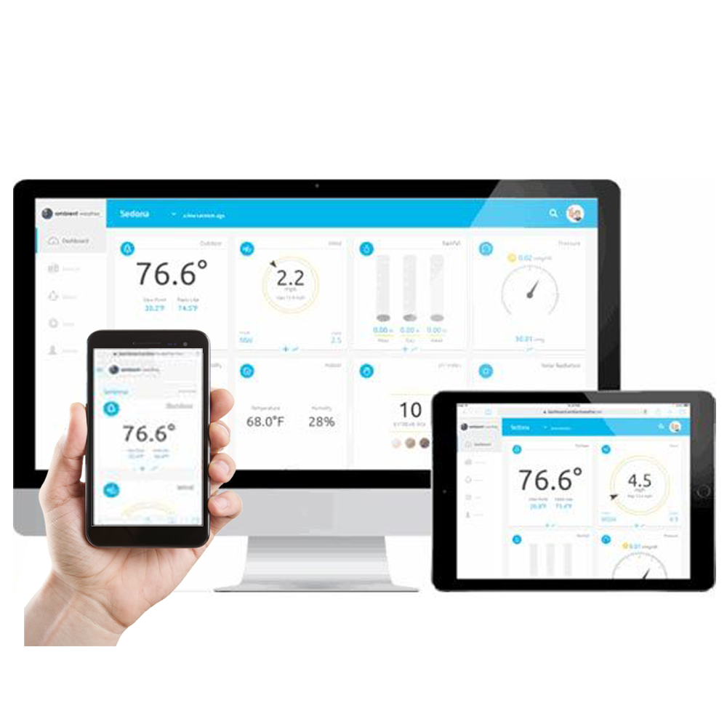
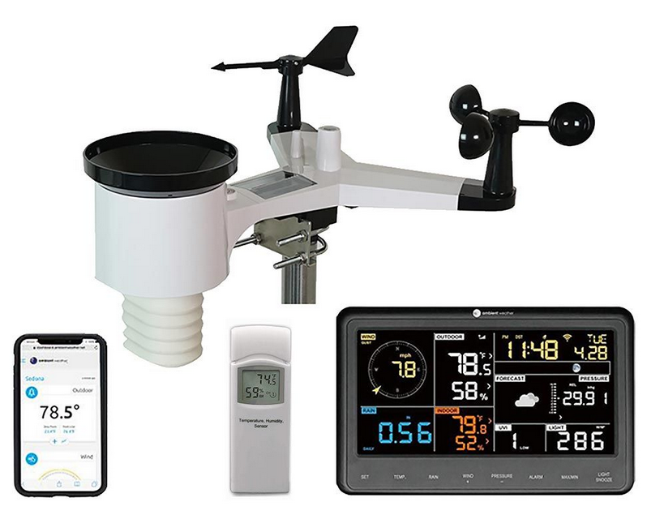
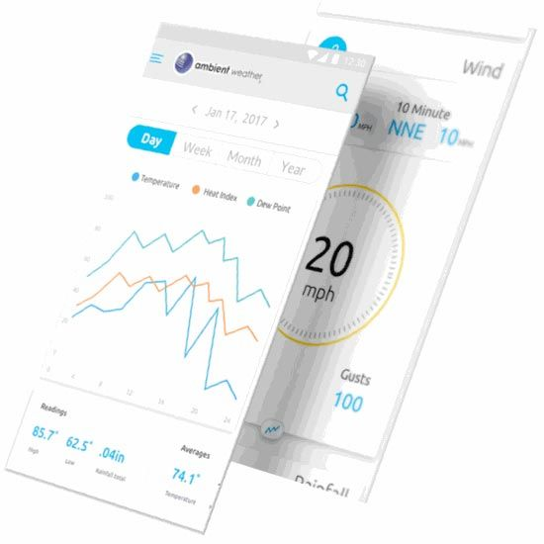
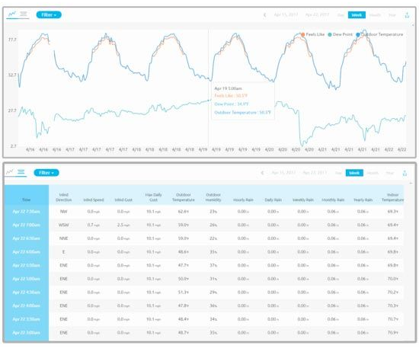
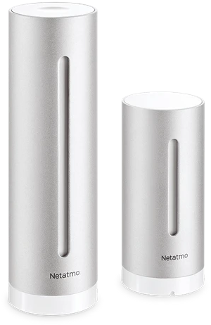
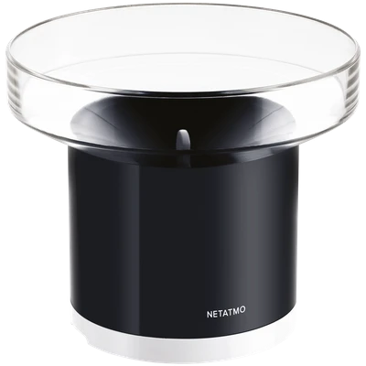
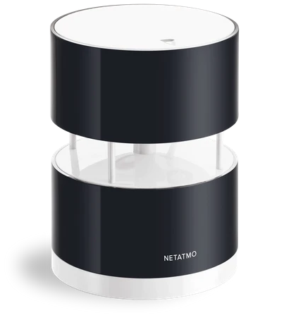
PWS (PERSONAL WEATHER STATION)
https://ambientweather.com/amws2902.html
https://www.netatmo.com

Slide 2
PWS SERVICES
Web service | PWS network in PL | Law | API | Frequency | Start
https://www.wunderground.com | >1000 | Non-commercial, individal usage | Yes, professional | 1-60min | 1995 (1993)
https://app.weathercloud.net | 773 | <30 dni: manualne sprawdzenie PWS >30dni: dane prywatne | No | 60min | 2015
https://www.awekas.at | 90 | Can not be usage | No | 60min | 2004
https://www.pwsweather.com https://www.aerisweather.com | 61 | Only commercial usage | Yes, professional | 1-30min | 2014
Subtask 1.1
Provide comprehensive survey of available data platforms at the European and Global level with the analysis of the API data access.
In relation to research activities in Italy (a doctorate project under way for the specific validation of the ICON model), a special attention will be made on PWS data related to the Meteonetwork and Centro Meteo Lombardo associations.
Especially, the second one is a very dense network that covers the area including and around Lombardy, subject to constant strict control by the members, characterized by the presence outside the inhabited centres, especially in very complex orography terrain.
The other aspect of the survey analysis are the legal limitations for data usage which may be a key issue in data application for the
research and operational use.
Web service | PWS network in PL | Law | API | Frequency | Start
https://openweathermap.org/ | b.d. | Non commercial up to 1 GET/min | Yes, professional | 1-60min | 2014
https://www.meteomatics.com | b.d. | Non commercial up to 0,3 GET/min | Tak, profesjonalne | 1-60min | 2012 (1979)
https://www.weatherapi.com/ | b.d. | Non commercial up to 0,4 GET/min | Tak, profesjonalne | 10-15min | 2019
https://www.google.com
https://medium.com/@imdipto/best-free-alternatives-to-the-wunderground-weather-api-21acb22450e6

Slide 3
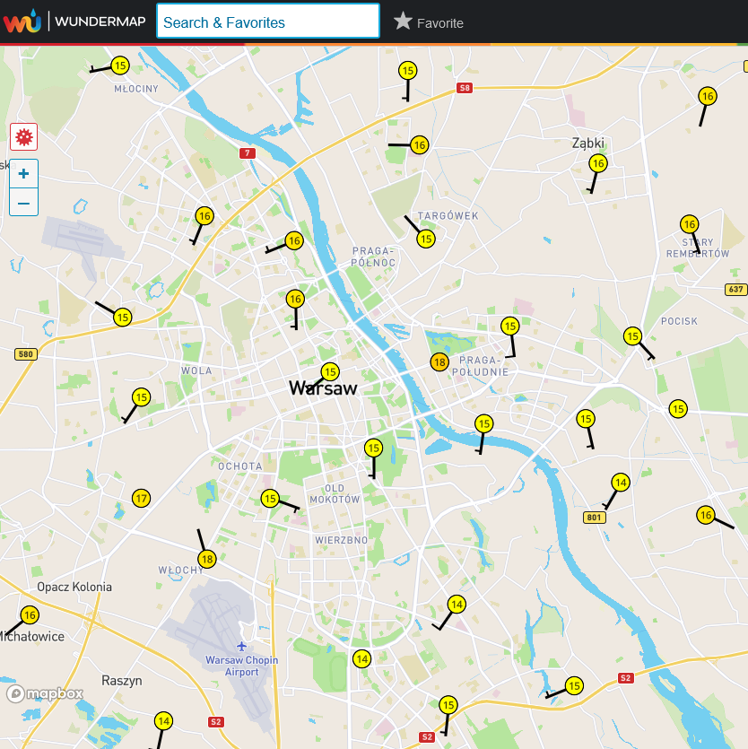
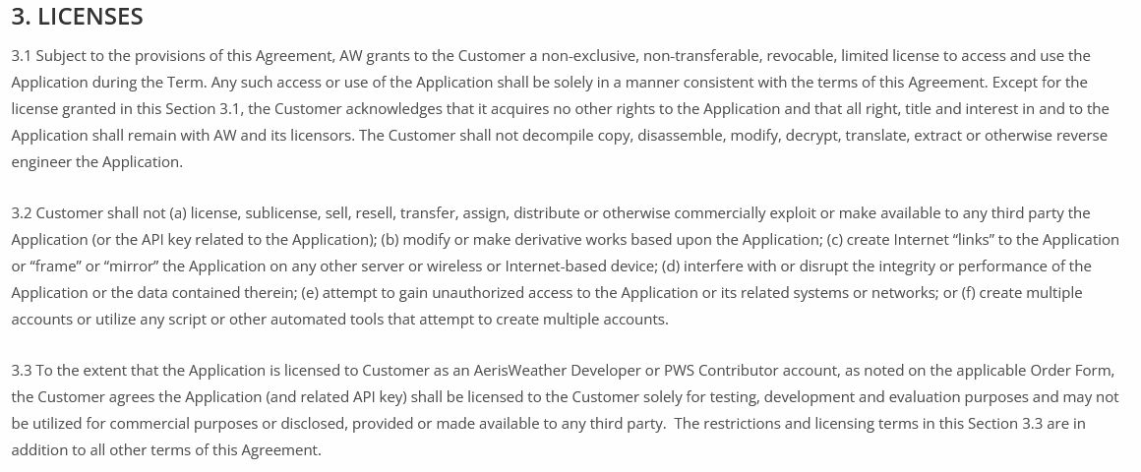
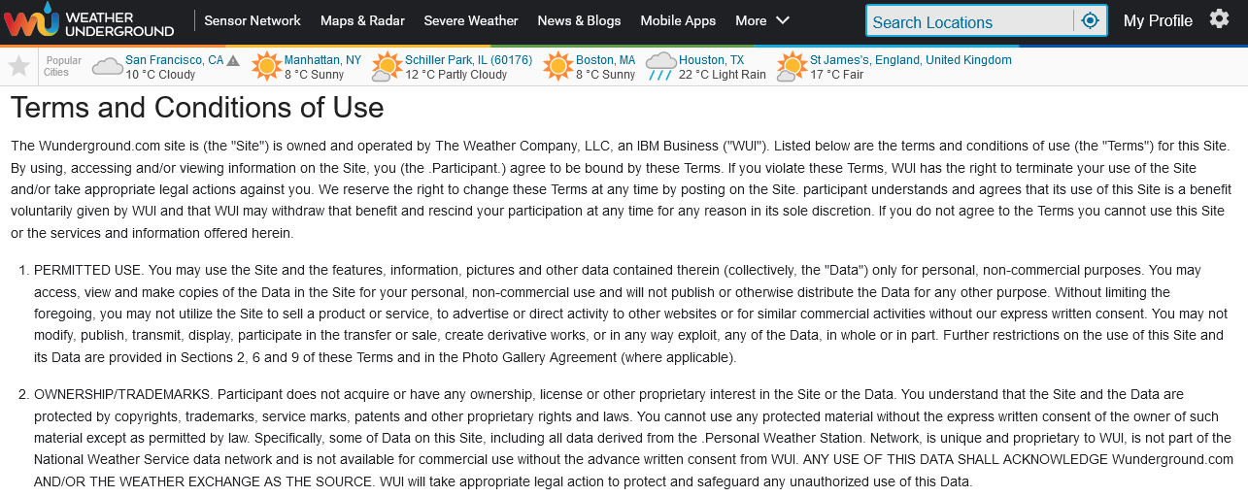
Tytuł prezentacji z tutaj
PWS SERVICES – NUMBERS OF STATIONS, LAW AND TERM OF USE
https://www.wunderground.com/wundermap

Slide 4
DATA ACCESS, API
POST
GET
DELETE
(CLIENTS) (API REQUEST) (API) (ENDPOINT API) (DATABASE)

Slide 5
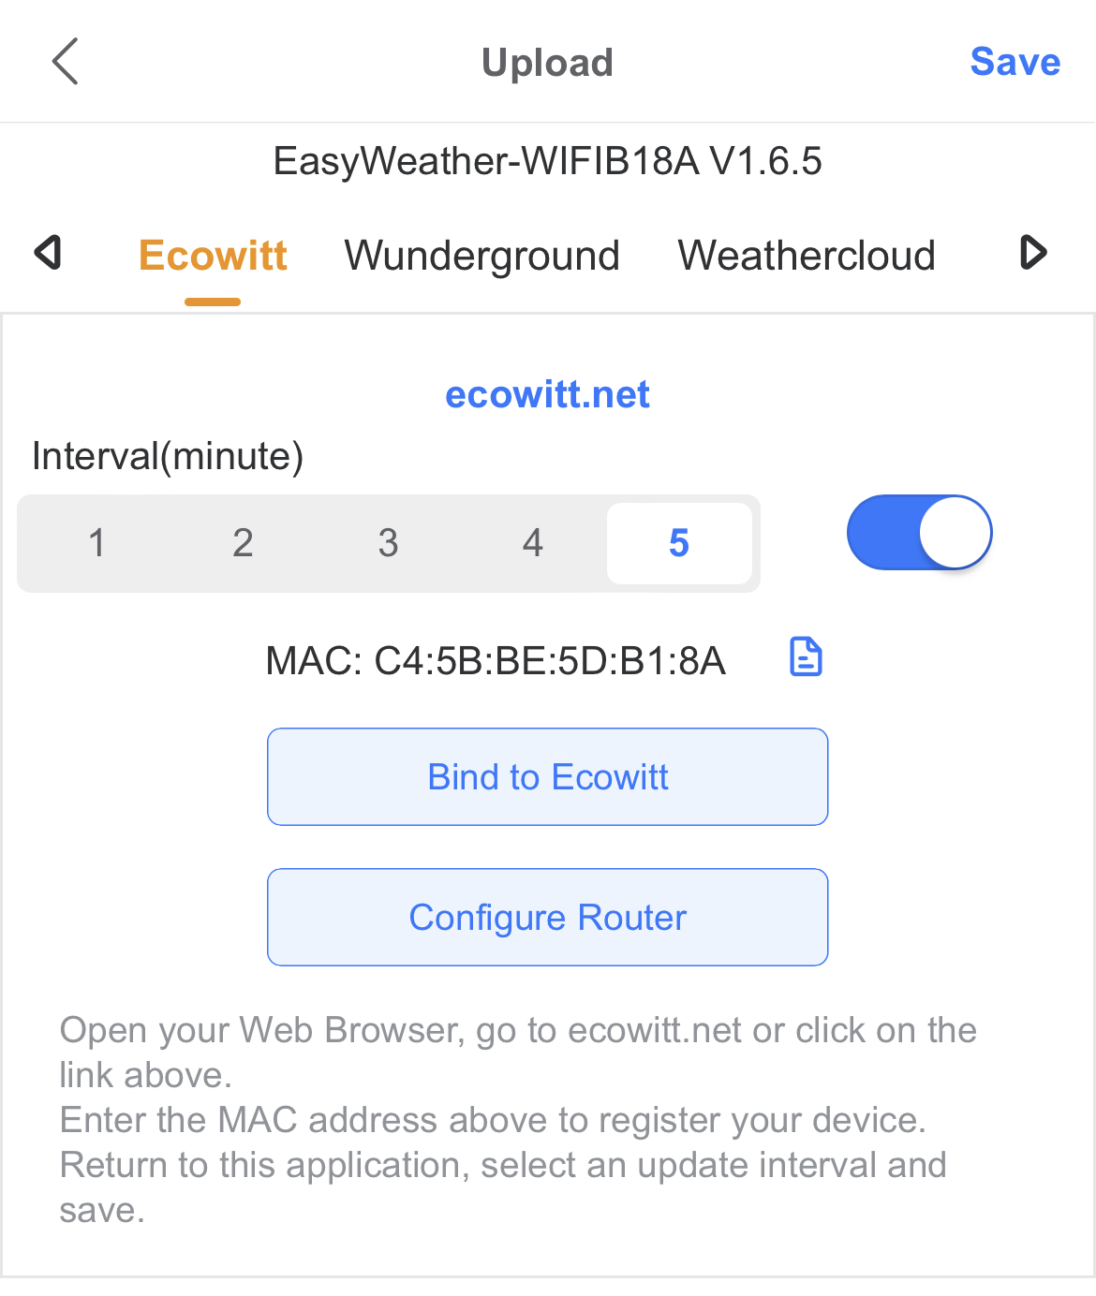
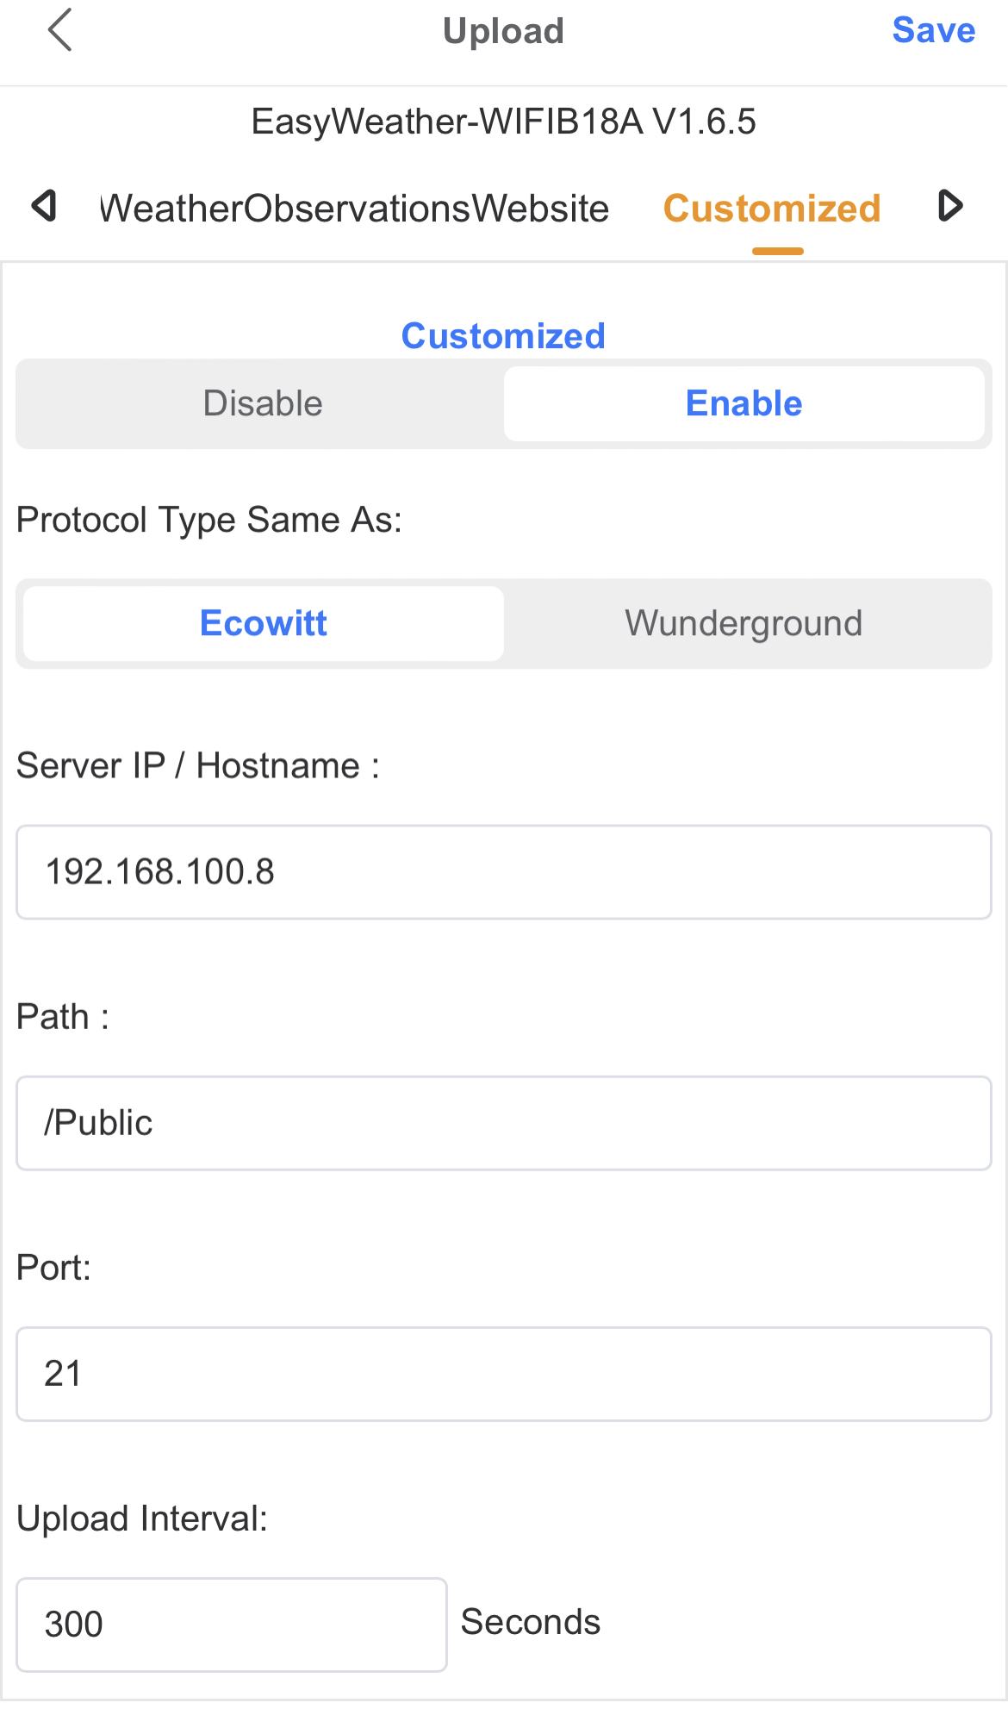
DATA ACCESS, API

Slide 6
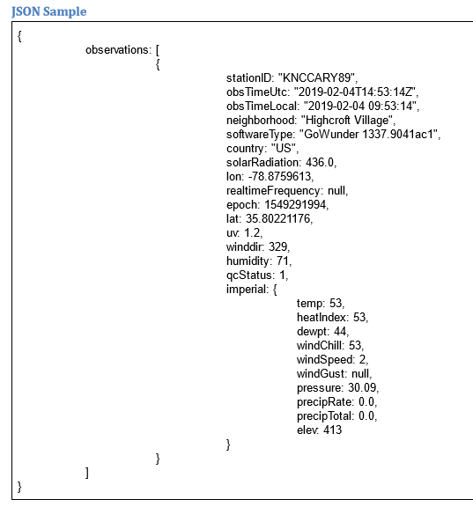
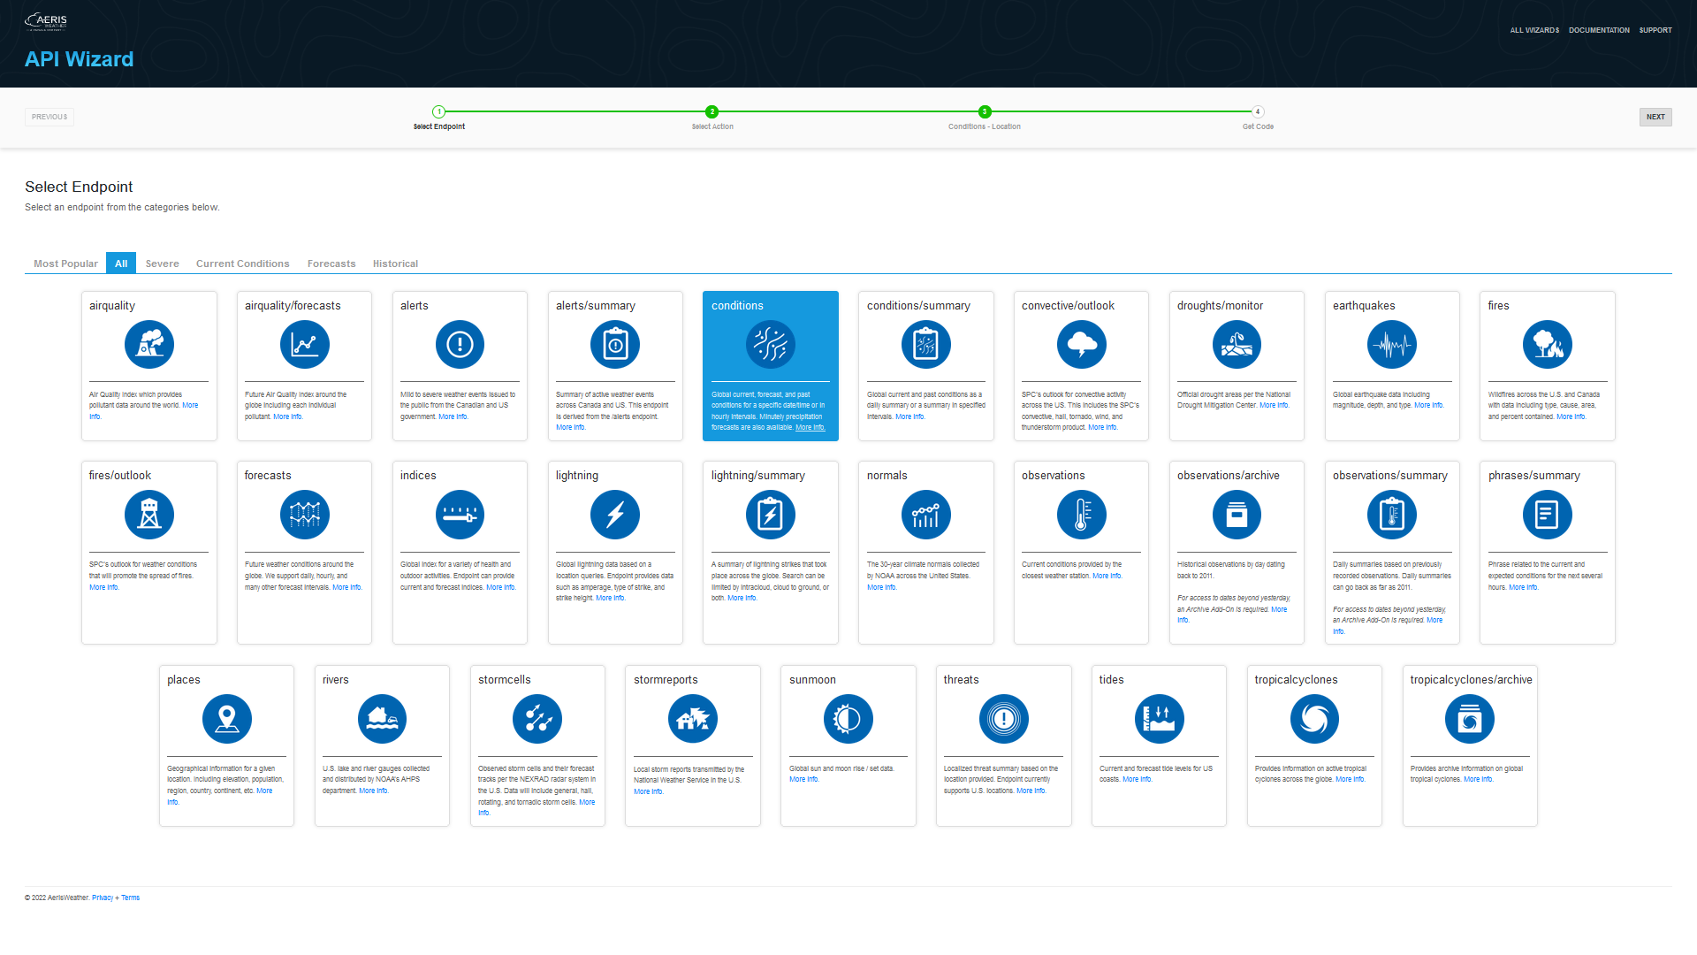
Tytuł prezentacji z tutaj
WEATHER UNDERGROUND (API ACCESS) – EXAMPLE OBSERVATIONS JSON
https://docs.google.com/document/d/1KGb8bTVYRsNgljnNH67AMhckY8AQT2FVwZ9urj8SWBs/edit#
https://www.aerisweather.com/wizard/product/api/

Slide 7
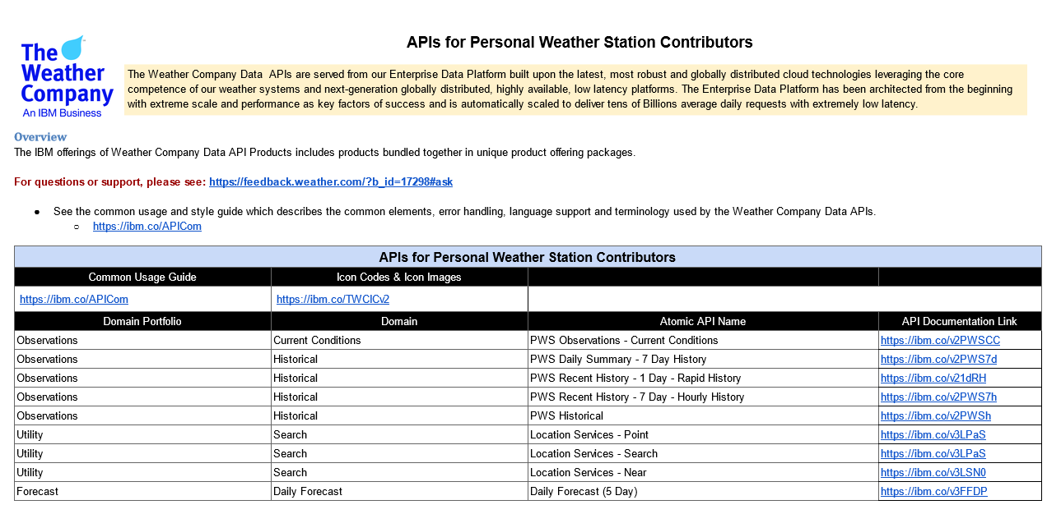
DATA ACCESS
Subtask 1.2
Testing the process of collection of a real-time PWS data (from IMGW-PIB employees that are using their own stations) by starting new internal database server. Several technical aspects will be explored as the efficient data formats for PWS imports (json, xml and other), applicability of an open source object-relational database systems (e.g. PostgreSQL), efficient solutions for GUI development with web frameworks (e.g. React), drawing charts and graphs with the stored data.
The experiences gained in this task will be collected in the documentation and useful software samples available to other COSMO partners (Git and doc), which may be interested in the development of their own local PWS databases.
With API user have access to data, f.e:
https://api.weather.com/v2/pws/observations/all/1day?stationId=IMAZOWIE62&format=json&units=e&apiKey= [CLIENT_SECRET]
Station ID:
Access to API with no errors:

Slide 8
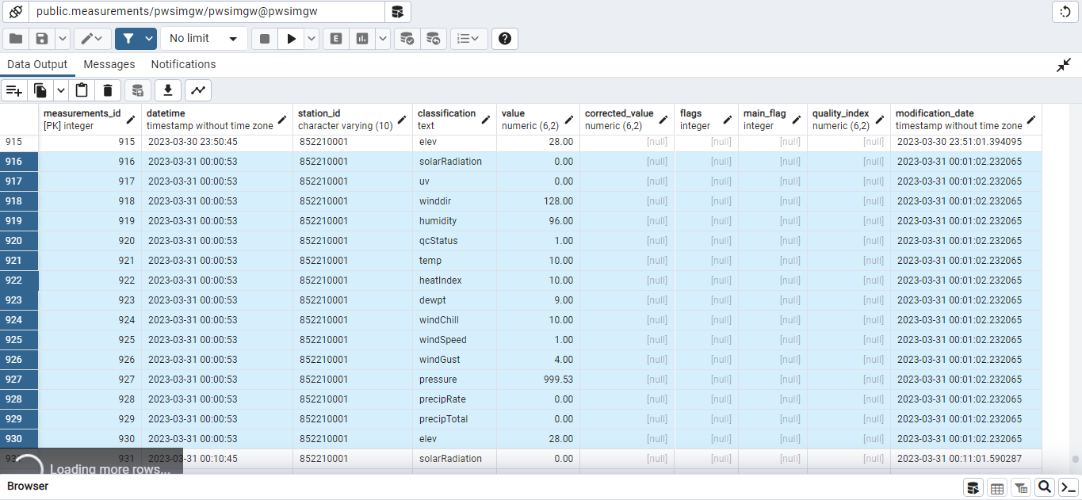
STORAGE IN IMGW DATABASE
data are storage in non SQL test database (pwsimgw),
DB frequency is 10min with all available parameters:
measure_id, datatime, station_id, classification with value (solarRadiation, UV, wind,
humdity, temp, heat, precip, elevation), non used now flags
(corrected, quality and modification date)
Subtask 1.3
In this task data stored in the PWS database will be tested for its integrity and correctness, by the incorporation of the appropriate QC algorithms within the database framework. The database developed at IMGW-PIB may also be further considered for other research purposes, including collection and processing of the PWS data from other COSMO partners. For this purpose, Task 1.3 will also explore the possibility of cooperation with other external research units, e.g. Cenagis (Centre for Scientific Geospatial Analyses and Satellite Computations), which provides an infrastructure as for the backup PWD database.

Slide 9
Dziękuję / Thank you Marcin Grzelczyk, Centrum Modelowania Meteorologicznego, Zakład Prognoz Numerycznych COSMO 26/04/2023, online

