Slide 1
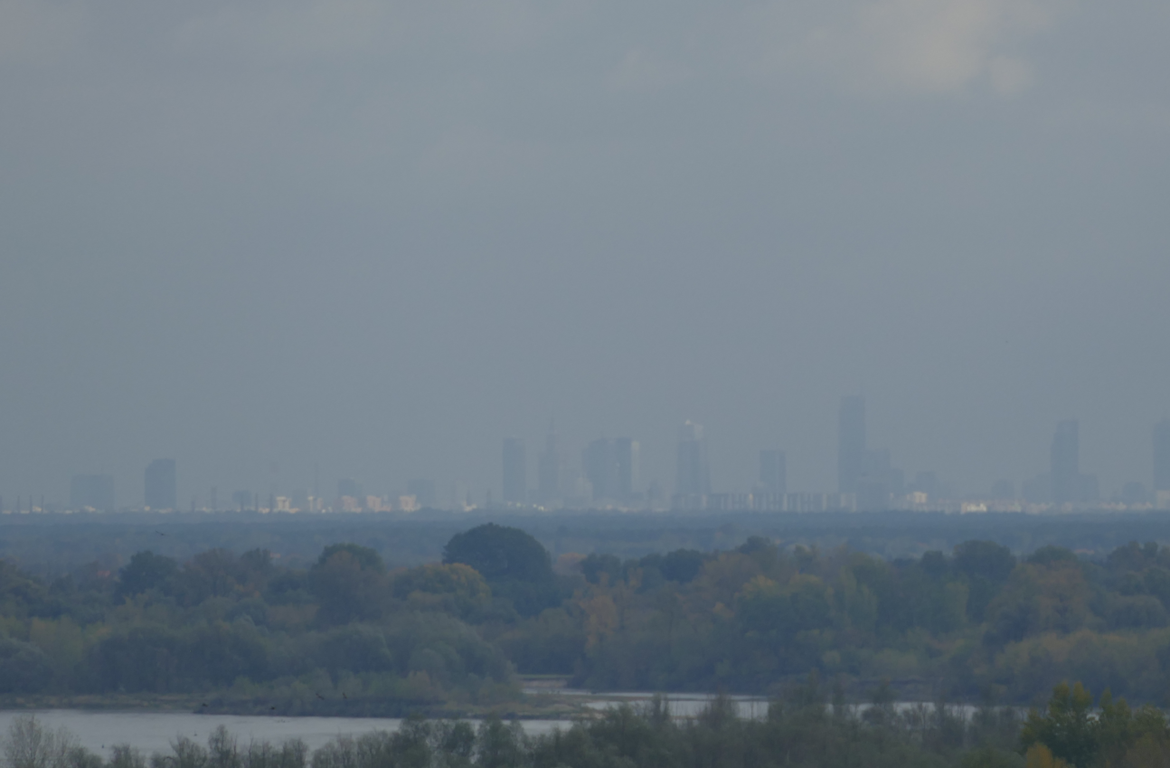
Task 3. Numerical experiments
Subtask 3.6: Warsaw
Andrzej Wyszogrodzki, Witold Interewicz, Adam Jaczewski
IMWM - Centre of Numerical Weather Prediction 22/02/2023, COSMO PP CITTA Meeting
photo by: Adam Jaczewski

Slide 2
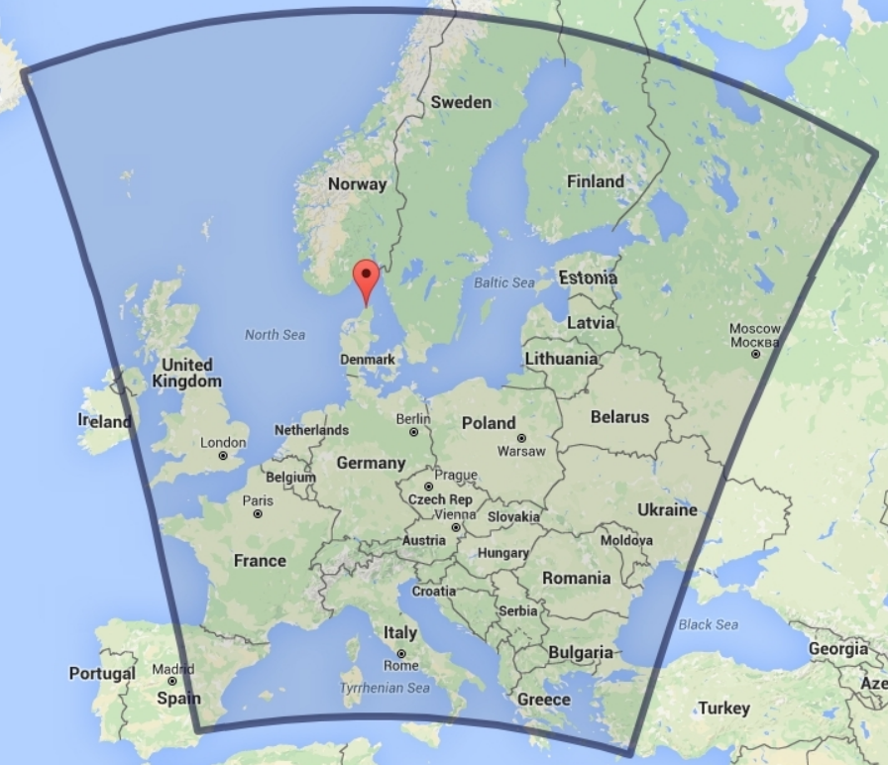
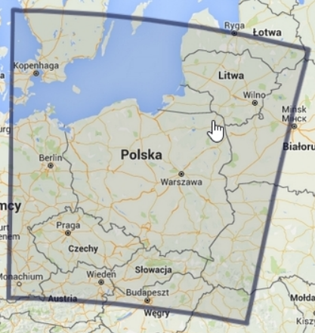
Current operational COSMO NWP system
currently working operationally
COSMO 7k0
COSMO 2k8

Slide 3
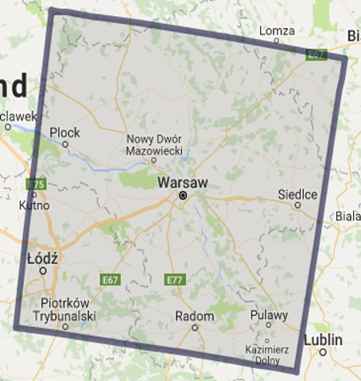
Additional nested domain for Warsaw aglomeration
terra_urb=False/True planned to work urban domain at high resolution
currently working operationally
COSMO 7k0
COSMO 2k8
COSMO 1k0

Slide 4
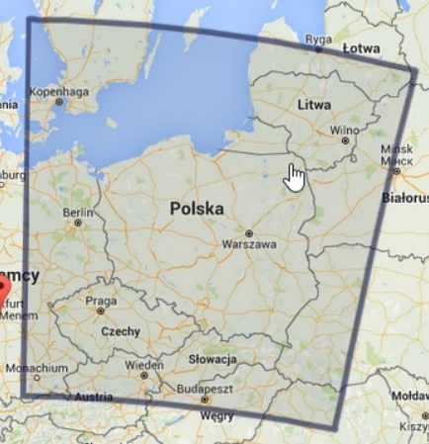
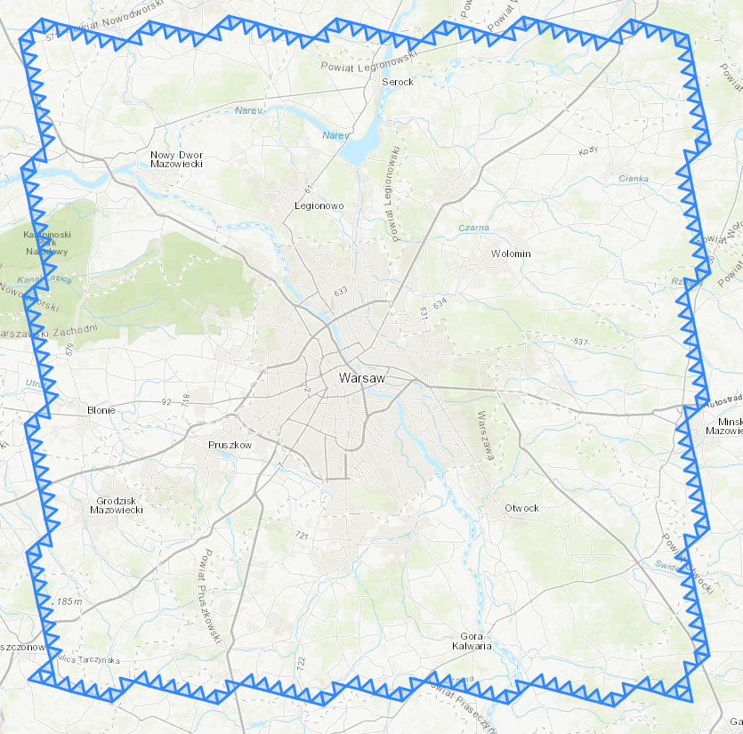
Additional nested domain for Warsaw aglomeration in ICON model
currently working as test production
urban domain at high resolution
ICON 2k5
ICON 1k0

Slide 5
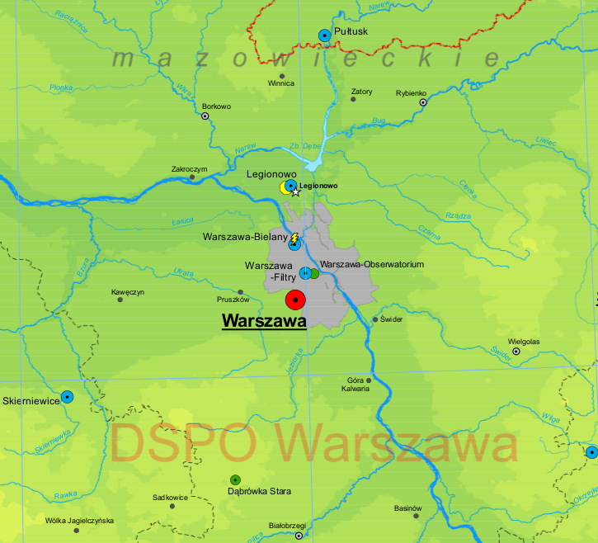
Observational data for verification
Meteorological stations in the Warsaw domain
RainGRS (radar adjusted surface precipitation data)

Slide 6
Configuration options of numerical experiments for Warsaw
simulation | landuse data | terra_urb | landuse switch | comment
gc_tuf | GLOBCOVER2009 | false | i_landuse_data = i_lu_globcover = 1
gc_tut | GLOBCOVER2009 | true | i_landuse_data = i_lu_globcover = 1
ecosg_tuf | ECOCLIMAP-SG | false | i_landuse_data = i_lu_ecosg = 6 ilookup_table_ecosg = 1 | uniform LCZ data based on GLOBCOVER 19 artificial surfaces
ecosg_tut_urban | ECOCLIMAP-SG | true | i_landuse_data = i_lu_ecosg = 6 ilookup_table_ecosg = 1 | uniform LCZ data based on GLOBCOVER 19 artificial surfaces
ecosg_tut_lcz | ECOCLIMAP-SG | true | i_landuse_data = i_lu_ecosg = 6 ilookup_table_ecosg = 2 | experimental LCZ setup based on Oke 2017

Slide 7
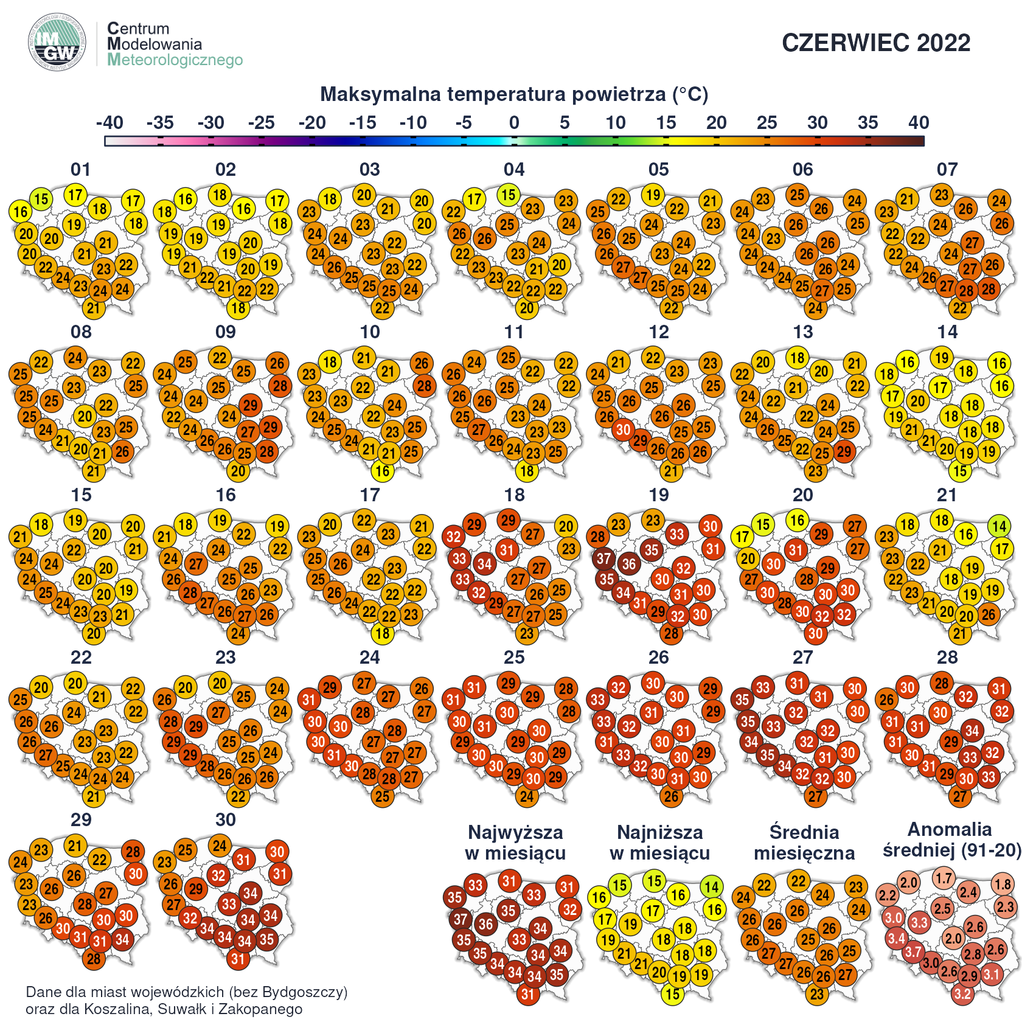
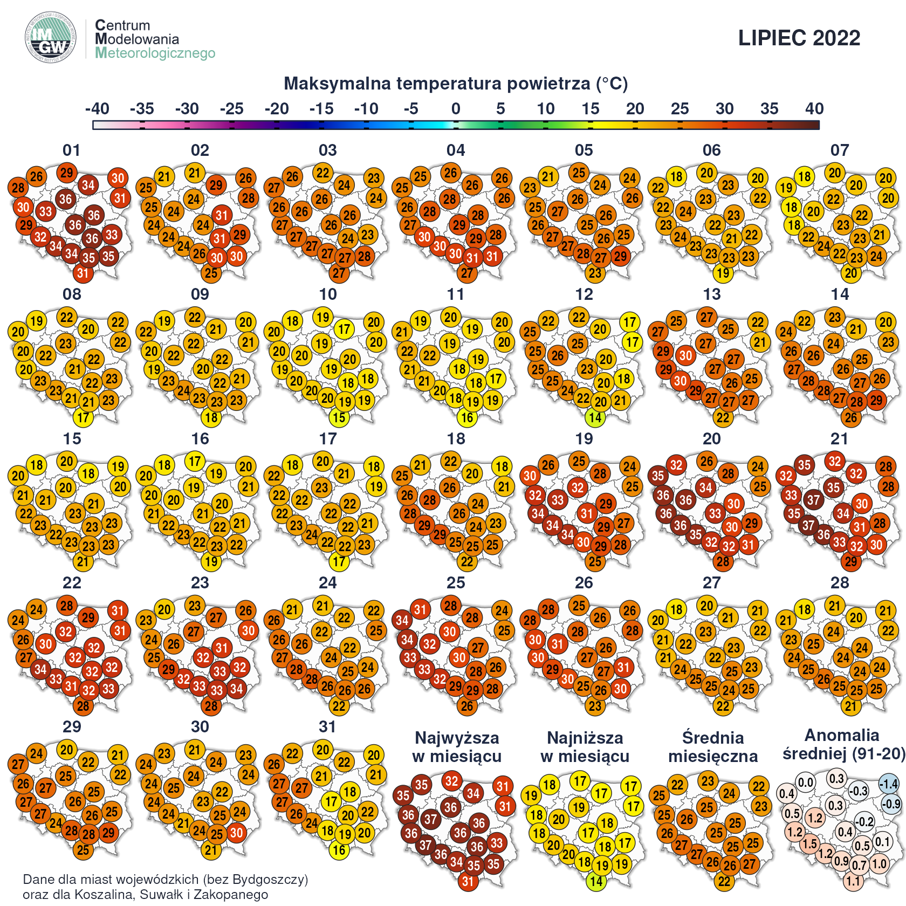
Periods with heatwave and extreme convective precipitation for preliminary case studies
JUNE 2022
JULY 2022
Daily maximum temperature
Daily maximum temperature

Slide 8
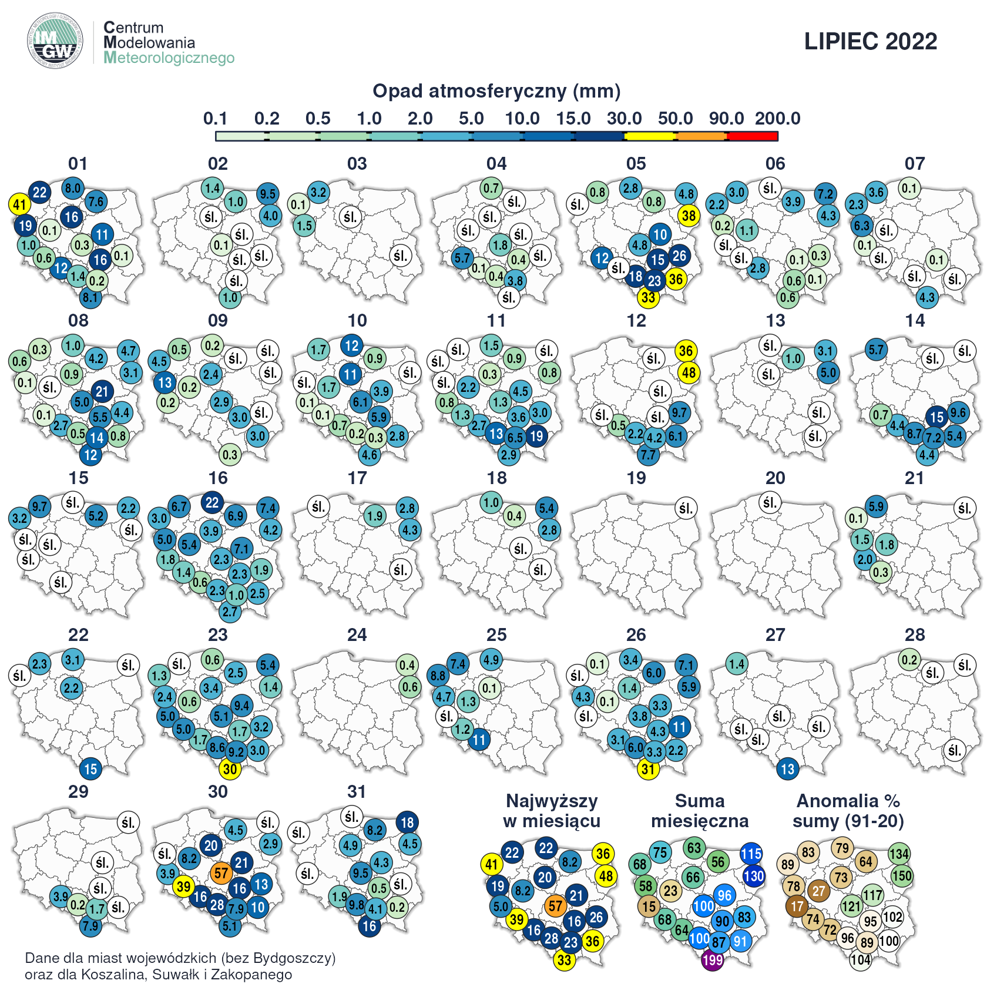
Periods with heatwave and extreme convective precipitation for preliminary case studies
JULY 2022
Daily precipitation

Slide 9
Thank you Adam Jaczewski
Institute of Meteorology and Water Management - National Research Institute
Centre of Numerical Weather Prediction
22/02/2023, COSMO PP CITTA Meeting

