Slide 1
Ecoclimap-sg and TERRA_URB in extpar
Jacopo Canton
2023.2.22 PP CITTÀ meeting

Slide 2
Outline
Ecoclimap-sg as a landuse database
Terra_urb implementation

Slide 3
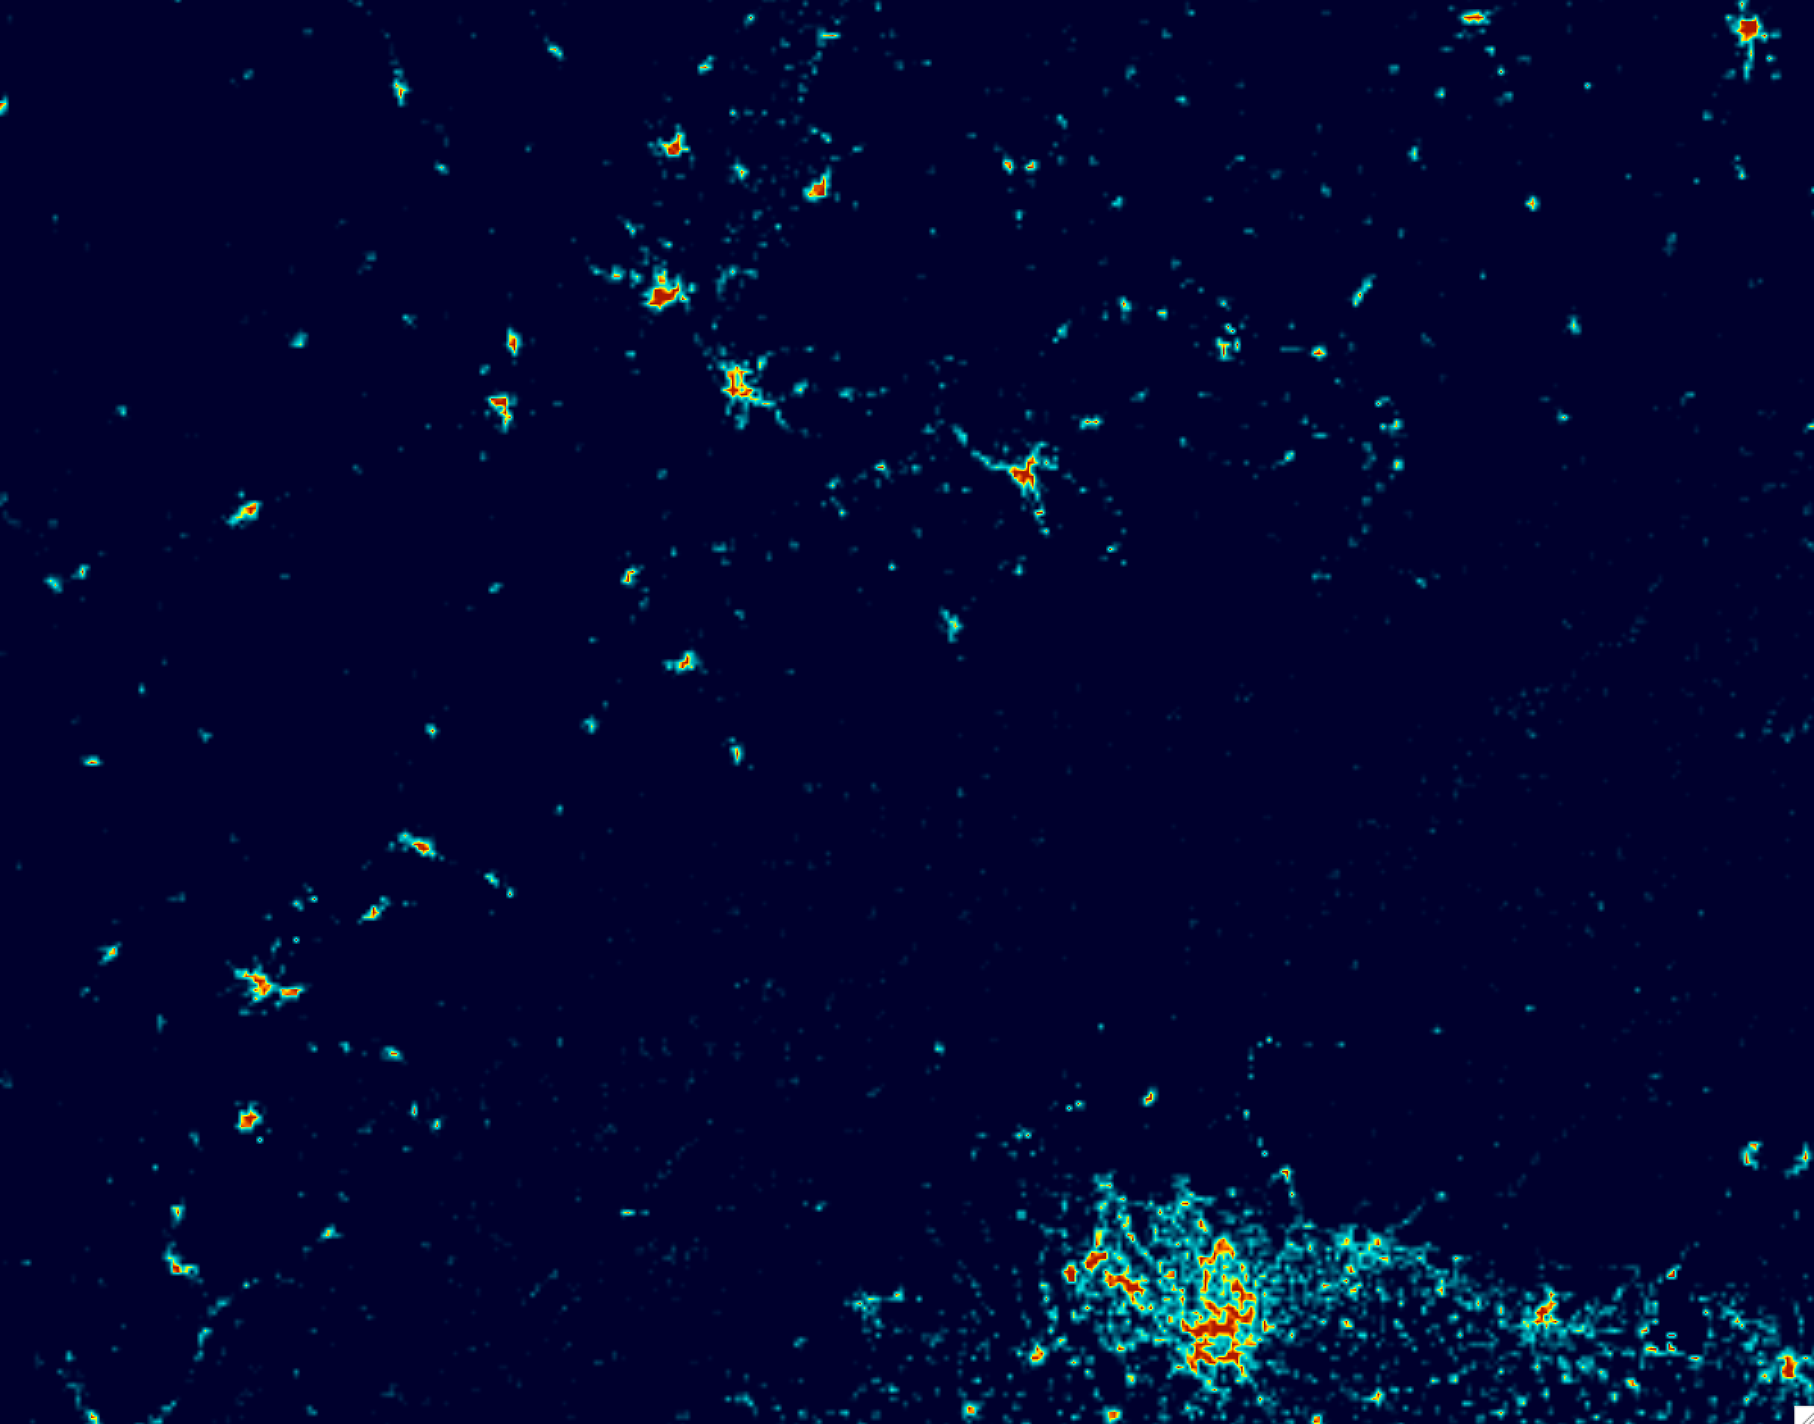
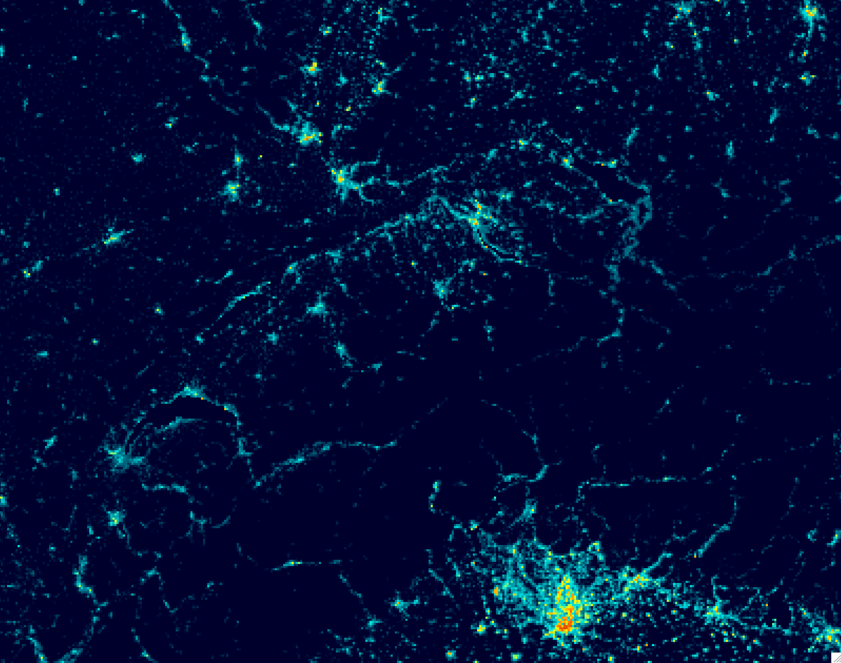
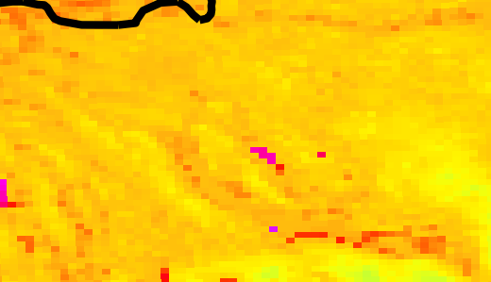
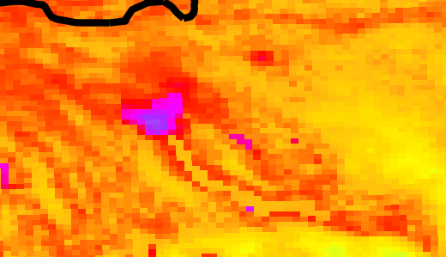
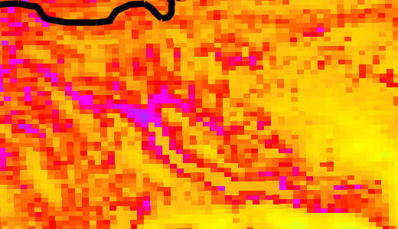
Globcover is bad (not only in Israel or Warsaw)
Globcover
Ecoclimap-sg + LCZs

Slide 4
Ecoclimap-sg
Implemented the code by Andrzej and Adam into the official extpar repository
Updated it with current extpar development and code structure
Updated the ecoclimap-sg database (formerly named ecosg_final_map)
Currently on a development branch, feel free to test and report
Tested the implementation in both COSMO and ICON
Discussion about the default lookup tables

Slide 5
Ecoclimap-sg
Discussion about the default lookup tables
1. sea and oceans 2. lakes 3. rivers 4. bare land 5. bare rock 6. permanent snow 7. boreal broadleaf deciduous 8. temperate broadleaf deciduous 9. tropical broadleaf deciduous 10. temperate broadleaf evergreen 11. tropical broadleaf evergreen 12. boreal needleleaf evergreen 13. temperate needleleaf evergreen 14. boreal needleleaf deciduous 15. shrubs 16. boreal grassland 17. temperate grassland 18. tropical grassland 19. winter C3 crops 20. summer C3 crops 21. C4 crops 22. flooded trees 23. flooded grassland | 24. LCZ1: compact high-rise 25. LCZ2: compact midrise 26. LCZ3: compact low-rise 27. LCZ4: open high-rise 28. LCZ5: open midrise 29: LCZ6: open low-rise 30: LCZ7: lightweight low-rise 31: LCZ8: large low-rise 32: LCZ9: sparsely built 33: LCZ10: heavy industry
e.g., with surface roughness z0

Slide 6
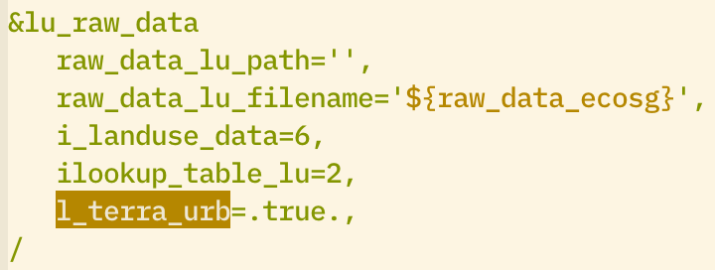
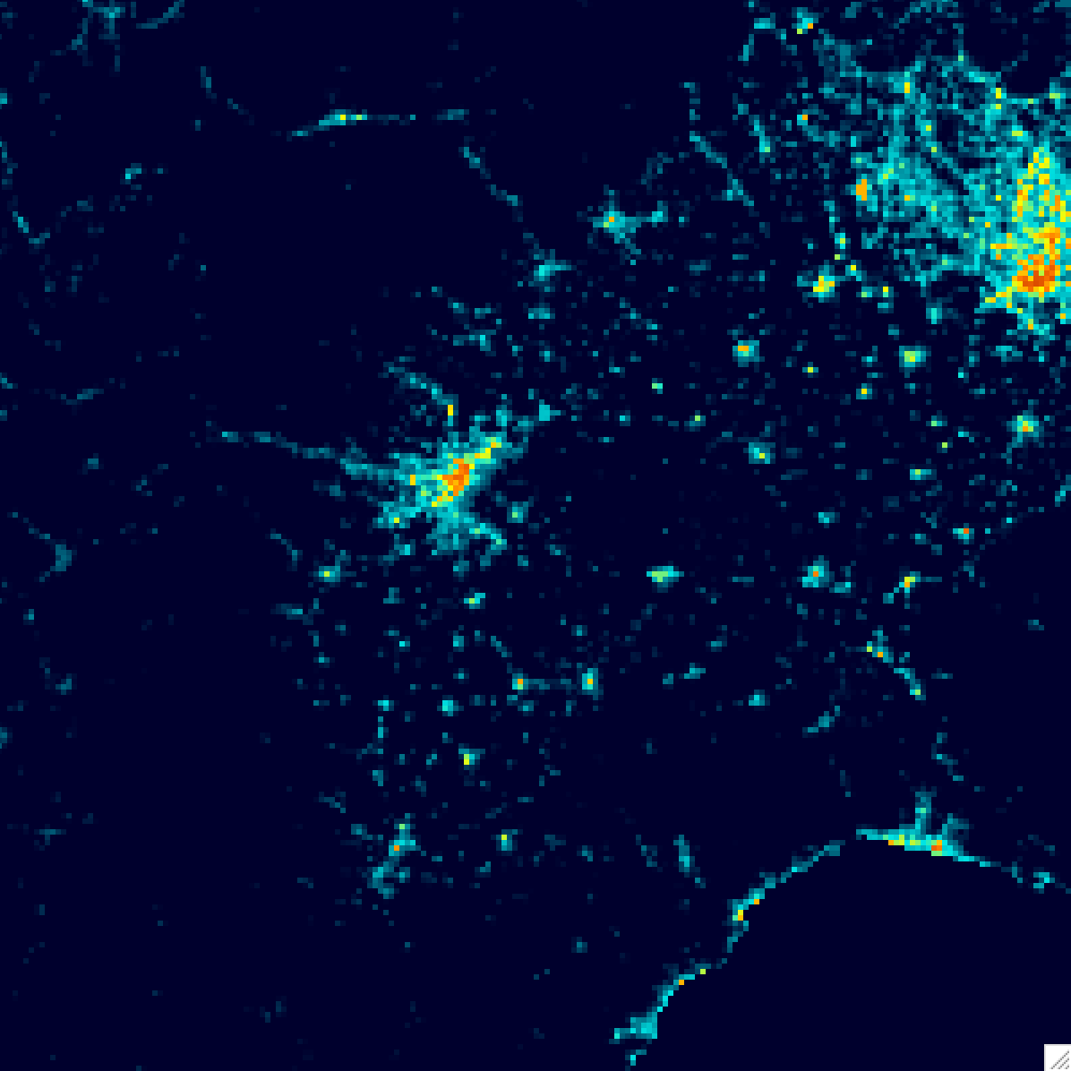
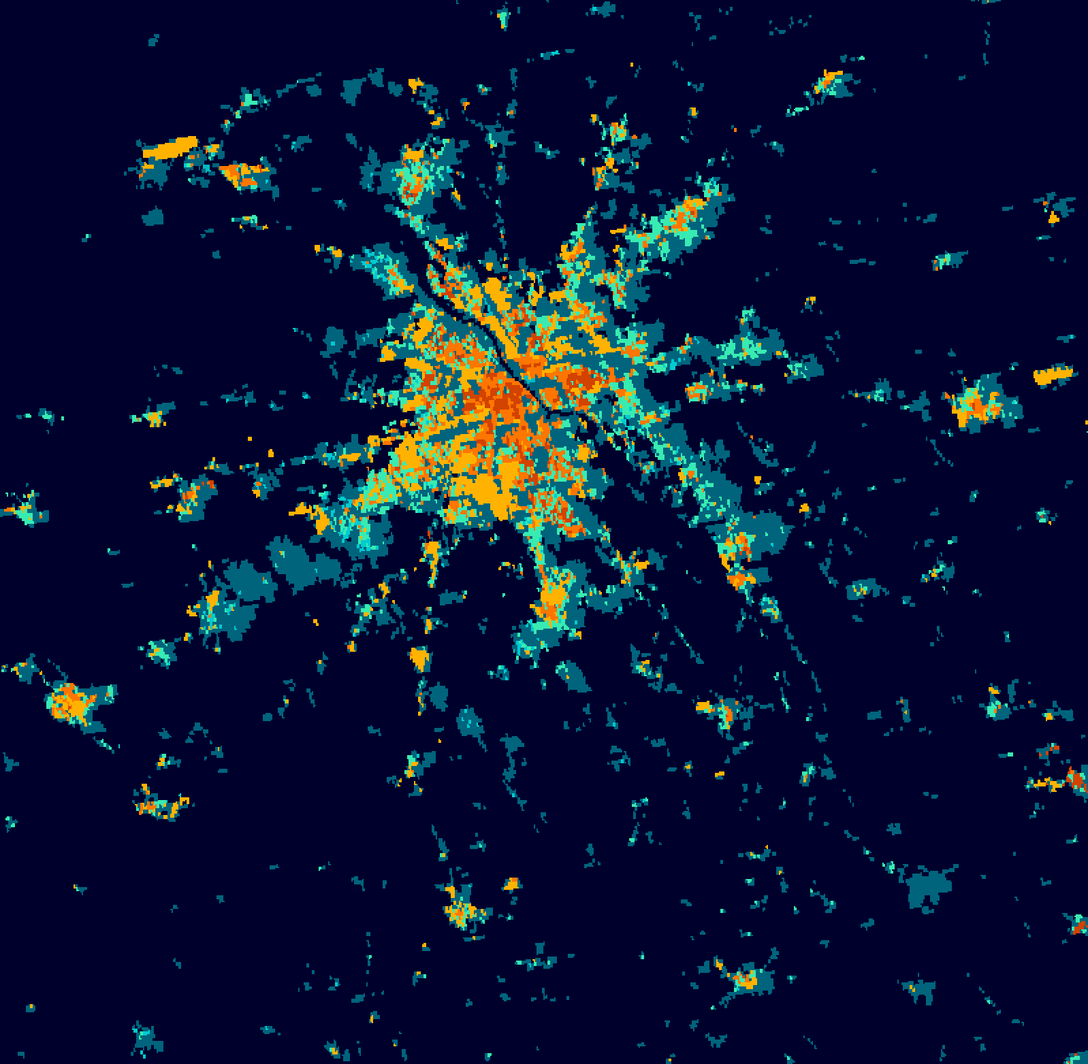
TERRA_URB
Implemented with a single namelist flag l_terra_urb
Implemented SURY / WUDAPT-TO-COSMO
Piedmont region
Switzerland
Warsaw
URBAN ISA AHF FR_PAVED URB_BLDFR URB_BLDH URB_H2W URB_SALB URB_TALB URB_EMIS | URB_SALB_FL URB_TALB_FL URB_EMIS_FL URB_SALB_BK URB_TALB_BK URB_EMIS_BK URB_HCON URB_HCAP

Slide 7
TERRA_URB
2D maps with ecoclimap_sg or a similar LCZ database

Slide 8
TERRA_URB
Testing with COSMO - works great, will need tuning

Slide 9
Ecoclimap-sg and TERRA_URB in extpar
TODO
Finish ICON implementation
Implement ecoclimap-sg and LCZs in ICON
Write documentation
Add updated database file to official repository
Implement other LCZ databases (e.g. the new global WUDAPT)
As suggested by Angelo: common datasets and namelists for PP CITTÀ?

