Slide 1
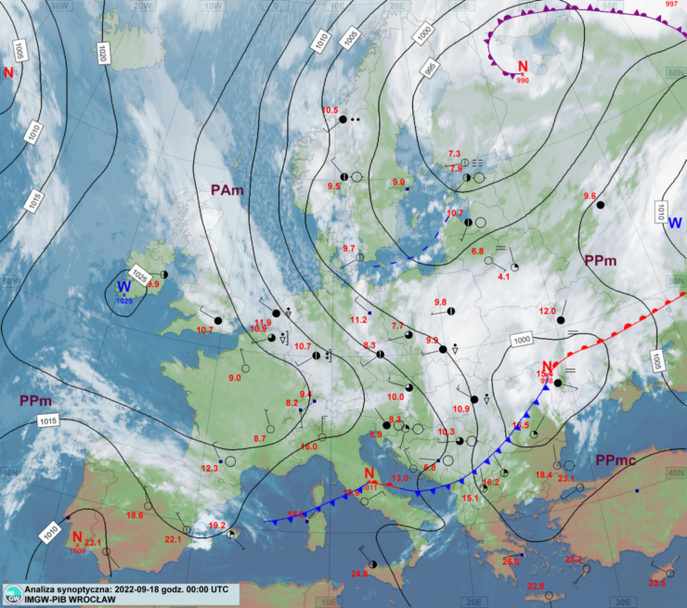
09.09.2022, 00 UTC
Synoptic situation
Western Poland is under the influence of an occluded front associated with a low centre over Southern England. The occluded front moves East, North-East but comes up against an area of high pressure centered over western Russia.

Slide 2
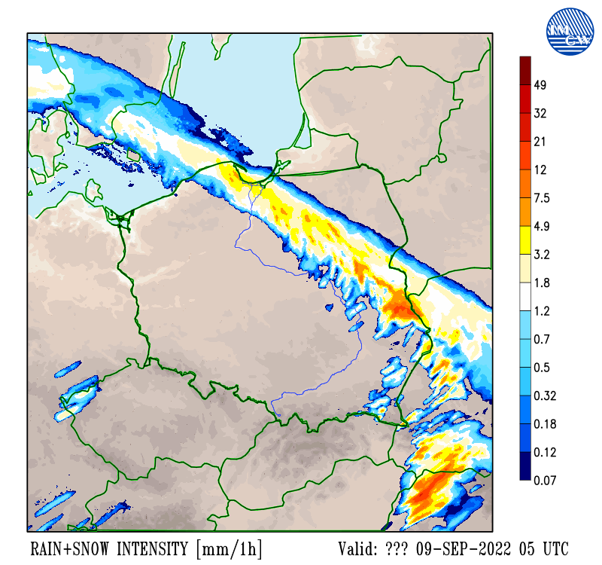
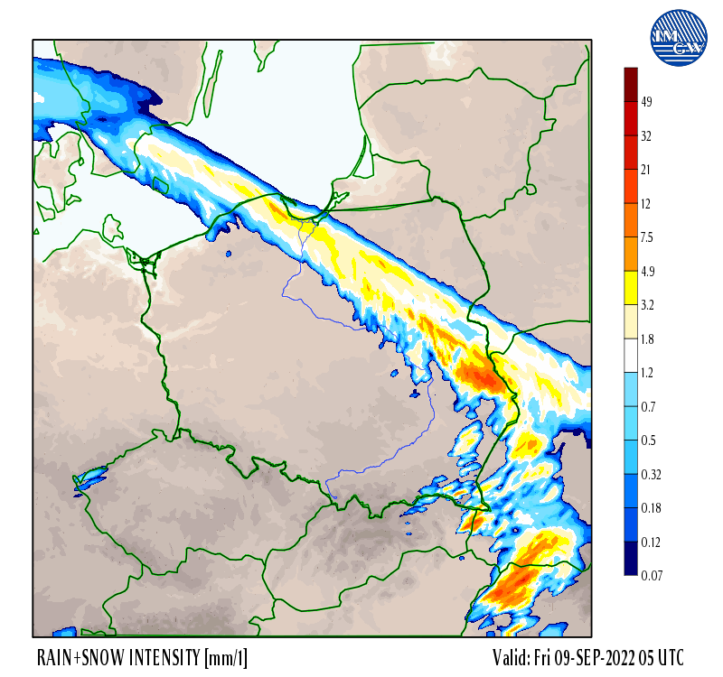
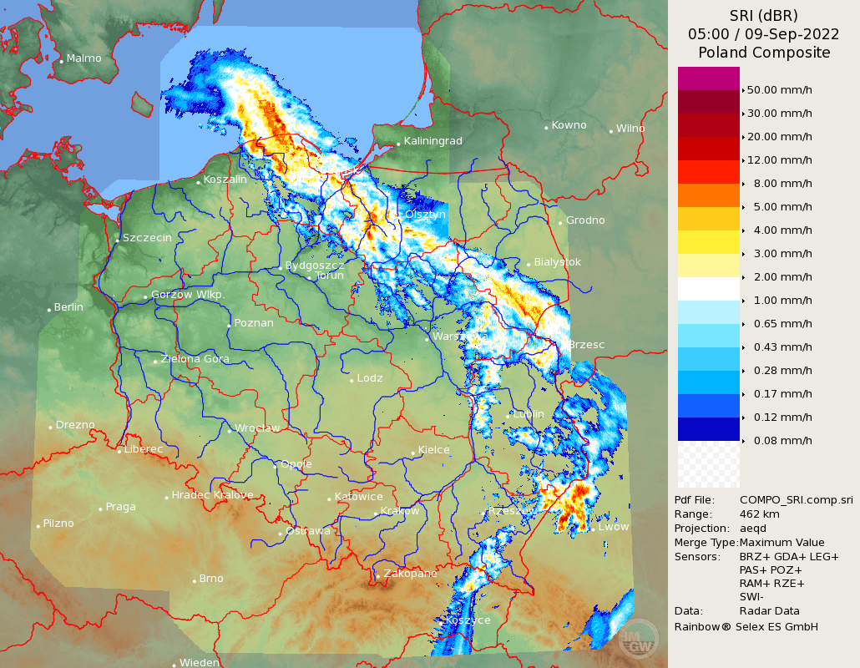
ICON PL 2.5 | COSMO PL 2.8 | RADAR
The both models have predicted precipitation quite well.

Slide 3
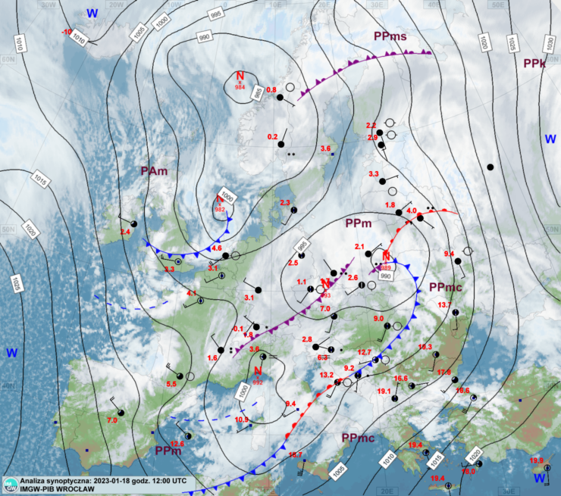
18.01.2023, 12UTC
Synoptic situation
A large area of low pressure with a low centre moving over the eastern part of Poland. The country is under the influence of two frontal systems.

Slide 4
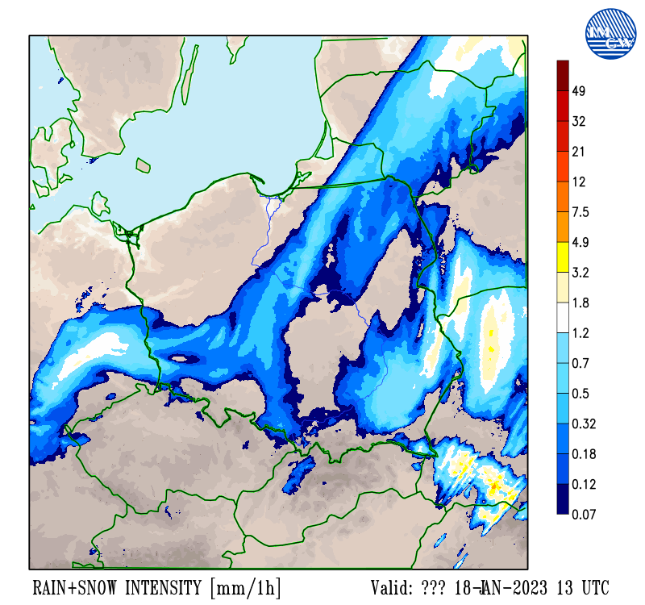
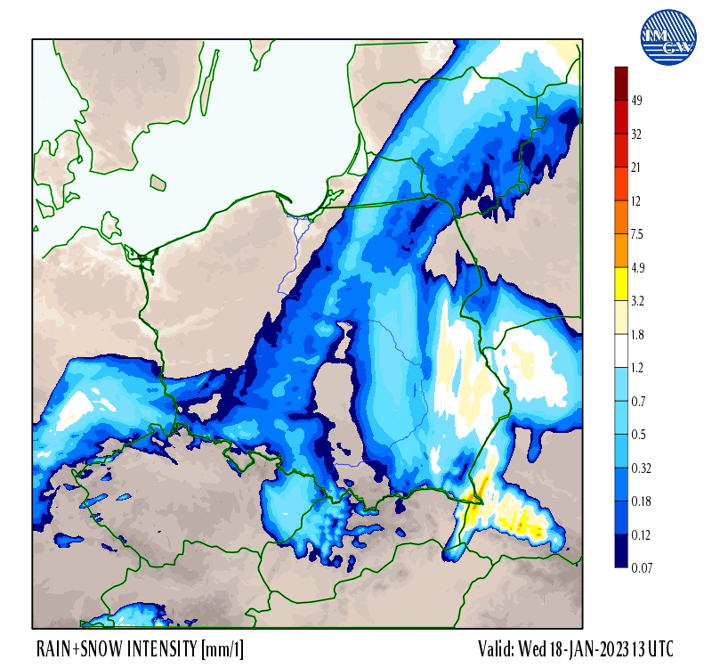
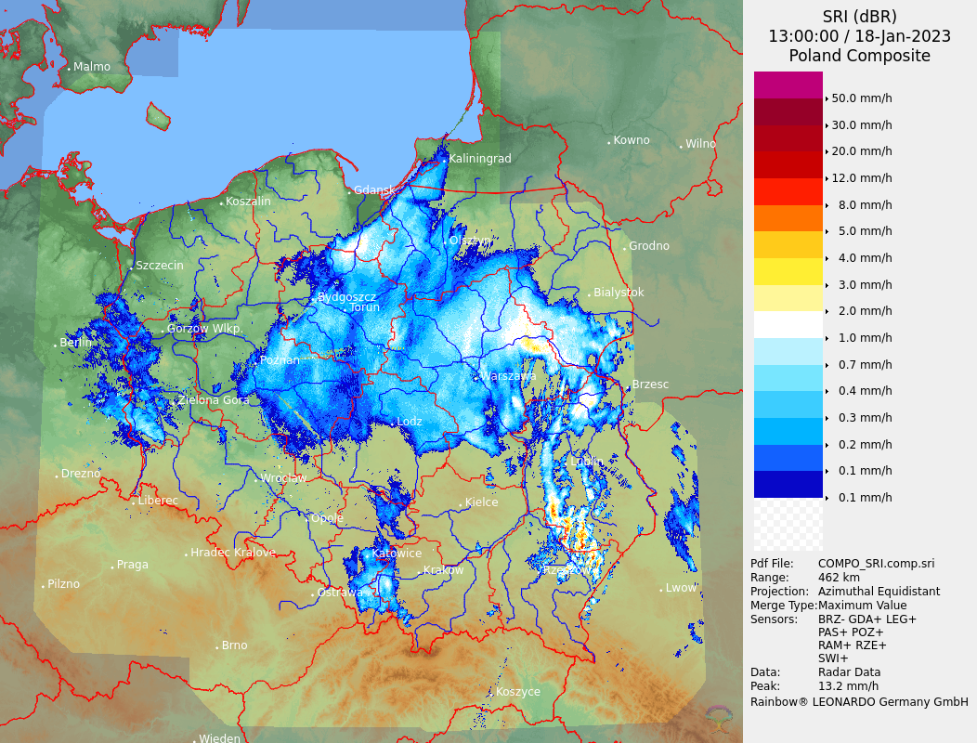
ICON PL 2.5 | COSMO PL 2.8 | RADAR

Slide 5
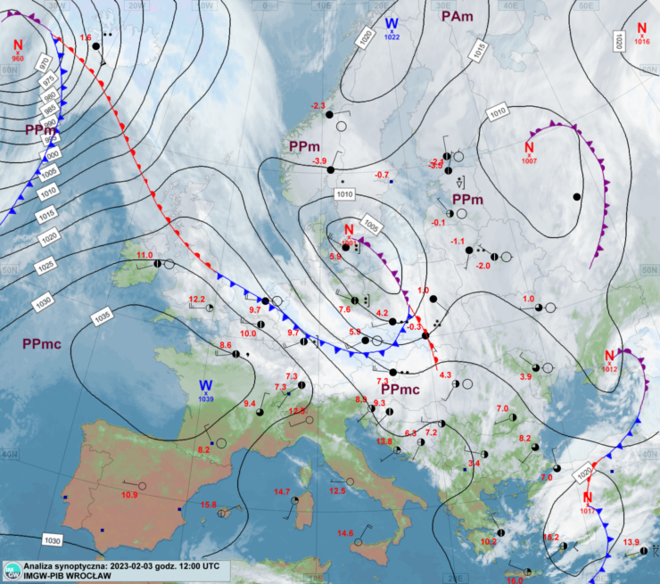
03.02.2023, 12UTC
Synoptic situation
Poland was under the influence of a low pressure, which, together with the system of atmospheric fronts, moved from the Baltic Sea to the South-East into the centre of the country. Moist Polar Maritime air mass was coming in from the West and Northwest.

Slide 6
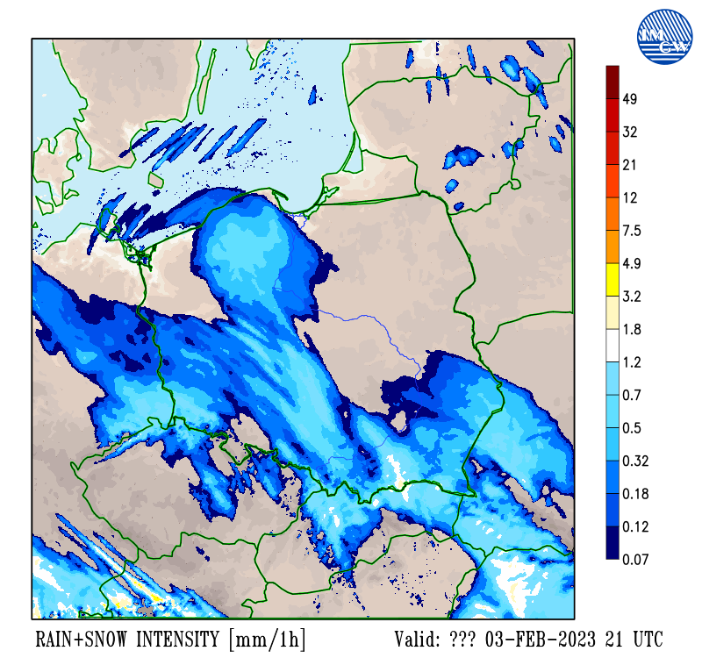
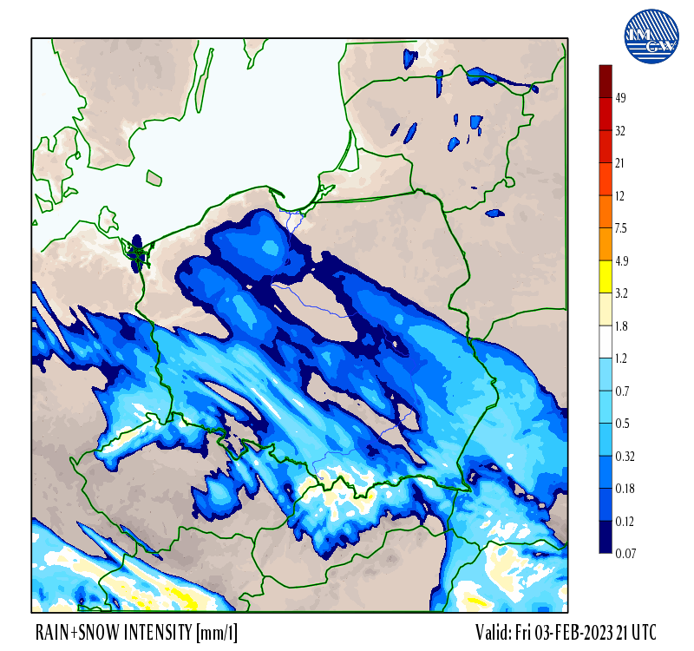
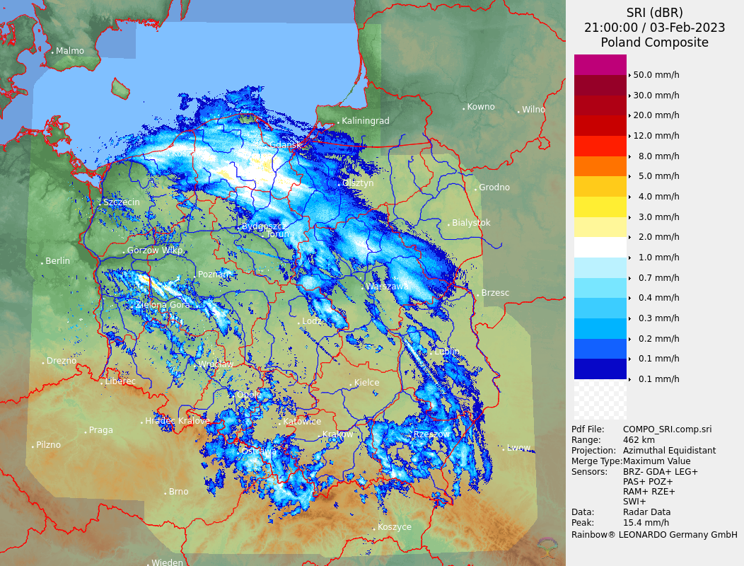
ICON PL 2.5 | COSMO PL 2.8 | RADAR

Slide 7
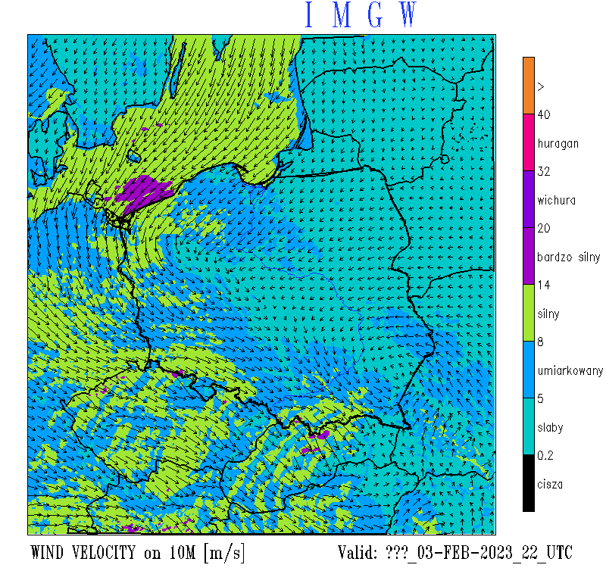
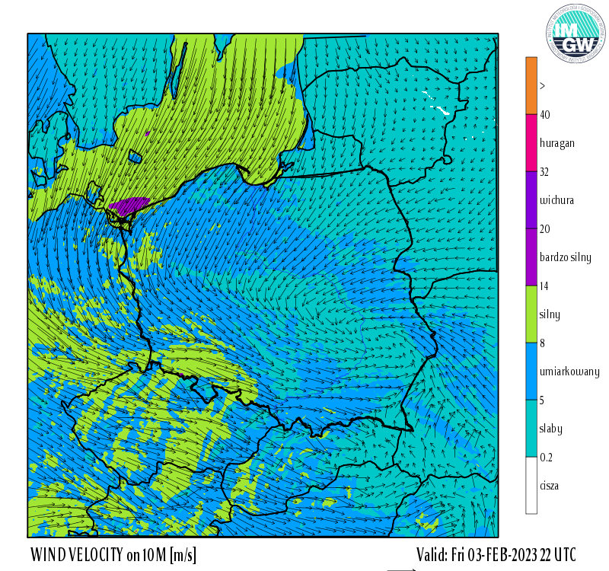
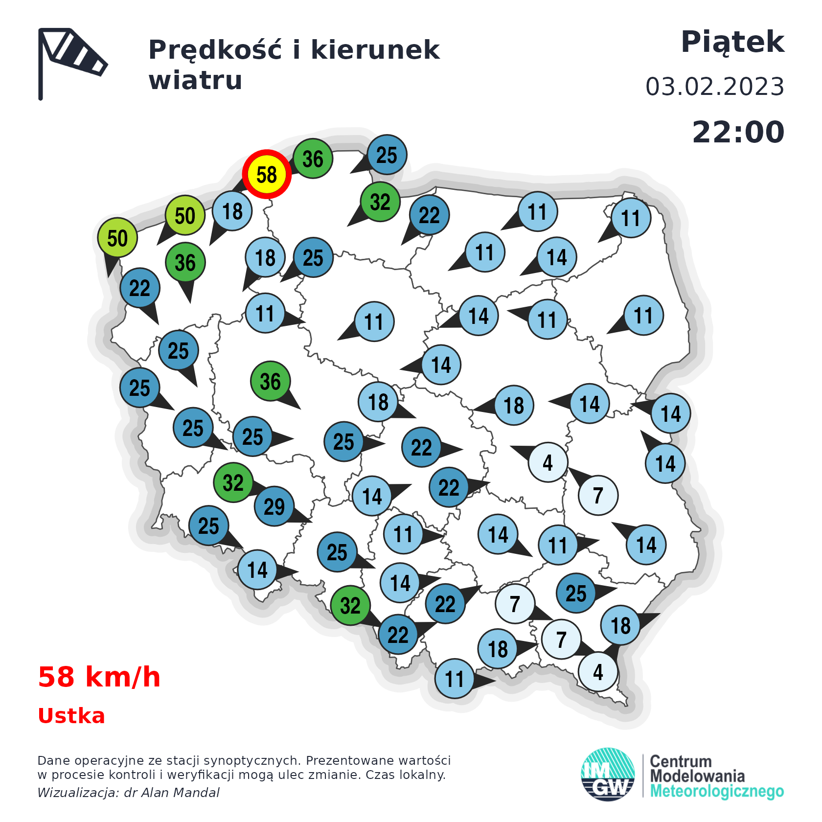
ICON PL 2.5 | COSMO PL 2.8 | OBSERVATIONS

Slide 8
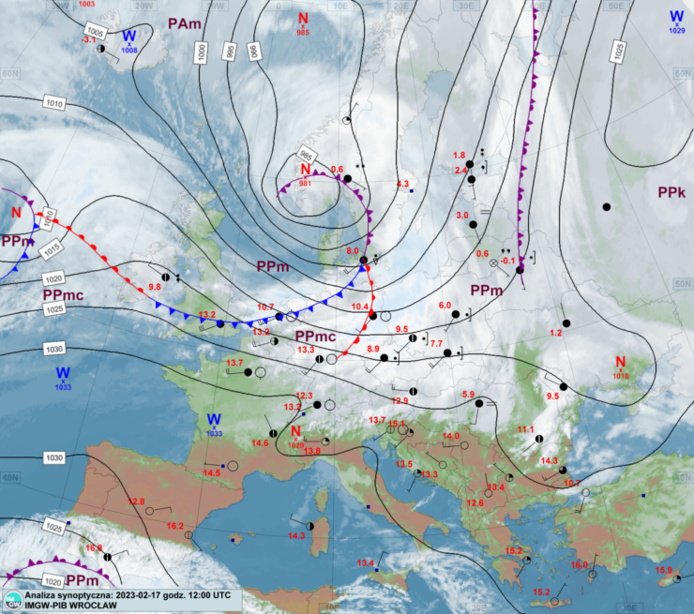
17.02.2023, 12UTC
Synoptic situation
A deep low is gradually approaching over the Baltic Sea. In the afternoon, a warm front (followed by a cold front) moves from West to East.

Slide 9
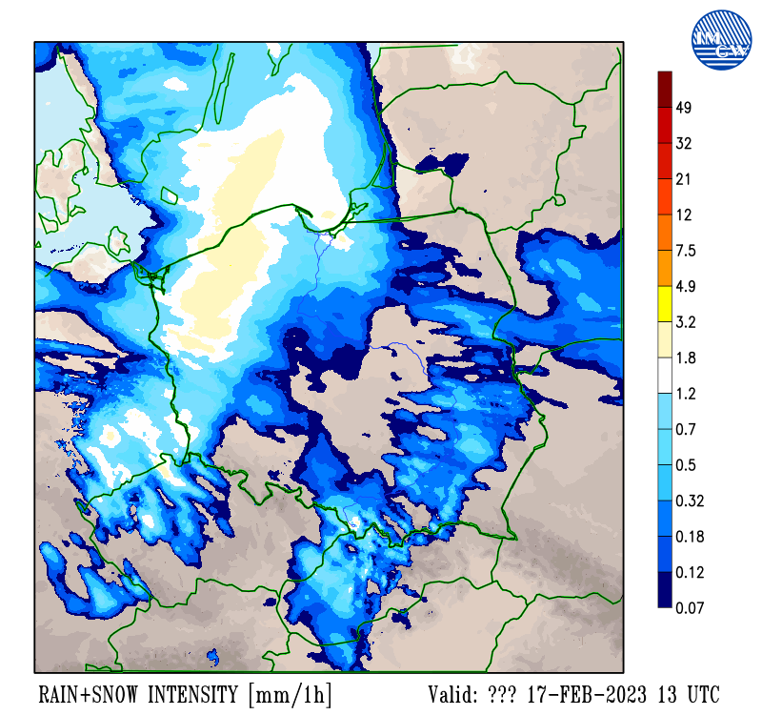
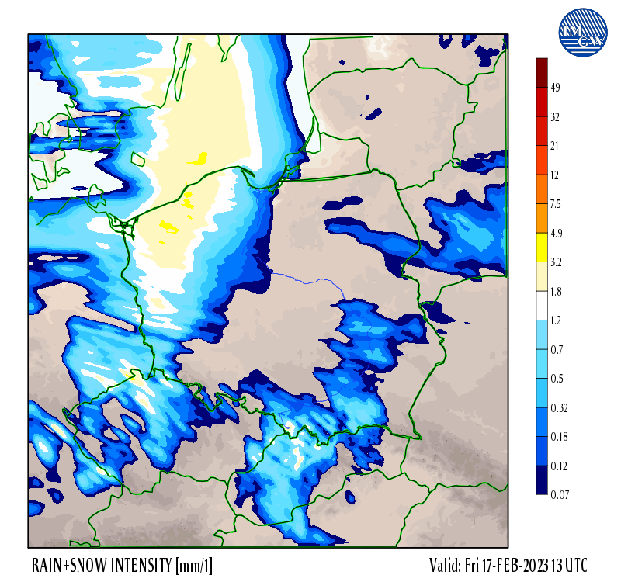
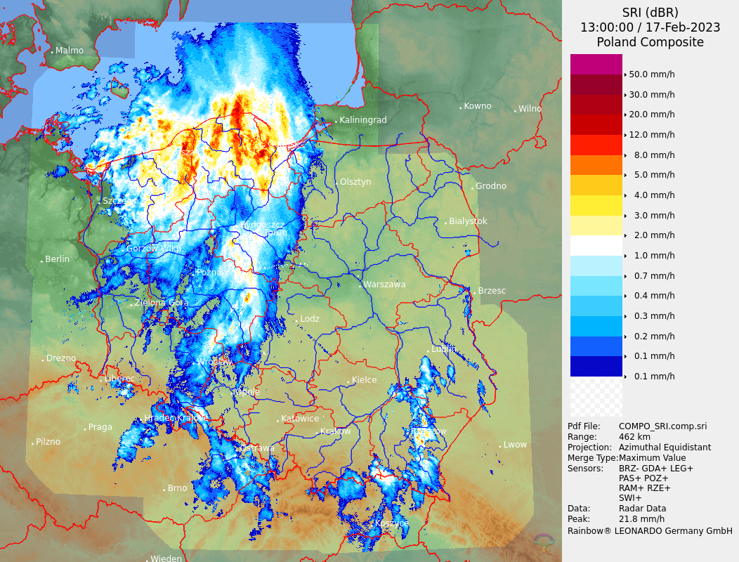
ICON PL 2.5 | COSMO PL 2.8 | RADAR

