Slide 1
HNMS cases SON-DJF
ICON-COMFORT

Slide 2
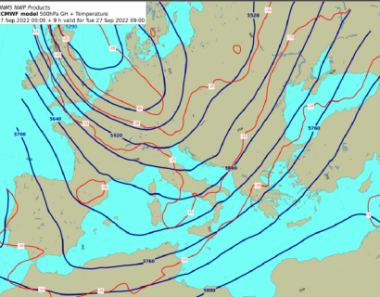
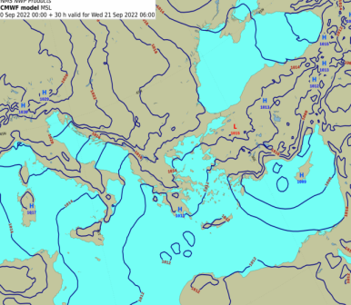
Non- extreme case of September 2022 : Differences between ICON-GR and
COSMO-GR
21/9/2022
The synoptic conditions indicate a trough over Greece coming from North with cold masses, leading to a combination of higher pressures over NW Balcans and lower over Cyprus. This is a typical ‘light northerly flow’ over Eastern Greece which produces rain over Eastern parts of Greece.

Slide 3
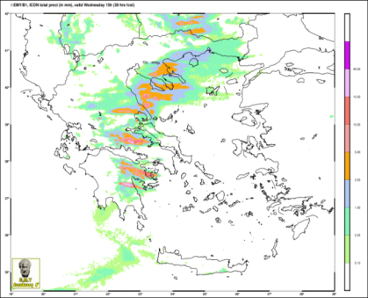
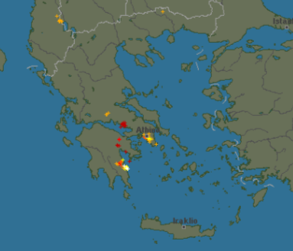
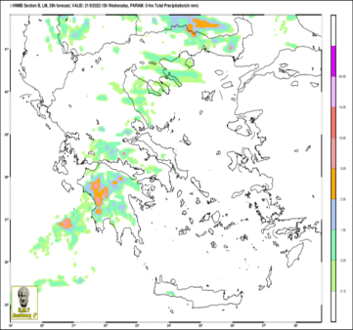
ICON-GR2.5 (0600 UTC)
There are differences between COSMO-GR and ICON-GR, where in this case, ICON-GR predicts more precipitation than COSMO over Thermaikos (Thessaloniki Gulf) which is a common behavior of the model. In this case, according to the measurements it is correct. However, no rain was predicted over Attica region while there were some stations that reported rain, as also shown on the lightnings image.
COSMO-GR4 (0600 UTC)

Slide 4
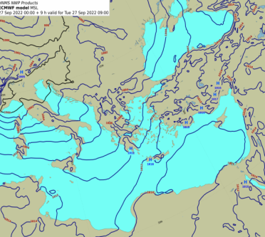
2. Non- extreme cases of September 2022 : Differences between ICON-GR and
COSMO-GR 27/9/2022
A N-NW flow over Greece coming from the West associated with frontal activity produces rain mainly over W and N of Greece. There are differences between the models, with ICON-GR producing more precipitation than measured.

Slide 5
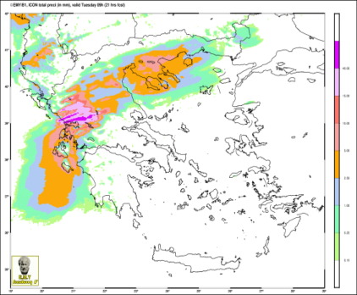
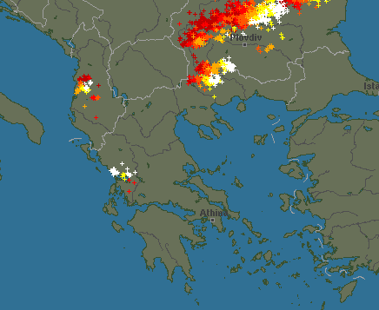
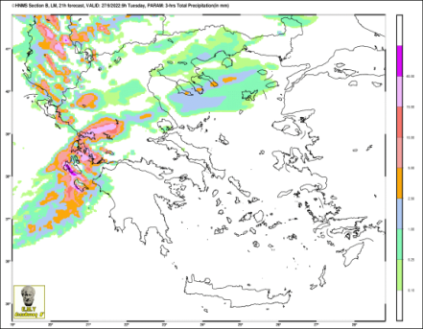
ICON-GR2.5 (2100 UTC)
According to the measurements, Thessaloniki
area did not report any rain, so in this case,
ICON-GR overestimated precipitation.
COSMO-GR4 (2100 UTC)

Slide 6
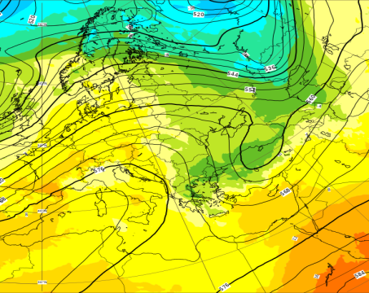
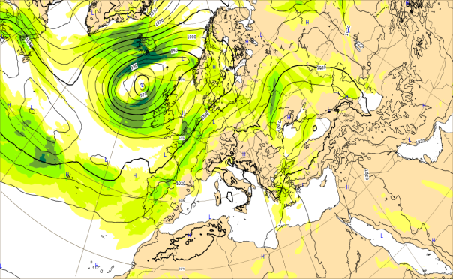
3. Non- extreme case of December 2022 : Wind speed Differences between ICON-GR and ECMWF-IFS 20/12/2022
High pressures over W Greece combined with low pressures over E parts led to a strong northerly flow over Aegean.

Slide 7
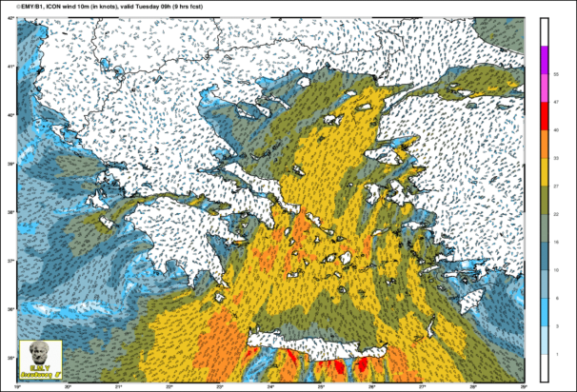
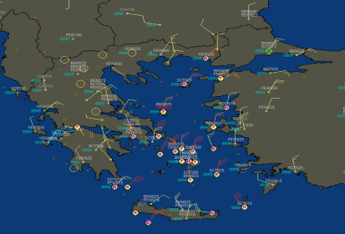
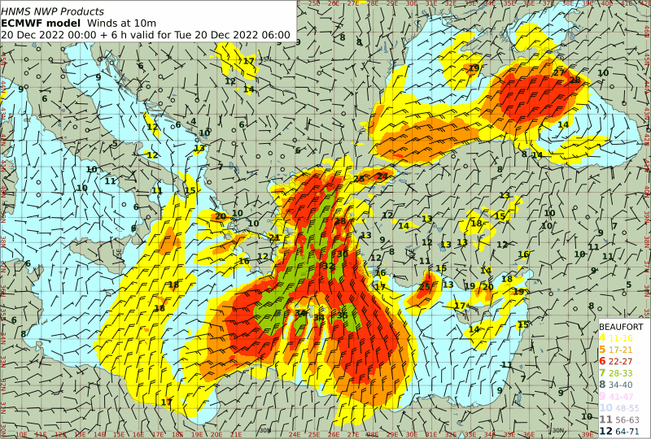
Different color scales make forecasters difficult to compare models. So, the yellow on the first plot corresponds to the red of the second (6B) while the orange of the first is the red of the second (7B). The difference between the plots are the localized areas of 7B and the katabatic winds S of Crete (red 8B) which is a common difference between the models in northerly winds. The observations are not sufficient to identify the differences
0900 UTC

Slide 8
“Gaia” frontal system
10-11/12/22

Slide 9
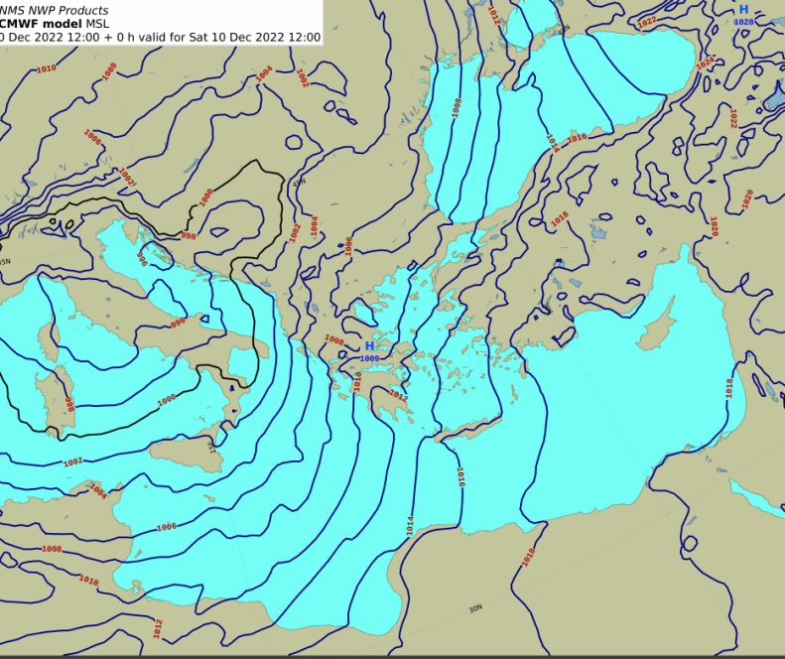
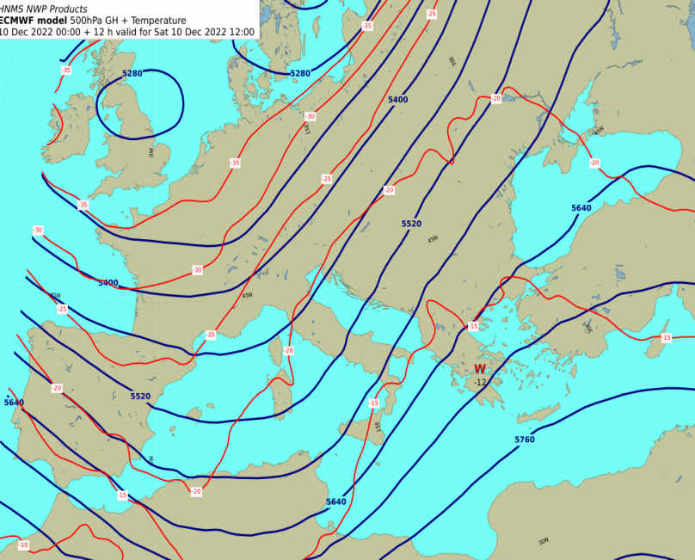
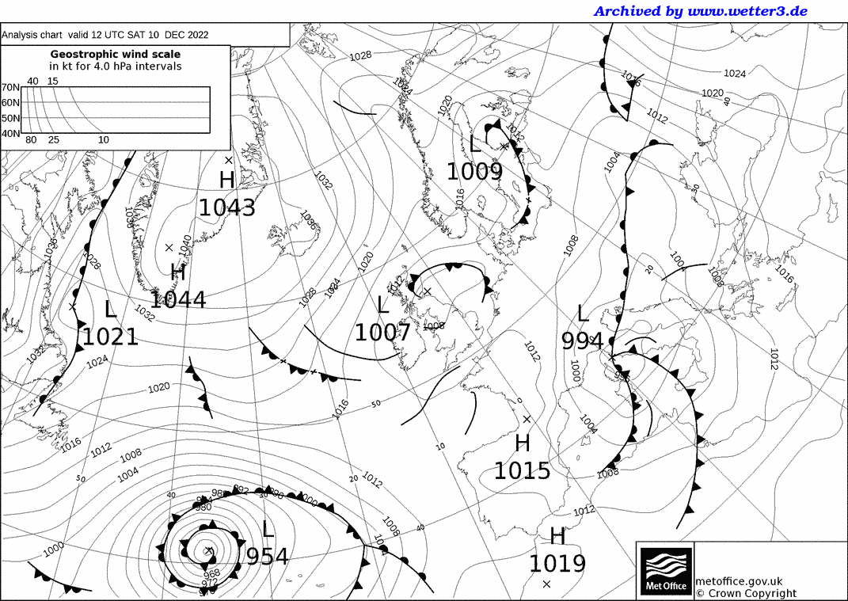
10/12/22 : Strong S –SW flow with frontal activity over the country brought heavy rain over W and E parts of Greece (less in Central)

Slide 10
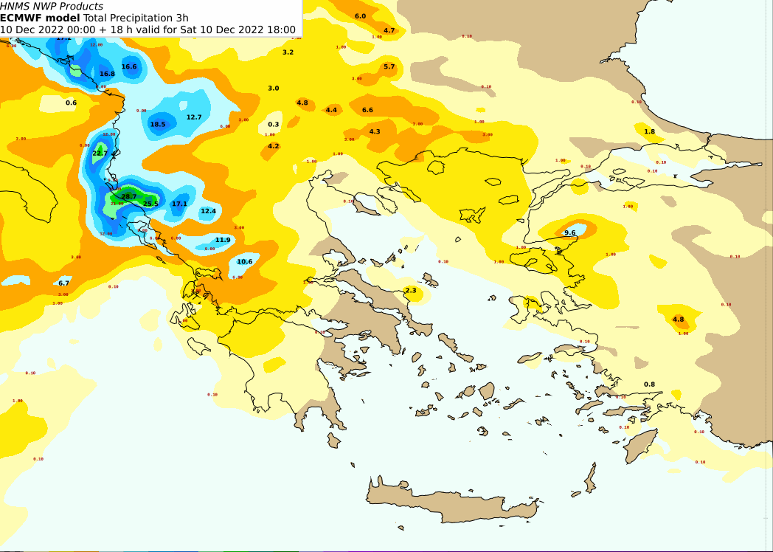
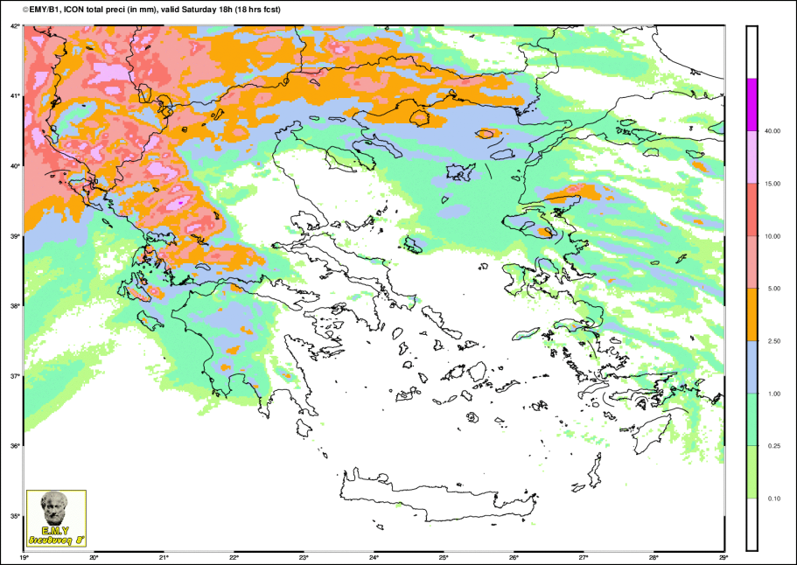
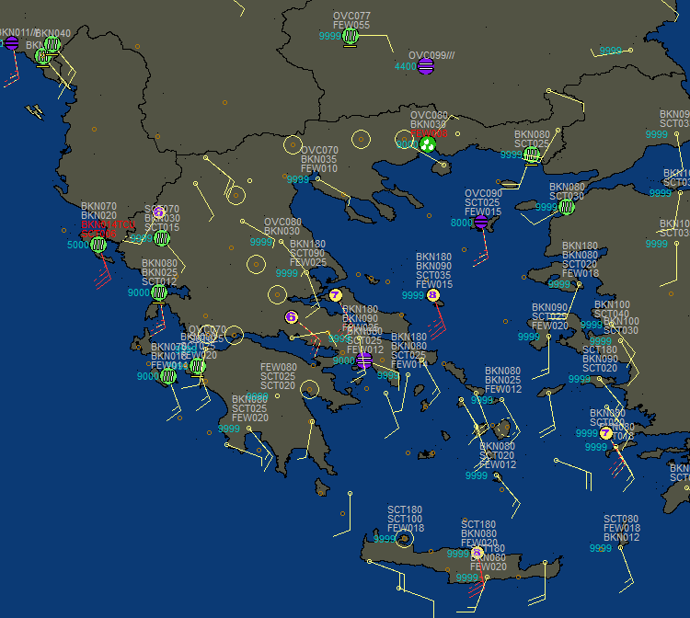
IFS
ICON-GR
10/12/22 1800 UTC The results are quite similar for a forecaster.
Some slight differences mainly over
E Greece show slight overestimation of IFS over this area.

Slide 11
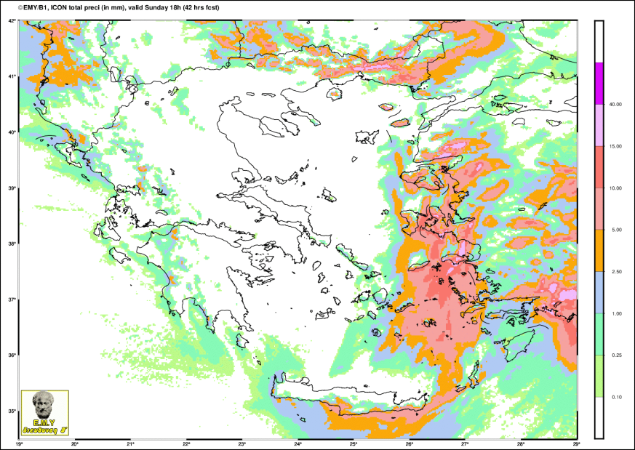
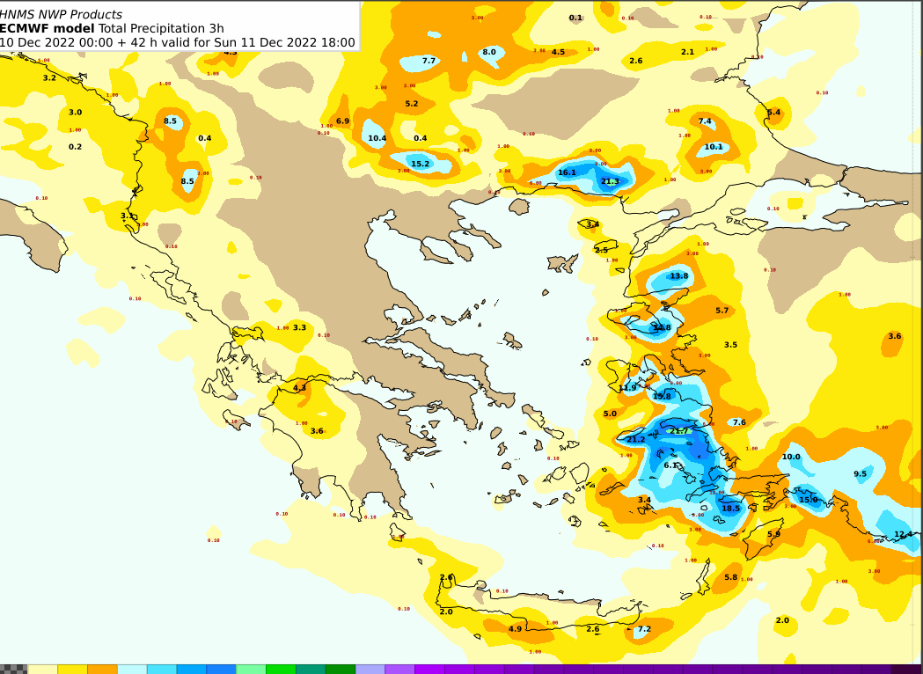
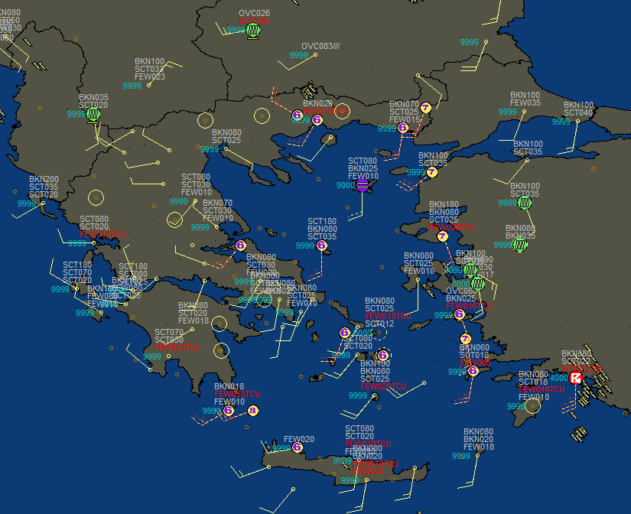
ICON-GR
IFS
11/12/22 1800 UTC Frontal acti Both models overestimate precipitation at Eastern Aegean.
Some slight differences also in Western Greece where both models show some rain, especially IFS which had already stopped.

Slide 12
10/12/22
HNMS product. Probability of thunderstorm. (weight factor of convective precipitation and cloud tops)

Slide 13
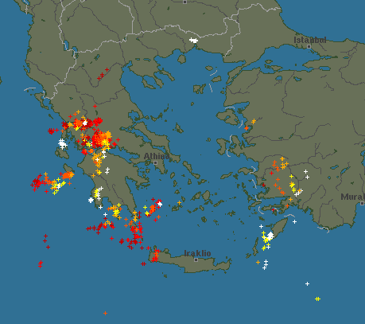
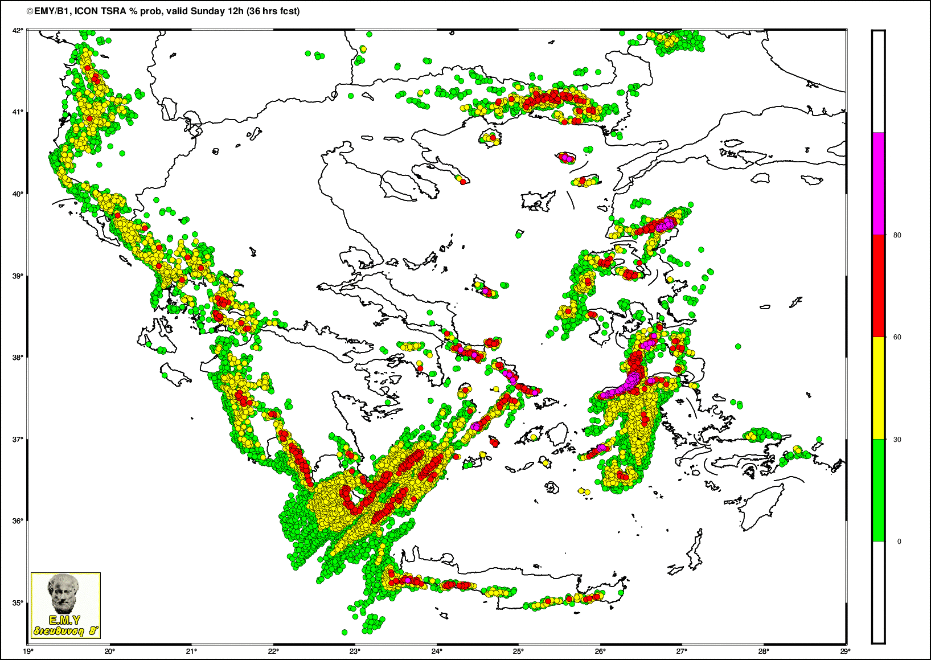
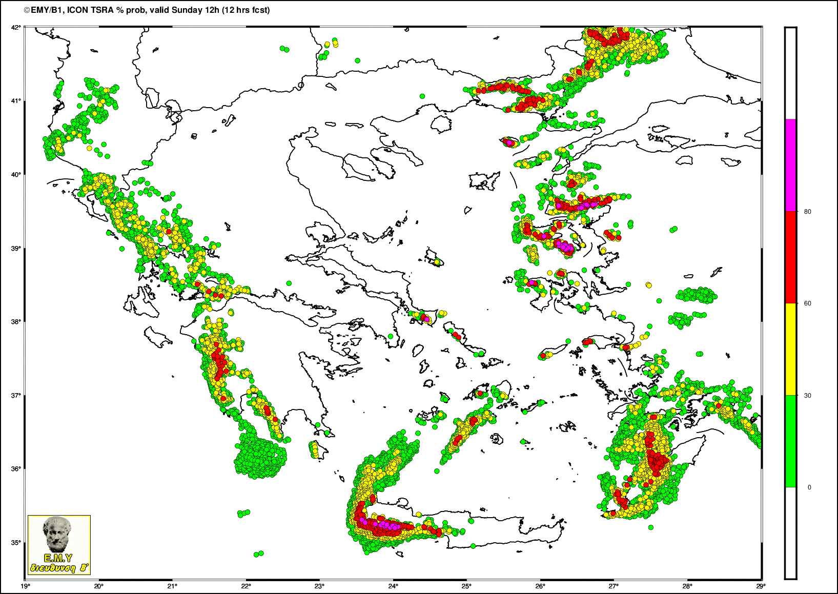
2
2
12UTC
36h
1
The product (36 and 12h of simulation) is
able to show the general lightnings distribution.
Some differences -SE islands (area1) is better predicted With the 12h simulation, while area 2 is underpredicted)
12h

Slide 14
Snow in Greece !
5/2/23

Slide 15
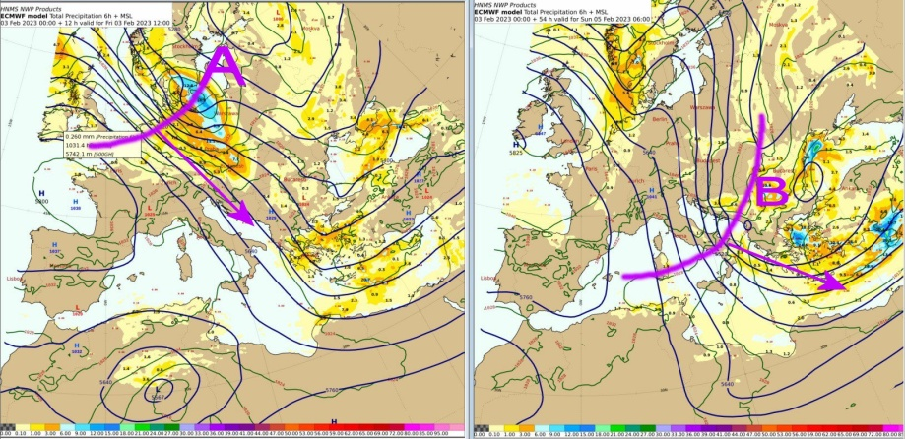
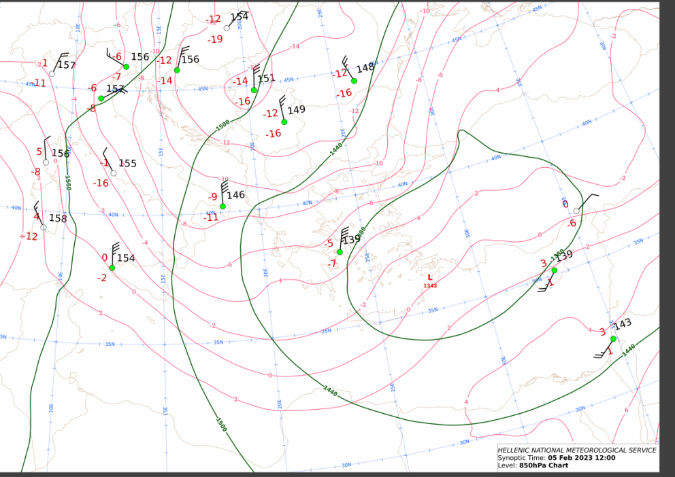
Strong perturbance over 500hpa coming from Scandinavian countries and Baltic Sea moving towards SE combined with cold air masses from Russia which moved S-SE due to the polar jet cooled air over the country (-7 over 850) which in combination of srtong N-NE winds brought snow over eastern Greece.

Slide 16
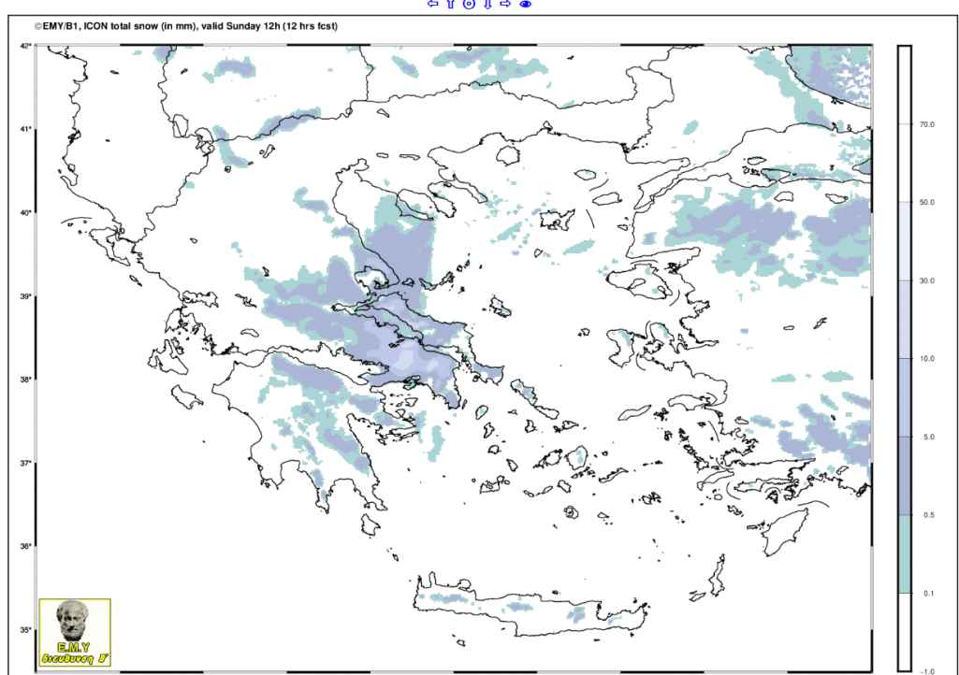
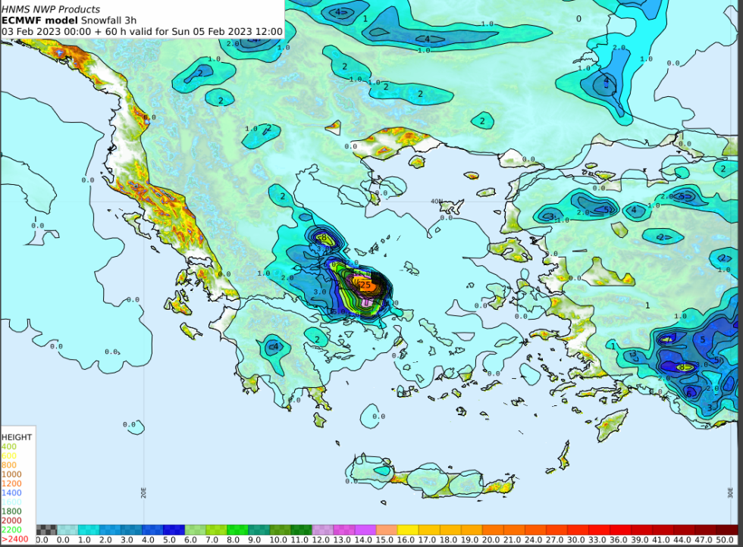
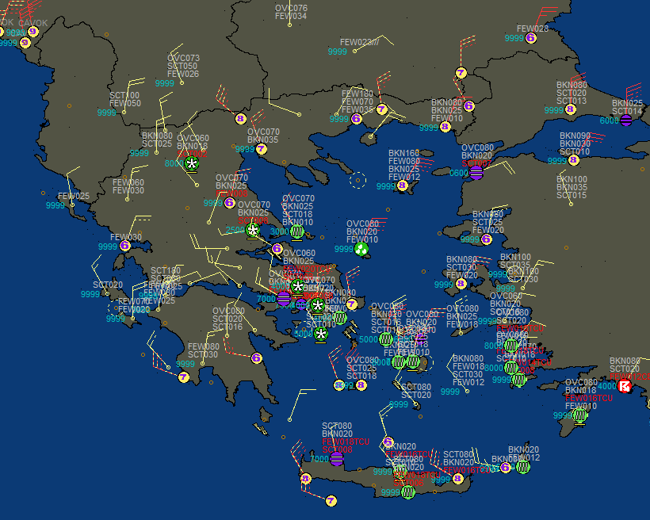
ICON-GR
IFS
Our new product of ICON-GR is snowfall (mm). The scales differ from IFS and this is a problem
for forecasters as they have to look carefully to see differences between models.
The two models similarly forecast snow over Eastern Greece. However, IFS predicts
more snow over Eastern Attica and Evia, while ICON-GR does not show a localized maximum. Due to the ‘red’ IFS warning, more snow than observed, was expected.

