Slide 1


COSMO General Meeting 2025
1-5 September 2025 Basel, Switzerland
Hellenic National Meteorological Service
Current Status and Future Plans
Panagiotis Skrimizeas – Theodore Andreadis
Additional contributions by Euripides Avgoustoglou, Dimitra Boukouvala and Flora Gofa

Slide 2
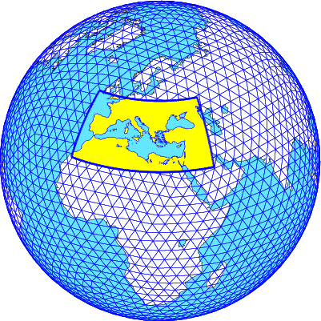
Current status
ICON operational
                The model setup
ICON runs twice a day (00 and 12UTC)
Runs performed at ECMWF
Analysis and boundary conditions from IFS
Resolution: ≈ 2.4Km
Forecast range: 72 hours
Area covered is south Europe, Black Sea,
Mediterranean and north African coast
Hourly output of three types (model, pressure and height levels)
No assimilation or any preproc performed

Slide 3
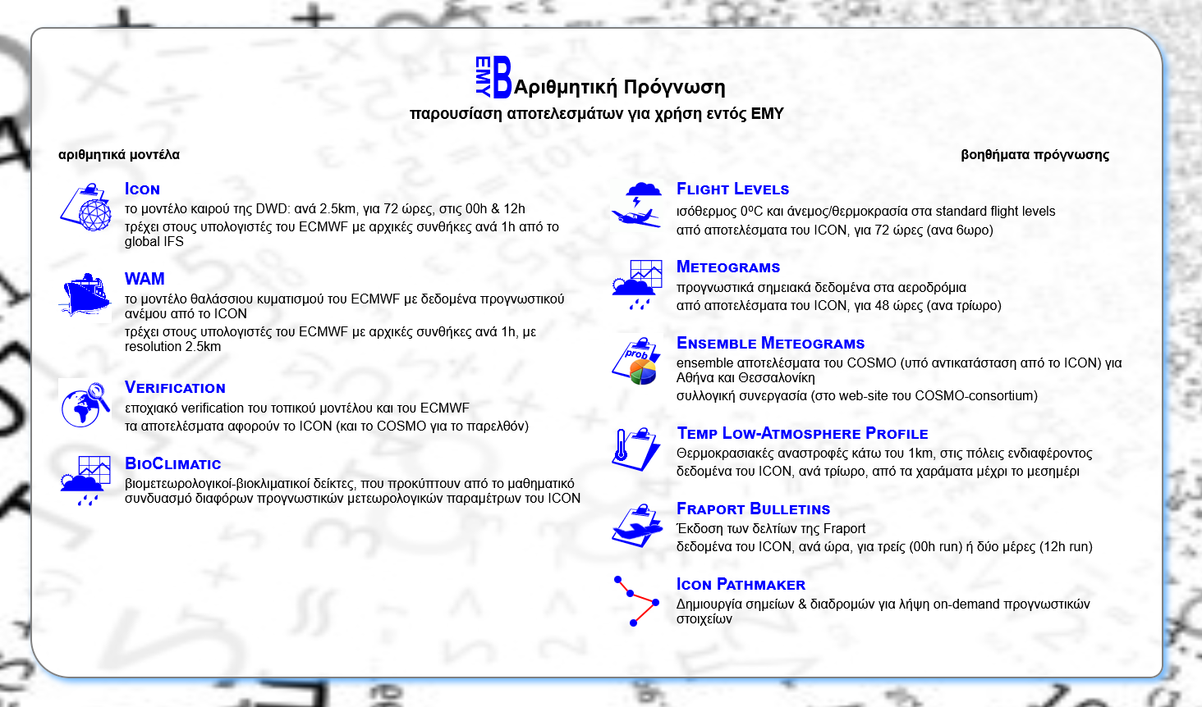
Current status
ICON operational

Slide 4
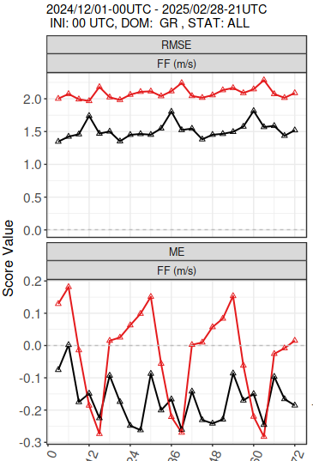
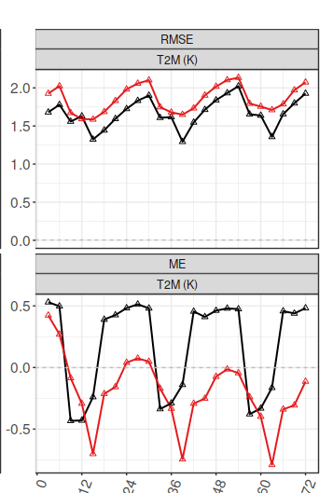
HNMS Verification Highlight
Scores for continuous parameters for Greek domain DJF24/25
ICON-GR2.5
IFS-ECMWF
RMSE
ME
2m Temperature
is overestimated at night
by ICON-GR
Wind speed
Better scores for ICON-GR

Slide 5
TAF verification software development (upd)
Can be applied to a dataset of TAFs and METARs of all available airports within a time window (month or season) and gives an indication on the forecast quality of wind , visibility and events such as RA/TSRA
Compares metar and TAF wind speed and direction for every forecast hour according to
user specified thresholds .
The output gives the percentage of correct and incorrect wind forecasts for all TAFs included in the Verification.
Every PROB40/PROB30 TEMPO for events such as RA /TSRA /SN is verified according to the events occurrence within the time window of the forecast period and it is considered as HIT, MISS or FALSE ALARM.
Categorical scores are given for all the TEMPO RA/TSRA etc predictions for all TAFS included in the verification.
The first estimates show good forecast results for wind speed and direction and satisfactory prediction of events occurrence with some false alarm tendency.
The procedure and preliminary results will be presented in COMECAP 2025.
dimitra.boucouvala@hnms.gr

Slide 6
Research Highlight
Implementation of COSMO model in the Evaluation of Eumetsat Aeolus Project
A systematic recording of extreme weather effects associated with the official warnings issued by HNMS is in progress along with their categorization from the synoptic and seasonal perspective. The performance of ECMWF-IFS as well as ICON-LAM will be evaluated and the technology obtained by ICON research in COSMO will be applied in order to modify the model configuration in favor of improved forecasts.
COSMO Model was used in hindcast mode forced with IFS Analysis with and without Aeolus assimilated data for the case of “Hephaestion” severe storm.
The results regarding precipitation threat scores over Greek synoptic stations displayed a preponderance of the forcing with Aeolus assimilated data.
A relevant presentation will be given in the 17ᵗʰ International Conference on Meteorology, Climatology & Atmospheric Physics (COMECAP 2025) along with a paper in MDPI Environmental and Earth Sciences Proceedings. An investigation for 11 more test cases spanned over 2020 fairly supports this trend and a peer reviewed publication is in progress.
Associated links:
https://www.eumetsat.int/eps-aeolus
https://comecap2025.com/
Euripides Avgoustoglou: euri@hnms.gr

Slide 7
Ongoing projects

Slide 8
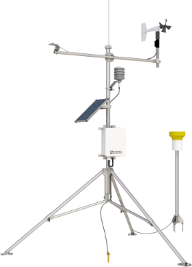
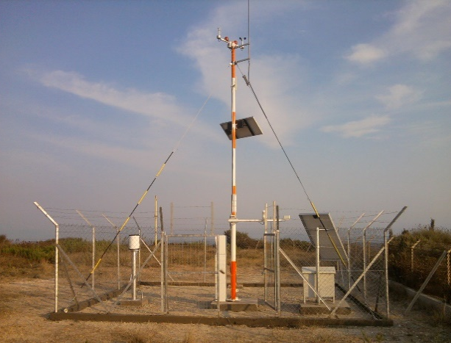
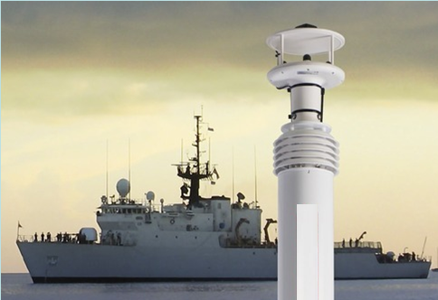
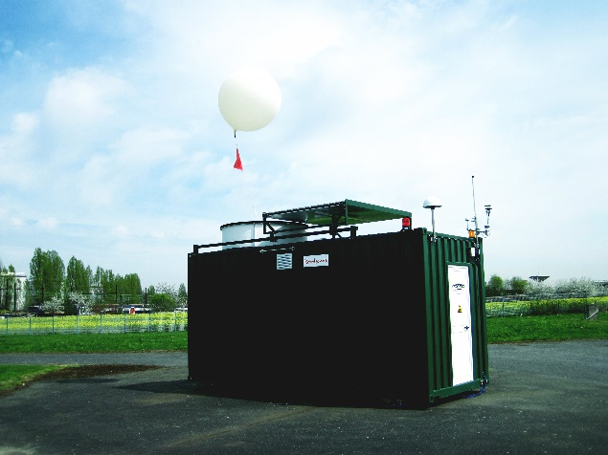
1st PROJECT
1st Project: Upgrade and Extension of Surface & Upper Air Observation network
50 Automatic Weather Stations (AWS)
30 Environmental AWS (E-AWS)
10 Portable AWS (P-AWS)
10 Shipboard AWS (S-AWS)
3 Automatic Radiosonde Systems (ARS)
Notes:
(Δ–4)
In more details….
The first part with the surface observation network upgrade includes the installation of 50 Automatic Weather Stations systems consisted of the most essential sensors, 30 Environmental AWS consisted of some more peculiar sensors, 10 shipboard AWS (S-AWS), 10 portable (P-AWS) and 3 fully automatic sounding systems (ARS).

Slide 9
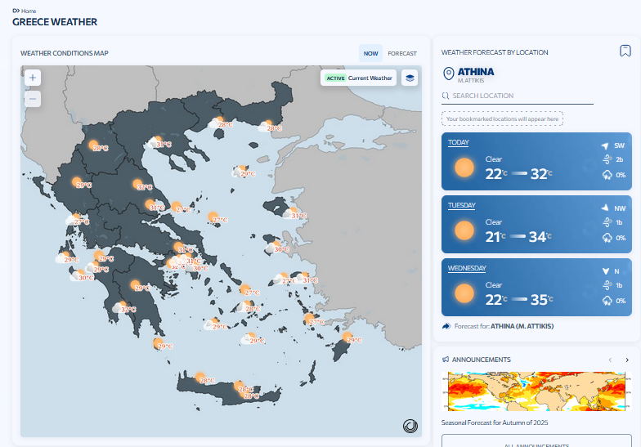
1st PROJECT
The newly added network
Notes:
(Δ–4)
In more details….
The first part with the surface observation network upgrade includes the installation of 50 Automatic Weather Stations systems consisted of the most essential sensors, 30 Environmental AWS consisted of some more peculiar sensors, 10 shipboard AWS (S-AWS), 10 portable (P-AWS) and 3 fully automatic sounding systems (ARS).

Slide 10
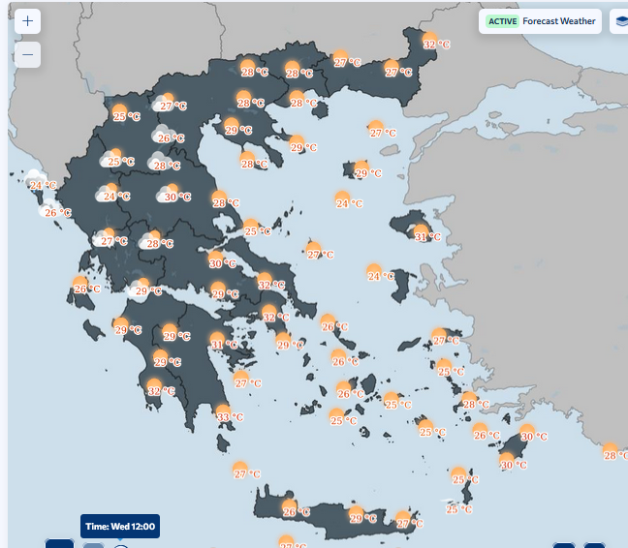
1st PROJECT
About 120 Met Stations over all Greece territory
Notes:
(Δ–4)
In more details….
The first part with the surface observation network upgrade includes the installation of 50 Automatic Weather Stations systems consisted of the most essential sensors, 30 Environmental AWS consisted of some more peculiar sensors, 10 shipboard AWS (S-AWS), 10 portable (P-AWS) and 3 fully automatic sounding systems (ARS).

Slide 11
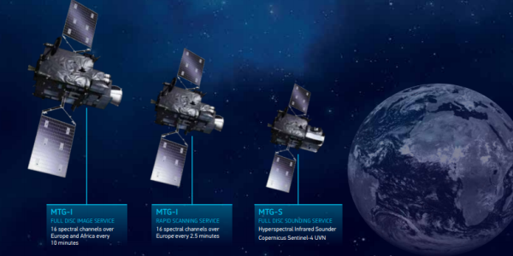
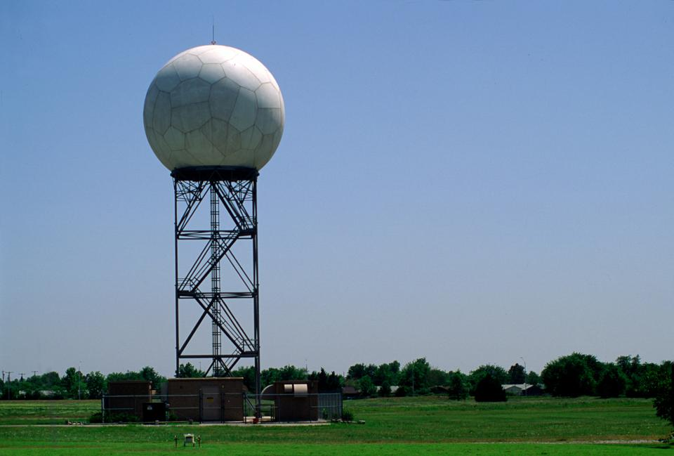
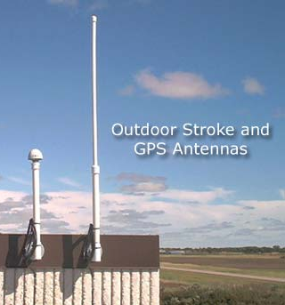
2nd PROJECT
2st Project: Implementation of a Nowcasting system for severe weather and for supporting Civil Protection Authority
1st phase includes: 30 automatic stations for Radar calibration, two MTG-compatible satellite data acquisition and processing stations, and a network of 12 lightning sensors.
2nd phase includes: New network of 7 – 10 Radar C-band Dual Pol Magnetron, and the infrastructure for a Nowcasting System.
Notes:
(Δ–8)
The second modernization project with the title of “Implementation of a nowcasting system for severe weather and for supporting Hellenic Civil Protection Authority” includes the upgrade and spatial expansion of our radar network covering the entire Hellenic territory with at least 10 new C-band dual polarization systems, the upgrade of our satellite receiving stations to be compatible with the new generation of EUMETSAT satellites MTG and METOP SG, the upgrade of our lightning detection network and the development of a Nowcasting system focusing on severe weather. The system will be able to produce warnings automatically which after a quality control from the on duty forecasters will be sent to civil protection services and then to public. The budget of the project is around 50 million euros and has a scheduling of at least 5 years.

Slide 12
2nd PROJECT
2st Project: Implementation of a Nowcasting system for severe weather and for supporting Civil Protection Authority
1st phase includes: 30 automatic stations for Radar calibration, two MTG-compatible satellite data acquisition and processing stations, and a network of 12 lightning sensors.
2nd phase includes: New network of 7 – 10 Radar C-band Dual Pol Magnetron, and the infrastructure for a Nowcasting System.
The implementation has started
Notes:
(Δ–8)
The second modernization project with the title of “Implementation of a nowcasting system for severe weather and for supporting Hellenic Civil Protection Authority” includes the upgrade and spatial expansion of our radar network covering the entire Hellenic territory with at least 10 new C-band dual polarization systems, the upgrade of our satellite receiving stations to be compatible with the new generation of EUMETSAT satellites MTG and METOP SG, the upgrade of our lightning detection network and the development of a Nowcasting system focusing on severe weather. The system will be able to produce warnings automatically which after a quality control from the on duty forecasters will be sent to civil protection services and then to public. The budget of the project is around 50 million euros and has a scheduling of at least 5 years.

Slide 13

3rd PROJECT
3rd Project: Procurement of a new HPC, and
Data Center upgrade.
The procurement process is delayed.
Notes:
(Δ–8)
The second modernization project with the title of “Implementation of a nowcasting system for severe weather and for supporting Hellenic Civil Protection Authority” includes the upgrade and spatial expansion of our radar network covering the entire Hellenic territory with at least 10 new C-band dual polarization systems, the upgrade of our satellite receiving stations to be compatible with the new generation of EUMETSAT satellites MTG and METOP SG, the upgrade of our lightning detection network and the development of a Nowcasting system focusing on severe weather. The system will be able to produce warnings automatically which after a quality control from the on duty forecasters will be sent to civil protection services and then to public. The budget of the project is around 50 million euros and has a scheduling of at least 5 years.

Slide 14
COSMO General Meeting 2025
1-5 September 2025 Basel, Switzerland
Hellenic National Meteorological Service
Current Status and Future Plans
Thank you for your attention

