Slide 1


WG S/I : news about our activities
Massimo Milelli and colleagues
4th September 2025, 27th COSMO General Meeting, Basel

Slide 2
Outlook
HPC activities @MeteoSwiss
Fieldextra
ICON-LEPS
NWP-TS
GLORI infrastructure
Documentation
New COSMO web site

Slide 3
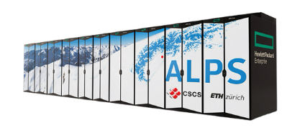
ICON on GPU
Code is being mostly used by MeteoSwiss, MPI-M and ETHZ on GPUs
Paper ICON-GPU for NWP is submitted and available as pre-print : https://doi.org/10.5194/egusphere-2025-3585
Planned GPU port: Emvorado
Courtesy of Xavier, MCH

Slide 4
CPU / GPU performance comparison
ICON-CH1-EPS Benchmark
8 AMD Epyc CPUs (64 cores) vs
8 A100 Nvidia GPUs
5.6x speed up factor when comparing CPU to GPU
Courtesy of Xavier, MCH

Slide 5
ICON port on GPU is mostly completed, reduced effort on maintenance and optimization
Several efforts are ongoing to modernize and make ICON more performance portable
  ICON-C
  WarmWorld: re-writing of some components using different languages -> C++ / KokKos
  EXCLAIM
Courtesy of Xavier, MCH

Slide 6
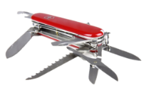
Fieldextra beyond July 2026
Petra Baumann is the new SCA
MeteoSwiss expects to run fieldextra operationally for ~5 more years
MeteoSwiss is building an NWP data processing framework in Python, and exploring new workflows
MeteoSwiss will focus on stabilization of the code, bug fixes, support of new GRIB codes, eccodes updates.
No huge effort on adding new features
petra.baumann@meteoswiss.ch, COSMO GM 2025, Basel 6
Courtesy of Petra, MCH

Slide 7
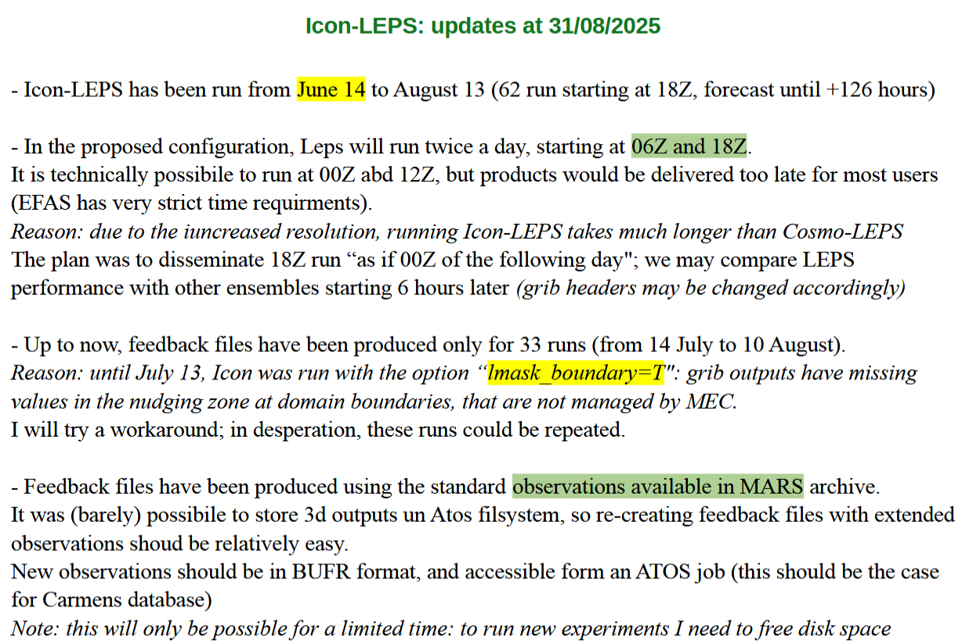
Courtesy of Enrico, Arpae

Slide 8
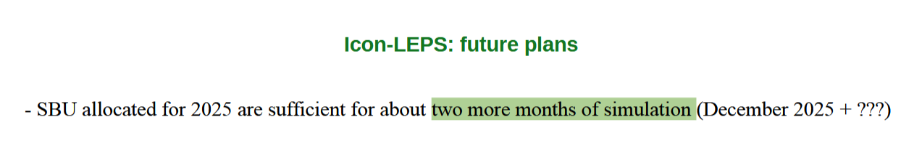
Courtesy of Enrico, Arpae

Slide 9
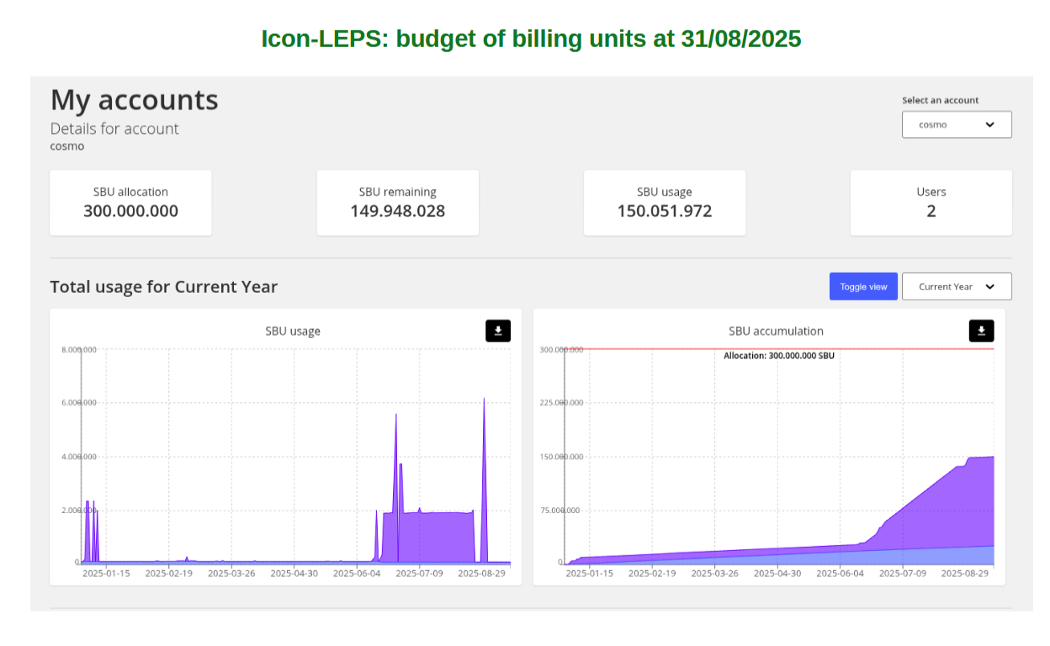
Courtesy of Enrico, Arpae

Slide 10
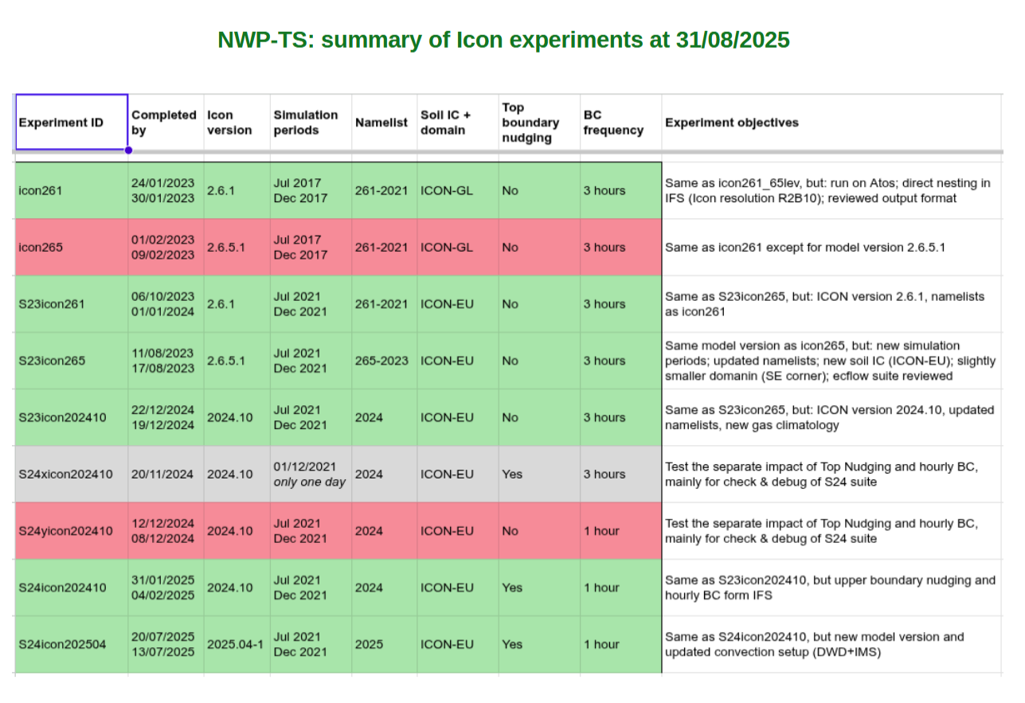
Courtesy of Enrico, Arpae

Slide 11
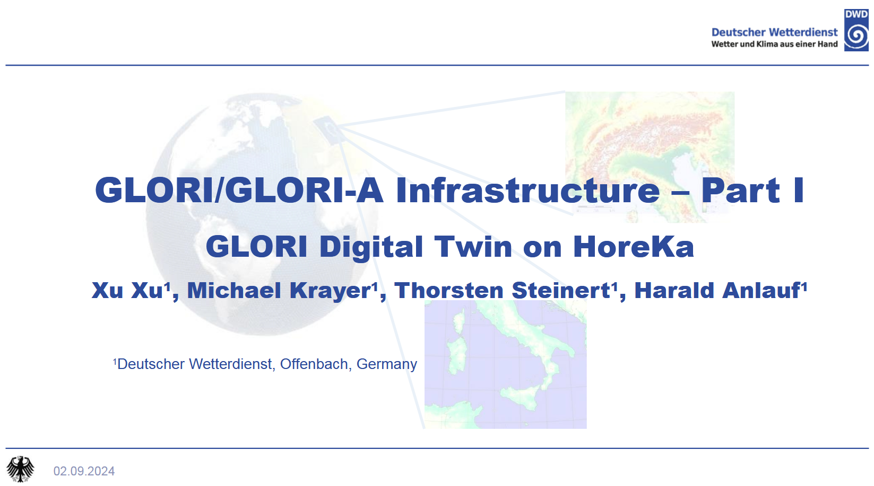
Courtesy of Xu, DWD

Slide 12
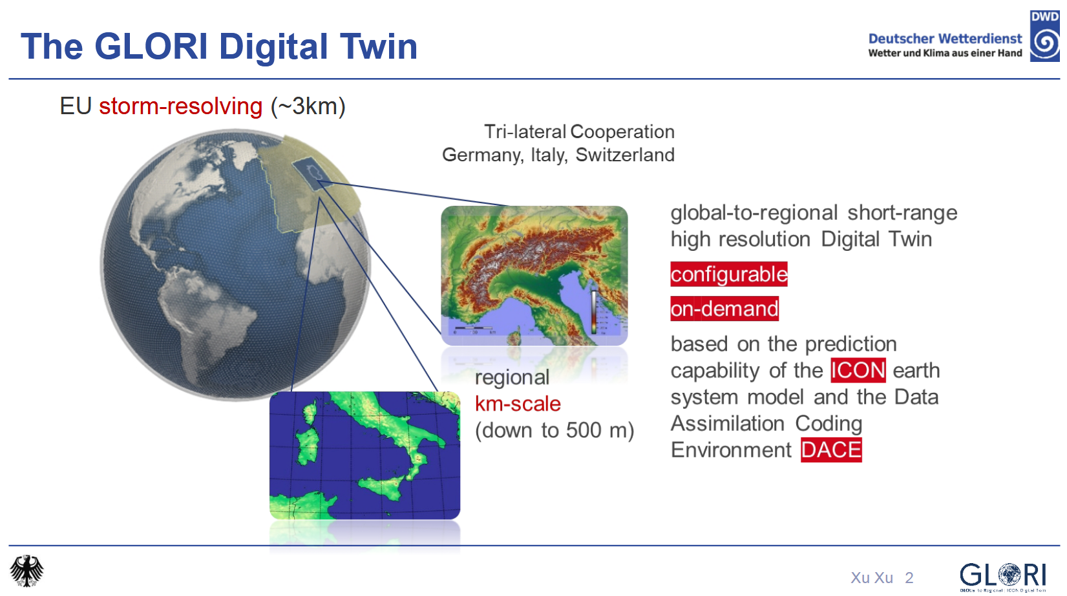
Courtesy of Xu, DWD

Slide 13
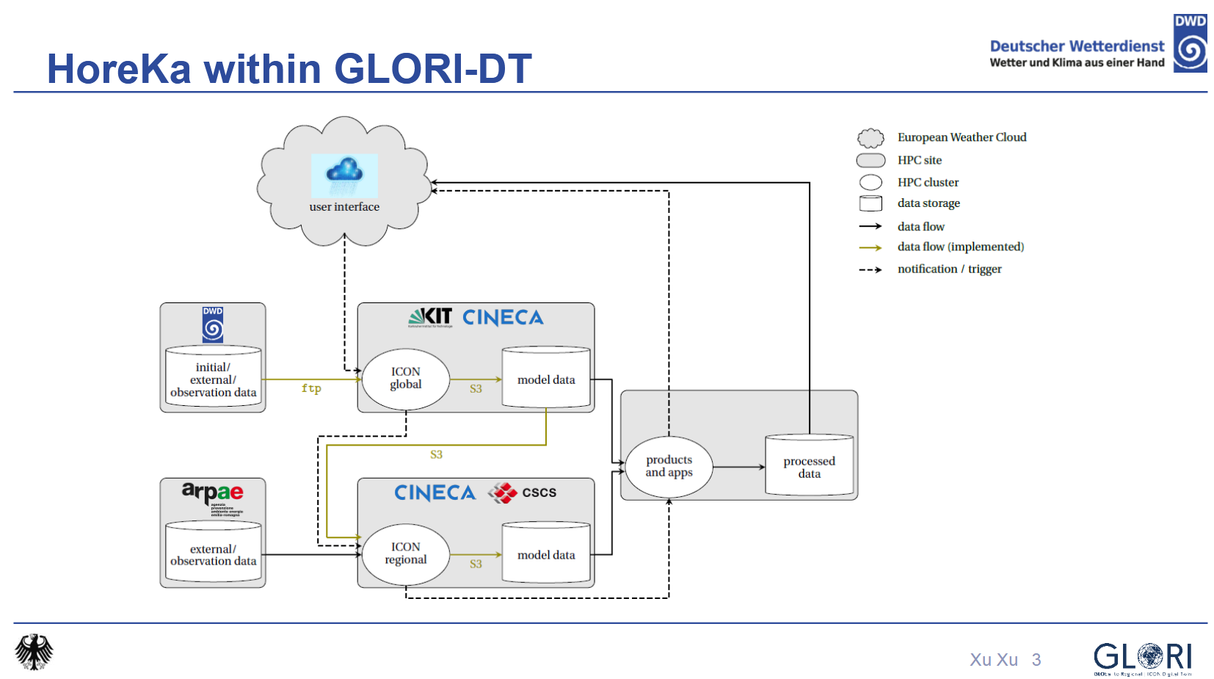
Courtesy of Xu, DWD

Slide 14
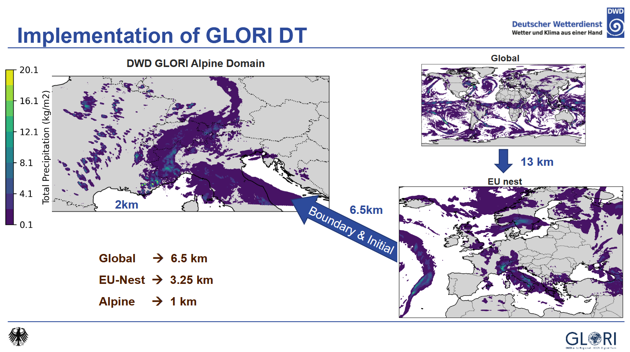
Courtesy of Xu, DWD

Slide 15
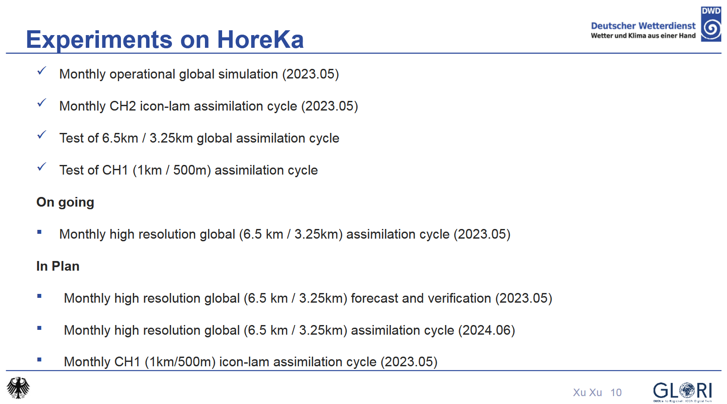
Courtesy of Xu, DWD

Slide 16
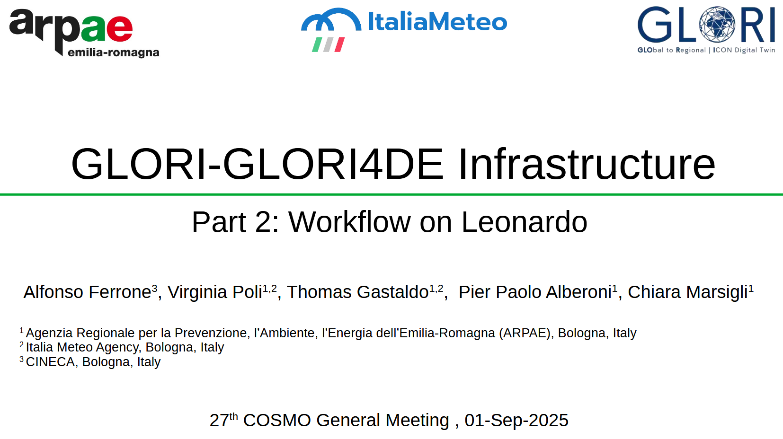
Courtesy of Alfonso, Arpae

Slide 17
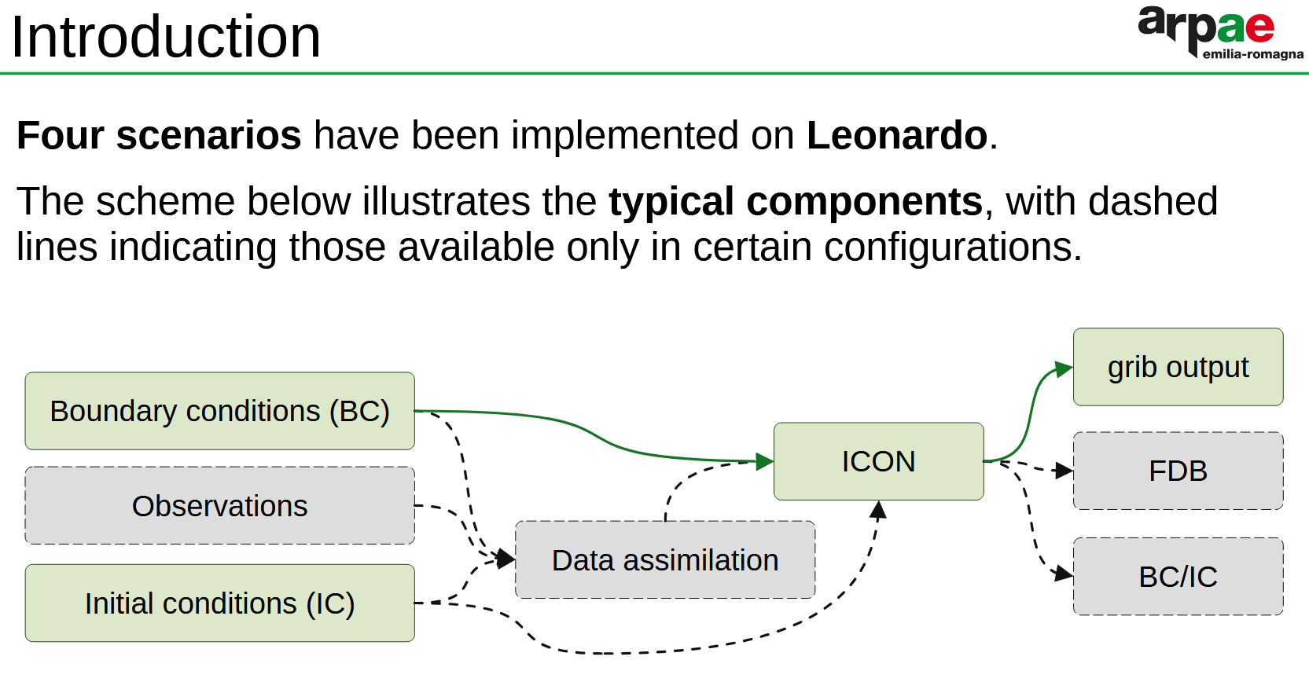
Courtesy of Alfonso, Arpae

Slide 18
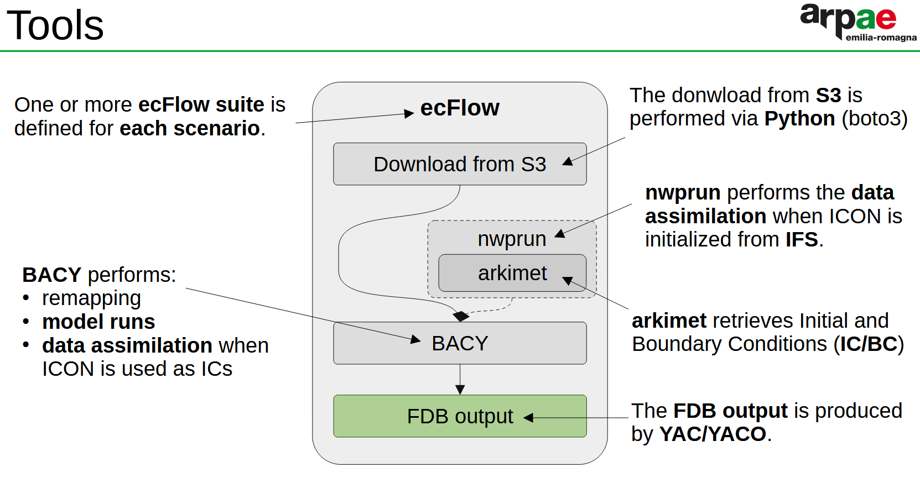
Courtesy of Alfonso, Arpae

Slide 19
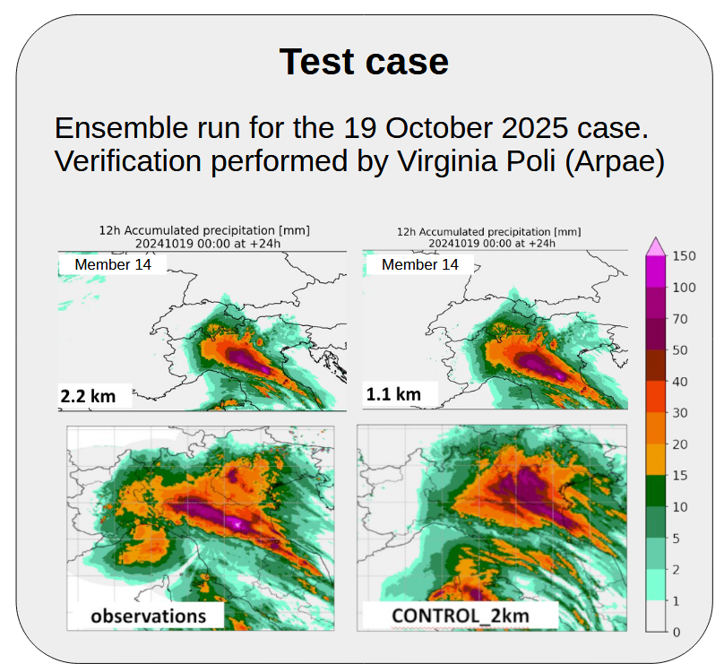
Courtesy of Alfonso, Arpae

Slide 20
Documentation
The documentation is updated:
  PP IMPACT -> Paper
  PP COMFORT -> TR
  PP MILEPOST -> internal report
  Newer EMVORADO user guide (Feb 2025)
  New NWP Test Suite Report
  New list of the 2025 per-diem and hotel-rates amounts
  2024 ESSL testbed report (evaluation of DWD nowcast)
Expected TRs during the next COSMO year (09/2025-08/2026): PP PROPHECY, PP CAIIR 2, PP CARMENs, PP CITTA’, PP KENDAScope (unless there are papers out of them)

Slide 21
Web site, points of discussion
The COSMO Steering Committee, decided to establish a small Task Team (TT) to design and prototype the new COSMO Website, considering the reorganization of the COSMO Working Groups and the successful migration to ICON model. The TT shall include the current webmaster (Theodore Andreadis, HNMS) as well as other volunteering experts from members and partners.
Who are the users
No duplication of info between www.cosmo-model.org and www.icon-model.org
Review of the current COSMO website, identifying obsolete contents or pages to be updated -> strong interaction with WG chair/co-chair

Slide 22
Structure of the consortium (WGs, STC, SMC, participants…)
A bit of history
All info about support license
Scientific docs such as papers, newsletter, TR
Events (ICCARUS, GM)
Verification results
ICON-LEPS maps (Consortium product)
Nextcloud (open source) as repository for docs, presentations… To be installed on the Greek server
FTEs page not movable to Gitlab
Namelist comparison tool only for internal use
External company to manage the design, keeping the COSMO brand and identity, but with a new logo

Slide 23
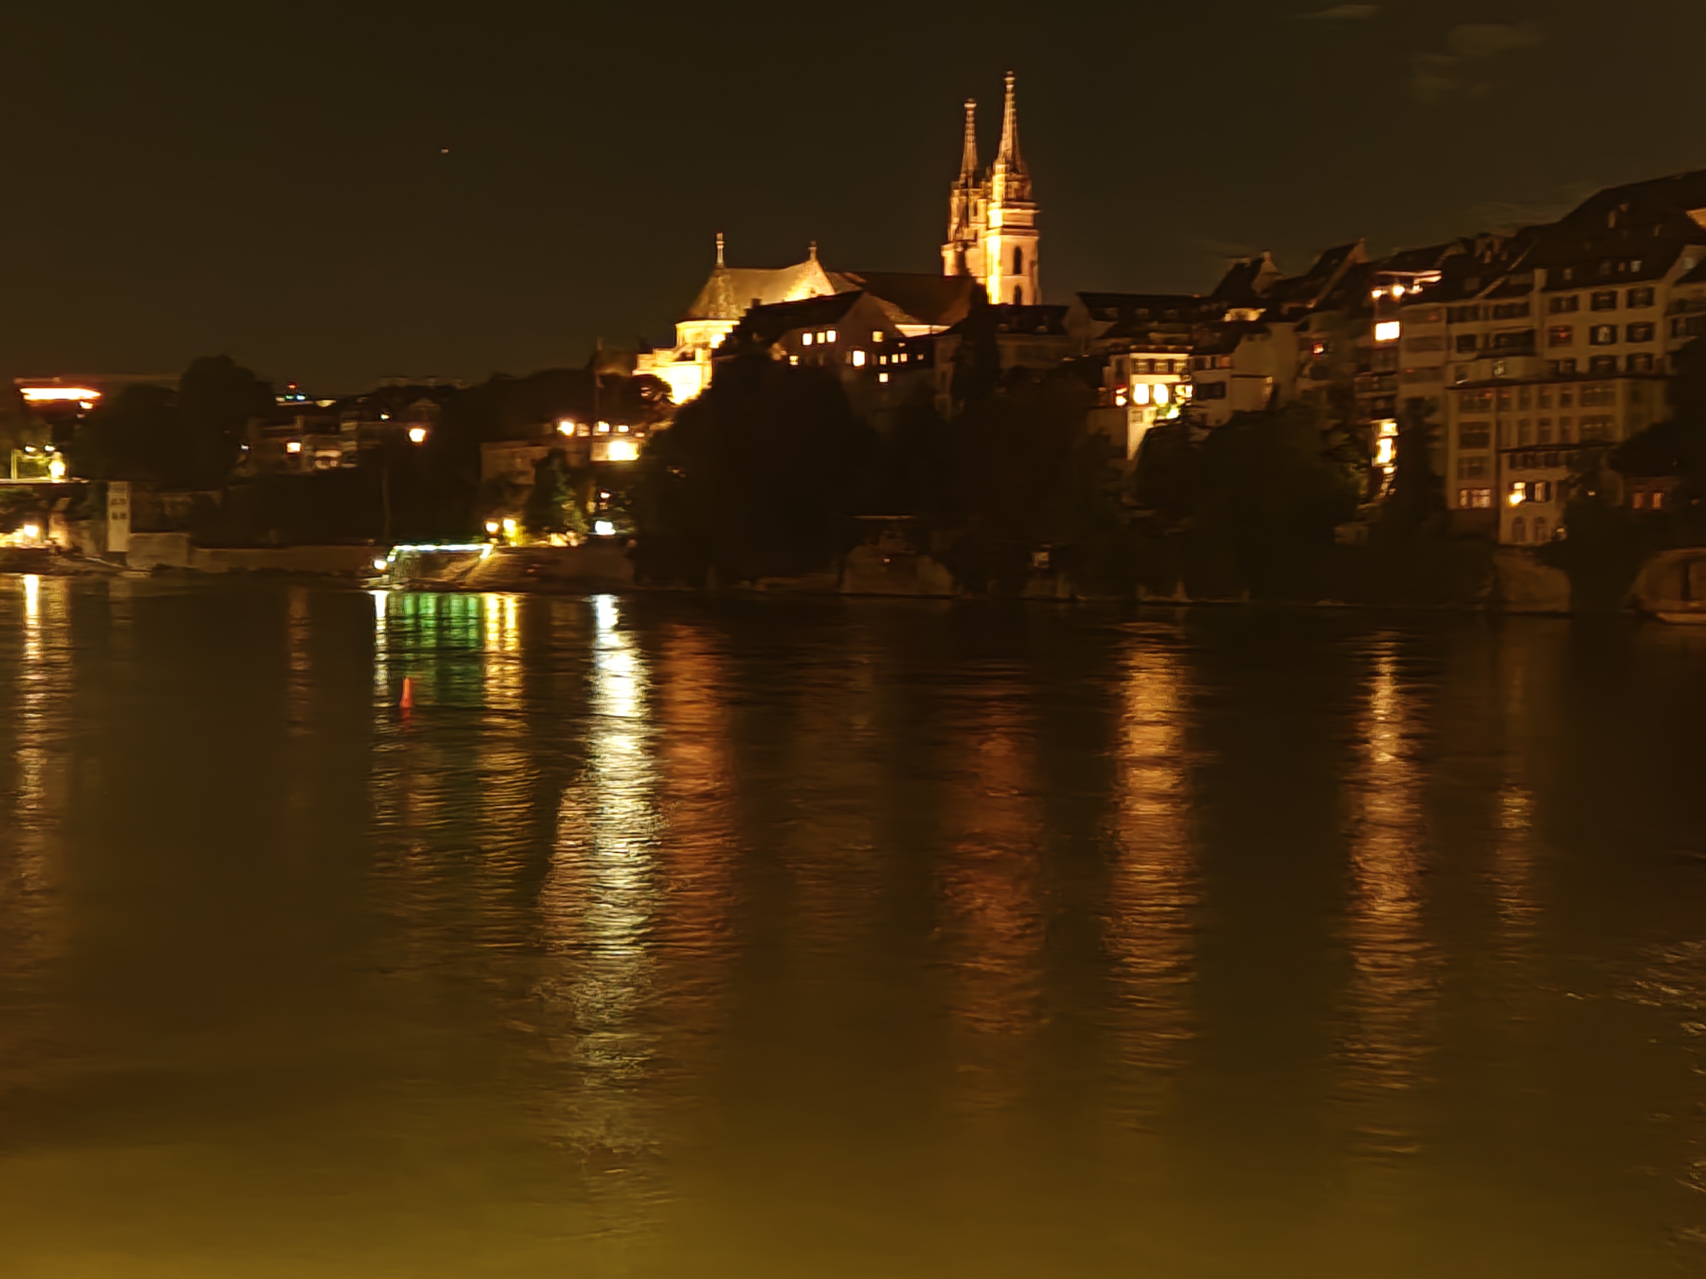
Thank you for the attention

