Slide 1
SCA Report for ICON-NWP
Ulrich Schättler
ICON Gatekeeper (in charge for COSMO)

Slide 2
Latest ICON Releases
NOTE:
This is not on contents of ICON, just some technical remarks to find yourself around.
For actual informations on latest ICON development see Daniel Riegers presentation on „ICON News“

Slide 3
Branches – Tags ⇨ Releases
On the public repository icon/icon-model:
Branches are named
release-2024.10-public
release-2025.04-public
Tags are named
icon-2024.10-public 09.10.24
icon-2025.04-public 29.04.25
  icon-2025.04-1-public 28.05.25
  icon-2025.04-2-public 18.07.25
When cloning the public repository you will get the latest branch and tag by default.
Fix in icon-2025.04-1-public: Enables using spun-up FLake variables from first guess in MODE_COMBINED
Fix in icon-2025.04-2-public: Increase buffer size for auxiliary field during nest start

Slide 4
Important Repositories
https://gitlab.dkrz.de/icon/icon-model
↑ open source release is taken from icon repository
https://gitlab.dkrz.de/icon/icon
↕ regular synchronizations
https://gitlab.dkrz.de/icon/icon-nwp
Open Source repository; open to the world
Private „upstream“ ICON repository
gathering developments from all subgroups
Private „downstream“ ICON repository for NWP
Used by NWP developers (also COSMO) to add developments through merge requests (MR)
For the private repositories see the Commits and Merge Request pages to learn about the past and future development work.
Special tags for DWD and MCH operational versions. More information on DWD versions:
  https://gitlab.dkrz.de/icon/wiki/-/wikis/ICON-NWP-operational-release-tags

Slide 5
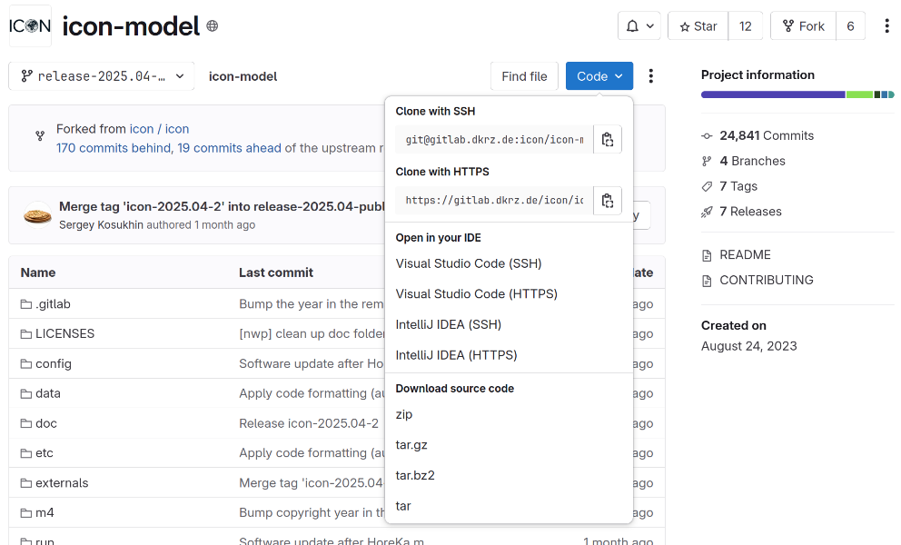
Important Repositories (II)
https://gitlab.dkrz.de/icon/icon-model
Public repository for open source releases
There is NO merge-requests page
But there is a commits page (at least for the latest release)
  https://gitlab.dkrz.de/icon/icon-model/-/commits/release-2025.04-public?ref_type=heads
  Clicking on a commit gives only basic informations on the changes for that commit
  The link to the corresponding merge request with more details goes to the private pages ☹
Another problem when „Download source code“
  The code for the externals is not contained in the tar-files due to a gitlab-problem
  You have to clone the code: git clone https://gitlab.dkrz.de/icon/icon-model.git
(Status as of August 2025)

Slide 6
License and Support Issues

Slide 7
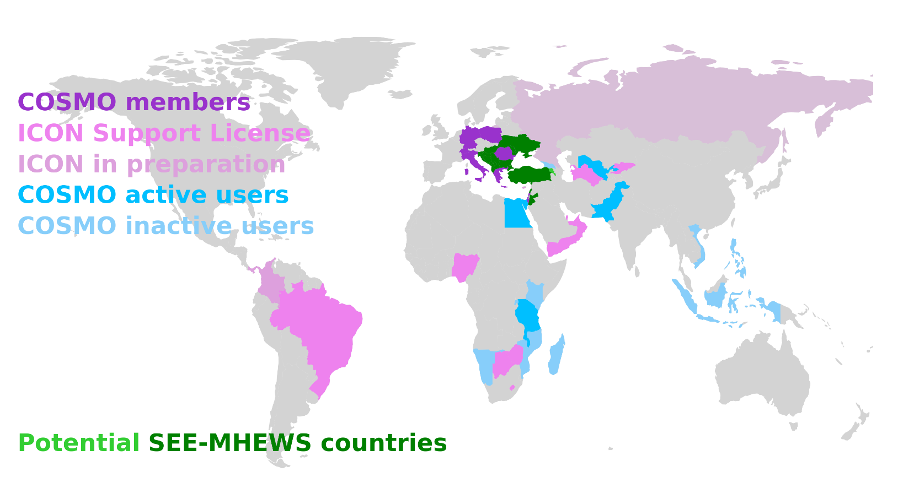
Status of ICON Licensees / Users of ICON Forecasts
Running ICON: Brazil (Navy), Qatar, Oman, UAE
Contracts also signed by: Botswana, Kirgistan, Lesotho, Nigeria, Turkmenistan, Yemen, Zimbabwe
Contracts already sent to: Brazil (INMET), Egypt, Tanzania.
Possible paying countries
  in negotiation: Cyprus
  stalled: Bahrain, Colombia, Panama
South-East European Multi-Hazard Early Warning Advisory System
  these countries have access to ICON forecasts performed by IMS at ECMWF computer
  see: www.see-mhews.org

Slide 8
COSMO Money 2025 and Beyond (Using World Bank Data)
Country | 2025 |  | 2026
 | GDPpc¹ | Fee | GDPpc² | Fee
Botswana | 7820.2 | 11,400 | 7,695.2 | 10,300
Brazil (INMET) | Still COSMO | Missing: 20,000 | 10,043.6 | 15,800
Brazil (Navy) | 8,917.7 | 13,700 | 10,280.3 | 16,300³
Oman | 21,549.8 | 20,000 | 20,248.4 | 20,000
Qatar | 80,195.9 | 2H2025: 10,000 | 76,275.9 | 20,000
Turkmenistan | 8,792.5 | 13,400 | 8,571.6 | 12,900
UAE | 49,070.7 | 20,000 | 49,377.6 | 20,000
 |  | 88,500 |  | 115,300
2025: GDPpc taken from https://data.worldbank.org/indicator/NY.GDP.PCAP.CD (August 2024); except Brazil (Navy) and Turkmenistan: prices were not raised.
2026: GDPpc taken from https://data.worldbank.org/indicator/NY.GDP.PCAP.CD (July 2025); except Brazil (INMET): still in negotiation about the contract.
Brazil Navy: If we want to raise the price, we have to tell them until end of September.

Slide 9
Support Activities
NWP Model Training in May 2025 (see next slides)
The Request Tracker is online and rather active after the Training:
  Nigeria and Botswana installed ICON and the ICON tools; Zimbabwe is in the process of doing so.
  With Nigeria we are now discussing a proper domain (size, resolution) for an update of COSMO.
Especially UAE uses the RT also for scientific questions
  radiation values in meteograph output, temperature bias
  Remember from last year, the „headache problem“: ICON consistently overestimates forecasted rainfall amounts. This is still not solved!

Slide 10
NWP Model Training

Slide 11
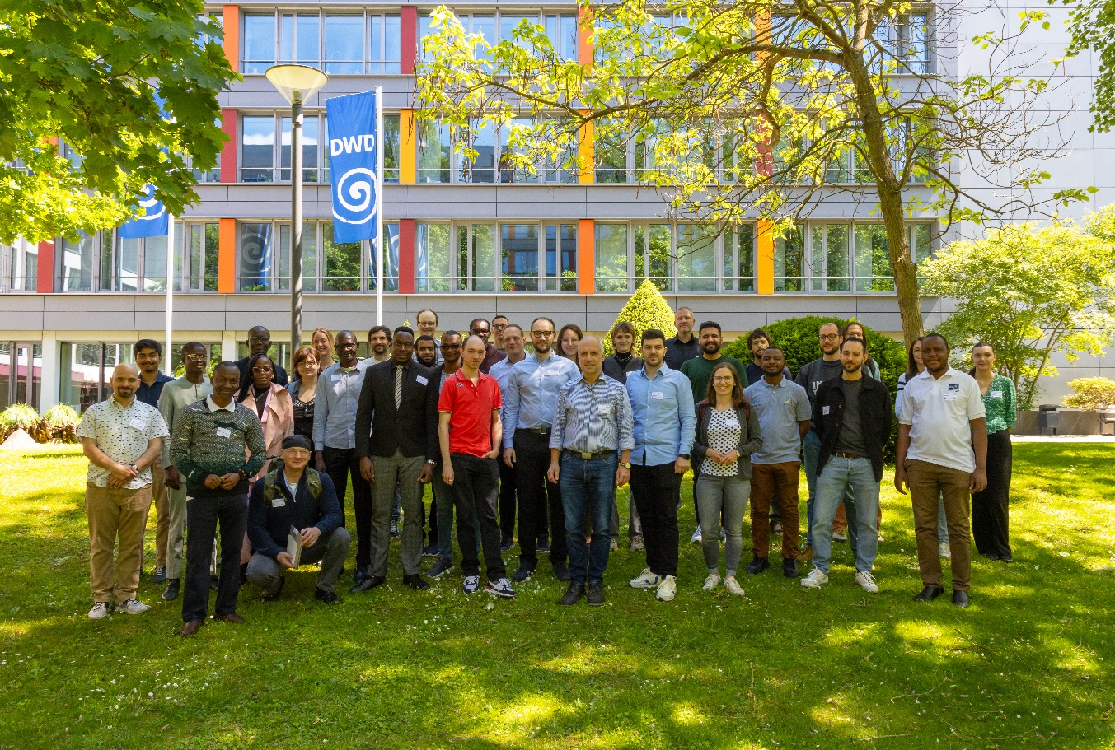
NWP Model Training 2025
Took place 12-16 May in Offenbach
Only CLM and MetService course this year; Academia took place in Hamburg in July.
40 accepted registrations for MetService course.
Preparation and organization by the proven Exercise Team (*). This year with support from Daniel Rieger.
Exercises performed on ECMWF Computer again.
Exercises for scheduling system (ecFlow) need elaboration.
No exercises yet for verification.
(*) Stefan Gabrian, Stefan Dinicila (NMA), Witold Interewicz (IMGW), Daniel Rieger, Ulrich Schättler, Sascha Brand (DWD)

Slide 12
NWP Model Training 2025
In principle, the NWP Model Training again was a success, BUT:
  From 40 accepted registrations, only 13 participants present.
  About 10 participants cancelled the registration before the course (due to visa or funding problems)
  15 participants did not show up without excuse!
  After the training we asked all missing participants for the reason for not showing up:
    At least they all answered!
    Reasons always were visa or funding problems.
At DWD we will have a meeting next week to discuss the future of the NWP Model Training at DWD
Aftermath: Another institute shows interest in using ICON:
  IGAD Climate Prediction and Applications Centre (ICPAC)
  (in addition to ASECNA, ACMAD)

Slide 13
NWP Model Training: Summary for MetServices
Again joint COSMO development of the exercises (based on the work from the last years).
Scheduling and ecflow need more elaboration. Sascha is working on a basic ecflow-suite to run ICON-LAM.
Since the Training:
Working closely together with Nigeria, Botswana and Zimbabwe to set up an operational ICON-LAM application
More countries on the list:
  Egypt, Georgia, Malawi, Pakistan, Tanzania, Turkmenistan, Ukraine, Uzbekistan (still using COSMO or at least getting data from DWD)
  Indonesia, Kenya, Madagascar, Mozambique, Namibia, Philippines, Vietnam (former COSMO users)

Slide 14
NWP Model Training for Academia
For the Academia group the Training was organized by natESM in Hamburg at DKRZ.
Material for this Training is available under the CC BY-NC-ND 4.0 license (Attribution-NonCommercial-NoDerivatives 4.0 International)
  https://gitlab.dkrz.de/icon-training/icon-training-2025-scripts: see also the „rendered version“
  Also the Jupyter Notebooks for the exercises can be accessed through this page
A new version of the Tutorial is also available: Tutorial 2025:
  https://www.dwd.de/DE/leistungen/nwv_icon_tutorial/pdf_einzelbaende/icon_tutorial2025.html

Slide 15
ICON on ATOS (ECMWF)

Slide 16
New Compiler Wrappers
atos2020.gcc-11.2.0, atos2020.intel-2021.4
removed explicit version numbers from libraries used
included libfyaml to be able to use coupling (yac): but --enable-coupling is not activated
included links to RTTOV (private installation): but --enable-rttov is not activated
(optionally) included python3 (has to be activated)
atos2020.intel-2025.0
uses new Intel compiler (oneapi: intel-llvm) 2025.0
Still no reproducibility for ecrad with OpenMP
Not provided:
atos2020.gcc-14.2.0: this compiler is buggy (crashes in a turbulence routine)
atos2020.gcc-15.1.0: works again for ICON, but not all necessary libraries are installed yet

Slide 17
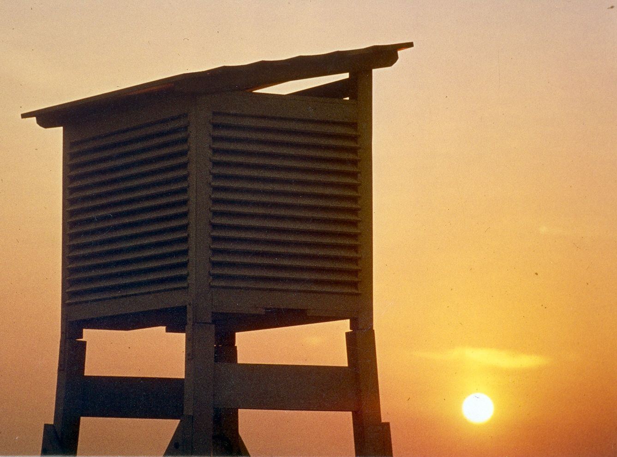
Thank you
for your attention

