Slide 1


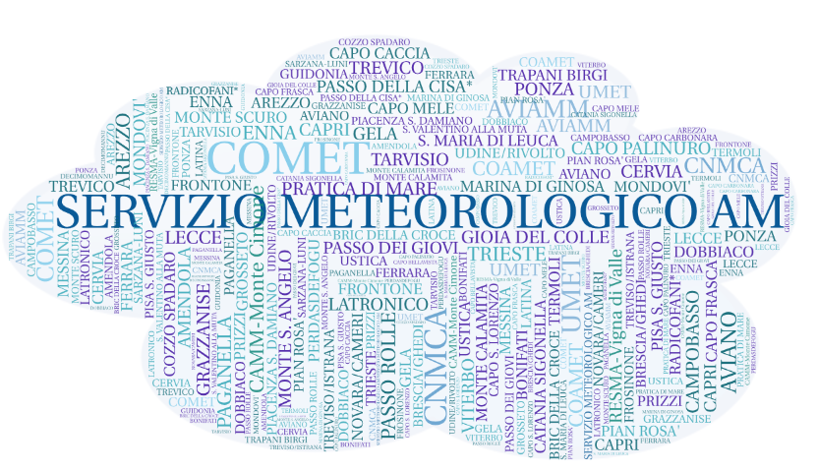



National Report - ITALY
News about
  Operations
  Research and development
  Scientific collaborations
Vision on
  Evolution of the national partnership
  Alignment with COSMO strategy
Antonio VOCINO, the CNMCA NWP group
and the “Italian COSMO family”
antonio.vocino@am.difesa.it
COSMO 27th General Meeting – Basel (CH), 1-4 September 2025

Slide 2
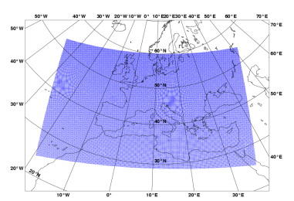
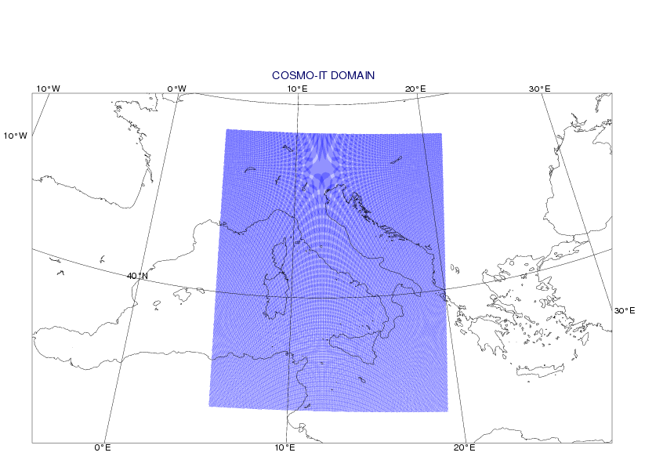

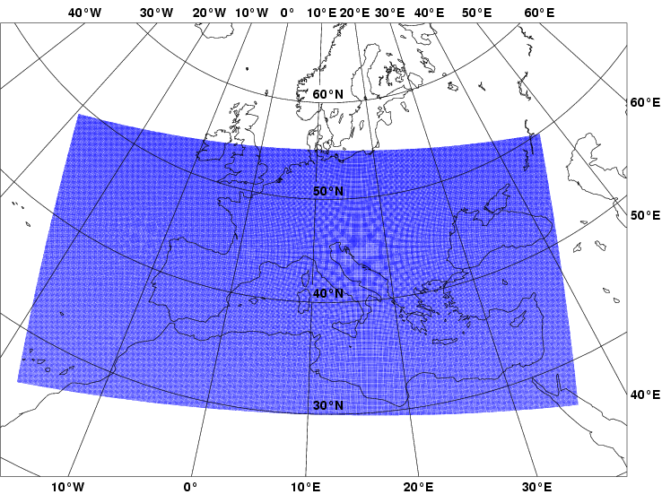
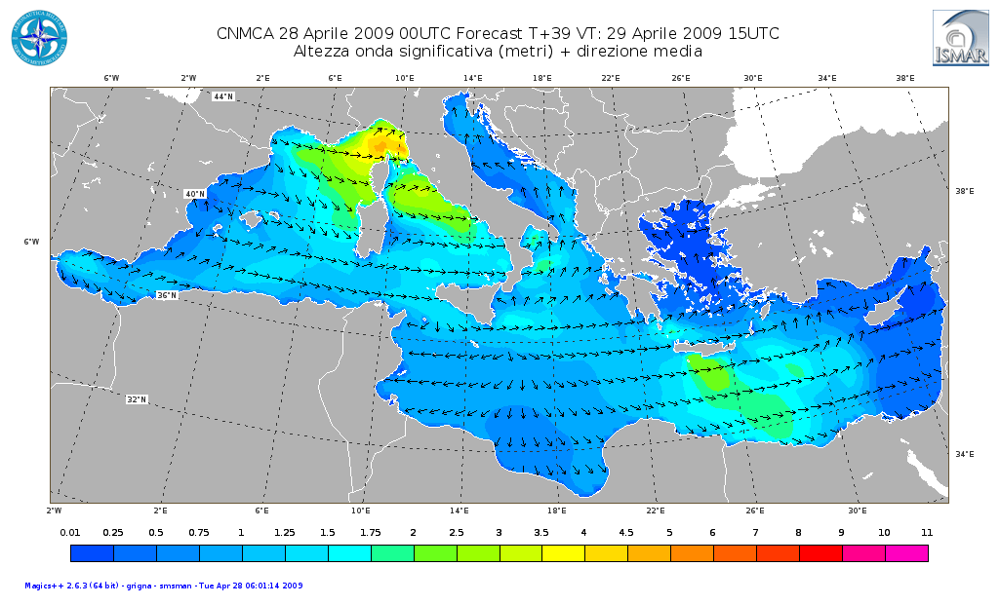
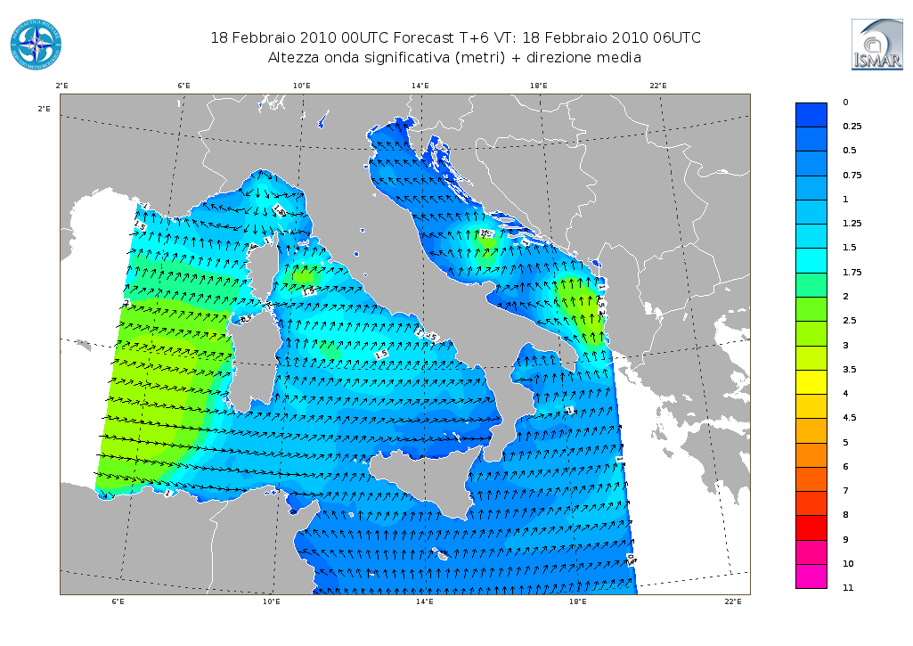
ItAF Met Service COSMO suites
Ensemble Data Assimilation:
Observations
RAOB (also descent), PILOT, SYNOP (also non-GTS), SHIP, BUOY, Wind Profilers/Radars, AMDAR-AIREP, Mode-S, Meteosat AMV, Metop scatt. winds, NOAA/Metop AMSUA/MHS and NPP/NOAA ATMS radiances
Operational since June 2011
3h cycle
7 km
49 v.l.
40+1 m.
Operational since nov 2018
1h cycle
2.2 km
65 v.l.
40+1 m.
LETKF
HR-LETKF
Boundary Conditions
(HRES, ENS)
Ensemble
Analysis
5 km
45 v.l.
Local Area Modeling:
2.2 km
65 v.l.
Deterministic
Analysis
7 km
45 v.l.
20 m.
parameterized convection
explicit convection
2.2 km
65 v.l.
20 m.
COSMO-IT
00-06-12-18 UTC up to 48/30h
COSMO-ME EPS
00-12 UTC
up to 72h
COSMO-ME
00-06-12-18 UTC up to 72h
Ensemble Prediction System:
COSMO-IT EPS
00-12 UTC up to 48h
NETTUNO-ME EPS
3’, 30 freq., 36 dir.
00 UTC up to 48h
NETTUNO-ME
3’, 30 freq., 36 dir.
00-12 UTC up to 72h
NETTUNO-IT
1’, 30 freq., 36 dir.
00-12 UTC up to 48h
COSMO 27th General Meeting – Basel (CH), 1-4 September 2025
Notes:
2
2
2
2
2
2
2
2
2

Slide 3
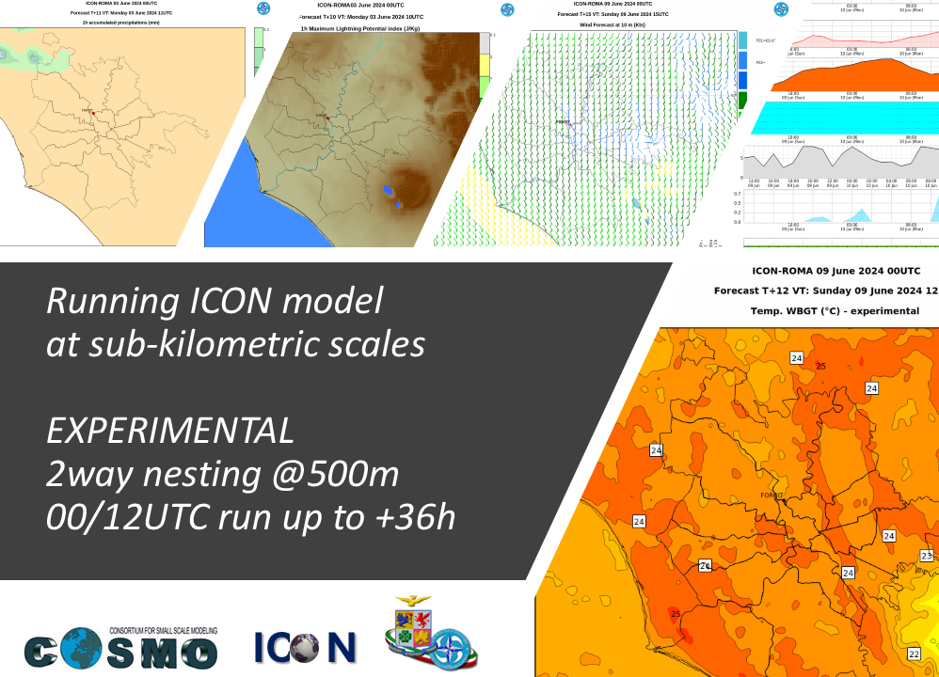
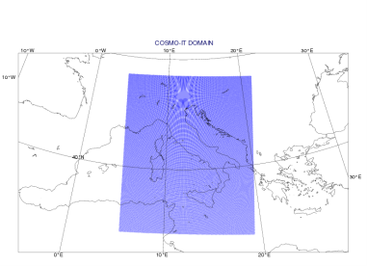


The ICON Model
Observations
RAOB (also descent), PILOT, SYNOP (also non-GTS), SHIP, BUOY, Wind Profilers/Radars, AMDAR-AIREP, Mode-S, Meteosat AMV, Metop scatt. winds, NOAA/Metop AMSUA/MHS and NPP/NOAA ATMS radiances
Ensemble Data Assimilation:
1h cycle
2.2 km
65 v.l.
40+1 m.
LETKF
Boundary Conditions
(HRES, ENS)
Ensemble
Analysis
Deterministic
Analysis
2.2 km
65 v.l.
20 m.
2.2 km
65 v.l.
ICON-IT EPS
ICON-IT
explicit
convection
Ensemble Prediction System:
Local Area Modeling:
COSMO 27th General Meeting – Basel (CH), 1-4 September 2025

Slide 4
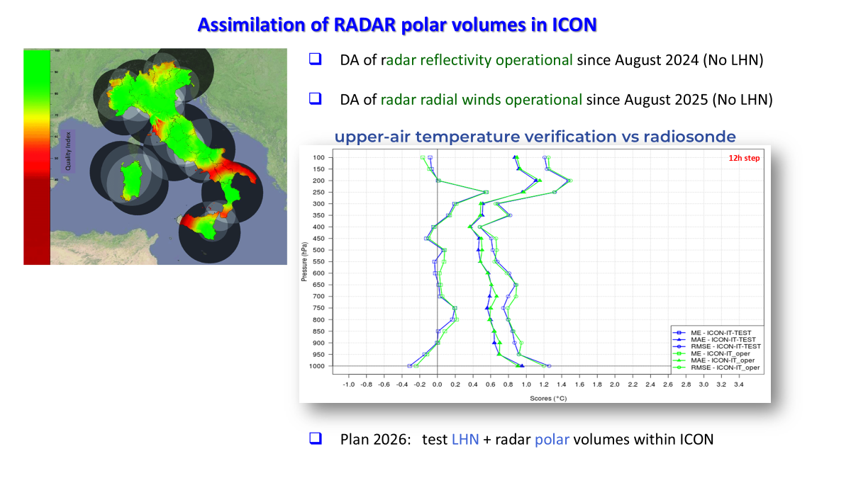
Work in progress (DA)
COSMO 27th General Meeting – Basel (CH), 1-4 September 2025

Slide 5
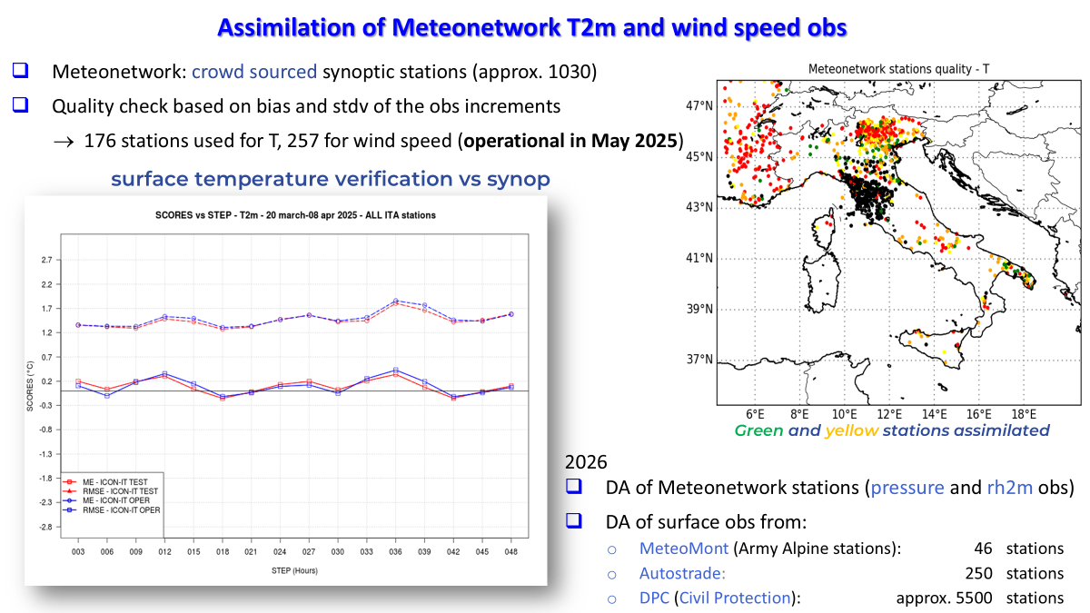
Work in progress (DA)
COSMO 27th General Meeting – Basel (CH), 1-4 September 2025

Slide 6
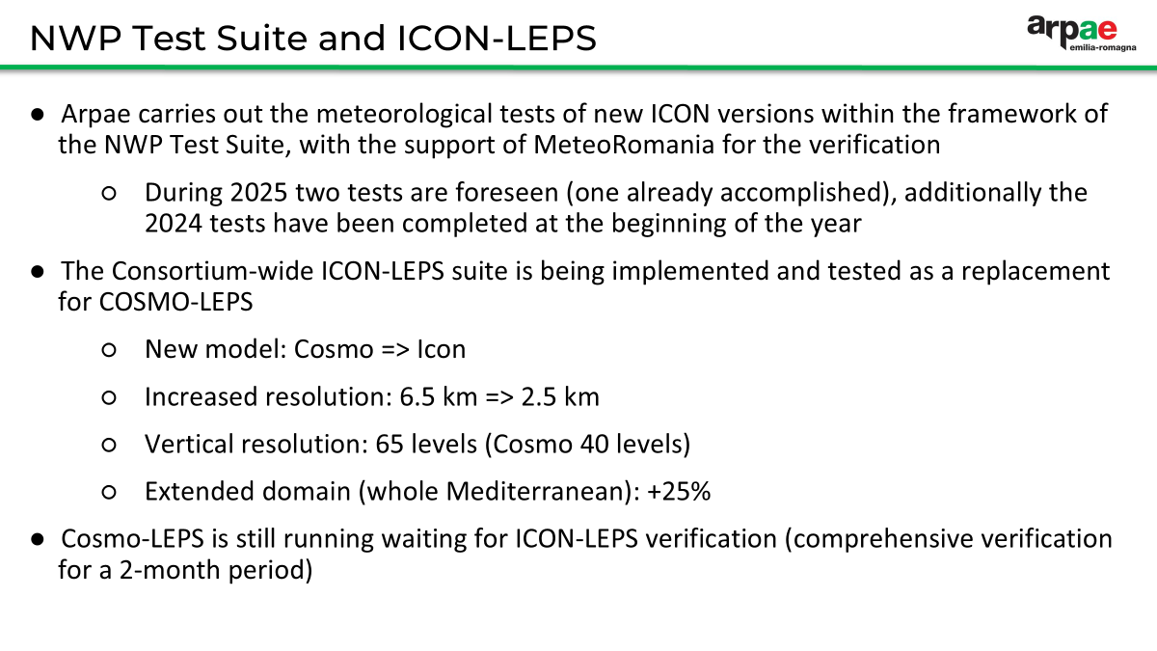
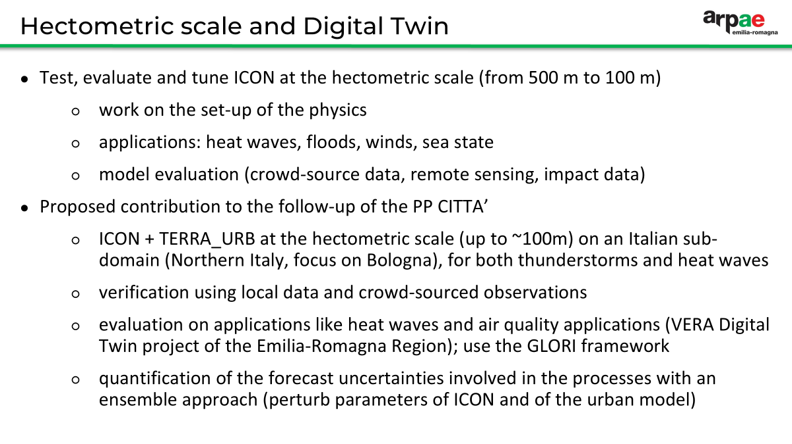
COSMO 27th General Meeting – Basel (CH), 1-4 September 2025

Slide 7
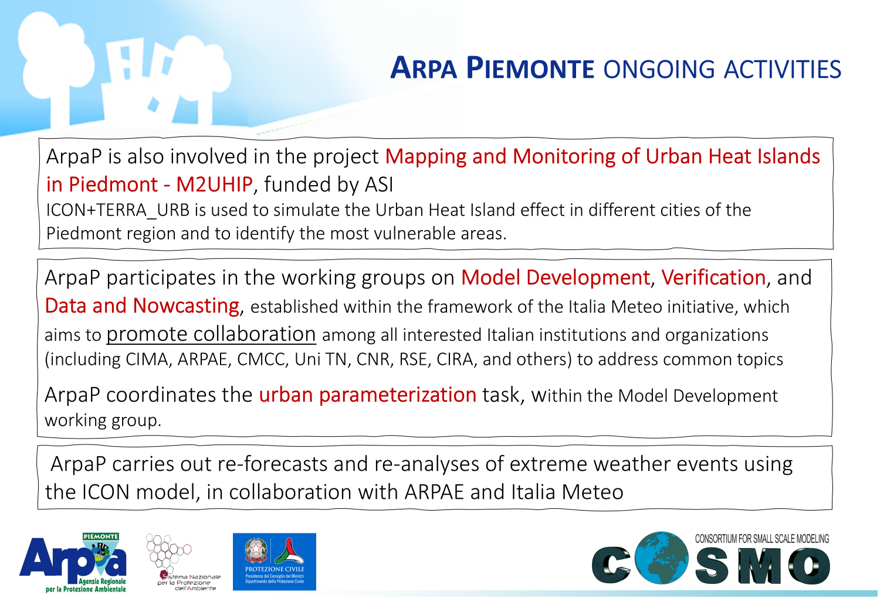
COSMO 27th General Meeting – Basel (CH), 1-4 September 2025

Slide 8
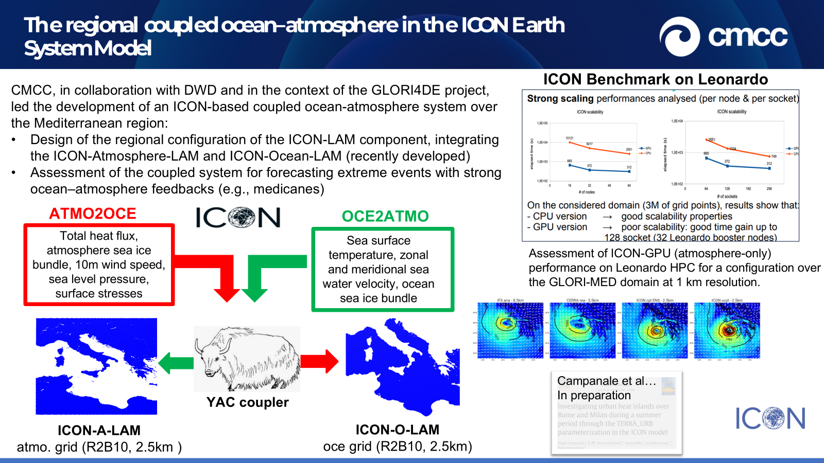
COSMO 27th General Meeting – Basel (CH), 1-4 September 2025

Slide 9
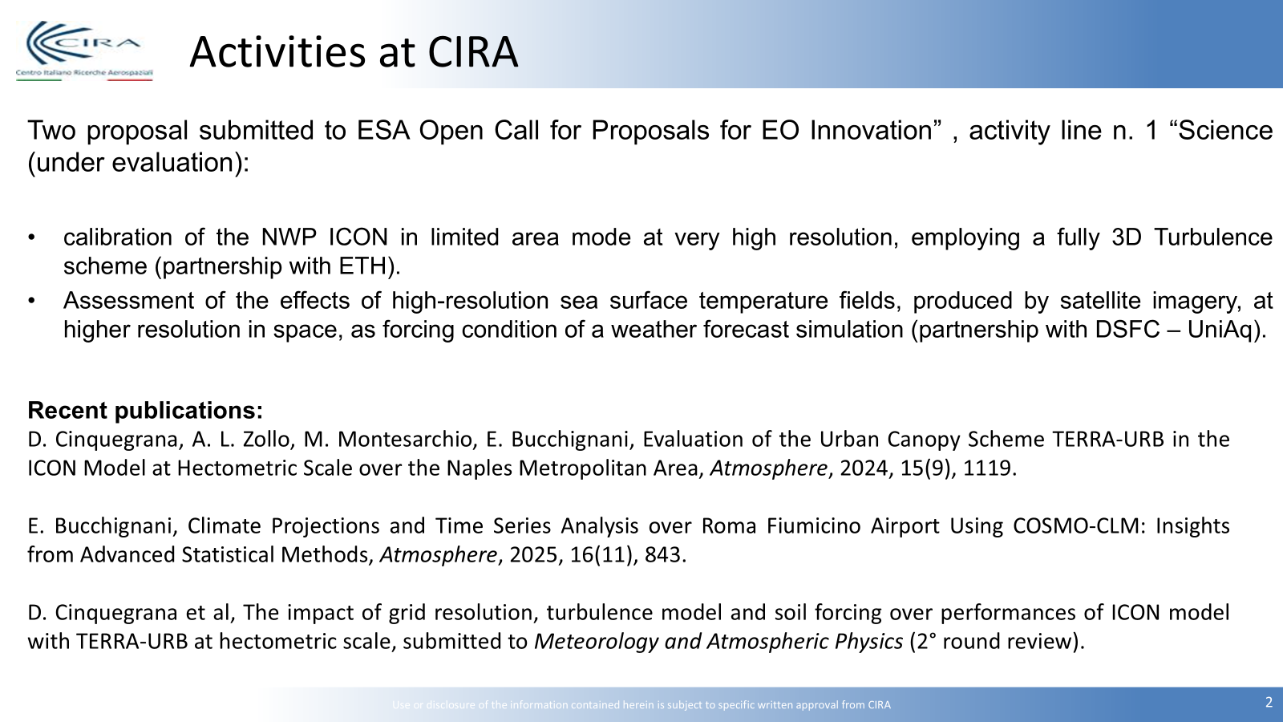
COSMO 27th General Meeting – Basel (CH), 1-4 September 2025

Slide 10
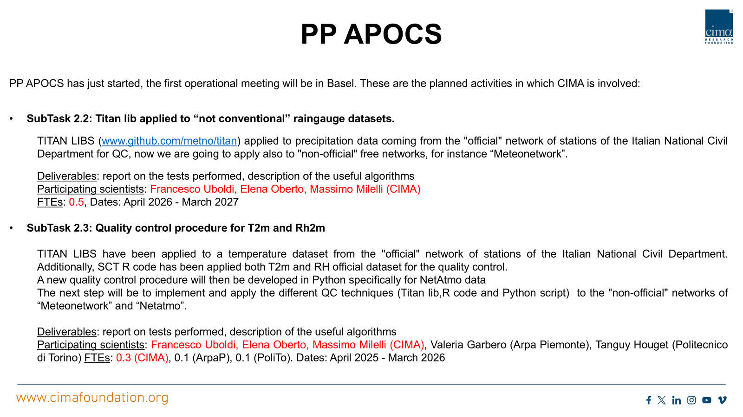
COSMO 27th General Meeting – Basel (CH), 1-4 September 2025

Slide 11
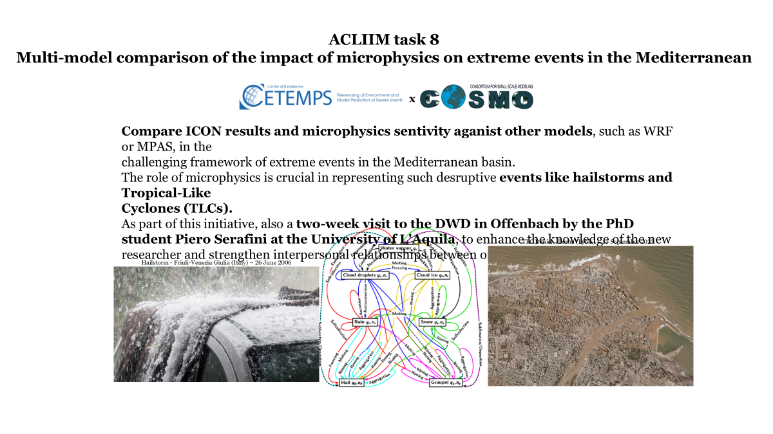
COSMO 27th General Meeting – Basel (CH), 1-4 September 2025

Slide 12
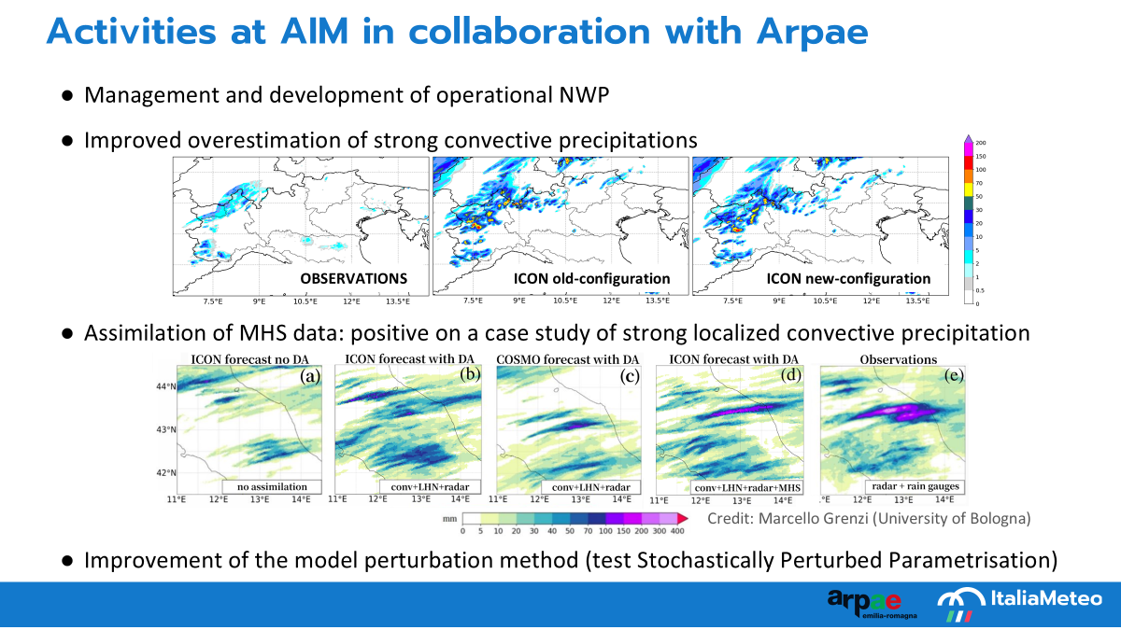
COSMO 27th General Meeting – Basel (CH), 1-4 September 2025

Slide 13
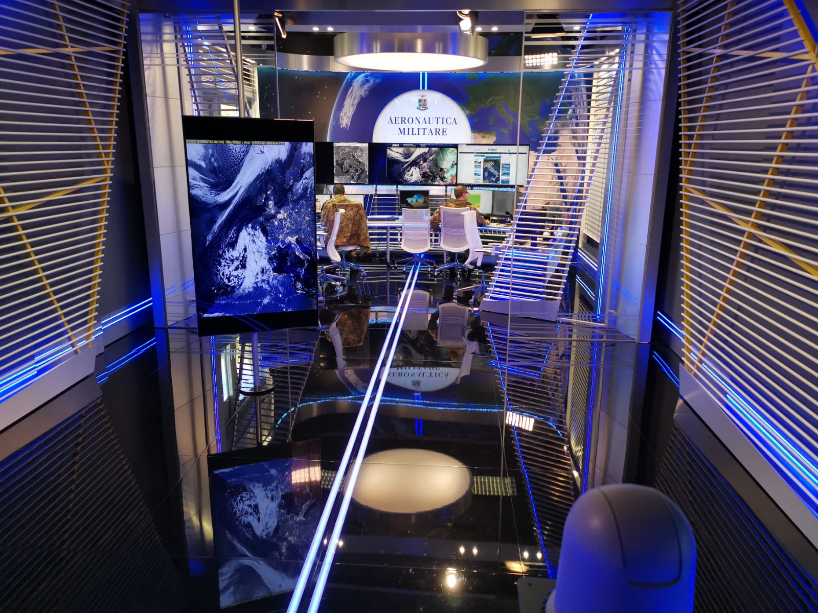
Rumors from our forecasting room…
recent ICON case studies
COSMO 27th General Meeting – Basel (CH), 1-4 September 2025

Slide 14


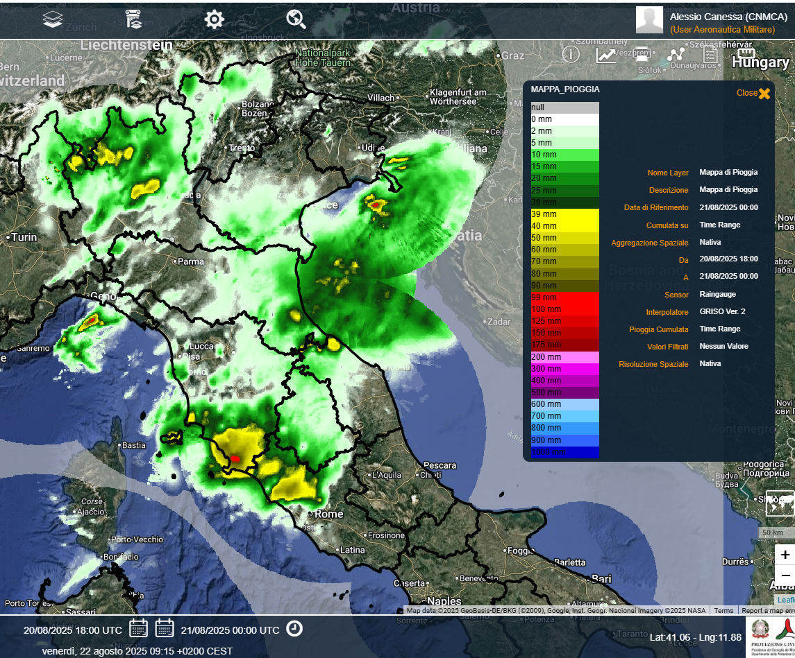
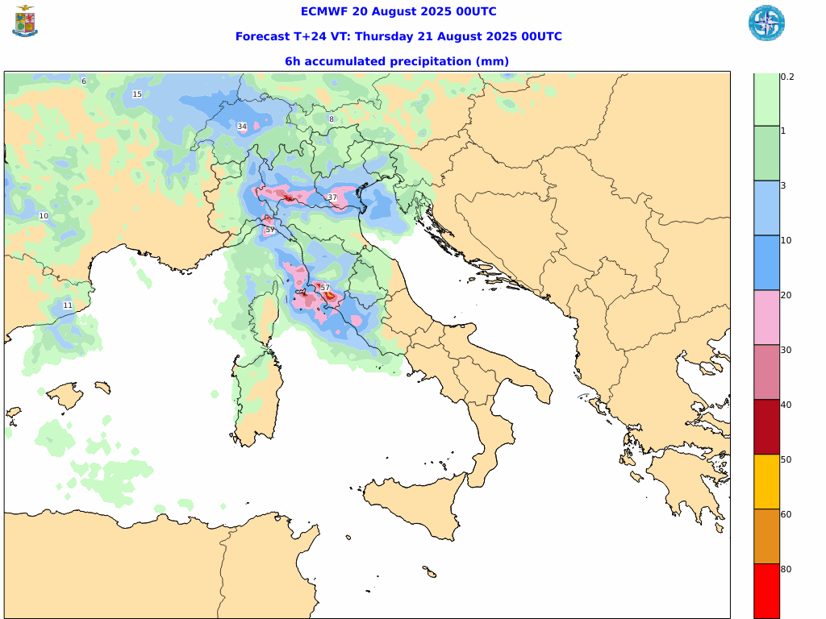
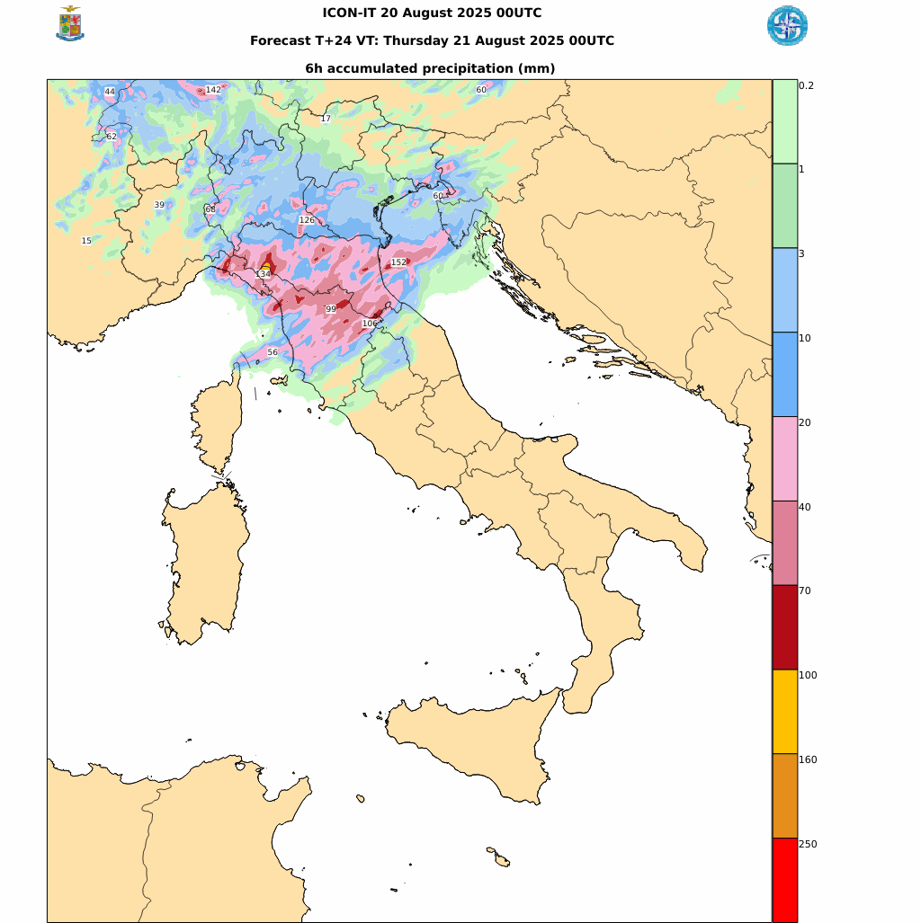


Case Study: intense TS over south Tuscany 20-21/08/2025
Icon tends to miss convection that starts at sea
Radar + rain gauges prec
18-24 UTC 20/08/25
IFS 00utc 20/08/25
Prec06h step +24h
ICON-IT 00utc 20/08/25
Prec06h step +24h
COSMO GM-2025, 01-05 September 2025 Basel, Switzerland

Slide 15
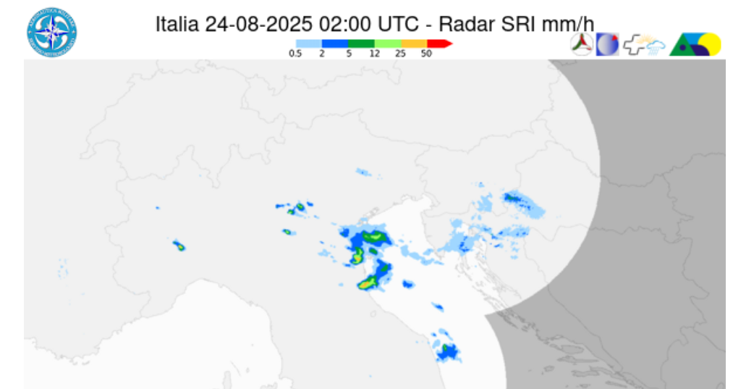
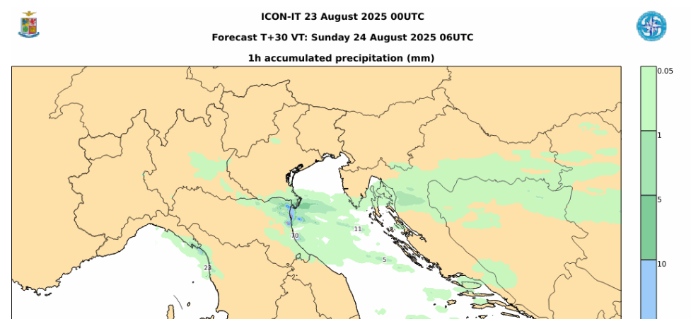
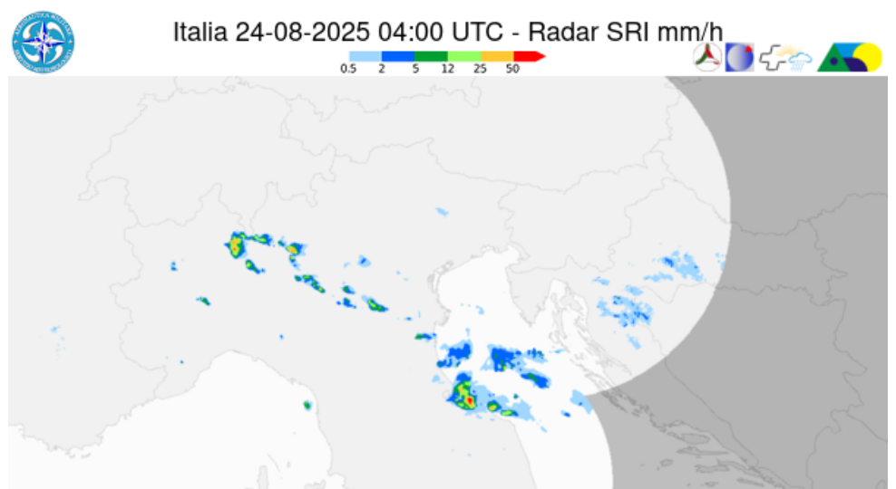
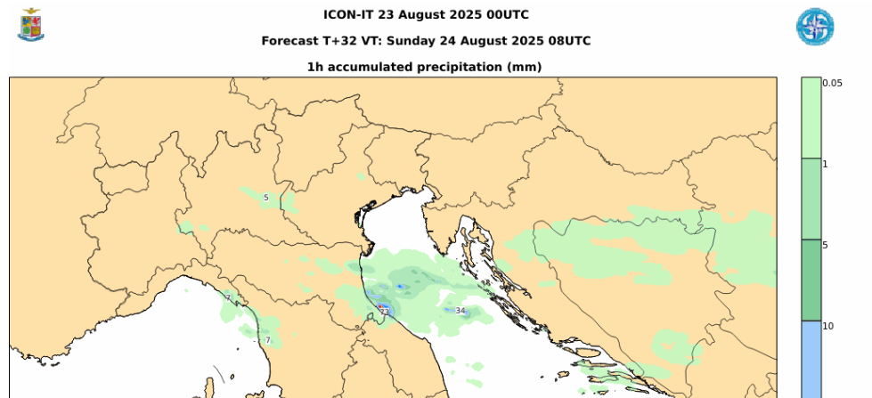
Case Study: intense TS over south Romagna 24/08/2025
Icon saw correctly the convection but with some hours of delay
Radar SRI
ICON-IT 00utc 23/08/25
prec1h
24/08/25 - 02utc
24/08/25 - 06utc - step +30h
24/08/25 - 04utc
24/08/25 - 08utc - step +32h
COSMO GM-2025, 01-05 September 2025 Basel, Switzerland

Slide 16
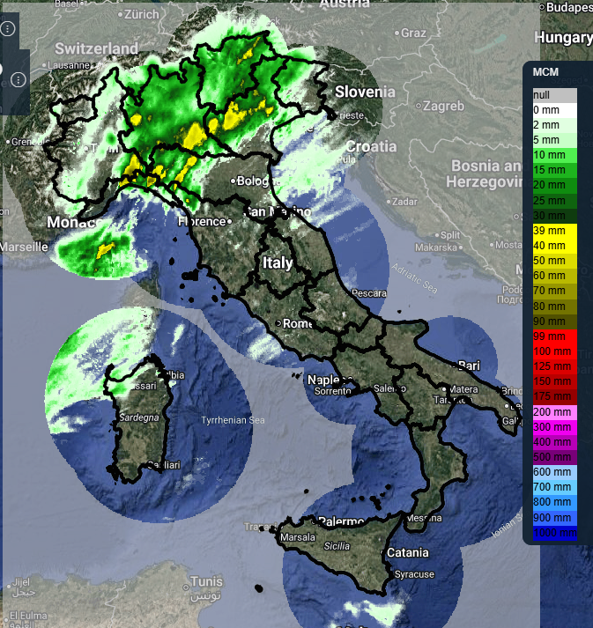
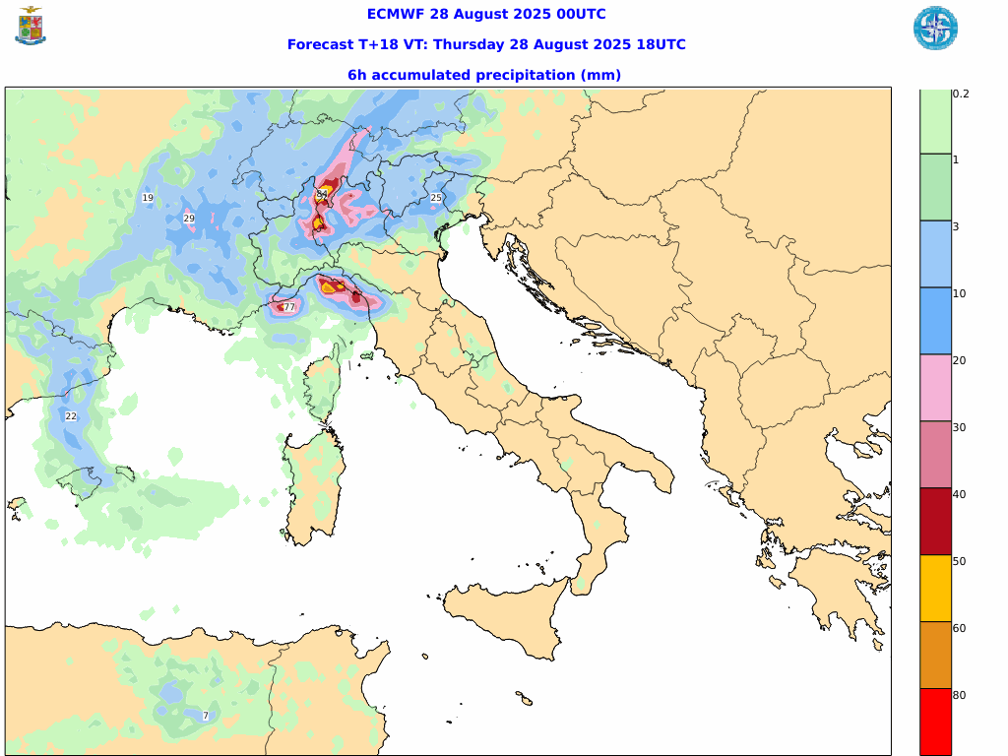
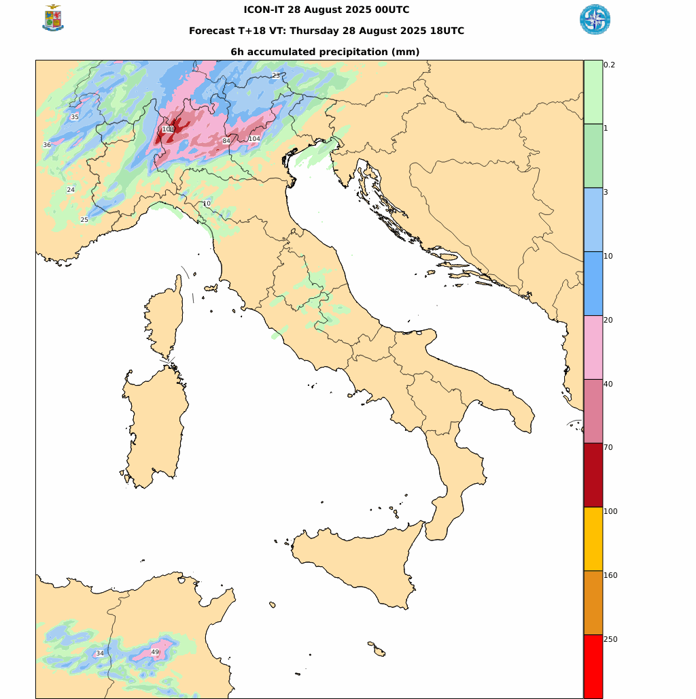
Case Study: precipitation over Liguria and Tuscany 28/08/2025
Radar + rain gauges prec
12-18 UTC 28/08/25
Overestimation for IFS, Week signal for ICON-IT
IFS 00utc 28/08/25
Prec06h step +18h
ICON-IT 00utc 28/08/25
Prec06h step +18h
COSMO GM-2025, 01-05 September 2025 Basel, Switzerland

Slide 17
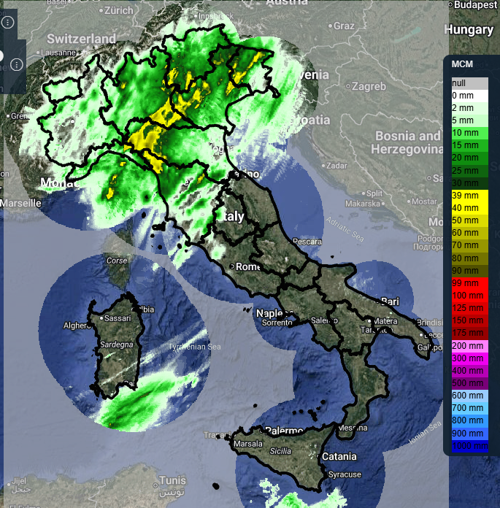
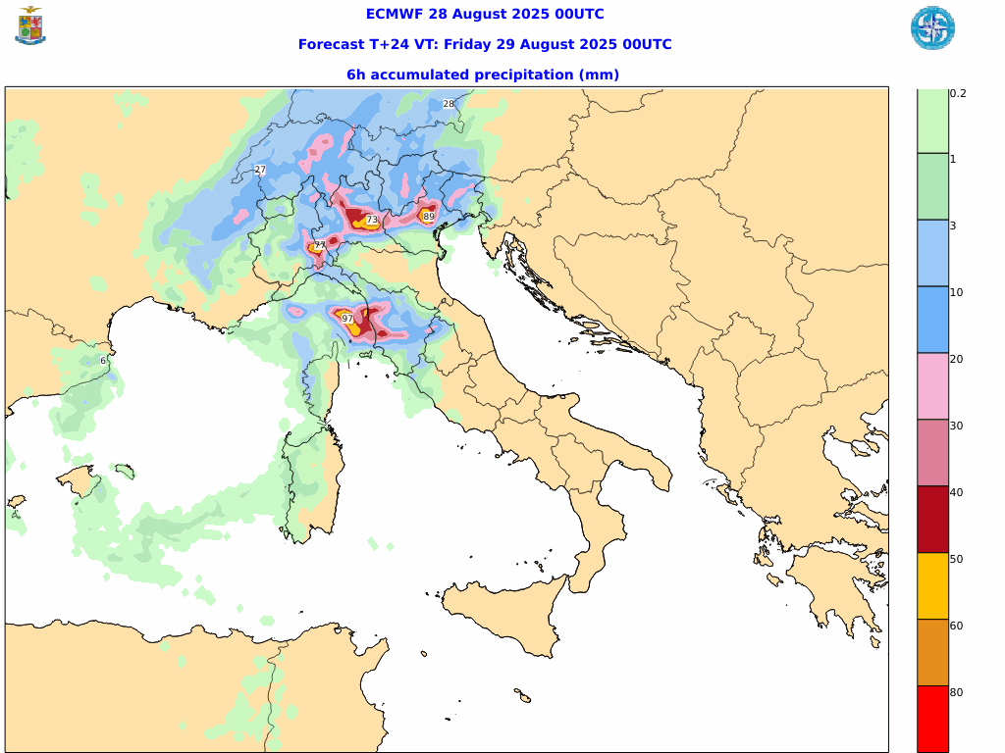
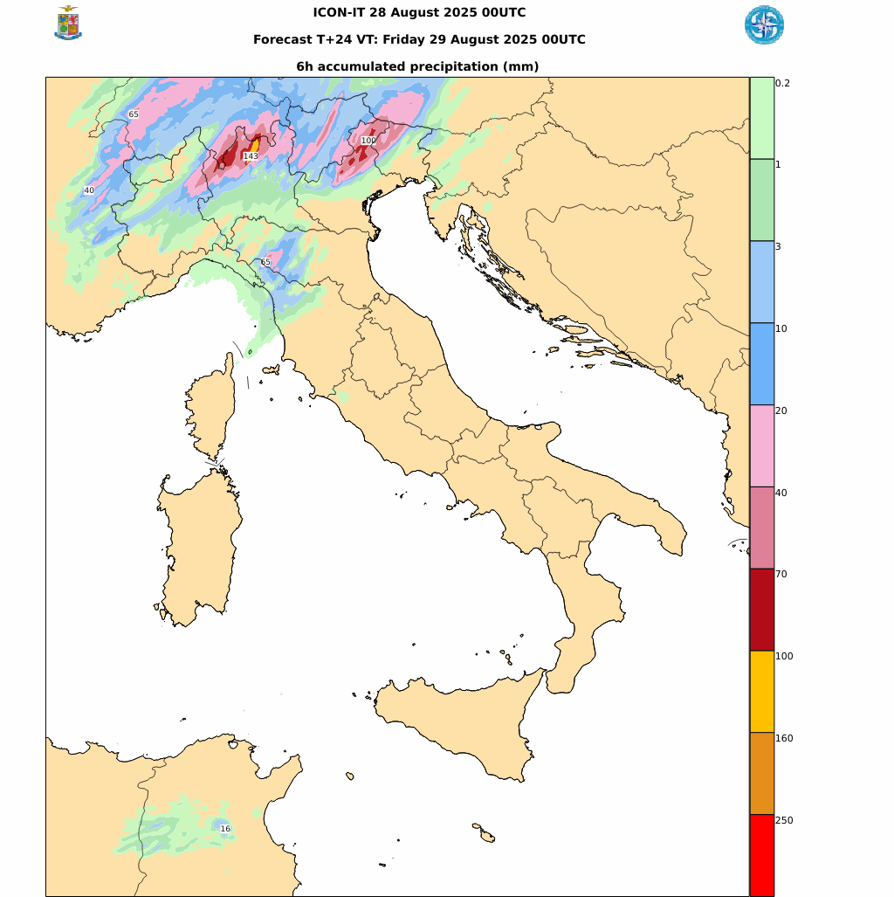
Case Study: precipitation FCST over Liguria and Tuscany 28/08/2025
Radar + rain gauges prec
18-24 UTC 28/08/25
Overestimation for IFS
Week signal for ICON-IT, especially at sea (TS line)
IFS 00utc 28/08/25
Prec06h step +24h
ICON-IT 00utc 28/08/25
Prec06h step +24h
COSMO GM-2025, 01-05 September 2025 Basel, Switzerland

Slide 18
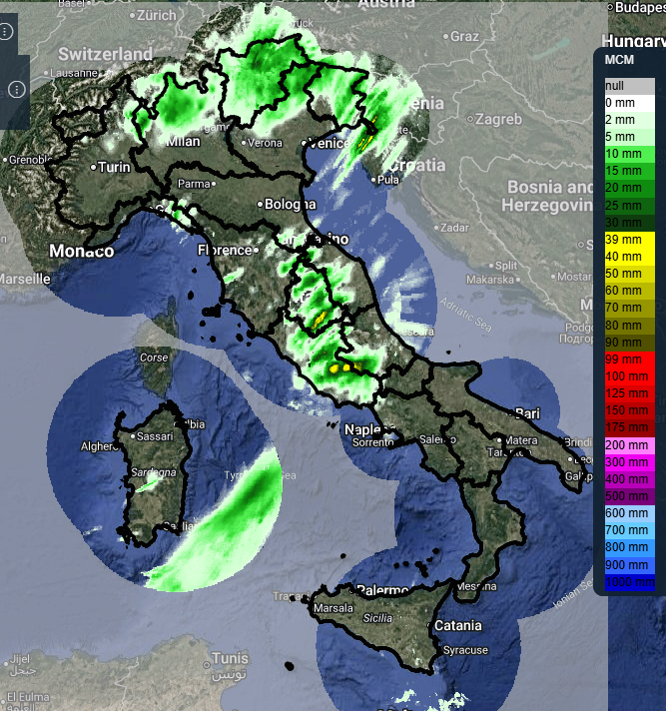
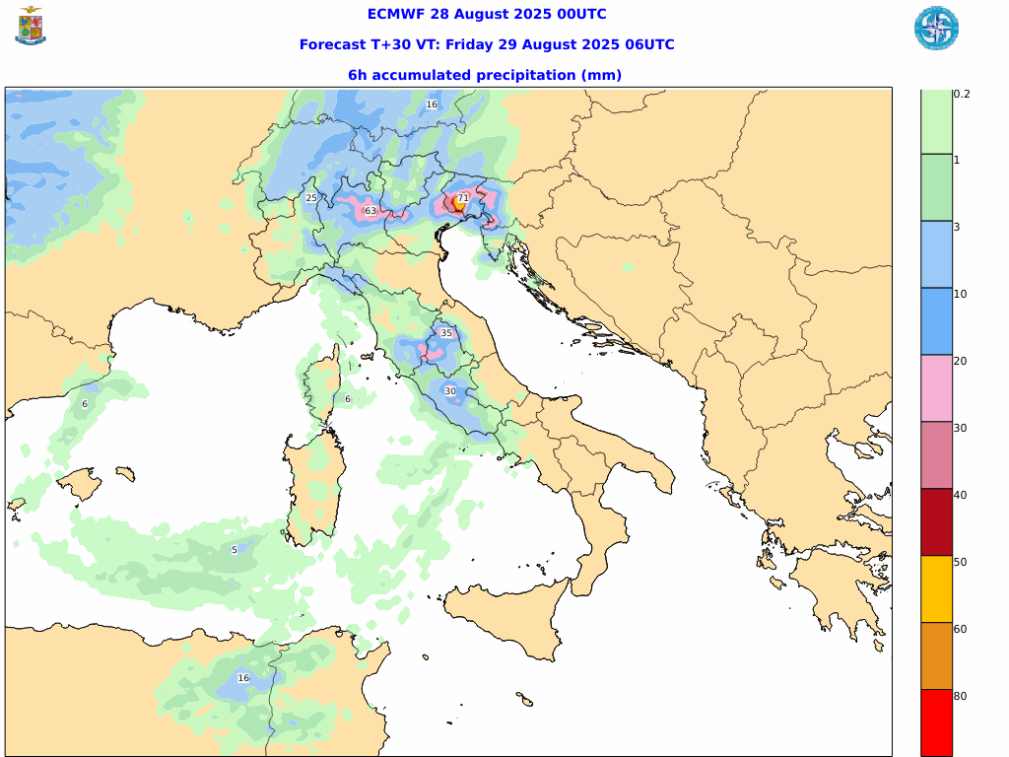
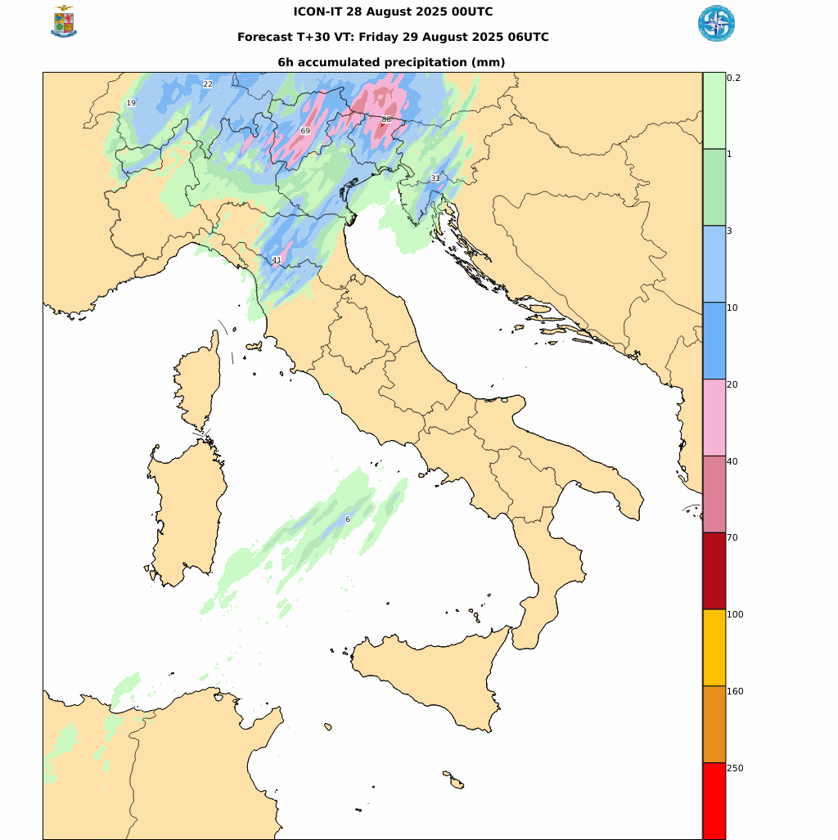
Case Study: precipitation FCST over Liguria and Tuscany 29/08/2025
Radar + rain gauges prec
00-06 UTC 29/08/25
Overestimation for both models in the North of Italy
No signal for ICON-IT in the Center of Italy
IFS 00utc 28/08/25
Prec06h step +30h
ICON-IT 00utc 28/08/25
Prec06h step +30h
COSMO GM-2025, 01-05 September 2025 Basel, Switzerland

Slide 19
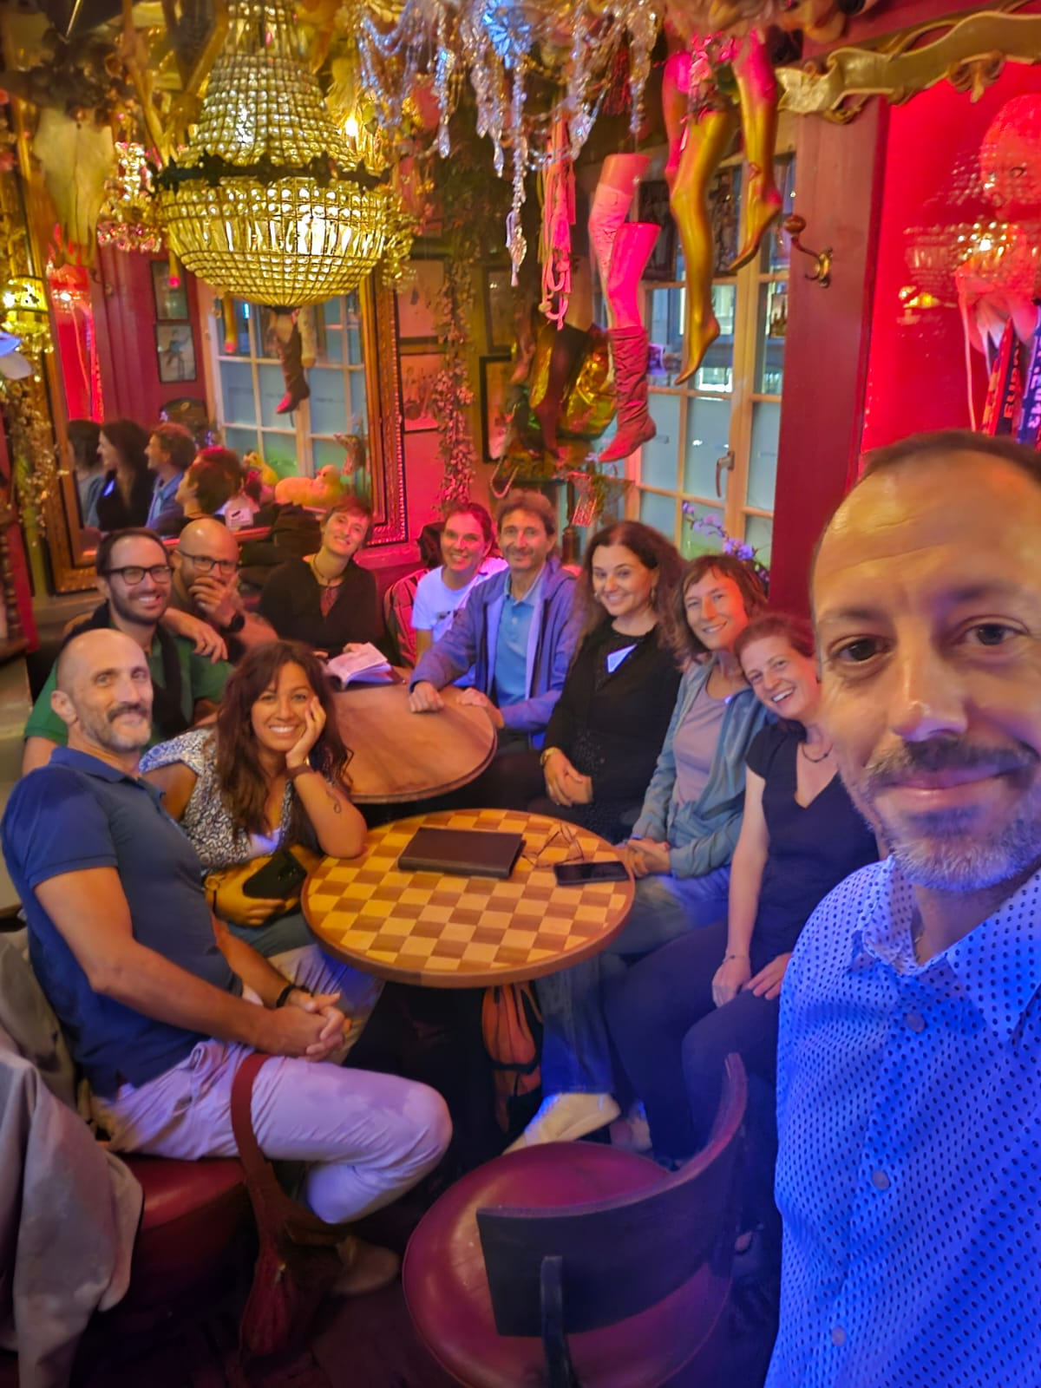
The way ahead
Fostering the COSMO narrative for the benefit of the Italian NWP community
Strengthening the national partnership
  +synergies +communication +coordination
  -duplications -autarchy -dispersion
Alignment with the COSMO strategy
  feeding the Working Groups
  bringing COSMO activities «at home»
  open-science and open-mind
But… how does it work?
Thank you
COSMO 27th General Meeting – Basel (CH), 1-4 September 2025

Slide 20
Post-credits…
COSMO 27th General Meeting – Basel (CH), 1-4 September 2025

Slide 21
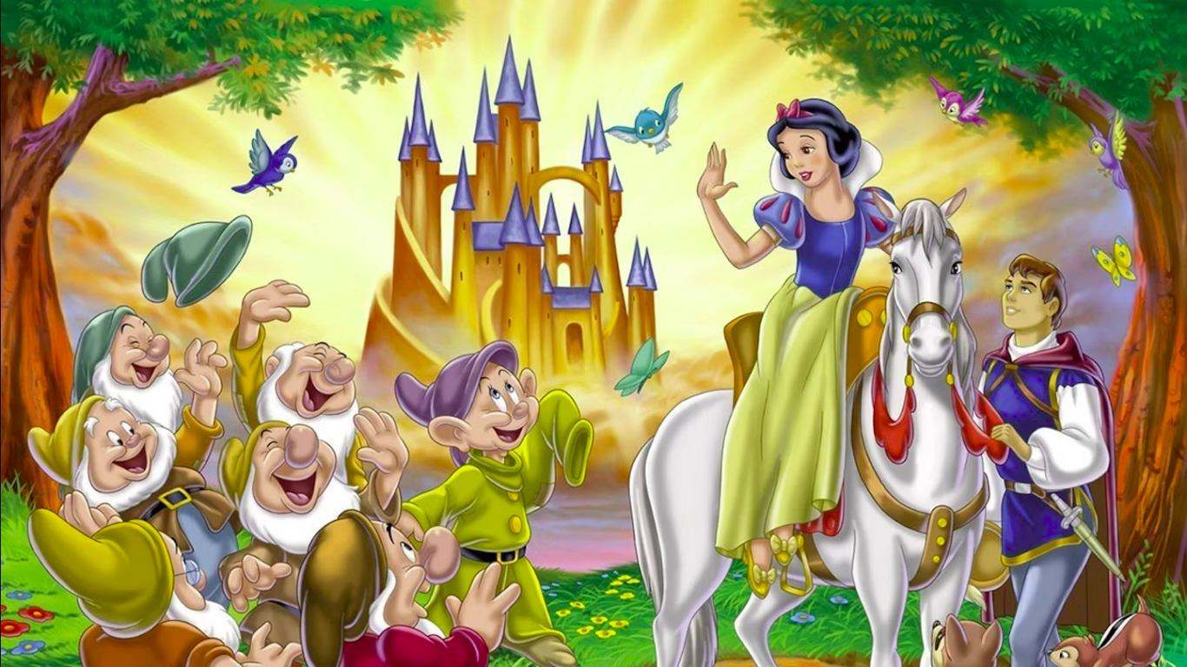
Mister
COSMO

