Slide 1

Overview WG DYN ‘dynamics and numerics’
- Work on ICON vertical advection scheme
- Status of the BRIDGE project
COSMO General Meeting, Basel
01-04 Sept. 2025
Michael Baldauf (DWD)

Slide 2
Truncation error analysis
for the piecewise parabolic method
David Strassmann¹, Daniel Reinert², Anurag Dipankar¹
(1) Center for Climate Systems Modelling, ETH Zürich
(2) Deutscher Wetterdienst, Offenbach
WG Dynamics & Numerics, COSMO GM 2025

Slide 3

The PPM method
Finite volume method for solving (non)-linear 1D scalar conservation laws
Introduced by Colella and Woodward in 1984.
Well established method in astrophysical and geophysical fluid dynamics.
Formally third-order accurate in space on non-uniform grids.
Used by ICON for the vertical transport of scalars (water vapor, condensates, dust, …).
Multiple analyses available in the literature (e.g. Zerroukat (2006), White & Adcroft (2008)),
however, with a focus on the spatial truncation error (uniform velocity case).
Aim of this work:
systematic truncation error analysis focusing on temporal discretization aspects
$$\frac{∂u}{∂t}+\frac{∂F(u)}{∂x}=0$$

Slide 4
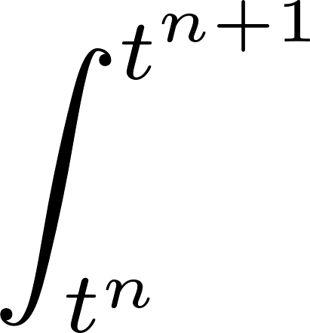
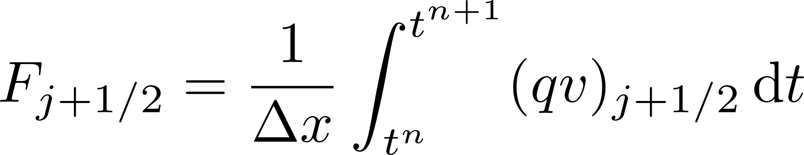
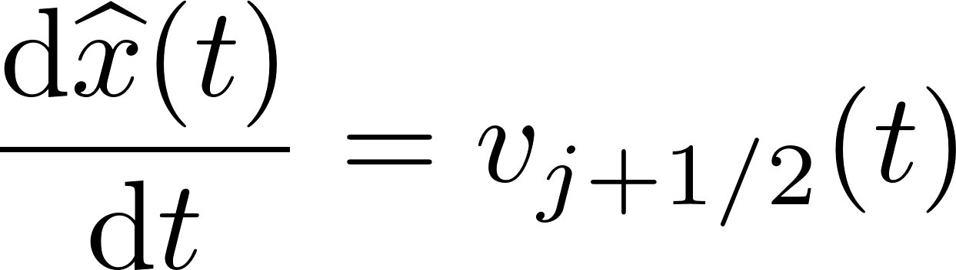
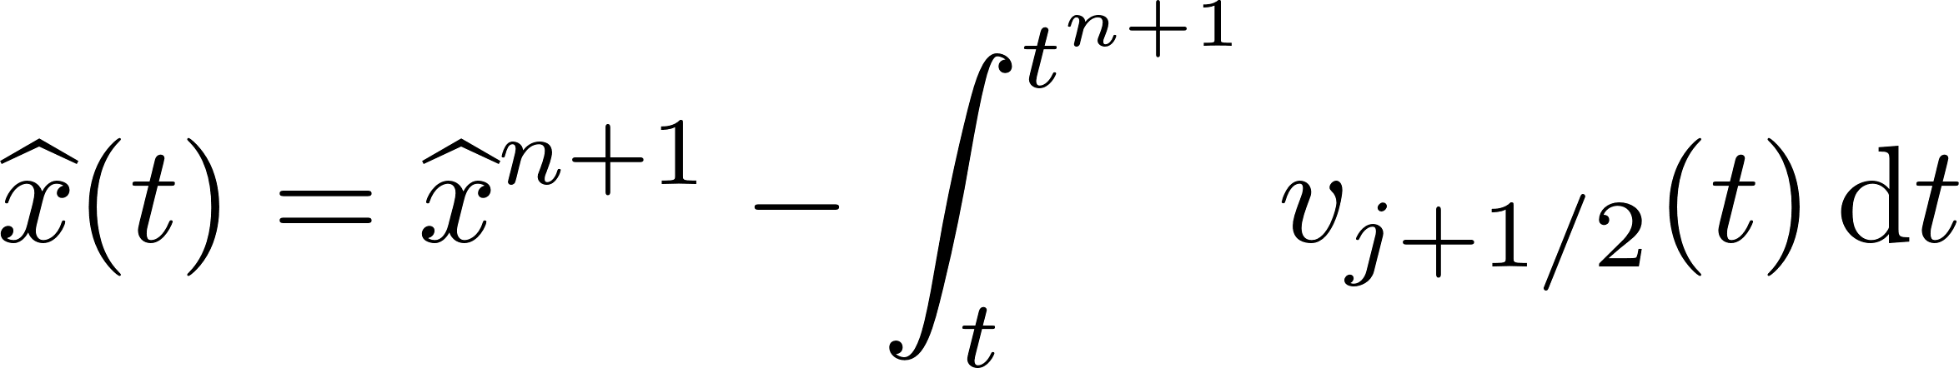

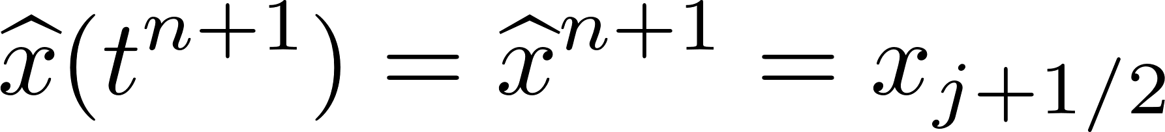
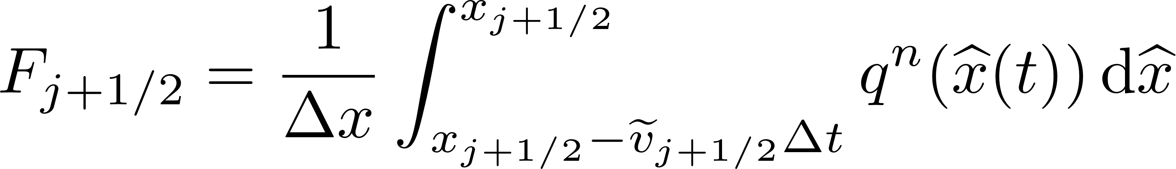





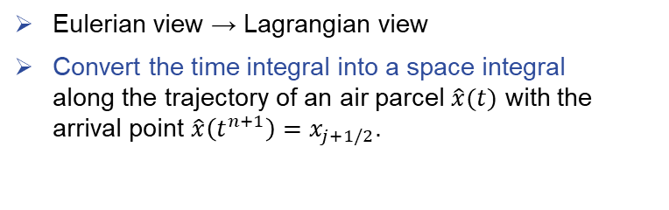
Standard PPM scheme (2/3)
Eulerian view → Lagrangian view
Convert the time integral into a space integral
along the trajectory of an air parcel $\hat{x}(t)$ with the arrival point $\hat{x}\left(t^{n+1}\right)=x_{j+1/2}$.
$$v>0$$
$${\hat{x}}^{n}$$
$${\hat{x}}^{n+1}$$
$$F_{j+1/2}$$
$$x_{j−1/2}$$
$$x_{j+1/2}$$
1D parcel trajectory
Variable substitution:
switch to Lagrangian view
new integration bounds:
temporal average

Slide 5
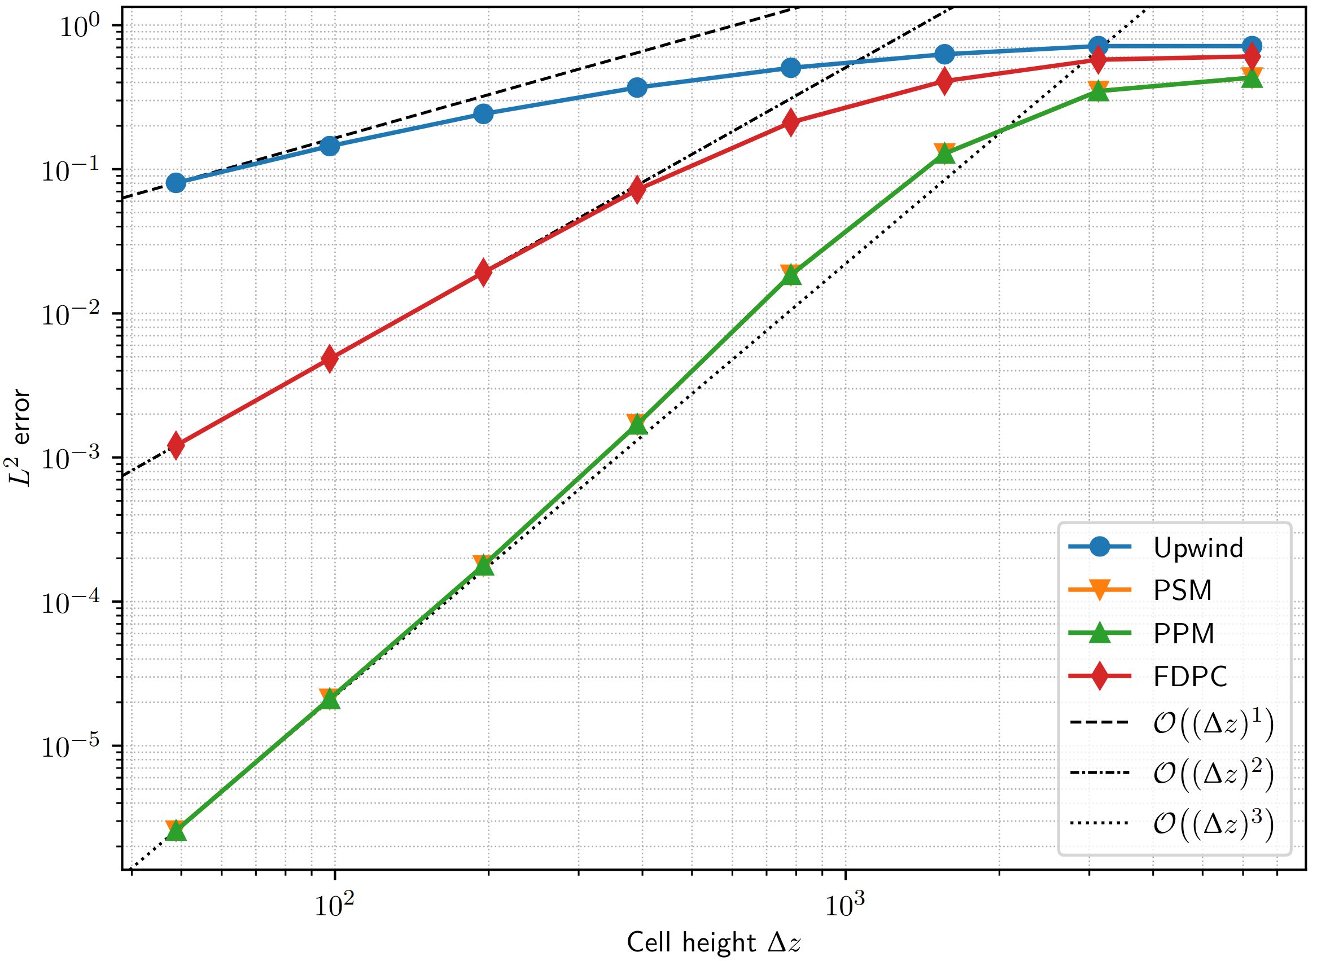
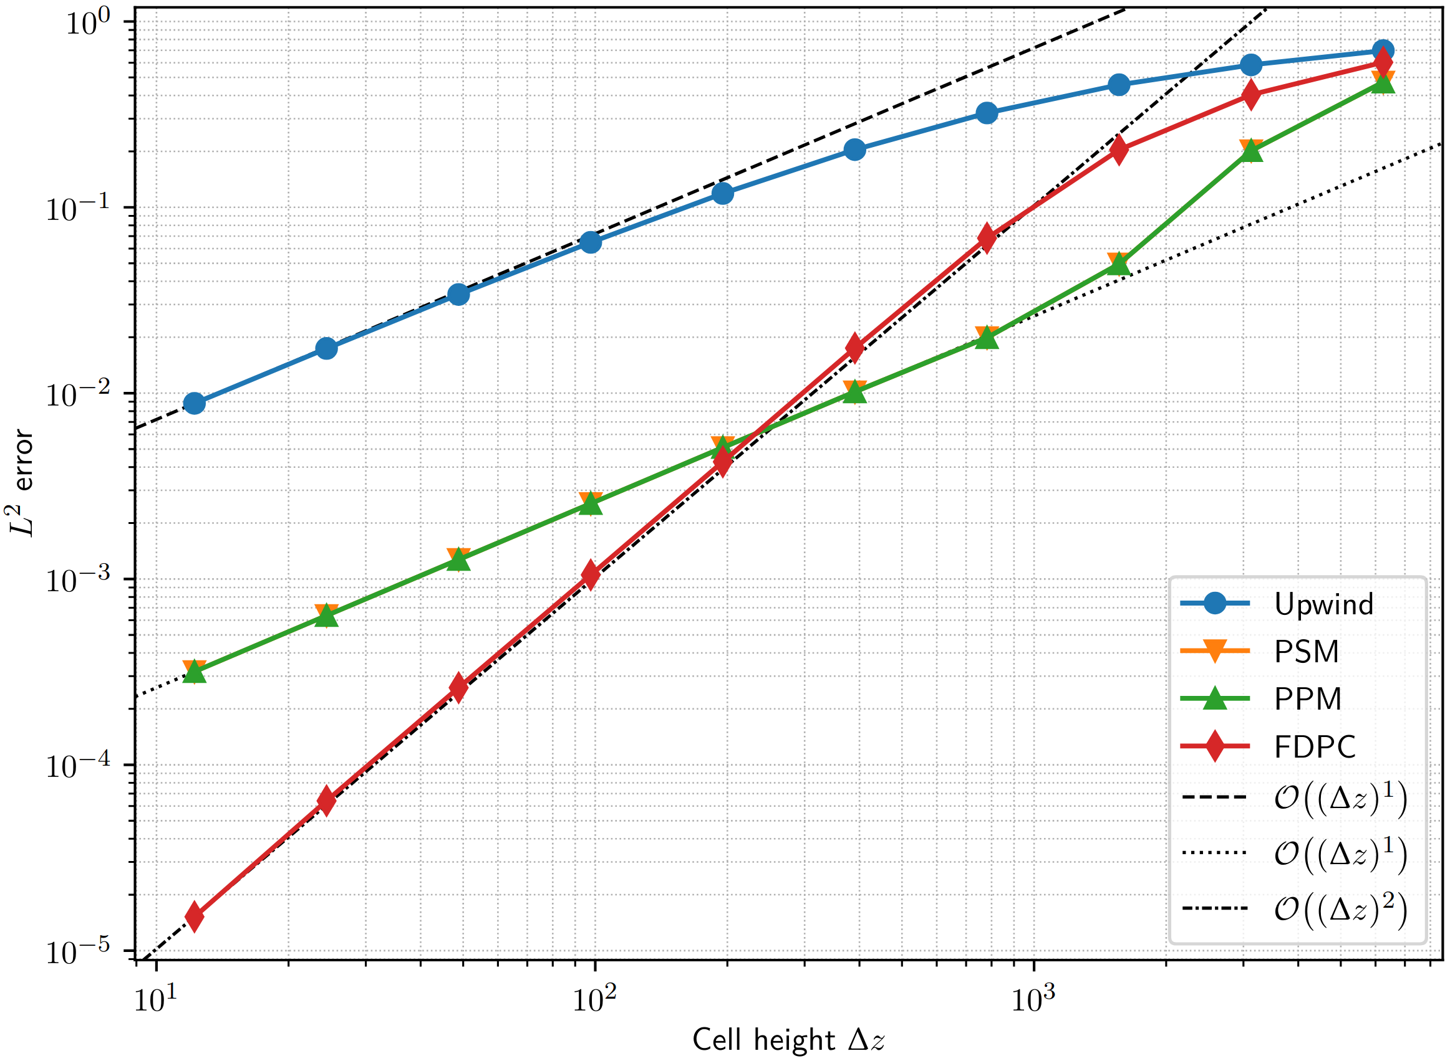


ICON results from David’s master thesis
1D (vertical) transport of a Gaussian hill on a uniform grid with C_{max}=0.5.
PPM: convergence rate drops to first-order for spatially varying v.
Is this an implementation issue or a property of the scheme?
$$v(t)\sim cos(πt)$$
$$v(z,t)\sim \cos\left(πt\right)\sin^{2}\left(πz/H\right)$$
© D. Strassmann
© D. Strassmann

Slide 6
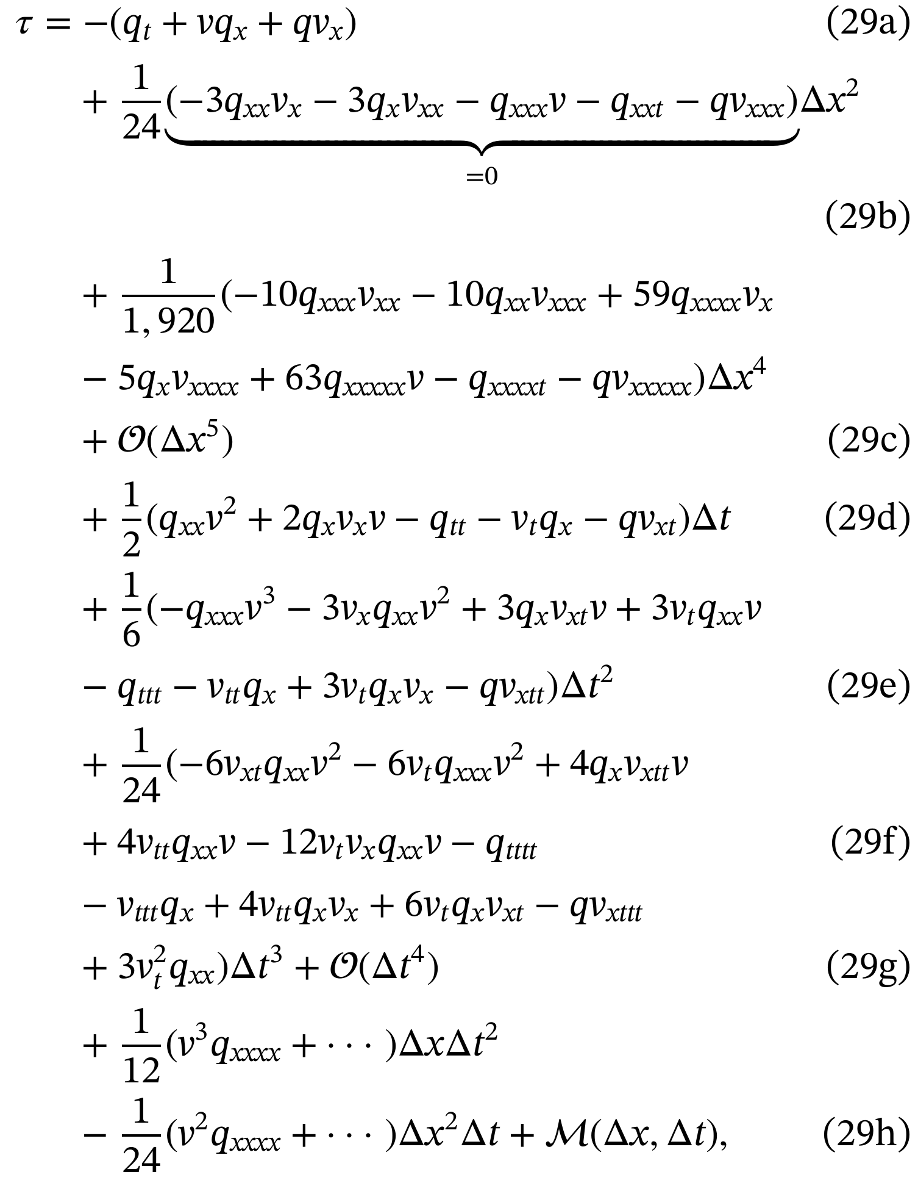
Example: truncation error for the case v(x,t)
Results simplify for the other cases
According to this analysis, the scheme is
  fourth-order accurate in space
  first-order accurate in time
😱

Slide 7
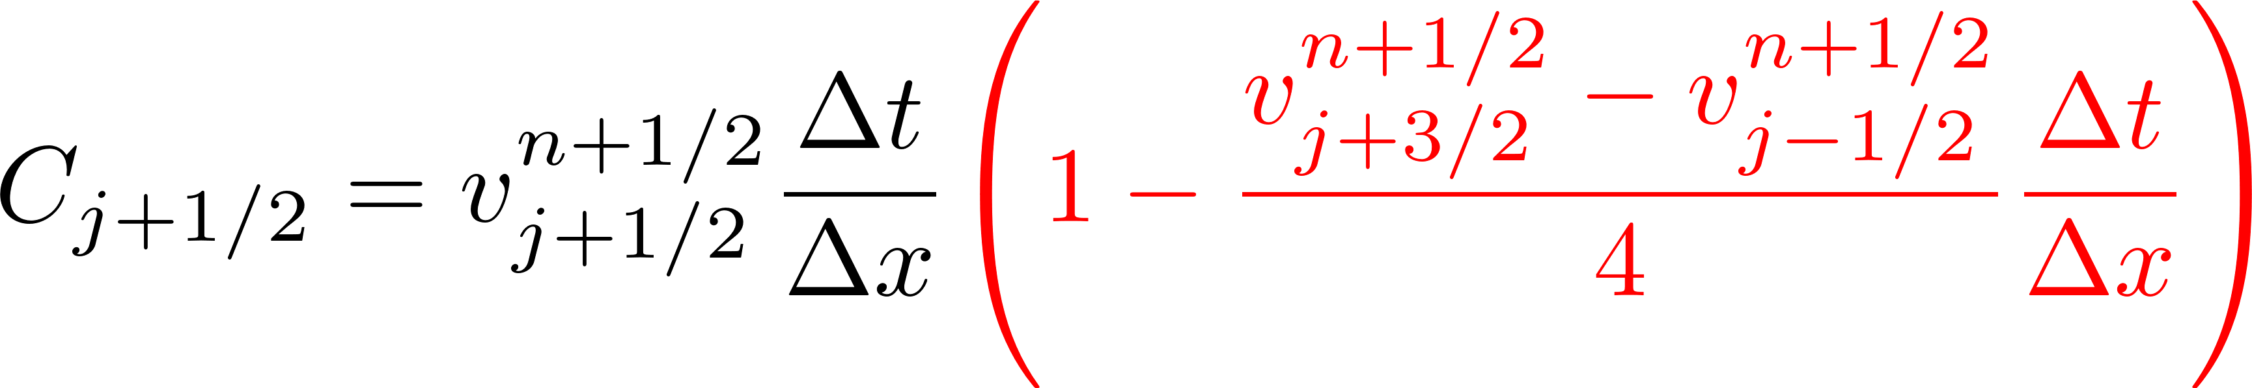
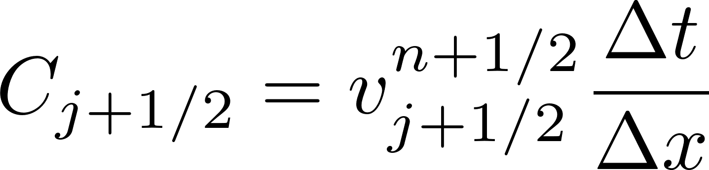
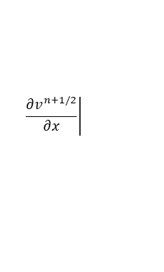
Second-order in time PPM scheme
No change in the flux function F.
Only the expression for the “Courant number” changes.
first order
second order
$$\left.\frac{{∂v}^{n+1/2}}{∂x}\right|$$
$$j+1/2$$
The truncation error for v(x,t) reads

Slide 8
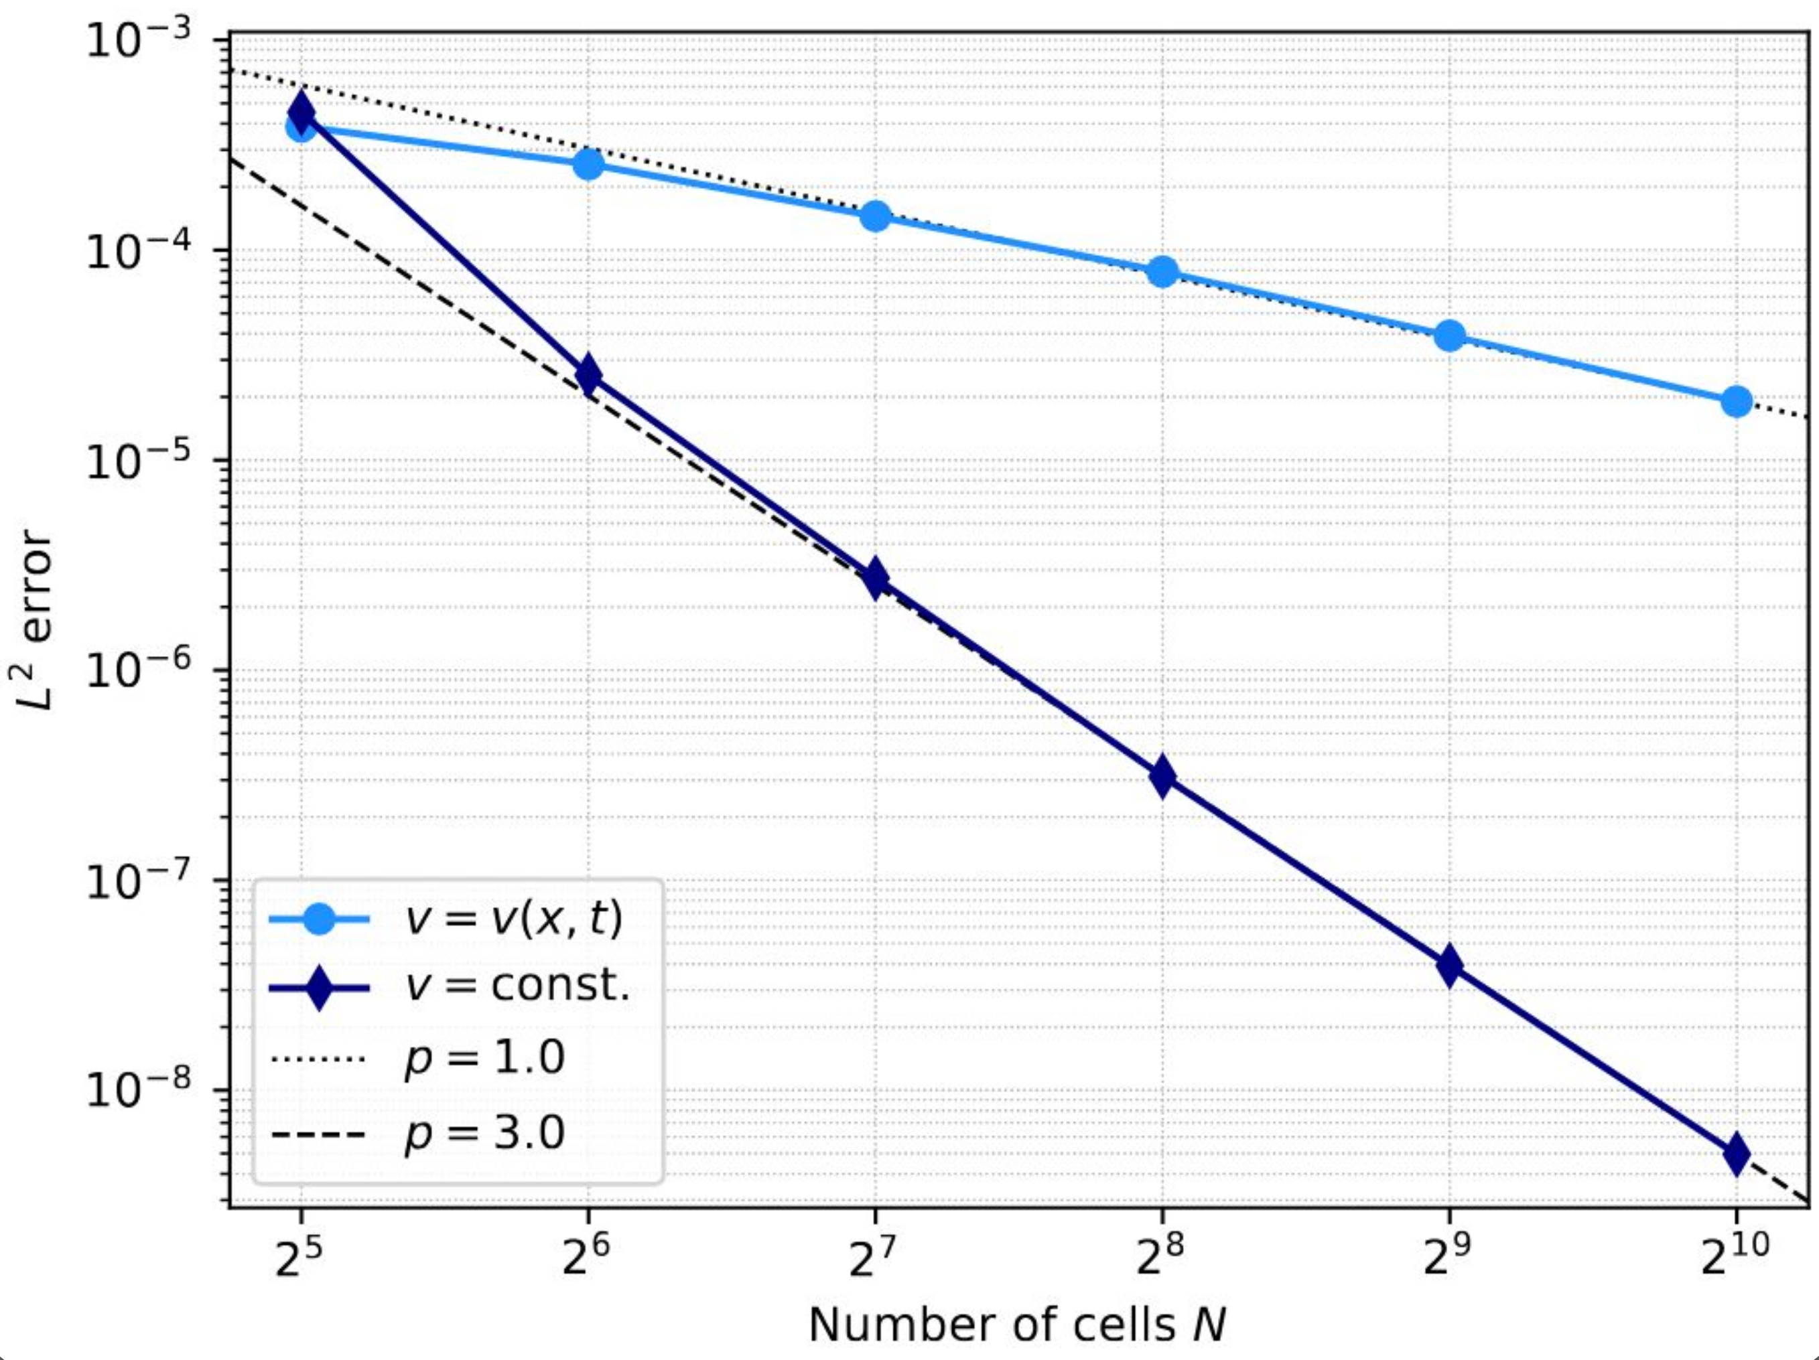
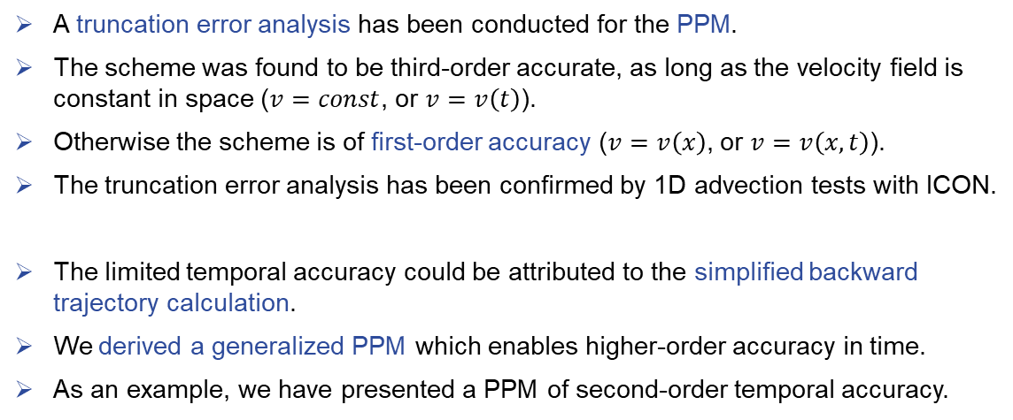
Summary
A truncation error analysis has been conducted for the PPM.
The scheme was found to be third-order accurate, as long as the velocity field is constant in space ($v=const$, or $v=v\left(t\right)$).
Otherwise the scheme is of first-order accuracy ($v=v\left(x\right)$, or $v=v\left(x,t\right)$).
The truncation error analysis has been confirmed by 1D advection tests with ICON.
The limited temporal accuracy could be attributed to the simplified backward trajectory calculation.
We derived a generalized PPM which enables higher-order accuracy in time.
As an example, we have presented a PPM of second-order temporal accuracy.
For details:
Strassmann, D., Reinert, D. & Dipankar, A. (2025) Truncation error analysis for the piecewise parabolic method. Q. J. R. Meteorol. Soc., e5074. Available from: https://doi.org/10.1002/qj.5074

Slide 9
Status of the BRIDGE project
Michael Baldauf (DWD)

Slide 10
BRIDGE (Basic Research for ICON with Discontinuous Galerkin Extension)
an informal project at DWD (runs since ~ 2020)
‚Classical‘ discontinuous Galerkin (DG) solver for Euler equations (with thermodyn.
variable either ρΘ or total energy) or shallow water, advection, … eqns.
Equations are formulated in covariant form using Ricci tensor calculus
(on spherical or ellipsoidal or flat manifolds)
→ clear distinction between: equations – metrics – DG discretization
Collocated nodal finite elements; Riemann solver: Lax-Friedrichs flux
Treatment of diffusion by Bassi, Rebay (1997) ‚RB1‘ scheme
Grid: horizontally (icosahedral) triangular, prismatic grid cells
Time integration: explicit RK or HEVI with IMEX-RK
Stabilization via exponential filtering
Baldauf (2020) JCP: Discontinuous Galerkin solver for the shallow-water equations in covariant form
on the sphere and the ellipsoid
Baldauf (2021) JCP: A horizontally explicit, vertically implicit (HEVI) discontinuous Galerkin scheme
for the 2-dimensional Euler and Navier-Stokes equations using terrain-following cordinates
M. Baldauf (DWD)
10

Slide 11
Very first steps towards moisture in BRIDGE

Slide 12
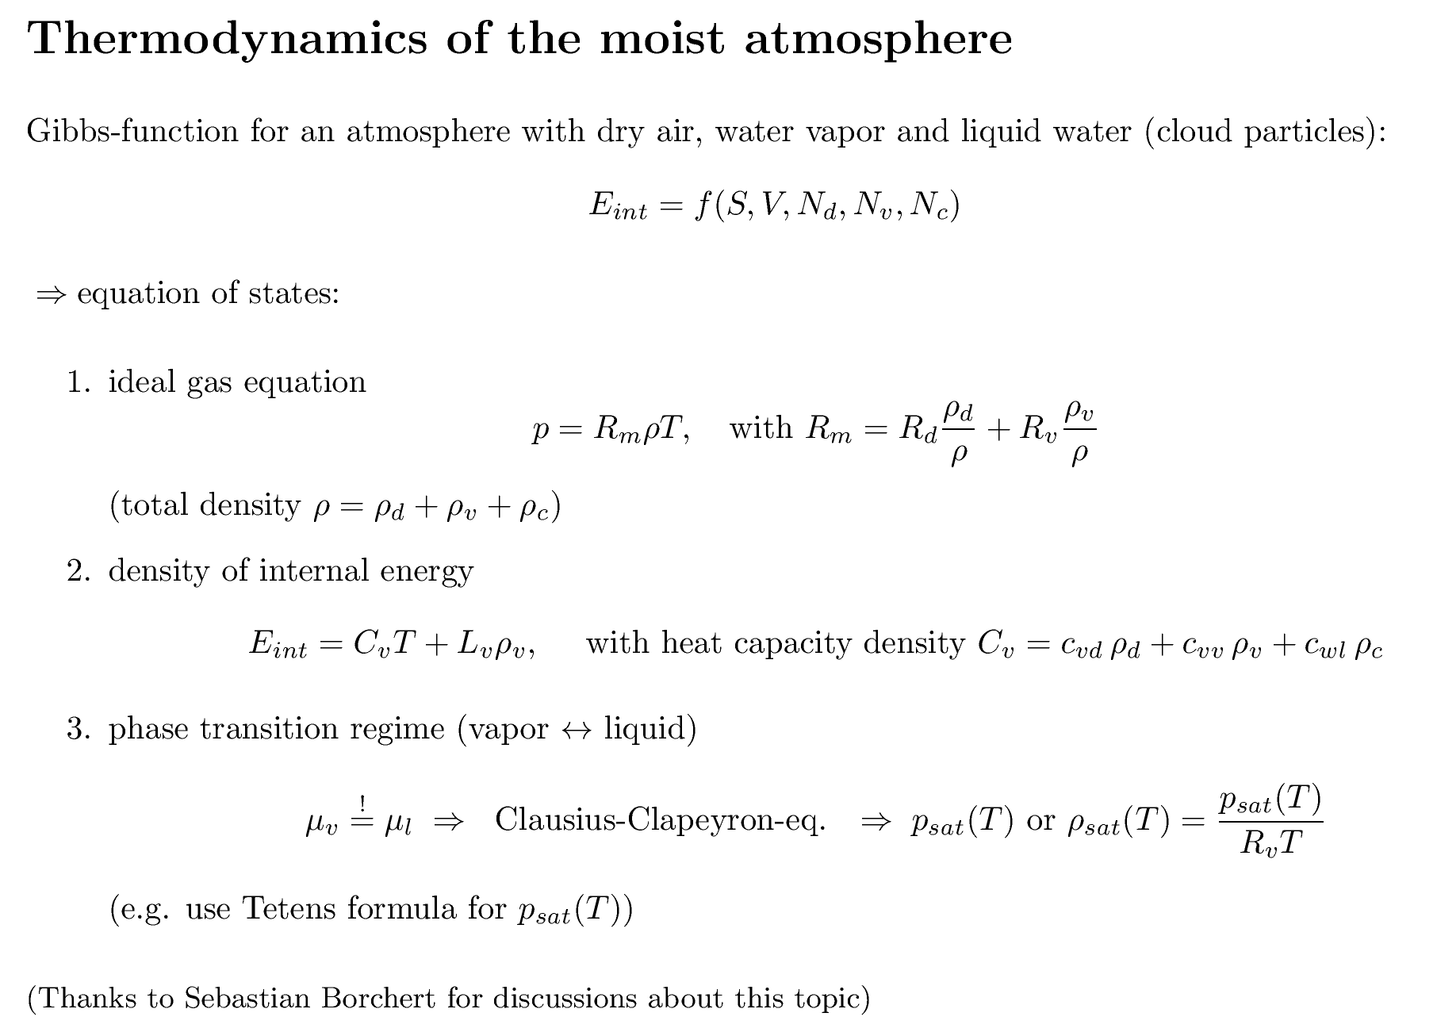
Very first steps towards moisture in BRIDGE

Slide 13
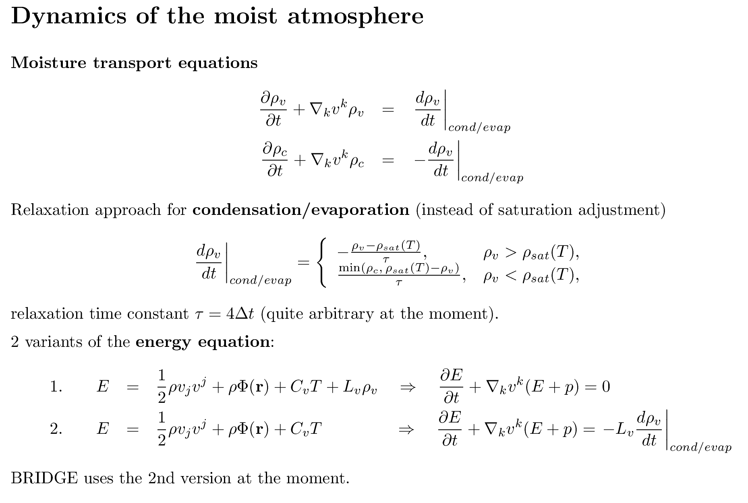
Very first steps towards moisture in BRIDGE

Slide 14
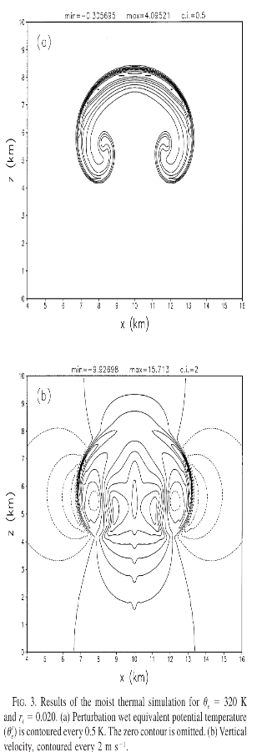
Very first steps towards moisture in BRIDGE
Bryan, Fritsch (2002) MWR test case
Set a warm bubble (+2 K) in an environment atmosphere with
dry case: pot. temp. Θ = 300 K, without moisture
moist case: equiv. pot. temp. Θ_{e} = 300 K, saturated atm.+clouds everywhere
dx=dz=100m
In both cases the w field should look quite similar (but not exactly identical)
Remarks:
the moist initialization procedure is not exactly clear … at least, for me …
(iteration is necessary for the environment, but also for the bubble setting?)
the buoyancy term must be adapted (not so nice…)
„No physical or computational diffusion is applied“.
Is this really the case …?

Slide 15
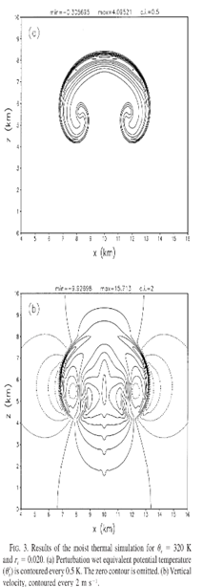
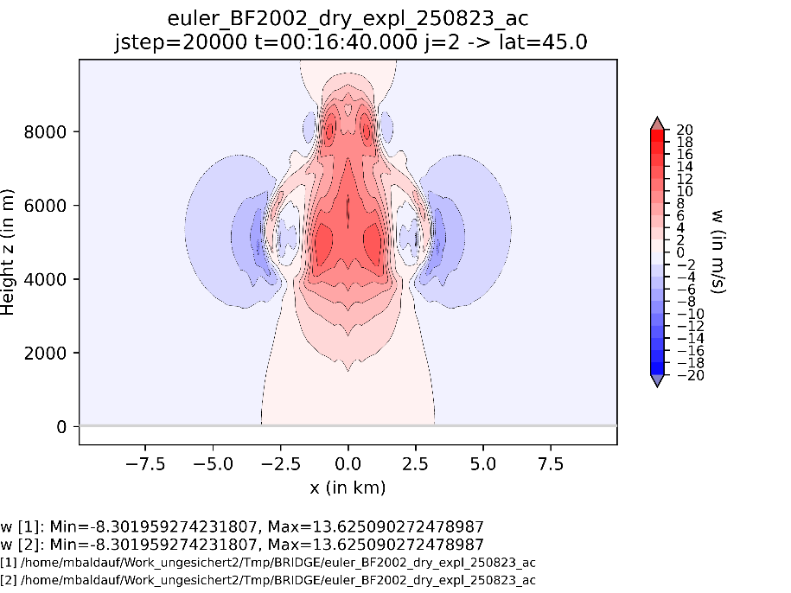
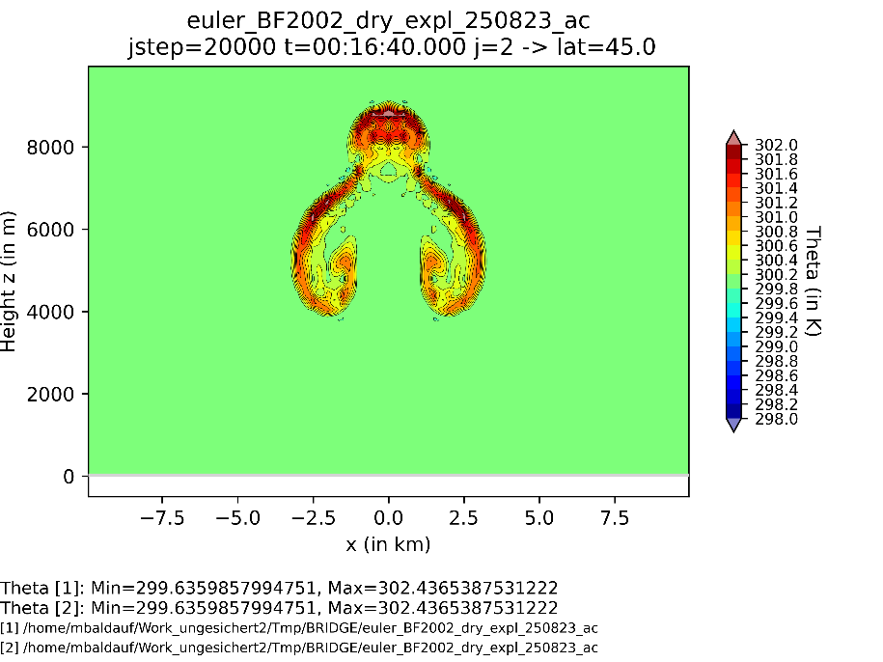
Very first steps towards moisture in BRIDGE
Bryan , Fritsch (2002) test, dry case: no diffusion, weak filtering
w
Θ

Slide 16
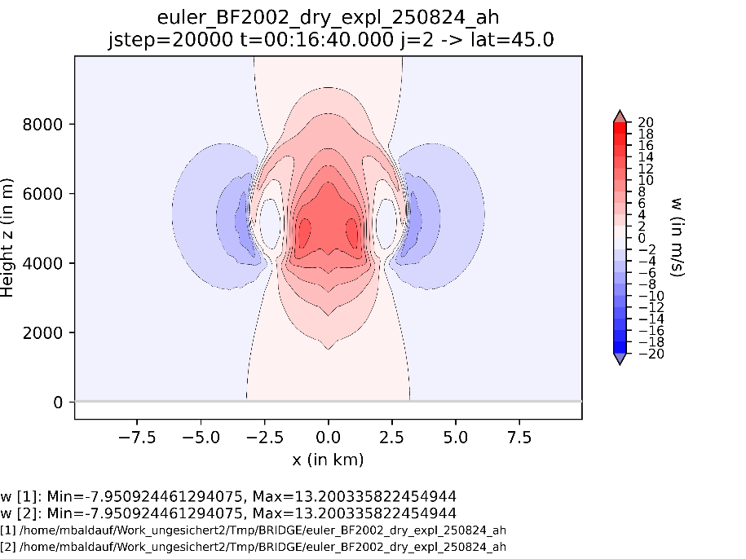
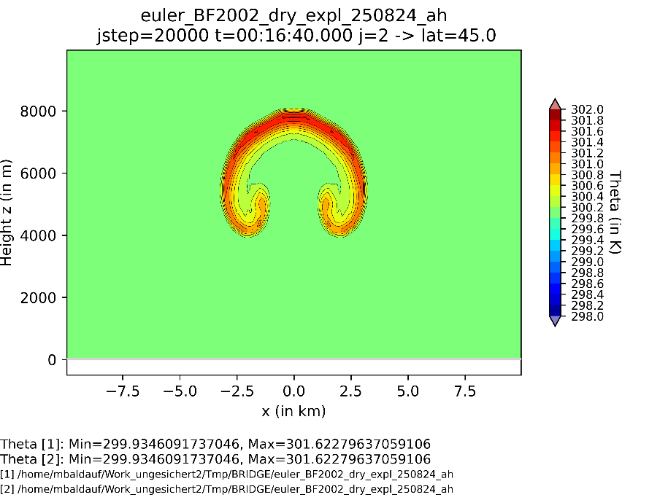
Bryan , Fritsch (2002) test, dry case: with diffusion K=20m²/s, no filtering

Slide 17
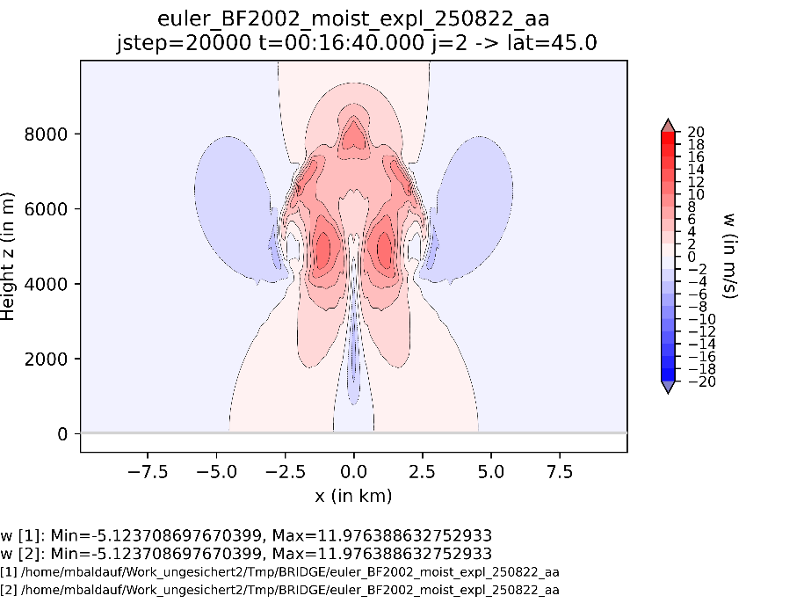
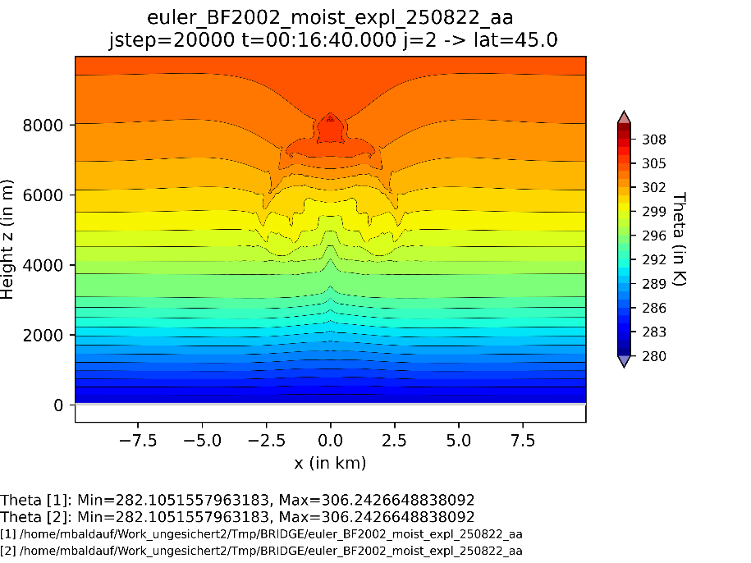
Very first steps towards moisture in BRIDGE
Bryan , Fritsch (2002) test, moist case: with diffusion K=10m²/s, no filtering
Max. oversaturation: 0.8%, relative change in water mass: 1.0e-15
w
Θ

Slide 18
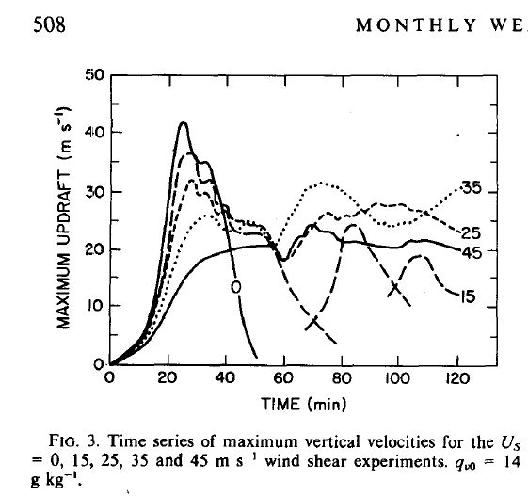
Very first steps towards moisture in BRIDGE
Weisman, Klemp (1982) MWR setup
Prescibe Θ and rel. humidity of an environment atmosphere; set in a warm bubble.
Use Kessler microphysics and a TKE turbulence scheme.
Remark: the purpose of the paper is the investigation
of supercell storms;
it is to a less extent a test case setup.
BRIDGE setup:
4th order DG, dx=8 km, dz=1300 …3600m
RK4, dt=0.05s
With diffusion, Km=Kh=10 m²/s
With filtering

Slide 19
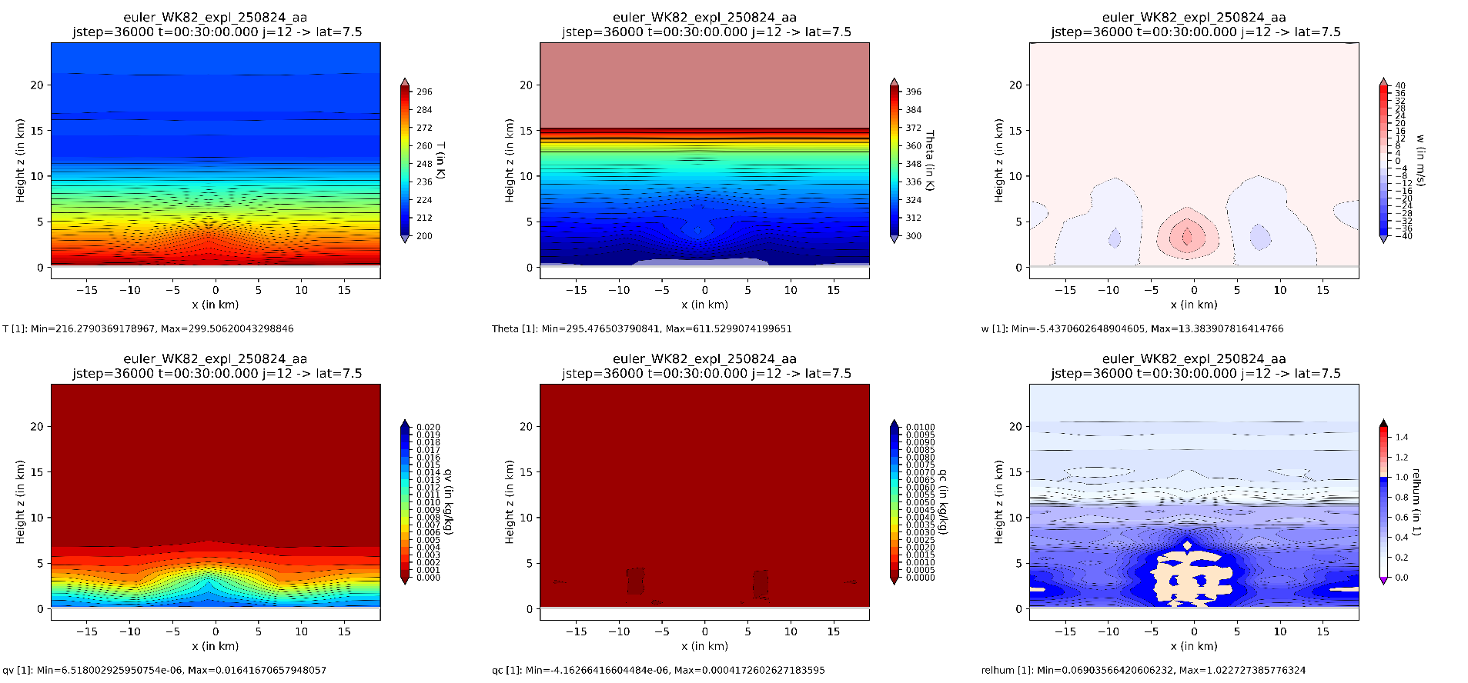
Very first steps towards moisture in BRIDGE
T
Θ
w
q_{v}
q_{c}
rh

Slide 20
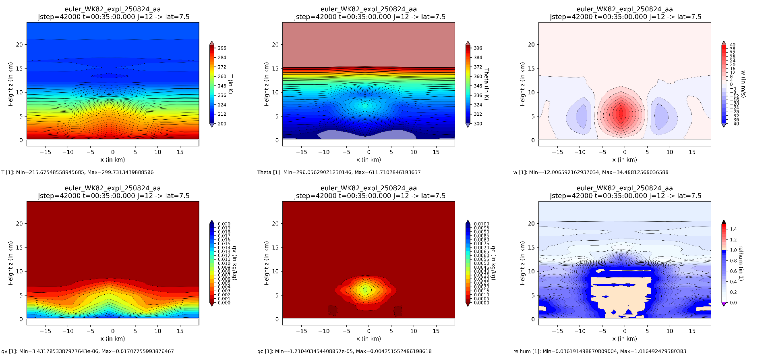
Very first steps towards moisture in BRIDGE
T
Θ
w
q_{v}
q_{c}
rh

Slide 21
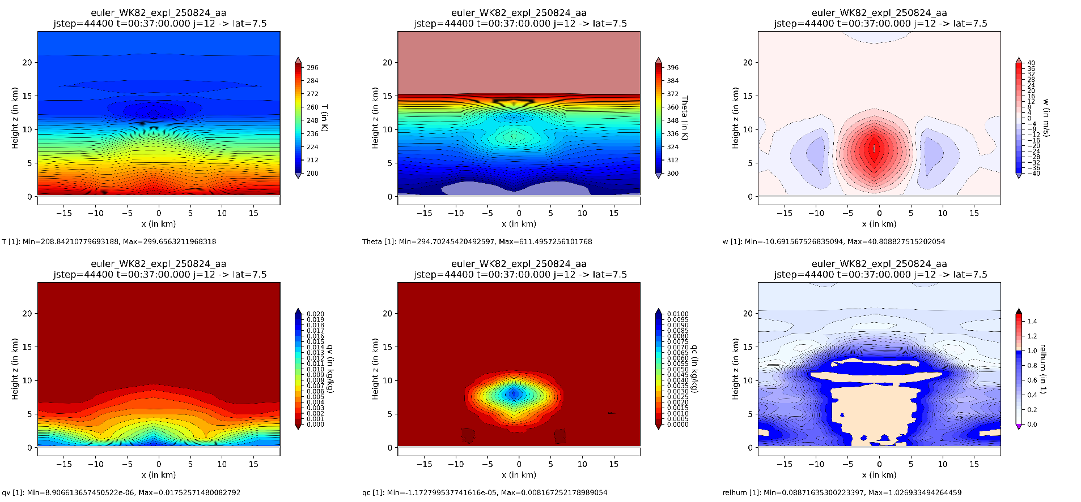
Very first steps towards moisture in BRIDGE
T
Θ
w
q_{v}
q_{c}
rh

Slide 22
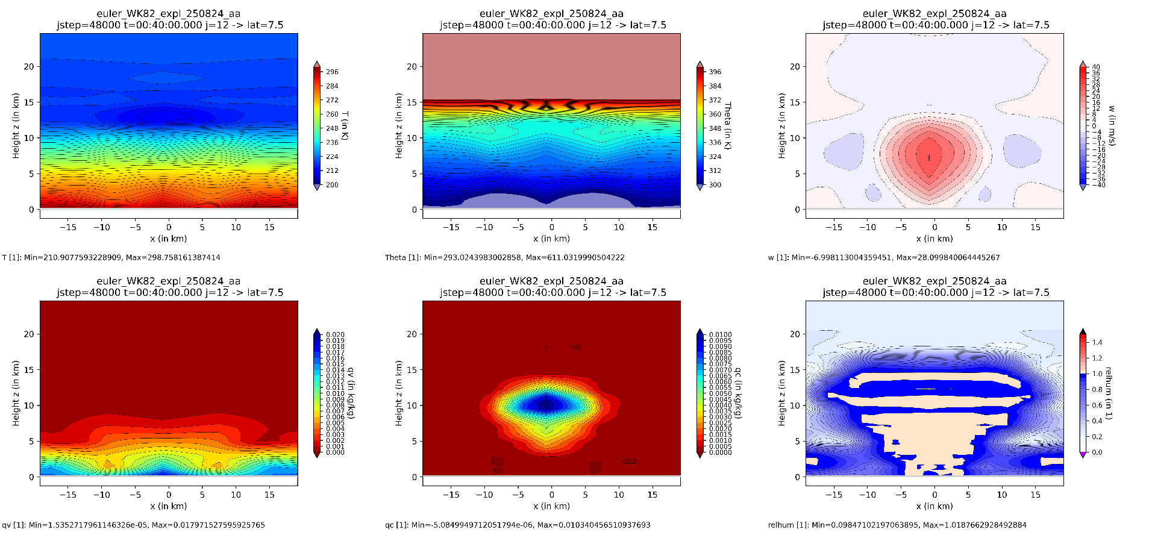
Very first steps towards moisture in BRIDGE
T
Θ
w
q_{v}
q_{c}
rh

Slide 23
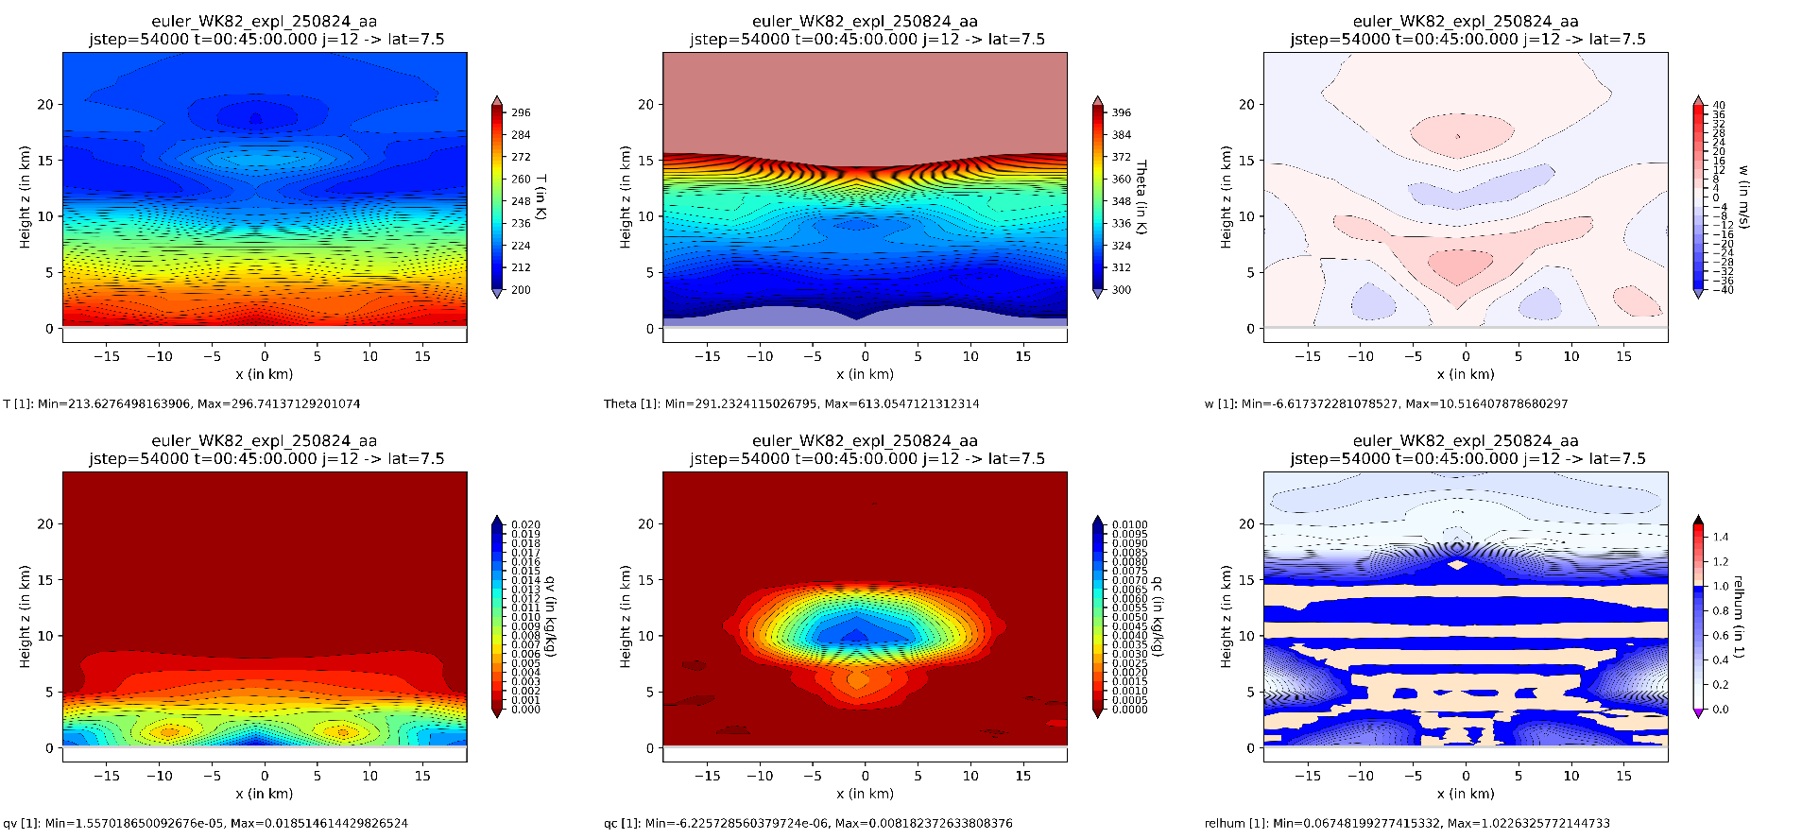
Very first steps towards moisture in BRIDGE
T
Θ
w
q_{v}
q_{c}
rh
Max. oversaturation: 4.3%, relative water mass conservation error ~ 3%

Slide 24
Very first steps towards moisture in BRIDGE
Summary
Some very first steps towards using microphysics in BRIDGE have been made:
  condensation/evaporation implemented;
  reduced conservation violation (=2nd step of Zhang, Shu, 2010)
  in a positivity pres. transport scheme
  with explicit time integration
  works satisfyingly in idealized test cases.
A lot of heavy todo‘s remain:
  True conserving, posit. pres. (and mass consistent?) advection scheme
  Couple with IMEX-RK (→ much larger dt), and splitting schemes
  Full Kessler with (implicit) sedimentation (and saturation adjustment?)

Slide 25
Ellipsoidal vs. spherical geopotential approximation
About the spherical and ellipsoidal geopotential approximation and first results with a Discontinuous Galerkin dynamical core
PDEs on the sphere 2025, Sao Paulo, Brasil
12-16 May 2025
Michael Baldauf (DWD, Germany)
M. Baldauf (DWD)
25

Slide 26
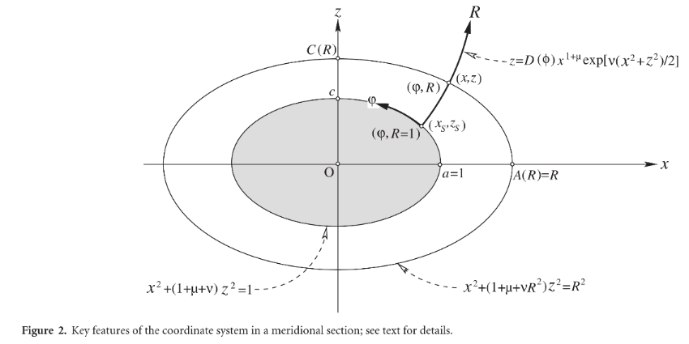


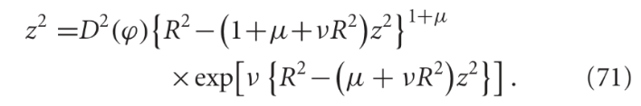
Ellipsoidal vs. spherical geopotential approximation
Ellipsoidal geopotential approximation (EGA) by Staniforth, White (2015) QJRMS
Ellipsoidal approximation:
coordinate surfaces with R=const.
with A(R)=R, C(R)=…
and the geopotential
To get an orthogonal coordinate system one
needs to solve iteratively:
Monopole
Quadrupole
Centrifugal
→ Φ=const. on surfaces with R=const.!
This approach in particular retains
Clairaut‘s fraction g_{pole}/g_{eq} !
In the following D(ϕ) is chosen so
that ϕ is the geographic latitude.
M. Baldauf (DWD)
26

Slide 27
Ellipsoidal vs. spherical geopotential approximation
What is a fair comparison between sphere and ellipsoid?
Idea: use a geostrophic+hydrostatic balanced, stationary initial state
Prescribe a purely zonal velocity field of the form v = u(ϕ,z) e_{λ}
p exists, if the integrability condition ∇× rhs = 0 is fulfilled
→ (generalized) thermal wind relationship = PDE for T(ϕ,z)
What is the correct boundary condition?
Method of characteristics → prescription of a T(z)-profile is possible
(e.g. at the equator)
Solve the PDE for T(ϕ,z) e.g. via a spectral solver.
Determine p via line integration.
Finally, add some perturbation (e.g. on v)
M. Baldauf (DWD)
27

Slide 28
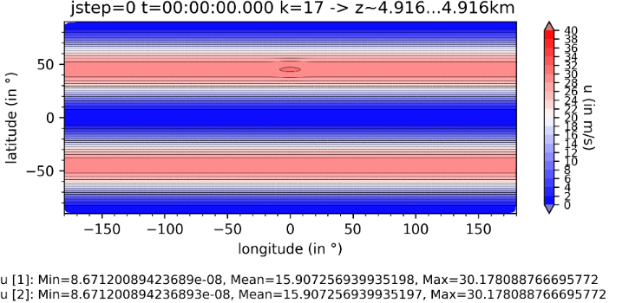
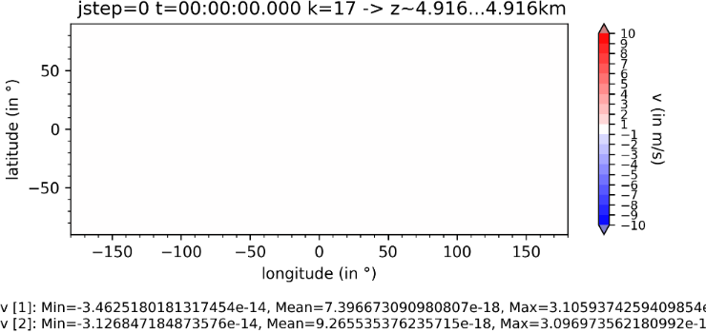
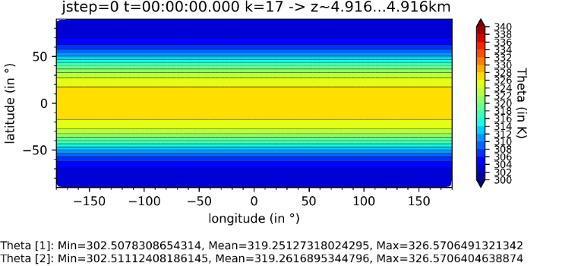
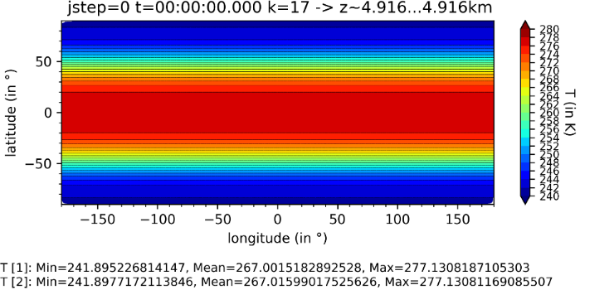
Ellipsoidal vs. spherical geopotential approximation
Baroclinic instability for u_{max}=35 m/s
Fields in z ~ 5 km, sphere (colors, dashed lines), ellipsoid (solid lines)
u
v
Θ
T
M. Baldauf (DWD)
28

Slide 29
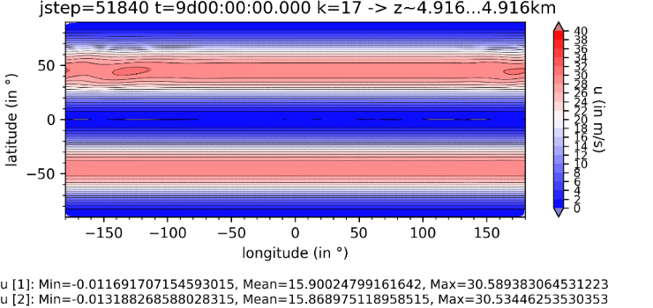
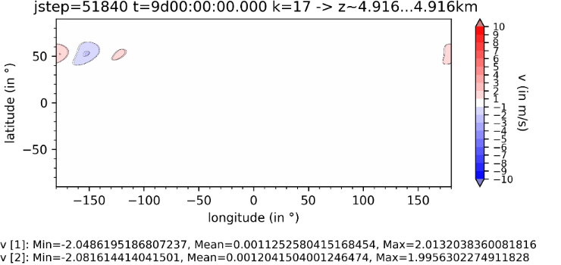
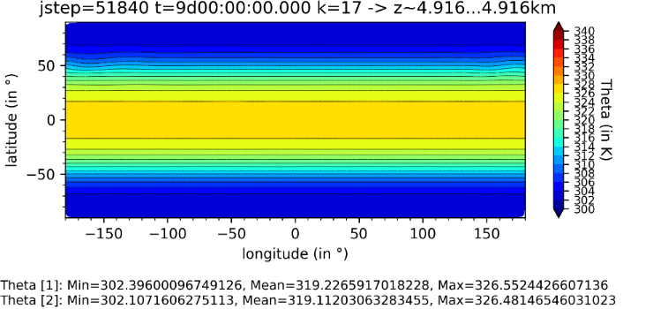
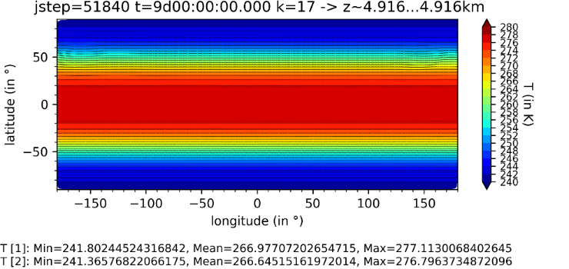
Ellipsoidal vs. spherical geopotential approximation
Baroclinic instability for u_{max}=35 m/s
Fields in z ~ 5 km, sphere (colors, dashed lines), ellipsoid (solid lines)
u
v
Θ
T
M. Baldauf (DWD)
29

Slide 30
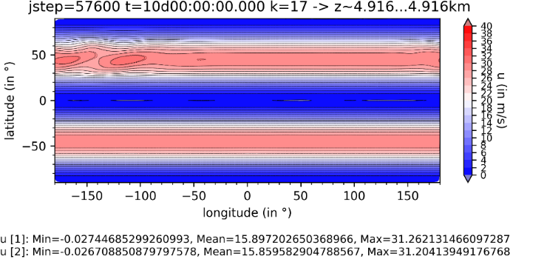
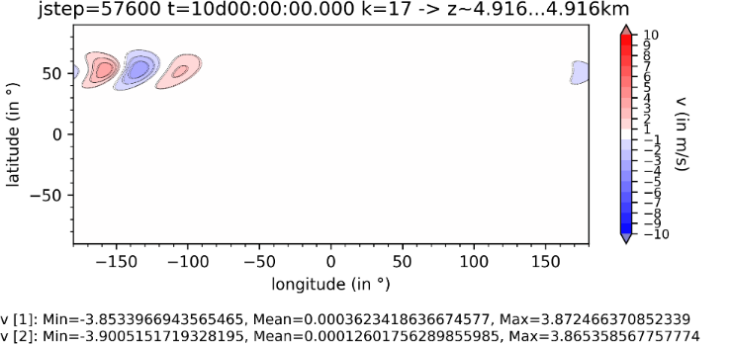
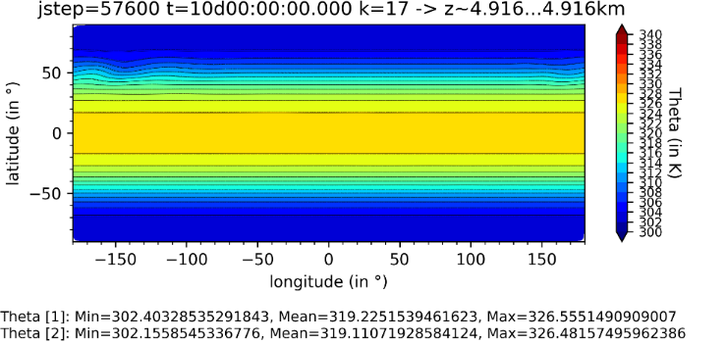

Ellipsoidal vs. spherical geopotential approximation
Baroclinic instability for u_{max}=35 m/s
Fields in z ~ 5 km, sphere (colors, dashed lines), ellipsoid (solid lines)
u
v
Θ
T
M. Baldauf (DWD)
30

Slide 31

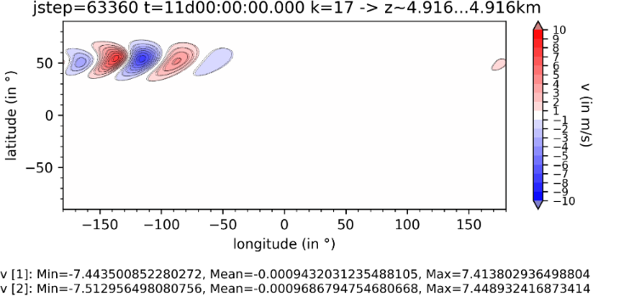


Ellipsoidal vs. spherical geopotential approximation
Baroclinic instability for u_{max}=35 m/s
Fields in z ~ 5 km, sphere (colors, dashed lines), ellipsoid (solid lines)
u
v
Θ
T
M. Baldauf (DWD)
31

Slide 32
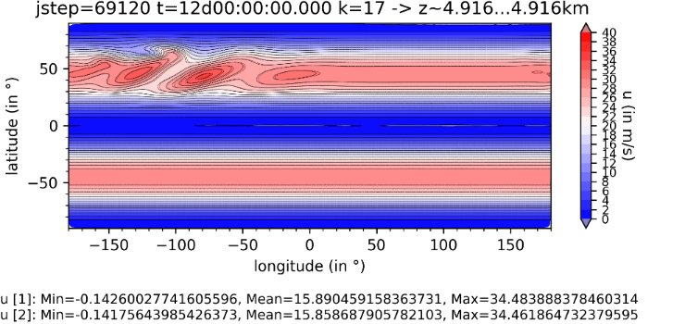
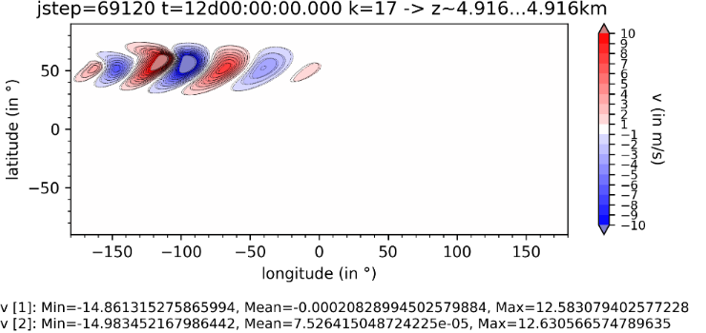
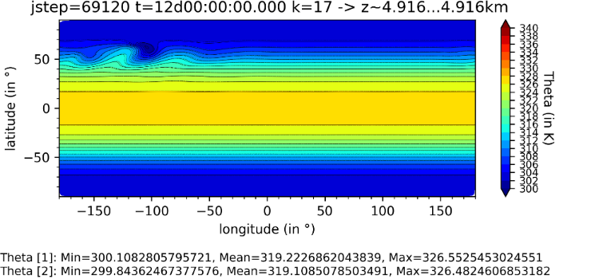

Ellipsoidal vs. spherical geopotential approximation
Baroclinic instability for u_{max}=35 m/s
Fields in z ~ 5 km, sphere (colors, dashed lines), ellipsoid (solid lines)
u
v
Θ
T
M. Baldauf (DWD)
32

Slide 33
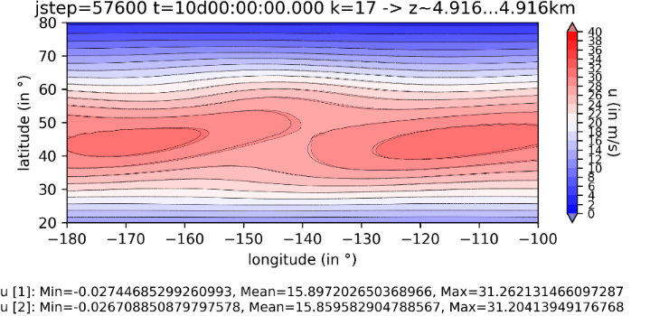
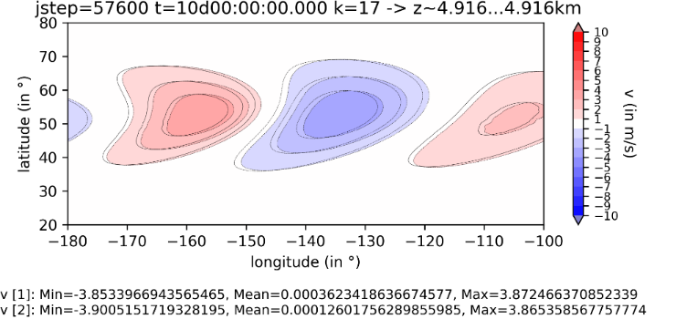


Ellipsoidal vs. spherical geopotential approximation
Baroclinic instability for u_{max}=35 m/s
Fields in z ~ 5 km, sphere (colors, dashed lines), ellipsoid (solid lines) (zoom in)
u
v
Θ
T
M. Baldauf (DWD)
33

Slide 34




Ellipsoidal vs. spherical geopotential approximation
Baroclinic instability for u_{max}=35 m/s
Fields in z ~ 5 km, sphere (colors, dashed lines), ellipsoid (solid lines) (zoom in)
u
v
Θ
T
M. Baldauf (DWD)
34

Slide 35



Ellipsoidal vs. spherical geopotential approximation
Determine Position of max v:
e-folding time ~ 1,46 d
t=9d
t=10d
t=11d
d Δlon/dt ~ -0.1°/d
Fair comparison:
consider the range of exponential
perturbation growth
M. Baldauf (DWD)
35
Notes:
T=9d: lon=-173°
T=10d: lon=-153°
T=11d: lon=-133°

Slide 36
Ellipsoidal vs. spherical geopotential approximation
Some statistics for max v position for baroclinic instability setups with different u_{max}
max u in m/s | z in km | dlon/dt in °/d | dx/dt in km/d | dx/dt in m/s | DΔlon/dt in °/d | dΔx/dt in km/d
25 | 2 | 13.8 | 920 | 10.6 | -0.068 | -4.5
„ | 5 | „ | „ | „ | -0.065 | -4.3
„ | 10 | „ | „ | „ | -0.053 | -3.5
35 | 2 | 18.9 | 1260 | 14.5 | -0.1 | -6.5
„ | 5 | „ | „ | „ | -0.088 | -5.9
„ | 10 | „ | „ | „ | -0.053 | -3.5
45 | 2 | 23.9 | 1590 | 18.4 | -0.20 | -13.1
„ | 5 | „ | „ | „ | -0.17 | -11.0
„ | 10 | „ | „ | „ | -0.12 | -8.0
M. Baldauf (DWD)
36

Slide 37
Ellipsoidal vs. spherical geopotential approximation
Summary
Effects of the ellipsoidal geopotential approximation (EGA) have been
investigated by use of a higher order Discontinuous Galerkin solver
Test scenario: development of a baroclinic instability;
compare positional shifts during the exponential growing phase
Effects are small and in the order of the ellipticity ε~0.003:
frontal shifts up to ~100 km / 7days for stronger jets
wave velocity slightly smaller for the ellipsoid
Nevertheless EGA might be relevant in the near future for NWP models
In this test scenario, EGA vs. SGA effects are significantly larger than
deep vs. shallow atm. effects
Outlook
Investigate influence of large scale mountains
Use higher resolution
M. Baldauf (DWD)

Slide 38
BRIDGE – collaboration with academia

Slide 39

Project: ICON-DG: Gearing up the ICON Model with Smarter Discretizations
in the call ‚WarmWorld Module 4 Smarter‘
by German Ministry of Research and Educ. (BMBF)
has been accepted.
Duration: 01.07.2024 - 30.06.2027
Project partners:
DLR Köln, Inst. for software technology, project leader: Johannes Markert
Univ. Köln, Division of Mathematics, group Prof. Gregor Gassner
postdoc: Tristan Montoya
DWD, M. Baldauf, BRIDGE group
Goal: develop further stabilization of DG schemes by designing
entropy stable / entropy conserving schemes (=obeying 2nd law of
thermodynamics) especially for the prismatic grid cells used in
ICON / BRIDGE with HEVI and horiz. flux transformations.
→ ‚Next Generation DG methods‘
e.g. Gassner, Winters (2021) Front. Phys.
M. Baldauf (DWD)
39

Slide 40




Discontinuous Galerkin (DG) methods in a nutshell
e.g. Cockburn, Shu (1989) Math. Comput.
Cockburn et al. (1989) JCP
Hesthaven, Warburton (2008)
1.) Finite-element representation
via Integration by parts
2.) Galerkin approach → weak formulation
From Nair et al. (2011) in ‚Numerical
techniques for global atm. models'
Discrete analogon:
summation by parts
→ also allows derivation of
stability statements.
3.) Finite-volume ingredient: numerical flux
4.) Gaussian quadrature for the volume and surface integrals
→ ODE-system for q^{(k)}_{jl}(t)
5.) Use a time-integration scheme (Runge-Kutta, …)
M. Baldauf (DWD)
40

Slide 41
Work done until now in the Warmworld project:
Task: adapt ‚summation by parts‘ (SBP) operators to the covariant formalism of Baldauf (2020, 2021).
This has been successfully achieved for the shallow-water equations on a cubed sphere grid (T. Montoya).
Related paper (almost ready for publication):
T. Montoya, A. M. Rueda-Ramirez, G. J. Gassner: Entropy-stable discontinuous spectral-element
methods for the spherical shallow water equations in covariant form
Next steps:
SBP operators for the full 3D problem with the covariant Euler equations.
Achieve SBP property on triangles (heavy problem!)
Meetings
First kick-off meeting 19./20. Sept. 2024 at DLR Köln
Project pres. at the Warmworld General Assembly, 14-16 Oct 2024, Bremerhaven
Project meeting at DWD am 27./28.03.
Bi-weekly online meetings between project partners and communication via Slack

Slide 42
Currently attempt to get funding from the
‚Second Phase of AEI-DFG Pilot Call in the Fields of Psychology, Particle and Nuclear Physics,
and Atmospheric Science, Oceanography and Climate Research’
AEI: Agencia Estatal de Investigación (Spanish State Research Agency)
DFG: Deutsche Forschungsgemeinschaft (German Research Foundation)
Project partners:
Andrés Rueda-Ramirez: prof. at the Polytechn. Univ. Madrid (from 1.4.2025)
Prof. Gregor Gassner (Univ. Köln)
M. Baldauf (DWD)
Goal (DWD part):
Improved, higher order time integration schemes for physics dynamics coupling
Actual status: AEI approved our proposal, no decision from DFG yet

Slide 43
Some other stuff …

Slide 44

Exponential filter with (local) conservation
transform amplitudes into an orthogonal polynomial base
with the first base function φ₁=const.
Orthogonality related to the scalar product
← done by Gram-Schmidt-orthogonalization during init. phase.
Filtering: reduce amplitudes Q_{j} with the exception of Q₁ (conservation!)
and transform back to nodal function space.
→ total filter matrix: F = V F V⁻¹
Practically used filter coeff.s for the Held, Suarez (1994) test:
F =diag( 1.0, 0.999985…, 0.9961…, 0.9047… )
However, for the simulations for ellipsoid/sphere comparison only weak filtering is used
F=diag( 1.0, 1.0 , 0.9998…, 0.939…)
M. Baldauf (DWD)
44

Slide 45

Held, Suarez (1994) test: global mass conservation
1200 days
Relative global mass increase of only 3 ⋅10⁻⁹ / yr !
M. Baldauf (DWD)
45

Slide 46


Falling cold bubble test (Straka et al (1993)): global conservation
Density
Energy

Slide 47


Baroclinic instability test (Jablonowski, Williamson (2006): global conservation
Density
Energy

Slide 48

BRIDGE Code optimisations
Profiling:
  gprof (unsatisfactory for BRIDGE)
  valgrind –tool=callgrind <executable> <Options>
  simple run time measurements (not very accurate)
Mass matrix: , , actually needed is: (M_{ij})⁻¹ a_{j}
has a tensor product representation, if J separates horiz. / vertic.
Improve tensor product multiplications
… several other stuff (in general reduce memory access) …
→ efficiency gain until now about 10-35% (much too less!)
Change the IMEX-RK time integration from SSP3(4,3,3) to SSP3(3,3,2):
reduces number of LSE solves from 4 to 3, and allows a 50% longer time step
→ additionally saves a factor of 2
→ Much more optimizations are necessary….

Slide 49
Output routines
until now: is done using YAC (→ interpolation) + netcdf fortran interface
  sometimes ‚memory explosion‘ occurs in larger simulations
new alternative: directly use FE ‚interpolation‘ and only netcdf fortran interface
  much simpler code
  ‚single column‘ simulations now possible (i.e. on 2 triangles)
  much faster output (every processor flushes to disc)
  however one has to collect output on processors (is done via Python xarray)

Slide 50
A slightly more realistic simulation with BRIDGE …
‚Limited area‘ simulation with initial/boundary values taken from the
geostropic/hydrostatic balancing scheme (see ellip./sphere topic above)
Nearly ICON-D2 area, R2B8 grid (dx~10km)
Orography on R2B10 (~2.5km), generated from R2B13 (~300m) ASTER data
DG 4th order SSP3(3,3,2) IMEX-RK-HEVI time integration
With TKE turbulence scheme

Slide 51


Slide 52


Slide 53


Slide 54


Slide 55


Slide 56


Slide 57



Slide 58


Slide 59


Slide 60


Slide 61


Slide 62


Slide 63


Slide 64


Slide 65


Slide 66
Milestones of the BRIDGE-project (status Sept. 2024)
0. first version of a FE/DG framework available, MPI parallelized Q2/2021 ✓
1. shallow water equations on the sphere, explicit time integration (RK) Q3/2021 ✓
2. 3D Euler equations on the sphere, explicit time integration (RK) Q1/2022 ✓
2.b with 3D diffusion (+ a simple turbulence scheme) BR1/BR2 Q2/2022 ✓/
2.c grid refinement works Q2/2022 ✓
3. Euler equations, HEVI time integration (IMEX-RK) Q3/2022 ✓
3.b optimization of the vertically implicit solver (Schur compl.,...) Q4/2022 ✓
3.c with 3D diffusion (+ a simple turbulence scheme), HEVI Q1/2023 ✓
4. cloud microphysics (Kessler) + tracer advection (positive definit)
+ explicit sedimentation scheme Q4/2022  !
4.b cloud microphysics (cloud ice, Graupel)
+ vertically implicit sedimentation scheme Q1/2023 !
5. HEVI diffusion on dt(fast phys.); physics-dynamics coupl./time integr. Q4/2023 ✓/
6. limited area (=use lateral BCs) version available Q1/2023 ✓/…
7.a vectorized version available Q2/2023
7.b GPU version Q1/2024
7.c general code optimization Q4/2024 !
8. coupling of a one-equation turbulence + BL scheme Q2/2023 ✓
M. Baldauf (DWD)
66

Slide 67
Milestones of the BRIDGE-project (status Sept. 2025)
0. first version of a FE/DG framework available, MPI parallelized Q2/2021 ✓
1. shallow water equations on the sphere, explicit time integration (RK) Q3/2021 ✓
2. 3D Euler equations on the sphere, explicit time integration (RK) Q1/2022 ✓
2.b with 3D diffusion (+ a simple turbulence scheme) BR1/BR2 Q2/2022 ✓/
2.c grid refinement works Q2/2022 ✓
3. Euler equations, HEVI time integration (IMEX-RK) Q3/2022 ✓
3.b optimization of the vertically implicit solver (Schur compl.,...) Q4/2022 ✓
3.c with 3D diffusion (+ a simple turbulence scheme), HEVI Q1/2023 ✓
4. cloud microphysics (Kessler) + tracer advection (positive definit)
+ explicit sedimentation scheme Q4/2022 
4.b cloud microphysics (cloud ice, Graupel)
+ vertically implicit sedimentation scheme Q1/2023 !
5. HEVI diffusion on dt(fast phys.); physics-dynamics coupl./time integr. Q4/2023 ✓/
6. limited area (=use lateral BCs) version available Q1/2023 ✓/…
7.a vectorized version available Q2/2023 !
7.b GPU version Q1/2024 !
7.c general code optimization Q4/2024 
8. coupling of a one-equation turbulence + BL scheme Q2/2023 ✓
M. Baldauf (DWD)
67

Slide 69
For discussion:
Do we still need physical model development in the
rapidly evolving AI environment?
Physical process studies in atmosphere, ocean, biosphere, … (academia, …)
For situations where training data are still rare or unsufficient:
  Climate forecasts, scenario simulations
  Pollution transport (in particular for those with rare training data)
  Space weather
  Weather forecast on other planets (Mars, …)
Hybrid models = combided physical + AI models (perhaps also for weather pred.)

Slide 71
Discontinuous Galerkin (DG) methods in a nutshell
e.g. Cockburn, Shu (1989) Math. Comput.
Cockburn et al. (1989) JCP
Hesthaven, Warburton (2008)
1.) Finite-element representation
2.) Galerkin approach → weak formulation
From Nair et al. (2011) in ‚Numerical
techniques for global atm. models'
3.) Finite-volume ingredient: numerical flux
4.) Gaussian quadrature for the volume and surface integrals
→ ODE-system for q^{(k)}_{jl}(t)
5.) Use a time-integration scheme (Runge-Kutta, …)
M. Baldauf (DWD)
71

Slide 72
Discontinuous Galerkin (DG) methods in a nutshell
e.g. Cockburn, Shu (1989) Math. Comput.
Cockburn et al. (1989) JCP
Hesthaven, Warburton (2008)
1.) Finite-element representation
higher order discretization ✓
2.) Galerkin approach → weak formulation
From Nair et al. (2011) in ‚Numerical
techniques for global atm. models'
works on unstructured grids ✓
Local conservation ✓
3.) Finite-volume ingredient: numerical flux
allows explicit time integration ✓
4.) Gaussian quadrature for the volume and surface integrals
→ ODE-system for q^{(k)}_{jl}(t)
allows massive parallelisation ✓
5.) Use a time-integration scheme (Runge-Kutta, …)
high computational intensity ✓
M. Baldauf (DWD)
72

Slide 73








Euler equations (in covariant form)
Continuity eq.:
Momentum eq.:
Energy budget eq.:
Variant 1: use density weighted potential temperature
Variant 2: use total energy density
p=p(θ)
E = E_{kin} + E_{pot} + E_{int}
p=p(E_{int})
In case of diffusion: T^{ik} → T^{ik} + T^{ik}_{diffus} , …
M. Baldauf (DWD)
73
M. Baldauf (DWD)

Slide 74

Very first steps towards moisture in BRIDGE
Tracer transport
Must be: conserving, positivity preserving, mass consistent
Here: positivity pres. and (almost) conserving
tracer advection by linear rescaling
=2nd step of Zhang, Shu (2010) scheme:
ρ_{v}
x
One grid cell

Slide 75
Very first steps towards moisture in BRIDGE
t_equation_base
<<abstract>>
init()
init_var()
flux_expl()
flux_expl_hface()
source_term_expl()
BRIDGE class structure of equation systems
t_eq_adv2D
t_eq_euler
flux_impl_x3()
source_term_impl()
…
t_eq_euler2
flux_impl_x3()
source_term_impl()
…
t_eq_shw
t_eq_adv3D
t_eq_tracer_micro
t_eq_tke
Sub equation
classes
Master equation classes
M. Baldauf (DWD)
75

Slide 76
Very first steps towards moisture in BRIDGE
Some coding remarks…
At the moment, only explicit RK-schemes are used for moisture.
New in BRIDGE: one can put a list of equation objects into a RK time integrator
→ simultanous solution of the whole equation system Euler + tracer + TKE + …
Equation objects also contain arrays for invariant fields (e.g. ref. state)
and diagnostic fields (e.g. T, K_{m});
(remark: metric coeff. have their own container).
Now they also contain ‚views‘ (=pointers to array subranges) to these fields,
which can be used in the flux and source term calculations.

Slide 77
Very first steps towards moisture in BRIDGE
First sanity checks:
consider only 1 grid cell with 1 quadrature point
and free-slip = no flux conditions (top/bottom) or periodic conditions (lateral)
Oversaturation test:
set T=300 K, ρ_{v} = ρ_{sat}(T) + 0.01 = 0.0360 kg/m³ → rel.hum.=138%, ρ_{c} = 0, p=101882 Pa
After 5 time steps:
T=304.9 K, ρ_{v} = 0.0336 kg/m³ → rel.hum=100%, ρ_{c} = 0.0024 kg/m³, p=103114 Pa ✓
Undersaturation test with evaporation:
set T=300 K, ρ_{v} = 0 kg/m³ → rel.hum.= 0%, ρ_{c} = 0.01 kg/m³, p=99136 Pa
After 5 time steps:
T=282.4 K, ρ_{v} = 0.009 kg/m³ → rel.hum=100%, ρ_{c} = 0.001 kg/m³, p=94431 Pa ✓

Slide 78
Very first steps towards moisture in BRIDGE
Bryan, Fritsch (2002): dry test case
BRIDGE setup:
4th order DG, dx=500m, dz=400m
RK4, dt=0.05s

Slide 79


Very first steps towards moisture in BRIDGE
Bryan , Fritsch (2002) test, dry case: no diffusion, no filtering

Slide 80


Very first steps towards moisture in BRIDGE
Bryan , Fritsch (2002) test, dry case: with diffusion K=10m²/s, no filtering

Slide 81


Very first steps towards moisture in BRIDGE
Bryan , Fritsch (2002) test, dry case: with diffusion K=10m²/s, weak filtering

Slide 82


Very first steps towards moisture in BRIDGE
Bryan , Fritsch (2002) test, dry case: with diffusion K=100m²/s, no filtering

Slide 83
Very first steps towards moisture in BRIDGE
Bryan , Fritsch (2002) test, dry case: with diffusion K=20m²/s, no filtering

Slide 84
Very first steps towards moisture in BRIDGE
Bryan, Fritsch (2002): moist test case

Slide 85


Very first steps towards moisture in BRIDGE
Bryan , Fritsch (2002) test, moist case: no diffusion, no filtering
Max. oversaturation: 1.1%

Slide 86


Very first steps towards moisture in BRIDGE
Bryan , Fritsch (2002) test, moist case: no diffusion, weak filtering
Max. oversaturation: 0.3%, relative water mass conservation error ~2e-12

Slide 87


Very first steps towards moisture in BRIDGE
Bryan , Fritsch (2002) test, moist case: with diffusion K=30m²/s, no filtering
Max. oversaturation: 0.16%, relative water mass conservation error ~ 1e-15

Slide 88
Very first steps towards moisture in BRIDGE
Next steps: time integration in a split scheme
Instead of using one RK-scheme for Euler+tracer (+TKE),
do time splitting:
RK-scheme for tracers
RK-scheme for Euler
dρ_{v}/dt_{cond/evap} from tracer scheme (to deliver energy tendency):
dρ_{v}/dt_{cond/evap} = Σ_{RK-stage s} b_{s} [dρ_{v}/dt_{cond/evap}]_{s}

Slide 89



Ellipsoidal vs. spherical geopotential approximation
Sequence of coordinates and their transformations in BRIDGE
0. Global Cartesian coordinates
1. Geographical coordinate
for external data and general I/O purposes
2. Local (gnomonial) coordinate
maps a spherical or ellipsoidal (or just flat) triangle
to a unit triangle.
Use covariant form of eqns. (Ricci tensor calculus)
avoids any singularity both in coordinates and in base vectors!
~ concept of a differentiable manifold (Baldauf (2020) JCP)
3. Unit coordinate
affine trafo., compatible to standard FE codes
4. Terrain-following coordinate
treat orography, use strong conservation form (Baldauf (2021) JCP)
5. Submapping coordinate
affine trafo., reduce number of flux transf. at edges
affine
trafo.
M. Baldauf (DWD)
89

Slide 90


Ellipsoidal vs. spherical geopotential approximation
Preliminary studies:
Comparison between sphere and ellipsoid for shallow water equations
Elliptical (confocal) coordinates
Galewsky et al.-test case for shallow water eqns.:
Bénard (2015) QJRMS
Baldauf (2020) JCP
These confocal ellipsoidal coord. are fine for sh.-w. simulations (i.e. for K, ξ=const.)
In the 3D case, it is highly advantageous to have constant geopotential
on all coordinate surfaces with constant vertical coordinate.
→ Confocal ellipsoidal coord. do not retain Clairauts fraction at all!
(White, Staniforth, Wood, 2008)
M. Baldauf (DWD)
90

Slide 91
Ellipsoidal vs. spherical geopotential approximation
Motivation:
Global weather forecast and climate models further increase resolution
and accuracy (e.g. DWD ICON, dx~13km, ECMWF IFS dx~9 km, …)
But obviously there are still fundamental model errors!
E.g. recently, it was found that IFS can be improved
by large-scale (!) spectral nudging towards an AI model.
Probably, the main errors are due to insufficient physical parameterizations.
However, our dynamical cores are doing several simplifications, too:
shallow atmosphere approximation (together with the ‚traditional‘ approx.)
today many models contain a deep atmosphere option (unified model, ICON, …)
spherical geopotential approximation (SGA),…
Extensions to ellipsoidal geopotential approximations (EGA), e.g.
White, Staniforth, Wood (2008) QJRMS: errors due to SGA are systematic!
Staniforth, White (2015) QJRMS
Dubos (2025) QJRMS: EGA vs SGA errors are of comparable order
as deep vs. shallow!
M. Baldauf (DWD)
91

Slide 92






Ellipsoidal vs. spherical geopotential approximation
The geophysical picture:
Gravito-centrifugal geopotential in quadrupole approximation
White, Staniforth, Wood (2008)
Ramsey (1940)
monopole
quadrupole
Centrifugal (exact)
φ : geocentric latitude (i.e. use spherical coord. λ, φ, r)
γ : Newton‘s gravitational constant 6.6743 ⋅10⁻¹¹ m³ kg⁻¹ s⁻²
M_{E} : mass of the earth 5.9722 ⋅10²⁴ kg
a : semi-major axis 6378,137 km, c : semi-minor axis 6356,752 km
2 dimensionless parameters:
≈ 0.00335 ellipticity
≈ 0.00346
For a uniform mass distribution:
For the earth: ε ≈ m
Clairaut‘s fraction:
Observed:
Geophysical numbers taken from WGS84
M. Baldauf (DWD)
92

Slide 93



Ellipsoidal vs. spherical geopotential approximation
Initial state for u_{max} = 35 m/s
u
T
This setup has some similarity with
Jablonowski, Williamson (2006) QJRMS
All simulations use
a R2B5L10 grid, i.e. Δx ~ 79km,
4th order DG scheme
SSP3(3,3,2) IMEX-RK scheme
Θ
M. Baldauf (DWD)
93
Notes:
U = 35 m/s + 1 m/s (perturb.)

Slide 94


Ellipsoidal vs. spherical geopotential approximation
Falling cold bubble in a viscous medium
test setup: Straka et al. (1993)
Reference solution
for θ from
Straka et al. (1993)
(Δx=Δz=25m)
BRIDGE, 4th order, Δx=Δz=400m
Θ
M. Baldauf (DWD)
94

Slide 95


Linear flow over mountains
Schaer et al. (2002) MWR, test case 5b: U₀=10m/s, N=0.01 1/s, a=5 km
Inflow conditions
U=10m/s
→ Slightly improve
similarity with the
analytic solution (black lines)
Periodic BCs
M. Baldauf (DWD)
95

Slide 96

Flow over mountains with steep slopes and vertical grid stretching
Schaer et al. (2002) MWR, test case 5b: U₀=10m/s, N=0.01 1/s, but a=10km
H_{oro}= 8000m,
α_{max} = 72°
With SSP3(3,3,2)
dt=0.375s
Δx=4 km; vertical grid stretching: Δz_{min}~46m, Δz_{max}~736m, z_{lowest QP}~10.3m
HEVI-DG simulation (4th order) remains stable even for steeper slopes! (Baldauf, 2021)
to avoid instability by strong gravity wave breaking, vertically implicit diffusion with K=100 m²/s was used
M. Baldauf (DWD)
96

Slide 97

3D Euler equations:
quasi-linear expansion of gravity and sound waves in a spherical shell
Baldauf, Reinert, Zängl (2014) QJRMS derive a linearized analytic solution for
test scenario (A): f = 0
test scenario (B): f = 10 * f_{geo}(45°) → f / N ~ 0.05
DG 4th order scheme with explicit time integration (4th order Runge-Kutta)
‚small planet‘:
R = R_{earth} / 50
S E N
M. Baldauf (DWD)
97
M. Baldauf (DWD)

Slide 98





3D Euler equations:
quasi-linear expansion of gravity and sound waves in a spherical shell
Baldauf, Reinert, Zängl (2014) QJRMS
analytic solution available
uses shallow atmosph. approx., U₀=0, f=0.
R= r_{earth} / 100 → almost isotropic grid cells
R2B5L12
R2B3L3
R2B5L12
ICON
R2B6L24
ICON
R2B7L48
R2B3L3
BRIDGE
BRIDGE, HEVI
R2B4L6
R2B7L48
BRIDGE, expl
R2B4L6
M. Baldauf (DWD)
98
Notes:
Wave expansion test on the sphere (see next slide):
HEVI- (ICON) and purely expl. time integration (BRIDGE) are comparable!
all simul. on our RCL (ICON: 32, 64, 384 proc. (thanks to D. Reinert!), BRIDGE: 16 proc.)
for an isotropic grid: HEVI still factor 4 more expensive than explicit solver
→ for grid anisotropy > 4:1 (in operational ICON we use more than 100:1)
the HEVI solver by far outperforms the explicit solver

Slide 99


Baroclinic instability test on the sphere
Jablonowski, Williamson (2006) QJRMS
BRIDGE DG 4th order
R2B3 → Δx ~ 315 km, Δt=40s
T in z=1.5km
T in 850 hPa
Δx ~ 60 km
Stabilization by an exponential filter
(formally of 8th order)
T in 850 hPa at t=9d (Fig. 7 from JW06)
M. Baldauf (DWD)
99
M. Baldauf (DWD)
Notes:
Anm. zu ‚850 hPa‘:
Z=1.5km bedeutet in lat=0° : 846hPa, in lat=45°: 830hPa, in lat=60°: 811 hPa, in lat=90° 783hPa 0=> consequently change a bit the color scale!

Slide 100

Held, Suarez (1994) test = ‚poor mans climate run‘
Only solve the pure Euler equations (no diffusion, no microphysics, …),
but add height and latitude dependent relaxation terms on the rhs of
the momentum and energy equations.
Stabilization by standard
exponential filtering
necessary.
M. Baldauf (DWD)
100

Slide 101



Held, Suarez (1994) test = ‚poor mans climate run‘
Init.:
Jab., Will. (2006)
Init.:
v=0, T=250K
From Held, Suarez (1994)
M. Baldauf (DWD)
101
BRIDGE

Slide 102
Held, Suarez (1994) test: global mass conservation
Relative global mass increase of only 3 ⋅10⁻⁹ / yr !
M. Baldauf (DWD)
102

Slide 103



Example of a LAM run: central Europe, R2B8 (~10km)-LAM grid
u
v
T
Constant inflow (u,v)=(10,10) m/s, N=0.01 1/s,
note: no geostrophic balance by the pressure field
pre_pr_oro.py: orography on R2B10, (~2.5km)
generated from R2B13 (~300m) ASTER data
M. Baldauf (DWD)
103

Slide 104



Ellipsoidal vs. spherical geopotential approximation
Baroclinic instability for u_{max}=35 m/s
Fields in z ~ 5 km, sphere, deep atm. (colors, dashed lines),
sphere, shallow atm. approx (solid lines)
M. Baldauf (DWD)

Slide 105
Beitrag von Michael B.
BRIDGE Ausgabeoptionen:
bisher: Ausgabe der Felder auf latlon-Gitter, per YAC interpoliert
neu: Ausgabe der Felder auf den Quadraturpunkten
+ vermeidet ‚Speicherexplosionen‘ durch YAC
+ code verständlicher, es wird nur die Fortran-netCDF-Schnittstelle benutzt
→ nun auch 1-Flächenfelder T850, ps, … ausgeben
→ alle Ausgabefelder in einer .nc Datei
+ ‚echte‘ (d.h. auf 2 Dreiecken) single column Simulation möglich
+ deutlich schnellere Ausgabe (kein Einsammeln, jeder Prozessor flushed
seine Ausgabe auf Platte)
Zusammenfügen der domains per Postprocessing notwendig
(Tool nc_collgrid.py, benutzt Python xarray-Paket)
Plots von Vertikalschnitten (lat-z, lon-z) benötigen externe Interpolation
+ direkterer Zugriff auf ‚Numerik‘ (Quadraturpunkte) insbes. bei Plots
auf Modellflächen und von Vertikalprofilen
+ vermeidet Interpolationsartefakte durch YAC

Slide 106

Beitrag von Michael B.
05.06.2025

Slide 107

Beitrag von Michael B.
05.06.2025

Slide 108

Referenzlösung
Jablonowski, Williamson (2006)

Slide 109

Beitrag von Michael B.
Neue Ausgabe auf Quadraturpunkten:
05.06.2025

Slide 110

Beitrag von Michael B.
Neue Ausgabe auf Quadraturpunkten:
05.06.2025

Slide 111
Workshop presentations in 2024
COSMO GM 2024, Offenbach
SRNWP/EWGLAM meeting 2024, Prague
‚Mathematics of the Weather‘ Workshop Bad Orb, online pres.
Planned in 2025
WG DYN meetings during ICCARUS 2025
WG DYN meeting at COSMO GM (27.08.25)
‚PDEs on the sphere‘, 12-16 May 2025, Brazil
COSMO GM, Switzerland
SRNWP/EWGLAM meeting 2025, Sweden

