Slide 1
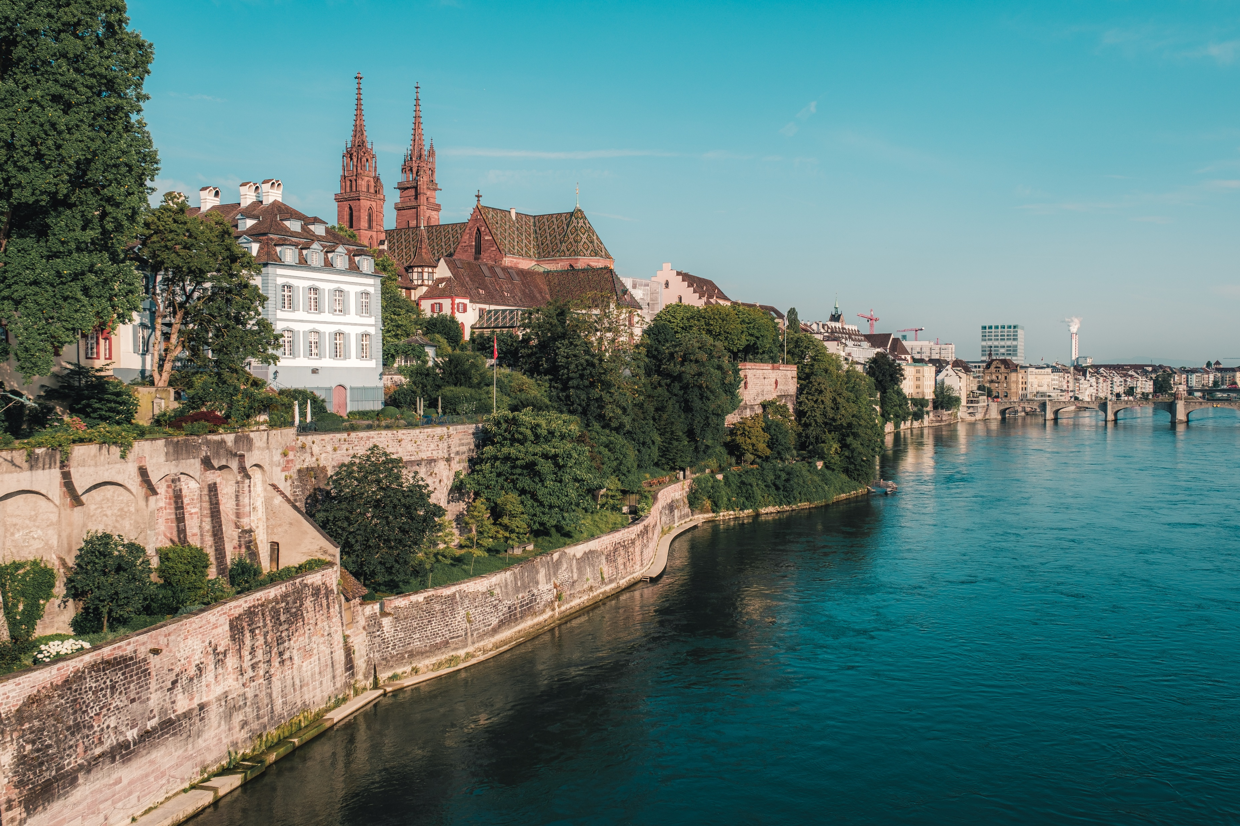
Welcome to Basel!

Slide 2

Important Information
COSMO General Meeting 2025
1-5 September 2025, Basel, Switzerland

Slide 3
Emergency Numbers
Ambulance 144
Police 117
Fire Service 118
REGA Swiss Air-Rescue 1414
Tox-Info 145
International Emergency Number 112

Slide 4
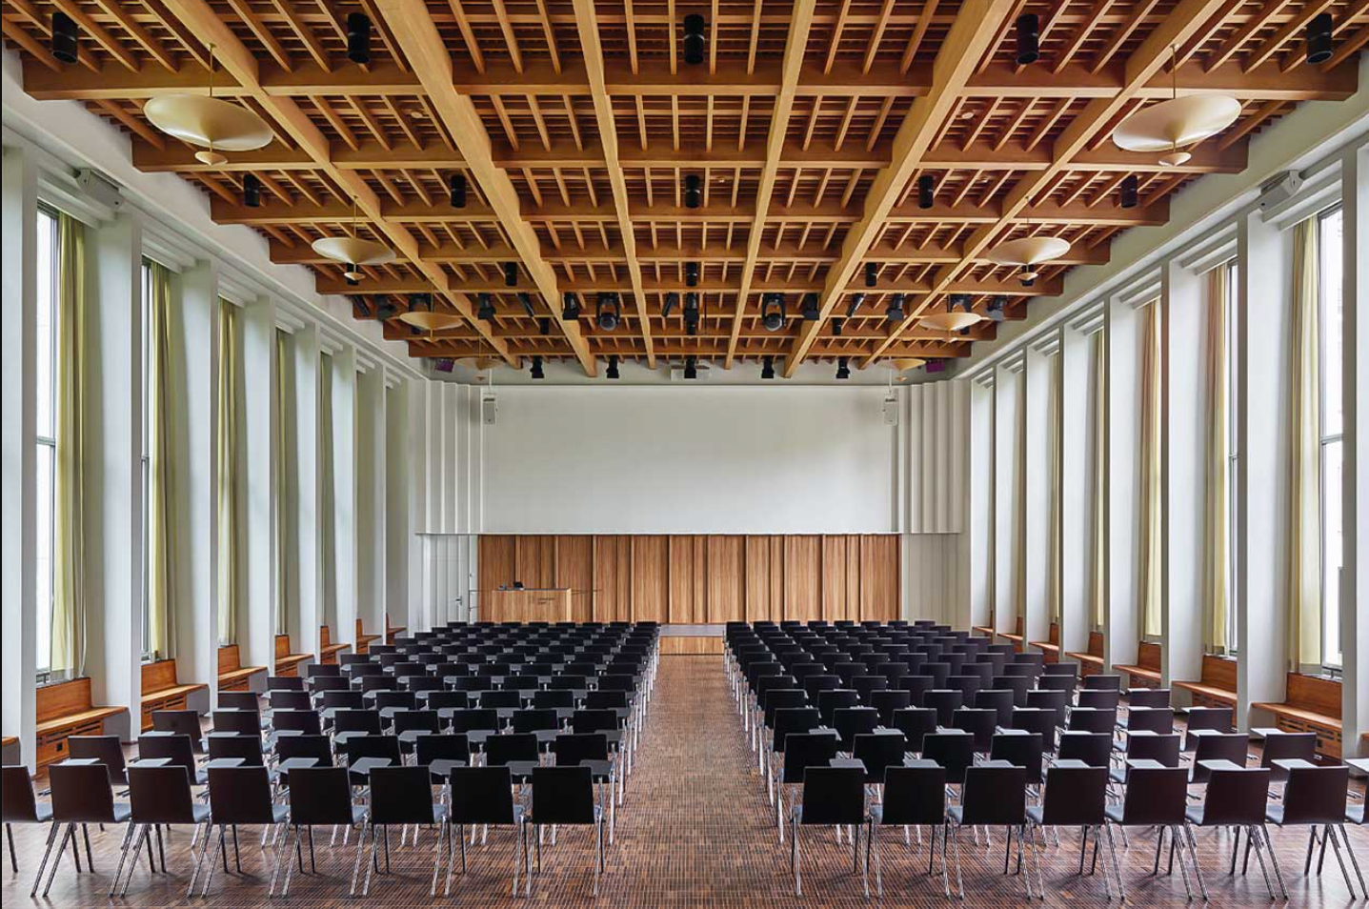
Schedule & Rooms
Working group sessions & STC meeeting:
  Monday all day, Tuesday afternoon
  First Floor, Seminarraum 104-107 and Regenzzimmer 111.
Plenary sessions:
  Tuesday, Wednesday and Thursday morning
  Ground Floor, Aula 033.
SMC meeting:
  Thursday afternoon and Friday morning
  First Floor, Regenzzimmer 111.
→ More information on the website

Slide 5
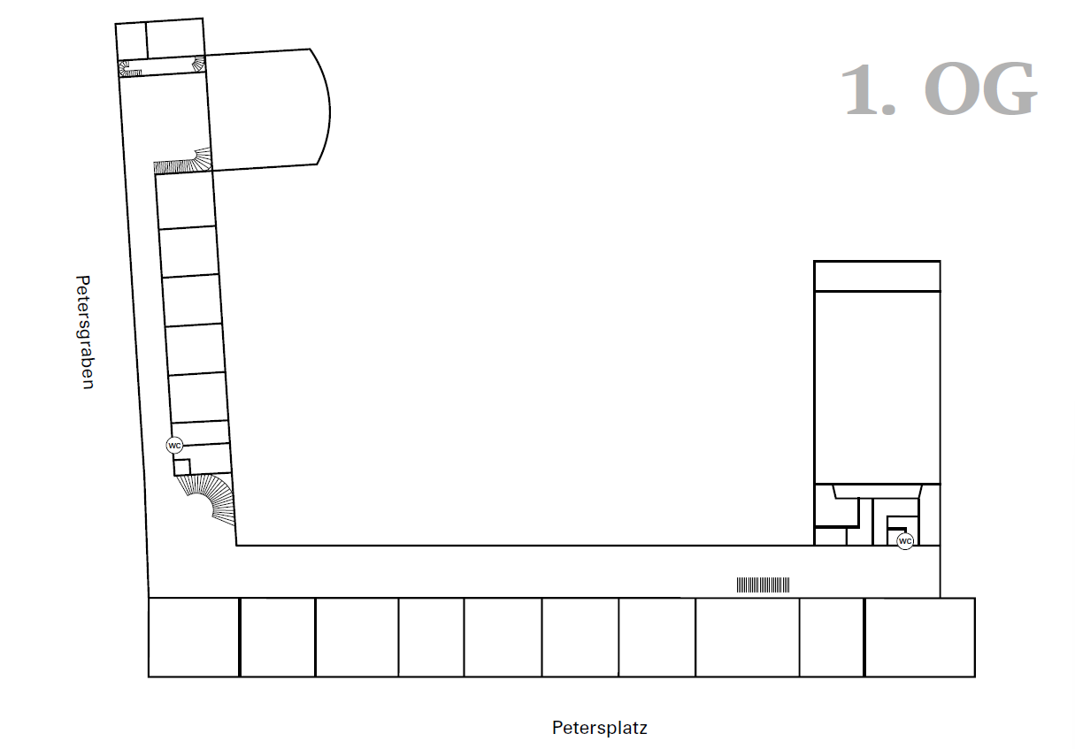
Site Plans
First Floor
STC
WG V/A
Seminarraum 103
WG S/I
Seminarraum 104
WG PHY
Seminarraum 105
WG PHY
Seminarraum 106
WG EPS
Seminarraum 107
WG DA
🚻
Regenzzimmer 111

Slide 6
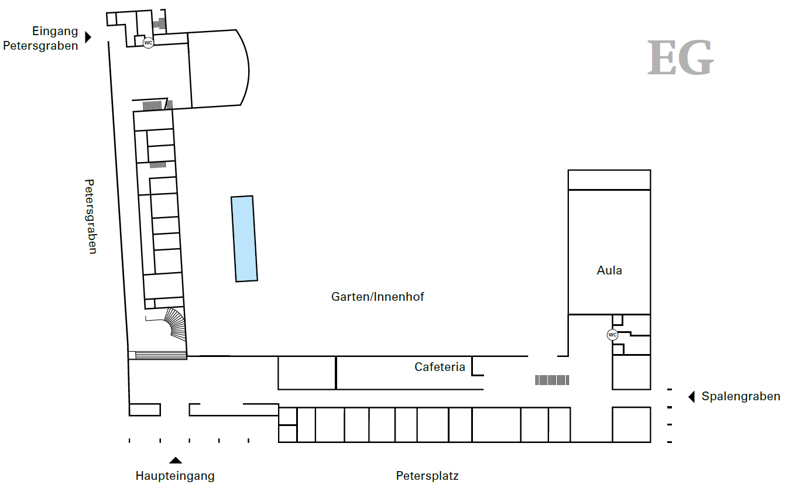
Site Plans
🚪 Side Entrance
Ground Floor
Aula 033
Plenary 🌏
Garden 🌳
Registration, Coffee Breaks & Apéro Site 🍸
🚻
Side Entrance 🚪
Main Entrance ⛩️

Slide 7
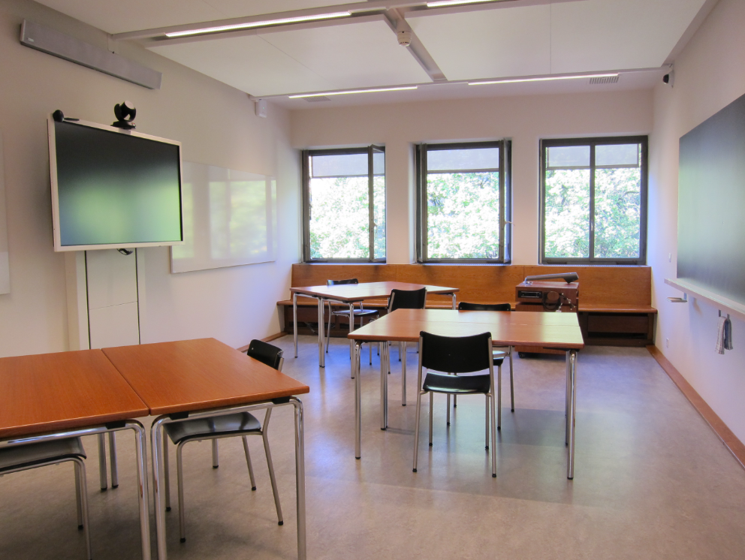
Study Rooms
If you wish to check your emails or work remotley, you can use the public study rooms or the cafeteria at the university.
Seminarraum 208 (quiet room)
Seminarraum 209 (loud room)
Cafeteria

Slide 8
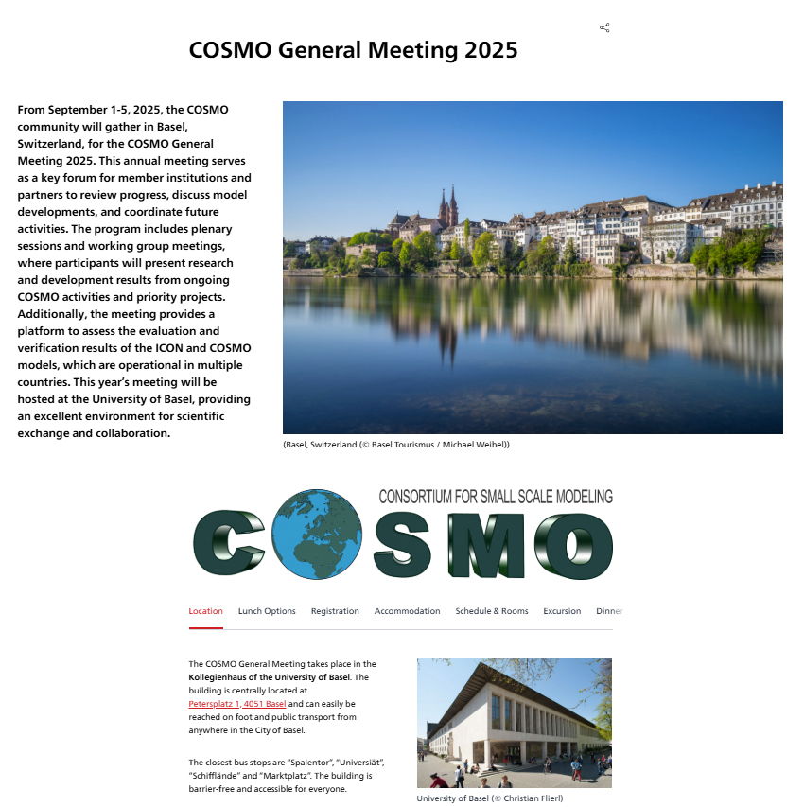
Website
There is a website with all necessary information about the COSMO General Meeting 2025.
→ To the website

Slide 9
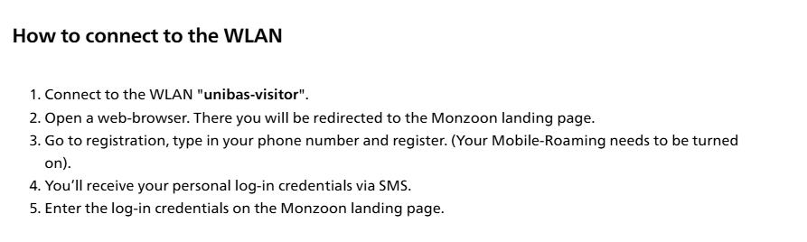
WLAN
→ Check out the “Location” section on the COSMO GM 2025 website.

Slide 10
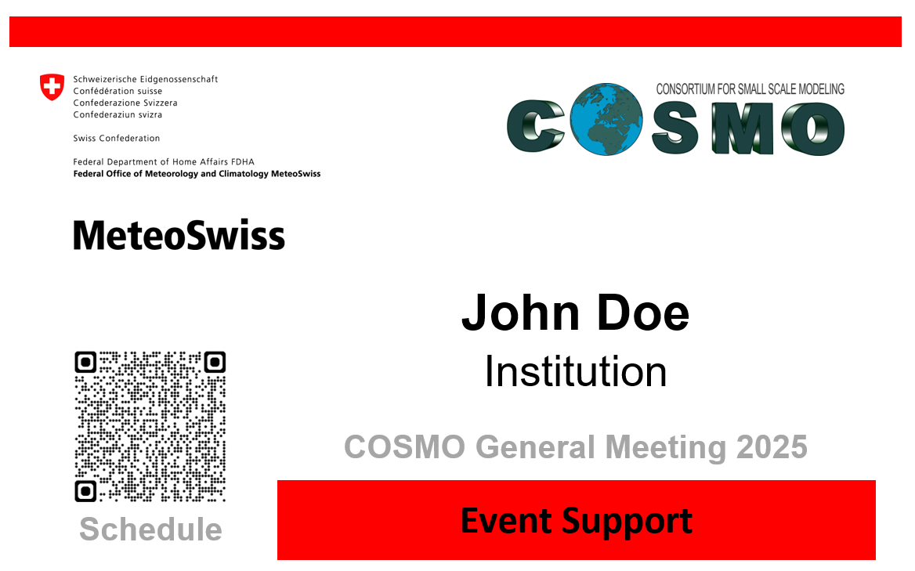
Name Tags
All participants wear name tags
If you need help, ask the people with event support name tags
→ You’ll find us in Seminarraum 103
Every name tag has a QR-code to the schedule
On your last day, please hand in your name tag to the event support team

Slide 11

Thank you for your attention!

