Slide 1


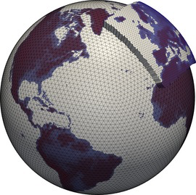
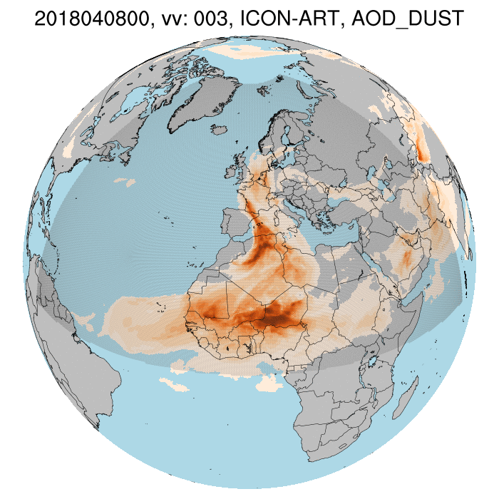
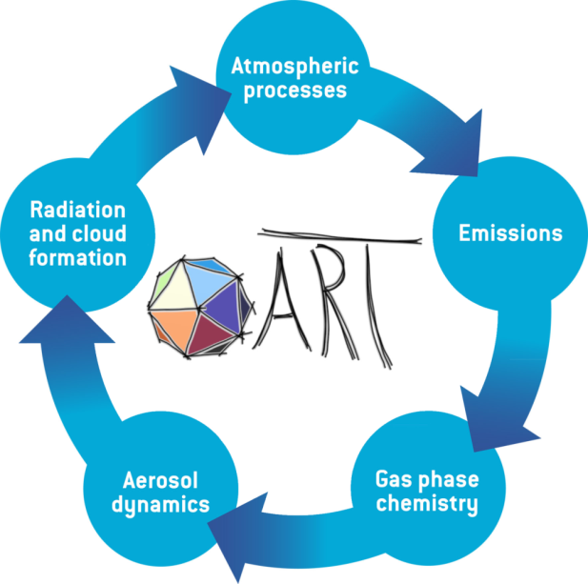
COSMO GM, Basel, September 2025
Ali Hoshyaripour and the ARTists

Slide 2

: open source release 2025.04
Point source
All natural aerosols
Biomass-burning plumes
Volcanic plumes (FPLUME)
Online emission module
MEGAN
New BB Plumes
Optics of all natural aerosols
Optics of internally mixed aerosols
Coupling with radiation (full and reduced grid)
Warm and cold activation
INAS ice nucleation scheme
Multiple radiation call
Prescribed optics in nc files
  Lifetime based
  Linearized schemes (LINOZ, N₂O-NOy)
  Simplified OH chemistry + O(1D)
  MECCA/KPP
  Dry and wet deposition for gases
  LINOZ V3
Modal treatment
AERODYN
ISORROPIA
Water uptake
Subpollen particles (SPP)
(--enable-art-gpl)

Slide 3
Dry deposition
by analogy to Ohm’s law that R_{i} is the sum of three resistances in series describing resistance to turbulent transport through the aerodynamic layer (R_{A}), resistance to diffusion through the quasi-laminar boundary layer (R_{B,i}), and resistance to surface uptake (R_{C,i}):
Source: Brasseur and Jacob 2017
Notes:
Think of the ‘big leaf’ as a porous medium above which the airflow follows atmospheric dynamics for deposition to a flat rough surface (Section 9.3.2), and below which some combination of surface processes leads to the actual uptake.

Slide 4
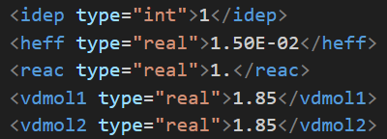
Dry Deposition
XML tags
Switch to activate dry deposition for given tracer
Effective Henry’s Law constant [M atm-1]
Reactivity of tracer from 0 to 1
Molecular diffusivities
<vdmol1> = ratio of D_{H2O}/D_{i} (substance i)
<vdmol2> = ratio of D₀/D_{i}, where D₀ is a reference substance (CO₂ or H₂O).
Note: In the current version, D₀ = D_{H₂O}, so vdmol1 = vdmol2!
Corina Keller

Slide 5
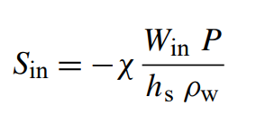
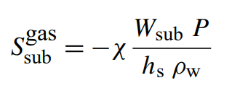

Wet Deposition
Parametrization
Based on [Simpson et al., 2012]. We distinguish between in- and sub-cloud scavenging.
Mixing ratio
Precipitation rate
Scavenging ratios W_{in}, W_{sub} are specified in XML file and are listed in Table S20 of [Simpson et al., 2012]
Water density
Scavenging depth, assumed to be 1000 m
Switch to activate wet deposition for given tracer
Scavenging ratios
Corina Keller

Slide 6
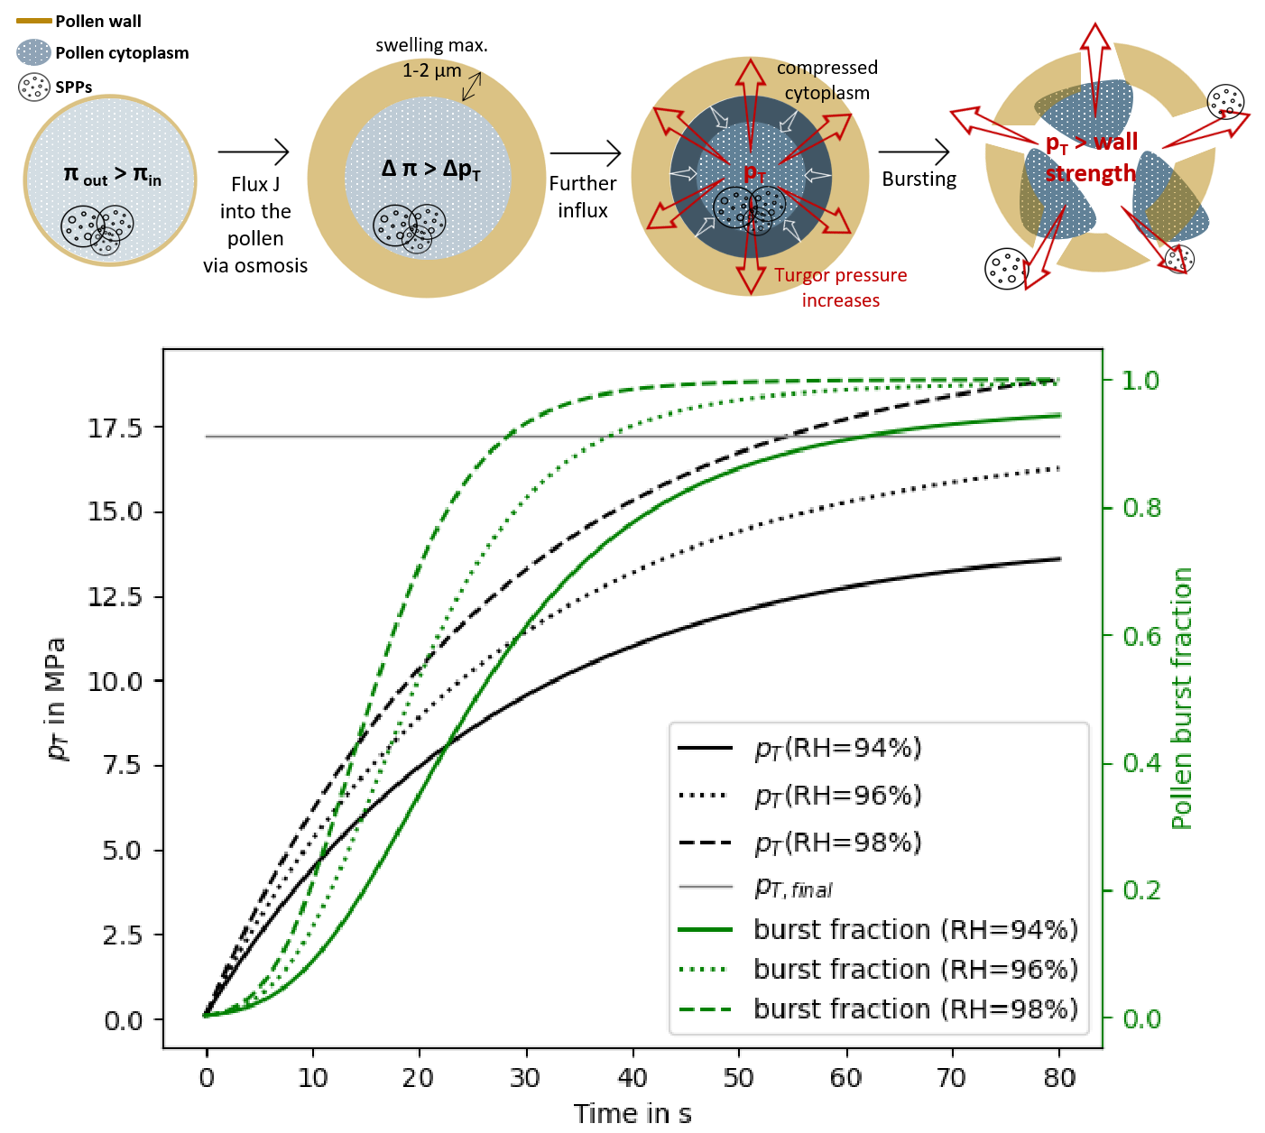
Pollen bursting & subpollen particles (SPPs)
High relative humidity (RH) triggers pollen grain bursting.
Higher RH → faster bursting & more grains affected.
~1,000 Subpollen Particles (SPPs) released per grain.
SPPs impact both human health & cloud processes (biological ice nucleation).
Zhou, 2014

Slide 7
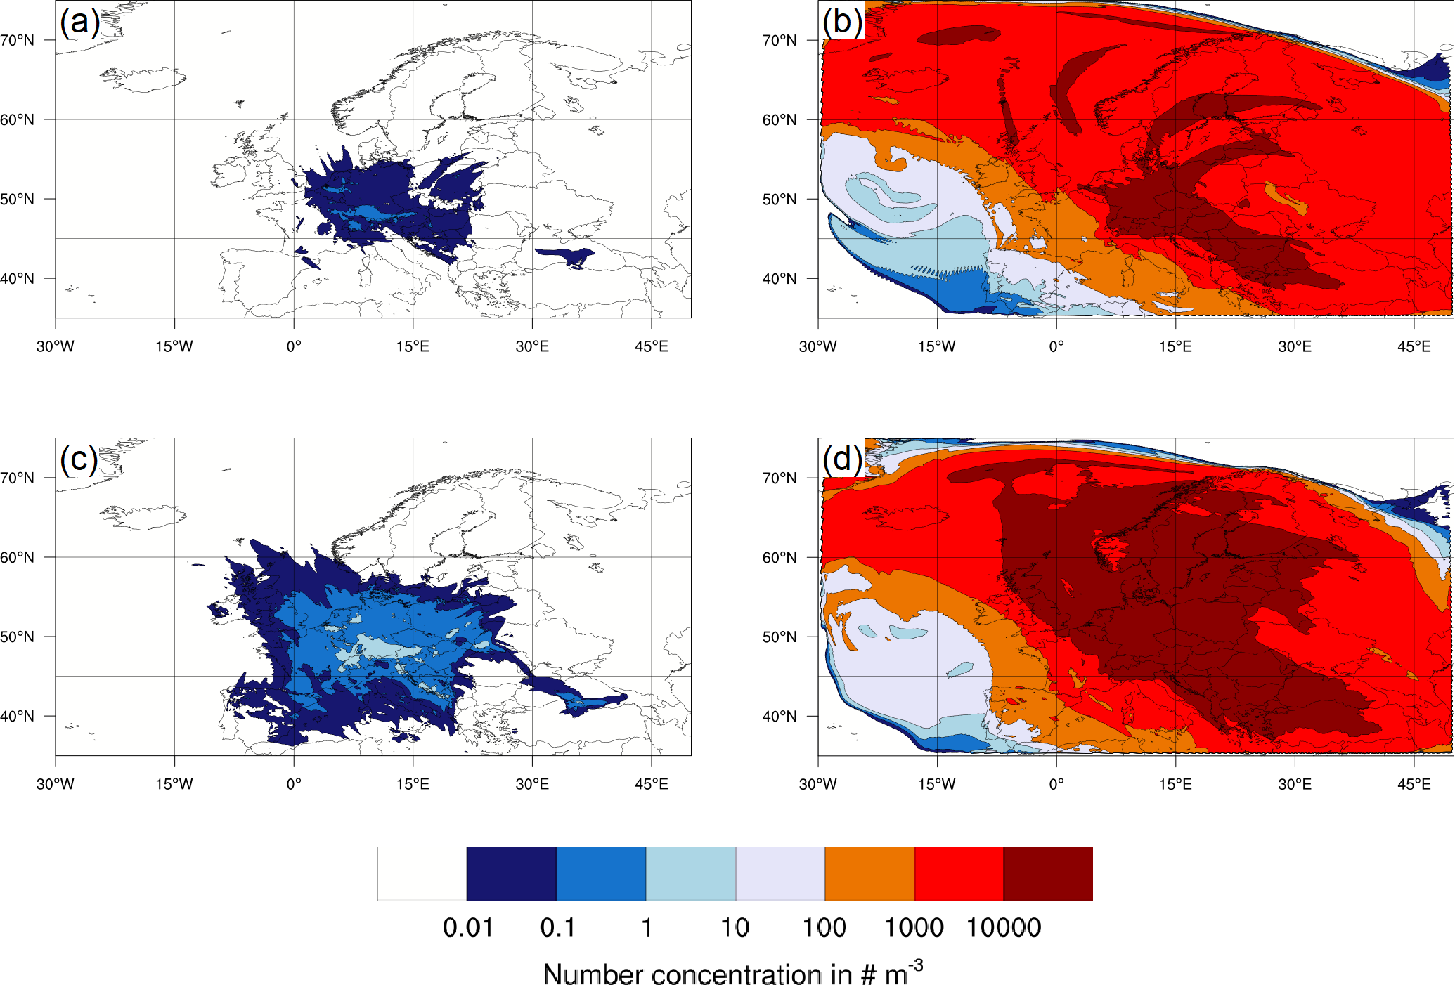
Pollen vs Subpollen on 29 March 2014
Birch pollen
SPP
H = 4000 m
H = 2000 m
Werchner et al. 2022

Slide 8
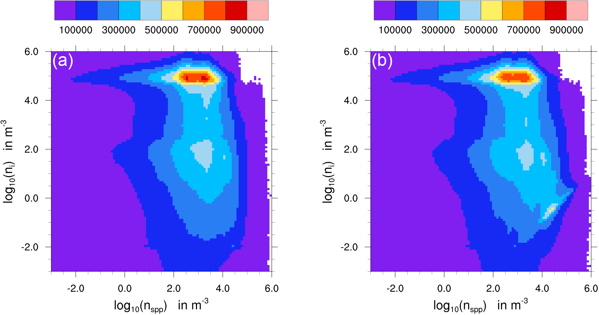
SPP as ice nuclei
w/o SPP as IN
w SPP as IN
Werchner et al. 2022

Slide 9
Prescribed aerosol optics in NetCDF database
Accelerated and consistent Mie code using python and C++ backend including standard workflow for generating new data.
Optical properties for prognostic (ecRad) and diagnostic (AERONET, satellite and lidar) calculations for externally (unmixed) and internally mixed aerosol.
Modularity and flexibility in choosing and adopting aerosol optical properties with the tag “lut_optics” in modes XML files. Example tags:
  dust_b nonspherical dust
  dust_b_mie spherical dust
  icoat15_dust_coa aged dust with 0.15×r inorganic coating
  ocoat15_dust_coa aged dust with 0.15×r organic coating

Slide 10
MieAI: fast and flexible online aerosol optics
Paper and repository published:
https://github.com/pankajkarman/MieAI
Implementation in ICON-ART completed.
Tests have been successful.
To be in OSR 2025.10
To be implemented in RTTOV in collaboration with DWD within a NWP SAF visiting scientist project

Slide 11

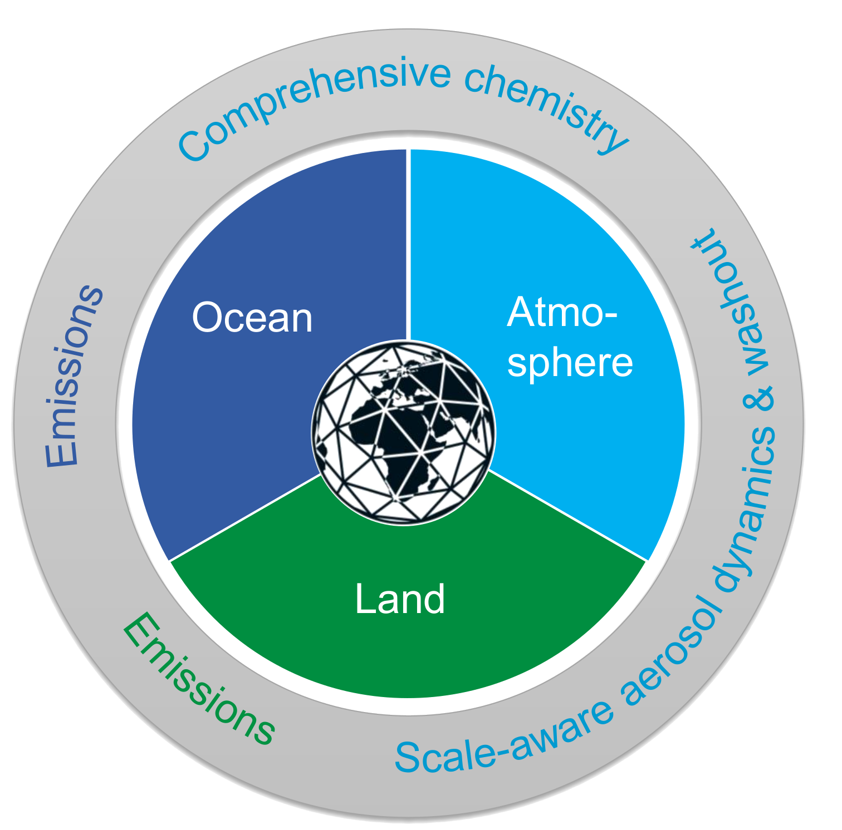

HErZ project (2023-2027)
Preparing ICON-ART for seasonal to decadal climate predictions in seamless regional to global model configurations → ICON-Seamless + ART = ICON-SmART
Emissions of natural aerosols and trace gases from fully coupled and interactive ocean and land modules
Comprehensive atmospheric chemistry (troposphere and stratosphere) → optimization and acceleration
ML-based and scale-aware aerosol dynamics and washout
Multi-year simulation with full chemistry and aerosol treatment
Presented at ICCARUS
Today’s focus

Slide 12
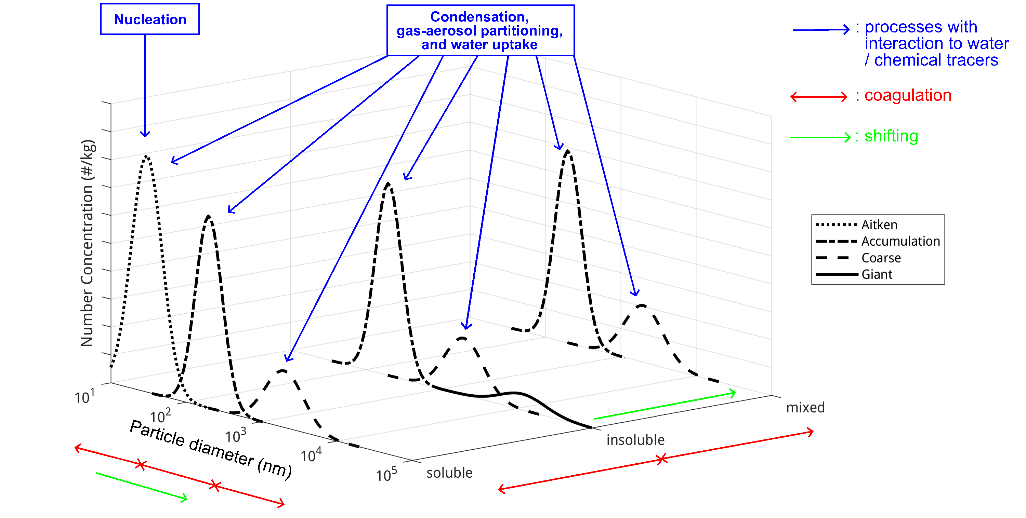
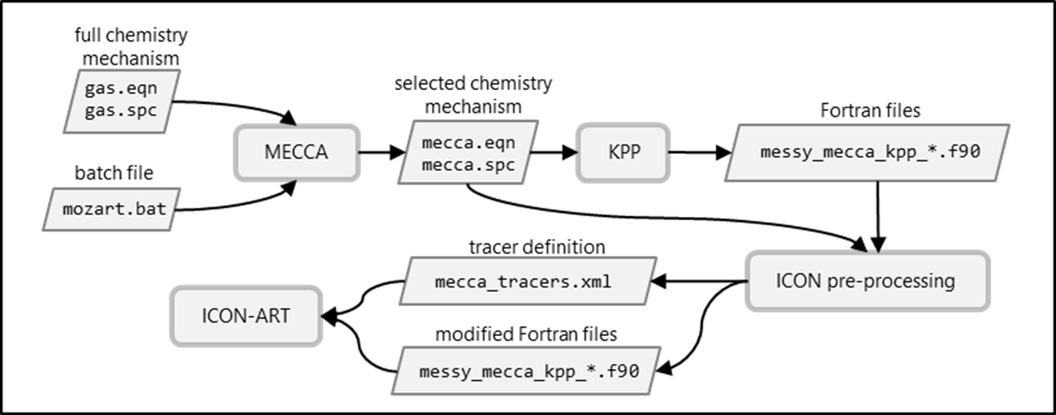

ICON-SmART: comprehensive aerosols + chem
Requires:
  Natural emissions → wildfires, dust, sea salt, DMS, biogenic with MEGAN
  Anthropogenic emissions → enable OEM for global and aerosol emissions
  Compatible chemistry (MOZART) and aerosol dynamics

Slide 13
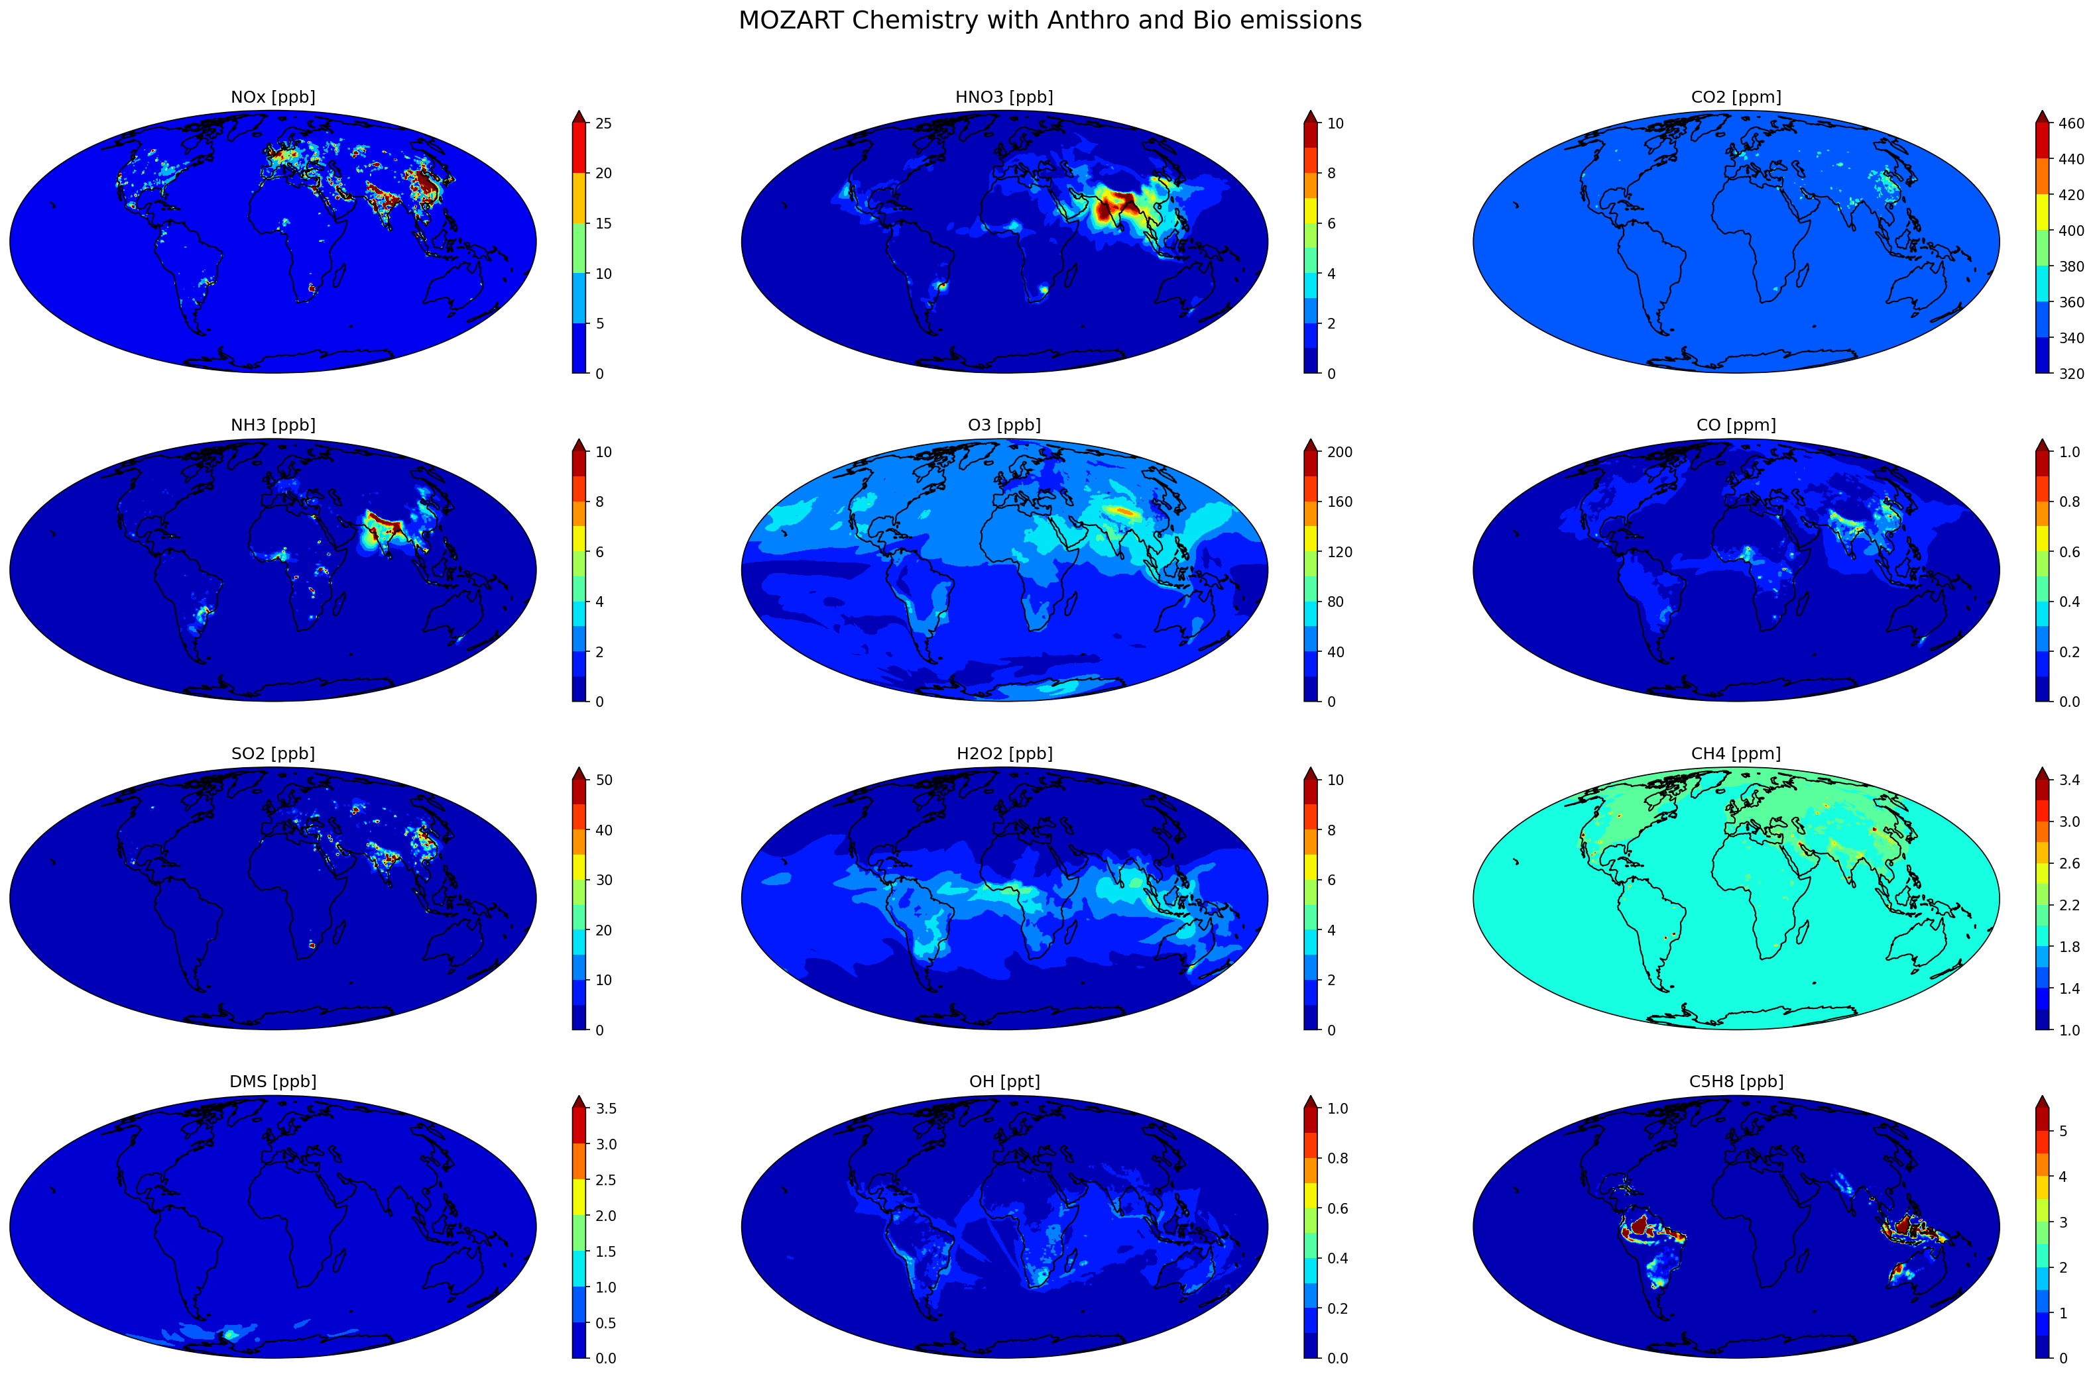
Preliminary results: 5-days average surface conc.
Sanhita Ghosh

Slide 14
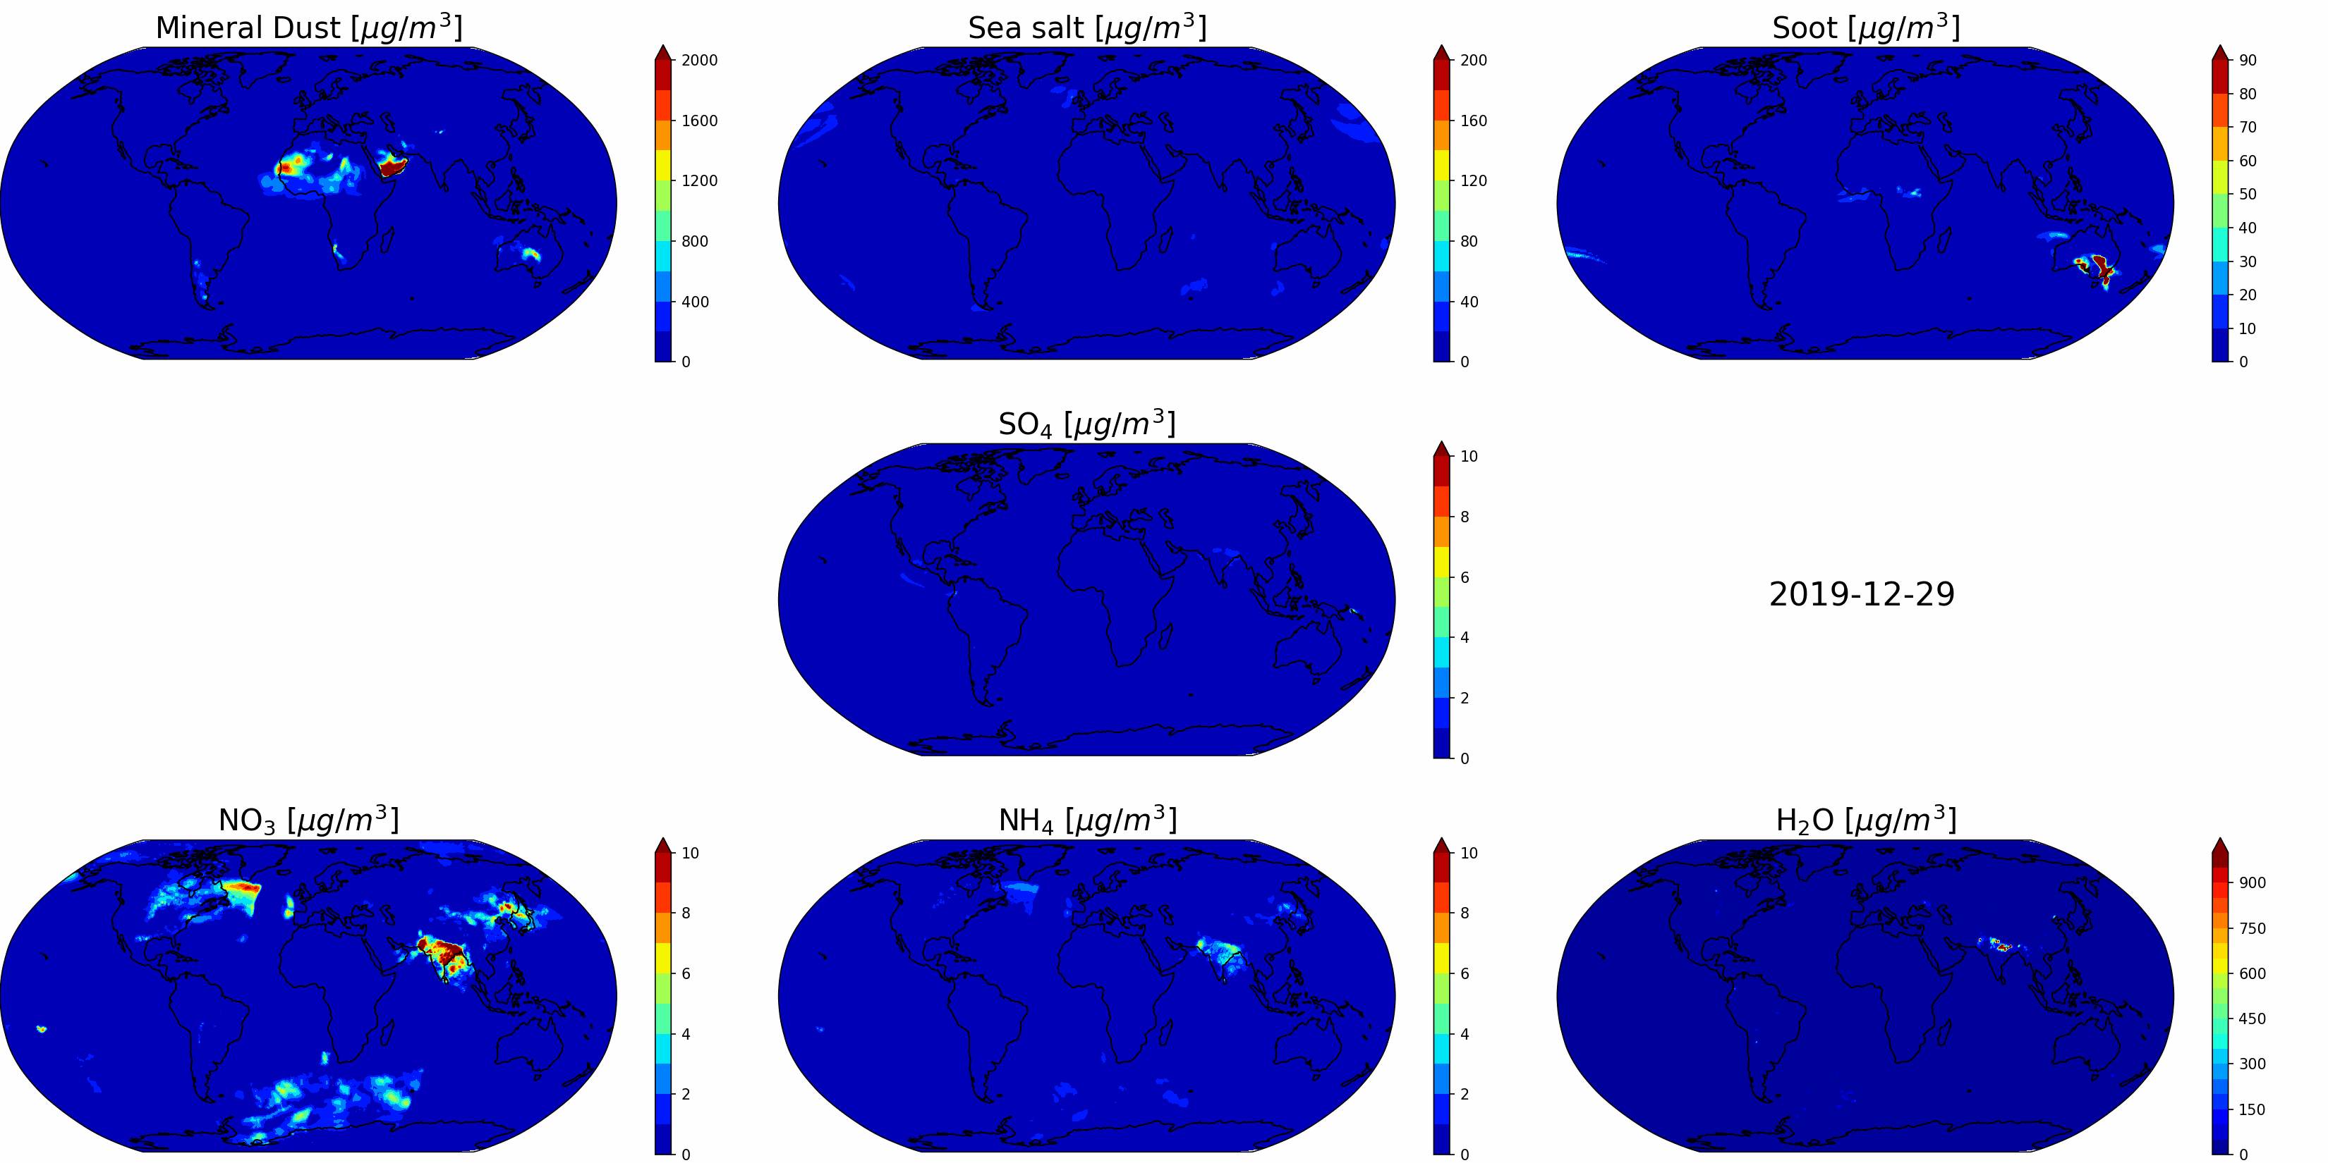
Preliminary results: aerosols
Evaluation and acceleration in progress!
Sanhita Ghosh and Pankaj Kumar

Slide 15
Community, support and training
ICON-ART training organized as a part of DWD-NatESM ICON training in July 2025 in Hamburg
Website including user guide: https://www.icon-art.kit.edu/
“ARTists forum” co-organized by KIT and EMPA 3-monthly meeting
New mailing list: icon-art-community@lists.kit.edu

Slide 16
: OSR 2025.10 (preliminary)
Coupling with dynamics
MieAI
CCN activation
OEM for global
Heat and moisture in BB plumes
  SmART Aerosol
  SOA parameterization
  SmART Chemistry

Slide 17
ICON-SmART: comprehensive chemistry
Requires:
  Natural emissions → e.g. wildfires, BVOCs with MEGAN
  Anthropogenic emissions → OEM extended for global applications
  Chemistry mechanism → MOZART (CAM-Chem) mechanism
  Species mapping …
Big thank to EMPA for the assistance!
Sanhita Ghosh, Florian Haenel

Slide 18
ICON-SmART: comprehensive aerosol
Requires:
  Natural emissions → wildfires, dust, sea salt, DMS
  Anthropogenic emissions → only aerosols, chemicals are re-initialized
  Chemistry (simplified)
  Aerosol dynamics
  SOA formation …

Slide 19
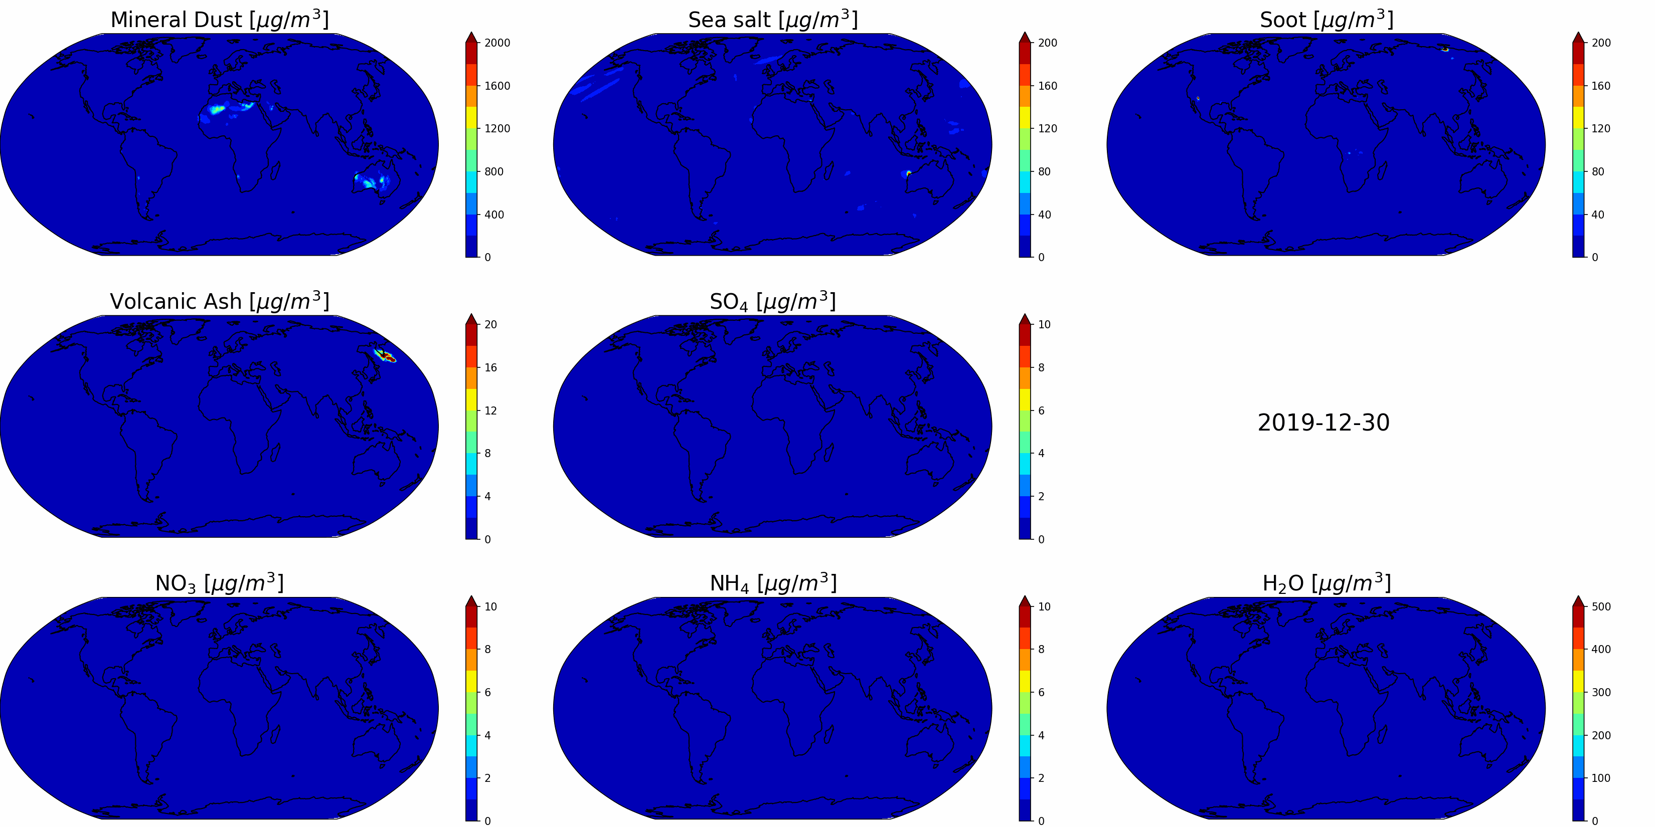
Preliminary results: aerosol surface concentrations
Pankaj Kumar

Slide 20
ICON-SmART: towards „fast“ chemistry and aerosols
Ongoing work:
  Natural emissions
  Anthropogenic emissions
  Efficient chemistry and aerosol dynamics
        Emulation of ISORROPIA and Cloud-J
        Using ~10 aerosol species instead of ~50
Relevance
keep the essential aerosol–radiation–cloud interactions that drive climate forcing
Consistency
remain traceable to detailed, physically based reference models.
Efficiency
reduce complexity to achieve feasible long climate simulations.

