Slide 1
WG Data Assimilation
Christoph Schraff
system developments and operational aspects
observations (from surface to clouds)
    radar (Z + Vr)
    ground-based GNSS ZTD + STD
    satellite radiances: all-sky IR WV + VIS FCI radiances; MTG IRS; MHS (MW Humidity Sounder)
    ground-based remote sensing (DIAL)
    crowd-sourced surface stations
KENDAscope wrap-up
AI-DA, re-analyses

Slide 2
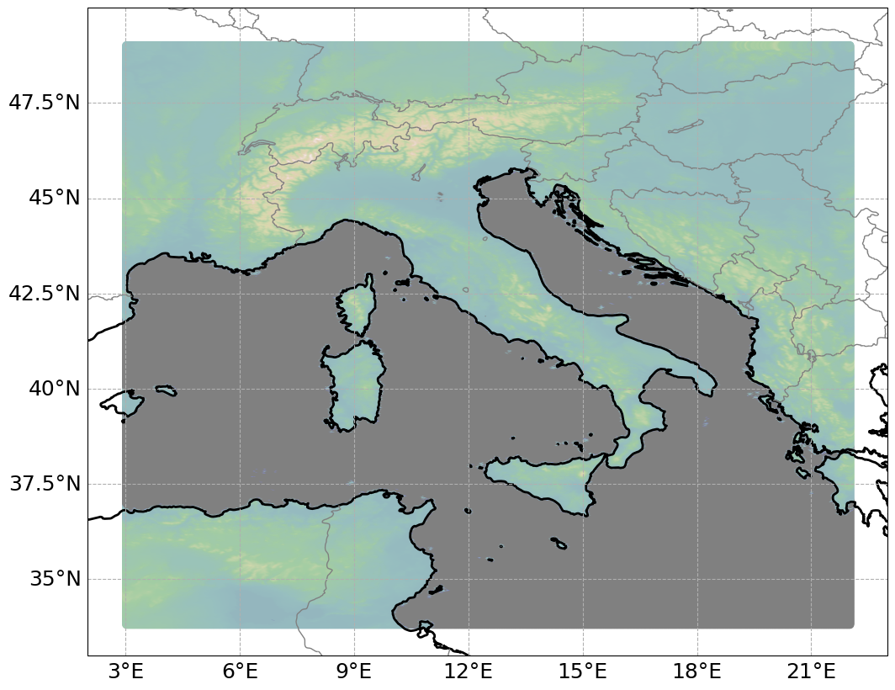

Towards 1 km resolution: 1.1 km tests (Virginia Poli, Thomas Gastaldo)
Model setup: 1.1 km resolution, 65 levels; same namelist employed operationally except for frcsmot: 0.2 → 0.0 (vertical smoothing of TKE; 0: no smoothing) and dt_gwd: 360 → 120.
ICON-1I domain
Evaluation over a 5-days period (16-20 Oct. 2024).
Three experiments compared:
CONTROL_2km: data assimilation and forecast using ICON-2I operational setup.
FCST_1km: forecast with ICON-1I initialized from CONTROL_2km analyses
DA+FCST_1km: data assimilation and forecast with ICON-1I; KENDA uses the same namelist as CONTROL_2km
A 24-h deterministic forecast is initialized every 3h (33 forecasts per configuration)

Slide 3
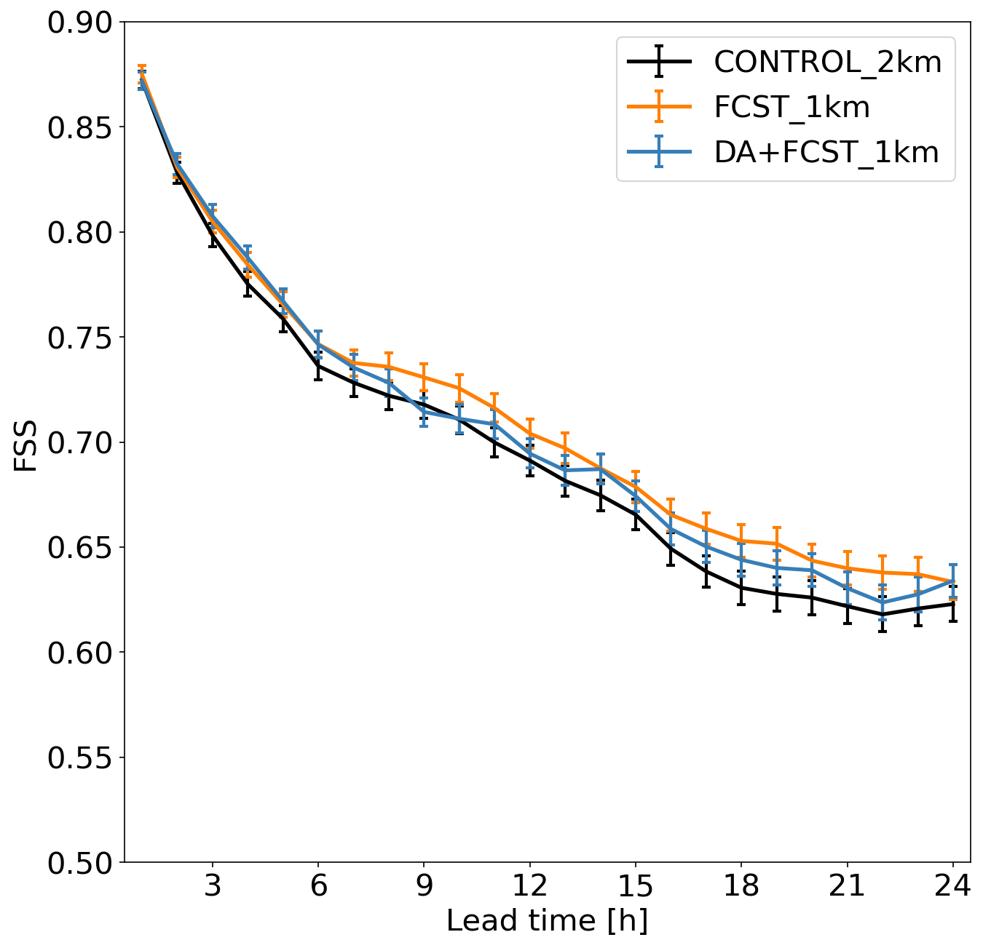
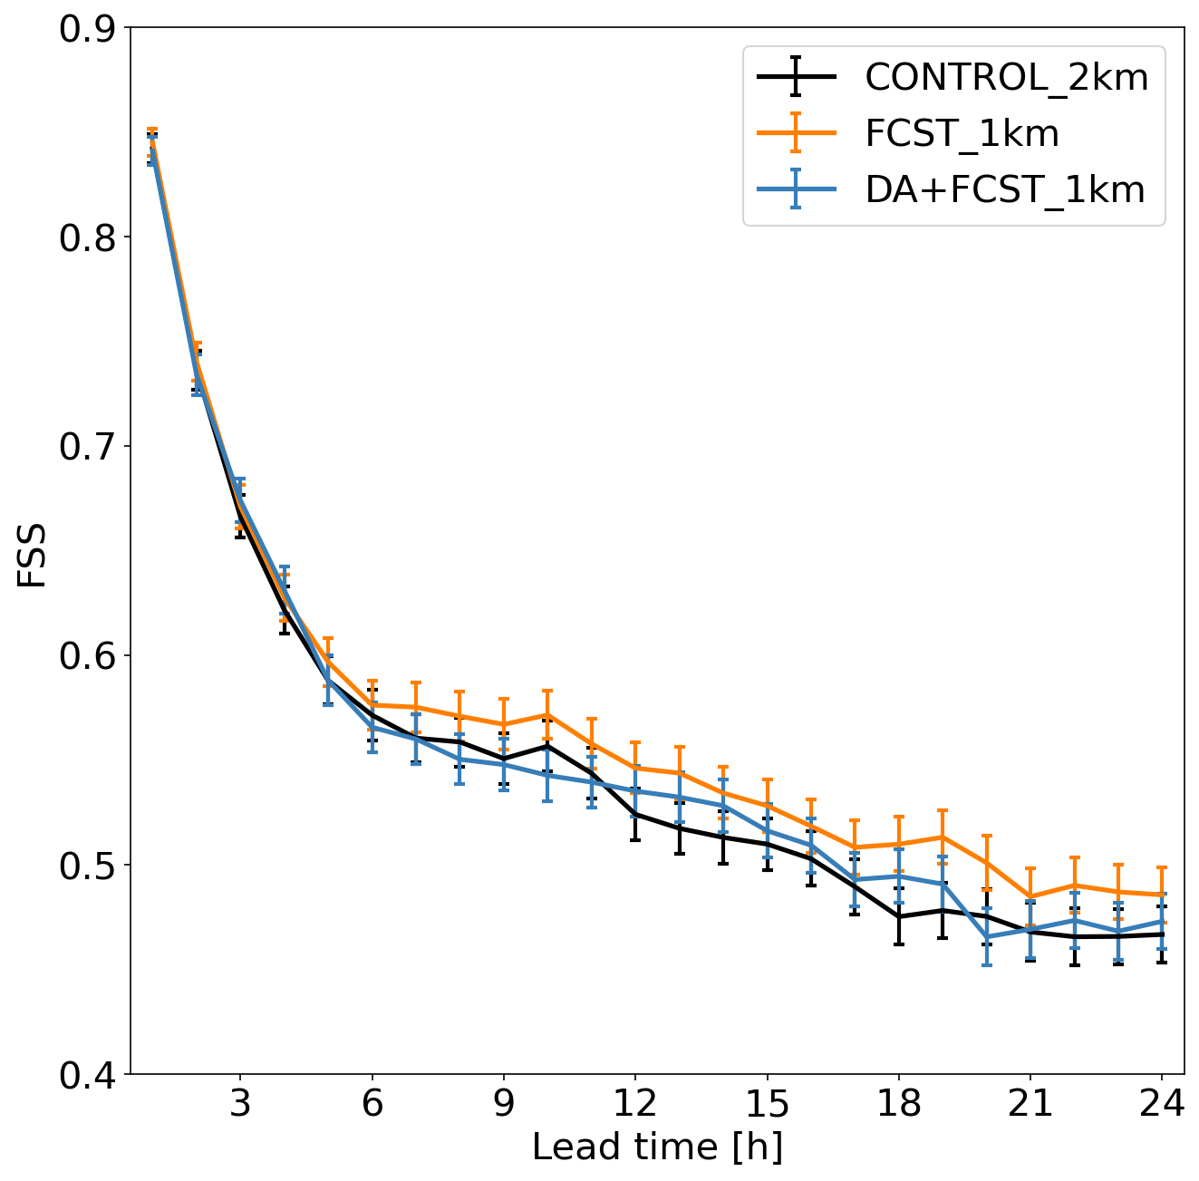
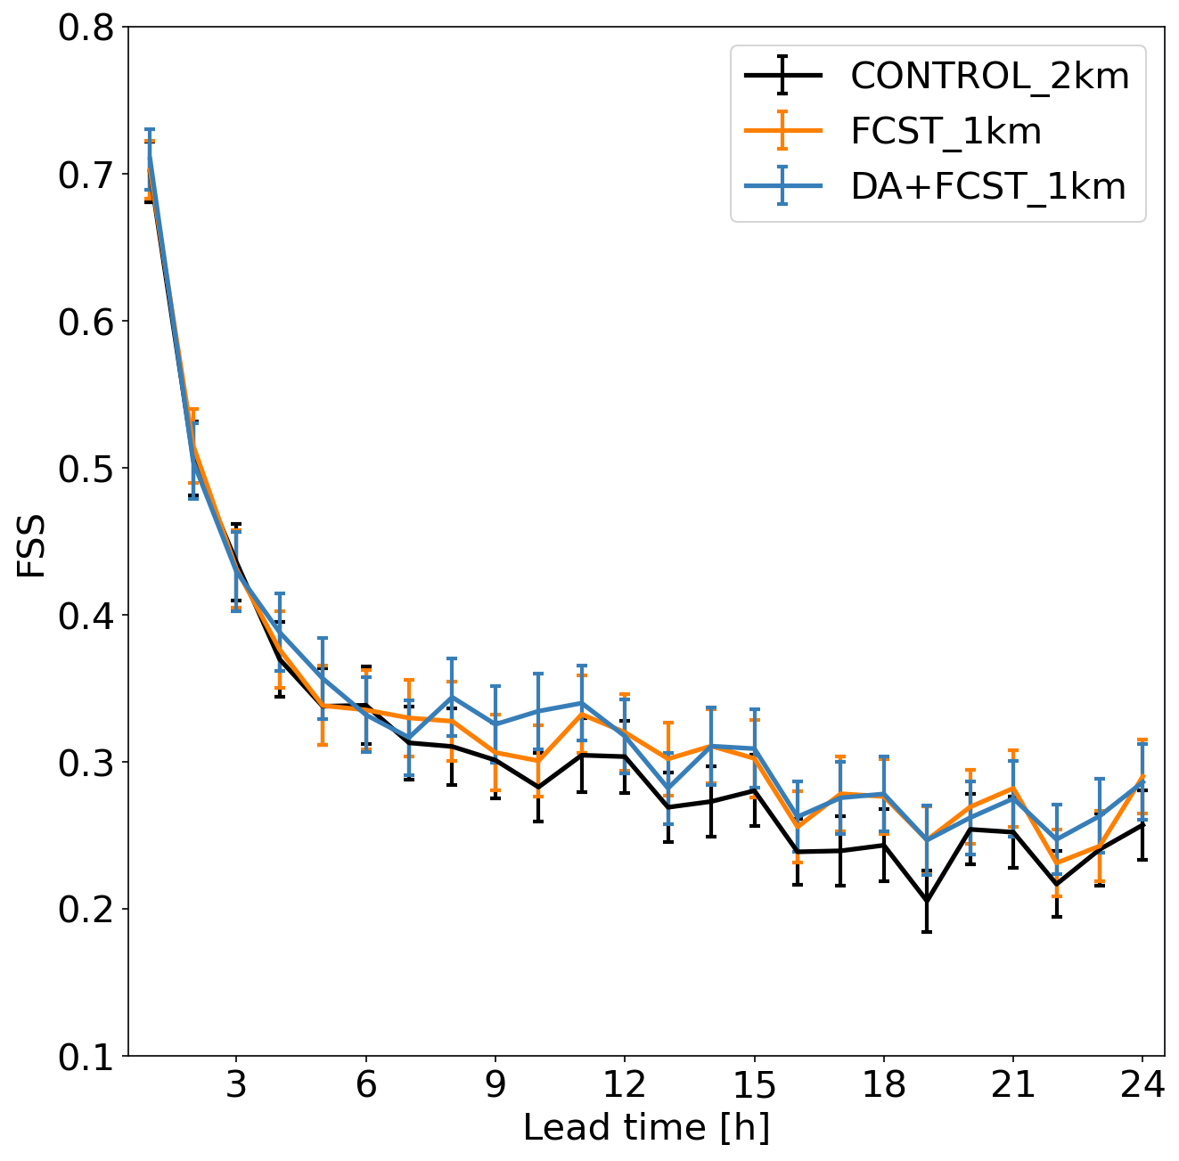
Towards 1 km resolution: QPF verification (FSS)
thr = 0.1 mm
thr = 1.0 mm
thr = 5.0 mm
Observations: hourly radar-estimated precipitation over Italy corrected with rain-gauges. Boxes: 0.2° x 0.2°

Slide 4
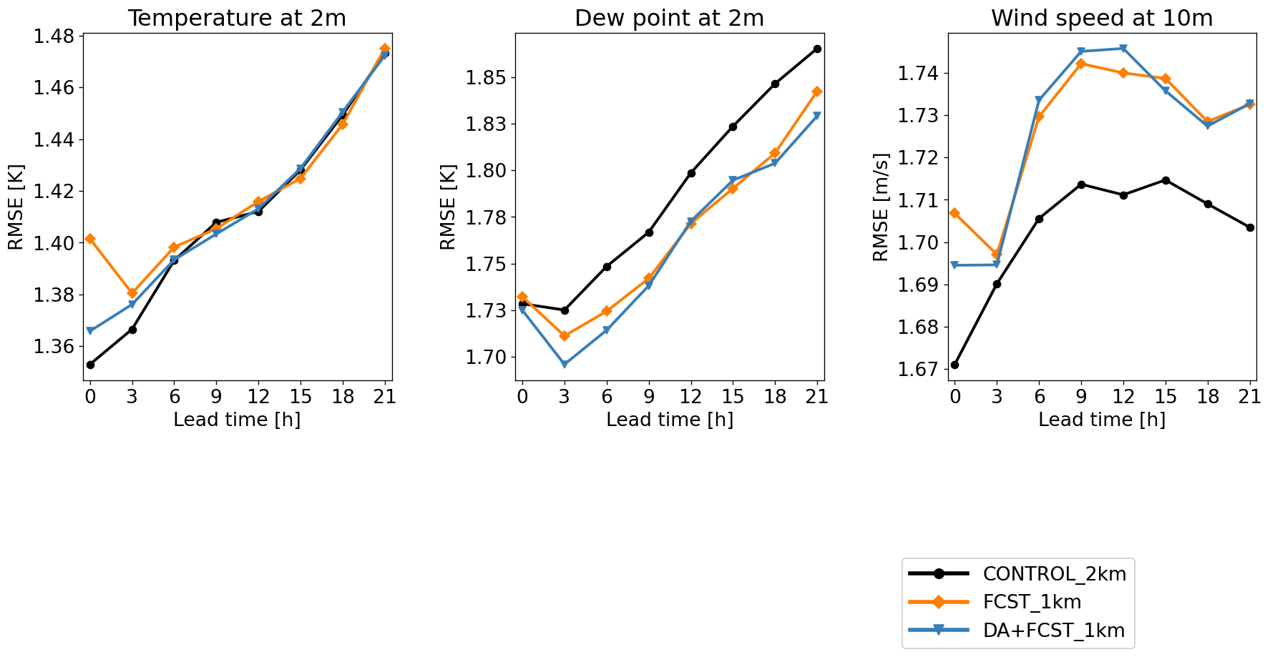
Towards 1 km resolution: near-surface variables
RMSE

Slide 5
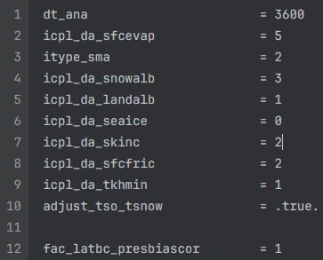
Adaptive Parameter Tuning in KENDA-CH1
APT uses time-smoothed analysis increments at lowest model level as predictor field
APT as at DWD,
except soil moisture & soil temperature
added as tuning parameters
(since the soil is unconstrained,
i.e. no nudging towards SMA-constrained
ICON-EU soil as at DWD)
Parallel KENDA-CH1 suite running since 15.05.25
new model setup
→ comparison with operational suite does not only show APT impact!

Slide 6
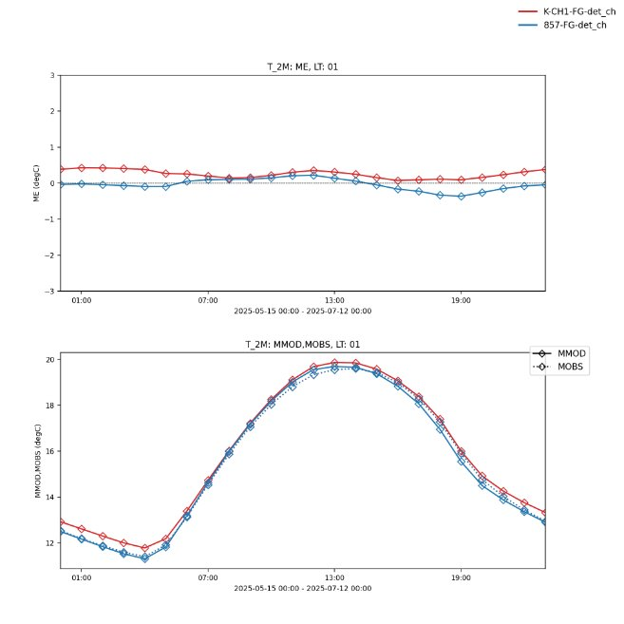
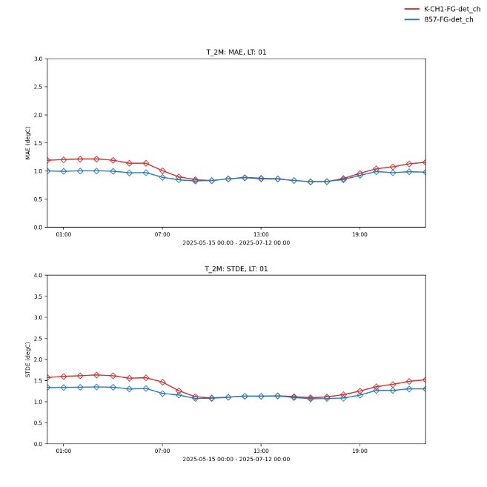
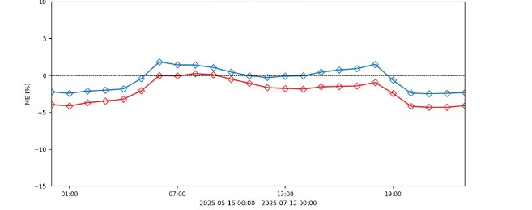
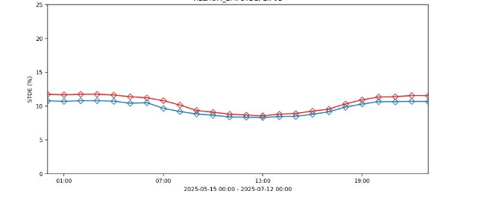
Adaptive Parameter Tuning in KENDA-CH1
Bias
STDDEV
APT
Reference
T2m
RH2m

Slide 7
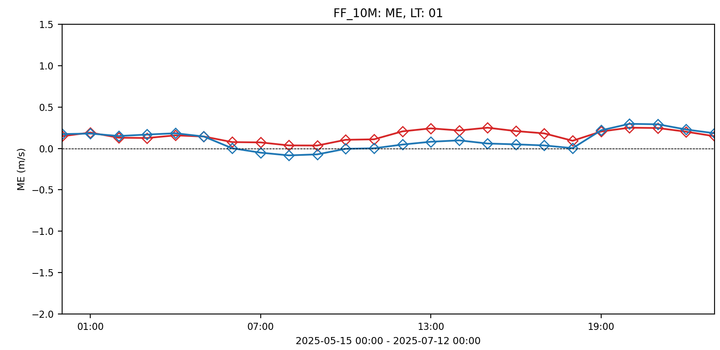
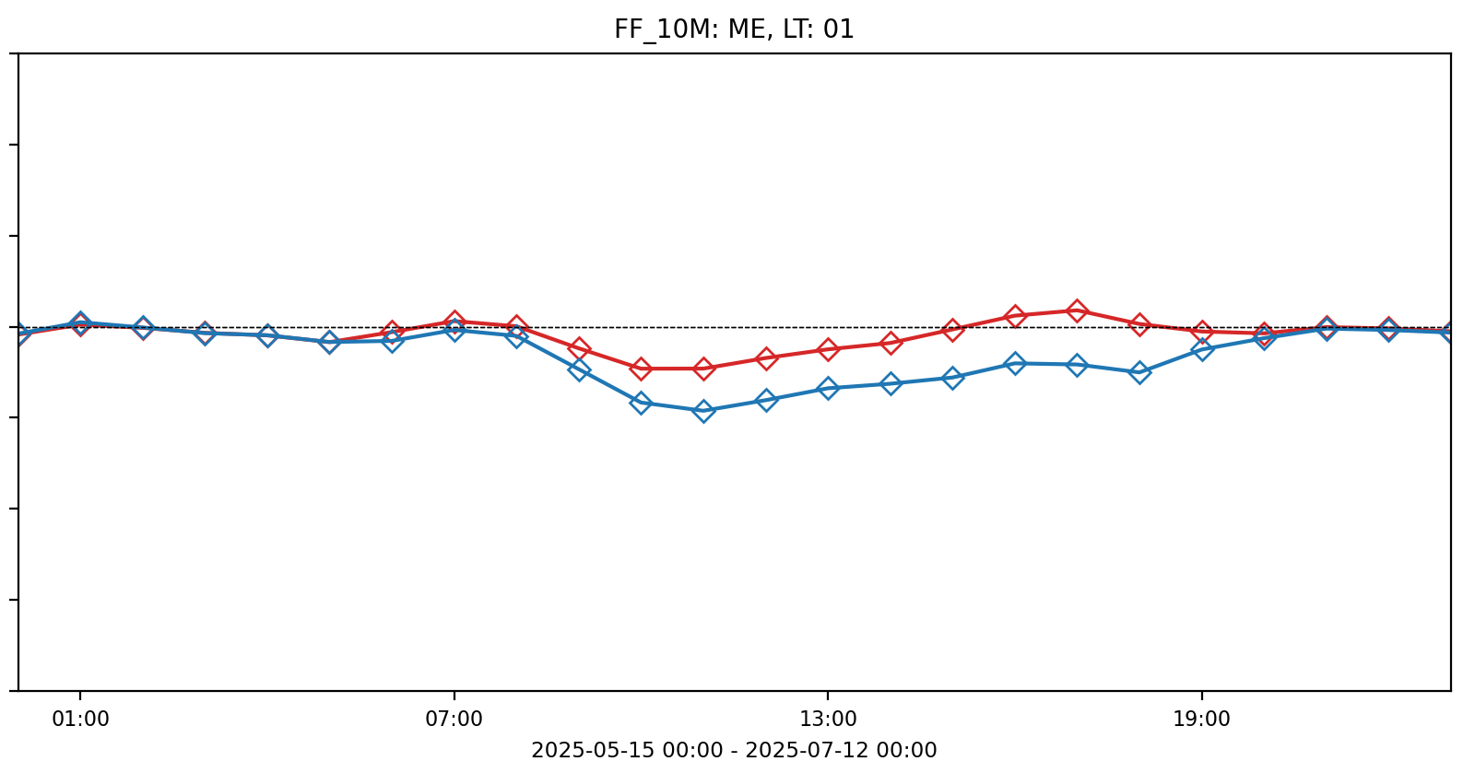
Adaptive Parameter Tuning in KENDA-CH1
Happy with T2m and RH2m tuning
Tuning of wind requires more attention, particularly in complex terrain
Swiss Plateau
Alpine Valleys
Bias
Station selection for 10-m wind:
Alpine + slope station may influence
Surface friction parameters in Valleys(?)

Slide 8
DA activities at DWD
Considerable resources from DA staff diverted to AI: AICON, AIDA
considerable less development on conventional DA / KENDA
(particularly algorithmic development – refinements LETKF; EnVar, 4DEnVar, PF, …)
however: restart of “code-redesign” (replacing DACE) which should now meet requirements of both
conventional DA (VAR, LETKF, for various applications: atm., ocean, surface, trace gases etc.)
and AI-DA (will take several years)

Slide 9
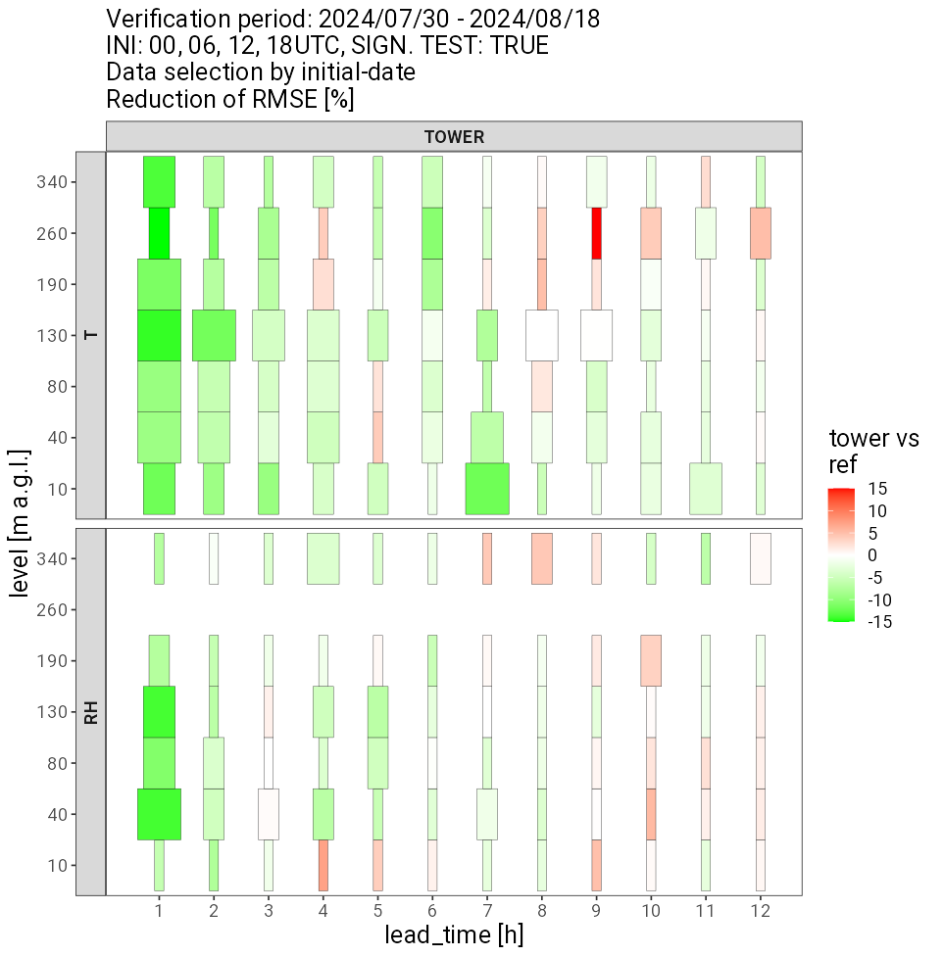
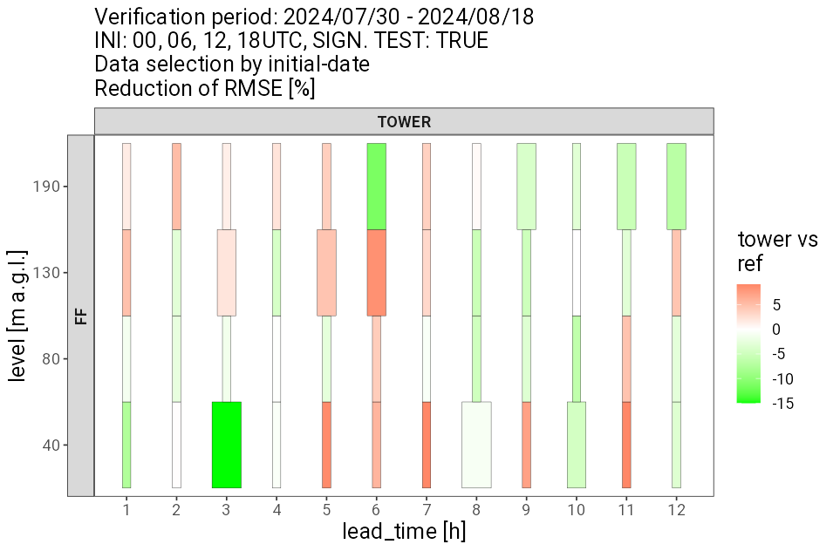
operational LETKF
Hendrik Reich, Harald Anlauf, Christoph Schraff et al
tower vs. ref:
RMSE
some technical + operational aspects
MEC: DA + verification, options for (required for ICON-D05) :
  use of model diagnostic 10-m wind
  instead of wind at lowest model level
  global radiation on horizontal plane
  including orographic shading
DA of 9 ICOS towers operational Feb. 2025
(100 – 340 m high)
ongoing work on WIGOS station ID in KENDA
(COSMO operators)
DE
T
summer (30.07. – 18.08.24)
RH
wind
speed
IT

Slide 10
Task 2: Observations (surface to clouds)
3-D radar reflectivity + radial velocity
Klaus Stephan, Uli Blahak, …
DE
parallel scanning of fof files implemented in LETKF (reduces cost from ((# radars/fof) * 2.5 s) ≅ 1 min to only 3 – 4 s)
→ will allow to use far more European radars
→ Feb. 2025: use all instead of only 9 French radars operationally
radars from (almost) all countries in ICON-D2 can be processed technically
IT

Slide 11
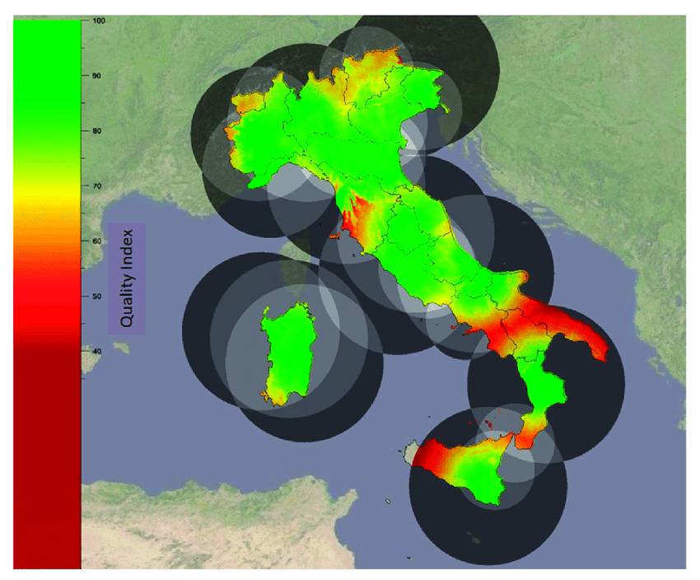
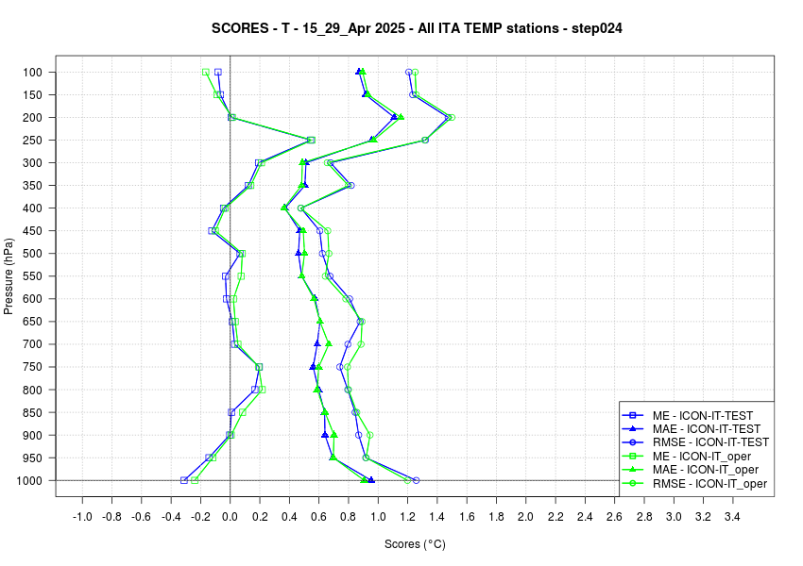
Assimilation of RADAR polar volumes in ICON
DA of radar reflectivity operational since August 2024 (No LHN)
DA of radar radial winds operational since August 2025 (No LHN)
upper-air temperature verification vs radiosonde
12h step
Plan 2026: test LHN + radar polar volumes within ICON

Slide 12
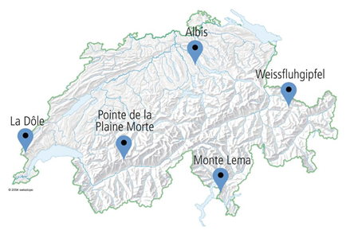
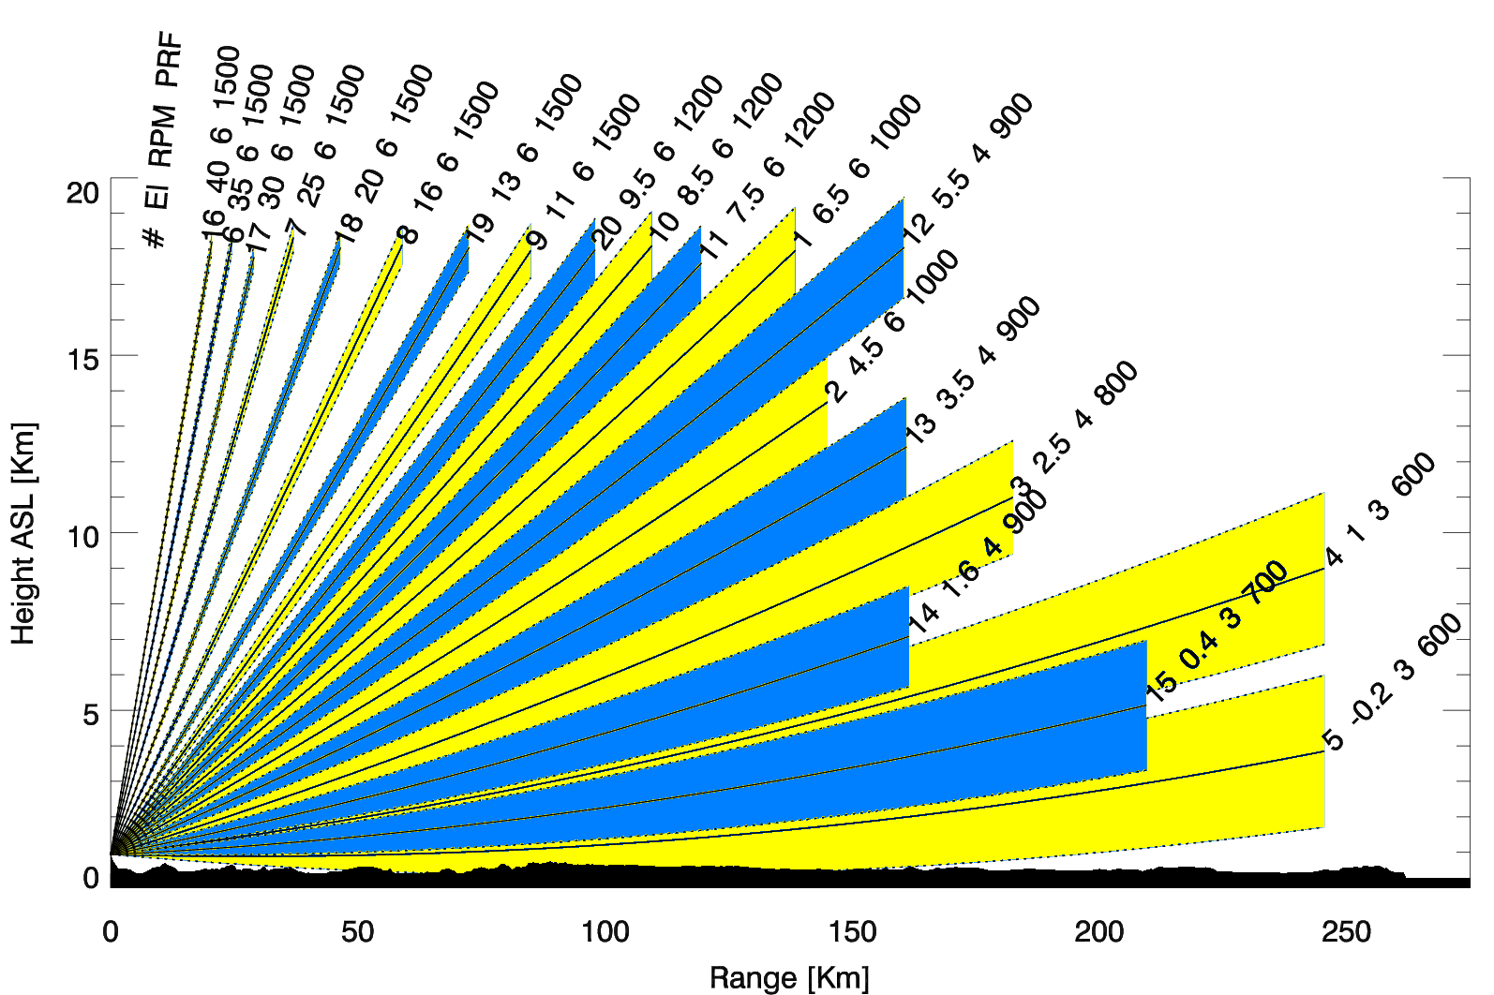
Assimilation of Radar Data in KENDA-CH1
(Alina Yapparova, Claire Merker)
Summer period with diurnal convection (01.06.2023 00 UTC - 14.06.2023 12 UTC)
KENDA-CH1 (1-hrly) and
ICON-CH1-EPS (every 12h +48h)
3D radar reflectivity assimilation + LHN:
  5 lowest elevations, 0 to 9000 m;
  obs and sim < 10 dBZ are set to 10 dBZ;
  QC: obs pre-processed with freq. maps (threshold = 3);
  5 km superobbing;
  const obs error of 10 dBZ

Slide 13
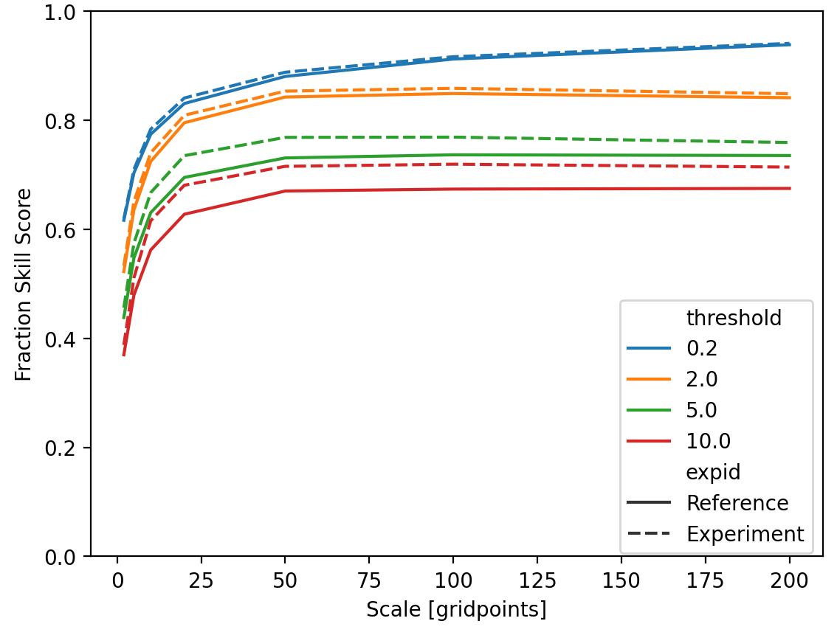
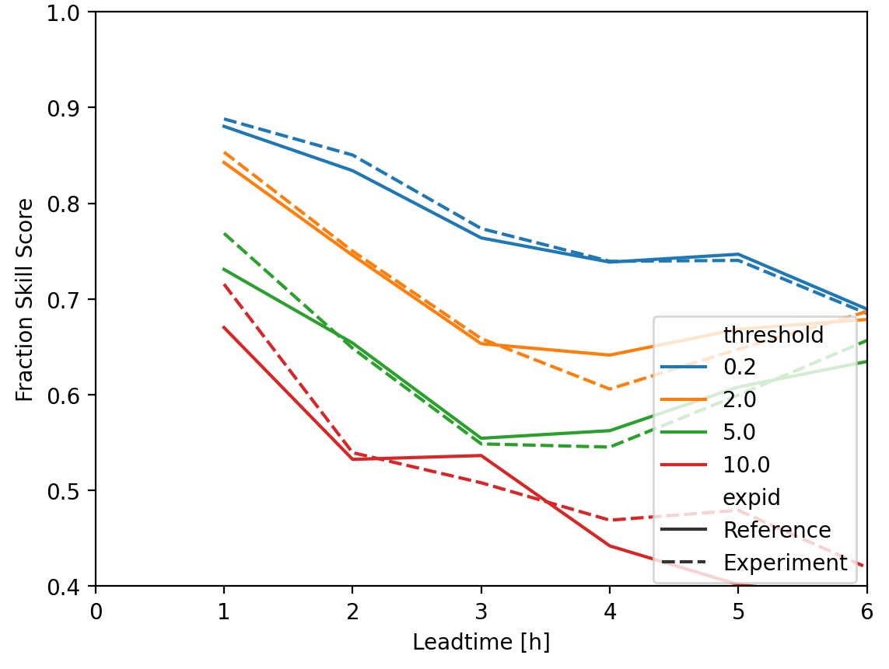
Assimilation of Radar Data in KENDA-CH1
Spatial Verification against Combiprecip
Lead time +1h
Scale 50km

Slide 14
Ground-based GNSS ZTD + STD
Michael Bender
DE
postponed, due to work on satellite implementation, then wind lidar & general obs monitoring
→ steps to make GNSS ZTD + STD operational:
  most important: replace overall one-value for ZTD obs error (12 mm, scaled for STD acc. to elevation) by station & product dependent obs error variances (as is already done for bias correction), which
    based on (1) O – B, and (2) least-square error info from data producer (contained in BUFR)
    can be as small as 6 mm (→ larger weight of obs)
    have been a very important aspect at other NWP centers
  tuning of vertical & horizontal localization (and horizontal positioning of STD),
IT

Slide 15
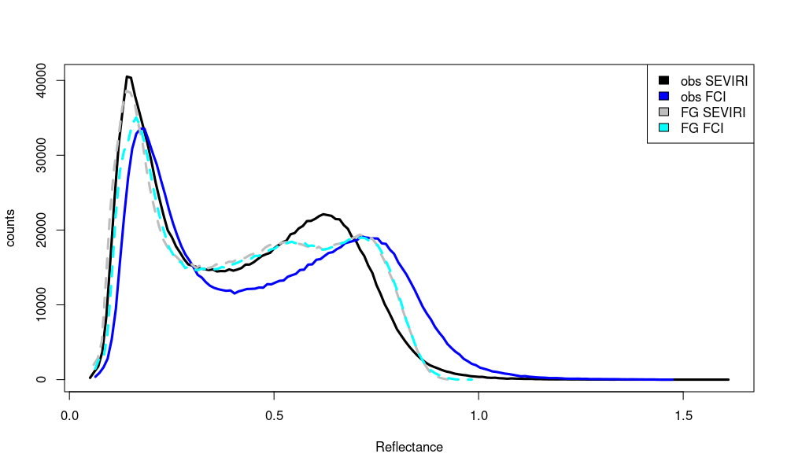
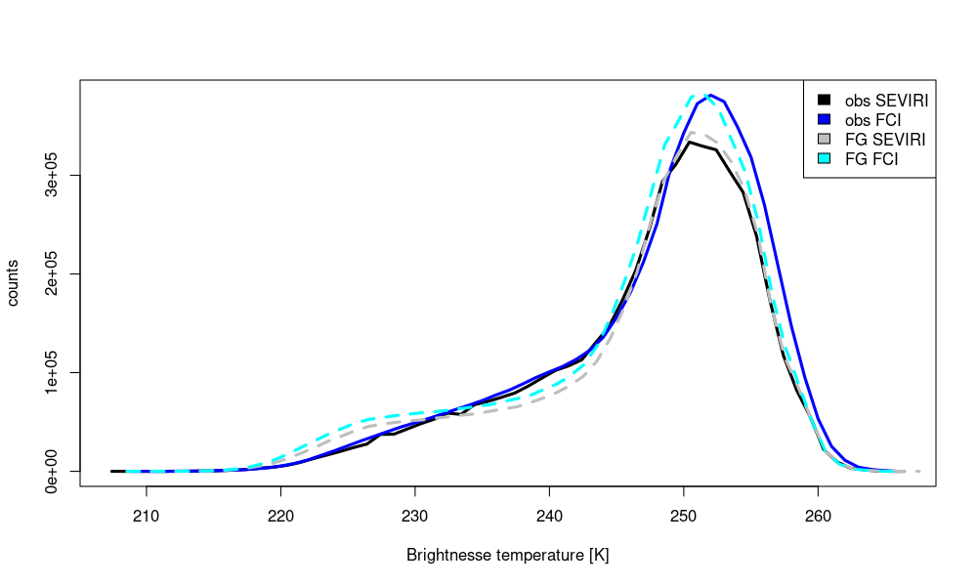
All-sky (SEVIRI → ) MTG FCI IR WV + VIS data
Annika Schomburg
monitoring: comparison to SEVIRI: 2D images, time series of RMSE + bias, histograms
VIS
  FCI has larger biases than SEVIRI
DE
10 – 31 Oct. 2024 (FCI passive)
IR WV
7.3 µm
reflectance
IT
BT [K]

Slide 16
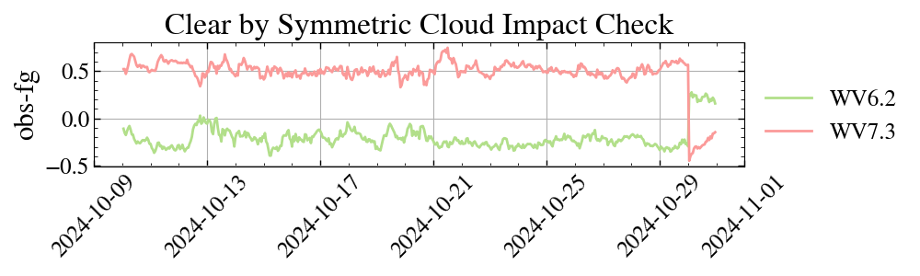
All-sky (SEVIRI → ) MTG FCI IR WV + VIS data
Annika Schomburg
→ need bias correction based on clear-sky cases, also in order to use clear-sky WV info well
clear-sky screening for bias correction by symmetric cloud impact check: FG_{all-sky} – FG_{clear} , Obs – FG_{clear} (for SEVIRI also: NWC-SAF cloud mask): implementation, tuning, evaluation (by Mahdiyeh Mousavi)
DE
uncorrected obs
time series 8 – 28 Oct. 2024 (passive FCI monitoring exp.)
→ bias (Obs_{orig} – FG) and (Obs_{bcor} – FG) found sensitive to symmetric cloud check in experiment,
|Obs – FG_{clear} | < threshold implies FG check!
→ this needs to be replaced by NWC-SAF cloud mask for clear-sky screening (for QC & BC)
IT

Slide 17
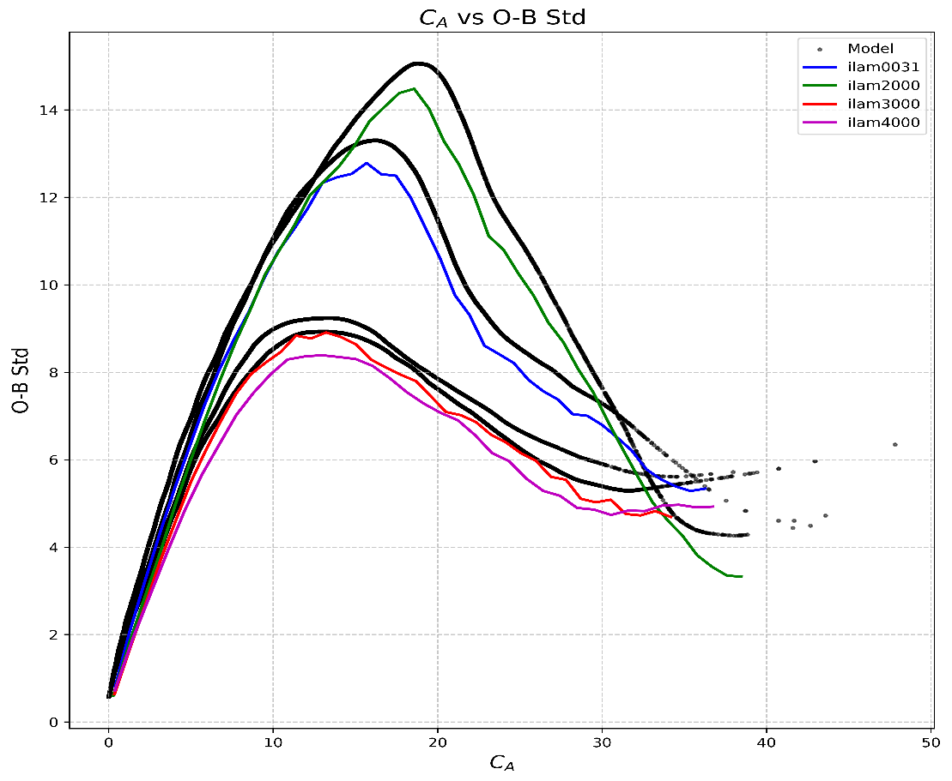
All-sky (SEVIRI → ) MTG FCI IR WV + VIS data
Annika Schomburg
Further steps:
re-train observation error model
(based on observation impact) for FCI
→ O – B for FCI very dependent on season(?)
or probably more on cloud type
(stratiform, convective)
run and evaluate
active assimilation experiment
(i.e. FCI active, SEVIRI passive)
Aug - Sept
June
January
January
IT

Slide 18
MTG IRS (hyperspectral IR sounder)
Mahdiyeh Mousavi, Christina Köpken-Watts, …
‘clear-sky’ assimilation of IRS (Mahdiyeh Mousavi, Christina Köpken-Watts)
temperature + humidity profile information (clear-sky, above clouds)
(e.g. to improve pre-convective environment)
MTG IRS launched in summer 2025, data in ~ 2026
→ IRS data for testing: simulated ‚obs’ (with RadSim) into fdbk file
real-data IASI, SEVIRI as proxy for IRS;
technical test in KENDA successful
simulated IRS obs – channel 59
(20200802, 1UTC)
ICON-LAM: mostly land → use of IRS observations over land
→ use surface-sensitive channels for analysis in middle + lower troposphere
  improvement of land surface emissivity → employ IR emissivity atlas (instead of constant values)
  skin temperature (model FG not good enough) → skin temperature retrieval from channels strongly
  sensitive to the surface (by inversion of radiative transfer eqn.)

Slide 19
MTG IRS (hyperspectral IR sounder)
Mahdiyeh Mousavi, Christina Köpken-Watts
cloud detection & adaptive bias correction: used in global EnVar for IASI, but major adaptation for…
– ICON-LAM (low model top → extension of FG with global fields for cloud detection) and
– KENDA (cloud detection + bias correction within ICON ensemble members)
(ongoing and) future work (a.o.; little resources available):
parallel obs processing in LETKF required for non-diagonal observation error covariance matrix R:
first version implemented, further technical tests to be done; R also needs to specified!
revisit channel selection (e.g. up to which height)
tests on thinning, height assignment, localization, …
code optimization needed for IRS assimilation with many channels (pre-thinning etc.)
option: assimilate all-sky IRS using clear-sky R (Okamoto)?
also important: slant radiative transfer, 4D-EnVar (for indirect wind info), horiz. obs error correlations

Slide 20
Satellite DA: MHS (Marcello Grenzi)
Testing the assimilation of humidity-sensitive microwave channels from the Microwave Humidity Sounder (MHS)
3 channels peaking at different levels (lowest channel only over sea - experiments ongoing over land too)
Clear-sky only (cloud detection - Buehler et al. 2007)
No interchannel correlations and no bias correction applied
Model & KENDA setup same as the operational system
Two 5-days experiments in September 2022 (severe convection event), presented at ICCARUS:
Control (operationally assimilated obs.)
MHS (operational obs. + MHS)
Currently experiments with the addition of SEVIRI all-sky data are also running: evaluate the benefit of combining infrared and microwave radiances.

Slide 21
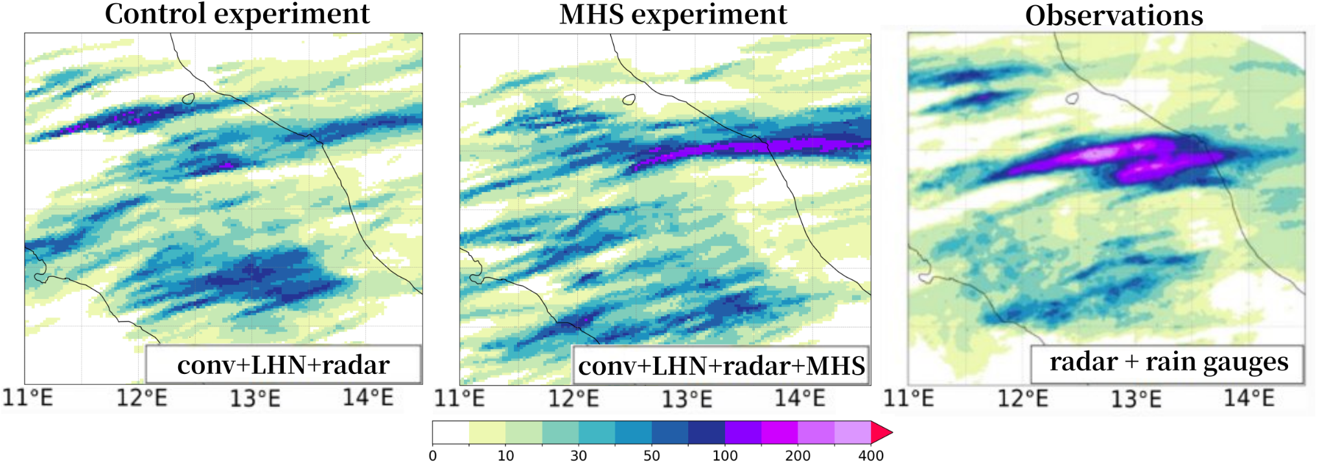
MHS assimilation: daily accumulated rainfall
mm
24h rainfall of 15 Sept. 2022 (forecast initialized at 00UTC), zoom over the area affected by the flood. MHS assimilation improves the forecast.

Slide 22
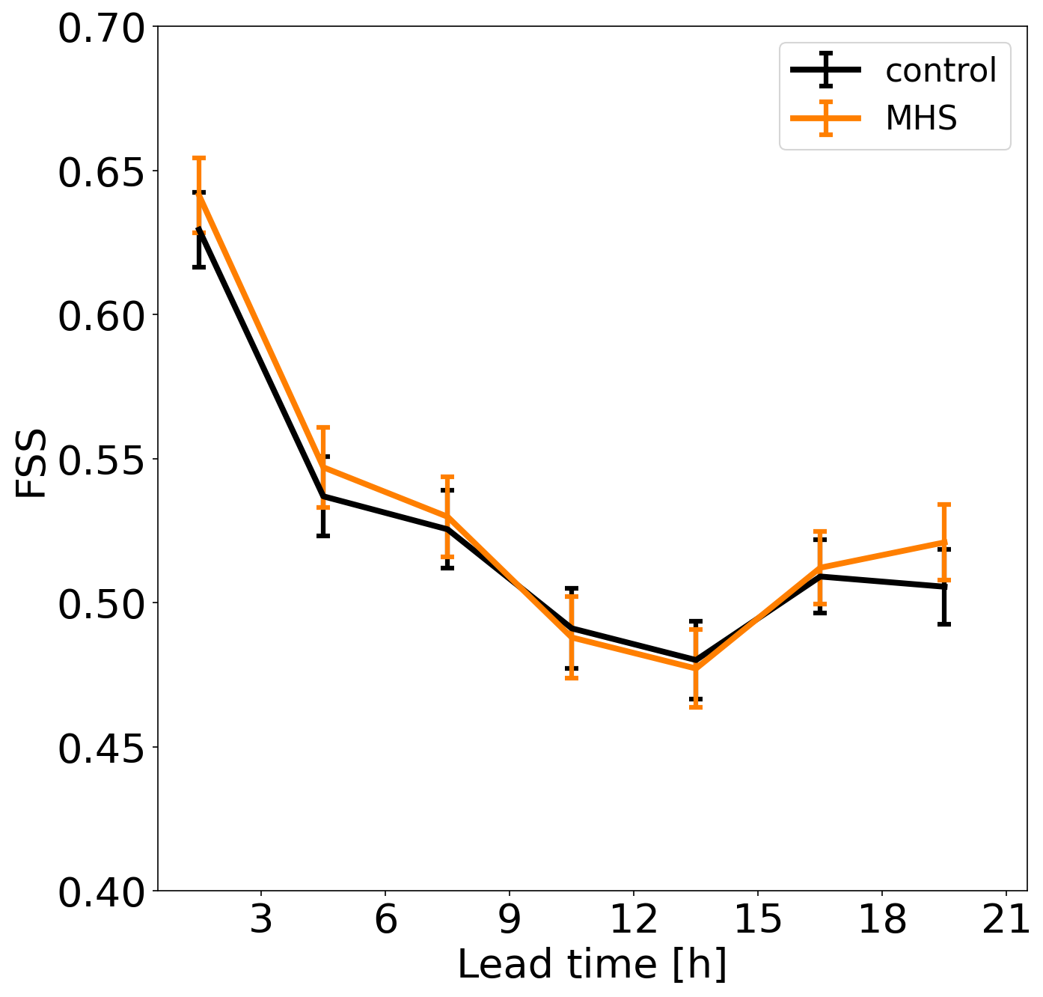
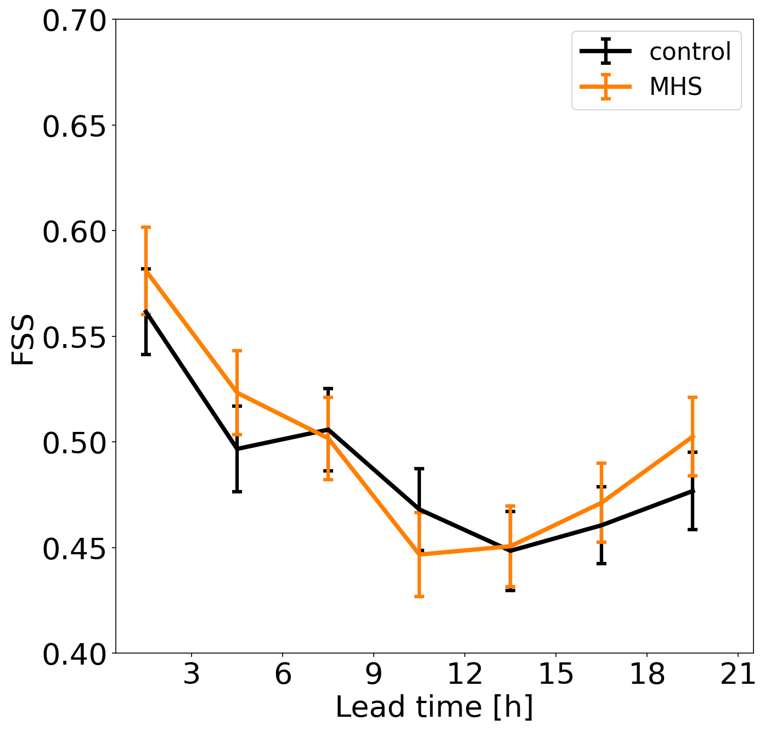
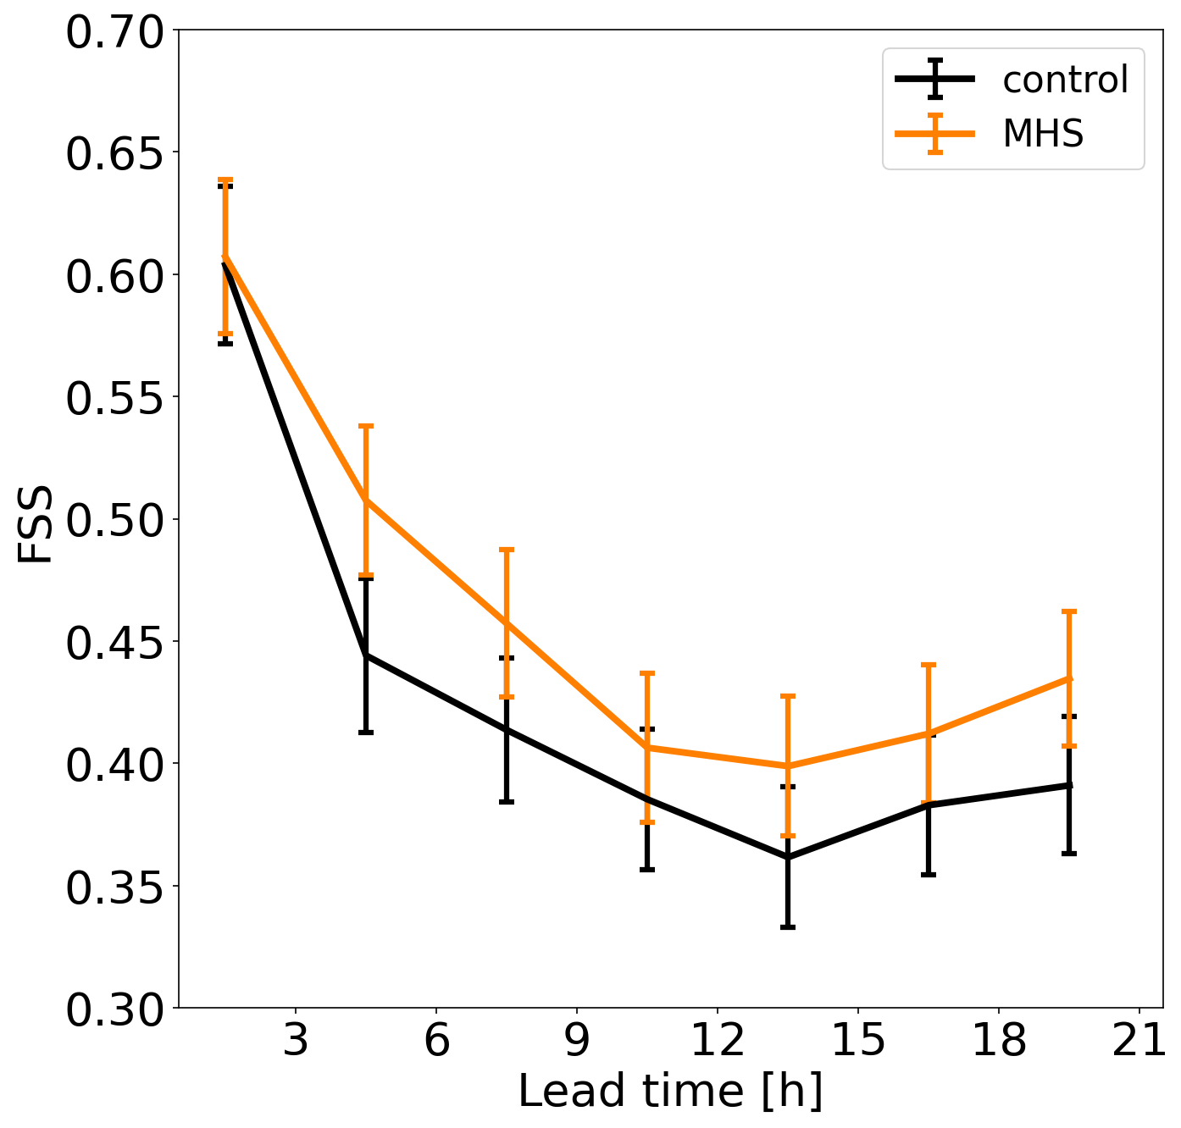
MHS assimilation: verification (FSS)
(~ 5 days)
thr = 0.1 mm
thr = 1.0 mm
thr = 5.0 mm
Observations: hourly radar-estimated precipitation over Italy corrected with rain-gauges. Boxes: 0.2° x 0.2°

Slide 23
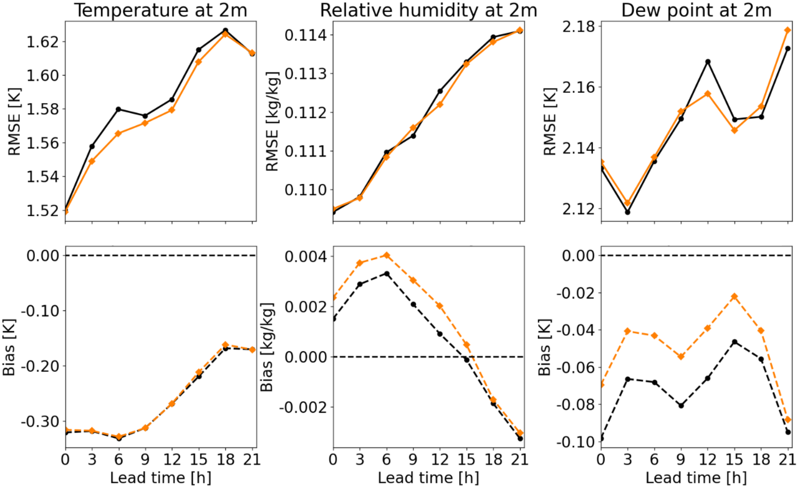
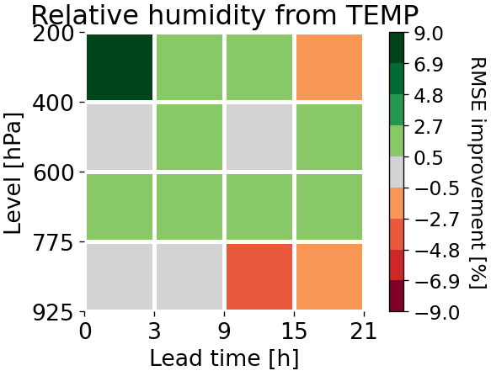

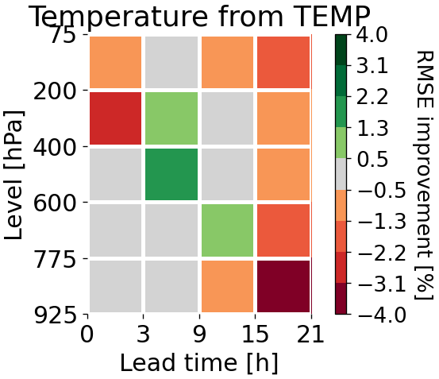
MHS assimilation: surface and upper levels variables
overall positive impact on surface variables & upper-level humidity (neutral on wind and pressure – not shown)
→ promising !
Positive values (green): MHS experiment better​

Slide 24
Satellite DA: ongoing activities (towards operationalization) (Francesca Vittorioso)
Pre-processing strategy under development
  Satellite data now received (since August) from EUMETSAT via the Terrestrial network
  As no satellite data assimilation is yet performed at ItaliaMeteo, the focus is on setting up a robust pre-processing chain
  Goal: ensure standardized, quality-controlled input data ready for future assimilation
Discussion with DWD on common approach
  Exploring the possibility of adopting or adapting the DWD pre-processor (sat_pp)
  Potential for joint documentation and knowledge transfer
  Opportunity to harmonize practices within the COSMO community, reducing duplication and facilitating interoperability

Slide 25
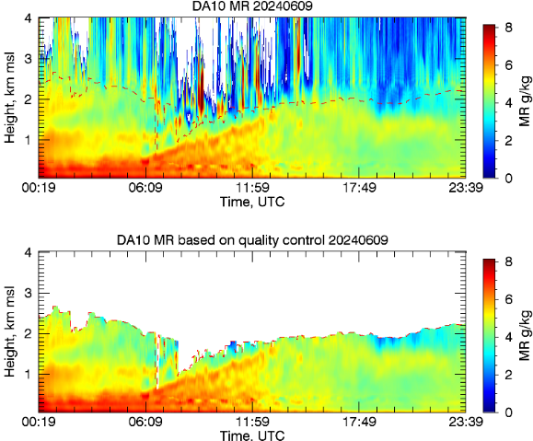
PBL profiler obs: DIAL (Differential Absorption Lidar)
Jens Pruschke
DIAL → vertical profiles of water vapour mixing ratio (MXR)
in lowest 3 – 4 km (or up to low cloud base),
resolution 10 m (30 m?), every 20 min
DWD plans to buy 10 – 14 DIAL instruments
for locations across Germany
1 testbed DIAL located at Lindenberg observatory
(BUFR data), maturity for DA tbd
DACE observation operator for MXR implemented
(in MEC), obs error set to 3g/kg

Slide 26
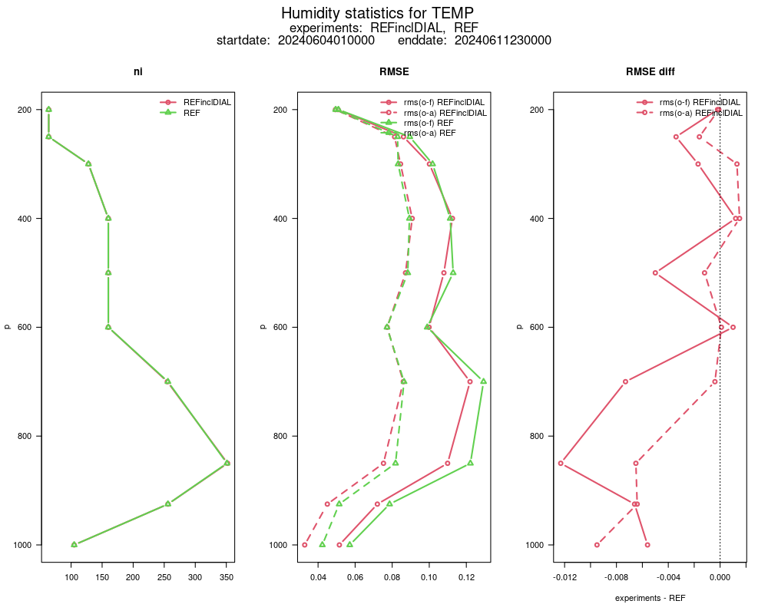
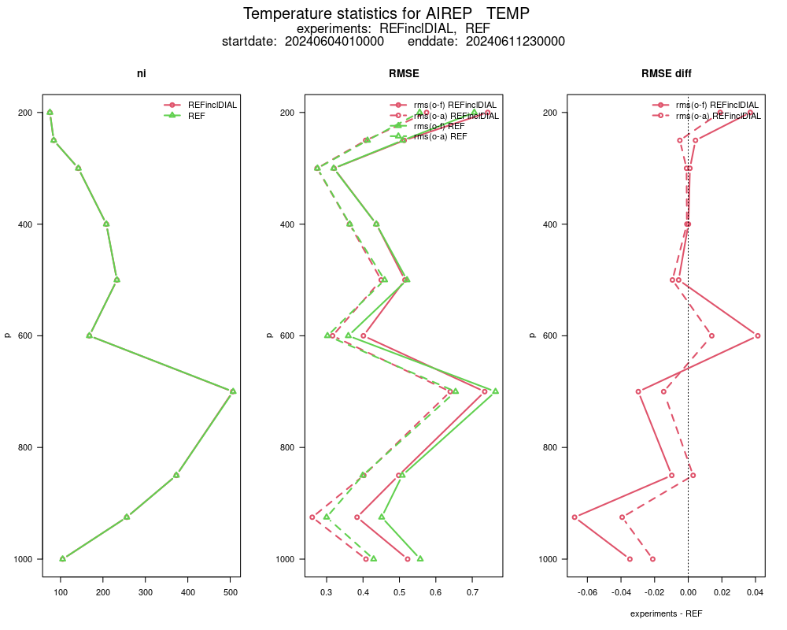
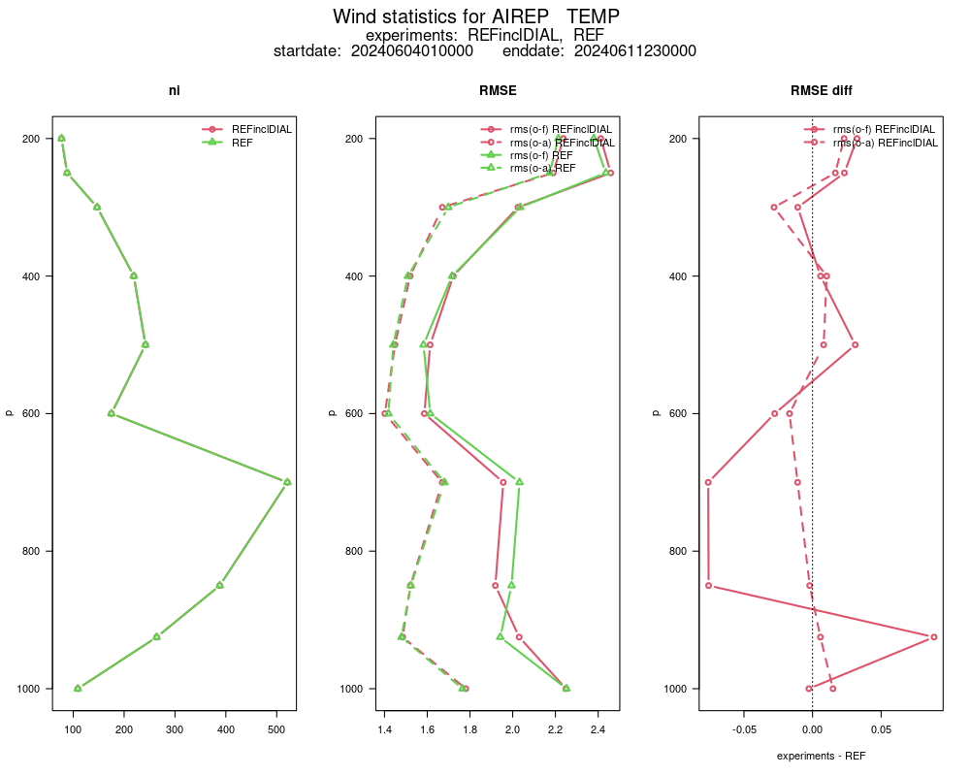
PBL profiler obs: DIAL (Differential Absorption Lidar)
Jens Pruschke
RMSE
first DA experiments over 8 days
(4 – 11 June 2024)
verification: obs_err_stats
around Lindenberg ( ± 0.1°)
→ positive impact on humidity (& temperature, wind)
REF
DIAL
next steps: further experiments with
  height dependent observation error
  profile thinning
  longer periods (summer/winter)
forecast verification
T
(TEMP, AIREP)
wind
(TEMP, AIREP)
RH
(TEMP)

Slide 27
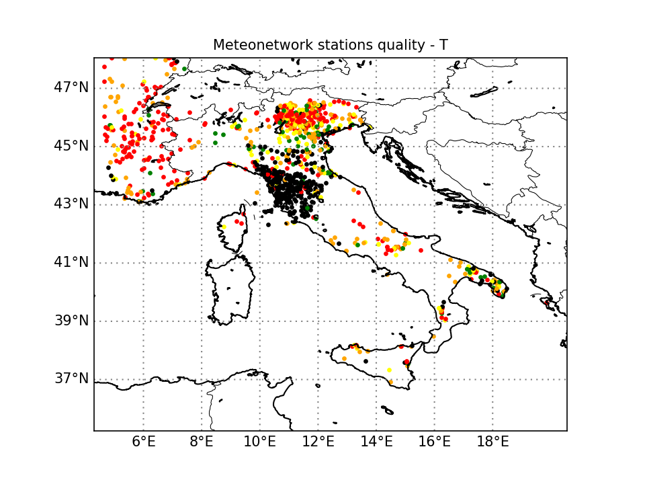
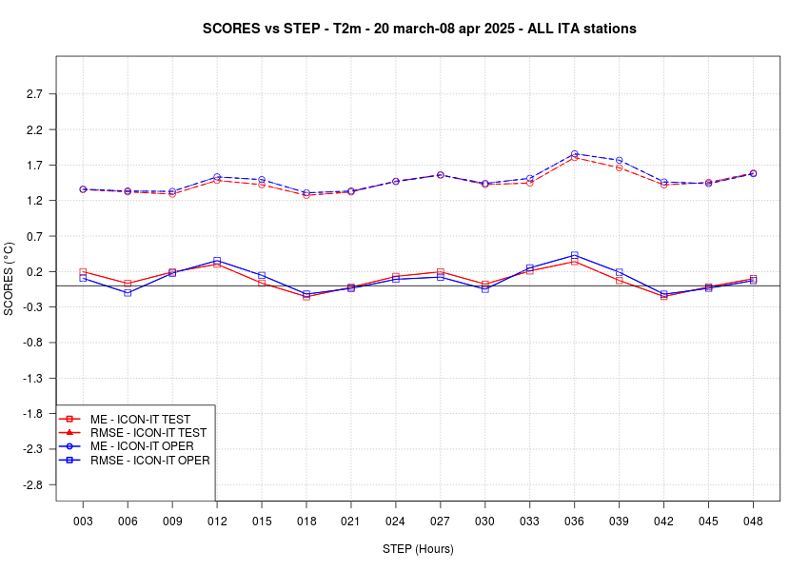
Assimilation of Meteonetwork T2m and wind speed obs
Meteonetwork: crowd sourced synoptic stations (approx. 1030)
Quality check based on bias and stdv of the obs increments
→ 176 stations used for T, 257 for wind speed (operational in May 2025)
surface temperature verification vs synop
Green and yellow stations assimilated
2026
DA of Meteonetwork stations (pressure and rh2m obs)
DA of surface obs from:
      MeteoMont (Army Alpine stations): 46 stations
      Autostrade: 250 stations
      DPC (Civil Protection): approx. 5500 stations

Slide 28
Brief KENDAscope review
Christoph Schraff
KENDAscope: KENDA from Surface to Cloud Observations Progressive Extension
(Sept. 2020 – Aug. 2025)
Task 1: algorithmic developments (operational KENDA; (C)EnVar)
Task 2: observations (from surface to clouds)
  2.1 Radar (Z + Vr)
  2.2 ground-based GNSS ZTD + STD (no positive impact after introduction of new Mode-S in 2022)
  2.3 all-sky IR WV + VIS radiances (SEVIRI)
  2.4 MTG IRS
  2.5 screen-level obs (T2M, RH2M; 10-m wind)
  2.6 PBL profiling obs (wind lidar, MW radiometer, Raman lidar, drones, DIAL, cloud radar, towers)
Task 3: soil / surface: SMA, snow
operationalized

Slide 29
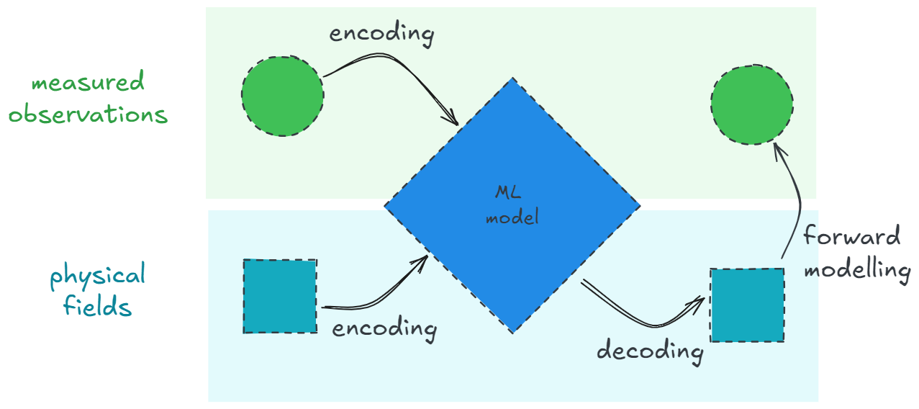






Data Assimilation with AI
THE METHOD
The classical data assimilation functional is used as a loss function to optimize the model weights:
reference: J. Keller and R. Potthast, arXiv:2406.00390
$$y$$
$${H(x}_{a})$$
$$J\left[x\right]=α{\left\|x−x_{b}\right\|}_{B^{−1}}^{2}+{\left\|H[x]−y\right\|}_{R^{−1}}^{2}$$
$α$: Tikhonov regulator
$x_{a}=\text{argmin}(J)$: analysis state
$x_{b}$: background state
$B$: model space covariance
$R$: observation space covariance
$H$: forward operator
$y$: observation
$$x_{b}$$
$$x_{a}$$
There is no target data (labels) for training!
The model learns to estimate the analysis from minimising the loss function.

Slide 30
Data Assimilation with AI
ACHIEVEMENTS
global DA of 2m temperature
reading and processing of NWP data and observations
NN forward operators
for in-situ data
post-processing of cloud diagnostics with SEVIRI data
basis for FRAIM
(AI framework at DWD,
with modularized AIDA)
IN DEVEOPMENT
DA of upper air observations for smaller domains
running RTTOV as forward operator inside a NN
(for DA of satellite data)
transformations of the physical state and loss function for more efficient evaluation
combination of different NWP forecasts (SYNCAST)
FUTURE PLANS
model parallelism with sharding
for global 3d atm. states
more efficient data handling for large datasets
implementation of more forward operators

Slide 31
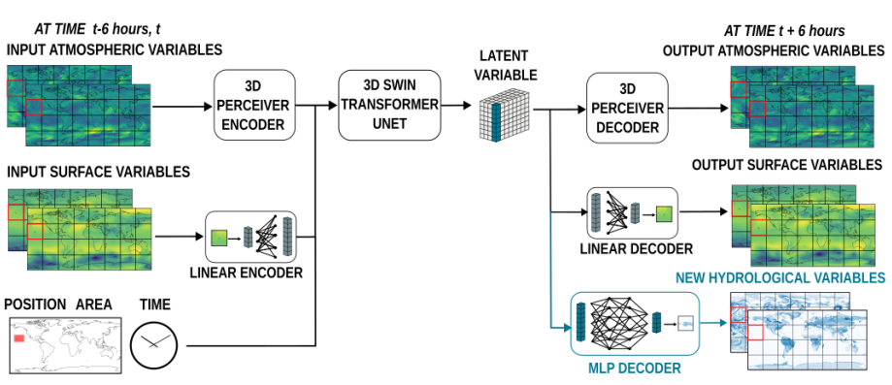
ML Data Assimilation
Currently developed MeteoSwiss emulator outperforming* the NWP system.
Plans to extend it to new sources by fine-tuning it on new sources of observations (e.g radar, satellite, SYNOP).
*e.g in terms of MSE but there are many caveats that come with ML methods
NEW OBSERVATION VARIABLES
Figure from https://arxiv.org/pdf/2506.19088
Add additional information sources on different grids
Notes:
31

Slide 32
WG Data Assimilation
Re-analysis (convective-scale, LAM)
Collaboration: first meeting in May (DWD, MeteoSwiss, ARPAE)
target
• facilitate the production of regional reanalyses within COSMO
and/or joint use of common regional reanalyses
facilitate sharing of historical / non-GTS Obs
sharing knowledge (which obs to use, pre-processing tools, monitoring ideas/tools,
re-ana configurations, solving issues with historical obs, …)

Slide 33
WG Data Assimilation
Re-analysis
DWD (Arianna Valmassoi a.o.)
ICON-DREAM: global EnVar, 2010 – 2024 available, working on back-extension (& forth ext.)
ICON-FORCE: ICON-D2-KENDA, for AI training dataset, all obs, 2015 – 2024;
  LHN reprocessed specifically for the reanalyses using all the available data
  production started in August (speed 8 (d / d))
FORCE-C: for climate applications, on conventional obs, longer periods (KU)
ARPAE (Antonio Giordani)
planned: I-DREAM-IT: ICON-2I-KENDA, for AI training dataset, all obs, 2010 – 2025;
  Conventional obs in LETKF, and LHN

Slide 34
WG Data Assimilation
Re-analysis
Meteo-Swiss (Daniel Leuenberger a.o.)
REA-L-CH1: re-analysis light: deterministic downscaling of ERA5, 2005 – 2025
  LHN using a new, homogeneous radar-gauge product
  Purpose: Wind climatology (climate division) & AI training dataset
comparison with KENDA-CH1 (2024)
  precipitation looks great (thanks to LHN)
  as expected, STDE is larger for REA-L than for KENDA-CH1 for CH (KENDA!) for all parameters except for wind / gusts in complex terrain

