Slide 1


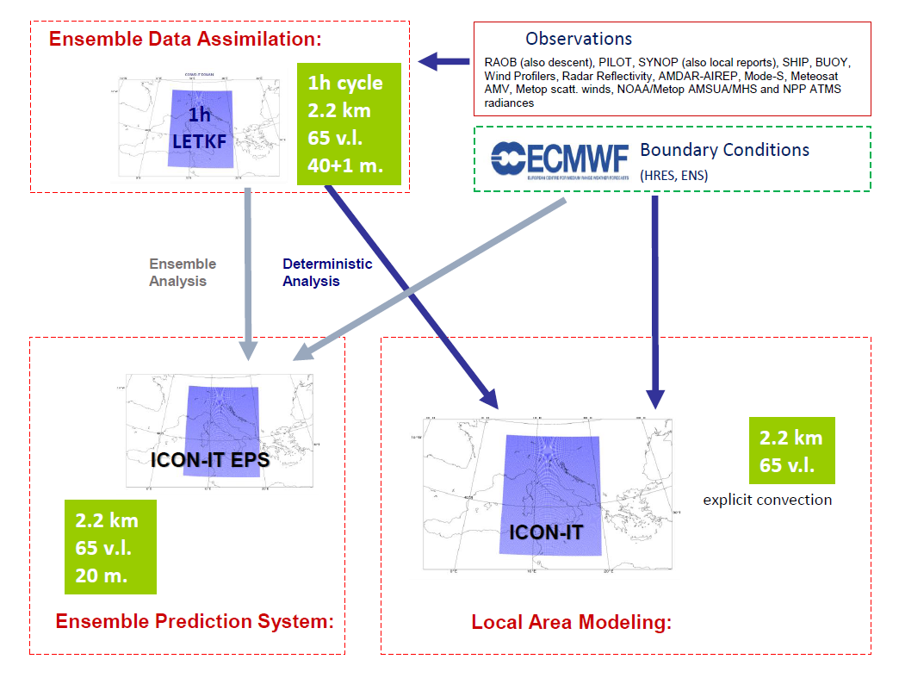


ICON-IT operational setup
+48h
ECMWF
ATOS platform
(icon-it DET, with 500m nesting over Rome, on local HPC)
COSMO GM-2025, 01-05 September 2025 Basel, Switzerland

Slide 2
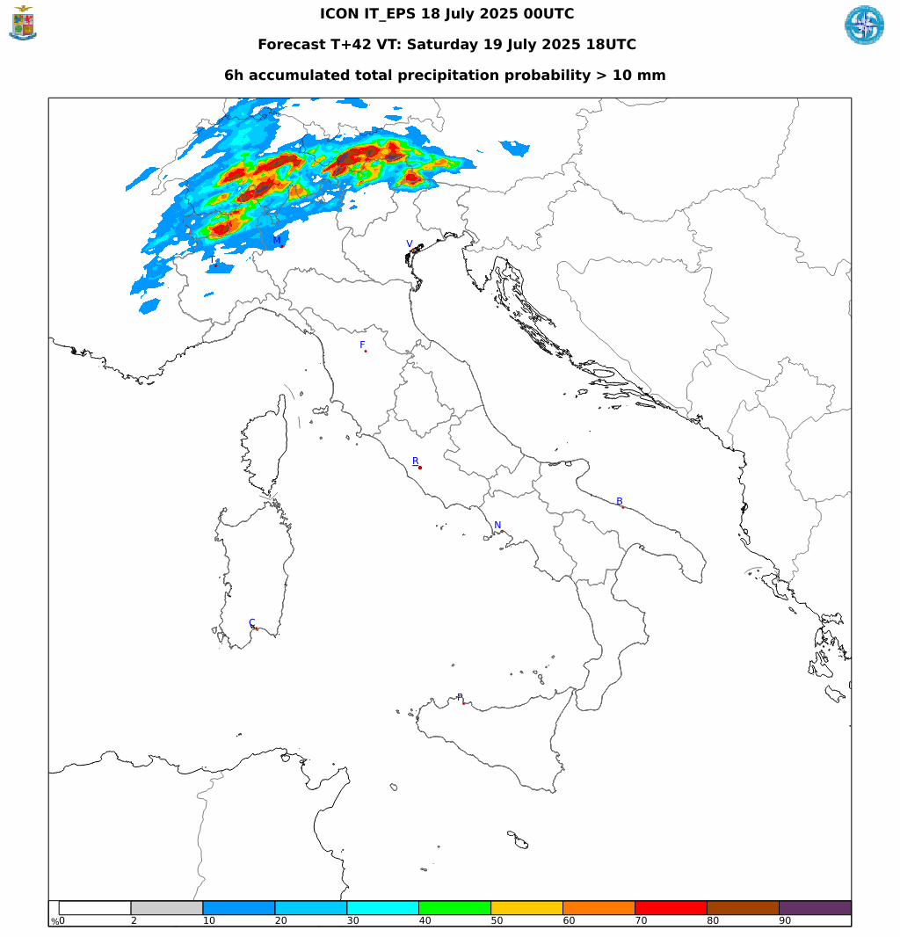
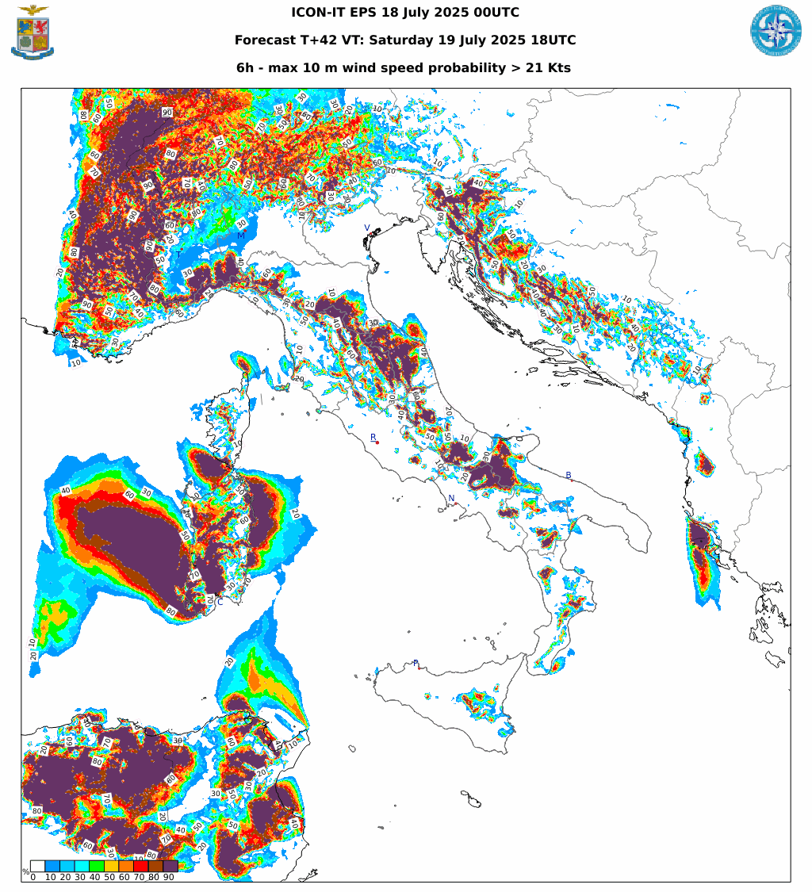
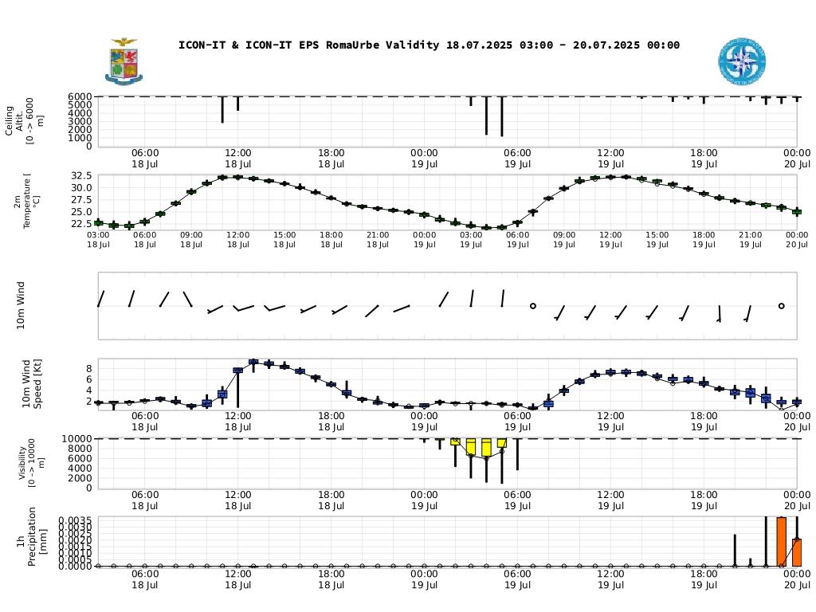
ICON-IT EPS
Operational from March 2025
Two operational runs a day (00utc, 12utc)
COSMO GM-2025, 01-05 September 2025 Basel, Switzerland

Slide 3
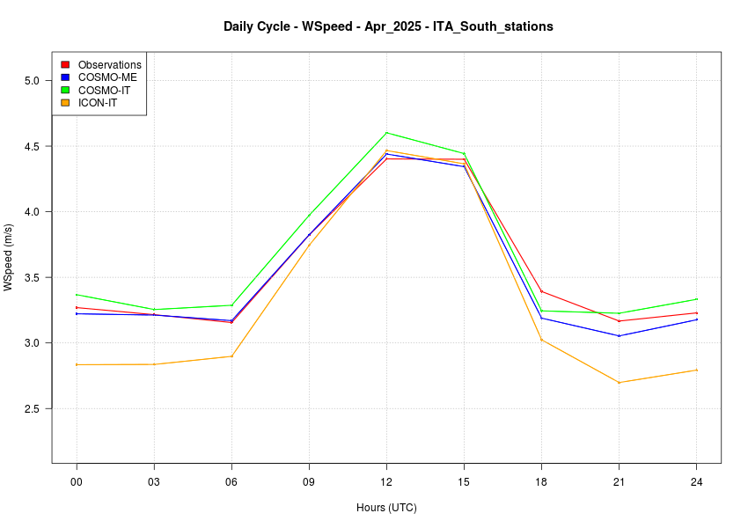
ICON verification and open issues
Good overall performances for ICON model
ICON-IT seems to underestimate WS10m especially during night hours
Daily cycle WS 10m,
ICON (orange) vs COSMO-ME and IT models (blue and green)
APRIL 2025, it appears to be systematic over different seasons
COSMO GM-2025, 01-05 September 2025 Basel, Switzerland

Slide 4
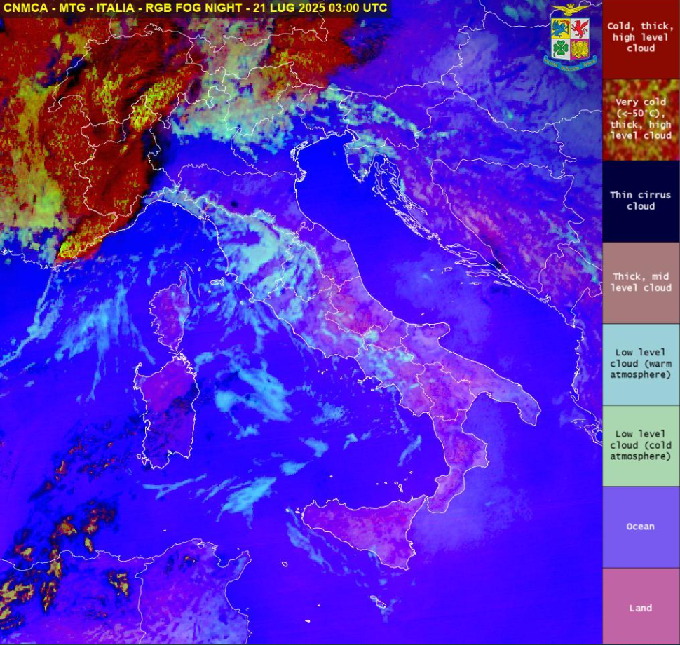
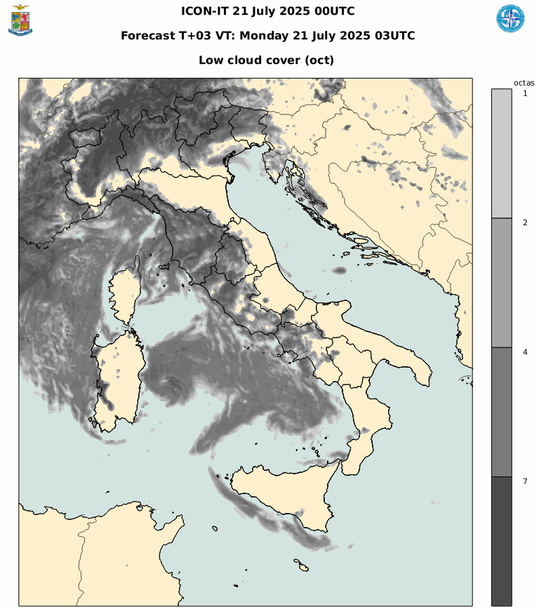
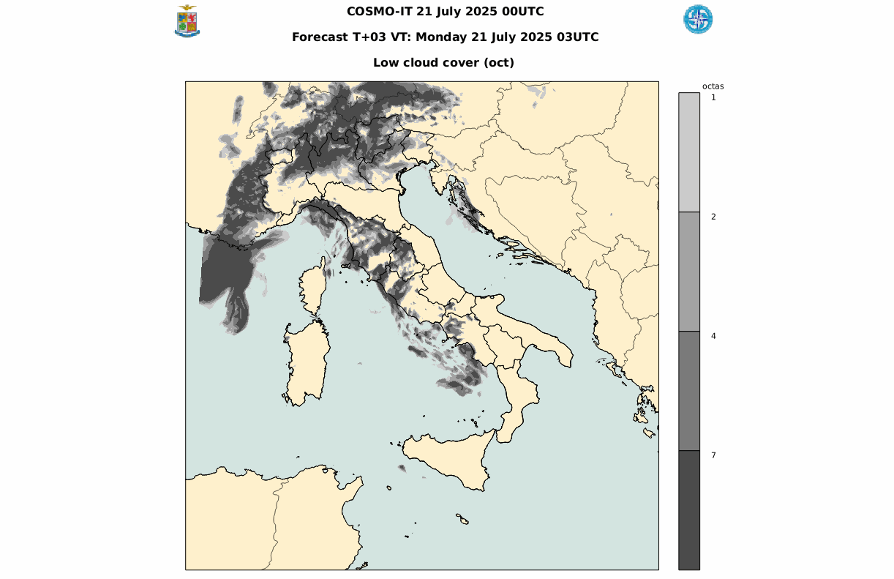
ICON verification and open issues
ICON-IT is more accurate than cosmo but it seems to overestimate low clouds according to forecasters, especially over sea
LOW CLOUDS
COSMO GM-2025, 01-05 September 2025 Basel, Switzerland

Slide 5
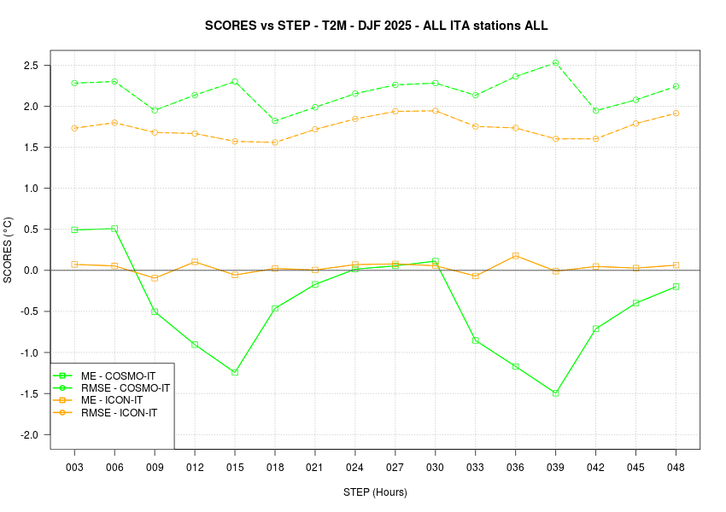
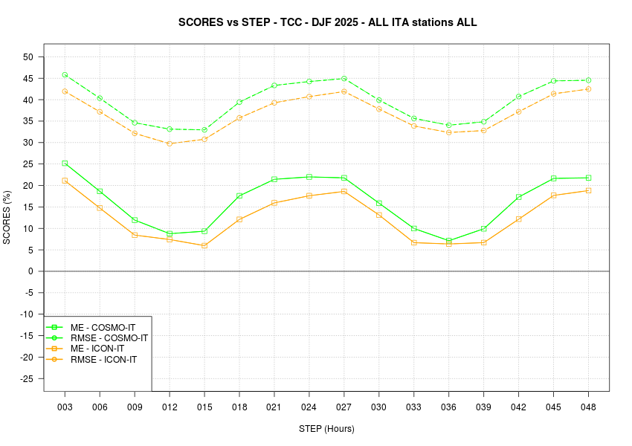
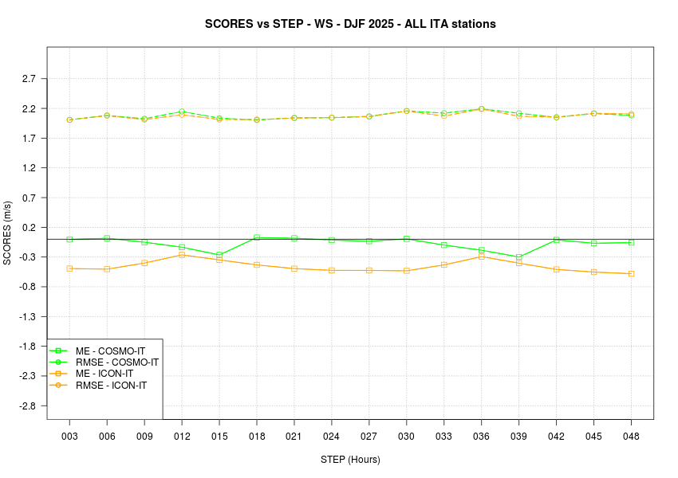
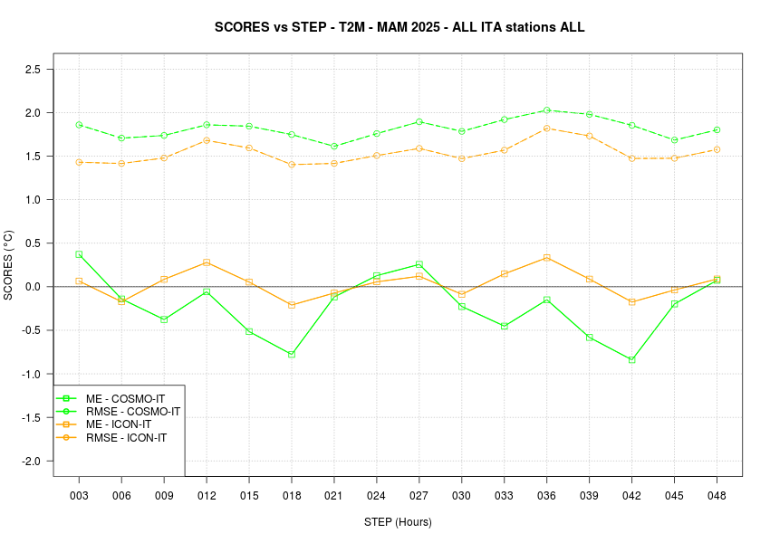
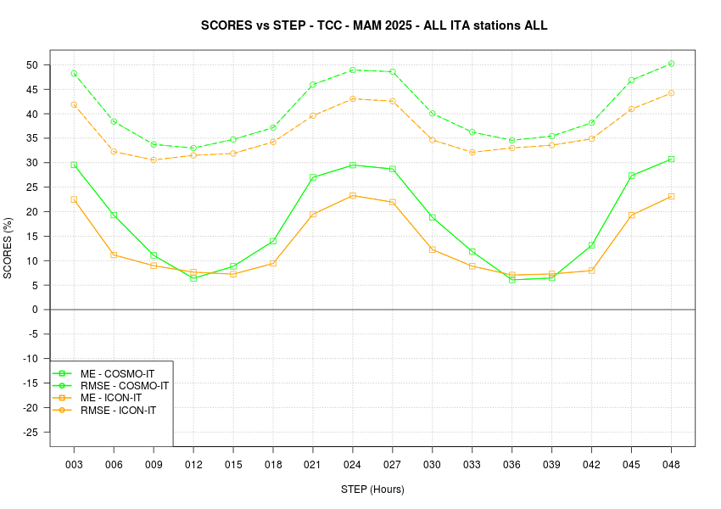
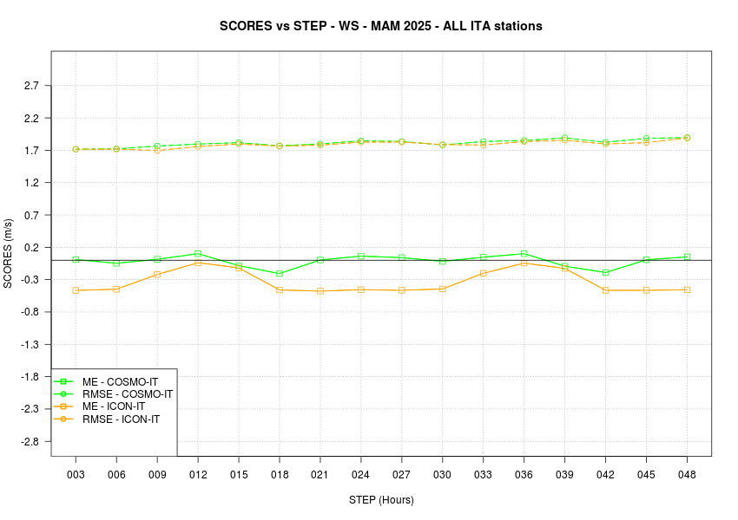
Verifications over national domain:
Scores ICON-IT vs COSMO-IT
T2m
TCC
WS_10m
DJF25
MAM25
COSMO GM-2025, 01-05 September 2025 Basel, Switzerland

Slide 6
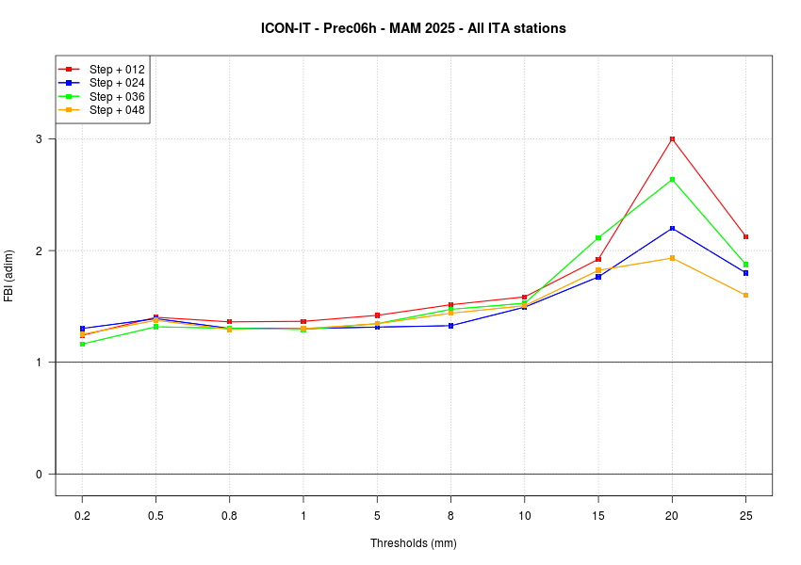
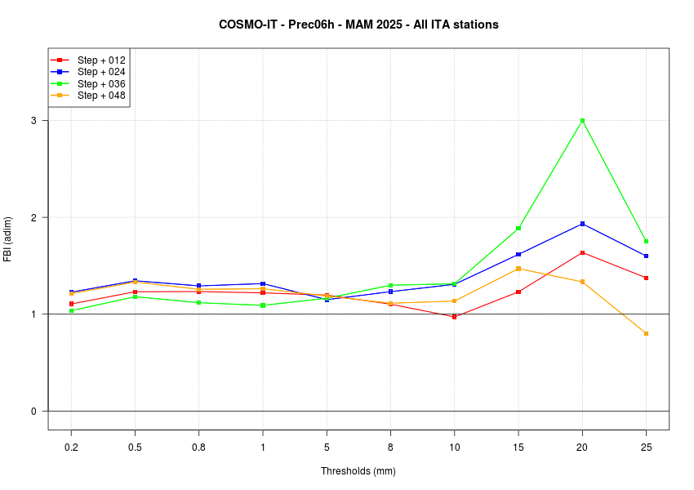
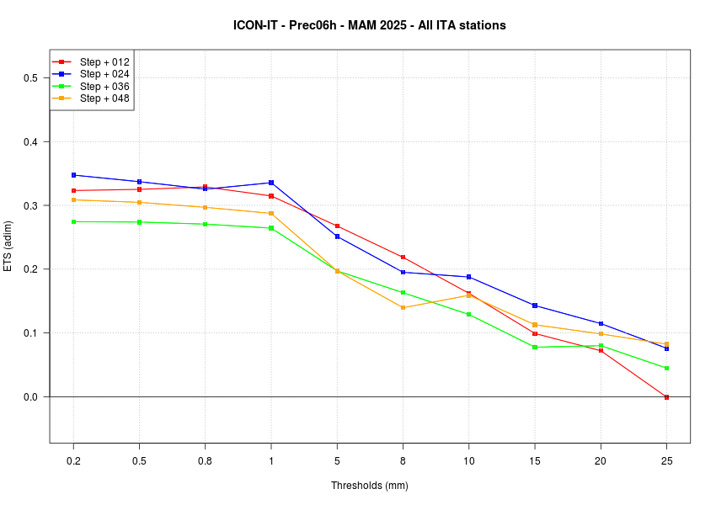
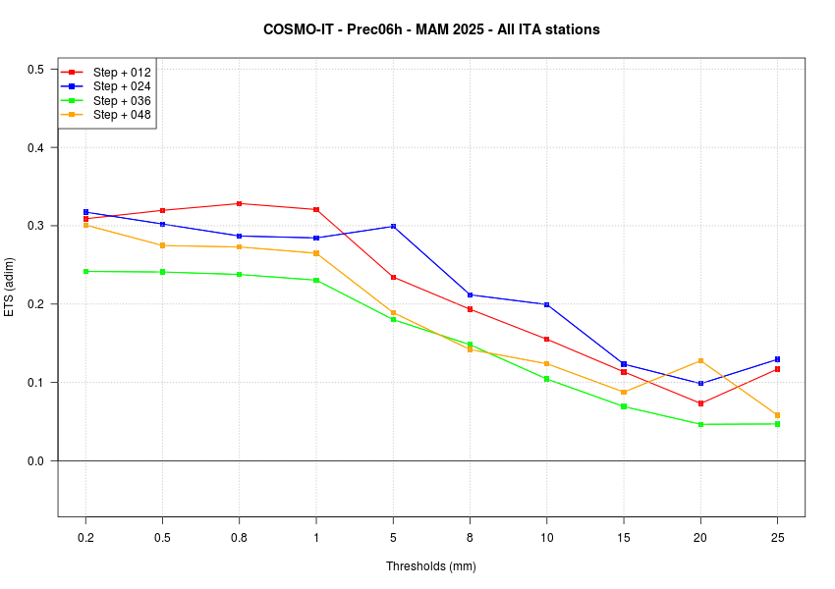
Verifications over national domain:
ICON-IT vs COSMO-IT, prec06h dichotomic scores
ICON-IT
COSMO-IT
MAM25
FBI
ETS
COSMO GM-2025, 01-05 September 2025 Basel, Switzerland

Slide 7
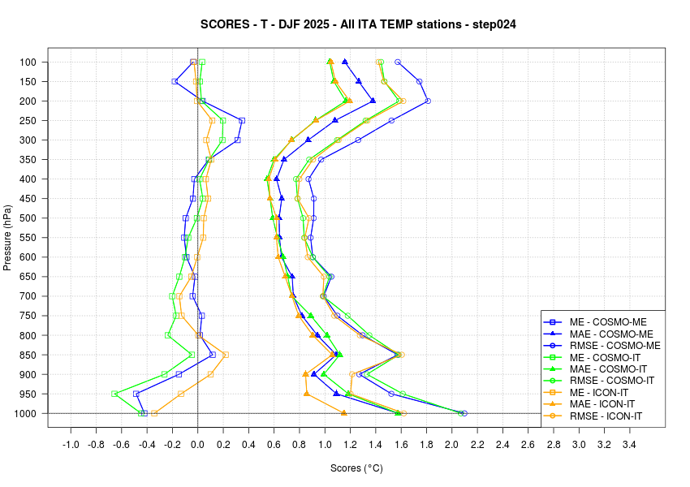
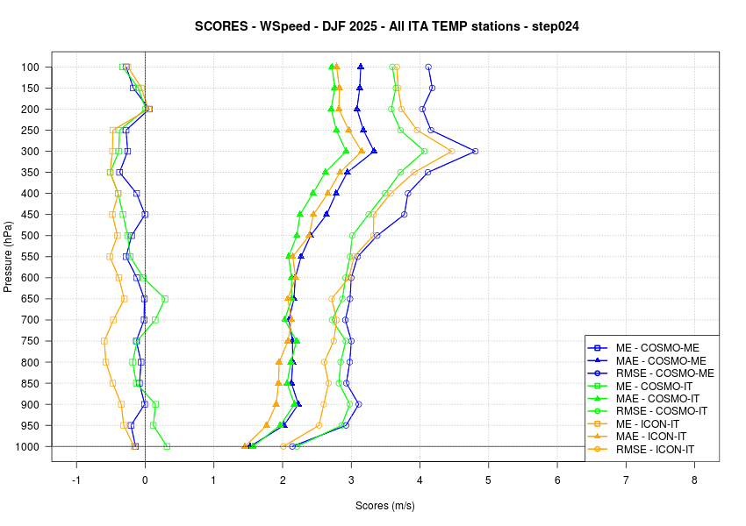
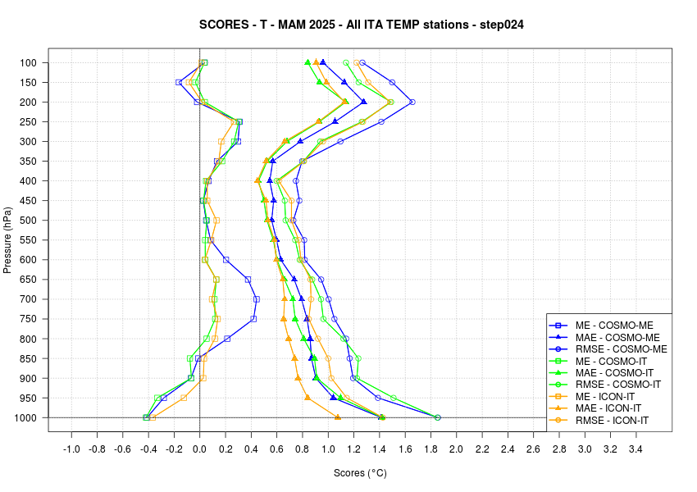
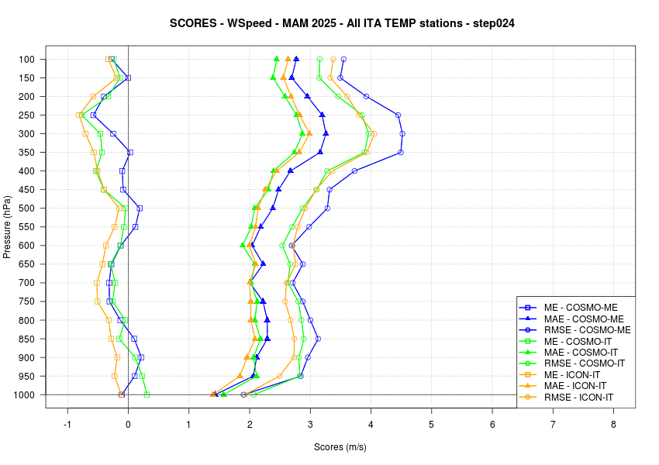
Verifications over national domain:
ICON-IT vs COSMO-IT vs COSMO-ME, upper
T
Wind
DJF25 step +24h
Wind:
negative bias
is present for ICON-IT model
T
Wind
MAM25 step +24h
COSMO GM-2025, 01-05 September 2025 Basel, Switzerland

