Slide 1
Comparison of NWP and ML verification results
With slide contributions by
Oliver Fuhrer, Carlos Osuna, Daniele Nerini,
Andreas Pauling, Francesco Zanetta, Alberto Pennino

Slide 2
People working on data-driven weather modeling at MeteoSwiss
Carlos Osuna
Alberto Penino
Andreas Pauling
Francesco Zanetta
Ophelia Miralles
Daniele Nerini
Marco Arpagaus
Radev Radi
Kerem Tezcan
Xavier Lapillonne
Simon Adamov
Katrin Ehlert
Petar Stamenkovic
David Leutwyler
Mary McGlohon
Jonas Bhend

Slide 3
ML efforts at MeteoSwiss
AI models offer fast and high-quality global weather forecasts but lack the resolution needed for Switzerland complex terrain, which requires frequent updates.
MeteoSwiss is developing a prototype AI-driven forecasting system tailored to Swiss needs (accuracy, warnings, new forecast products).
The prototype will be open-source and developed with partners including ETH Zurich, SDSC, CSCS, and ECMWF (Machine Learning Pilot Project MLPP).
2025
deterministic emulator
hourly, 1km
2026
assimilation of real-time observations
2027
ensemble forecasts
2028
sub-kilometer sub-hourly

Slide 4
Verification tools for ML
No common verification in ECMWF MLPP
=> all partners use their own tools so far
MCH:
  Observation-based verification (MEC/FFV2)
  «truth» = Observations
  Analysis-based verification: whole grid is verified (COSMO-2)
  «truth» = Analysis

Slide 5
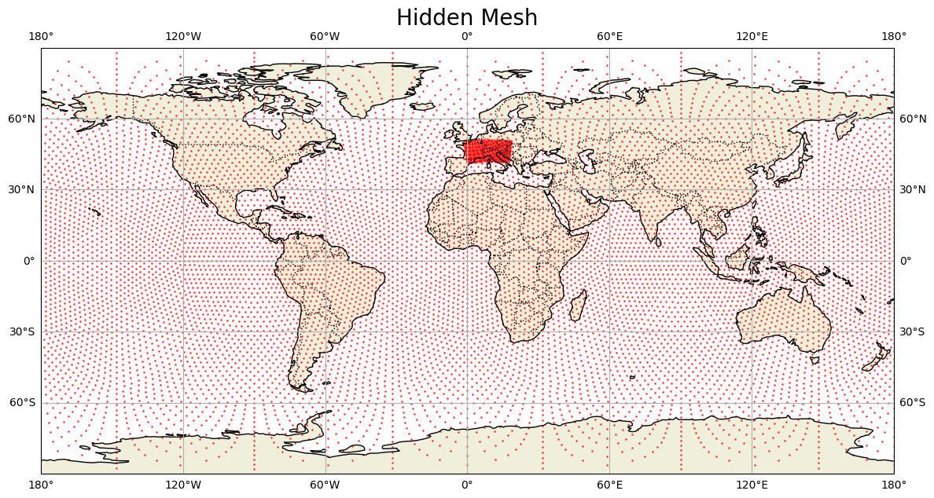
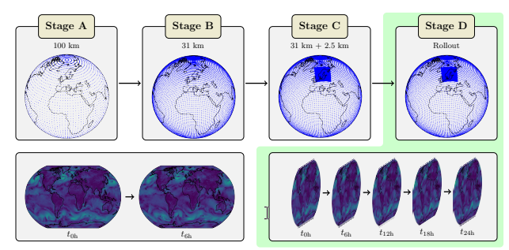
Stretched grid approach (Nipen et al. 2024)
Combine global and regional dataset in a single multi-resolution grid
Transfer-learning using four-stage training procedure
Notes:
Sequentially adapt the model to more complex tasks.
Harness the greater data availability of ERA5.
Gradually refines the model, allowing it to reach a local minima.
Drastic increase in performance vs starting directly at stage C.

Slide 6
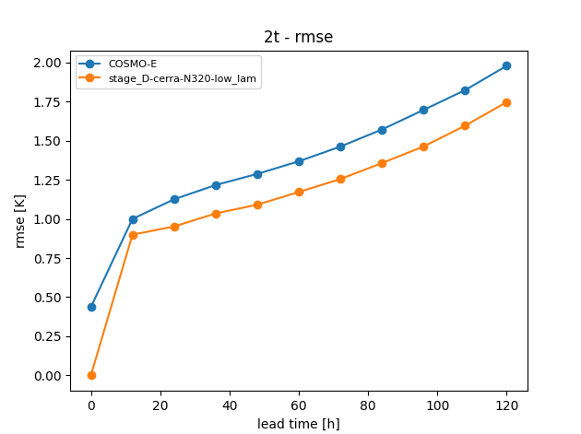
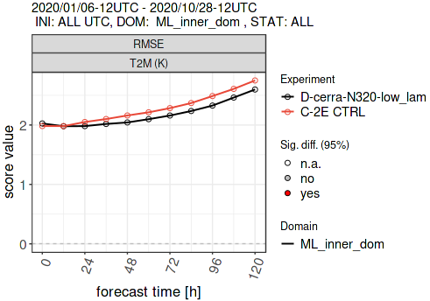
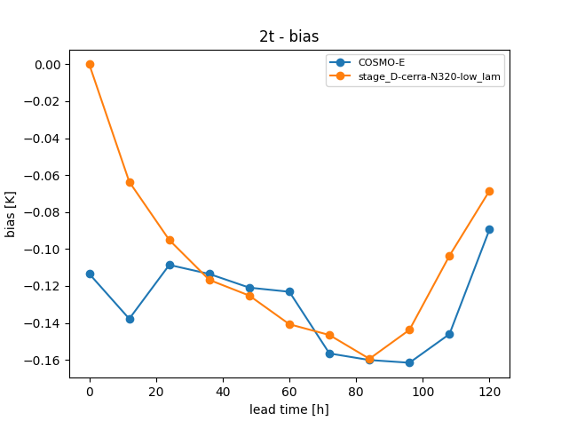
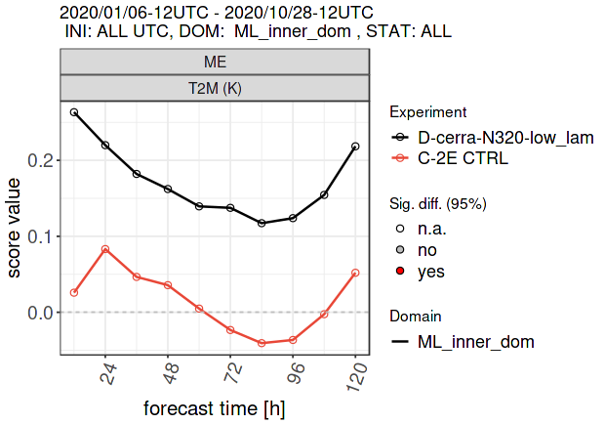
NWP/ML comparison: T_2M
Notes:
Caveats
Jump in the first lead time (MEC): In the observation-based verification at +0h lead time tends to score worse than the following lead times which is counter-intuitive. A possible explanation is that the analysis for COSMO-2E was upscaled from the 1km resolution model. As the topographies are quite different, the COSMO-2E runs start with unbalanced parameters and need a number of timesteps to reach a physical equilibrium state. This applies especially to wind but also (to a lesser extent) to humidity and temperature. The same feature can also be observed in the operational surface verification tool Movero.
Difference between skill of ML and NWP baseline at analysis time: We use the control of the analysis ensemble for the initialization and evaluation of the forecasts in the analysis-based evaluation. The COSMO-E control run, however, has been started from the mean of the analysis ensemble. Thereby, the evaluation favors the ML-based model and most notably the forecast performance at initialization differs between COSMO-E and the candidate ML model.
Describe, which is better, compare absolute vailes

Slide 7
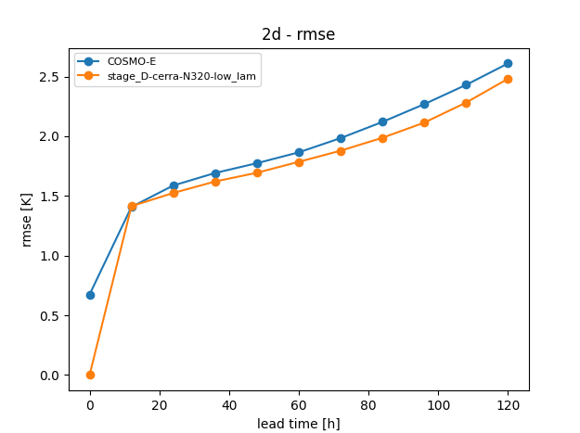
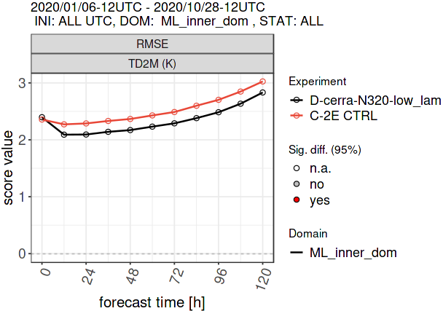
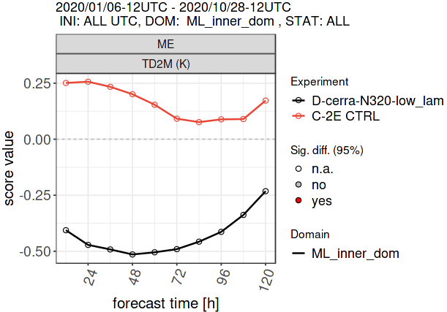
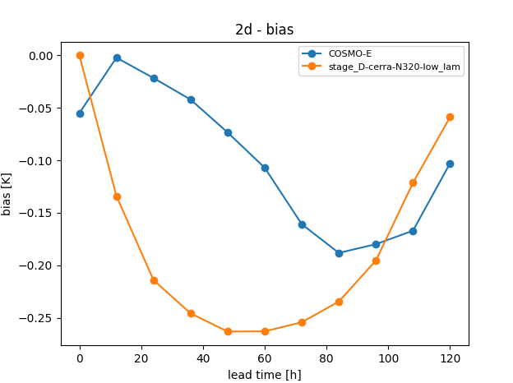
NWP/ML comparison: TD_2M

Slide 8
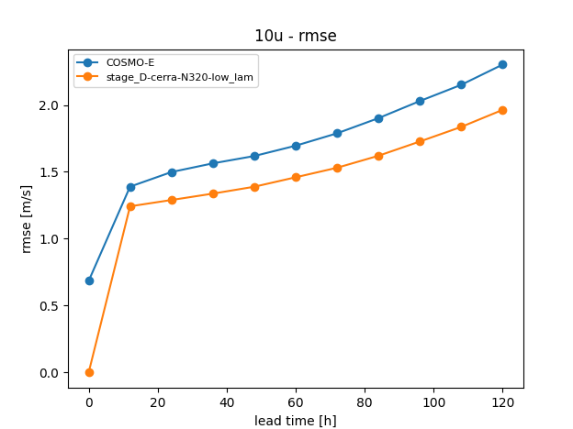
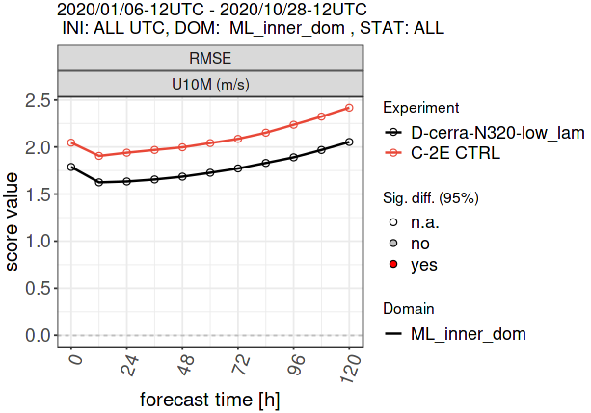
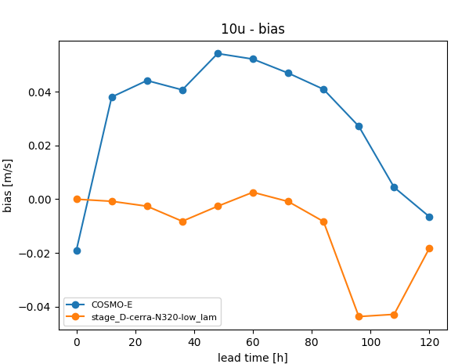
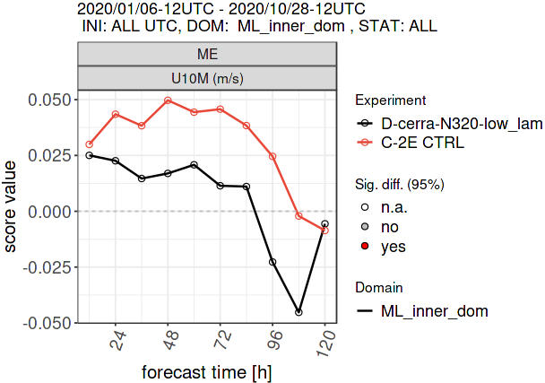
NWP/ML comparison: U

Slide 9
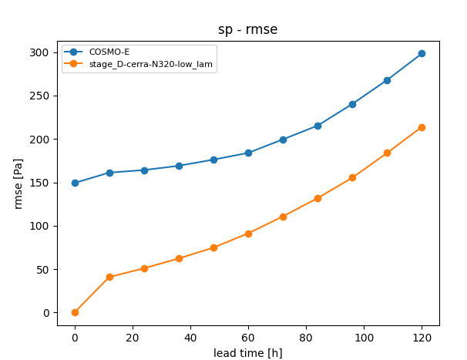
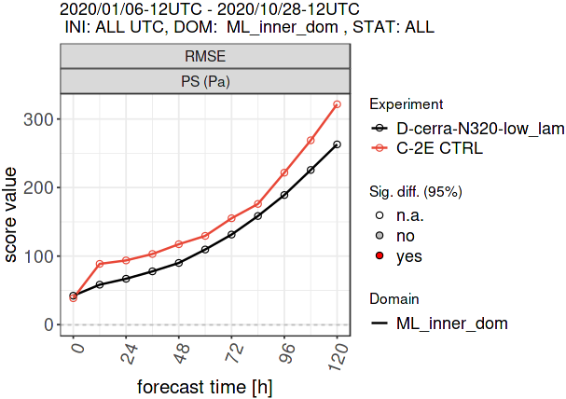
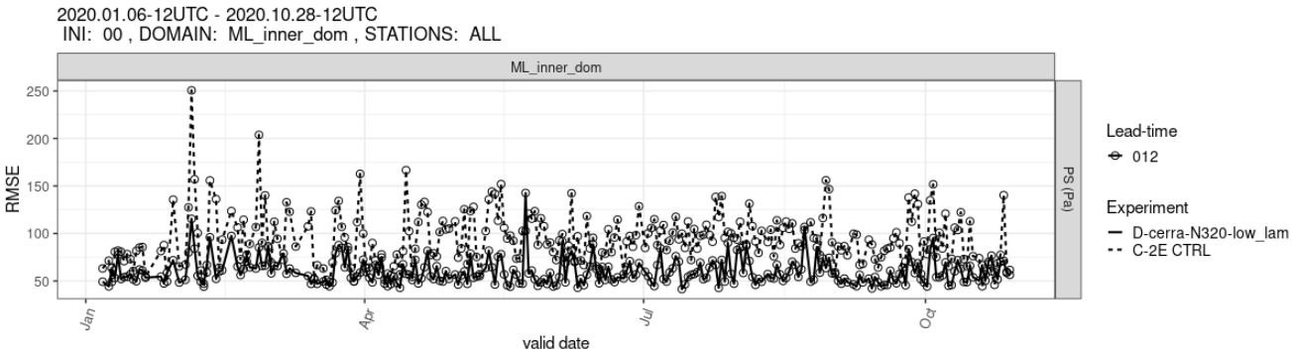
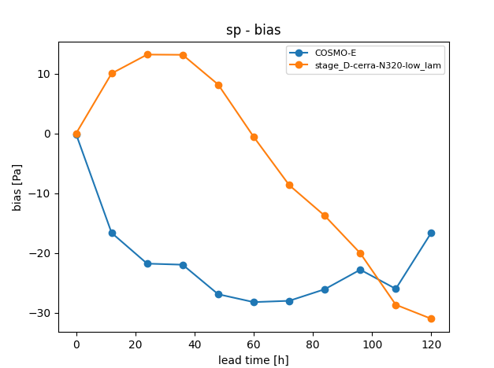
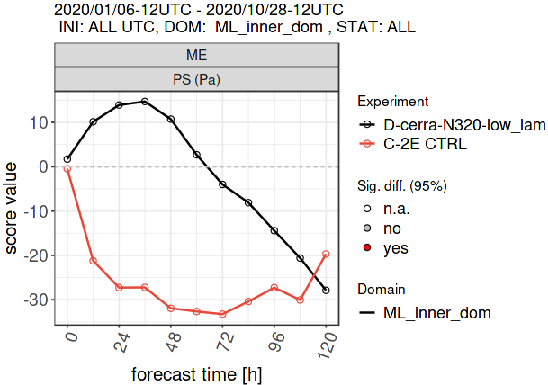
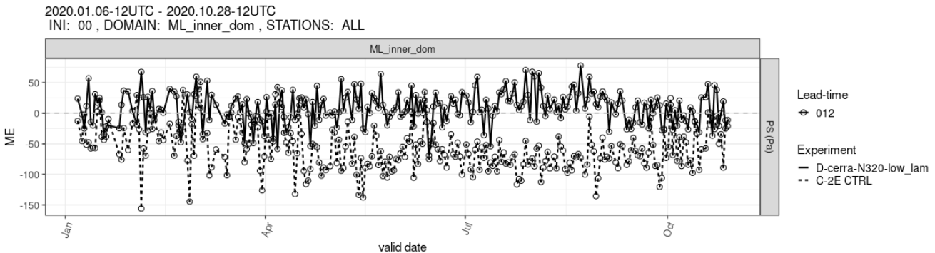
NWP/ML comparison: SP

Slide 10
Take home messages
The ML model at MeteoSwiss using stretched grid approach outperforms COSMO-2 for T_2M, TD_2M, U and SP (RMSE, and mostly also ME)
Some variables still missing (TOT_PREC, GUST, upper air …)
Analysis-based verification undergoing major refactoring/extension

Slide 12
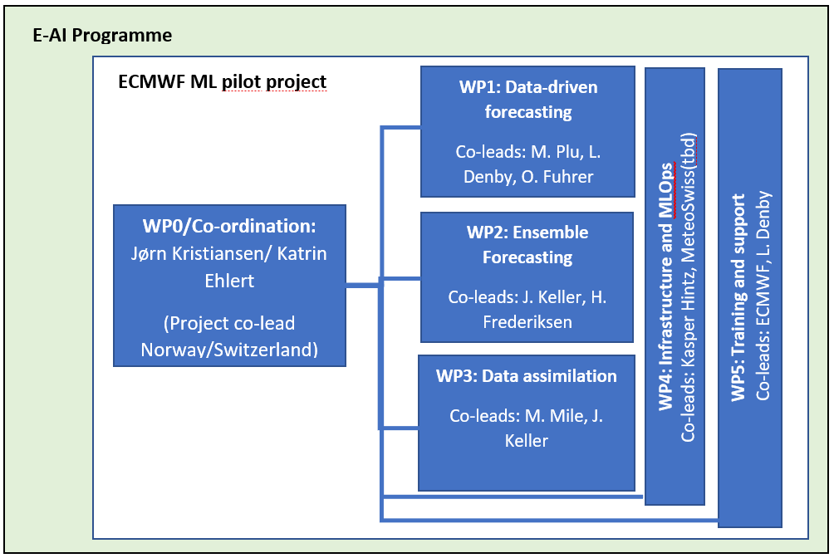
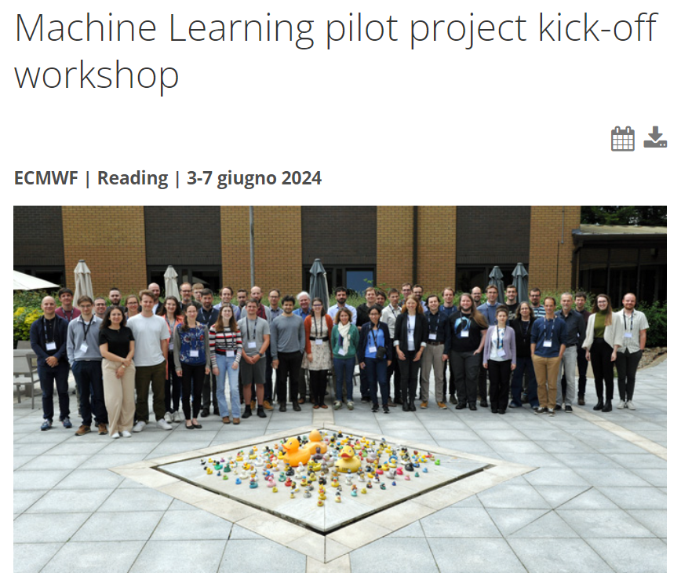


ECMWF ML Pilot Project
- Goal: advancing the use of machine learning (ML) in numerical weather prediction.
- Methods: evaluate and develop ML-based forecasting models, integrate ML into existing workflows, and enhance operational readiness through robust evaluation and infrastructure development.

Slide 13
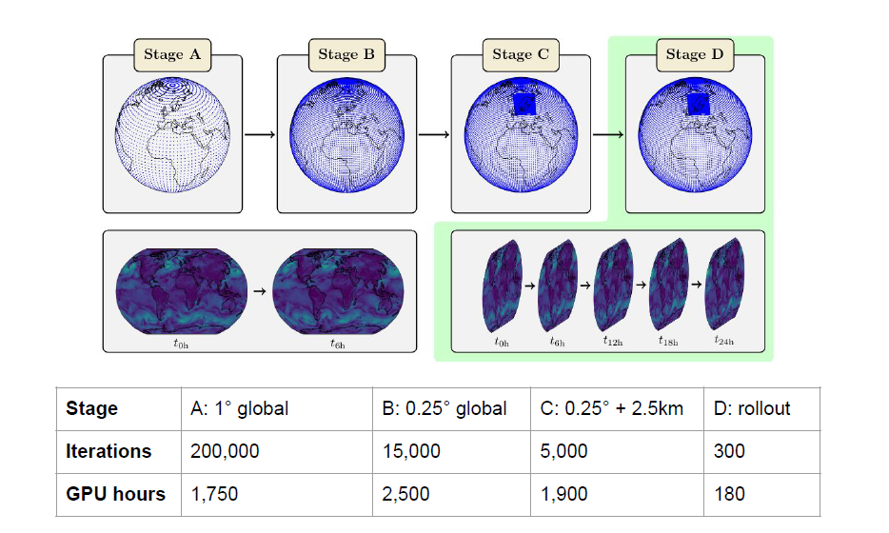
Training Schedule
Transfer Learning:
Sequentially adapt the model to more complex tasks.
Harness the greater data availability of ERA5.
Gradually refines the model, allowing it to reach a local minima.
Drastic increase in performance vs starting directly at stage C.

