Slide 1

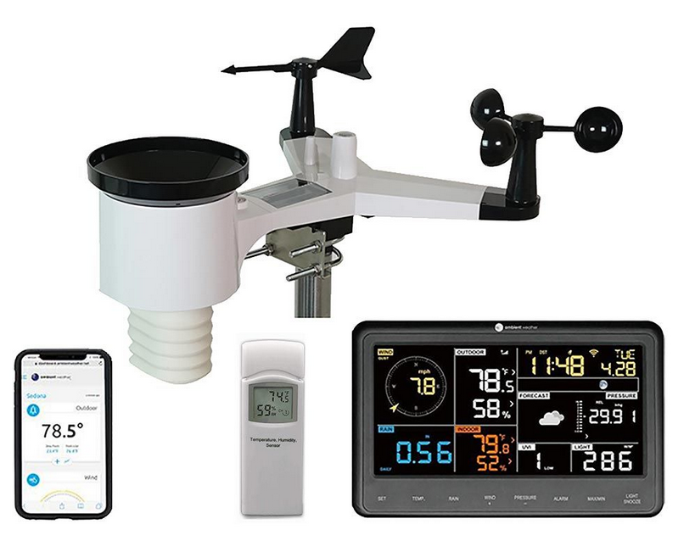
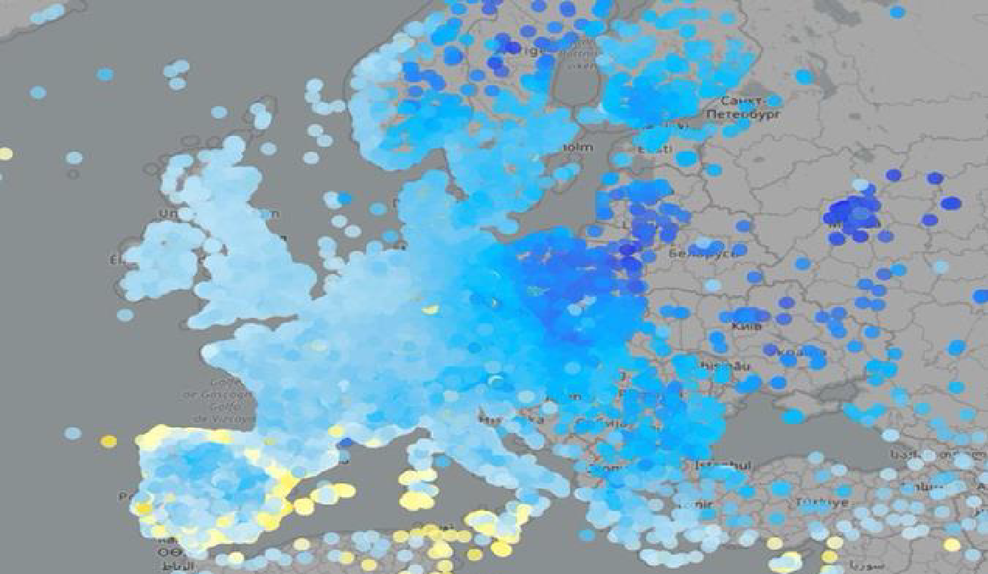







IMGW-PIB: Artur Surowiecki, Andrzej Wyszogrodzki, Witold Interewicz, Grzegorz Zakrzewski, Jan Szturc, Anna Jurczyk, Katarzyna Ośródka, Magdalena Szaton, Radosław Drożdżoł, Bartłomiej Sobczyk, Adam Jaczewski
HNMS: Flora Gofa, Dimitra Boucouvala
CIMA: Massimo Milelli, Elena Oberto, Francesco Uboldi
ARPA Piemonte: Valeria Garbero
Politecnico di Torino: Tanguy Houget
CNMCA: Valerio Cardinali
Priority Project: APOCS (Application of Personal Weather Station and Opportunistic Sensor Data CrowdSourcing)
SMC: 26 June 2024

Slide 2
COSMO PP APOCS Tasks
PP APOCS Purpose: extension of the work done in PT EPOCS
Participants: IMGW-PIB, HNMS, CIMA, CNMCA,
ARPA-Piemonte, Politecnico di Torino
PP Leader: Artur Surowiecki (IMGW-PIB), initially Marcin Grzelczyk
FTEs:
- in COSMO year 2025: 2.788
- in COSMO year 2026: 2.599
- in COSMO year 2027: 0.513
Total FTEs: 5.7 FTE + 0.2 external
Duration: 2 years
Start: April 2025
Scheduled completion: August 2027

Slide 3
COSMO PP APOCS Tasks
Task 1 Development of COSMO PWS database
Subtask 1.1 Survey on available PWS from COSMO employees (IV-XII.2025)
Subtask 1.2 Building up passer for decoding data formats (IV-IX.2025)
Subtask 1.3 Adaptation or building up transfer protocols (IV-IX.2025)
Subtask 1.4 Development database functionalities (IX.2025-VIII.2027)
Task 2 Extended testing for different QC algorithms for different precipitation data sources and other parameters (temperature, RH)
SubTask 2.1: Adaptation of the RainGaugeQC system to CML-based precipitation data
(IV.2025-III.2026)
SubTask 2.2: Titan lib applied to “not conventional” raingauge datasets (IV.2026-III.2027)
SubTask 2.3: Quality control procedure for T2m and Rh2m% (IV.2025-III.2026)

Slide 4
COSMO PP APOCS Tasks
Task 3 Adaptation of private/citizen datasets for verification over Greece
SubTask 3.1: Titan lib applied to meteorological data in the Greek domain (IV.2025-II.2026)
SubTask 3.2: Climatology based Interpolation methodology of precipitation data from various sources (IV.2025-VI.2026)
Task 4. Application of PWS-based gridded products (to model data assimilation and verification)
SubTask 4.1: Improving RainGRS+ precipitation estimates by combining different types of data in more efficient and seamless manner (IV.2025-III.2026)
SubTask 4.2: Spatial verification techniques based on gridded precipitation observation enhanced with crowdsource data (III.2026-XII.2026)
SubTask 4.3: Application of PWS to NWP model verification in urban areas (IX.2025-III.2026).
SubTask 4.4: Application of gridded RainGRS+ precipitation estimates for assimilation in NWP models (COSMO-RUC) (IX.2025-III.2027)
Sub Task 4.5: Application of Meteonetwork PWS at CNMCA: testing stability and consistency before using (IV.2025-III.2026)

Slide 5
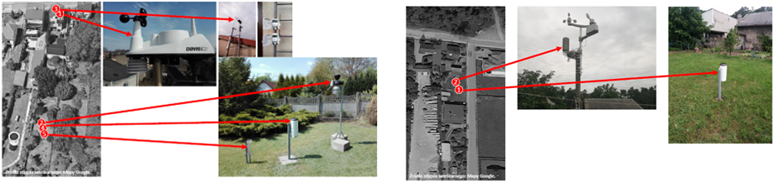
COSMO PP APOCS Tasks
Task 1 Development of COSMO PWS database
The first tests with employee devices and the test database were successful
The project assumes to create PWS database which include a larger number of stations for internal tests
Possibility of adding external participants from COSMO partners and other collaborating institutions.
Include data QC software and web based GUI with visualization

Slide 6
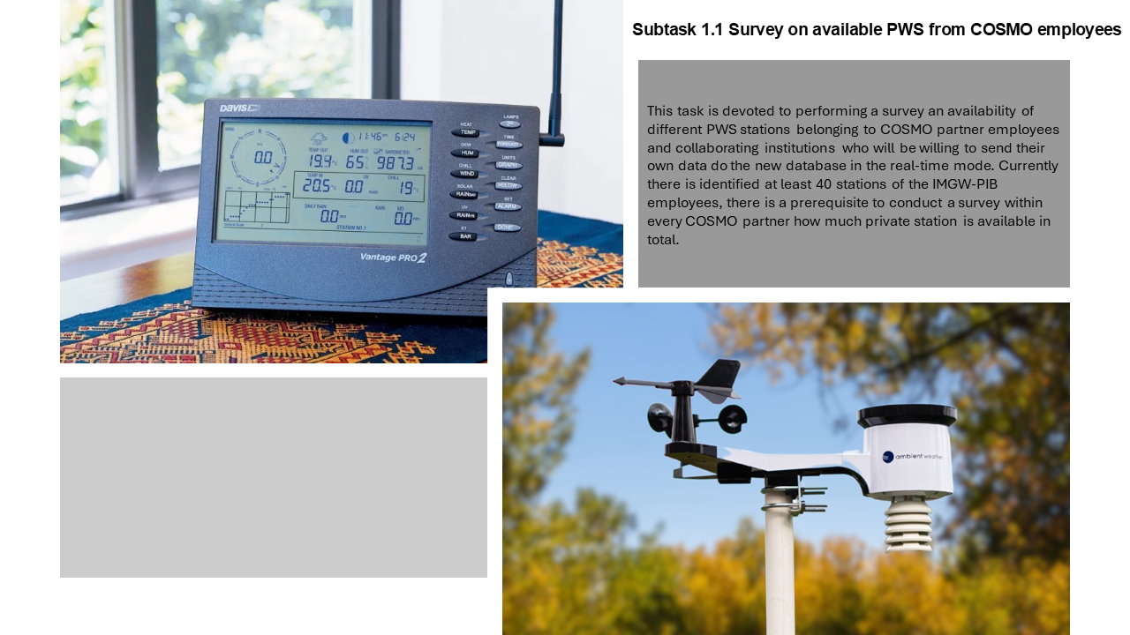
COSMO PP APOCS Tasks

Slide 7
COSMO PP APOCS: Subtask 1.1 status
Current status
We identified several dozens of weather stations launched by IMGW-PIB employees that may satisfy the QC data requirements
We plan to further promote of the project among IMGW-PIB employees in order to acquire data from new PWS locations
Finally, we will launch a dedicated website for registering PWSs operated by any stakeholder interested in sharing PWS data with IMGW-PIB for the project purposes
However, there are some limitations regarding the acquisition of data from PWSs, e.g. some entities that collect and share PWS data on behalf of their providers have exclusive rights to use that data

Slide 8
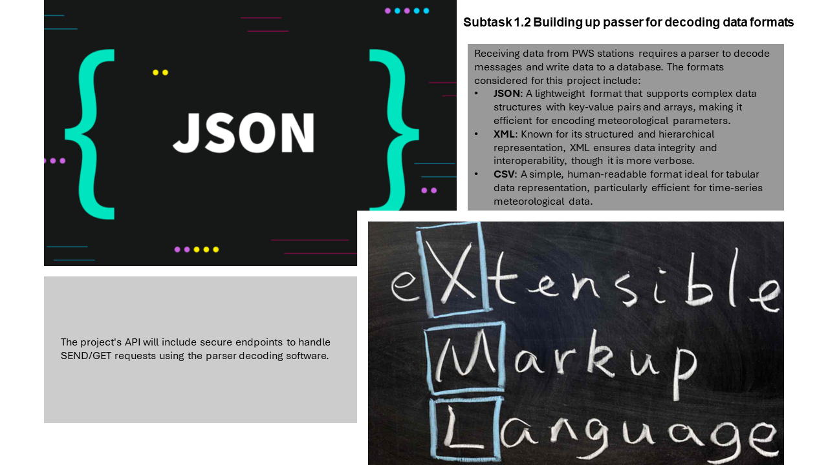
COSMO PP APOCS Tasks

Slide 9
COSMO PP APOCS: Subtask 1.2 status
Current status
As a data parser, IMGW-PIB developed an API that enables data delivery from PWS produced by leading weather station manufactures
The API separates delivered PWS data from internal data storage system, satisfying internal security requirements
The API decodes delivered data and inserts data as records into the internal database (PostgreSQL)
The PostgreSQL database enables seamless data conversion to the commonly used data formats such as .CSV, .XML or .JSON
Start of the testing phase of the API
Possibility of further development (e.g. adaptation to new protocols for data delivery from PWSs).

Slide 10
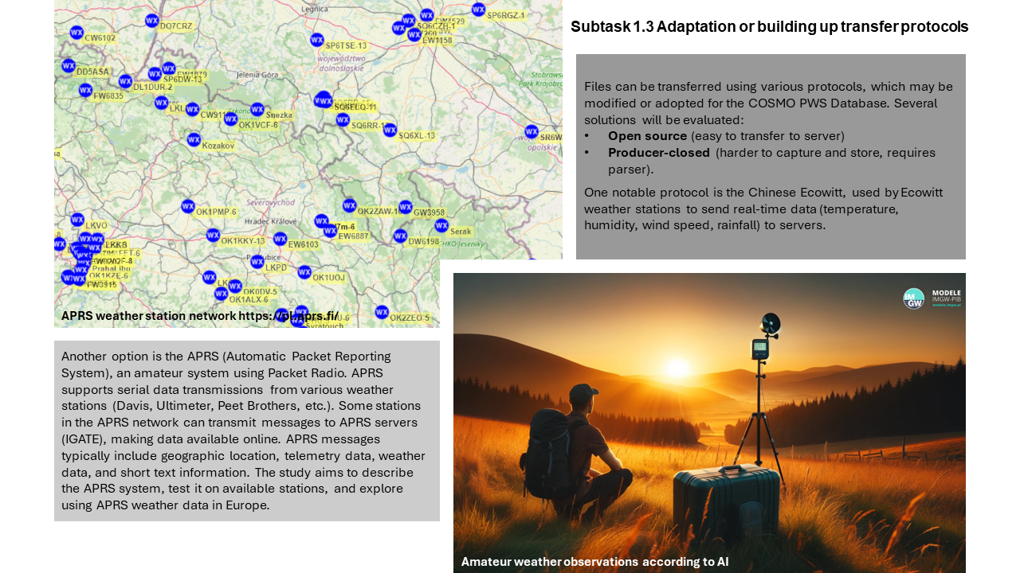
COSMO PP APOCS Tasks

Slide 11
COSMO PP APOCS: Subtask 1.3 status
Current status
A large part of this subtask must be carried out in paralel with the subtask 1.2 as its deliverables largely overlap with the results of that subtask.
The API prepared as a part of the subtask 1.2 should be enable adaptation to new PWS data protocols.
We plan to use PWS data transmitted via APRS (Automatic Packet Reporting System). This task requires an additional API module that enable decoding, inserting and storying this data into PostgreSQL databse. This module is currently under development.

Slide 12
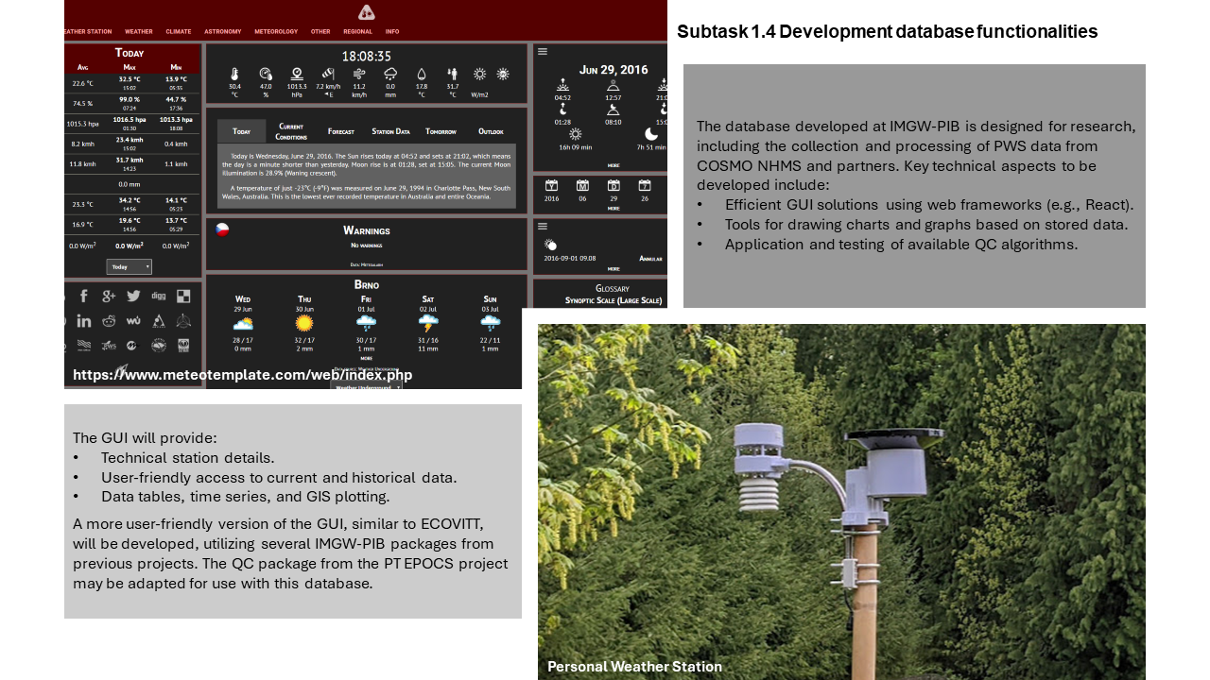
COSMO PP APOCS Tasks

Slide 13
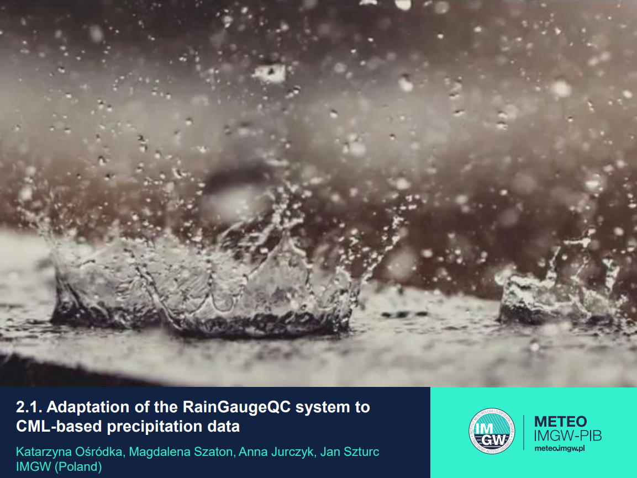

Slide 14

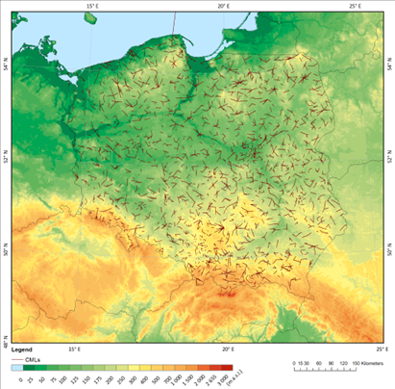
COSMO PP APOCS Tasks
SubTask 2.1: Adaptation of the RainGaugeQC system to CML-based precipitation data
CML-based precipitation is characterized by a spatial distribution and error structure very different from point rain gauge or spatial radar data.
The uncertainty in the precipitation estimation depends on the length of the link, the signal frequency, interference from moisture in the atmosphere, among others.
Many of these factors are impossible to quantify. It is therefore necessary to develop a QC methodology that takes these specifics into account.
Participants: Katarzyna Ośródka, Magdalena Szaton, Anna Jurczyk, Jan Szturc (IMGW-PIB)

Slide 15
COSMO PP APOCS: Subtask 2.1 status
Current status of work
Dictionary files were prepared with lists of commercial microwave links (CMLs) treated as virtual rain gauges.
CML data was processed and converted to formats compatible with the RainGaugeQC system, including conversion to a final time resolution of 10 min.
Work is currently underway to improve the loading of this data at the same time as data from telemetric rain gauges, and to adapt this software to precipitation data obtained from CMLs, which have a much more complex spatial structure.

Slide 16


COSMO PP APOCS Tasks
SubTask 2.2: Titan lib applied to “not conventional” raingauge datasets
It is useful and interesting to apply the QC (Titan software) also to "non-official" free networks, for instance “Meteonetwork”
Participating scientists: Francesco Uboldi, Elena Oberto, Massimo Milelli (CIMA)
SubTask 2.3: Quality control procedure for T2m and Rh2m%
Primary scope: apply Spatial Consistency Test (SCT, new R code developed) to the official temperature dataset and to study and investigate the results.
Furthermore both Titalib and SCT R code can also be applied to relative humidity (RH) official dataset for the quality control.
A new QC procedure will then be developed in Python specifically for NetAtmo data and compared to the Titanlib package
Participating scientists: Francesco Uboldi, Elena Oberto, Massimo Milelli (CIMA), Valeria Garbero (Arpa Piemonte), Tanguy Houget (Politecnico di Torino)

Slide 17
COSMO PP APOCS: Subtasks 2.2 & 2.3 status
Current status
The quality control procedure is operationally applied at CIMA every day/month for National Civil Potection meteorological data
Development of Python procedures in order to download Meteonetwork dataset
Metadata and weather station registry check on T2m and RH% (Dew point) have been implemented and made operational
A 4-step Quality Control Sequence has been established
Spatial Consistency Test (STC) reimplemented in R for detailed analysis of its effects or behaviour, further refinements required
Development of a new quality control procedure for NetAtmo observational data

Slide 18

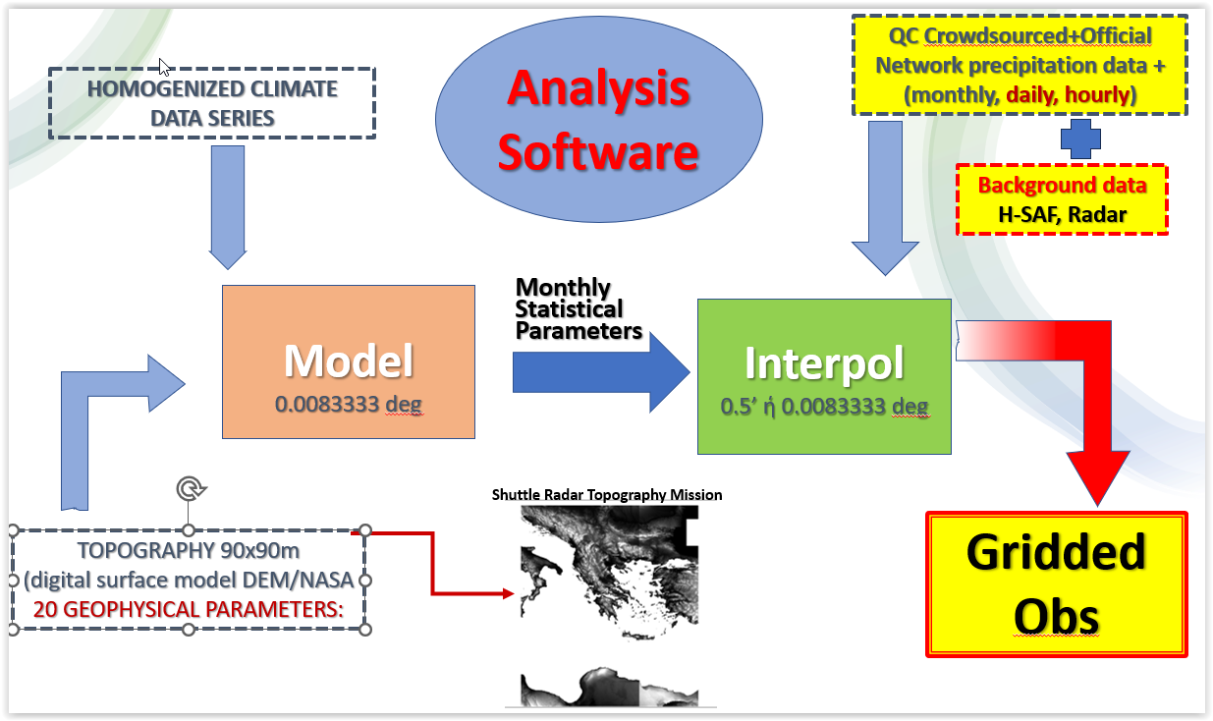
COSMO PP APOCS Tasks
TASK 3: Adaptation of private/citizen datasets for verification purposes over Greece

Slide 19
COSMO PP APOCS Tasks
TASK 3: Adaptation of private/citizen datasets for verification purposes over Greece
SubTask 3.1: Titan lib applied to meteorological data in the Greek domain
Installation testing and application of TITAN software for a quality control of Temp and Preci over the Greek domain.
Gather meteorological datasets from private networks and crowdsourced data, focusing on areas with inadequate coverage of the HNMS network is. The terms of operational/research use of such data will be identified.
Application of TITAN software package for a quality control of ground measurements from the "official" network of stations of HNMS, and "non-official" network
Set up an optimized methodology for production of a reliable - quality controlled - homogenenized dataset of point measurements
Participants: Dimitra Boucouvala, HNMS.

Slide 20
COSMO PP APOCS: Subtask 3.1 status
Current status
TITAN was installed and some sample programs for precipitation were tested for the Italian domain with sample data input
Clarifications on the parameters (e. g. deviation and thresholds) may be needed and discussed

Slide 21
COSMO PP APOCS Tasks
TASK 3: Adaptation of private/citizen datasets for verification purposes over Greece
SubTask 3.2: Climatology based Interpolation methodology of precipitation data from various sources
A verification procedure must be based on equally realistic and detailed observations as high-res forecasts. Precipitation observations from “official” and “unofficial” networks together with remote sensing data can only increase the accuracy of the “true” location of rainfall events.
Methodology to create precipitation gridded datasets for areas with complex terrain as Greece, which is based on an interpolation method that uses long climate data series to determine the geographical characteristics that this parameter is best correlated with, as well as remote sensing estimates as background information to cover the areas where observations are insufficient.
Application on datasets resulted from SubTask 3.1, with the addition of H-SAF precipitation estimates mainly to over sea areas that ground observations are not available.
Participants: Flora Gofa, HNMS.

Slide 22
COSMO PP APOCS: Subtask 3.2 status
Current status
MISH software have been installed on the local machine
Using homogenized long time series of precipitation data from the HNMS network to calculate the best correlations with geophysical data

Slide 23
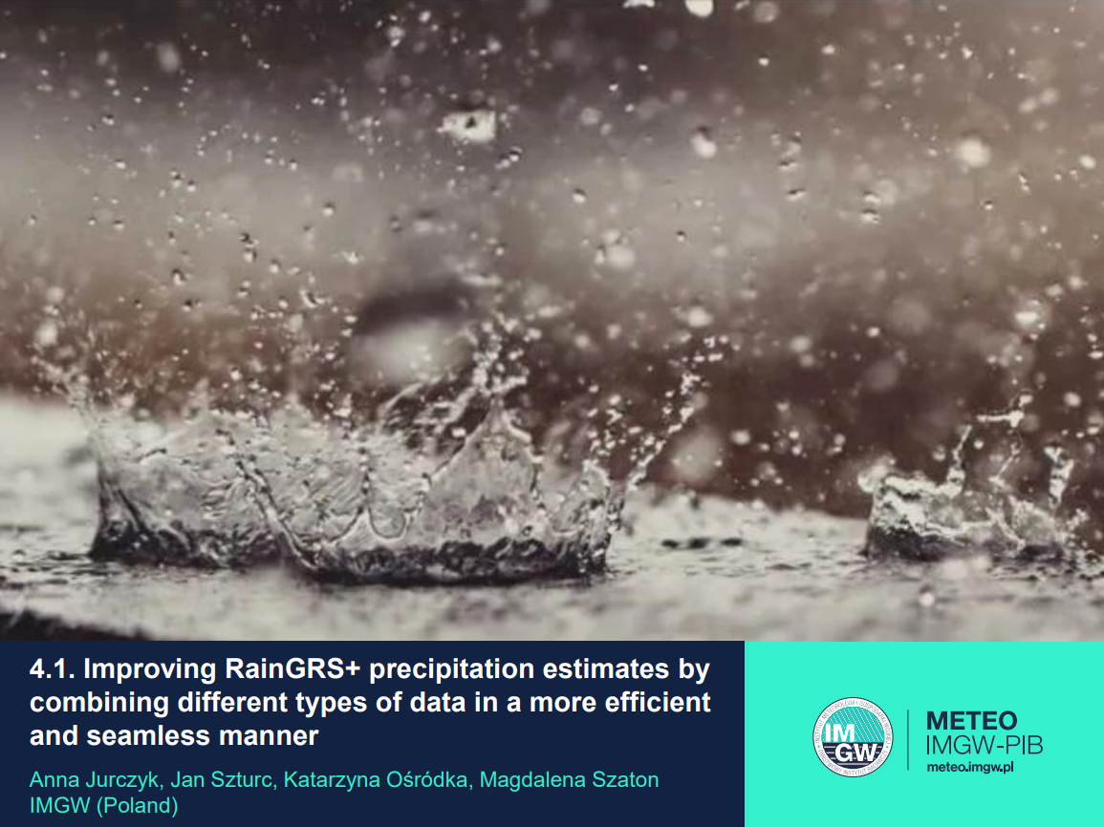

Slide 24
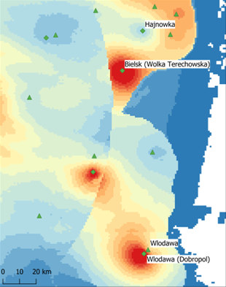
COSMO PP APOCS Tasks
SubTask 4.1: Improving RainGRS+ precipitation estimates by combining different types of data in more efficient and seamless manner
The RainGRS+ system, developed as part of the EPOCS project, requires improvements related to the specifics of the additional data included in the extended “+” version of the system, particularly the inclusion of OPERA radar composite maps.
These data, in addition to their lower spatial resolution (~2km), have a different quality, which depends on the institutions providing their data and the QC algorithms they use.
This requires the development of a technique to combine radar data of different origins for a seamless merging of POLRAD+ and OPERA data.

Slide 25
COSMO PP APOCS Tasks
SubTask 4.1: Improving RainGRS+ precipitation estimates by combining different types of data in more efficient and seamless manner
Planned works
In the frame of further work, a case study of implementation of the methodology for incorporating PWS and CML-based precipitation data into RainGRS+ system will be performed
Verification of the results will be carried out using precipitation from Hellmann's manual rain gauges (daily totals) as a reference.
In addition, the RainGRS+ system will be adapted to the new domains of the NWP model versions COSMO2.8 and ICON2.5.
Participants: Anna Jurczyk, Jan Szturc, Katarzyna Ośródka, Magdalena Szaton

Slide 26
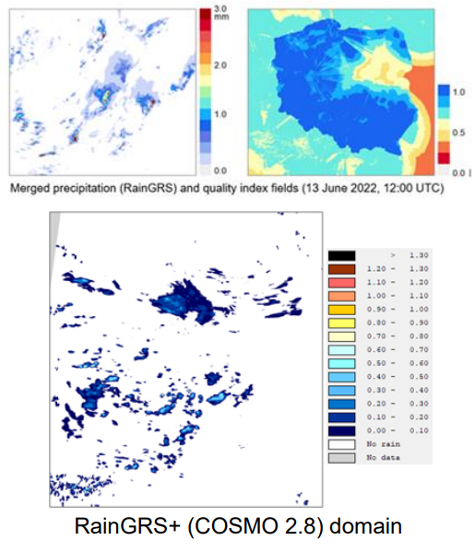
COSMO PP APOCS: Subtask 4.1 status
Current status of work
Work is underway to develop a technique for combining radar data from different sources in order to achieve a seamless connection between POLRAD+ and OPERA data.
Once access to precipitation data from the PWS and CML networks has been obtained, work will be carried out to develop a methodology for incorporating them into RainGRS+.
Currently, algorithms for data quality control (RainGaugeQC) are adapted to this data.

Slide 27
COSMO PP APOCS Tasks
SubTask 4.2: Spatial verification techniques based on gridded precipitation observations enhanced with crowdsource data
Spatial verification methodologies are subsequently applied to certain convective events that accentuate the relative skill of high resolution forecasts in revealing characteristics in the precipitation patterns such as structure and intensity that can be applied with equally detailed gridded observation fields.
Participants: Flora Gofa, Dimitra Boucouvala, HNMS.

Slide 28

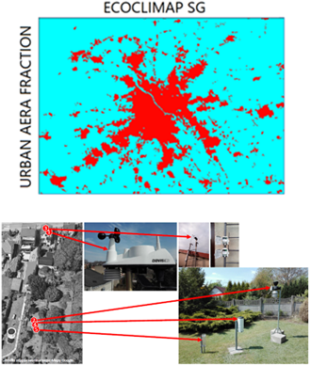
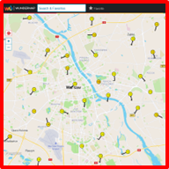
COSMO PP APOCS Tasks
SubTask 4.3: Application of PWS to NWP model verification in urban areas
Implementation of TERRA_URB in COSMO and ICON-LAM models has been made within PP-CITTA.
Local Climate Zones (LCZs) have been incorporated into TERRA_URB model based on ECOCLIMAP-SG land use data.
Better representation of urban heterogeneity in high-resolution NWP require also much denser observational network for model verification.
COSMO and ICON-LAM simulations will be evaluated based on measurements (temperature, humidity and wind) from PWS or other professional observational networks operated by independent agencies.
Participating scientists: Adam Jaczewski (IMGW-PIB)

Slide 29
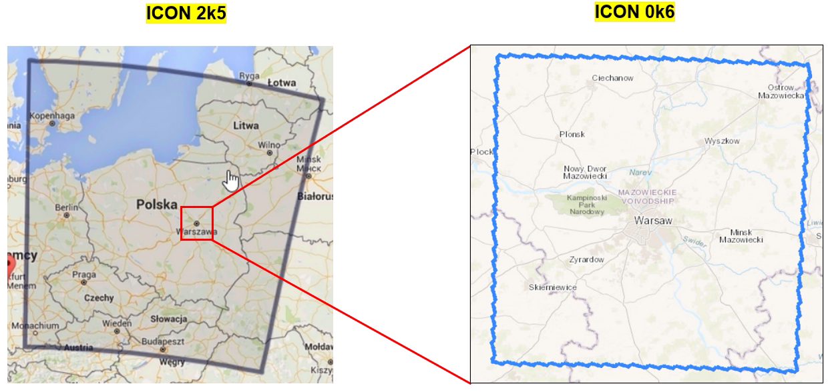
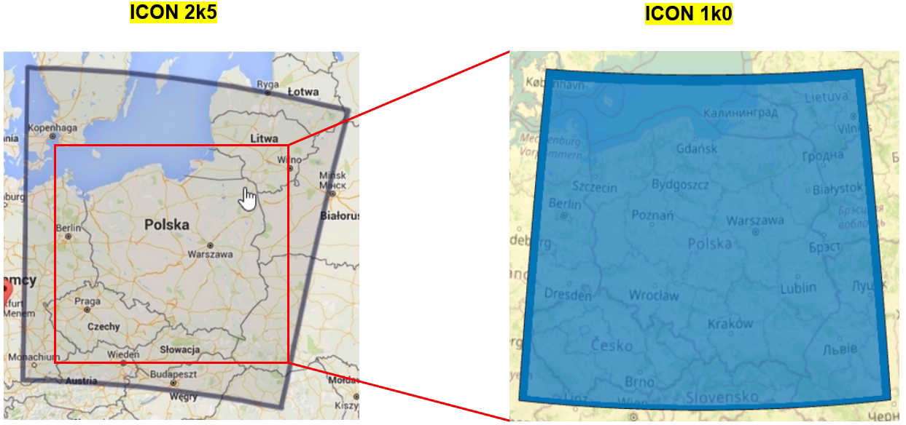
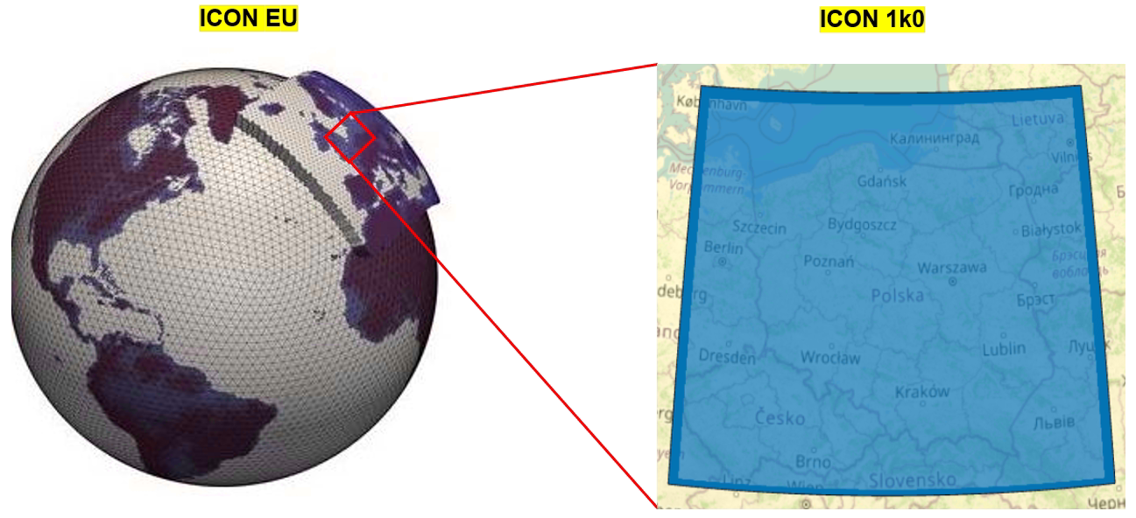
COSMO PP APOCS: Subtask 4.3 status
Current status
Currently, 3 possible nested domains are considered. Two of them are based on IMWM’s operational ICON 2k5 forecasting system.
The Warsaw domain has been introduced in PP CITTA. It is also possible to make high resolution forecasting system for Poland at 1 km resolution based on ICON 2k5 or driven directly by ICON EU.
The simulations will be run with TERRA_URB, and besides the PWS data, the RainGRS system will be used for verification of precipitation fields.

Slide 30
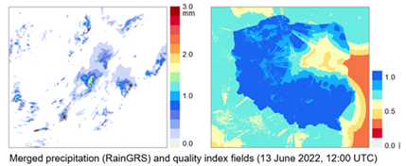
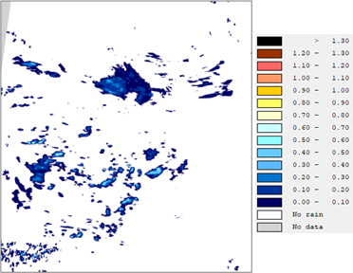
COSMO PP APOCS Tasks
Subtask 4.4: Application of gridded RainGRS+ precipitation estimates for assimilation in NWP models (COSMO-RUC)
Very short-range precipitation forecasts with
COSMO-RUC @IMGW-PIB at 2.8km and LHN data assimilation (DA)
Currently DA utilizes radar OPERA SRI precipitation composites at 2km resolution and 15 min frequency.
RainGRS+ composite developed in PT EPOCS includes PWS data at 1km resolution grid and 5 minute time intervals.
The performance of new COSMO-RUC setup and the quality of the NWP forecast with RainGRS+ composite will be performed
RainGRS+ (COSMO 2.8) domain
Participating scientists: Andrzej Wyszogrodzki, Artur Surowiecki, Anna Jurczyk (IMGW-PIB)

Slide 31
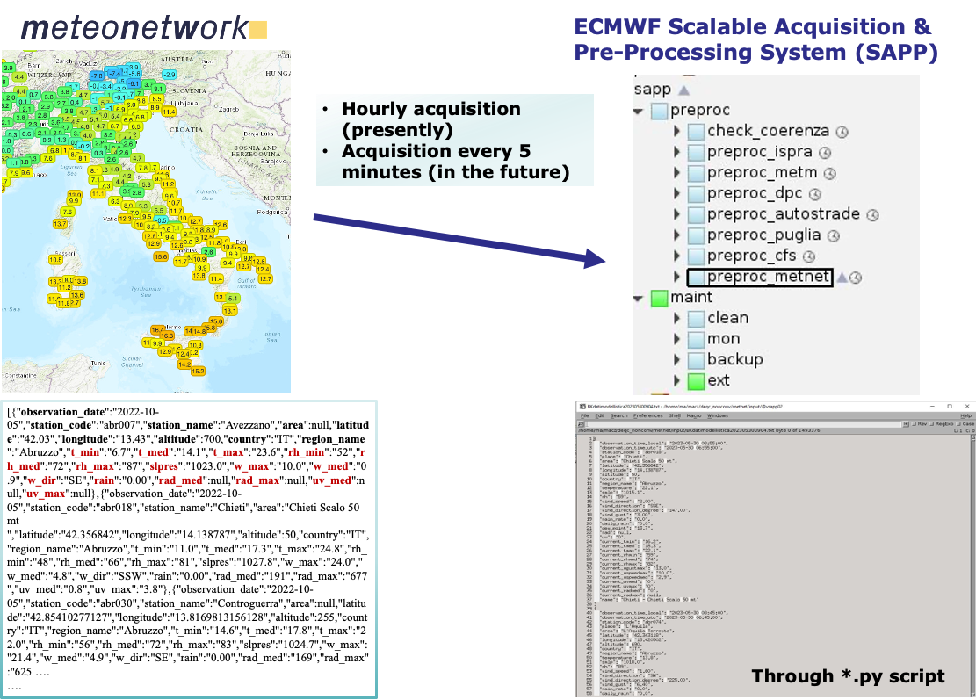
COSMO PP APOCS Tasks
Subtask 4.5: Application of Meteonetwork PWS at CNMCA: including observations in ICON-IT DA cycle
Participating scientist: Valerio Cardinali (CNMCA)

Slide 32
COSMO PP APOCS: Subtask 4.5 status
Current status
The first phase of works on assimilating observational (measurement) data from Meteonetwork into ICON 2.2 km model has been performed. It consisted of 2 steps:
Analysis of the observational data quality and comparison with conventional synoptic observation assimilated using a standard procedure
Assimilation of good quality temperature and wind data from Meteonetwork and running a parallel test with experimental settings.
Future plans:
Running the test for pressure and relative humidity observational data
Running similar experiments for other available unconventional weather station networks

