Slide 1
Impact of Gust Measurement Standards
Gust Measurement Standards and their Impact on Model Verification: MeteoSwiss 1s- versus WMO 3s-running-average
Pirmin Kaufmann, MeteoSwiss
COSMO GM, Basel, Switzerland, 1 September 2025

Slide 2
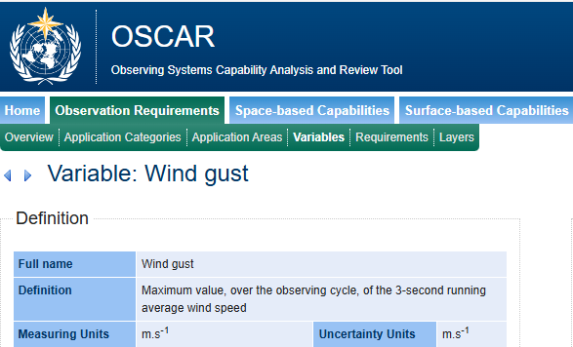
WMO Definition of Gust

Slide 3

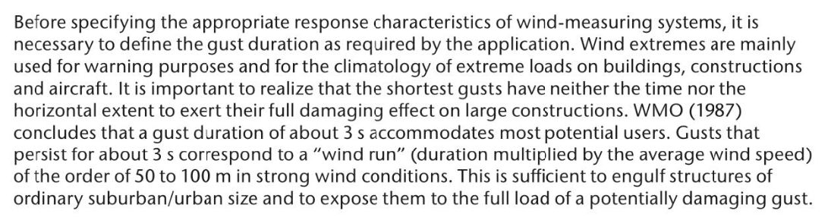
WMO-No. 8
Work = Force ∙ displacement
5.8.2 Peak gusts and standard deviation

Slide 4
However …
Country | NWS | Gust Definition
Germany | DWD | 3 s (to be confirmed)
France | MeteoFrance | 3 s (to be confirmed)
Austria | GeoSphere | 2 s
Italy | Meteo Alto Adige | 3 s (except mountain peaks: 1 s)
Italy | ARPA Lombardia, ARPA Piemonte | 5 s
Italy | Centro Funzionale Valle d’Aosta | 1 s
Switzerland | MeteoSwiss | 1 s

Slide 5
Measured Frequencies of Occurrence
All Swiss Stations; Winter (DJF) 2023/24, Summer (JJA) 2024, Winter 2024/25
Score | Season | 3s Gusts (WMO) | 1s Gusts (MCH) | Relative Change 3s → 1s
Frequency of medium gusts ≥ 12.5 m/s (≈ 25 kn) | Wi 23/24 Su 2024 Wi 24/25 | 9.9% 2.90% 7.6% | 11.0% 3.50% 8.4% | 11% increase 21% increase 11% increase
Frequency of strong gusts ≥ 20 m/s (≈ 70 km/h) | Wi 23/24 Su 2024 Wi 24/25 | 1.88% 0.227% 1.36% | 2.27% 0.295% 1.65% | 21% increase 30% increase 21% increase
Frequency of very strong gusts ≥ 25 m/s (= 90 km/h) | Wi 23/24 Su 2024 Wi 24/25 | 0.612% 0.058% 0.367% | 0.769% 0.072% 0.493% | 26% increase 24% increase 34% increase

Slide 6
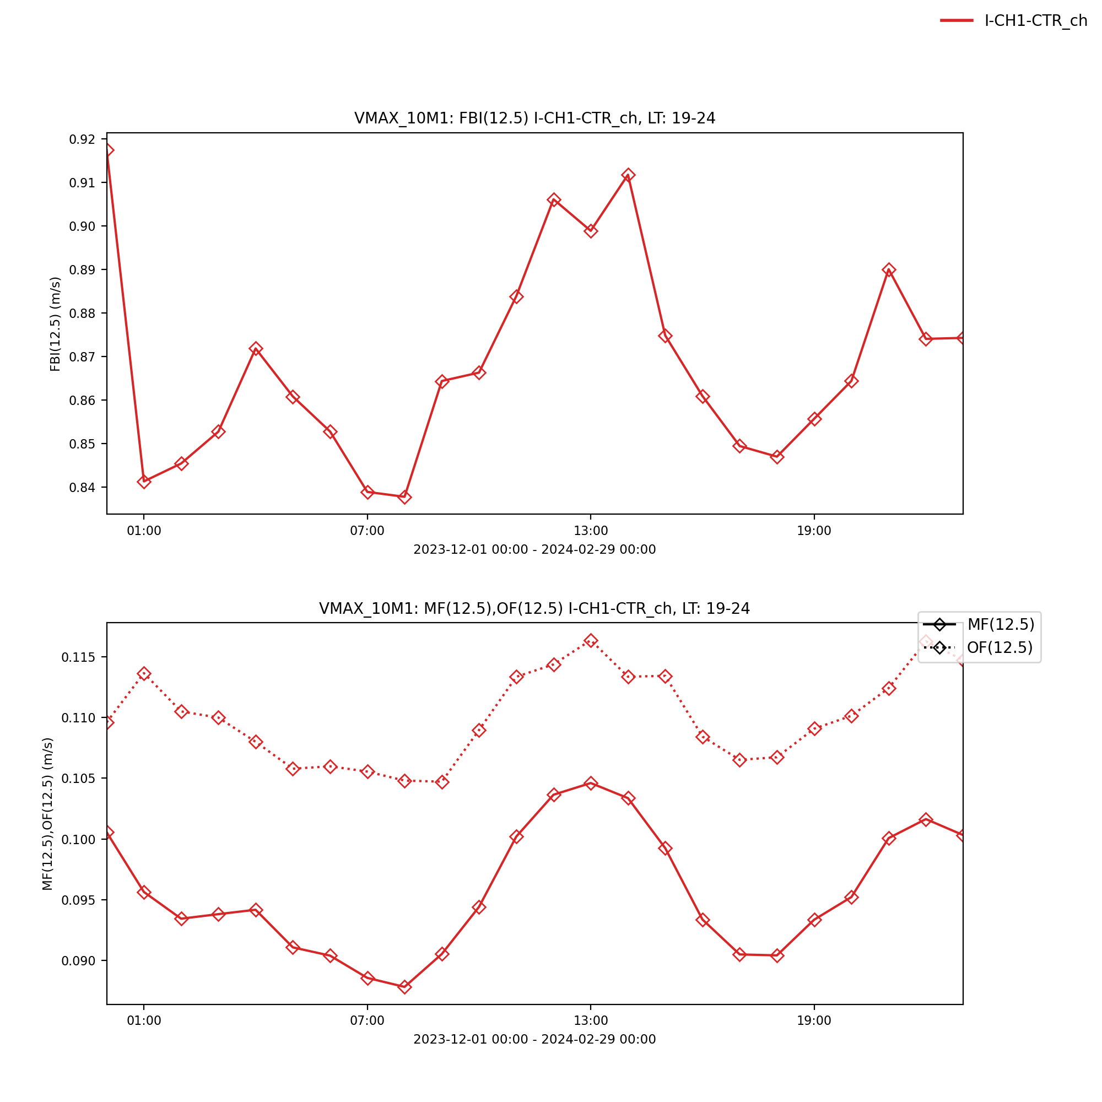
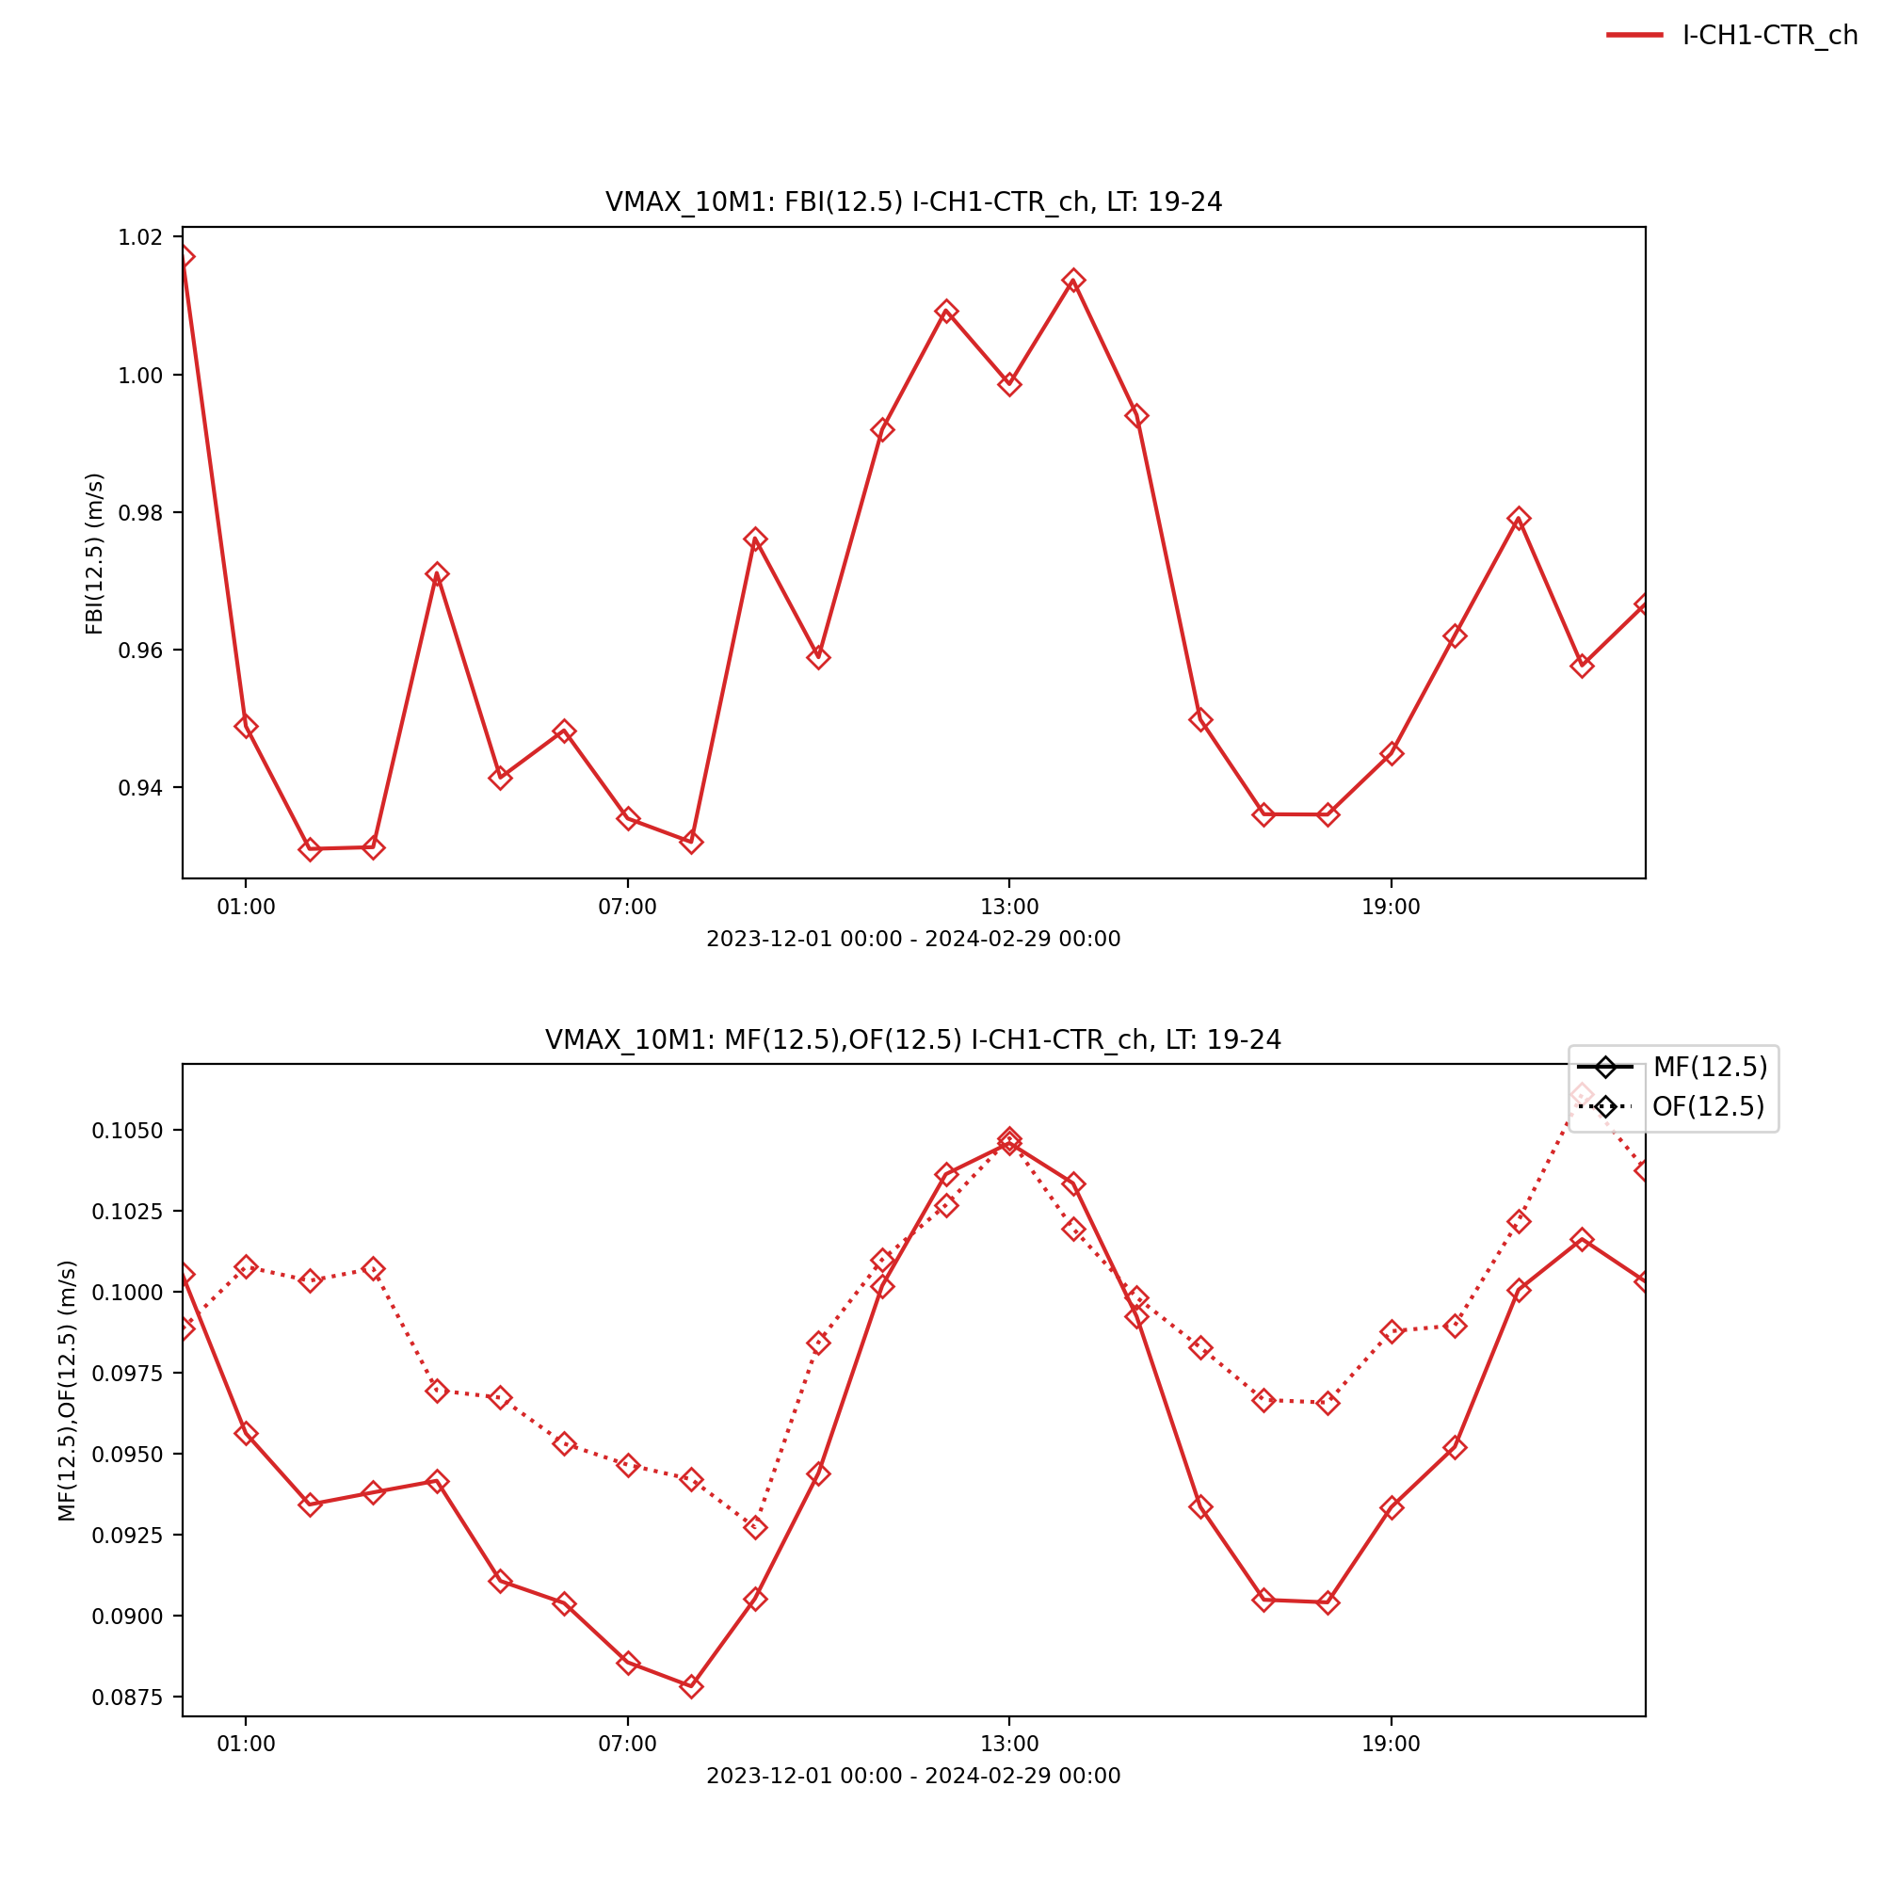
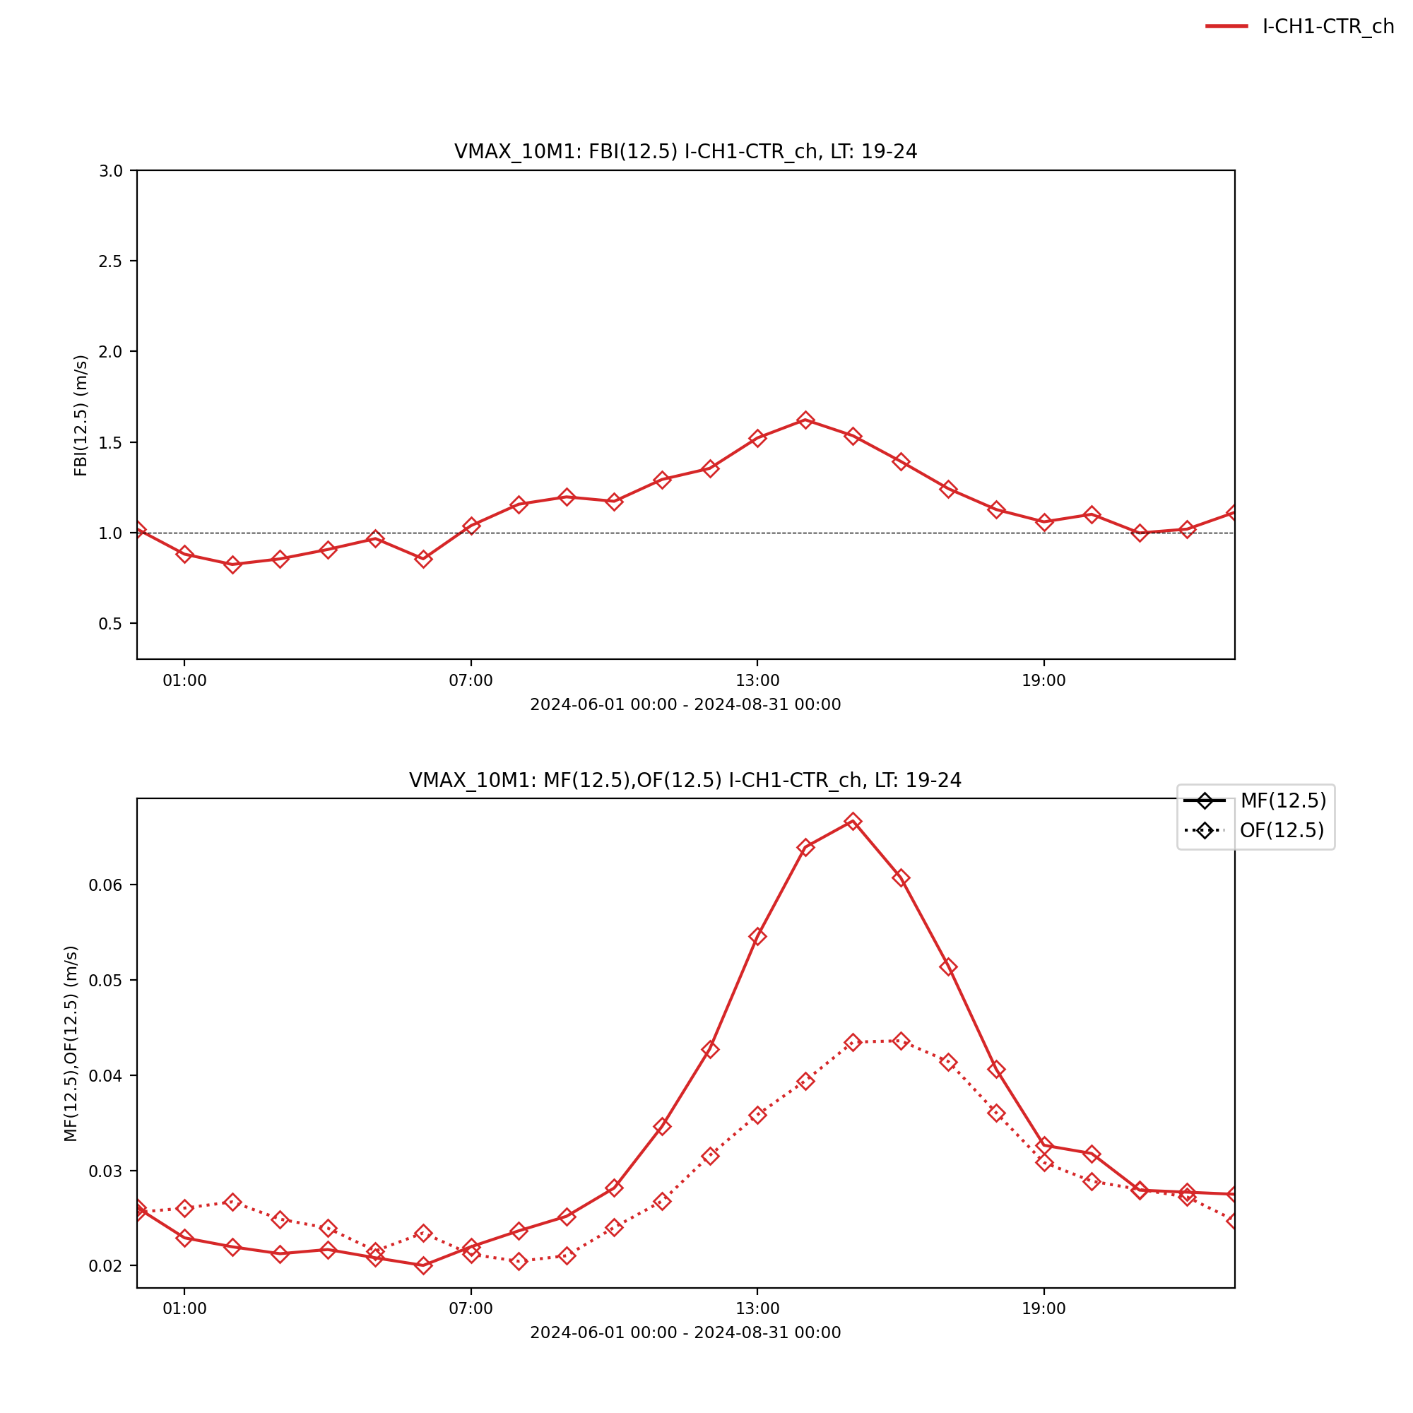

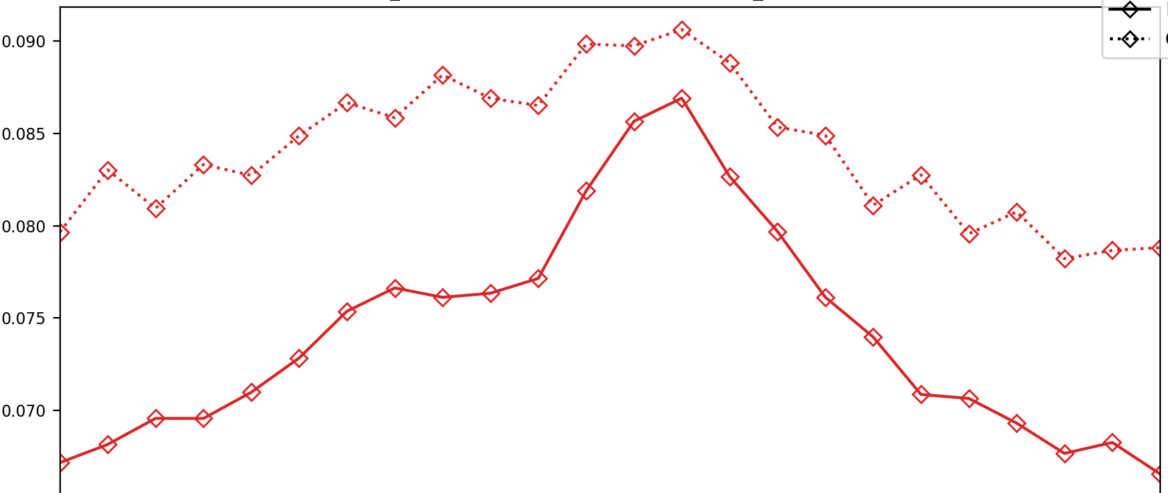
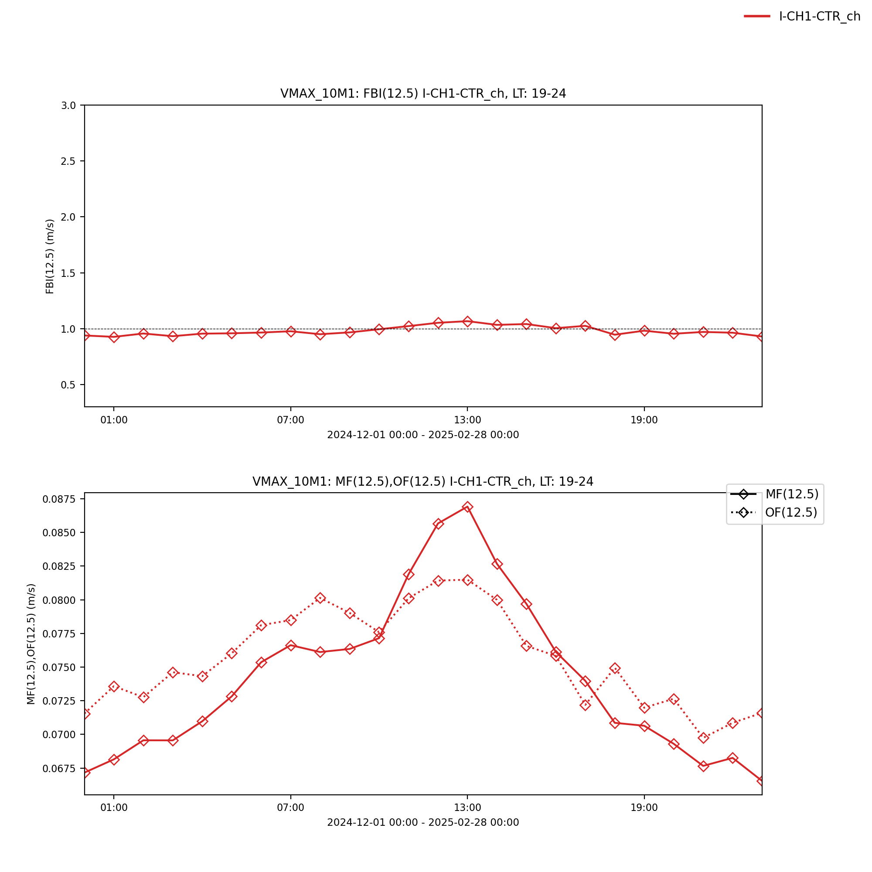
Freq. Medium Gusts
DJF 2023/24
Diurnal Cycle
Gusts > 12.5 m/s (≈ 25 kn)
◇⚊◇ ICON-CH1-EPS
◇𝌀◇ Obs: 1s gusts
◇𝌀◇ Obs: 3s gusts
JJA 2024
DJF 2024/25

Slide 7
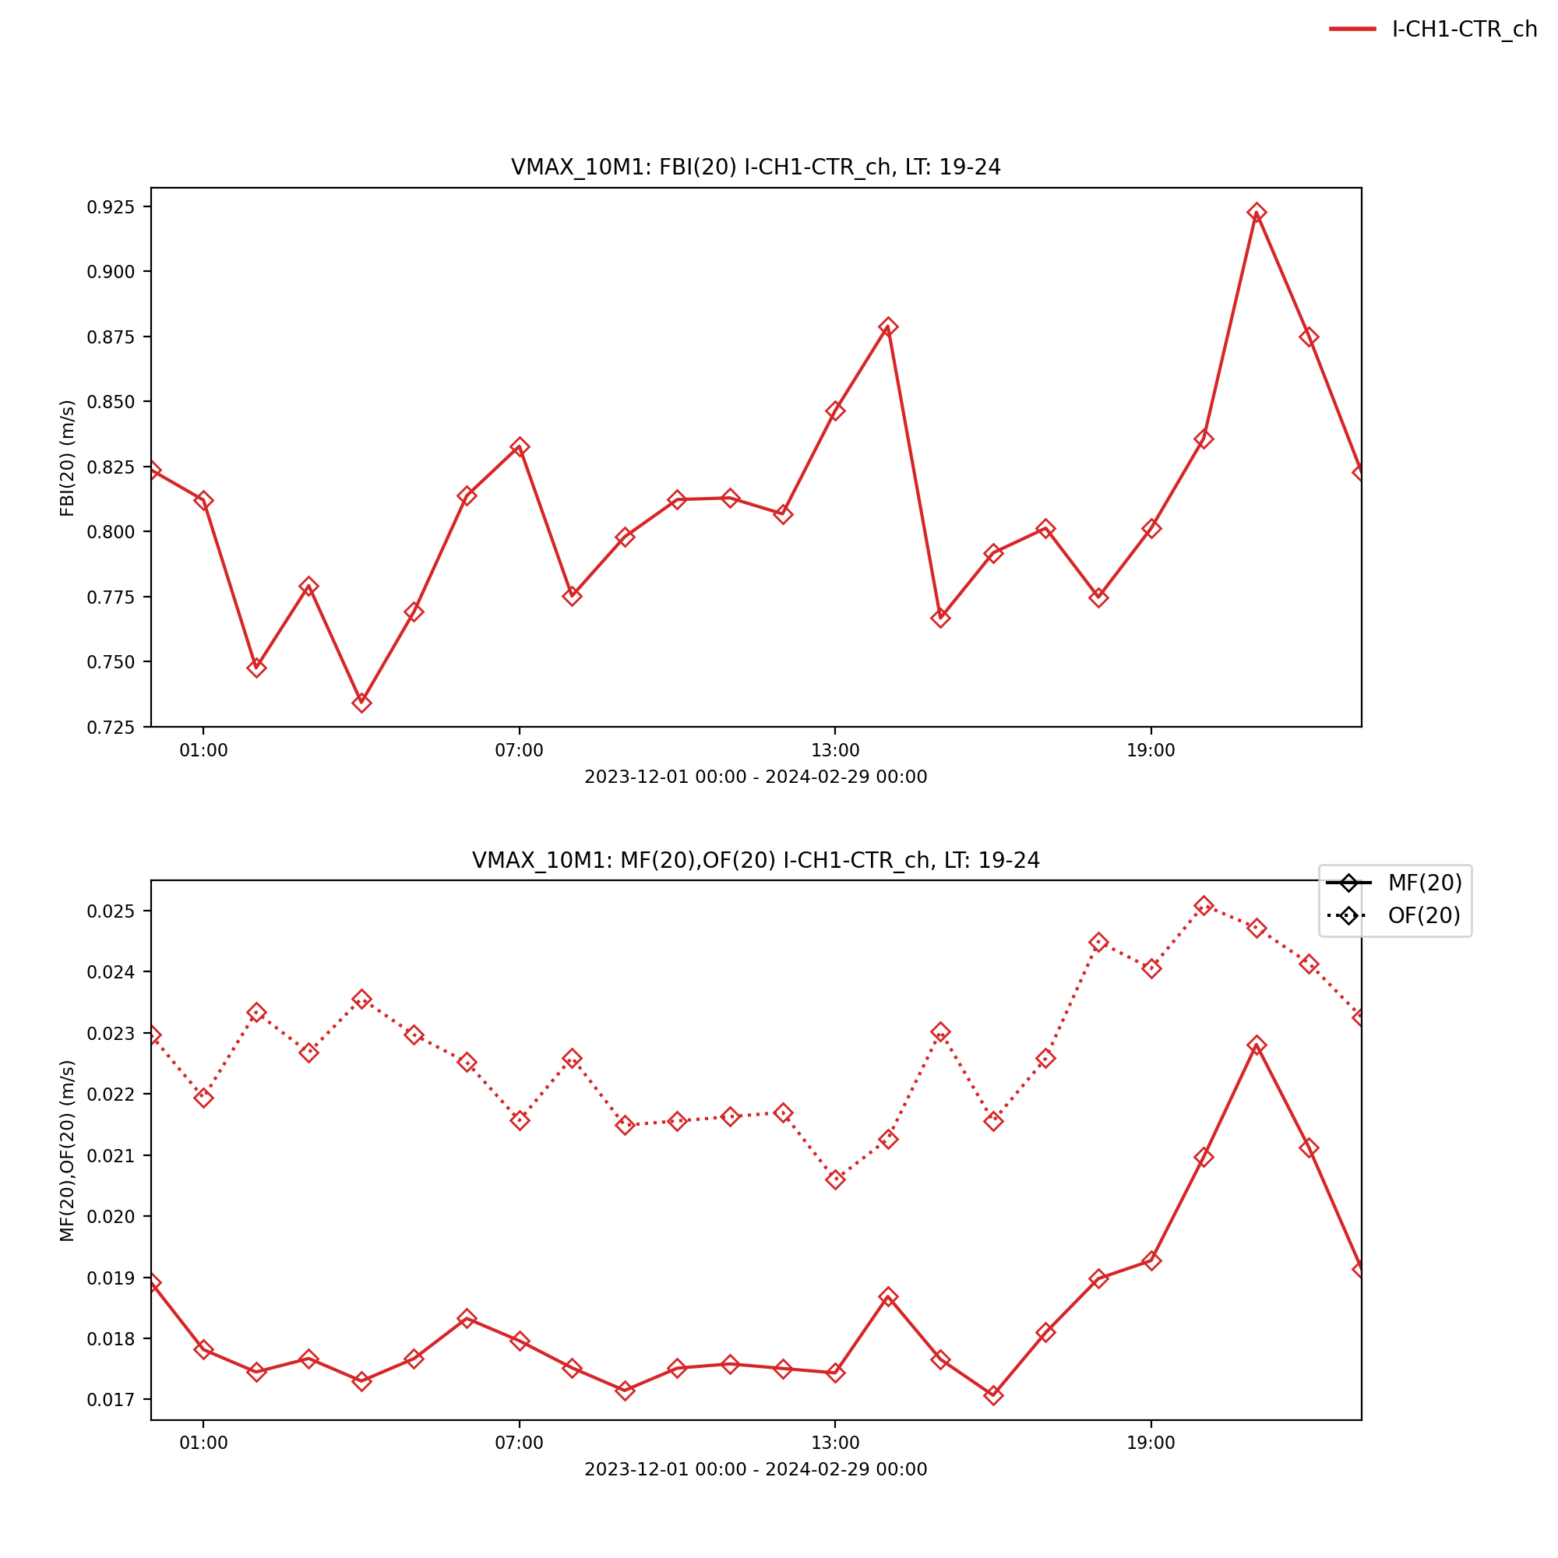
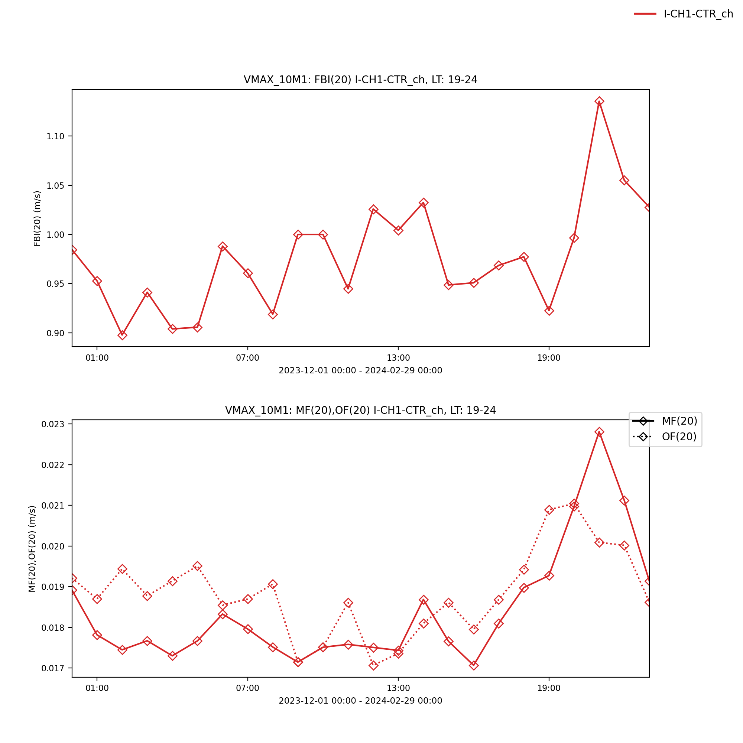
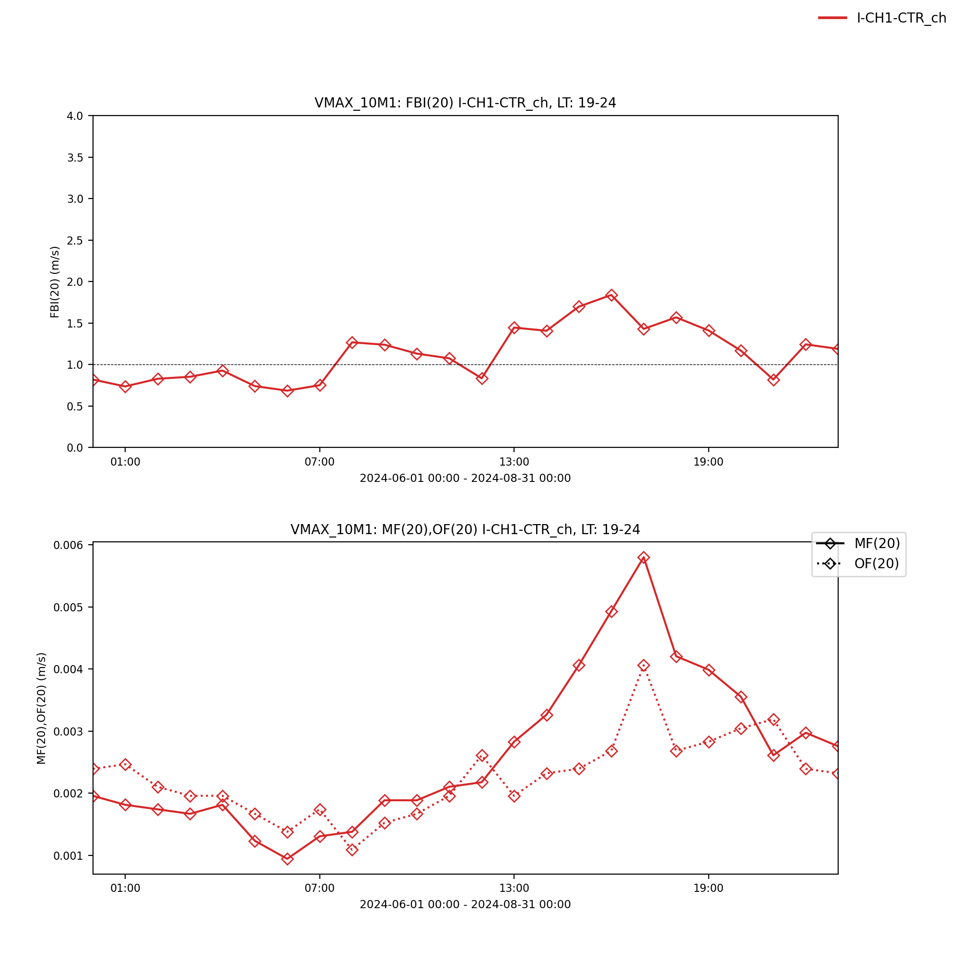
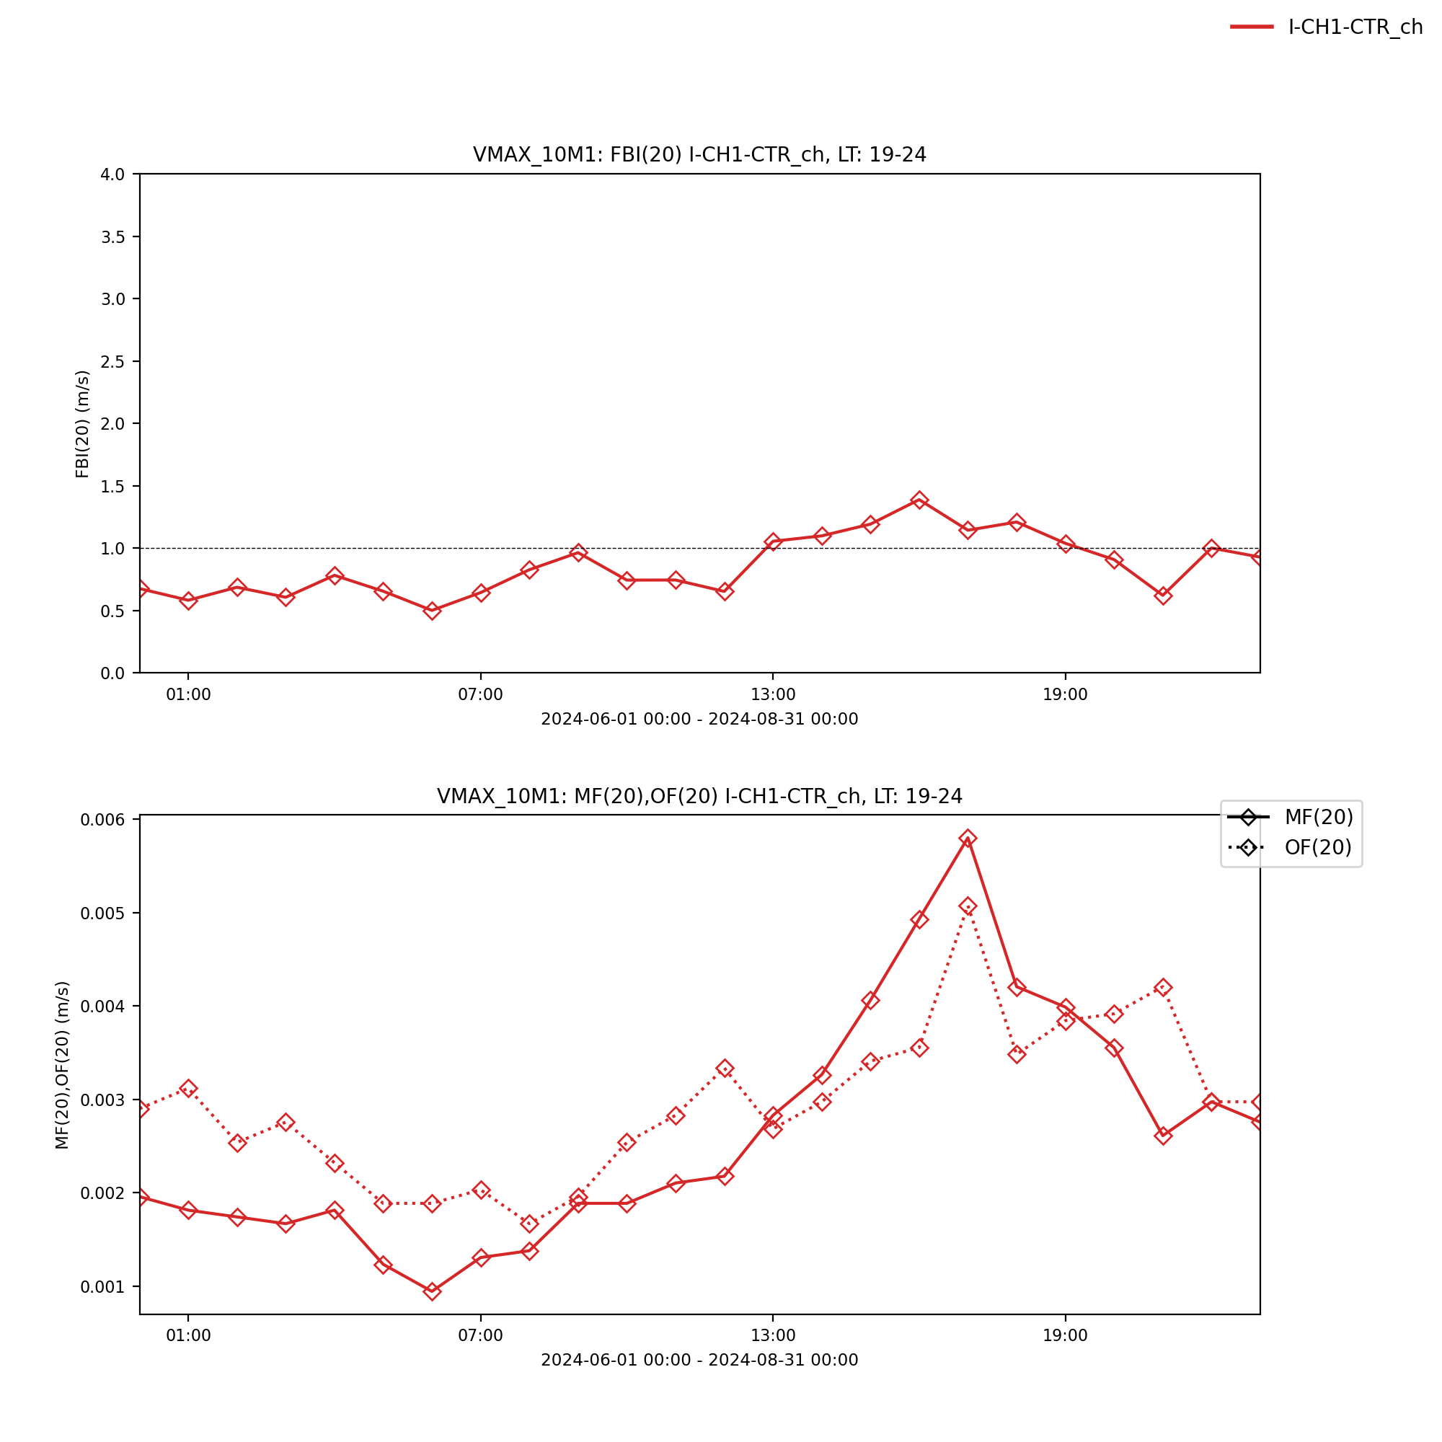
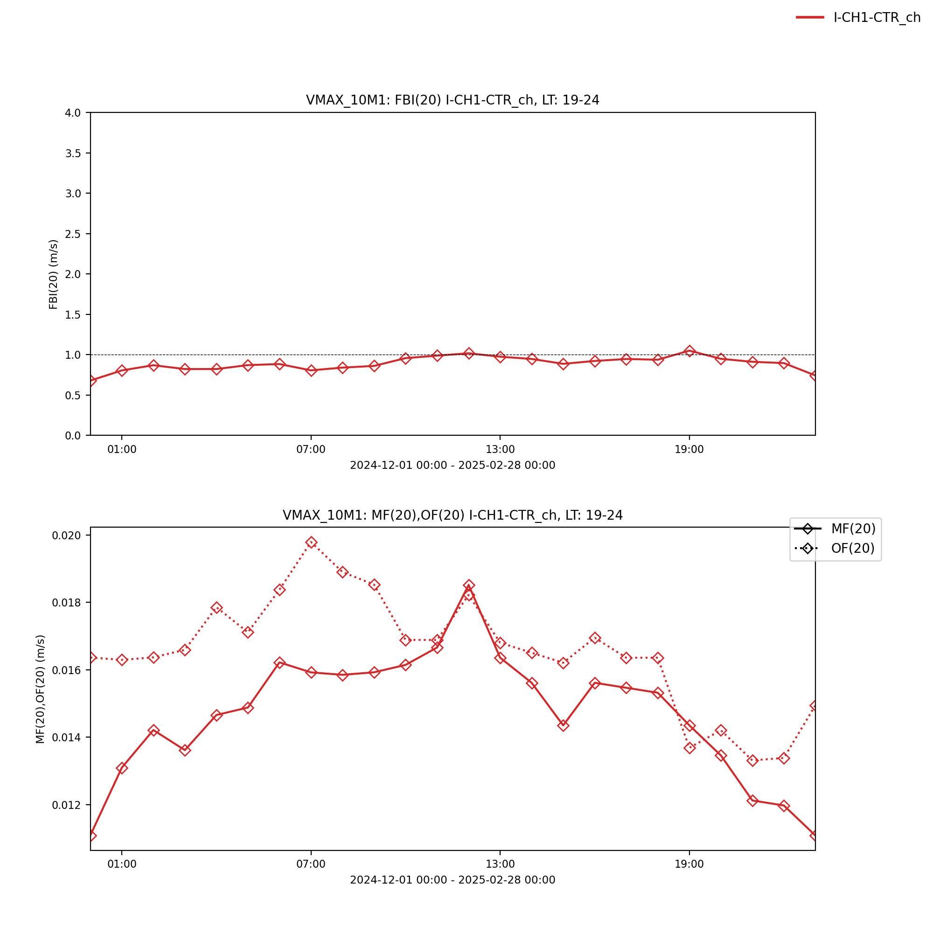
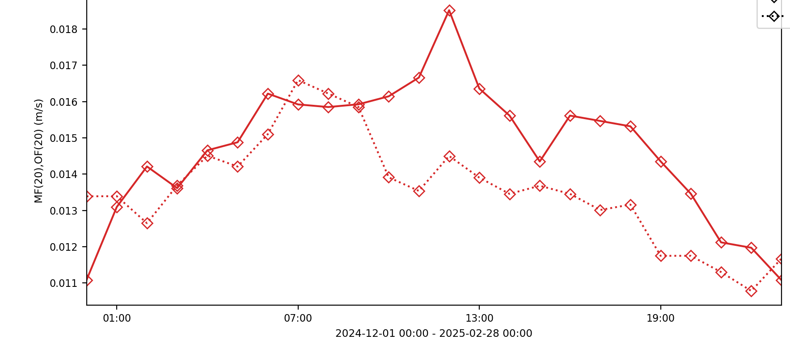
Freq. Strong Gusts
DJF 2023/24
Diurnal Cycle
Gusts > 20 m/s (≈ 70 km/h)
◇⚊◇ ICON-CH1-EPS
◇𝌀◇ Obs: 1s gusts
◇𝌀◇ Obs: 3s gusts
JJA 2024
DJF 2024/25

Slide 8
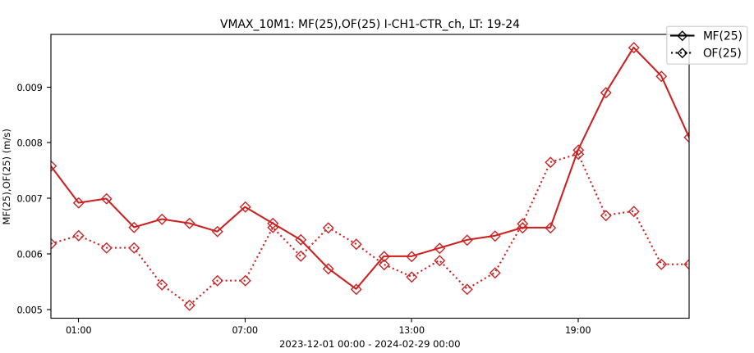
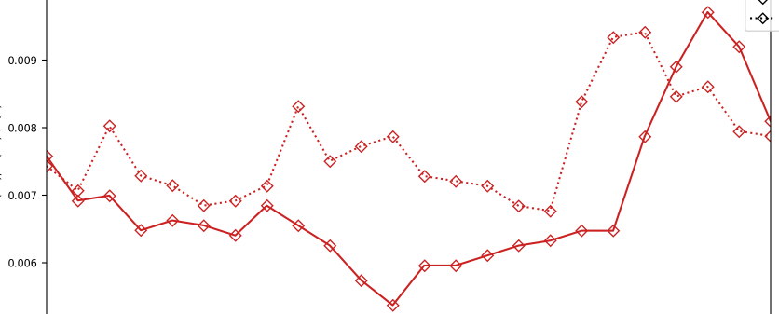
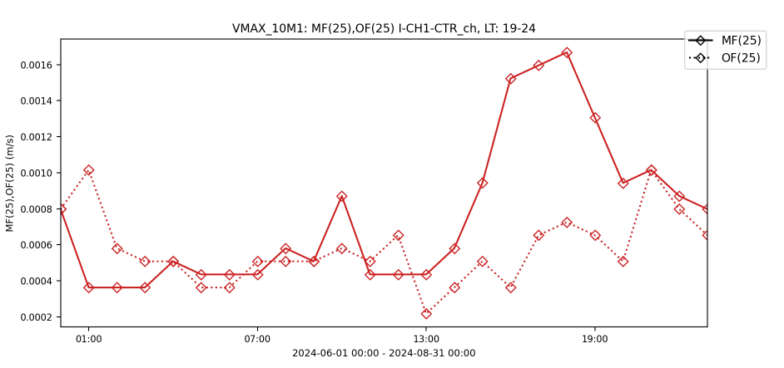
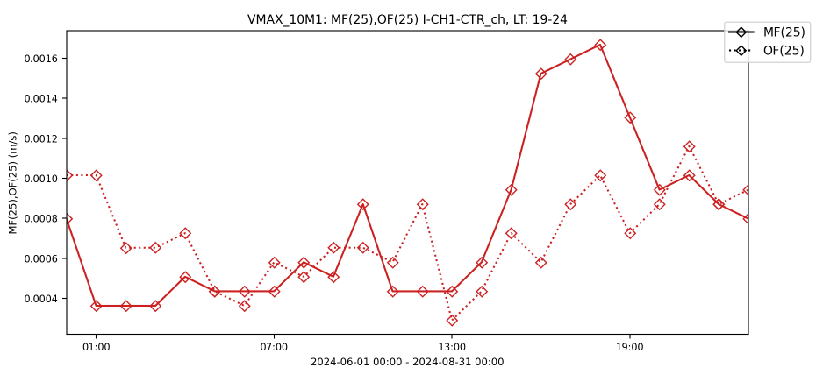
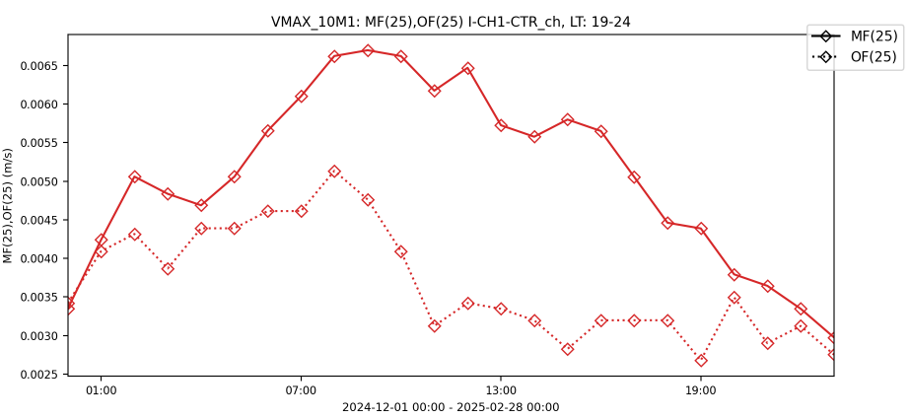
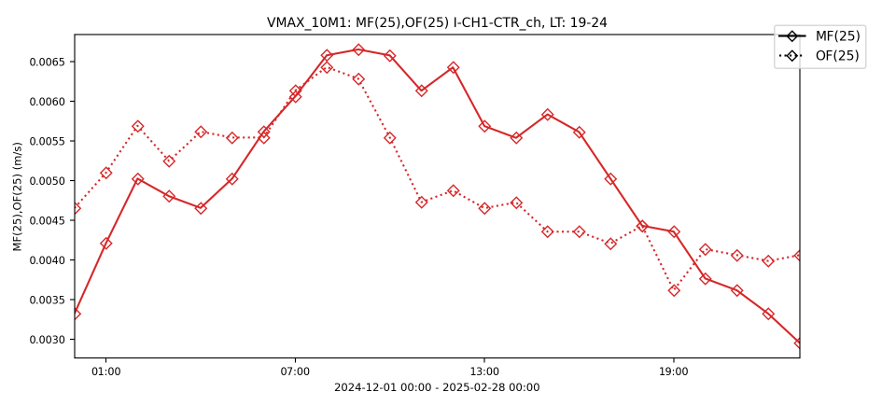
Freq. Very Strong Gusts
Diurnal Cycle
DJF 2023/24
Gusts > 25 m/s (= 90 km/h)
◇⚊◇ ICON-CH1-EPS
◇𝌀◇ Obs: 1s gusts
◇𝌀◇ Obs: 3s gusts
JJA 2024
DJF 2024/25

Slide 9
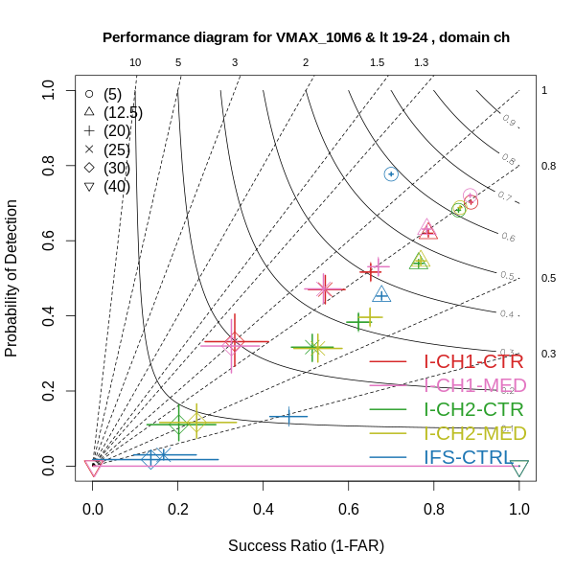
Model Performance 1 s Gusts 6 h Max.
Winter 2024/25
Weak gusts:
(seemingly) underestimated by ICON models
(overestimated by IFS)
Very strong gusts:
about ok in ICON-CH1
underestimated in ICON-CH2 (missing in IFS)

Slide 10
Change in ICON-CH1-EPS Scores
Score | Sea. | Change 1s → 3s Gusts | Relative Change
Frequency Bias ≥12.5 m/s | DJF JJA DJF | 0.87 → 0.96 0.97 → 1.17 0.88 → 0.98 | Decrease of underestimation (9% less) Overestimation appears (17%) Underestimation vanishes (10% less)
Frequency Bias ≥20 m/s | DJF JJA DJF | 0.81 → 0.98 0.89 → 1.16 0.89 → 1.08 | Decrease of underestimation (17% less) Change from under- to overestimation Change from under- to overestimation
Frequency Bias ≥25 m/s | DJF JJA DJF | 0.90 → 1.13 1.06 → 1.34 1.03 → 1.38 | Change from under- to overestimation Increase of overestimation (28% more) Increase of overestimation (35% more)
Eq. Threat Score ≥12.5 m/s | DJF JJA DJF | 0.44 → 0.44 0.25 → 0.24 0.44 → 0.44 | No change (similar for other thresholds and for Threat Score)

Slide 11
Summary
1s-gusts have 10% – 30% higher frequency of occurrence than WMO-conformant 3s-gusts
ICON-CH1 model always overestimates daytime gusts in summer, this worsens when compared to 3s-gusts
ICON-CH1 model often underestimates gusts in winter, this improves when compared to 3s-gusts
Threat Score (Success Index), Equitable Threat Score are insensitive to length of gust averaging period
Pirmin.Kaufmann@MeteoSwiss.ch

