Slide 1


PP CARMENS
PP-Leader Ioan-Stefan GABRIAN
with contributions from F. Fundel, Marsigli Chiara (DWD), F. Gofa, D. Boucouvala, T. Andreadis (HNMS), F. Batignani (CoMET), P. Khain, (IMS), A. Pauling, Pirmin Kaufmann (MCH), S. Dinicila (NMA) , Enrico Minguzzi(Arpae)
27th COSMO General Meeting

Slide 2


Project Objectives
Each participating service to have set up a web shiny platform where at least one season of scores based on local EPS system outputs, will have been calculated (MEC+FFV2) and uploaded. - All the applications of the system, mec, ffv2, shiny currently have the ability required to fulfil the project.
An EPS dedicated shiny platform on COSMO web that the stats (rdata) files from each EPS system plus COSMO-LEPS will be uploaded at least for a season following all the prerequisites of CP verification.
After the completion of the PP this infrastructure will be used for COMMON PLOTS activity for following year.

Slide 3
Task 1 | Administrative Tasks | Status | Start | End
1.1 | Administrative Tasks | Ongoing | 2022-09 | 2024-09
1.2 | Technical Support | Ongoing | 2022-09 | 2024-09
All the members of the PP CARMENs have been enrolled on gitlab for a better management of possible issues!
Hands on (up to 3 hours) meeting on 26th of August for problem solving.

Slide 4
Task 2 | MEC and Rfdbk system adaptations for EPS systems | Status | Start | End
2.1 | MEC instructions for Feedback Files based on EPS model output | Finalized: 05.2024 | 2022-09 | 2024-02
 | IFS ENS can no longer be processed by MEC
2.2 | MEC instructions of Rfdbk for ENS production and probabilistic scores | Finalized: 07.2024 | 2022-09 | 2024-02
2.3 | EPS evaluation guidelines as part of Common Plot activity | to be closed at a later date | 2022-09 | 2024-02
 | First draft of the deliverable available
2.4 | Scripts to produce verification scores for EPS forecasts | Finalized: 07.2024 | 2022-09 | 2024-02
 | Script examples/templates to produce the Scorefiles from model output
COSMO PP CARMENS Task 2 Deliverables available at:
https://www.cosmo-model.org/view/repository/wg5/PP-CARMENS/Deliverables

Slide 5
Task 3 | Semi-automatic use of the Rfdbk for ENS production and probabilistic scores | Status |  |  | Start | End
3.1 | Installation and adaptation of MEC-Rfdbk system for EPS | Started 06.2024 | Workflow implemented |  | 2022-09 | 2024-02
 | NMA, HNMS, DWD, MCH and IMS tested the verification system MEC/FFV2 successfully. PST tested succefully the procedures on ECMWF MARS
3.2 | Preparation of Seasonal FF and test with Rfdbk | Started 06.2024 |  | to be closed at a later date | 2022-09 | 2024-02
 | To produce 2 seasons of FF, ScoreFiles Provided the 2 months of verif data, DWD, MCH, IMS, NMA. HNMS produced but did not yet provide .
3.3 | Adaptation of Shiny visualization libraries for EPS | Started 06.2024 |  | to be closed at a later date | 2022-09 | 2024-02
 | NMA, DWD, MCH successfully installed a new version of Shiny server with all the ENS.
3.4 | Test of system features on Seasonal EPS forecasts over Common Area | Optional |  | TBD | 2022-09 | 2024-02
 | Dependent on the task 2.3

Slide 6
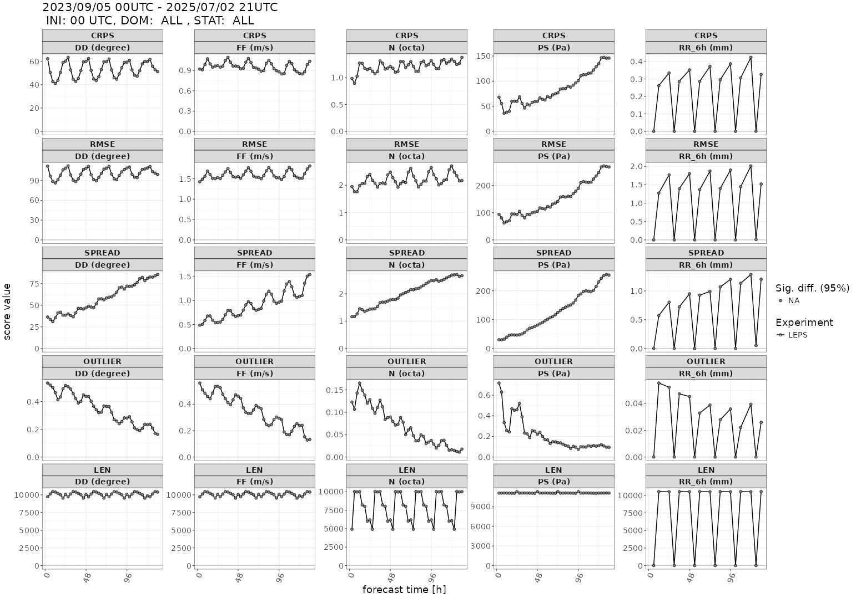

Slide 7
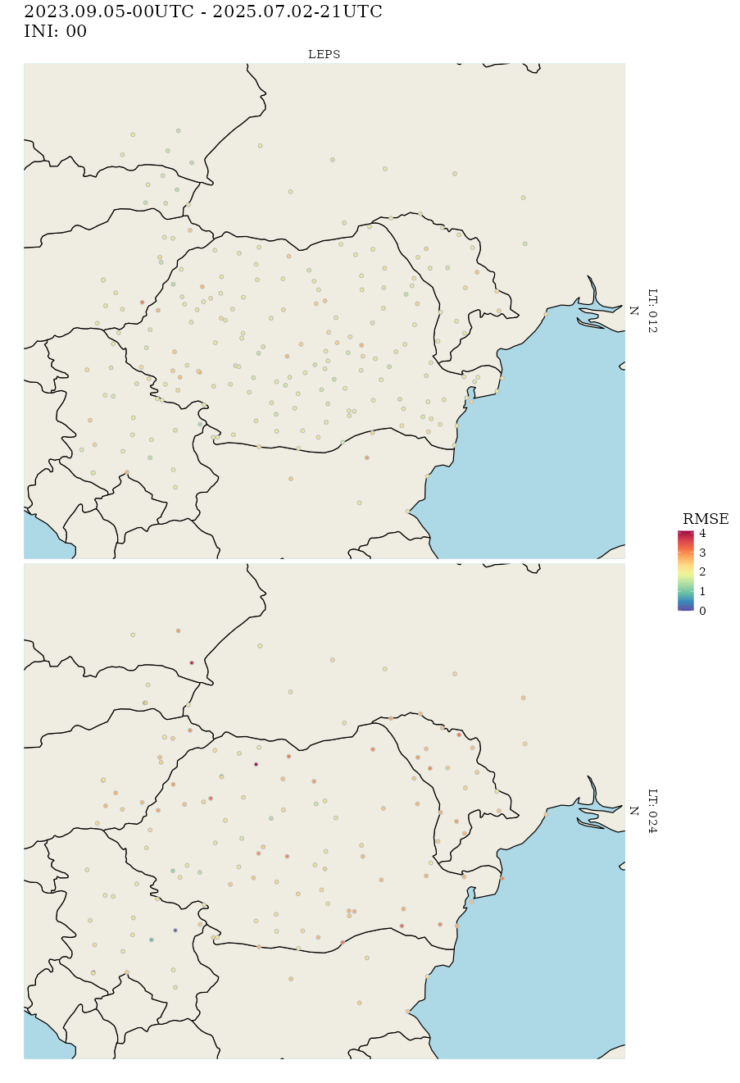
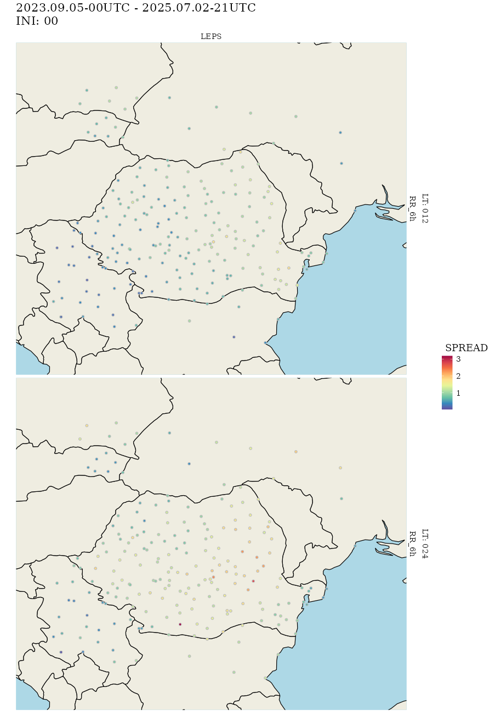

Slide 8
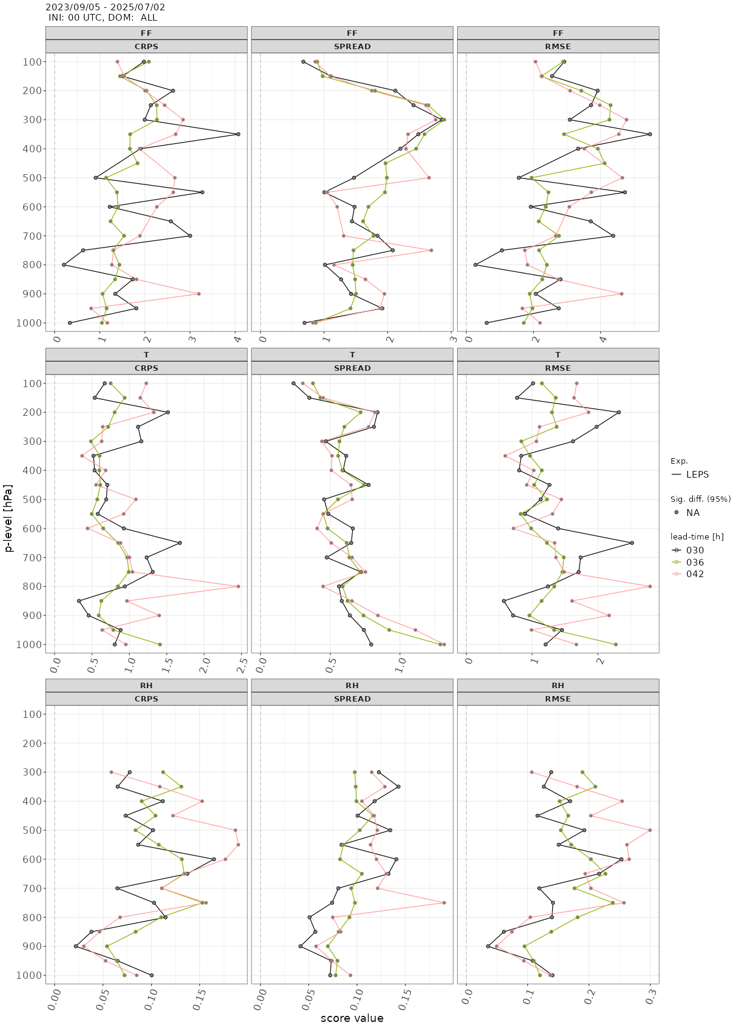

Slide 9
PP CARMENs
Delays due to lack of human resources generally
Guidelines and templates for MEC/ FFV2/Shiny Apps for ENS – available on GitLab.dkrz repository and on NMA FTP server
  DWD
  IMS
MEC/FFV2 and FF & scores / Local Shiny adaptation - unknown
  HNMS & NMA
Workflow & Tests / Some issues with missing fields – TB investigated
  MCH
Workflow & Tests / Scores for TEMP / Tackling cumulated field issues
  CNMCA & IMGW
Adaptation of the scripts and namelist for MEC / Work in progress
Project Support Team will continue to provide support for the remaining issues.
COSMO GM - Basel - September 2025
Notes:
9

Slide 10
Thank you for your attention!
COSMO GM - Basel - September 2025

