Slide 1
Priority Task EGALITE – work completed, final report
Andrzej Mazur, IMWM-NRI
Christoph Siewert, Deutscher Wetterdienst
Pirmin Kaufmann, MeteoSwiss

Slide 2
PT EGALITE - Early warninG and AnaLysIs sysTEm for release and dispersion of contaminants
PT EGALITE
Early warninG and AnaLysIs sysTEm
for release and dispersion of contaminants.

Slide 3
PT EGALITE - Early warninG and AnaLysIs sysTEm for release and dispersion of contaminants
Contents
Priority Task EGALITE – information, results, follow-up…
  Introduction
  Participants, models, domains …
  Survey
  First dry run
  Second dry run
  Status and summary – final report, extension PT→PP

Slide 4
PT EGALITE - Early warninG and AnaLysIs sysTEm for release and dispersion of contaminants
Introduction
A need for improvement/developing early warning systems (EWAS) being able to respond to release of toxic and/or harmful substances into the atmosphere.
”Early Warning” – the ability to quickly provide information about the occurrence of an event and its possible consequences.
Released contamination/pollution – dangerous due to its nature (i.e., radioactive, toxic…) and/or emission intensity (i.e., the amount released).
Operational EWAS use meteorological data (an output from operational meteorological forecast models).
PT EGALITE aims at gathering/exchange the experience available among COSMO partners on the connection: numerical weather forecasts – pollutant dispersion modeling in favor of new- and/or of existing EWAS that respond to the mentioned threats.

Slide 5
PT EGALITE - Early warninG and AnaLysIs sysTEm for release and dispersion of contaminants
Participants, models, domains…
Three main parties involved in the PT – DWD (Christoph Siewert), MeteoSwiss (Pirmin Kaufmann) and IMWM (Andrzej Mazur).
↓
Three dispersion models used for tests, dry runs and comparisons.
Every participants applied both high- and medium resolution domain to calculations

Slide 6
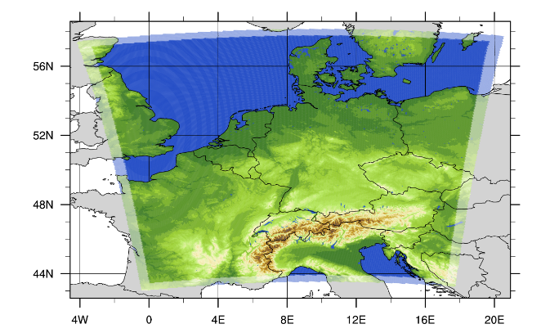
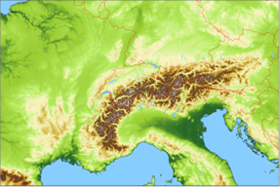
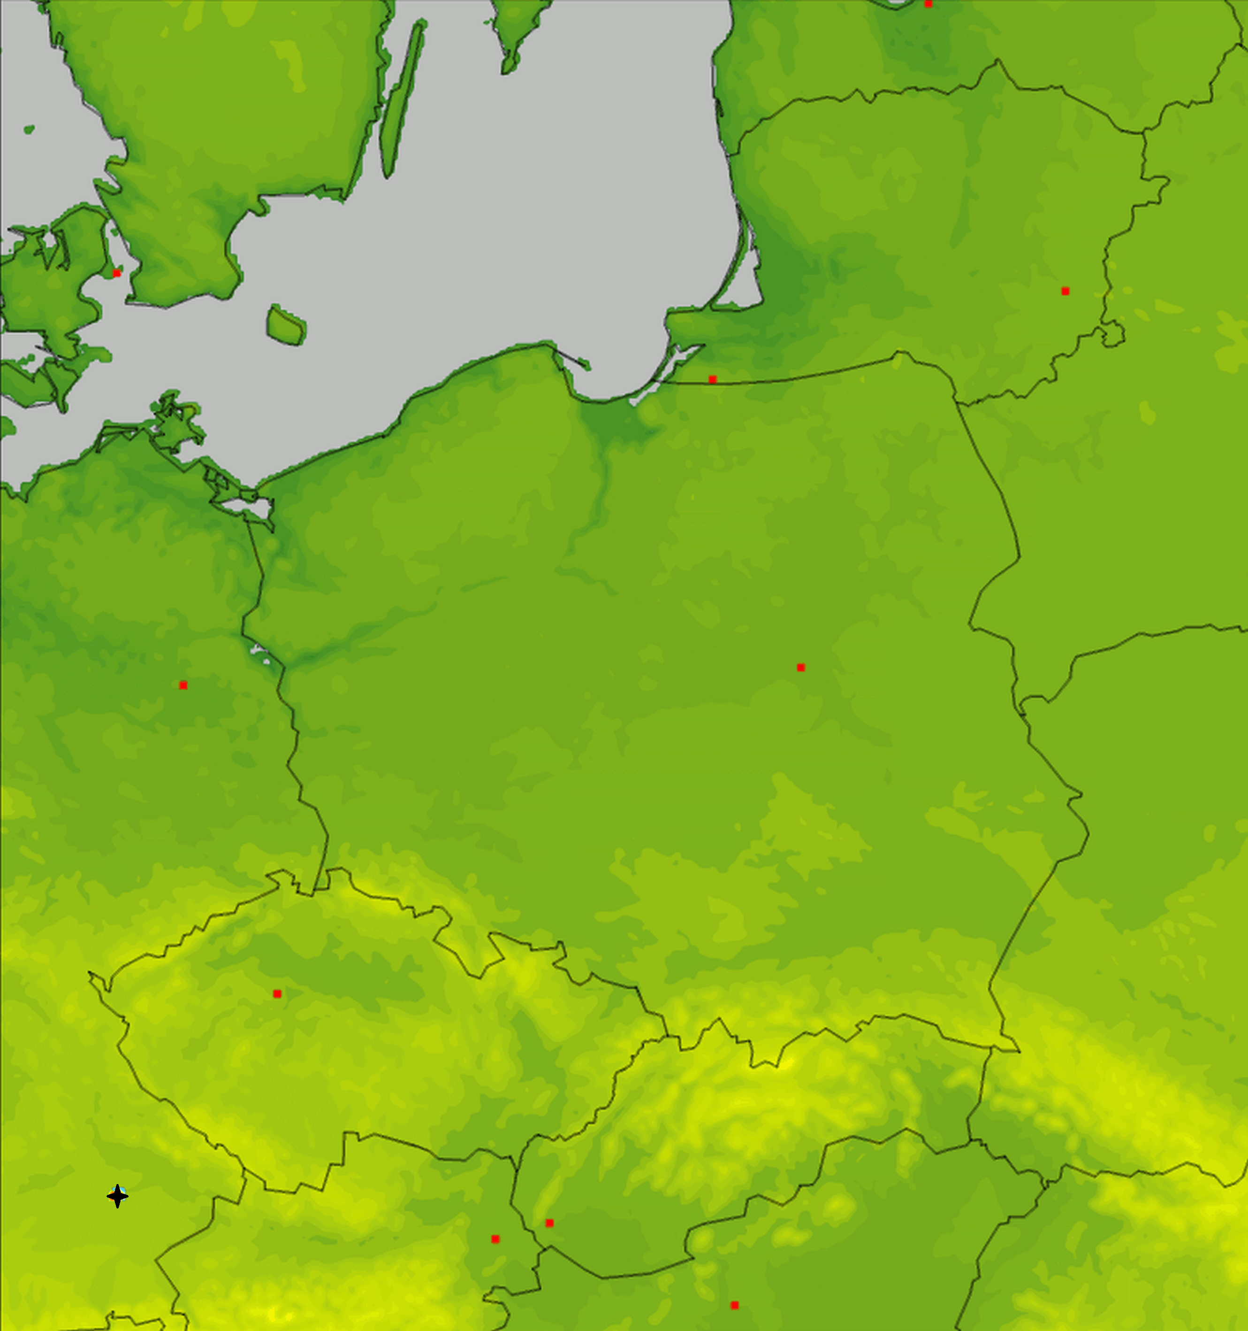
PT EGALITE - Early warninG and AnaLysIs sysTEm for release and dispersion of contaminants
Participants, models, domains…
IMGW – high resolution
(rotated lat-lon, 2.8 km, ~0.025°)
DWD – high resolution
(regular lat-lon, 0.02°)
MCH – high resolution
(rotated lat-lon, 1.0 km)

Slide 7
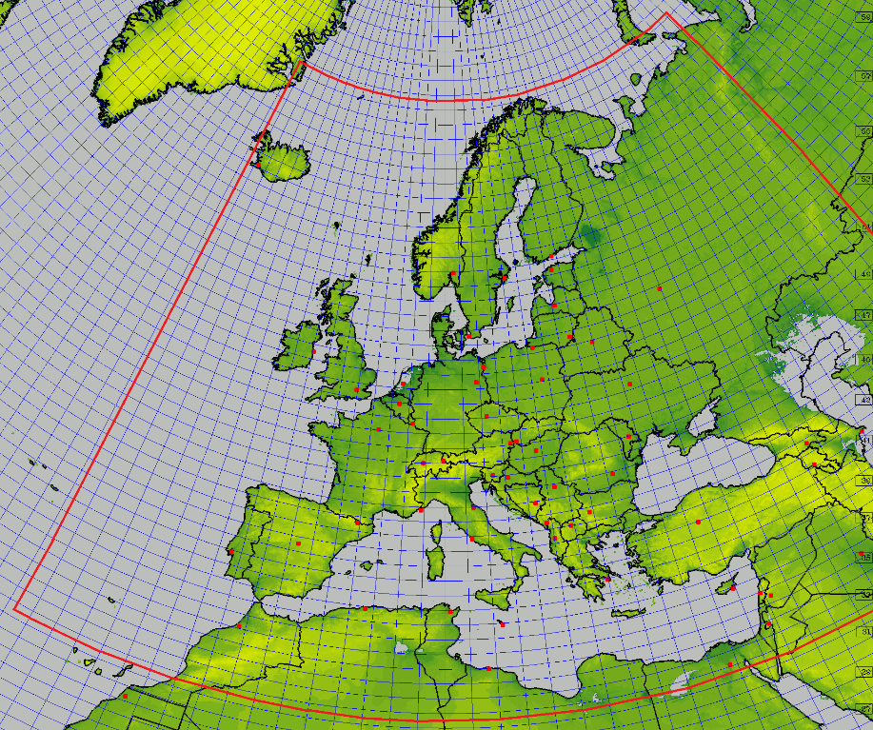
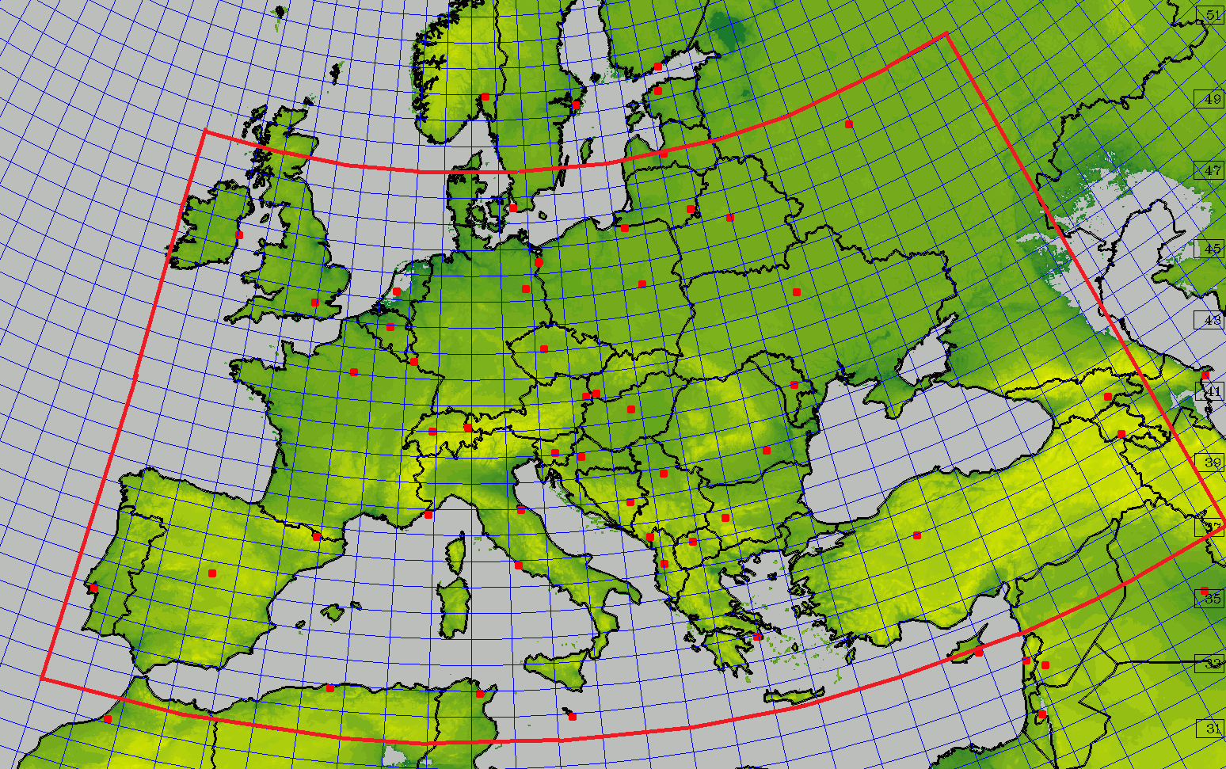
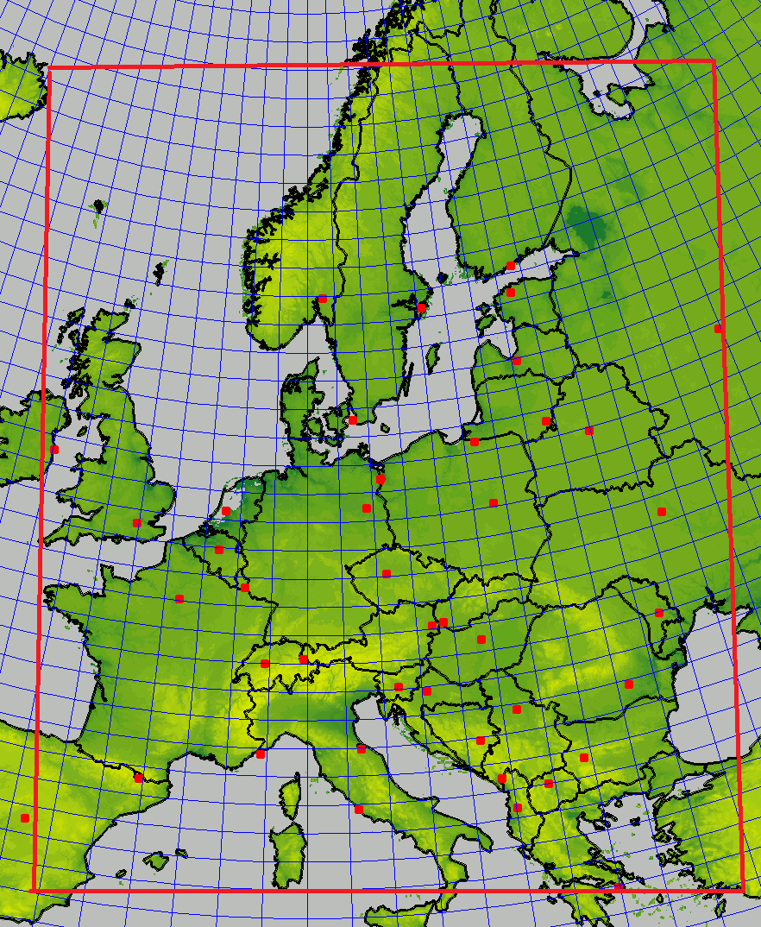
PT EGALITE - Early warninG and AnaLysIs sysTEm for release and dispersion of contaminants
Participants, models, domains…
IMGW – medium resolution
(rotated lat-lon, 7 km, ~0.0625°)
MCH – medium resolution
(regular lat-lon, 0.1°)
DWD – medium resolution
(regular lat-lon, 0.0625°)

Slide 8
PT EGALITE - Early warninG and AnaLysIs sysTEm for release and dispersion of contaminants
Survey
Subtask 1. General survey
Detailed review and survey of the systems running and plans for further developments at collaborating parties, description and comparison of scientific background, methods used and setup(s).
Deliverables:
Reports on review/survey; info on the comparison results, suggestions for further research.
Subtask 2. Tests and intercomparisons
Preparing and conducting exercises ("dry runs") regarding threats of potential releases from identified sources in domains specific to each participant and/or in a jointly established common area.
The results of such exercises will of course contribute to the final report.
Deliverables:
Intermediate reports, final report, comparison results, guidelines/ suggestions for further research directions, publication in JCR journal.

Slide 9
PT EGALITE - Early warninG and AnaLysIs sysTEm for release and dispersion of contaminants
First dry run
Subtask 2 – first test ("dry run")
  The first "dry run" for release of radioactive material from NPP of Isar, Germany (it is no longer operational but, still, it is in the "common area" of our domains for dispersion calculations).
  All participants did the calculations for both high- and medium resolution dispersion models.
  All participants did the calculations using own models AND own sets of (input) meteorological data.
  Results were transferred to – again – common area, to compare results not only qualitatively, but also quantitatively.

Slide 10
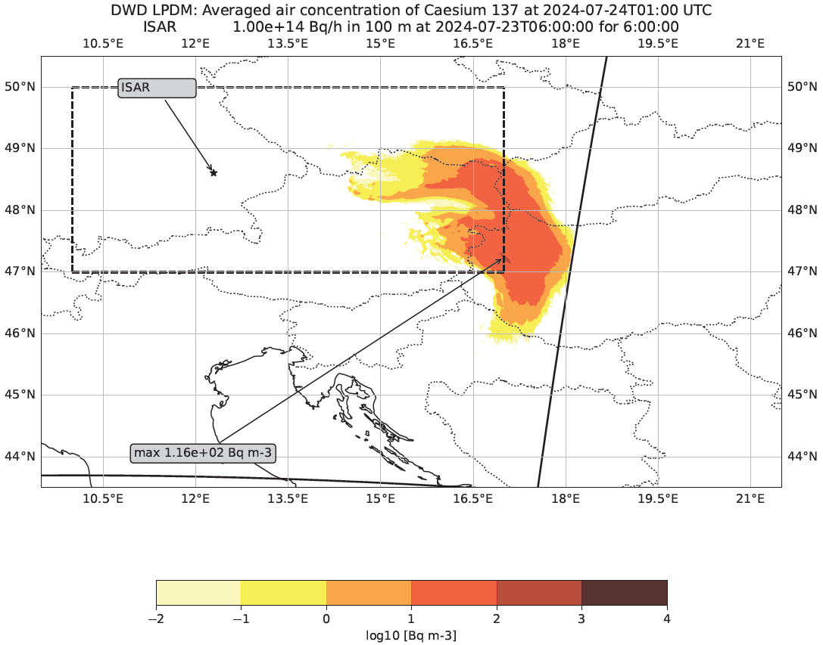
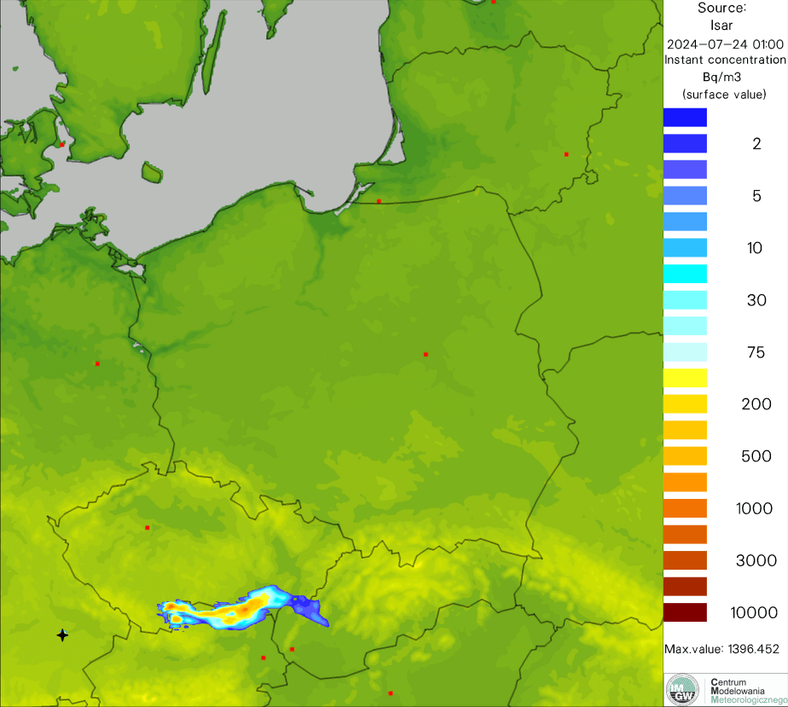
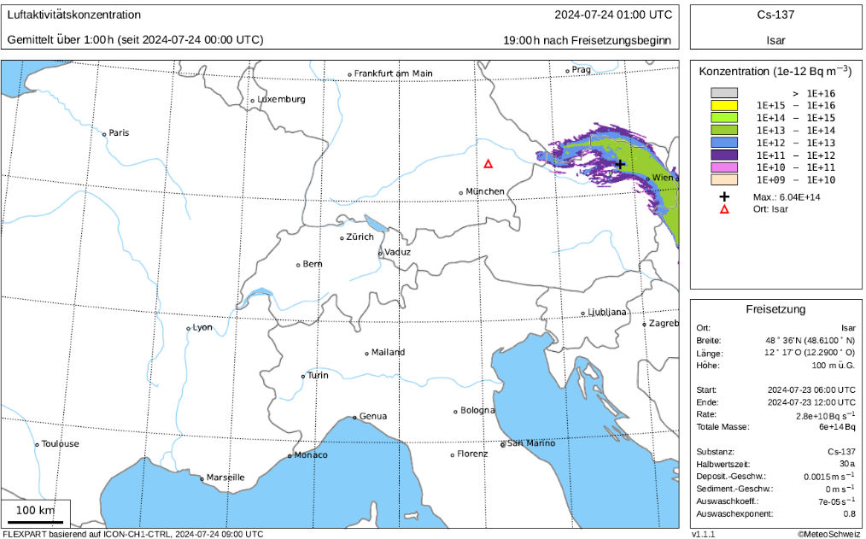
PT EGALITE - Early warninG and AnaLysIs sysTEm for release and dispersion of contaminants
First dry run
The setup of "dry run" for release of radioactive material from NPP of Isar, Germany – location in domains

Slide 11
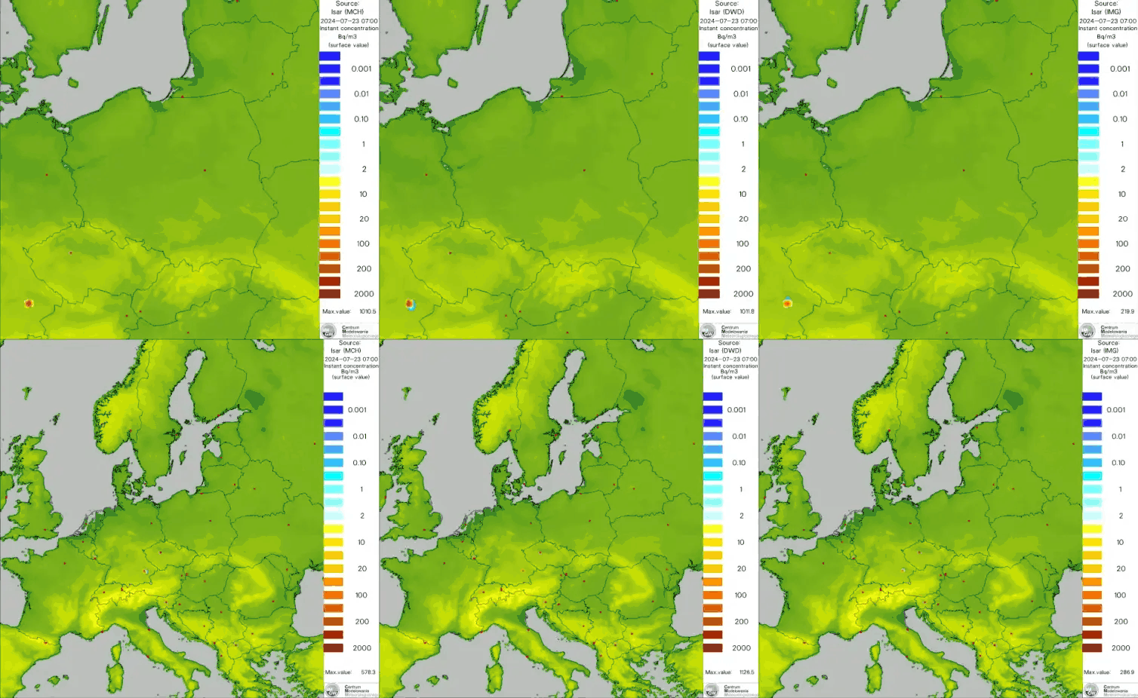
Comparison of MCH/DWD/IMWM results of dry run – release from ISAR NPP (high/med resolution simulation)
Running/finished PP/PTs

Slide 12
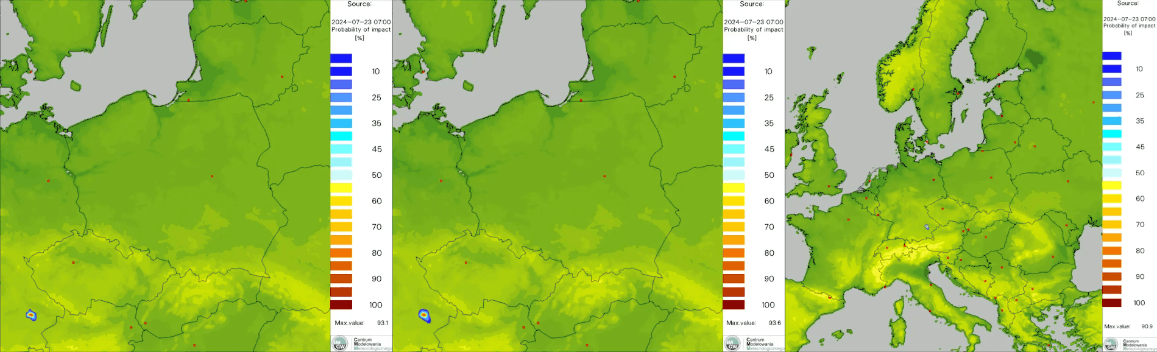
PT EGALITE - Early warninG and AnaLysIs sysTEm for release and dispersion of contaminants
First dry run
Probability of impact (POI)
Visualization of which points the contamination cloud will pass over, according to the simulations of individual models
Left – high resolution models only; right – medium resolution models only; middle panel – both types of models

Slide 13
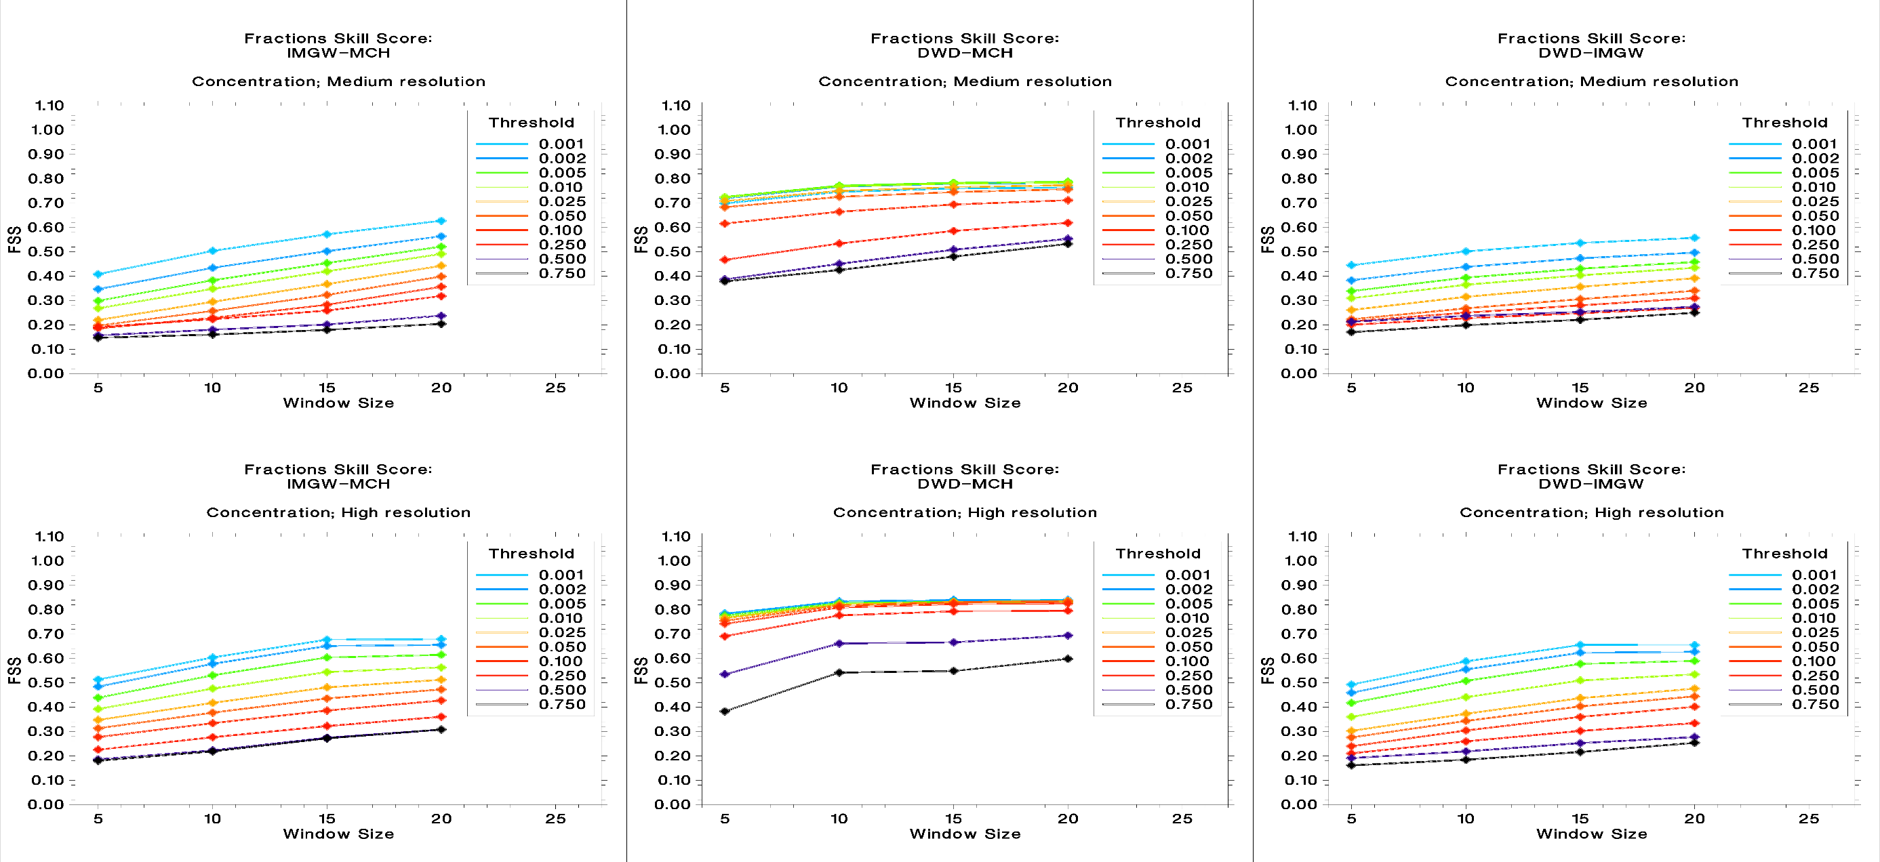
PT EGALITE - Early warninG and AnaLysIs sysTEm for release and dispersion of contaminants
First dry run
Comparison of MCH/DWD/IMWM results of dry run – release from ISAR NPP (high/low resolution simulation)
Relative FSS – concentration

Slide 14
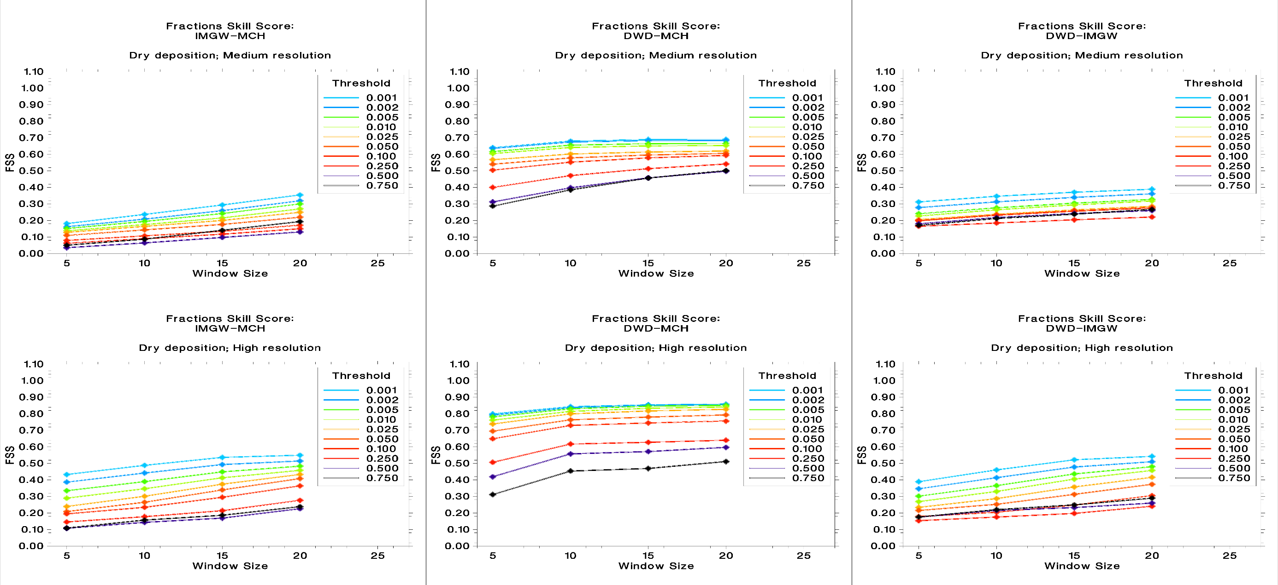
PT EGALITE - Early warninG and AnaLysIs sysTEm for release and dispersion of contaminants
First dry run
Comparison of MCH/DWD/IMWM results of dry run – release from ISAR NPP (high/low resolution simulation)
Relative FSS – dry deposition

Slide 15
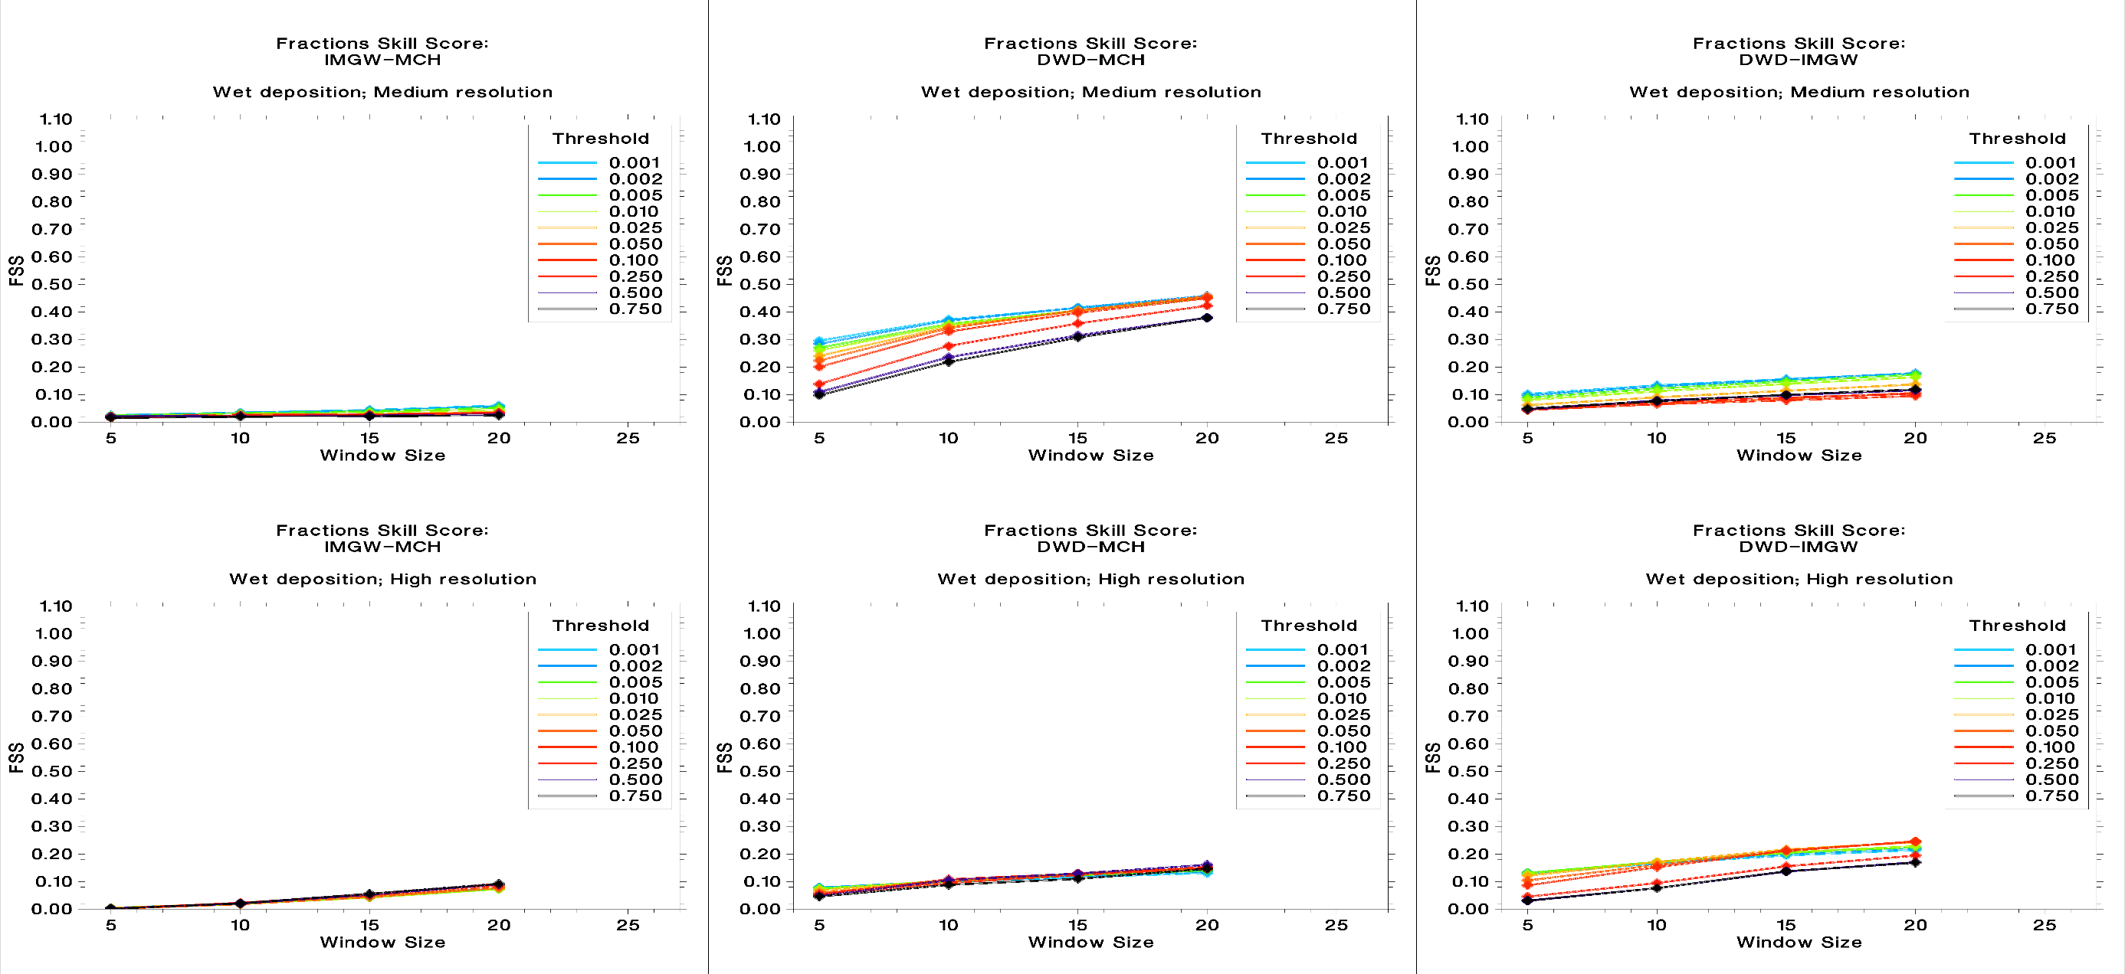
PT EGALITE - Early warninG and AnaLysIs sysTEm for release and dispersion of contaminants
First dry run
Comparison of MCH/DWD/IMWM results of dry run – release from ISAR NPP (high/low resolution simulation)
Relative FSS – wet deposition

Slide 16
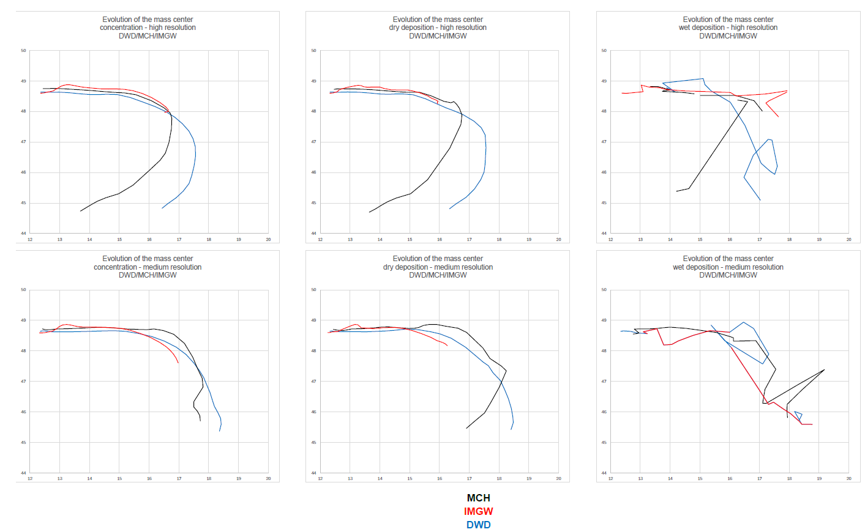
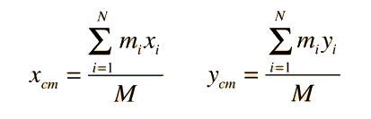
PT EGALITE - Early warninG and AnaLysIs sysTEm for release and dispersion of contaminants
First dry run
x_{cm}, y_{cm}: coordinates od center of mass
M – total mass in the system
m_{i}x_{i},– moments of individual masses (x)
m_{i}y_{i} – moments of individual masses (y)
Evolution of center of mass of fields (conc., dry dep., wet dep.) for high and medium resolution calculations

Slide 17
PT EGALITE - Early warninG and AnaLysIs sysTEm for release and dispersion of contaminants
Second dry run
Subtask 2 – Second "dry run"
  The second "dry run" also concerned the release of radioactive materials from the Isar nuclear power plant in Germany.
  All participants performed calculations using high-resolution dispersion models.
  Unlike the first dry test, all participants performed calculations using their own models AND a common set of (input) meteorological data (provided by DWD, thanks to Christoph!).
  The results were again transferred to a common domain and compared.
  All calculations were carried out exclusively for high-resolution domains.

Slide 18
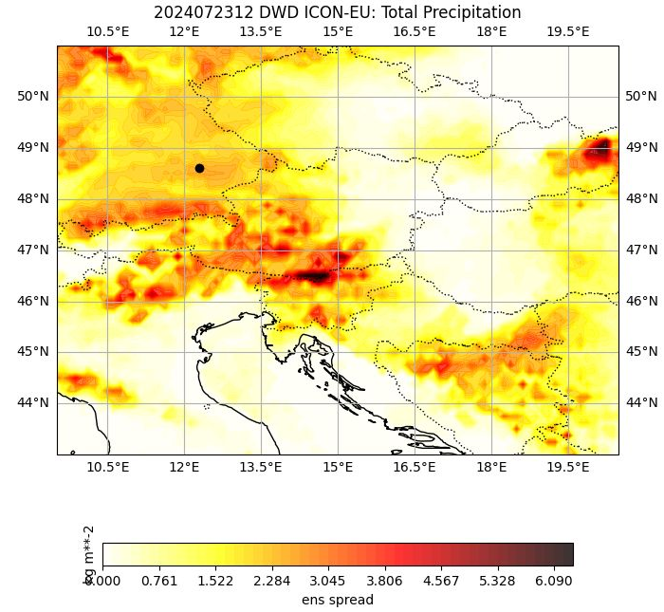
PT EGALITE - Early warninG and AnaLysIs sysTEm for release and dispersion of contaminants
Second dry run
Subtask 2 – Second "dry run". Motivation: The primary source of the discrepancy is (was) likely meteorological data. This is best seen in the figure showing the evolution of the center of mass in individual domains, especially in the case of wet deposition. The reason may be the uncertainty associated with determining the meteorological (e.g. precipitation) data.
An example of a measure of uncertainty – the spread of total precipitation of the DWD ICON-EU ensemble.

Slide 19
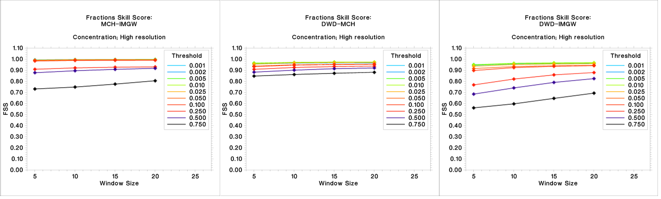
PT EGALITE - Early warninG and AnaLysIs sysTEm for release and dispersion of contaminants
Second dry run
Comparison of MCH/DWD/IMWM results of dry run – release from ISAR NPP (high resolution simulation)
Relative FSS – concentration

Slide 20
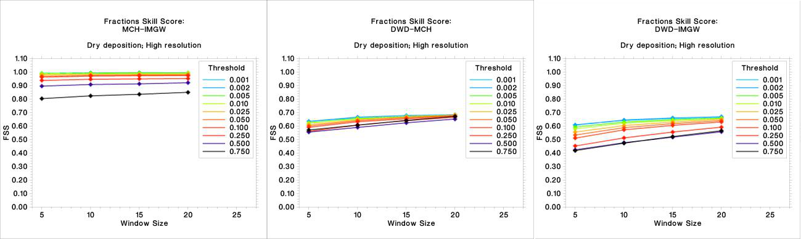
PT EGALITE - Early warninG and AnaLysIs sysTEm for release and dispersion of contaminants
Second dry run
Comparison of MCH/DWD/IMWM results of dry run – release from ISAR NPP (high resolution simulation)
Relative FSS – dry deposition

Slide 21
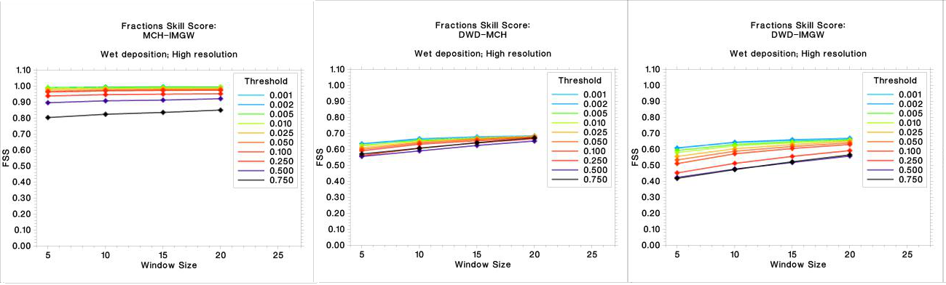
PT EGALITE - Early warninG and AnaLysIs sysTEm for release and dispersion of contaminants
Second dry run
Comparison of MCH/DWD/IMWM results of dry run – release from ISAR NPP (high resolution simulation)
Relative FSS – wet deposition

Slide 22
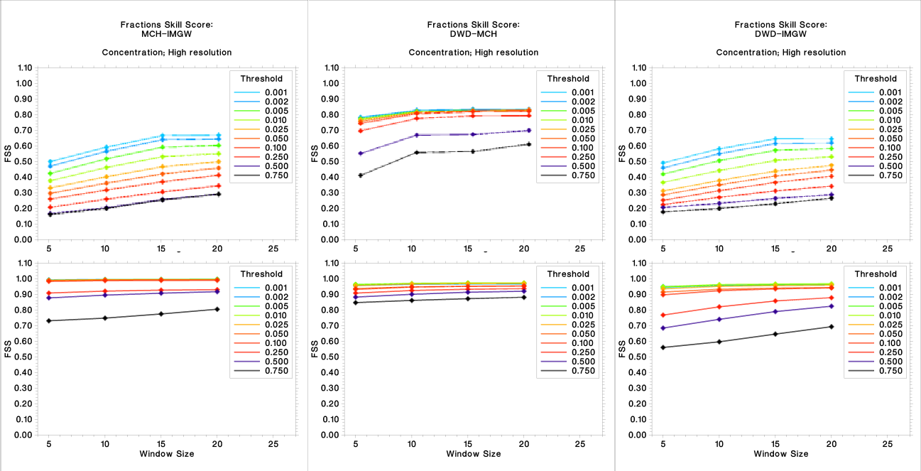
PT EGALITE - Early warninG and AnaLysIs sysTEm for release and dispersion of contaminants
Relative FSS – concentration. Upper row – first dry run; lower row – second dry run

Slide 23
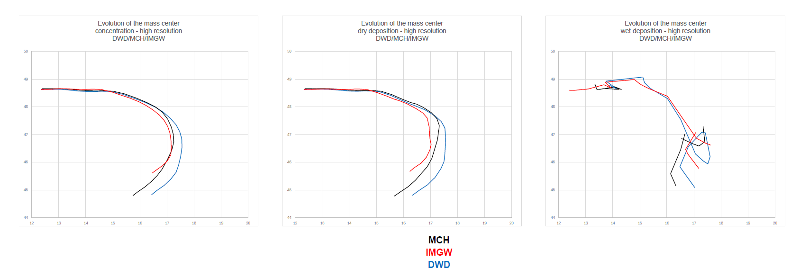
PT EGALITE - Early warninG and AnaLysIs sysTEm for release and dispersion of contaminants
Second dry run
x_{cm}, y_{cm}: coordinates od center of mass
M – total mass in the system
m_{i}x_{i},– moments of individual masses (x)
m_{i}y_{i} – moments of individual masses (y)
Evolution of center of mass of fields (conc., dry dep., wet dep.) for high resolution calculations

Slide 24
PT EGALITE - Early warninG and AnaLysIs sysTEm for release and dispersion of contaminants
Overall status and summary
The first test showed that the results of dispersion calculations are very strongly dependent on meteorological data (their quality and accuracy).
This is especially evident when considering the results of wet deposition calculations and/or the evolution of the center of mass over time.
Hence, the second test was conducted using common (i.e., identical and homogeneous) meteorological data for all participants.
The results converged significantly (see FSS for the second dry run).
When the same meteorological fields are used as basis of the dispersion simulation, the results are clearly more comparable. Especially the DWD and MeteoSwiss concentrations are very close to each other. For the dry/wet deposition, the IMGW and MeteoSwiss simulations are the closest.
This means that the "residual" differences, which are obviously visible in all cases, stem from the different dispersion modeling software.
Therefore, the extension of this project should aim to eliminate this source of discrepancy.
This conclusion may require further research, maybe in the frame of an extension of the current Priority Task.

Slide 25
PT EGALITE - Early warninG and AnaLysIs sysTEm for release and dispersion of contaminants
Overall status and summary
Current status: PTask finished; final report is ready – in preparation to publication
All (sub)tasks have been completed
Suggestion for follow-up – working title AFFORD (AFtermath of early warning and analysis system FOR Release and Dispersion of contaminants):
The next (logical) step in the research should be experiments using both common (unified) meteorological data AND software. For this purpose, we plan to use the FLEXPART program (available at NILU and/or PHAIDRA websites). In addition to conducting the experiment on the initially selected source, the work should be repeated for several other sources, not just NPPs.
People of EGALITE (thnx!!!):
Christoph Siewert (DWD),
Pirmin Kaufmann (MCH),
and
Andrzej Mazur (IMWM)

Slide 26
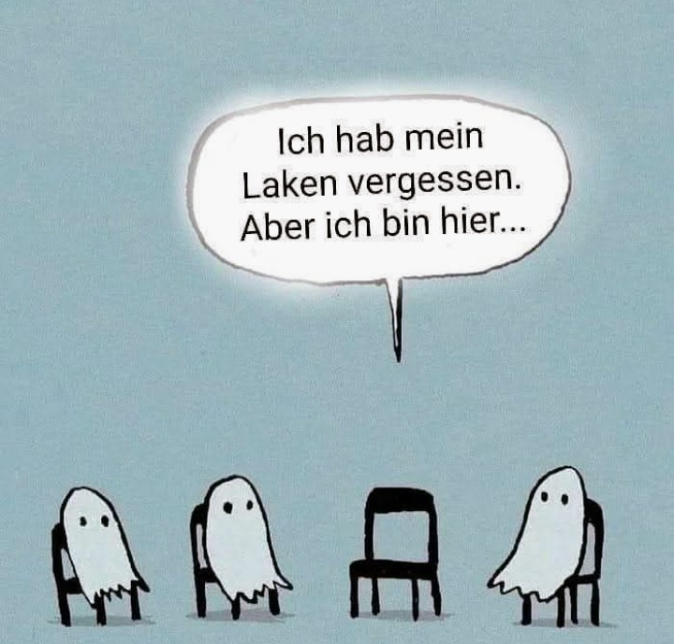
Webex/Teams/Zoom connection sometimes is like talking with deceased…
I forgot my sheet. But I am here…

