Slide 1




PP-APOCS
Elena Oberto¹, Francesco Uboldi¹, Massimo Milelli¹, Valeria Garbero², Tanguy Houget³
1, CIMA Foundation
2, ARPA Piemonte
3, PoliTO (Politecnico di Torino)

Slide 2
SubTask 2.2: Titan lib applied to “not conventional” raingauge datasets.
TITAN LIBS (www.github.com/metno/titan) applied to precipitation data coming from the "official" network of stations of the Italian National Civil Department for QC, now we are going to apply also to "non-official" free networks, for instance “Meteonetwork”.
Deliverables: report on the tests performed, description of the useful algorithms
Participating scientists: Francesco Uboldi, Elena Oberto, Massimo Milelli (CIMA)
FTEs: 0.5, Dates: April 2026 - March 2027

Slide 3
QC PRECIPITATION - A BRIEF RECAP: TITAN LIB APPLICATION
Titanlib range check (<0mm; >600mm) on hourly data
Completeness of daily values (rejected daily values if number of hours < 24)
Titanlib range check on daily data (>1000mm)
Titanlib isolation check (pre-operational fine tuning)
Titanlib sequential tests on daily data/seasonal data: buddy check and buddy event check with several different configurations (depending on seasonal/weather configuration)
The buddy check: it compares an observation against its neighbours and flags outliers in a radius specified by the user.
The buddy check flags observations if the (absolute value of the) difference between the observations and the average of the neighbours normalized by the standard deviation in the circle is greater than a predefined threshold.
If the standard deviation of values in the neighbourhood is less than a chosen value, min_std, then a value of min_std is used instead.
min_std should be roughly equal to the standard deviation of the error of a typical observation. If it is too low, then too many observations will be flagged in areas where the variability is low.
The buddy event check: observations are converted into yes/no values of exceeding a specified threshold (event_threshold).
The threshold argument in this test is minimum fraction of other observations in the neighbourhood that must agree with the observation being inspected. If event_threshold=0.2 and threshold=0.25, then an observation exceeding 0.2 requires that at least 25% of the other observations within the radius also exceed 0.2. If an observation is less than 0.2, then 25% must also be below 0.2.
(thanks to U. Pellegrini for installing Titan lib and preparing R/bash scripts to run the QC)

Slide 4
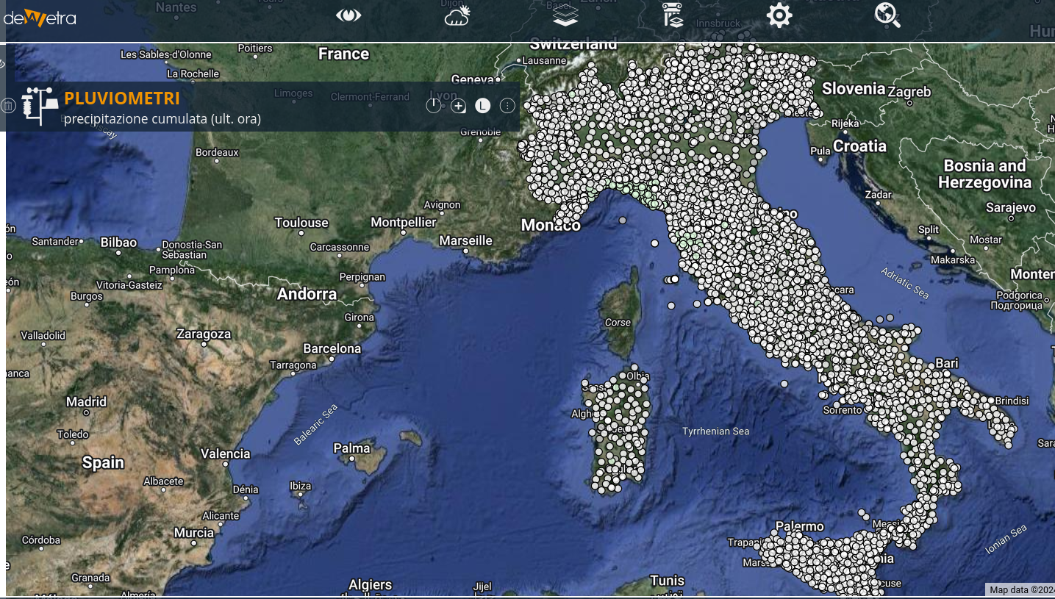
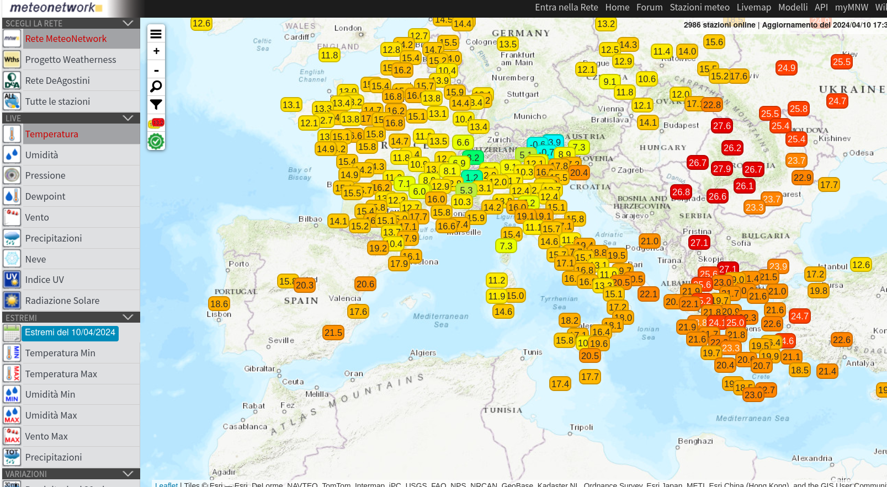
OFFICIAL NATIONAL HIGH RESOLUTION DATASET
The QC TitanLib is operationally applied to official datataset.
It has been developed a Python procedures to download not official dataset MNW
WORK IN PROGRESS….
METEONETWORK(NOT OFFICIAL) DATASET

Slide 5
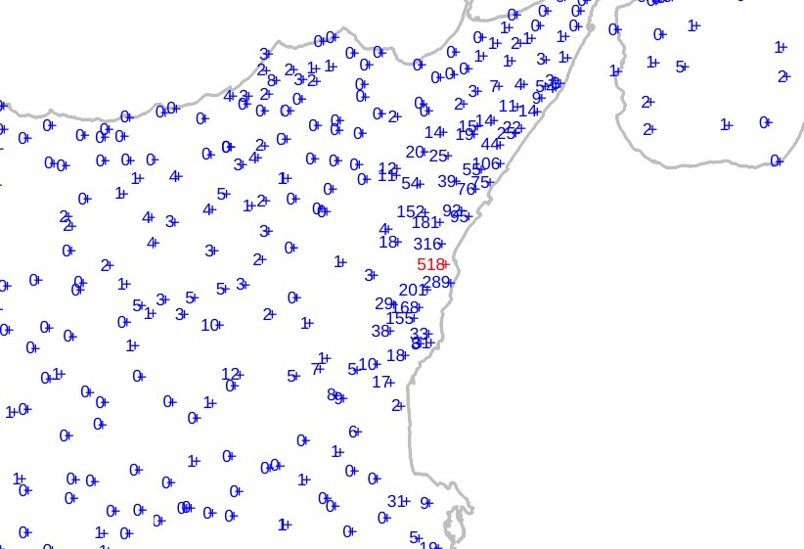
Rejected data should always undergo manual verification, as ambiguous or borderline cases such as this may occur 🤔
13/11/2024 buddy event: radius= 60 km; num_min= 10; event_threshold= 400; threshold= 0.2
? Is this value reliable? Should we accept or reject this value?
In this case, it is appropriate to investigate further.

Slide 6

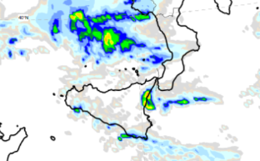
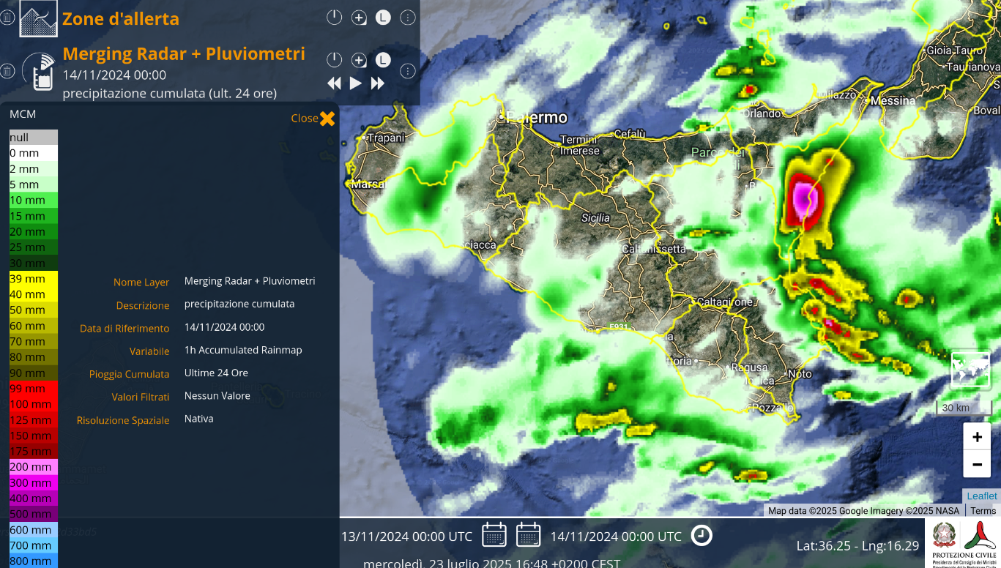
Merging radar + raingauges (24h cumulated)

Slide 7
SubTask 2.3: Quality control procedure for T2m and Rh2m
SCT R code have been applied to a temperature dataset from the "official" network of stations of the Italian National Civil Department. Additionally, it has been also applied to RH official dataset for the quality control.
A new quality control procedure will then be developed in Python specifically for NetAtmo data
The next step will be to implement and apply the different QC techniques (Titan lib,R code and Python script) to the "non-official" networks of “Meteonetwork” and “Netatmo”.
Deliverables: report on tests performed, description of the useful algorithms
Participating scientists: Francesco Uboldi, Elena Oberto, Massimo Milelli (CIMA), Valeria Garbero (Arpa Piemonte), Tanguy Houget (Politecnico di Torino) FTEs: 0.3 (CIMA), 0.1 (ArpaP), 0.1 (PoliTo). Dates: April 2025 - March 2026

Slide 8
Metadata and weather station registry check
Coordinate Validation Requirements
The coordinates must exist (i.e., not be null or missing).
They must be valid numerical values, and different from zero.
They must fall within the boundaries of the Italian territory.
Identical data series should not be associated with different latitude/longitude values.
Different data series should not share the same latitude/longitude coordinates.
IQR (Inter quartile range): obs-forecast
1. INPUT:
- Hourly observed values at each weather station
- Hourly NWP (Numerical Weather Prediction) model estimates
2. ASSUMPTION:
- Model estimates are not exact but their variability is realistic.
3. CALCULATION (per station, per hour):
a. Compute D = Observation - Model Estimate
b. Calculate IQR_D = IQR of D over the month
c. Calculate IQR_Model = IQR of model estimates over the month
4. COMPARISON:
IF IQR_D << IQR_Model:
→ Observation likely matches the model's spatial reference
→ Station considered reliable
ELSE IF IQR_D ≈ IQR_Model (and it is big):
→ station’s position is most likely incorrect
→ Flag station as unreliable
5. OUTPUT:
- Update of monthly "whitelist" (trusted stations)
- Update of monthly "blacklist" (untrusted stations)
Metadata
If (elev. staz. – elev. dem) < 40 m → ok;
else elev. staz. = elev. dem
If elev. staz. = 0 .and. SLM = coast → ok;
else if elev. staz. = 0 .and. SLM= earth →elev. staz. = elev. dem

Slide 9
Quality Control Sequence
Step 1: Temperature observations are checked: range check -50°C<T2m<50°C
Step 2: T2m QC: Background Field (BF) + Spatial Consistency Test (SCT) control
Step 3: Relative humidity observations are checked: range check 5%≤RH≤100%
Step 4: Relative humidity: if T2m has passed QC → T dew point calculated
Step 5: T dew point: Background Field (BF) + Spatial Consistency Test (SCT) control
Main Quality Control Method
- Test: Spatial Consistency Test (SCT) (Lussana, Uboldi & Salvati, 2010).
A formulation of the SCT is included in the open-source library Titan (https://github.com/metno/titanlib), but it has been entirely re-implemented using the scripting language of the R statistical software, in order to enable detailed analysis of its effects and behavior.
- Technique: Optimal Interpolation (OI)
The SCT is based on the objective analysis and data assimilation algorithm known as Optimal Interpolation (OI), which requires a Background Field (BF). BF is an estimate of the analysis field that is independent of the observations, usually derived from a numerical forecast for the same variable at the same time. For quality control purposes, however, it was decided to construct a local background estimate using nearby observations. This estimate is used for a preliminary, coarser check—referred to as the Background Field (BF) check—performed prior to the SCT, which is more refined.

Slide 10
BF
The background estimate for temperature (T) and dew point (TD) is calculated at each observation site using nearby stations within 30 km for T and 50–60 km for TD. The observation under test is excluded from this computation. A vertical gradient is derived via least-squares from neighboring station values and elevations, allowing all nearby data to be adjusted to the target elevation. The median of these adjusted values is used as the background field (BF), offering robustness against outliers. In the BF check, each observation is compared with its background field (BF) value using two thresholds: a large one (T: 6 °C, TD: 12 °C) and a small one (T: 1 °C, TD: 1 °C). Observations differing from the BF by more than the large threshold are classified as gross errors (GE) and discarded, and the ones differing from BF for less than the small threshold are directly validated, without undergoing other tests.
Optimal Interpolation
F. Uboldi, C. Lussana and M. Salvati, 2008. Three-dimensional spatial interpolation of surface meteorological observations from high-resolution local networks. Meteorological Applications, 15, 331-345, DOI:10.1002/met.76
OI minimizes the mean square error of the analysis
The OI analysis expression at station locations, i.e., the analysis estimate of the observations, is given by the following equation:
yo= vector (M) observation, yb= vector (M) background, ya = vector (M) analysis, S = background error covariance matrix (MxM), R = observation error covariance matrix (MxM)

Slide 11
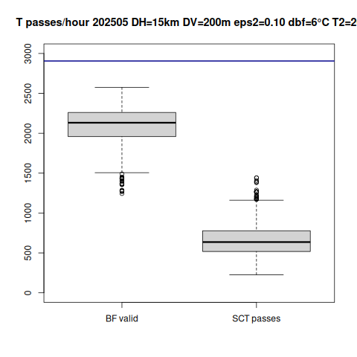
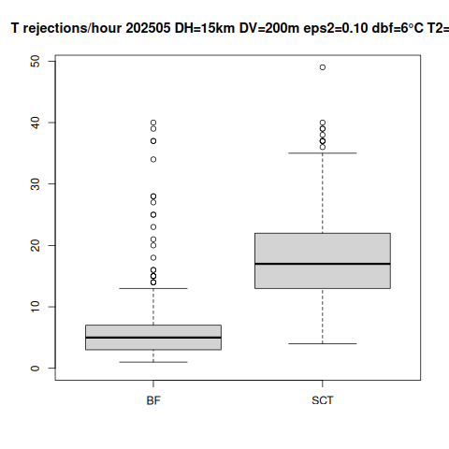
Number of temperature observations validated by the BF check and accepted by the SCT (left-hand plot), and number of observations rejected by the BF check and by the SCT (right-hand plot), per hour, May 2025

Slide 12
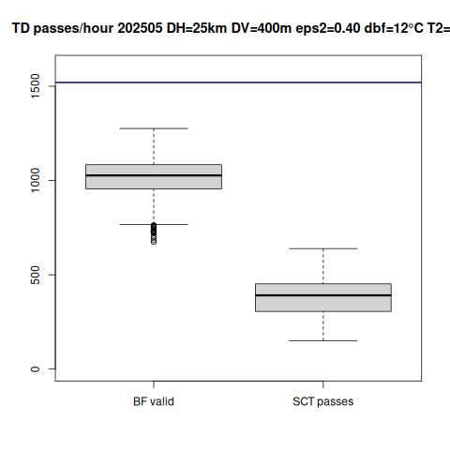
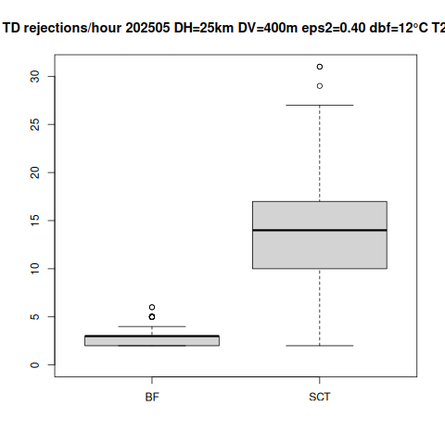
Number of TD observations validated by the BF check and accepted by the SCT (left-hand plot), and number of observations rejected by the BF check and by the SCT (right-hand plot), per hour, May 2025

Slide 13
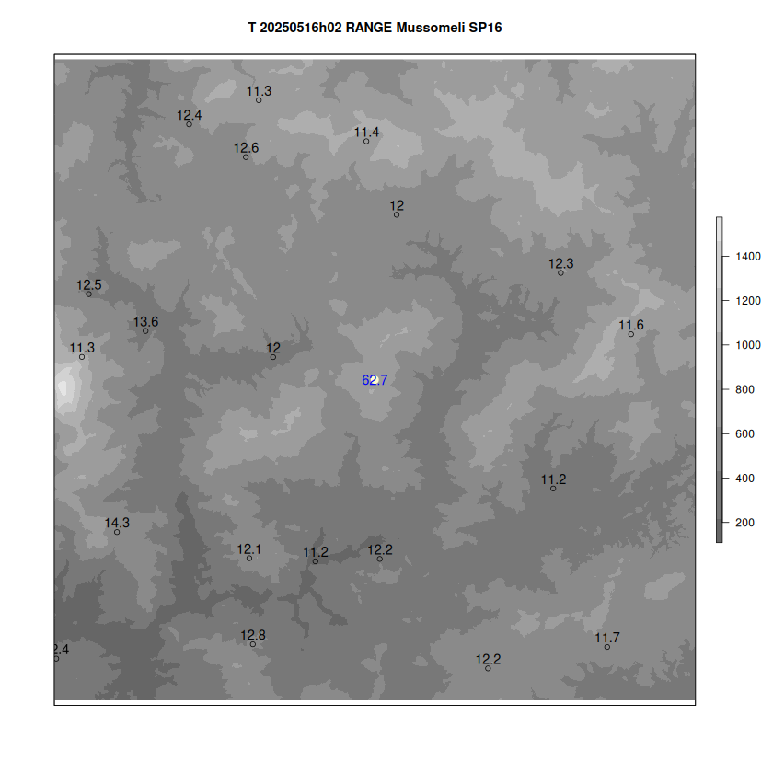
2025-05-16 02:00
Temperature observation rejected by the preliminary RANGE check

Slide 14
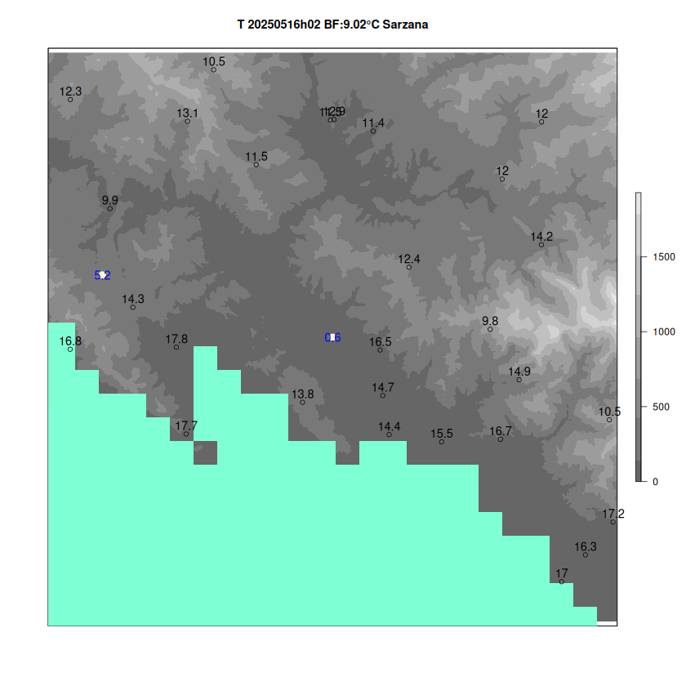
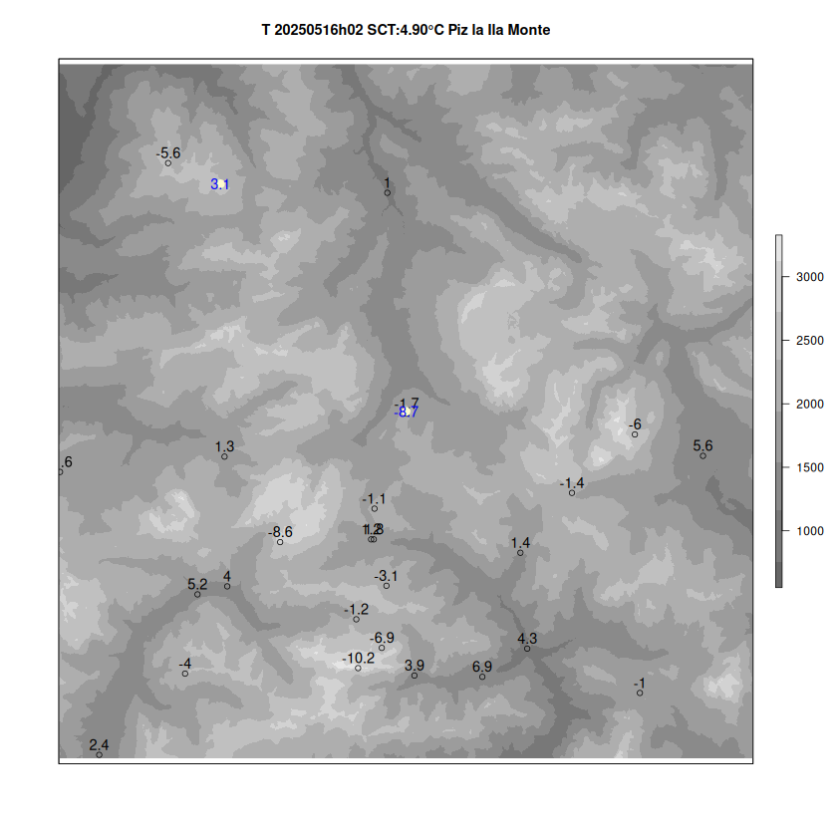
QC T2m 2 control tests based on spatial consistency , BF: rougher , SCT: finer

Slide 15
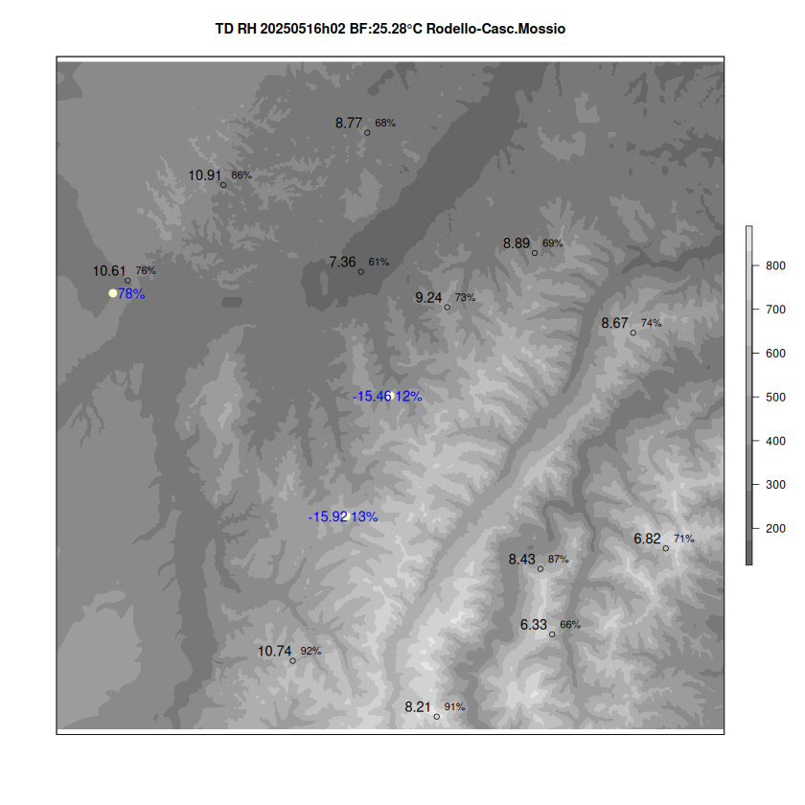
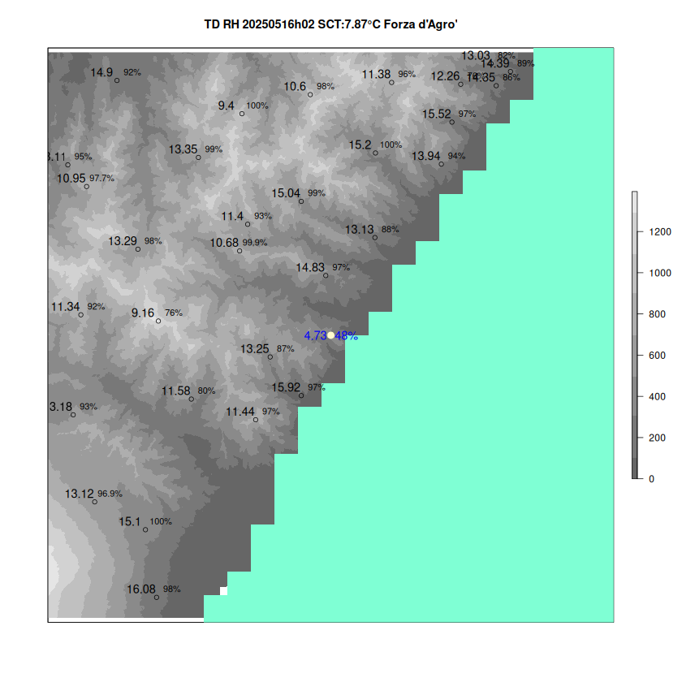
QC RH2m --> TD2m 2 control tests based on spatial consistency , BF: rougher , SCT: finer

Slide 16
Update on Arpa Piemonte
/PoliTO activities
SubTask 2.3: Quality control procedure for T2m and Rh2m
A new quality control procedure for NetAtmo data has been developed in Python. This method is based on an updated version of the Napoly approach and contextual analysis.
The novel QC methodology was applied to NetAtmo observations from the summer of 2022 and compared with CrowdQC+, a quality control procedure also designed for NetAtmo data written in R.
Additionally, a dedicated Python script was developed to retrieve data using the official NetAtmo API.

Slide 17
Novel QC procedure
Init – initialization: removes stations containing only NaN values across all timestamps
M1 – location-based filtering: removes stations sharing identical coordinates (lon, lat)
M2 – statistical outlier detection: detects temperature outliers every 5 minutes using robust z-scores and removes stations with more than 20% of flagged data
M4 – correlation analysis: removes stations with Pearson correlation coefficients below 0.9 when compared to the spatial median temperature
O1 – hourly data sufficiency: removes measurements from station-hours where missing data exceeds 80% in an hour
O3 – monthly data sufficiency: removes station-months where missing data exceeds 20%
Limitations of the method
it does not consider contextual metadata of individual measurements (e.g., altitude), which may explain variability between stations
it does not exploit spatial correlations between nearby stations, which could help detect outliers

Slide 18
Novel QC procedure
MC - contextual methodology: an initial approach to integrate environmental context into quality control procedures
The method uses environmental features (altitude, building surface fraction, sky view factor, Normalized Difference Vegetation Index, mean building height and impervious surface fraction) to assess the validity of temperature measurements, based on the assumption that stations with similar characteristics should record similar temperatures.
After standardizing the features, the method computes Euclidean distances in a 6D feature space to identify the 5 nearest neighbours (k=5) for each station. At each time step, it calculates the mean and standard deviation of the neighbours’ temperatures and flags as suspicious any measurement with a z-score > 3.
Limitations of the method
it is dependent on the selected features: if relevant contextual variables are missing or poorly defined, the method’s effectiveness in detecting outliers may be reduced
it does not account for temporal dynamics

Slide 19
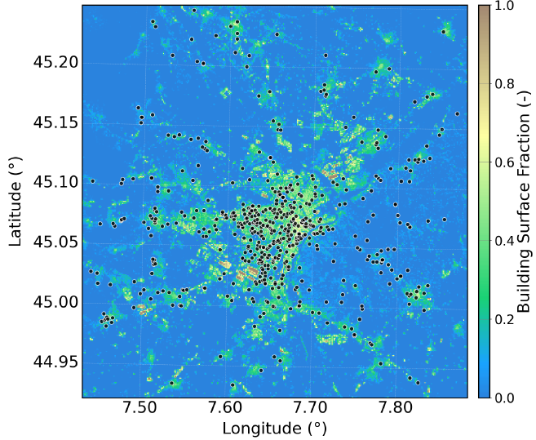

NetAtmo stations
A dedicated Python script was developed to retrieve data using the official NetAtmo API
Analysed 673 NetAtmo stations
for June, July and August 2022
Init - removed 128 empty stations
545 stations

Slide 20
QC procedure
[M1,M2, M4, O1, O2]
____________________
Starting filter: M1
Removed 53 stations
After M1:
Data retained: 89.8% |
Stations retained: 90.3%
492 stations
____________________
Starting filter: M2
Removing 75 suspicious stations
(> 20% data removed during the step)
After M2_napoly:
Data retained: 72.7% |
Stations retained: 76.5%
417 stations
____________________
Starting filter: M4
7 stations for month 6
9 stations for month 7
11 stations for month 8
After M4: Data retained: 71.3% |
Stations retained: 75.8%
413 stations

Slide 21
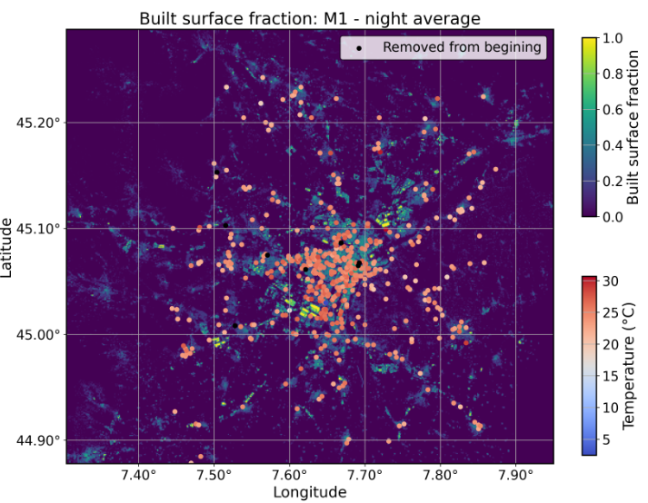
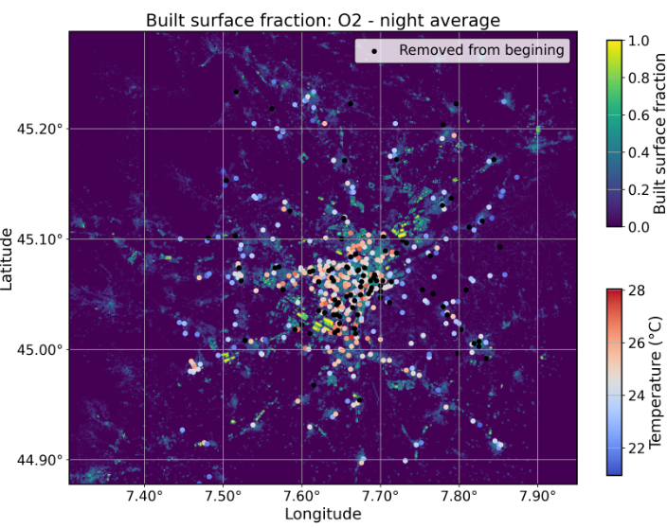
QC procedure
[M1,M2, M4, O1, O2]
____________________
Starting filter: O1
Removed data for 176 station-month
Removed 10 empty stations
After O1: Data retained: 66.5% |
Stations retained: 73.9%
____________________
Starting filter: O2
Datapoints removed = 6878
After O2: Data retained: 66.5% |
Stations retained: 73.9%
403 stations

Slide 22
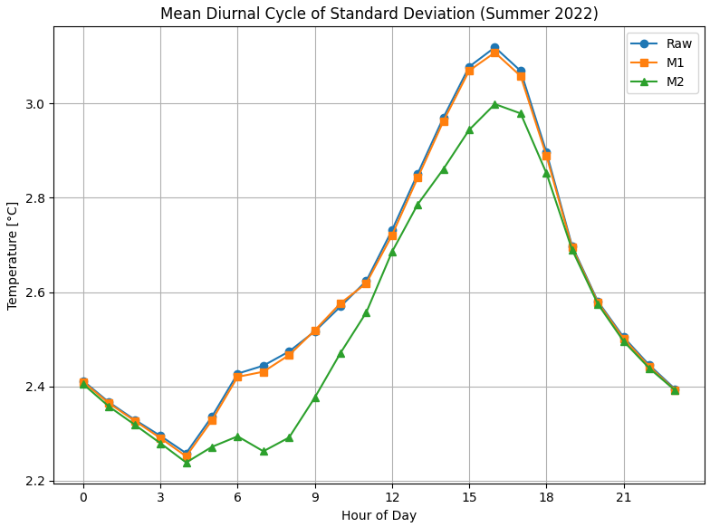
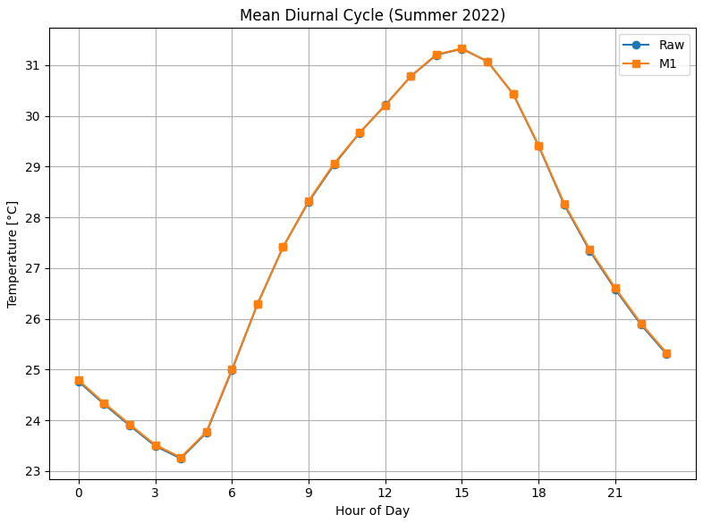
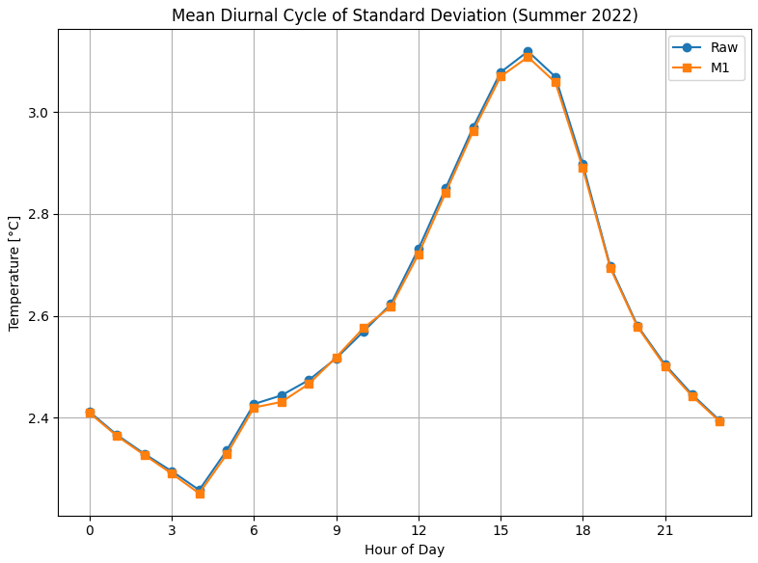
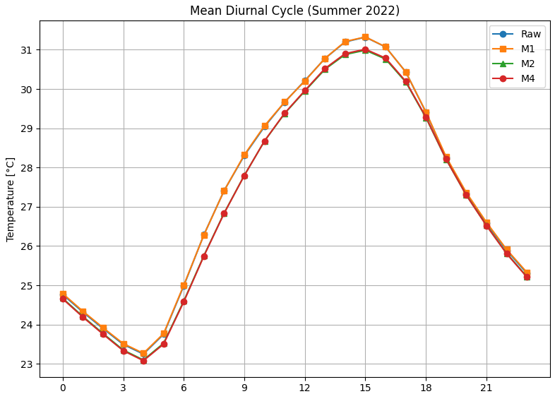
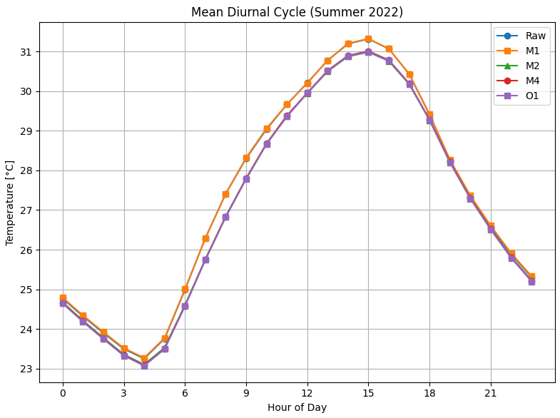
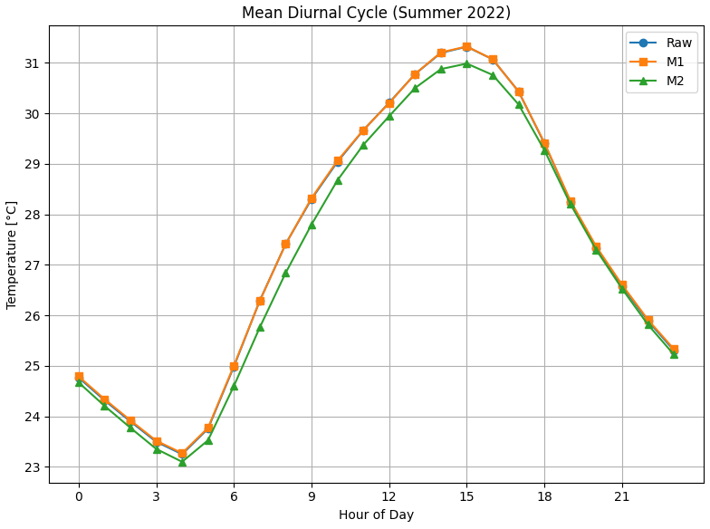
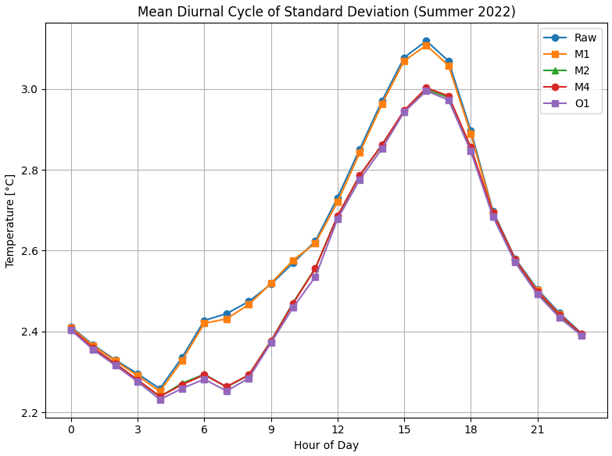
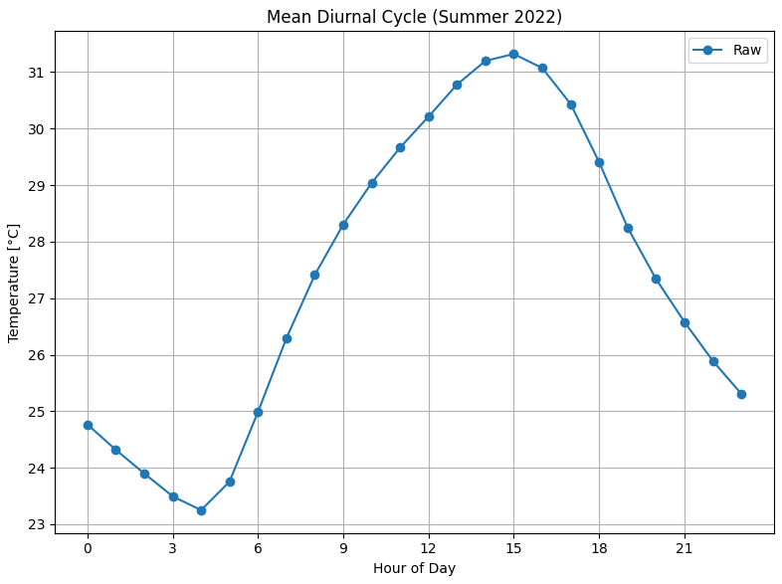
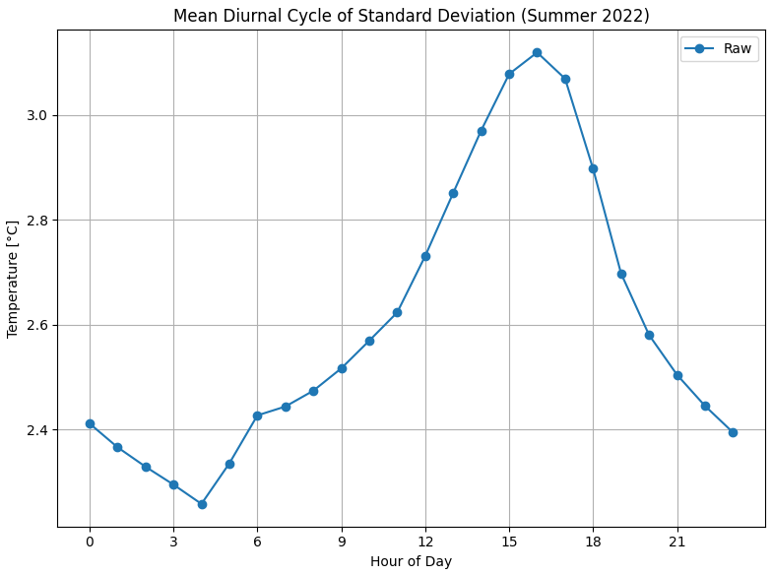
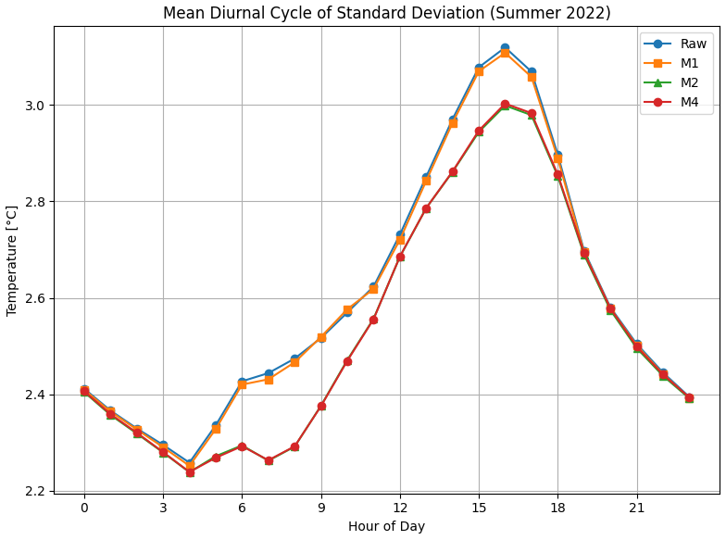
QC procedure
[M1,M2, M4,O1, O2]
Standard deviation is higher during the daytime
The QC procedure reduces both the standard deviation and the mean

Slide 23
QC procedure
[M1,MC, M4, O1, O2]
___________________
Starting filter: M1
Removed 53 stations
After M1: Data retained: 89.8% |
Stations retained: 90.3%
492 stations
____________________
Starting filter: MC
Cleaning data using features contextual outlier scores
Features: ABH, Alt., Built SF, Imp. SF, NDVI, SVF (100 m resolution)
Removing 68 suspicious stations
(> 20% data removed during step)
After M_outliers: Data retained: 72.8% | Stations retained: 77.8%
424 stations
____________________
Starting filter: M4
48 stations for month 6
68 stations for month 7
57 stations for month 8
Removed 36 empty stations
After M4: Data retained: 62.8% |
Stations retained: 71.2%
388 stations

Slide 24
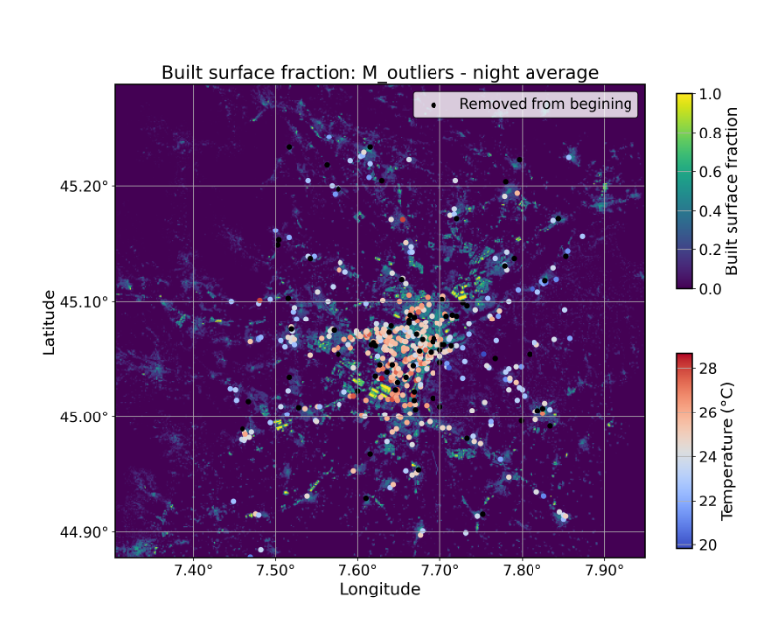
QC procedure
[M1,MC, M4, O1, O2]
____________________
Starting filter: O1
Removed data for 236 station-month combinations
Removed 18 empty stations
After O1: Data retained: 57.5% | Stations retained: 67.9%
____________________
Starting filter: O2
Datapoints removed = 7862
After O2: Data retained: 57.5% |
Stations retained: 67.9%

Slide 25
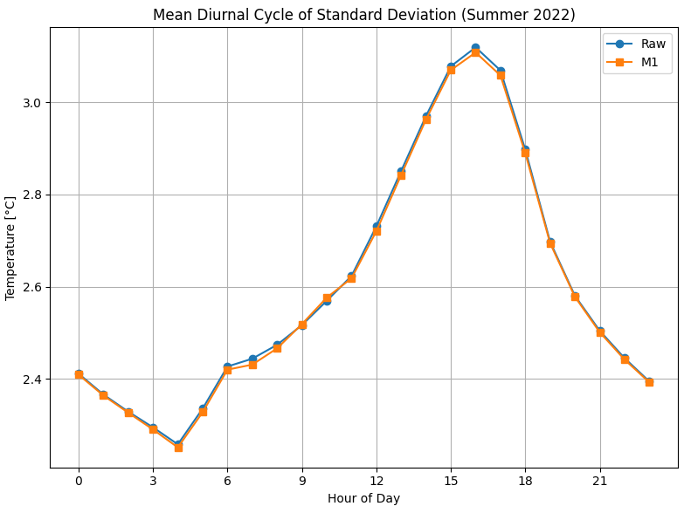


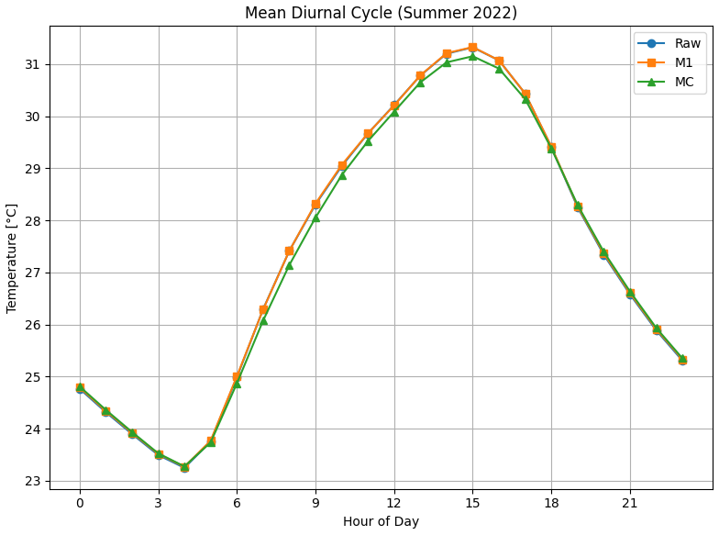
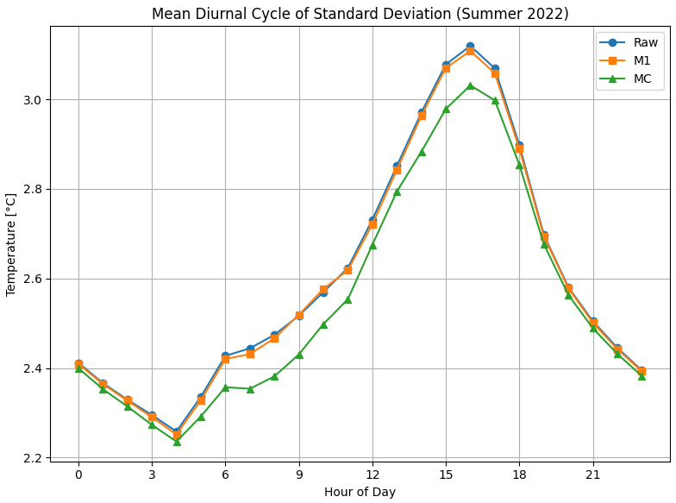
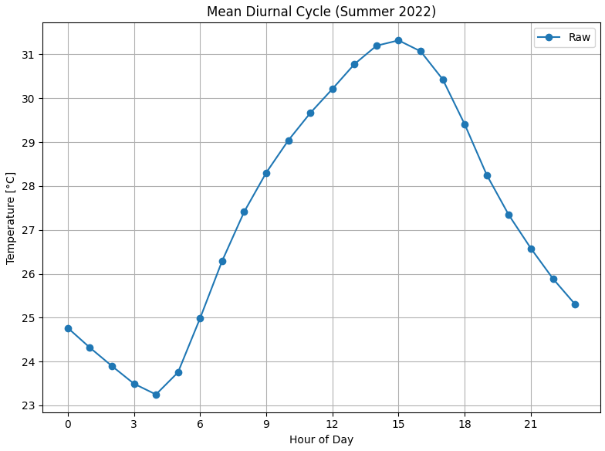
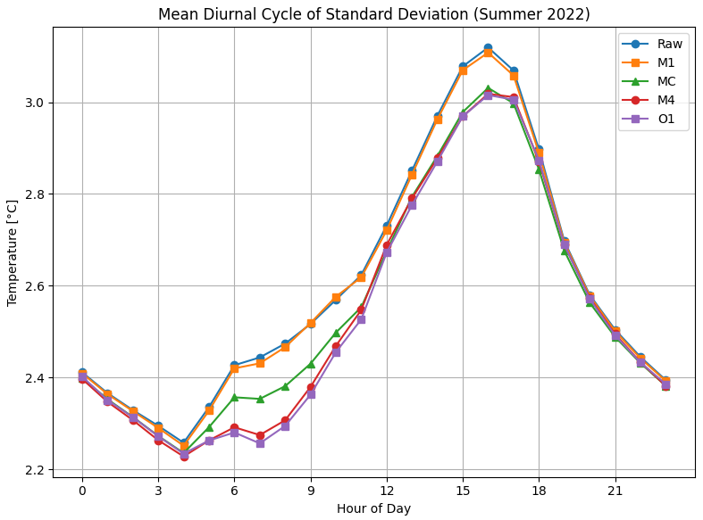
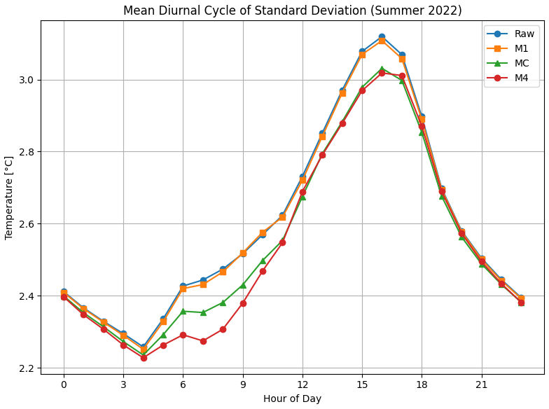
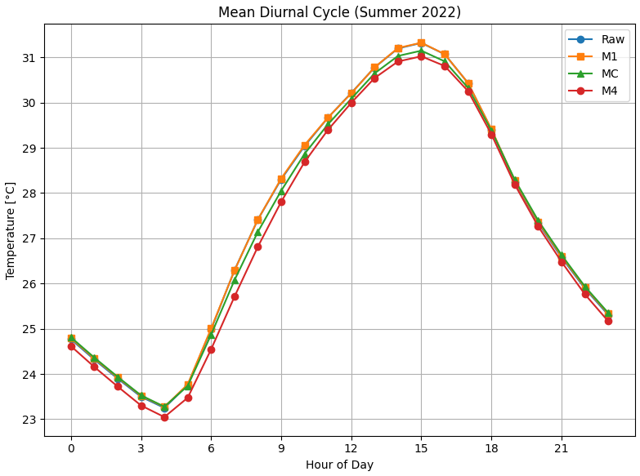
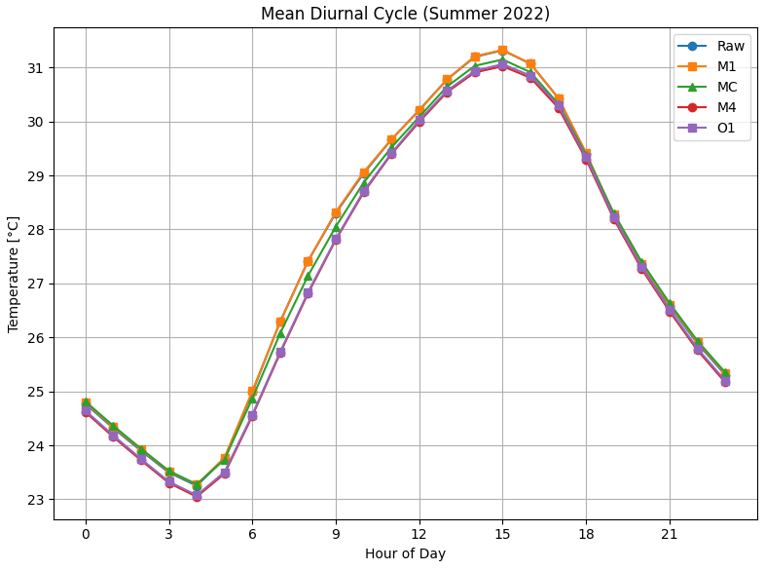
QC procedure
[M1,MC, M4, O1, O2]
Standard deviation higher during daytime hours
The QC procedure reduces both the standard deviation and the mean

Slide 26
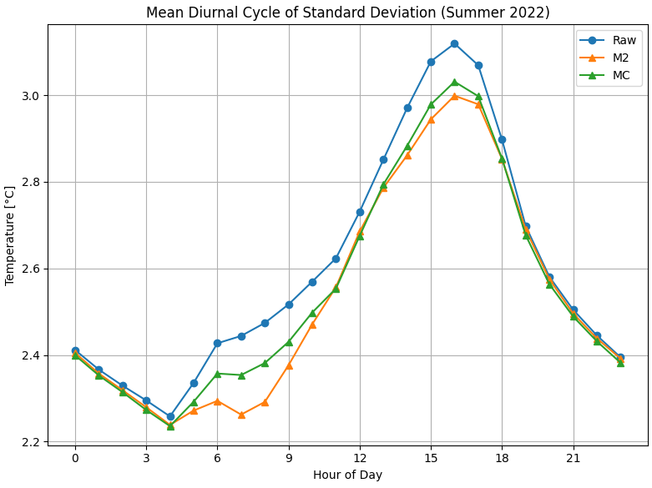
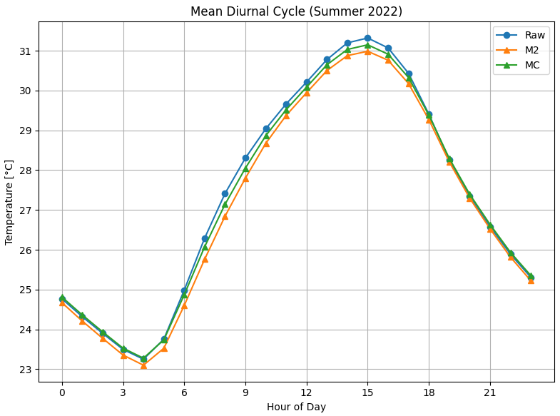
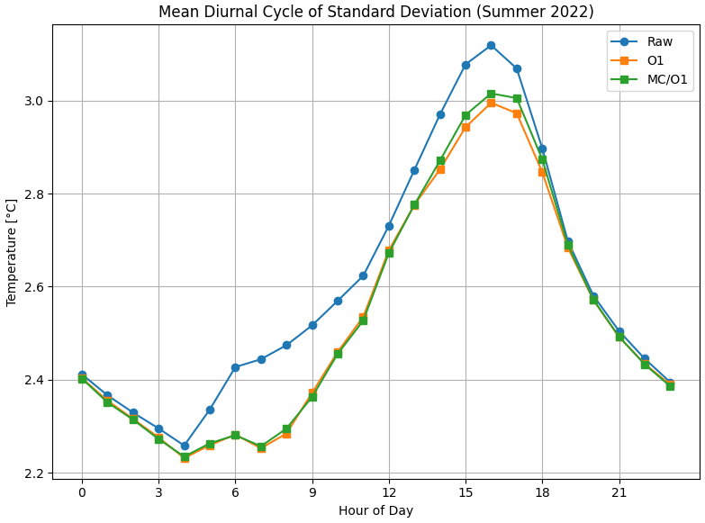
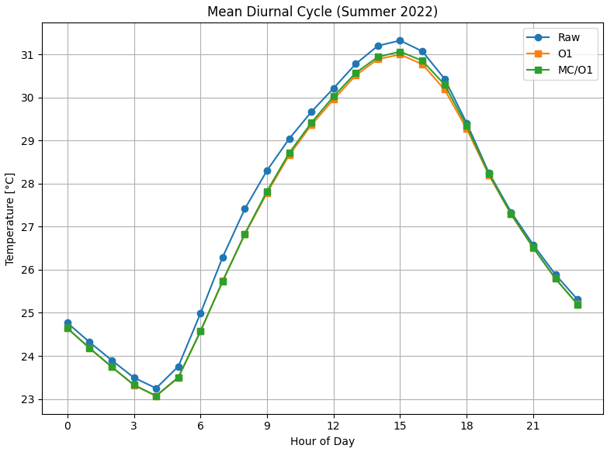
QC procedure
Napoly vs Contextual
Napoly and the contextual method yield quite different results, but the overall procedures produce similar standard deviation and mean values

