Slide 1
FFV2 Update
Kontakt:
Felix Fundel
Deutscher Wetterdienst
Referat FE 12
Frankfurter Straße 135
63067 Offenbach am Main
E-Mail: Felix.Fundel@dwd.de
Tel.: +49 (0) 69 / 80 62 -2422

Slide 2
Outline
MEC
FFV2
Shiny Apps

Slide 3
General Info
MEC, FFV2 and Shiny Apps on dkrz DACE gitlab
Discontinuation of code management on my private gitlab
https://gitlab.dkrz.de/dace/feedback_file_verification
All COSMO partners should have access

Slide 4
MEC (H. Anlauf)
Humidities
Changed coefficients for the calculation of saturation water vapour (from Magnus-Tetens/Murray (1967) to IFS/BUCK (1981), soon Hardy (1998))
This effects the conversion of TD to RH from radiosonde and aircraft reports
Also required an adaption in FFV2
Wind
predictions are now taken from FF10M instead of the lowest model level
Model level winds are only fallback if 10m wind is not available
10 min. average is preferred over instant wind if both are available
Backward compatible with &veri_obs: u10_use_mlevel = .true. ! default: .false.
Global Radiation
Both short names ASWDIR_S and ASWDIR_S_OS are accepted where ASWDIR_S_OS is preferred if both fields exist (might cause temporal inconsistencies)
AI Models
Support for AI Models on reduced set of model levels (e.g. AICON)
Notes:
ASWDIR_S (Downward direct short wave radiation ux at surface)
ASWDIR_S_OS (. . . on horizontal plane including orographic shading)

Slide 5
FFV2
Treatment of 10m Winds
Old:
No use of winds above 100m station height in DA
Therefore those winds had quality flag ‘rejected’ (state=7)
For verification those winds were used, i.e. all data with state=7 had to be read but only wind data were used
Own set of quality criteria for wind had to be defined
New:
ICON DA now uses all wind observations
Verification can rely on DA quality flags now (as for other variables)
Old behaviour can be forced by namelist entry (useRejectedWinds ‘TRUE’)
Still some optional filters for wind based on sso_stdh and, hardcoded, for too large wind differences between obs and model (>40m/s) exist.

Slide 6
FFV2
Data File Format
Old:
Final score files for use with apps where saved as *.Rdata
New:
Final score files can optionally be saved as *.qs by namelist entry qsave ’TRUE’
https://cran.r-project.org/web/packages/qs/index.html
qs is notably faster, especially for large score files (station based or time-series scores)
qs package is required for FFV2 as for shiny apps, later versions of qs are supposed to be backward compatible
Note: Intermediate score files are still Rdata

Slide 7
FFV2
New R Version
Old:
FFV2 package was built with R 4.2.0
New:
FFV2 package is built to work with R 4.4.1
Dependency on rgeos was removed
Current dependencies on external R packages:
sp,sf,parallel,data.table,SpecsVerification,matrixStats,RNetCDF,stringr,survival,grid,verification,reshape2,pcaPP,qs(>= 0.27.2),scoringRules

Slide 8
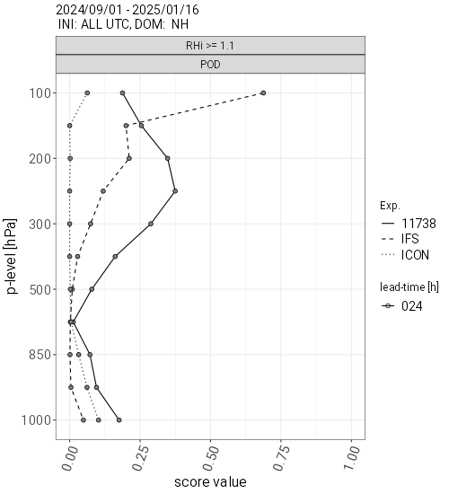
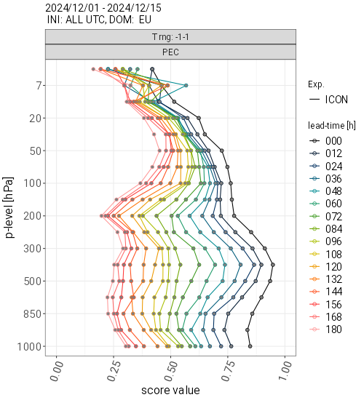
FFV2
Rel. Humidity over Ice RH_{i} & Categorical Verification of Vertical Profiles
RH_{i} can now be calculated during verification and used in TEMP verification
Continuous verification of RH_{i} is mostly not helpful
Therefor a categorical verification of upper-air observation was implemented
This allows to verify events, e.g. RH_{i} >110% (left, POD) or T+-1K (right, hit-rate)
(Outcome of a project on a 2-moment ice microphysics for ICON)
Notes:
RHI = RH * e_w/e_i e_=saturation pressure over water or ice

Slide 9
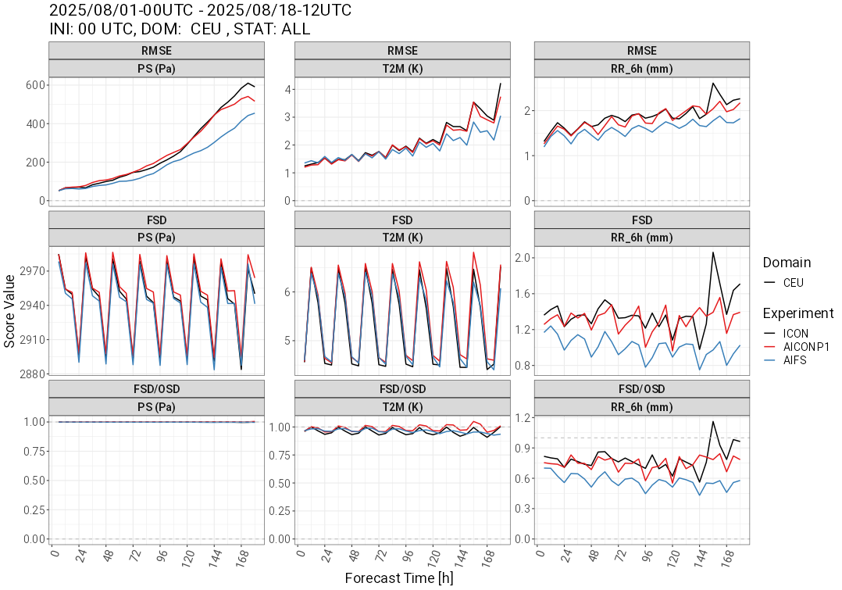
FFV2
New Scores
Threshold Weighted CRPS
Proper ensemble score with weight on (rare) events
Test phase (include with namelist entry TW ‘TRUE’)
Unclear added value to e.g. Brier score
Activity
Quantify forecast and observation activity (spatial variability)
Smoother fields will be reflected by a reduced std. dev. of the forecasts
Reduced activity can explain a reduction in RMSE
Relevant for current AI models that show reduced RMSE due to smooth forecast fields
Still, a more detailed view on activity is important, e.g. a scale dependent analysis using power-spectra

Slide 10
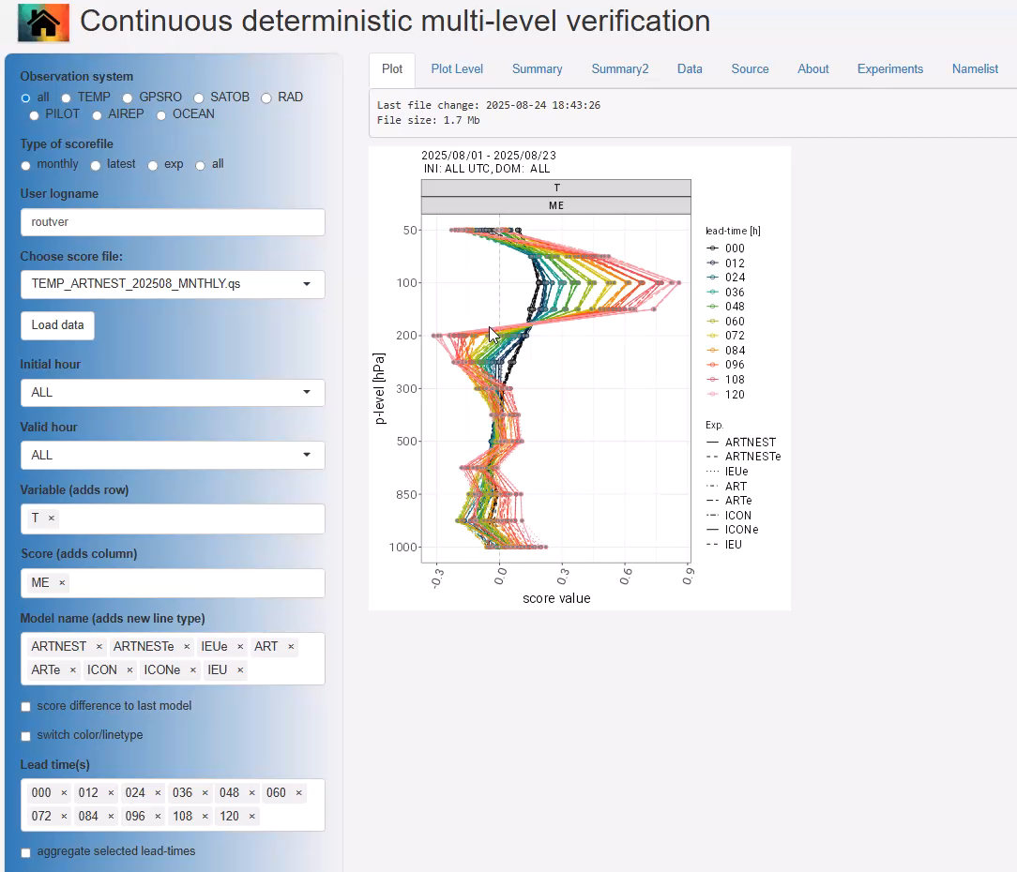
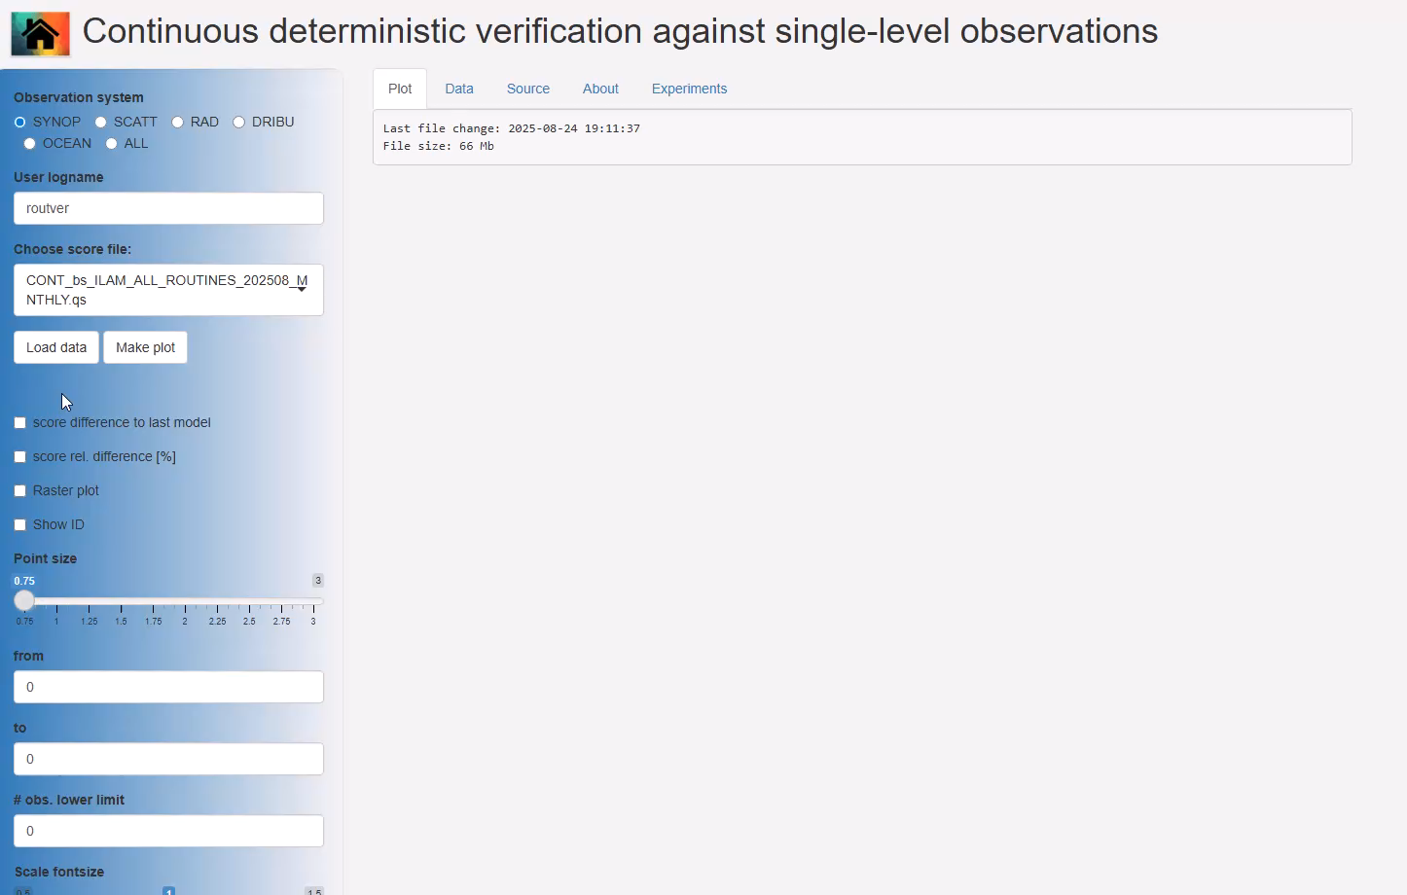
Shiny Apps
Reading qs and Rdata score files
Interactive zooming in station based map plots
Increase size of plot fonts
Plot layout of vertical score profile plots (switch meaning of color/linetype)

Slide 11
OTHER STUFF

Slide 12
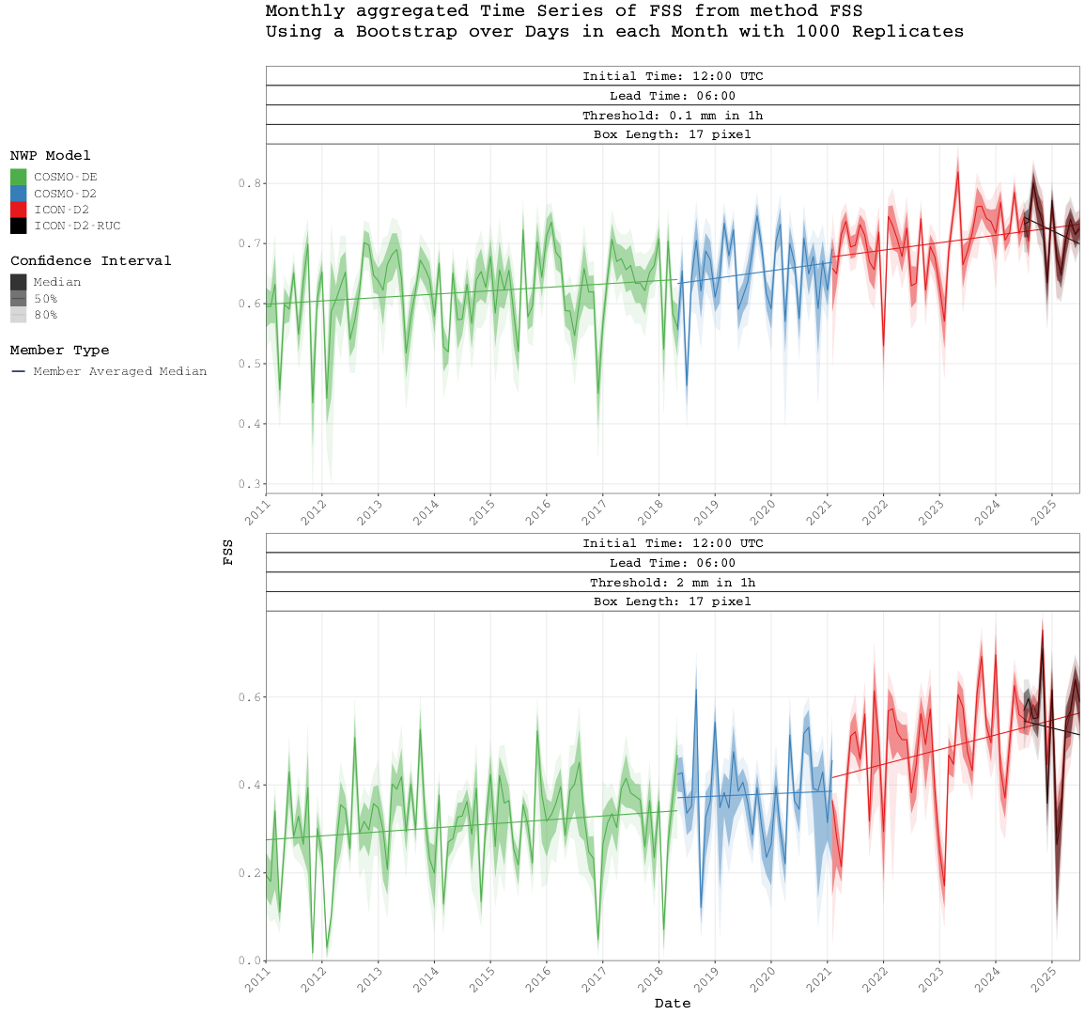
Precipitation (M. Hoff)
Demonstrating improved precip. forecasts is hard
Long-term trend in precip. forecast quality
Spatial verification against rain composite (cal.)
FSS (and other scores) starting 2011
Based on DWD local ensemble model
Clear improvement over the years
Especially with the introduction of ICON

Slide 13
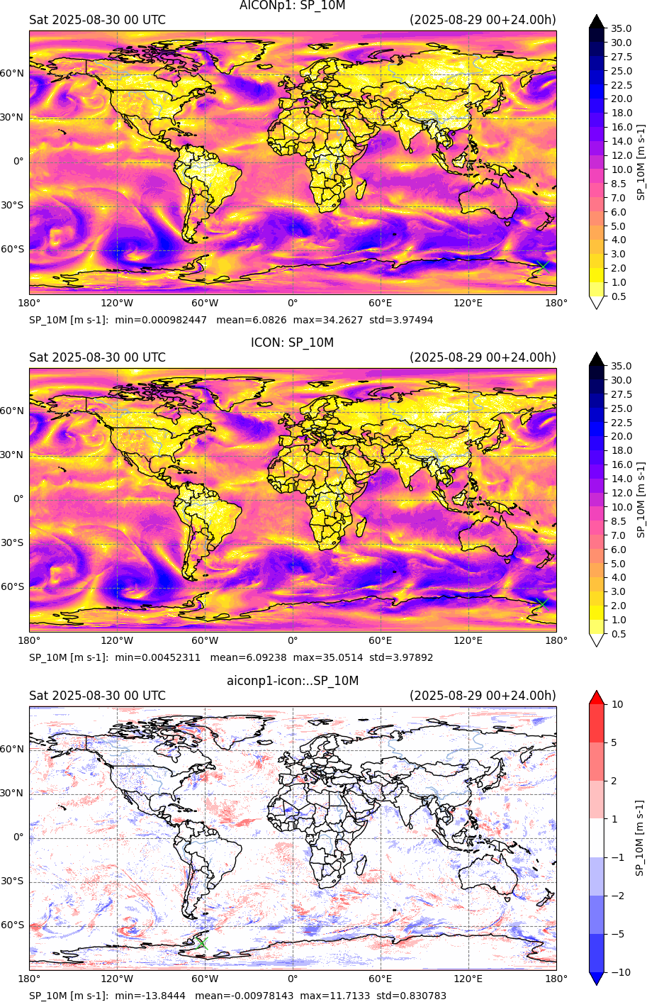
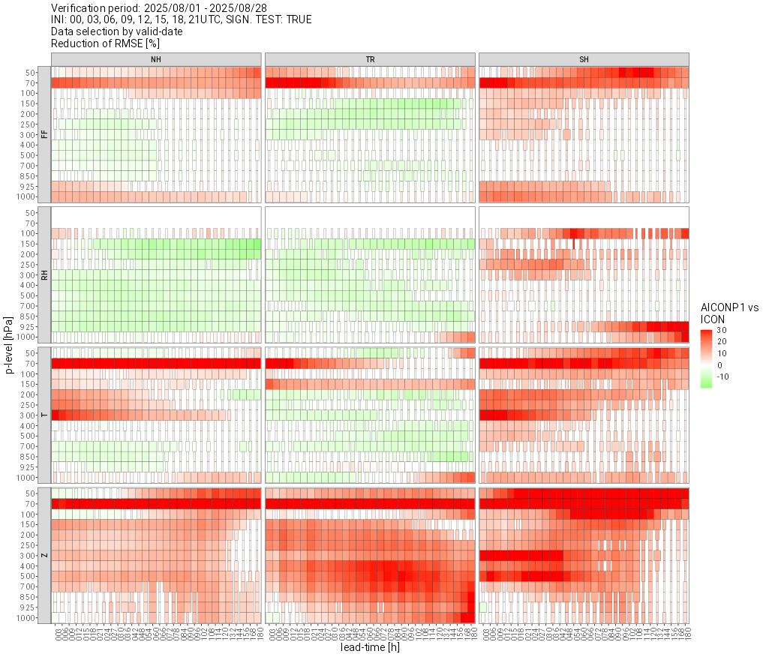
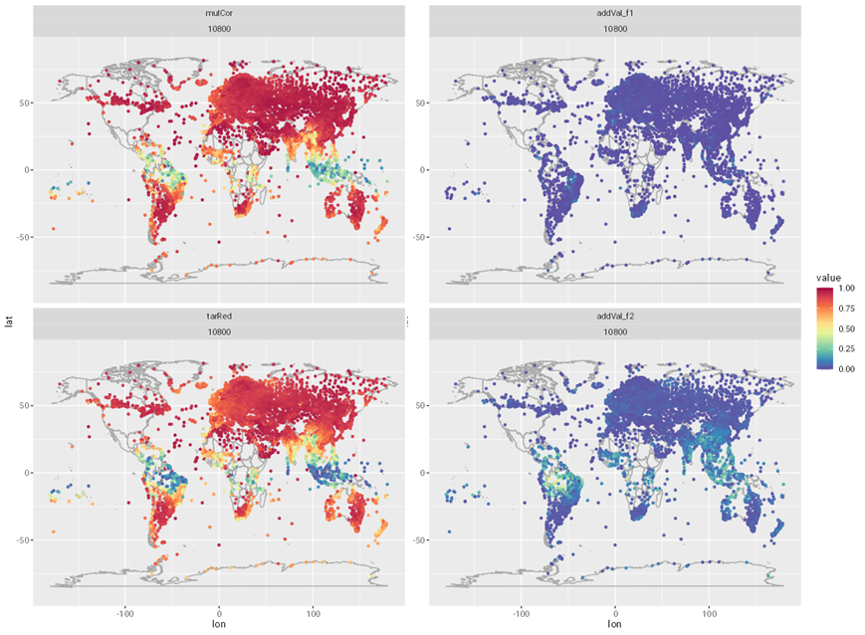
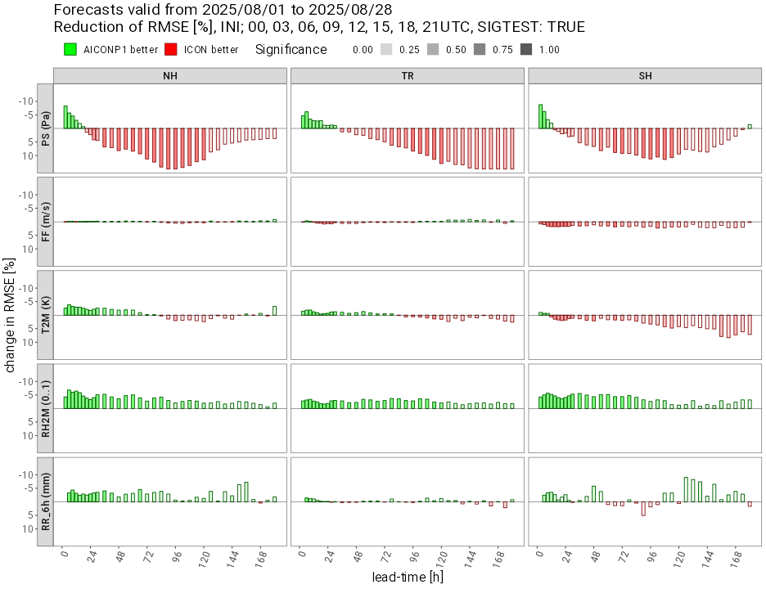
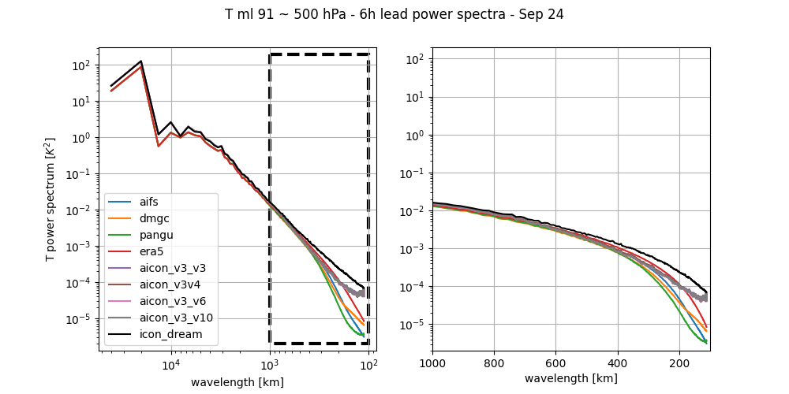
AICON
AICON will become internally operational this week
  More intense evaluation also by forecasters
  Limited output FF10M, T2M, TD2M, RH2M, TOT_PREC and U, V, RH, T, Z on 13 model levels (close to standard pressure levels)
  Some artefacts like unphysical values or unrealistic precipitation at some grid cells need to be addressed
AICON verification
  Standard scores look promising
  Additional methods and metrics are under development
  Scale dependent activity (spatial variance) (Britta Seegebrecht)
  Simple, observation based activity estimate in FFV2 (Felix Fundel)
  Additionally explained variance after Glowienka-Hense et al. (2020) (Sabrina Wahl)
Upcoming developments
  AICON-LAM

Slide 14
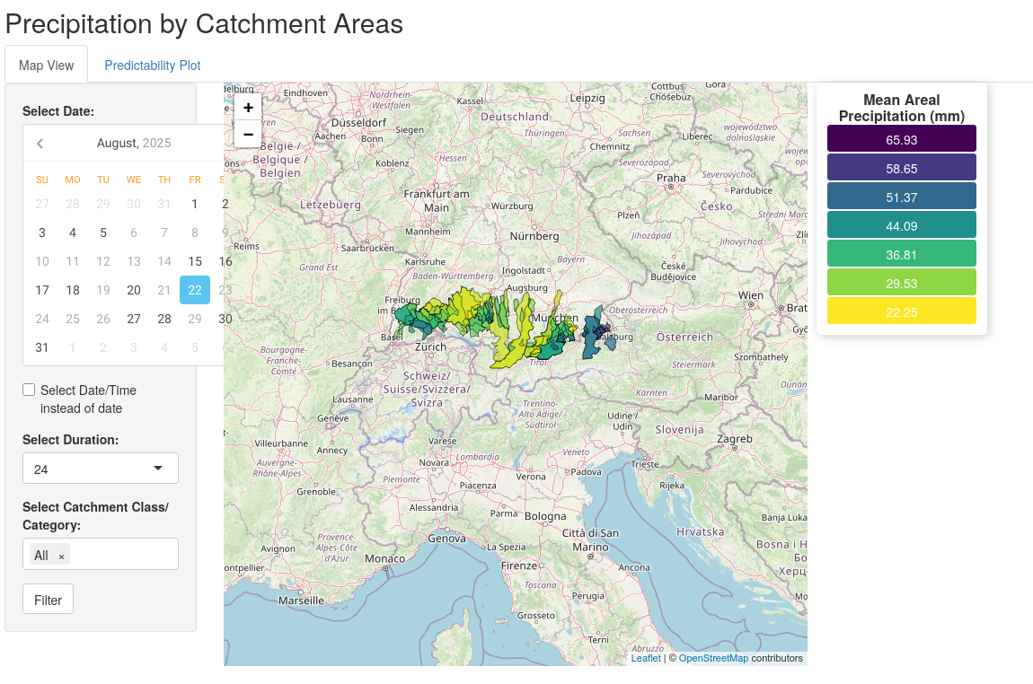
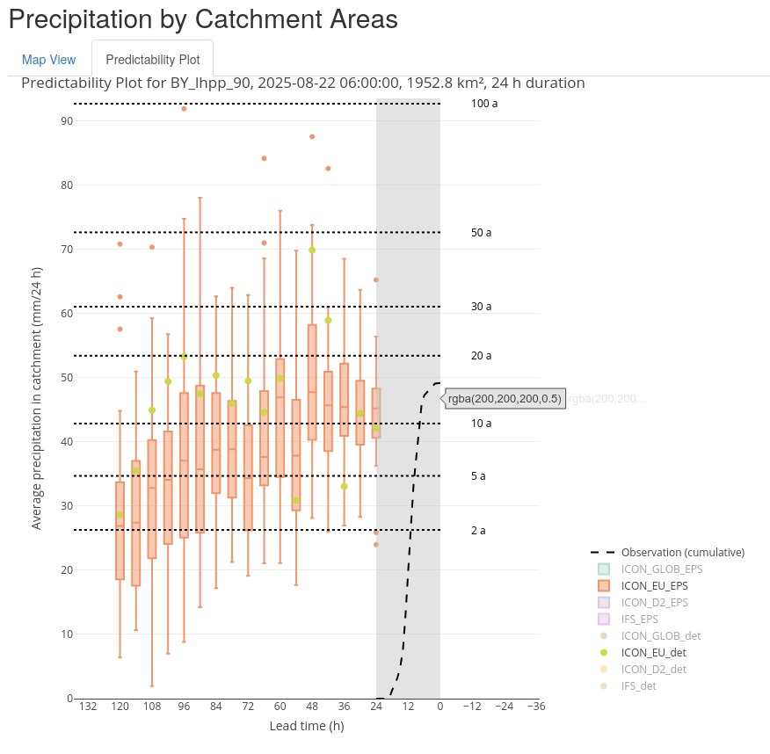
CoDesign
Predictability of catchment precipitation as support for hydrological services

