Slide 1
SCA Report for ICON-NWP
Ulrich Schättler
ICON Gatekeeper (in charge for COSMO)

Slide 2
Latest ICON Releases
NOTE:
This is not on contents of ICON, just some technical remarks to find yourself around.
For actual informations on latest ICON development see Daniel Riegers presentation on „ICON News“

Slide 3
Important Repositories
https://gitlab.dkrz.de/icon/icon-nwp
Private repository for NWP developments; should be used by COSMO developers
To see what is going on: https://gitlab.dkrz.de/icon/icon-nwp/-/merge_requests
Or what has happened already: https://gitlab.dkrz.de/icon/icon-nwp/-/commits/master?ref_type=heads
  Clicking on a special commit gives you a link to the corresponding merge request with (hopefully) appropriate documentation on the changes: „!xyz“
Special tags for DWD and MCH operational versions. More information on DWD versions:
  https://gitlab.dkrz.de/icon/wiki/-/wikis/ICON-NWP-operational-release-tags
https://gitlab.dkrz.de/icon/icon
Private „upstream“ repository; parent repository for icon-nwp, icon-mpim (and others)
„Downstream“ repositories will be synchronized at least before publication of an open source release
Also has pages for merge requests and commits

Slide 4
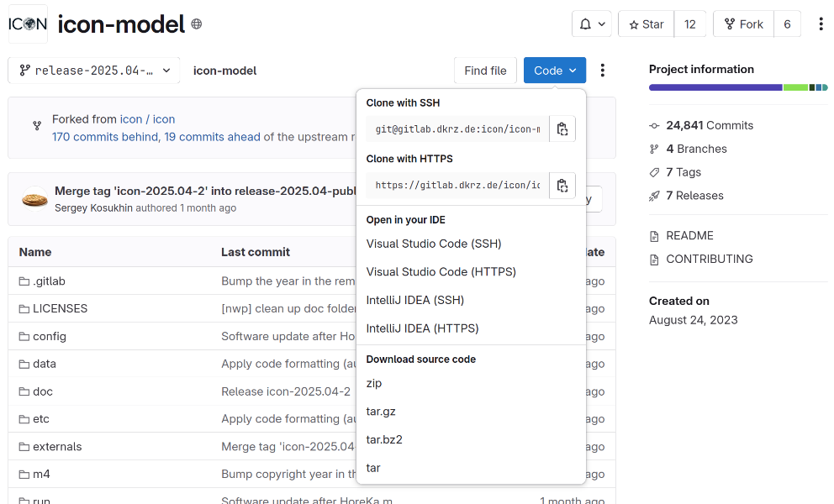
Important Repositories (II)
https://gitlab.dkrz.de/icon/icon-model
Public repository for open source releases
There is NO merge-requests page
But there is a commits page (at least for the latest release)
  https://gitlab.dkrz.de/icon/icon-model/-/commits/release-2025.04-public?ref_type=heads
  Clicking on a commit gives only basic informations on the changes for that commit
  The link to the corresponding merge request with more details goes to the private pages ☹
Another problem when „Download source code“
  The code for the externals is not contained in the tar-files due to a gitlab-problem
  You have to clone the code: git clone https://gitlab.dkrz.de/icon/icon-model.git
(Status as of August 2025)

Slide 5
Branches – Tags ⇨ Releases
On the public repository icon/icon-model:
Branches are named
release-2024.10-public
release-2025.04-public
Tags are named
icon-2024.10-public 09.10.24
icon-2025.04-public 29.04.25
  icon-2025.04-1-public 28.05.25
  icon-2025.04-2-public 18.07.25
When cloning the public repository you will get the latest branch and tag by default.
Fix in icon-2025.04-1-public: Enables using spun-up FLake variables from first guess in MODE_COMBINED
Fix in icon-2025.04-2-public: Increase buffer size for auxiliary field during nest start

Slide 6
DWD ICON Tools
Version 2.7.0 available since 26 March 2025
Fix for kilometric grid
Changes to infrastructure
Version 2.8.0 available since 30 July 2025
gridgen: Modified index sorting for edges and vertices to reduce MPI communication in ICON setup phase
Consistent naming of dimensions (ncells instead of cells, because ICON expects ncells)
Proper implementation of linear RBF kernel
NOTE:
DWD does not support the ICON Tools officially

Slide 7
License and Support Issues

Slide 8
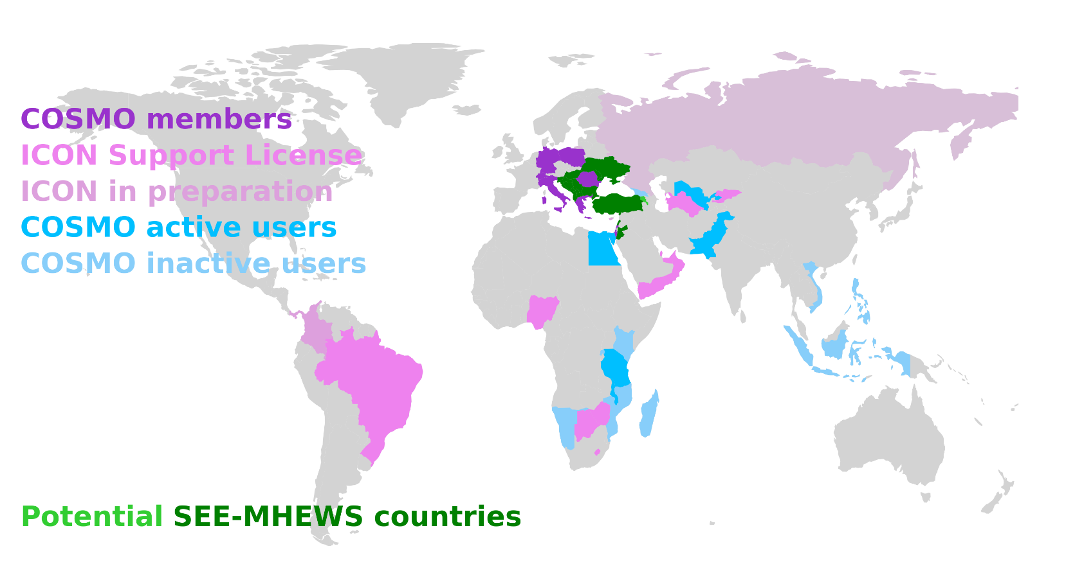
Status of ICON Licensees / Users of ICON Forecasts
Running ICON: Brazil (Navy), Qatar, Oman, UAE
Contracts also signed by: Botswana, Kirgistan, Lesotho, Nigeria, Turkmenistan, Yemen, Zimbabwe
Contracts already sent to: Brazil (INMET), Egypt, Tanzania.
Possible paying countries
  in negotiation: Cyprus
  stalled: Bahrain, Colombia, Panama
South-East European Multi-Hazard Early Warning Advisory System
  these countries have access to ICON forecasts performed by IMS at ECMWF computer
  see: www.see-mhews.org

Slide 9
COSMO Money 2025 and Beyond (Using World Bank Data)
Country | 2025 |  | 2026
 | GDPpc¹ | Fee | GDPpc² | Fee
Botswana | 7820.2 | 11,400 | 7,695.2 | 10,300
Brazil (INMET) | Still COSMO | Missing: 20,000 | 10,043.6 | 15,800
Brazil (Navy) | 8,917.7 | 13,700 | 10,280.3 | 16,300
Oman | 21,549.8 | 20,000 | 20,248.4 | 20,000
Qatar | 80,195.9 | 2H2025: 10,000 | 76,275.9 | 20,000
Turkmenistan | 8,792.5 | 13,400 | 8,571.6 | 12,900
UAE | 49,070.7 | 20,000 | 49,377.6 | 20,000
 |  | 88,500 |  | 115,300
GDPpc taken from https://data.worldbank.org/indicator/NY.GDP.PCAP.CD (August 2024); except Brazil (Navy) and Turkmenistan: prices were not raised.
GDPpc taken from https://data.worldbank.org/indicator/NY.GDP.PCAP.CD (July 2025); except Brazil (INMET): we sent the contract already beginning of 2025

Slide 10
Support Activities
NWP Model Training in May 2025 (see next slides)
The Request Tracker is online and rather active after the Training:
  Nigeria and Botswana installed ICON and the ICON tools; Zimbabwe is in the process of doing so.
  With Nigeria we are now discussing a proper domain (size, resolution) for an update of COSMO.
Especially UAE uses the RT also for scientific questions
  radiation values in meteograph output, temperature bias
  Remember from last year, the „headache problem“: ICON consistently overestimates forecasted rainfall amounts. This is still not solved!

Slide 11
NWP Model Training

Slide 12
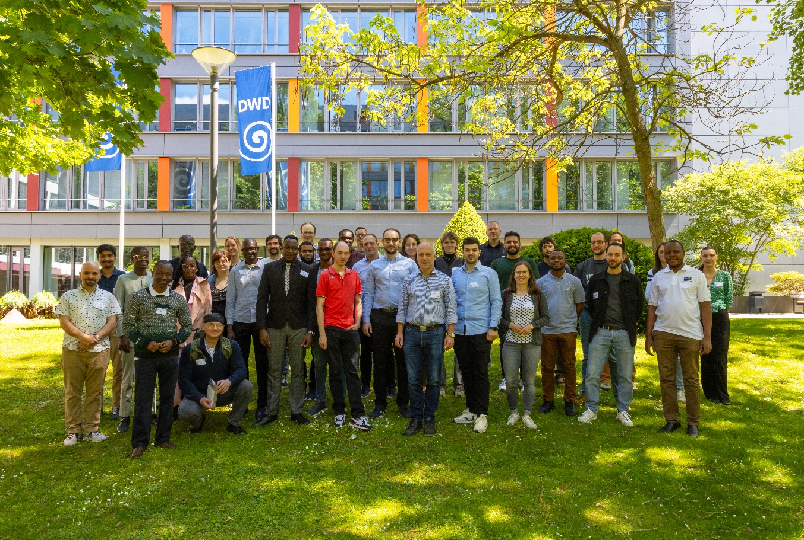
NWP Model Training 2025
Took place 12-16 May in Offenbach
Only CLM and MetService course this year; Academia took place in Hamburg in July.
40 accepted registrations for MetService course.
Preparation and organization by the proven Exercise Team. This year with support from Daniel Rieger.
Exercises performed on ECMWF Computer again.
Exercises for scheduling system (ecFlow) need elaboration.
No exercises yet for verification.

Slide 13
NWP Model Training 2025
In principle, the NWP Model Training again was a success, BUT:
  Only 13 participants present.
  About 10 participants cancelled the registration before the course (due to visa or funding problems)
  15 participants did not show up!
  After the training we asked all missing participants for the reason for not showing up:
    At least they all answered!
    Reasons always were visa or funding problems.
At DWD we will have a meeting next week to discuss the future of the NWP Model Training at DWD
Aftermath: Another institute shows interest in using ICON:
  IGAD Climate Prediction and Applications Centre (ICPAC)
  (in addition to ASECNA, ACMAD)

Slide 14
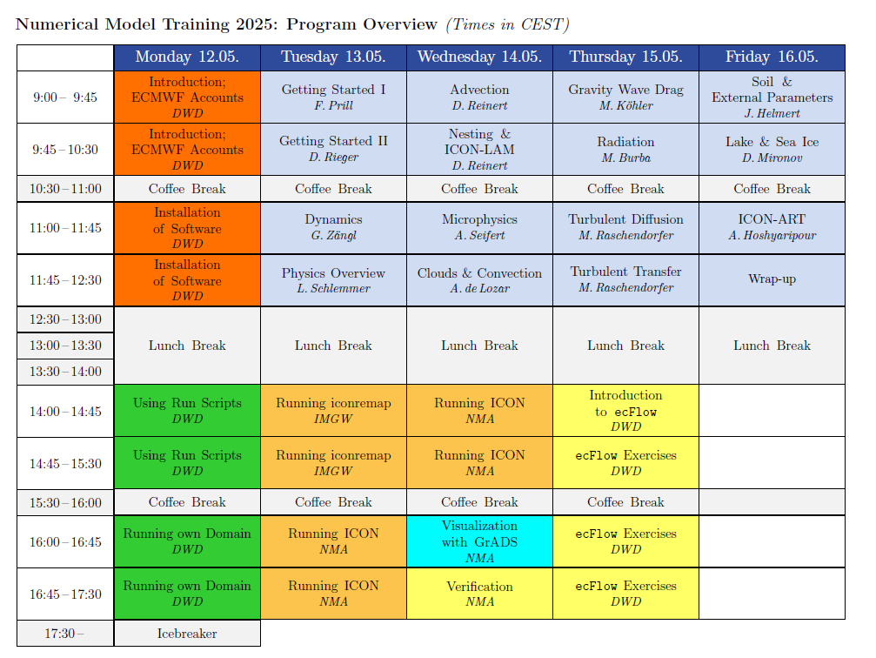
Time Table for MetServices
Modified timetable compared to former years:
Already started on Monday morning.
But still time for exercises is rather short.
Challenges:
How to fit all material in one week?
Knowledge in Linux and shell scripts.
Advantage this year:
Had 5 tutors for 13 participants

Slide 15
NWP Model Training: Summary for MetServices
Again joint COSMO development of the exercises (based on the work from the last years).
Scheduling and ecflow need more elaboration. Sascha is working on a basic ecflow-suite to run ICON-LAM.
Since the Training:
Working closely together with Nigeria, Botswana and Zimbabwe to set up an operational ICON-LAM application
More countries on the list:
  Egypt, Georgia, Malawi, Pakistan, Tanzania, Turkmenistan, Ukraine, Uzbekistan (still using COSMO or at least getting data from DWD)
  Indonesia, Kenya, Madagascar, Mozambique, Namibia, Philippines, Vietnam (former COSMO users)

Slide 16
NWP Model Training for Academia
For the Academia group the Training was organized by natESM Project in Hamburg at DKRZ.
Material for this Training is available under the CC BY-NC-ND 4.0 license (Attribution-NonCommercial-NoDerivatives 4.0 International)
  https://gitlab.dkrz.de/icon-training/icon-training-2025-scripts: see also the „rendered version“
  Also the Jupyter Notebooks for the exercises can be accessed through this page
A new version of the Tutorial is also available: Tutorial 2025:
  https://www.dwd.de/DE/leistungen/nwv_icon_tutorial/pdf_einzelbaende/icon_tutorial2025.html

Slide 17
ICON on ATOS (ECMWF)

Slide 18
New Compiler Wrappers
atos2020.gcc-11.2.0, atos2020.intel-2021.4
removed explicit version numbers from libraries used
included libfyaml to be able to use coupling (yac): but --enable-coupling is not activated
included links to RTTOV (private installation): but --enable-rttov is not activated
(optionally) included python3 (has to be activated)
atos2020.intel-2025.0
uses new Intel compiler (oneapi: intel-llvm) 2025.0
Still no reproducibility for ecrad with OpenMP
Not provided:
atos2020.gcc-14.2.0: this compiler is buggy (crashes in a turbulence routine)
atos2020.gcc-15.1.0: works again for ICON, but not all necessary libraries are installed yet

Slide 19
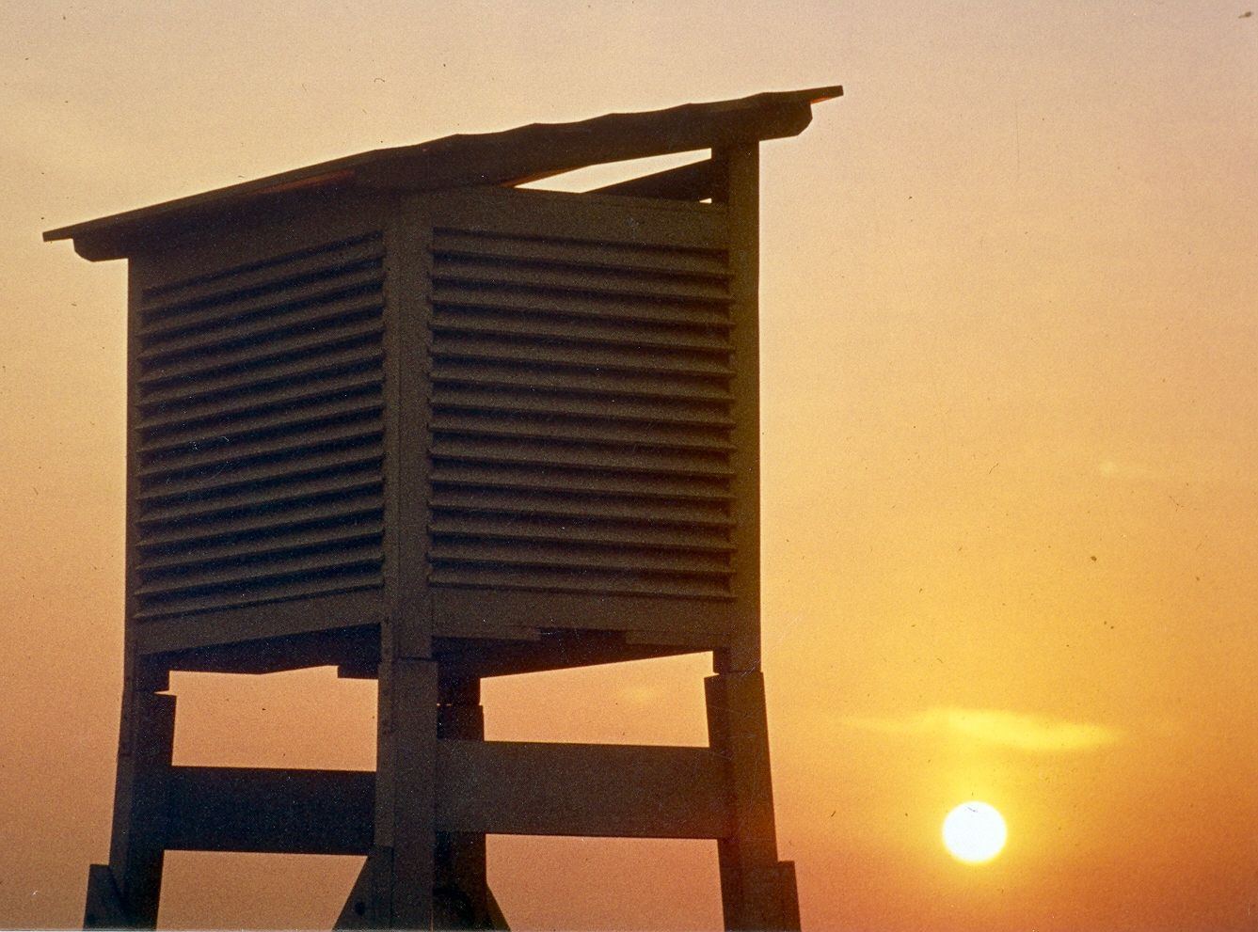
Thank you
for your attention

