Slide 1
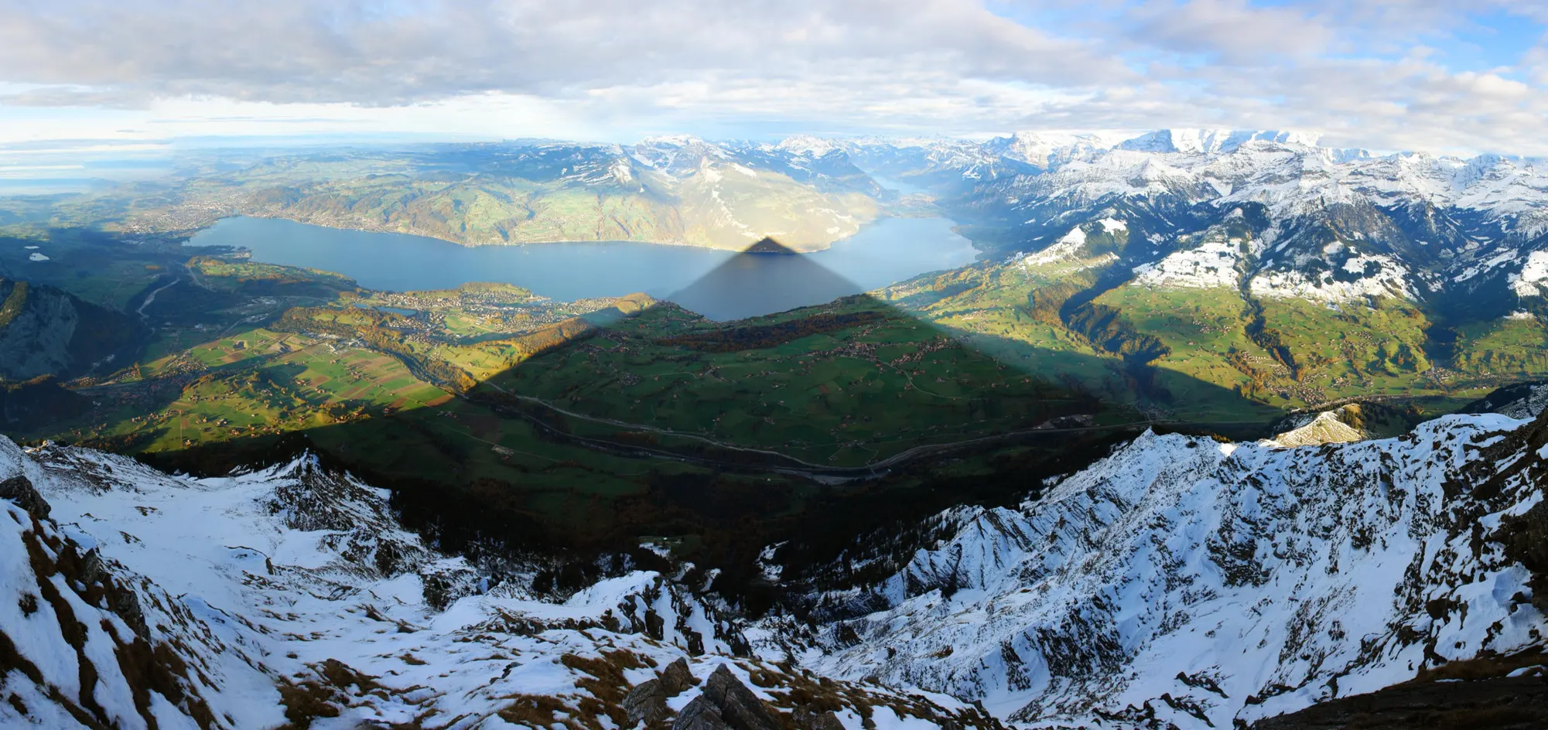
Updated radiation-topography scheme in ICON and the new subgrid-scale variant
Christian R. Steger and MeteoSwiss SEND Team
Shadow of Niesen (Bernese Oberland, Switzerland) (www.bernerzeitung.ch / Bruno Petroni)
COSMO General Meeting, 01 – 05 September 2005, Basel, Switzerland

Slide 2
Topics
EXTPAR topographies: MERIT corrections and Copernicus DEM
Radiation-topography (radtopo) grid-scale scheme
Radtopo subgrid-scale scheme
Outlook: New background albedo
Notes:
Reason why improvements in EXTPAR topography dataset also mentioned → crucial input for radtopo scheme

Slide 3
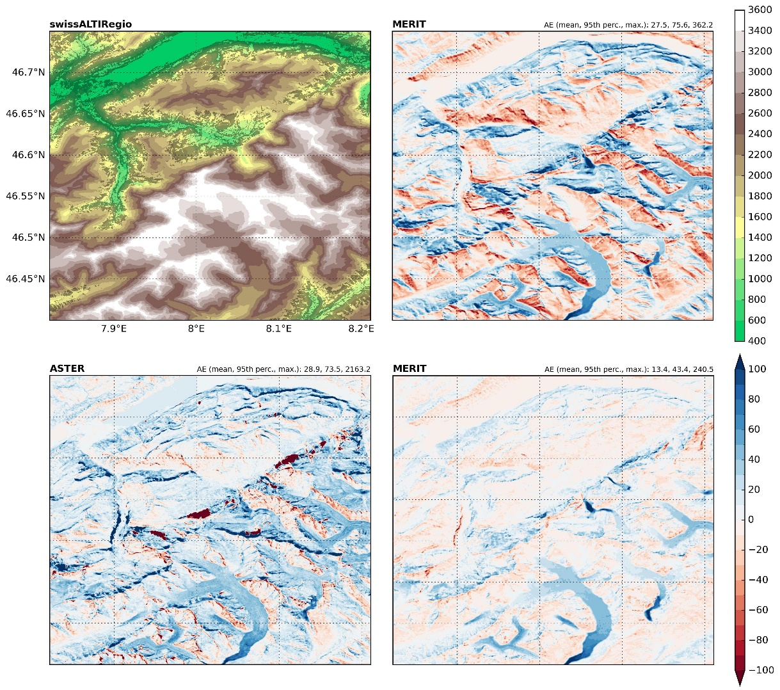
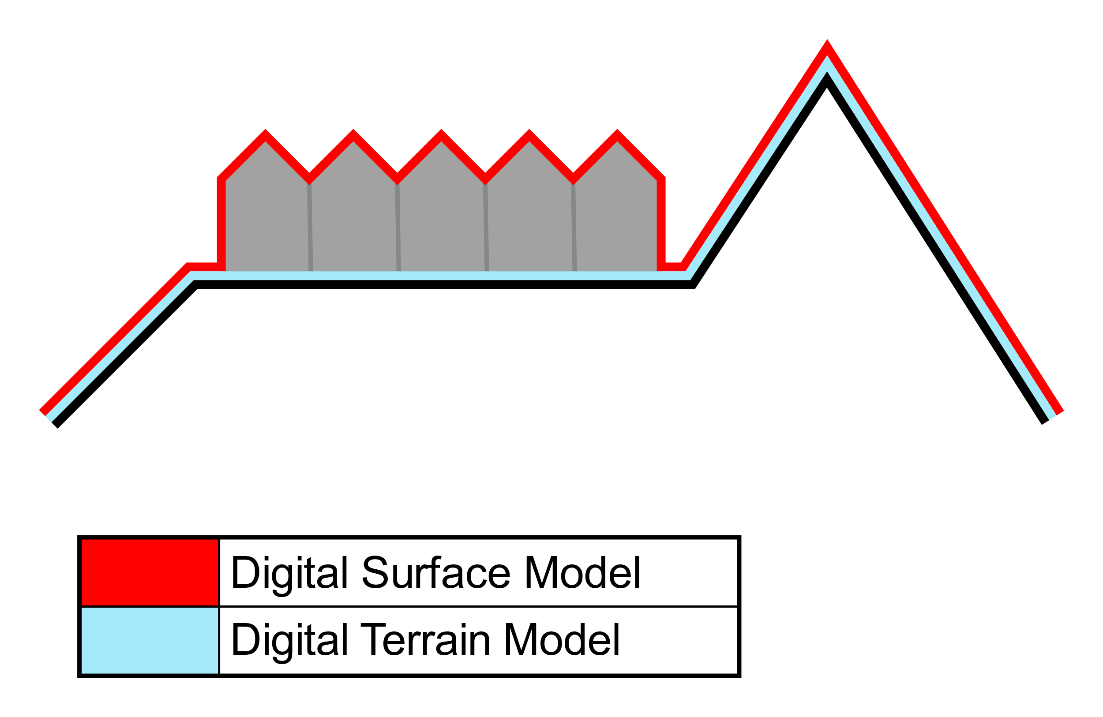
EXTPAR topography MERIT/REMA
existing
(wikipedia.org)
DEM types
swissALTIRegio: DTM
MERIT: ~DTM
ASTER: DSM
new
merge requests in EXTPAR / extpar-input-data
merged / pending
→ soon available
Notes:
Figure: ASTER and MERIT DEM vs swissALTIRegio (high-quality reference elevation model)
MERIT EXTPAR input data reprocessed (→ grid cells shifted latitudinally by one cell) & coordinate shift in EXTPAR fixed
Shifted MERIT data only as good as ASTER in terms of error statistics
Grey area in upper left panel: high vegetation (forest) and urban area according to CORINE land cover → not considered for error statistics (because difference in DSM/DTM)

Slide 4
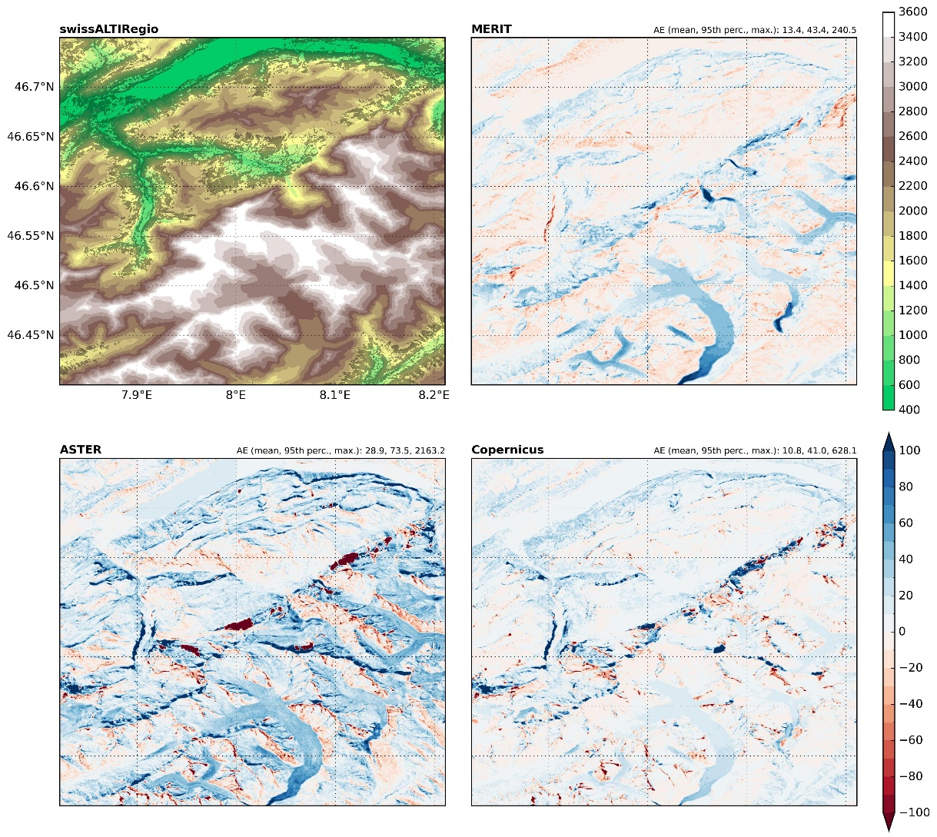
EXTPAR topography Copernicus DEM
New EXTPAR input data set: Copernicus DEM
30 m resolution
DSM
TanDEM-X mission (2011 - 2015)
Abs. dev. | Mean | 95th perc. | Max.
ASTER | 13.1 m | 41.4 m | 2163.2 m
MERIT | 7.0 m | 23.7 m | 240.5 m
Copernicus | 4.7 m | 16.6 m | 645.5 m
(for Switzerland)
merge requests in
EXTPAR / extpar-input-data
pending
→ soon available
Notes:
Distinctive artefacts in ASTER data (particularly at steeper north-facing walls)
Copernicus DEM generally best in terms of error statistics (particularly for glaciated regions with fast elevation changes → Copernicus DEM based on more recent satellite data)
But superior performance of Copernicus DEM not only because of glaciated area → see statistics for entire Switzerland

Slide 5
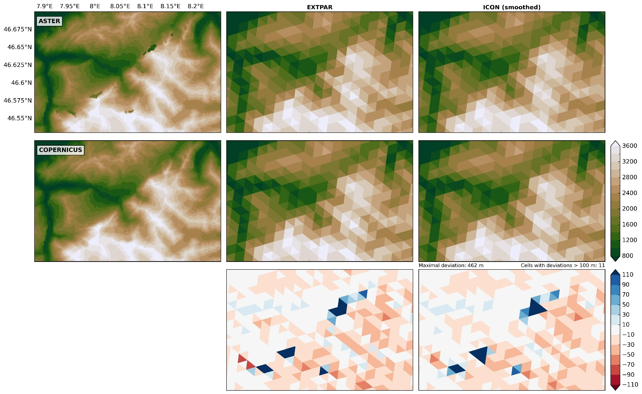
EXTPAR topography Aggregated/smoothed DEM
COPERNICUS - ASTER
Notes:
Pronounced artefacts in ASTER data translate to spatially aggregated data
Also for operational 1km ICON grid, deviations are significant
Testing of new topography input for operational setup: complicated because atmospheric levels change due to terrain-following coordinates → initialisation problem…
Accurate DEM not only beneficial for mean model elevation but also for for sub-grid scale orography (SSO) parameters (→ effects on atmospheric flow)

Slide 6
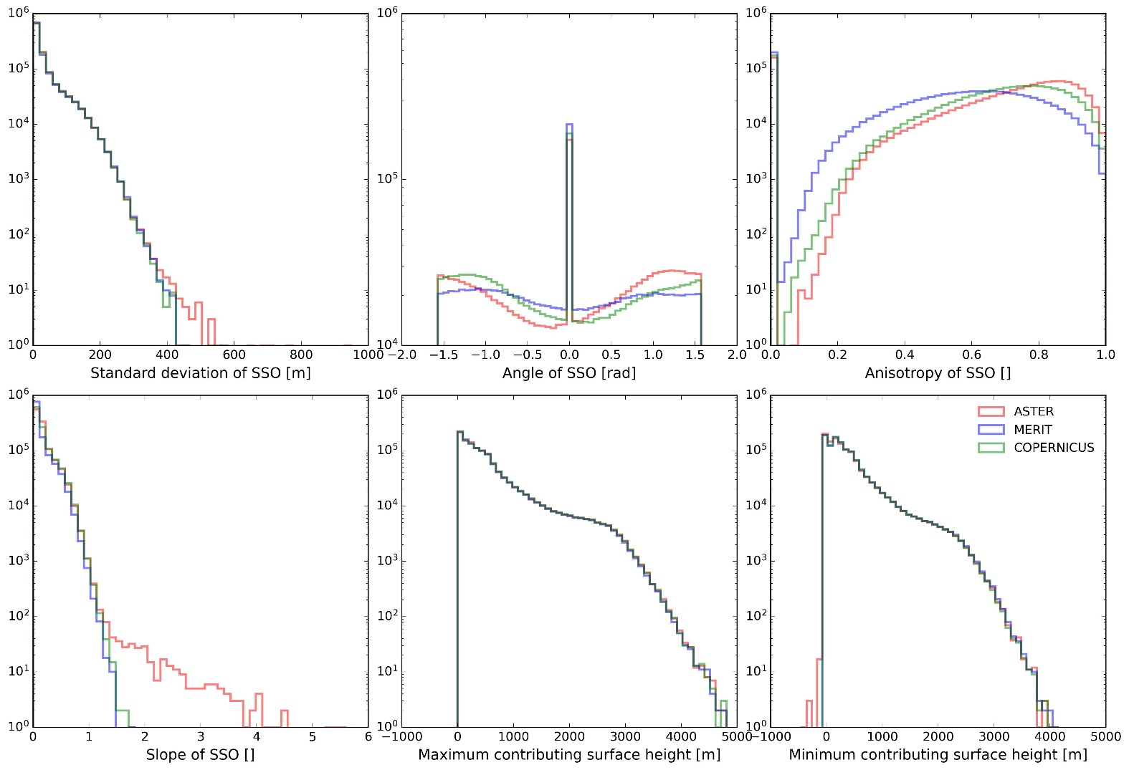
EXTPAR topography SSO parameters
MeteoSwiss domain,
1 km resolution,
1’150’000 grid cells
Notes:
SSO: sub-grid scale orography
Histogram → Y-axis: logarithmic, shows number of ICON grid cells
ASTER: (Very) large values for SSO standard deviation / slope → areas with artefacts
Angle of SSO also surprisingly different between DEMs (note: y-axis goes from 10⁴ to 10⁶)
Anisotropy higher in ASTER than in Copernicus/MERIT
SSO (inwp_sso) on in both ICON 1km and 500m
More information on e.g. SSO drag → ICON tutorial 3.8.7

Slide 7
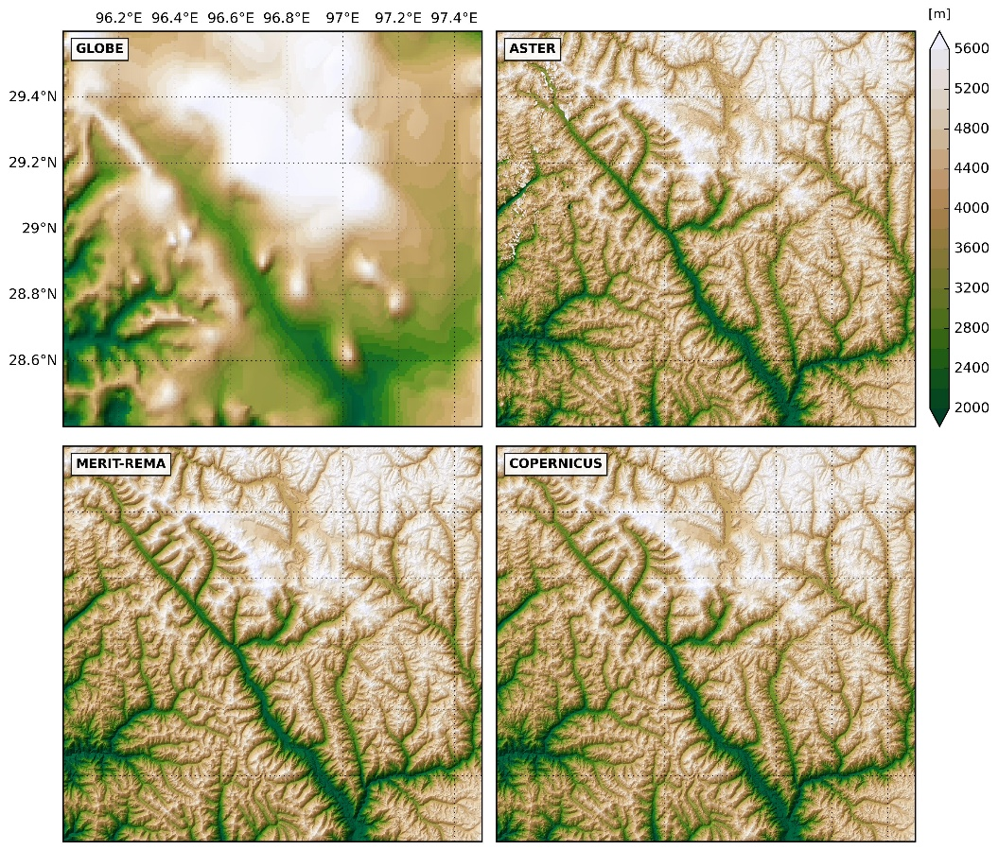
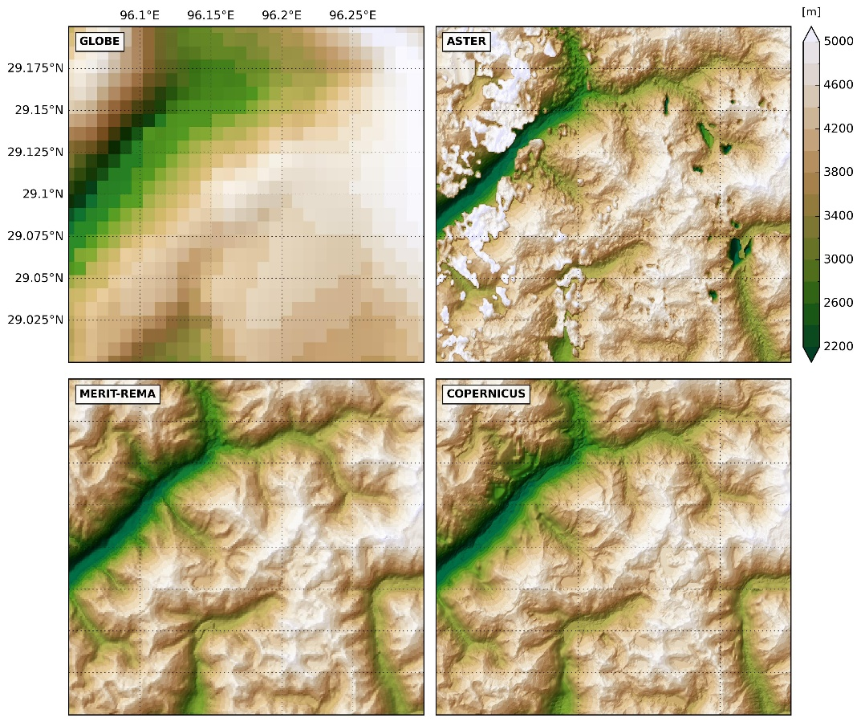
EXTPAR topography Brief global comparison
Notes:
Briefly updated a plot from my PostDoc-time at ETH (where we run COSMO over Himalayas and Atlantic (incl. parts of South America))
GLOBE/ASTER: severe artefacts in some regions (ASTER: problematic for high-resolution ICON runs) → better use Copernicus DEM or MERIT/REMA (both seem to be very accurate for all regions…)
Shown region: Eastern Himalayas

Slide 8
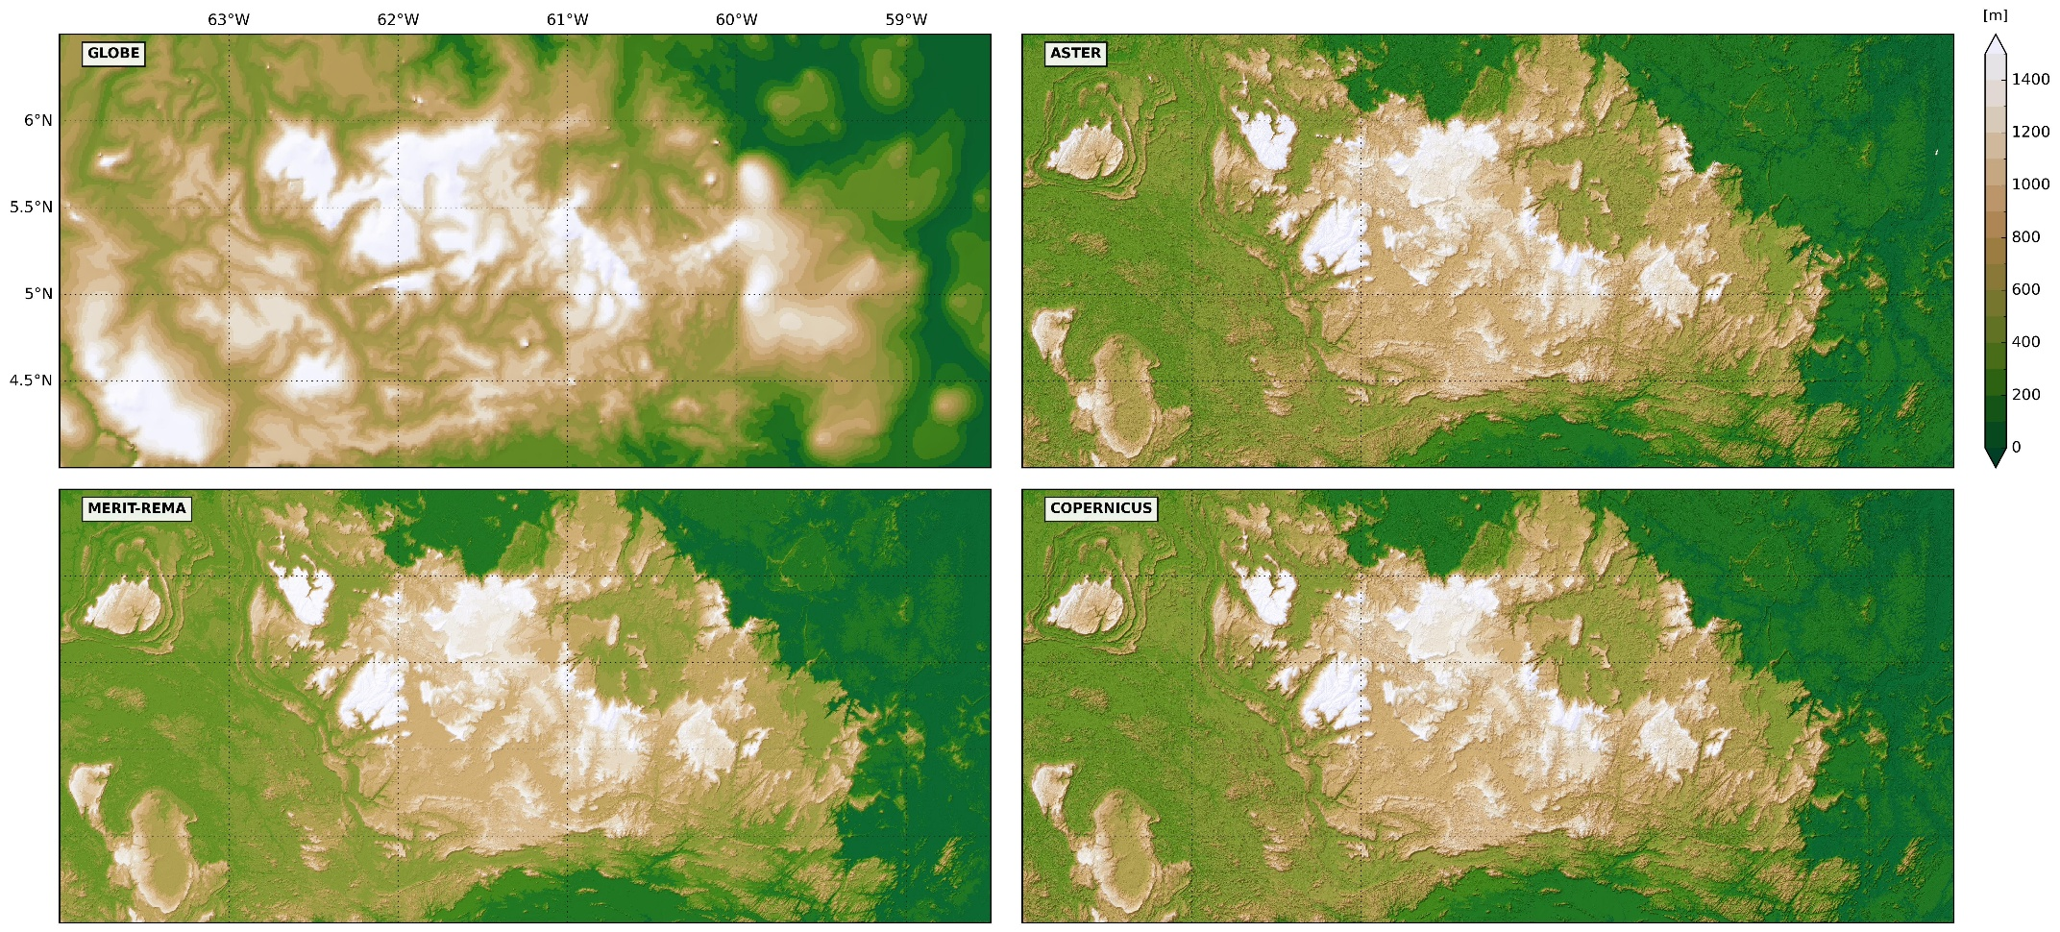
EXTPAR topography Brief global comparison
Notes:
Shown region: South America (northern part)
Display such EXTPAR input data comparison plots on EXTPAR webpage?

Slide 9
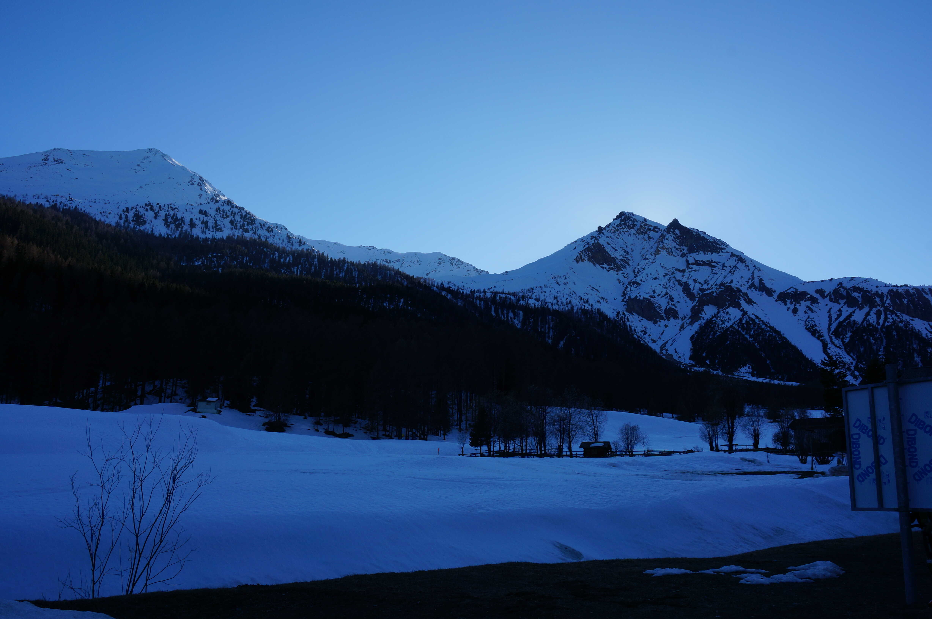
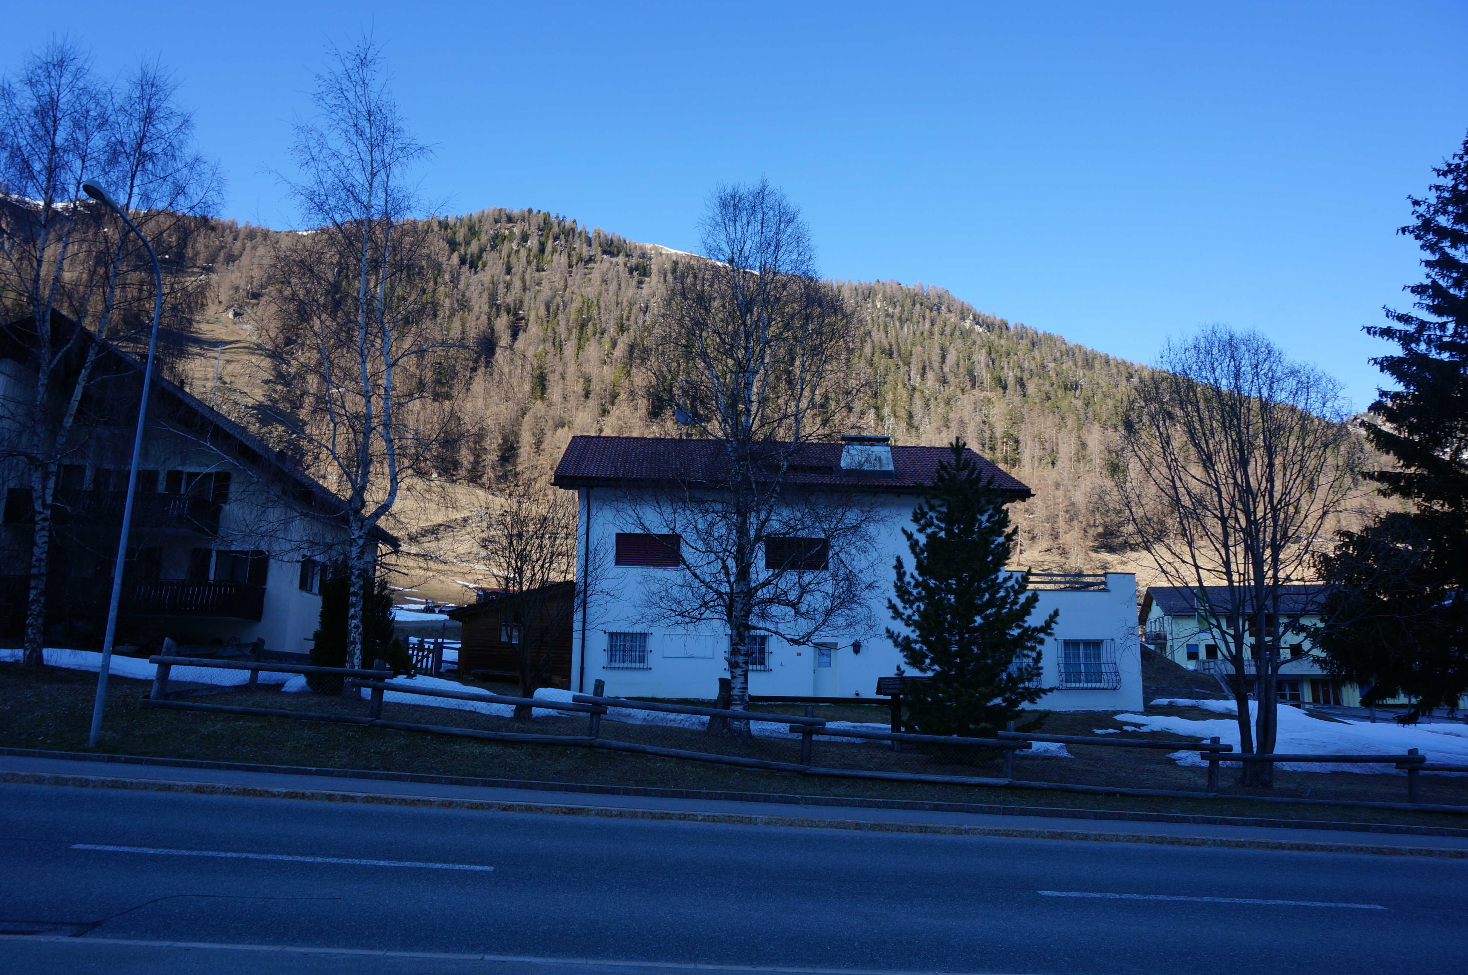
Radtopo grid-scale Motivation
NE-facing
SW-facing
Tschierv, Val Müstair, Switzerland, March 2019
Notes:
Slope effect, self- and terrain shading

Slide 10
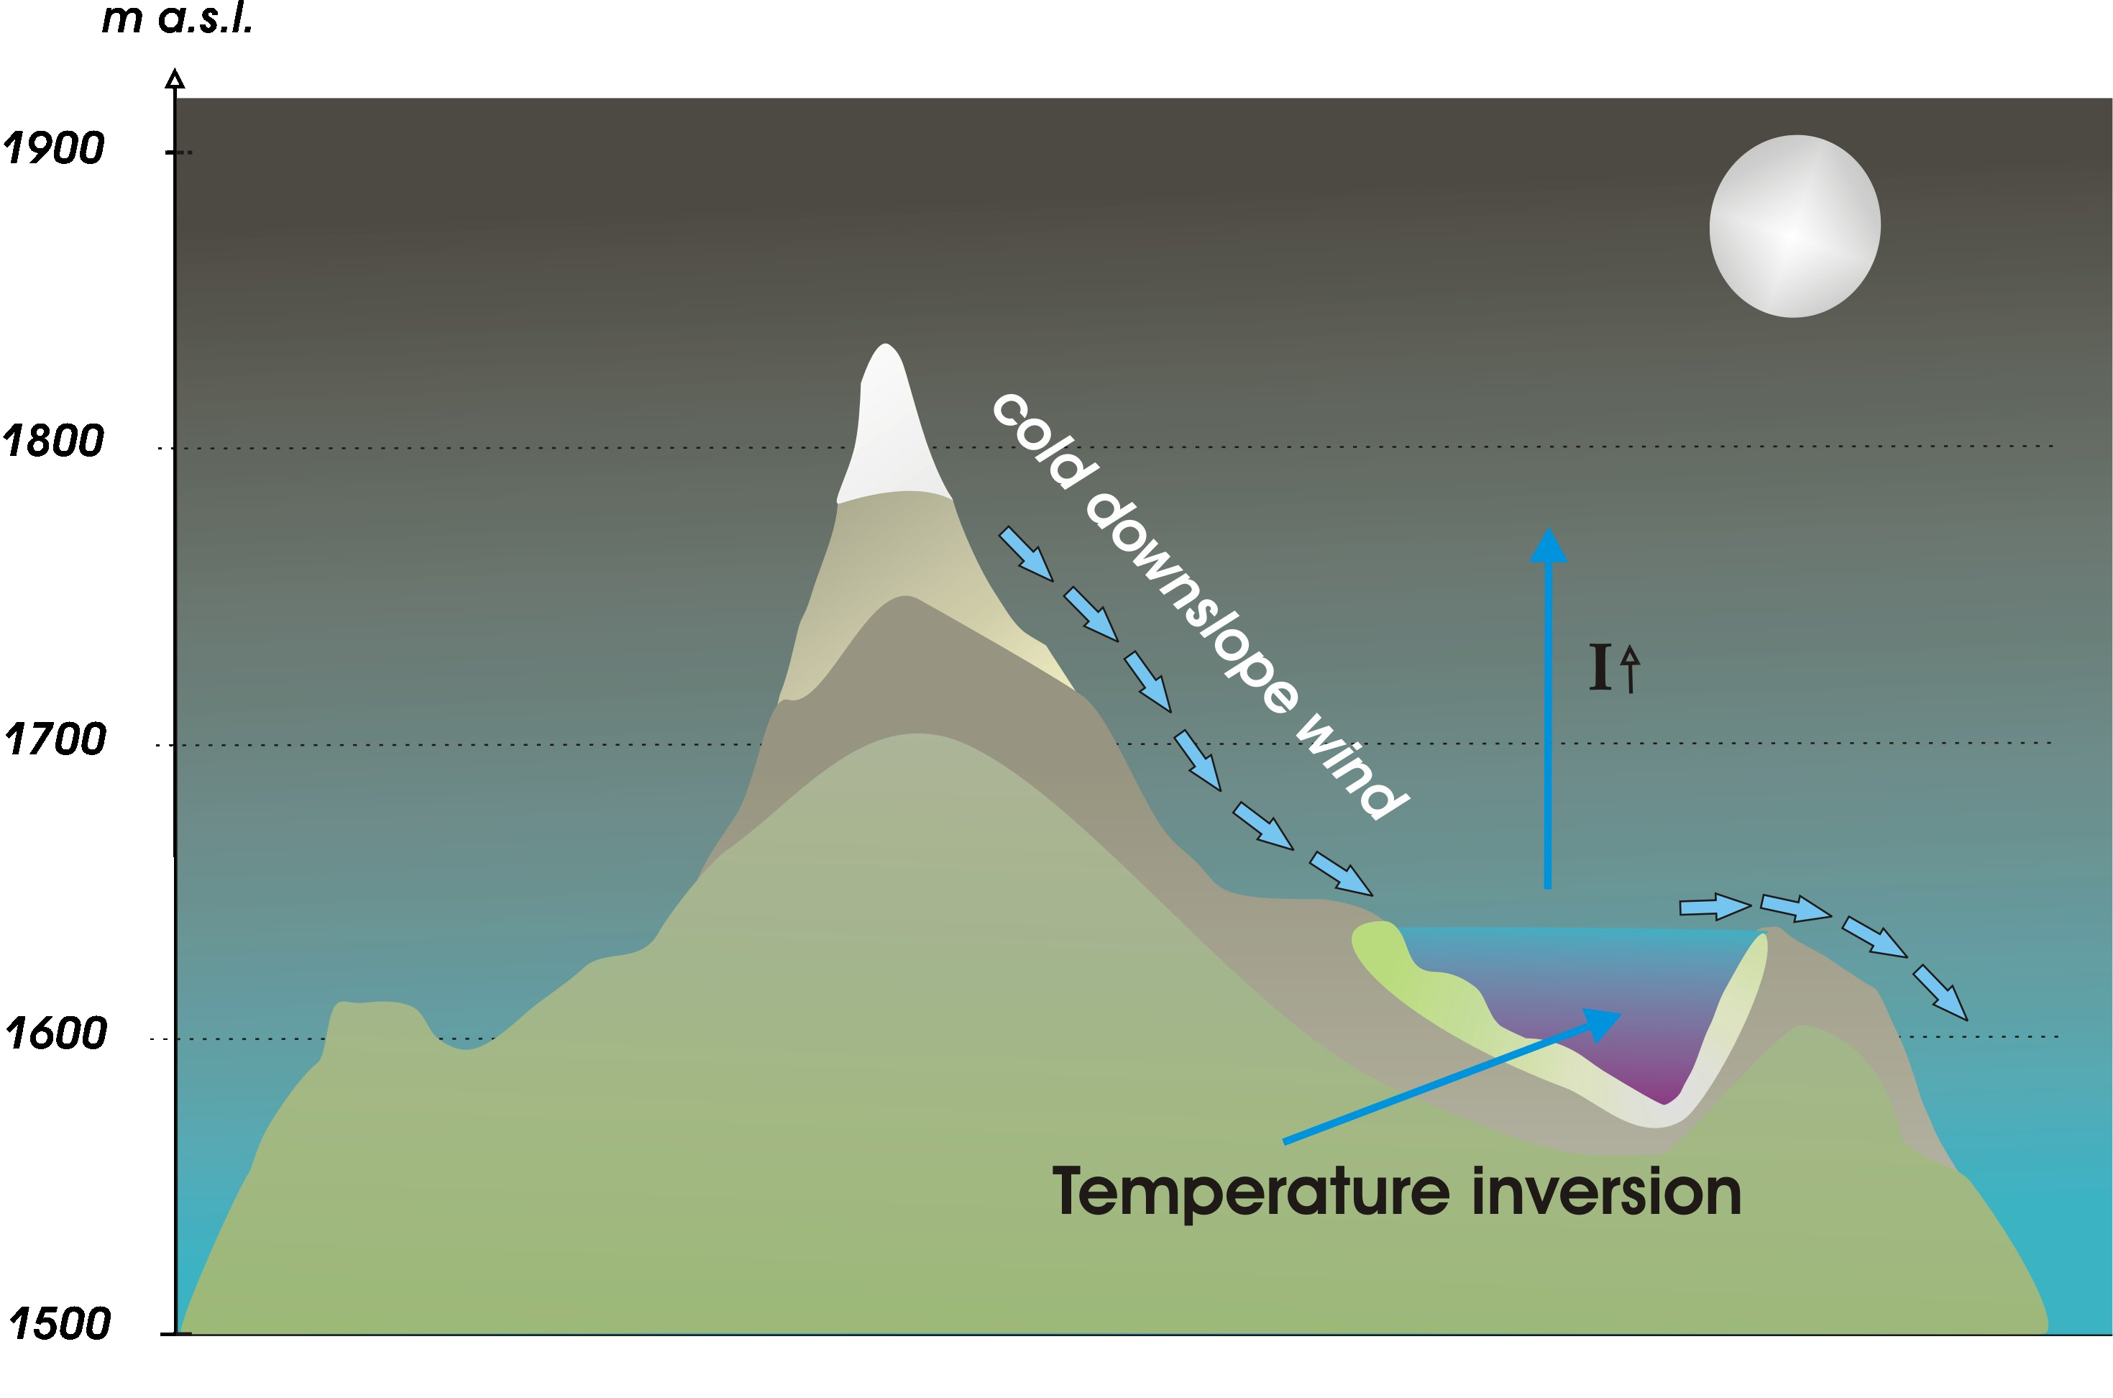
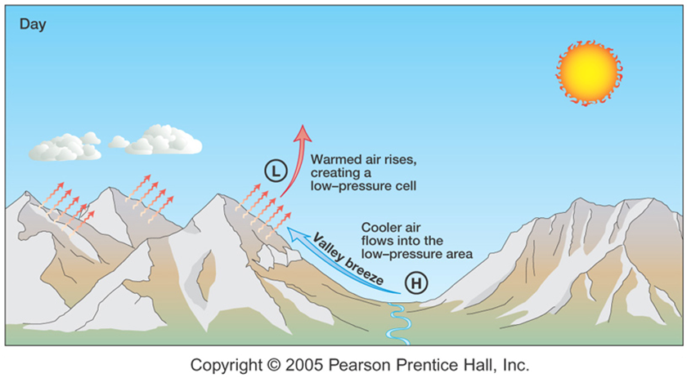
Radtopo grid-scale Motivation
Formation of cold air pool during night
(https://en.wikipedia.org/wiki/Cold-air_pool)
http://geophile.net/Lessons/atmosphere/atm_circulation_06.html (cropped)
Capture influences on atmosphere like:
near-surface temperature
wind circulation systems
convection formation
On a small scale → cold temperatures in depressions depend on radiative cooling (and thus the sky view factor)
Notes:
Relevant to represent effects of topography on surface radiation online in NWP model (not in post-processing) to capture feedbacks on atmosphere…

Slide 11
Radtopo grid-scale Relevant processes
Atmospheric model
(→ two-stream approximation)
◉
▼
✭
 | Effect | Relevant spatial scale
▼ | Incoming direct shortwave radiation (slope, topographic shading) | < than ridge-to-ridge distance (~10 km)
◉ | (Multiple) reflection of shortwave radiation by sloped terrain → “effective albedo” < “planar albedo” | All scales
✭ | Incoming longwave radiation (exchange between sloping terrain) | < than ridge-to-ridge distance (~10 km)
Notes:
Slope effect, self- and terrain shading

Slide 12
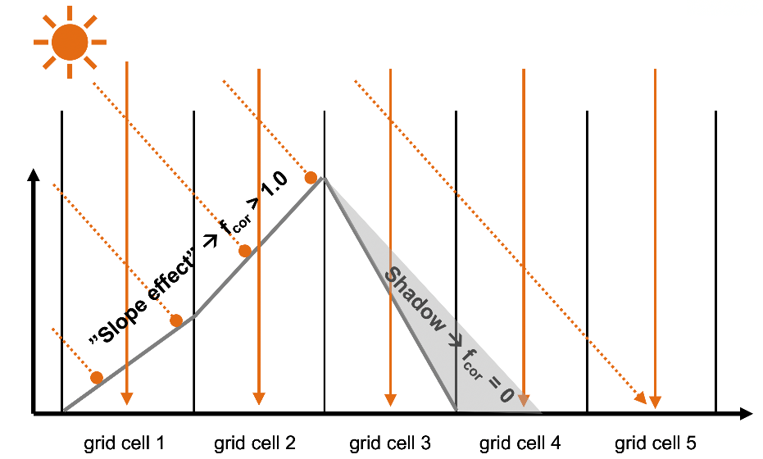
Radtopo grid-scale Implementation into ICON
Correction of downward direct shortwave radiation:
f_{cor} = mask_{shadow} ∙ angle_{correction}
↓SW_{dir}* = f_{cor} ∙ ↓SW_{dir}
Correction of downward diffuse short- and longwave radiation due to terrain reflection/emission
Sky view factor (SVF) < 1.0
↑SW, ↑LW
Notes:
Downward direct shortwave radiation: simply multiply with correction factor that depends on local terrain slope and aspect as well as terrain horizon
Currently, only effects of incoming SW direct beam radiation are considered: other effects (terrain reflection/emission of radiation) are second-order effects and more difficult to accurately consider with a simple & computationally efficient scheme (→ however, might become relevant on very-high resolution; e.g. 100 m)

Slide 13
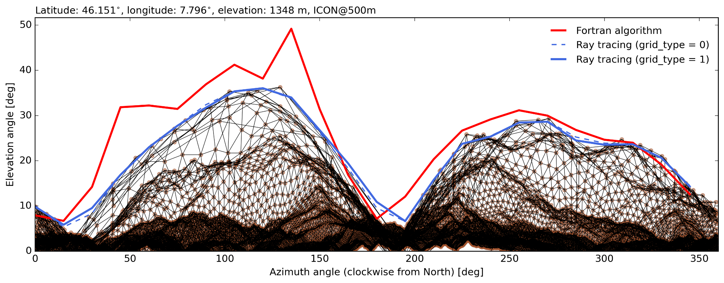

Radtopo grid-scale Improvement I: new horizon algorithm in EXTPAR
Algorithm based on high-performance ray tracing library Intel Embree
(Steger et al., 2022)
Advantage of new horizon algorithm:
More accurate
Substantially faster (>250x for resolutions ~100 m and below)
merge requests in
EXTPAR pending
→ soon available
Notes:
New algorithm is more accurate and substantially faster for (sub-)kilometer scales

Slide 14
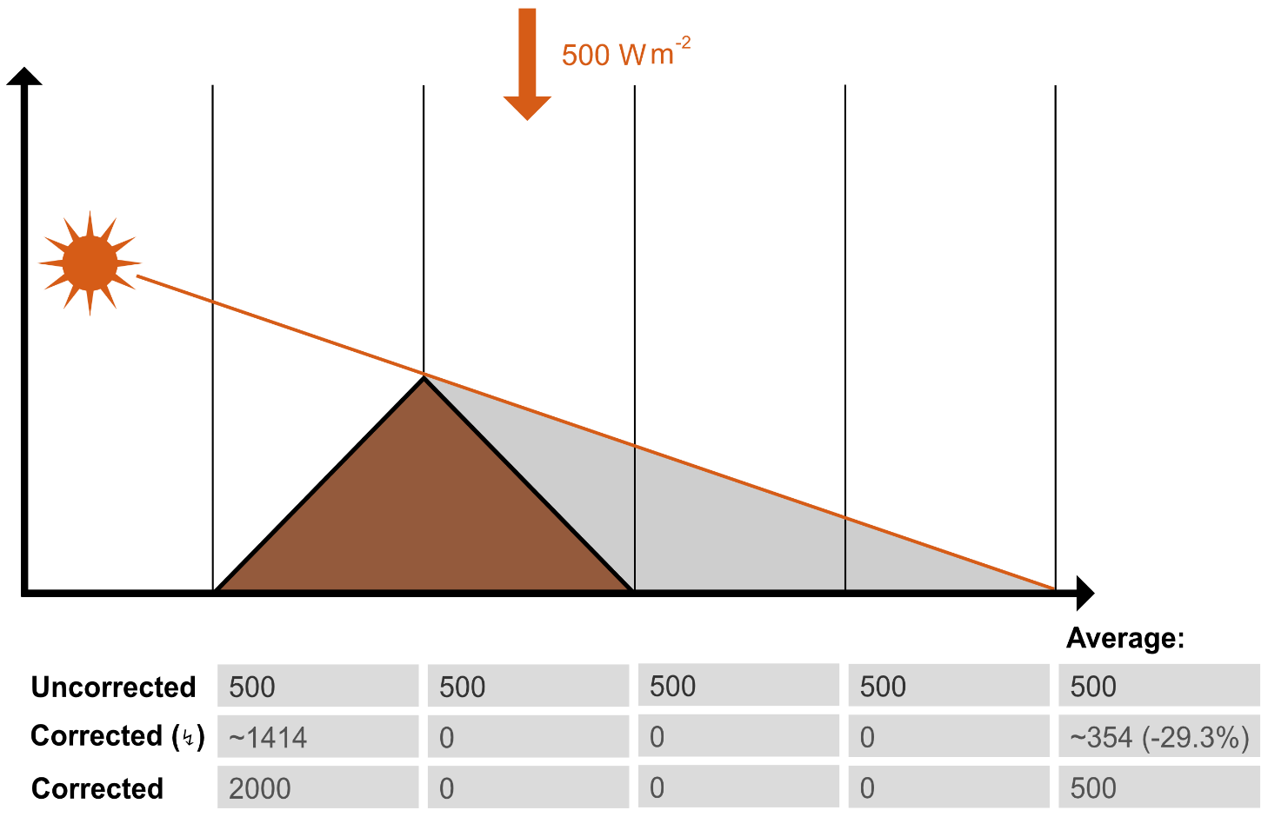
Radtopo grid-scale Improvement II: energy conservation
vs.
Surface area increase of sloped cell consider in f_{cor}
Notes:
When the increase of the slope surface is considered, energy is conserved for a uniform radiation field when the fluxes are horizontally integrated → Quasi-energy conservative
However, the new treatment creates an inconsistency in the area over which surface fluxes are computed (see illustration at the top right)

Slide 15
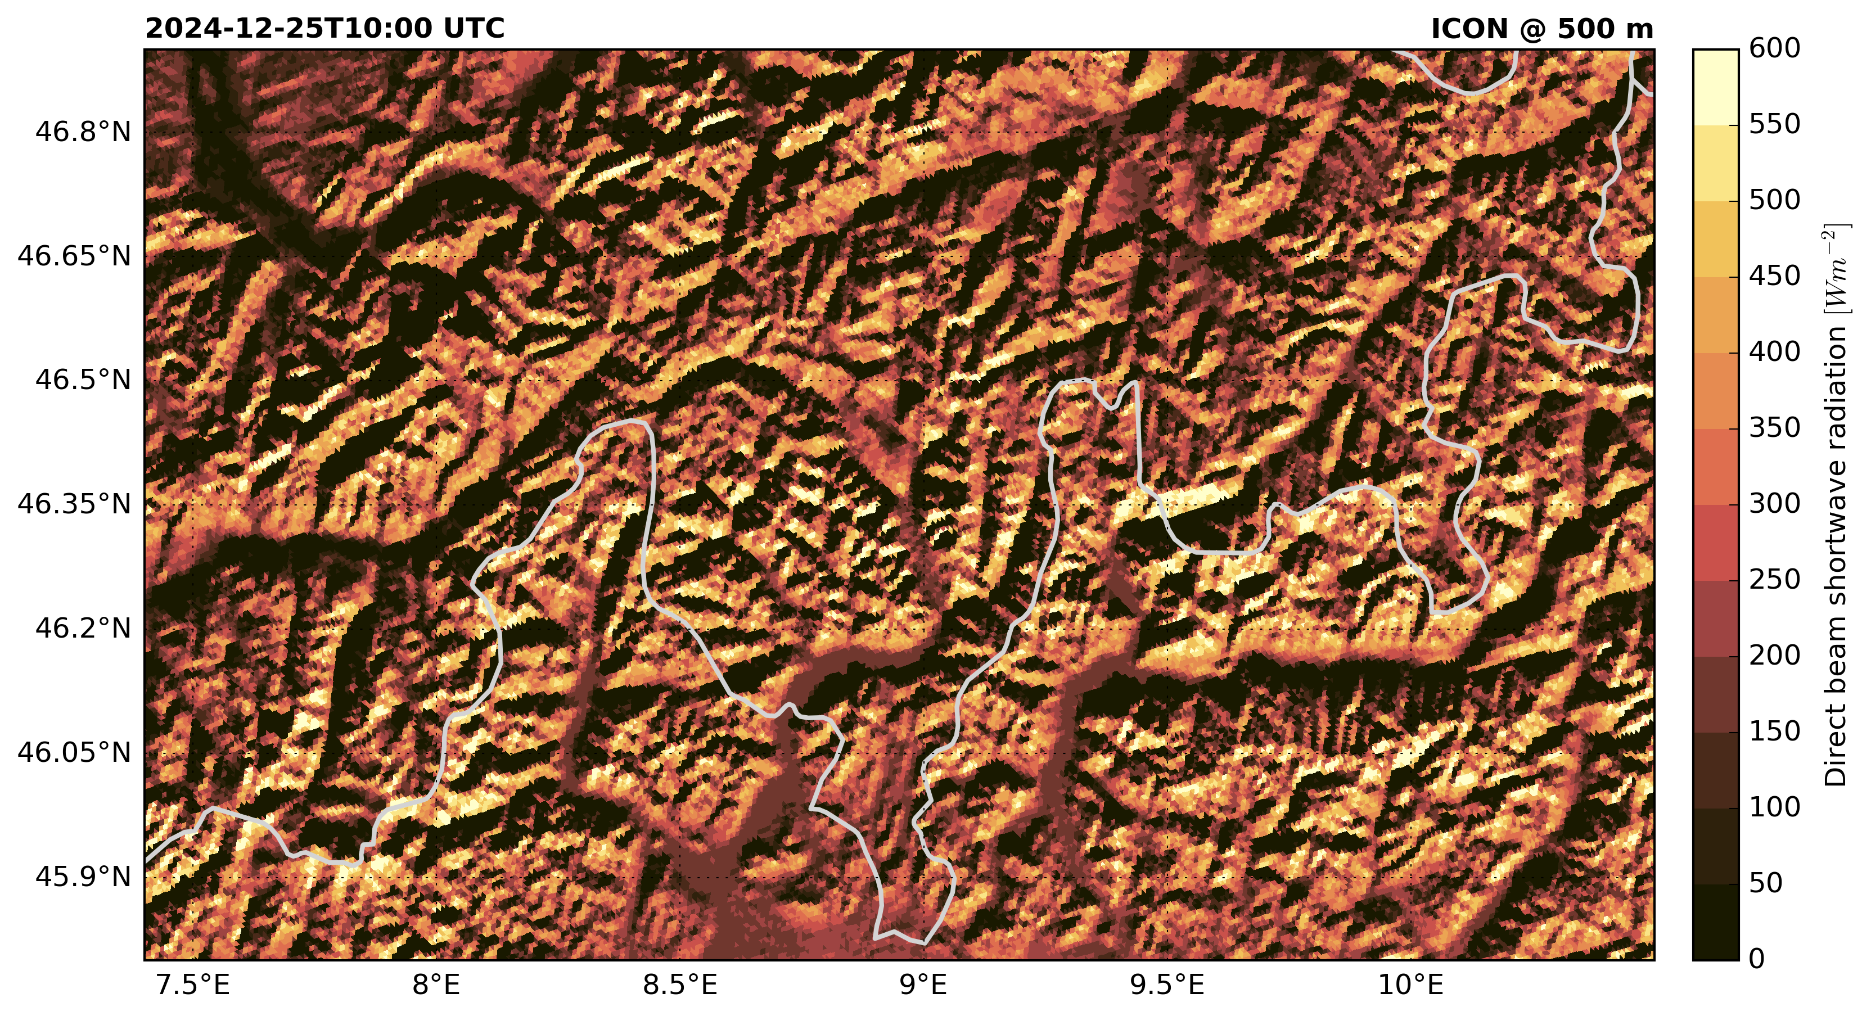
Radtopo grid-scale SW direct downward radiation
Notes:
Example of corrected SW_{dir} flux for mostly clear-sky winter day close to winter solstice
Some low clouds / fog in larger valleys with lakes (→ foothills of the Alps)

Slide 16
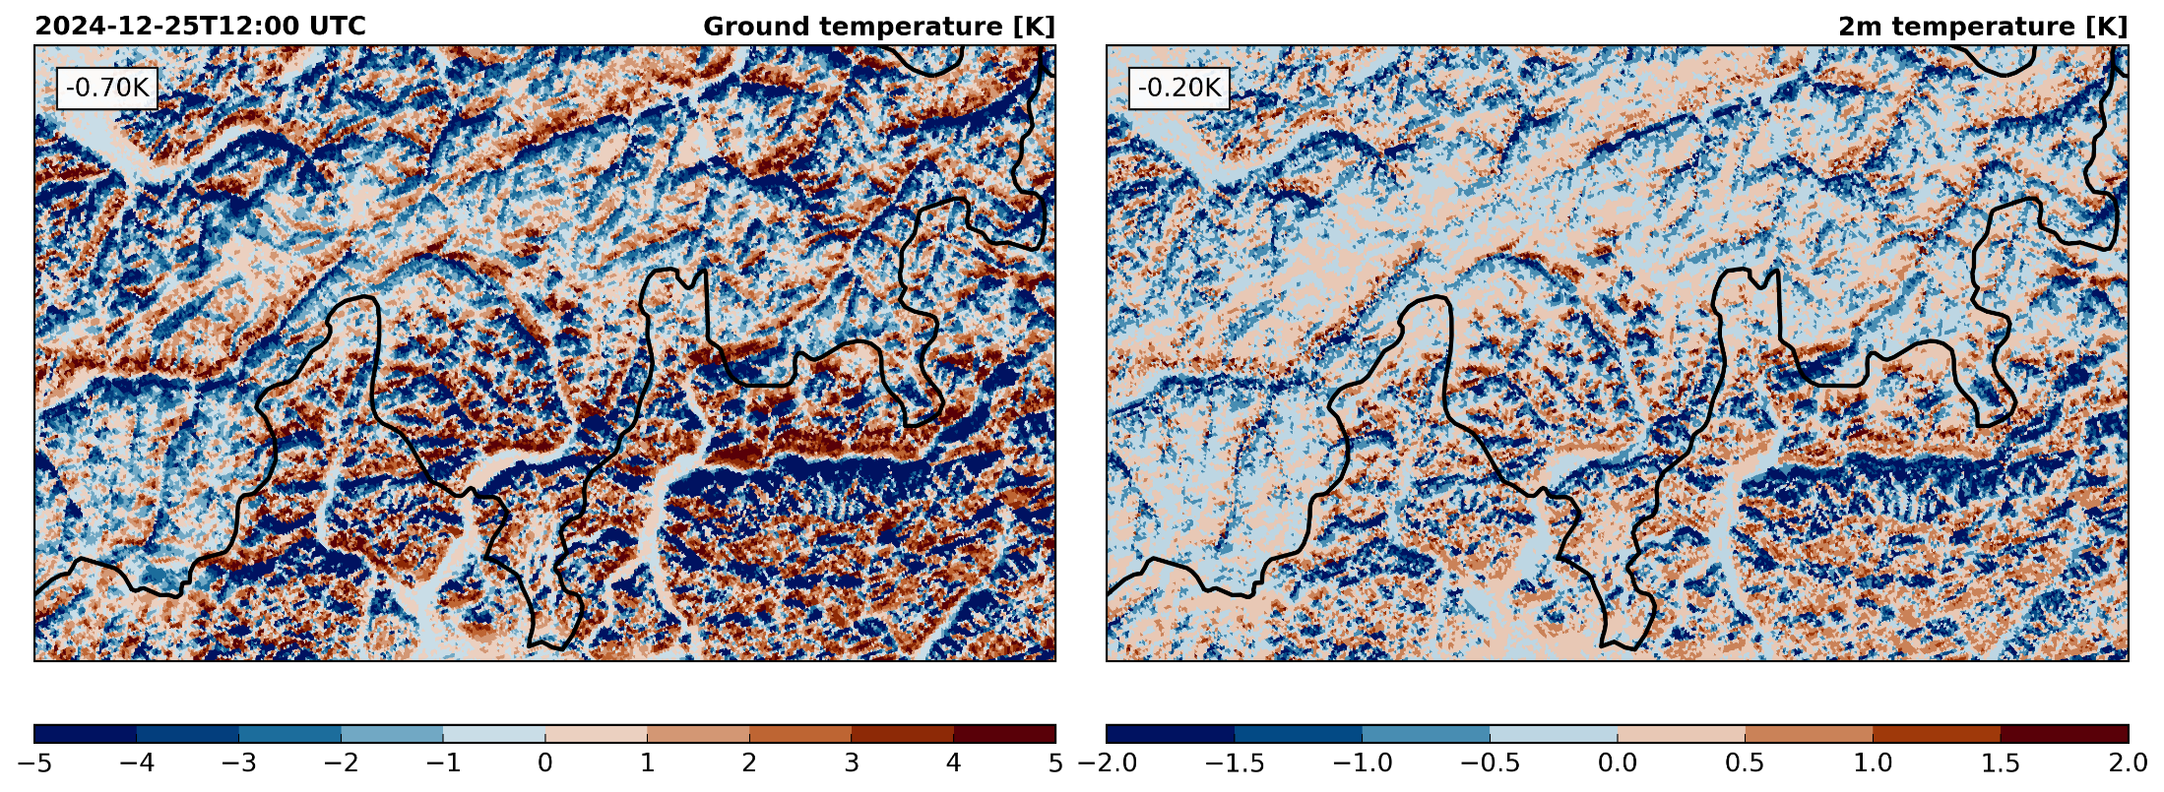
Radtopo grid-scale Effect on near-surface temperature
Notes:
Effect of activated radtopo scheme on simulated ground and near-surface (2m air) temperature → distinctive impact on ground temperature (> 5 K) and near surface temperature (> 2 K)
Interesting observation: horizontally integrated effect on temperature does not cancel out → reason: contributing radiation correction is ”asymmetric” (for a uniform radiation field) → average f_{cor} < 1.0

Slide 17
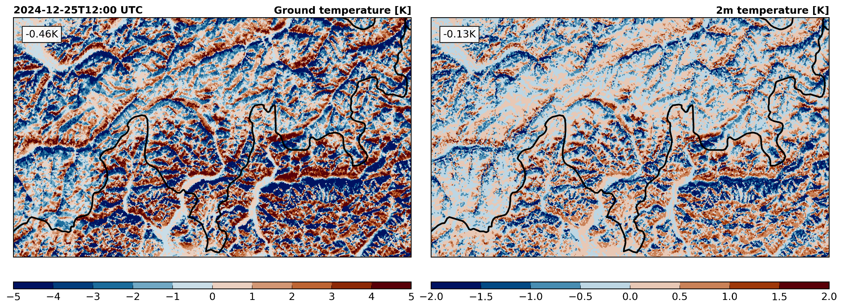
Radtopo grid-scale Effect on near-surface temperature
f_{cor} = mask_{shadow} ∙ angle_{correction} ∙ area_{factor}
Notes:
Interesting observation: net effect on temperature is still negative, although radiation only redistributed

Slide 18
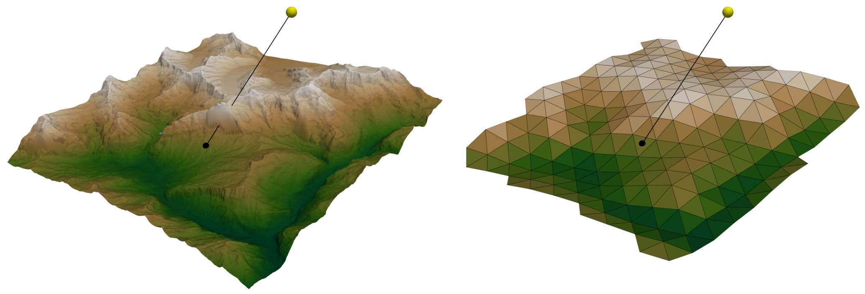
Radtopo subgrid-scale Limitation of grid-scale scheme
Sun position:
15.10.2024, 11:30 UTC
Copernicus DEM
30 m
ICON @ 1km
Notes:
Grindelwald with Eiger north face
Sun position: noon close to equinox

Slide 19
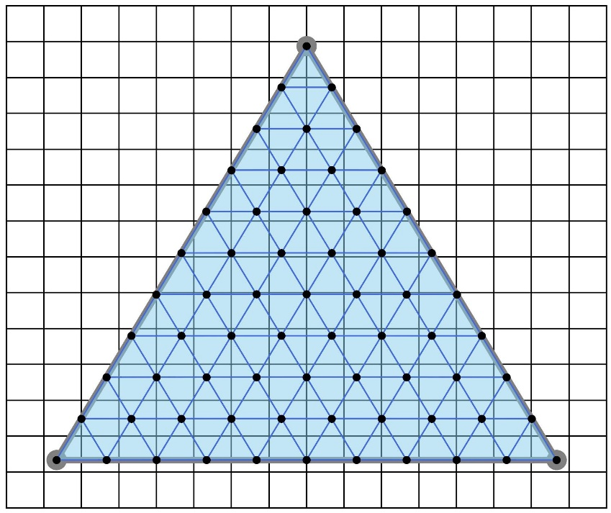
Radtopo subgrid-scale Implementation into ICON
Copernicus DEM (30 m)
Method I
Aggregate slope angle/aspect (mean) and terrain horizon (quantiles) on ICON cells
↯
Bi-linearly interpolate elevation to subgrid cell vertices
Compute slope angle/aspect and terrain horizon for every subgrid triangle
~1.57•10⁹ subgrid cells
~160•10⁹ rays
ca. 45 min computing time on 1 CSCS node
Method II
Aggregate f_{cor} on ICON cells
ICON cell (~1km)
Subgrid cells
Implementation in EXTPAR/ICON almost completed
Notes:
Test

Slide 20

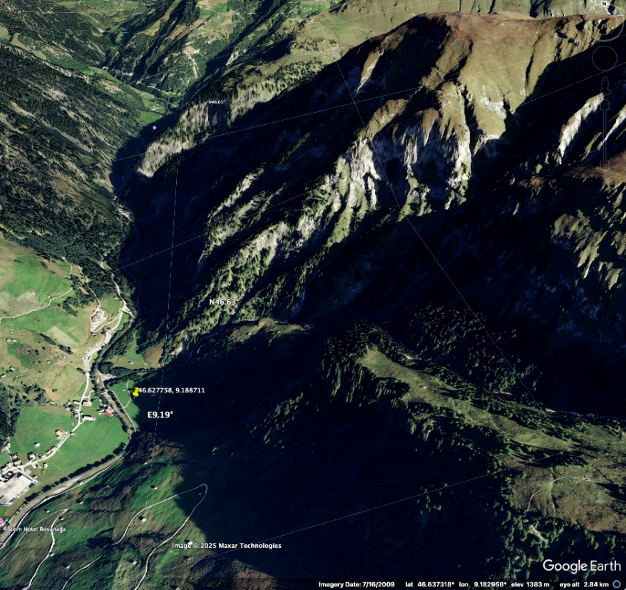
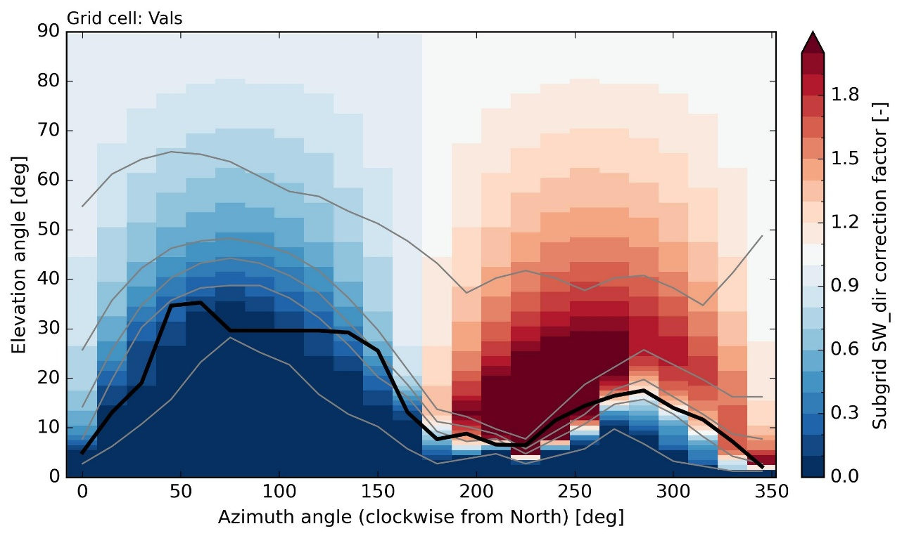
Radtopo subgrid-scale Implementation into ICON
Subgrid-scale horizons (quantiles: 0, 25, 50, 75, 100)
MeteoSwiss station
Grid-scale horizon

Slide 21
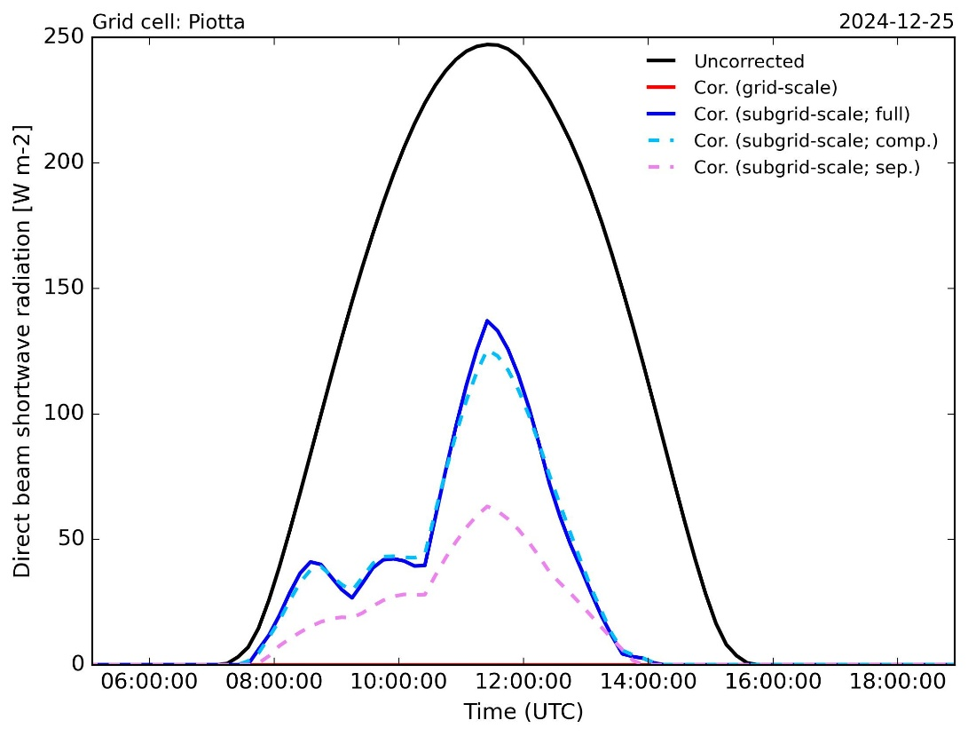
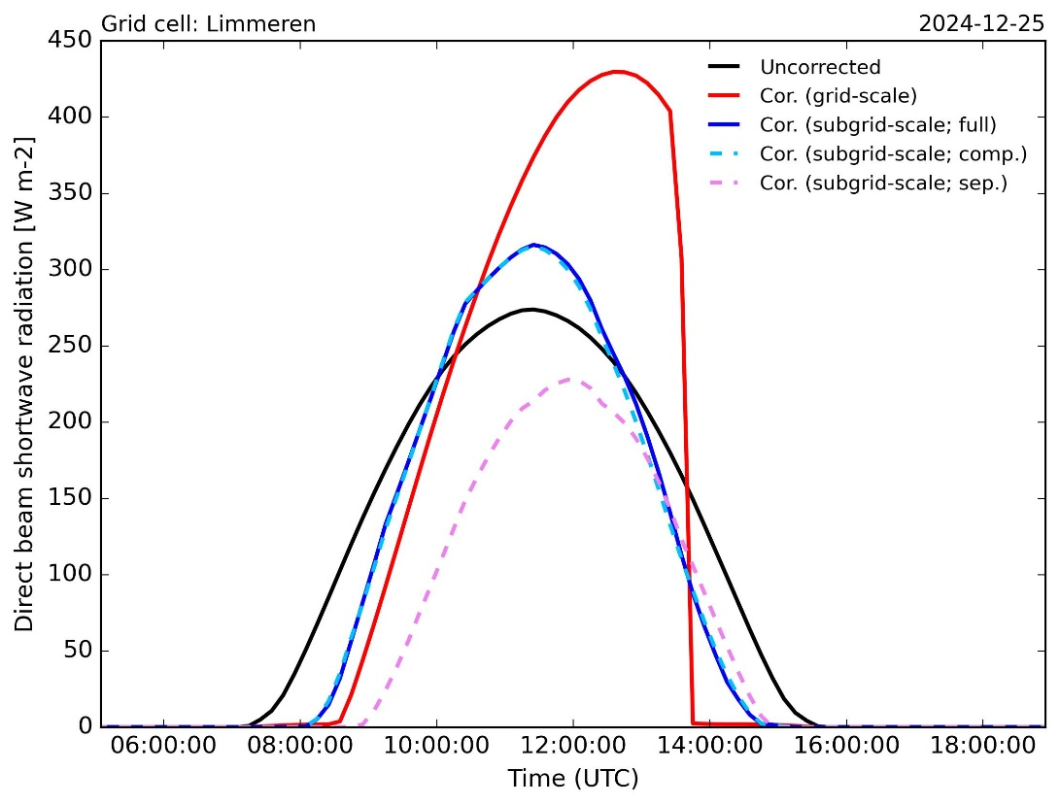
Radtopo subgrid-scale Examples of diurnal surface radiation
Notes:
Compressed: 15x smaller memory requirement

Slide 22
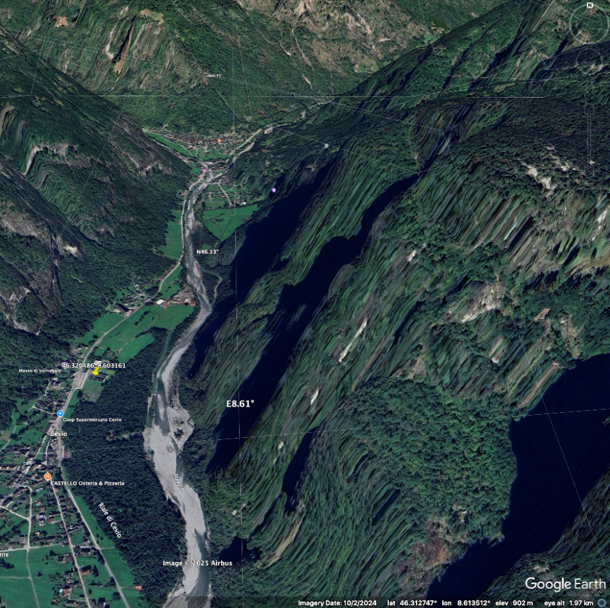
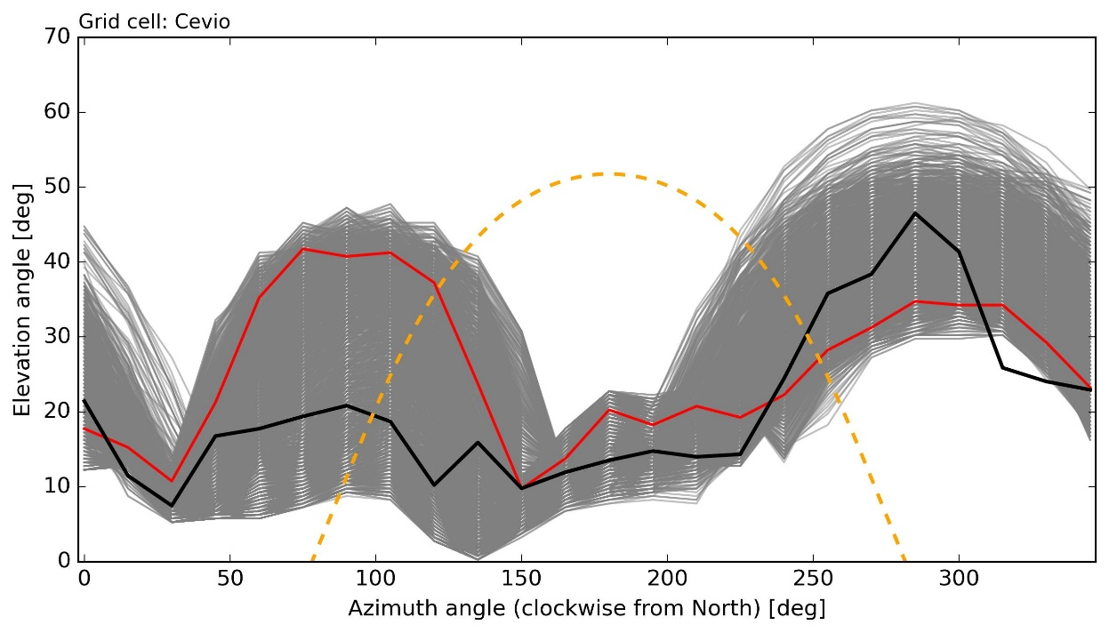
Radtopo subgrid-scale Model output verification
Subgrid-scale horizons
MeteoSwiss station
Horizon @ MeteoSwiss station
Grid-scale horizon
Next steps
Verify grid-scale radtopo schemes with surface radiation station data
Verify subgrid-scale radtopo with horizon from station (see above)
Notes:
Issue of verification with station data: verification of radiation-related parameters (like global radiation and sunshine duration) strongly depends on how the station is located relative to the ICON grid cell circumcenter
Sun position: today (2025.09.01)

Slide 23
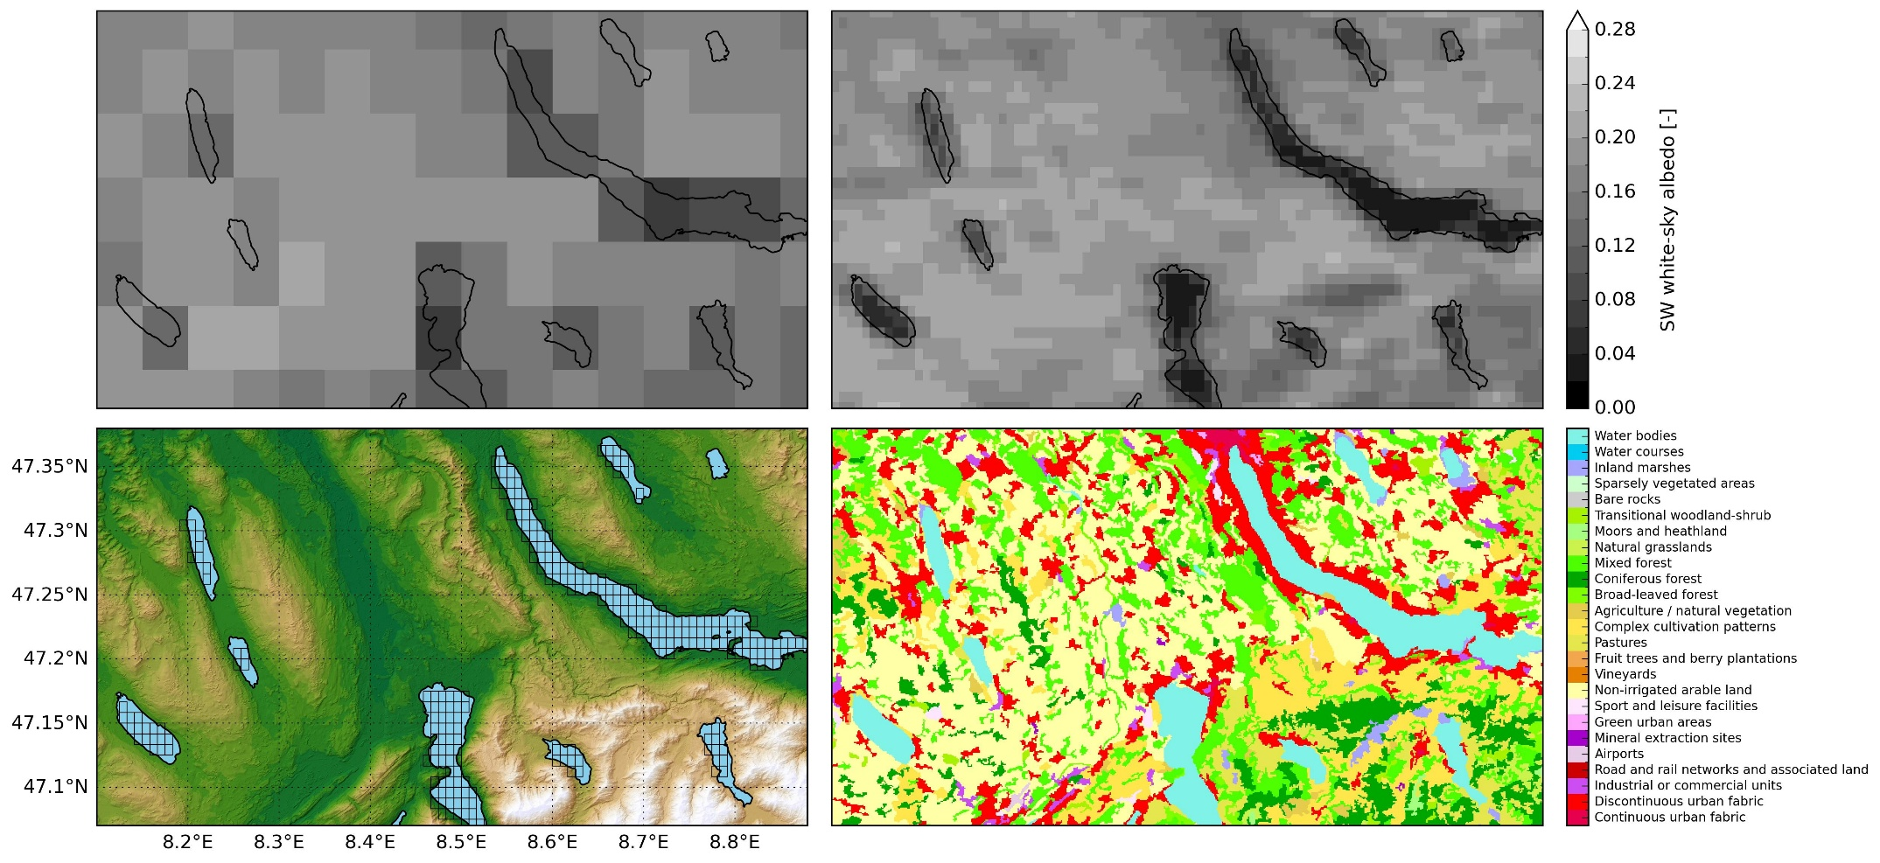
EXTPAR topography New 1km background albedo - June
Notes:
Current work: replace 5km background albedo in EXTPAR with more recent and higher-resolution data (1km)
Figure panels: upper row: 5km and 1km albedo, lower row: Copernicus DEM (30 m) with boxes albedo < 0.1, CORINE 100 m land cover
Broadband white sky albedo computed from 7 spectral bands
Advantage of new albedo dataset: low lake albedo does not spread into neighboring terrain, agreement with land cover dataset seems good (e.g. darker forest-covered patch north of Ägerisee)

Slide 24
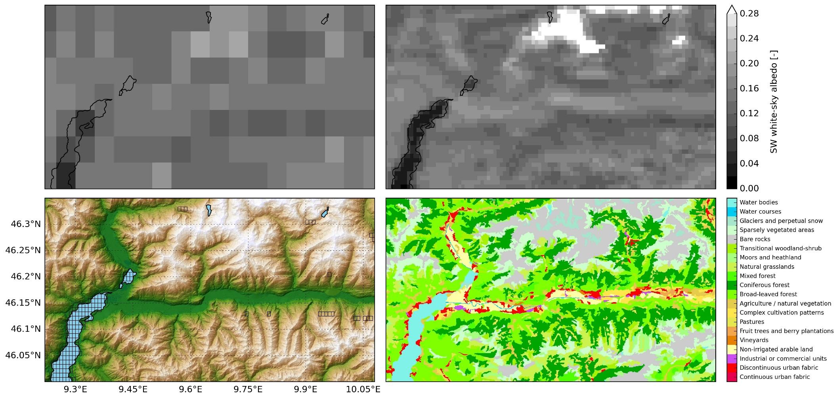
EXTPAR topography New 1km background albedo - June
Month: June
Notes:
Agreement with land cover data set again good: valley flanks are darker (forest), valley bottom higher albedo

Slide 25
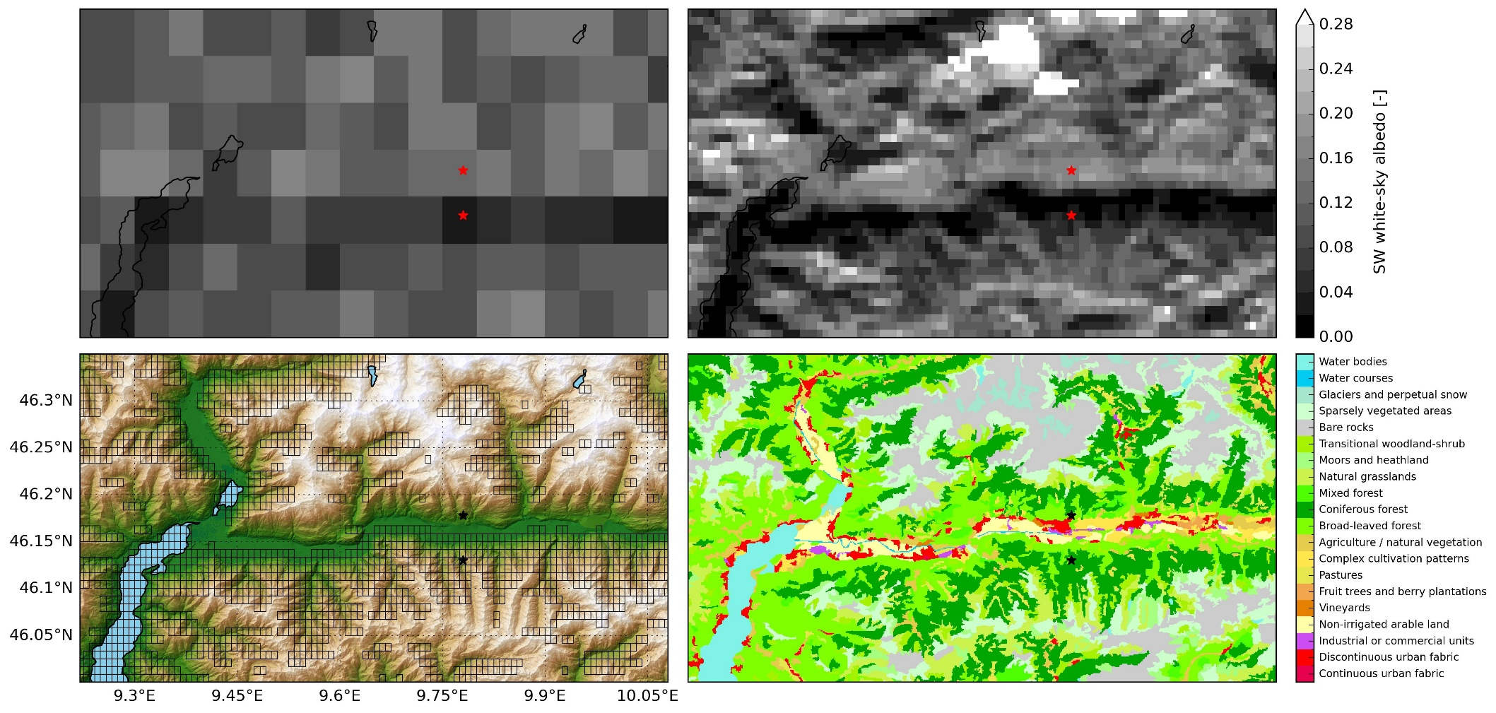
EXTPAR topography New 1km background albedo - December
Month: June
Notes:
MODIS processing algorithm for radiance: assumes horizontally flat terrain irrespective of real terrain
Reality: Illumination in complex terrain depends on orientation of surface relative to the sun and shading from neighboring terrain
MODIS data with topographic artefacts somewhat counterbalances radtopo (e.g. shaded slopes have albedo of ~ 0.0 → all incoming radiation is absorbed…)

Slide 26
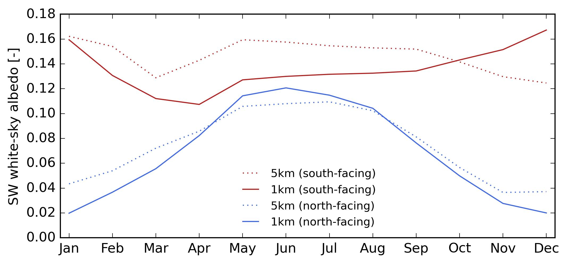
EXTPAR topography New 1km background albedo - December
Month: June

