Slide 1


PP-CITTÀ – status and outlook
Adam Jaczewski, Andrzej Wyszogrodzki, Witold Interewicz, Bartłomiej Sobczyk
Division of Numerical Weather Prediction
02/09/2025, 27th COSMO General Meeting, Urban Modelling
photo by: Gabriel Jaczewski

Slide 2

The IMWM’s contribution to CITTA’ PP
Task 2. External parameters
Subtask 2.2: New urban external parameters in EXTPAR for ICON(-LAM)
Using Local Climate Zones (Stewart and Oke 2012) as a proxy for these urban canopy parameters in EXTPAR
Task 3. Numerical experiments
Subtask 3.6: Warsaw
Assessment of the new scheme and the urban effects in Warsaw.

Slide 3
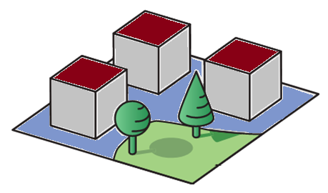
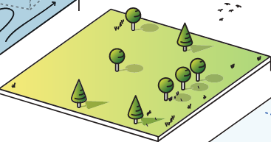


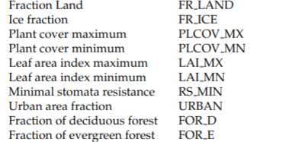

External parameters for the surface schemes
Urban cover
Natural cover
Urban tile
Natural tile
TERRA
TERRA_URB

Slide 4
Mapping ECOCLIMAP-SG to GLOBCOVER natural classes

Slide 5
TERRA_URB’s two tiles approach in urban areas
Urban canopy
Natural land cover

Slide 6
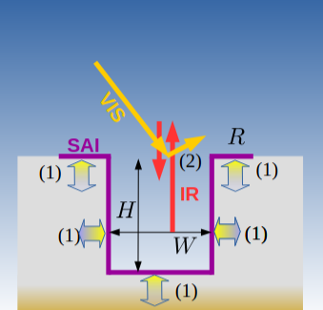
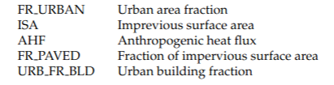
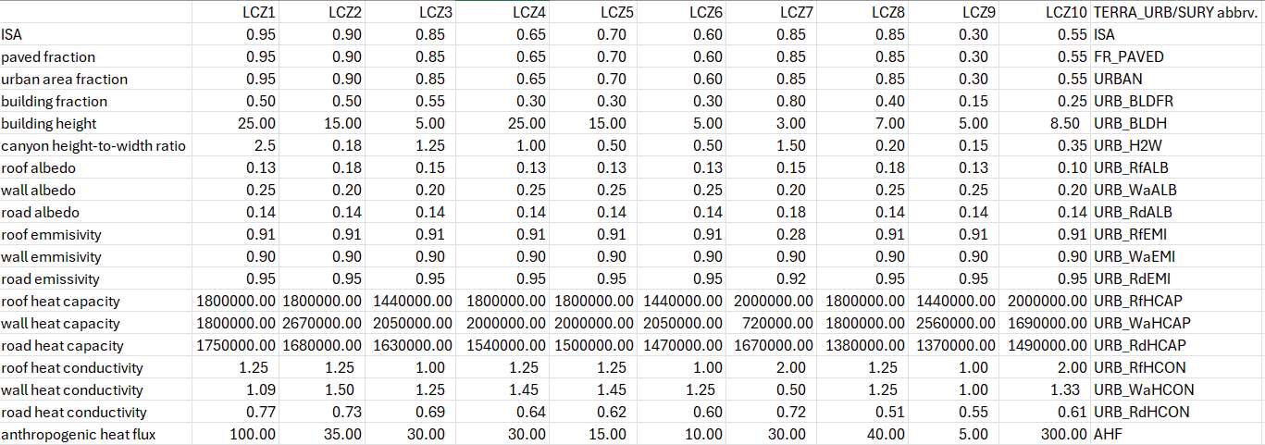
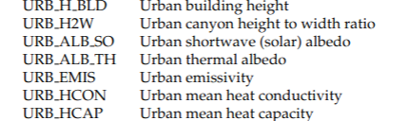
EXTPAR parameters for urban and natural tiles
Urban canyon
(TERRA_URB)
Wouters, H., et al., 2016. The efficient urban canopy dependency parametrization (SURY) v1.0 for atmospheric modelling: description and application with the COSMO-CLM model for a Belgian summer. Geosci. Model Dev. 9, 3027–3054.

Slide 7
EXTPAR parameters for urban and natural tiles
Urban canyon
(TERRA_URB)

Slide 8
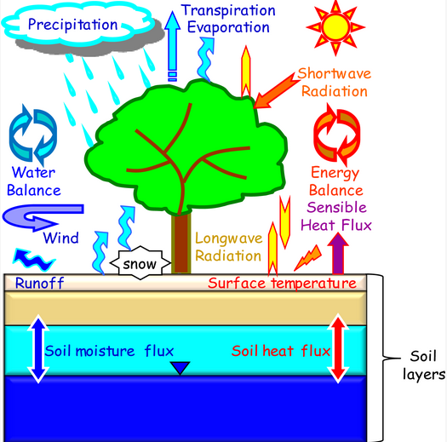
EXTPAR parameters for urban and natural tiles
Urban canyon
(TERRA_URB)
Natural cover
(TERRA)
https://doi.org/10.3390/rs5126838

Slide 9
The source variables for the values

Slide 10
Main assumptions for the parameters in the LCZ’s natural tile
Root depth
  higher when more vegetation – in the 0.6 – 2 range
Minimal and maximal plant cover correspond to the Oke’s values, except:
  where only maximum values exist, minimal value is taken as Globcover’s minimal (0.1)
Minimal and maximal LAI is proportionally shared between Globcover’s values (0.1 – 1.6) according to minimal and maximal plant cover values
Surface thermal emissivity
  higher than for urban cover (0.98)
Minimal stomata resistance
  higher when less vegetation – in the 30 – 1200 range
Notes:
.

Slide 11
ECOCLIMAP-SG’s LCZ lookup tables

Slide 12
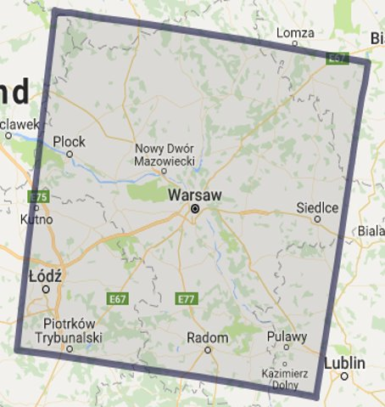
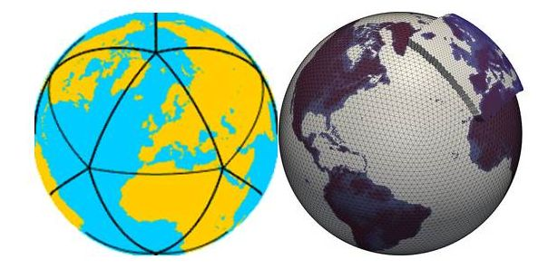
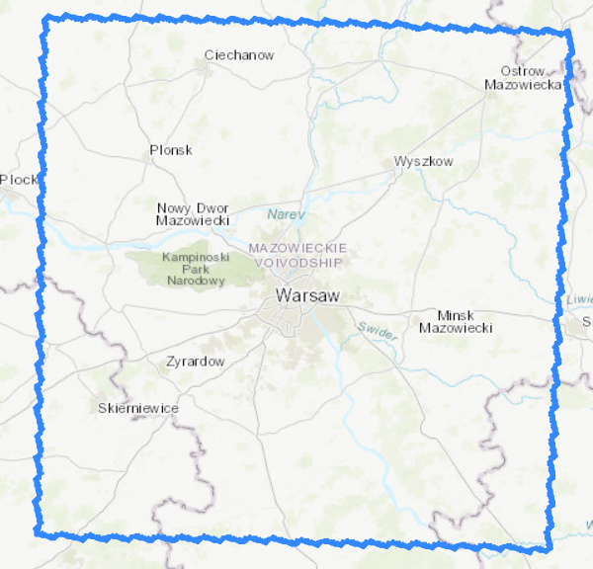
Case study for June/July 2022 heatwave
COSMO and ICON-LAM configurations
ICBC
IC: ICON global analysis daily
2022-06-22:2022-07-02@00UT
BC: every 3 hr
forecast time: 48 hr
COSMO
Resolutions:
1 km
Landuse:
GLOBCOVER
ECOCLIMAP-SG
ICON-LAM
Resolution
600 m
no TERRA_URB
Landuse:
GLOBCOVER
Notes:
The models’ domains cover approximately 100 x 100 km2. The COSMO and ICON-LAM models are tested at 1 km and 600 m resolutions, respectively.
GLOBCOVER and ECOCLIMAP-SG are used for COSMO simulation, and ICON-LAM is run with GLOBCOVER. We tested the urban parameterisation only in the COSMO model.
The initial and boundary conditions are the global ICON analysis. Hindcasts were initialised at 00UT every day from 22 June to 1 July 2024 and ran for 48 hours.
It should be noted that we have yet to finish COSMO simulations with 2-dimensional urban parameters based on the LCZ approach.

Slide 13
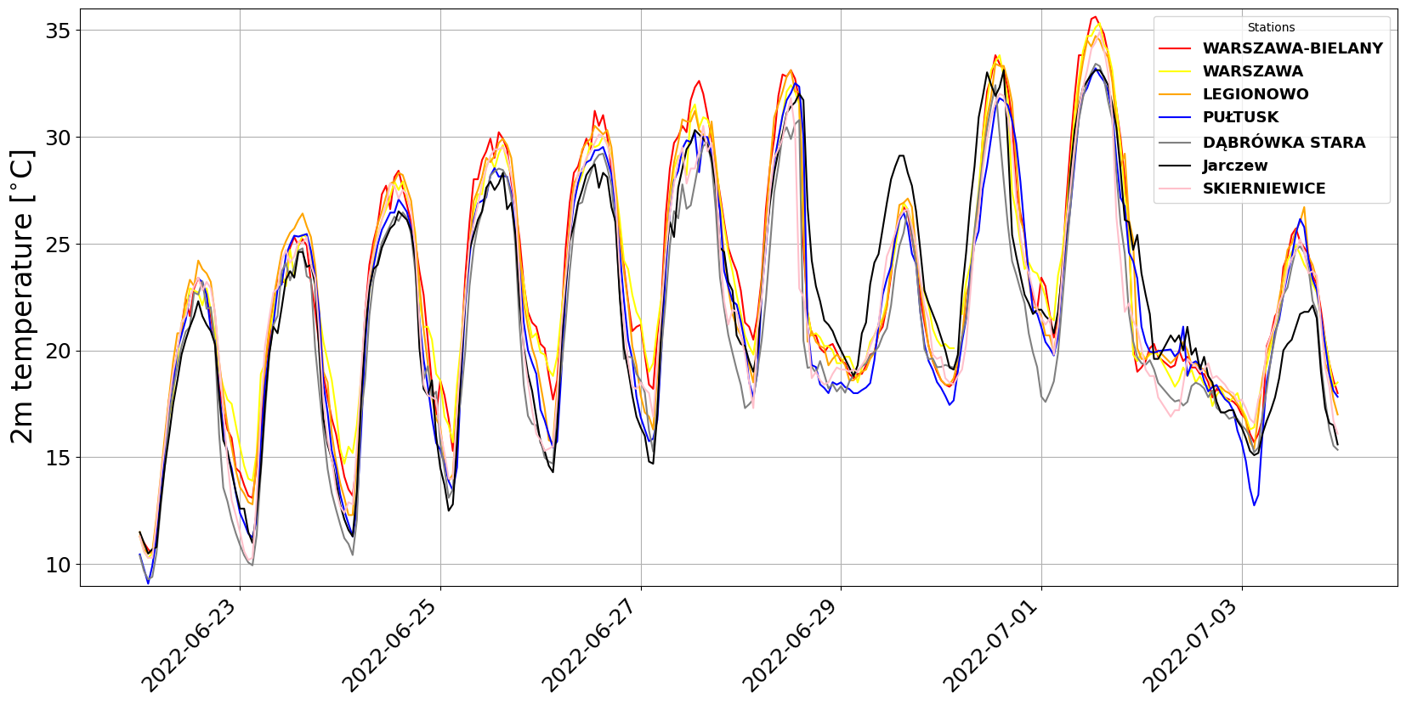
Case study for June/July 2022 heatwave
T2m observation series
Notes:
For the test simulation, a period of heat wave and strong convection in the city area was selected, covering the end of June and the beginning of July 2022.
During this period, on 26-28 June, the maximum temperature in urban areas exceeded 30°C.
On 30 June and 1 July, the highest monthly temperatures of 34°C and 36°C, respectively, were observed.
On 1 July, the front passed through with heavy precipitation – the daily total of 11 mm was recorded, followed by rapid cooling.

Slide 14
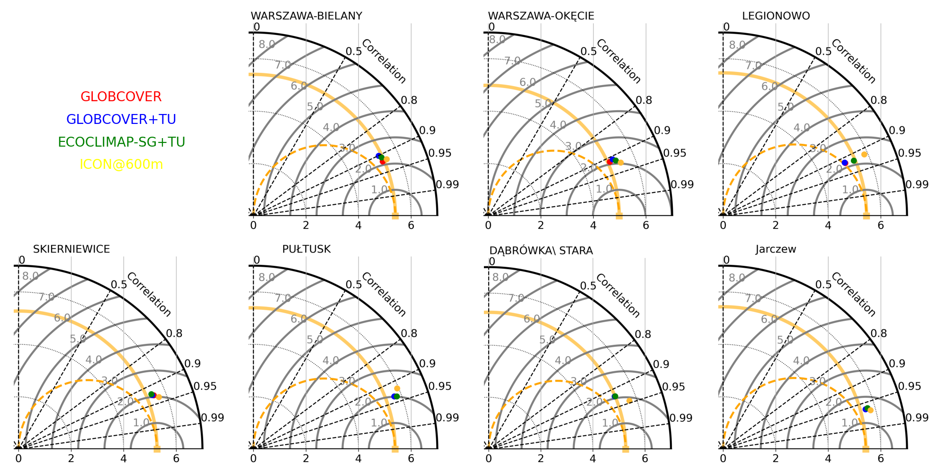
Case study for June/July 2022 heatwave
Taylor diagram summary

Slide 15
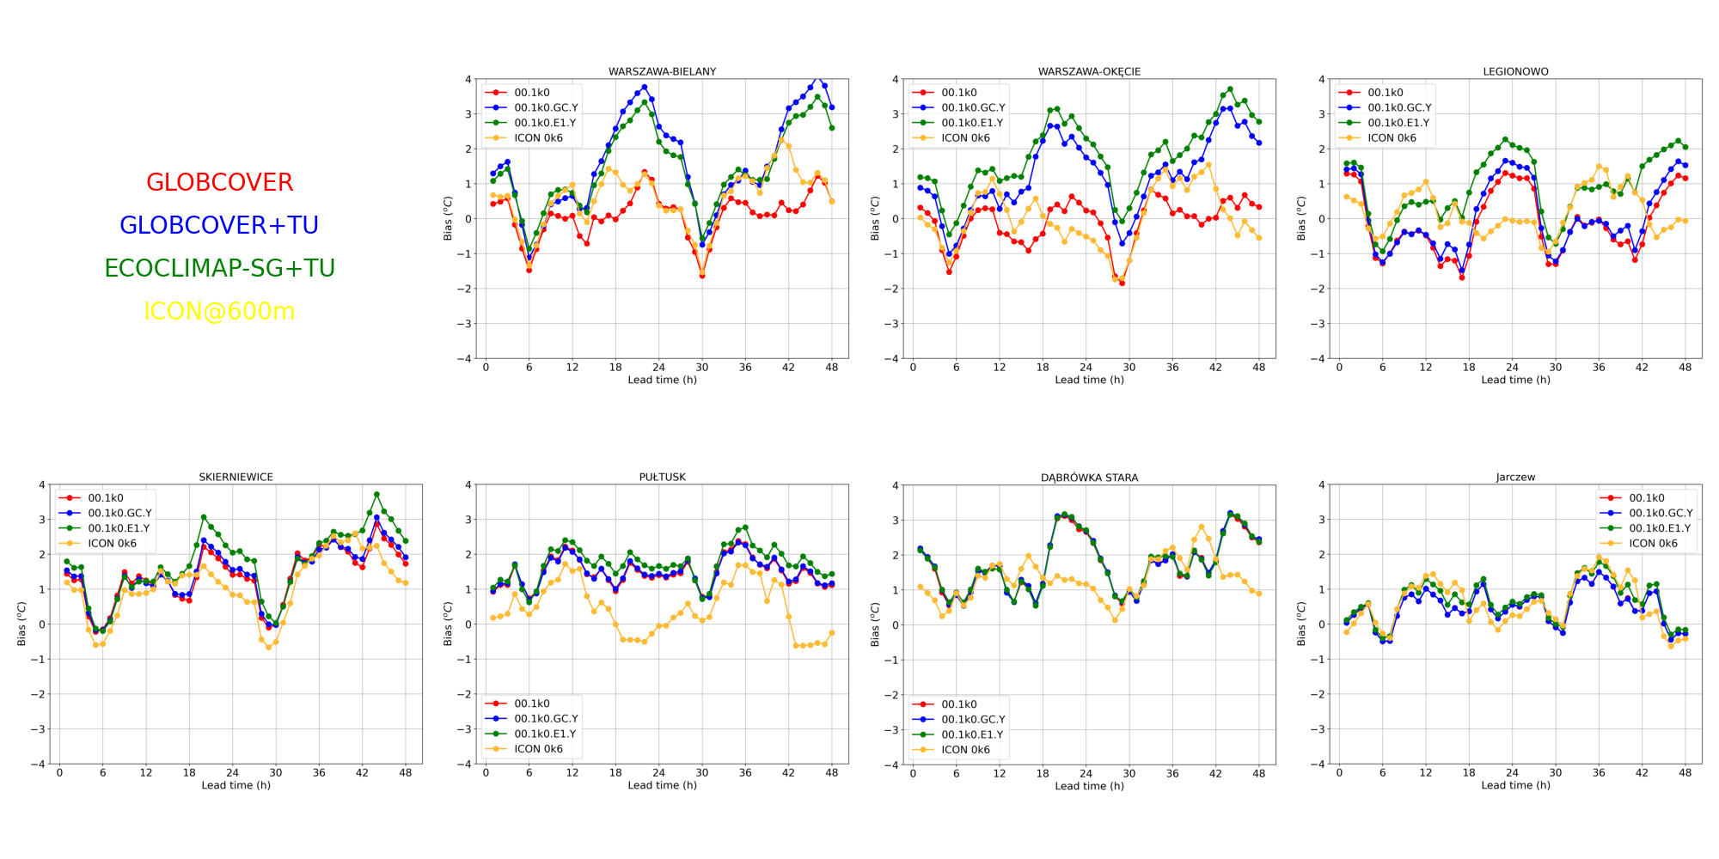
Case study for June/July 2022 heatwave
Model bias
Notes:
The following figures show model bias in relation to lead time for individual stations.
The upper panel covers results for two urban stations and one suburban station, while the lower panel corresponds to results for rural stations.
Unsurprisingly, the bias course for rural stations is similar for simulations with and without TERRA_URB.
On the other hand, a run with urban parameterisation switched on exhibits higher bias for urban stations.

Slide 16
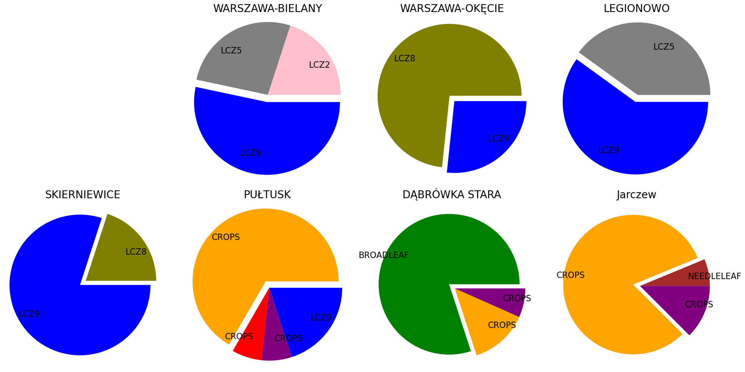
Shares of ECOCLIMAP-SG classes in the EXTPAR’s aggregation
Notes:
Another crucial point for using the LCZ approach and spatially varying urban parameters is that the aggregation procedure made in EXTPAR mixes values for the parameters from different classes. This can disturb the evaluation procedure and lead to misinterpretation of the results.

Slide 17
Issues and some recommendations
Root depth
the higher values can be applied in order to eliminate the warm and dry bias that typically appears during
the hot and dry summer periods (x 2.5 or using crootdp2 = 2.5, Varentsov et al., 2020)
The roughness length
should based on the obstacles’ height, mainly trees (higher values) or grass (the lowest values)
LAI and PLCOV
inconsistency with ECOCLIMAP-SG as satellite data sources are masked in urban areas
(no vegetation is assumed in the cities)
Skin conductivity
only limited research on that aspect is available, e.g. Trigo et al. (2015) suggest a reduction of skin conductivity
Surface thermal emissivity
is higher than for urban cover (0.98)
Stomatal resistance
the values could be quite high for grass (~1000) or bare soil (2500), see e.g. Kato et al. (2008)

Slide 18
Proposal for tasks in the CITTA follow-up project
TASK: Revision of external parameters for urban modelling based on global LCZs and UCPs datasets
U-Surf: A Global 1 km spatially continuous urban surface property dataset for kilometer-scale urban-resolving Earth system modeling. Cheng, Y. et al., 2024; Earth System Science Data Discussions 1–38. https://doi.org/10.5194/essd-2024-416
GloUCP: A global 1 km spatially continuous urban canopy parameters for the WRF model. Liao et al., 2024; Earth System Science Data Discussions 1–21. https://doi.org/10.5194/essd-2024-408
Global 1-km land surface parameters for kilometer-scale Earth system modeling. Li, L., 2024;Earth System Science Data 16, 2007–2032. https://doi.org/10.5194/essd-16-2007-2024
Urban Atlas Land Cover/Land Use 2018 (vector), EEA, 2020, Europe, 6-yearly, Jul. 2021. https://doi.org/10.2909/FB4DFFA1-6CEB-4CC0-8372-1ED354C285E6
WUDAPT, Ching et al., 2018: An Urban Weather, Climate, and Environmental Modeling Infrastructure for the Anthropocene. Bulletin of the American Meteorological Society 99, 1907–1924. https://doi.org/10.1175/bams-d-16-0236.1
TASK: Numerical experiments - Poland

Slide 19
Numerical experiments – motivation
impervious surfaces can exacerbate flood risk by reducing infiltration, and they also actively participate in the local energy balance by providing latent heat flux, thereby influencing local temperatures
special attention will be paid to extreme precipitation cases, which may lead to local flash flood events
data from over a dozen meteorological stations are available for verification in the urban areas in Poland. Measurements of surface atmospheric variables are available at hourly resolution
RainGRS high spatial and temporal resolution nowcasting precipitation analysis will be used for spatial verification of rainfall forecasts
Notes:
W przypadku modelu ICON symulację na siatce 600 m2 opieramy na produkcji operacyjnej ICON 2,5 km2.

Slide 20
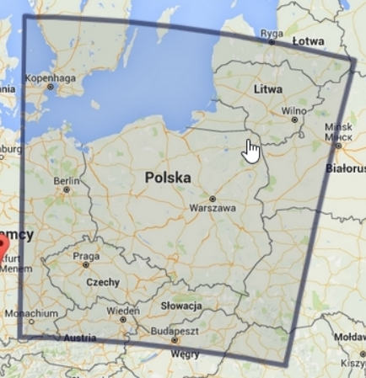
Numerical experiments – Poland: nested ICON domain for Warsaw
ICON 2k5
ICON 0k6
Notes:
W przypadku modelu ICON symulację na siatce 600 m2 opieramy na produkcji operacyjnej ICON 2,5 km2.

Slide 21
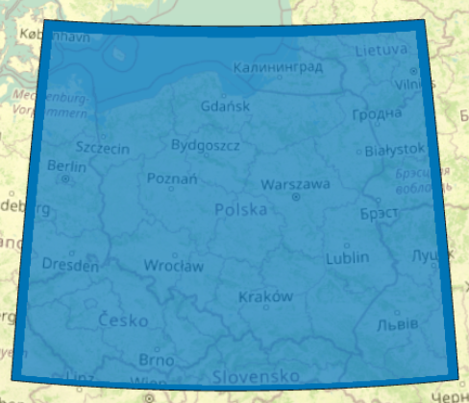
Numerical experiments – Poland: nested ICON domain for Poland
ICON 2k5
ICON 1k0
Notes:
W przypadku modelu ICON symulację na siatce 600 m2 opieramy na produkcji operacyjnej ICON 2,5 km2.

Slide 22
Numerical experiments – Poland: nested ICON domain for Poland
ICON EU
ICON 1k0
Notes:
W przypadku modelu ICON symulację na siatce 600 m2 opieramy na produkcji operacyjnej ICON 2,5 km2.

Slide 23

Thank you
Adam Jaczewski
Division of Numerical Weather Prediction, IMWM, Poland
02/09/2025, COSMO GM

