Slide 1

PP CITTA’
Update on high-resolution experiments with ICON-LAM
Valeria Garbero, Arpa Piemonte
GM2025 Basilea, 02/09/2025

Slide 2
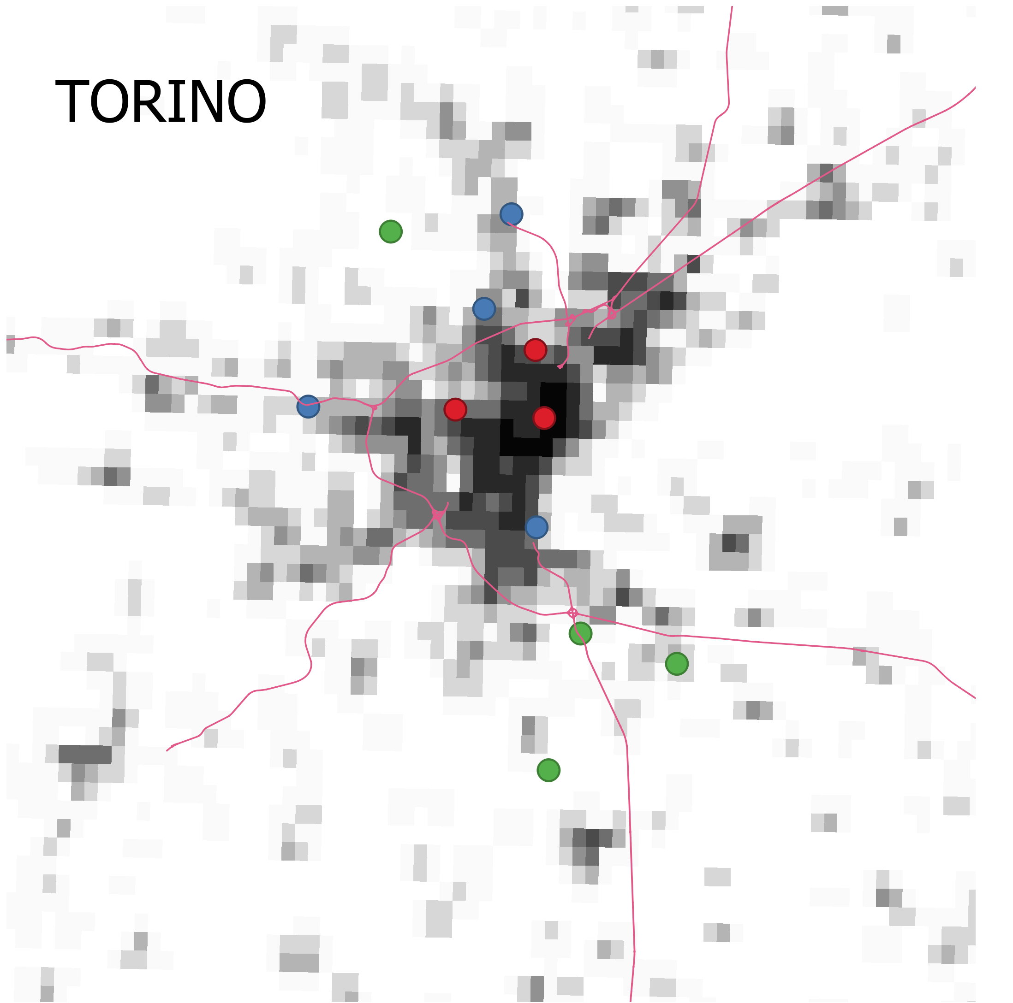
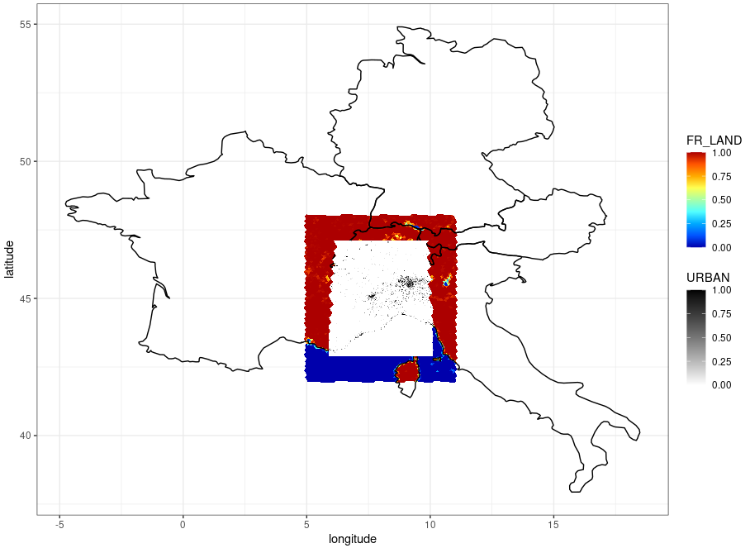


Experiment set-up
9-18 June 2022 heatwave on Turin
ICON-2I namelist
External parameters:
GLOBCOVER landuse classification (2009)
ICBC from ICON-EU analysis
at 7 km resolution (R03B08)
ICON-LAM domain
@ 1 km resolution
*Tuning factors for specifying AHF depending on climatological t2m
Notes:
I performed simulations at 1 km resolution in hindcast mode, focusing on a heatwave event over Turin in June 2022, using initial and boundary conditions from ICON.
The simulation domain covers Piedmont, in northwestern Italy, with a focus on the city of Turin.
I tested ICON in three different configurations:
ref0: without the urban parameterization (TERRA_URB),
exp0 and exp1: with the urban scheme activated,
exp: including a seasonal cycle for the Anthropogenic Heat Flux (AHF).

Slide 3
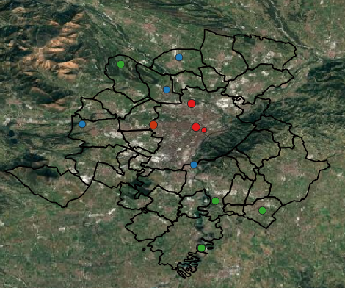
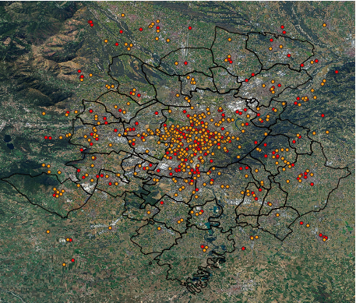
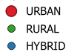
Model validation
Turin and surroundings
Netatmo Citizen Weather Stations (CWS) network
Official ARPA meteorological network
denser but accurate..?
Contextual uncertainty due to placements
595 stations
in 2022
12 stations
Notes:
The model validation was carried out using temperature data from both the official Arpa meteorological network and the NetAtmo Citizen Weather Network.
The NetAtmo network is significantly denser, with nearly 600 stations compared to just 12 official stations.
But can we consider these measurements reliable?
NetAtmo observations are certainly affected by higher errors, the so-called contextual uncertainty, which arises from improper sensor placement (e.g., too close to walls, exposed to direct sunlight, or sheltered areas), leading to inaccurate temperature readings.

Slide 4
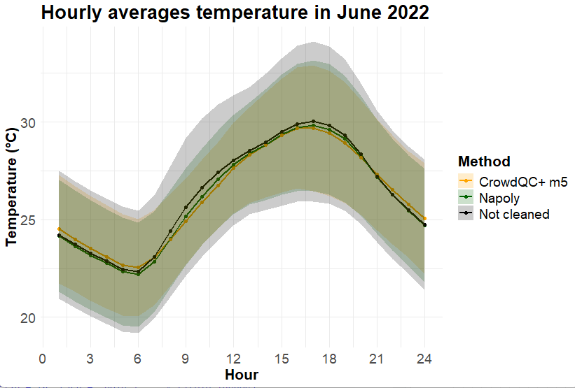
Quality Control of Netatmo Data
Adapted version of the Napoly method (Napoly et al., 2018)
CrowdQC+—A Quality-Control for Crowdsourced Air-Temperature Observations (Fenner et al., 2021)
370 stations
in June 2022
Code | Procedure
Init | Initialization
M1 | Location-based filtering (Lat/Lon)
M2 | Statistical outlier detection
M3 | Threshold-based station removal
M4 | Correlation analysis
O1 | Hourly data sufficiency
O3 | Monthly data sufficiency
Level | Details
m1 | Lat/Lon check
m2 | Distribution check
m3 | Validity
m4 | Temporal correlation
m5 | Spatial buddy check
June 2022 hourly mean
258 stations
in June 2022
Notes:
For this reason, it is essential to conduct a Quality Control (QC) assessment to reduce errors and improve the reliability of the observations.
We adopted two different methods: CrowdQC+, a quality control approach for crowdsourced air temperature observations developed by Fenner et al., and an adapted version of the Napoly method.
The analysis of hourly mean temperatures shows that both QC methods effectively reduce the amplitude of the envelope, which represents the standard deviation, indicating improved data consistency.

Slide 5
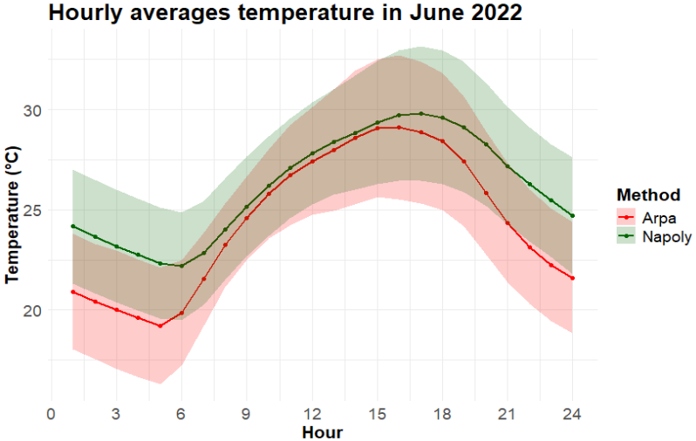
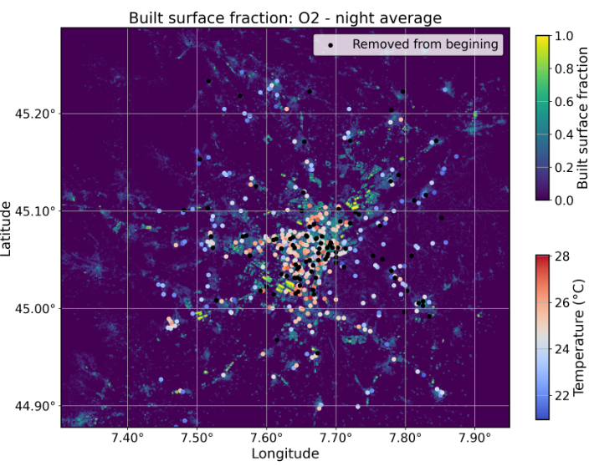
Mean diurnal cycle of t2m
June 2022
NetAtmo data, cleaned with Napoly-based QC procedure, were considered (40% of the stations)
NetAtmo stations are warmer than official ones: poor siting or real microscale effects?
Notes:
We applied the Napoly method, which led to the removal of 40% of the stations.
When comparing the hourly mean temperatures from Arpa stations and NetAtmo stations cleaned using the Napoly method, a warm bias emerges—particularly during the nighttime.
This positive bias could be attributed to microscale effects, or it may still result from residual errors linked to sensor placement. Further investigation is needed to clarify this.
However, one consideration is important: while WMO-compliant stations are designed to represent synoptic-scale conditions, NetAtmo stations are almost always located near residential areas, and in this sense, they may offer a more realistic representation of the temperatures actually experienced by the population.

Slide 6
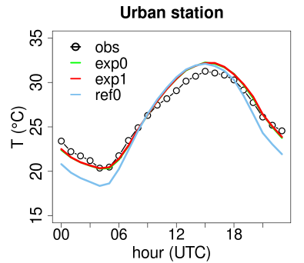
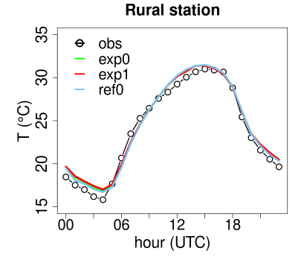
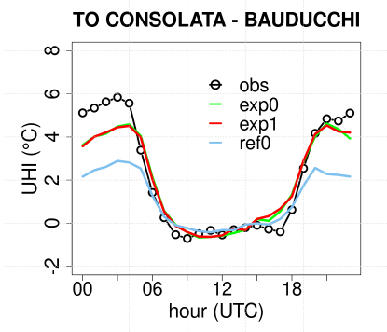

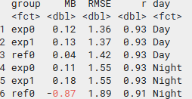
Results: Arpa stations
Exp0 is slightly better than exp1
Exp0 and Exp1 improve both MB and RMSE, especially during the night, compared to Ref0
Notes:
Exp0 performs slightly better than Exp1, and both Exp0 and Exp1 show improvements in both Mean Bias (MB) and Root Mean Square Error (RMSE), particularly during the night, when compared to Ref0.
This indicates that the urban parameterization improves the model’s ability to reproduce the Urban Heat Island (UHI) effect, as shown in the final figure.

Slide 7
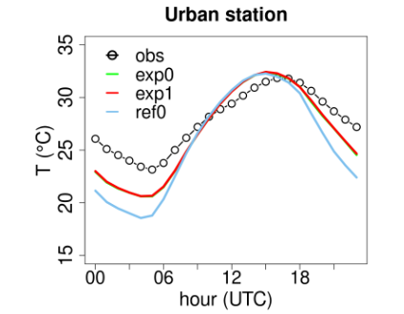
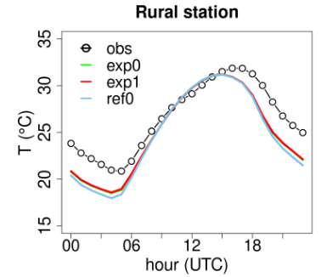

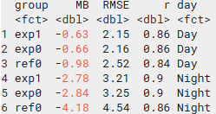
Results: NetAtmo stations
Warmer bias of NetAtmo stations
ICON @1 km resolution cannot capture micro-scale heterogeneity
Exp1 is slightly better than exp0
Exp0 and Exp1 improve both MB and RMSE, especially during the night, compared to Ref0, but..
Temperatures are underestimated, especially during night
Notes:
Exp1 performs slightly better than Exp0. Both Exp0 and Exp1 improve Mean Bias (MB) and Root Mean Square Error (RMSE), especially during the night, compared to Ref0.
However, temperatures are significantly underestimated, specially at night, which can be linked to the warm bias observed in the NetAtmo stations. Nevertheless, the temperature variability related to microscale heterogeneity, which is likely revealed by the high-density NetAtmo data, cannot be captured by ICON due to its 1 km resolution.

Slide 8
TERRA_URB improves the representation of the UHI effect over Turin during a past heat wave
NetAtmo stations show a warmer bias compared to official stations (designed for synoptic conditions): due to erroneous placement or real micro-scale effects? They may better capture temperatures actually experienced by people
Further experiments are planned through model tuning and improvements to ICON could involve the integration of urban parameters based on LCZ and local datasets
With optimized quality control, the NetAtmo network could support the downscaling of ICON+TERRA_URB using urban features and machine learning techniques
Conclusion and further works

