Slide 1


PP CITTA’ and beyond
Massimo Milelli
1st September 2025, 27th COSMO General Meeting, Basel

Slide 2
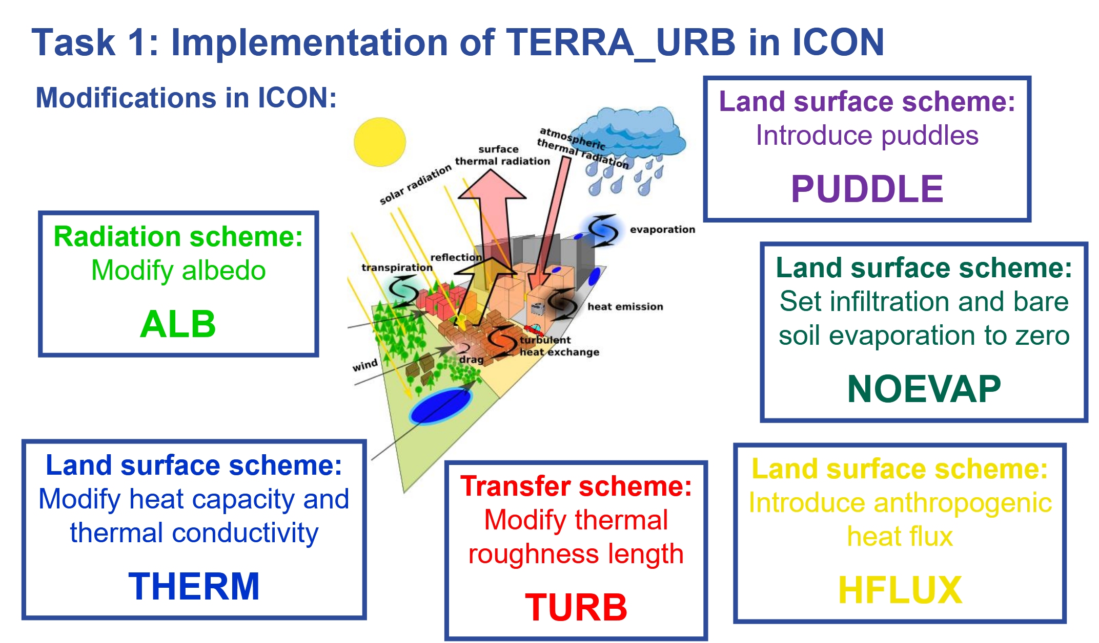
Courtesy of Jan-Peter Schulz (DWD/CMCC)

Slide 3
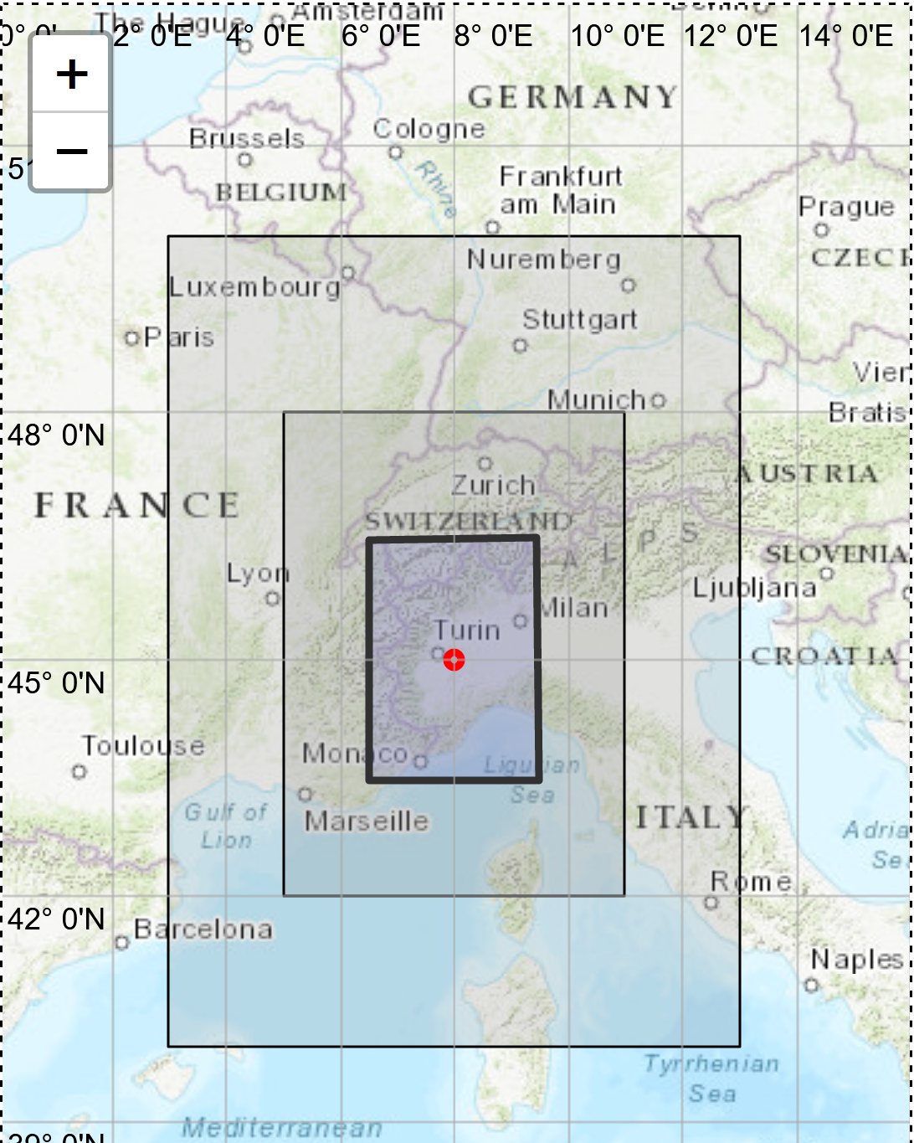
Simulations setup
Hindcast:
2023050100 - 2023070100
ICON 7km -> ICON 3.5km -> ICON 1.8km -> ICON 900m
ICON (latest master branch)

Slide 4
Simulations setup
URB | lterra_urb=T | lurbalb=T | lurbahf=T | Itype_eisa=2
CTR | lterra_urb=F | / | / | /
itype_eisa=2: Infiltration and evaporation on impervious surfaces are zero. All precipitation goes into surface runoff.

Slide 5
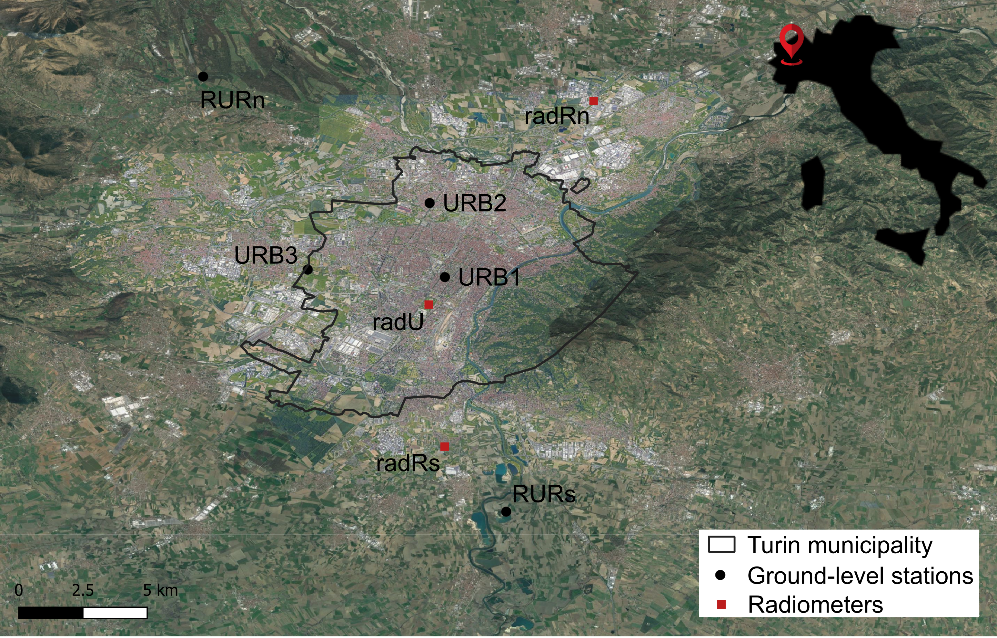

Slide 6
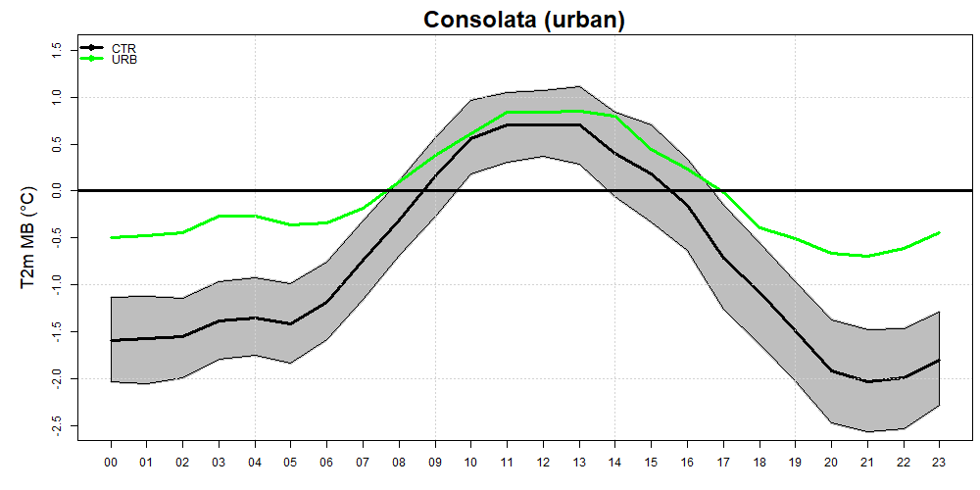
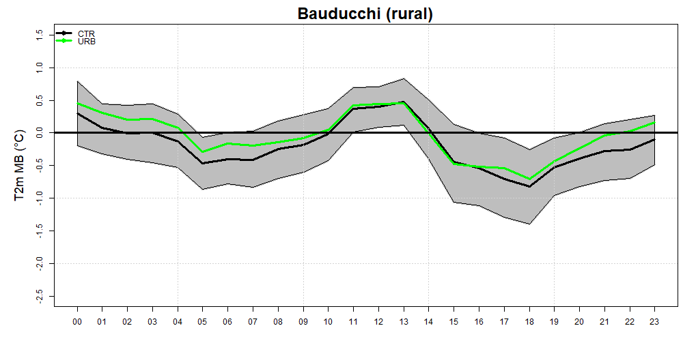
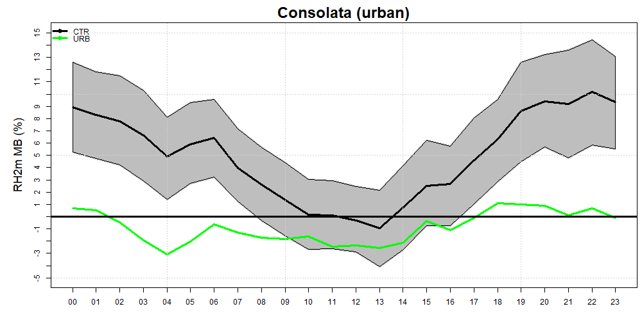
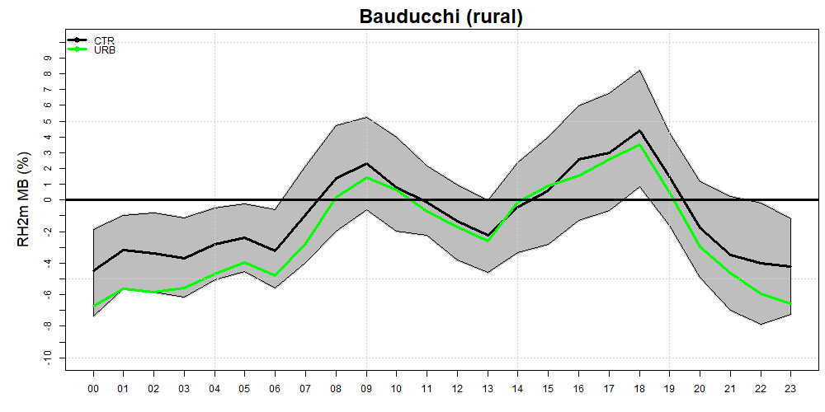
URB1 Average daily cycle of the BIAS RURs

Slide 7
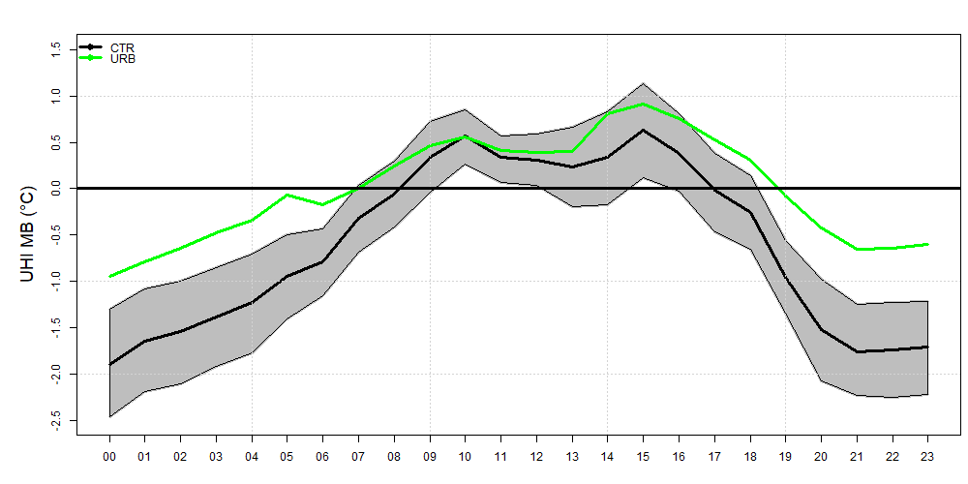
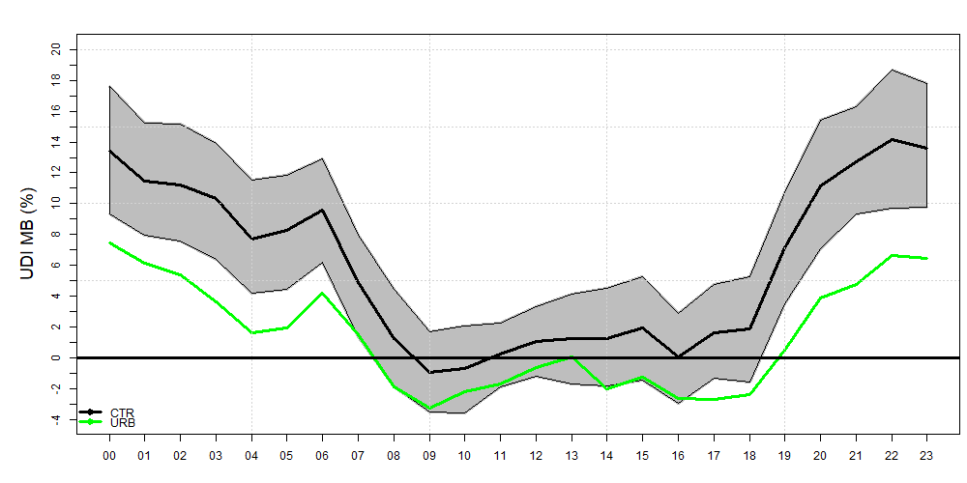
Average daily cycle of the BIAS UHI and UDI (URB1 - RURs)

Slide 8
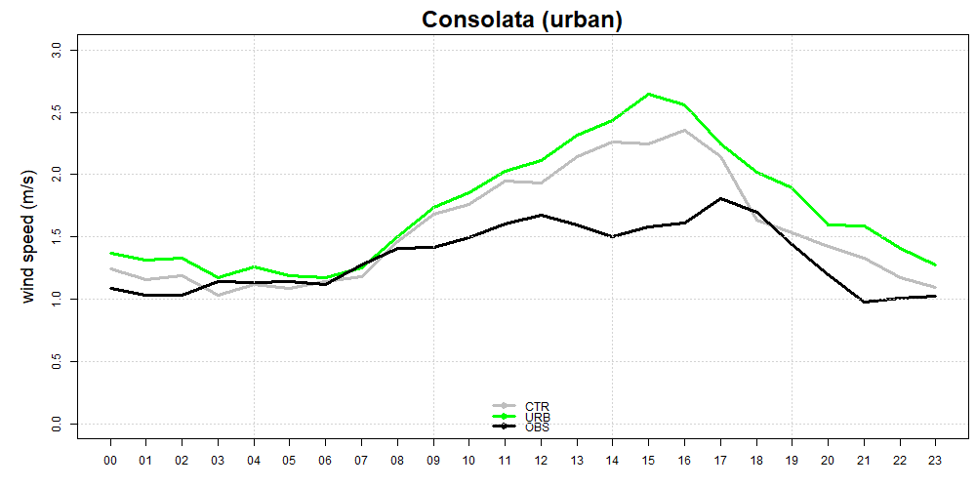
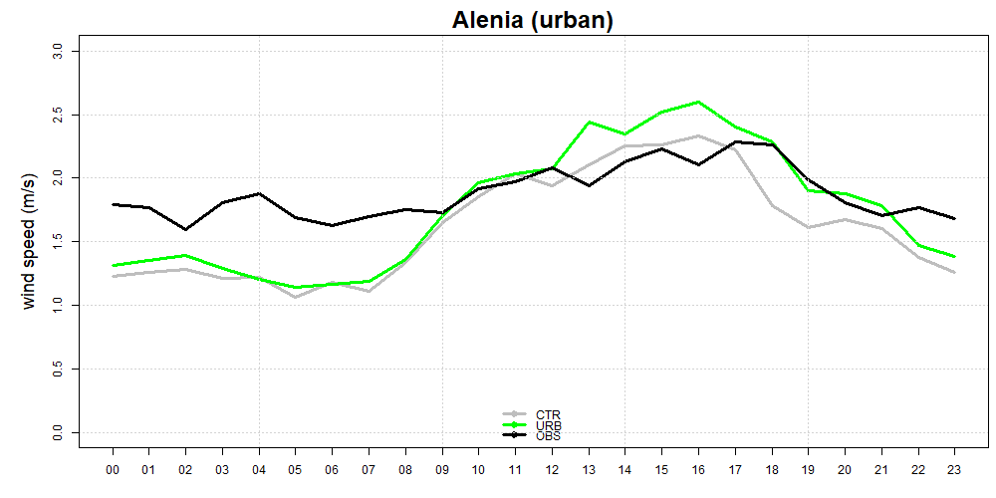
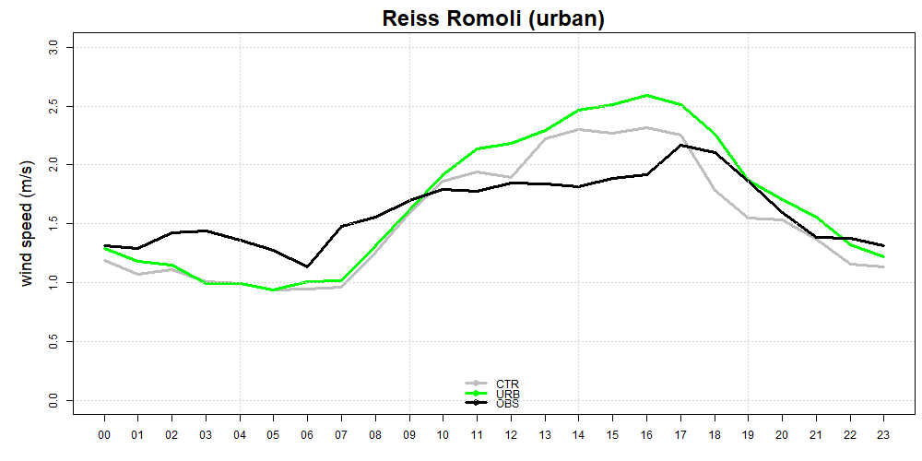
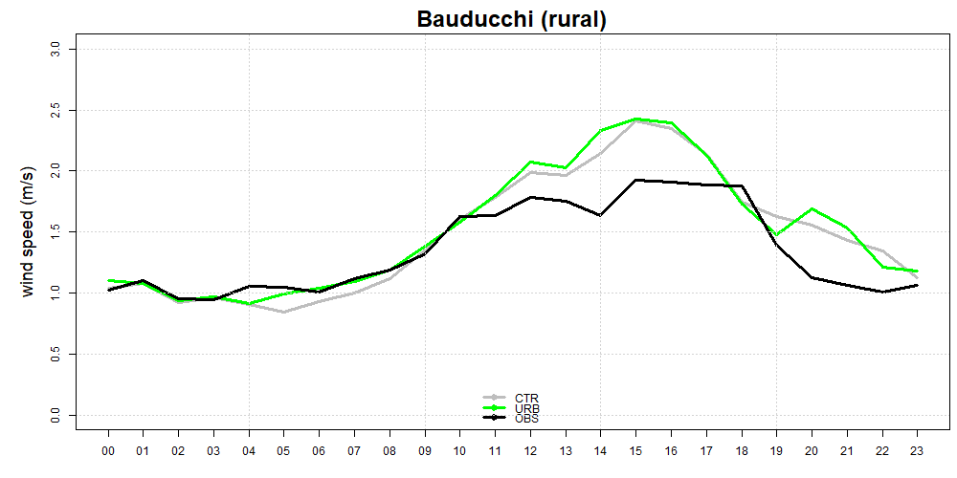
Average daily cycle of wind speed

Slide 9
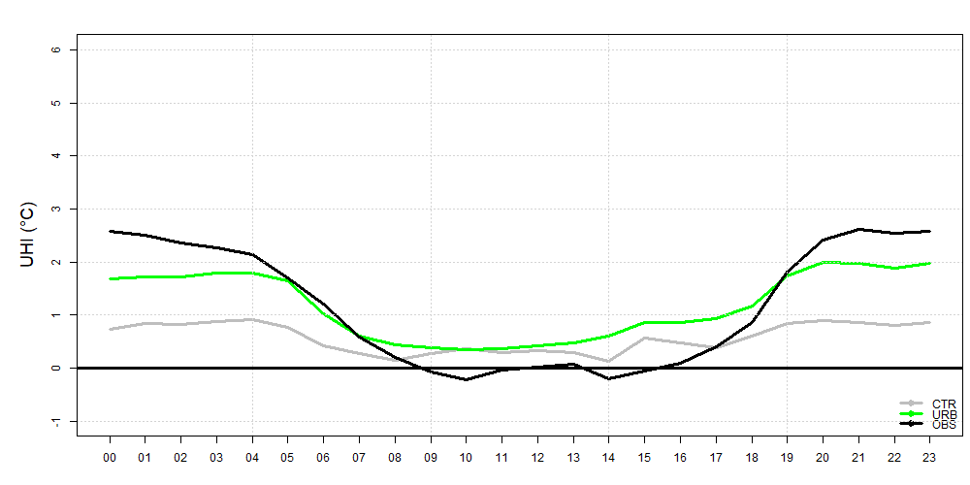
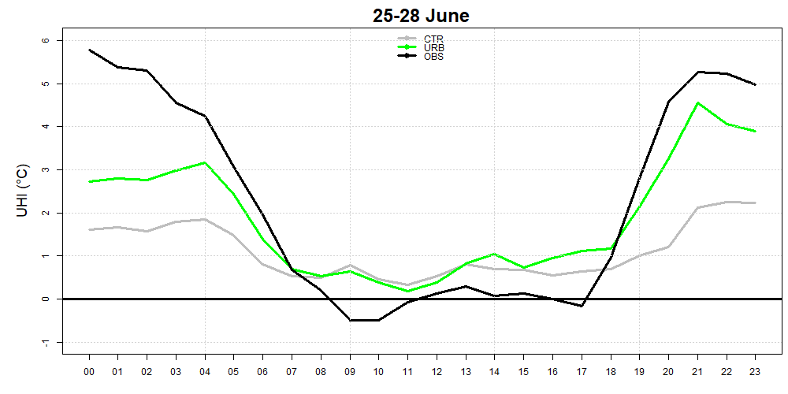
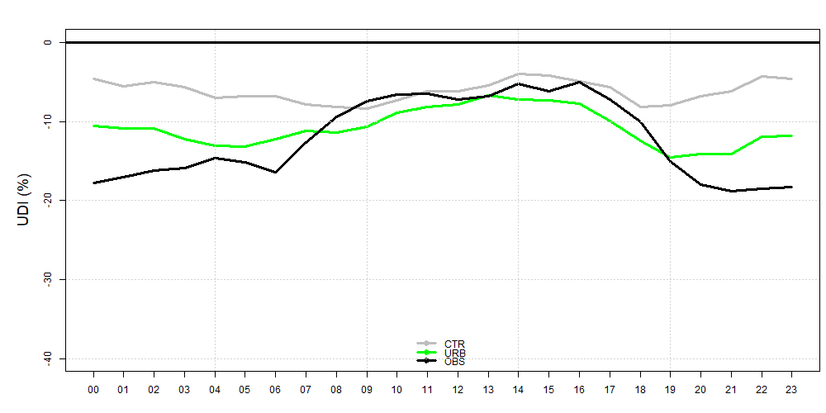
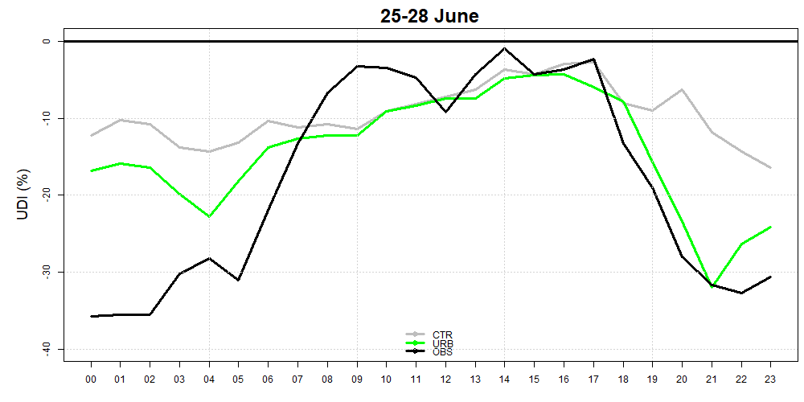
Average daily cycle of UHI and UDI during the heatwave of 25-28 June 2023

Slide 11
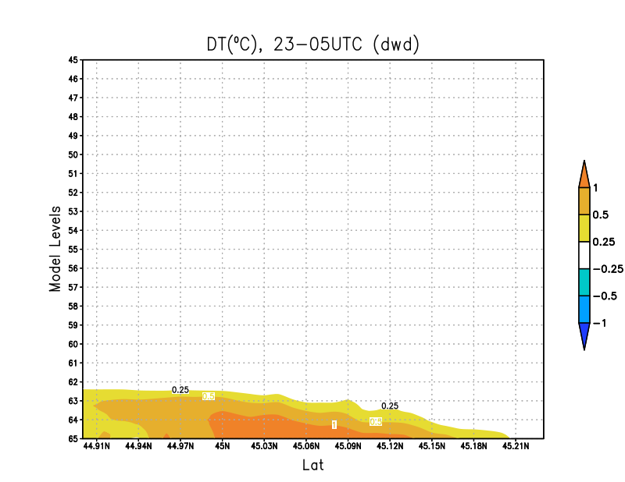
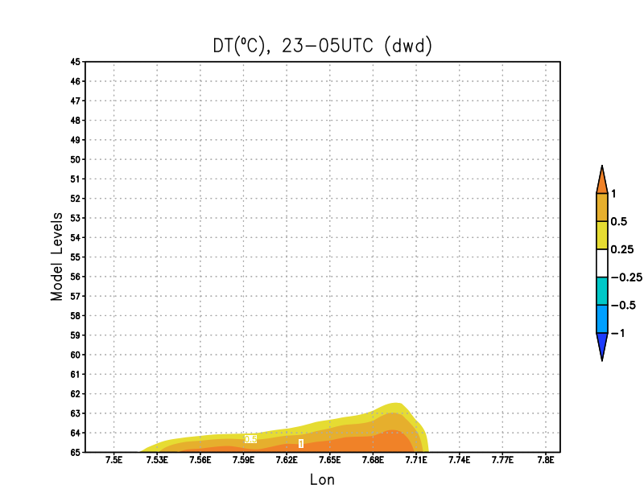
Mean nocturnal T (23UTC-05UCT) di URBrun-CTRrun
Urban areas warmer up to 150-200 m a.g.l.
S-N section
W-E section

Slide 12
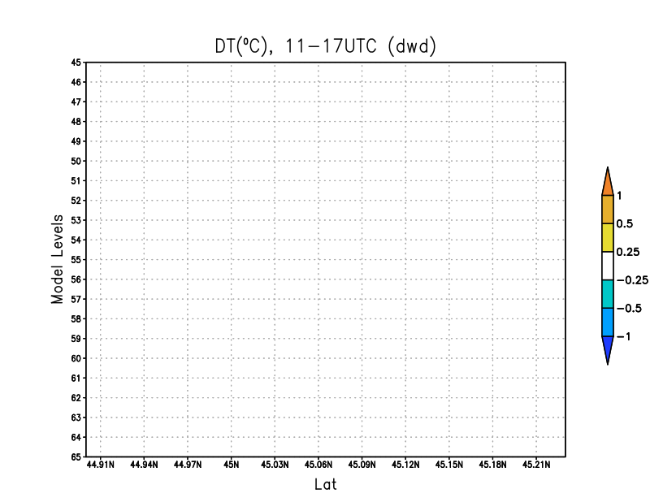
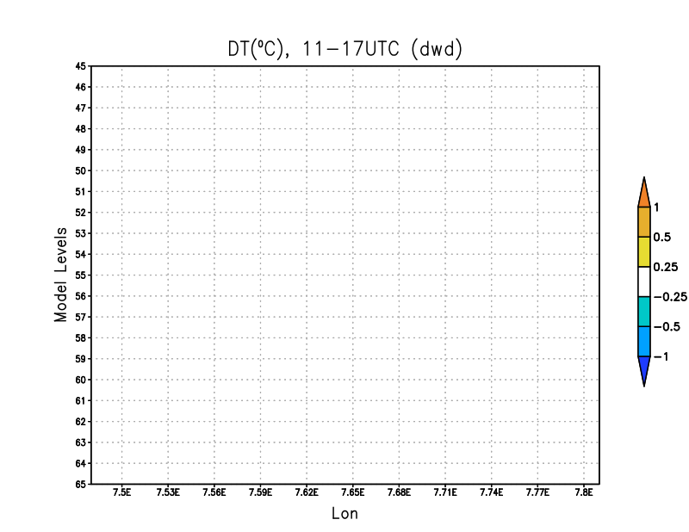
Mean diurnal T (11UTC-17UCT): URBrun-CTRrun
S-N section
W-E section

Slide 13
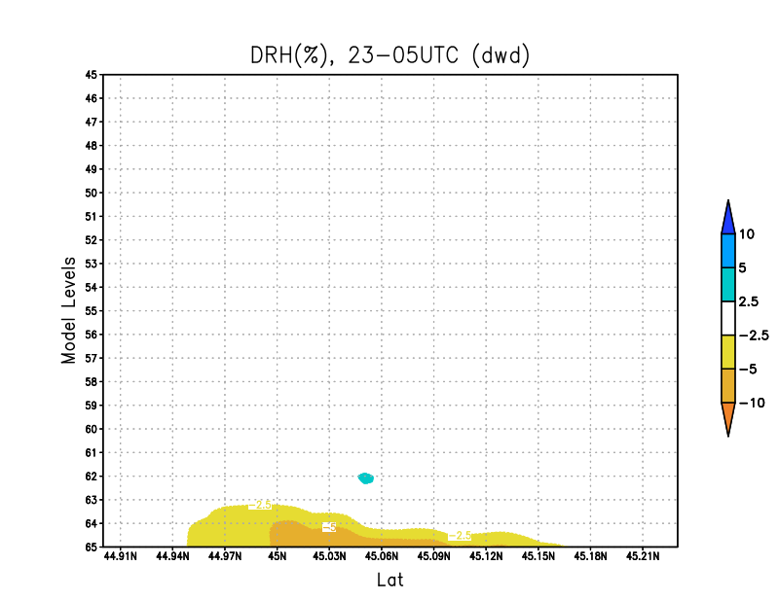
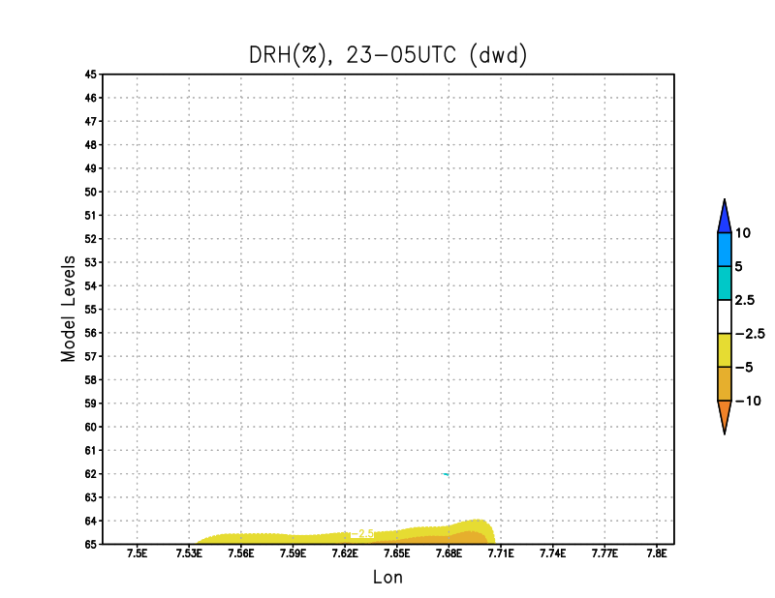
RH nocturnal average (23UTC-05UCT): URBrun-CTRrun
Urban area drier up to 150-200 m a.g.l.
S-N section
W-E section

Slide 14
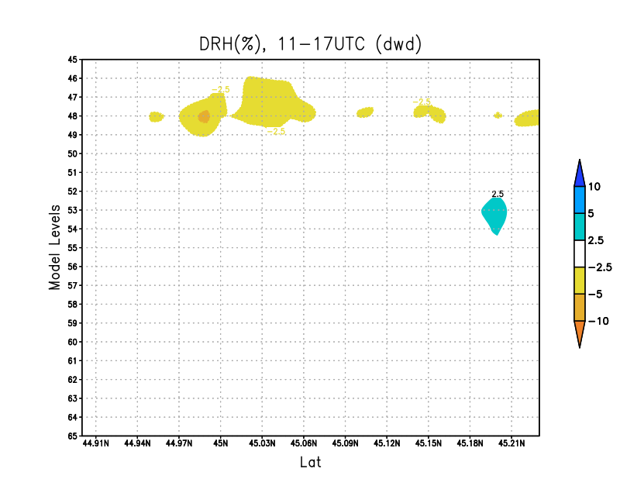
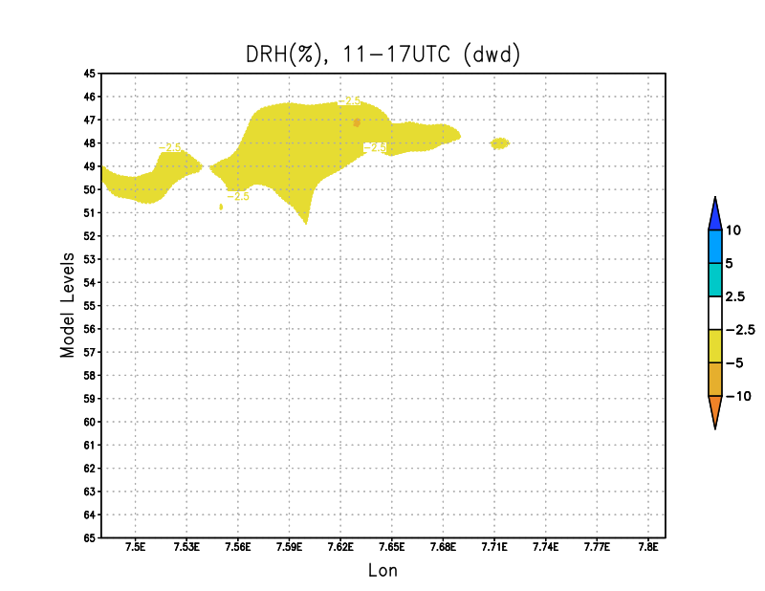
RH diurnal average (11UTC-17UCT): URBrun-CTRrun
S-N section
W-E section

Slide 15
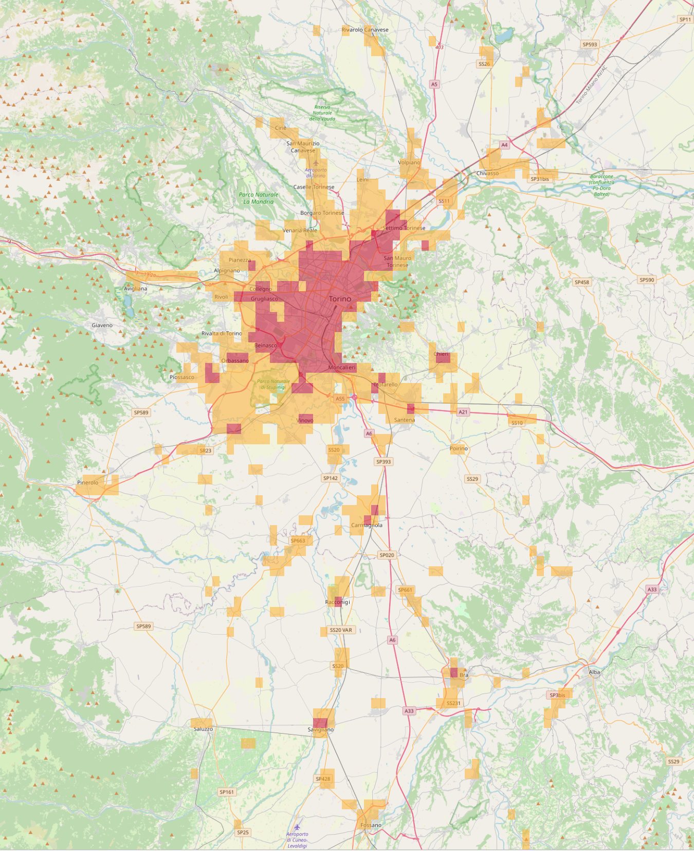
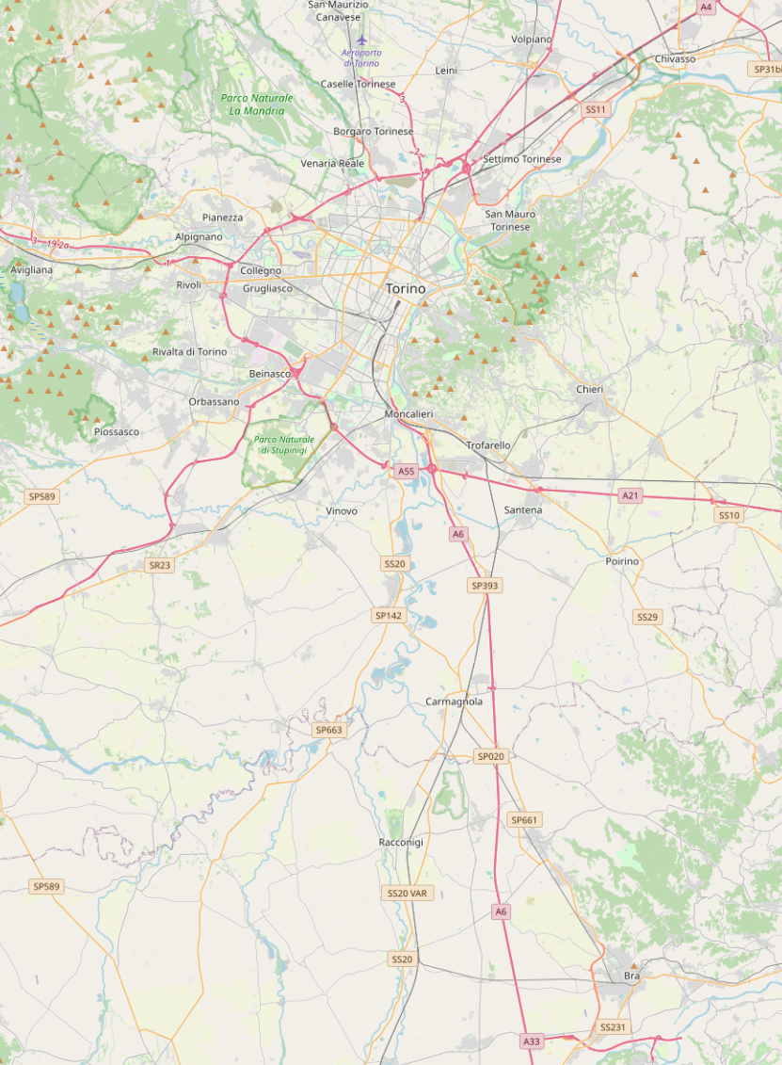
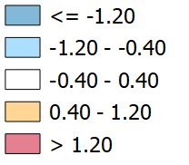
URBrun-CTRrun
T2m average 23-05UTC
T2m average 11-17UTC

Slide 16
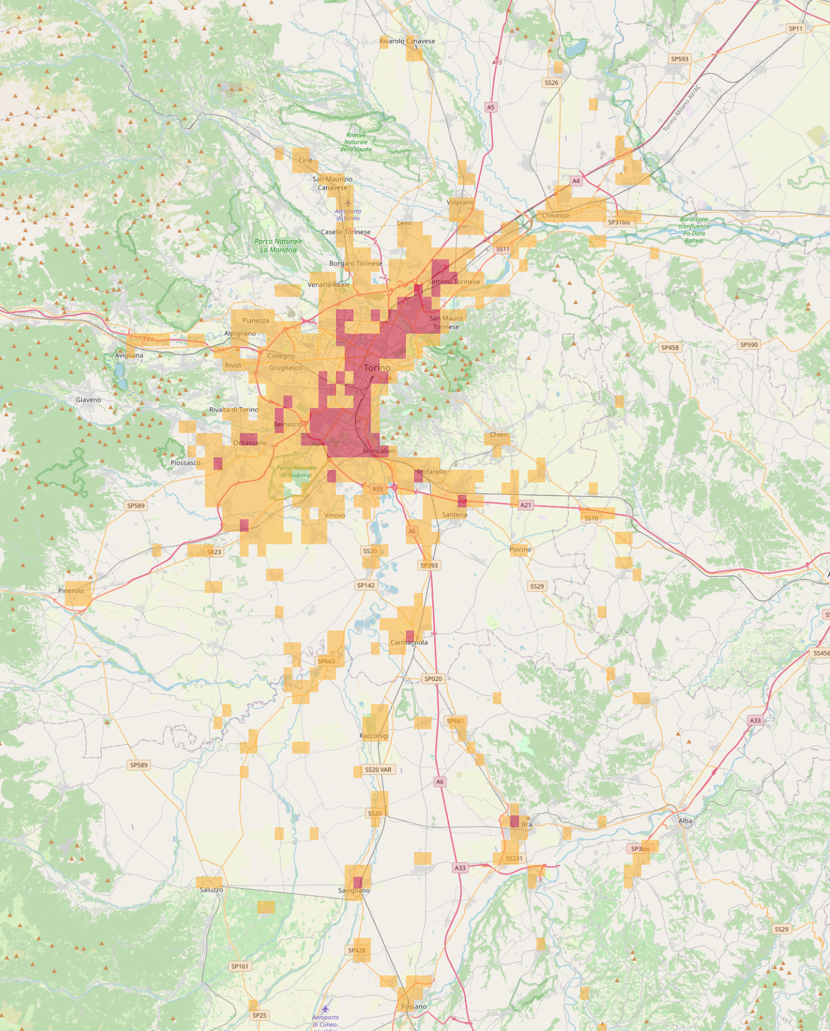
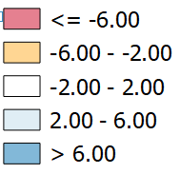
RH2m average 23-05UTC
RH2m average 11-17UTC

Slide 17
Conclusions
In urban areas, for temperature at 2 metres (T2m) and relative humidity at 2 metres (RH2m), the URB simulation performs better (statistically) during the night, while the URB and CTR simulations are statistically similar during the day.
In rural areas, there are no significant differences (and that's fine).
Wind speed is generally not well described, and the differences between URB and CTR are small.
The vertical sections show how the URB run is warmer and drier above urban areas up to around 150-250 m during the night, with no changes during the day.
The spatial variation of T2m shows night-time warming above urban areas and neutral effects during the day. Similarly, the spatial variation of RH2m shows that urban areas are drier at night, with no changes during the day.

Slide 18
Next steps
Try Ecoclimap SG
And then another PP? Possible topics:
  Inclusion of more 2d fields in EXTPAR (urban and thermal features as we had in COSMO)
  Use of other global datasets (for instance AHF)
  Use of PWS (e.g. Netatmo…) for validation -> link with PP APOCS
  BEP-BEM parametrization (towards hectometric scale)
BEP (Building Effect Parameterization): this scheme represents the physical impact of buildings on the atmosphere. It accounts for shading, drag forces, and radiation trapping by urban canyons. BEM (Building Energy Model): this simulates internal building energy dynamics, such as heating, ventilation, and air conditioning (HVAC) systems. It calculates energy exchanges between indoor spaces and the external environment (walls, roofs, windows). The BEP+BEM coupled approach enhances urban simulations by:
  Capturing the two-way interaction between buildings and the atmosphere
  Accurately estimating anthropogenic heat release due to building energy use
  Improving forecasts of urban heat island (UHI) intensity and diurnal temperature variations
  Allowing for scenario-based assessments, such as evaluating green infrastructure or energy efficiency strategies
  Coupling with ICON-ART to analyze pollutant dispersion under different heat emission scenarios

Slide 19
Thank you for the attention !

