Slide 1

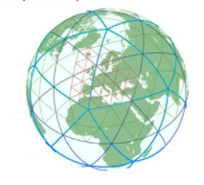
CITTA status at IMS
Yoav Levi and Pavel Khain
COSMO PP CITTA‘ Sep. 2025
COSMO GM 2025, Basel

Slide 2
Previously on Città
The urban parametrization is operational since 30.7.2023.
2 identical hindcast runs one with urban parametrization and the other without for the year 2024.
Due to reproducibility problem it is difficult to compare.
Wind verified against upper air Lidar observation in Jerusalem.
COSMO GM 2025, Basel

Slide 3
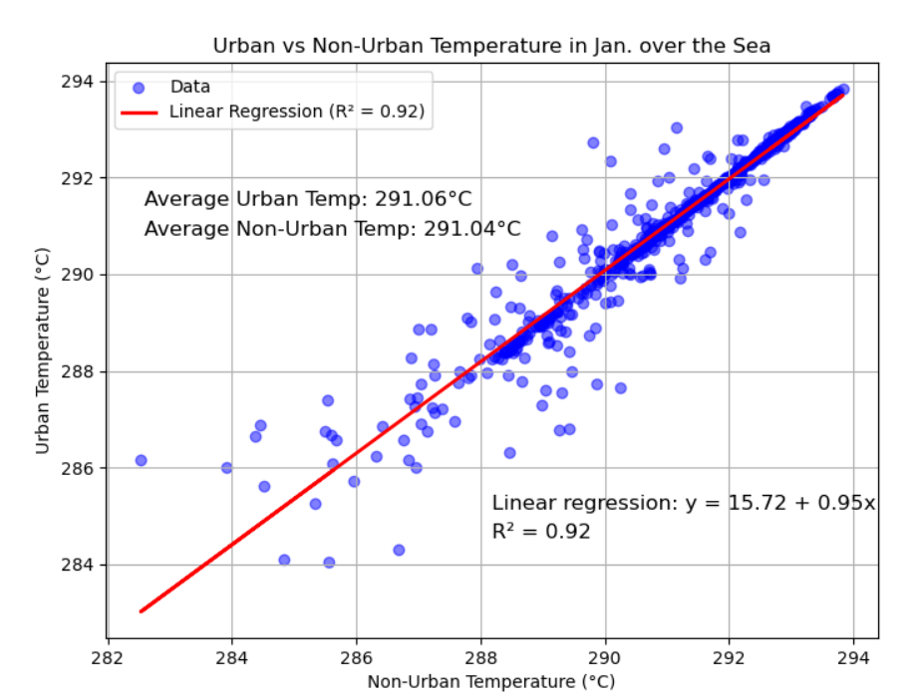
Non-Urban
Is there a reproducible problem?
Low correlation over the sea ->
suspect INTEL + OPEN-MP on ATOS
may bias the results
COSMO GM 2025, Basel

Slide 4

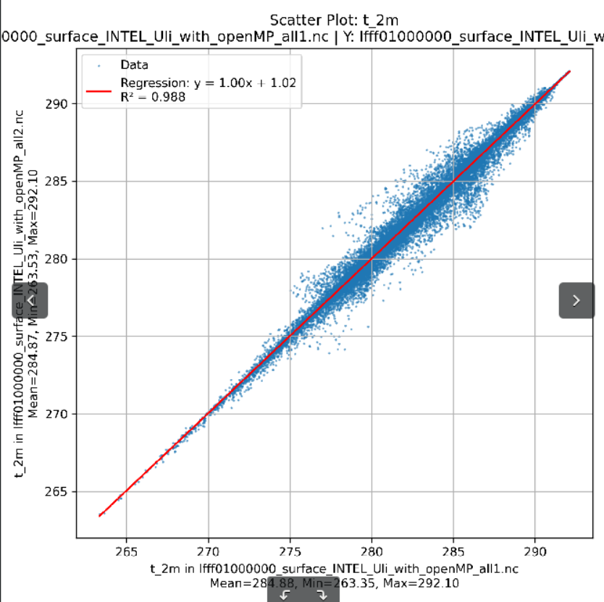
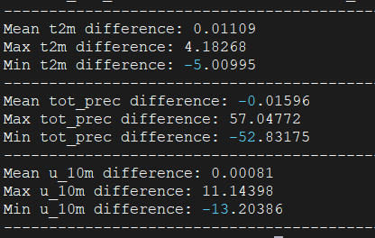
Intel (Uli) ecRad with OMP
COSMO GM 2025, Basel

Slide 5
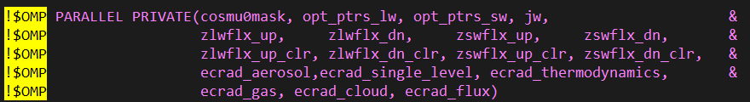
Solution:
Remove the OMP from ecRad
substitute all !$OMP -> ! !$OMP in these files (add exclamation mark):
atm_phy_nwp/mo_nwp_ecrad_interface.f90
externals/ecrad/radiation/radiation_save.F90
For output:
src/io/shared/mo_name_list_output.f90
src/io/shared/mo_post_op.f90
src/io/shared/mo_util_cdi.f90
src/include/omp_definitions.inc does not work
Final tuning is still required
COSMO GM 2025, Basel

Slide 6
experiments
 | nodes | Reproducible | Run time | Ratio | SBUs | Ratio
Intel+openMP | 4 | NO | 00:04:13 | 1 | 613.99 | 1
GNU w/o openMP | 4 | yes | 00:13:05 | 3.10 | 1905.06 | 3.1
GNU+openMP | 4 | yes | 00:05:51 | 1.39 | 851.82 | 1.39
Intel w/o openMP | 4 | yes | 00:08:51 | 2.11 | 1288.65 | 2.1
Intel threads-per-core=1 | 8 | NO | 0:03:02 | 0.71 | 883.37 | 1.42
Intel+openMP | 1 | NO | 00:20:18 | 4.81 | 738.971 | 1.20
Intel+openMP RRTM | 4 | yes | 0:03:58 | 0.94 | 577.586 | 0.94
Intel ecrad w/o OpenMP | 4 | yes | 0:04:39 | 1.10 | 677.086 | 1.10
Intel-llvm (Uli) + openMP | 4 | NO | 0:04:06 | 0.97 | 597.001 | 0.97
Intel-llvm ecrad w/o OpenMP | 4 | yes | 0:04:46 | 1.13 | 694.074 | 1.13
Intel-llvm (Matan) ecrad w/o OpenMP | 4 | yes | 0:04:15 | 1.01 | 626.123 | 1.02
COSMO GM 2025, Basel

Slide 7

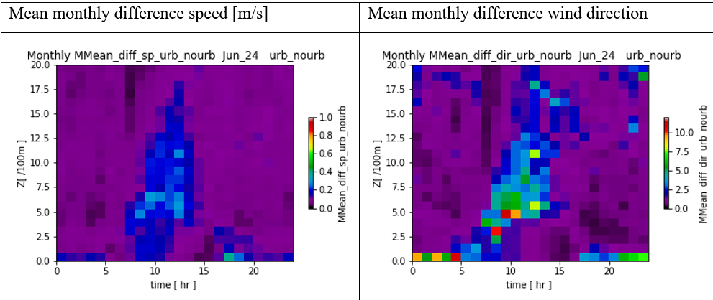
Urban vs. no Urban
Sigalit Berkovic
2 km
Urban parametrization increases the average wind speed by less than 0.5 m/s
most of the effect at the lowest level at night. The sea breeze?
COSMO GM 2025, Basel

Slide 8
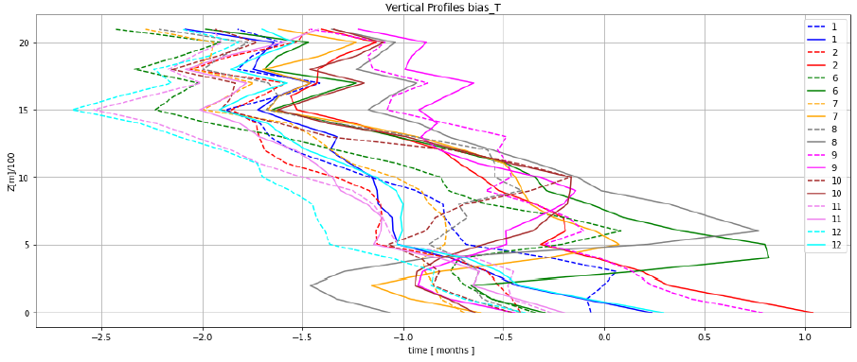
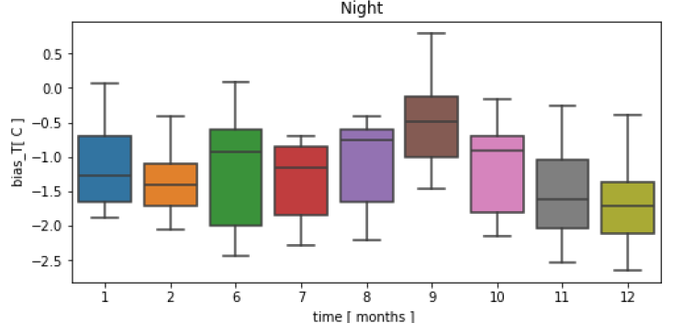
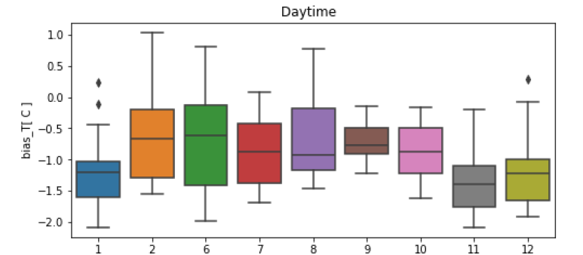
Temp. Verification
Bet Dagan sonde
Jan. night ---
Jan. day
Feb.
Sigalit Berkovic
2 km
1 km
Mostly negative bias that increase with height
COSMO GM 2025, Basel

Slide 9
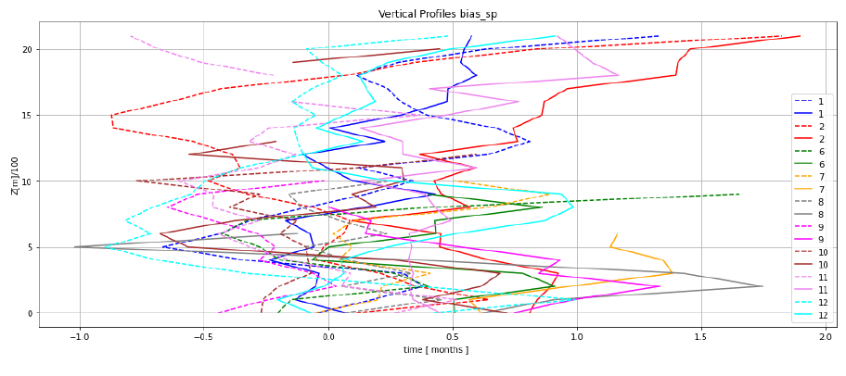
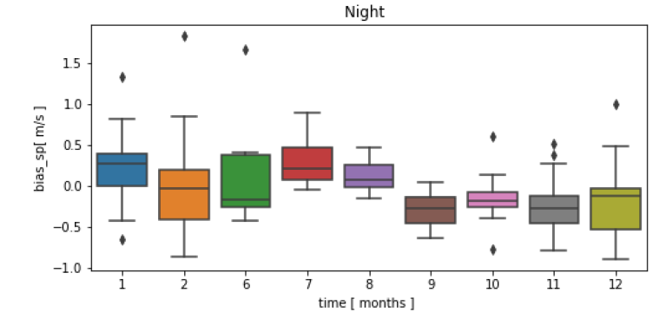
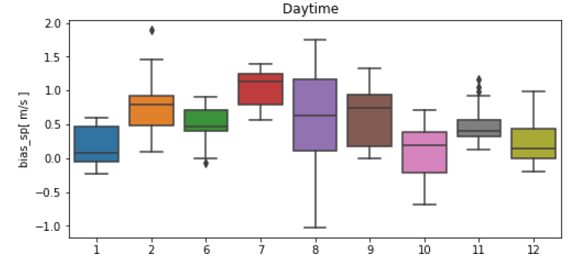
Wind Speed Verification
Sigalit Berkovic
2 km
Jan. night ---
Jan. day
1 km
During the day +~0.5 m/sec bias ->
Increase Zo
COSMO GM 2025, Basel

Slide 10
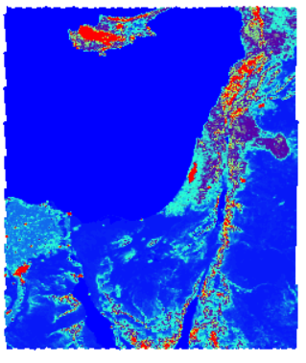
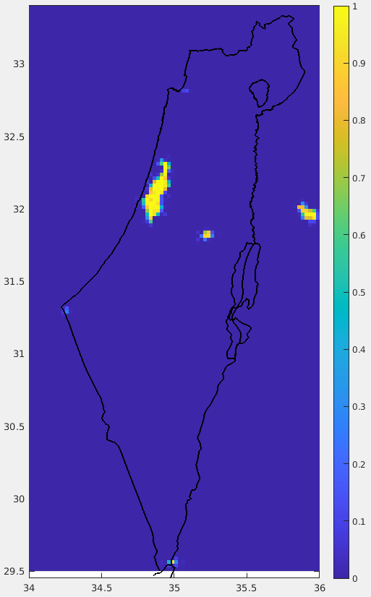
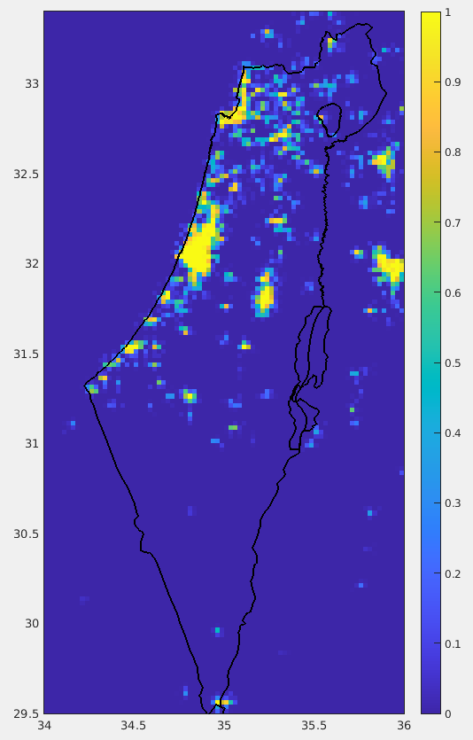
Z₀ and paved fraction
Z₀ in DOM01.extpar.nc
FR_PAVED GlobCover
FR_PAVED NEW
Z0 Looks like FR_PAVED GlobCover (non urban)
If Z₀ was not changed by mistake we discovered the city breeze
COSMO GM 2025, Basel

Slide 11
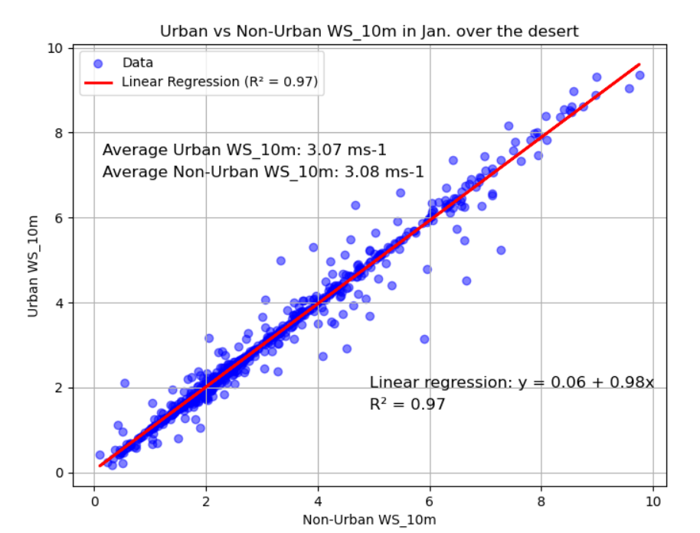
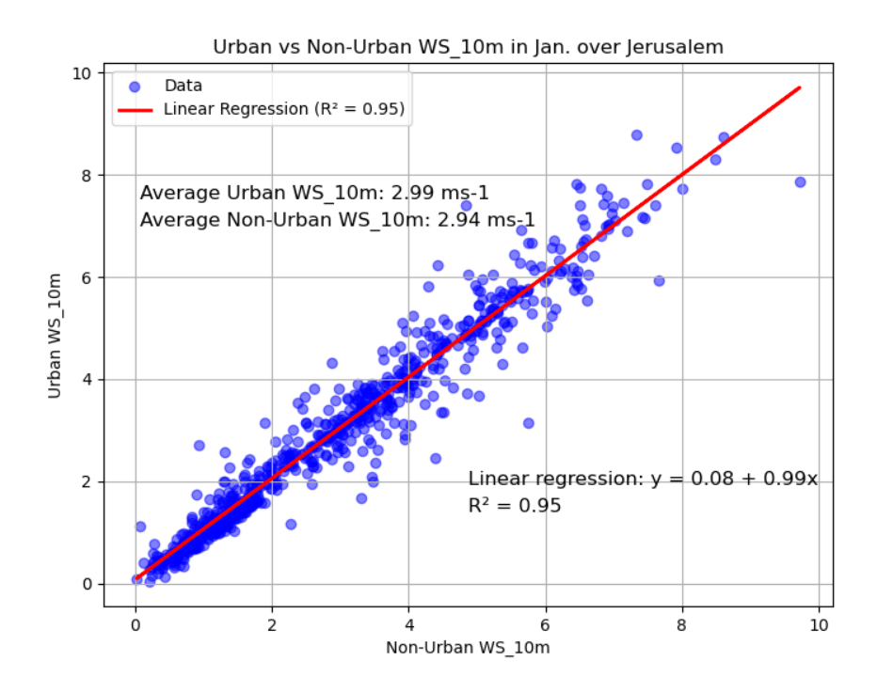
UHI induced city breeze
Rural desert
Jerusalem
Similar average wind speed
Average city breeze = 0.05 m/s (1.7%)
COSMO GM 2025, Basel

Slide 12
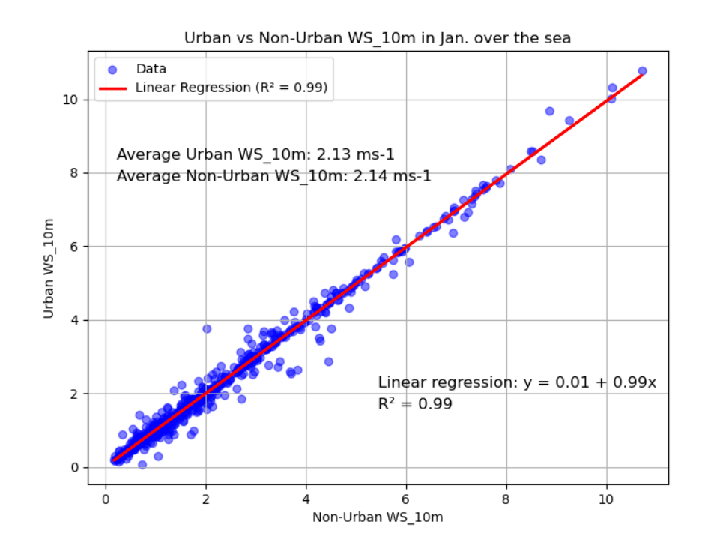
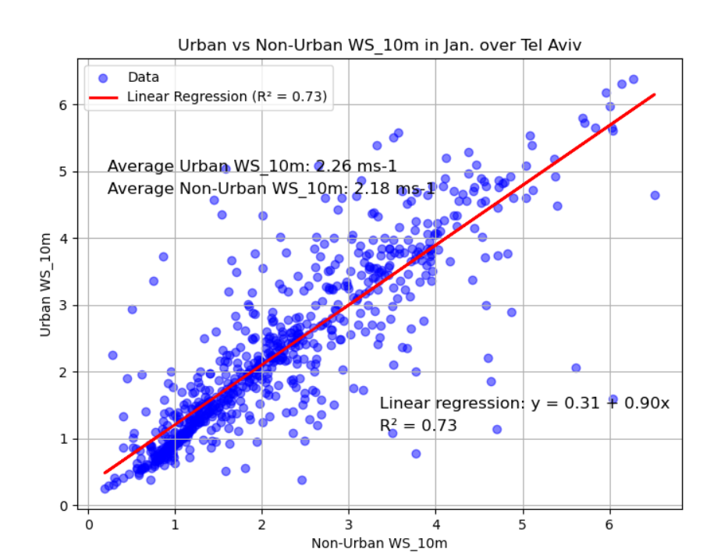
Urban effect on Wind Speed
Sea
Tel Aviv
Similar average wind speed
Average city breeze = 0.08 m/s (3.7%)
COSMO GM 2025, Basel

Slide 13
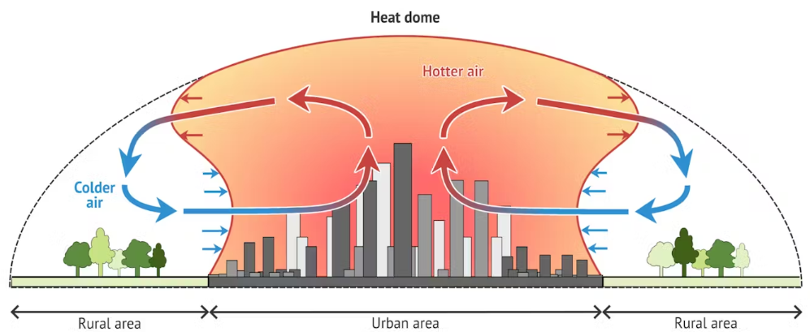
Did we find a measure for the city breeze?
COSMO GM 2025, Basel

Slide 14
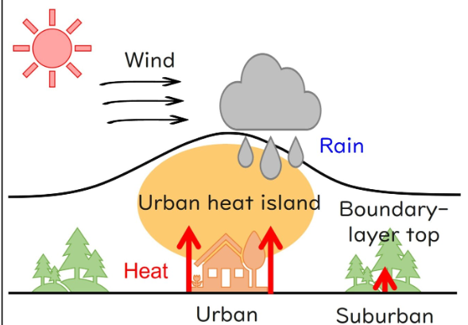
Summary
Should we use Ecoclimap-SG for correct Z₀ in urban areas?
Next?
COSMO GM 2025, Basel

Slide 15
Thanks for the attention
COSMO GM 2025, Basel

Slide 16
Wind Speed Verification
COSMO GM 2025, Basel

Slide 17
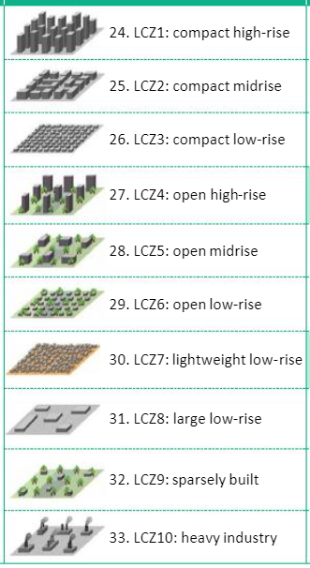
FR_PAVED NEW
Carmela Apreda (CMCC)
sea
ECOCLIMAP-SG (300m resolution)
Roni Drori (IMS)
Urban classes 24-33
↓
GlobCover class 19
on triangular grid
Classes 27, 28, 29, 32 are partially urban. Taking them as 1 leads to overestimation in Urban fraction

