Slide 1

COSMO PP CITTA’ achievements

Slide 2
But … this is well known (see e.g. ICUC12 Rotterdam)!
“optimal” external parameters with ECOCLIMAP SG
in production at IMS, 2023, and DWD, 2025
WMO WWRP Research Demonstration Project Paris 2024 Olympics

Slide 3
COSMO PP CITTA’ achievements
COSMO – Quo Vadis?

Slide 4
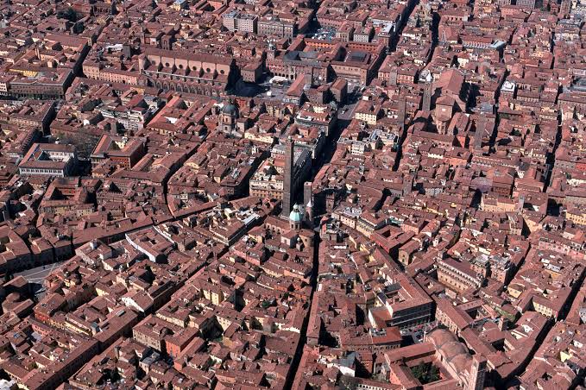
A bit of history
Bi-lateral collaboration between the DWD and MeteoSwiss to develop and use a NWP system in production started before 1992, with in particular a yearly meeting in Germany (Bad Säckingen), precursor of the COSMO General Meeting.
The COSMO Consortium was formed in October 1998 by the Deutscher Wetterdienst (DWD) and MeteoSwiss, initially to develop a non-hydrostatic regional atmospheric model based on DWD “Lokalmodell” (LM).
MoU signed in April 1999 by Met Services of Germany, Switzerland, Italy and Greece. First GM in Bologna, in September 1999.
jean-marie.bettems@meteoswiss.ch, COSMO GM 2025, Basel 4
Notes:
How to keep track of all these developments (and there are probably more)?
Where to put the focus? NIX? ConSAT (2-5)?
The puzzle : ConSAT (2-5)
What are the next steps? Integrate in modularized TERRA …
How to structure all these tasks and define small packages?
Tool to support this? Use something like GitHub plan (or equivalent on GitLab @DKRZ)?
… organize that with Harel and Matthias
The puzzle : NIX
What are the next steps? Solve issue at mountain points? Integrate in modularized TERRA?
Resources?
… KIT may have some resources (e.g. 0.5 FTE over one year… for deposition…)
… Sascha may continue to work partly on NIX at DWD (official demand through COSMO/Roland … prepare with Christian)
What is the involvement of Nander?
Speak with Marco …
The puzzle : topo shading
What is the plan for this development?
Speak with Marco …

Slide 5
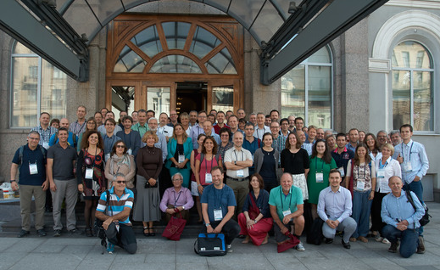
A bit of history
For about 20 years, till the new ICON model became the focus around 2018, the COSMO Consortium was the place to be for collaborating to the model development (at least if you were not sitting at DWD), with the yearly COSMO General Meeting as the main event of the year.
One strength of the Consortium was certainly to unite a large group of scientists, from different institutions with multiple fields of expertise.
COSMO GM St Petersburg, 2018
jean-marie.bettems@meteoswiss.ch, COSMO GM 2025, Basel 5
Notes:
How to keep track of all these developments (and there are probably more)?
Where to put the focus? NIX? ConSAT (2-5)?
The puzzle : ConSAT (2-5)
What are the next steps? Integrate in modularized TERRA …
How to structure all these tasks and define small packages?
Tool to support this? Use something like GitHub plan (or equivalent on GitLab @DKRZ)?
… organize that with Harel and Matthias
The puzzle : NIX
What are the next steps? Solve issue at mountain points? Integrate in modularized TERRA?
Resources?
… KIT may have some resources (e.g. 0.5 FTE over one year… for deposition…)
… Sascha may continue to work partly on NIX at DWD (official demand through COSMO/Roland … prepare with Christian)
What is the involvement of Nander?
Speak with Marco …
The puzzle : topo shading
What is the plan for this development?
Speak with Marco …

Slide 6
And now?
The COSMO Consortium is one among many actors, and the COSMO General Meeting is one event among many.
ML techniques are taking more and more resources away from NWP developments, and a new pan-European Consortium for ML based forecast will most probably be created.
Because resources are everywhere limited, this is a real problem…
Is COSMO still relevant? And to whom?
What is its specific role?
What is its future?
Quo Vadis?
🤔
jean-marie.bettems@meteoswiss.ch, COSMO GM 2025, Basel 6
Notes:
How to keep track of all these developments (and there are probably more)?
Where to put the focus? NIX? ConSAT (2-5)?
The puzzle : ConSAT (2-5)
What are the next steps? Integrate in modularized TERRA …
How to structure all these tasks and define small packages?
Tool to support this? Use something like GitHub plan (or equivalent on GitLab @DKRZ)?
… organize that with Harel and Matthias
The puzzle : NIX
What are the next steps? Solve issue at mountain points? Integrate in modularized TERRA?
Resources?
… KIT may have some resources (e.g. 0.5 FTE over one year… for deposition…)
… Sascha may continue to work partly on NIX at DWD (official demand through COSMO/Roland … prepare with Christian)
What is the involvement of Nander?
Speak with Marco …
The puzzle : topo shading
What is the plan for this development?
Speak with Marco …

Slide 7
Quo Vadis… WG PHYS?
The Consortium provides…
  networking of people and of organizations
  overview of activities in the community at large
  vehicle for cooperation
Some recent success stories (WG PHYS soil&surface)
  CITTA’ (you know that one 😉)
  NIX (community snow model for NWP and climate, brings SLF expertise)
jean-marie.bettems@meteoswiss.ch, COSMO GM 2025, Basel 7
Notes:
How to keep track of all these developments (and there are probably more)?
Where to put the focus? NIX? ConSAT (2-5)?
The puzzle : ConSAT (2-5)
What are the next steps? Integrate in modularized TERRA …
How to structure all these tasks and define small packages?
Tool to support this? Use something like GitHub plan (or equivalent on GitLab @DKRZ)?
… organize that with Harel and Matthias
The puzzle : NIX
What are the next steps? Solve issue at mountain points? Integrate in modularized TERRA?
Resources?
… KIT may have some resources (e.g. 0.5 FTE over one year… for deposition…)
… Sascha may continue to work partly on NIX at DWD (official demand through COSMO/Roland … prepare with Christian)
What is the involvement of Nander?
Speak with Marco …
The puzzle : topo shading
What is the plan for this development?
Speak with Marco …

Slide 8
COSMO – Quo Vadis?
So, I do not really know …

Slide 9
But anyhow thanks for these many interesting years!
My last COSMO GM
(I retire in July 2026)!
👋🏼

