Slide 1
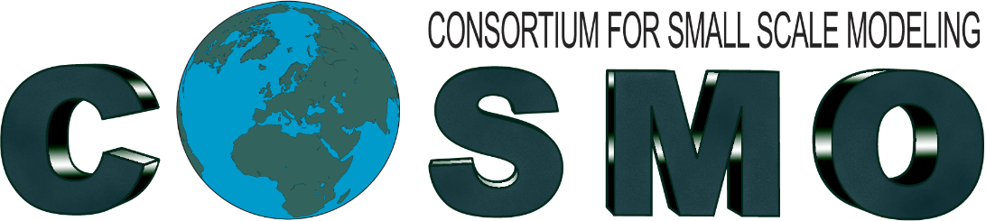


February 19th, 2025 – Meeting promoted by ItaliaMeteo to establish national coordination among selected working groups, focusing on the most relevant modeling topics for the Agency.
Working groups
Data Assimilation
Verification
Observational Data and Nowcasting
Model Development
Operational Chains at CINECA
Within the 'Model Development' working group, the task on the urban parameterization has been identified and will be coordinated by V. Garbero from ARPA Piemonte

Slide 2






May 22th, 2025 – On-line meeting on the urban parameterization task
Aim: to promote collaboration and exchange among Italian institutions, including those from other Consortia.
Participants: V. Garbero (coordinator) for Arpa Piemonte, M. Milelli, L. Monaco and A. Zonato from CIMA, L. Giovannini from University of Trento, R. Bonanno from RSE (Ricerca sul Sitema Energetico), A. Campanale from CMCC, D. Cinquegrana from CIRA and C. Marsigli from ArpaE
Each participant presented their activities related to urban parameterization.

Slide 3
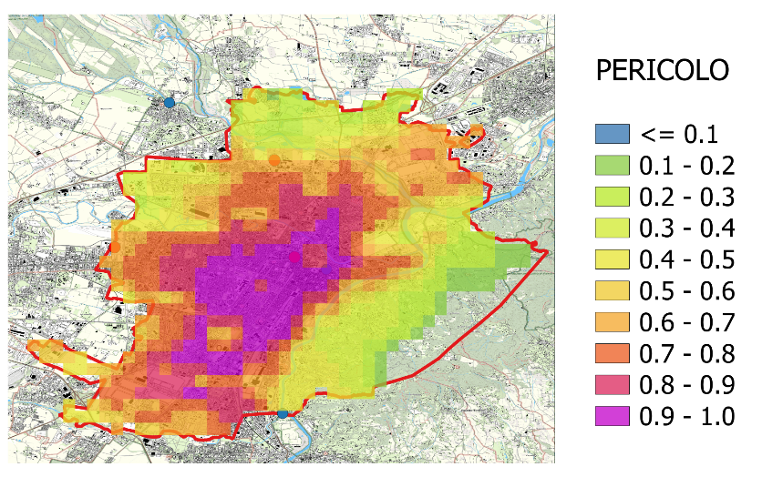
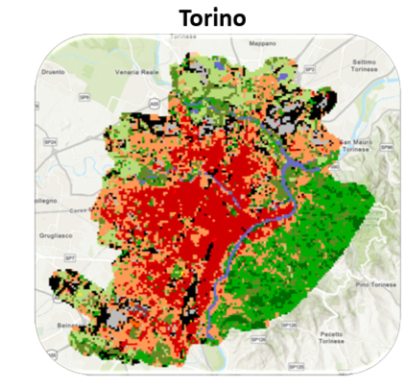
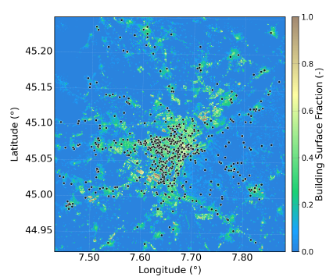

Urban Heat Island Analysis and Modeling at the Urban Scale:
Activities of Arpa Piemonte
LCZ classification
ICON+TERRA_URB (COSMO PP CITTA’)
UHI HAZARD
NetAtmo CWS + MACHINE LEARNING
RMSE=0.84
R²=0.46

Slide 4
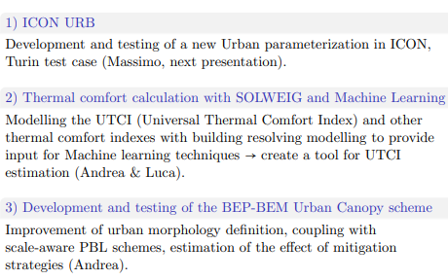
Modeling activities in urban areas
at CIMA

Slide 5
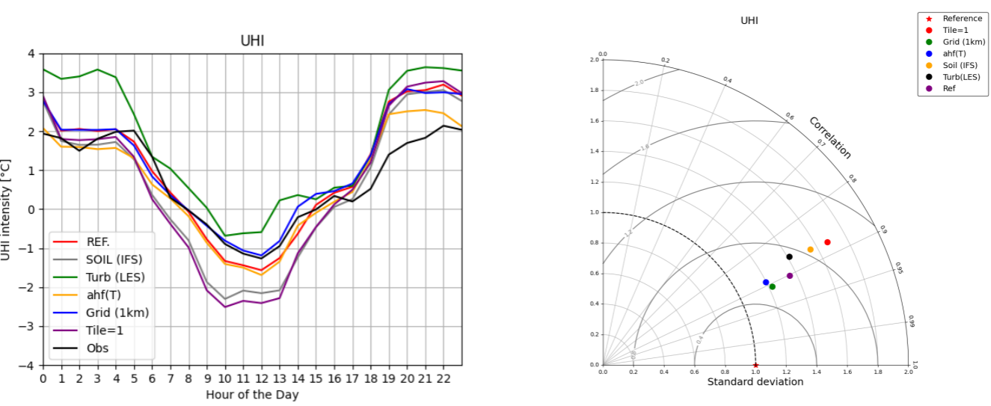
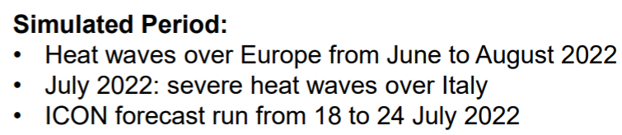
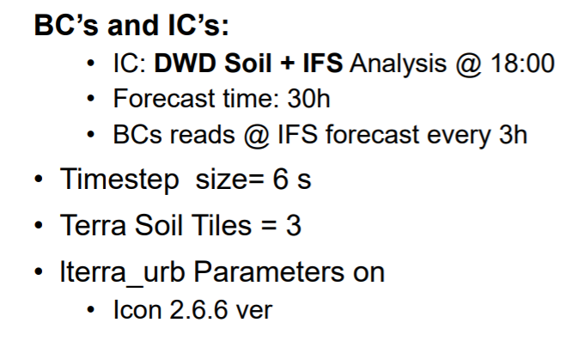
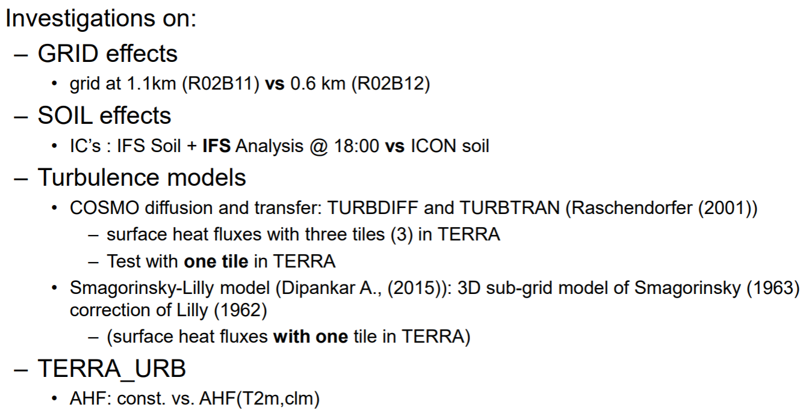
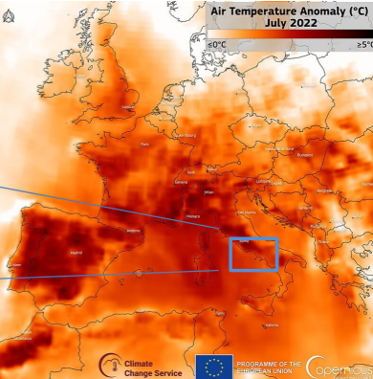
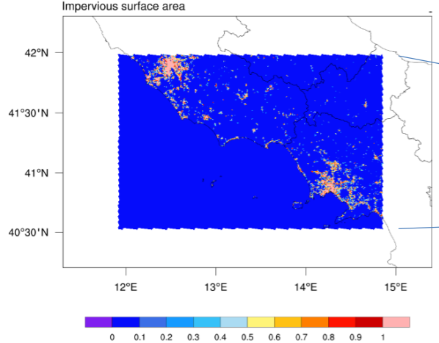
Urban modeling for the Naples Metropolitan Area:
Activities of CIRA

Slide 6
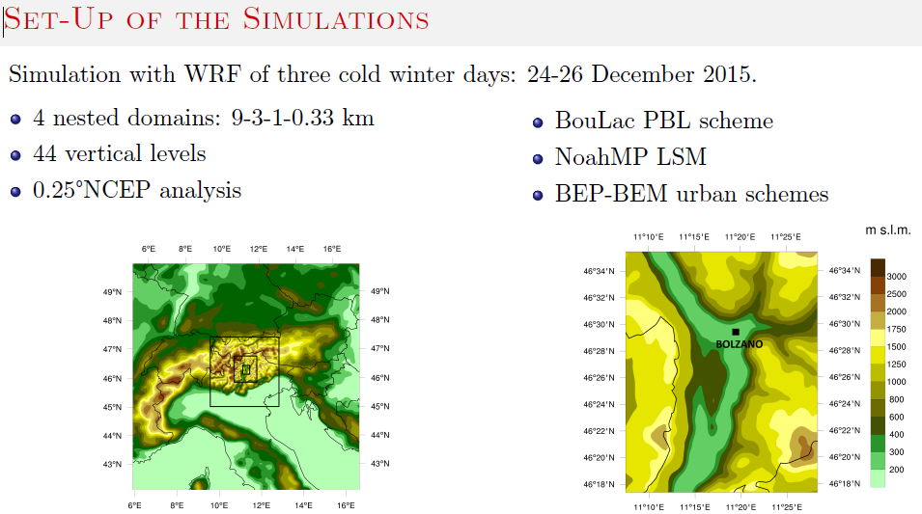
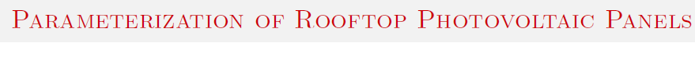


Urban parameterizations for mesoscale meteorological models:
Activities at the University of Trento
Energy Consumption - Bolzano
WRF+ single-layer urban canopy model
New urban parameterizations..

Slide 7
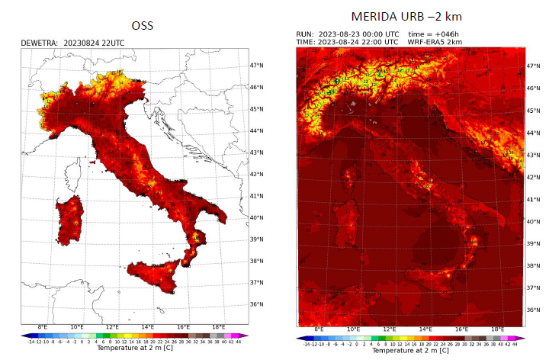
Use of urban models for high-resolution reanalysis with a focus on the Milan area:
Activities in RSE
Urban reanalysis with downscaling of ERA5 reanalysis using 2 km simulations
WRF v4.7 – USGS land useActivation of the urban model SLUCM (single-layer urban canopy model) to simulate heatwave effects in urban environments
Inclusion of LCZs (Local Climate Zones) to characterize the urban canopy (W2W project)
Model validation using temperature measurements in urban areas (DEWETRA, ARPA Lombardia + Netatmo)
High-resolution downscaling (~600 m) over the Milan urban area (NDOWN or similar methods)
Simulation of anthropogenic effects on heat fluxes
Reconstruction of past climate and activation of the model for forecasting purposes
Further downscaling to 100 m using the HRLDAS Land Surface Model for soil field reconstruction
WRF

Slide 8

Focalise on common cases already investigated in order to compare the different models and approaches
Data sharing: DEM, DSM (UT-GLOBUS), and other datasets, as well as data sources
Implementation of ECOCLIMAP or CORINE in ICON (CMCC, ARPAP)
→ Reclassification into 23 GLOBCOVER classes
→ Fortran module modification to take into account new land cover classes and new look-up tables (Jan-Peter?)
?? Integration of 2D urban parameters in ICON to exploit global or local datasets (ARPAP)
AND NOW..?
Random thoughts

Slide 9
AHF estimation: investigate alternative data sources and eventually include modulation
BEM/BEP implementation in ICON (CIMA)
LES simulations to be compared with NPW model results (CIRA)
Urban flooding: how urban areas impact precipitation pattern (ARPAE)
AND NOW..?
Random thoughts
THANK YOU!

