Slide 1


On the Vertical Sensitivity of ICON Model Over Greece
Euripides Avgoustoglou, Hellenic National Meteorological Service (HNMS)
In Support and Collaboration with,
Harel Muskatel, Pavel Khain and Yoav Levi, Israel Meteorological Service (IMS)
27th COSMO General Meeting, Basel-Switzerland, September 1-5, 2024
Euripides Avgoustoglou, Hellenic National Meteotological Service, 27th COSMO GM , Basel-Switzerland, September 1-5, 2025
01

Slide 2
General Motivation
Understanding the vertical resolution sensitivity of regional climate models is crucial for improving their performance, particularly in areas with complex atmospheric dynamics. The ICON-LAM (ICOsahedral Nonhydrostatic Limited-Area Model) offers high-resolution capabilities and is increasingly used for regional forecasting and climate simulations.
Euripides Avgoustoglou, Hellenic National Meteotological Service, 27th COSMO GM , Basel-Switzerland, September 1-5, 2025
02

Slide 3
NWP Motivation
Cloud and Convective Processes: Accurate vertical layering is essential for capturing the vertical extent of cloud formation, convective updrafts, and precipitation development.
Orographic Influences: In regions with complex topography, vertical sensitivity determines how terrain-induced uplift and lee-side effects are modeled.
Boundary Layer Representation: Vertical resolution strongly influences how well ICON-LAM simulates phenomena in the planetary boundary layer, such as turbulence, surface-atmosphere exchanges, and diurnal cycles.
Euripides Avgoustoglou, Hellenic National Meteotological Service, 27th COSMO GM , Basel-Switzerland, September 1-5, 2025
03

Slide 4
Technical Motivation
Grid Configuration & Stability: ICON-LAM uses a vertically stretched grid. Investigating sensitivity helps define trade-offs between resolution, stability, and computational load.
Parameterization Performance: Vertical discretization affects the effectivenes of cloud microphysics, radiation, and turbulence schemes, which often rely on vertical gradients.
Data Assimilation Efficiency: Better understanding of vertical sensitivity ensures more accurate integration of vertical profile observations, such as radiosondes and satellite retrievals.
Euripides Avgoustoglou, Hellenic National Meteotological Service, 27th COSMO GM , Basel-Switzerland, September 1-5, 2025
04

Slide 5
Practical Impacts
Forecast Accuracy: Enhanced vertical resolution can improve short-term forecasts of fog, low-level jets, and severe weather phenomena.
Model Adaptability: Tailoring vertical resolution for specific geographic or meteorological conditions can boost ICON-LAM’s adaptability and operational relevance.
Regional Climate Modeling: In long-term simulations, vertical sensitivity influences energy balance, moisture transport, and surface temperature gradients that are vital for regional climate assessments.
Euripides Avgoustoglou, Hellenic National Meteotological Service, 27th COSMO GM , Basel-Switzerland, September 1-5, 2025
05

Slide 6
Rationale
Greece presents an ideal case study for such an investigation due to its:
Complex Topography:
Mountainous terrain and coastal interactions influence vertical atmospheric processes like orographic lifting, boundary layer development, and convective activity.
Frequent Extreme Atmospheric Phenomena:
Greece experiences diverse meteorological events, including Mediterranean cyclones, heat-waves, and Saharan dust intrusions, all of which are sensitive to vertical resolution.
Model Uncertainty Reduction:
Assessing vertical level sensitivity can help identify optimal configurations for ICON-LAM, improving accuracy in temperature, wind, and precipitation profiles.
Regional Forecasting Applications:
Enhanced vertical resolution may improve short-term weather forecasting in Greece, benefiting sectors like agriculture, tourism, and disaster preparedness.
Contribution to Broader Scientific Goals:
Results can inform best practices for ICON-LAM deployment in other regions and refine parameterization schemes in limited-area models.
Euripides Avgoustoglou, Hellenic National Meteotological Service, 27th COSMO GM , Basel-Switzerland, September 1-5, 2025
06

Slide 7
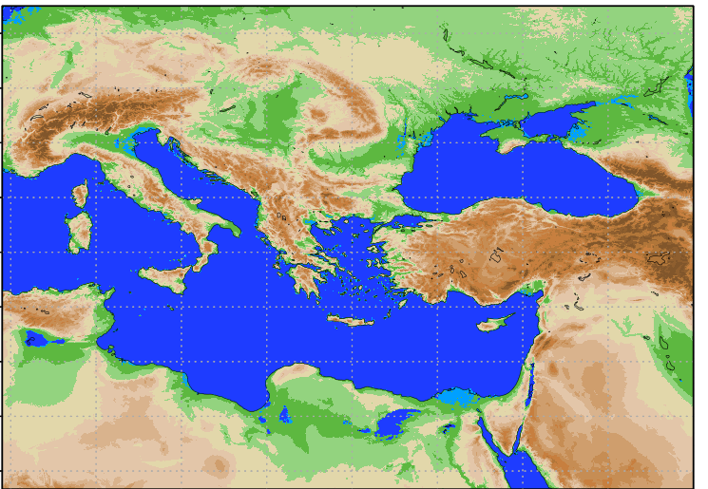
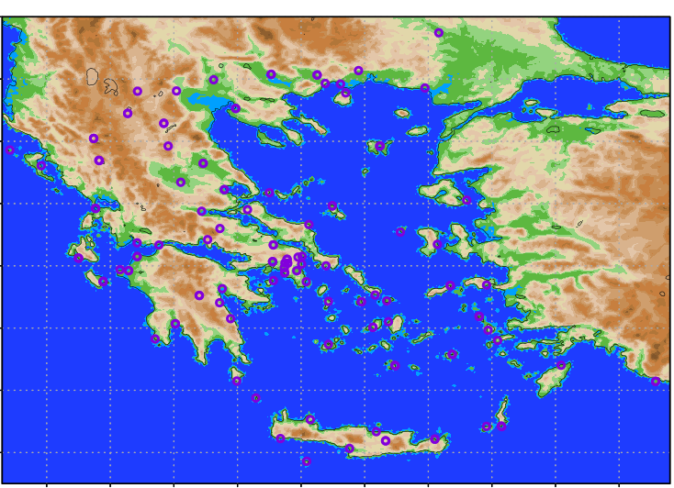
Model Domain
HNMS Station Positions
Radiosond Stations
Stations most affected by storm “Daniel”
Thessaloniki (LG16622)
Larisa (LG16648)
Nea Aghialos (LG16665)
Skiathos (LG16684
Lamia (LG16675)
Helliniko(LG16716)
Heraklio(LG16754)
Euripides Avgoustoglou, Hellenic National Meteotological Service, 27th COSMO GM , Basel-Switzerland, September 1-5, 2025
07

Slide 8
Model Set-up highlights
Horizontal grid: R2B10 ~ 2,5km (1621x1061 grid Lon/Lat points)
Model time step: dtime = 24 s
Convection parameterization scheme: inwp_convection = 1 (Tiedke) ! It might be considered experimenting with turning off deep convection parameterization (inwp_convection = 0) to allow explicit convection.
Time interval for calling the convection parameterization scheme: dt_conv = 120 s
Time interval between successive lateral boundary condition updates: dtime_latbc = 10800 s
Time interval for calling the radiation scheme: dt_rad = 720 s
Minimum time scale for Rayleigh friction damping: efdt_min_raylfric = 7200 s
Time interval for calling the subgrid-scale orography (SSO) parameterization scheme: dt_sso = 120 s
Time interval for calling the gravity wave drag (GWD) parameterization scheme: dt_gwd = 360 s
Vertical Levels | Suitability | Notes
65 | ✅ Standard Reference | Common in operational ICON setups like ICON-D2
100 | ✅ Stronger vertical detail | Useful for high-resolution convection and cloud studies
130 | ✅ Excellent for upper-atmosphere studies | May require tuning of damping and physics schemes
Euripides Avgoustoglou, Hellenic National Meteotological Service, 27th COSMO GM , Basel-Switzerland, September 1-5, 2025
08

Slide 9
Model level heights up to “tropopause” above sea surface (grid point view)
m
level
Euripides Avgoustoglou, Hellenic National Meteotological Service, 27th COSMO GM , Basel-Switzerland, September 1-5, 2025
09

Slide 10
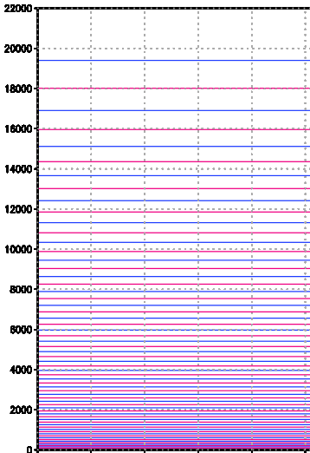
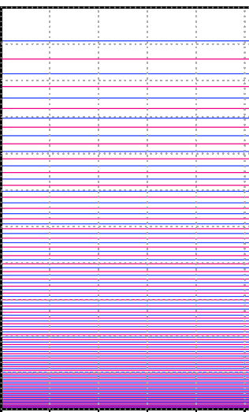
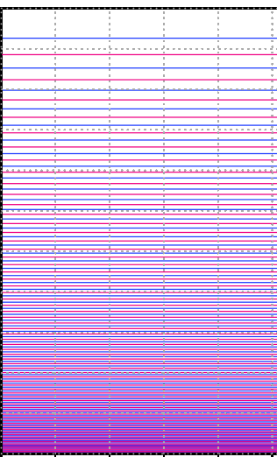
Model level heights up to “tropopause” above sea surface (cross section view)
65 Levels
100 Levels
130 Levels
Euripides Avgoustoglou, Hellenic National Meteotological Service, 27th COSMO GM , Basel-Switzerland, September 1-5, 2025
10

Slide 11
Model level heights up to 5000 meters above sea surface (grid point view)
m
level
Euripides Avgoustoglou, Hellenic National Meteotological Service, 27th COSMO GM , Basel-Switzerland, September 1-5, 2025
11

Slide 12
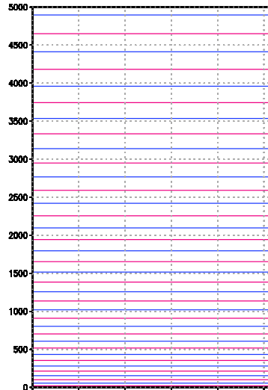
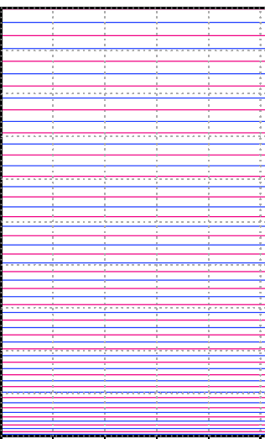
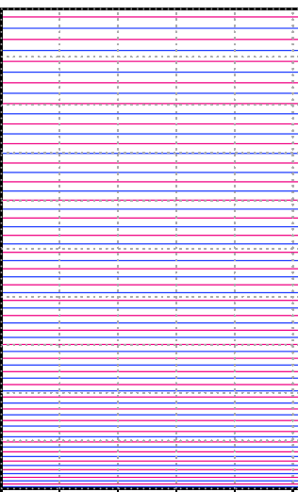
Model level heights up to 5000 meters above sea surface (cross section view)
37/65 Levels
53/100 Levels
65/130 Levels
Euripides Avgoustoglou, Hellenic National Meteotological Service, 27th COSMO GM , Basel-Switzerland, September 1-5, 2025
12

Slide 13
Model level heights 300 - 3000 meters above sea surface grid point view
m
level
Euripides Avgoustoglou, Hellenic National Meteotological Service, 27th COSMO GM , Basel-Switzerland, September 1-5, 2025
13

Slide 14
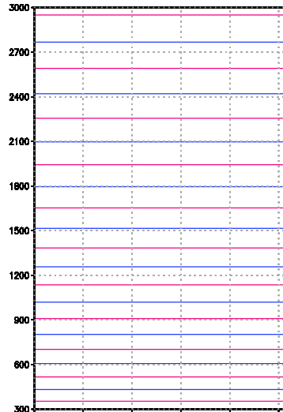
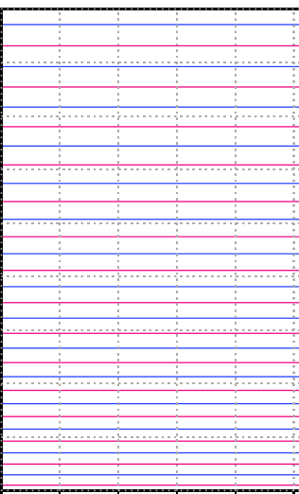
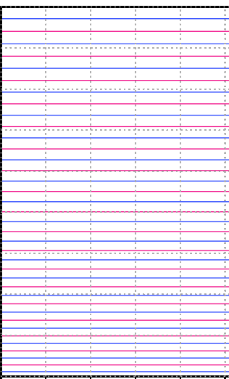
Model level heights 300 - 3000 meters above sea surface grid point view
21/65 Levels
30/100 Levels
37/130 Levels
Euripides Avgoustoglou, Hellenic National Meteotological Service, 27th COSMO GM , Basel-Switzerland, September 1-5, 2025
14

Slide 15
Model level heights up to 500 meters above sea surface grid point view
m
level
Euripides Avgoustoglou, Hellenic National Meteotological Service, 27 ^{th} COSMO GM , Basel-Switzerland, September 1-5, 2025
15

Slide 16
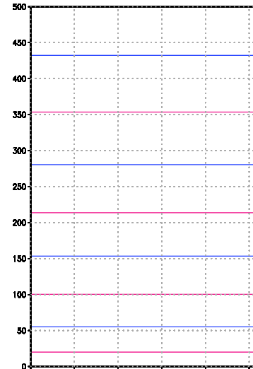
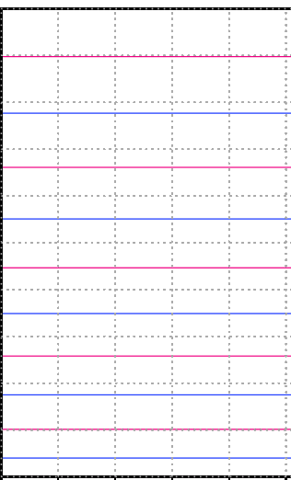
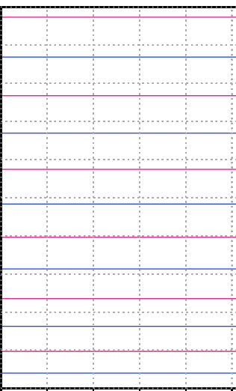
Model level heights up to 500 meters above sea surface cross section view
9/65 Levels
11/100 Levels
13/130 Levels
Euripides Avgoustoglou, Hellenic National Meteotological Service, 27th COSMO GM , Basel-Switzerland, September 1-5, 2025
16

Slide 17
HNMS Station Positions
Focused on:
Radiosond Stations
Stations most affected by storm “Daniel”
Thessaloniki (LG16622)
Larisa (LG16648)
Nea Aghialos (LG16665)
Skiathos (LG16684
Lamia (LG16675)
Helliniko(LG16716)
Heraklio(LG16754)
Temperature and Specific Humidity profiles vs. IFS analysis
Forecasted 48 hs accumulated precipitation.
Euripides Avgoustoglou, Hellenic National Meteotological Service, 27th COSMO GM , Basel-Switzerland, September 1-5, 2025
17

Slide 18
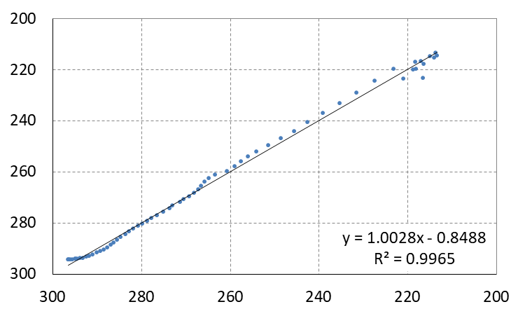
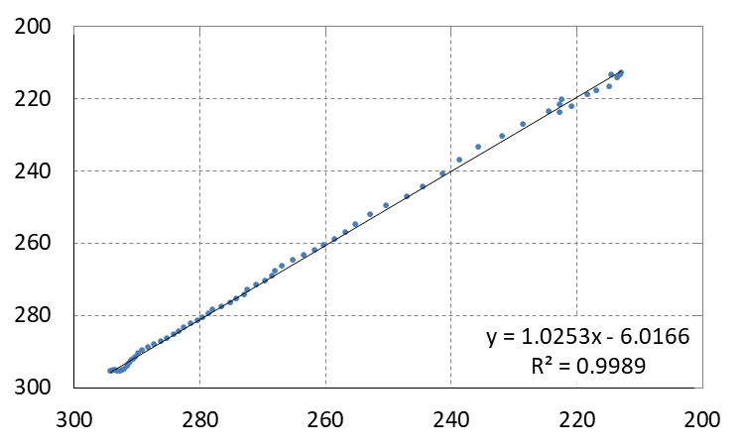
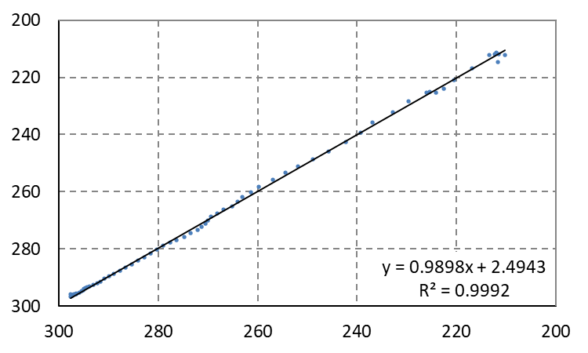
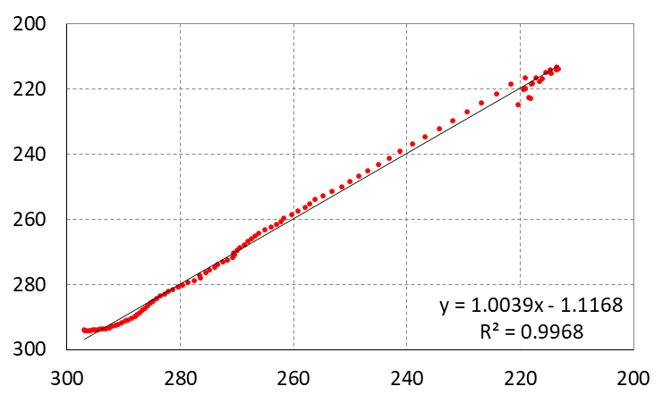
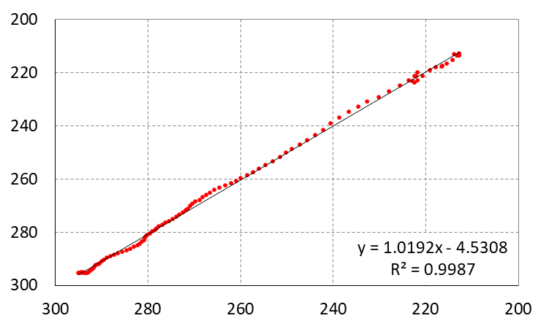
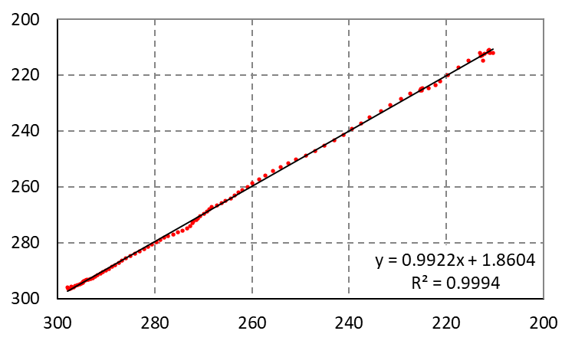
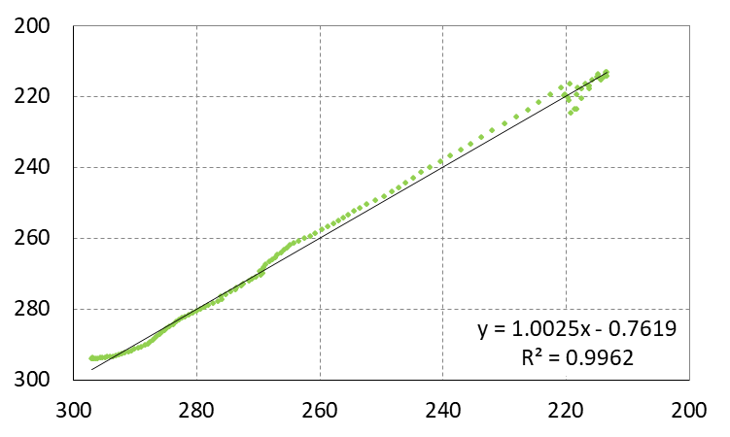
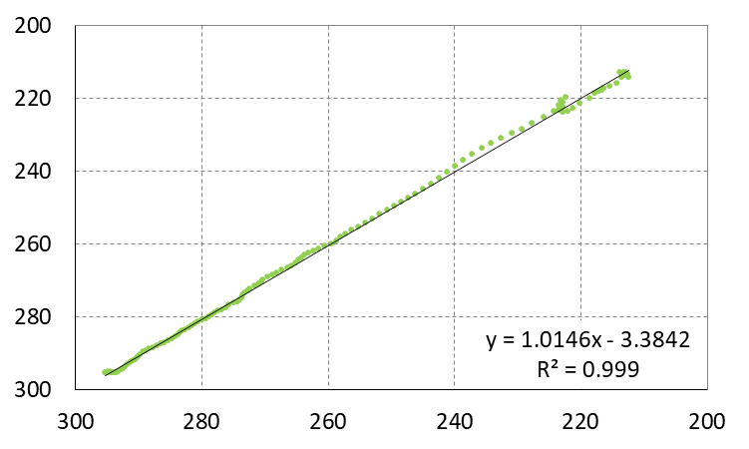
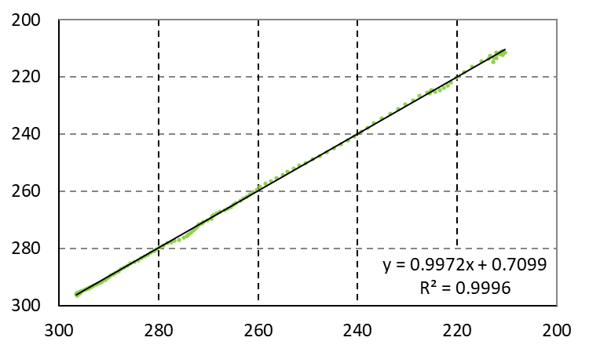
Temperature Correlations (K):
Analysis (vertical) 20230600 UTC vs. Forecast (horizontal) 00+24hs
Thessaloniki
Helliniko
Heraklio
65_levels
100_levels
130_levels
Euripides Avgoustoglou, Hellenic National Meteotological Service, 27th COSMO GM , Basel-Switzerland, September 1-5, 2025
18

Slide 19
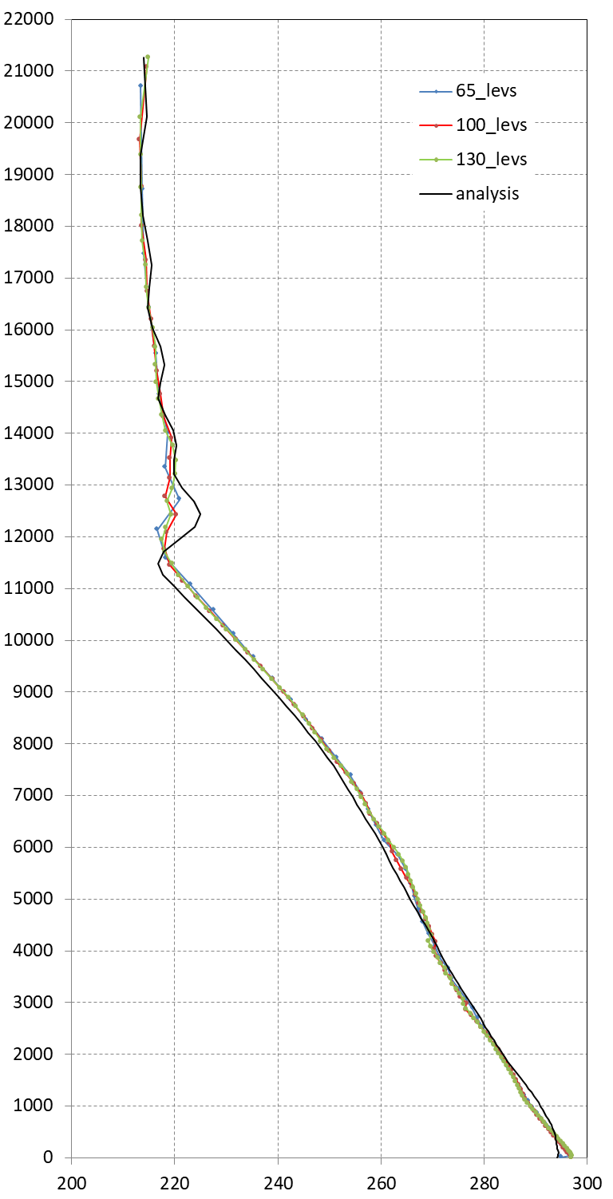
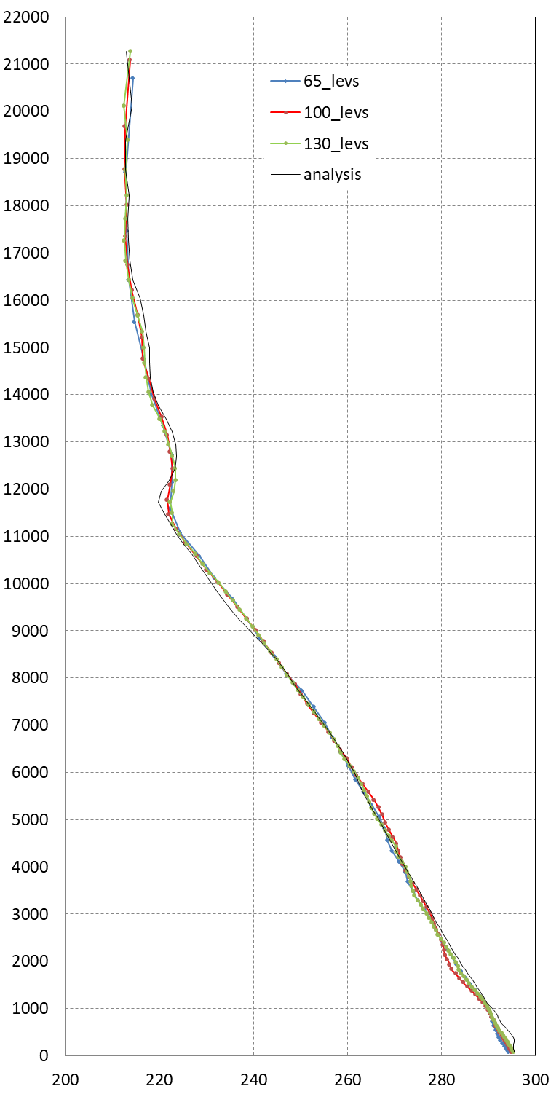
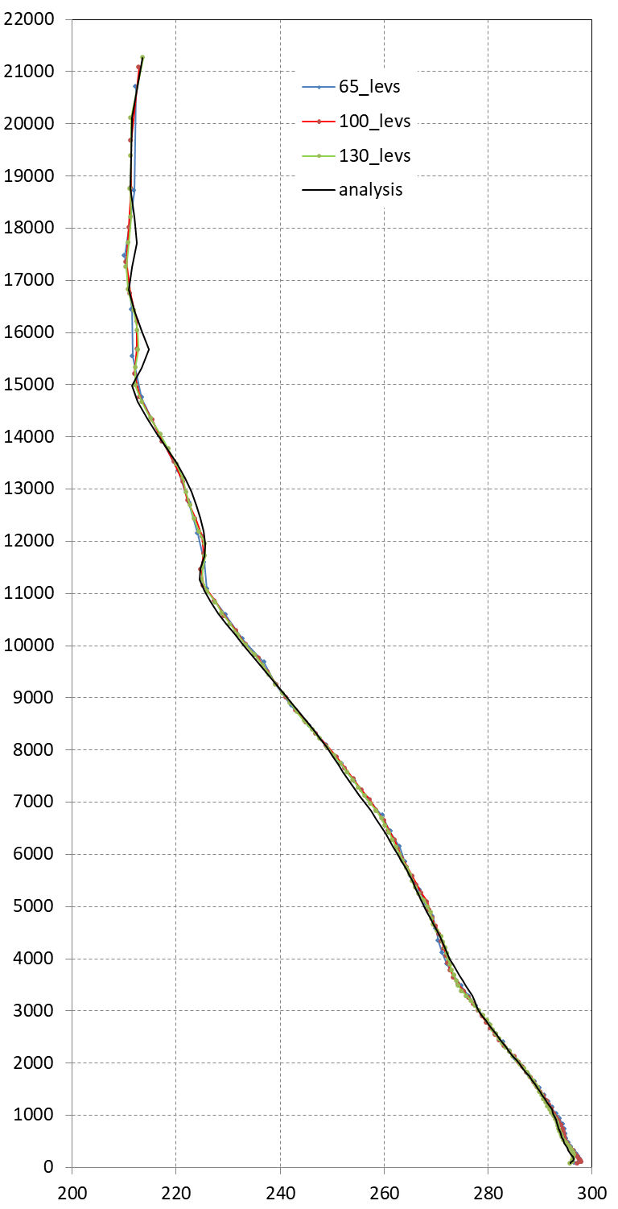
Temperatue vertical profiles:
Analysis 20230600 UTC vs. Forecast 00+24hs
m
Thessaloniki
Helliniko
Heraklio
K
Euripides Avgoustoglou, Hellenic National Meteotological Service, 27th COSMO GM , Basel-Switzerland, September 1-5, 2025
19

Slide 20
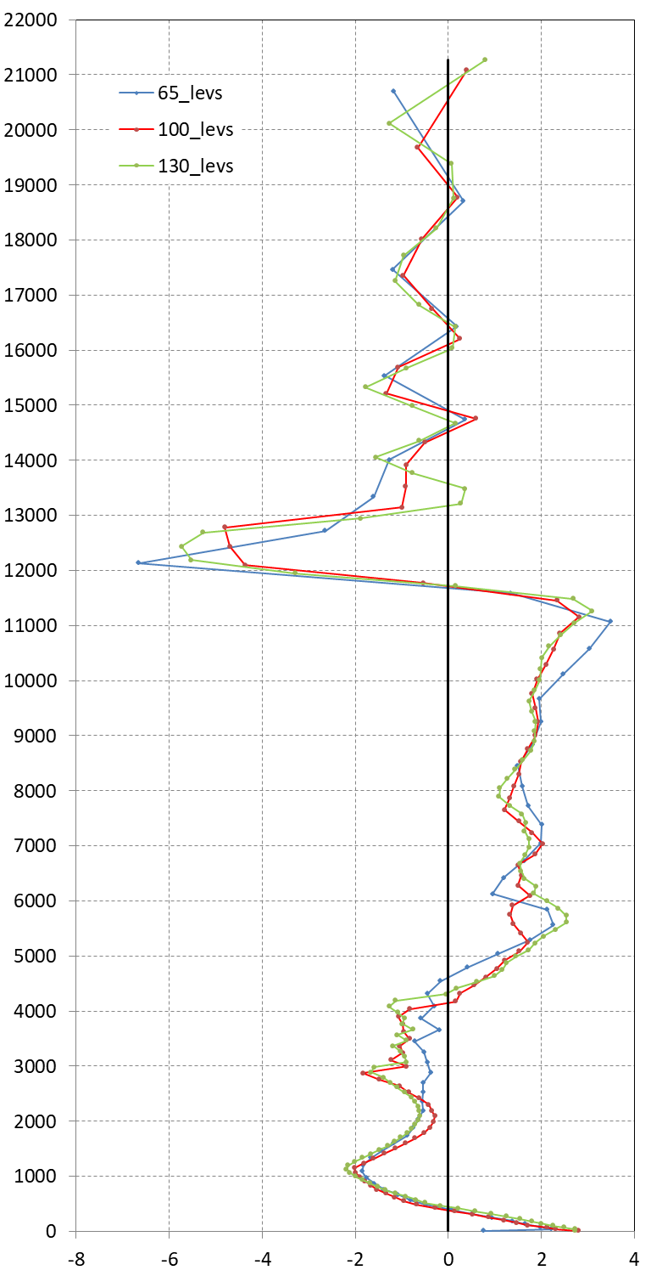
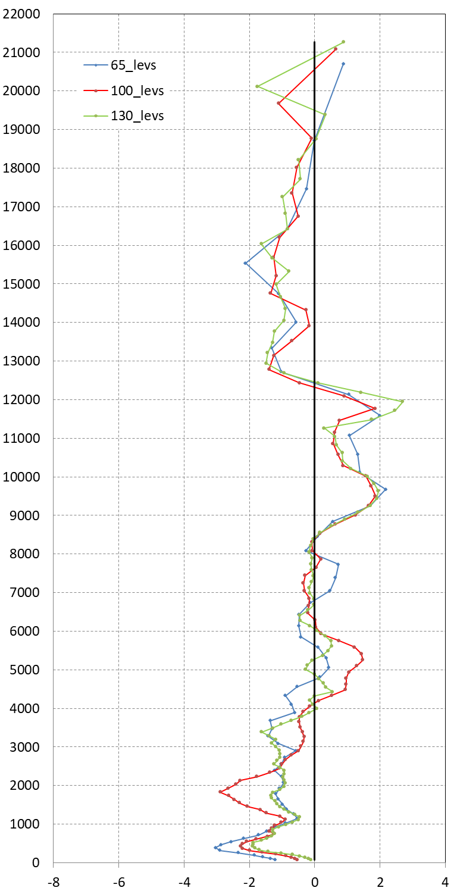
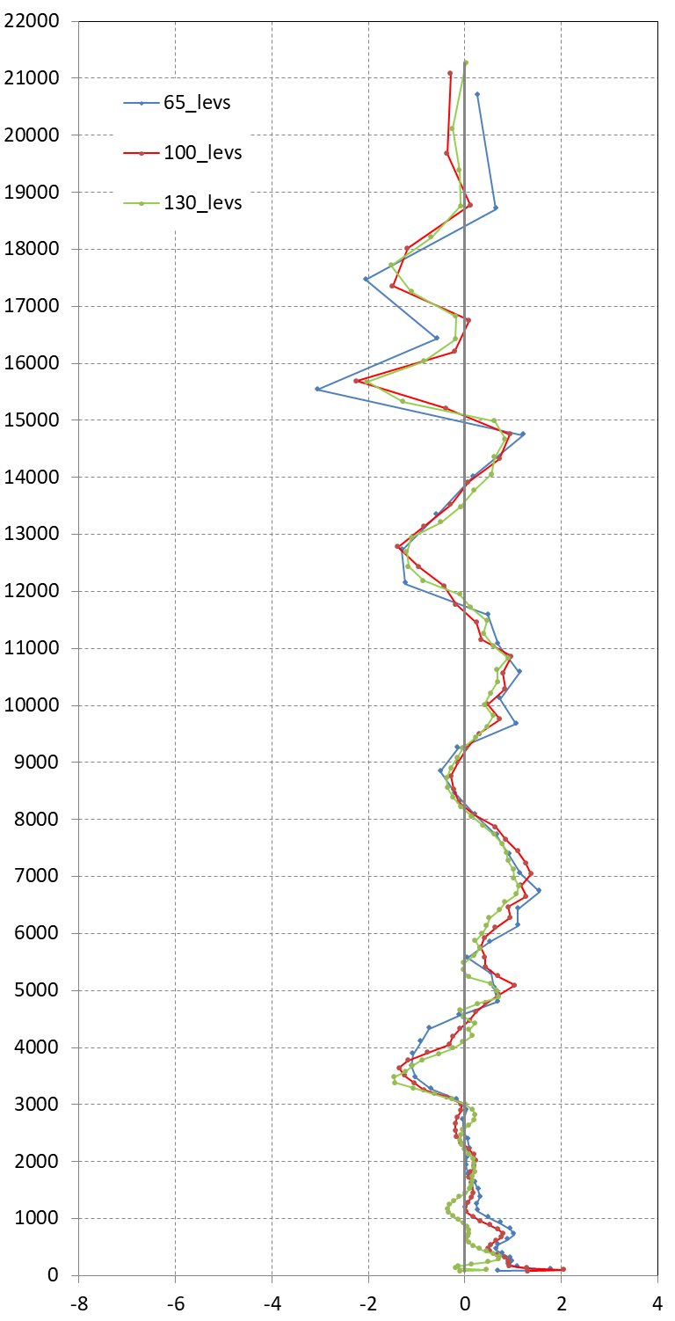
Temperature bias of vertical profiles:
Analysis 20230600 UTC vs. Forecast 00+24hs
m
MB MAB
65_levs: 0.117 1.320
100_levs: 0.088 1.336
130_levs: 0.111 1.457
MB MAB
65_levs: -0.632 1.097
100_levs: -0.479 1.019
130_levs: -0.399 0.851
MB MAB
65_levs: 0.218 0.697
100_levs: 0.183 0.572
130_levs: 0.027 0.431
Thessaloniki
Helliniko
Heraklio
K
Euripides Avgoustoglou, Hellenic National Meteotological Service, 27th COSMO GM , Basel-Switzerland, September 1-5, 2025
20

Slide 21
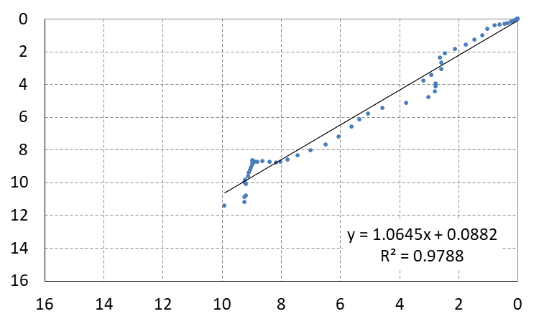
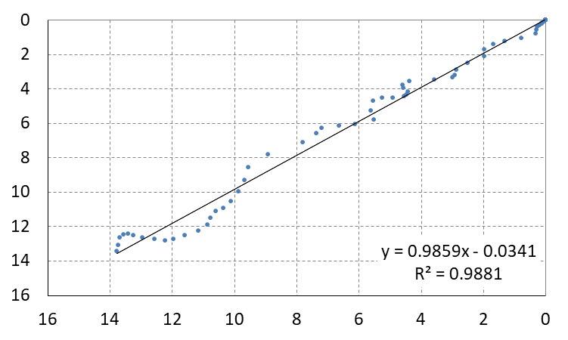
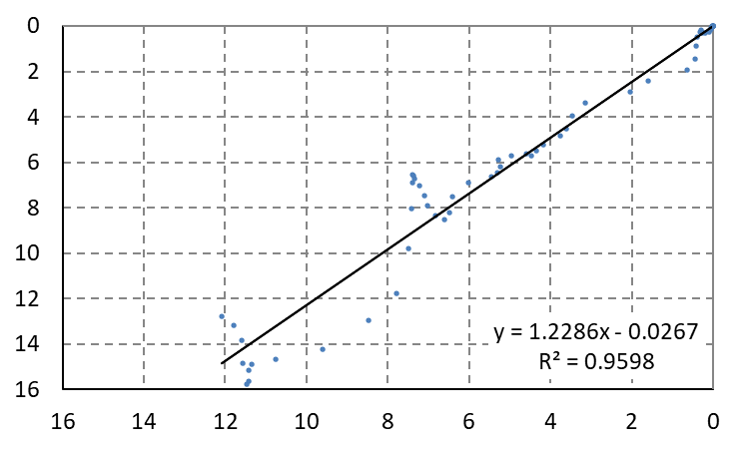
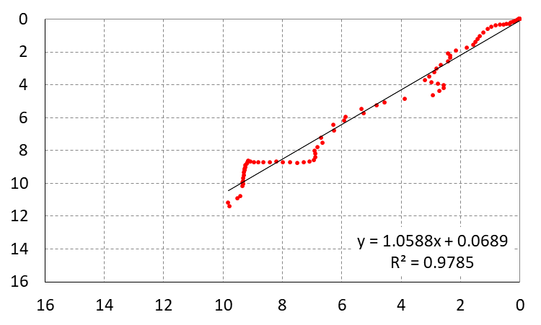
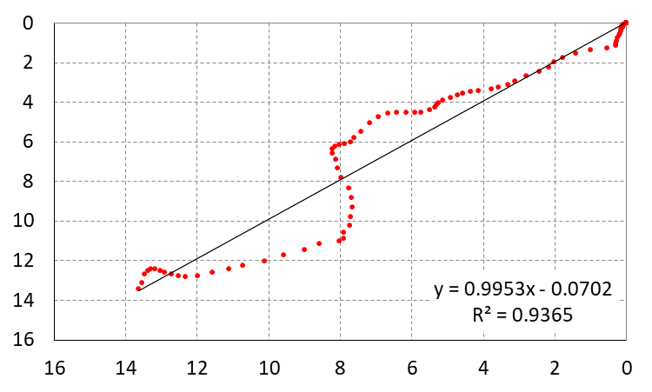
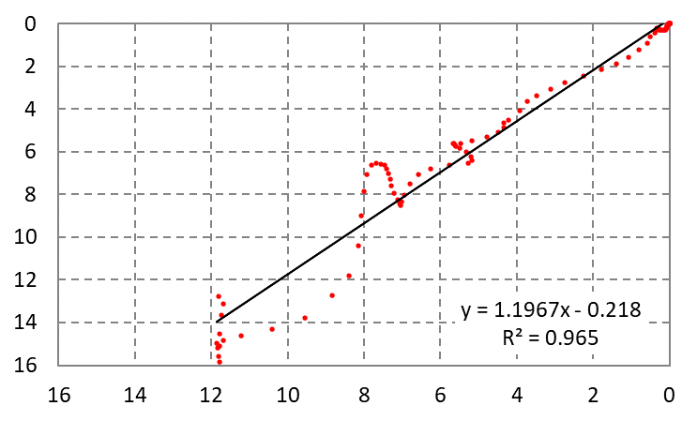
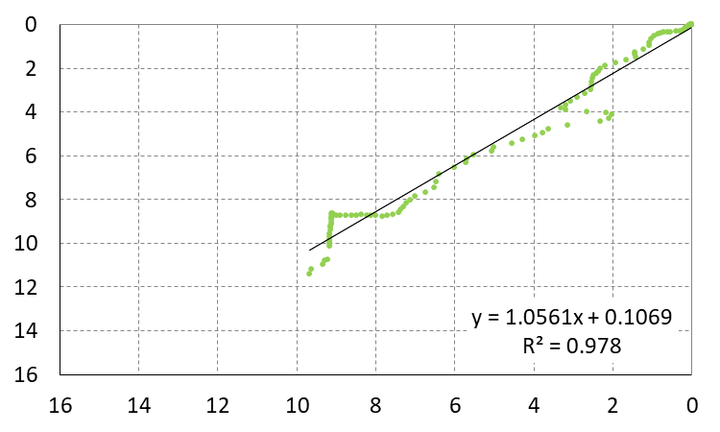
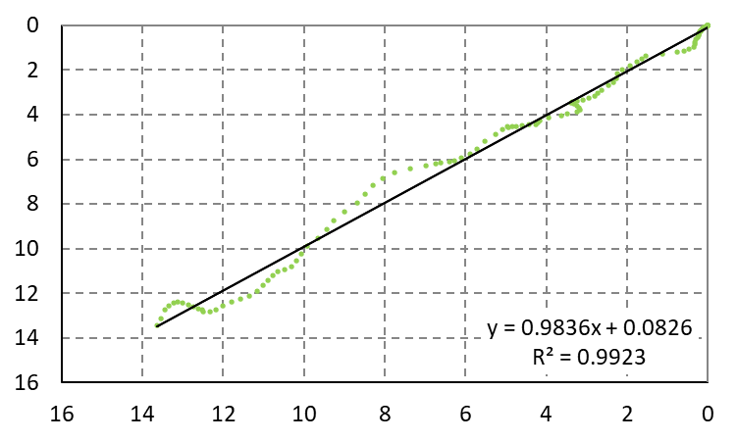
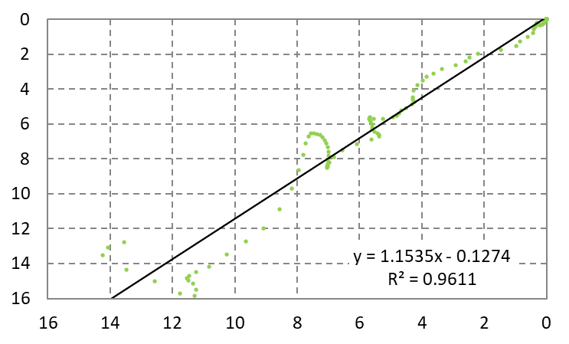
Specific humidity Correlations (g/Kg):
Analysis (vertical) 20230600 UTC vs. Forecast (horizontal) 00+24hs
Thessaloniki
Helliniko
Heraklio
65_levels
100_levels
130_levels
Euripides Avgoustoglou, Hellenic National Meteotological Service, 27th COSMO GM , Basel-Switzerland, September 1-5, 2025
21

Slide 22
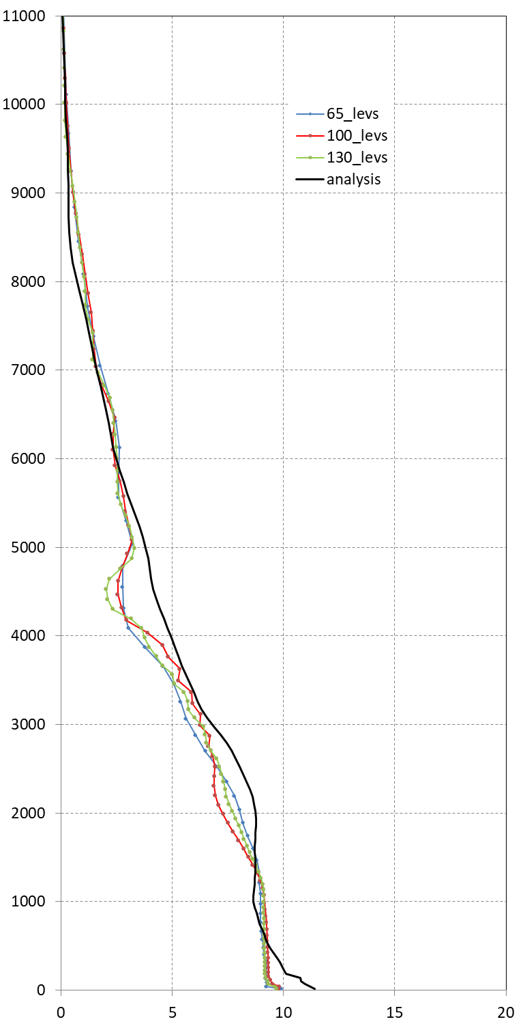
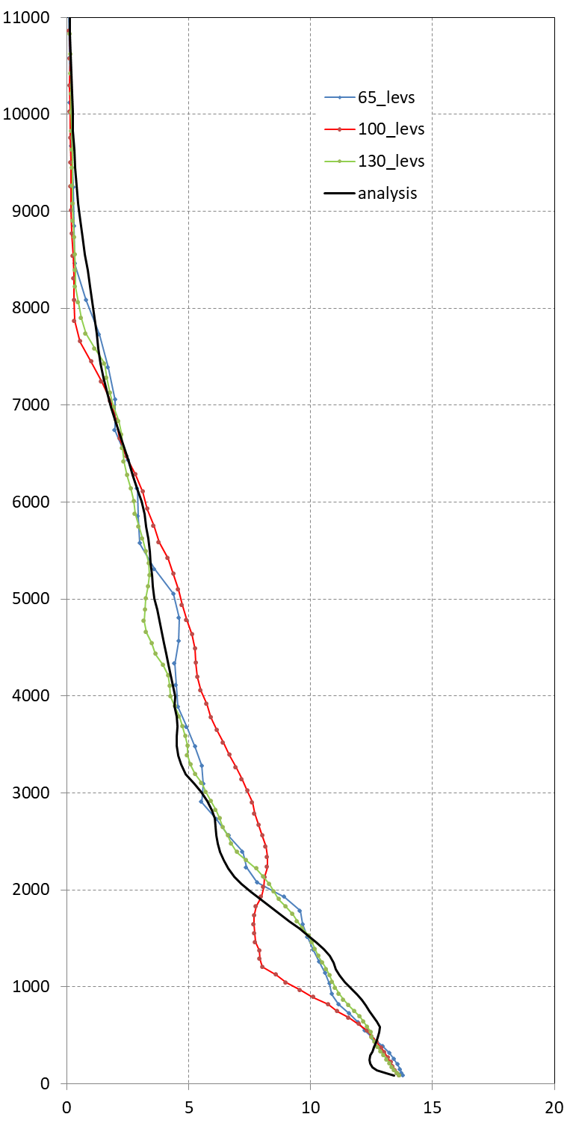
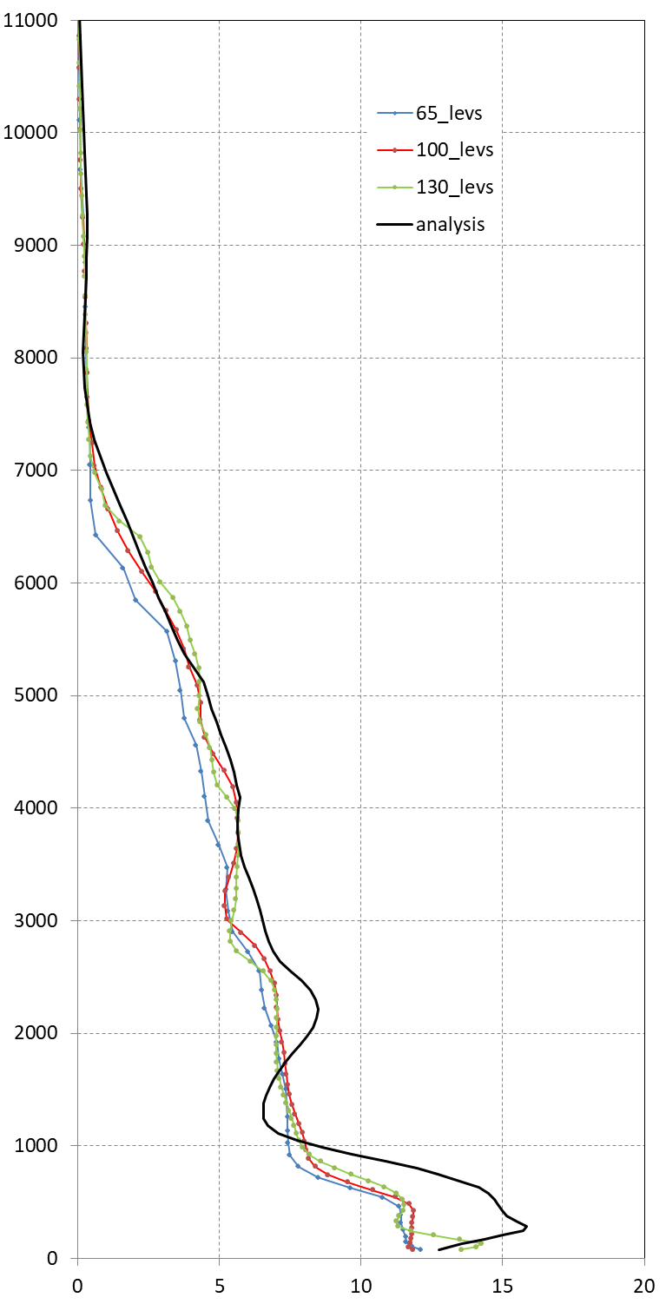
Specific humidity vertical profiles:
Analysis 20230600 UTC vs. Forecast 00+24hs
m
Thessaloniki
Helliniko
Heraklio
g/Kg
Euripides Avgoustoglou, Hellenic National Meteotological Service, 27th COSMO GM , Basel-Switzerland, September 1-5, 2025
22

Slide 23
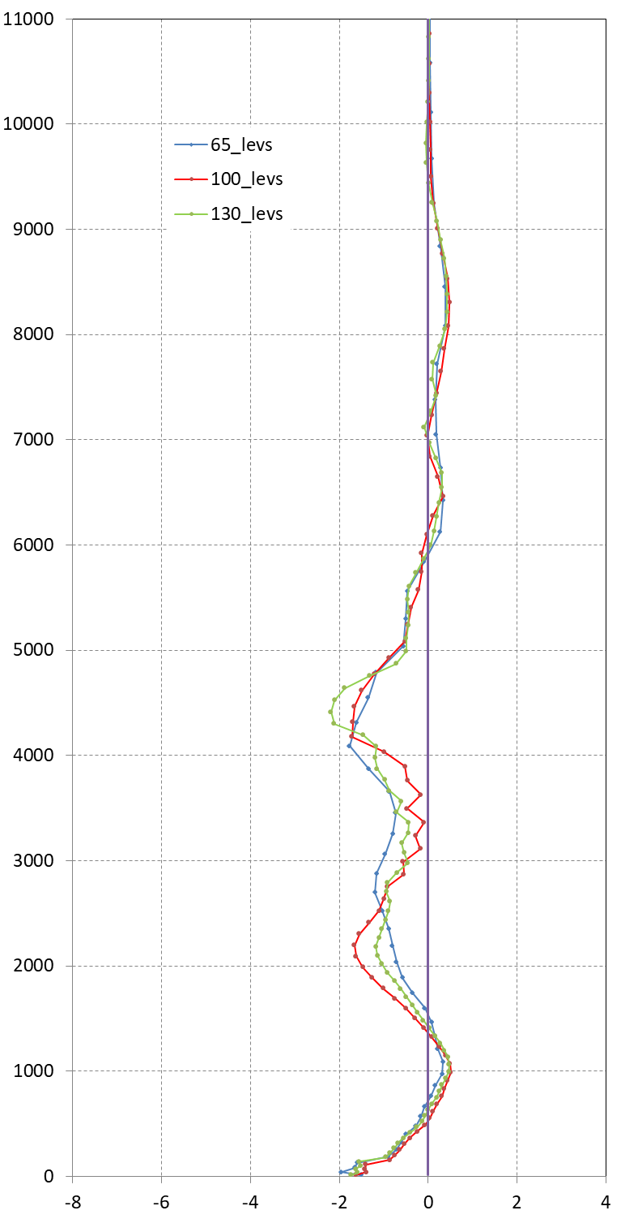
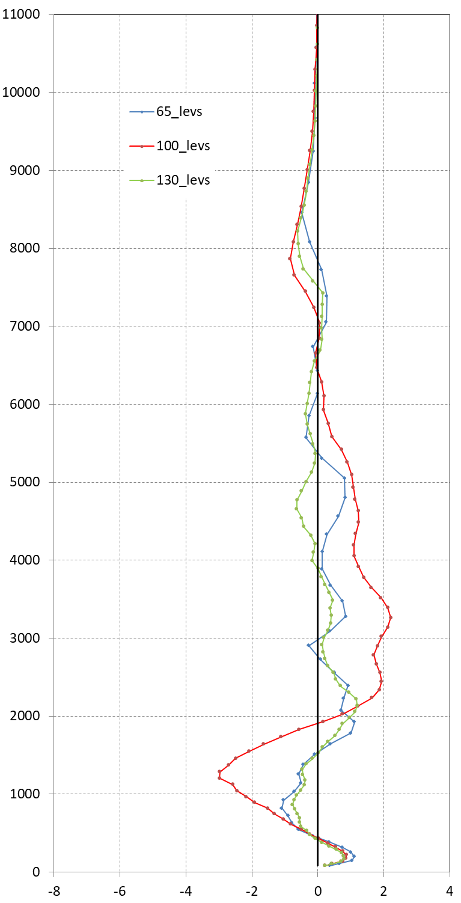
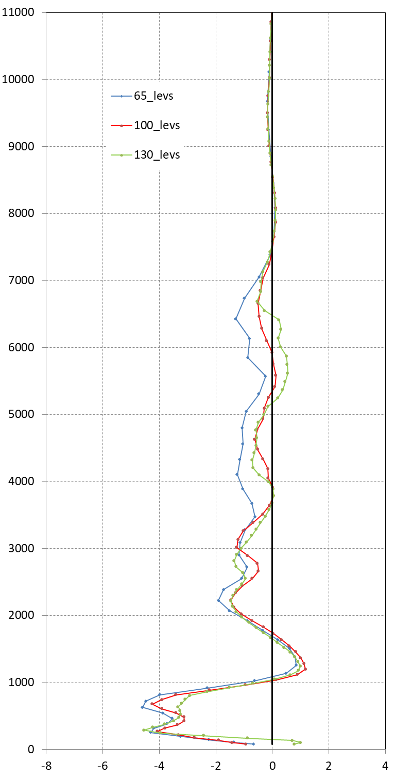
Specific humidity bias of vertical profiles:
Analysis 20230600 UTC vs. Forecast 00+24hs
m
Thessaloniki
Helliniko
Heraklio
MB MAB
65_levs: -0.380 0.510
100_levs: -0.316 0.460
130_levs: -0.330 0.459
MB MAB
65_levs: 0.112 0.400
100_levs: 0.094 0.826
130_levs: -0.007 0.291
MB MAB
65_levs: -1.002 1.099
100_levs: -0.640 0.776
130_levs: -0.518 0.706
g/Kg
Euripides Avgoustoglou, Hellenic National Meteotological Service, 27th COSMO GM , Basel-Switzerland, September 1-5, 2025
23

Slide 24
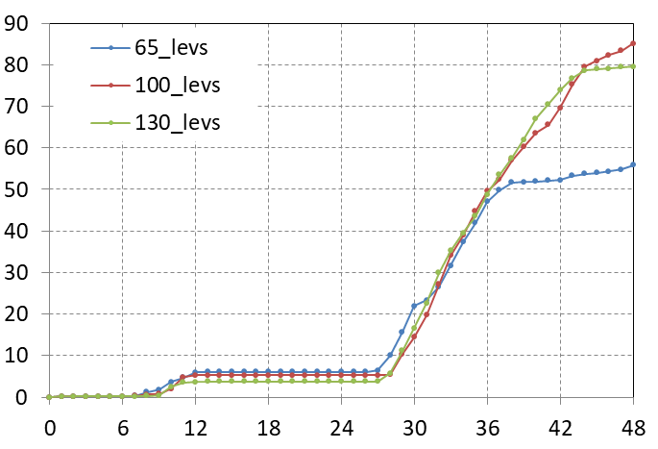
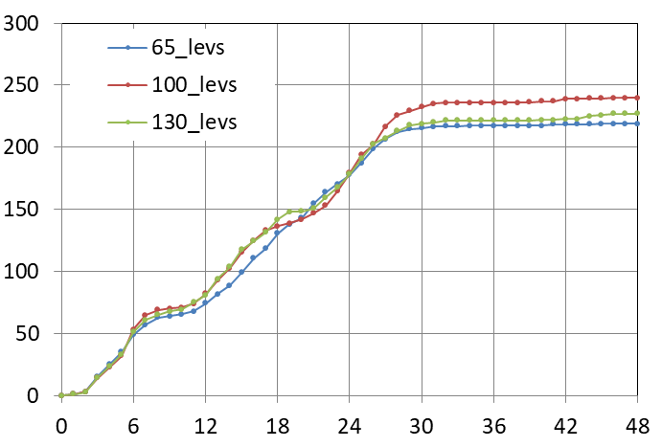
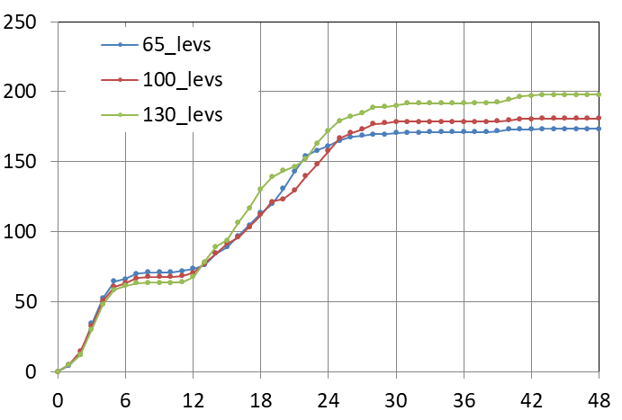
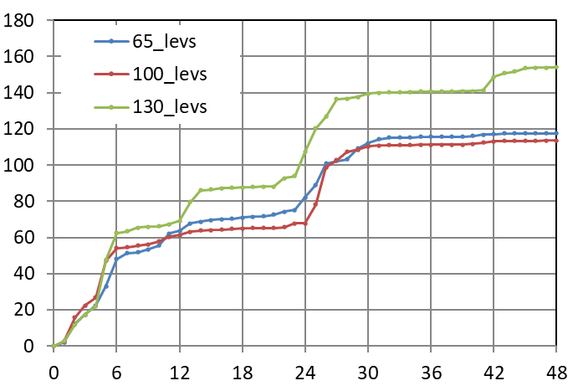
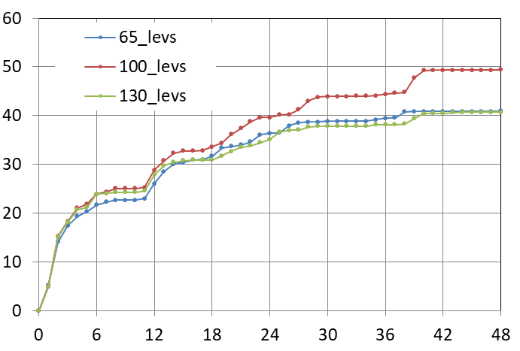
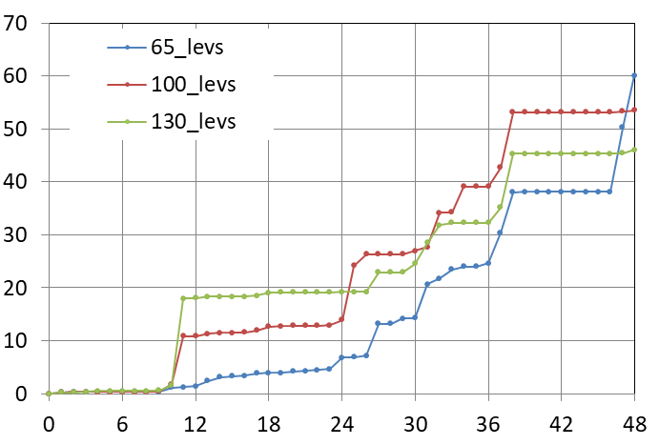
m
Accumulated precipitation (mm) for 20230905_00 (0 to 48hs)
Thessaloniki
Larisa
Nea Aghialos
Skiathos
Lamia
Helliniko
hs
Euripides Avgoustoglou, Hellenic National Meteotological Service, 27th COSMO GM , Basel-Switzerland, September 1-5, 2025
24

Slide 25






Accumulated precipitation (mm) for 20230905_00+48HS
65 Levels
100 Levels
130 Levels
100 - 65 Levels
130 - 65 Levels
130 - 100 Levels
Euripides Avgoustoglou, Hellenic National Meteotological Service, 27th COSMO GM , Basel-Switzerland, September 1-5, 2025
25

Slide 26
CONCLUSIONS AND PROSPECTS
Vertical resolution influences model performance rather significantly. Tests with 65, 100, and 130 levels revealed clear sensitivities in temperature, specific humidity, and precipitation fields.
Finer layering is expected to enhance the representation of boundary layer processes, cloud microphysics, and vertical moisture transport.
Bias reduction looks evident but nonlinear. Increasing levels tends to reduce mean biases, though gains beyond 100 levels should be expected with further physics retuning.
Computational cost vs. accuracy trade-off is critical. While 130 levels might offer improved vertical fidelity, they demand more resources and may require adjustments to time step and damping schemes.
By extending the sensitivity analysis to include multiple aerosol climatologies, the understanding of ICON-LAM’s vertical dynamics is expected to improve, but also unlock new insights into cloud-radiation interactions and precipitation variability. This multidimensional approach is expected to strengthen the scientific robustness of the present effort and open the door to more targeted improvements in model physics and regional forecasting.
Euripides Avgoustoglou, Hellenic National Meteotological Service, 27th COSMO GM , Basel-Switzerland, September 1-5, 2025
26

