Slide 1


Influence of perturbation of surface temperature on temperature inversion at selected SYNOP stations in Poland – intro, preliminary results
A. Mazur, T. Tabalchuk, A. Wyszogrodzki
01/09/2025, Basel

Slide 2
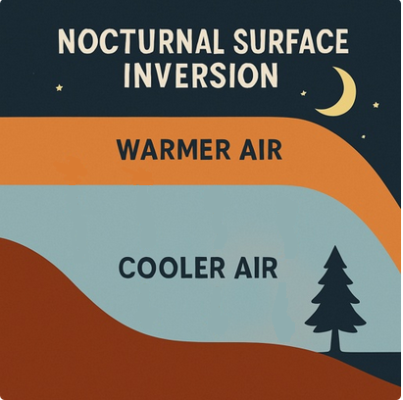
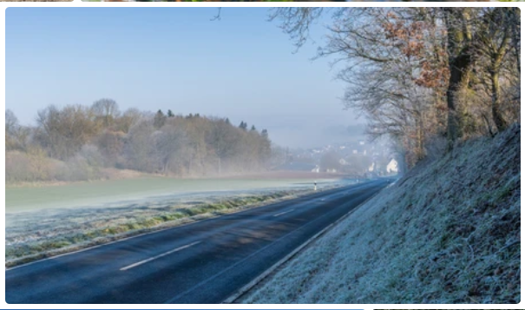
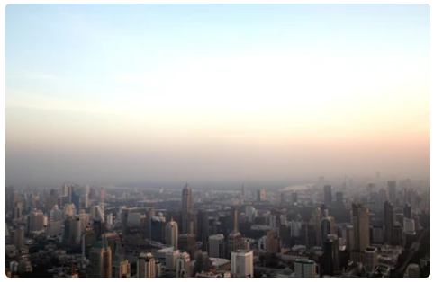
MOTIVATION
A nocturnal surface-based temperature inversion refers to a phenomenon in the lower troposphere where air temperature increases with height. Accurate forecasting of such inversions is important due to their role in enhancing the risk of frost events during the autumn–spring period and in promoting the accumulation of air pollutants near the surface, potentially exerting adverse effects on human health.

Slide 3
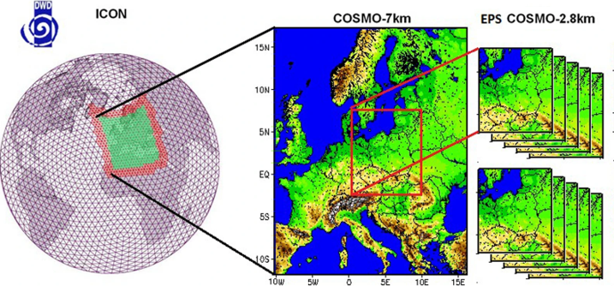
METHODS
Modeling used the COSMO-2k8 ensemble with surface temperature perturbations, along with a separate deterministic run. The 20 ensemble members were split into two groups: 1–10 with perturbations in initial conditions only; 11–20 with perturbations in both initial and boundary conditions

Slide 4
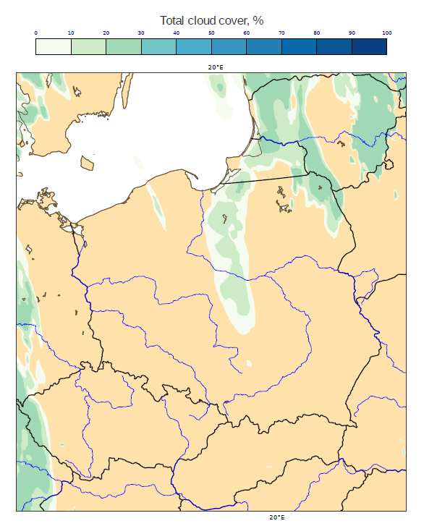
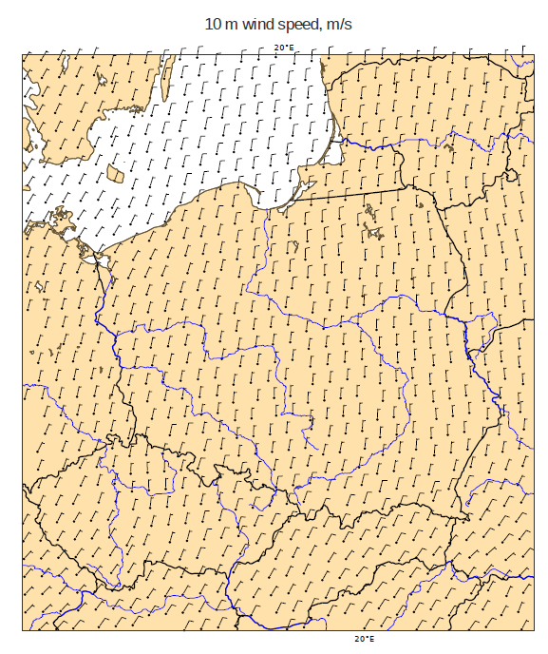
METHODS
Nocturnal inversions form under clear skies (enhanced radiative cooling) and weak winds or calm conditions (minimal vertical mixing). We analyzed 2011–2025 data, selecting dates with cloud cover over Poland ≤ 0.5 oktas, wind speed ≤ 3 m/s. An additional requirement was sunset before 18 UTC (the forecast initialization time) to exclude the influence of incoming solar radiation.

Slide 5
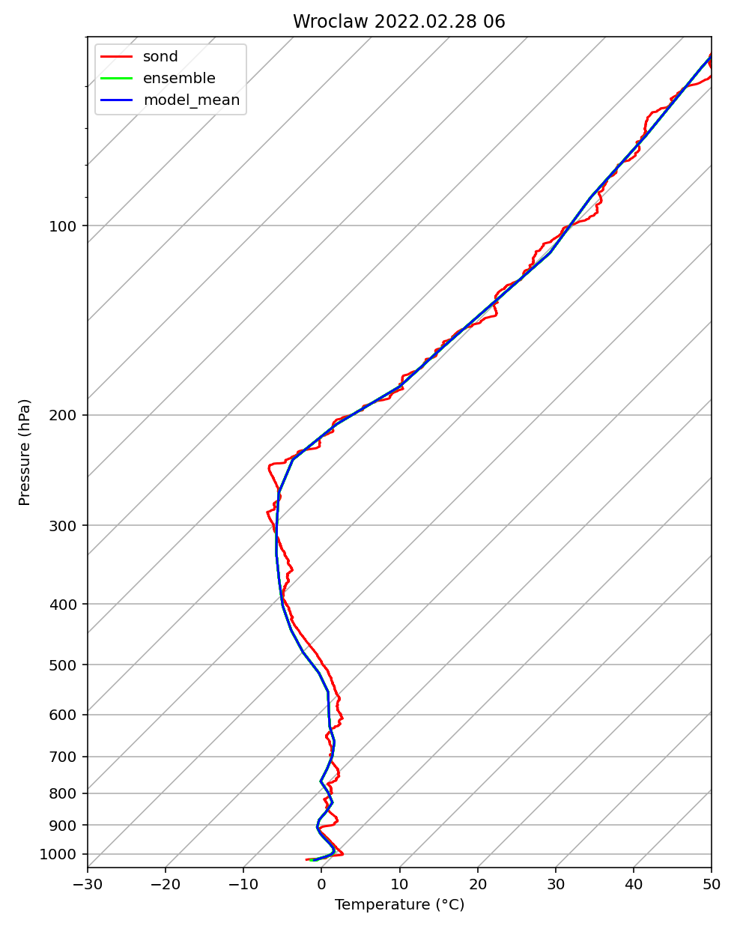
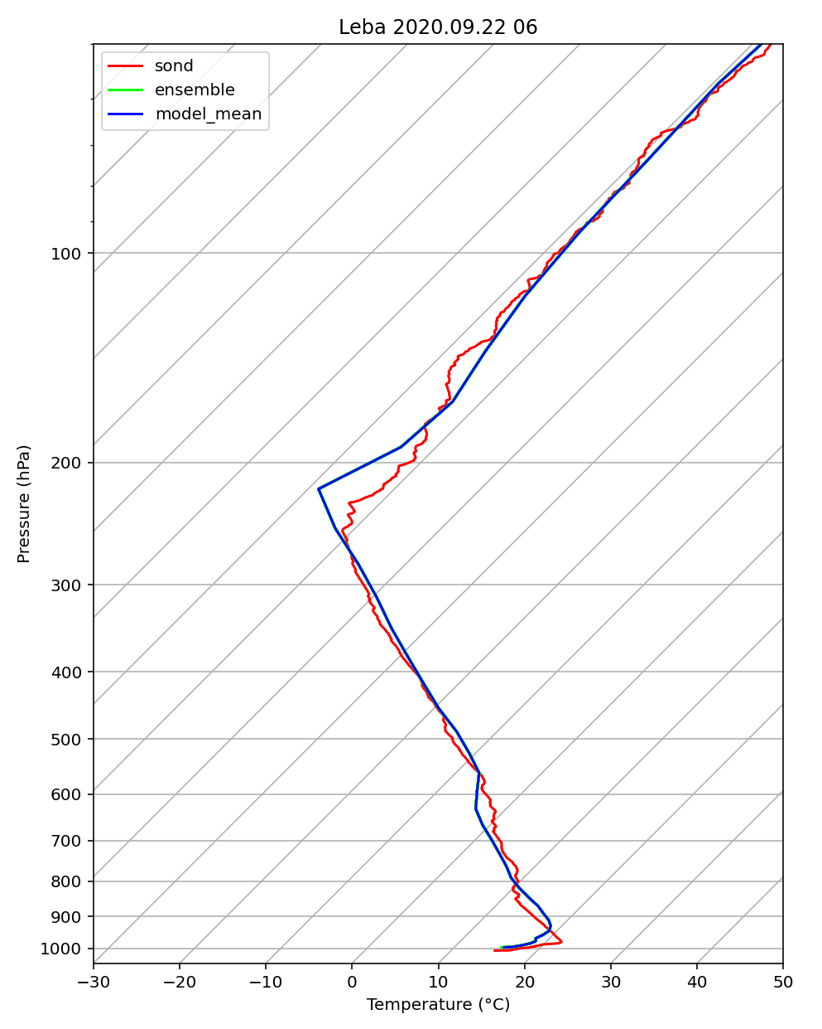
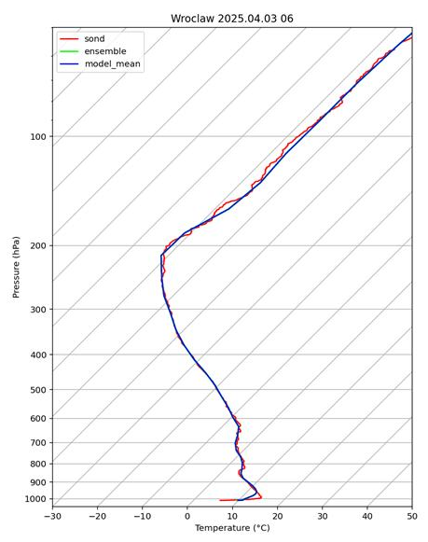
ANALYSIS
Synop data were analyzed to select stations with 0 oktas cloud cover and wind ≤ 3 m/s during the modeling period. For initial analysis, Leba and Wroclaw were chosen as they also conduct radiosonde launches. Observations and model data showed good agreement in vertical temperature profiles.

Slide 6
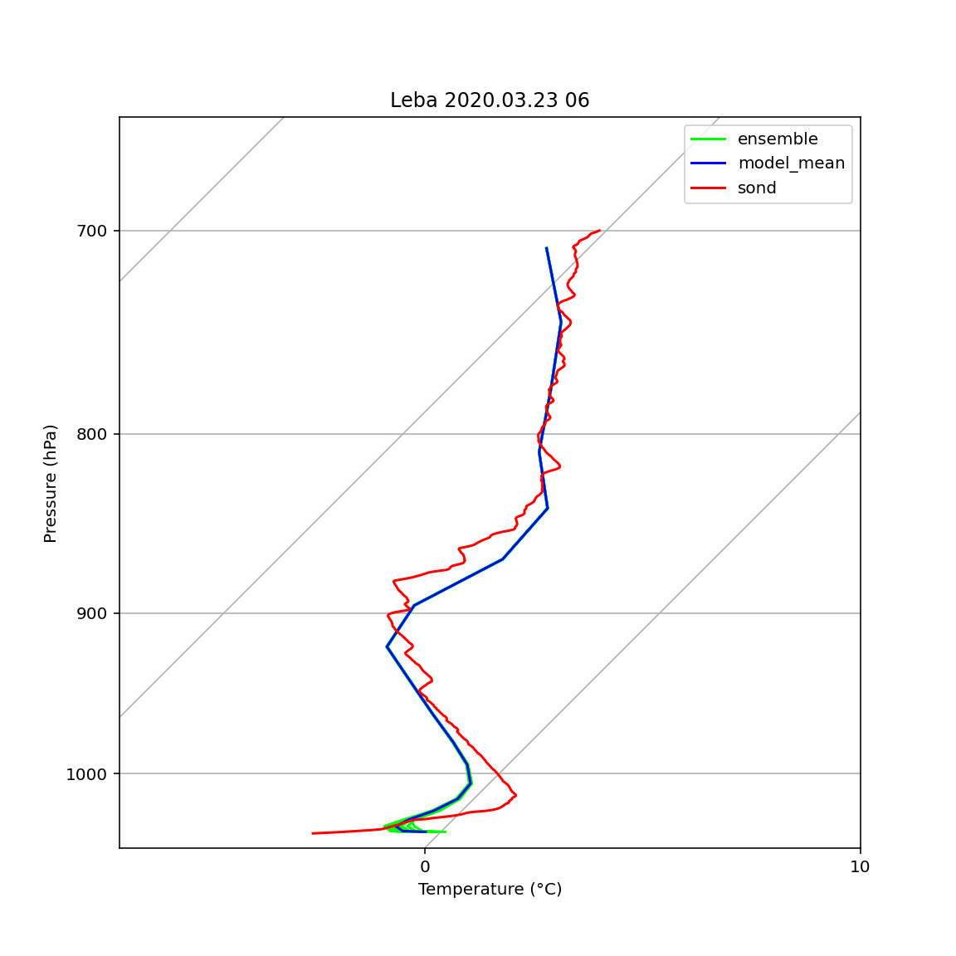
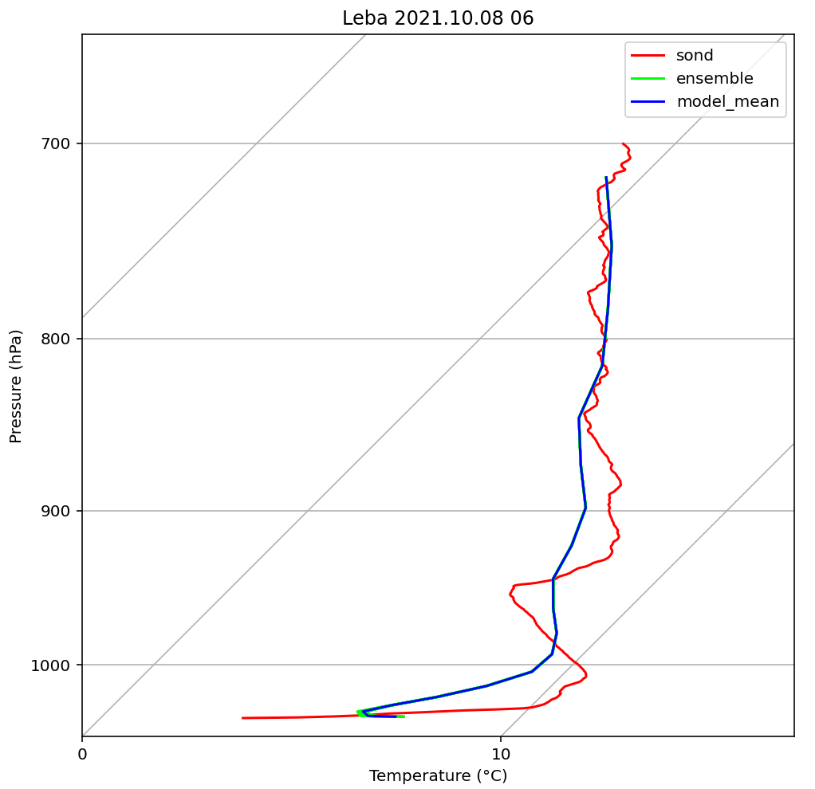
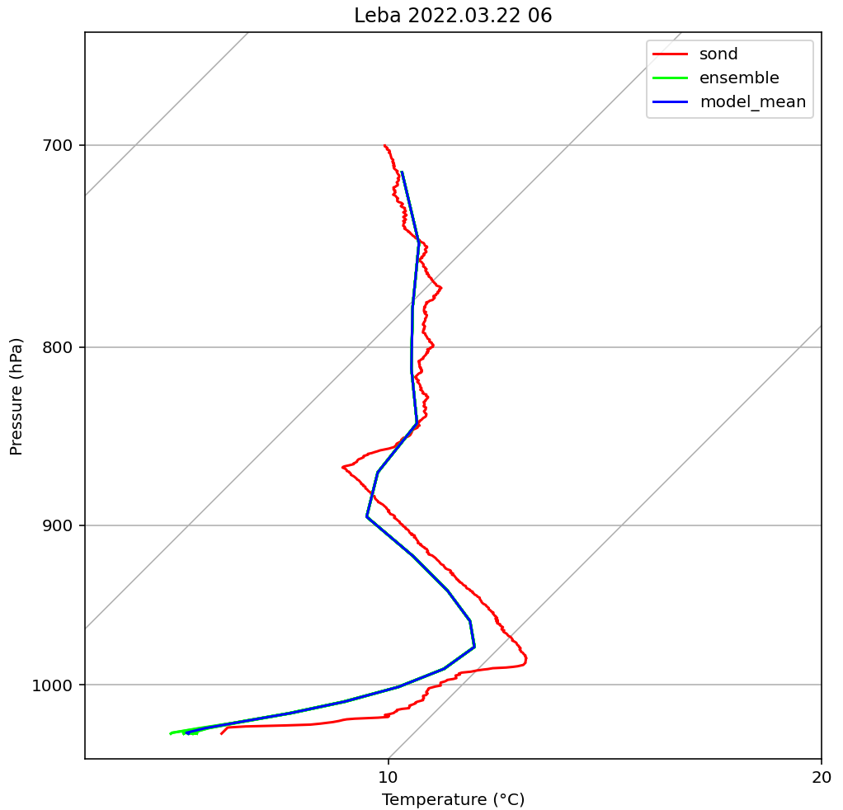
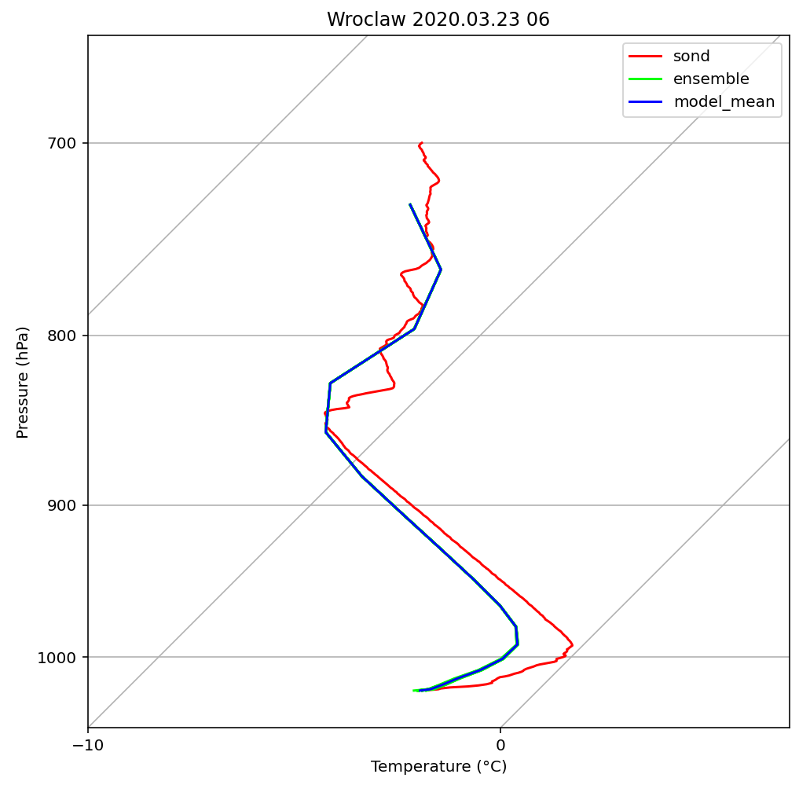
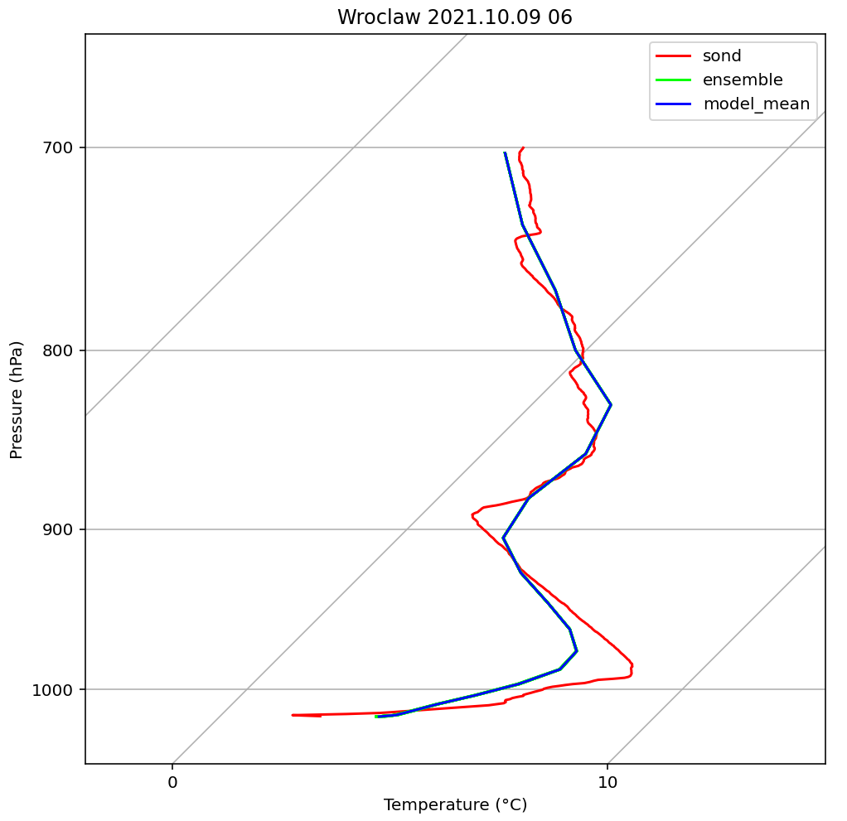
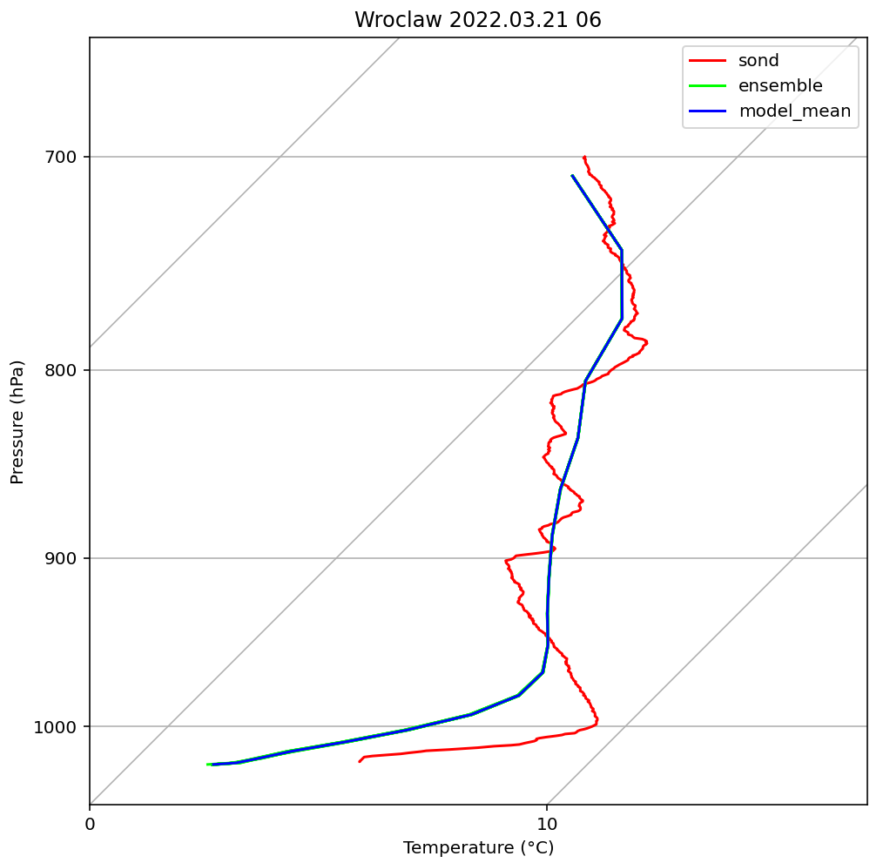
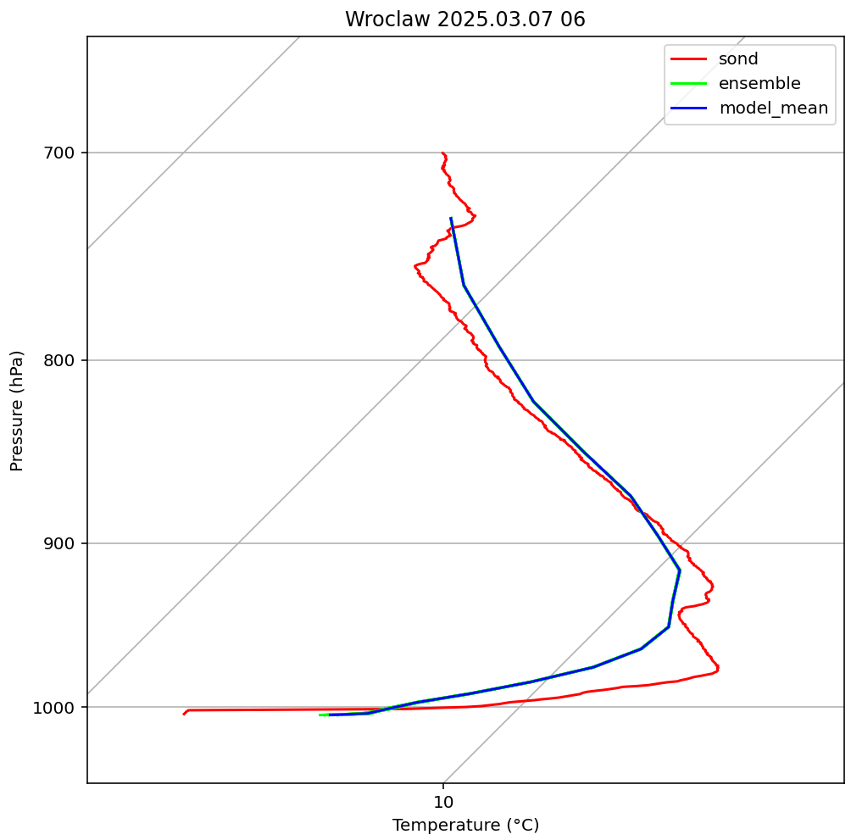
ANALYSIS
However, in the near-surface layer, most cases show significant deviations between the modeled and observed temperature profiles, both positive and negative, while at higher levels the ensemble members exhibit almost no spread in air temperature values.

Slide 7
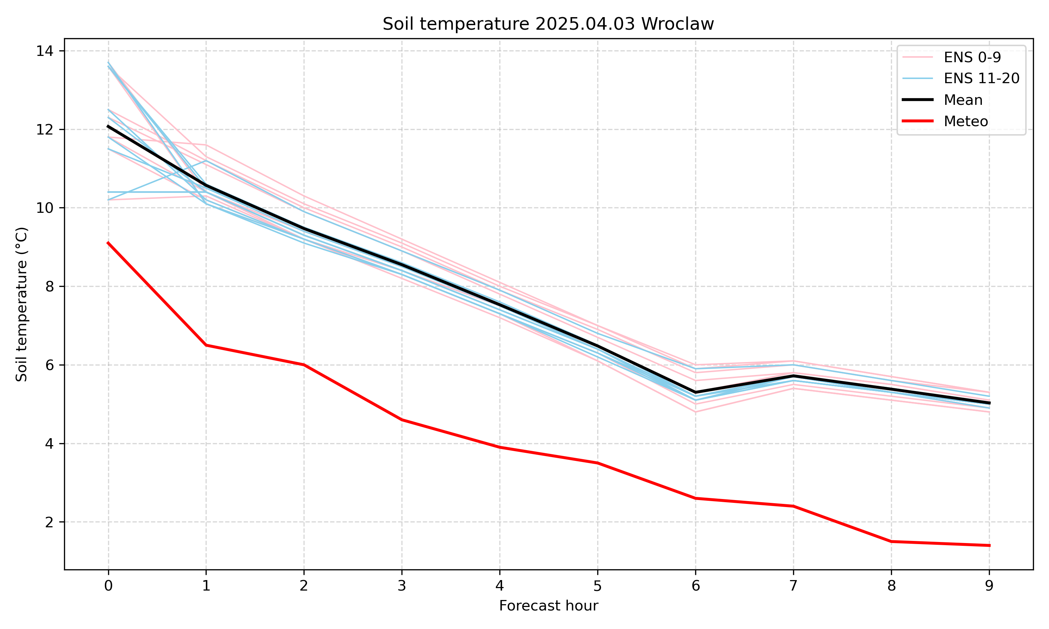
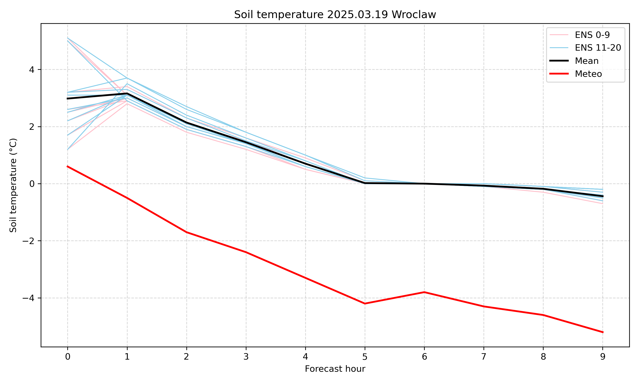
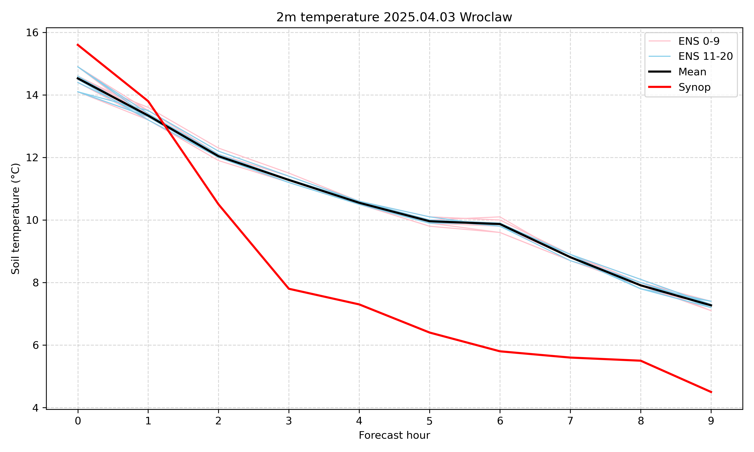
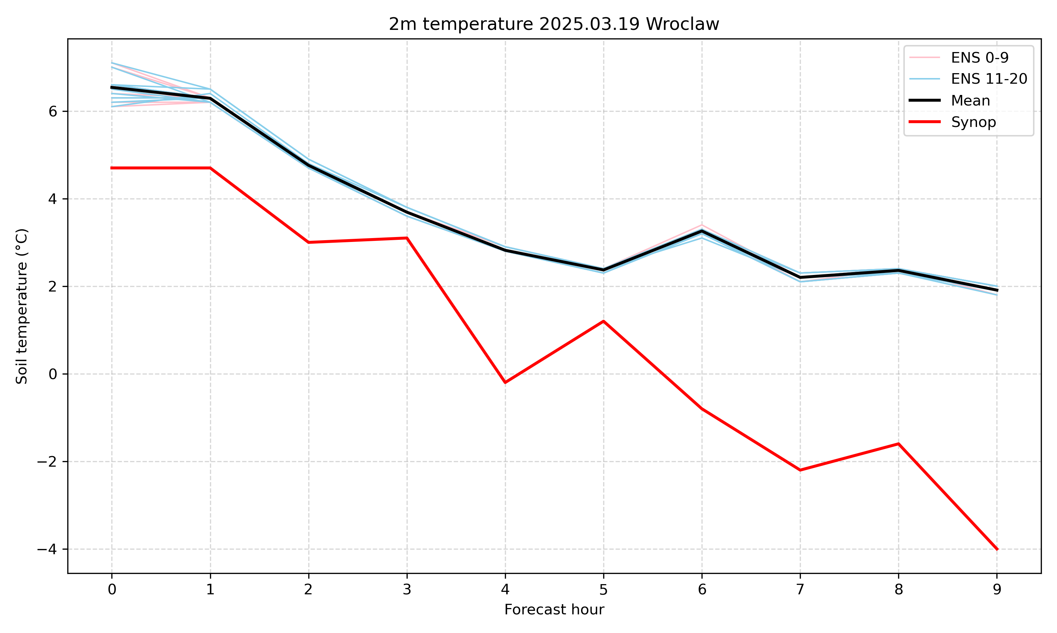
ANALYSIS
Most simulated events show a rapid decrease in surface temperature spread across ensemble members, leading to reduced air temperature spread at 2m and above.

Slide 8
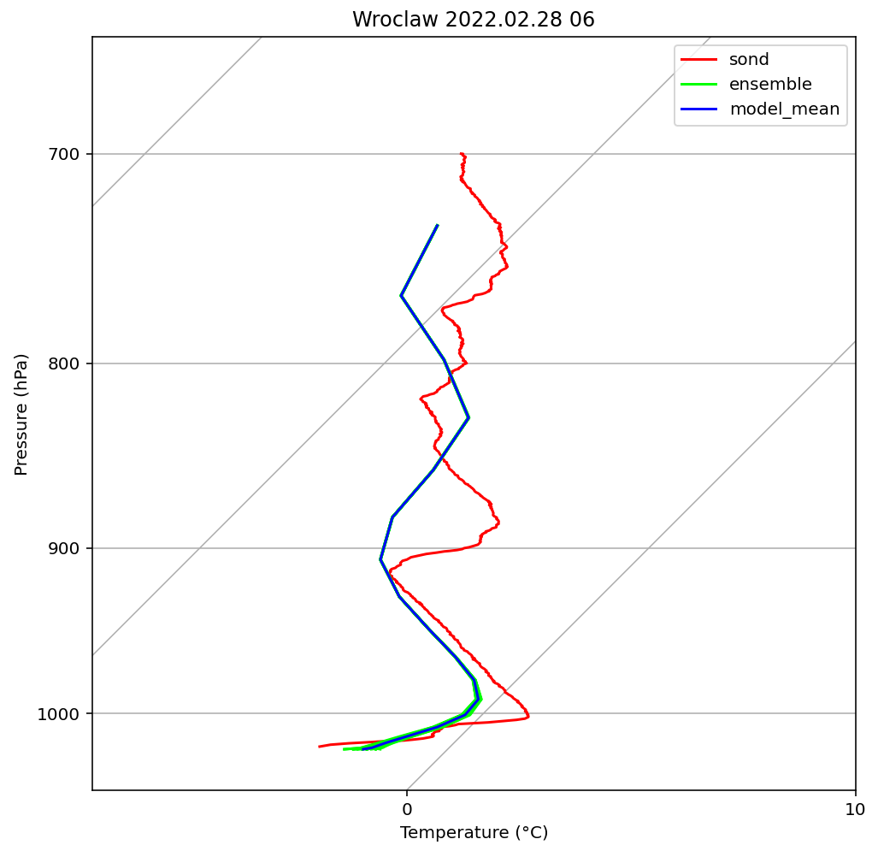
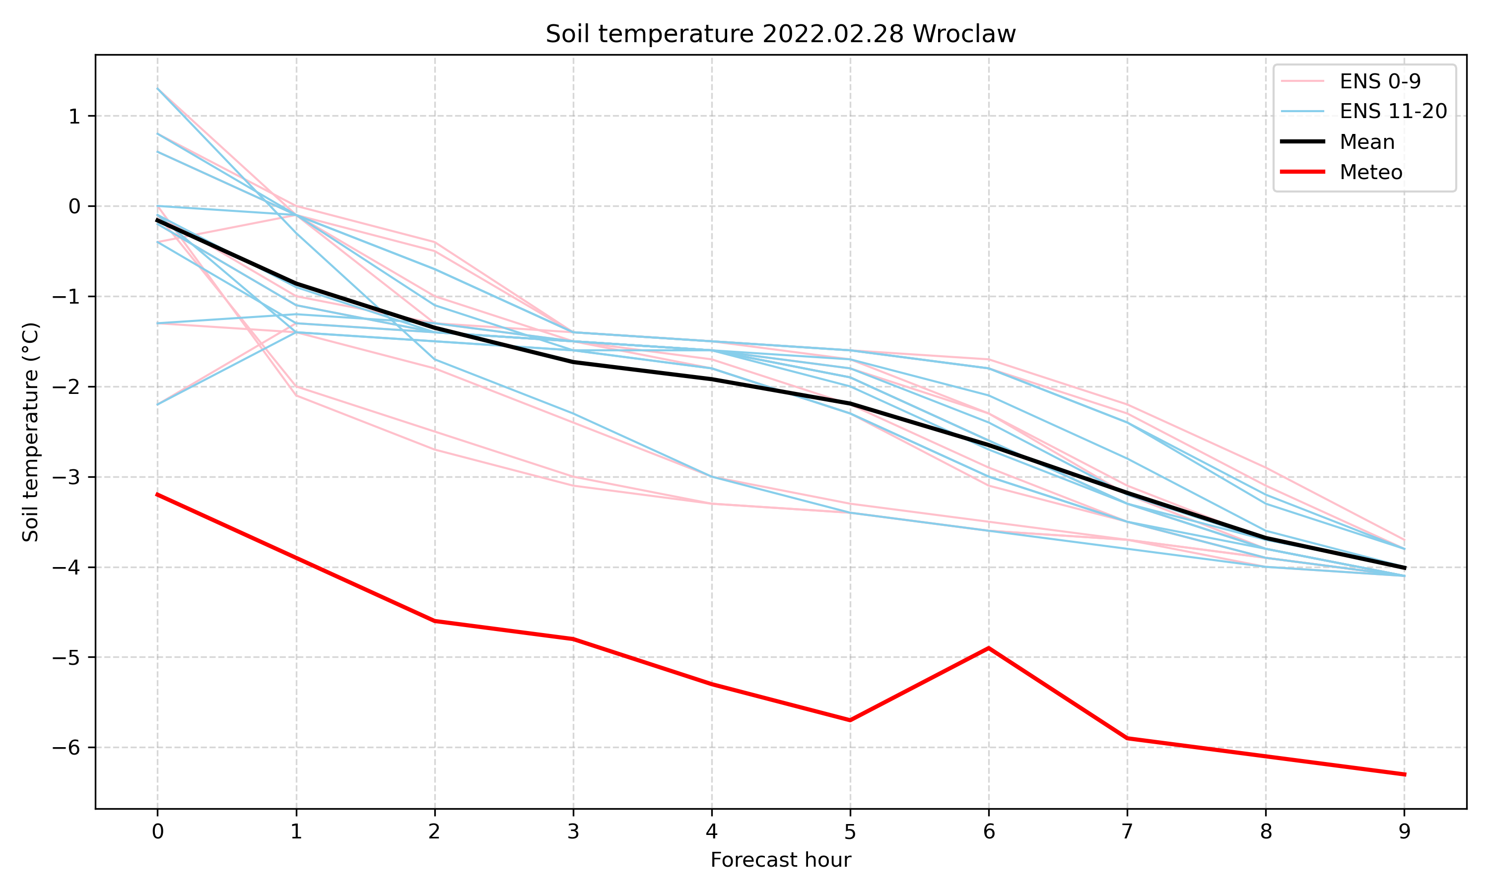
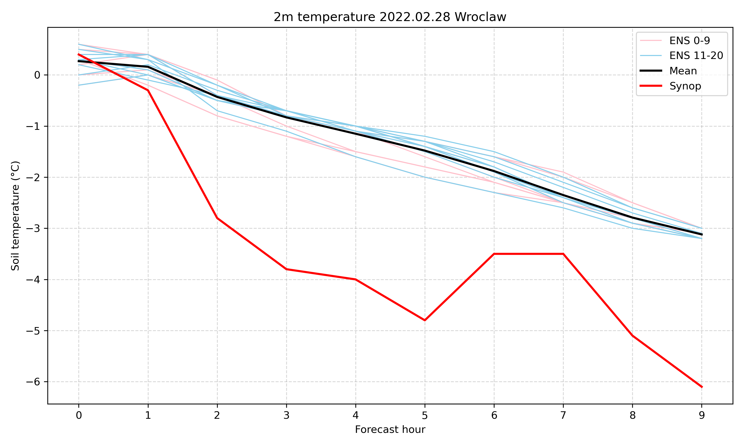
ANALYSIS
For the case of 2022.02.28, when the spread of surface temperature values persists throughout the modeling period, a greater spread in air temperature values is observed, leading to improved temperature forecasts.

Slide 9
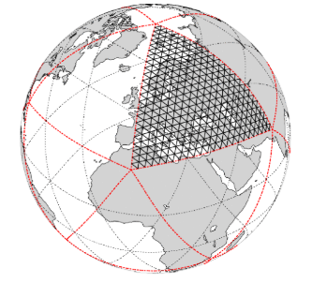
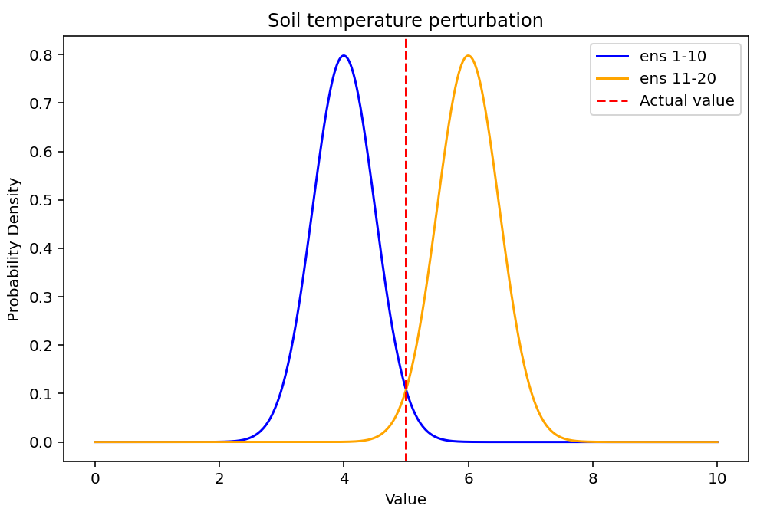
NEXT STEPS
Repeat simulation using the ICON model
Test a new scheme for introducing surface temperature perturbations
to maintain amplitude

Slide 10
Thank you
A. Mazur, T. Tabalchuk, A. Wyszogrodzki
01/09/2025, Basel
Instytut Meteorologii i Gospodarki Wodnej – Państwowy Instytut Badawczy
Institute of Meteorology and Water Management – National Research Institute
01-673 Warszawa, ul. Podleśna 61 | tel.: +48 22 569 41 00 | fax: +48 22 834 18 01 | e-mail: imgw@imgw.pl | www.imgw.pl
Regon: 000080507 | NIP: 525-000-88-09

Slide 11
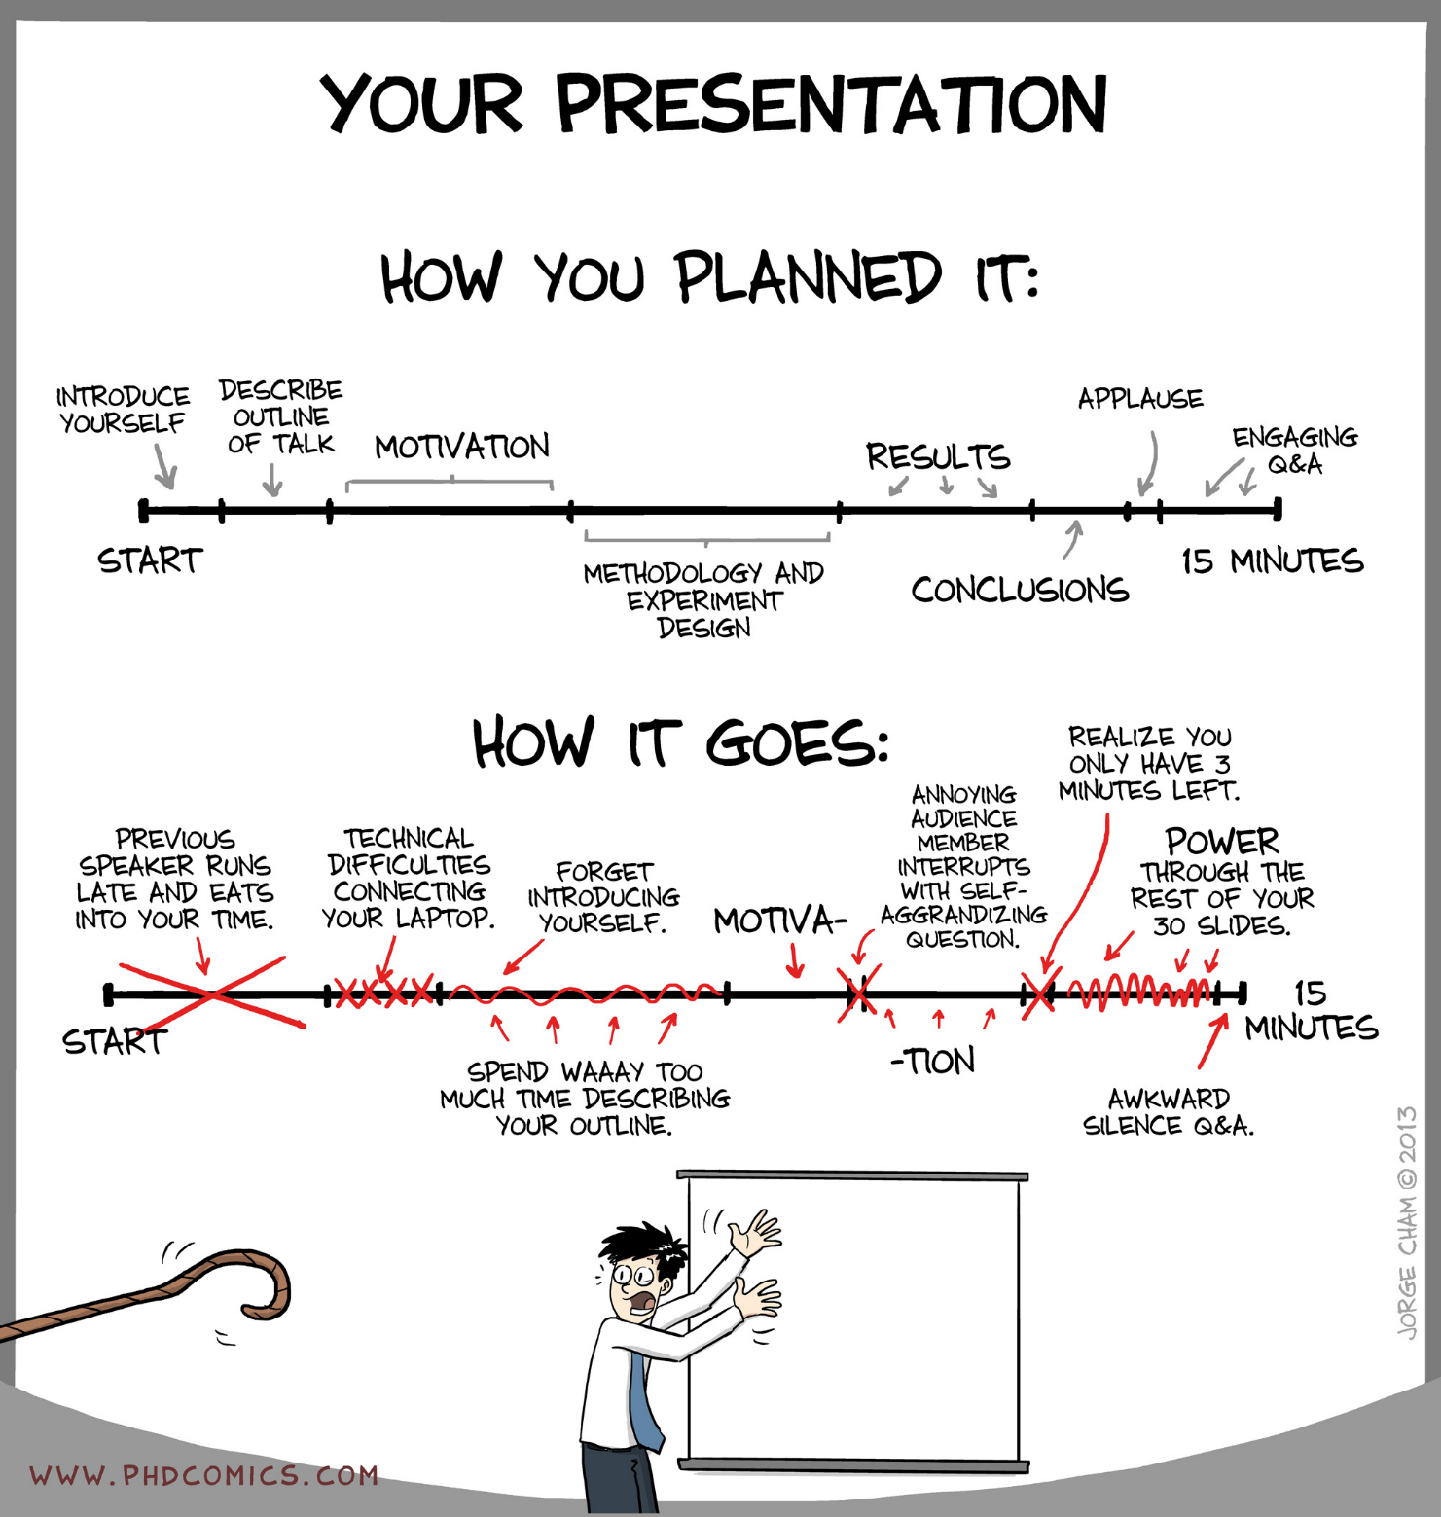
That’s all from me,
Thank you for hearing me out!!!

