Slide 1
Recent Advances in surface analysis at DWD
Martin Lange,Thomas Hüther, Gernot Geppert

Slide 2
Outline
Surface anaysis methods – code development
Present state and future plans
2d-Var snow analysis,
Description, verification, operationalisation

Slide 3
Code Libraries (initial release)
SMA_GME(2009-)
SMA_LM (1999-2016)
Sfcana (2002)
fortran 77
Sfc2mga (2010)
DACE (2002)
Dace-O
(Fortran 2003)
SMA
SST
Snow
T2m,Rh2mm
Atmosphere
Ocean
2d-Var(z,t)
Jacobian
parameterized
Cressman
Optimal Interpolation
3d-EnVar,
Scratch
2023
Harmonisation Minimisation,
Obs-QC
Dace
2d-EnVar
3d-EnVar
2025
Dace Redesign
Explicit EKF /
Training AI based Jacobians
T2m, Rh2m, LAI,
Sat.-based SSM, TSfc
Dace 2
(2d-EnVar)
3d-EnVar
?
consolidated

Slide 4
2D-Var for Surface Analysis
Based on code base for atmospheric 3D-EnVar analysis DACE (Data Assimilation Coding Environment).
Same data structures, parallelisation, observation processing
New representation of operators as abstract interfaces for flexible implementation of different grids and methods

Slide 5
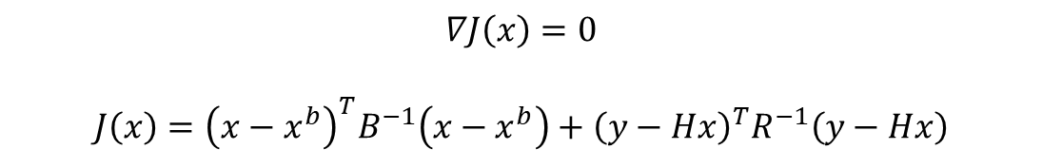
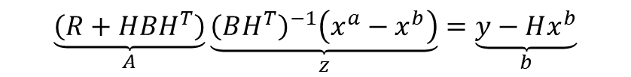

2D-Var for Surface Analysis
Minimisation of cost function
Solve minimisation efficient in observation space
Linear equation system can be solved iteratively by standard conjugate gradient.
Solution for state variable in model space obtained by post multiplication
All operators provided by abstract interfaces between different data types, defined procedures addressed via function pointers
Allows flexible implementation of new methods and grids

Slide 6
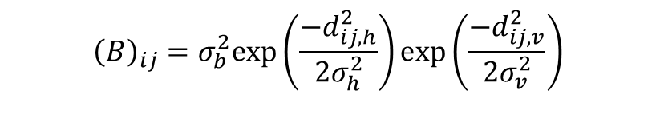
Error estimates
Implementation Details
Snow analysis
𝜎_{h} = 175 km
𝜎_{v} = 200 m
Special treatment of land and sea surfaces
Multivariate analysis
  Separate analysis of land and sea grid points
Modified interpolation at coastlines
Observations checks
Sanity checks
Remove doublegangers
First guess check
Thinning
Bg and Obs error variance estimates from Desroziers statistics
Linear uncertainty model with respect to surface and model heights

Slide 7
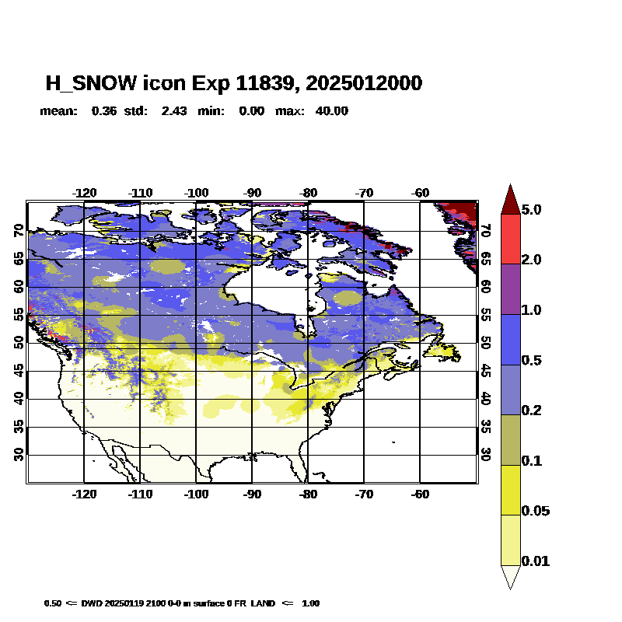
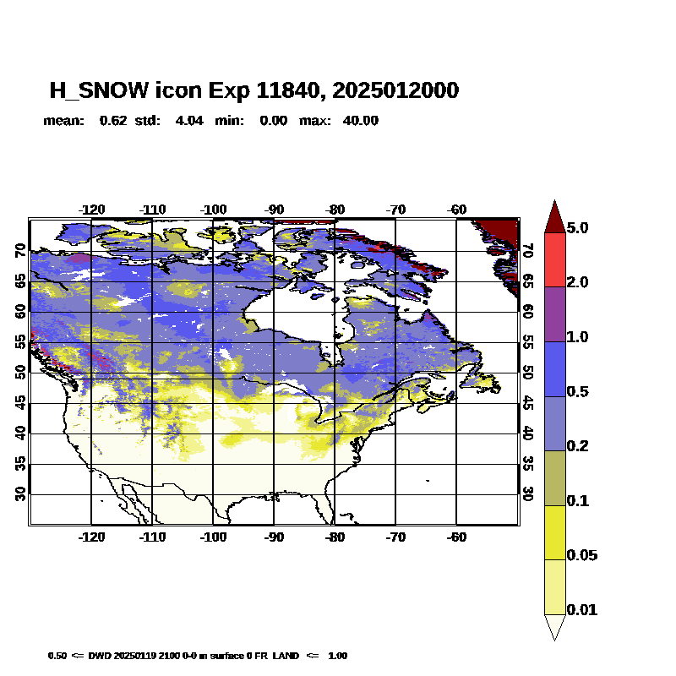
2D-Var Results
Cressman
2DVar

Slide 8
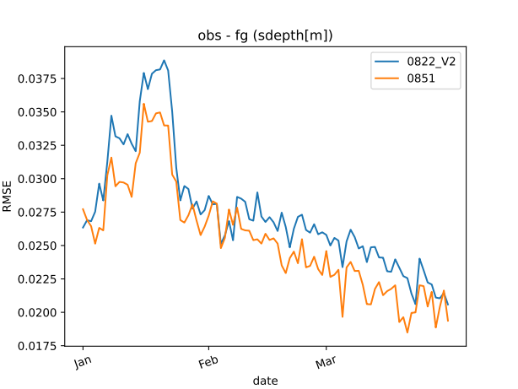
2D-Var Results
BACY Experiments
Jan – Mar 2024
Reference: 0822_V2
2DVar: 0851
Verification at 06h

Slide 9
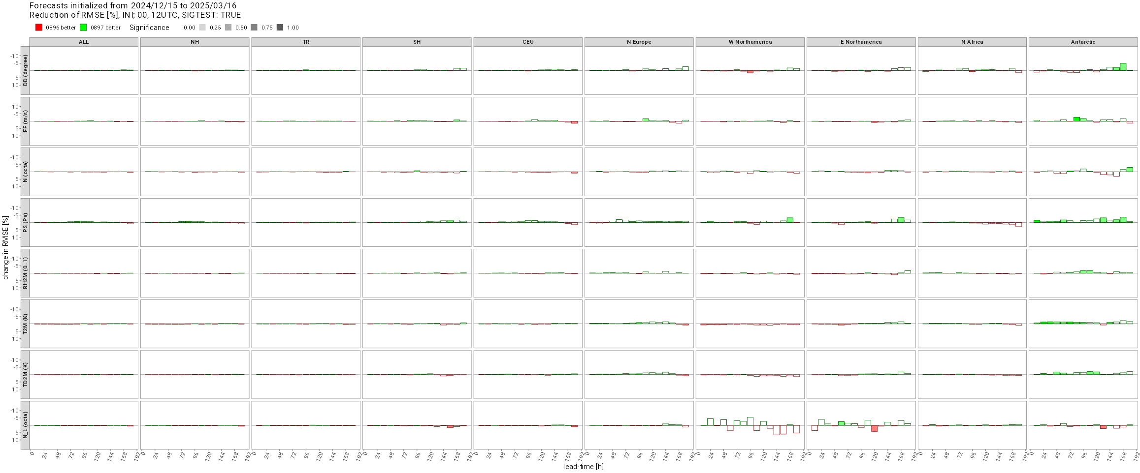
2D-Var Results
Surface verification 20241215 - 20250316

Slide 10
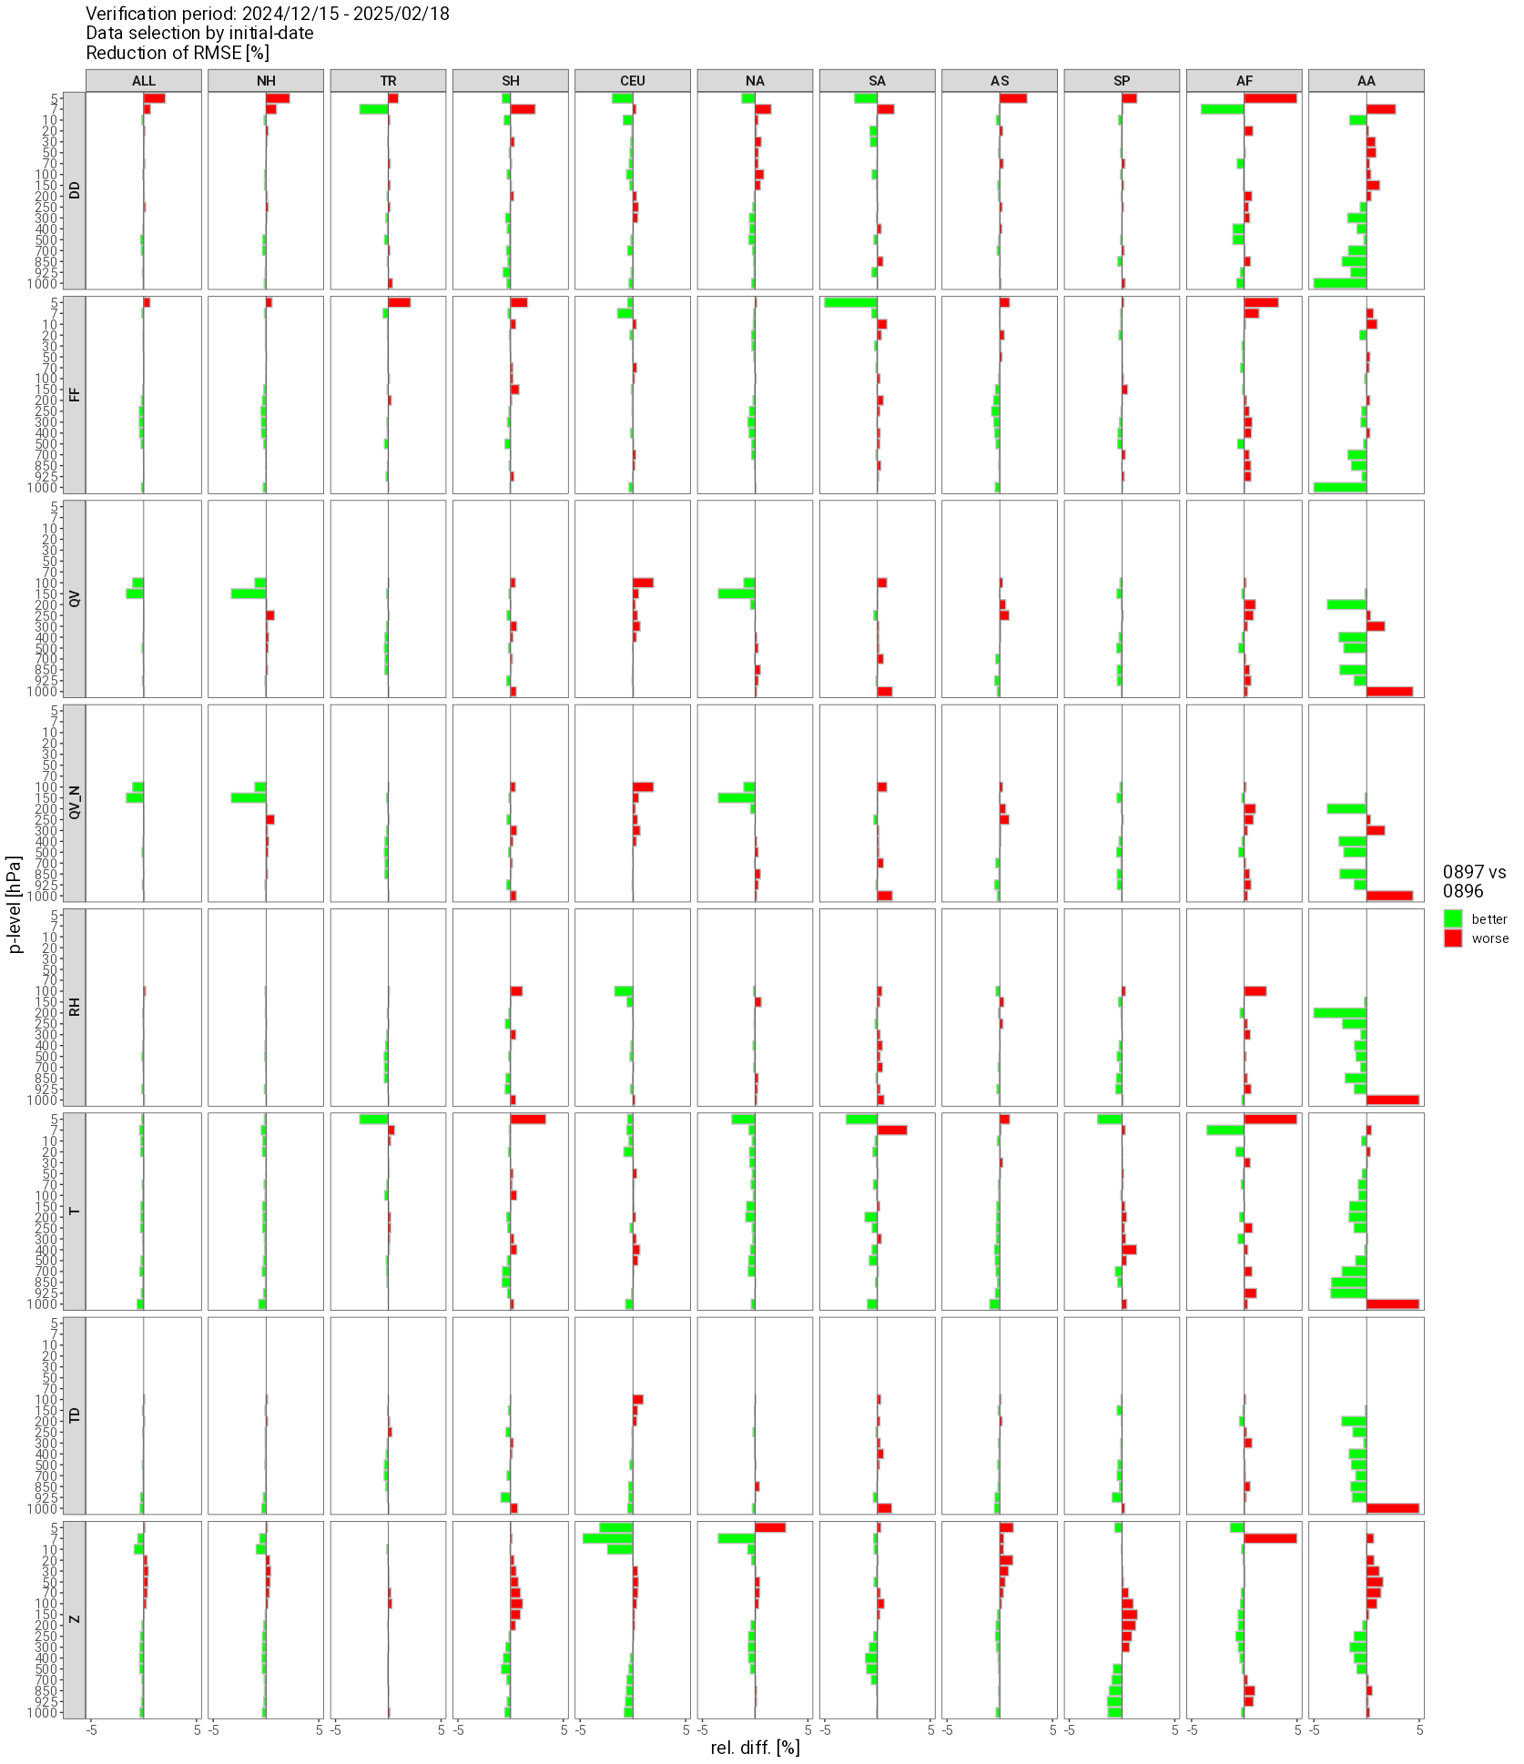
Temp verification 20241215 - 20250316

Slide 11
Summary 2D-Var
Development of 2D-Var for snow analysis
Current experiments indicate overall neutral scores
Pathological circle like pattern in snow depth removed
Next steps
setting up near real-time NUMEX experiment
usage of IMS (Integrated multi-sensor product (satellite + in-situ obs, by US) snow mask in regions with sparse observation coverage (currently negative impact, further tests will follow)
hopefully in parallel suite before this winter

