Slide 1
DA activities at DWD
Christoph Schraff
Considerable resources from DA staff diverted to AI: AICON, AIDA
considerable less development on conventional DA / KENDA
(particularly algorithmic development – refinements LETKF; EnVar, 4DEnVar, PF, …)
however: restart of “code-redesign” (replacing DACE) which should now meet requirements of both
conventional DA (VAR, LETKF, for various applications: atm., ocean, surface, trace gases etc.)
and AI-DA (will take several years)
This talk:
Operational + technical aspects
Observation development: Radar, GNSS, FCI, MTG IRS, ground-based remote-sensing…
AI-DA
(re-analysis)

Slide 2
operational LETKF
Hendrik Reich, Harald Anlauf, Christoph Schraff et al
technical + operational aspects
rof files (easy to produce fdbk file input w/o simulated obs, obs errors …, for Synop, TEMP, PILOT, aircraft):
in dace-dev, ready to use (experimental, only DACE obs operators)
MEC: DA + verification, options for (required for ICON-D05 verif.) :
  use of model diagnostic 10-m wind instead of wind at lowest model level
  global radiation on horizontal plane including orographic shading
DA of ICOS towers operational Feb. 2025 (see later; more flexible choices of obs operator & blacklisting)
ongoing work on WIGOS station ID in KENDA (COSMO operators)
options for use of new coefficients (IFS) of Magnus formula (for saturation vapour pressure),
and for Hardy (1998) formula for conversion of radiosonde TD → RH
(small impact on forecast quality,
RMSE vs. radiosonde humidity reduced due to using different obs values in the verification)
DE
IT

Slide 3
Task 2: Observations (surface to clouds)
Task 2.1: 3-D radar reflectivity + radial velocity
Klaus Stephan, Harald Anlauf, Jana Mendrok, Klaus Vobig, Lisa Neef, Alberto de Lozar, Kobra Koshravian, Uli Blahak, …
DE
research done / ongoing (beyond KENDA, not ready for use in DA):
TCI (targeted covariance inflation), reflectivity texture DA, ZDR (microphysics, Emvorado)
LHN with the 2-moment microphysics (Sinfony-RUC operational):
  tackle underestimation of precip in DA cycle with LHN, spin-up, …
parallel scanning of fof files implemented in LETKF (reduces cost from ((# radars/fof) * 2.5 s) ≅ 1 min to only 3 – 4 s)
→ will allow to use far more European radars
→ Feb. 2025: use all instead of only 9 French radars operationally
radars from all countries in ICON-D2 can be processed technically
Emvorado (+ DACE) able to process several types of radars simultaneously with different settings
(Jana Mendrok)
→ allows simultaneous processing / DA of C-band and x-band volumes, cloud radar vertical profiles
IT

Slide 4
Task 2.2: Ground-based GNSS ZTD + STD
Michael Bender
DE
postponed, due to focus on satellite implementation, then wind lidar & general obs monitoring
→ steps to make GNSS ZTD + STD operational:
  most important: replace overall one-value for ZTD obs error (12 mm, scaled for STD acc. to elevation) by station & product dependent obs error variances (as is already done for bias correction), which
    based on (1) O – B, and (2) least-square error info from data producer (contained in BUFR)
    can be as small as 6 mm (→ larger weight of obs)
    have been a very important aspect at other NWP centers
  tuning of vertical & horizontal localization (and horizontal positioning of STD),
IT

Slide 5
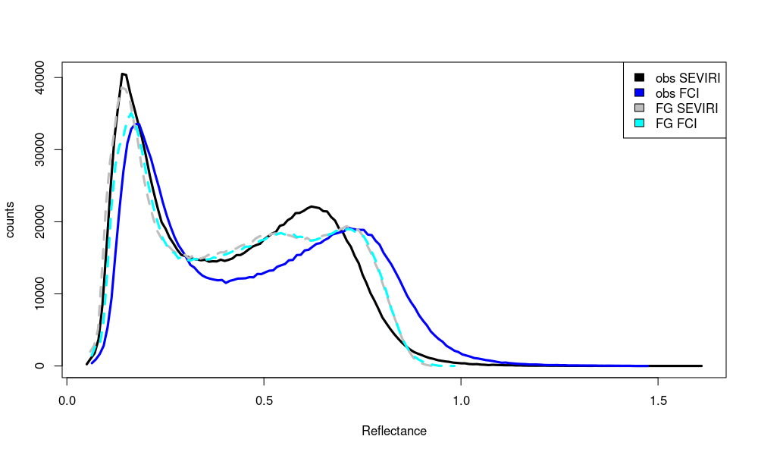
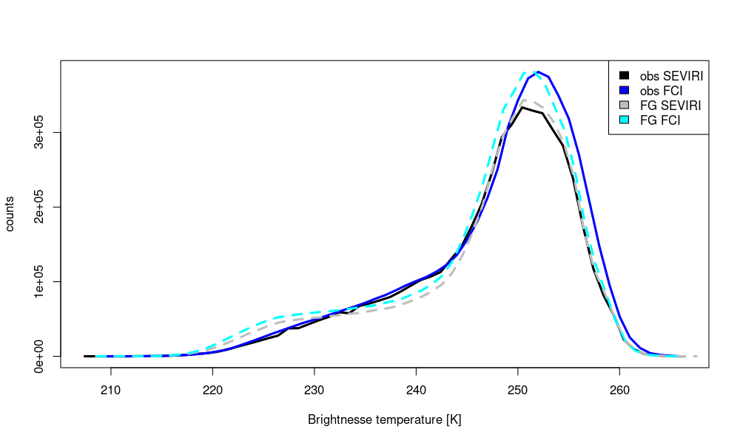
Task 2.3: All-sky (SEVIRI → ) MTG FCI IR WV + VIS data
Annika Schomburg
monitoring: comparison to SEVIRI: 2D images, time series of RMSE + bias, histograms
VIS
  FCI has larger biases than SEVIRI
DE
10 – 31 Oct. 2024 (FCI passive)
IR WV
7.3 µm
reflectance
IT
BT [K]

Slide 6
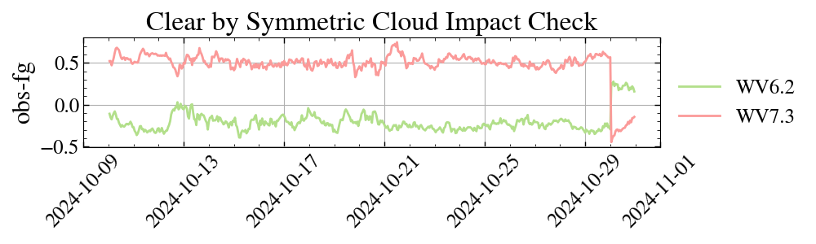
Task 2.3: All-sky (SEVIRI → ) MTG FCI IR WV + VIS data
Annika Schomburg
clear-sky screening for bias correction by symmetric cloud impact check: FG_{all-sky} – FG_{clear} , Obs – FG_{clear} (for SEVIRI also: NWC-SAF cloud mask): implementation, tuning, evaluation (by Mahdiyeh Mousavi)
DE
uncorrected obs
time series 8 – 28 Oct. 2024 (passive FCI monitoring exp.)
→ bias (Obs_{orig} – FG) and (Obs_{bcor} – FG) found sensitive to symmetric cloud check in experiment,
|Obs – FG_{clear} | < threshold implies FG check!
→ this needs to be replaced by NWC-SAF cloud mask for clear-sky screening (for QC & BC)
IT

Slide 7
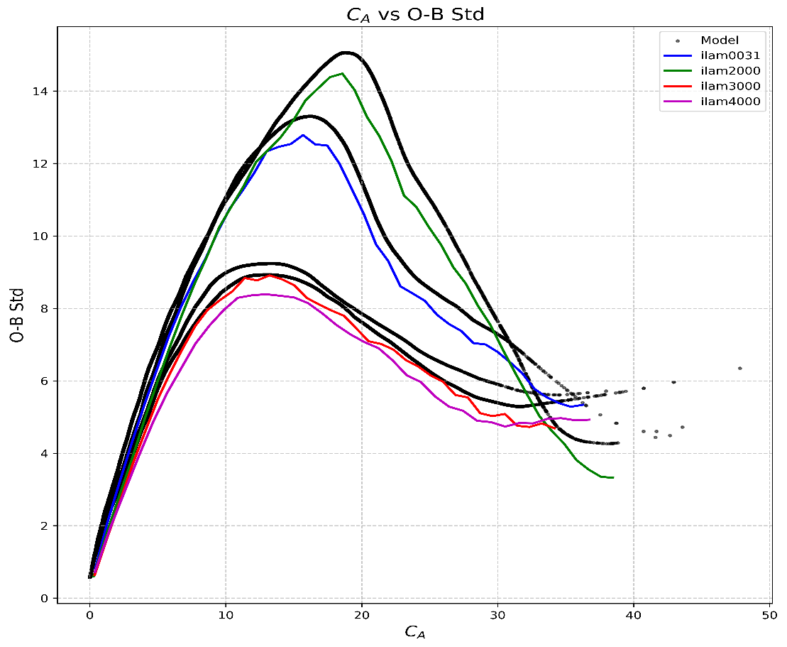
Task 2.3: All-sky (SEVIRI → ) MTG FCI IR WV + VIS data
Annika Schomburg
Further steps:
re-train observation error model
(based on observation impact) for FCI
→ O – B for FCI very dependent on season(?)
or probably more on cloud type
(stratiform, convective)
run and evaluate
active assimilation experiment
(i.e. FCI active, SEVIRI passive)
Aug - Sept
June
January
January
IT

Slide 8
Task 2.4: MTG IRS (hyperspectral IR sounder)
Mahdiyeh Mousavi, Christina Köpken-Watts, …
‘clear-sky’ assimilation of IRS (Mahdiyeh Mousavi, Christina Köpken-Watts)
temperature + humidity profile information (clear-sky, above clouds)
(e.g. to improve pre-convective environment)
MTG IRS launched in summer 2025, data in ~ 2026
→ IRS data for testing: simulated ‚obs’ (with RadSim) into fdbk file
real-data IASI, SEVIRI as proxy for IRS;
technical test in KENDA successful
simulated IRS obs – channel 59
(20200802, 1UTC)
ICON-LAM: mostly land → use of IRS observations over land
→ use surface-sensitive channels for analysis in middle + lower troposphere
  improvement of land surface emissivity → employ IR emissivity atlas (instead of constant values)
  skin temperature (model FG not good enough) → skin temperature retrieval from channels strongly
  sensitive to the surface (by inversion of radiative transfer eqn.)

Slide 9
Task 2.4: MTG IRS (hyperspectral IR sounder)
Mahdiyeh Mousavi, Christina Köpken-Watts
cloud detection & adaptive bias correction: used in global EnVar for IASI, but major adaptation for…
– ICON-LAM (low model top → extension of FG with global fields for cloud detection) and
– KENDA (cloud detection + bias correction within ICON ensemble members)
(ongoing and) future work (a.o.; little resources available):
parallel obs processing in LETKF required for non-diagonal observation error covariance matrix R:
first version implemented, further technical tests to be done; R also needs to specified!
revisit channel selection (e.g. up to which height)
tests on thinning, height assignment, localization, …
code optimization needed for IRS assimilation with many channels (pre-thinning etc.)
option: assimilate all-sky IRS using clear-sky R (Okamoto)?
also important: slant radiative transfer, 4D-EnVar (for indirect wind info), horiz. obs error correlations

Slide 10
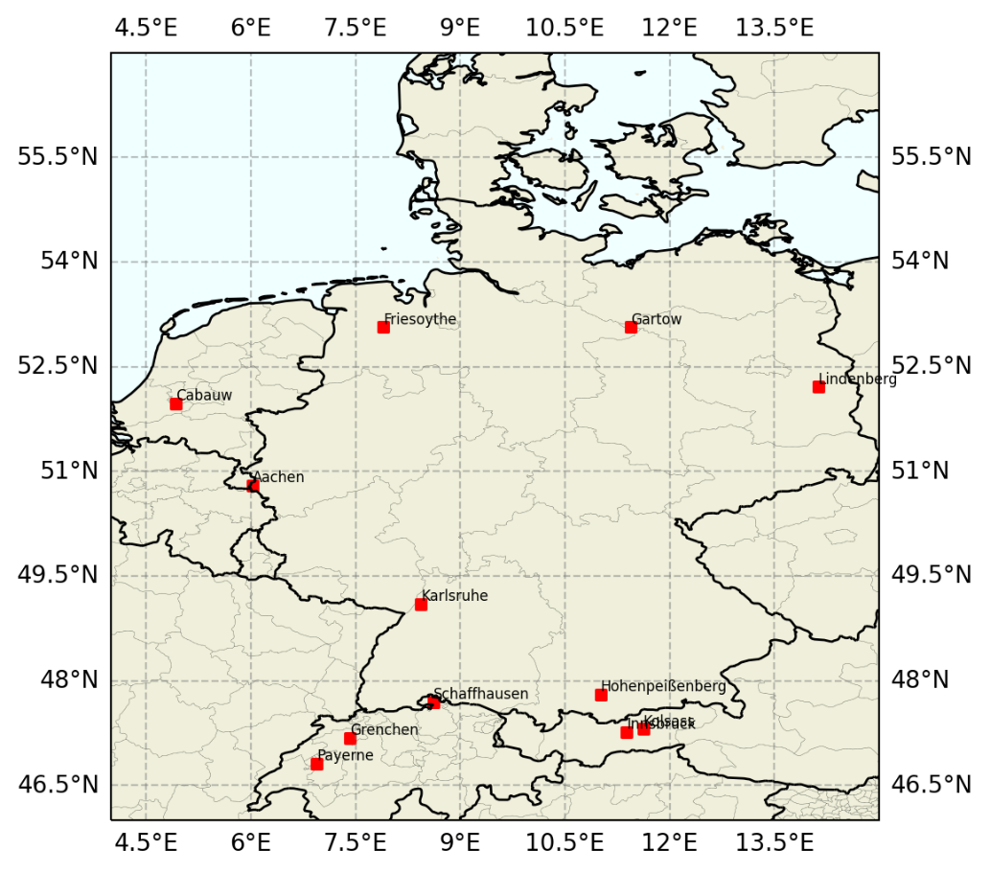
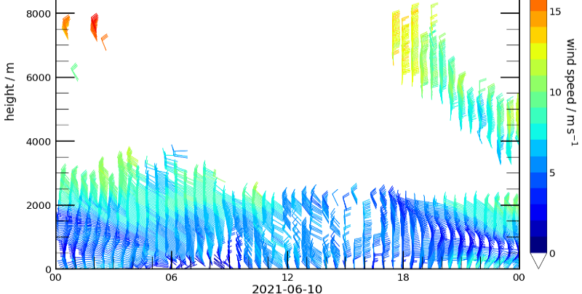
Task 2.6: PBL profiler obs: wind lidars
Michael Bender
E-profile: BUFR reports created by UK Met Office
(corrected very recently)
in DWD data base with 20 min latency
monitoring of O – B being set up
German lidars still being optimized
2 further lidars (out of 13 planned to be purchased by DWD) under testing (Hamburg)

Slide 11
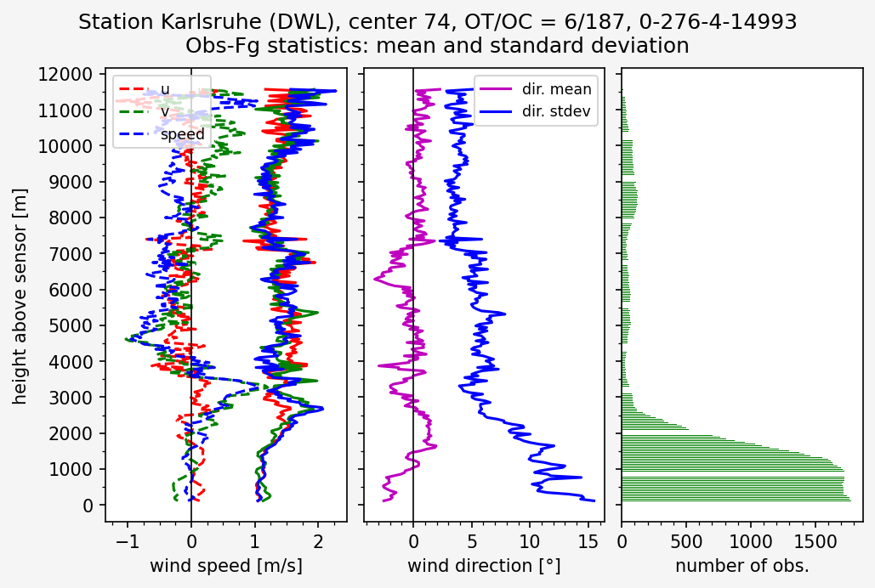
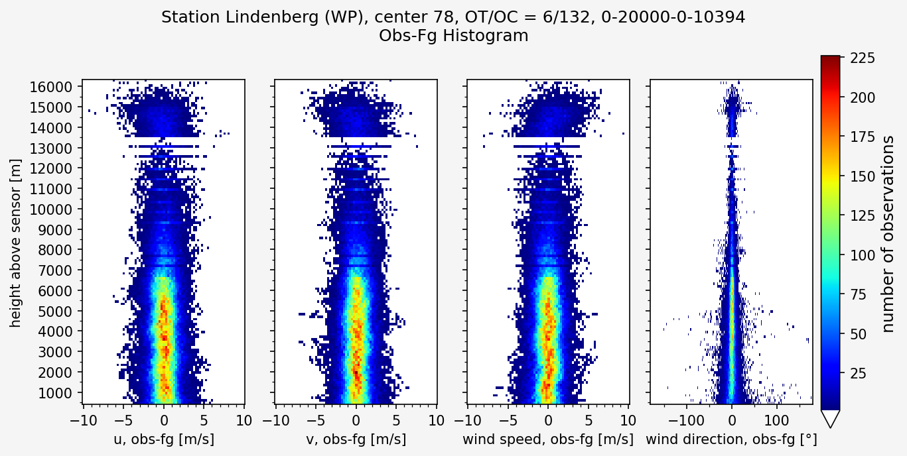
Task 2.6: PBL profiler obs: wind lidars
Michael Bender
Monitoring (May 2025: German stations, Cabauw, Innsbruck (above 1500 m), Payerne, Grenchen, Schaffh. good
Impact experiment May 2025: no results yet (results by end of this week!)
Swiss stations not used, because we can distinguish them (yet) from the collocated profilers in the blacklist)
Notes:
The technical key facts are those ones:
Ist an instrument from Vaisala the so called WindCube. The wavelength is a bit larger as for the DIAL, the range wide above 3km
The time resolution is configurable, however the optimal setting still have to be find, this is a sensitive quantity regarding DA.
It is also an active instrument.
The upper image shows the profiles of dampened backscatter signals for one day. Clear signals can be seen in the lower area and also at higher altitudes in the early morning hours. The grainy signals are not real signals that are filtered out. The lower image shows the altitude profiles of the wind vector derived from them. You can see the nice connection between the backscatter signals and the wind vectors.
Side-node:
Range depends on aerosol concentration and cloud condition
More instruments available (other company), however not yet in DA for NWP

Slide 12
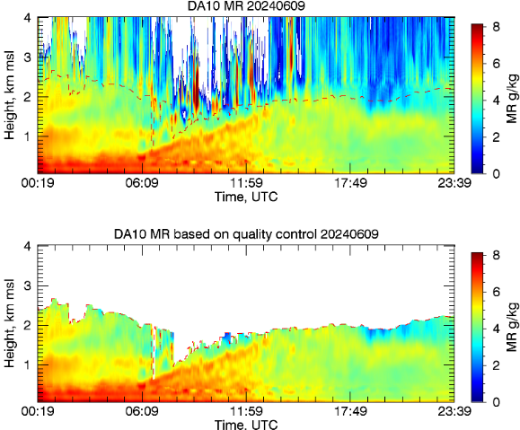
Task 2.6: PBL profiler obs: DIAL (Differential Absorption Lidar)
Jens Pruschke
DIAL → vertical profiles of water vapour mixing ratio (MXR)
in lowest 3 – 4 km (or up to low cloud base),
resolution 10 m (30 m?), every 20 min
1 testbed DIAL located at Lindenberg observatory
(BUFR data), maturity for DA tbd
DACE observation operator for MXR implemented
(in MEC), obs error set to 3g/kg

Slide 13
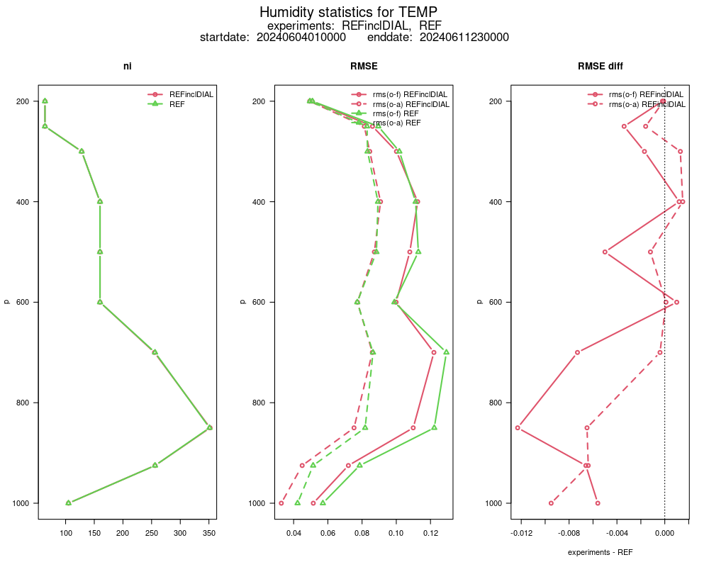
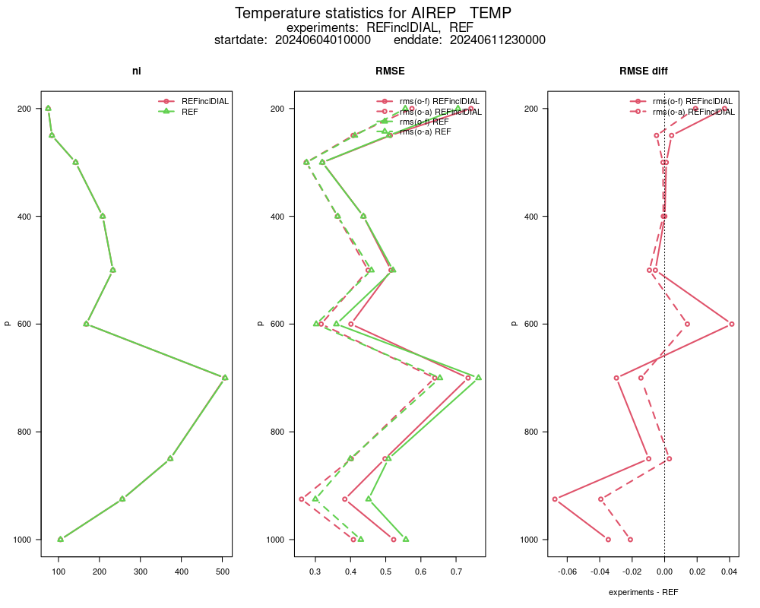
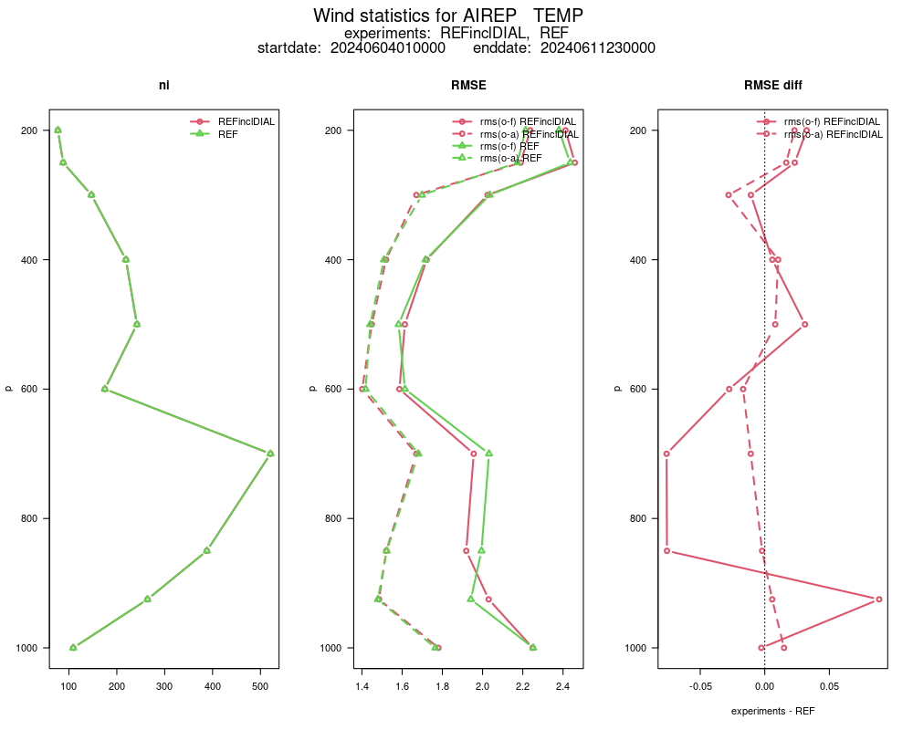
Task 2.6: PBL profiler obs: DIAL (Differential Absorption Lidar)
Jens Pruschke
RMSE
first DA experiments over 8 days
(4 – 11 June 2024)
verification: obs_err_stats
around Lindenberg ( ± 0.1°)
REF
DIAL
next steps: further experiments with
  height dependent observation error
  profile thinning
  longer periods (summer/winter)
forecast verification
DWD plans to buy 10 – 14 DIAL instruments
for locations across Germany
T
(TEMP, AIREP)
wind
(TEMP, AIREP)
RH
(TEMP)

Slide 14
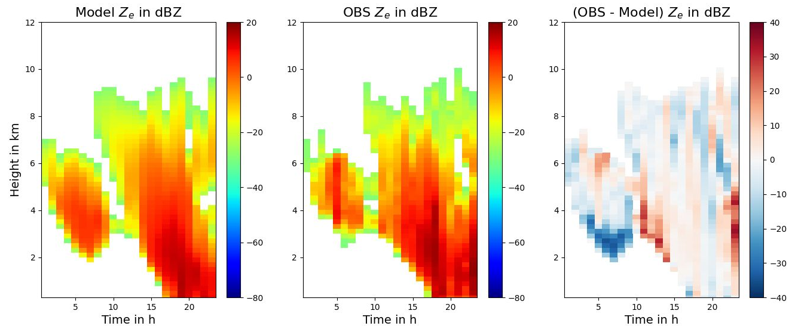
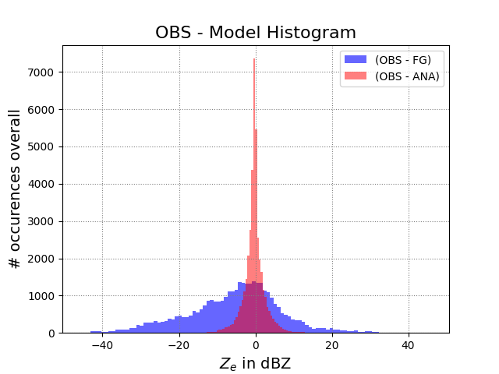
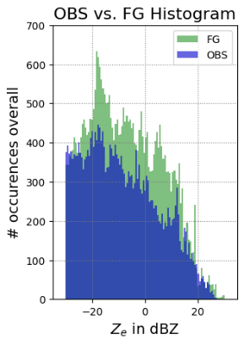
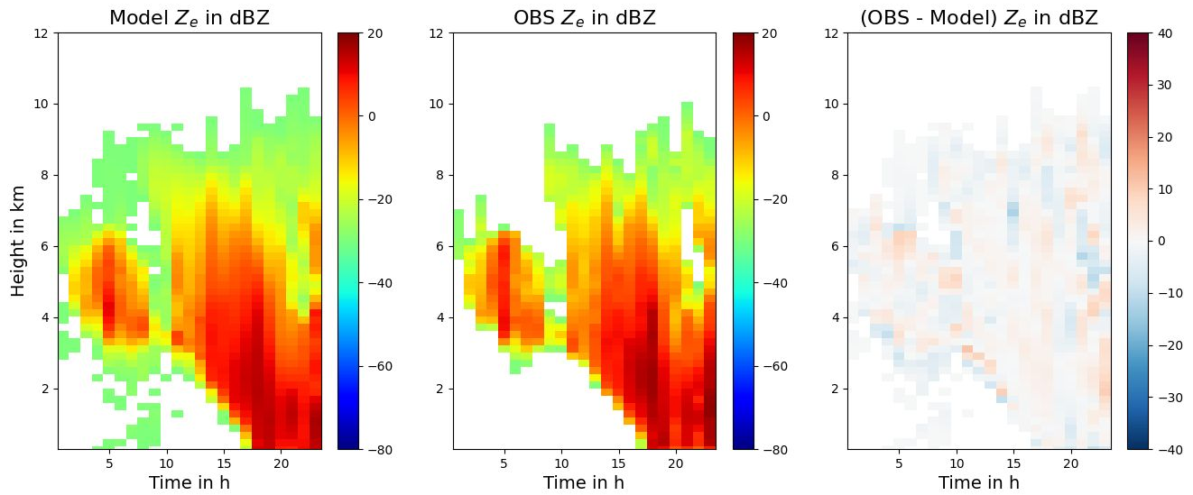
Task 2.6: PBL profiler obs: cloud radar
Jens Pruschke
DA of vertical profile of radar reflectivity from pulsed 35GHz cloud radar at Lindenberg (EMVORADO adjusted)
example: time series of OBS – Model for 1 day (08.02.2024) in a winter period (deterministic run)
settings: − observation error: 6 dBZ
− lower reflectivity threshold for DA: -30 dBZ
− vertical superobbing: 200m intervals
First Guess
statistics of 9 day period (01.02. – 09.02.2024):
Analysis
next: sensitivity exp., set rainy obs to passive,
verify forecasts & against other obs

Slide 15
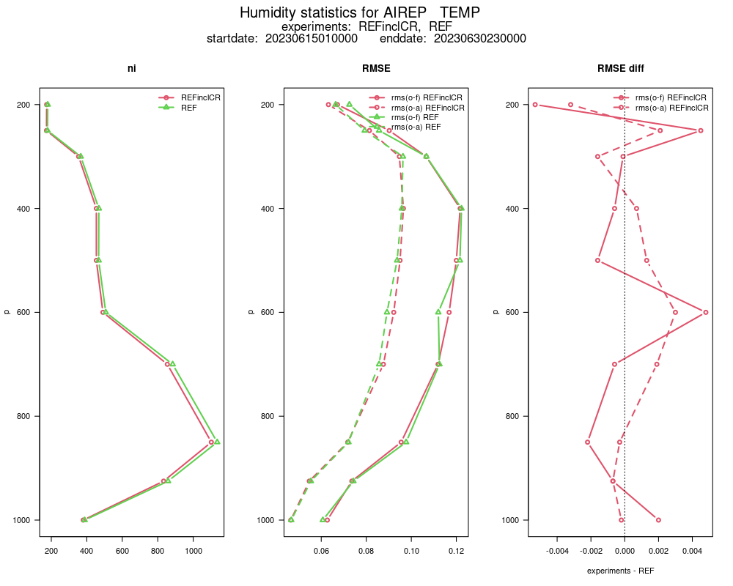
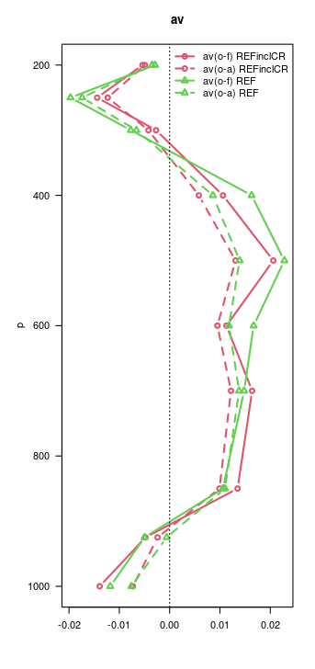
Task 2.6: PBL profiler obs: cloud radar
Jens Pruschke
Impact experiment
15.06. – 30.06.2023
REF: operational settings
cloud radar obs error: 4 dBZ
verification area:
Lindenberg +/- 1°
neutral impact
Notes:
Zeitraum auch oben gesehen.
Ohne Niederschlagsradare
Region um Lindenberg
TEMPS: 10393,10184
PILOT hat nur Wind

Slide 16
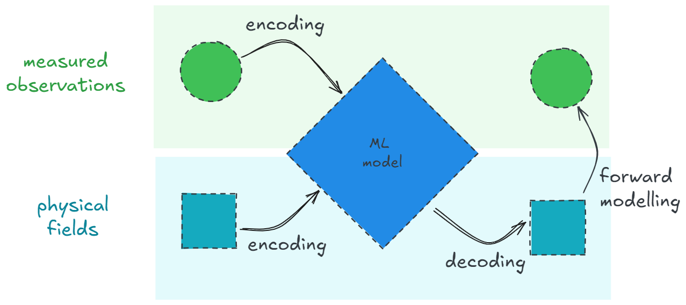






Data Assimilation with AI
THE METHOD
The classical data assimilation functional is used as a loss function to optimize the model weights:
reference: J. Keller and R. Potthast, arXiv:2406.00390
$$y$$
$${H(x}_{a})$$
$$J\left[x\right]=α{\left\|x−x_{b}\right\|}_{B^{−1}}^{2}+{\left\|H[x]−y\right\|}_{R^{−1}}^{2}$$
$α$: Tikhonov regulator
$x_{a}=\text{argmin}(J)$: analysis state
$x_{b}$: background state
$B$: model space covariance
$R$: observation space covariance
$H$: forward operator
$y$: observation
$$x_{b}$$
$$x_{a}$$
There is no target data (labels) for training!
The model learns to estimate the analysis from minimising the loss function.

Slide 17
Data Assimilation with AI
ACHIEVEMENTS
global DA of 2m temperature
reading and processing of NWP data and observations
NN forward operators
for in-situ data
post-processing of cloud diagnostics with SEVIRI data
basis for FRAIM
(AI framework at DWD,
with modularized AIDA)
IN DEVEOPMENT
DA of upper air observations for smaller domains
running RTTOV as forward operator inside a NN
(for DA of satellite data)
transformations of the physical state and loss function for more efficient evaluation
combination of different NWP forecasts (SYNCAST)
FUTURE PLANS
model parallelism with sharding
for global 3d atm. states
more efficient data handling for large datasets
implementation of more forward operators

Slide 18
WG Data Assimilation
AIDA
Basic idea: train / learn DA cost function (minimize distance to FG and obs)
prospects
investigate different AI model architectures (graph NN, transformers (attention mechanism), …)
parallelism (Anemoi); building synergies by contributing to and learning from Anemoi
ML as a “all-in-one package” (incl. BC, QC, forward operators, …)
global analyses for surface observations (T2M, snow depth → much larger domains)
DA of radiosondes / aircraft on limited domains
incorporation of more complex observations (radar and satellites)
conceptual studies towards ensemble DA

Slide 19
Task 2.6: PBL profiler obs: ICOS towers
Christoph Schraff
ICOS: Integrated Carbon Observation System
ecosystem, ocean, atmosphere
(greenhouse gases)
9 towers in Germany
(within ICON-D2: Cabauw NL,
Ispra IT, 1 CZ, 3 FR
(no access to data yet))
heterogeneous architectures,
max. heights 98 – 341 m
(min. heights 10 – 60 m)
T, RH on 2 – 6 levels,
wind on 1 – 5 levels
plus 2 towers at former nuclear power plants
Helgoland 110 m

Slide 20
Task 2.6: PBL profiler obs: ICOS towers
Christoph Schraff
tower T, RH: upper-air “HASL” operator always better
tower wind: choice of operator depends on
the tower and observation level
(i.e. sometimes surface “HOSAG” oper.
better, typically for lower levels)
→ need to look at each individual tower / level
aircraft, TEMP,
wind profiler
model equivalent: HASL
T, RH, wind vertically interpolated
T, RH,
wind
tower
T2M, RH2M, 10-m wind obs
wind
ICOS towers: wind speed is underestimated at many towers / levels (→ wind blacklisted)
real
orography
assimilated data:
  T : 34 obs levels from 9 towers
  RH: 28 obs levels from 9 towers
  wind: 8 obs levels from 4 + 2 towers
model equivalent: HOSAG
T2M, RH2M, 10-m wind
(T2M: height correction)
model orography (grid point)

Slide 21
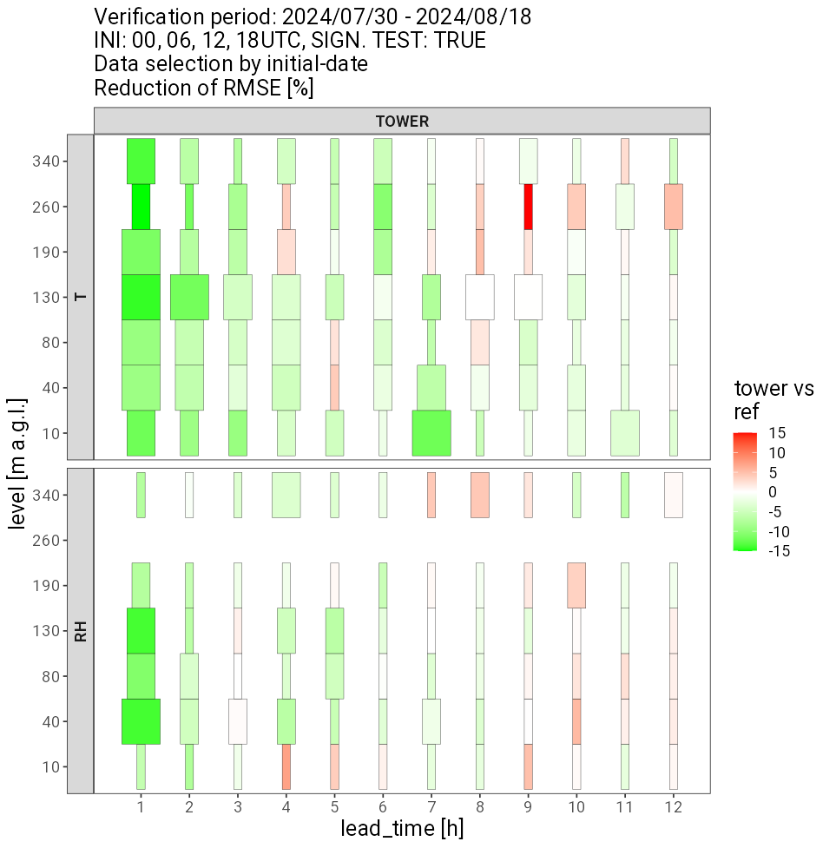
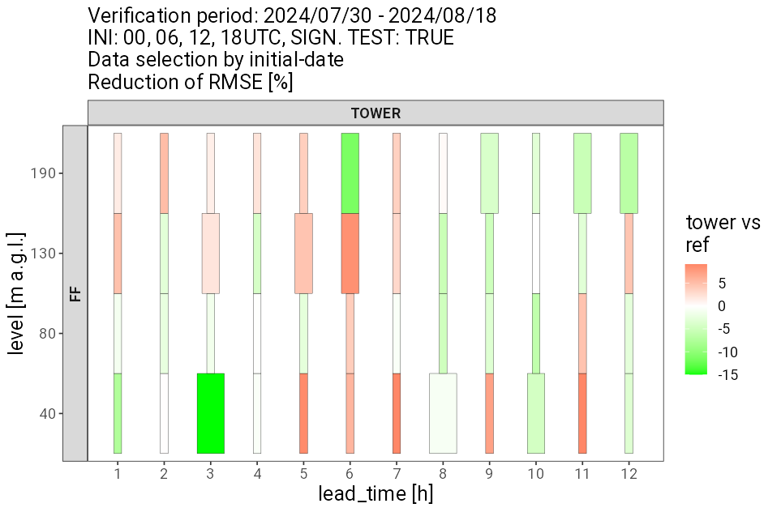
Task 2.6: PBL profiler obs: ICOS towers
Christoph Schraff
impact experiments (2 winter + 2 summer periods),
verification against towers:
large positive impact vs. tower T + RH in first hour(s)
little impact on tower wind (only 8 obs levels from 6 towers)
operational since 02.02.2025,
(neutral in standard verification, only 1 week)
tower vs. ref:
RMSE
T
summer (30.07. – 18.08.24)
RH
wind
speed

Slide 22
WG Data Assimilation
Re-analysis (for AI training) (Arianna Valmassoi a.o.)
FORCE (ICON-D2)
FORCE-C: only conventional obs, for climate applications
(longer periods) (KU)
status
production started in August for 2 out of 3 streams (start: 2025; computation speed 8 (d / d))
(still need to obtain MODE-S Feb 2016 (?) – May 2017)
LHN reprocessed specifically for the reanalyses using all the available data
Output: https://ninjoservices.dwd.de/wiki/display/~avalmass/ICON-FORCE+output
problems
issues with SEVIRI data: swap between 2 satellites due to malfunctioning,
technical adaptation to also use Meteosat-9 (never used operationally)
many other problems here and there due to the obs in the archive
(“FORCE production is not a smooth road at the moment”).

Slide 23
WG Data Assimilation
Re-analysis (for AI training) (Arianna Valmassoi a.o.)
DREAM back-extension (global)
status: ongoing technical work in processing CDR/rescued observations
tested: GPSRO (UCAR, ROMSAF), scatterometer (ESR, Oceansat2, seawind)
ongoing: Eumetsat polar AMV (conversion NetCDF to BUFR WMO-standard)
ERA6 rescued observations (rescued obs in BUFR-D, DA needs adaptation)
not yet tested: JMA AMV; Eumetsat geostat. AMVs (MFG, MSG, to be converted to BUFR)
some of the issues
AMVs/SCATT: need to adapt QIs, obs error functions & thinning based on experiments
GPSRO: need to re-tune for UCAR obs that have a discontinuity at 20-21km impact height;
need complete re-tuning of DA system for the period prior to GPSRO
conventional obs: we need to blend ERA6 obs with DWD archived obs (deal w. locations mismatches),
and check when/how to apply bias correction of the ERA6 obs

Slide 24
WG Data Assimilation
Re-analysis
Collaboration: first meeting in May (DWD, MeteoSwiss, ARPAE)
target
• facilitate the production of regional reanalyses within COSMO
and/or joint use of common regional reanalyses
facilitate sharing of historical / non-GTS Obs
sharing knowledge (which obs to use, pre-processing tools, monitoring ideas/tools,
re-ana configurations)

