Slide 1
Update from MeteoSwiss concerning excessive ensemble spread for precipitation
Marco Arpagaus for the MeteoSwiss team
COSMO General Meeting, 01.09.2025

Slide 2

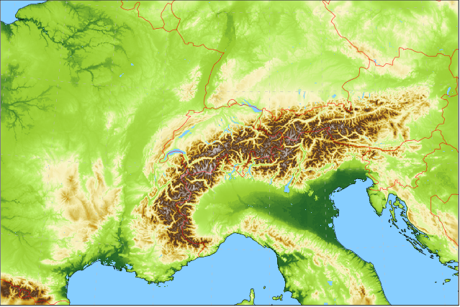
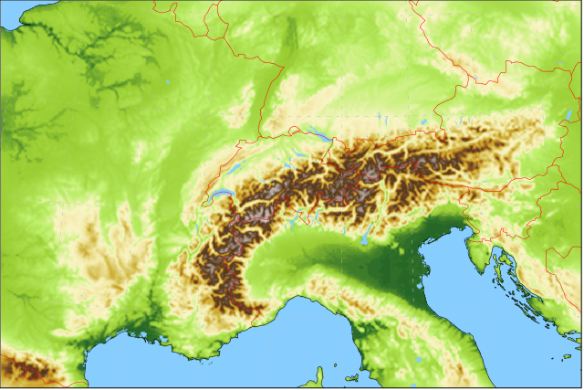
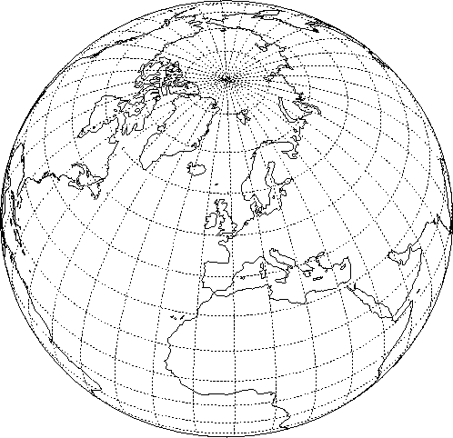
Forecasting System based on
recap
2024
Lateral boundary conditions: IFS ENS
9 (18) km
4x per day
Ensemble Data Assimilation: LETKF
40+1 members at 1.0 km grid size with ICON-CH1 setup (SPPT)
hourly cycling
operational since 28 May 2024
ICON-CH1-EPS: 33 hour forecasts, 8x per day
1.0 km grid size (R19B08), 80L
11 ensemble members
ICON-CH2-EPS: 5 day forecasts, 4x per day
2.1 km grid size (R19B07), 80L
21 ensemble members

Slide 3
Verification ICON vs COSMO (and vs ICON-D2)
partial update of presentation from last year

Slide 4
Verification summary ICON vs COSMO excluding “heavy”-precipitation issues
Structure (spatial and temporal) better in ICON than COSMO (all parameters)
Probabilities better in ICON than COSMO (all parameters)
ICON has larger bias for (details on following slides)
  Temperature at valley stations
  Global radiation at valley stations
  Wind speed in complex topography
→ Overall ICON-CH1/2-EPS is clearly better than COSMO-1/2E

Slide 5
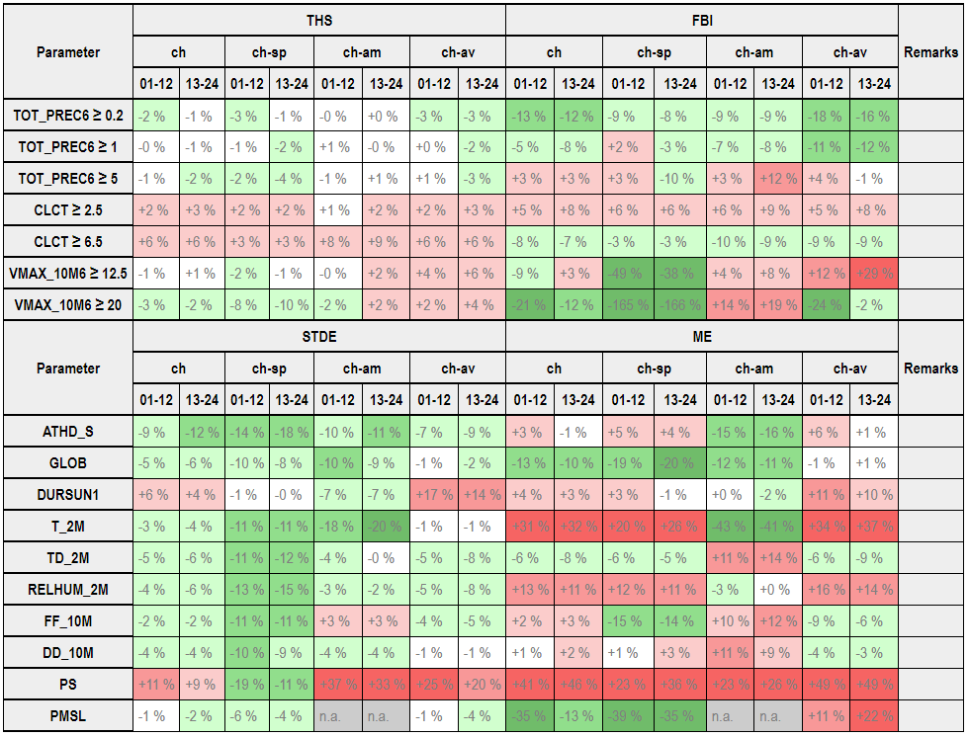
Verification ICON-CH1-EPS surface variables
Sep/Oct/Nov 2023
ICON better
COSMO better
Figure: Pirmin Kaufmann

Slide 6
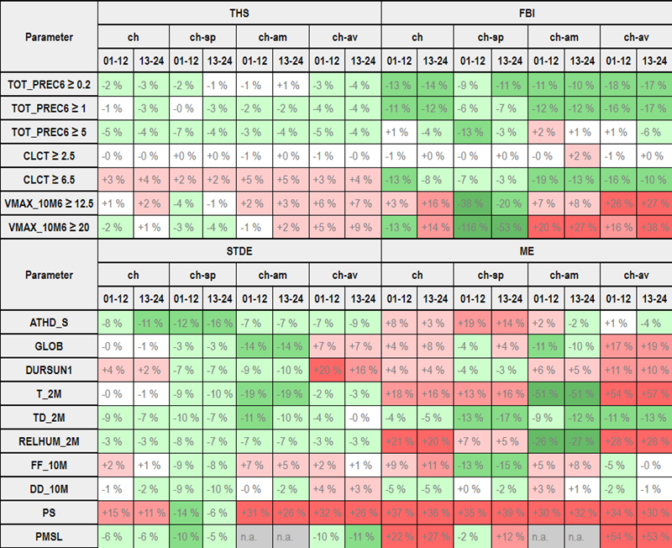
Verification ICON-CH1-EPS surface variables
Dec/Jan/Feb 2023/24
ICON better
COSMO better
Figure: Pirmin Kaufmann

Slide 7
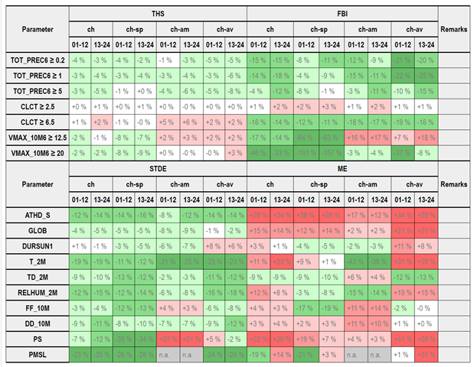
Verification ICON-CH1-EPS surface variables
Mar/Apr/May 2024
ICON better
COSMO better
Figure: Pirmin Kaufmann

Slide 8
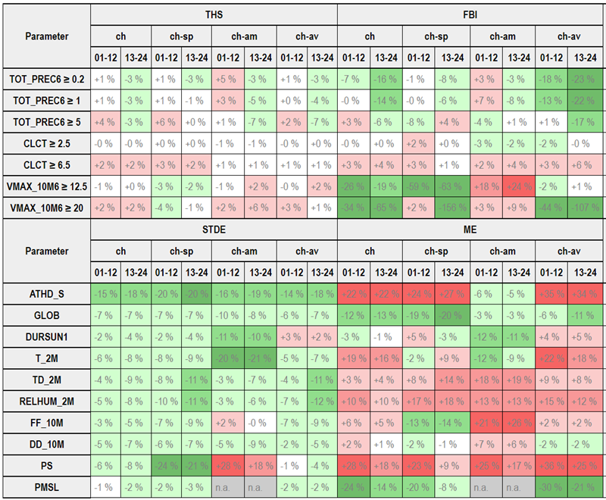
Verification ICON-CH1-EPS surface variables
Jun/Jul/Aug 2024
ICON better
COSMO better
Figure: Pirmin Kaufmann

Slide 9
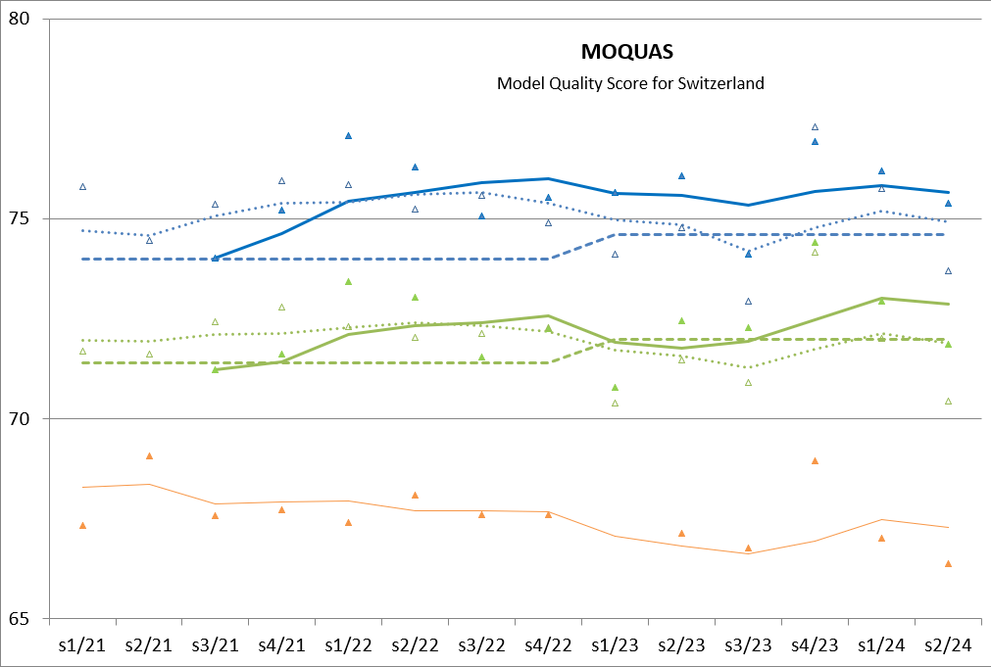
Development MOQUAS ICON vs COSMO
ICON
COSMO
ICON better than COSMO since 2022 (except for s3/22)
ICON: model evolving; median since summer 2023
+1 day
+3 days
30% precipitation (ETS)
30% cloudiness (ETS)
30% temperature (MAE)
10% wind speed (MAE)
+3 days IFS
Figure: Pirmin Kaufmann

Slide 10
Most severe deficiencies (vs COSMO)
Temperature at 2m (T2m): warm bias (mean error (ME))
all seasons; most pronounced in Alpine valleys
Relative humidity at 2m (RH2m): behaviour is often reflecting problems in T2m (i.e., in winter and spring); unclear behaviour in summer
Global radiation (GLOB): overestimation (mean error (ME))
most severe as compared to COSMO: winter and spring, in Alpine valleys
Wind speed at 10m (FF10m): underestimation (mean error (ME))
most pronounced for Alpine mountains, but also for Alpine valleys
… plus specific «heavy»-precipitation issues (more later …)
Note (for MeteoSwiss): The biases for T2m and FF10m can be removed by post-processing – No post-processing yet for GLOB (and “heavy”-precipitation), though!

Slide 11
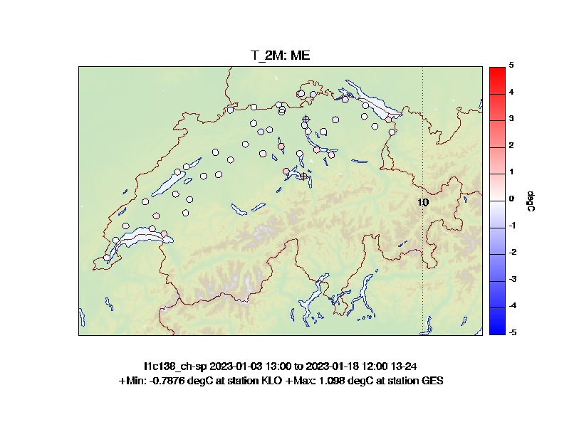
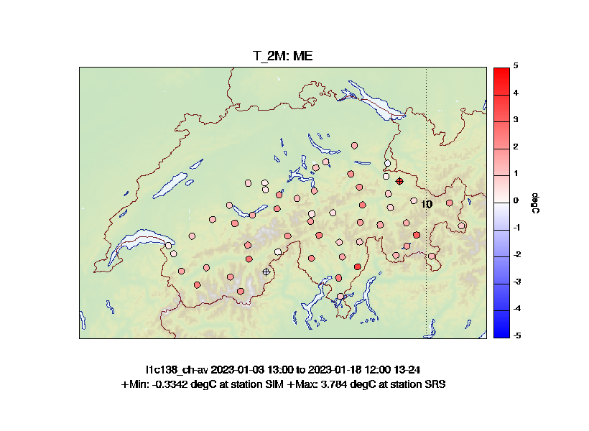
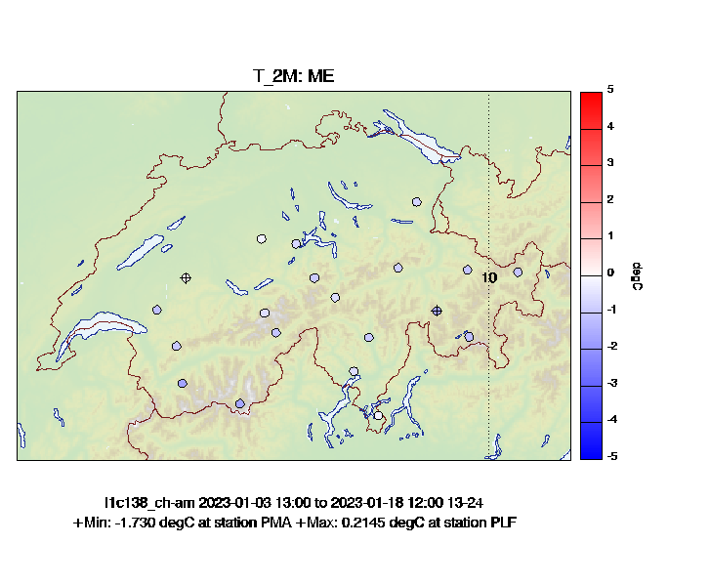
Verification domains (T2m, rainy winter)
AM: Alpine «Mountains»
SP: Swiss Plateau
AV: Alpine «Valleys»
Figures: Pirmin Kaufmann

Slide 12
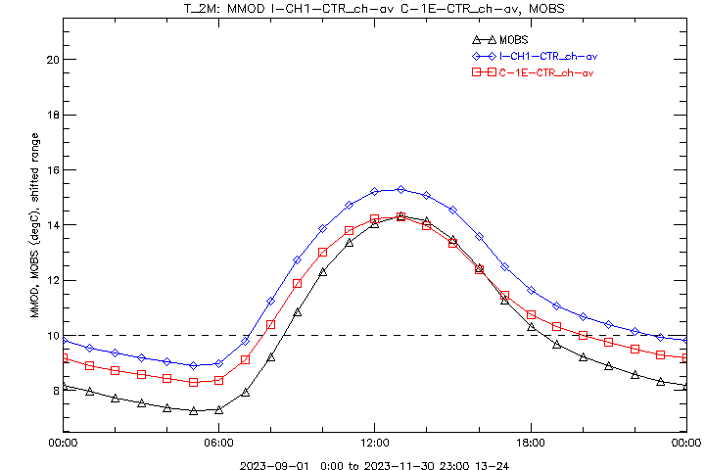
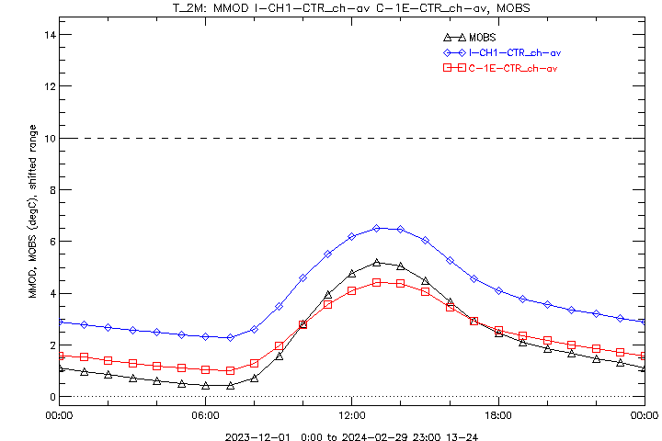
T2m in valleys
∆─∆ Observations
□─□ COSMO-1E Ctrl
◊─◊ ICON-CH1 Ctrl
Sep/Oct/Nov 2023
Dec/Jan/Feb 2023/24
Figures: Pirmin Kaufmann

Slide 13
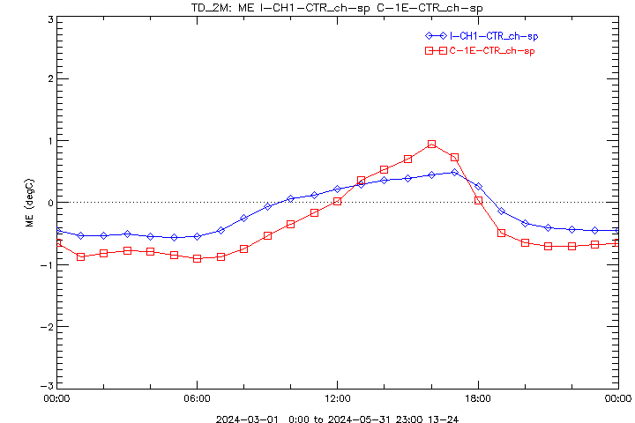
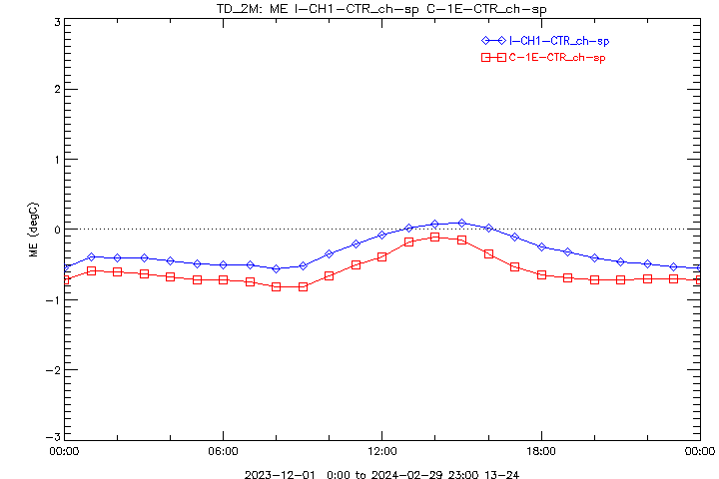
Dewpoint over Swiss Plateau
ICON: small dry bias at night, wet bias at daytime, all seasons
COSMO: large afternoon wet bias, except in winter
∆─∆ Observations
□─□ COSMO-1E Ctrl
◊─◊ ICON-CH1 Ctrl
Diurnal Cycle
(Summer, Autumn,) Spring
Winter
Figures: Pirmin Kaufmann

Slide 14
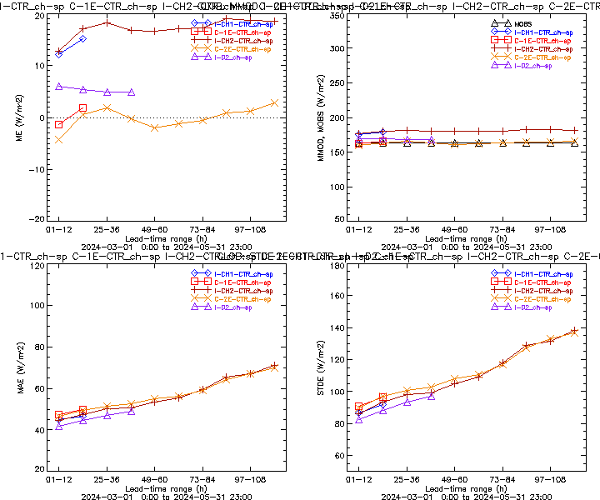
Global radiation over Swiss Plateau
Mar/Apr/May 2024
Figures: Pirmin Kaufmann

Slide 15
Gusts (and mean wind) …
Note: Different SSO tuning for ICON-CH1-EPS and ICON-CH2-EPS (→ impact on wind), but identical gust parameterisation. – Gust parametrisation in ICON is different from the one in COSMO.
THS & ETS better for ICON than for COSMO
FAR lower (better) for ICON than for COSMO
POD (and FBI) lower (too low) for ICON than for COSMO for low thresholds
improvements wrt COSMO larger for high thresholds (than for low ones)
improvements wrt COSMO larger for gusts (than for mean wind)
differences for gust scores between 1km & 2km smaller for ICON than for COSMO
Note: Conclusions mainly based on re-forecasts at 2km (3y)

Slide 16
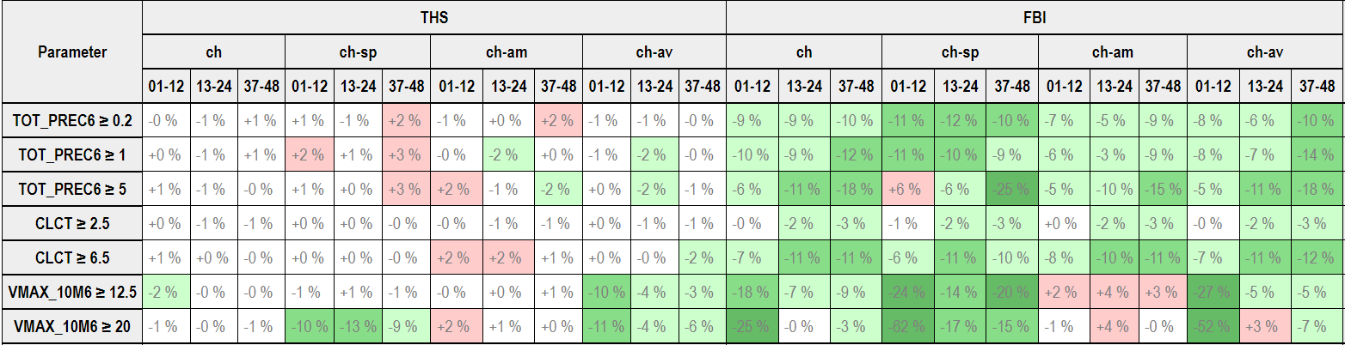
ICON-CH2 vs ICON-D2, Dichotomous
ch-sp Swiss Plateau
ch-am Alpine Mountain Tops
ch-av Alpine Valley Floors
Threat score about neutral
Frequency bias mostly better
Mar/Apr/May 2024
Figure: Pirmin Kaufmann

Slide 17
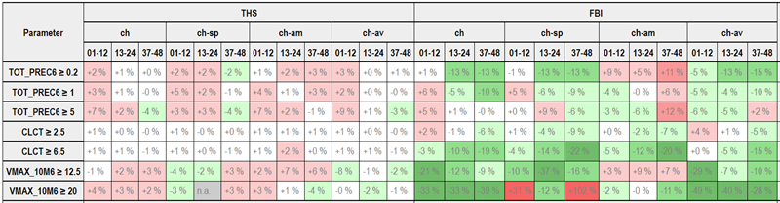
ICON-CH2 vs ICON-D2, Dichotomous
ch-sp Swiss Plateau
ch-am Alpine Mountain Tops
ch-av Alpine Valley Floors
Threat score about neutral
Frequency bias mostly better
Jun/Jul/Aug 2024
Figure: Pirmin Kaufmann

Slide 18
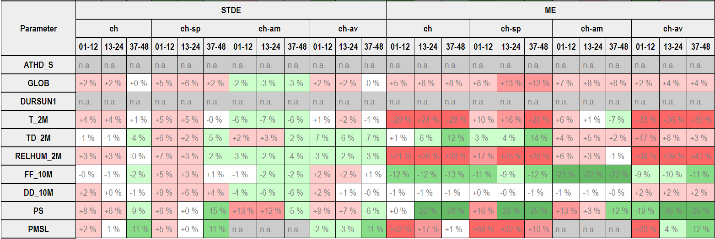
ICON-CH2 vs ICON-D2, Continuous
ch-sp Swiss Plateau
ch-am Alpine Mountain Tops
ch-av Alpine Valley Floors
In general ICON-CH2 similar to ICON-D2
Bias for (GLOB,) T2m, RH, PMSL worse (→ APT!)
Mar/Apr/May 2024
Figure: Pirmin Kaufmann

Slide 19
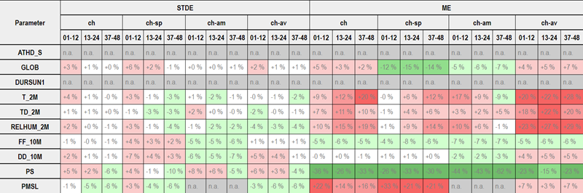
ICON-CH2 vs ICON-D2, Continuous
ch-sp Swiss Plateau
ch-am Alpine Mountain Tops
ch-av Alpine Valley Floors
In general ICON-CH2 similar to ICON-D2
Bias for (GLOB,) T2m, RH, PMSL worse (→ APT!)
Jun/Jul/Aug 2024
Figure: Pirmin Kaufmann

Slide 20
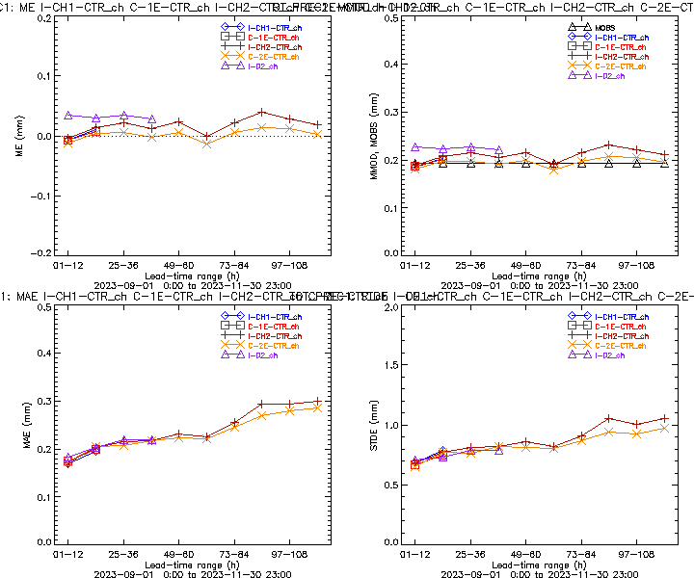
1h Precipitation over Switzerland (CTRL)
Sep/Oct/Nov 2023
Figures: Pirmin Kaufmann

Slide 21
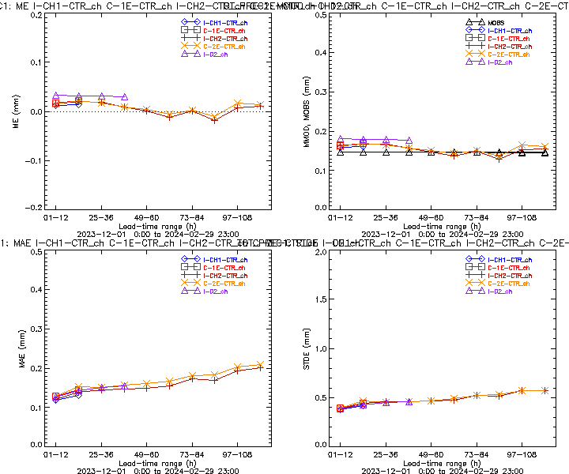
1h Precipitation over Switzerland (CTRL)
Dec/Jan/Feb 2023/24
Figures: Pirmin Kaufmann

Slide 22
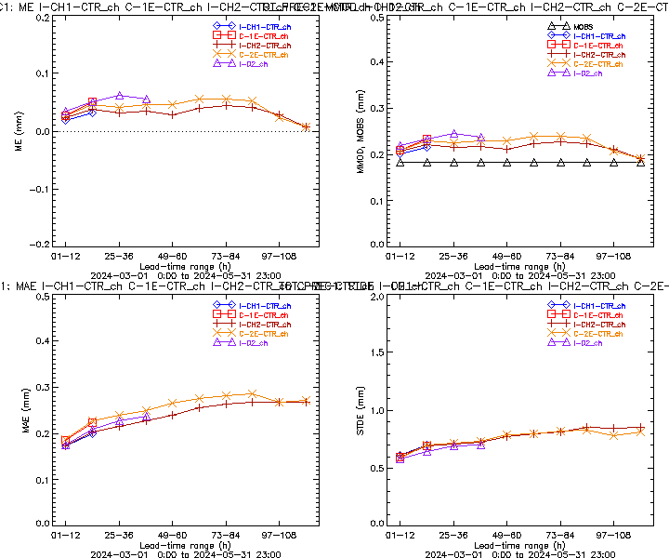
1h Precipitation over Switzerland (CTRL)
Mar/Apr/May 2024
Figures: Pirmin Kaufmann

Slide 23
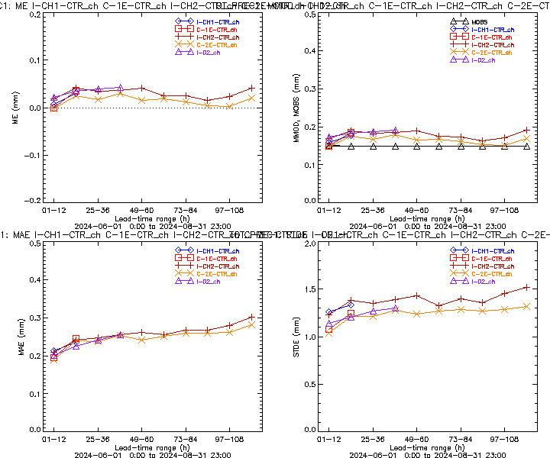
1h Precipitation over Switzerland (CTRL)
Jun/Jul/Aug 2024
Figures: Pirmin Kaufmann

Slide 24
excessive ensemble spread for precipitation

Slide 25
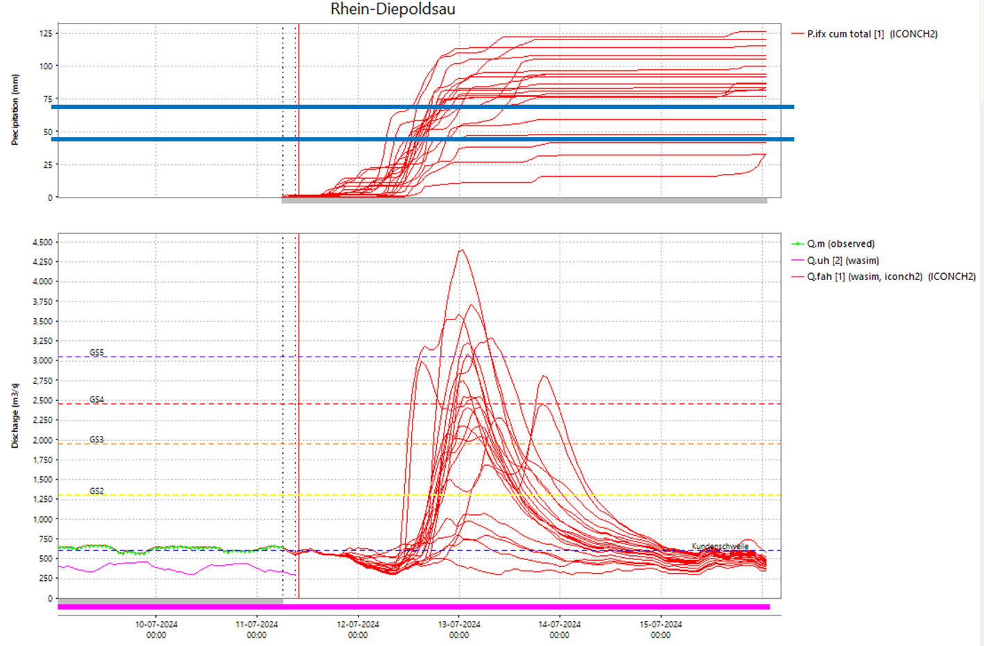
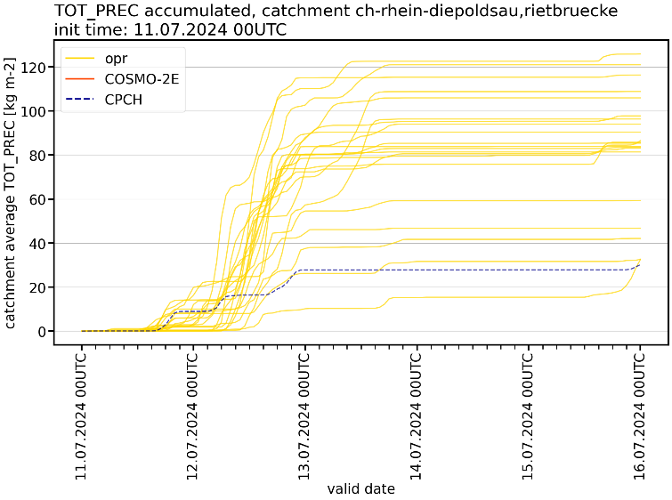
Excessive ensemble spread for precipitation
recap
2024
Hydrologists: “excessive spread and frequent overestimation in the runoff forecasts”
→ multiple events in early summer 2024 (May-Jul); large convective contributions
Figures: BAFU / Lukas Jansing

Slide 26
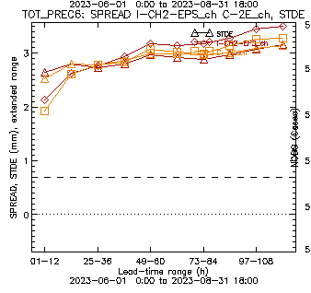
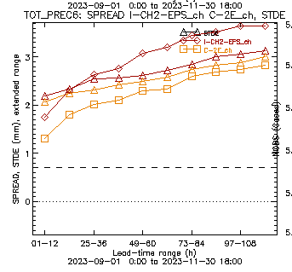
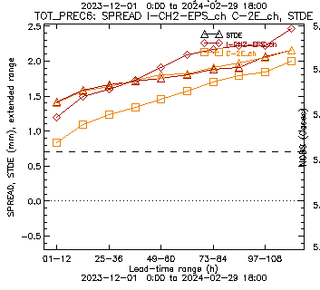
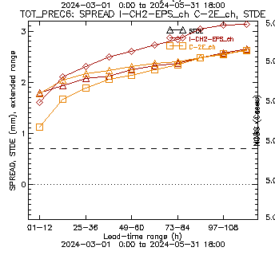
Precipitation, spread vs skill – ICON vs COSMO
recap
2024
Ensemble spread exceeds skill (STDE) in all past seasons for ICON-CH2-EPS
for the large lead times
Triangles: skill
JJA 2023
SON 2023
DJF 2024
MAM 2024
No SPPT!
COSMO-2E
ICON-CH2-EPS
Figures: Pirmin Kaufmann

Slide 27
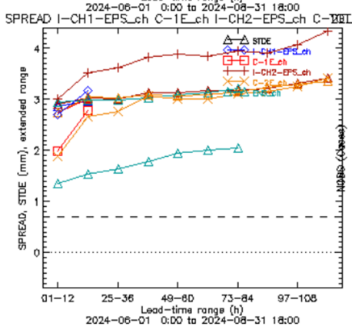
Precipitation, spread vs skill – ICON vs COSMO
recap
2024
Ensemble spread exceeds skill (STDE of ensemble mean) in all seasons for ICON-CH2-EPS for the large lead times
Triangles: skill
SON 2023
DJF 2024/25
MAM 2024
JJA 2024
COSMO-2E
ICON-CH2-EPS
Figures: Pirmin Kaufmann

Slide 28
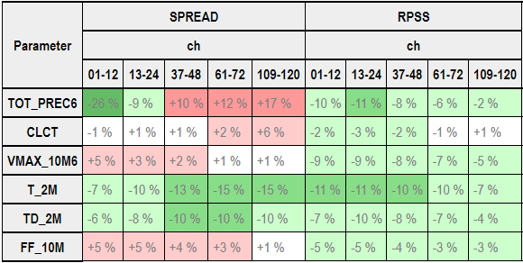
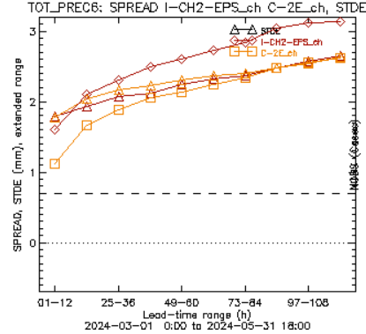
Ensemble scores – ICON vs COSMO
recap
2024
Spread/skill relation
  Better for 2m temperature and dewpoint
  Cloud coverage, gusts: similar
Precipitation spread better for short lead time but too large after +12h
Spread of wind speed smaller
RPSS better for all parameters!
SPREAD/SKILL
Mar/Apr/May 2024
Figures: Pirmin Kaufmann

Slide 29
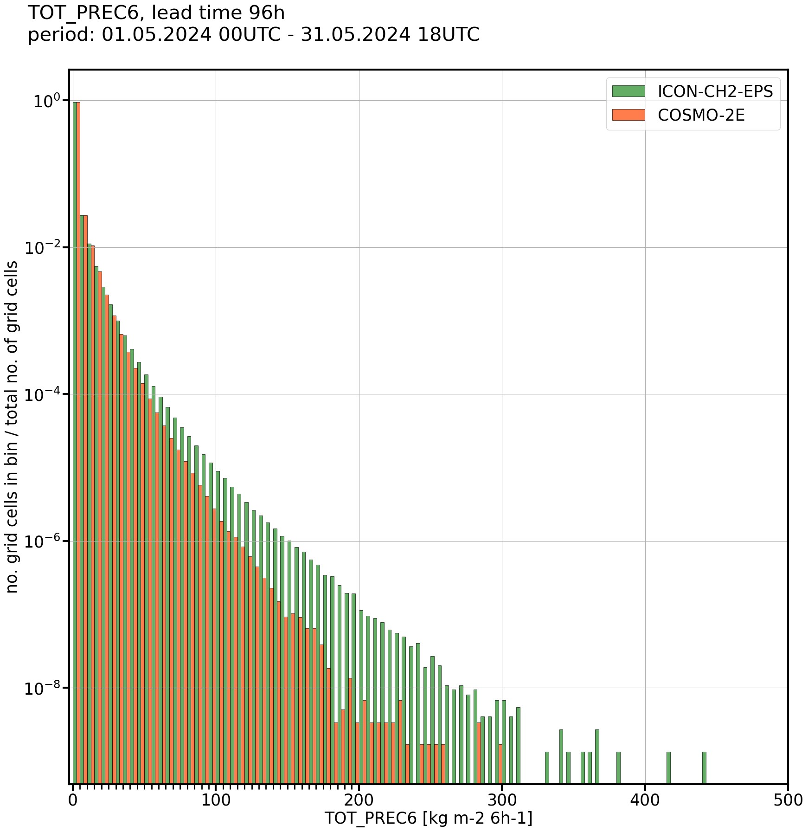
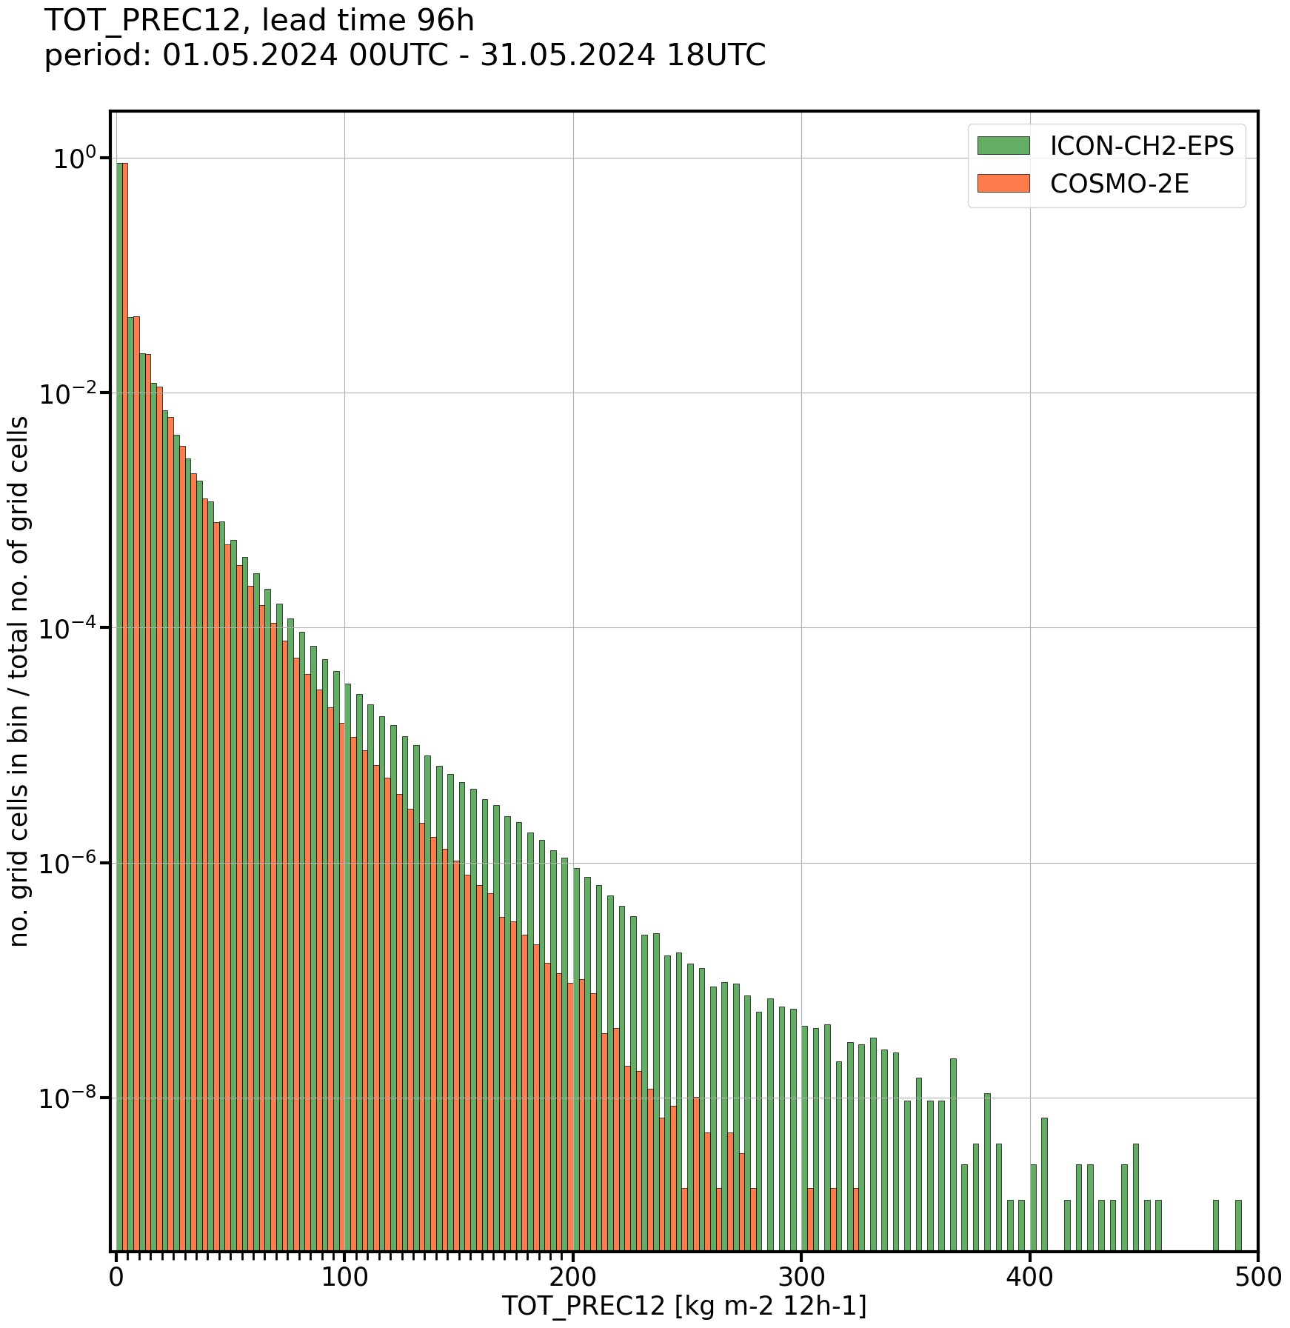
Precipitation, distribution – ICON vs COSMO
recap
2024
Comparison of precipitation from ICON and COSMO for +4d lead time in May 2024
→ ICON-CH2-EPS produces higher precipitation amounts than COSMO-2E
(conclusion valid for different aggregations and lead times)
6h-precip
12h-precip
Normalized histograms of precipitation aggregated over all members and init times:
Figures: Lukas Jansing

Slide 30
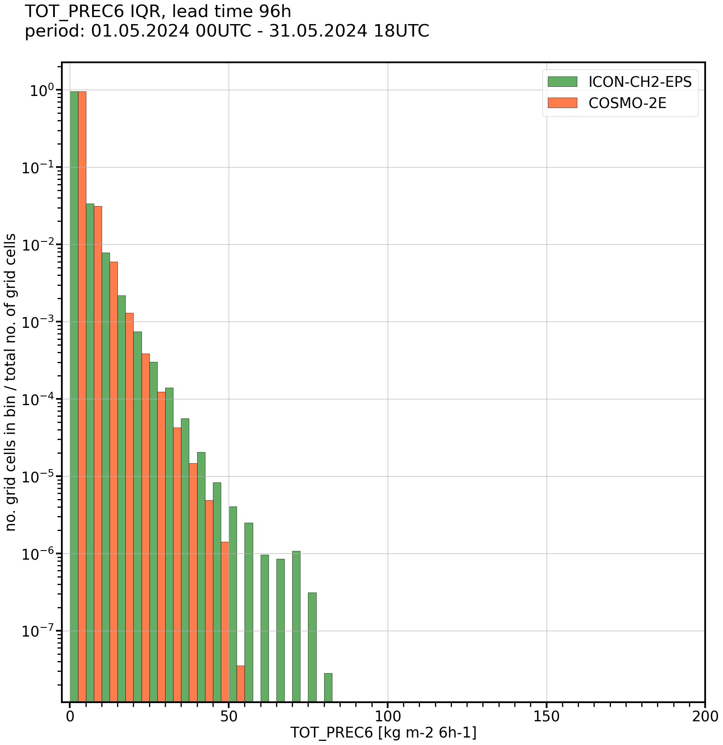
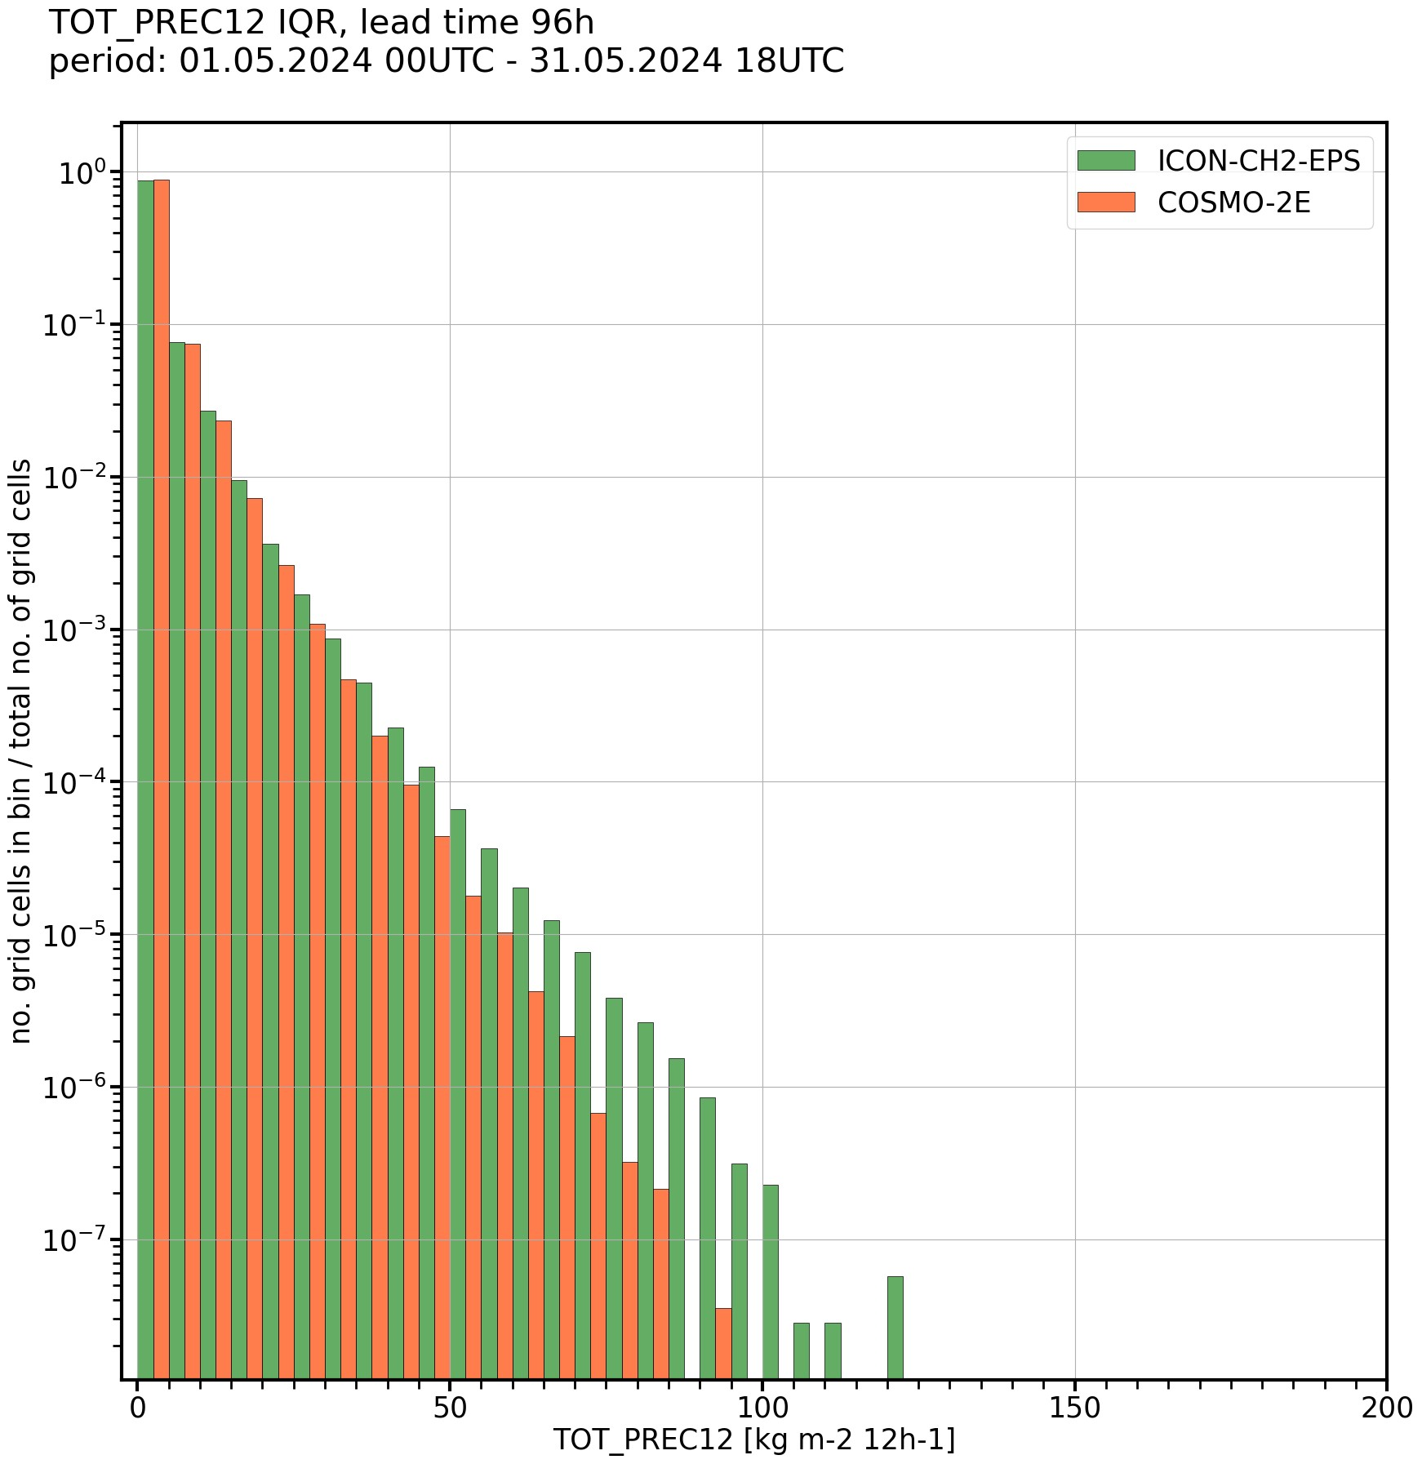
Precipitation, InterQuartileRange – ICON vs COSMO
recap
2024
Comparison of precipitation from ICON and COSMO for +4d lead time in May 2024
→ ICON-CH2-EPS produces a larger ensemble spread than COSMO-2E
(conclusion valid for different aggregations and lead times)
6h-precip IQR
12h-precip IQR
Normalized histograms of precipitation IQR (= Q3 – Q1) aggregated over all members and init times:
Figures: Lukas Jansing

Slide 31
Precipitation – potential explanations
recap
2024
The search for an explanation (and a fix) …
Technical error? → Can be excluded (see first plot)
SPPT causing too much spread and too high precipitation values? → test
Too high instability in the vertical profile, too vigorous convection?
Precipitation efficiency in microphysics too high?
Issue with LBCs? → unlikely
Too weak topography smoothing? → no evidence so far
Slide: Lukas Jansing

Slide 32
Precipitation – ICON experiments, 01-13 Jul 2024
recap
2024
E-suites to test out sensitivity of ICON to different namelist settings:
270: lgrayzone_deepconv = .true., lshallowconv_only = .false.
  Goal: Reduce CAPE in the vertical profile and dampen convection
271: rlam_heat = 1 (rat_sea = 8)
  Goal: Reduce the scaling factor of the laminar boundary layer for heat to dampen near-surface temperatures and convection
272: lsppt = .false.
  Goal: Switch of SPPT to reduce spread and precipitation amounts
273: range_rn = 0.3
  Goal: Reduce random numbers in SPPT to dampen spread
274: lsppt = .false, lgrayzone_deepconv = .true., lshallowconv_only = .false.
  Goal: Test combined effect of no SPPT and lgrayzone_deepconv
Reduce convection
Reduce model perturba-tions
Reduce both
Slide: Lukas Jansing

Slide 33
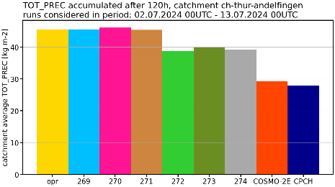
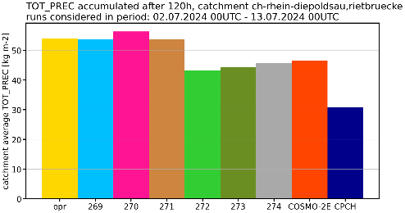
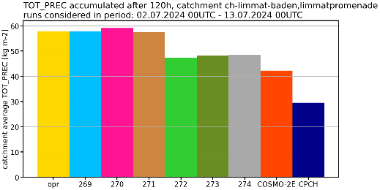
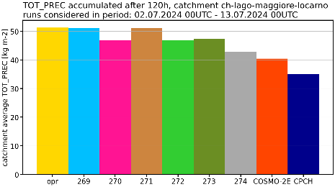
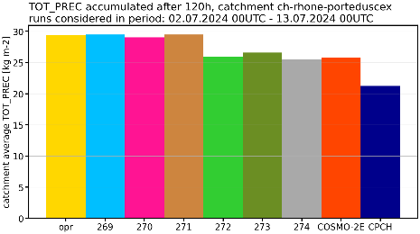
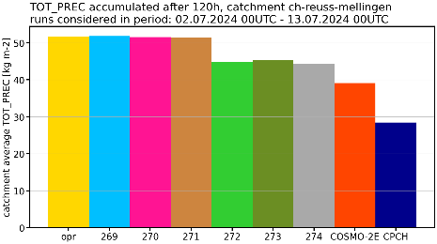
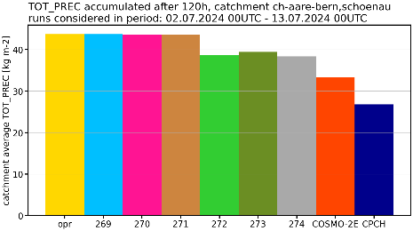
Precipitation – ICON experiments, 01-13 Jul 2024
recap
2024
Accumulated +5d precip, all members and forecasts – average for large-scale river catchments
→ Only changing model perturbations reduces precipitation
Thur
Rhein
Limmat
Lago
Maggiore / Ticino
Rhone
Reuss
Aare
Slide: André Walser

Slide 34
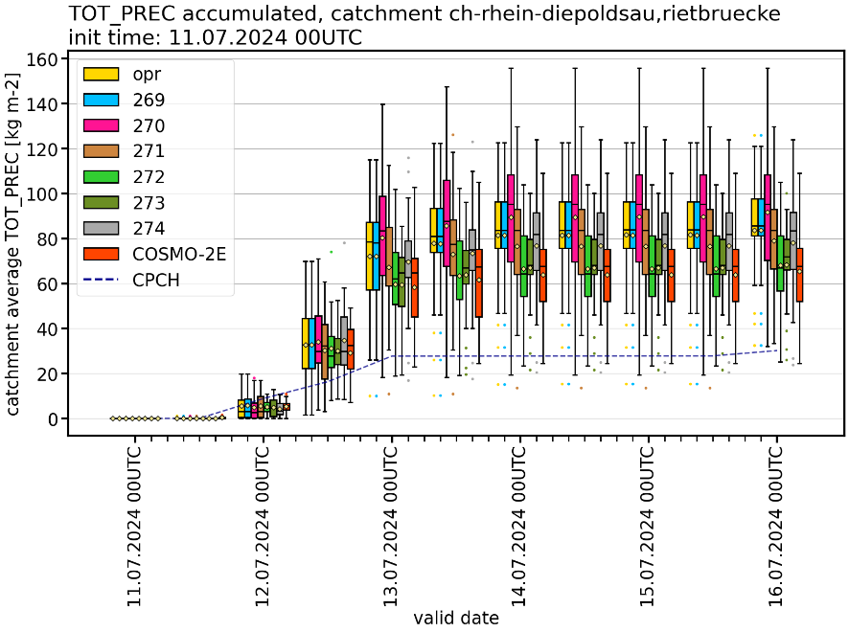
Precipitation – Rhine catchment case
recap
2024
forecast of 11.07.2024 00 UTC
ICON-CH2-EPS with reduced and skipped model perturbations shows a smaller precipitation spread, similar to COSMO-2E
Reduced precipitation in the median, but still more than COSMO-2E and CombiPrecip (CPCH)
Slide: André Walser

Slide 35
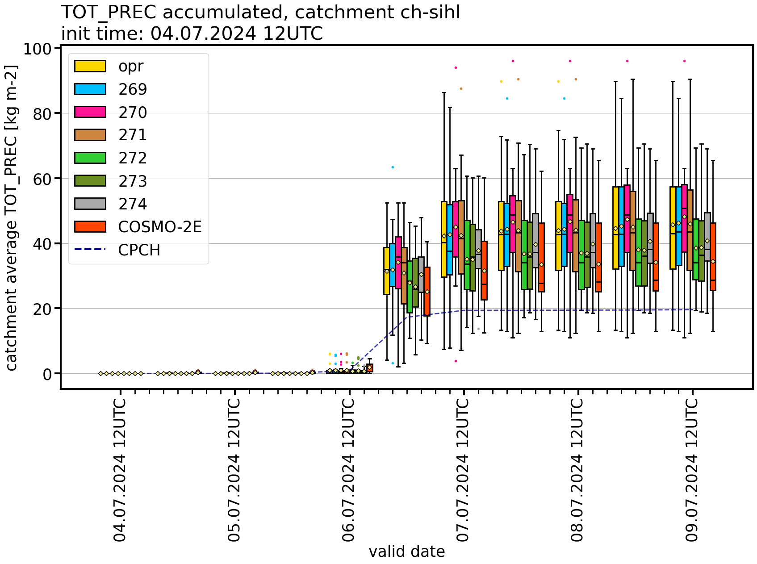
Precipitation – Sihl catchment case
forecast of 04.07.2024 12 UTC
recap
2024
ICON-CH2-EPS with reduced and skipped model perturbations shows a smaller precipitation spread, similar to COSMO-2E
Reduced precipitation in the median, but still more than COSMO-2E and CombiPrecip (CPCH)
Slide: André Walser

Slide 36
Excessive spread for precipitation – Summary
recap
2024
Not a technical issue (interpolation, aggregation, workflow,..)
ICON-CH2-EPS produces higher precipitation amounts and larger spread than COSMO-2E
Reduction of the model perturbations reduces the precipitation of the ICON-CH2-EPS members on average and the precipitation spread, and hence mitigates the excessive precipitation spread issue
However, the ICON-CH2-EPS uncertainty forecasts for temperature, humidity and wind speed get worse (not shown)
Still unclear why model perturbations in ICON trigger more excessive precipitation than in COSMO → investigations ongoing
Slide: André Walser

Slide 37
Excessive spread for precipitation – Summary
update
Not a technical issue (interpolation, aggregation, workflow,..)
ICON-CH2-EPS produces higher precipitation amounts and larger spread than COSMO-2E
Reduction of the model perturbations reduces the precipitation of the ICON-CH2-EPS members on average and the precipitation spread, and hence mitigates the excessive precipitation spread issue
However, the ICON-CH2-EPS uncertainty forecasts for temperature, humidity and wind speed get worse (not shown)
Still unclear why model perturbations in ICON trigger more excessive precipitation than in COSMO → investigations ongoing
Reduction of exaggerated convective precipitation rates / peaks does not substantially reduce the excessive spread for precipitation

Slide 38
Experiments for lsppt = .false.
NEW
Three 2-week periods in 2023
winter orographic precip period
(03.01.2023 00 UTC - 17.01.2023 12 UTC)
spring «Aprilwetter» period
(03.04.2023 00 UTC - 17.04.2023 12 UTC)
summer convection period
(01.06.2023 00 UTC - 14.06.2023 12 UTC)
Only verification results for ICON-CH2-EPS shown.

Slide 39
Surface verification: ICON-CH2-EPS ensemble

Slide 40
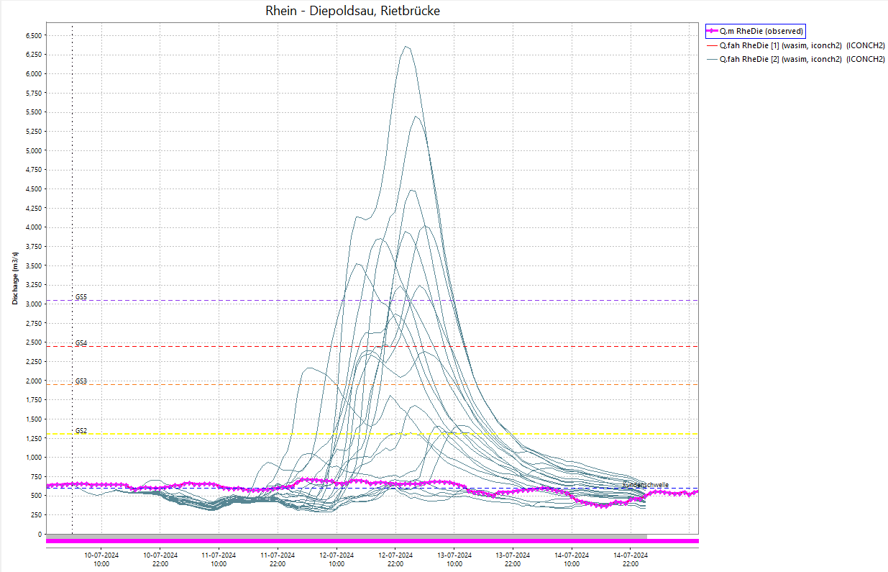
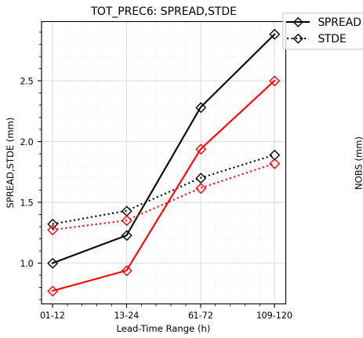
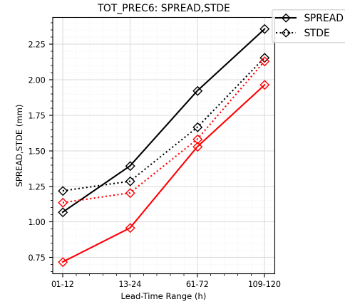
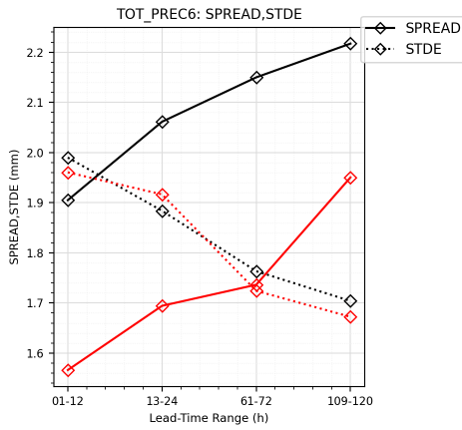

Positive effects: spread of TOT_PREC
NEW
Decrease in spread, spread is below STDE for the majority of periods and lead times
winter
spring
summer
reference
experiment
Slide: Lukas Jansing

Slide 41



Positive effects: bias of TOT_PREC
NEW
Decrease in bias of ensemble mean
winter
spring
summer
reference
experiment
Slide: Lukas Jansing

Slide 42



Positive effects: STDE of TOT_PREC
NEW
Slight decrease in STDE for majority of periods and lead times
winter
spring
summer
reference
experiment
Slide: Lukas Jansing

Slide 43



Positive effects: CLCT
NEW
Slight decrease in bias of ensemble mean for 2 periods
winter
spring
summer
reference
experiment
Slide: Lukas Jansing

Slide 44



Negative effects: Decrease in spread
NEW
(Slight) decrease in spread for many of the other variables: T_2M, TD_2M, FF_10M, VMAX_10M6 (less so for CLCT, PS and PMSL) → SPREAD/STDE gets worse
winter
spring
summer
Slide: Lukas Jansing

Slide 45



Negative effects: Decrease in spread
NEW
(Slight) decrease in spread for many of the other variables: T_2M, TD_2M, FF_10M, VMAX_10M6 (less so for CLCT, PS and PMSL) → SPREAD/STDE gets worse
winter, e.g. VMAX_10M6
spring, e.g. TD_2M
summer, e.g. T_2M
Slide: Lukas Jansing

Slide 46
Negative effects: Decrease in RPSS
NEW
Slight decrease in RPSS for some of the other variables: FF_10M, VMAX_10M6, T_2M, TD_2M (less so for CLCT)
winter
spring
summer
Slide: Lukas Jansing

Slide 47



Negative effects: Decrease in RPSS
NEW
Slight decrease in RPSS for some of the other variables: FF_10M, VMAX_10M6, T_2M, TD_2M (less so for CLCT)
winter, e.g. FF_10M
spring, .e.g. VMAX_10M6
summer, e.g. T_2M
Slide: Lukas Jansing

Slide 48



Negative effects: Increase in wind bias
NEW
Increase in bias of ensemble mean for FF_10M and VMAX_10M6
winter, VMAX_10M6
spring , VMAX_10M6
summer, VMAX_10M6
Slide: Lukas Jansing

Slide 49
Surface verification: ICON-CH1-EPS ensemble

Slide 50




Positive effects: spread of TOT_PREC
NEW
Decrease in spread, spread is below STDE for all periods and lead times (too much reduction?)
winter
spring
summer
reference
experiment
Slide: Lukas Jansing

Slide 51



Positive effects: bias of TOT_PREC
NEW
Slight decrease in bias of ensemble mean
winter
spring
summer
reference
experiment
Slide: Lukas Jansing

Slide 52



Positive effects: STDE of TOT_PREC
NEW
Slight decrease in STDE for majority of periods and lead times
winter
spring
summer
reference
experiment
Slide: Lukas Jansing

Slide 53



Negative effects: Decrease in spread
NEW
(Slight) decrease in spread for many of the other variables: T_2M, TD_2M, FF_10M, VMAX_10M6, PS, PMSL (less so for CLCT) → SPREAD/STDE gets worse
winter
spring
summer
Slide: Lukas Jansing

Slide 54



Negative effects: Decrease in spread
NEW
(Slight) decrease in spread for many of the other variables: T_2M, TD_2M, FF_10M, VMAX_10M6, PS, PMSL (less so for CLCT) → SPREAD/STDE gets worse
winter, e.g. VMAX_10M6
spring, e.g. PMSL
summer, e.g. T_2M
reference
experiment
Slide: Lukas Jansing

Slide 55
Negative effects: Decrease in RPSS
NEW
Slight decrease in RPSS for some of the other variables: T_2M, TD_2M, FF_10M, VMAX_10M6 (less so for CLCT)
winter
spring
summer
Slide: Lukas Jansing

Slide 56



Negative effects: Decrease in RPSS
NEW
Slight decrease in RPSS for some of the other variables: T_2M, TD_2M, FF_10M, VMAX_10M6 (less so for CLCT)
winter
spring
summer
reference
experiment
Slide: Lukas Jansing

Slide 57



Negative effects: Increase in wind bias
NEW
Increase in bias of ensemble mean for FF_10M and VMAX_10M6
winter
spring
summer
reference
experiment
Slide: Lukas Jansing

Slide 58
Summary for lsppt = .false. experiments
NEW
Precipitation bias of the ensemble mean decreases, STDE tends to decrease as well for some periods, spread decreases (below STDE for most periods / lead times)
Spread and RPSS tend to decrease for the other variables
Negative wind and gust bias of the ensemble mean tend to increase
Slide: Lukas Jansing

Slide 59

Decision (hopefully temporary …):
Deactivate SPPT in ICON-CH2-EPS, but keep it in ICON-CH1-EPS
operational since 11 December 2024
operational
no SPPT
maximum observed runoff
Figures: Karsten Jasper (BAFU)

