Slide 1
Data assimilation activities at MeteoSwiss
Daniel Leuenberger, Marco Arpagaus, Claire Merker, Radi Radev, Alina Yapparova
MeteoSwiss
COSMO GM 2025, Basel

Slide 2
Overview of activities
Preambulum: New model setup
Reanalysis light (REA-L-CH1)
3D Radar volume assimilation (Alina’s talk)
APT in KENDA-CH1 and ICON-CH1-EPS (Claire’s talk)
Machine Learning Data Assimilation

Slide 3
New Model Setup
Aim: reduce overestimated precipitation and introduce new model features
ICON settings
  Microphysics settings
    Supersaturation in updrafts (tune_supsat_limfac = 2.0)
    Snow-to-graupel conversion by riming (tune_zcsg = 0.25)
    Snow terminal fall speed velocity (tune_v0_snow=20)
  Reduce turbulent mixing on sloped terrain (itune_slopecorr = 1)
  Take into account orographic shading
  Performance boost (20-30% faster)
KENDA settings
  Relative humidity threshold above which obs. are set to saturation: 96% -> 100%
  Correct handling of sfc stations who do not measure surface pressure
  Dismiss stations above 3000m asl
  LETKF version 2.23
Tested and approved, but not yet operational due to technical and organizational reasons

Slide 4


New Model Setup
Reduction of high-intensity precipitation peaks (FBI > 5 mm/h).
Summer: More frequent light-rain events, not detrimental. High intensity events still too frequent.
Winter: More pronounced underestimation of moderate precip. event frequency (albeit little data).
Substantial reduction of biases in 2m temperature and sunshine duration, in particular in Alpine valleys and in winter.
21% faster ICON-CH1, and 28% faster ICON-CH2

Slide 5
Reanalysis light (REA-L-CH1) 2005 - 2025
Purpose
  Wind climatology (MCH climate division)
  Data set for ML learning
Deterministic downscaling of ERA5 on ICON-CH1-EPS grid
LHN using a new, homogeneous radar-gauge product
Snow analysis every 24h
4 batches à 6y with one year overlap for soil spin-up
Soil taken from operational KENDA-CH1 at 1.1.2025 (for all 4 batches!)
New model setup
Elapsed time: 2 months (12 GPU nodes), 280TB of data

Slide 6
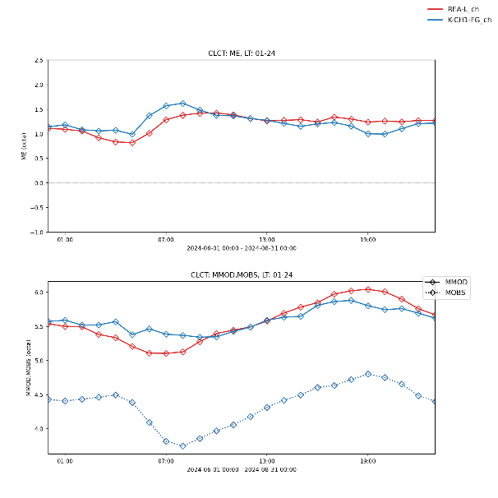
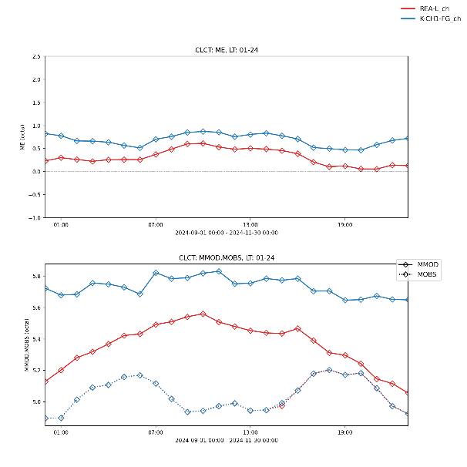
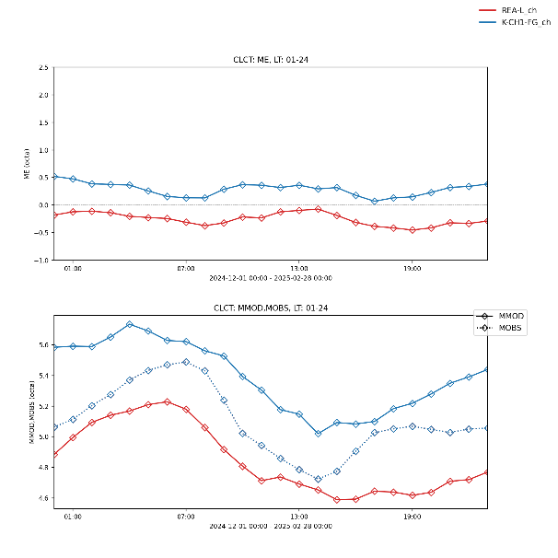
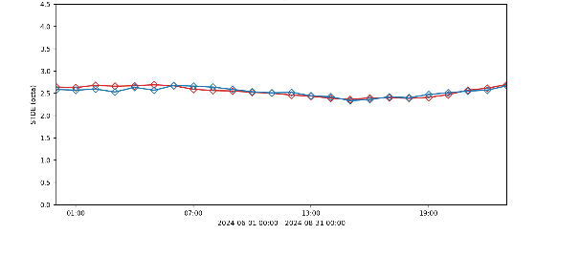
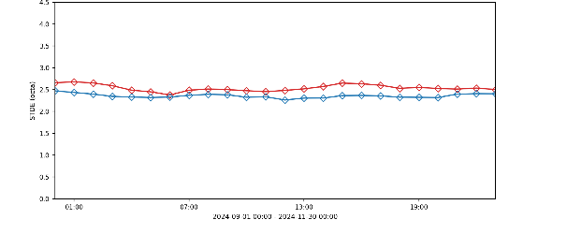
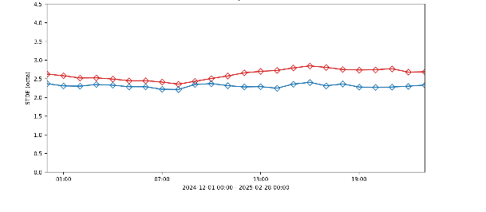
Verification: Clouds
JJA 2024
SON 2024
DJF 2024/25
Bias
STDDEV
KENDA-CH1 REA-L-CH1
also different behaviour for different regions
significantly larger STDE for REA-L than for opr for SON and especially DJF; more pronounced for plateau

Slide 7
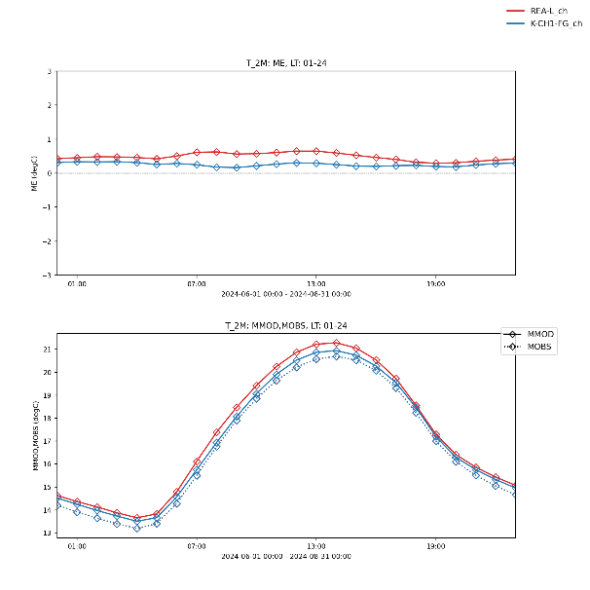
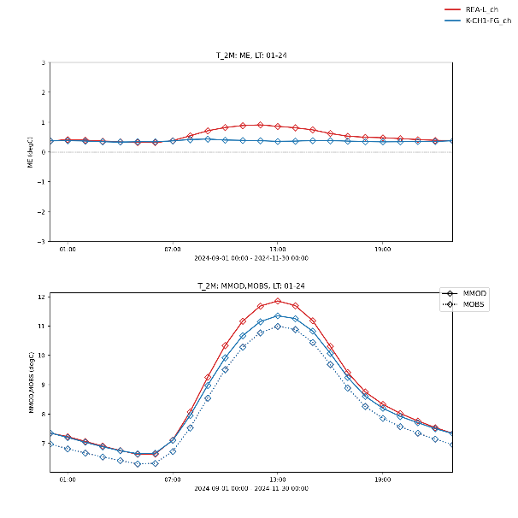
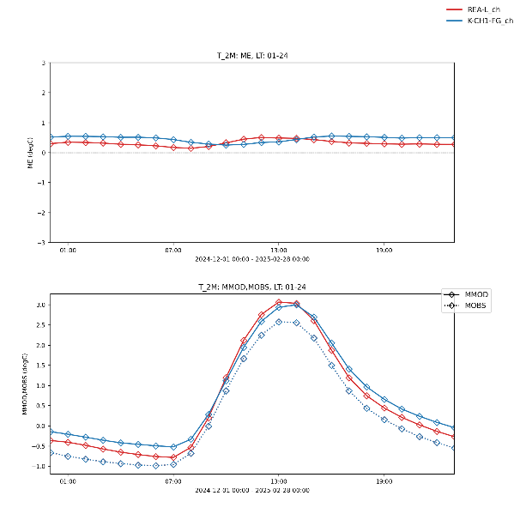
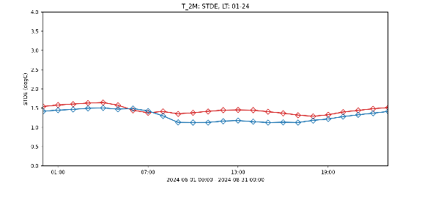
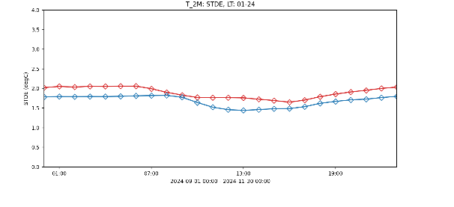
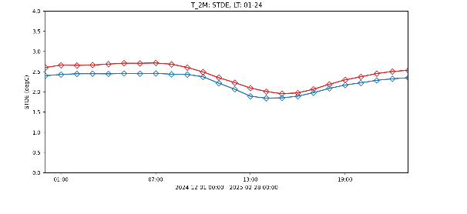
Verification: Temperature at 2m
JJA 2024
SON 2024
DJF 2024/25
Bias
KENDA-CH1 REA-L-CH1
STDDEV
bias (ME) smaller for valleys (shading++), larger for plateau
larger STDE for REA-L than for opr; more pronounced for plateau but smaller STDE for valleys (→ KENDA!, shading++)

Slide 8
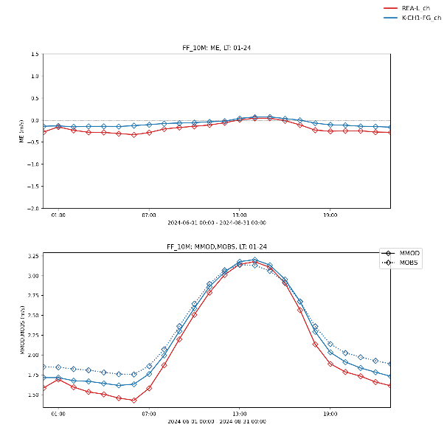
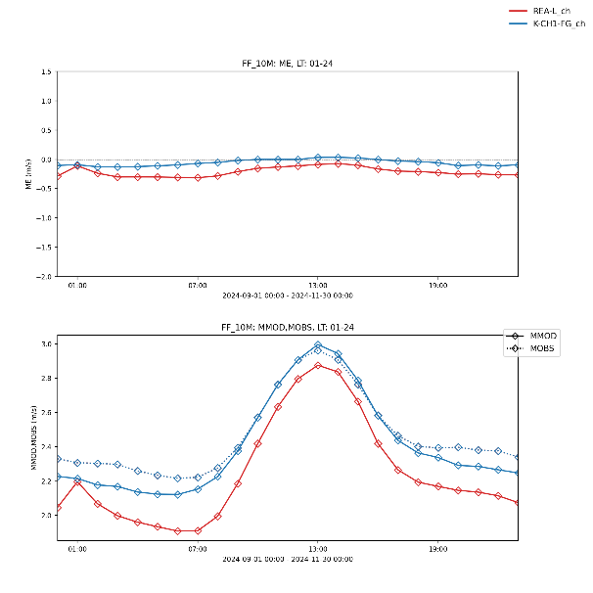
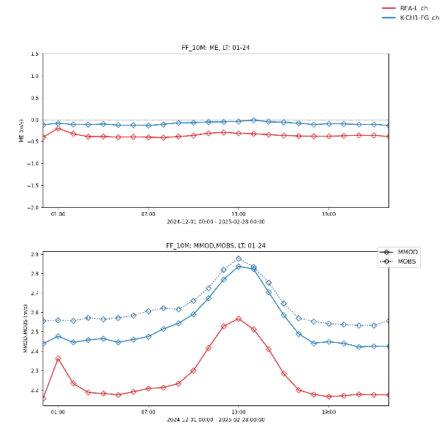
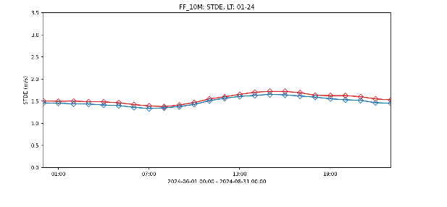
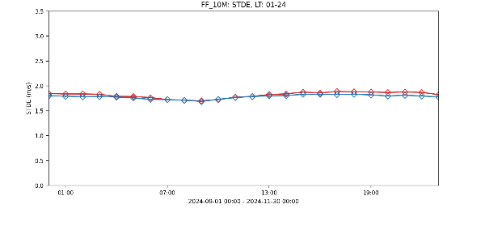
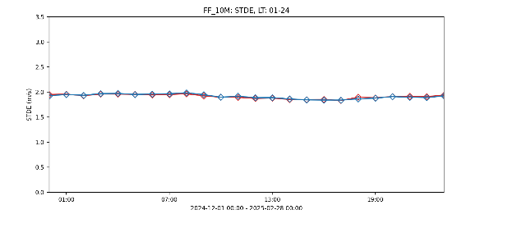
Verification: Wind speed at 10m
JJA 2024
SON 2024
DJF 2024/25
Bias
KENDA-CH1 REA-L-CH1
STDDEV
reduced wind speed, resulting in (stronger) negative bias, especially for valleys and peaks (largest)
almost identical STDE for REA-L and opr for CH

Slide 9
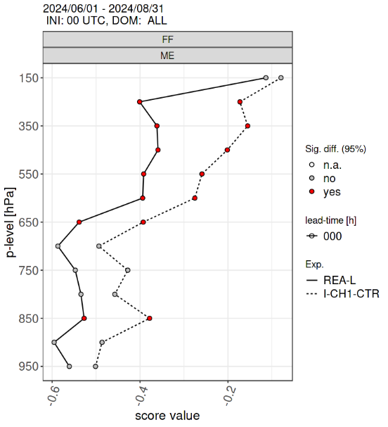
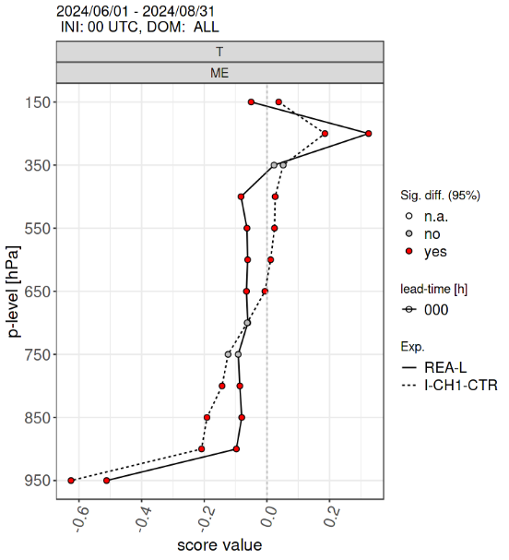
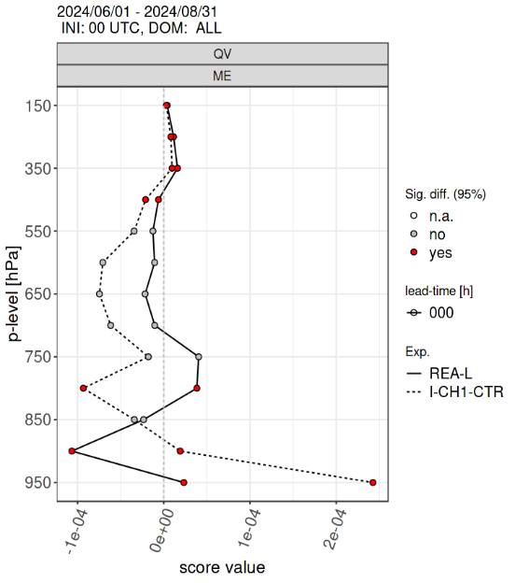
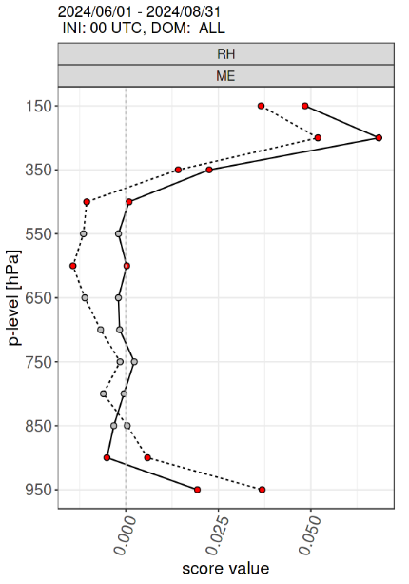
Verification: Profiles (JJA)
Bias
KENDA-CH1 REA-L-CH1
STDE in REA-L larger than opr (KENDA!)

Slide 10
Reanalysis light (REA-L-CH1) 2005 - 2025
Comparison with KENDA-CH1 (2024)
Precipitation looks great (thanks to LHN).
As expected, STDE is larger for REA-L than for KENDA-CH1 for CH (KENDA!) for all parameters except for wind / gusts in complex terrain
Bias for REA-L is comparable to the bias of KENDA-CH1; as hoped for, new model version shows positive impact for some parameters and some regions
Wind speed is lower in REA-L (?); STDE is sometimes better (complex topography) (?!)
Cloudiness is lower in REA-L (?)

Slide 11
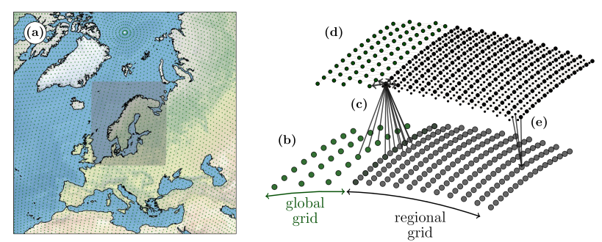
ML Data Assimilation
MeteoSwiss is currently building an ML system to generate data-driven forecasts
The system aims at covering the lead time range from analysis over nowcasting to forecasts up to approx. 10d (seamless)
The system is developed using ECMWF’s anemoi framework, the current focus is on a stretched-grid GNN architecture (developed at MetNorway)
Figure from https://arxiv.org/pdf/2409.02891v1
We will investigate two methods to introduce observations into the system
Notes:
11

Slide 12
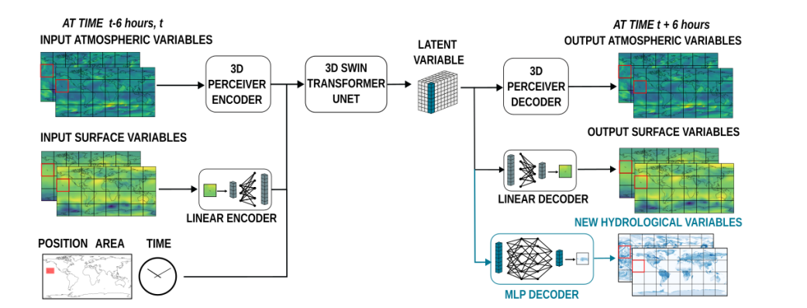
ML Data Assimilation
Currently developed MeteoSwiss emulator outperforming* the NWP system.
Plans to extend it to new sources by fine-tuning it on new sources of observations (e.g radar, satellite, SYNOP).
*e.g in terms of MSE but there are many caveats that come with ML methods
NEW OBSERVATION VARIABLES
Figure from https://arxiv.org/pdf/2506.19088
Add additional information sources on different grids
Notes:
12

Slide 13
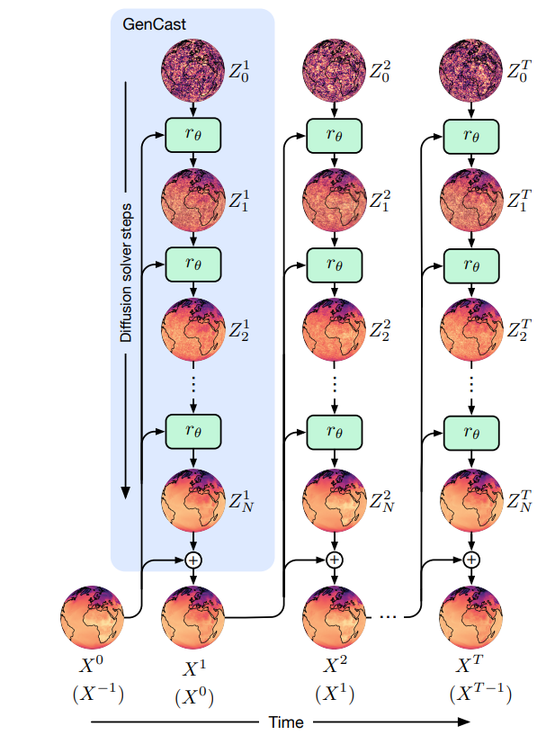
ML Data Assimilation
Working towards diffusion based emulator for ensemble generation.
Can exploit the iterative sampling of diffusion to produce state estimates consistent with observations.
Figure from https://arxiv.org/pdf/2312.15796v1
Notes:
13

Slide 14
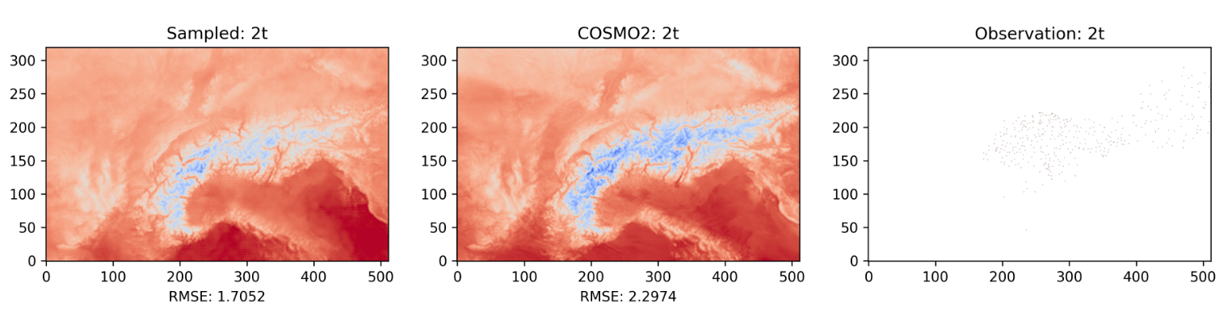
ML Data Assimilation
ML T2m Forecast
COSMO-2 T2m Forecast
T2m Observations
RMSE against COSMO-KENDA Analysis
Proof of concept diffusion model showed promising results.
Diffusion guidance method does not require training with observations.
Can flexibly add new observations sources given an observation operator.
Notes:
14

Slide 15
Summary
Successful production of 20y Reanalysis light (REA-L-CH1)
  Good quality when compared to KENDA-CH1 (2024)
Progress in 3D Volume Radar Assimilation
  Slight positive impact in precipitation forecast
Successful test of APT in KENDA-CH1
  Positive impact of T and RH tuning, FF tuning needs further investigation
Started work in ML Data Assimilation

Slide 16
Outlook
Continue 3D Radar Volume assimilation
Continue ML data assimilation
Work towards introduction of APT in KENDA-CH1
Improve ICON regression tests with DACE coupling (intern just started)
Develop CI/CD for LETKF (intern just started)
Contribute to joint COSMO Reanalysis Effort

Slide 17
Details about new NWP model changes

Slide 18
New Feature: Supersaturation in Updrafts
New Feature: tune_supsat_limfac = 2.0
Supersat. = max(0.005 * w, limfac * QC / QV)
RH
Model now takes into account the slight supersaturation occurring in convective updrafts (e.g., Pruppacher and Klett, 1997, Ch. 7).
Implemented proportional to the updraft speed: 1% supersaturation per 2 m/s updraft velocity
1
RH
1
Acknowledgement to Alberto de Lozar (DWD), Günther Zängl (DWD) and Axel Seifert (DWD)

Slide 19

Snow-To-Graupel Conversion by Riming
Reduction of snow-to-graupel riming rate: tune_zcsg = 0.5 → 0.25
Slower fall speed of snow as compared to graupel reduces local maxima.
Acknowledgement to Alberto de Lozar (DWD), Günther Zängl (DWD) and Axel Seifert (DWD)

Slide 20

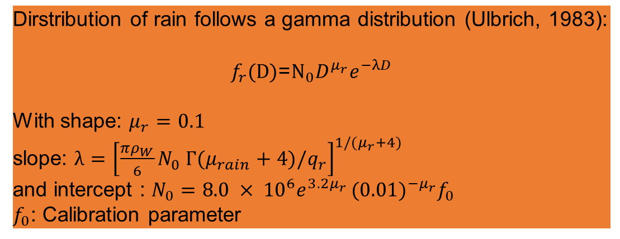
Rain represented as a collection of drops
Representing the full histogram of drop sizes is too expensive. Parameterized by assuming a drop size distribution.
Dirstribution of rain follows a gamma distribution (Ulbrich, 1983):
$$f_{r}\text{(}\text{D}\text{)}\text{=}{\text{N}}_{0}D^{μ_{r}}e^{−λD}$$
With shape: $μ_{r}=0.1$
slope: $λ={\left[\frac{πρ_{W}}{6}N_{0} Г(μ_{rain}+4)/q_{r}\right]}^{1/(μ_{r}+4)}$
and intercept : $N_{0}=8.0 × {10}^{6}e^{3.2μ_{r} }{(0.01)}^{−μ_{r}}f_{0}$
$f_{0}$: Calibration parameter

Slide 21
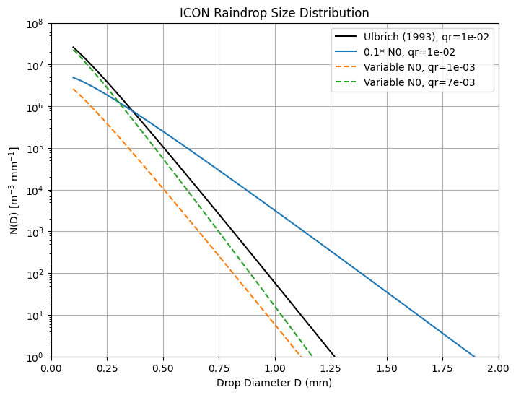

Intercept Parameter of Rain Dropsize Distribution
The size distribution of rain drops is currently shifted towards larger droplets to avoid excessive evaporation of light rain below the cloud base (blue curve).
This artificial shift is now restricted to light-to moderate rainfall intensities, reducing the droplet fall speed, and thus local intensity peaks of heavy rainfall (orange and green lines).
approaches
Ulbrich (1993)
for high qr
current $f_{0}$
flatter at
moderate qr

Slide 22
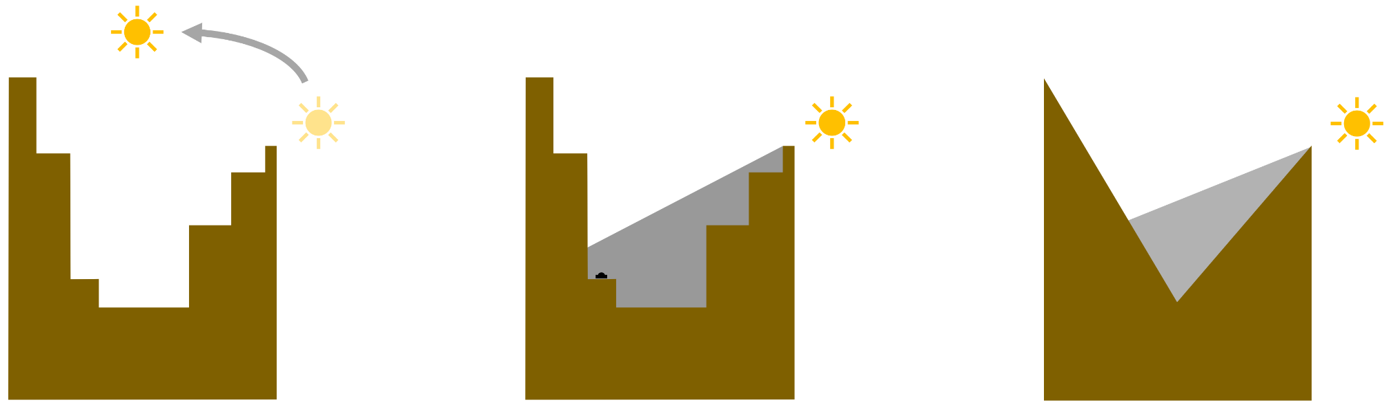
New Output for Orographic Shading
ASOD_S
No correction
(for downstream models)
ASOD_S_OS
Correction for topographic shading
(used for validation
and for DURSUN)
ASOD_S_TAN_OS
and slope effect
(passed to land-surface model)
Acknowledgement to Jonas Jucker (C2SM), Günther Zängl (DWD) and Sebastian Borchert (DWD)

Slide 23
Other Changes
ICON-CHx: (Bugfix) Calibration factor for terminal fall velocity of snow: tune_v0_snow=25 -> 20
ICON-CHx: Reduce turbulent mixing on sloped terrain (slope-dependent reduction of surf. transfer coefficient (rlam_heat) and minimal turbulent diffusion calibration coefficient (tkred_sfc): itune_slopecorr = 0 → 1
ICON-CHx: (Bugfix) Switch off two-way feedback to (non-existent) coarse domain: lfeedback = false (no change)
ICON-CHx: Mask interpolation zone in triangular output (undefs): lmask_boundary=.true.
KENDA-CH1: Relative humidity threshold above which obs. are set to saturation: 96% -> 100%
KENDA-CH1 : Correct handling of sfc stations who do not measure surface pressure
KENDA-CH1 : Dismiss stations above 3000m asl
KENDA-CH1 : New LETKF binary

Slide 24
Perf Changes
Namelist changes
  Activation of CUDA graphs: lcuda_graph_lnd = .TRUE., lcuda_graph_turb_tran = .TRUE.
  Reduction of timers: timers_level = 1 (in &run_nml)
Change in running
  #SBATCH --distribution=plane=4
Change in compilation
  O2 and Mstack_arrays

